Slide 1


WP5: Integration into a new LINAC Cryomodule Zoom meeting, Dec 03, 2025 WP Leader: Nuno Elias (ESS) WP Deputy: Vittorio Parma (CERN)
All information contained in this presentation and any accompanying documents is for iSAS project only, and must be treated as strictly confidential.
Any dissemination, distribution or other use of this information without the consent of its owner is prohibited.
Funded by the European Union. Views and opinions expressed are however those of the authors only and do not necessarily reflect those of the European Union or the European Commission. Neither the European Union nor the granting authority can be held responsible for them.

Slide 2
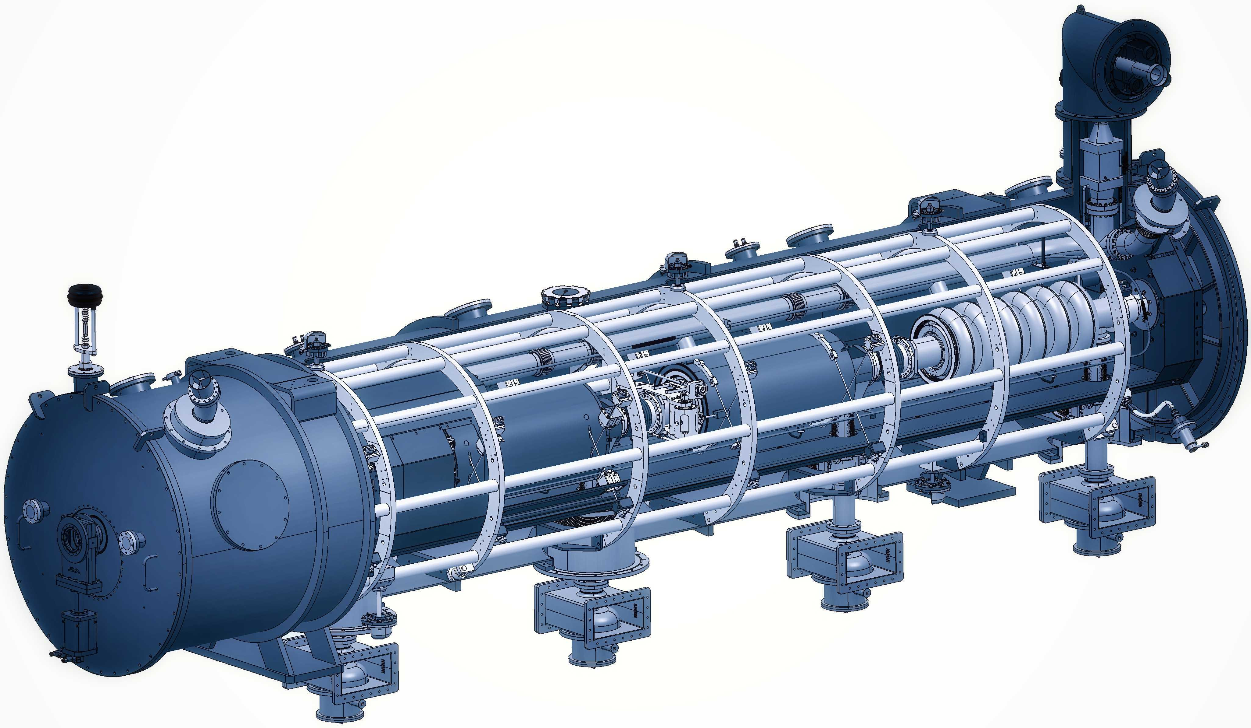
WP5: Integration into a new LINAC Cryomodule
ESS | CNRS | CERN | EPFL
Convener: Nuno Elias (ESS)
Main contacts with other partners: G. Olry (CNRS), V. Parma. CERN); M. Siedel (EPFL)
The design of any LINAC cryomodule is optimised to meet the specific research objectives of the accelerator facility, while addressing common challenges such as high-power electric fields, ultra-low temperatures, ultra-high vacuum, precise alignment, etc.
WP5's main goal is to tackle the common engineering challenges of integrating iSAS technologies into a parametric design of a new cryomodule, building on developments made with ESS cryomodules whilst benchmarking against other facilities.
In addition, to unlock the full energy-saving capability of this cryomodule, the objective of WP5 is to also address the challenging beam dynamics requirements when operating the new cryomodule in Energy Recovery Linacs with recirculating beams.

Slide 3
WP5: Integration into a new LINAC Cryomodule
ESS | CNRS | CERN | EPFL
Convener: Nuno Elias (ESS)
Main contacts with other partners: G. Olry (CNRS), V. Parma. CERN); M. Siedel (EPFL)
Task 5.1: Coordination on cryomodule design activities– M1-M48
• General coordination by ESS as described above.
Task 5.2: ESS cryomodules experience and benchmarking with other recent facilities– M1-M36
• Compile the lesson learned from the ESS CM testing activities, technical commissioning, and initial operation.
• Benchmarking with projects in the implementation phase (worldwide).
• Develop a roadmap to develop a new, sustainable CM design.
Task 5.3: Sustainable criteria for LINAC cryomodule design– M24-M48
• Integrate findings from the other iSAS WPs into a generic CM design.
• Explore the sustainability criteria for the design.
Task 5.4: Beam Dynamics for ERL-based accelerators with energy-efficient cryomodules – M1-M48
• Simulate the beam dynamics of ERL-based accelerators when the energy efficient CM is included.
• Study the lattice design to optimize the beam and energy saving performances.

Slide 4
WP5: Integration into a new LINAC Cryomodule
ESS | CNRS | CERN | EPFL
Work Plan

Slide 5
WP5 – Coordination: status/evolution of Task 5.1
Task 5.1: Coordination on cryomodule design activities– M1-M48
• General coordination by ESS as described above.
Milestone 5.1 : In-person WP kick-off meeting at ESS (Due date: M3 or Jun-2024)
Milestone 5.1 : Impact Risk analysis (Due date: M24 or Feb-2026
Deliverable 5.1 : Compilation of ESS CM lessons learned & benchmarks (Due date: M24 or Feb-2026)
Deliverable 5.2 : Roadmap for the CM design (Due date: M36 or Feb-2027)
Deliverable 5.3 : Parametric design for a sustainable CM with iSAS tech. (Due date: M46 or Dec-2027)
Deliverable 5.4 : Report on beam dynamics study for ERL with iSAS CM (Due date: M43 or Sep-2027)
M5.1
D5.1
D5.2
D5.3
Y0
Y1
Y2
Y3
D5.4
Y4
Task 5.1
Task 5.1
M
M
Task 5.2
Task 5.2
D
D
D
D
D
Task 5.3
Task 5.3
D
D
Task 5.4
Task 5.4
D
D
D
D
D
Mar
2024
Mar
2025
Mar
2026
Mar
2027
Feb
2028

Slide 6
WP5 – Coordination: status/evolution of Task 5.1
Task 5.1: Coordination on cryomodule design activities– M1-M48
• General coordination by ESS as described above.
Past developments
Regular WP5 meetings + dedicated meetings task specific
Mar24; Apr24; Jul24; Sep24; Jan25 + (12-19)Nov24_T5.2 ; (7)Mar25_T5.4; Jul25; Sep25, Oct25
Milestone 5.1 : “In-person WP kick-off meeting at ESS” : Completed
Recruitment PhD student (EPFL): Started: (Apr-2024) ; Completed (Oct-2024)
Current developments
Ongoing Recruitment of junior engineer/ scientist (ESS) : Start: (Mar-25) ;
Assignment of 2 years to be supporting activities related to WP5 and WP6
Possible extension to be considered, to cover up to the end of project
More than 40 candidates, 2selected for interviews.1st interview done (18-Aug and Aug-21)
Final site interview 04-Sep-2025, selection Complete (Oct-25). Started 20-Oct-2025

Slide 7
WP5 – Experience/Benchmark CMs: status of Task 5.2
Task 5.2: ESS cryomodules experience and benchmarking with other recent facilities – M1-M36
• Compile lesson learned from the ESS CM testing activities, technical commissioning, initial operation.
• Benchmarking with projects in the implementation phase (worldwide).
• Develop a roadmap to develop a new, sustainable CM design.
Past developments
Discussions with relevant people: ESS CM lifecycle
Gathering of relevant high-level information
Preliminary table-of-contents for ESS CM lessons learned report
Current developments
Developing of on the ‘ESS CM lessons learned’ report structure
Alignment with CM ‘benchmarking template’
New member in place, report used as a good tool for training
• Compile lesson learned from the ESS CM testing activities, technical commissioning, initial operation.
Deliverable 5.1 : Compilation of ESS CM lessons learned & benchmarks (Due date: M24 or Feb-2026)
Deliverable 5.2 : Roadmap for the CM design (Due date: M36 or Feb-2027)

Slide 8
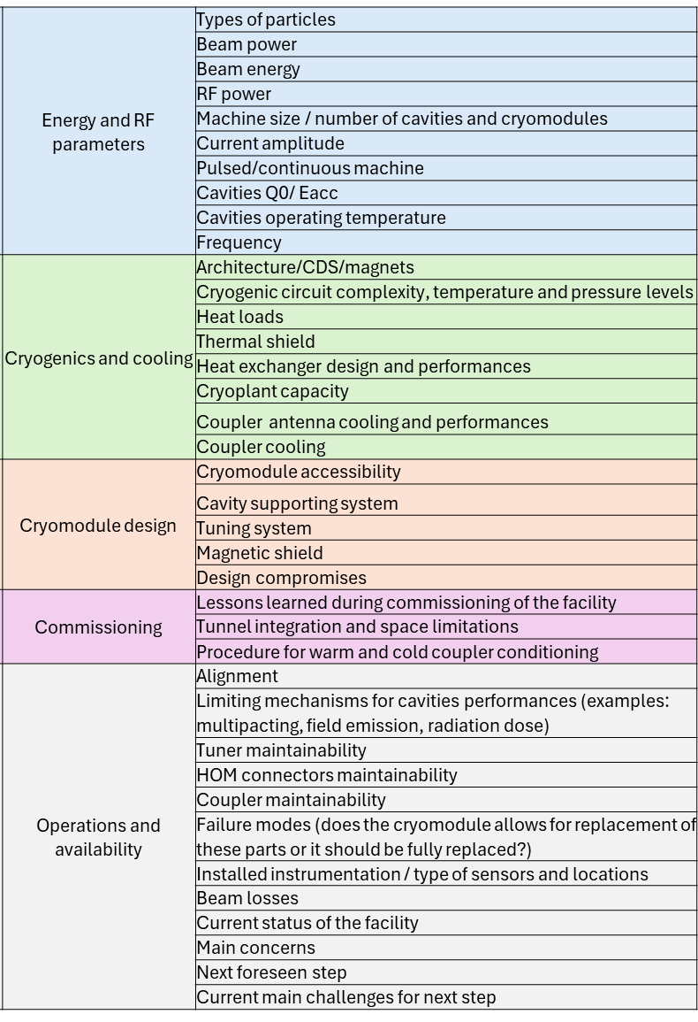
WP5 – Experience/Benchmark CMs: status of Task 5.2
Task 5.2: ESS cryomodules experience and benchmarking with other recent facilities – M1-M36
• Benchmarking with projects in the implementation phase (worldwide).
Past developments
Benchmarking parameters defined in the previous point (5.2.1)
Benchmarking facilities: SNS, LHC, PIP-II, XFEL, LCLSII
Definition of a questionnaire to receive a uniform response from the facilities
Identification of the contact people in the different facilities
Bibliographic search completed to propose a suggestion to every answer (reviewing can be easier than completing a blank questionnaire)
Draft of the Questionnaire (pre-filled for all labs LHC and ESS)

Slide 9
WP5 – Experience/Benchmark CMs: status of Task 5.2
Task 5.2: ESS cryomodules experience and benchmarking with other recent facilities – M1-M36
• Benchmarking with projects in the implementation phase (worldwide).
Current developments
Questionnaire finalization
Contact list finalization
First trial with LHC and ESS to get a feedback on the proposed questions
Distribution of the questionnaire to the facilities (LHC, ESS, XFEL, SNS, LCLS-II, PIP-II)
Next Steps
Finalization of meetings with some of the labs
Follow-up meeting foreseen to discuss the answers
Last part of the questionnaire focuses on lessons learned in the implementation or upgrade phases (PIP-II, XFEL CW upgrade - topics presented at TTC)
LHC: https://docs.google.com/forms/d/1wqlIFyOtbY00YnkxaNhExeMHGPyX6kKb7QaqQRTjmgM/edit
ESS: https://docs.google.com/forms/d/1td3yb0P23F1IB4Cw-KodH_P-IiHvcFamlbIpEZXD0KQ/edit
https://cernbox.cern.ch/s/3lQ9qoYJCciadwh

Slide 10
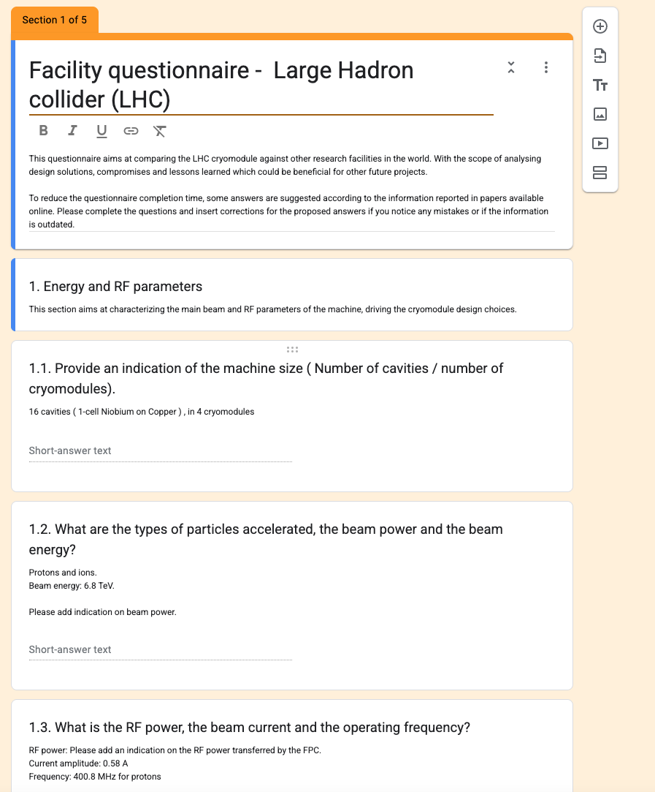
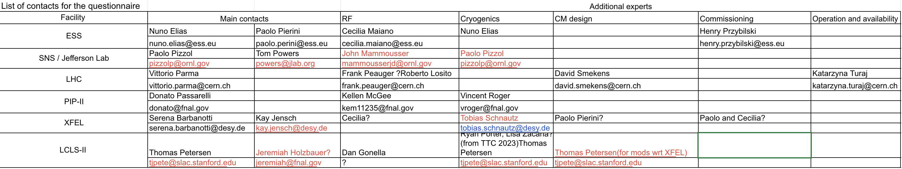
WP5 – Experience/Benchmark CMs: status of Task 5.2
Task 5.2: ESS cryomodules experience and benchmarking with other recent facilities – M1-M36
• Benchmarking with projects in the implementation phase (worldwide).
LHC: https://docs.google.com/forms/d/1wqlIFyOtbY00YnkxaNhExeMHGPyX6kKb7QaqQRTjmgM/edit
ESS: https://docs.google.com/forms/d/1td3yb0P23F1IB4Cw-KodH_P-IiHvcFamlbIpEZXD0KQ/edit
Current developments

Slide 11
WP5 – Design new CM: status/evolution of Task 5.3
Task 5.3: Sustainable criteria for LINAC cryomodule design – M24-M48
• Integrate findings from the other iSAS WPs into a generic CM design.
• Explore the sustainability criteria for the design.
Past developments
This task is set to start on M24 (Mar26)
Current developments
Attention to Sustainability criteria strategies applied to “Technology Areas”.
Attention to implementation of performance criteria of technology areas and its integration.
Breakdown of CM sub-systems (<- input from benchmarking)
Discussions on KPI associated with each sub-system.
Brainstorming of ideas initiated in Oct
Plan in-person meeting at IJCLAB in 28-Jan-2026, to prepare for a smooth start, meeting focus mostly on task 5.3.prepare with parametric design (create a team)
Deliverable 5.3 : Parametric design for a sustainable CM with iSAS tech. (Due date: M48 or Feb-2028)

Slide 12


WP5 – Design new CM: status/evolution of Task 5.4
Task 5.4: Beam Dynamics for ERL-based accelerators with energy-efficient cryomodules – M1-M48
• Simulate the beam dynamics of ERL-based accelerators when the energy efficient CM is included.
• Study the lattice design to optimize the beam and energy saving performances.
Past developments:
Meetings with PERLE collaboration, discussing details on the RF structure and HOM’s
Evaluated and tested beam dynamics codes to enable ERL simulations
Written code to enable flexible simulations and gathering of results
Current developments:
General SRF cavity beam dynamic studies
short-range and long-range wakefields (HOM’S)
single- and multi-bunch instabilities
General energy recovery efficiency studies after the degrading of beams throughout an ERL or ERL collider
Evaluate ERL collider/light source applications for iSAS technology and perform studies on these applications

Slide 13
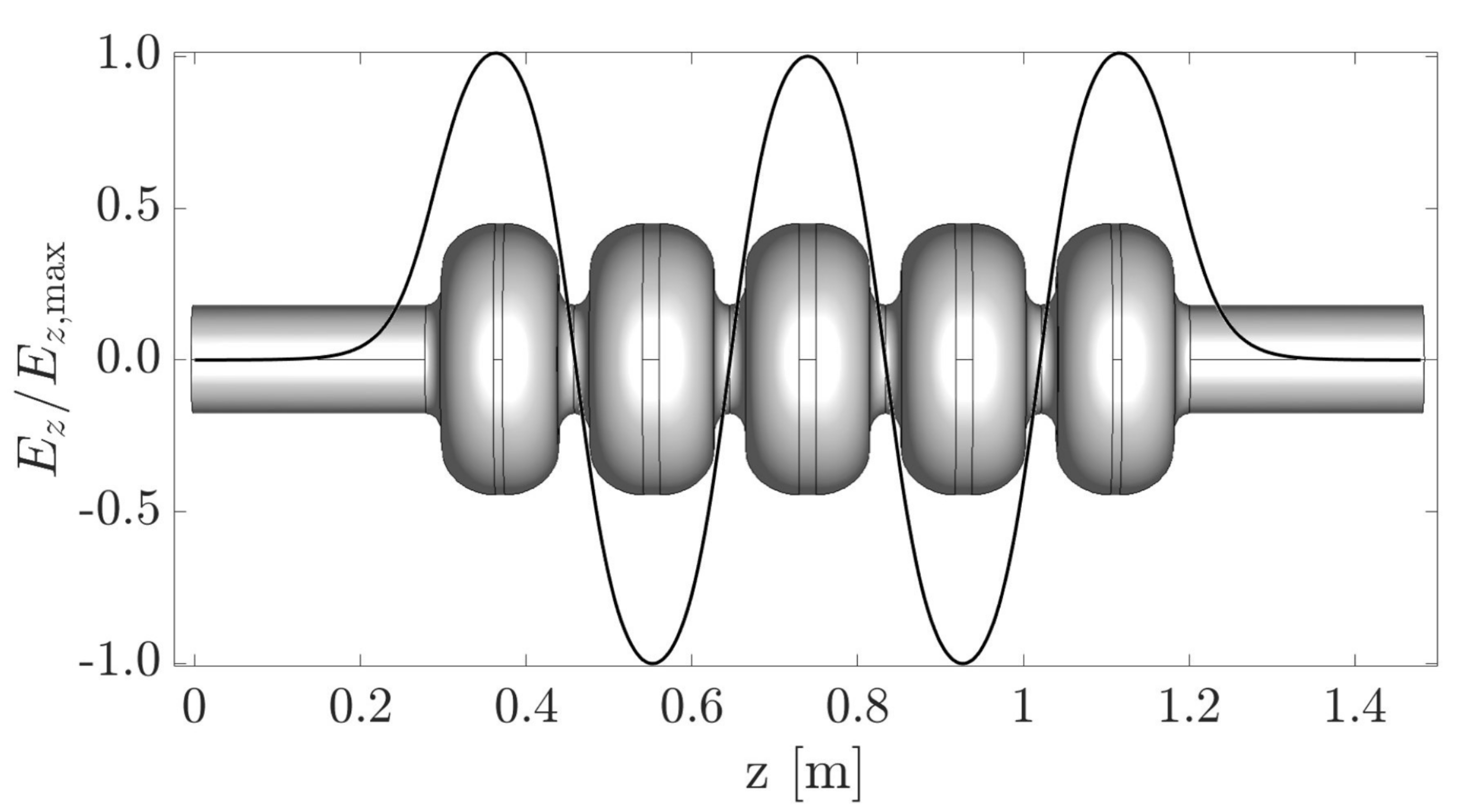
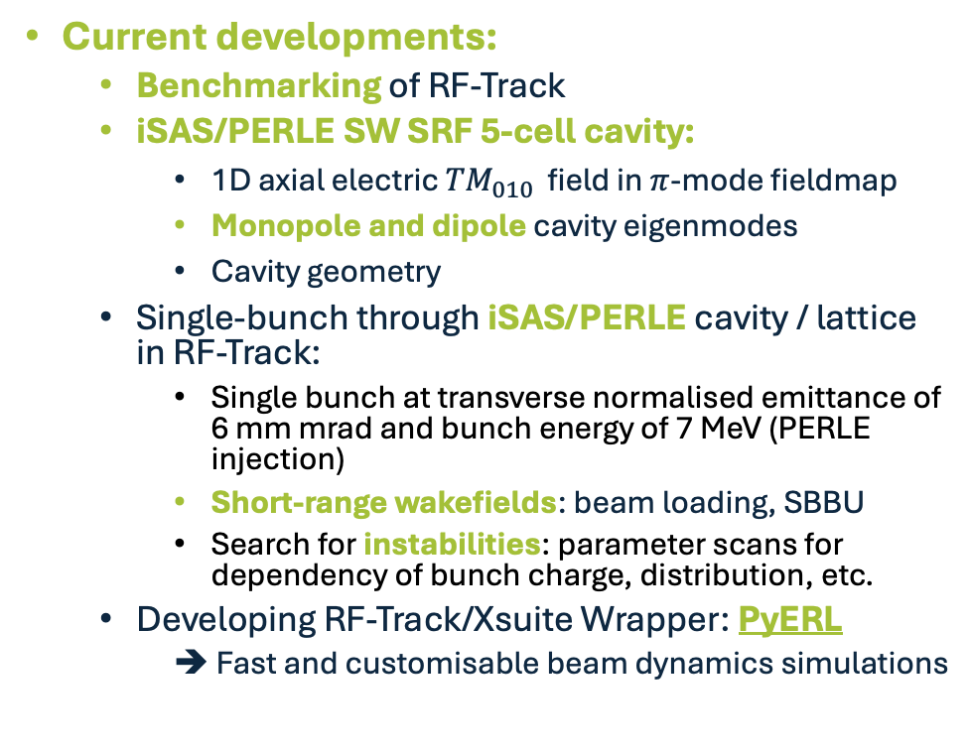
WP5 – Design new CM: status/evolution of Task 5.4
Task 5.4: Beam Dynamics for ERL-based accelerators with energy-efficient cryomodules – M1-M48
Current developments:
Benchmarking of RF-Track
iSAS/PERLE SW SRF 5-cell cavity:
1D axial electric ${TM}_{010 }$field in $π$-mode fieldmap
Monopole and dipole cavity eigenmodes
Cavity geometry
Single-bunch through iSAS/PERLE cavity / lattice in RF-Track:
Single bunch at transverse normalised emittance of 6 mm mrad and bunch energy of 7 MeV (PERLE injection)
Short-range wakefields: beam loading, SBBU
Search for instabilities: parameter scans for dependency of bunch charge, distribution, etc.
Developing RF-Track/Xsuite Wrapper: PyERL
➔ Fast and customisable beam dynamics simulations
Figure 5: Normalised axial electric field amplitude of the TM010-π mode at 801.58 MHz in the 5 half-wave cell bare-cavity for PERLE, with an energy gain of 20.5 MeV [C. Barbagallo, “Design and optimization of higher order mode couplers for the superconducting cavities of the PERLE energy recovery linac”].

Slide 14
WP5 – Design new CM: status/evolution of Task 5.4
Task 5.4: Beam Dynamics for ERL-based accelerators with energy-efficient cryomodules – M1-M48
Simulate the beam dynamics of ERL-based accelerators when the energy efficient CM is included - FEB 2028
Benchmarking of beam dynamics tracking codes - OCT 2025
Development of Multi bunch and multi pass simulation - OCT 2025
Single and multi-bunch instability analysis of ISAS typical cavity in PERLE lattice - AUG 2026
Energy recovery performances - FEB 2028
Evaluation of ERL proposed applications - JUL 2027
Energy recovery efficiency studies - JUL 2027
Final report - Sep 2027
Timeline
Under completion
Next Step
Following Phase
Deliverable 5.4 : Report on beam dynamics study for ERL with iSAS CM (Due date: M43 or SEP-2027)

Slide 15
WP5 – Design new CM: status/evolution of Task 5.4
Task 5.4: Beam Dynamics for ERL-based accelerators with energy-efficient cryomodules – M1-M48
Current developments
Long range wake field model
Beam loading model update
Latice (new) needs input from Alex
Multi-pass recirculation simulation (including collective effects)
Instability studies ( multi bunch, iSAS cavity), participate on PERLE workshop

Slide 16
WP5 – Title: points of attention
Points of attention: Setup meeting schedule in advance
This Meeting, Wednesday (Oct-01, 11AM)
Next Meeting, 1st week of the month Wednesday (Nov-05, 11AM)
Following meeting, 1st week of the month Wednesday (Dec-03, 11AM)

Slide 17
WP5 – Title: financial status
Financial status :
any developments?
New developments

Slide 18
Thank you

