Slide 1

Innovate for Sustainable Accelerating Systems
WP5: Integration into a new LINAC Cryomodule
Convener: Nuno Elias (ESS)
MEETING #04 (ESS+Zoom)
12-13th of September 2024

Slide 2
Meeting AGENDA:
- Introductions
- Overview of iSAS WP5 objectives, tasks, milestones and deliverables
- Open Discussion & Collaborative planning (next steps)
- Preparations for iSAS kick-off meeting (slides)
- Meeting conclusions and Wrap up.

Slide 3
Introductions
iSAS-WP5 member list (task lead):
ESS: Nuno Elias; Paolo Pierini; Henry Przybilzki; Marek Skiba
(Cecilia Maiano; Philippe Goudket; Mamad Eshraqi)
CERN: Vittorio Parma; Karin Canderan;
(Eric Montesinos; Marco Garlasche; Alick Macpherson)
CNRS (IJCLAB): Guillaume Olry; Yolanda Gomez Martinez; Patxi Duthil; Frederic Bouly
(Gilles Olivier; Denis Reynet; Sylvain Brault; Herve Saugnac)
EPFL: Mike Seidel; Tatiana Pieloni
INFN: Dario Giove; Cristian Pira; Giorgio Keppel; Giovanni Bisoffi; Giorgio Mauro; Maria Rosaria Masullo

Slide 4
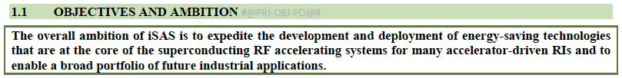
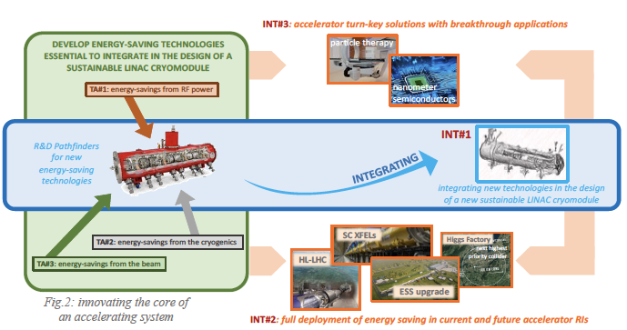
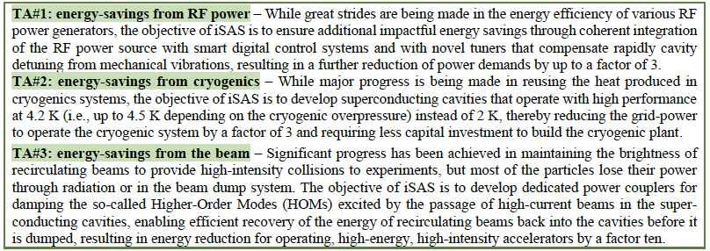
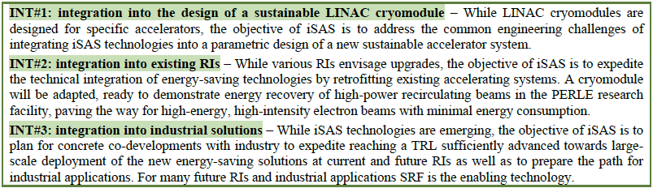
iSAS Project
iSAS proposal: Mar-2023
iSAS accepted: Jul-2023
iSAS start: Mar-2024

Slide 5
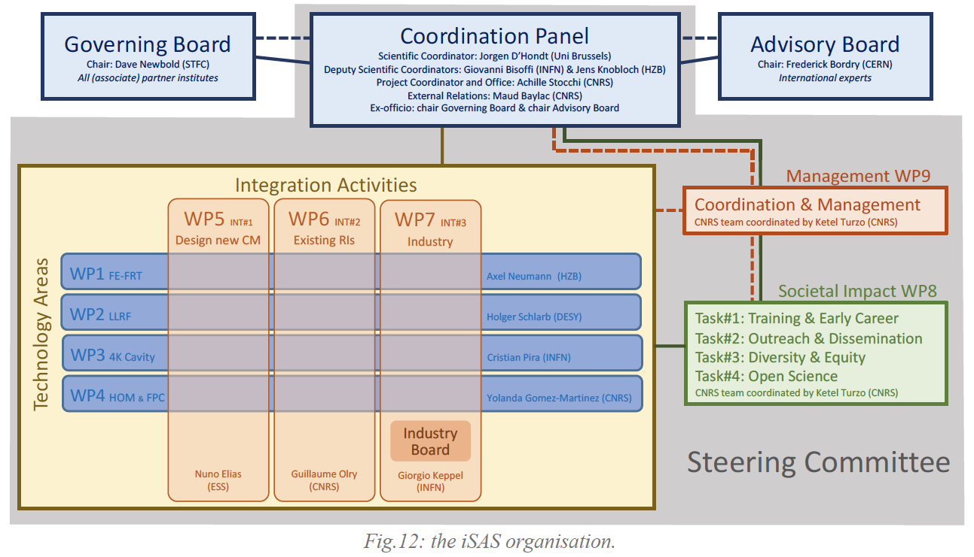
iSAS Organization

Slide 6
WP5: Integration into a new LINAC Cryomodule
ESS, CNRS, CERN, INFN, EPFL
Convener: Nuno Elias (ESS)
Main contacts with other partners: V. Parma (CERN), G. Olry (CNRS), M. Seidel (EPFL), D. Giove (INFN)?
Task 5.1: Coordination on cryomodule design activities– M1-M48
• General coordination by ESS as described above.
Task 5.2: ESS cryomodules experience and benchmarking with other recent facilities– M1-M36
• Compile the lesson learned from the ESS CM testing activities, technical commissioning, and initial operation.
• Benchmarking with projects in the implementation phase (worldwide).
• Develop a roadmap to develop a new, sustainable CM design.
Task 5.3: Sustainable criteria for LINAC cryomodule design– M24-M48
• Integrate findings from the other iSAS WPs into a generic CM design.
• Explore the sustainability criteria for the design.
Task 5.4: Beam Dynamics for ERL-based accelerators with energy-efficient cryomodules – M1-M48
• Simulate the beam dynamics of ERL-based accelerators when the energy efficient CM is included.
• Study the lattice design to optimize the beam and energy saving performances.

Slide 7
WP5 (INT#1) – Design new CM: status/evolution of Task 5.1
Task 5.1: Coordination on cryomodule design activities– M1-M48
• General coordination by ESS as described above.
Task 5.1 (ESS, CNRS, CERN)
This task needs to coordinate with WP1, WP3, WP4 and WP6 activities.
Joint meetings during the design and construction phases of HOM, RF couplers, FE-FRTs and prototype
module will be required.
Milestone 5.1 : In-person WP kick-off meeting at ESS (Due date: M3 or Jun-2024)

Slide 8
WP5 (INT#1) – Design new CM: status/evolution of Task 5.2
Task 5.2: ESS cryomodules experience and benchmarking with other recent facilities– M1-M36
• Compile the lesson learned from the ESS CM testing activities, technical commissioning, and initial operation.
• Benchmarking with projects in the implementation phase (worldwide).
• Develop a roadmap to develop a new, sustainable CM design.
Task 5.2 (ESS, CNRS, CERN) –
This task sets the first deliverable of the WP5 by organising a technical review of the ESS CM design, tests and commissioning experiences.
Operational results will be described, analysed and correlated with the project design choices. As part of this activity a benchmarking with other CM designs will be performed.
An additional intermediate deliverable at mid-project will set the roadmap for integrating the initial progress with the technology developments obtained in WP1 to 4 into a new, optimized energy-efficient CM design. By involving industrial partners in the review process, the technical and financial feasibility of fabricating instruments based on iSAS technology will be addressed.
Deliverable 5.1 : Compilation of ESS CM lessons learned & benchmarks (Due date: M24 or Feb-2026)
Deliverable 5.2 : Roadmap for the CM design (Due date: M36 or Feb-2027)

Slide 9
WP5 (INT#1) – Design new CM: status/evolution of Task 5.3
Task 5.3: Sustainable criteria for LINAC cryomodule design– M24-M48
• Integrate findings from the other iSAS WPs into a generic CM design.
• Explore the sustainability criteria for the design.
Task 5.3 (ESS, CNRS, CERN) –
This task is dedicated to the main deliverable of the WP5, i.e., a parametric design of a sustainable cryomodule. Based on the developed technical roadmap and under the guidance of a pan-European forum of experts, the developments of the parametric design will be conducted.
Direct or indirect, the relevant European institutes will be engaged and a continues dialogue with WP1-4 experts will enhance the transversal integration activity.
In addition to the technical, energy-efficiency and performance criteria in the roadmap, also cost-efficiency criteria will be considered. The integration of heat exchangers, thermal shields, cryogenic line, vacuum and monitoring instruments will be addressed.
Deliverable 5.2 : Compilation of ESS CM lessons learned & benchmarks (Due date: M24 or Feb-2027)
Deliverable 5.3 : Parametric design for a sustainable CM with iSAS tech. (Due date: M48 or Feb-2028)

Slide 10
WP5 (INT#1) – Design new CM: status/evolution of Task 5.4
Task 5.4: Beam Dynamics for ERL-based accelerators with energy-efficient cryomodules – M1-M48
• Simulate the beam dynamics of ERL-based accelerators when the energy efficient CM is included.
• Study the lattice design to optimize the beam and energy saving performances.
Task 5.4 (EPFL, CNRS, CERN) –
The beam dynamics study will include collaborations with leading research groups across Europe. ERL-specific beam dynamics effects using dedicated simulations will study the impact of the new sustainable SRF system on the beam quality, the attainable intensity and the efficiency of energy recovery in a quantitative way.
The study will first identify the most relevant beam dynamics effects in ERL mode including the new iSAS technologies.
Thereafter, realistic lattice parameter sets will be developed for specific research applications of ERL-based accelerators that will allow to specify the tolerances and acceptable HOM amplitudes.
These results will help in the development of efficiency-optimized ERL-based accelerators. The results also set limits on the required HOM damping for the cryomodule that will be designed in this work package and feed back into the HOM design criteria in WP4.
Deliverable 5.4 : Report on beam dynamics study for ERL with iSAS CM (Due date: M48 or Feb-2028)

Slide 11
WP5: plans to achieve milestones & deliverables
Milestone 5.1 : In-person WP kick-off meeting at ESS (Due date: M3 or Jun-2024)
Deliverable 5.1 : Compilation of ESS CM lessons learned & benchmarks (Due date: M24 or Feb-2026)
Deliverable 5.2 : Roadmap for the CM design (Due date: M36 or Feb-2027)
Deliverable 5.3 : Parametric design for a sustainable CM with iSAS tech. (Due date: M48 or Feb-2028)
Deliverable 5.4 : Report on beam dynamics study for ERL with iSAS CM (Due date: M48 or Feb-2028)
M5.1
D5.3
D5.1
D5.2
D5.4
Y0
Y1
Y2
Y3
Y4
Task 5.1
Task 5.1
Task 5.2
Task 5.2
Task 5.3
Task 5.3
Task 5.4
Task 5.4

Slide 12
WP5 (INT#1) – Design new CM: status/evolution of Tasks
Task 5.1: Coordination on cryomodule design activities– M1-M48
Setup of iSAS-WP5 member list:
ESS: Nuno Elias; Paolo Pierini; Henry Przybilzki; Marek Skiba (Cecilia Maiano; Philippe Goudket; Mamad Eshraqi)
CERN: Vittorio Parma; Karin Canderan; (Eric Montesinos; Marco Garlasche; Alick Macpherson)
CNRS (IJCLAB): Guillaume Olry; Yolanda Gomez Martinez; Patxi Duthil; Frederic Bouly (Gilles Olivier; Denis Reynet; Sylvain Brault; Herve Saugnac)
EPFL: Mike Seidel; Tatiana Pieloni
INFN: Dario Giove; Cristian Pira; Giorgio Keppel; Giovanni Bisoffi; Giorgio Mauro; Maria Rosaria Masullo
Meeting #01 (remote)
- Introductions
- Overview of iSAS WP5 objectives, tasks, milestones and deliverables
- Open Discussion & Collaborative planning (next steps)
- Preparations for iSAS kick-off meeting (slides)
- Meeting conclusions and Wrap up.
Task 5.2: ESS cryomodules experience and benchmarking with other recent facilities– M1-M36
Task 5.3: Sustainable criteria for LINAC cryomodule design– M24-M48 (Not Started)
Task 5.4: Beam Dynamics for ERL-based accelerators with energy-efficient cryomodules – M1-M48

Slide 13
WP5 (INT#1) – Design new CM: points of attention
e.g. important collaborations with other WPs and/or the broader accelerator R&D landscape
e.g. new challenges for the implementation of the tasks
e.g. new opportunities potentially leading to revisited tasks/milestones/deliverables
…

Slide 14
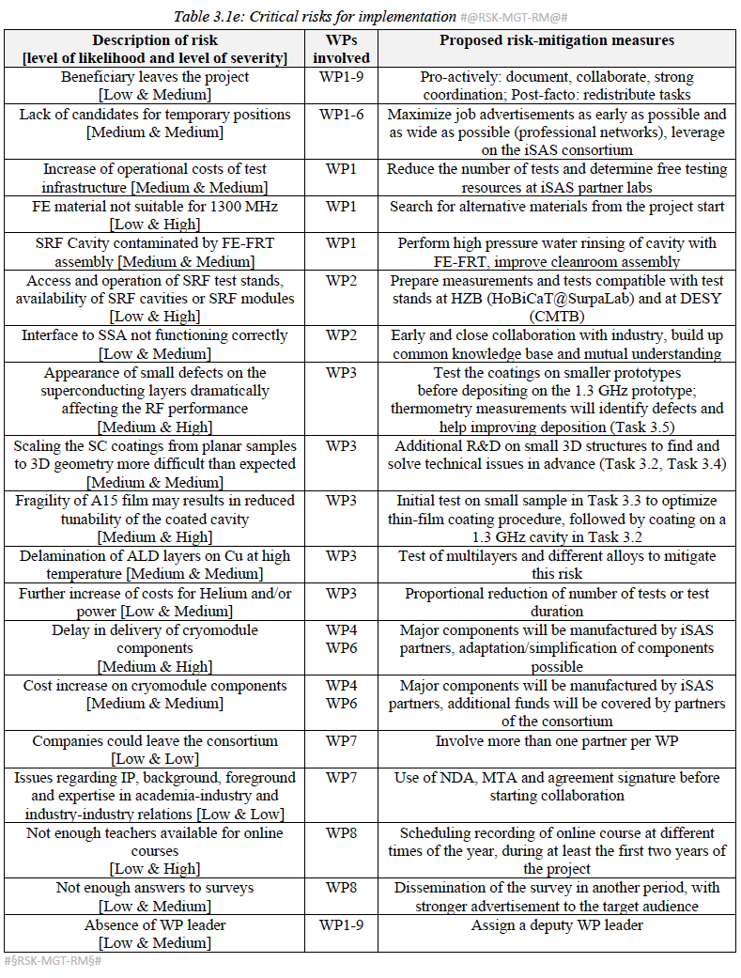
WP5 (INT#1) – Design new CM: Critical Risks
Beneficiary leaves the project
Pro-actively: Document, Collaborate, strong coordination
Lack of candidates for temporary positions
Maximize job advertisements as early as possible and as wide as possible (professional networks), leverage on the iSAS consortium
Absence of WP leader
Assign a deputy WP leader
Allocated WP budget exceeded by costs
?Cost report and control?
…

Slide 15
WP5 : budget plans
(message from Jorgen D’HONDT)
with from page 171 the investment aspects, i.e. human resources and costs. On page 174 the overview where WP5 has 102kEUR from the EU budget. It would be interesting to verify if this budget still matches the expected costs to achieve the milestones and deliverables of WP5, for example by listing concretely the expected investments (human and materials) especially for Tasks 5.2 and 5.3.
The PhD student for Task 5.4 is not on the EU budget but is a budget directly from EPFL

