Slide 1












First transport of antimatter in a truck across CERN
Jonathan Morgner
BASE Collaboration
CERN
IJCLab Orsay

Slide 2







BASE – Collaboration
BASE-Mainz: Proton magnetic moment, new technologies.
BASE-CERN: Antiproton magnetic moment, proton/antiproton q/m ratio
BASE-STEP: Transportable antiproton traps
BASE-Hannover/PTB: BASE-LOGIC / QLEDS laser cooling project, new technologies
BASE-HHU: Offline measurements with transported antiprotons
Five experiments
9 institutes
~30 collaborators
~10 at CERN
Institutes: RIKEN, MPIK, CERN, University of Mainz, Tokyo University, GSI Darmstadt, University of Hannover, PTB Braunschweig, ETH Zuerich

Slide 3
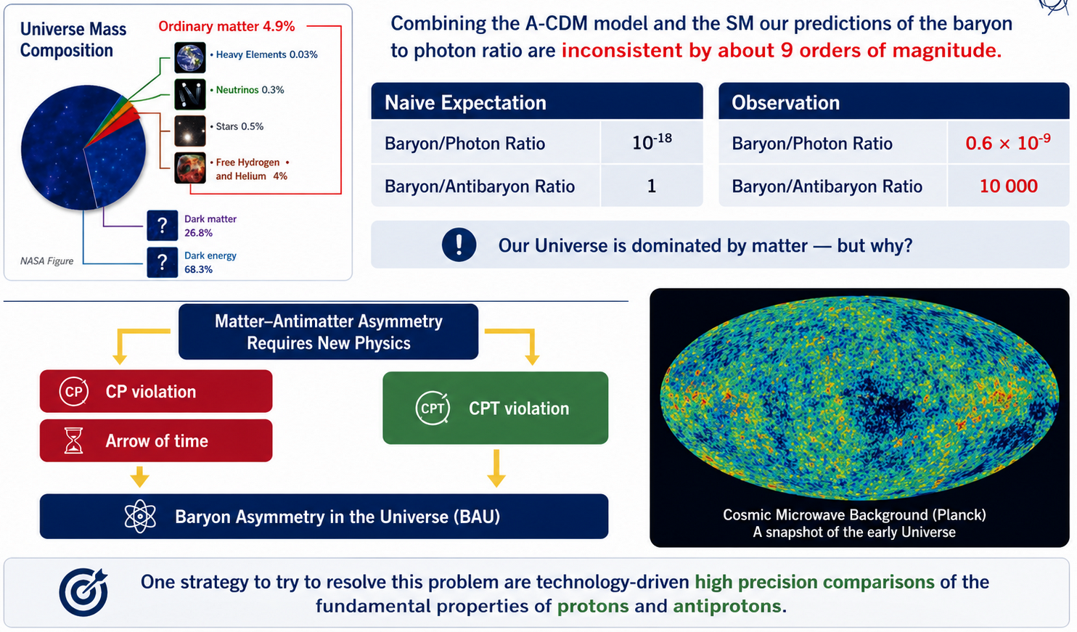
Matter / antimatter asymmetry

Slide 4
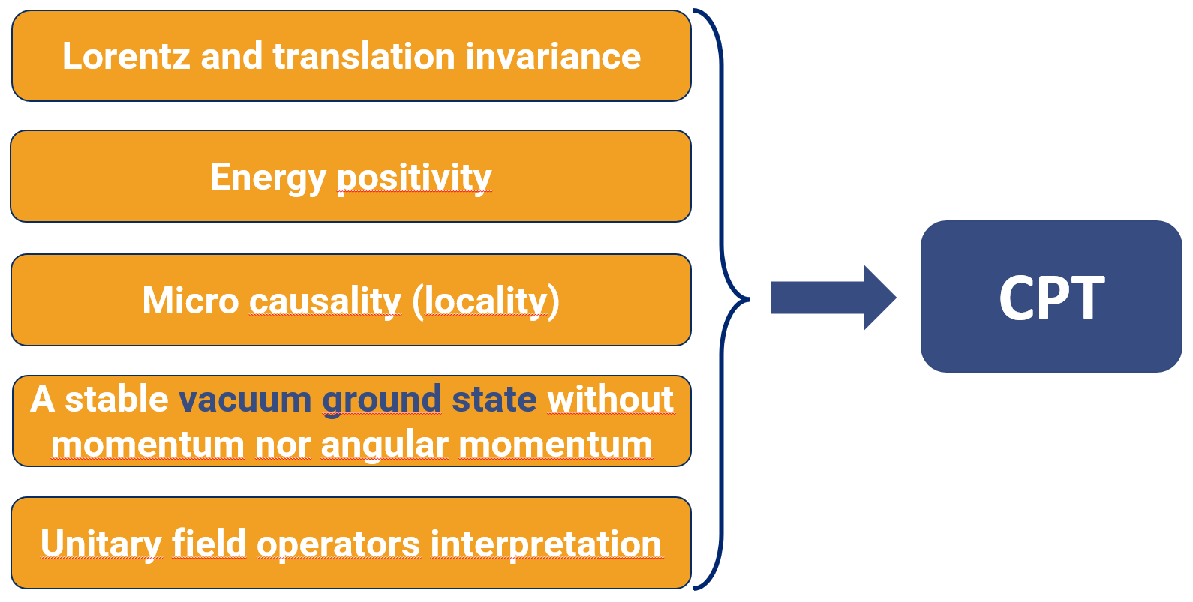
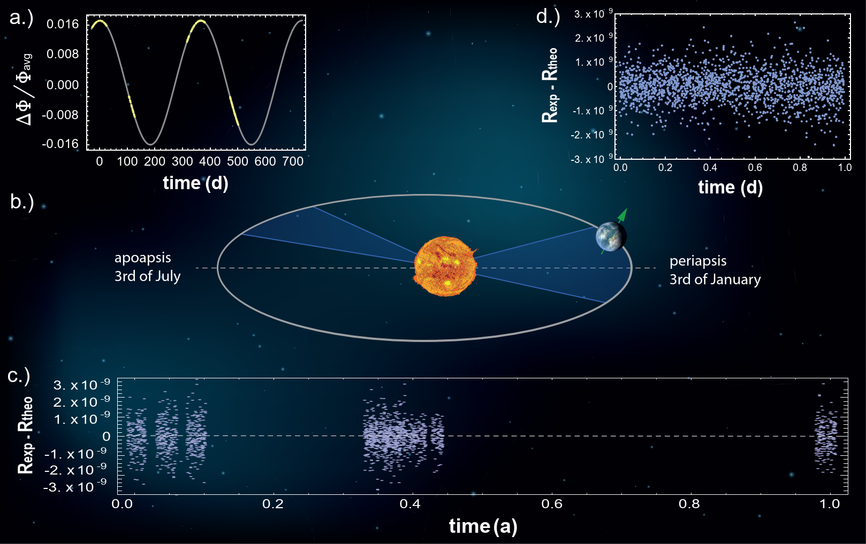
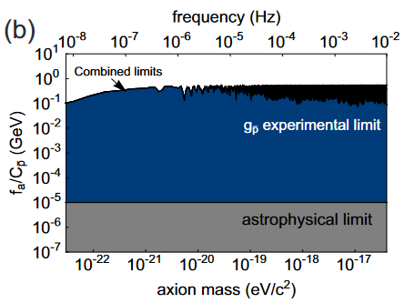
The Physics
Measurements of Proton/Antiproton Fundamental Constants with high precision
Tests of CPT Invariance
Search for DM and Exotic Interactions
$$\left(iγ^{μ}D_{μ}−m−{a_{μ}γ}^{μ}−b_{μ}γ_{5}γ^{μ}\right)ψ=0$$
Current most precise tests of CPT invariance with baryons is a BASE measurement (q/m – 16 p.p.t.)

Slide 5
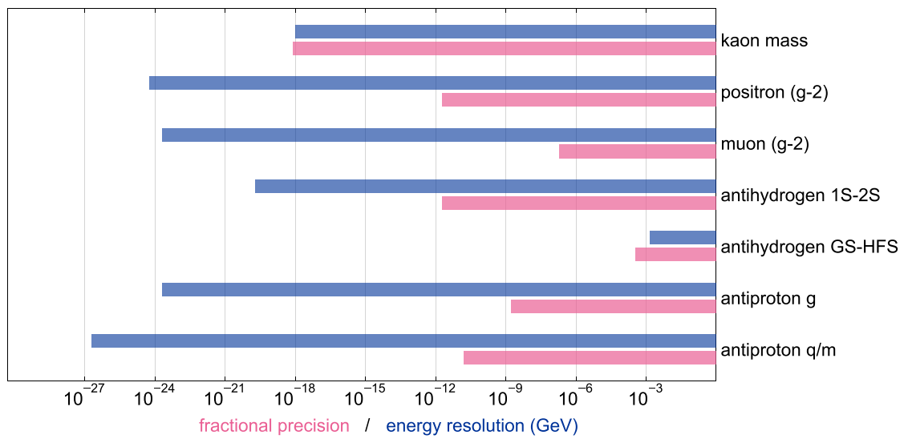

Comparison of existing CPT tests
Antiproton lifetime
10.2 years New J. Phys. 19.8 (2017): 083023
High precision mass spectroscopy
High precision magnetic moment measurements
16 ppt antiproton-to-proton charge–mass ratio measurement Nature 601.7891 (2022): 53-57.
1.5 ppb antiproton magnetic moment measurement Nature 550, 371-374 (2017)
Towards the first sub 100 ppt measurement

Slide 6
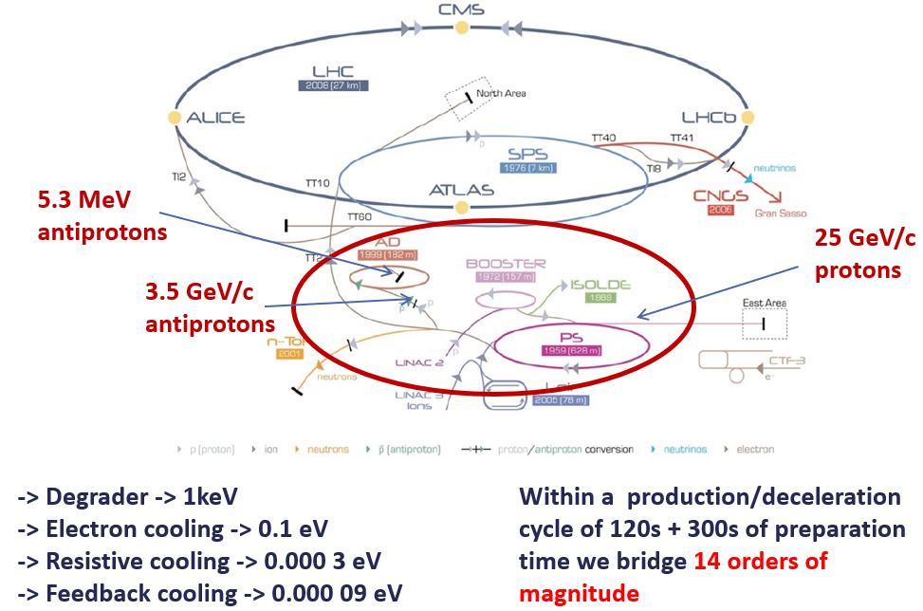
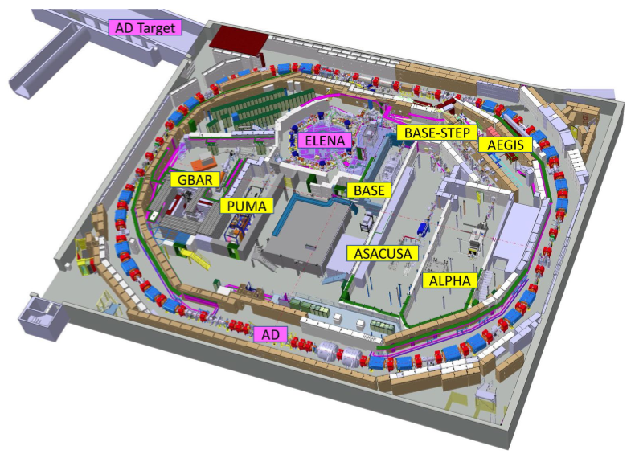
The AD/ELENA-Facility
ALPHA,
Spectroscopy of 1S-2S in
antihydrogen
ASACUSA, ALPHA
Spectroscopy of GS-HFS in antihydrogen
ALPHA, AEgIS, GBAR
Test free fall weak equivalence principle with antihydrogen
ASACUSA
Antiprotonic helium spectroscopy
BASE, BASE-STEP
Fundamental properties
of the proton/antiproton, tests of clock WEP / tests of exotic physics / antimatter-dark matter interaction, etc...
PUMA
Antiproton/nuclei scattering to study neutron skins
TELMAX
Experimental Area for short term experiments with antiprotons
antihydrogen
antiprotons
60 Research Institutes/Universities – 350 Scientists – 6 Active Collaborations

Slide 7
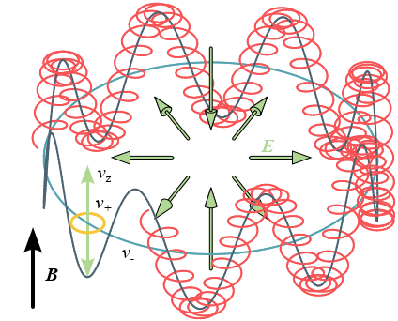
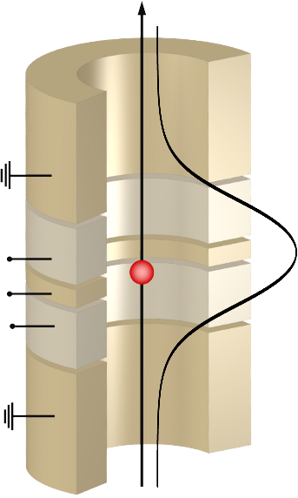
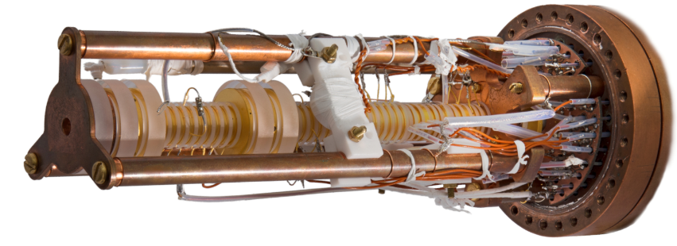
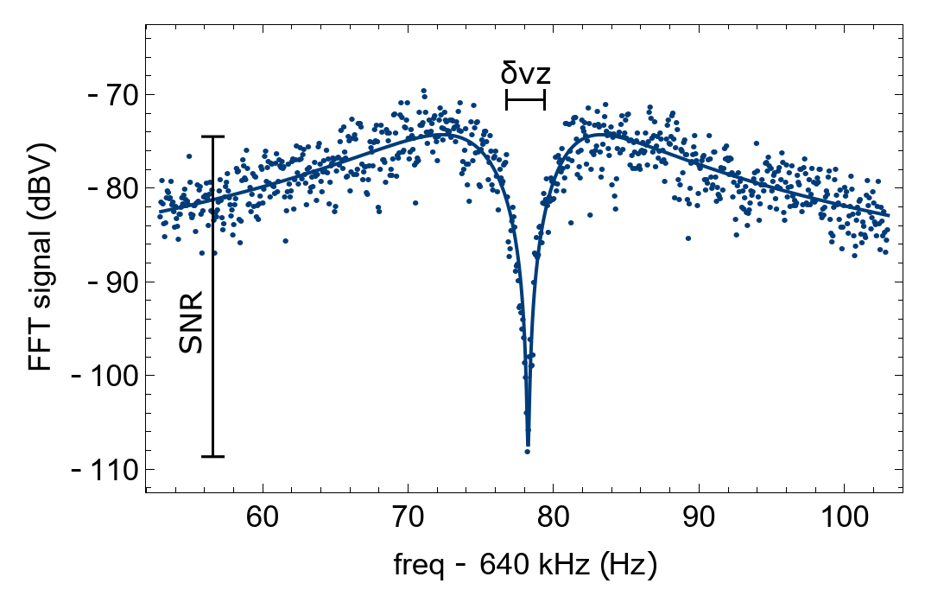
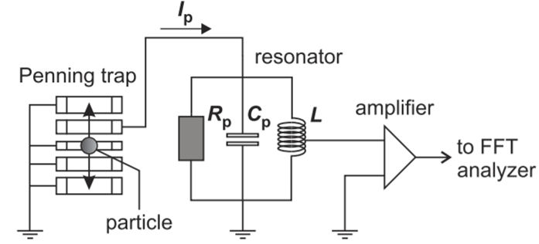
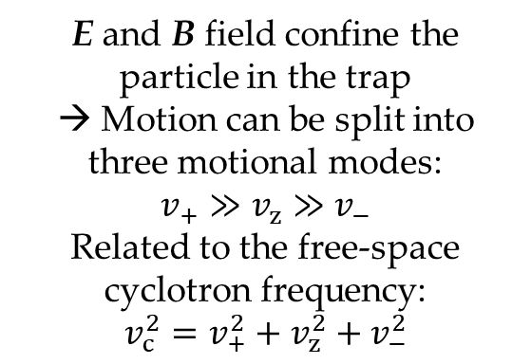
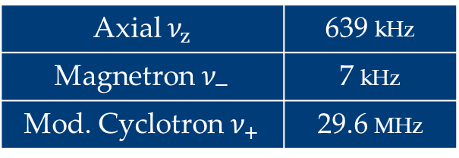
Penning trap
E and B field confine the particle in the trap
→ Motion can be split into three motional modes:
$$v_{+}≫v_{z}≫v_{−}$$
Related to the free-space cyclotron frequency:
$$v_{c}^{2}=v_{+}^{2}+v_{z}^{2}+v_{−}^{2}$$
Axial $ν_{z}$ | 639 kHz
Magnetron $ν_{−}$ | 7 kHz
Mod. Cyclotron $ν_{+}$ | 29.6 MHz
Non-destructive single-particle detection via image-currents

Slide 8
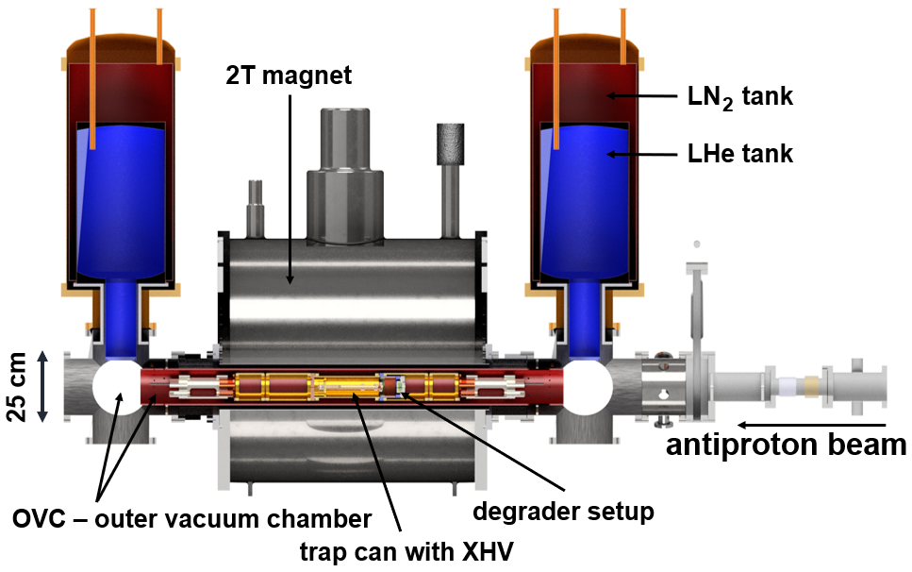
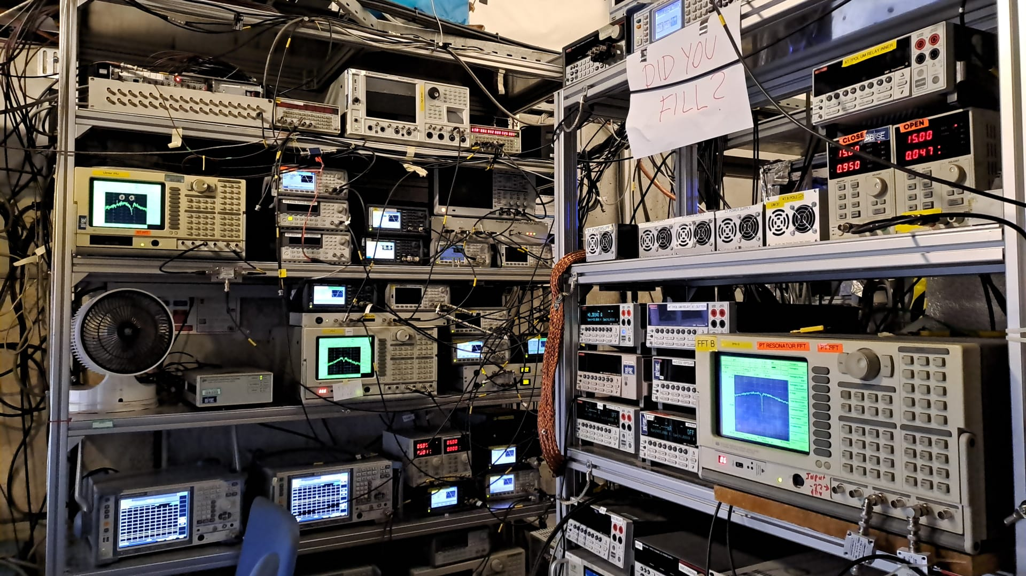
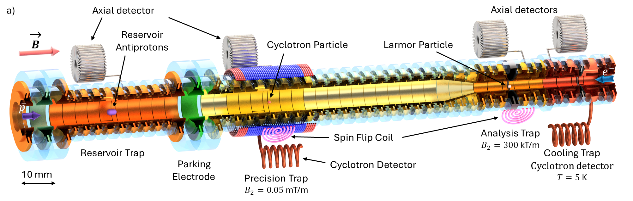
Apparatus

Slide 9
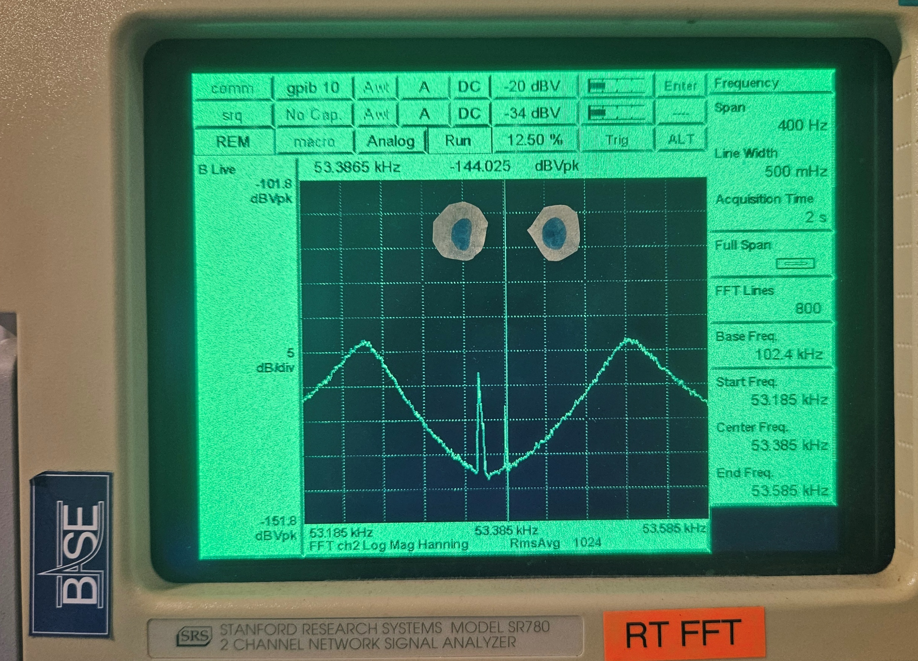
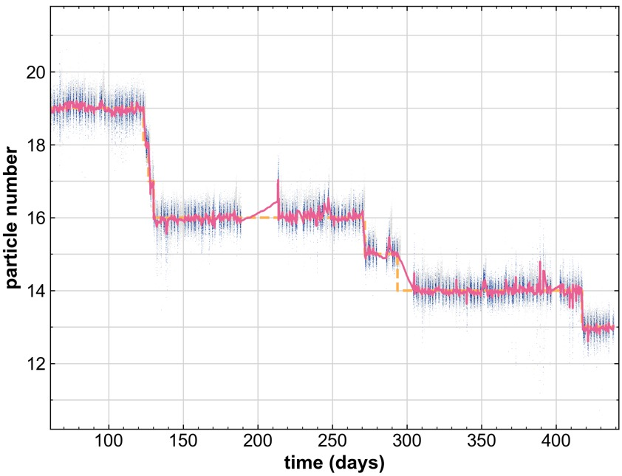
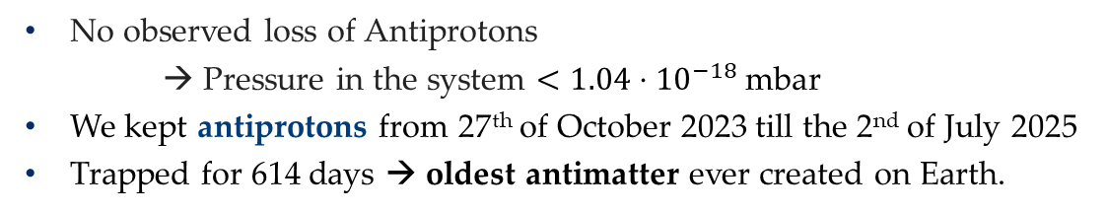
Antiproton lifetime
We just captured ~300 antiprotons on the 8th of May
No observed loss of Antiprotons
→ Pressure in the system $<1.04⋅{10}^{−18} \text{mbar}$
We kept antiprotons from 27th of October 2023 till the 2nd of July 2025
Trapped for 614 days → oldest antimatter ever created on Earth.
4.5 months without loss
6 antiprotons used during the entire 2024 campaign
4 months without loss
Antiproton lifetime data collected since 2014: > 55 y
Submitted, under revision

Slide 10
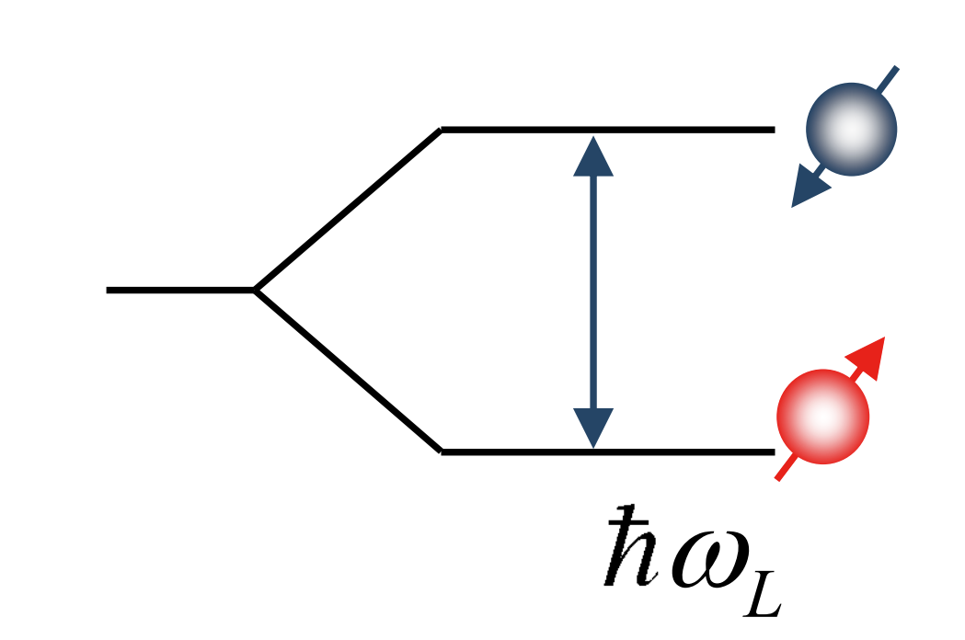
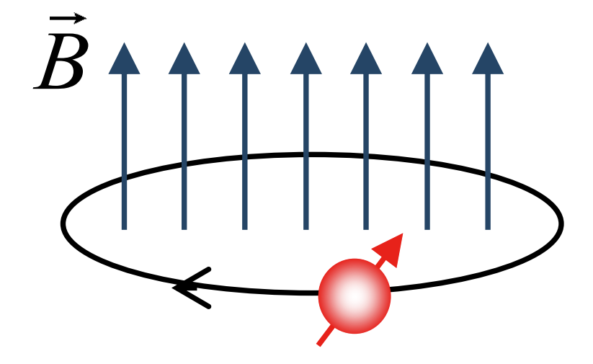
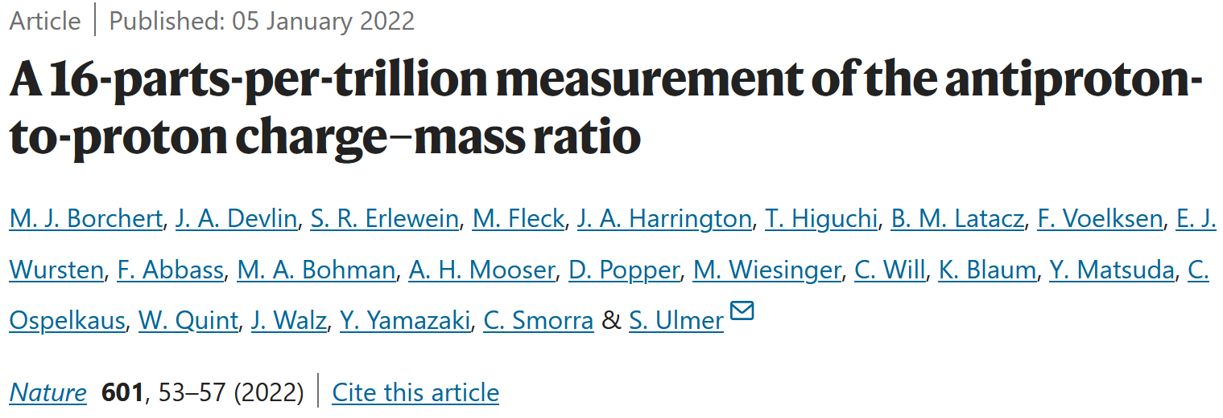
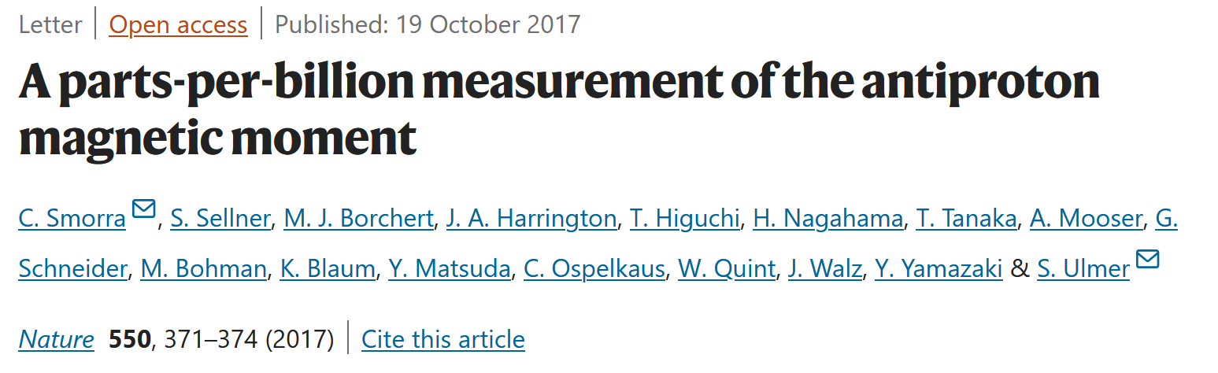




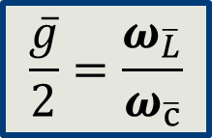
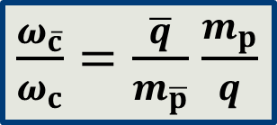

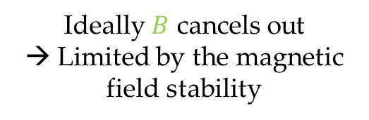

Measurements
Antiproton
Proton
$$B$$
$$B$$
Ideally $B$ cancels out
→ Limited by the magnetic field stability
$$ω_{\overline{L}}=\frac{\overline{g}}{2}\frac{\overline{q}}{m_{\overline{p}}}B$$
$$ω_{\overline{c}}=\frac{\overline{q}}{m_{\overline{p}}}B$$
$$ω_{c}=\frac{q}{m_{p}}B$$
Compare Antiproton with Proton to test CPT
$$\frac{\overline{g}}{2}=\frac{ω_{\overline{L}}}{ω_{\overline{c}}}$$
$\frac{ω_{\overline{c}}}{ω_{c}}=\frac{\overline{q}}{m_{\overline{p}}}$ $\frac{m_{p}}{q}$
Determine magnetic moment
Antiproton-to-proton
charge-to-mass ratio

Slide 11
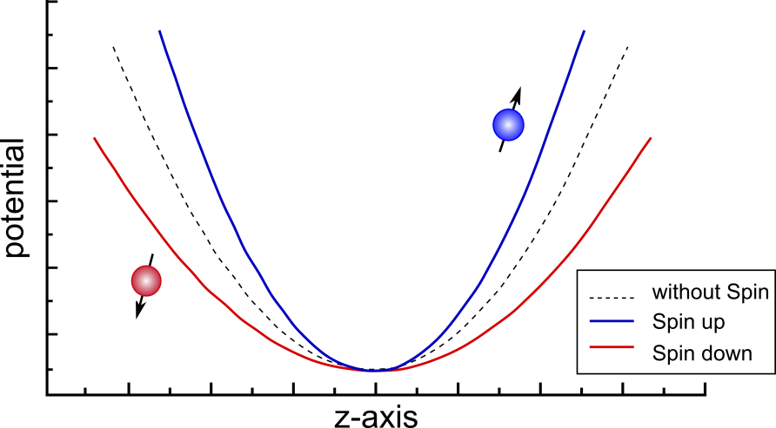
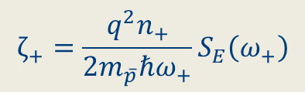
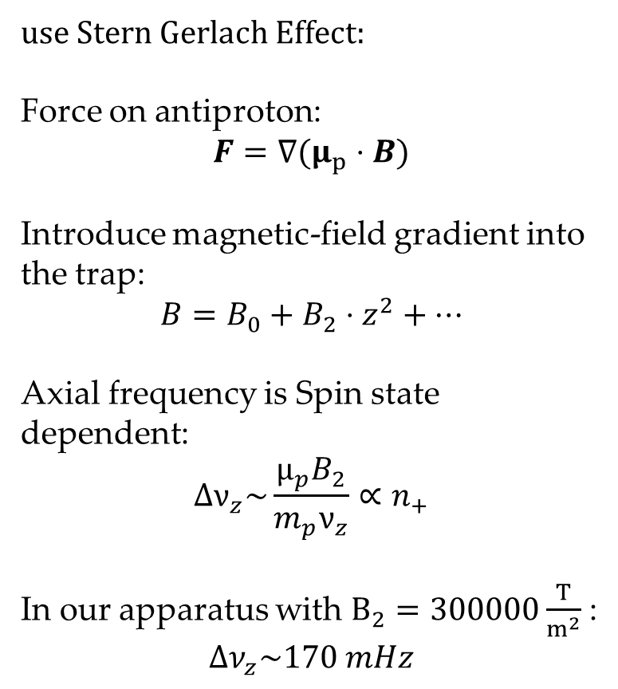
Spin state detection
use Stern Gerlach Effect:
Force on antiproton:
$$F=∇\left.(μ_{p}⋅B)\right.$$
Introduce magnetic-field gradient into the trap:
$$B=B_{0}+B_{2}⋅z^{2}+…$$
Axial frequency is Spin state dependent:
$$Δν_{z}\sim \frac{μ_{p}B_{2}}{m_{p}ν_{z}}∝n_{+}$$
In our apparatus with $B_{2}=300000\frac{T}{m^{2}}$:
$${∆ν}_{z}\sim 170 mHz$$
cold particle (50mK)
hot particle (1K)
axial trapping potential
high-fidelity spin state resolution
fidelity at 65%, not useful for measurements
$$ζ_{+}=\frac{q^{2}n_{+}}{2m_{\overline{p}}\text{ℏ}ω_{+}}S_{E}\left(ω_{+}\right)$$
We need a cold particle to resolve spin state

Slide 12
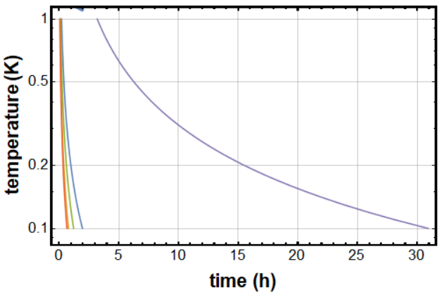
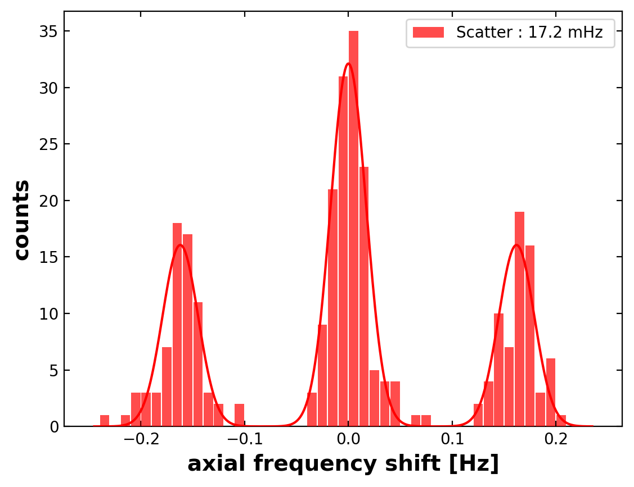
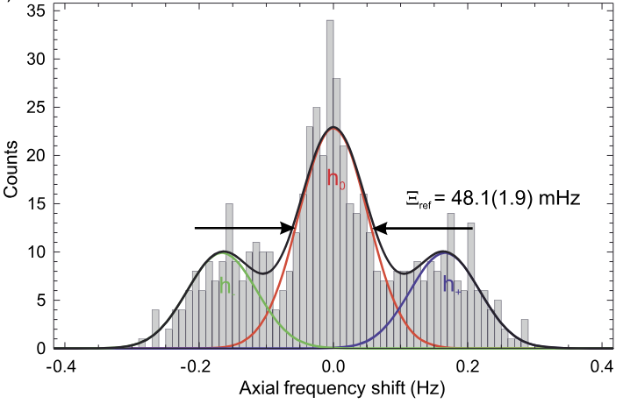
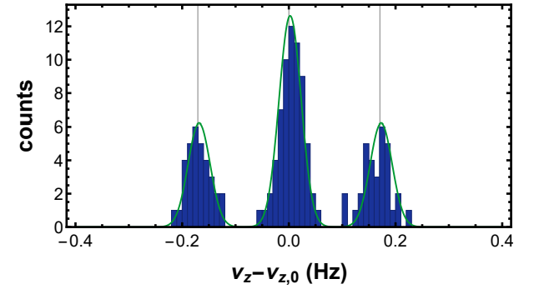
Spin state detection
Recent game changer is a dedicated cooling trap
→ error-rate smaller by a factor of >5000 (PRL 133.5 (2024): 053201)
  Robust 200mK particle preparation in 8 minutes.
Ongoing : phase sensitive methods for higher temperature acceptance.
Dip method (antiproton); C. Smorra et al., Phys. Lett. B 769 (2017) 1–6
Dip method with improved AT electronics at Cooling Trap; B.M. Latacz et al., PRL 133.5 (2024): 053201.
Axial phase methods –
(B. Arndt, P. Geissler, et al.)
2025
2024
2016

Slide 13
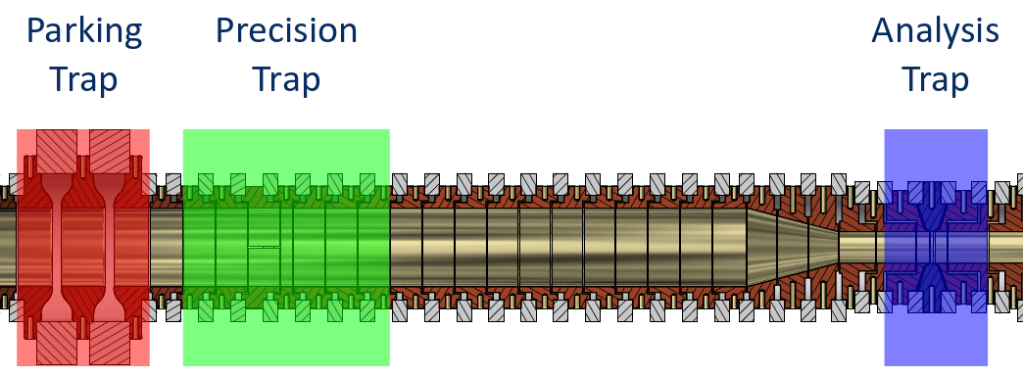
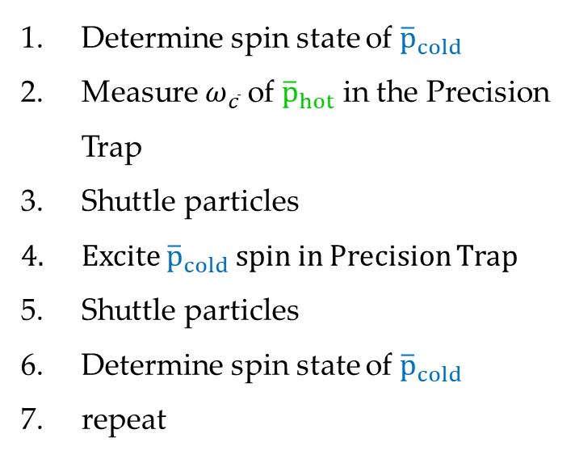
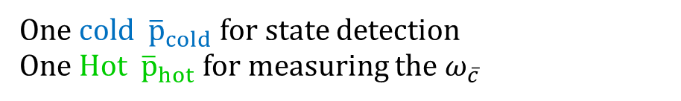
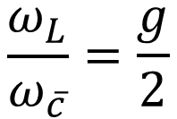
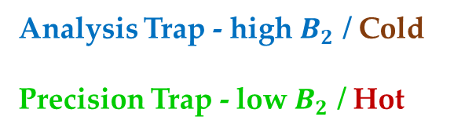
Two trap and two particle method
Analysis Trap - high $B_{2}$ / Cold
Precision Trap - low $B_{2}$ / Hot
$$\frac{ω_{L}}{ω_{\overline{c}}}=\frac{g}{2}$$
One cold ${\overline{p}}_{cold}$ for state detection
One Hot ${\overline{p}}_{hot}$ for measuring the $ω_{\overline{c}}$
Determine spin state of ${\overline{p}}_{cold}$
Measure $ω_{\overline{c}}$ of ${\overline{p}}_{hot}$ in the Precision Trap
Shuttle particles
Excite ${\overline{p}}_{cold}$ spin in Precision Trap
Shuttle particles
Determine spin state of ${\overline{p}}_{cold}$
repeat
Cycletime between 15 to 45 min.
Notes:
13

Slide 14
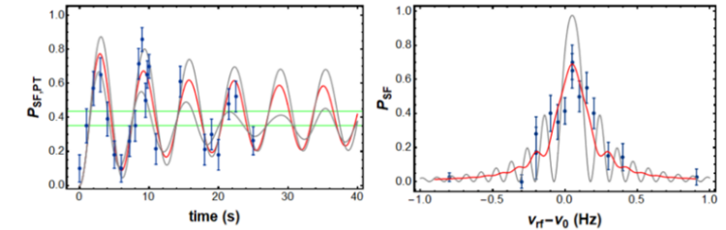
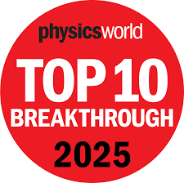
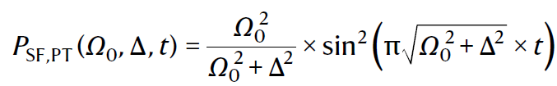






Coherent spin-state spectroscopy
Lineshape parameter:
Rabi resonance shape:
Convolution with Gaussian:
Each „bin” is average of 20 points, single point takes 15 min
$$∆ν_{L}=ν_{L}\frac{B_{2}}{B_{0}}\frac{k_{B}T_{z}}{mω_{z}^{2}}$$
$$T_{z}=\text{8.5(3)} \text{K}$$
$$ν_{z}=\text{636712} \text{Hz}$$
$$ν_{L}=\text{82.794} \text{MHz}$$
$$B_{0}=\text{1.945} \text{T}$$
We observe a coherent spin-state with a single antiproton for the first time ever!!
Nature 644, pages 64–68 (2025)

Slide 15
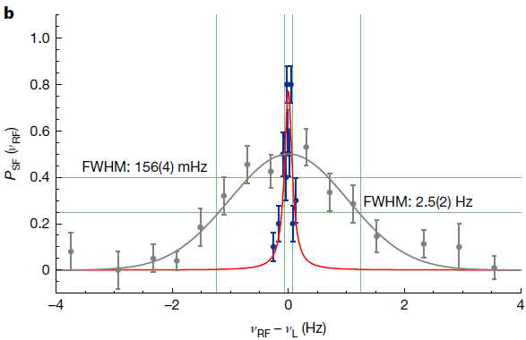
Frequency sweep at maximum inversion
At Ω/(2π) ≈ 50 mHz and a drive time of 16 s
Inversion 2016: 0.5 → Incoherent
Inversion 2023: 0.77 → Coherent
FWHM reduced by factor of 16
~77(4) % spin state inversion in the center
Nature 644, pages 64–68 (2025)

Slide 16
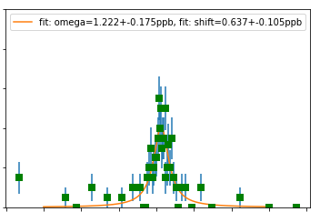
Antiproton / proton measurements
Antiproton:
  First run: data collected between 28.12.2023 and 26.01.2024
  Second run: data collected between 22.12.2024 and 10.02.2025
Proton: measurement carried out May to July 2023
 | 2016 | 2024/2025
FWHM | 2.5 Hz | < 200 mHz
Sigma (stat) | 123 mHz | < 10 mHz
PRELIMINARY
Statistical line center resolution at about 100 ppt precision - 15 times better.
Systematic studies ongoing (tough at this accuracy in the AD).

Slide 17
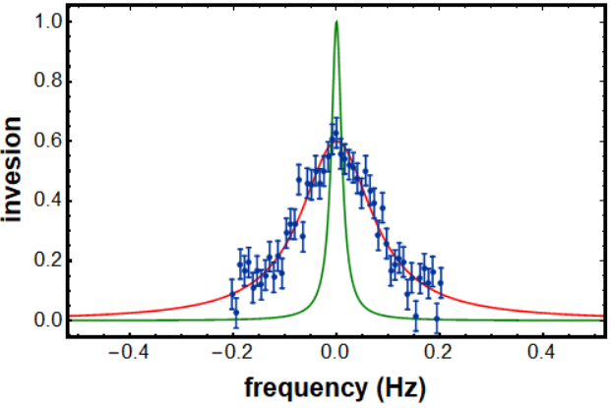
Future: Coherent single particle measurement
Achieved coherence time of 50.2(4.8) s
FWHM: 20 mHz
Center: < 10 ppt
Possible based on 50s spin coherence time measurement
Inversion
FWHM: 200 mHz
Center: 70 ppt
Measured subset of 2024/2025 with AD-OFF
frequency (Hz)
Plan: Magnetic moment measurement with single antiproton / proton:
  Phase sensitive cylotron frequency measurements:
  Phase sensitive detection in the AT
  Fast particle cooling in the CT
→ Achieve 10 ppt precision

Slide 18
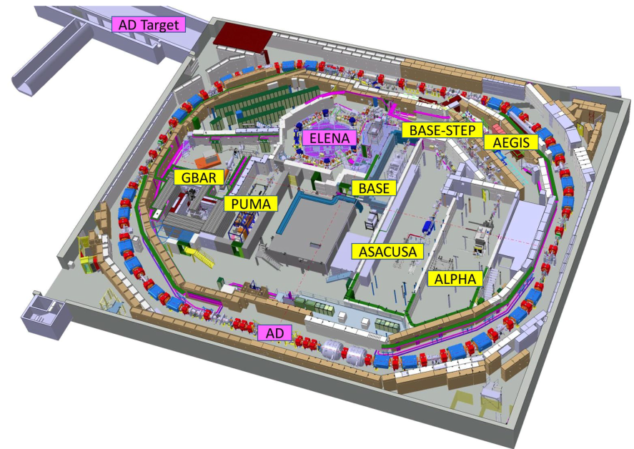
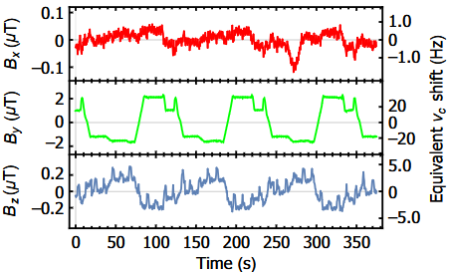

The big limitation
AD fluctuations for 8 months of the year
While AD is running no high-precision Measurement possible.
→ Use the upcoming long shutdown!
→ Move antiprotons out of the antimatter factory

Slide 19
Charge-to-Mass Ratio Measurements
Next precision goal is the p.p.t. level
 | AD/ELENA-ON | BASE best (AD/ELENA OFF) | BASE best (Offline Laboratory) | Best Penning Traps
Fluctuation | 2000ppt / 60mHz / 4nT (shielded) | 200ppt / 6mHz / 0.4nT | 200ppt / 6mHz / 0.4nT | 70ppt / 2.2mHz / 0.13nT
Precision goal | 2 ppt | 2 ppt | 2 ppt | 2ppt
Measurements | 1.000.000 | 10.000 | 10.000 | 820
Realistic Sampling | 23 years | 3 months | 3 months | 2.5 days
Total measurement time | > 1 lifetime of an Exp.Phys. | 3 years (AD) | 9 months | 2 weeks?

Slide 20





BASE-STEP apparatus
Transport antiprotons from the only available source
Use in offline laboratories to multiply experiments on antiprotons
Crucial technology, not only for antiproton transport but also for future spectroscopy of ${\overline{H}}_{2}^{−}$.
Christian Smorra

Slide 21




BASE-STEP apparatus
Open system for injection and ejection while keeping good vacuum
Multi-trap-system for controlled separation
First proton transport in 2024 (Nature 641, 871–875 (2025))

Slide 22




BASE-STEP upgrades in 2025
December 2024 to February 2025
Single-Proton
Precision Measurement
BASE-STEP transported to Düsseldorf
Clear potential for considerably improved experiments in the offline laboratories at HHU
April to August 2025: System Upgrades

Slide 23


BASE-STEP capture
100 keV antiprotons from ELENA are injected into BASE-STEP
Degrader reduces kinetic energy to the keV range
Capture at these low energies by pulsing electric confining potentials.
14.10.2025: STEP connected to Beamline
2 Month of commissioning
and beam steering
December 2025:
First antiproton capture in BASE-STEP
Leonhardt, Morgner et. al. in preparation

Slide 24




First Antiproton Road Transport

Slide 25



Leonhardt, Morgner et. al. in preparation

Slide 26

Leonhardt, Morgner et. al. in preparation

Slide 27




First Antiproton Road Transport
24th of March 2026
92 antiprotons were successfully transported
Not a single antiproton lost
Excellent vacuum conditions
Leonhardt, Morgner et. al. in preparation

Slide 28

First Antiproton Road Transport
24th of March 2026
Transport took place around the CERN campus
Took in total ~3 hours
Liquid Helium cooled
Connection to a cold head during transport planned in the future for long distance transport
Leonhardt, Morgner et. al. in preparation

Slide 29






Antiprotons on the road 2027 and beyond
BASE–CERN → offline laboratory?!?
BASE–HHU:
  New generation of Penning-Trap experiments in commissioning

Slide 30

Thanks for your attention

Slide 32



Summary of SME limits by BASE
Magnetic Moment Measurements
Coefficient | Limit
$$\left|{\tilde{b}}_{p}^{z}\right|$$ | $$<{1.8⋅10}^{−24} GeV$$
$$\left|{\tilde{b}}_{p}^{XX} +{\tilde{b}}_{p}^{YY} \right|$$ | $$<{1.1⋅10}^{−8} {GeV}^{−1}$$
$$\left|{\tilde{b}}_{p}^{ZZ} \right|$$ | $$<{7.8⋅10}^{−9} {GeV}^{−1}$$
$$\left|{\tilde{b}}_{p}^{∗z}\right|$$ | $$<{3.5⋅10}^{−24} GeV$$
$$\left|{\tilde{b}}_{p}^{∗XX} +{\tilde{b}}_{p}^{∗YY} \right|$$ | $$<{7.4⋅10}^{−9} {GeV}^{−1}$$
$$\left|{\tilde{b}}_{p}^{∗ZZ} \right|$$ | $$<{2.7⋅10}^{−8} {GeV}^{−1}$$
2022 Charge-to-Mass Ratio Measurement
Coefficient | Limit
$${\tilde{b}}_{p}^{∗X}$$ | $$<{9.7⋅10}^{−25} GeV$$
$${\tilde{b}}_{p}^{∗Y}$$ | $$<{9.7⋅10}^{−25} GeV$$
$$\left|{\tilde{b}}_{p}^{∗XX} −{\tilde{b}}_{p}^{∗YY} \right|$$ | $$<{5.4⋅10}^{−9} {GeV}^{−1}$$
$${\tilde{b}}_{p}^{∗XZ}$$ | $$<{3.7⋅10}^{−9} {GeV}^{−1}$$
$${\tilde{b}}_{p}^{∗YZ}$$ | $$<{3.7⋅10}^{−9} {GeV}^{−1}$$
$${\tilde{b}}_{p}^{∗XY}$$ | $$<{2.7⋅10}^{−9} {GeV}^{−1}$$

