Slide 1

WP5: Integration into a new LINAC Cryomodule
Task 5.2: ESS cryomodule experience and benchmarking with other recent facilities
Focus: Benchmarking with projects in the implementation phase (worldwide).
Karin Canderan (CERN, SY-RF) on behalf of WP5
22/04/2026

Slide 2
WP5's main goal is to tackle the common engineering challenges of integrating iSAS technologies into a parametric design of a new cryomodule, building on developments made with ESS cryomodules whilst benchmarking against other facilities.
The scope of the benchmarking study is to establish a robust baseline for the definition of the sustainability criteria to consider for the design of a new cryomodule.
The study has been conducted through a questionnaire across five key domains, in order to receive a structured and comparable set of answers from the facilities.
This comparative approach highlights how differing requirements, constraints, and strategic priorities shape design choices and lead to distinct technical configurations.
Study conducted for high-beta elliptical cryomodules with frequencies between 400MHz and 1.3GHz, across six facilities SNS, LHC, PIP-II, XFEL, LCLS-II, and ESS, to ensure a relevant comparison
Notes:
The study aimed to benchmark the ESS cryomodule, thereby similar “cryomodule types” were selected, focusing the study specifically on cryomodules with high-beta elliptical cavities with frequencies between 400MHz and 1.3GHz. This ensured that the comparison remained relevant and provided a validated technical baseline.

Slide 3
  1
Beam and RF parameters
Main steps of the benchmarking methodology:
Definition of key technical areas of interest to be included in the benchmarking study
Proposal of cryomodule design concepts, facilities and experts
Definition of specific points of interest for each area and drafting of the questionnaire
Literature research and pre-filling of the answers
Initial contact and questionnaire distribution
Follow-up face-to-face interviews
Compilation of answers and final report.
  2
Cryogenic Systems and thermal management
  3
Cryomodule design
  4
Commissioning insights
  5
Operational experience and reliability

Slide 4
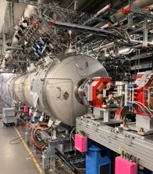
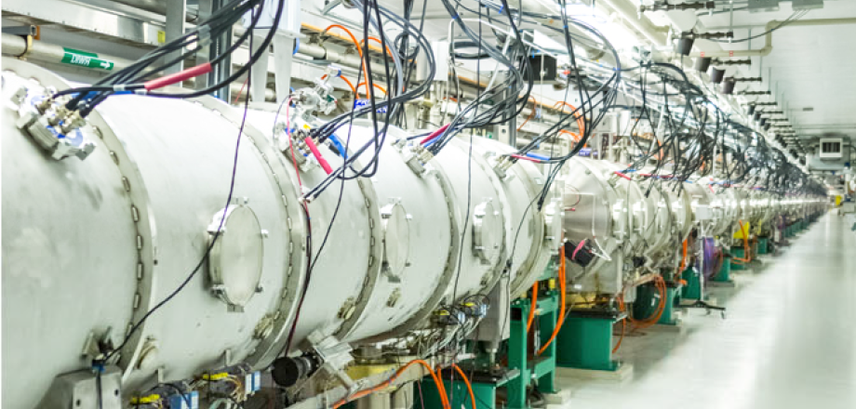
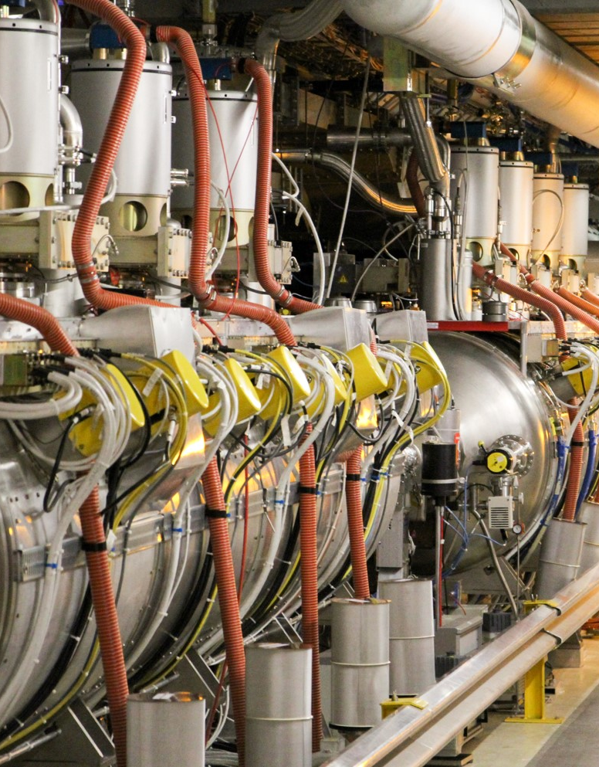
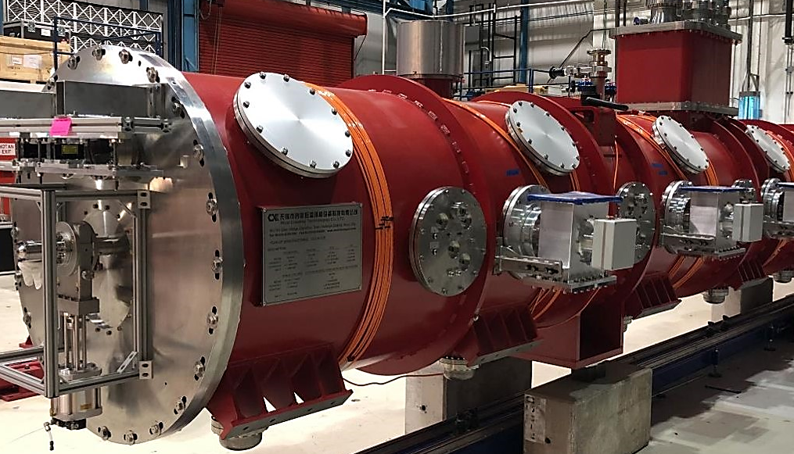
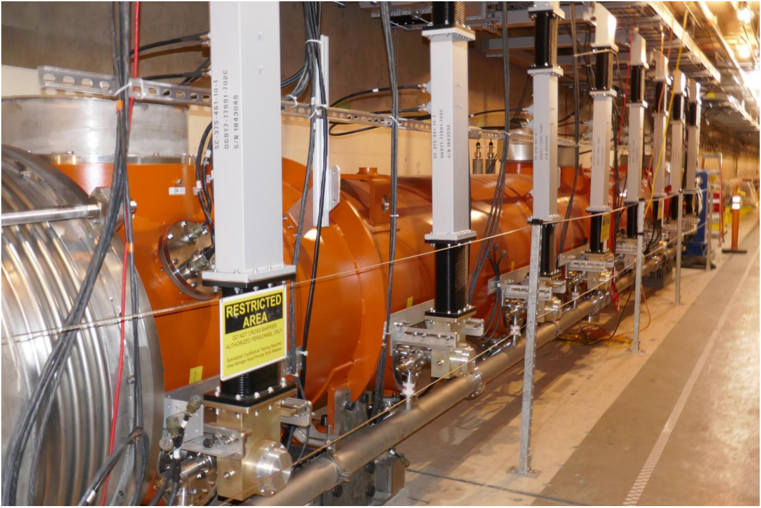
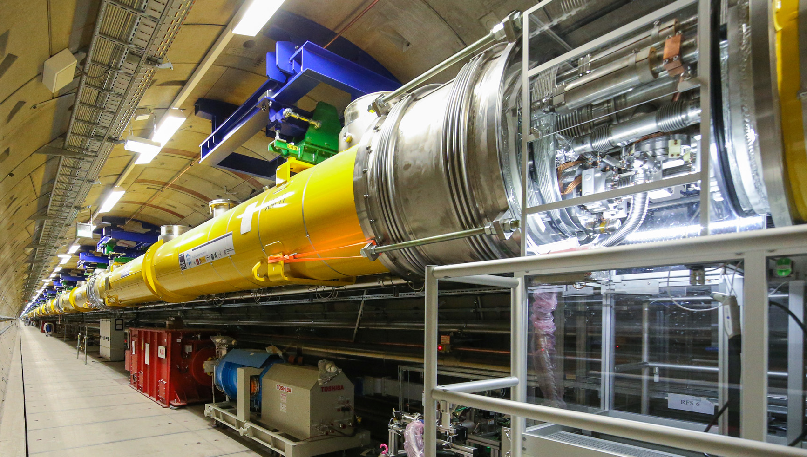
Facilities
Spallation Neutron Source (SNS)
European Spallation Source (ESS)
Large Hadron Collider (LHC)
Proton Improvement Plan II (PIP-II)
European X-ray Free-Electron Laser (XFEL)
Linac Coherent Light Source II (LCLS-II)
Notes:
The chosen facilities represent a broad spectrum of machine parameters - particles, current, beam power, frequency, duty cycle, etc. - and design philosophies – segmented / continuous layout, cavity supporting systems, cryogenic schemes, etc. In this way, a diverse range of high-beta designs was represented.
The facilities represent a wide spectrum of maturity and lifecycle stages.
This diversity allows for a comprehensive analysis of the transition from "as-designed" specifications to "as-operated" realities.
By including facilities that range from those starting installation soon to those with years of proven performance, the benchmarking exercise can capture lessons learned across the full engineering lifecycle. This ensures that the proposed roadmap for a sustainable "Cryomodule of the Future" is informed by both cutting-edge design and the practical challenges of long-term maintainability and hardware degradation.

Slide 5
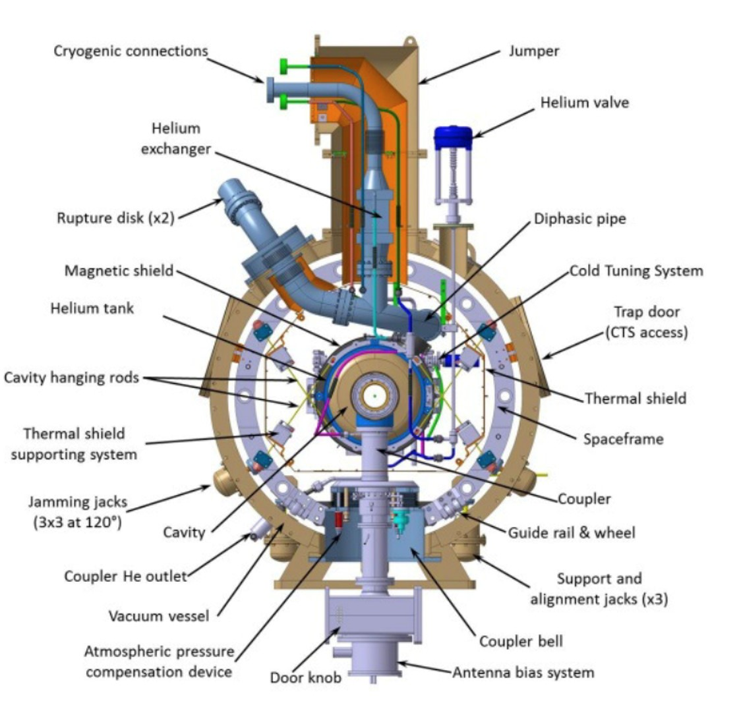
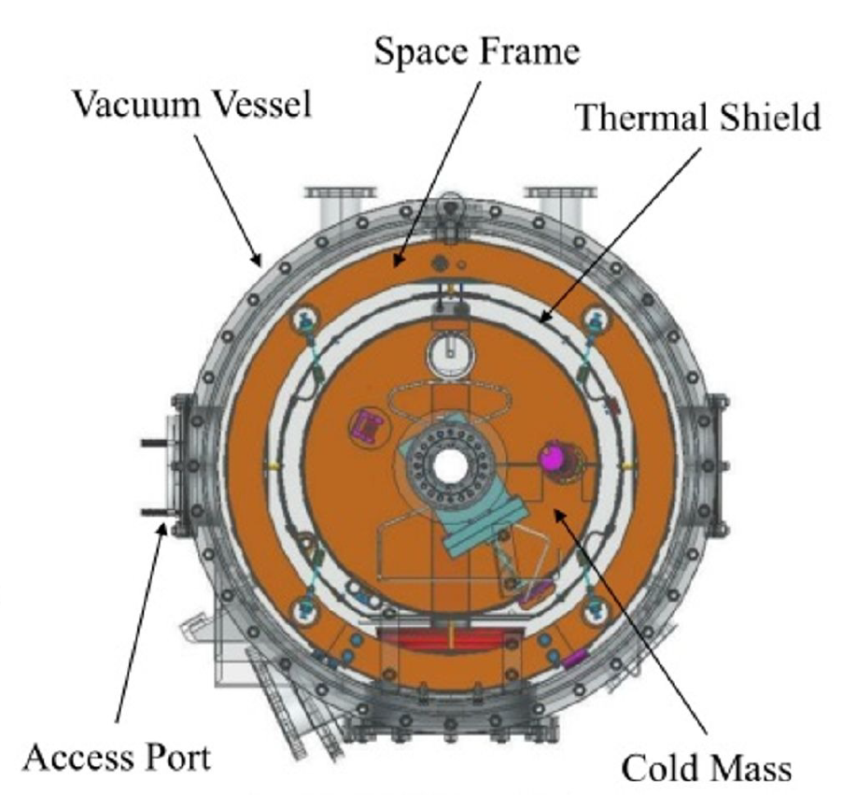
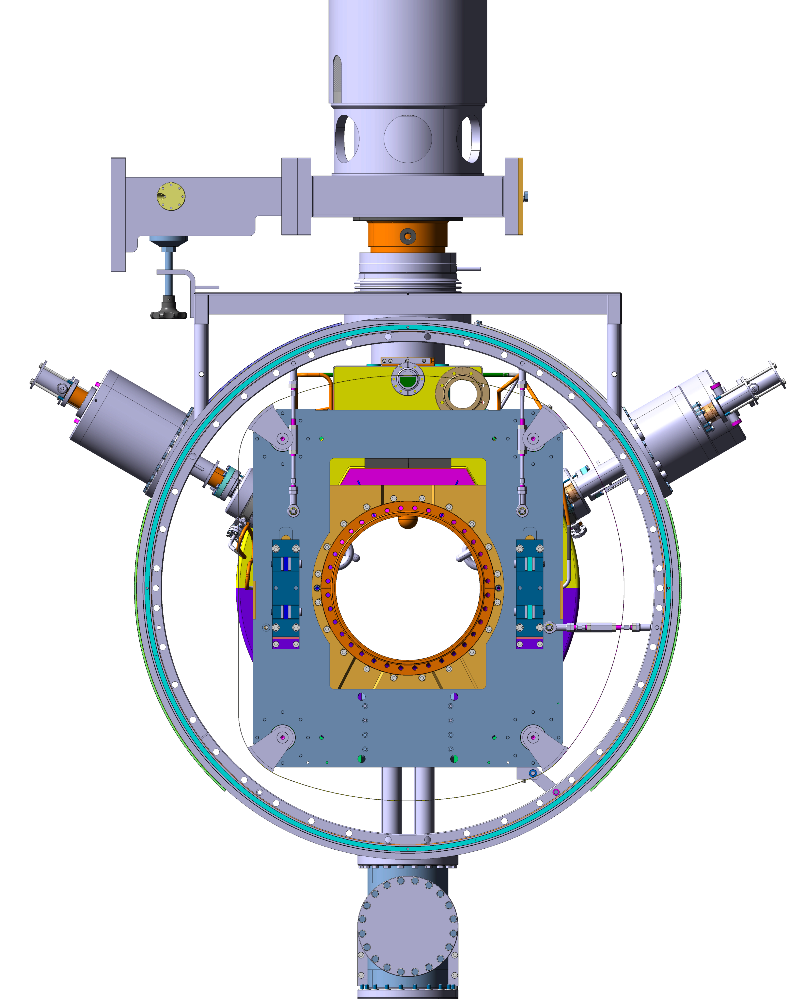
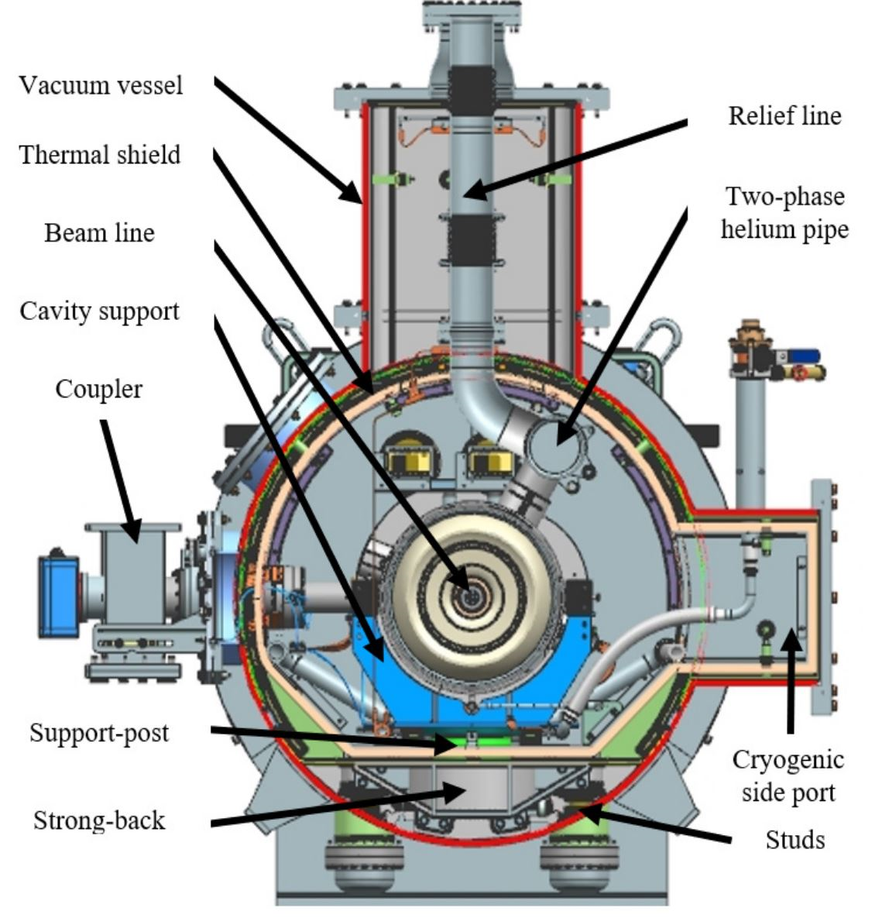
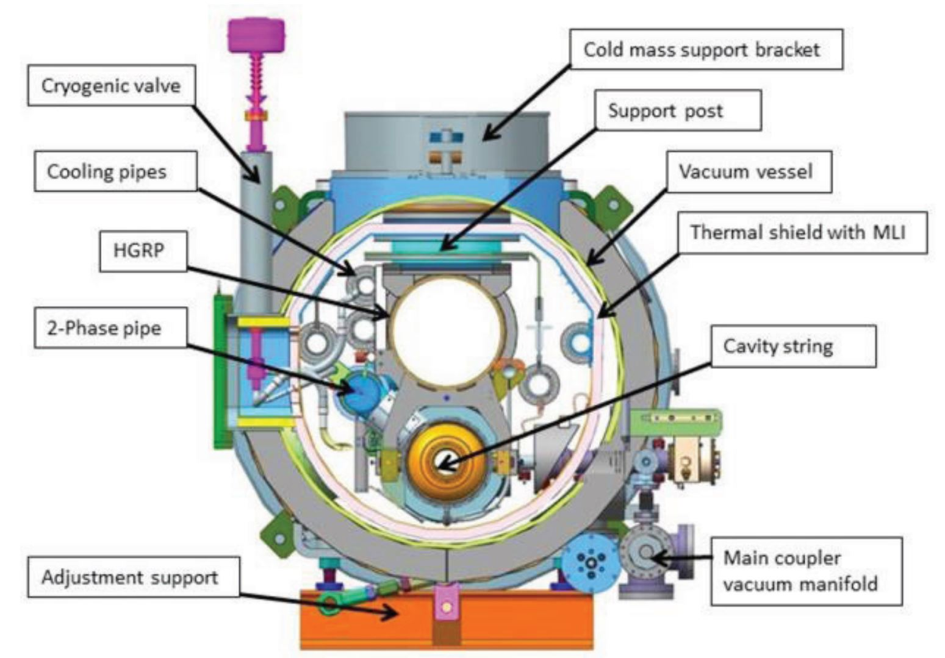
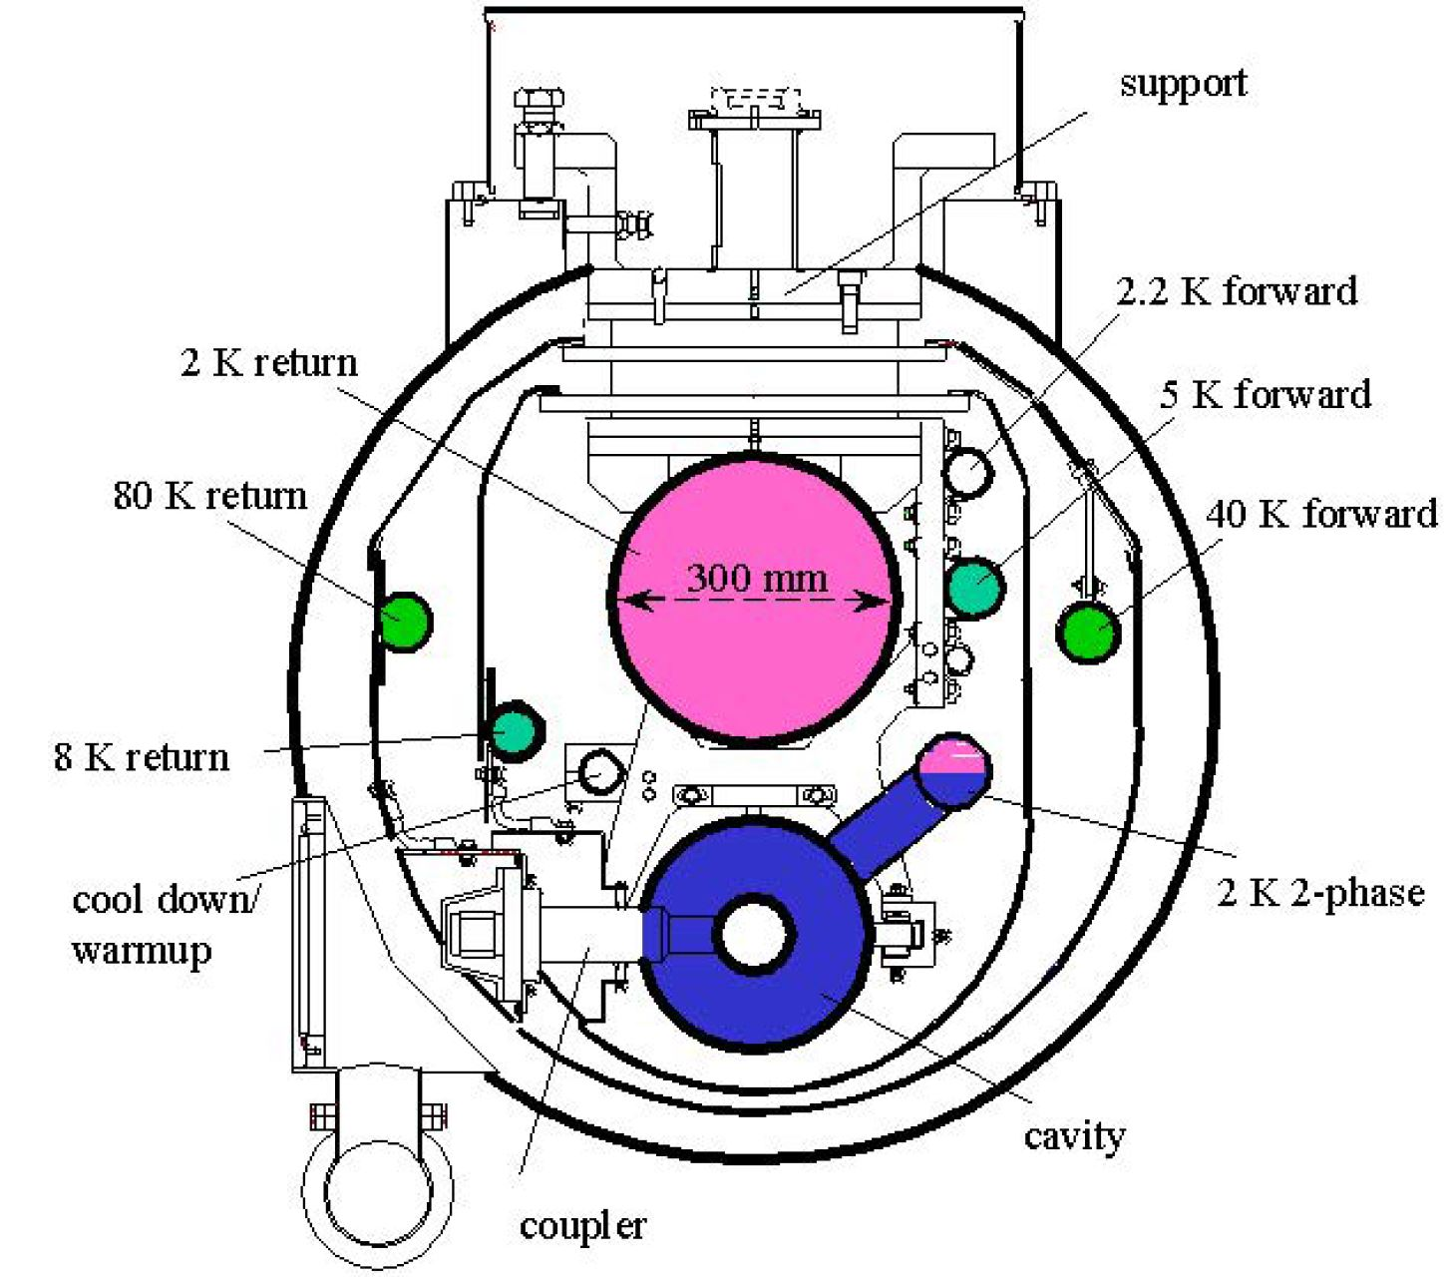
CM design concepts
FPC with movable antenna
HOM couplers connectors
Cavity frame for support and tuning
Tie rods supports for the frame
SNS
Helium tank
ESS
LHC
Cavity beam pipe flange
Tuner external motor
PIP-II
XFEL
LCLS-II

Slide 6
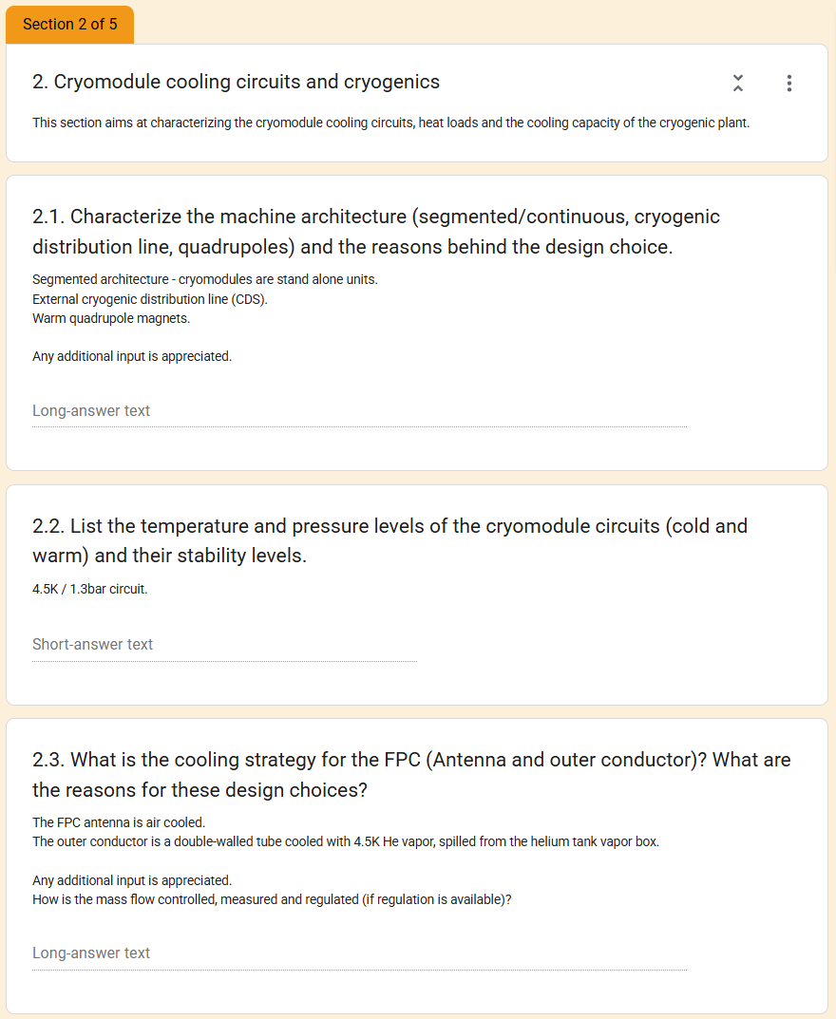
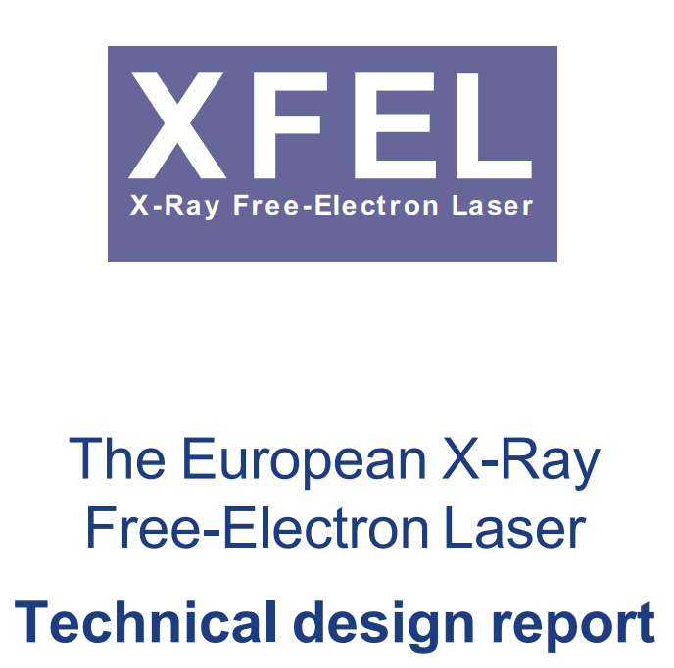
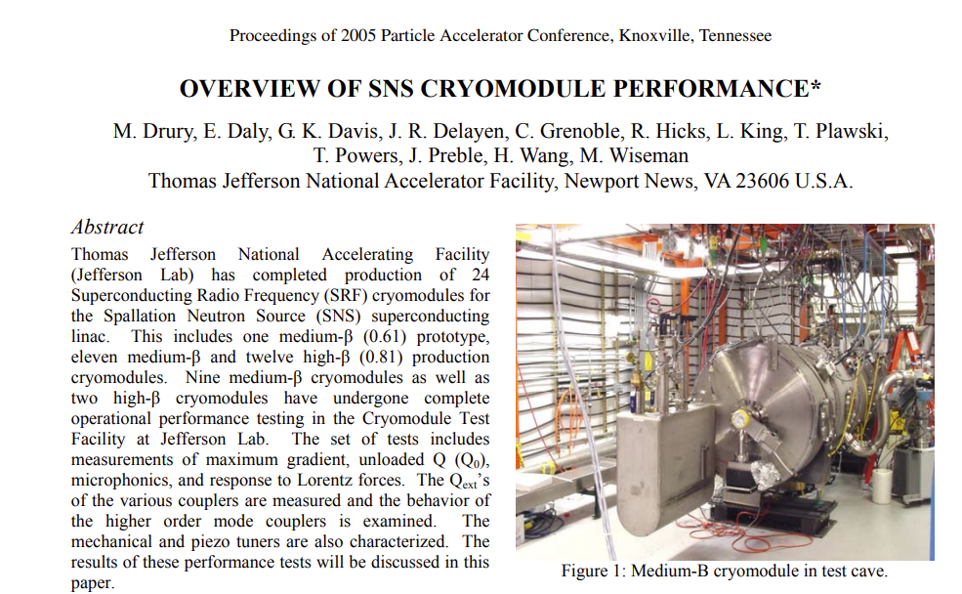
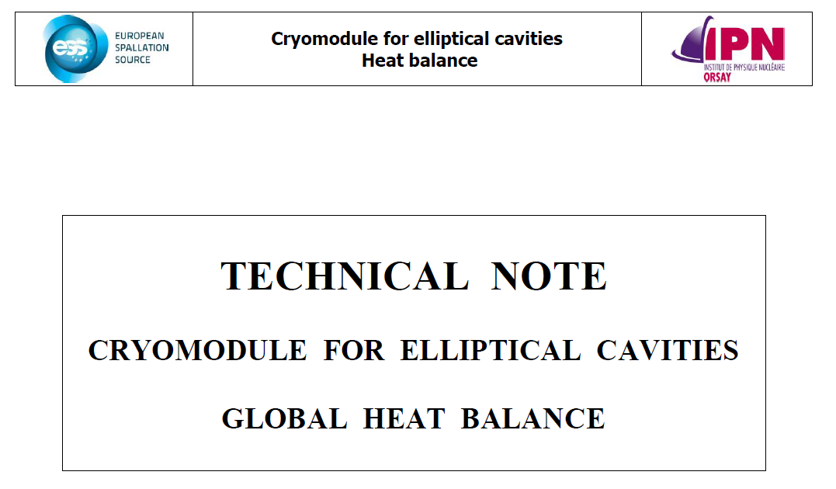
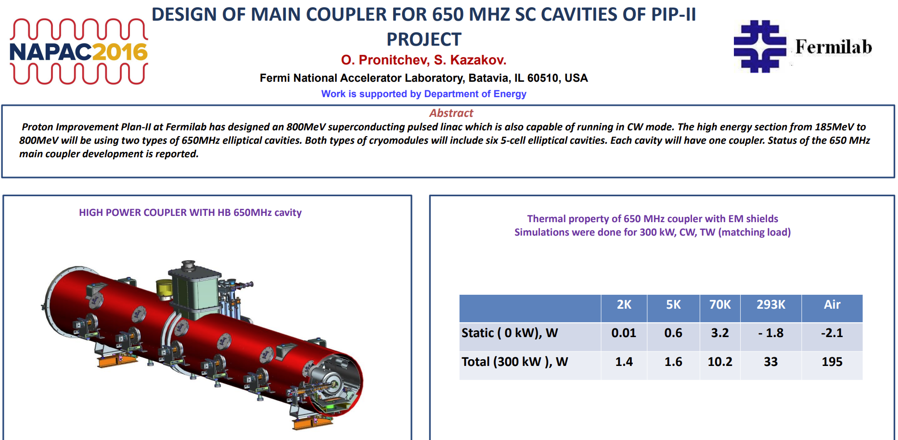
Literature research and pre-filling of the answers
The questionnaire were sent with pre-filled answers to:
Optimize Discussions: minimize the time spent reviewing information publicly available
Reduce Burden: allowing the experts to focus on correcting inaccuracies or providing context that isn't found in published papers.
Increase Accuracy: This "correction-based" feedback loop often reveals discrepancies between the "as-designed" specifications and the "as-operated" reality.
Data is collected from a wide spectrum of technical repositories:
Technical Design Reports (TDRs): These serve as record of the initial machine architecture, cooling circuit logic, and design constraints.
Scientific Papers & Published Articles
Conference Presentations and Proceeding: Real-time technical challenges and machine availability data.
Internal Technical Notes (where available)

Slide 7
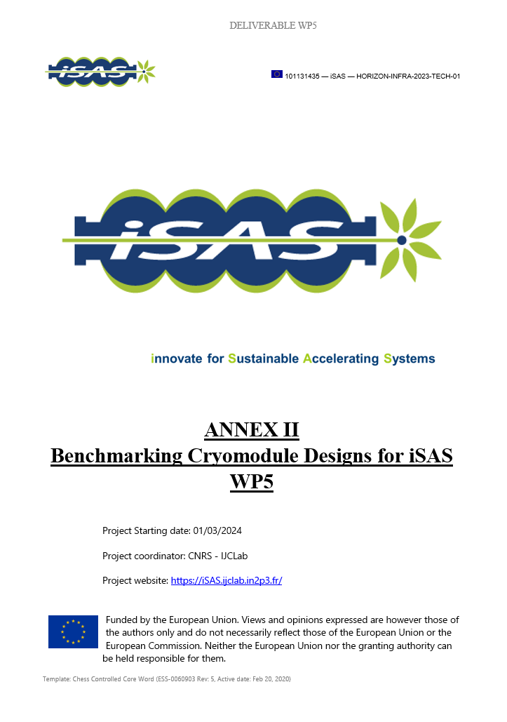
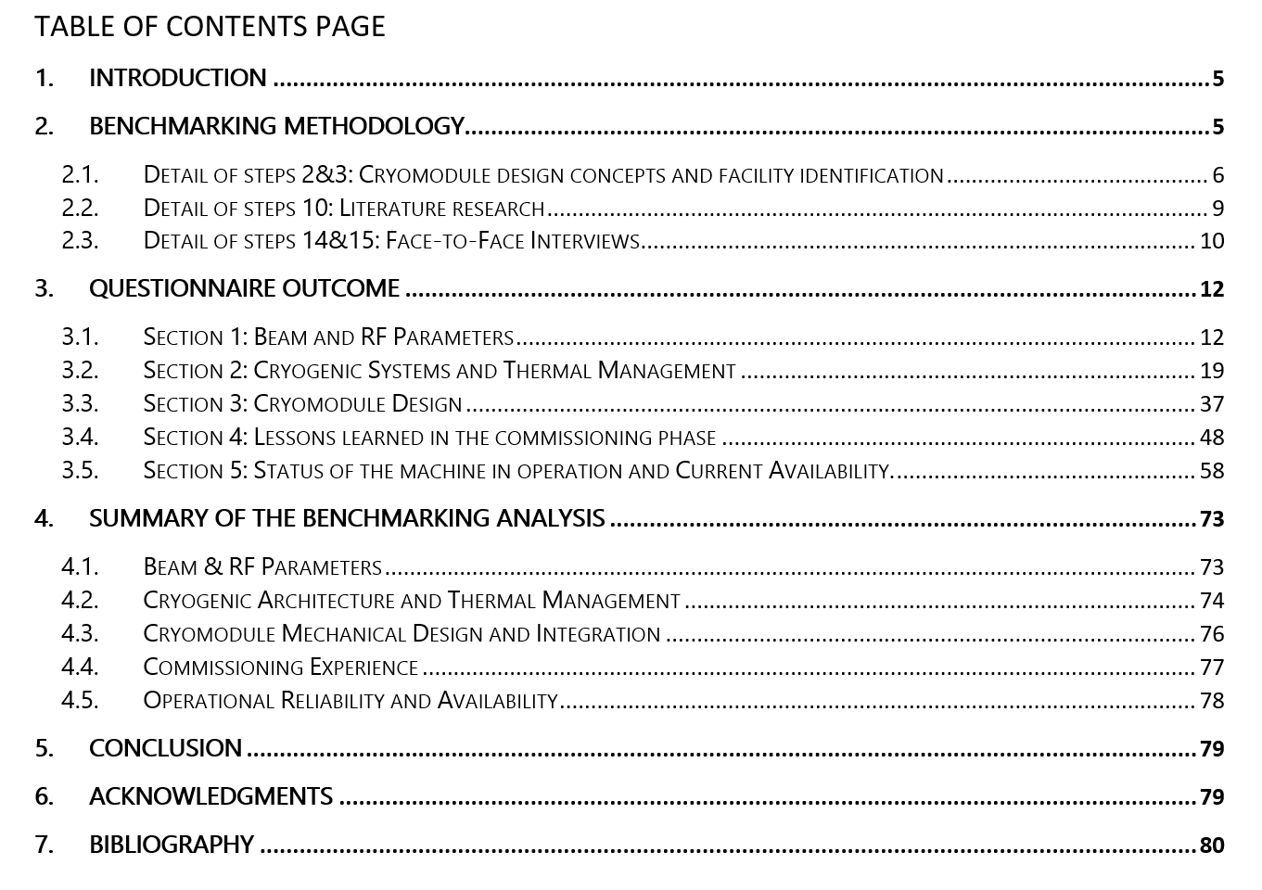
Face-to-face Interview and Compilation of answers
This series of technically rich meetings across the six world-leading facilities required coordinating the calendar of high-level experts across multiple time zones.
A critical factor for the success of these sessions was the pre-filled questionnaire: focus on high-level discussion.
The atmosphere was exceptionally amicable, honest, and collaborative: "fruitful" dialogue and unexpected insights into operational and commissioning hurdles.
Given the high volume of information, the compilation of the answers resulted in complete and broad comparison, capturing the technical details and the operational reality of high-beta cryomodules at the selected facilities.

Slide 8
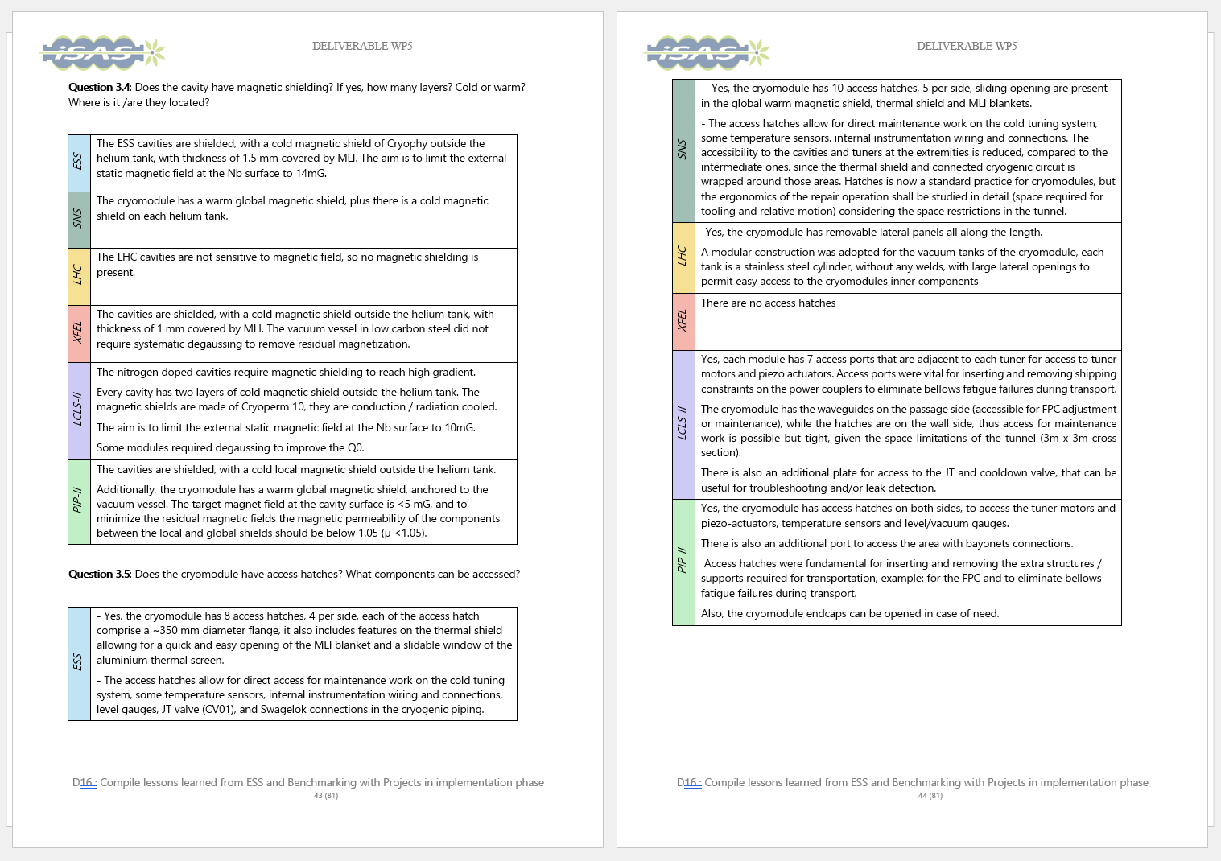
Face-to-face Interview and Compilation of answers
This series of technically rich meetings across the six world-leading facilities required coordinating the calendar of high-level experts across multiple time zones.
A critical factor for the success of these sessions was the pre-filled questionnaire: focus on high-level discussion.
The atmosphere was exceptionally amicable, honest, and collaborative: "fruitful" dialogue and unexpected insights into operational and commissioning hurdles.
Given the high volume of information, the compilation of the answers resulted in complete and broad comparison, capturing the technical details and the operational reality of high-beta cryomodules at the selected facilities.

Slide 9
Summary of the benchmarking analysis
Beam and RF parameters
  1
•Focus: particles, accelerating gradients, operating frequencies, duty cycle.
•Goal: Understand how beam physics requirements drive the complexity and energy demands of the CM.
The beam structure requirements and RF parameters, including choice of frequency, fundamentally dictate the SRF and cryomodule architecture:
ESS | SNS | LHC | XFEL | LCLS-II | PIP-II
CW machines prioritize high Q₀ to minimize dynamic losses, while pulsed machines tend to push higher peak gradients
The type of machine (circular multi-pass, linear single-pass) and particles to be accelerated also dictate different requirement (alignment, losses, beam stability thresholds, etc.)
Wide range in delivered FPC power. Moreover, within the limit of the six facilities considered, two main families were identified, when it comes to orientation within the cryomodule, either vertical or horizontal.
In proton linear accelerators, the beam exhibits lower sensitivity to trapped HOM perturbations
 |  |  | LCLS-II and PIP-II use nitrogen-doped cavities to achieve a high Q₀: 2.7x10¹⁰ at 16 MV/m for LCLS-II and 3.3x10¹⁰ at 21 MV/m for PIP-II.
 |  |  | Peak value gradient above 16MV/m for all the facilities operating in pulsed mode. ESS and XFEL cavities are equipped with fast-piezo tuners, while SNS cavities do not need fast compensation with piezo actuators.
 |  |  | XFEL, LCLS-II, and PIP-II operates with average RF power of 2.15kW, 7kW and 35kW respectively, with FPCs designed for a peak power of 156 kW, 7 kW and 43kW respectively, at the nominal duty cycle. The FPCs have horizontal orientation and bellows in the transmission line ensure sufficient flexibility to compensate for the cold mass thermal contraction.
 |  |  | ESS, SNS and LHC operates with average RF power of 43 kW, 44kW and 300 kW respectively, with FPCs designed for a peak power of 1.1 MW, 550kW and 350 kW respectively, at the nominal duty cycle. The FPCs have a vertical - bottom or top for the LHC- orientation, these designs do not have bellows in the transmission line.
 |  |  | ESS and PIP-II cavities do not have HOM couplers. SNS originally included HOM couplers, however operational experience indicated they were not required to achieve goal performances, and given occasional leaks and failures, they have been progressively removed during cryomodule repairs.
 |  |  | Circular colliders like the LHC, and electron machines like XFEL and LCLS-II require the integration of HOM couplers in the cavity design.

Slide 10
Summary of the benchmarking analysis
Cryogenic Systems and thermal management
  2
•Focus: Machine architecture, Cooling circuit layouts, temperature and pressure levels, static and dynamic heat loads, and cooling capacity cryogenic plant. Management of helium inventory and ODH risk
•Goal: Characterizing design choices for cryogenic systems.
Significant diversity exists in cooling circuit segmentation, temperature levels, and thermal shield configurations
A multi-level temperature architecture (2K, 4.5/ 5-10K, 35–80 K) is standard across all facilities.
For cavities operating at low duty cycles, static heat loads strongly impact the total cryogenic consumption. For cavities operating in CW instead, the cryogenic losses are driven by the dynamic heat loads (except for LHC).
For the FPC outer conductor, it was observed a preference for the active cooling with helium, for operation with high average RF power (>40/50 kW). Active cooling is considered more flexible / adjustable, than fixed thermal intercepts.
Cryogenic distribution strategy (continuous vs segmented) strongly affects maintainability and failure recovery capability.
ESS | SNS | LHC | XFEL | LCLS-II | PIP-II
 |  |  |  |  | A three-level architecture (typically 2 K, 4.5–10 K, and 35–80 K) is the standard for optimizing thermal efficiency across all facilities.
 | Due to assembly compromises, the LHC uses a single temperature level (4.5 K) and a floating thermal shield made of MLI blankets.
 |  |  |  | The percentage of static heat load, compared to the total heat load to the cavity bath, is indicated per facility: ESS 44.1%, SNS 73.7%, LHC 83.7%, XFEL 45.8%
 |  | The percentage of static heat load, compared to the total heat load to the cavity bath, is small for facilities operating in CW, LCLS-II 10%, PIP-II 12.5%.
 |  |  | Active helium cooling is considered more flexible for high average RF power operations or for designs qualified for higher values of peak power, ESS, SNS and LHC use ~5 K helium to cool the FPC outer conductors.
 |  |  | Facilities with lower average power, such as XFEL, LCLS-II, and PIP-II, the outer conductor is cooled with fixed temperature thermal intercepts (copper braids) connected to the cryogenic lines.
 |  | Accelerating modules are integrated into a single vacuum vessel string. In case of maintenance the entire linac must be warmed up.
 |  | Cryomodules are stand-alone units, with access hatches, connected to the external distribution line via bayonets. The maintenance work may be performed through the access hatches, otherwise the cryomodule can be removed with the rest of the machine cold.
 |  | Cryomodules are stand-alone units, with access hatches, connected to the external distribution line via jumper with welded connections. The maintenance work may be performed through the access hatches, otherwise the cryomodule can be removed, warming up the linac

Slide 11
Summary of the benchmarking analysis
Cryomodule design
  3
•Focus: characterize internal components, cavity string assemblies, power couplers, tuners, and magnetic shielding.
•Goal: Map the constraints, design choices and integration aspects regarding the cryomodule design and its assembly sequence
While cavity technology is broadly similar (elliptical SRF cavities), integration philosophies differ:
Variations in cavity supporting schemes, vacuum forces compensation, longitudinal references and alignment strategies have been identified.
Helium tank design influences mechanical stiffness and microphonics sensitivity.
Variations in Magnetic shielding implementation (cold vs warm, single vs multi-layer) with impact on achievable Q₀
Some facilities reported design compromises made to facilitate assembly, reduce cost, or drivers related to schedule
The integration of a second thermal shield, when in presence of the 8-10K heat intercept, was evaluated but not always considered convenient
It appears now a standard to include access hatches in the cryomodule design.
ESS | SNS | LHC | XFEL | LCLS-II | PIP-II
 |  | Cavities are supported by the Helium Gas Return Pipe (GRP), which acts as the main structural backbone and an Ivar rod that provides longitudinal anchoring.
 |  | Cavities are supported and aligned with spaceframe at ambient temperature connected to the vacuum vessel. For the SNS cryomodule, a Nitronic rod is added for longitudinal anchoring.
 | Cavities are supported by a frame anchored to the vacuum vessel through six tie rods.
 | Cavities are supported by two support posts (one fixed, one sliding) mounted on a strongback support at ambient temperature.
 |  |  |  |  | The introduction of a cold magnetic shield outside the helium tank is a common practice for all the facilities using Niobium cavities. LCLS-II cavities have two layers of cold magnetic shielding.
 |  | SNS and PIP-II cryomodules have also a warm global magnetic shield.
 |  | LCLS-II and PIP-II cavities rely as well on fast cooldown across the Nb transition temperature to sweep out the trapped magnetic flux and reach the required Q₀.
 | LHC cavities in copper with Nb coating are not sensitive to magnetic field.
 |  | For LCLS-II and PIP-II, given the availability of a low temperature heat intercept, it was evaluated the possibility of having a second thermal shield. Although, the effective reduction of the heat load to the 2K was not considered sufficient to justify the cost, complexity and space occupation of a second shield.
 | In the XFEL cryomodule instead, there are two thermal shields, resulting in very minimal heat loads to the cavity bath.

Slide 12
Summary of the benchmarking analysis
Commissioning insights
  4
•Focus: Knowledge gained during the assembly, testing, and initial installation phases.
•Goal: Document technical difficulties in the commissioning phase, providing useful feedback for future sustainable designs.
Several key elements emerged during the discussion on commissioning experience and lessons learned:
A primary goal across facilities is to minimize discrepancies between "as-designed" and "as-tested/operated" performance, specifically addressing issues like cryoplant limitations and unexpected heat load differences
Success depends on maximizing preparation before tunnel installation, maintaining strong in-house expertise, accurate planning that allows smooth sequence and sufficient flexibility
It is strongly recommended to develop the design of cryomodules and their associated services together, to ensure system compatibility and avoid late-stage conflicts
Focusing on continuous quality controls and accurate interface matching is essential to reduce rework

Slide 13
Summary of the benchmarking analysis
Operational experience and reliability
  5
•Focus: Factors limiting cryomodule performance, mitigation strategies, machine availability, capability for maintenance, repair and replacement.
•Goal: Use real-world operational data to ensure that energy-saving innovations do not compromise the facility's scientific output.
Long-term availability emerged as a critical sustainability metric. Facilities emphasized:
Redundancy of internal equipment is critical in operation (ex: facilities now design for extra RF capacity, when possible, to compensate for individual cavity failures without beam degradation).
Different experiences have been described regarding cavity performance degradation and strategies for compensation with the remaining cavities.
Modular cryogenic systems and replacement strategies. The ability or not to isolate a single cryomodule for maintenance without affecting adjacent units strongly impacts overall machine uptime.
Importance of accessibility was emphasized, more specifically for couplers and tuners.
Failure modes reported include FPC degradation, tuner actuator failure, and vacuum-related incidents.
Cryoplant trips remain a major bottleneck for availability.
The cryoplant design includes safety margins to compensate for uncertainty in the estimation of cryomodule static and dynamic heat loads.

Slide 14
Beam and RF parameters
Conclusions
  1
•Focus: particles, accelerating gradients, operating frequencies, duty cycle.
•Goal: Understand how beam physics requirements drive the complexity and energy demands of the CM.
Beam and RF parameters are the design drivers, while cryogenic efficiency impacts the overall sustainability.
Common trends, (multi-level temperature architectures, modular cryogenic segmentation, accessibility) have emerged as industry standards.
High availability and long-term reliability are primary metrics for sustainability.
The data gathered, through this "fruitful" and transparent collaboration, forms the strategic and technical backbone for the WP5 roadmap.
These insights establish a consolidated knowledge base that will guide the development of a new generation of high-efficiency and resilient cryomodules.
Cryogenic Systems and thermal management
  2
•Focus: Machine architecture, Cooling circuit layouts, temperature and pressure levels, static and dynamic heat loads, and cooling capacity cryogenic plant. Management of helium inventory and ODH risk
•Goal: Characterizing design choices for cryogenic systems.
Cryomodule design
  3
•Focus: characterize internal components, cavity string assemblies, power couplers, tuners, and magnetic shielding.
•Goal: Map the constraints, design choices and integration aspects regarding the cryomodule design and its assembly sequence
Commissioning insights
  4
•Focus: Knowledge gained during the assembly, testing, and initial installation phases.
•Goal: Document technical difficulties in the commissioning phase, providing useful feedback for future sustainable designs.
Operational experience and reliability
  5
•Focus: Factors limiting cryomodule performance, mitigation strategies, machine availability, capability for maintenance, repair and replacement.
•Goal: Use real-world operational data to ensure that energy-saving innovations do not compromise the facility's scientific output.

Slide 15
Next steps
Translate the gathered knowledge into practical engineering strategies, to build a Roadmap for the development of a new generation of high-efficiency and resilient cryomodules (D17).
Focusing on thermal performance, enhanced reliability, reduced maintenance needs, and greater adaptability to the requirements of next-generation accelerator facilities.
The resulting guidelines will directly contribute to the next deliverable of WP5: the development of a Parametric tool for cryomodule design (Task 5.3 - D18).
This tool will serve as a practical guide for designing sustainable cryomodules, supporting more informed, efficient, and performance-driven engineering decisions.

Slide 16
Acknowledgments
We wish to extend their sincere gratitude to the experts who participated in the benchmarking process, the amount of information shared have exceeded our expectations.
SNS (Spallation Neutron Source, Oak Ridge, USA)
John Mammoser
Paolo Pizzol
ESS (European Spallation Source, Lund, Sweden)
Paolo Pierini
Nuno Elias
Emma Simpson
Henry Przibliski
Marek Skiba
CERN (LHC, Geneva, Switzerland)
Vittorio Parma
Karin Canderan
Katarzyna Turaj
Krzysztof Brodzinski
David Smekens
PIP-II (Fermi National Laboratory, Batavia, Illinois, USA)
Donato Passarelli
Vincent Roger
XFEL (European X-ray Free Electron Laser, Hamburg, Germany)
Serena Barbanotti
Kay Jensch
Julien Branlard
Joshua Einstein-Curtis
LCLS-II (Linac Coherent Light Source II, SLAC, California, USA)
Thomas Petersen
Sebastian Aderhold

Slide 18
Supporting slides

Slide 19
SNS
ESS
SNS | The linac uses 30 segmented cryomodules (11 Medium-beta, 19 High-beta) with bulk Niobium cavities operating at 2.1K. It operates in pulsed mode (7.8% duty cycle) at 805 MHz with a peak RF power of 550 kW. Cryomodules have a segmented layout, the stand-alone units are connected via "end cans" and bayonet connections to the external cryogenic distribution line. The cooling scheme includes 4.5 K supercritical helium (3 bar), 2 K saturated helium (31 mbar), and a 35–55 K thermal shield. Like ESS, the cavities are supported and aligned with a spaceframe, with the addition of a Nitronic rod for longitudinal anchoring. The fixed antenna FPCs are vertically oriented and use active helium cooling for the outer conductor. Cavities are equipped with a cold mechanical slow tuner, and fast piezo actuators, not used in standard operation. It includes 10 access hatches to access tuning system, sensors, connectors and instrumentation. SNS has a standard procedure for replacing FPCs in the tunnel using a mobile local cleanroom Status: in operation since 2006, now with the recently installed PPU cryomodules.
ESS | The superconducting section in its nominal configuration comprises 43 cryomodules (13 Spoke, 9 Medium-beta, and 21 High-beta) bulk Niobium cavities operating at 2K. It operates in pulsed mode (4% duty cycle) at 704.42 MHz for elliptical modules, with a peak RF power of 1.1 MW. Cryomodules have a segmented layout with stand-alone units connected via jumper connections to external cryogenic distribution line. The cooling scheme includes 4.5 K supercritical helium (3 bar), 2 K saturated helium (31 mbar), and a 35–50 K thermal shield. The ESS cavities are supported and aligned with spaceframe at ambient temperature connected to the vacuum vessel. The FPCs are vertically oriented at the bottom, active helium cooling is used for the outer conductor and water cooling for the antenna. The tuning system includes a cold stepper motor and two fast piezo compensators. The design features 8 access hatches for in-tunnel maintenance of tuners, sensors, and valves. Status: Technical and beam commissioning on going, aiming for "Beam-on-Target" milestone.

Slide 20
CM design concepts
LCLS-II | The main linac is composed by 35 accelerator modules with Nitrogen-doped bulk Niobium cavities, operating at 2K. It operates in Continuous Wave (CW) mode, at 1.3 GHz with a peak RF power of 7 kW. The accelerating modules have a continuous layout, thus are connected into single vacuum vessel. The cryogenic lines are embedded in the vacuum vessel, the cryogenic scheme includes two circuits for thermal interception (5-8K, 35-55K), and the 2.2 K supply line, with a dedicated JT valve and cooldown / warmup valve for each module. The 2-phase line of each module is sectorized for independent level control given the tunnel slope (0.5%). Cavities require fast cooldown across the Nb transition temperature to sweep out the trapped magnetic flux and reach high Q₀. As for the XFEL design, cavities are supported by the Helium Gas Return Pipe (GRP), which acts as the main structural backbone and an Ivar rod that provides longitudinal anchoring. The FPCs have a movable antenna and horizontal orientation. Cooling for FPC outer conductors is provided by fixed copper thermal intercepts. The tuning system uses cold stepper motors and fast piezo actuators. The LCLS-II design includes 7 access ports per module for maintenance. Status: LCLS-II is undergoing a long shut-down for a major high-energy upgrade, adding 23 additional cryomodules to its existing infrastructure
XFEL | The main linac comprises 96 cryomodules with 8 cavities each in bulk Niobium operating at 2K. It operates in pulsed mode (1.37% duty cycle) at 1.3 GHz with peak RF power of 156 kW. The accelerating modules have a continuous layout, thus are connected into single vacuum vessel. The cryogenic lines are embedded in the vacuum vessel, the cryogenic scheme includes two circuits for thermal interception (5-8K, 40-80K), and the 2.2 K supply line, with a dedicated JT valve and cooldown / warmup valve for cryo-strings of 12 modules. Cavities are supported by the Helium Gas Return Pipe (GRP), which acts as the main structural backbone and an Ivar rod that provides longitudinal anchoring. The FPCs have a movable antenna and horizontal orientation. Cooling for FPC outer conductors is provided by fixed copper thermal intercepts. The tuning system uses cold stepper motors and fast piezo actuators. To minimize the heat loads to the cold mass the XFEL modules have two actively cooled thermal shields. The XFEL design does not include access hatches. Status: XFEL has been in continuous operation since 2017 and recently completed its first full warm-up/cool-down cycle for maintenance. Feasibility study for operation at higher duty cycle on going.
XFEL
LCLS-II

Slide 21

CM design concepts
PIP-II | The linac includes 23 SRF cryomodules of 5 different types. The focus of the questionnaire is the high beta 650 MHz cryomodules, with 6 Niobium cavities, operating at 2K, in Continuous Wave (CW), with a peak RF power of 43 kW. Cryomodules have a segmented layout, the stand-alone units are connected with bayonet connections to the external cryogenic distribution line. The cooling scheme includes: 2 K saturated helium (30 mbar), and two circuits for thermal interception (4.5-15K, 35-50K). Cavities require fast cooldown across the Nb transition temperature to sweep out the trapped magnetic flux and reach high Q₀. The cavities are supported by two support posts (one fixed, one sliding) mounted on a strongback support at ambient temperature. FPCs have a fixed antenna, horizontal orientation, and use fixed thermal intercepts at 5 K and 50 K for the outer conductor cooling. The FPC antenna is air-cooled. Cavities are equipped with cold mechanical slow tuners with stepper motor and fast piezo actuators. The design features access hatches on both sides for tuner and sensor maintenance. Status: PIP-II is in the production phase, with series cryomodules expected to be delivered starting in the summer of 2026 and tunnel installation beginning late that same year.
FPC with movable antenna
HOM couplers connectors
Cavity frame for support and tuning
Tie rods supports for the frame
LHC
Helium tank
Cavity beam pipe flange
PIP-II
LHC | The system consists of 4 cryomodules (4 cavities each) made of OFE Copper with a Niobium thin film coating operating at 4.5K. It operates in Continuous Wave (CW) at 400.8 MHz with a peak RF power of 300 kW. Cryomodules have a segmented layout with stand-alone units connected via jumper connections to external cryogenic distribution line. The cooling scheme features the 4.5 K saturated He (1.3 bar) circuit, helium is spilled from the helium tank to actively cool feedthroughs. The thermal shield is floating, not active cooled, made of MLI blankets. Cavities are supported by a frame anchored to the vacuum vessel through six tie rods. The FPCs feature a movable antenna (60 mm stroke), they are vertically oriented at the top, and the outer conductor is cooled with saturated 4.5 K helium. The cavities are equipped with a slow mechanical tuner, is driven by an external warm stepper motor. The design features removable lateral panels for access to internal components. Status: in operation since 2010, Hi-Lumi upgrade installations / upgrade will occur in the Long Shutdown 3 (mid 2026).
Tuner external motor

