Slide 1




iSAS WP5.4: iSAS from a beam dynamics perspective
April 22th 2026
Supervisors: Mike Seidel and Tatiana Pieloni
Acknowledgements: Andrea Latina, Carmelo Barbagallo, Julien Michaud, Alex Fomin, Akira Miyazaki, David Amorim, Elias Métral
Funded by the European Union. Views and opinions expressed are however those of the authors only and do not necessarily reflect those of the European Union or the European Commission. Neither the European Union nor the granting authority can be held responsible for them.

Slide 2
Research goals
Beam Dynamics for ERL-based accelerators with energy-efficient cryomodules
Single- and multi-bunch instability studies in the iSAS/PERLE cryomodules
Development of simulation tools
Multi-pass recirculation model
Wake field model
Single- and multi-bunch beam breakup and beam loading studies
Energy-recovery efficiency studies

Slide 3
Benchmarking cavity fields
Figure 1: Comparison of the evolution of the transverse beta functions and beam size of a bunch through the PERLE cryomodule between Bmad/Tao, BDSIM, RF-Track, and the PERLE RF field map simulated in RF-Track; the grey rectangles on top indicate the location of the 5-cell standing-wave cavities.
Notes:
bmad is used at PERLE

Slide 4
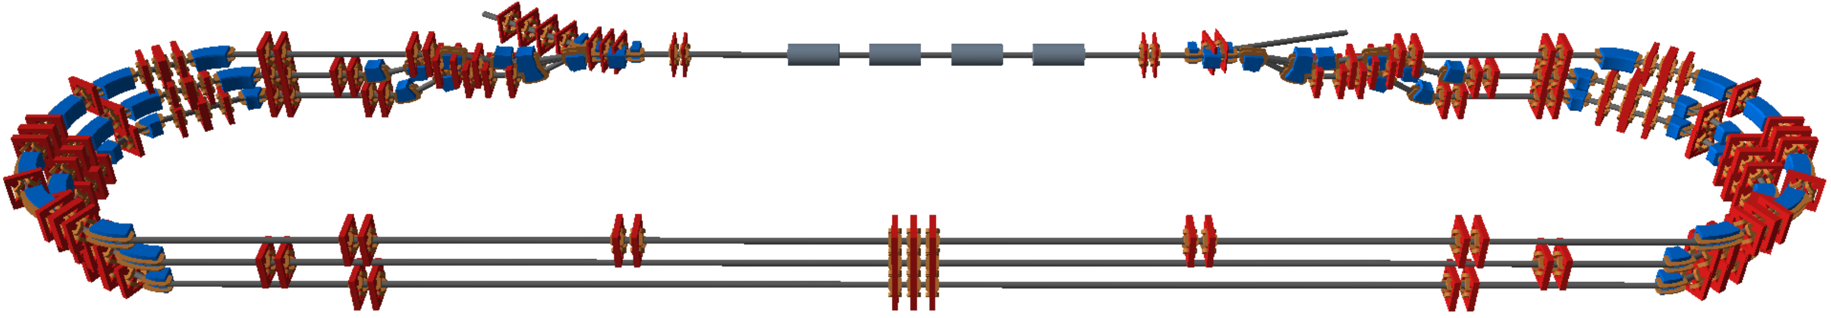
Model of recirculating linac
Multi-pass recirculation model
Lattice is split up separate beamlines and connected by spreader and recombiner sections
Beam is split up separate bunches
Each bunch is assigned a global time value in the heap queue (0, bunch spacing, 2*bunch spacing, 3*bunch spacing etc.)
Pop bunch with lowest the global time value out of the heap queue
Determine the beamline depending on bunch location and bunch parameters
Track bunch individually in a separate beamline
Bunch and global time are updated and pushed into the heap queue
Repeat until all bunches reach the dump
Stich all simulation together into one simulation
Figure 2: Schematic overview of the PERLE 250 MeV lattice in the BDSIM/Geant4 visualiser.

Slide 5
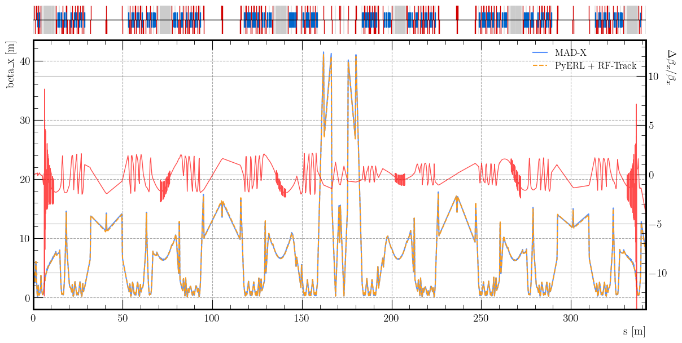
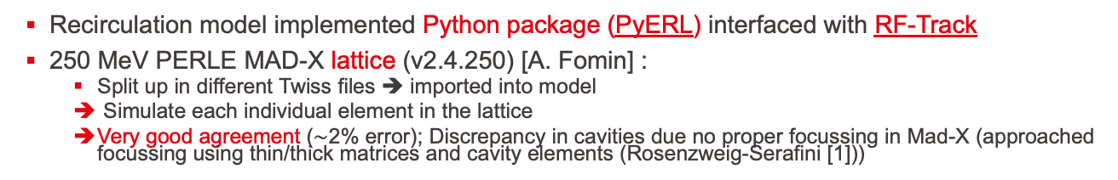
Recirculation model of 250 MeV PERLE
Recirculation model implemented Python package (PyERL) interfaced with RF-Track
250 MeV PERLE MAD-X lattice (v2.4.250) [A. Fomin] :
Split up in different Twiss files ➔ imported into model
Simulate each individual element in the lattice
Very good agreement ($\sim$2% error); Discrepancy in cavities due no proper focussing in Mad-X (approached focussing using thin/thick matrices and cavity elements (Rosenzweig-Serafini [1]))
Figure 3: Comparison of the horizontal beta function through the PERLE 250 MeV lattice.

Slide 6
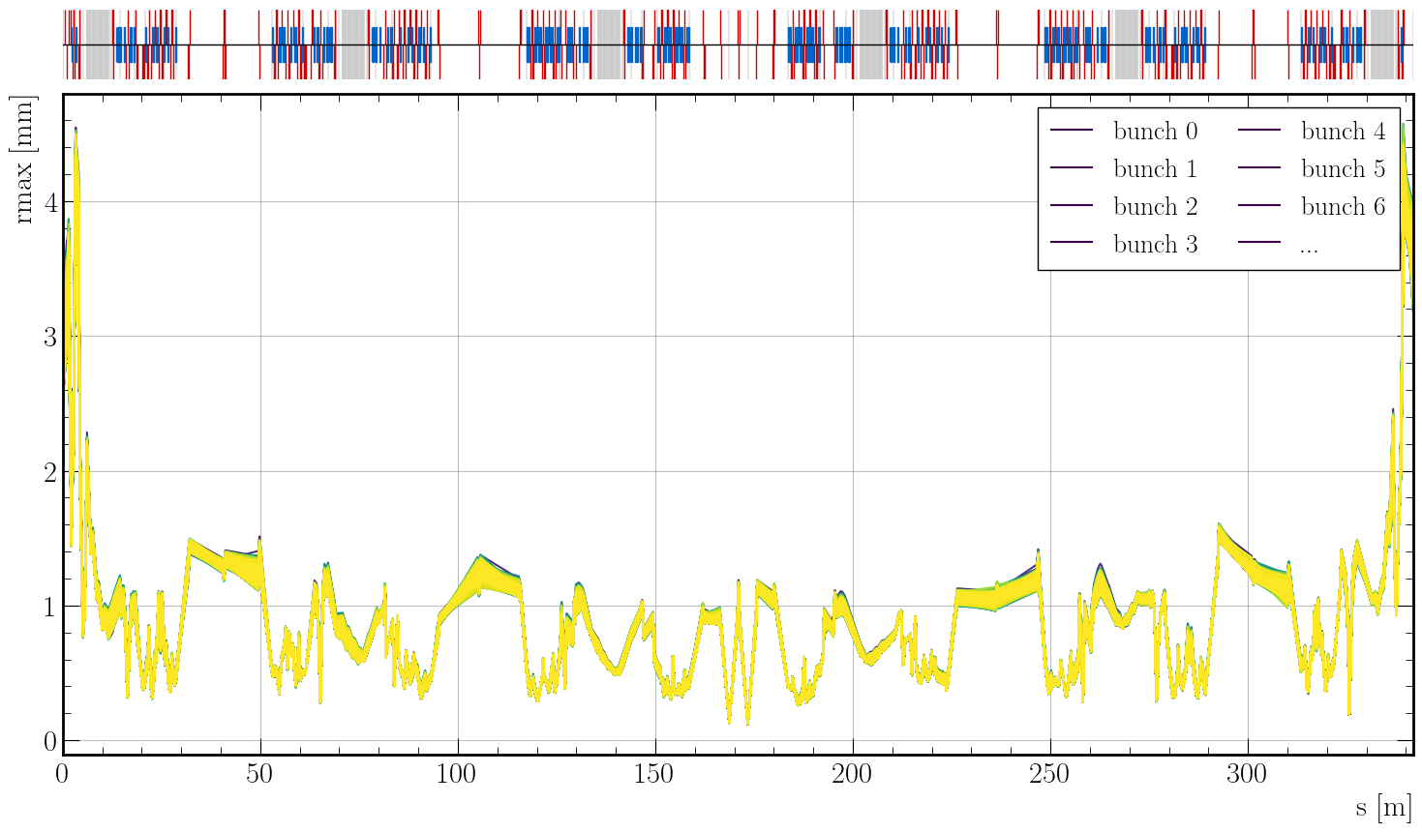
Recirculation model of 250 MeV PERLE
Figure 4: Maximum horizontal radius of 10k bunches passing through the PERLE 250 MeV lattice at an operating beam current of 120 mA.

Slide 7
Research goals
Beam Dynamics for ERL-based accelerators with energy-efficient cryomodules
Single- and multi-bunch instability studies in the iSAS/PERLE cryomodules
Development of simulation tools
Multi-pass recirculation model
Wake field model
Single- and multi-bunch beam breakup and beam loading studies
Energy-recovery efficiency studies

Slide 8
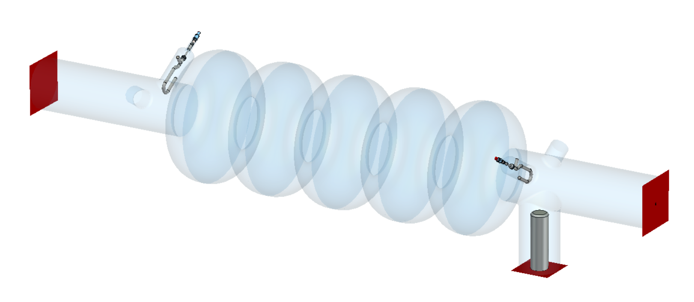
Wake field model for recirculating lattices
What do we need to simulate wake fields in the recirculating model to study HOM instabilities?:
RF-Track’s current wake field model only works for “linear lattices”
Wake fields need to excite, accumulate and be evaluated for each bunch/slice
Wake fields need to be “remembered” by the element across simulations
Wake fields for asymmetric structures
“Dressed cavity”: HOM couplers, fundamental power coupler etc.
Asymmetric excitation of HOM’s
Figure 5: 5-half-wave-cell standing wave dressed cavity with 2H2P HOM-damping scheme and fundamental power coupler [P. Duchesne].

Slide 9
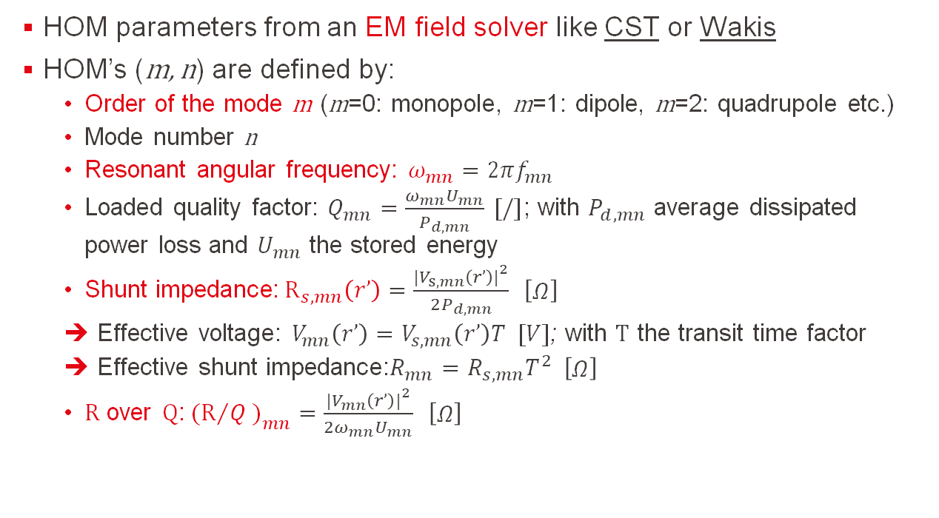
Higher-order mode parameters
HOM parameters from an EM field solver like CST or Wakis
HOM’s (m, n) are defined by:
Order of the mode m (m=0: monopole, m=1: dipole, m=2: quadrupole etc.)
Mode number n
Resonant angular frequency: $ω_{mn}=2πf_{mn}$
Loaded quality factor: $Q_{mn}=\frac{ω_{mn}U_{mn}}{P_{d,mn}} [/]$; with $P_{d,mn}$ average dissipated power loss and $U_{mn}$ the stored energy
Shunt impedance:${ R}_{s,mn}\left(r’\right)=\frac{{\left.|\right.V}_{s,mn}\left(r’\right){\left.|\right.}^{2}}{2P_{d,mn}} \left[\begin{matrix}Ω\end{matrix}\right]$
Effective voltage: $V_{mn}\left(r’\right)=V_{s,mn}\left(r’\right)T [V]$; with $T$ the transit time factor
Effective shunt impedance:$R_{mn}=R_{s,mn}T^{2} \left[\begin{matrix}Ω\end{matrix}\right]$
$R$ over $Q$:${ (R}/Q{\left.)\right.}_{mn}=\frac{{\left.|\right.V}_{mn}\left(r’\right){\left.|\right.}^{2}}{{2ω}_{mn}U_{mn}} \left[\begin{matrix}Ω\end{matrix}\right]$

Slide 10
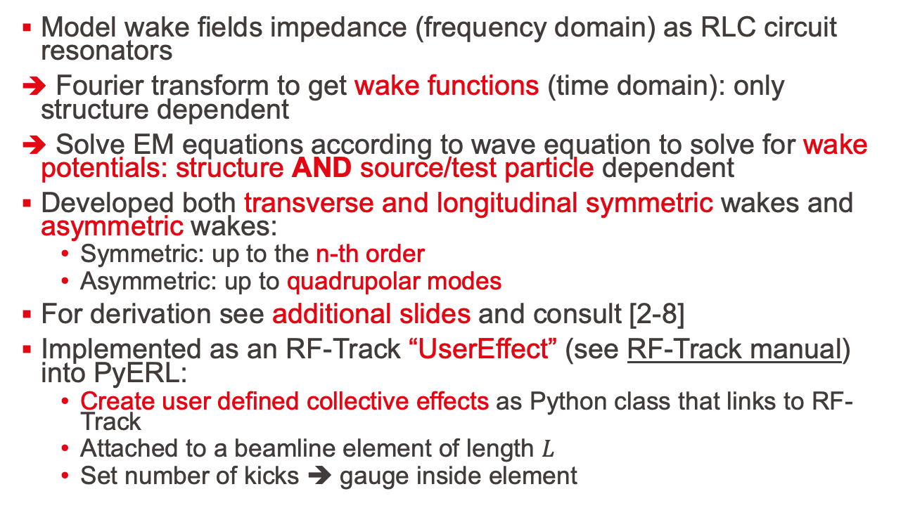
Model of wake fields
Model wake fields impedance (frequency domain) as RLC circuit resonators
Fourier transform to get wake functions (time domain): only structure dependent
Solve EM equations according to wave equation to solve for wake potentials: structure AND source/test particle dependent
Developed both transverse and longitudinal symmetric wakes and asymmetric wakes:
Symmetric: up to the n-th order
Asymmetric: up to quadrupolar modes
For derivation see additional slides and consult [2-8]
Implemented as an RF-Track “UserEffect” (see RF-Track manual) into PyERL:
Create user defined collective effects as Python class that links to RF-Track
Attached to a beamline element of length $L$
Set number of kicks ➔ gauge inside element

Slide 11
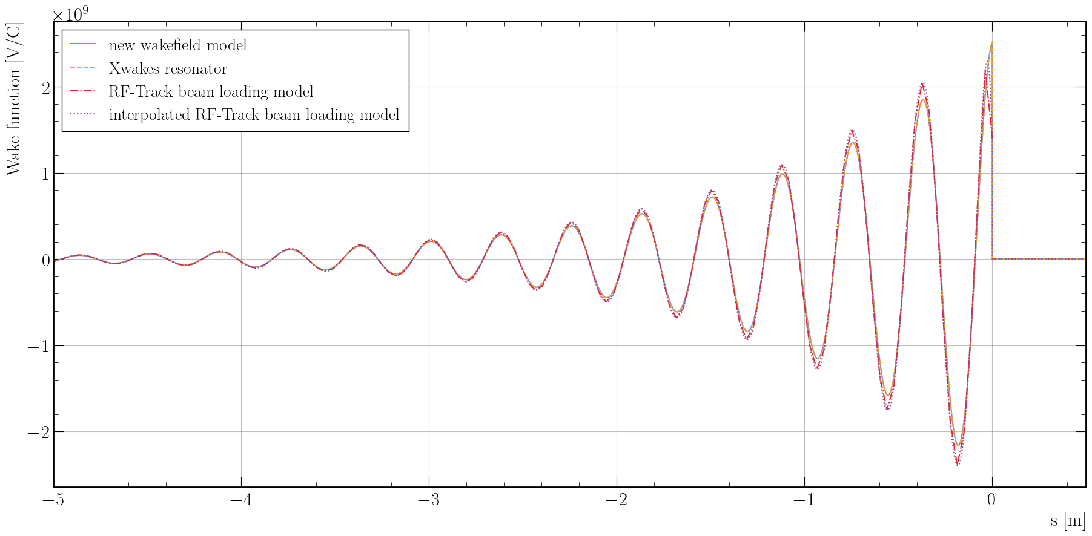

Longitudinal wake function benchmark
New wakes vs Xwakes: ${10}^{−15}$; New wakes vs RF-Track beam loading: ${10}^{−1}$
Figure 6: Longitudinal wake function comparison with $f =801.58 MHz$, ${ r}/Q=1$, and $Q =10$.

Slide 12
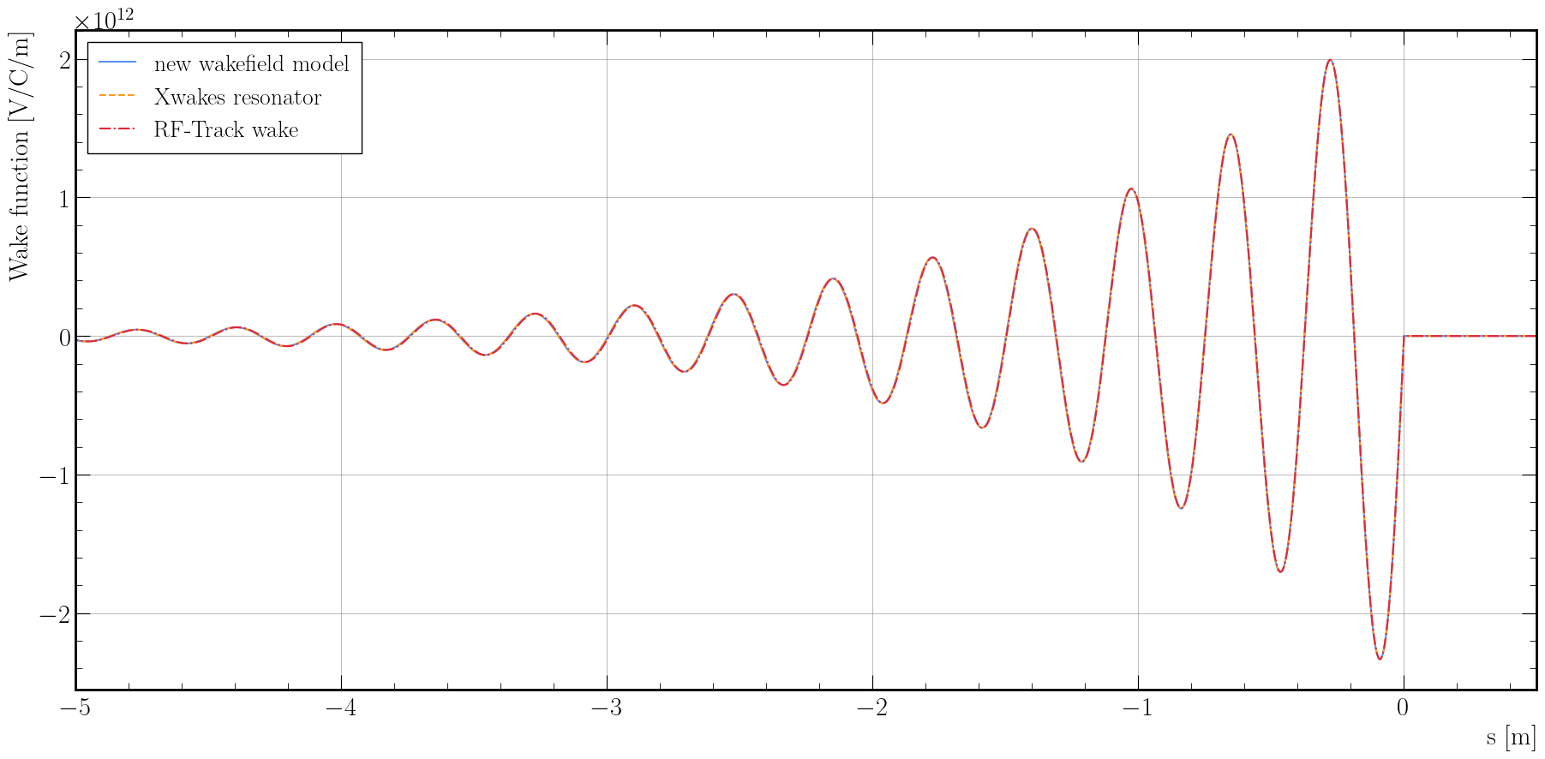

Transverse wake function benchmark
New wakes vs Xwakes: ${10}^{−15}$; New wakes vs RF-Track dipolar wakes: ${10}^{−2}$
Figure 7: Transverse wake function comparison with $f =801.58 MHz$, ${ r}/Q=1$, and $Q =10$.

Slide 13
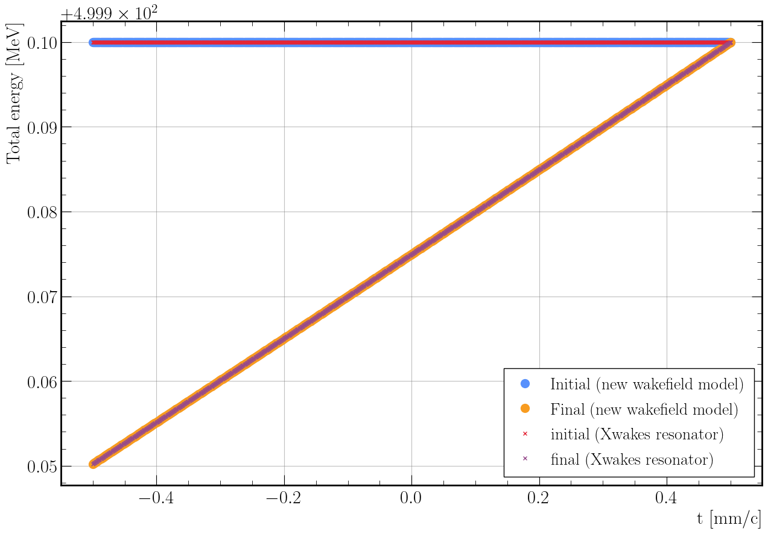

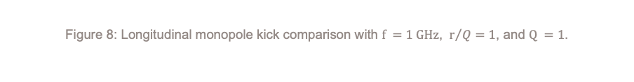
Longitudinal monopole kick benchmark
New wakes vs Xwakes: difference of order ${10}^{−13}$
Figure 8: Longitudinal monopole kick comparison with $f =1 GHz$, ${ r}/Q=1$, and $Q =1$.

Slide 14
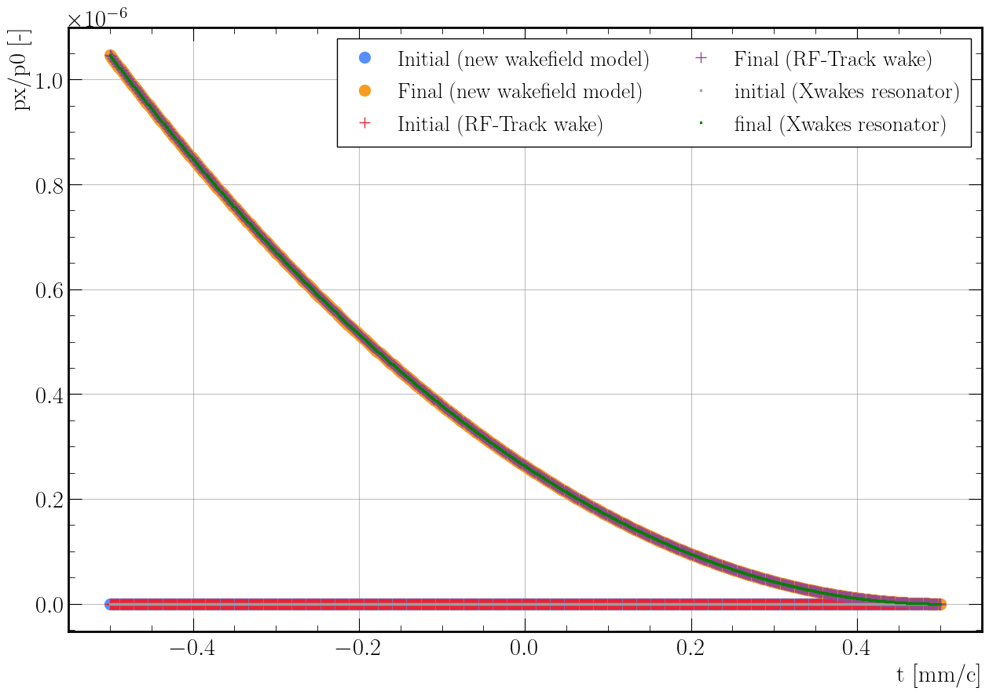
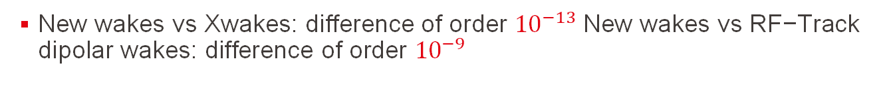
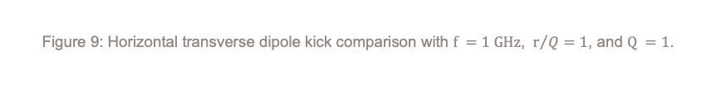
Transverse dipole kick benchmark
New wakes vs Xwakes: difference of order ${10}^{−13} \text{New} \text{wakes} \text{vs} \text{RF}\text{−}\text{Track} \text{dipolar} \text{wakes}\text{: }\text{difference} \text{of} \text{order} {10}^{−9}$
Figure 9: Horizontal transverse dipole kick comparison with $f =1 GHz$, ${ r}/Q=1$, and $Q =1$.

Slide 15
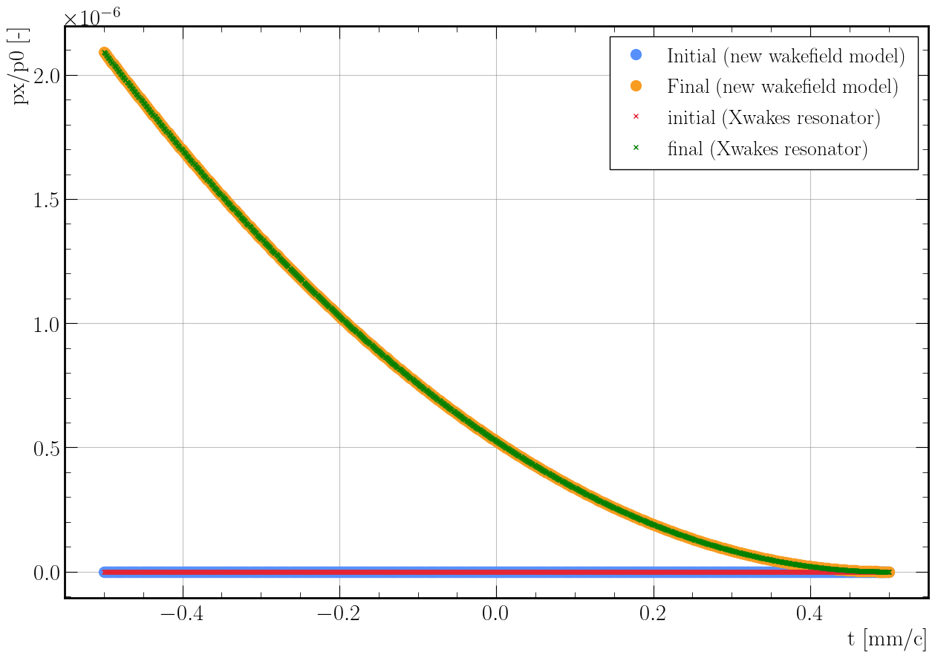


Transverse quadrupole kick benchmark
New wakes vs Xwakes: difference of order ${10}^{−12}$
Figure 10: Horizontal transverse quadrupole kick comparison with $f =1 GHz$, ${ r}/Q=1$, and $Q =1$.

Slide 16
What has been developed?
Recirculation model that works for arbitrary recirculating lattices
General axisymmetric and two-fold symmetric wake field model that works in RF-Track and in recirculating lattices
Benchmarked wake field model against Xwakes (PyHEADTAIL)
Xwakes: good agreement
Small differences are due to different integration methods (thin kick vs integrated kick)
RF-Track: Not very good agreement
Intrinsic differences in wake field models
What is next?
Extend model for non-ultra-relativistic regimes
Extend model for travelling wave structures
Implement both recirculation and wake field models in C++ into RF-Track for significant speed increase
General optimisations

Slide 17
Research goals
Beam Dynamics for ERL-based accelerators with energy-efficient cryomodules
Single- and multi-bunch instability studies in the iSAS/PERLE cryomodules
Development of simulation tools
Multi-pass recirculation model
Wake field model
Single- and multi-bunch beam breakup and beam loading studies
Energy-recovery efficiency studies

Slide 18
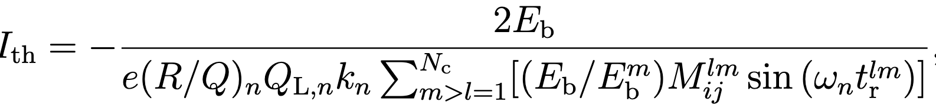
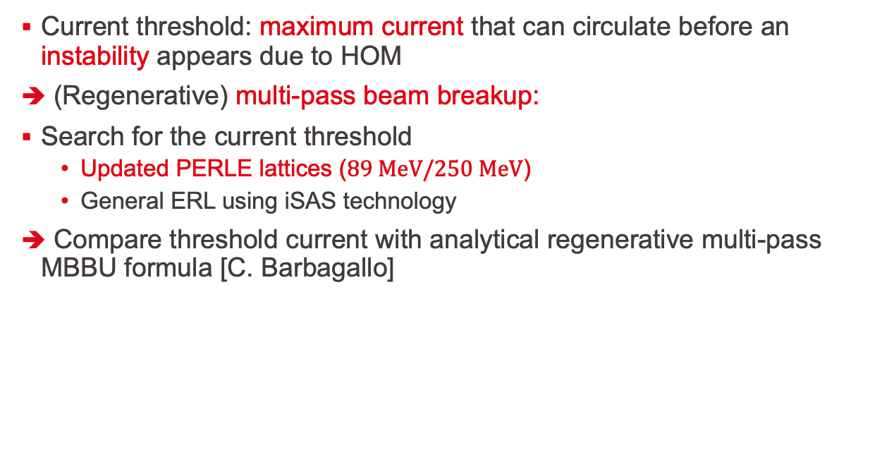
First study: search for current threshold
Current threshold: maximum current that can circulate before an instability appears due to HOM
(Regenerative) multi-pass beam breakup:
Search for the current threshold
Updated PERLE lattices ($89 MeV/250 MeV$)
General ERL using iSAS technology
Compare threshold current with analytical regenerative multi-pass MBBU formula [C. Barbagallo]

Slide 19

Simulation setup
Full recirculation in 250 MeV PERLE lattice (v2.4.250) [A. Fomin]
30 dipole HOM modes in iSAS/PERLE dressed cold cavity [P. Duchesne]
Bunches are injected at normal distributed transverse offsets (sigma is $8\%$ of the beam size ($0.1 mm$))
Since dipole wake field wavelengths are at least $0.2 m$
Bunch length is about $1\%$ of wavelength
Rigid-bunch as first approximation: one macroparticle per bunch (similar to BBU codes such ERLBBU, TDBBU, bi, BBU-R)
Decouple short-range and long-range wake field regimes
Figure 11: Schematic overview of the PERLE 250 MeV lattice in the BDSIM/Geant4 visualiser.

Slide 20
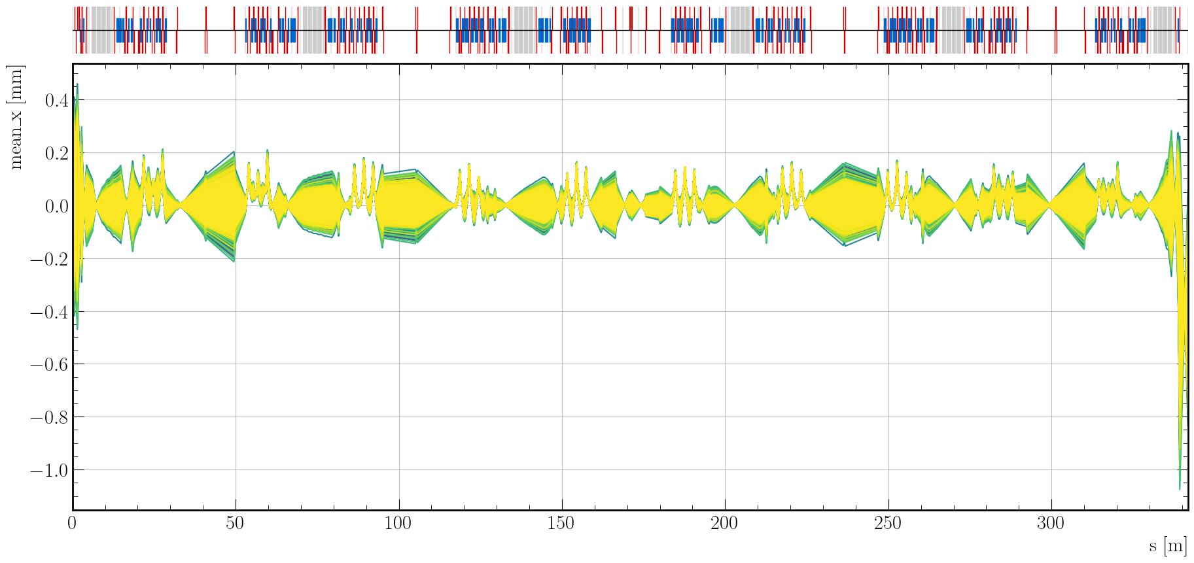
End-to-end simulation of PERLE at 20 mA
Full recirculation of 25k bunches (25k particles)
Stable at design injection beam current of 20 mA ➔ operating beam current of 120 mA
Figure 12: Horizontal bunch position of 25k bunches passing through the PERLE 250 MeV lattice at 20 mA.

Slide 21
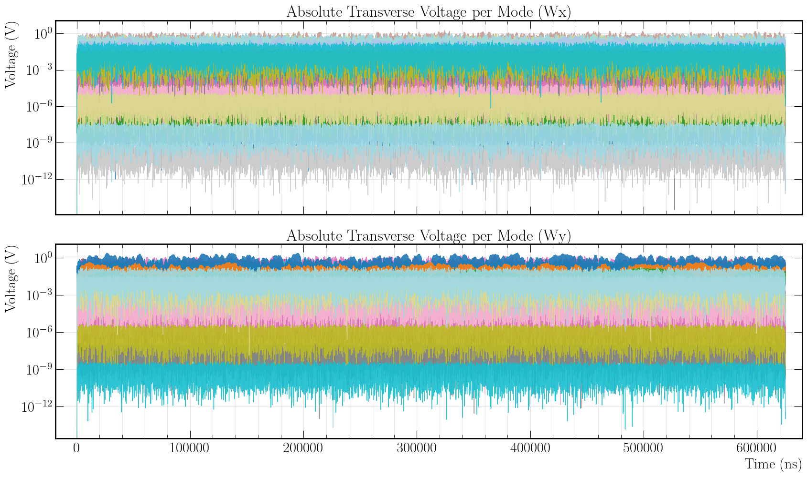
Dipole HOM voltage in cavities at 20 mA
No instability
Figure 13: The average evolution of individual horizontal and vertical dipole HOM voltages experienced by a test particle at a 1 mm offset inside the 4th PERLE dressed 5-cell half-wave cavity excited by 25k bunches passing through the PERLE 250 MeV lattice at 20 mA.

Slide 22
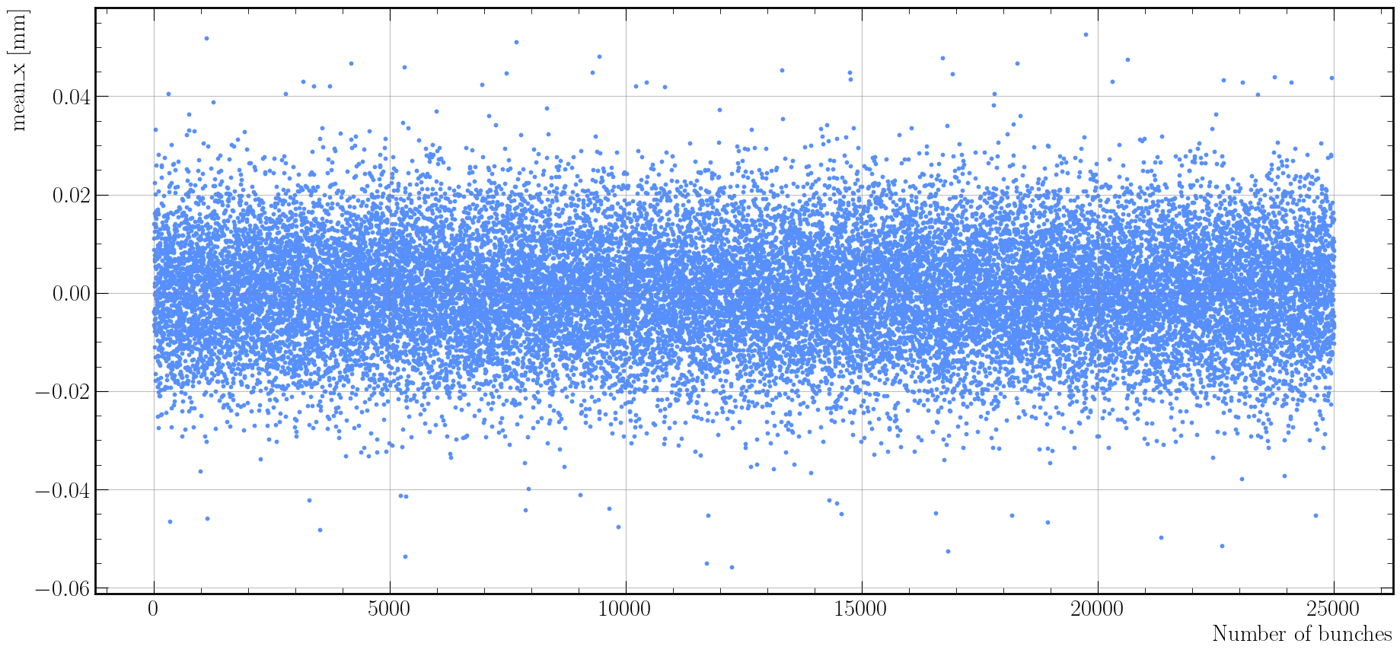
Average horizontal position at 20 mA
Figure 14: Average horizontal position of 25k bunches at the exit of the 250 MeV PERLE linac after the last decelerating pass at 20 mA.

Slide 23
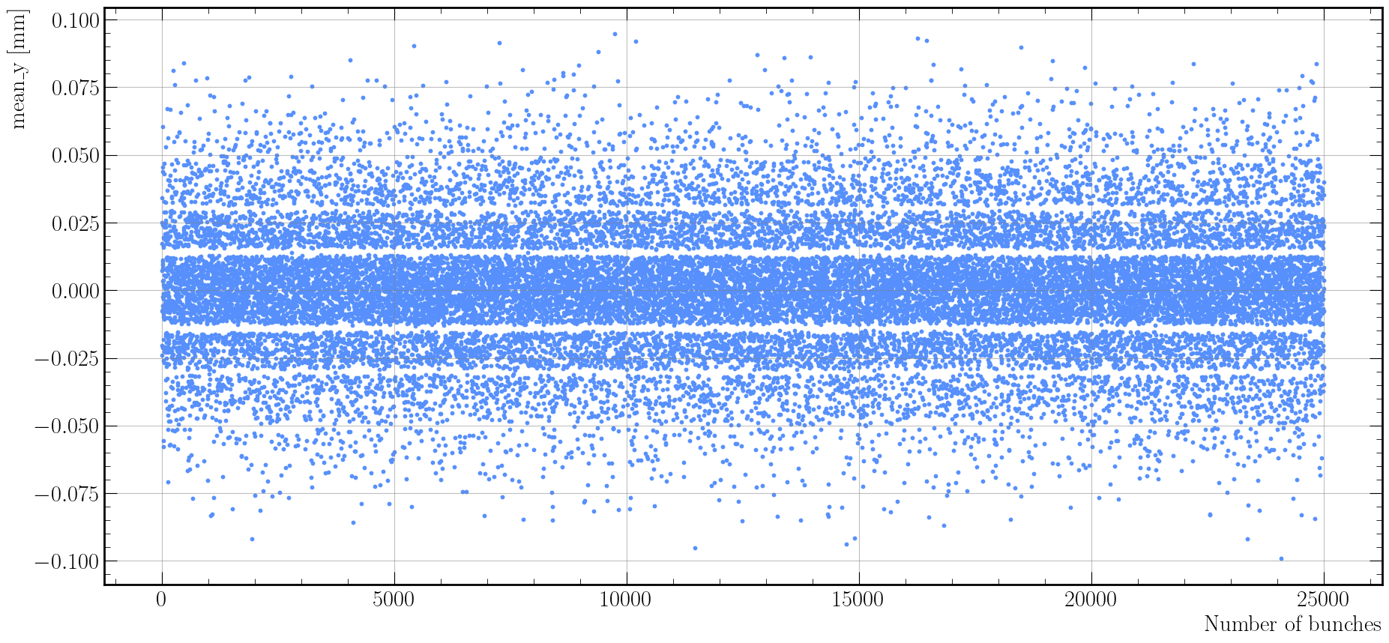
Average vertical position at 20 mA
Horizontal bands? Artifact of rigid-bunch?
Figure 15: Average vertical position of 25k bunches at the exit of the 250 MeV PERLE linac after the last decelerating pass at 20 mA.

Slide 24
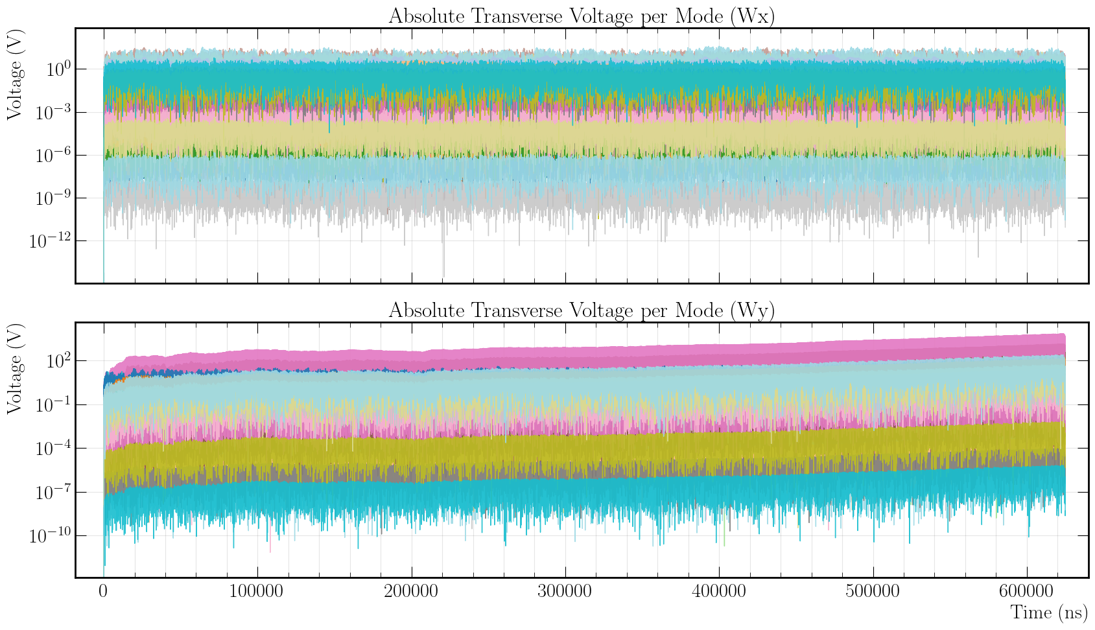
Dipole HOM voltage in cavities at 435 mA
No instability
Instability appears
Figure 16: The average evolution of individual horizontal and vertical dipole HOM voltages experienced by a test particle at a 1 mm offset inside the 4th PERLE dressed 5-cell half-wave cavity excited by 25k bunches passing through the PERLE 250 MeV lattice at 435 mA.

Slide 25
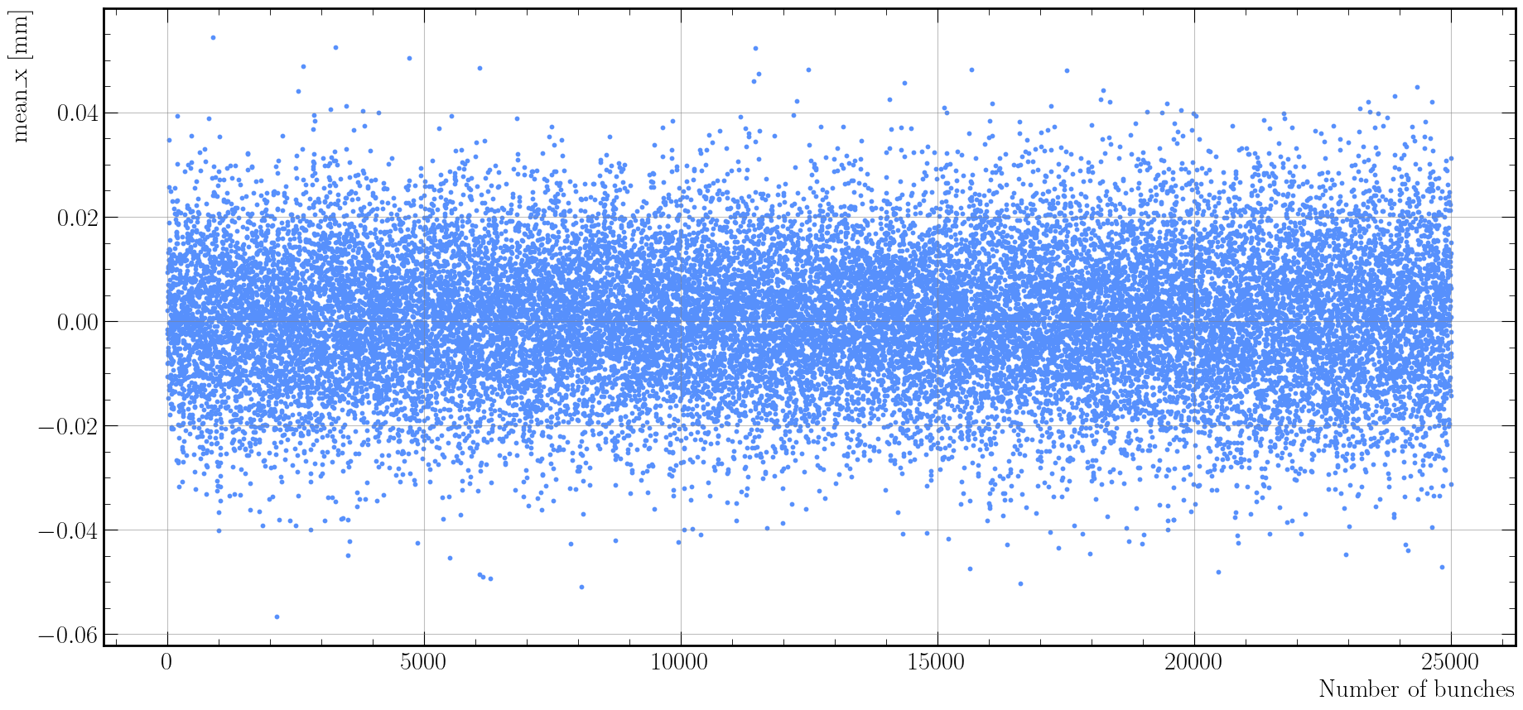
Average horizontal position at 435 mA
Figure 17: Average horizontal position of 25k bunches at the exit of the 250 MeV PERLE linac after the last decelerating pass at 435 mA.

Slide 26
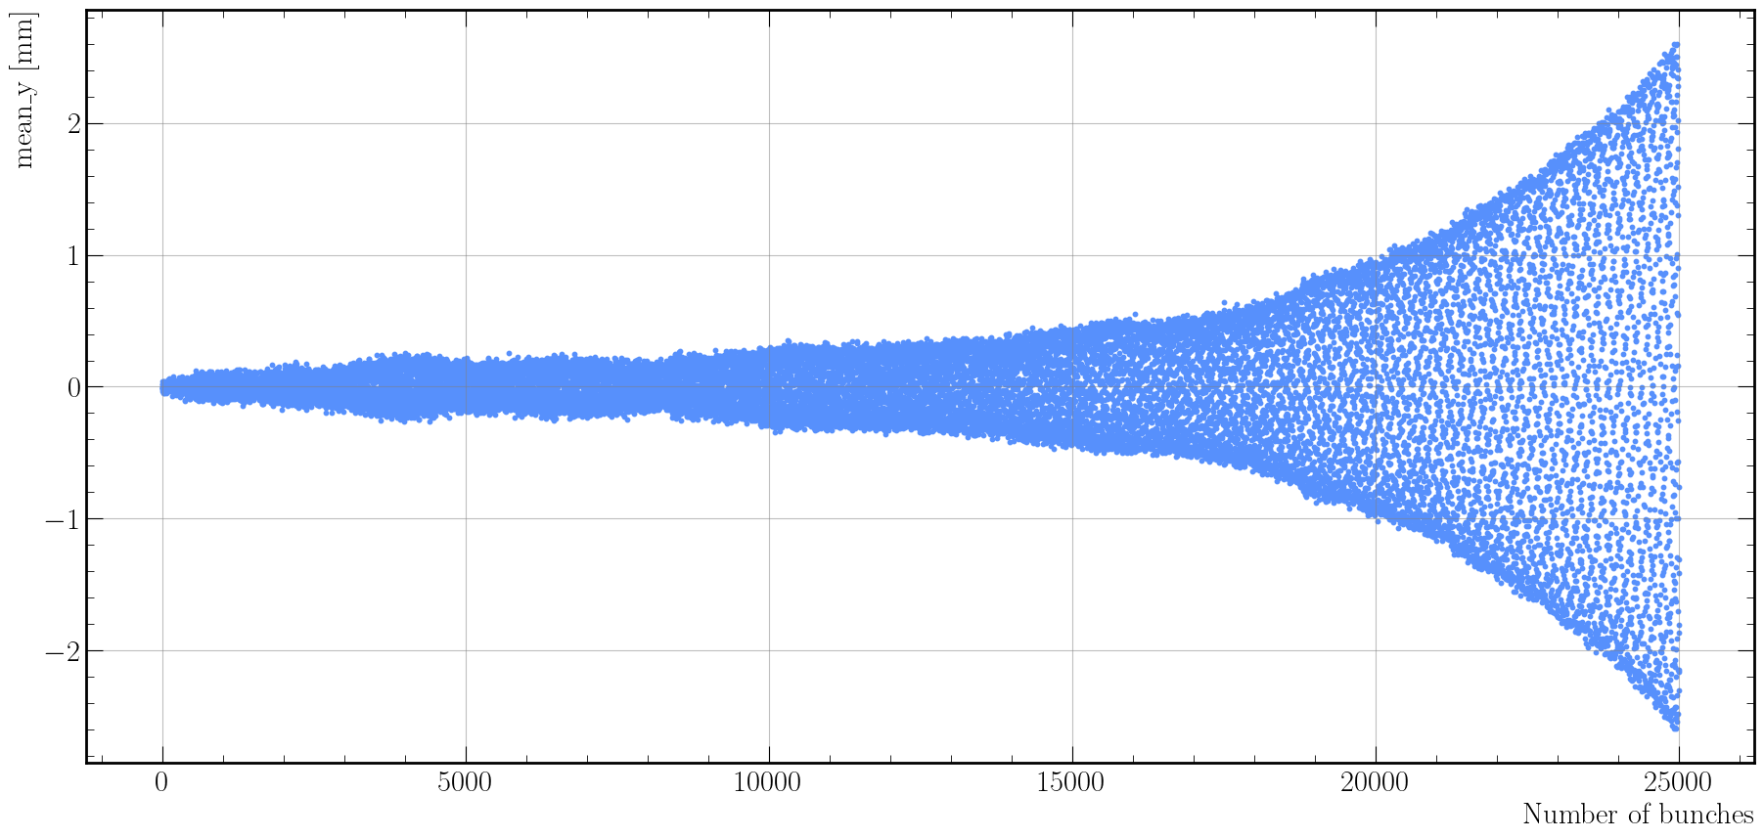
Average vertical position at 435 mA
Figure 18: Average vertical position of 25k bunches at the exit of the 250 MeV PERLE linac after the last decelerating pass at 435 mA.

Slide 27
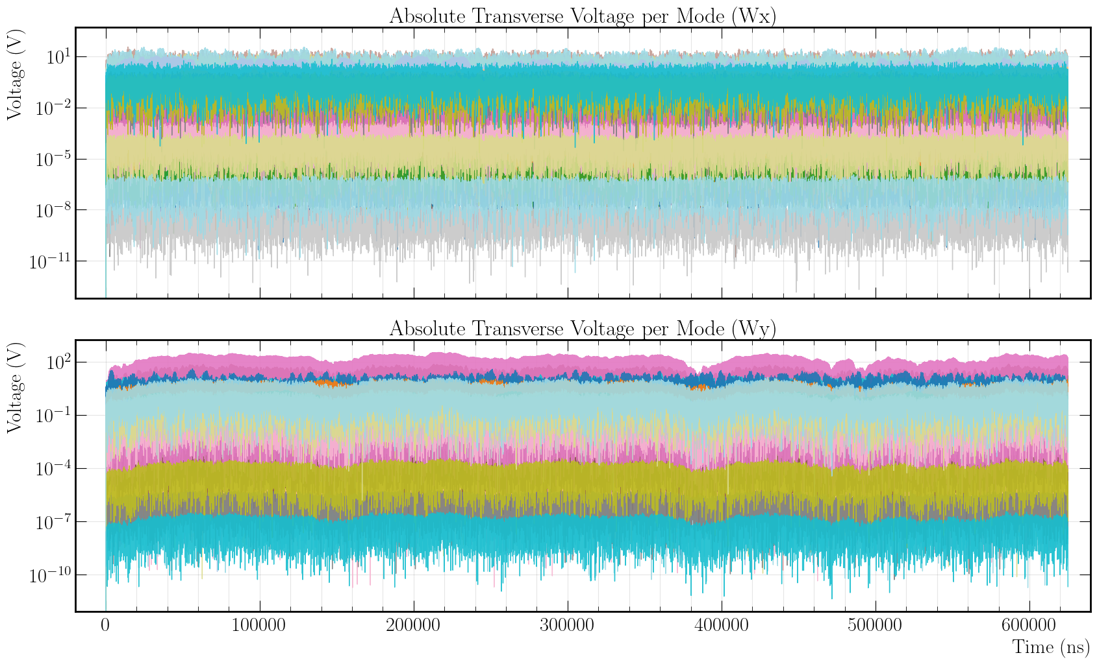
Dipole HOM voltage in cavities at 430 mA
No instability
No instability;
“battle” between decay and excitation
Figure 19: The average evolution of individual horizontal and vertical dipole HOM voltages experienced by a test particle at a 1 mm offset inside the 4th PERLE dressed 5-cell half-wave cavity excited by 25k bunches passing through the PERLE 250 MeV lattice at 430 mA.

Slide 28
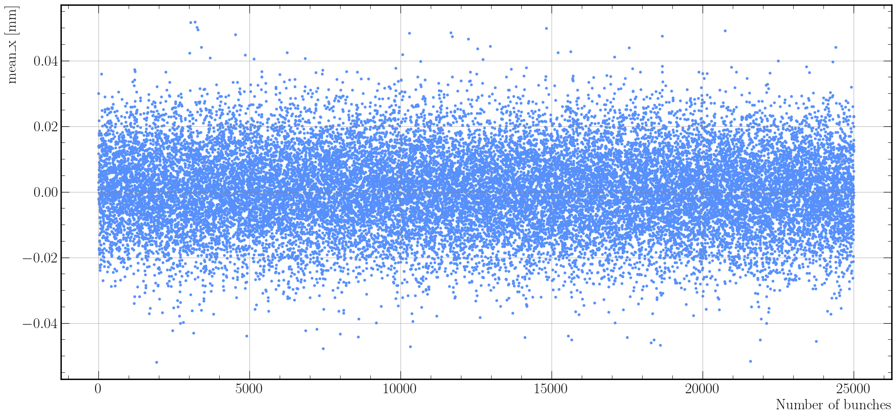
Average horizontal position at 430 mA
Figure 20: Average horizontal position of 25k bunches at the exit of the 250 MeV PERLE linac after the last decelerating pass at 430 mA.

Slide 29
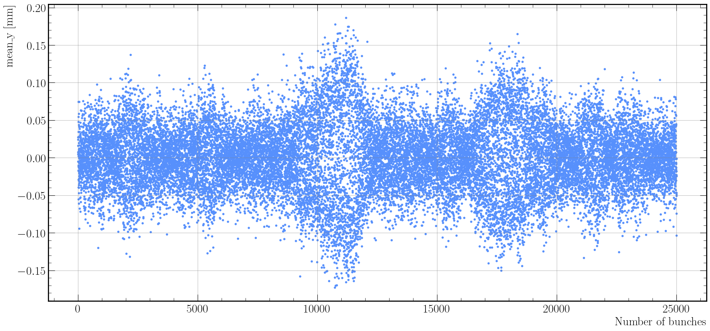
Average vertical position at 430 mA
Figure 21: Average vertical position of 25k bunches at the exit of the 250 MeV PERLE linac after the last decelerating pass at 430 mA.

Slide 30
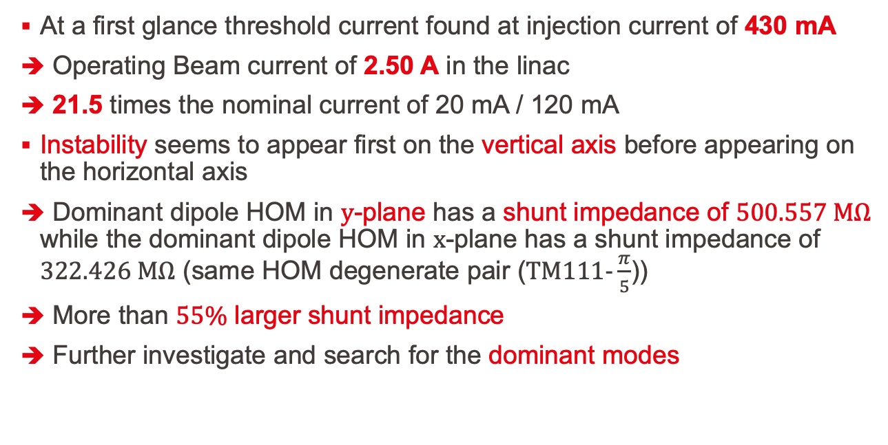
First results for threshold current
At a first glance threshold current found at injection current of 430 mA
Operating Beam current of 2.50 A in the linac
21.5 times the nominal current of 20 mA / 120 mA
Instability seems to appear first on the vertical axis before appearing on the horizontal axis
Dominant dipole HOM in $y$-plane has a shunt impedance of $500.557 MΩ$ while the dominant dipole HOM in $x$-plane has a shunt impedance of $322.426 MΩ$ (same HOM degenerate pair ($TM111-\frac{π}{5}$))
More than $55\%$ larger shunt impedance
Further investigate and search for the dominant modes

Slide 31
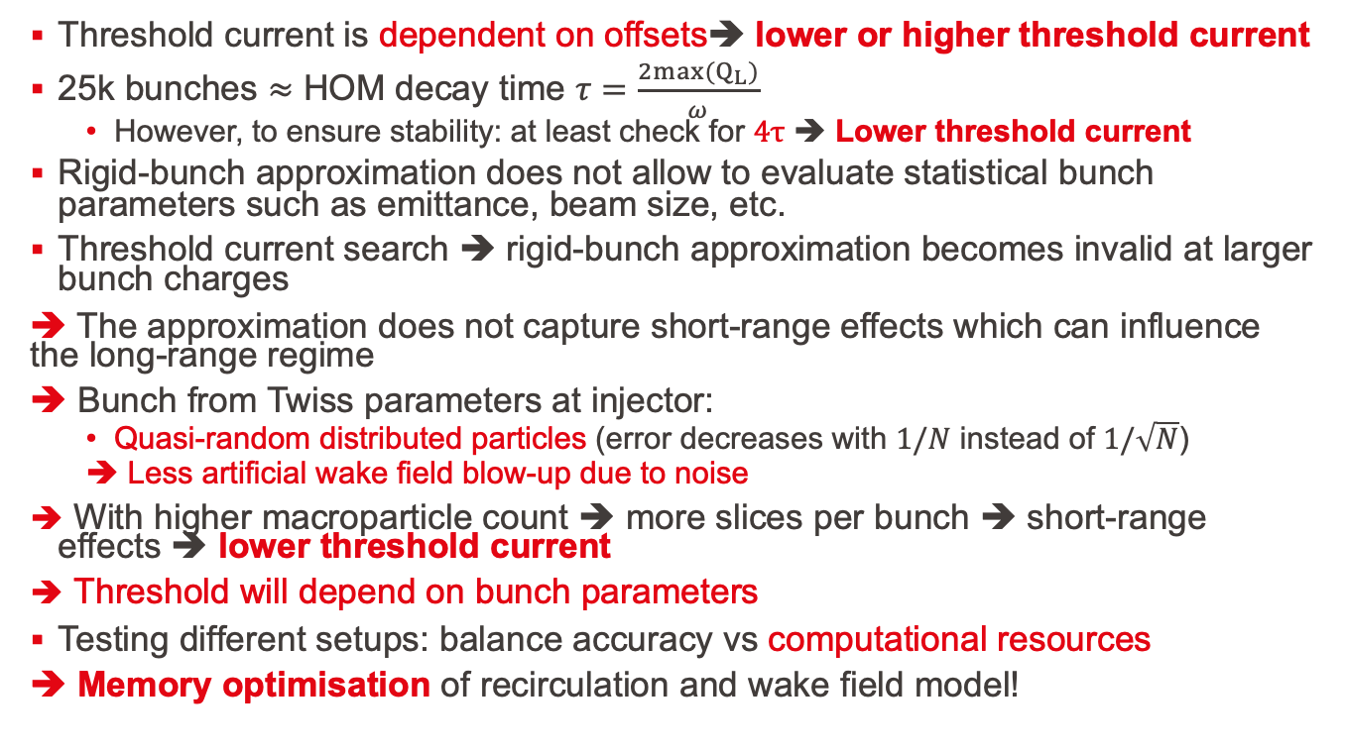
Caveats
Threshold current is dependent on offsets➔ lower or higher threshold current
25k bunches $≈$ HOM decay time $τ=\frac{2{max(Q}_{L})}{ω}$
However, to ensure stability: at least check for $4τ$ ➔ Lower threshold current
Rigid-bunch approximation does not allow to evaluate statistical bunch parameters such as emittance, beam size, etc.
Threshold current search ➔ rigid-bunch approximation becomes invalid at larger bunch charges
➔ The approximation does not capture short-range effects which can influence the long-range regime
➔ Bunch from Twiss parameters at injector:
Quasi-random distributed particles (error decreases with $1/N$ instead of $1/\sqrt{N}$)
Less artificial wake field blow-up due to noise
With higher macroparticle count ➔ more slices per bunch ➔ short-range effects ➔ lower threshold current
Threshold will depend on bunch parameters
Testing different setups: balance accuracy vs computational resources
➔ Memory optimisation of recirculation and wake field model!

Slide 32
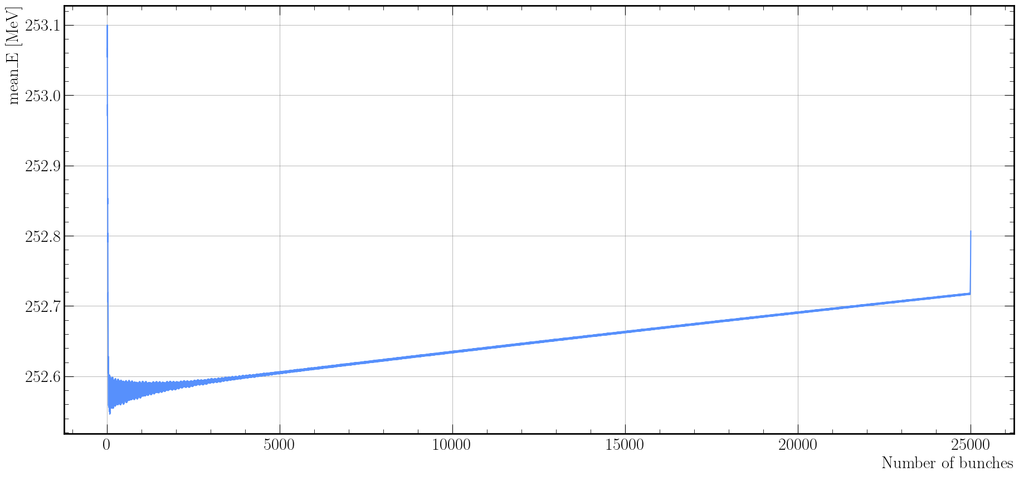

Second study: effect of beam loading
Transient beam loading $\sim 45$ bunches
Beam energy is not nominal ➔ Implement LLRF system to feedback on phase and amplitude
Figure 23: Average vertical position of 25k bunches at the exit of the 250 MeV PERLE linac after the last acceelrating pass at 20 mA.
Steady-state beam loading

Slide 33
What next?
For PERLE and general ERL:
Continue dipole current threshold study
Continue rigid-bunch + extend to full bunch
Dependency on beam parameters, filling patterns, misalignments
Develop BBU instability recognition routine
Determine HOM thresholds
Critical impedance, quality factor
Effect of fundamental/monopole modes on beam loading AND beam breakup
Introduce LLRF system to mitigate beam loading in transient regime
Investigate mitigation techniques
Introduce frequency jitter by machine errors
Energy recovery efficiency in PERLE
Energy recovery efficiency in ERL collider
General collider study
Still decide on optimal option for study on specific ERL-based collider project:
ERLC with assistance of Kaoru Yokoya and Tatsuya Nakada
erc@CERN with assistance of Andrew Hutton
LHeC, FCC-ee ERL, and more….

Slide 34
Bibliography
[1] J. Rosenzweig and L. Serafini, “Transverse particle motion in radio-frequency linear accelerators,” Phys. Rev. E, vol. 49, no. 2, pp. 1599–1602, Feb. 1994, doi: 10.1103/physreve.49.1599.
[2] T. P. Wangler, RF linear accelerators, 2nd completely rev. and enl. Ed. in Physics textbook. Weinheim: Wiley-VCH, 2008.
[3] A. W. Chao, Ed., Handbook of accelerator physics and engineering, Second edition. Hackensack, New Jersey: World Scientific, 2013.
[4] A. W. Chao, Physics of collective beam instabilities in high energy accelerators. in Wiley series in beam physics and accelerator technology. New York: Wiley, 1993.
[5] T. Weiland and R. Wanzenberg, “Wake fields and impedances,” in Lecture Notes in Physics, vol. 400, Berlin, Heidelberg: Springer Berlin Heidelberg, 1992, pp. 39–79. doi: 10.1007/3-540-55250-2_26.
[6] K. L. F. Bane, P. B. Wilson, and T. Weiland, “Wake fields and wake field acceleration,” in AIP Conference Proceedings, AIP, 1985, pp. 875–928. doi: 10.1063/1.35182.
[7] C. Barbagallo, “Design and optimization of higher order mode couplers for the superconducting cavities of the PERLE energy recovery linac”.
[8] S. Heifets, A. Wagner, and B. Zotter, “Generalized impedances and wakes in asymmetric structures,” SLAC/AP--110, 663316, Jan. 1998. doi: 10.2172/663316.

Slide 35
Additional slides

Slide 36
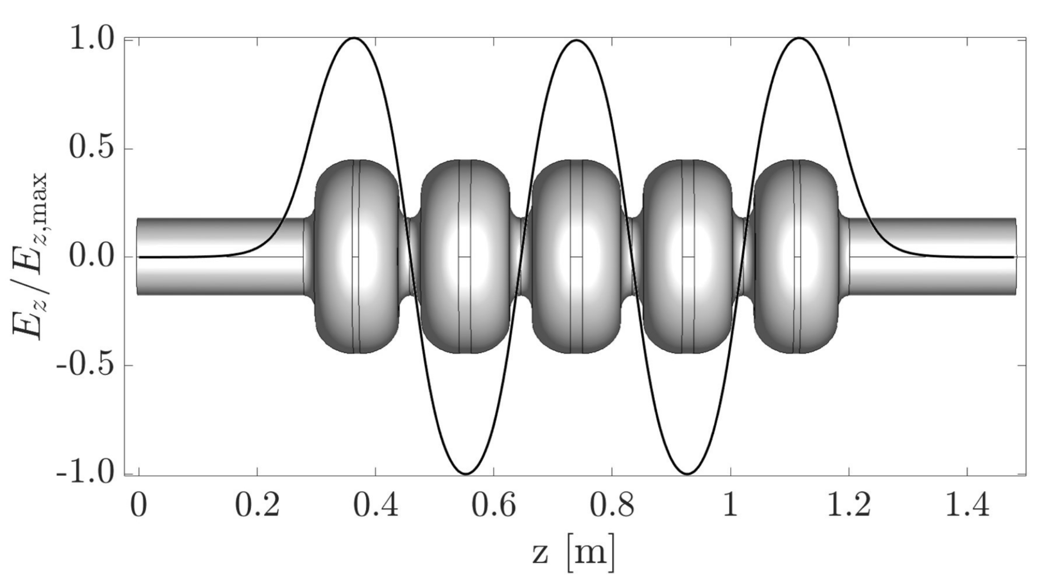
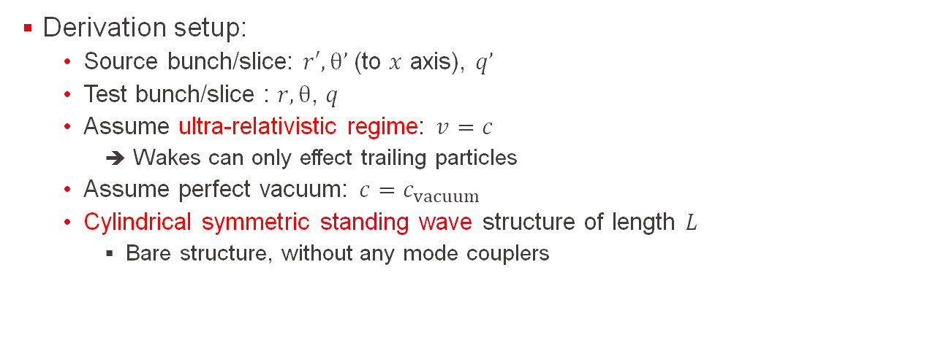
HOM’s in a cylindrical symmetric structure
Derivation setup:
Source bunch/slice: $r′,θ’$(to $x$ axis), $q’$
Test bunch/slice : $r,θ$, $q$
Assume ultra-relativistic regime: $v=c$
Wakes can only effect trailing particles
Assume perfect vacuum: $c=c_{vacuum}$
Cylindrical symmetric standing wave structure of length $L$
Bare structure, without any mode couplers
Figure 25: Normalised axial electric field amplitude of the TM010-π mode at 801.58 MHz in the 5 half-wave cell bare cavity for PERLE, with an energy gain of 20.5 MeV [7].

Slide 37
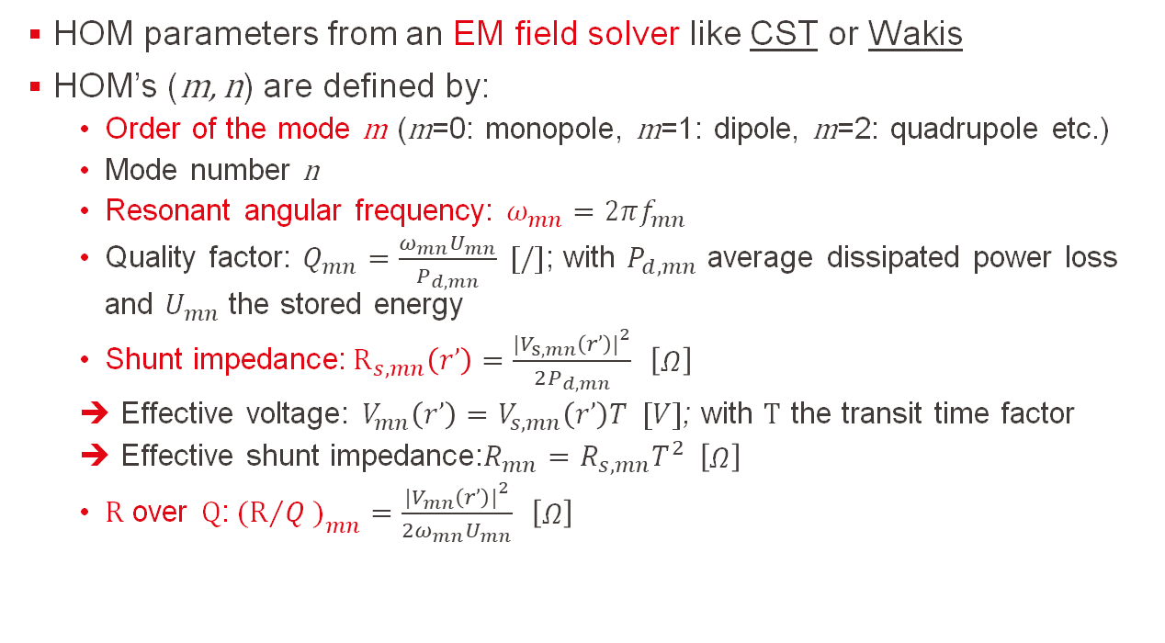
Higher-order mode parameters
HOM parameters from an EM field solver like CST or Wakis
HOM’s (m, n) are defined by:
Order of the mode m (m=0: monopole, m=1: dipole, m=2: quadrupole etc.)
Mode number n
Resonant angular frequency: $ω_{mn}=2πf_{mn}$
Quality factor: $Q_{mn}=\frac{ω_{mn}U_{mn}}{P_{d,mn}} [/]$; with $P_{d,mn}$ average dissipated power loss and $U_{mn}$ the stored energy
Shunt impedance:${ R}_{s,mn}\left(r’\right)=\frac{{\left.|\right.V}_{s,mn}\left(r’\right){\left.|\right.}^{2}}{2P_{d,mn}} \left[\begin{matrix}Ω\end{matrix}\right]$
Effective voltage: $V_{mn}\left(r’\right)=V_{s,mn}\left(r’\right)T [V]$; with $T$ the transit time factor
Effective shunt impedance:$R_{mn}=R_{s,mn}T^{2} \left[\begin{matrix}Ω\end{matrix}\right]$
$R$ over $Q$:${ (R}/Q{\left.)\right.}_{mn}=\frac{{\left.|\right.V}_{mn}\left(r’\right){\left.|\right.}^{2}}{{2ω}_{mn}U_{mn}} \left[\begin{matrix}Ω\end{matrix}\right]$

Slide 38
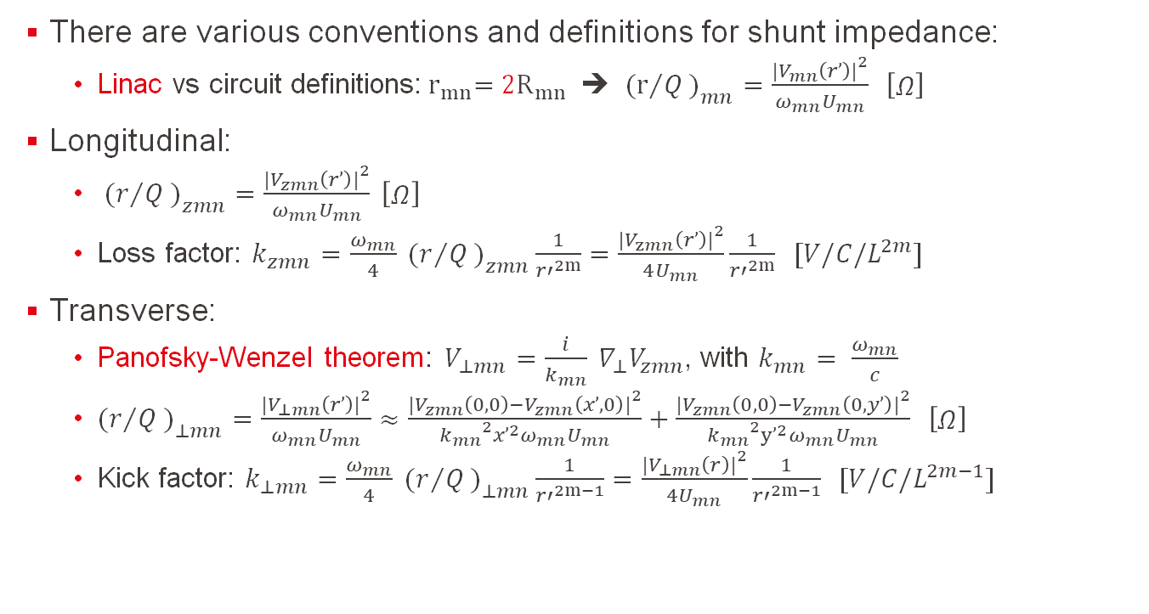
Higher-order mode parameters
There are various conventions and definitions for shunt impedance:
Linac vs circuit definitions:${ r}_{mn}={ 2R}_{mn}$ ➔ ${ (r}/Q{\left.)\right.}_{mn}=\frac{{\left.|\right.V}_{mn}\left(r’\right){\left.|\right.}^{2}}{ω_{mn}U_{mn}} \left[\begin{matrix}Ω\end{matrix}\right]$
Longitudinal:
${ (r}/Q{\left.)\right.}_{zmn}=\frac{{\left.|\right.V}_{zmn}\left(r’\right){\left.|\right.}^{2}}{ω_{mn}U_{mn}} \left[\begin{matrix}Ω\end{matrix}\right]$
Loss factor: $k_{zmn}=\frac{ω_{mn}}{4}{ (r}/Q{\left.)\right.}_{zmn}\frac{1}{{r′}^{2m}}=\frac{{\left.|\right.V}_{zmn}\left(r’\right){\left.|\right.}^{2}}{4U_{mn}}\frac{1}{{r′}^{2m}} [V/C/L^{2m}]$
Transverse:
Panofsky-Wenzel theorem: $V_{⊥mn}=\frac{i}{k_{mn}} ∇_{⊥}V_{zmn}$, with $k_{mn}= \frac{ω_{mn}}{c}$
${(r}/Q{\left.)\right.}_{⊥mn}=\frac{{\left.|\right.V}_{⊥mn}\left(r’\right){\left.|\right.}^{2}}{ω_{mn}U_{mn}}≈\frac{{\left.|\right.V}_{zmn}\left(0,0\right)−V_{zmn}\left(x’,0\right){\left.|\right.}^{2}}{{k_{mn}}^{2}{x’}^{2}ω_{mn}U_{mn}}+\frac{{\left.|\right.V}_{zmn}\left(0,0\right)−V_{zmn}\left(0,y’\right){\left.|\right.}^{2}}{{k_{mn}}^{2}{y’}^{2}ω_{mn}U_{mn}} \left[\begin{matrix}Ω\end{matrix}\right]$
Kick factor: $k_{⊥mn}=\frac{ω_{mn}}{4}{ (r}/Q{\left.)\right.}_{⊥mn}\frac{1}{{r′}^{2m−1}}=\frac{{\left.|\right.V}_{⊥mn}\left(r\right){\left.|\right.}^{2}}{4U_{mn}}\frac{1}{{r′}^{2m−1}} [V/C/L^{2m−1}]$

Slide 39
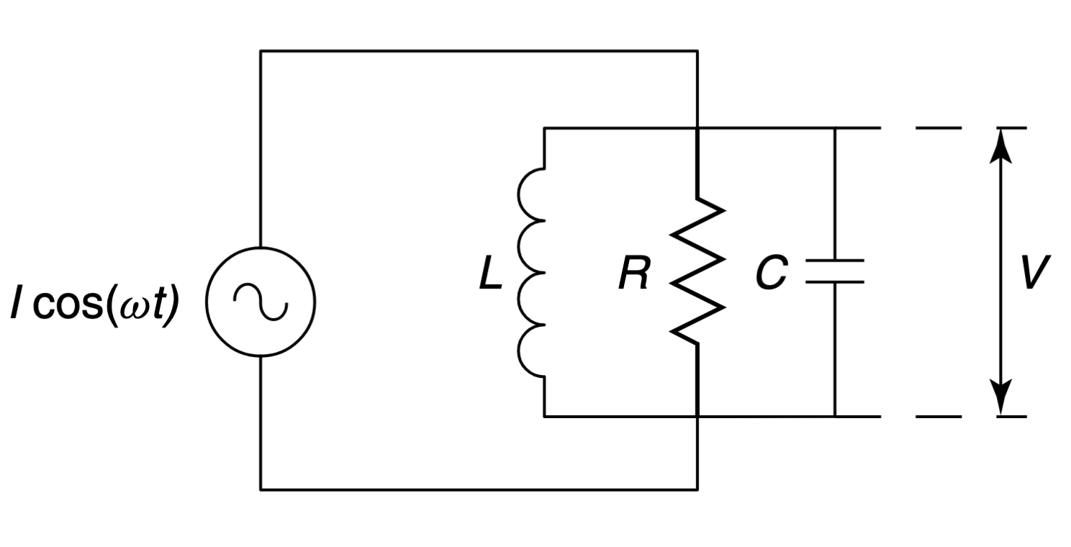
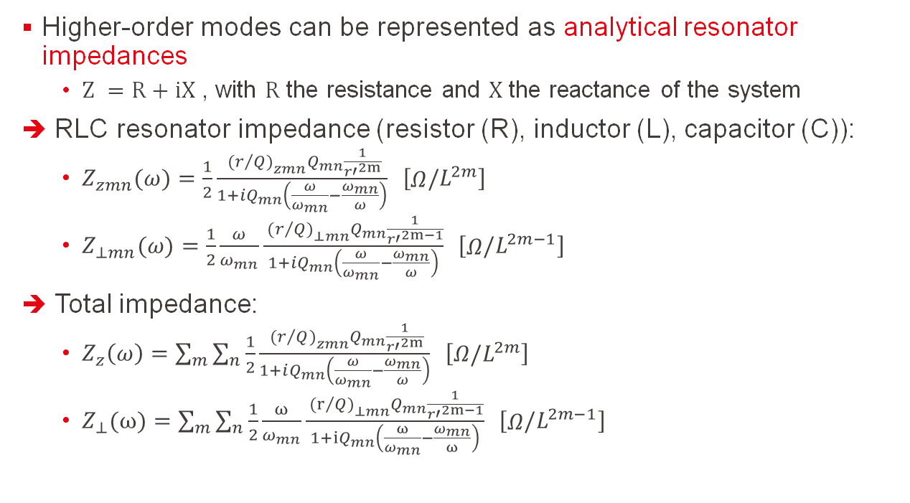
Analytic resonator impedance
Higher-order modes can be represented as analytical resonator impedances
$Z =R+iX$ , with $R$ the resistance and $X$ the reactance of the system
RLC resonator impedance (resistor (R), inductor (L), capacitor (C)):
$Z_{zmn}(ω)=\frac{1}{2}\frac{{{ (r}/Q{\left.)\right.}_{zmn}Q}_{mn}\frac{1}{{r′}^{2m}}}{1+iQ_{mn}\left(\frac{ω}{ω_{mn}}−\frac{ω_{mn}}{ω}\right)} \left[\begin{matrix}Ω\end{matrix}/L^{2m}\right]$
$Z_{⊥mn}(ω)=\frac{1}{2}\frac{ω}{ω_{mn}}\frac{{{ (r}/Q{\left.)\right.}_{⊥mn}Q}_{mn}\frac{1}{{r′}^{2m−1}}}{1+iQ_{mn}\left(\frac{ω}{ω_{mn}}−\frac{ω_{mn}}{ω}\right)} \left[\begin{matrix}Ω\end{matrix}/L^{2m−1}\right]$
Total impedance:
$Z_{z}\left(ω\right)=\sum_{m}{\sum_{n}{\frac{1}{2}\frac{{{ (r}/Q{\left.)\right.}_{zmn}Q}_{mn}\frac{1}{{r′}^{2m}}}{1+iQ_{mn}\left(\frac{ω}{ω_{mn}}−\frac{ω_{mn}}{ω}\right)} \left[\begin{matrix}Ω/L^{2m}\end{matrix}\right]}}$
$Z_{⊥}(ω)=\sum_{m}{\sum_{n}{\frac{1}{2}\frac{ω}{ω_{mn}}\frac{{{ (r}/Q{\left.)\right.}_{⊥mn}Q}_{mn}\frac{1}{{r′}^{2m−1}}}{1+iQ_{mn}\left(\frac{ω}{ω_{mn}}−\frac{ω_{mn}}{ω}\right)}}} \left[\begin{matrix}Ω\end{matrix}/L^{2m−1}\right]$
Figure 26: LRC circuit [2].

Slide 40
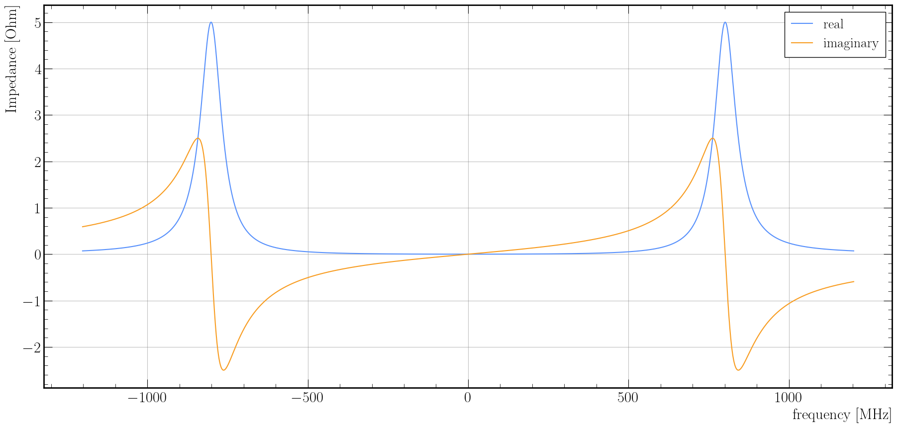
Analytic resonator impedance
Figure 27: Real and imaginary part of a narrow-band resonator impedance with $f =801.58 MHz$, ${ r}/Q=1$, and $Q =10$.

Slide 41
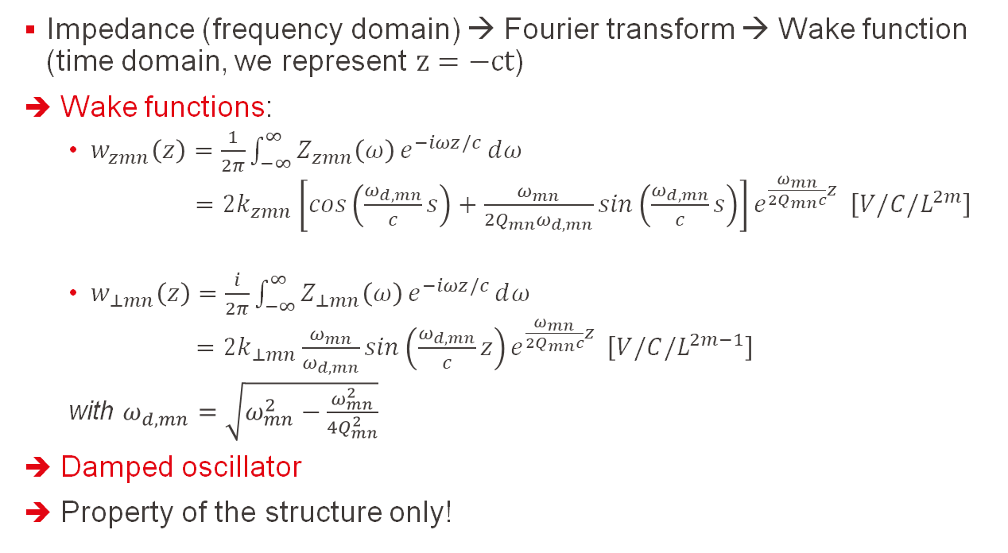
Single-mode resonator wake function
Impedance (frequency domain) → Fourier transform → Wake function (time domain, we represent $z=−ct$)
Wake functions:
$w_{zmn}\left(z\right)=\frac{1}{2π}\int_{−∞}^{∞}{Z_{zmn}\left(ω\right)}e^{−iωz/c}ⅆω$
$=2k_{zmn}\left[cos\left(\frac{ω_{d,mn}}{c}s\right)+\frac{ω_{mn}}{2Q_{mn}ω_{d,mn}}sin\left(\frac{ω_{d,mn}}{c}s\right)\right]e^{\frac{ω_{mn}}{2Q_{mn}c}z} \left[V/C/L^{2m}\right]$
$w_{⊥mn}\left(z\right)=\frac{i}{2π}\int_{−∞}^{∞}{Z_{⊥mn}\left(ω\right)}e^{−iωz/c}ⅆω$
$=2k_{⊥mn}\frac{ω_{mn}}{ω_{d,mn}}sin\left(\frac{ω_{d,mn}}{c}z\right)e^{\frac{ω_{mn}}{2Q_{mn}c}z} \left[V/C/L^{2m−1}\right]$
with $ω_{d,mn}=\sqrt{ω_{mn}^{2}−\frac{ω_{mn}^{2}}{4Q_{mn}^{2}}}$
Damped oscillator
Property of the structure only!

Slide 42
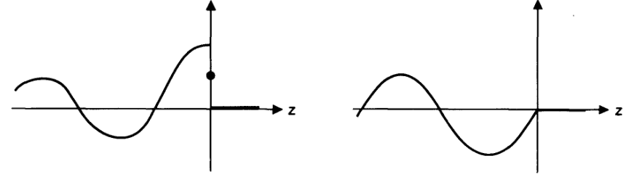
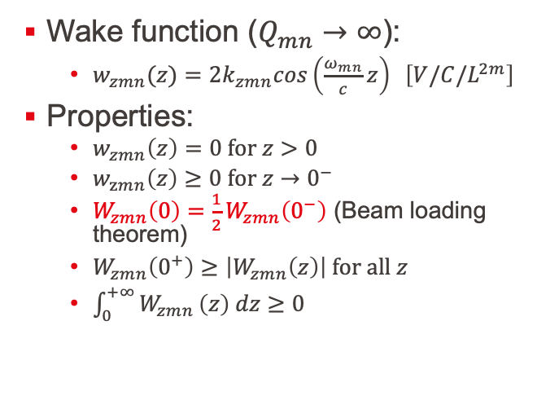
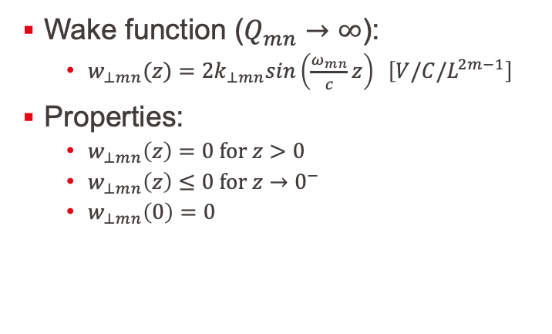
Wake function properties
Wake function ($Q_{mn}→∞$):
$w_{zmn}(z)={2k}_{zmn}cos\left(\frac{ω_{mn}}{c}z\right) \left[V/C/L^{2m}\right]$
Properties:
$w_{zmn}\left(z\right)=0 \text{for} z>0$
$w_{zmn}\left(z\right)≥0 \text{for} z→0^{−}$
$W_{zmn}\left(0\right)=\frac{1}{2}W_{zmn}\left(0^{−}\right)$ (Beam loading theorem)
$W_{zmn}\left(0^{+}\right)≥\left|W_{zmn}\left(z\right)\right| \text{for} \text{all} z$
$\int_{0}^{+∞}{W_{zmn}}\left(z\right) dz≥0$
Wake function ($Q_{mn}→∞$):
$w_{⊥mn}(z)={2k}_{⊥mn}sin\left(\frac{ω_{mn}}{c}z\right) \left[V/C/L^{2m−1}\right]$
Properties:
$w_{⊥mn}\left(z\right)=0 \text{for} z>0$
$w_{⊥mn}\left(z\right)≤0 \text{for} z→0^{−}$
$w_{⊥mn}\left(0\right)=0$
Figure 28: Left: Shape of the longitudinal wake function. Right: Shape of the transverse wake function [4].

Slide 43
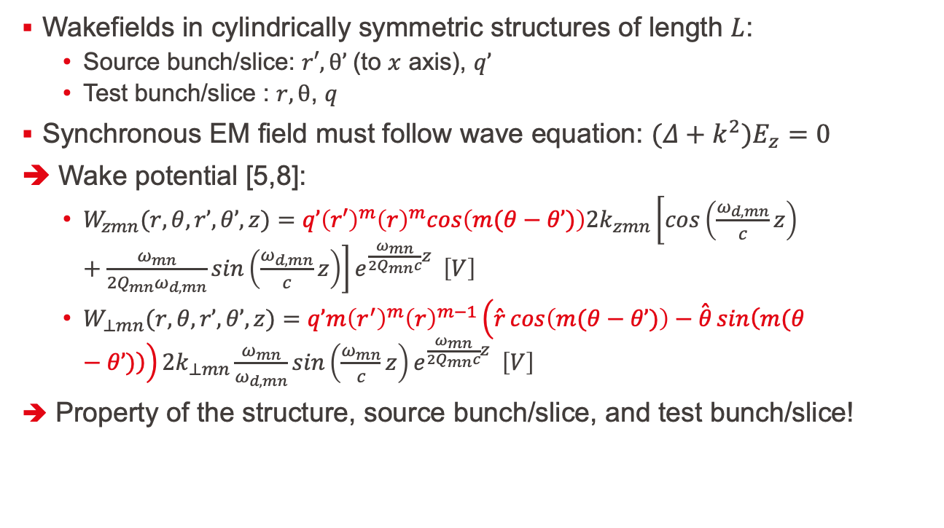
Single-mode axisymmetric wake potential
Wakefields in cylindrically symmetric structures of length $L$:
Source bunch/slice: $r′,θ’$(to $x$ axis), $q’$
Test bunch/slice : $r,θ$, $q$
Synchronous EM field must follow wave equation: $(Δ+k^{2})E_{z}=0$
➔ Wake potential [5,8]:
$W_{zmn}(r,θ,r’,θ’,z)={q’\left(r′\right)}^{m}{\left(r\right)}^{m}cos\left(m(θ−θ’)\right)2k_{zmn}\left[cos\left(\frac{ω_{d,mn}}{c}z\right)+\frac{ω_{mn}}{2Q_{mn}ω_{d,mn}}sin\left(\frac{ω_{d,mn}}{c}z\right)\right]e^{\frac{ω_{mn}}{2Q_{mn}c}z} \left[V\right]$
$W_{⊥mn}(r,θ,r’,θ’,z)=q’m{\left(r^{′}\right)}^{m}{\left(r\right)}^{m−1}\left(\overset{ˆ}{r}cos\left(m(θ−θ’)\right)−\overset{ˆ}{θ}sin\left(m(θ−θ’)\right)\right)2k_{⊥mn}\frac{ω_{mn}}{ω_{d,mn}}sin\left(\frac{ω_{mn}}{c}z\right)e^{\frac{ω_{mn}}{2Q_{mn}c}z} \left[V\right]$
Property of the structure, source bunch/slice, and test bunch/slice!

Slide 44
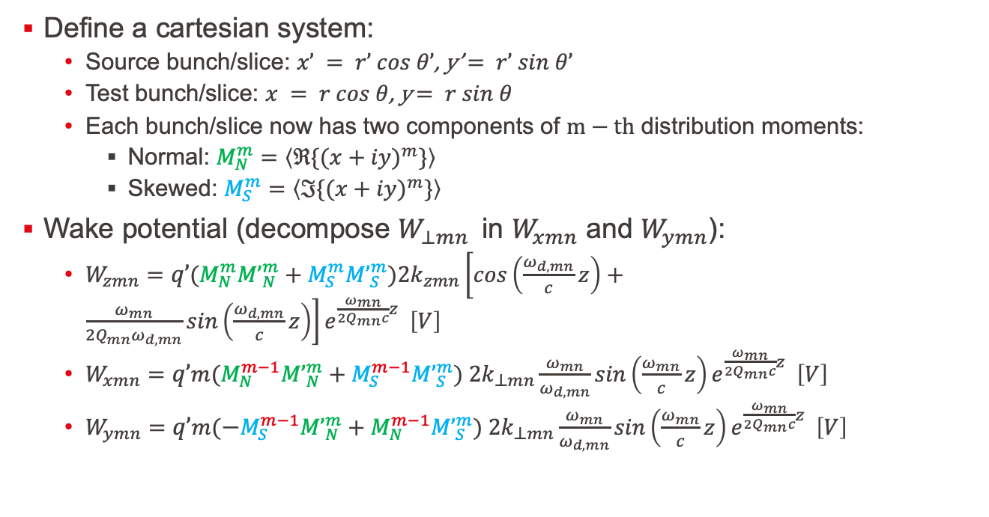
Single-mode axisymmetric wake potential
Define a cartesian system:
Source bunch/slice: $x’ = r’ cos θ’$, y’$= r’ sin θ’$
Test bunch/slice: $x = r cos θ$, y$= r sin θ$
Each bunch/slice now has two components of $m−th$ distribution moments:
Normal: $M_{N}^{m}=\left\langle ℜ{\{(x+iy)}^{m}\}\right\rangle$
Skewed: $M_{S}^{m}=\left\langle ℑ{\{(x+iy)}^{m}\}\right\rangle$
Wake potential (decompose $W_{⊥mn}$in $W_{xmn}$ and $W_{ymn}$):
$W_{zmn}=q’(M_{N}^{m}{M’}_{N}^{m}+M_{S}^{m}{M’}_{S}^{m})2k_{zmn}\left[cos\left(\frac{ω_{d,mn}}{c}z\right)+\frac{ω_{mn}}{2Q_{mn}ω_{d,mn}}sin\left(\frac{ω_{d,mn}}{c}z\right)\right]e^{\frac{ω_{mn}}{2Q_{mn}c}z} \left[V\right]$
$W_{xmn}=q’m(M_{N}^{m−1}{M’}_{N}^{m}+M_{S}^{m−1}{M’}_{S}^{m}) 2k_{⊥mn}\frac{ω_{mn}}{ω_{d,mn}}sin\left(\frac{ω_{mn}}{c}z\right)e^{\frac{ω_{mn}}{2Q_{mn}c}z} \left[V\right]$
$W_{ymn}=q’m(−M_{S}^{m−1}{M’}_{N}^{m}+M_{N}^{m−1}{M’}_{S}^{m}) 2k_{⊥mn}\frac{ω_{mn}}{ω_{d,mn}}sin\left(\frac{ω_{mn}}{c}z\right)e^{\frac{ω_{mn}}{2Q_{mn}c}z} \left[V\right]$

Slide 45
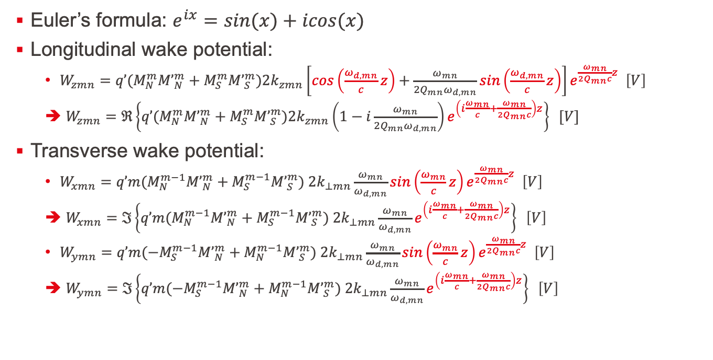
Axisymmetric wake potential phasor representation
Euler’s formula: $e^{ix}=sin(x)+icos(x)$
Longitudinal wake potential:
$W_{zmn}=q’(M_{N}^{m}{M’}_{N}^{m}+M_{S}^{m}{M’}_{S}^{m})2k_{zmn}\left[cos\left(\frac{ω_{d,mn}}{c}z\right)+\frac{ω_{mn}}{2Q_{mn}ω_{d,mn}}sin\left(\frac{ω_{d,mn}}{c}z\right)\right]e^{\frac{ω_{mn}}{2Q_{mn}c}z} \left[V\right]$
$W_{zmn}=ℜ\left\{q’(M_{N}^{m}{M’}_{N}^{m}+M_{S}^{m}{M’}_{S}^{m})2k_{zmn}\left(1−i\frac{ω_{mn}}{2Q_{mn}ω_{d,mn}}\right)e^{\left(i\frac{ω_{mn}}{c}+\frac{ω_{mn}}{2Q_{mn}c}\right)z}\right\} [V]$
Transverse wake potential:
$W_{xmn}=q’m(M_{N}^{m−1}{M’}_{N}^{m}+M_{S}^{m−1}{M’}_{S}^{m}) 2k_{⊥mn}\frac{ω_{mn}}{ω_{d,mn}}sin\left(\frac{ω_{mn}}{c}z\right)e^{\frac{ω_{mn}}{2Q_{mn}c}z} \left[V\right]$
$W_{xmn}=ℑ\left\{q’m(M_{N}^{m−1}{M’}_{N}^{m}+M_{S}^{m−1}{M’}_{S}^{m}) 2k_{⊥mn}\frac{ω_{mn}}{ω_{d,mn}}e^{\left(i\frac{ω_{mn}}{c}+\frac{ω_{mn}}{2Q_{mn}c}\right)z}\right\} \left[V\right]$
$W_{ymn}=q’m({−M}_{S}^{m−1}{M’}_{N}^{m}+M_{N}^{m−1}{M’}_{S}^{m}) 2k_{⊥mn}\frac{ω_{mn}}{ω_{d,mn}}sin\left(\frac{ω_{mn}}{c}z\right)e^{\frac{ω_{mn}}{2Q_{mn}c}z} \left[V\right]$
$W_{ymn}=ℑ\left\{q’m({−M}_{S}^{m−1}{M’}_{N}^{m}+M_{N}^{m−1}{M’}_{S}^{m}) 2k_{⊥mn}\frac{ω_{mn}}{ω_{d,mn}}e^{\left(i\frac{ω_{mn}}{c}+\frac{ω_{mn}}{2Q_{mn}c}\right)z}\right\} \left[V\right]$

Slide 46
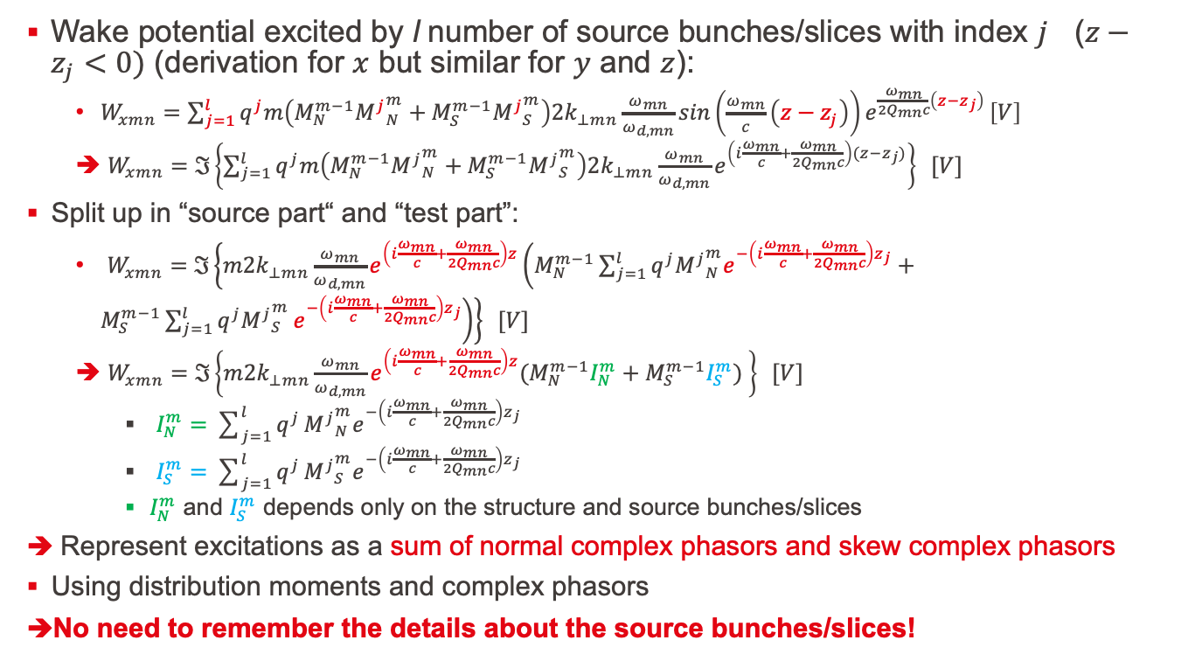
Axisymmetric wake potential phasor representation
Wake potential excited by l number of source bunches/slices with index $j$ ($z−z_{j}<0)$ (derivation for $x$ but similar for $y$ and $z$):
$W_{xmn}=\sum_{j=1}^{l}{q^{j}m\left(M_{N}^{m−1}{M^{j}}_{N}^{m}+M_{S}^{m−1}{M^{j}}_{S}^{m}\right)2k_{⊥mn}\frac{ω_{mn}}{ω_{d,mn}}sin\left(\frac{ω_{mn}}{c}\left(z−z_{j}\right)\right)e^{\frac{ω_{mn}}{2Q_{mn}c}\left(z−z_{j}\right)}}\left[V\right]$
$W_{xmn}=ℑ\left\{\sum_{j=1}^{l}{q^{j}m\left(M_{N}^{m−1}{M^{j}}_{N}^{m}+M_{S}^{m−1}{M^{j}}_{S}^{m}\right)2k_{⊥mn}\frac{ω_{mn}}{ω_{d,mn}}e^{\left(i\frac{ω_{mn}}{c}+\frac{ω_{mn}}{2Q_{mn}c}\right)(z−z_{j})}}\right\} [V]$
Split up in “source part“ and “test part”:
$W_{xmn}=ℑ\left\{m2k_{⊥mn}\frac{ω_{mn}}{ω_{d,mn}}e^{\left(i\frac{ω_{mn}}{c}+\frac{ω_{mn}}{2Q_{mn}c}\right)z}\left(M_{N}^{m−1}\sum_{j=1}^{l}{q^{j}{M^{j}}_{N}^{m}e^{−\left(i\frac{ω_{mn}}{c}+\frac{ω_{mn}}{2Q_{mn}c}\right)z_{j}}}+M_{S}^{m−1}\sum_{j=1}^{l}{q^{j}{M^{j}}_{S}^{m}}e^{−\left(i\frac{ω_{mn}}{c}+\frac{ω_{mn}}{2Q_{mn}c}\right)z_{j}}\right)\right\} [V]$
$W_{xmn}=ℑ\left\{m2k_{⊥mn}\frac{ω_{mn}}{ω_{d,mn}}e^{\left(i\frac{ω_{mn}}{c}+\frac{ω_{mn}}{2Q_{mn}c}\right)z}(M_{N}^{m−1}I_{N}^{m}+M_{S}^{m−1}I_{S}^{m}) \right\} [V]$
$I_{N}^{m}=\sum_{j=1}^{l}{q^{j}}{M^{j}}_{N}^{m}e^{−\left(i\frac{ω_{mn}}{c}+\frac{ω_{mn}}{2Q_{mn}c}\right)z_{j}}$
$I_{S}^{m}=\sum_{j=1}^{l}{q^{j}}{M^{j}}_{S}^{m}e^{−\left(i\frac{ω_{mn}}{c}+\frac{ω_{mn}}{2Q_{mn}c}\right)z_{j}}$
$I_{N}^{m}$ and $I_{S}^{m}$ depends only on the structure and source bunches/slices
Represent excitations as a sum of normal complex phasors and skew complex phasors
Using distribution moments and complex phasors
No need to remember the details about the source bunches/slices!

Slide 47
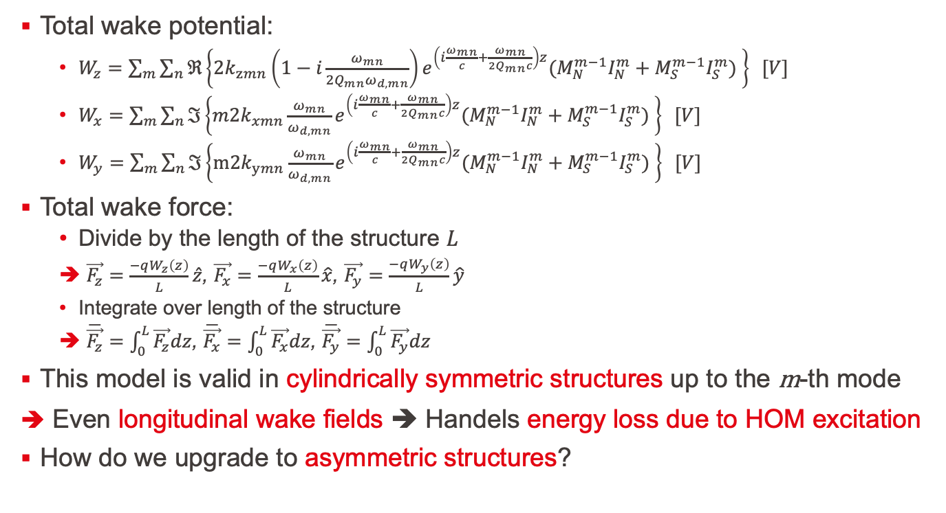
Total axisymmetric wake potential
Total wake potential:
$W_{z}=\sum_{m}{\sum_{n}{ℜ\left\{2k_{zmn}\left(1−i\frac{ω_{mn}}{2Q_{mn}ω_{d,mn}}\right)e^{\left(i\frac{ω_{mn}}{c}+\frac{ω_{mn}}{2Q_{mn}c}\right)z}(M_{N}^{m−1}I_{N}^{m}+M_{S}^{m−1}I_{S}^{m}) \right\} [V]}}$
$W_{x}=$ $\sum_{m}{\sum_{n}{ℑ\left\{m2k_{xmn}\frac{ω_{mn}}{ω_{d,mn}}e^{\left(i\frac{ω_{mn}}{c}+\frac{ω_{mn}}{2Q_{mn}c}\right)z}(M_{N}^{m−1}I_{N}^{m}+M_{S}^{m−1}I_{S}^{m}) \right\} [V]}}$
$W_{y}=$ $\sum_{m}{\sum_{n}{ℑ\left\{m2k_{ymn}\frac{ω_{mn}}{ω_{d,mn}}e^{\left(i\frac{ω_{mn}}{c}+\frac{ω_{mn}}{2Q_{mn}c}\right)z}(M_{N}^{m−1}I_{N}^{m}+M_{S}^{m−1}I_{S}^{m}) \right\} [V]}}$
Total wake force:
Divide by the length of the structure $L$
$\vec{F_{z}}=$ $\frac{−qW_{z}\left(z\right)}{L}\hat{z}$, $\vec{F_{x}}=\frac{−qW_{x}\left(z\right)}{L}\hat{x}$, $\vec{F_{y}}=\frac{−qW_{y}\left(z\right)}{L}\hat{y}$
Integrate over length of the structure
$\overline{\vec{F_{z}}}=\int_{0}^{L}{\vec{F_{z}}dz}$, $\overline{\vec{F_{x}}}=\int_{0}^{L}{\vec{F_{x}}dz}$, $\overline{\vec{F_{y}}}=\int_{0}^{L}{\vec{F_{y}}dz}$
This model is valid in cylindrically symmetric structures up to the m-th mode
Even longitudinal wake fields ➔ Handels energy loss due to HOM excitation
How do we upgrade to asymmetric structures?

Slide 48

Single-mode asymmetric wake potential
Asymmetric structure ➔ different transverse shunt impedances for $x$and $y$
Following [8], we can write the general asymmetric wake potential as two power series in $r$ and in $r’$, with $r_{±}=x±iy$; $k$ is the source particle order and $m$ is test particle order:
$W_{zmn}=\sum_{k}{\left[α_{mnk}\left(s\right){r’}_{+}^{k}+β_{mnk}\left(s\right){r’}_{−}^{k}\right]r_{+}^{m}}+\left[α_{mnk}^{∗}\left(s\right){r’}_{−}^{k}+β_{mnk}^{∗}\left(s\right){r’}_{+}^{k}\right]r_{−}^{m}$
$W_{xmn}=\sum_{k}{m\left\{\left[a_{mnk}\left(s\right){r’}_{+}^{k}+b_{mnk}\left(s\right){r’}_{−}^{k}\right]r_{+}^{m−1}+\left[a_{mnk}^{∗}\left(s\right){r’}_{−}^{k}+b_{mnk}^{∗}\left(s\right){r’}_{+}^{k}\right]r_{−}^{m−1}\right\}}$
$W_{ymn}=\sum_{k}{im\left\{\left[a_{mnk}\left(s\right){r’}_{+}^{k}+b_{mnk}\left(s\right){r’}_{−}^{k}\right]r_{+}^{m−1}−\left[a_{mnk}^{∗}\left(s\right){r’}_{−}^{k}+b_{mnk}^{∗}\left(s\right){r’}_{+}^{k}\right]r_{−}^{m−1}\right\}}$
For axisymmetric: $k=m$
Asymmetry ➔ Approximate by two-fold rotational symmetry
Symmetry around $(x,z)$-plane and around $(y,z)$-plane
$W_{zmn}$ even in $x$ and $y$
$W_{xmn}$ odd in $x$ and even $y$
$W_{ymn}$ even in $x$ and odd $y$
$m$ and $k$ have the same parity
Higher multipole components are much smaller, and can be neglected
$k$ becomes the lowest allowed value

Slide 49

Single-mode asymmetric wake potential
Loss and kick factor now have units $[V/C/L^{k+m}]$ and $[V/C/L^{k+m−1}]$
Monopole modes ($m=0$, $k=0$):
$W_{z0n}=ℜ\left\{q’2k_{z0n}\left(1−i\frac{ω_{0n}}{2Q_{0n}ω_{d,0n}}\right)e^{\left(i\frac{ω_{0n}}{c}+\frac{ω_{0n}}{2Q_{0n}c}\right)z}\right\} \left[V\right]$
$W_{x0n}=W_{y0n}=0 \left[V\right]$
Dipole modes ($m=1$, $k=1$):
$W_{z1n}=ℜ\left\{q’(xx’+yy’)2k_{z1n}\left(1−i\frac{ω_{1n}}{2Q_{1n}ω_{d,1n}}\right)e^{\left(i\frac{ω_{1n}}{c}+\frac{ω_{1n}}{2Q_{1n}c}\right)z}\right\} \left[V\right]$
$W_{x1n}=ℑ\left\{q’x’2k_{x1n}\frac{ω_{1n}}{ω_{d,1n}}e^{\left(i\frac{ω_{1n}}{c}+\frac{ω_{1n}}{2Q_{1n}c}\right)z}\right\} \left[V\right]$
$W_{y1n}=ℑ\left\{q’y’2k_{y1n}\frac{ω_{1n}}{ω_{d,1n}}e^{\left(i\frac{ω_{1n}}{c}+\frac{ω_{1n}}{2Q_{1n}c}\right)z}\right\} \left[V\right]$
Quadrupole modes ($m=2$, $k=0$):
$W_{z2n}=ℜ\left\{q’(x^{2}−y^{2})2k_{z2n}\left(1−i\frac{ω_{2n}}{2Q_{2n}ω_{d,2n}}\right)e^{\left(i\frac{ω_{2n}}{c}+\frac{ω_{2n}}{2Q_{2n}c}\right)z}\right\} \left[V\right]$
$W_{x2n}=ℑ\left\{q’2x2k_{x2n}\frac{ω_{1n}}{ω_{d,1n}}e^{\left(i\frac{ω_{1n}}{c}+\frac{ω_{1n}}{2Q_{1n}c}\right)z}\right\} \left[V\right]$
$W_{y2n}=ℑ\left\{q’2y2k_{y2n}\frac{ω_{2n}}{ω_{d,2n}}e^{\left(i\frac{ω_{2n}}{c}+\frac{ω_{2n}}{2Q_{2n}c}\right)z}\right\} \left[V\right]$

Slide 50

Total asymmetric wake potential
Again, wake potentials are excited by l number of source bunches/slices
Total wake potential:
$W_{z}=\sum_{m}{\sum_{n}{W_{zmn}}}; W_{x}=\sum_{m}{\sum_{n}{W_{xmn}};}W_{y}=\sum_{m}{\sum_{n}{W_{ymn}}} [V]$
Total wake force:
Divide by the length of the structure $L$
$\vec{F_{z}}=$ $\frac{−qW_{z}\left(z\right)}{L}\hat{z}$, $\vec{F_{x}}=\frac{−qW_{x}\left(z\right)}{L}\hat{x}$, $\vec{F_{y}}=\frac{−qW_{y}\left(z\right)}{L}\hat{y}$
Integrate over length of the structure
$\overline{\vec{F_{z}}}=\int_{0}^{L}{\vec{F_{z}}dz}$, $\overline{\vec{F_{x}}}=\int_{0}^{L}{\vec{F_{x}}dz}$, $\overline{\vec{F_{y}}}=\int_{0}^{L}{\vec{F_{y}}dz}$
This model is valid in asymmetric structures (two-fold rotational symmetry) up to quadrupole modes

Slide 51


Kick benchmark setup
Bunch properties:
1000 macro particles
total particles= 1e14,
particle type = electrons
beam energy = 500 MeV
bunch length = 1 mm
horizontal and vertical transverse offset = 1 mm
RF-Track/New wakes:
${ r}/Q=1 [Ohm]$; $Q=1$; $f = {10}^{9} [Hz]; nbins = 1000$
Drift element: $total_length = 1e−6 [m]; cfx_steps = 1$
Xwakes:
${ R}/Q=1/2 [Ohm]\text{; }Q=1\text{; }f = {10}^{9} [Hz]\text{; }\text{num}\text{_}\text{slices}= 1000$
Thin kick
Differences between Xsuite and RF-Track:
Thin kick vs integrated kick
Even though $cfx_steps = 1$ ➔ kick is still divided by two: one in the beginning and one in the end
Even though $total_length = 1e−6 [m]$ ➔ There will be a small degree of bunch lengthening happening due to the kick in the beginning ➔ Final kick will be different

