Slide 1
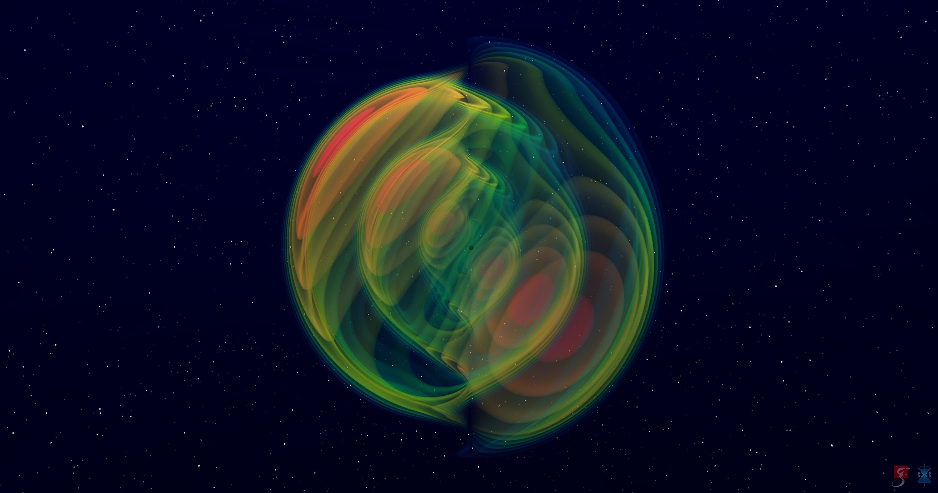



Beyond Circles
Stationary axisymmetric black holes and the breaking of circularity
Jacopo Mazza
IJCLab, CNRS/IN2P3,
Université Paris-Saclay
Journée GdR OG
IJCLab, Orsay
May 27th, 2026

Slide 2
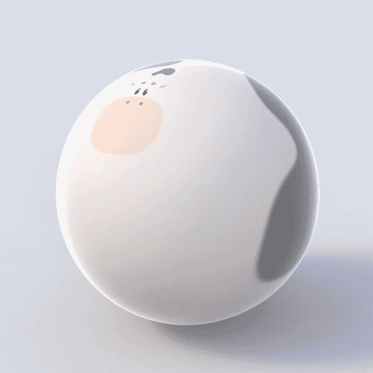
The talk, in a nutshell
Topic
stationary & axisymmetric isolated objects
[i.e. rotating BHs]
‘Claim’
many well-established properties are not obvious beyond GR
CIRCULARITY
‘additional’ symmetry of BHs in (vacuum) GR
what does it imply?
what do we lose by not having it?
Keenan Crane [link]

Slide 3
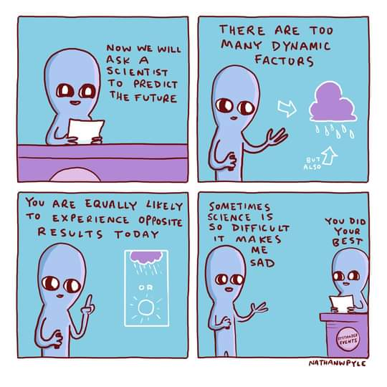
Outline
What is circularity?
Definition(s) and interpretation
Why circularity?
Why not circularity?
Moving beyond circularity
A metric of sufficient generality
[i.e. the most general rotating metric]
‘Solving’ circularity
Properties of non-circular BHs
Rotosurface
Horizon mechanics
Towards thermodynamics
E. Babichev, JM, JCAP 10 (2025) 011 [2505.08880]
F. Del Porro, JM,
[2511.02911]
[Nathan W. Pyle]

Slide 4
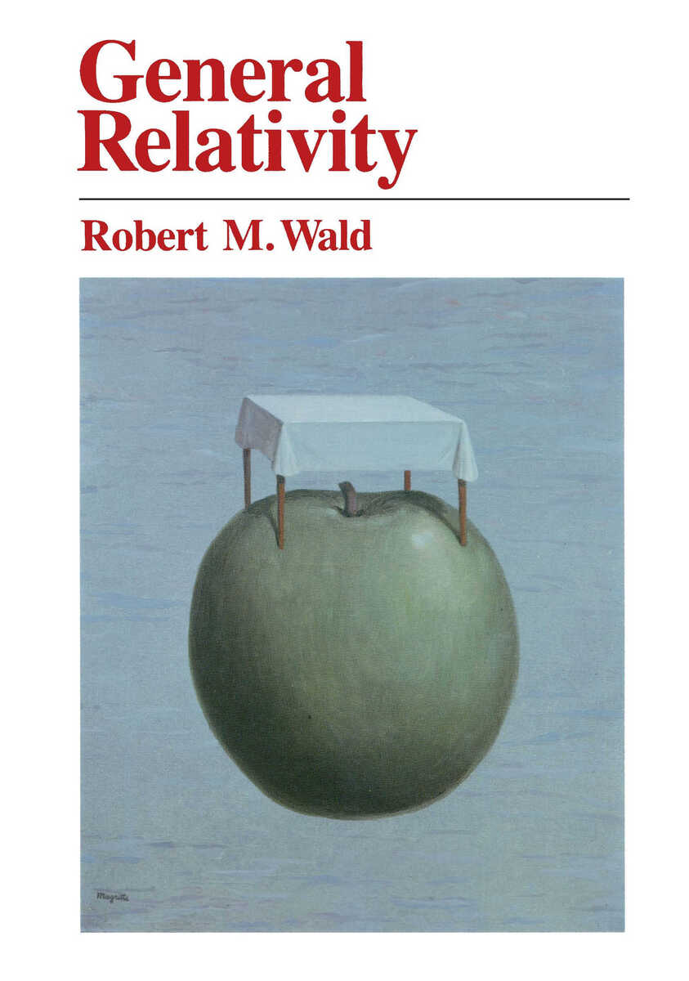
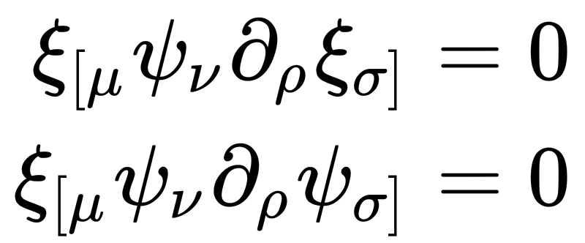
What is circularity?
Def
A stationary & axisymmetric spacetime
is said to be circular
if it can be foliated by codimension-2 surfaces orthogonal to the Killing vectors
Killing vectors
𝜉^{𝜇} ……… stationarity
𝜓^{𝜇} ……… axisymmetry
by Frobenius’ theorem
[everywhere]

Slide 5
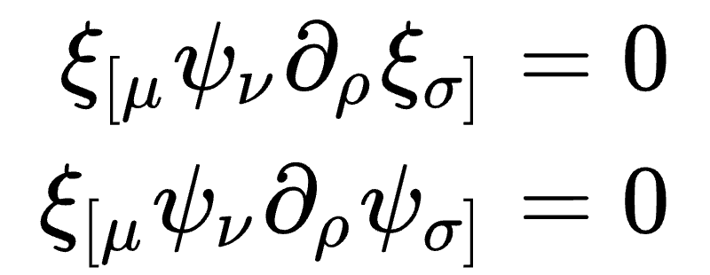
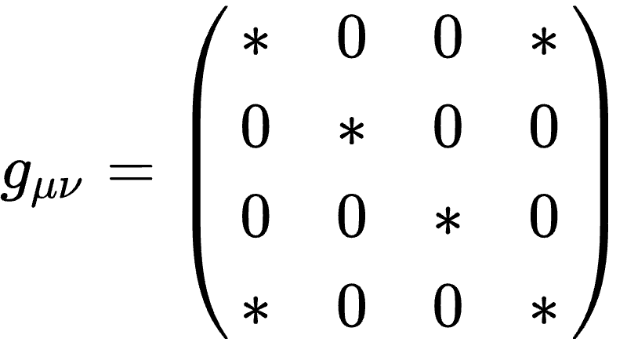

Circularity and geometry
Circularity conditions
geometric statement on Killing flows
Practically,
there exist coordinates such that
t
r
𝜃
$$φ$$
t, 𝜑…. Killing coordinates
(t – 𝜑) symmetry:
t → – t, 𝜑 → – 𝜑
5 ‘free’ functions,
g_{𝜇𝜈} = g_{𝜇𝜈}(r,𝜃)
i.e. Boyer–Lindquist coordinates

Slide 6
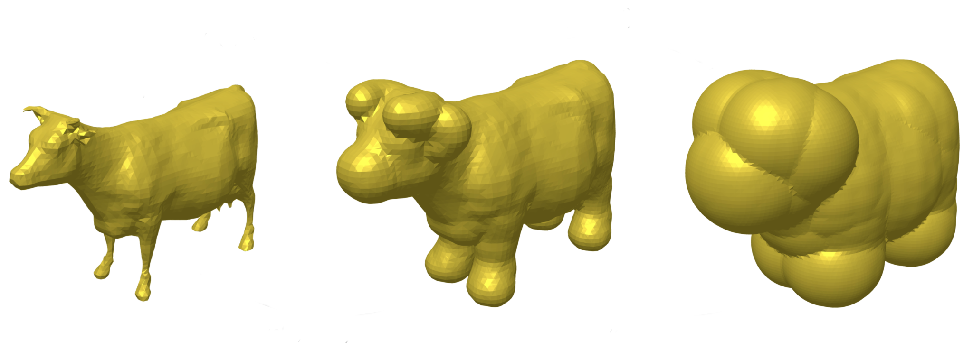
Why circularity?
Circularity is quite ubiquitous, because:
many GR sol’s are circular
some beyond-GR sol’s are circular
‘square peg in a circular hole’:
beyond-GR sol’s that are continuously connected to GR are circular
simplicity
block-diagonalisation of g_{𝜇𝜈}
and more…
Xie, Zhang, Silva, de Rham, Witek, Yunes,
PRL 126 (2021) 241104 [2103.03925]
Lehman [2504.00506]

Slide 7
Why not circularity?
Some beyond GR sol’s are not circular
Cubic Galileon [numerical]
Grandclement, CQG 41, 025012 (2024) [2308.11245]
Van Aelst, Gourgoulhon, Grandclément, Charmousis, CQG 37 035007 (2020) [1910.08451]
Semiclassical gravity [numerical]
Fernandes,
PRD 108 (2023) 6, 6 [2305.10382]
Einstein–æther [numerical]
Adam, Figueras, Jacobson, Wiseman,
Class. Quant. Grav. 39 (2022) 12, 125001 [2108.00005]
Disformal Kerr [analytical]
Anson, Babichev, Charmousis, Hassaine, JHEP 2021 (2021) 18 [2006.06461]
Ben Achour, Liu, Motohashi, Mukohyama, Noui, JCAP 11 (2020) 001 [2006.07245]
‘Locality principle’ regular BHs [analytical-ish]
Eichhorn, Held,
JCAP 05 (2021) 073 [2103.13163]

Slide 8
Moving beyond circularity
To explore consequences of circularity breaking,
need ‘new’ framework
1
‘need a metric’:
need gauge choice that combines generality and minimality
[i.e. equivalent of Boyer–Lindquist gauge]
E. Babichev, JM,
JCAP 10 (2025) 011 [2505.08880]
2
then it depends, we’ll see…
e.g. for thermodynamics, maybe need new ways of computing surface gravity, etc.
F. Del Porro, JM,
[2511.02911]

Slide 9
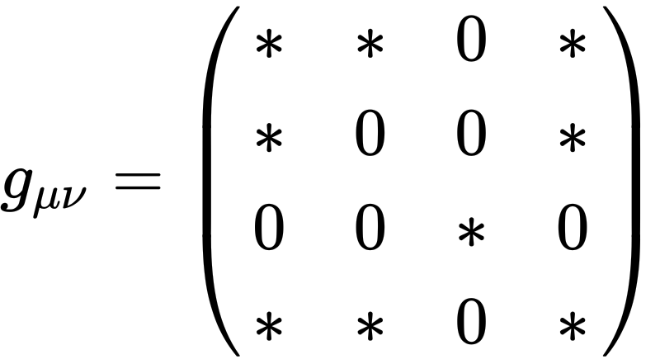
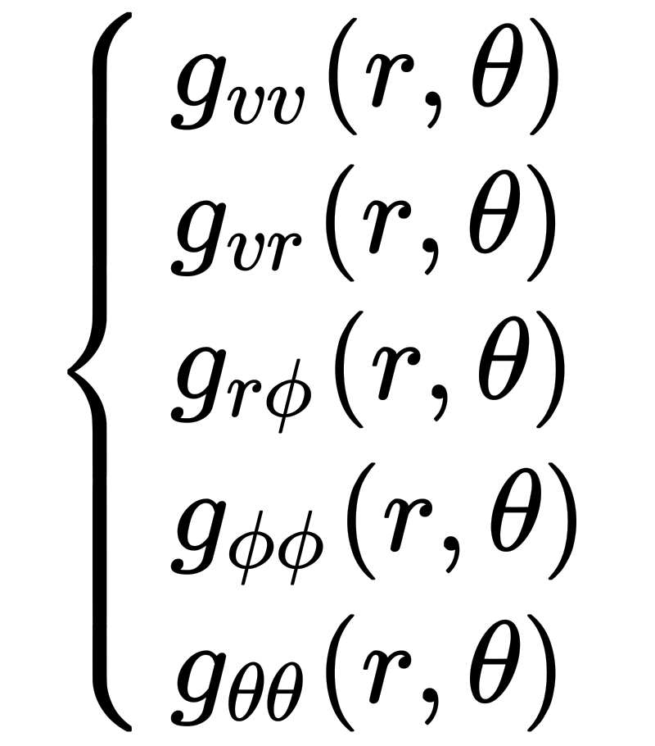
General stationary & axisymmetric metric
What is the most general stationary and axisymmetric metric?
No one really knows…
Kerr-like
gauge
‘Kerr’ as in ‘Kerr ingoing coordinates’
[not Kerr solution]
6 ‘free’ functions
Comments:
Important open problem!
Beware of claims saying that BL-like metrics are most general: no!
Current phenomenological parametrisations all circular by desing
[our answer]
v r 𝜃 𝜑
existence not obvious,
[see paper]
Killing coordinates
gauge fixing not complete
non-Killing coordinates

Slide 10
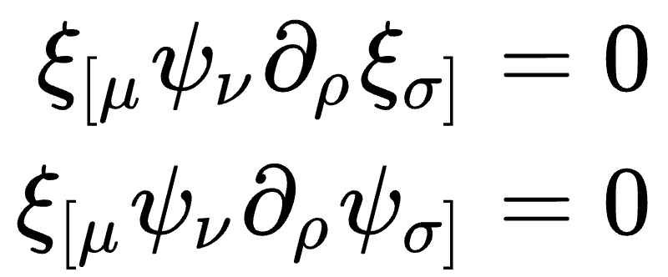
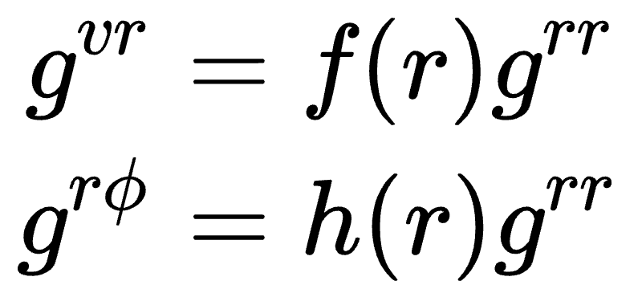
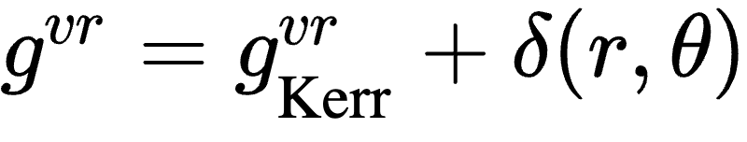
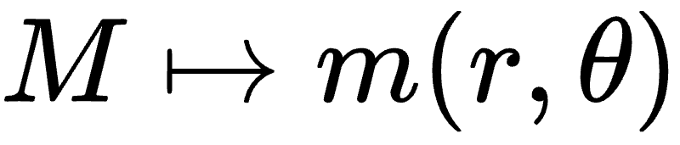
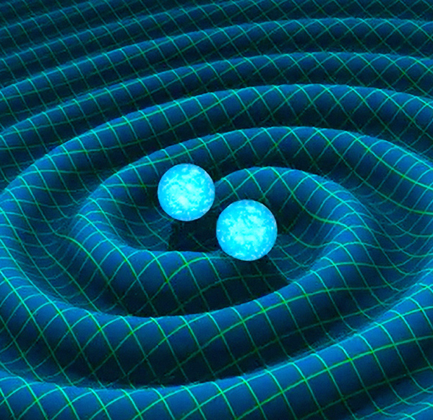
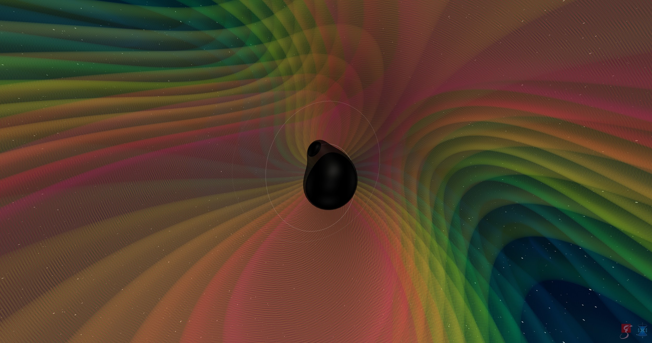
‘Solving’ circularity
Kerr-like gauge describes
circular and non-circular spacetimes
Idea: use it to ‘solve’ circularity conditions
used them to construct two examples,
both simple deformations of Kerr
‘Minimal’ breaking
‘Not-so-minimal’ breaking
E. Babichev, JM, JCAP 10 (2025) 011 [2505.08880]

Slide 11
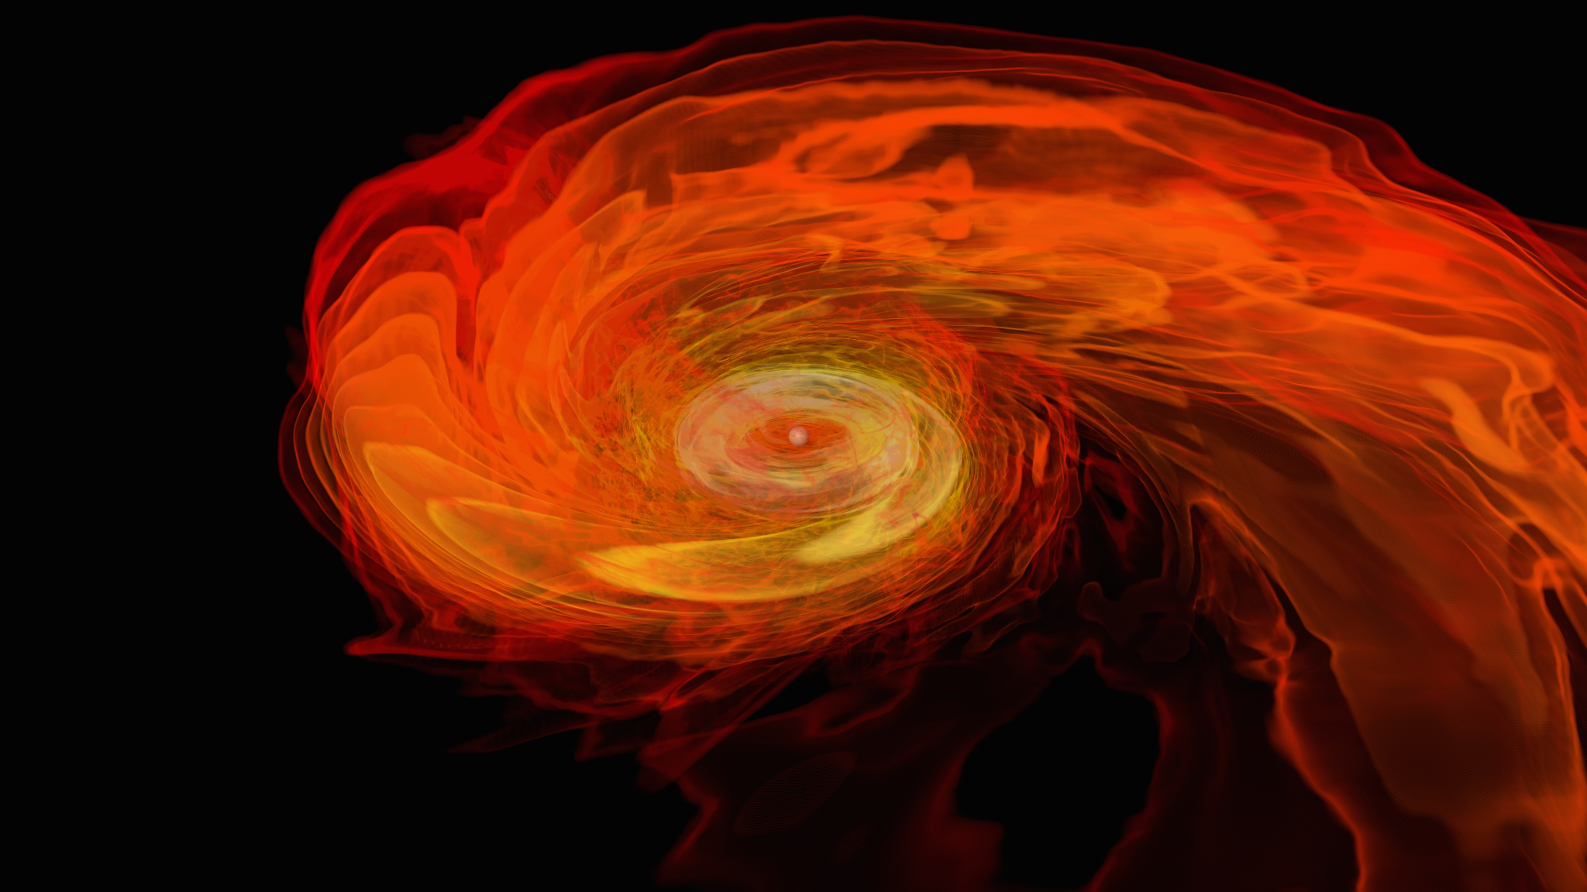
Properties of non-circular BHs
Non-separability of geodesics
(and Klein–Gordon), no Killing tensor
not really due to circularity breaking
(Near-)horizon structure is different
new relevant surface outside H:
rotosurface
event horizon not Killing horizon
phenomenological consequences
?
thermodynamics
?
F. Del Porro, JM,
[2511.02911]
[NASA/AEI/ZIB/M. Koppitz and L. Rezzolla]

Slide 12
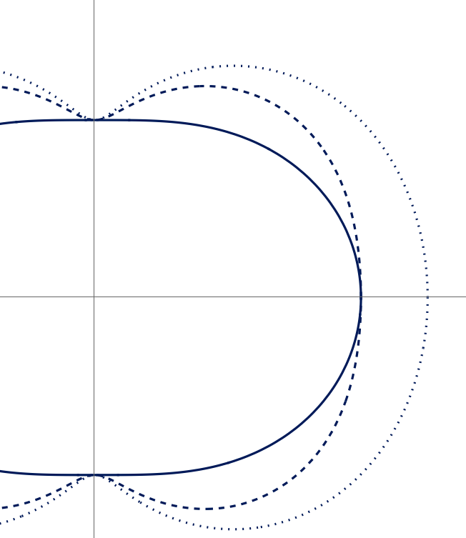
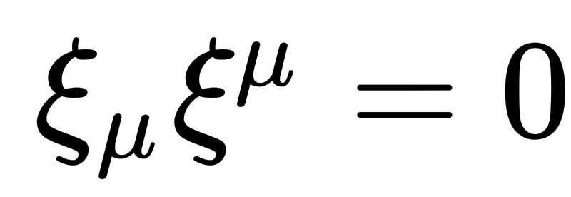

The rotosurface
A consequence of circularity breaking: a ‘new’ surface appears
ergosurface,
static limit
rotosurface, stationary limit
event horizon
in Kerr they coincide but in general they are different
pheno consequences
of rotosorfaces?

Slide 13
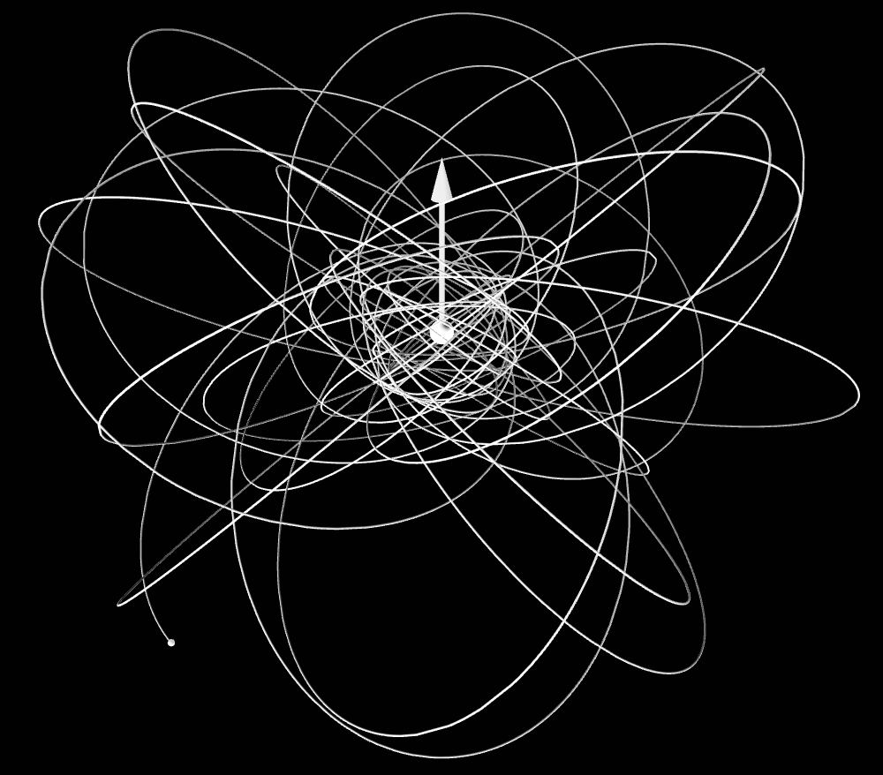
Rotosurface and examples
Minimal
Rotosurface and horizon coincide,
horizon is a ‘sphere’
Have fun!
Non-minimal
Rotosurface and horizon differ,
Everything known analytically
Maarten van de Meent [link]

Slide 14
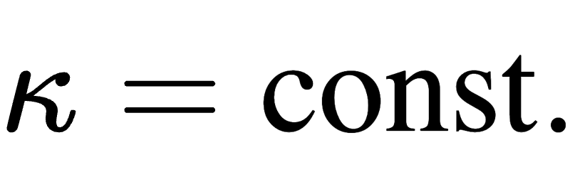
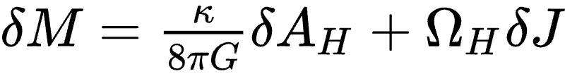
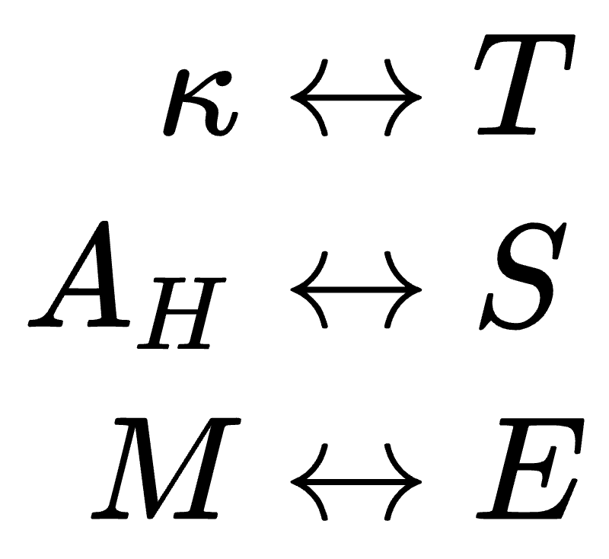
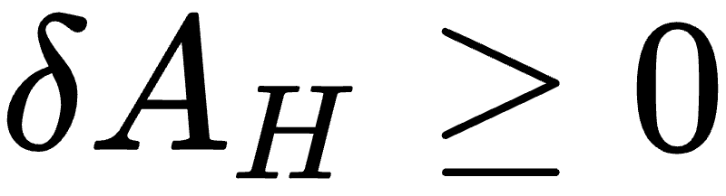
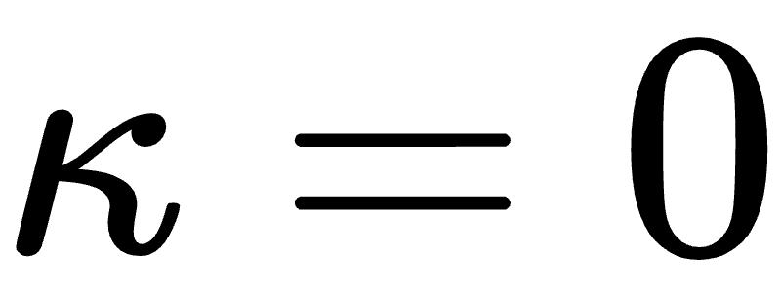
The horizon
Usually
[i.e. vacuum GR]
BH event horizons are also Killing horizons
i.e. they are generated by Killing vectors
Four laws of
‘BH mechanics’
Four laws of
‘BH thermodynamics’
rigidity theorem
0th law
Several consequnces:
1st law
𝛺_{H}
constant over H
surface gravity 𝜅 constant over H
2nd law
different notions of
surface gravity coincide
3rd law
unattainable
with circularity

Slide 15
Non-Killing horizon
without circularity
Horizons
not Killing,
in general
?
?
?
Usually
[i.e. vacuum GR]
BH event horizons are also Killing horizons
i.e. they are generated by Killing vectors
Four laws of
‘BH mechanics’
Four laws of
‘BH thermodynamics’
rigidity theorem
0th law
?
?
Several consequnces:
?
1st law
𝛺_{H}
constant over H
surface gravity 𝜅 constant over H
2nd law
different notions of
surface gravity coincide
3rd law
unattainable
?
F. Del Porro, JM,
[2511.02911]

Slide 16
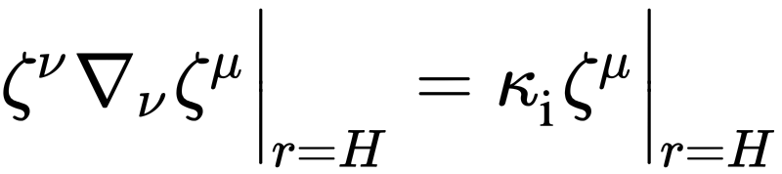
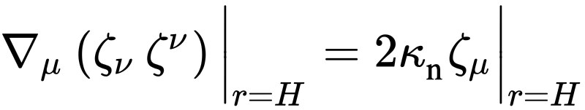
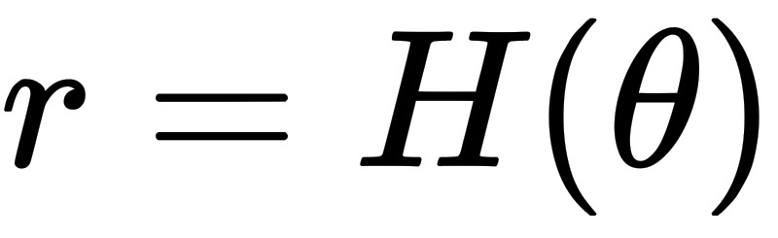
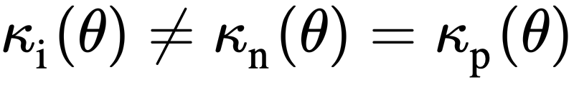
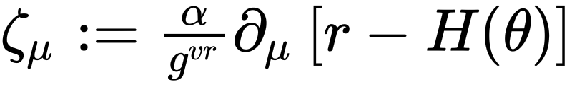
Surface gravities
We computed three notions of surface gravity
F. Del Porro, JM,
[2511.02911]
𝜅 inaffinity
𝜅 normal
𝜅 peeling
[see next slide]
on-horizon surface gravities
near-horizon surface gravity
assume the horizon is
then define
non-constant, and different

Slide 17
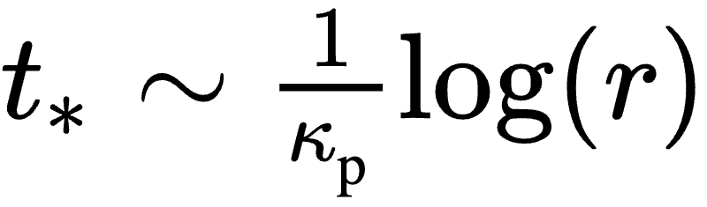
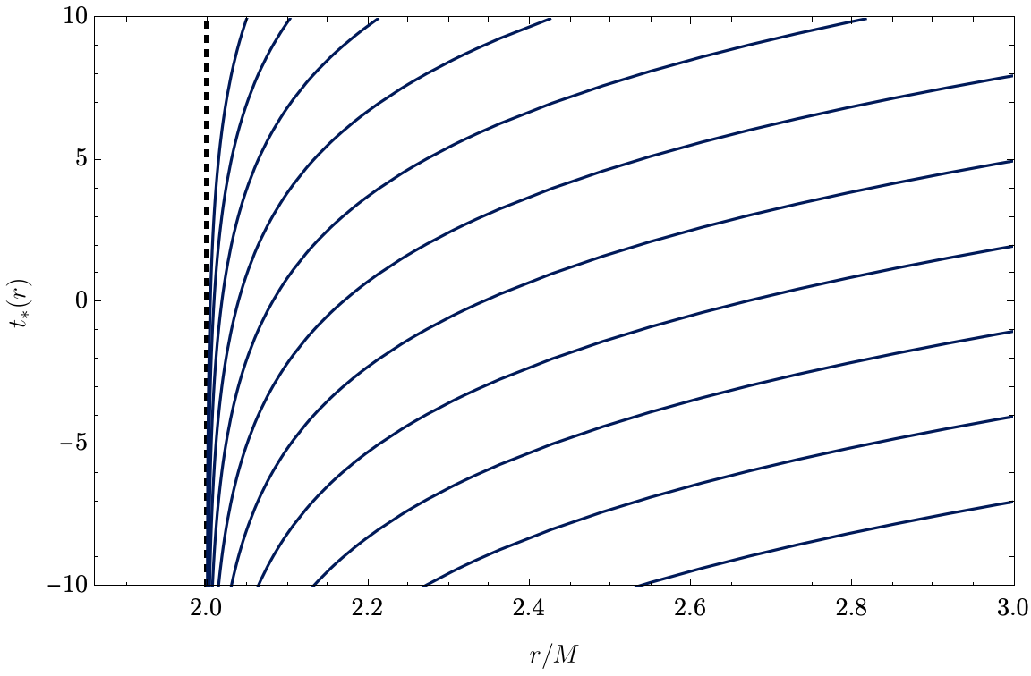
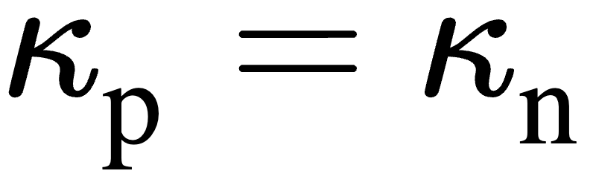
Peeling surface gravity
Outgoing causal geodesics “peel off” of the horizon
peeling surface gravity
despite the lack of geodesic separability, we can compute:
w/ good choice of normalisation
[Schwarzschild]

Slide 18
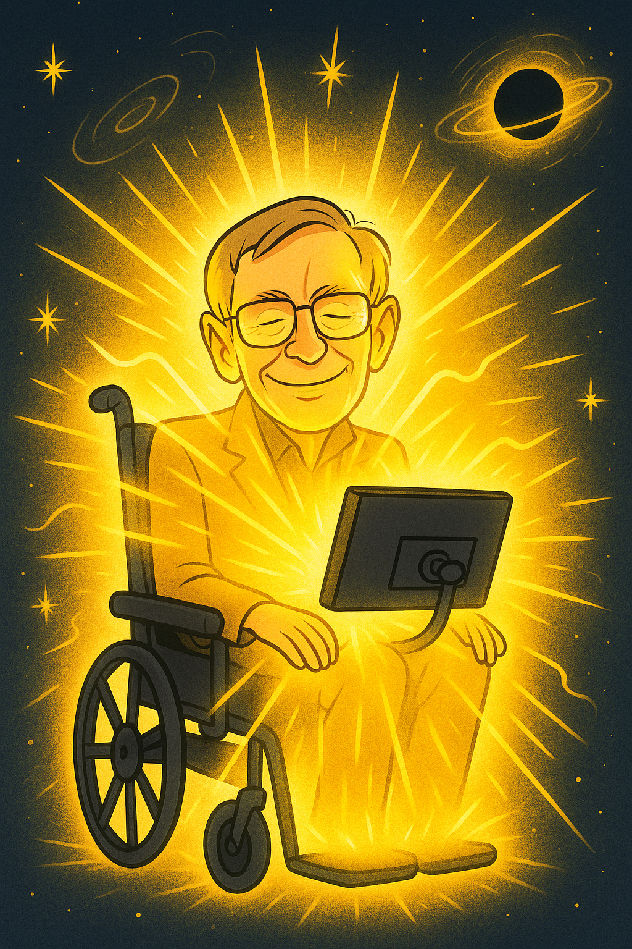
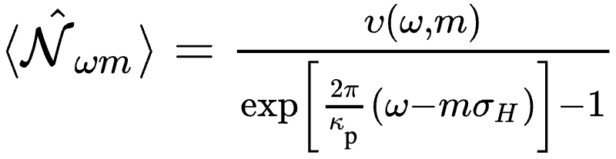
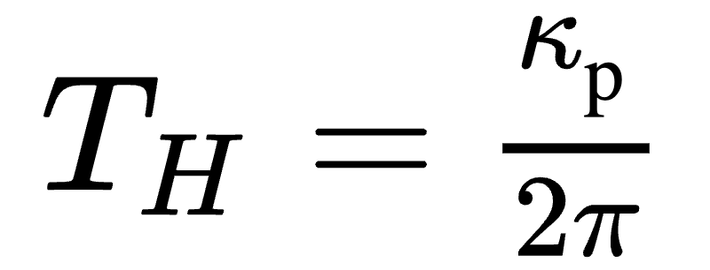
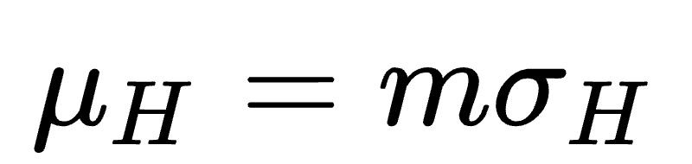
Hawking radiation
The peeling entails Hawking radiation
Via tunnelling method, we find:
an observer at infinity detects particles with spectral density
Bose–Einstein-ish
distribution w/
and
AI generated

Slide 19
Towards thermodynamics
Comments on the four laws of mechanics of non-Killing horizons:
[0th law] constancy of 𝜅: does not hold
[1st law] energy conservation: [w/ caveats] holds in averaged form
[2nd law] horizon’s area cannot decrease: holds under the same assumptions as usual
[3rd law] unattaibility of extremal state: same as usual
Open questions:
Thermodynamic interpretation?
Out of equilibrium / local
(i.e. non global) equilibrium / ?
[...]

Slide 20
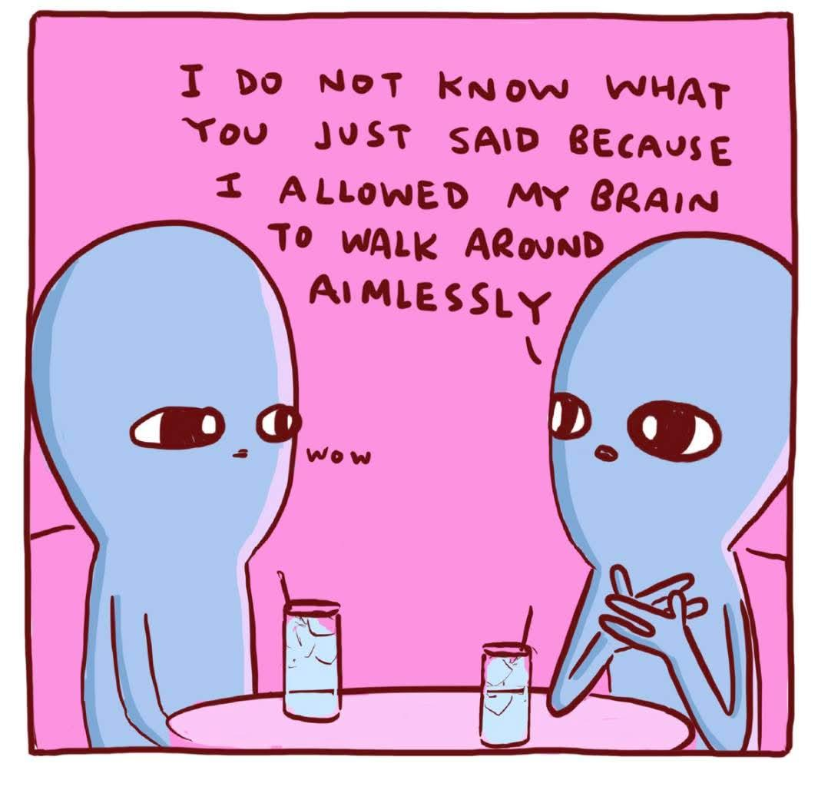
Recap & Food for thought
Circularity
‘accidental’ symmetry
[might not hold beyond GR]
main consequences
found most general stationary & axisymmetric metric
solved circularity conditions
constructed simple examples
rotosurface separate
from horizon
event horizon
not Killing
surface gravities are different
and not constant
yet, Hawking radiation; thermodynamics?
E. Babichev, JM, JCAP 10 (2025) 011 [2505.08880]
[Nathan W. Pyle]
F. Del Porro, JM,
[2511.02911]

Slide 21
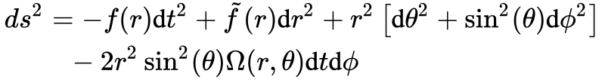
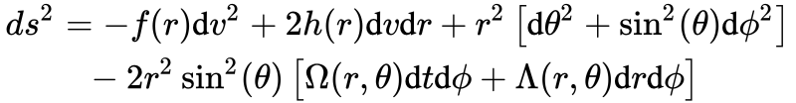
What’s next?
soon on
(non-)circularity TV
What about slow rotation?
Usually, slow rotation means Hartle–Thorne [Lense–Thirring] metric
this is circular
Is there something ‘protecting’ circularity
at 𝒪(a),
or are we missing some slowly rotating sol’s?
[ 𝛺(r,𝜗) = 𝒪(a) ]
e.g. this
is not circular
?
[ 𝛺(r,𝜗), 𝛬(r,𝜗) = 𝒪(a) ]
stay tuned…

Slide 22
Thanks!
Get in touch
jacopo.mazza@ijclab.in2p3.fr
Image credits:
N. Fischer, H. Pfeiffer, A. Buonanno (Max Planck Institute for Gravitational Physics),
Simulating eXtreme Spacetimes (SXS) Collaboration

Slide 23
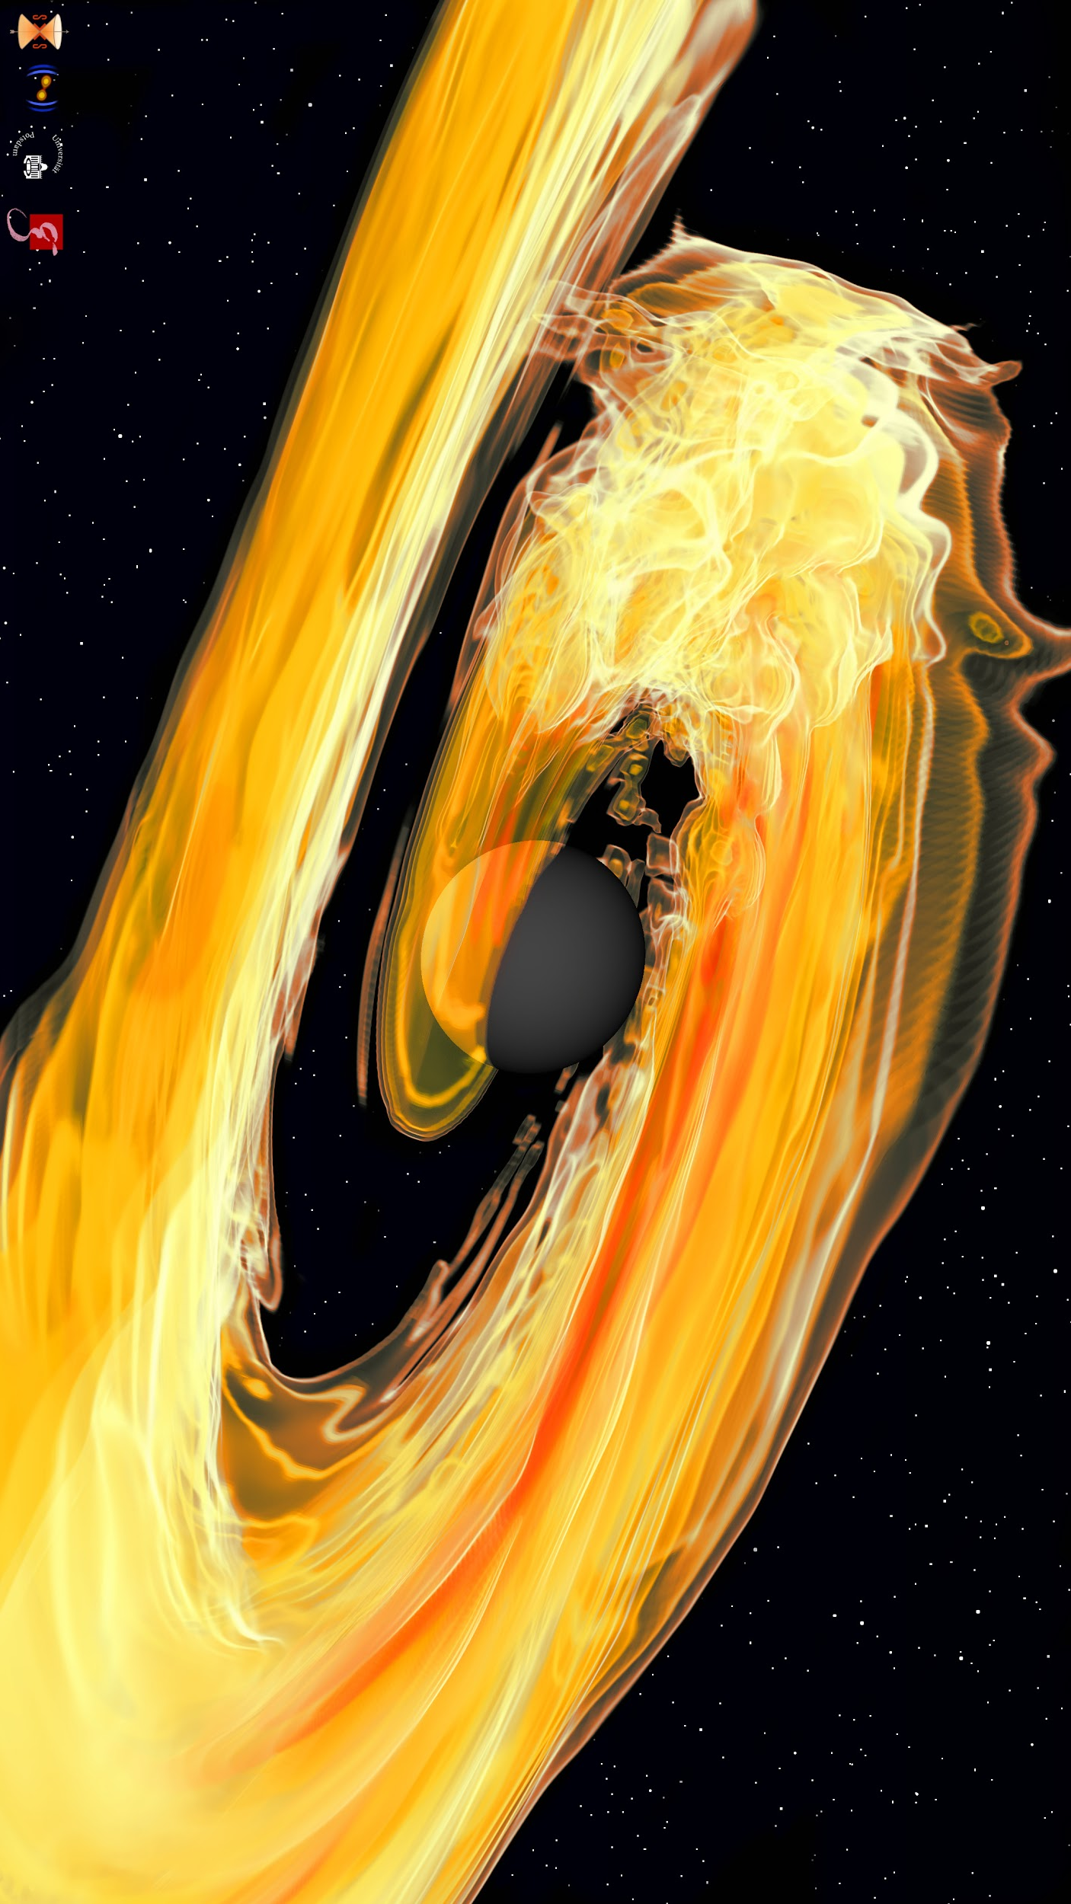
Backup Slides

Slide 24
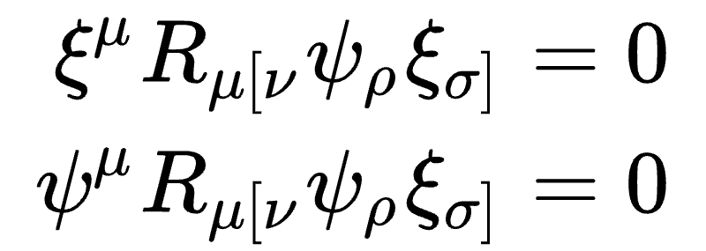
[BckUp] Circularity and (more) geometry
Since you liked…
… you might also like
[everywhere]
[everywhere]
+
equivalent formulations
in ‘normal’ situations
[at least at one point]
use Killing eq.’s and some assumptions

Slide 25
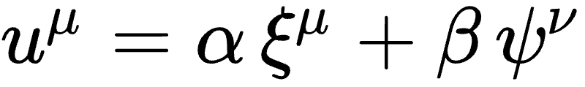
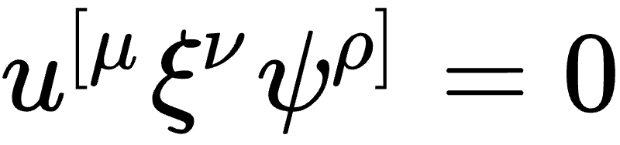
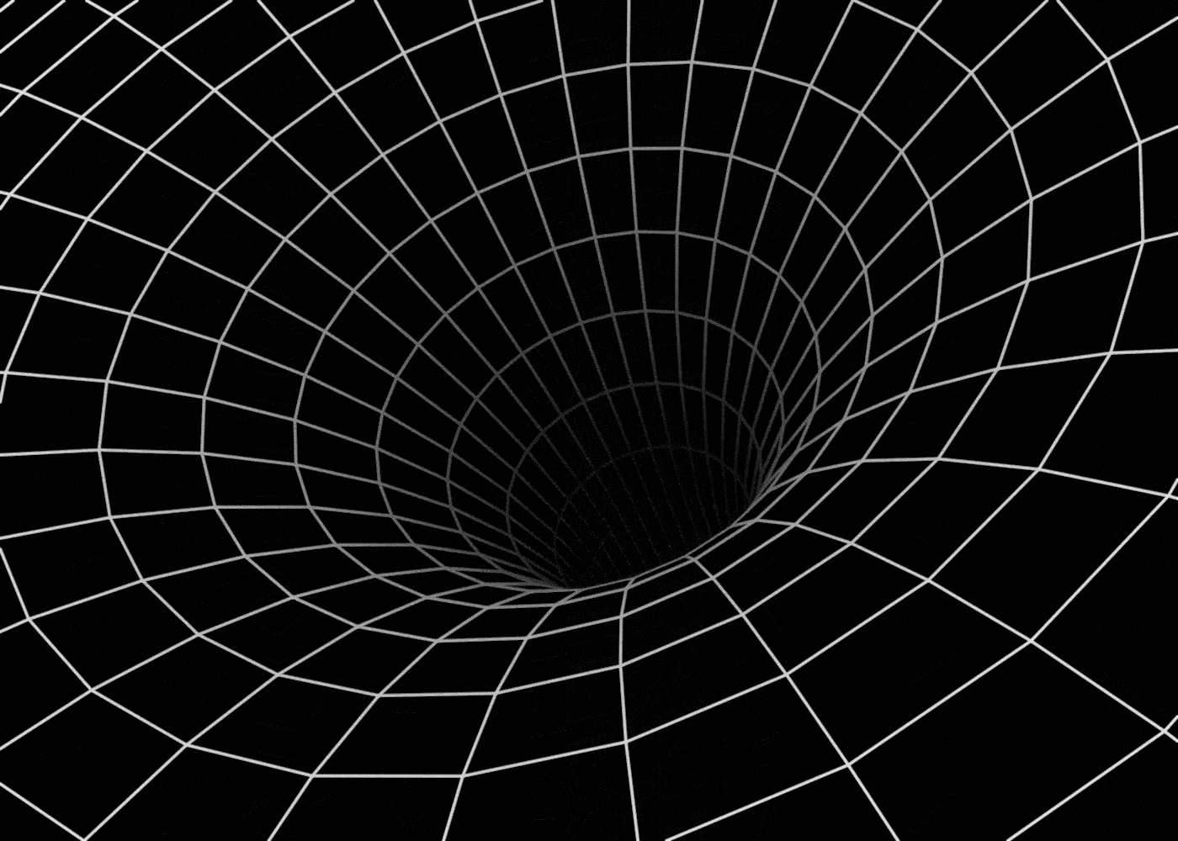
[BckUp] Circularity and matter
statement on
symmetry of sources
via field equations
[everywhere]
Einstein spaces automatically circular
SET of a fluid: velocity
Kerr–Newman (A)dS, etc.
[James Zanoni/Quanta Magazine]
[NASA/AEI/ZIB/M. Koppitz and L. Rezzolla]

Slide 26

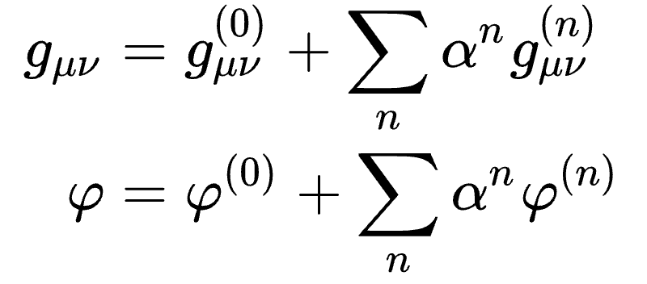
[BckUp] Square peg in circular hole
Y. Xie, J. Zhang, H.O. Silva, C. de Rham, H. Witek and N. Yunes,
PRL 126 (2021) 241104 [2103.03925]
‘Square peg in a cirucla hole’
beyond-GR theories like
theorem
operators up to dim 4
higher order
if
then
that allow perturabtive treatment
𝜑 scalar …… 𝜉^{𝜇}𝜕_{𝜇}𝜑 = 0
𝜑 vector …… 𝜑 circular
[…]
g_{𝜇𝜈} circular
order by order in 𝛼

Slide 27
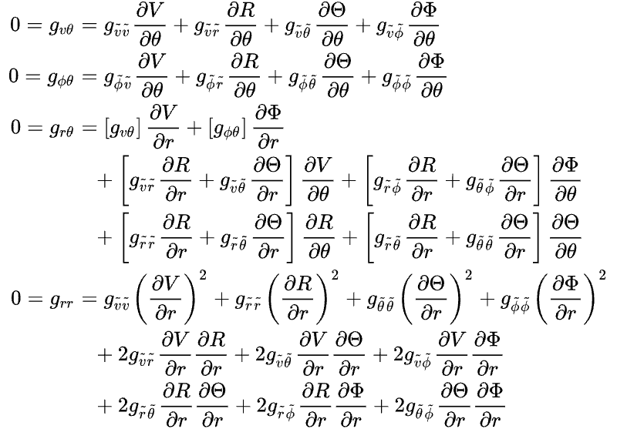
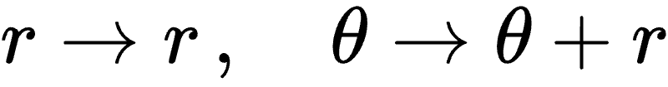
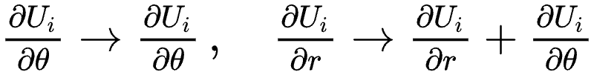
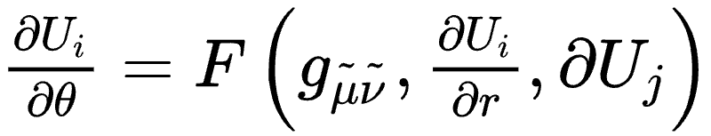
[BckUp] Kerr-like gauge
Kerr-like gauge condition
perform coordinate change
[tilt Cauchy surface]
Cauchy–Kovalvskaya form

Slide 28




[BckUp] Remarks
Indeces up
Indeces down
nice
not (so) nice
Solved conditions are existence conditions for coordinate change to ‘Boyer–Lindquist form’
[NASA, ESA, CSA, STScI (JWST)]

Slide 29







[BckUp] ‘Minimal’ deformation
Solved circularity conditions
‘soft’ breaking
surfaces @ same location
but H not Killing, and

Slide 30

[BckUp] ‘Not-so-minimal’ deformation
Choose horizon profile H(𝜃),
then reverse-engineer the metric
horizon, rotosurface, ergosphere
known analytically

Slide 31





[BckUp] Horizon generators
Horizon
surface
normal
generator
would-be
Killing vector
tangent to H

Slide 32




[BckUp] Surface gravities
Assume the horizon is
then define
inaffinity surface gravity
on-horizon surface gravities
normal surface gravity
compute them both
depend on position on H

Slide 33

Smarr’s formula
We can prove this geometric identity, no field equations
Komar mass
normal surface gravity
horizon area
averages over H
angular velocity
[sort of]
Komar angular momentum
dissipation [?]
vanishes in minimal case H’ = 0

Slide 34
Thanks!
Get in touch
jacopo.mazza@ijclab.in2p3.fr
Image credits:
N. Fischer, H. Pfeiffer, A. Buonanno (Max Planck Institute for Gravitational Physics),
Simulating eXtreme Spacetimes (SXS) Collaboration

Slide 35
Friday - 12 Decembre 2025 - https://indico.in2p3.fr/event/37628/overview
Timing: 23 min + 5 min
Beyond circles: stationary axisymmetric black holes and the breaking of circularity
Circularity is an accidental symmetry of the Kerr metric, one that is widely assumed when searching for rotating black hole solutions in modified gravity as well as when constructing models of Kerr mimickers. Though extremely enticing, circularity is often an excessively restrictive assumption, and understanding the consequences of its loss is thus crucially relevant. In this seminar, I wish to present some recent results on the subject: After describing in detail what this symmetry entails, I will show how to construct stationary and axisymmetric spacetimes exhibiting a controlled breaking of circularity; then, I will describe the impact of circularity breaking on the hole’s horizon, focusing in particular on the laws of black hole mechanics. This discussion is thus going to be pertinent for anyone with an interest in compact astrophysical objects and their phenomenology, in general relativity and beyond.

Slide 36
The talk, in a nutshell
Many well-established properties
of stationary & axisymmetric BHs
are not obvious beyond GR
‘form’ of g_{𝜇𝜈},
i.e. coordinate choice
event horizon properties
[Killing/not Killing]
CIRCULARITY
Keenan Crane [link]

Slide 37
‘Solving’ circularity
checking circularity for given metric
easy
The circularity conditions are PDEs for metric components
constructing ‘simple’ non-circular metrics
hard
idea
‘solve’ conditions,
translate them into algebraic relations
used them to construct two examples, both simple deformations of Kerr:
‘minimal’
‘not so minimal’
E. Babichev, JM, JCAP 10 (2025) 011 [2505.08880]

