Slide 1
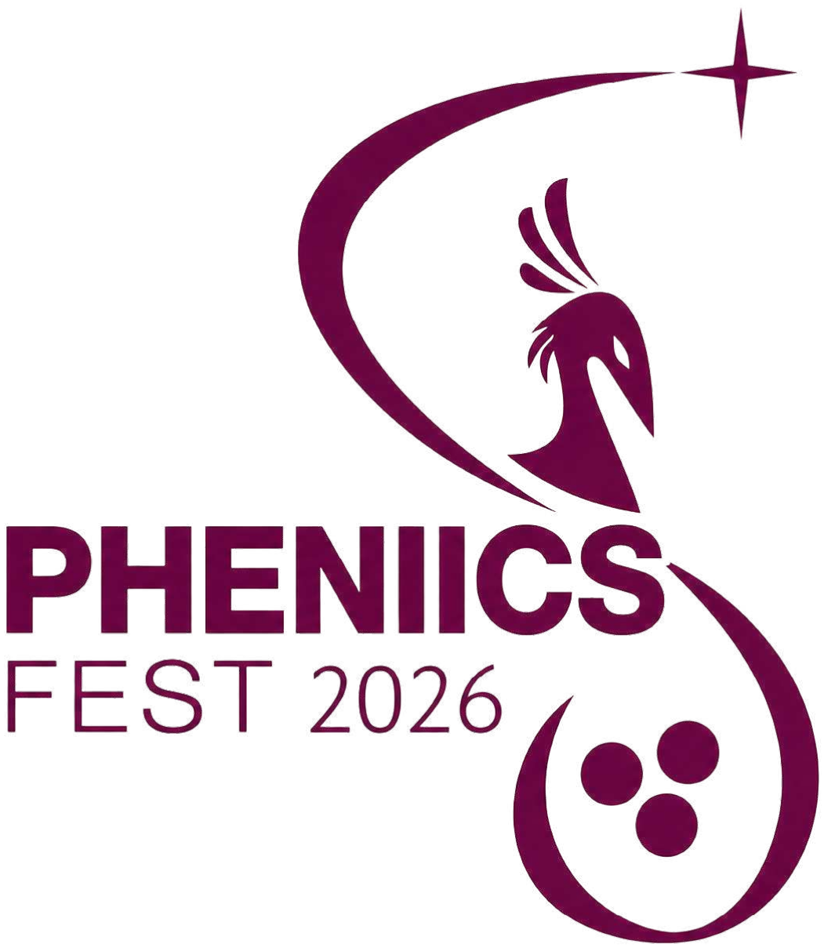



Joint detection of gravitational waves with gamma ray burst

Slide 2
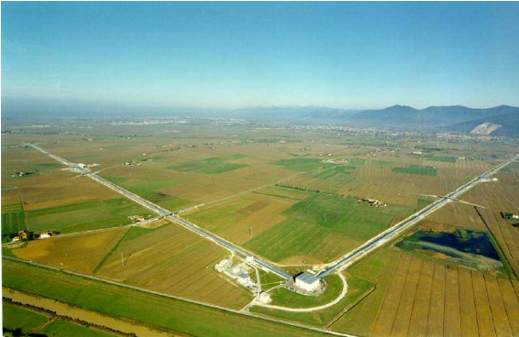
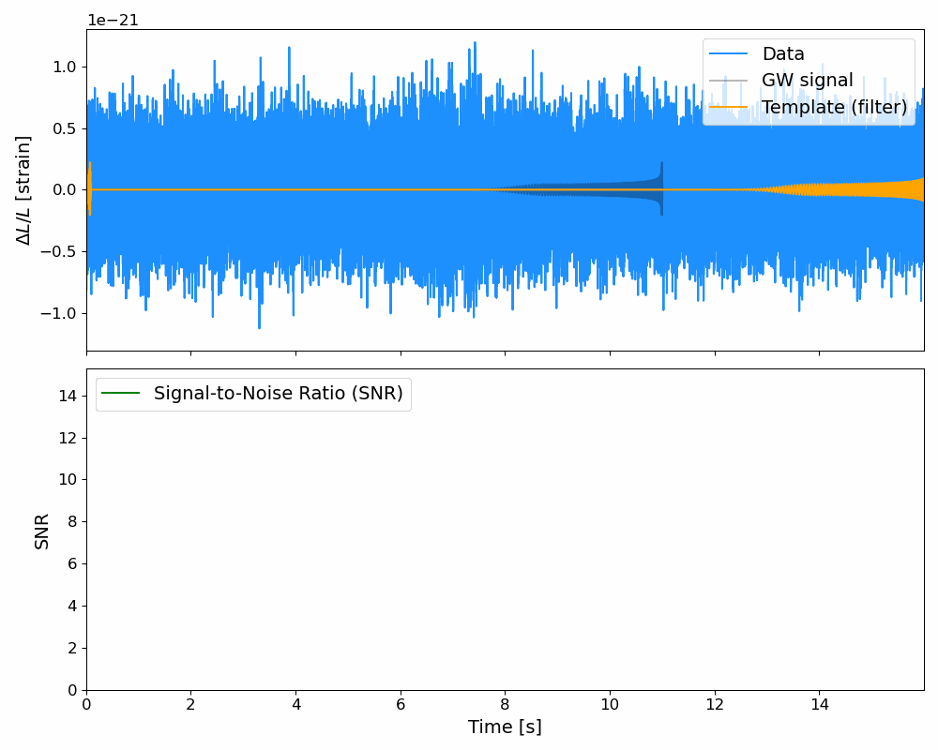
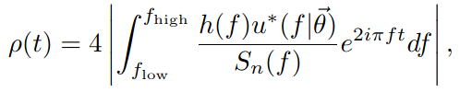
Gravitational Waves (GW)
Violent astrophysical phenomenon (for example merger of Black holes or Neutron stars)
Michelson Interferometer is a way to directly detect GW
Signal amplitude is drown in noise in those detectors -> use matched filtering to detect them

Slide 3
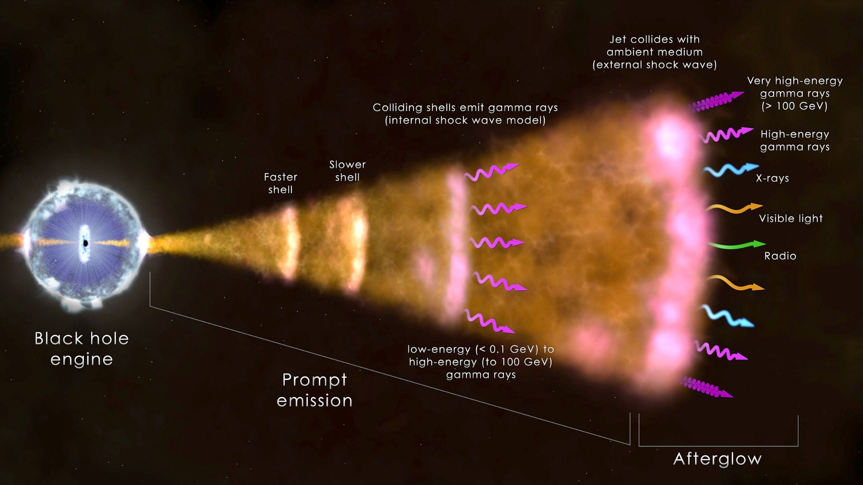
Gamma Ray Burst (GRB)
Very bright event in the universe that emits gamma radiations (Fireball model for the jet emission) but not only (afterglow)
Two types of GRBs : short and long
Source: Wikipedia

Slide 4
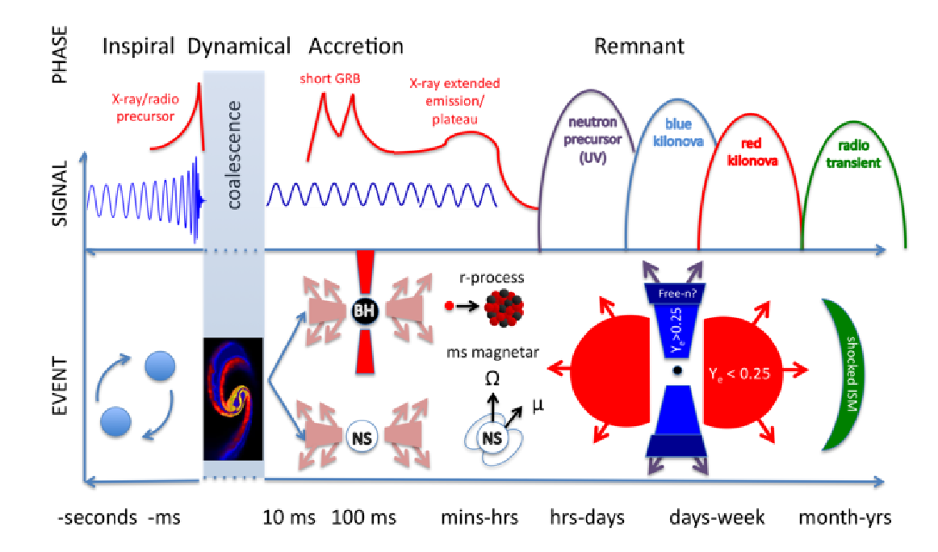
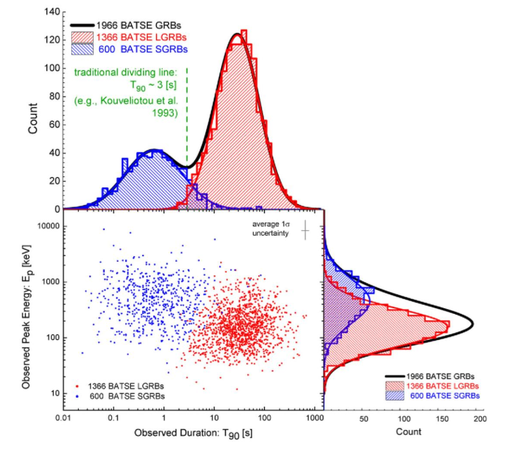
Short GRB
Source: Amir Shahmoradi 2013
Source: Fernandez & Metzger (2016)

Slide 5
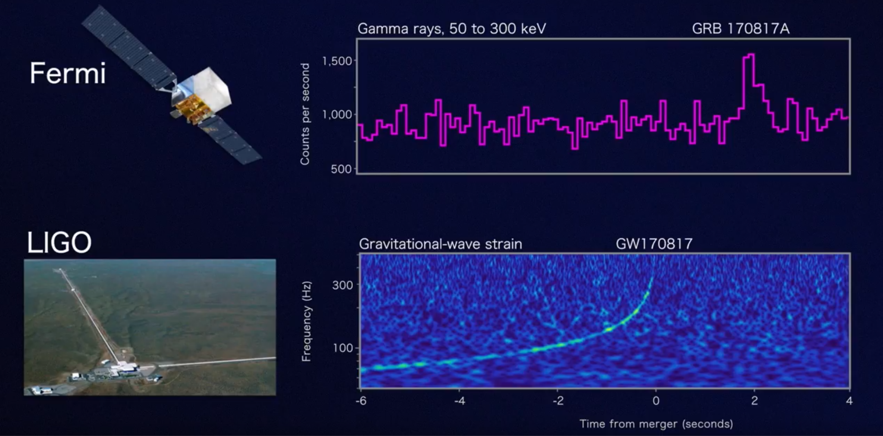
Multimessenger astronomy

Slide 6
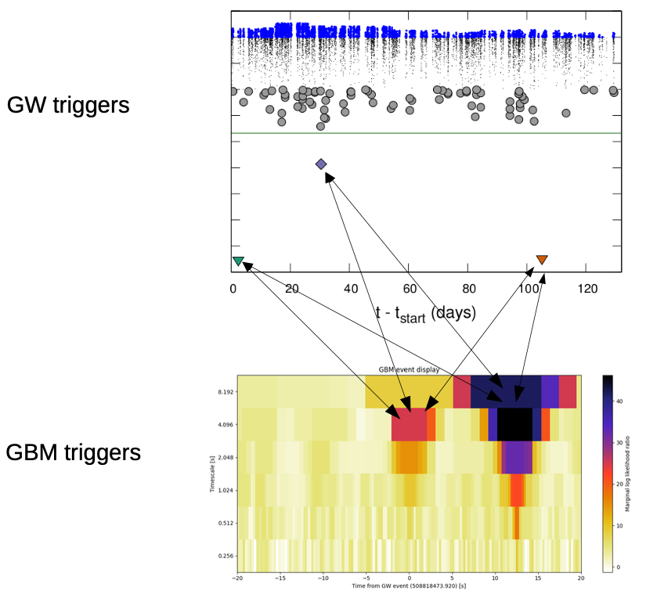

Data analysis for multimessenger astronomy
Externally triggered search
(https://arxiv.org/pdf/2306.04373)

Slide 7
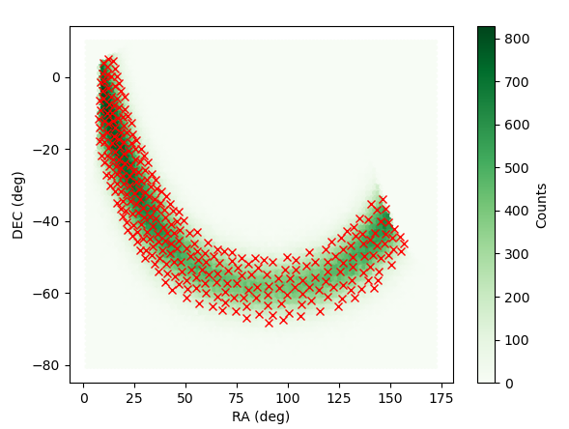
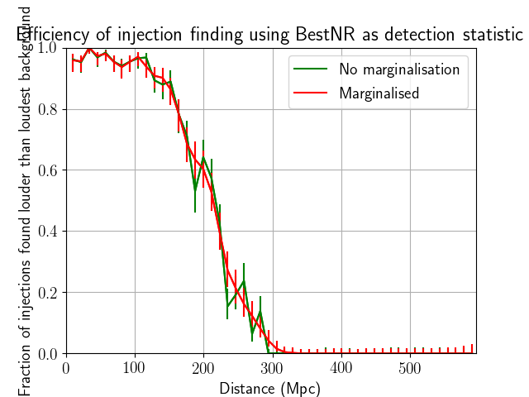
PyCBC-eXternally Triggered Search
From external trigger
  On-source window
  Off-source window
    Background
    Sensitivity
  Sky location
From search
  Exclusion distance curve
  P value of on source triggers

Slide 8
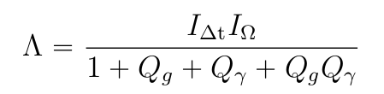
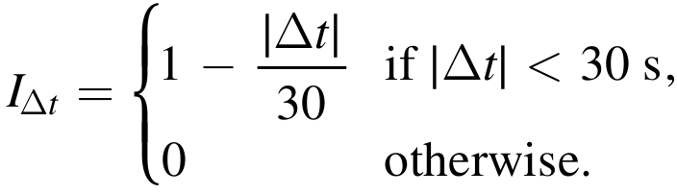
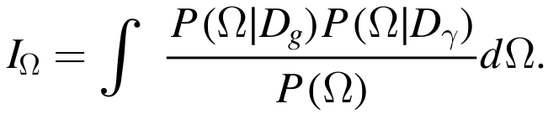
Deep analysis
Pillas et al. 2023

Slide 9
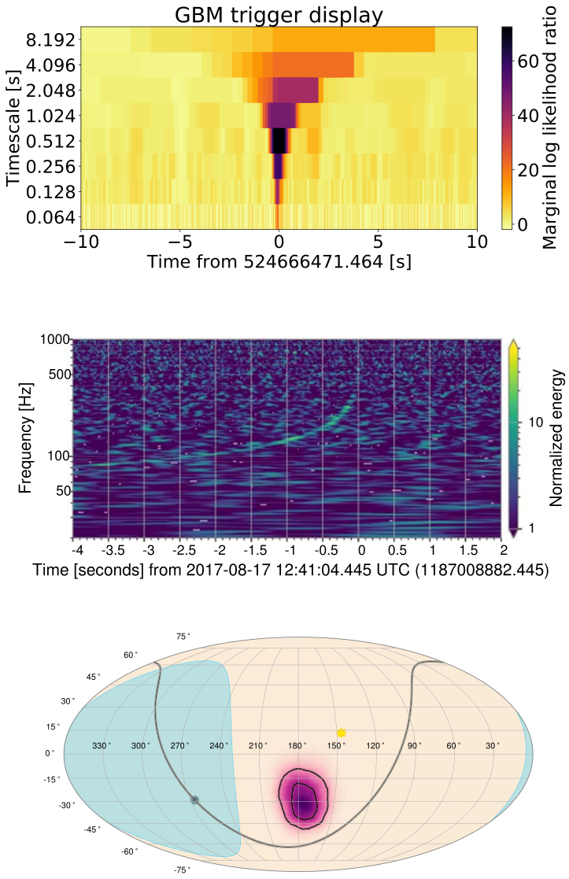
Pillas et al. 2023

Slide 10
Deep analysis

Slide 11
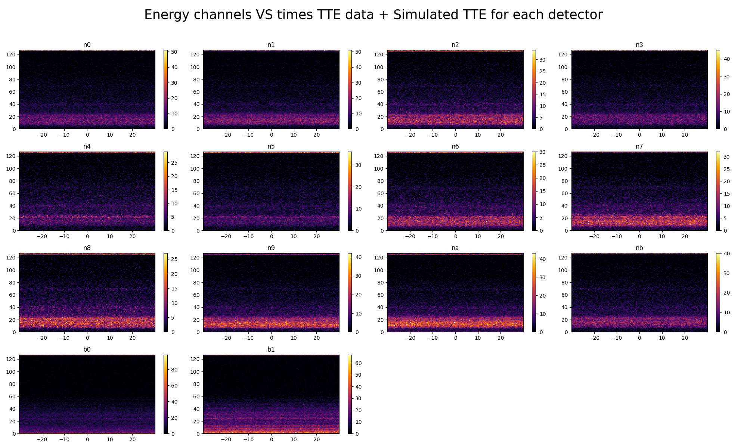
Deep analysis

Slide 12
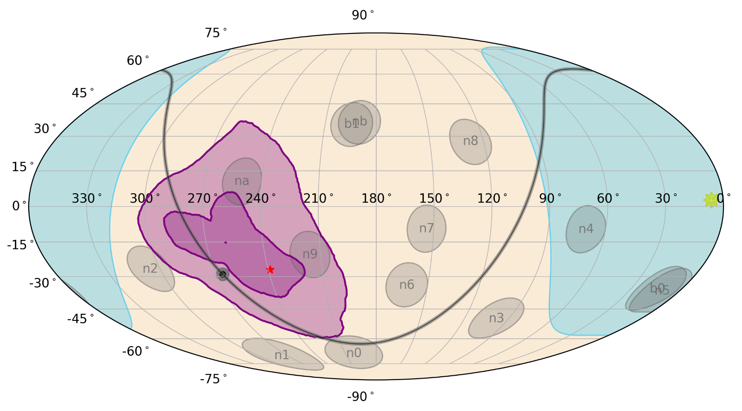
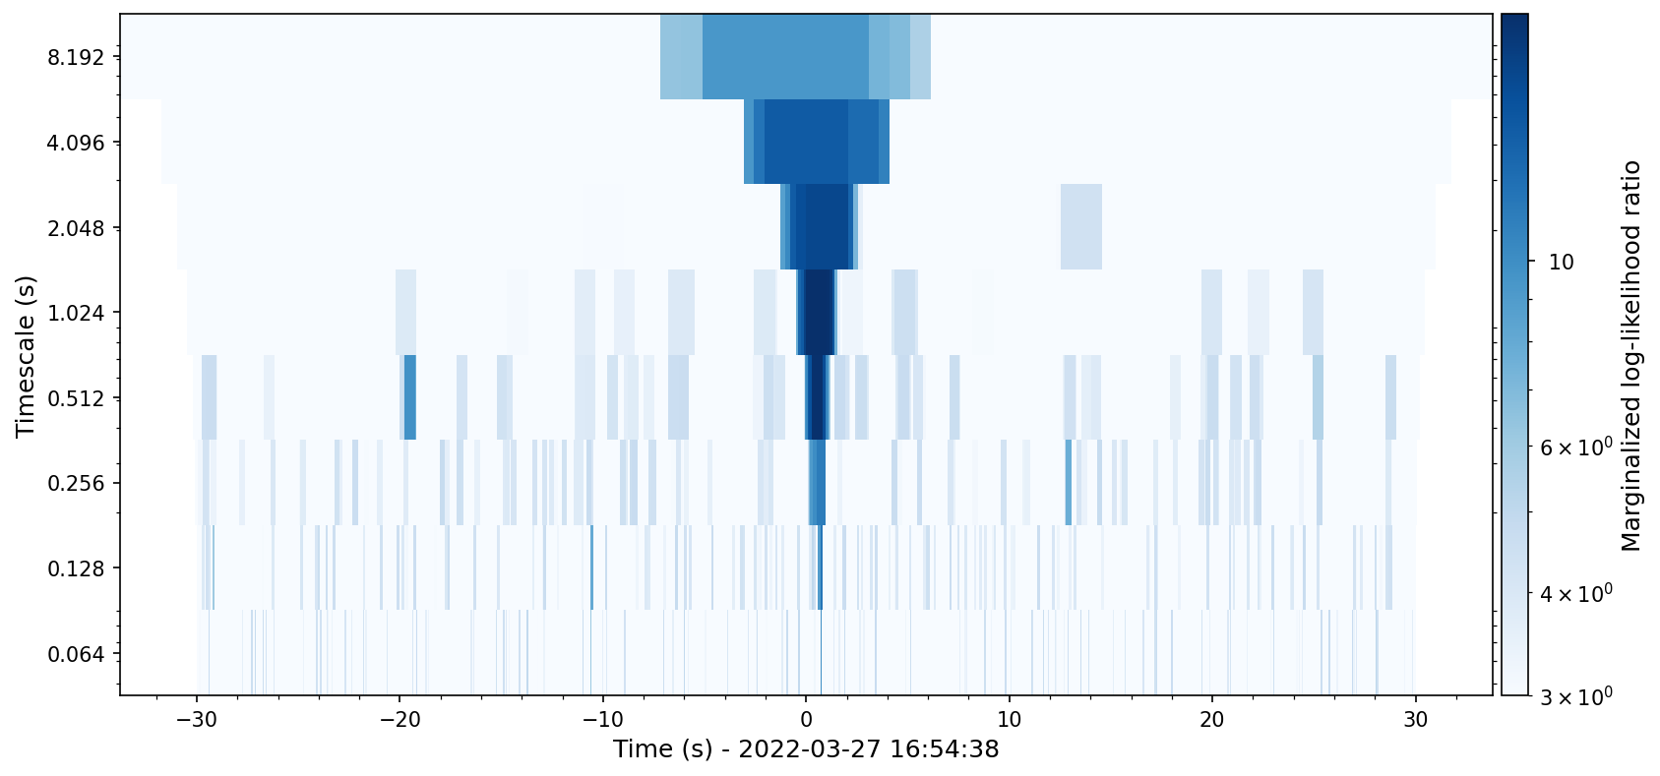

Slide 13
What I’m doing now ?
My mood rn :

Slide 14

What I’m doing now ?
My mood rn :

Slide 15

What I’m doing now ?
My mood rn :

Slide 16
Thanks for your attention !

Slide 17
Back-up Slides

Slide 18
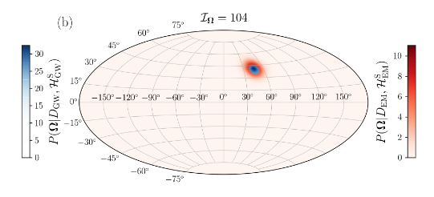
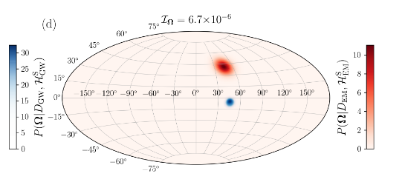
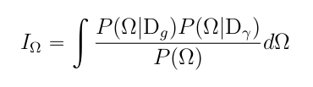
Project Summary
Pillas et al. 2023 method : Deep Joint analysis of associations between GRB and GW events
Find time and sky overlaps
Build a statistic to rank the GW-GRB association

Slide 19
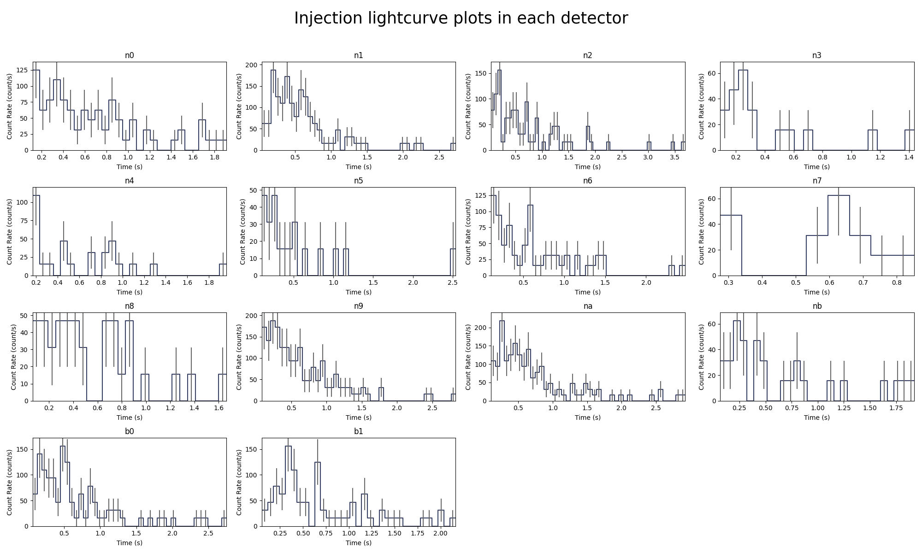

Slide 20
Injection parameters
Amplitude : 0.005 (norris function)
Sky location : 180 deg -47 deg
Peak Energy 300 keV
Time : 2022-03-27T16:54:38

Slide 21
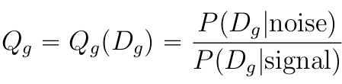
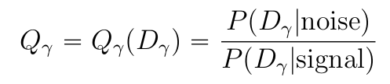
Bayes factor

Slide 22
Why doing multimessenger astronomy ?
Nuclear Physics
Population’s studies
Equation of state of Neutron Star
Understanding better the model of emission of GRB (jet…)
Cosmology

