Slide 1


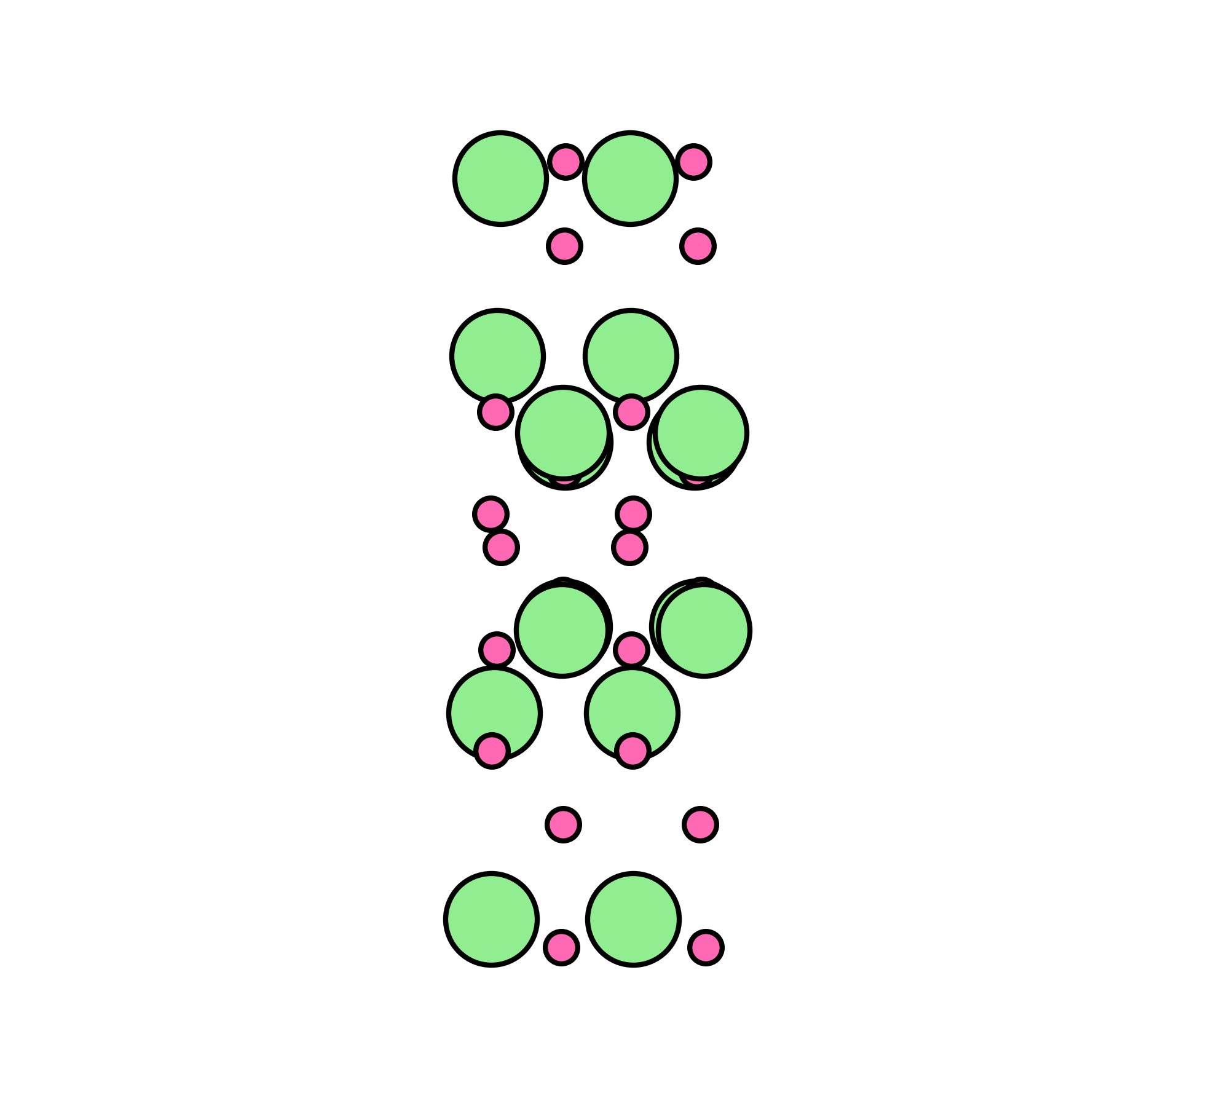
Radiation resistance of gallium oxide
Joanna Matulewicz
PHENIICS Fest
8 June 2026
Supervision: prof. Frederico Garrido, Université Paris-Saclay, France
dr hab. Renata Ratajczak, National Centre for Nuclear Research, Poland

Slide 2
Outline
Motivation
Methodology
Results
Conclusion
What is β-Ga₂O₃?
Potential applications
Why is it implanted with rare earth ions?
Ion implantation
RBS/c
XRD
TEM
What happens after implantation with rare earth ions
Next steps

Slide 3
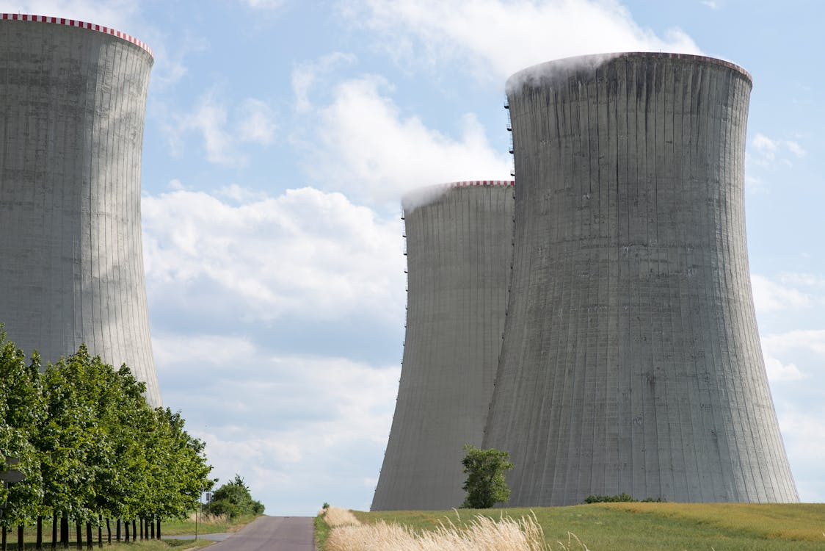

β-Ga₂O₃
Wide bandgap semiconductor: 4.8 eV
It can handle high voltage
It can withstand high temperature
Resistant to high radiation
Low cost of production
Potential use: power electronics, optoelectronics, photodetectors, gas sensors…

Slide 4
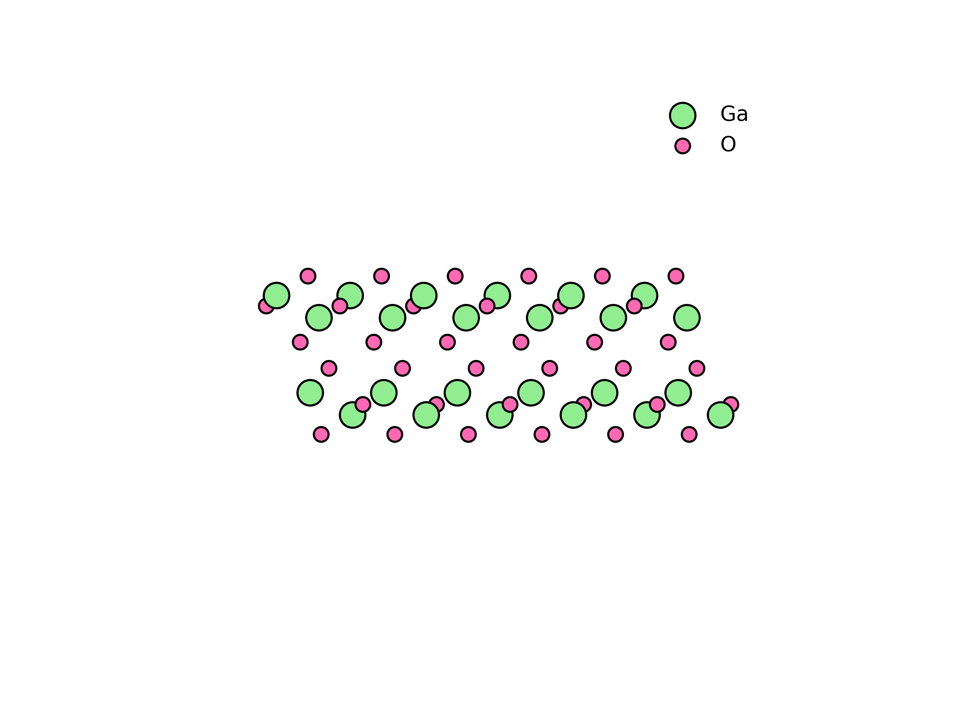
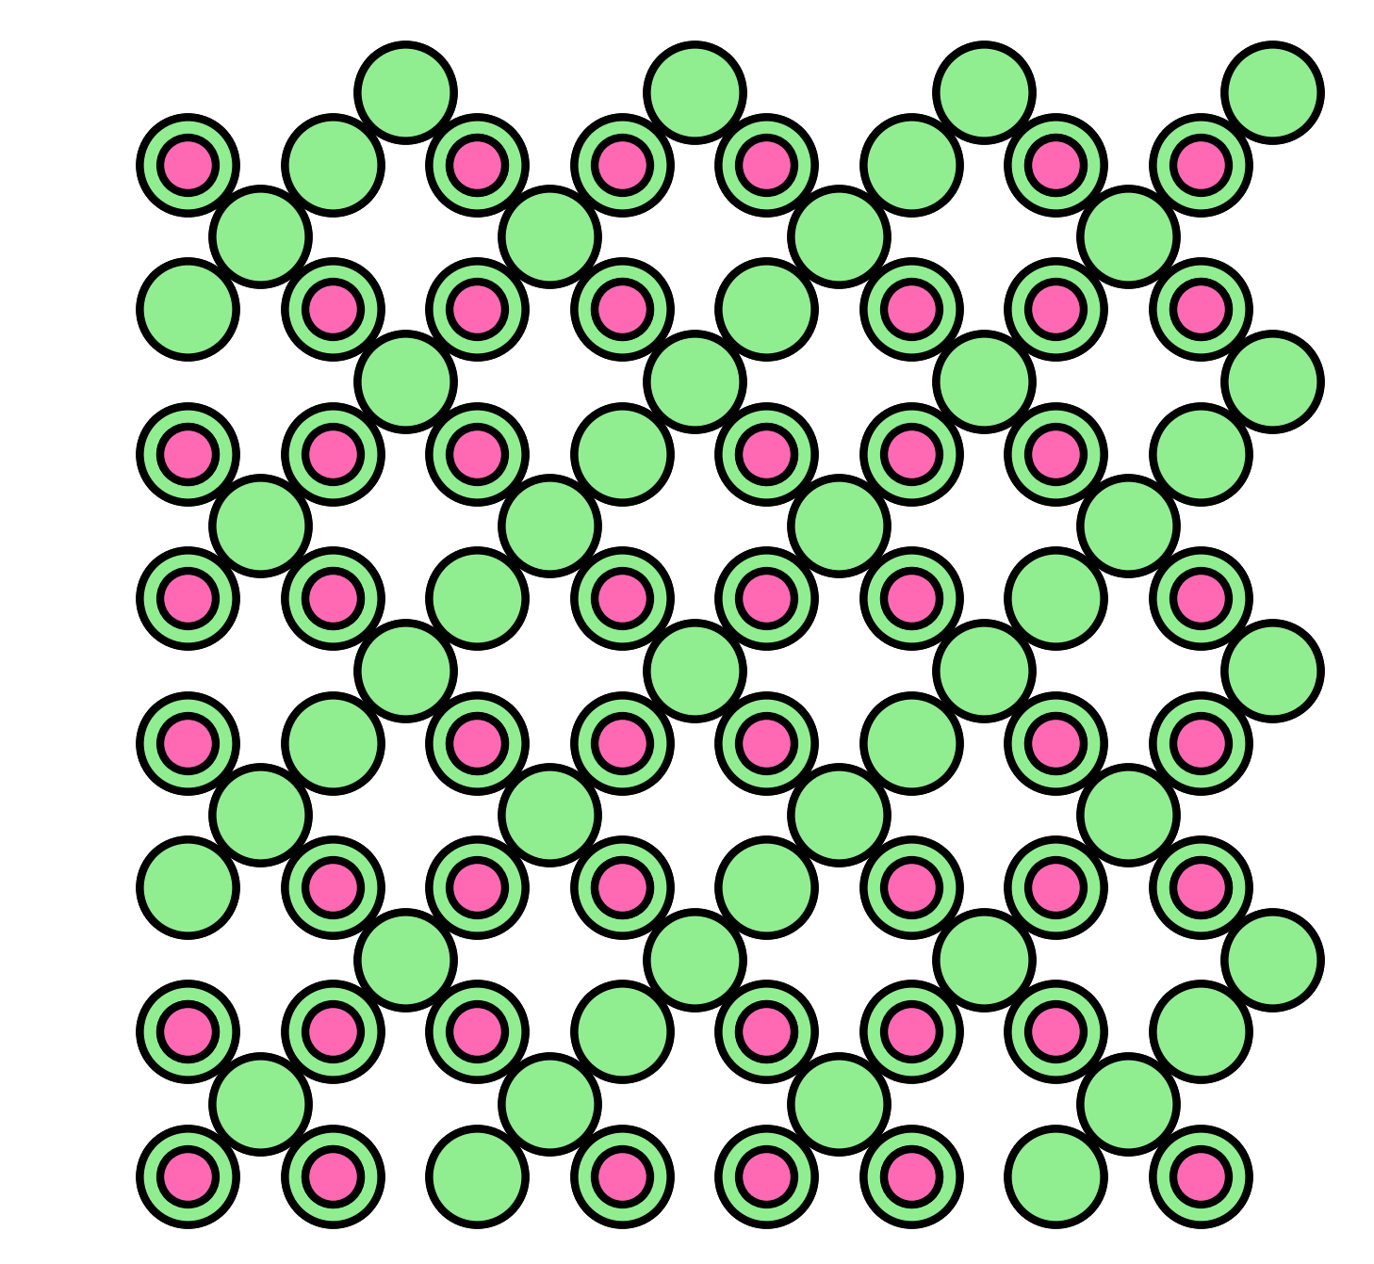
Why β-Ga₂O₃?
Ga₂O₃ is a crystal
β-Ga₂O₃ is the most stable form of Ga₂O₃
β-Ga₂O₃
monoclinic
γ-Ga₂O₃
cubic
500°C

Slide 5
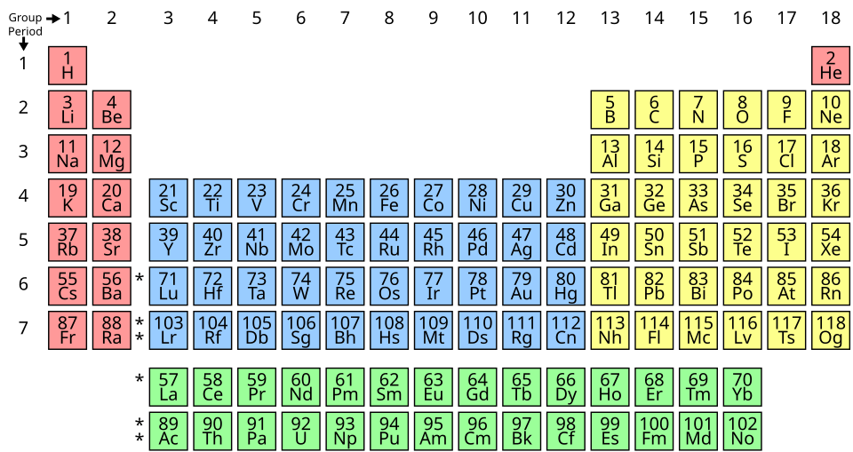
Rare earth doping
Doping with rare earth (RE) ions modifies the optical response
Doping with Yb extends the photoluminescence range into infrared
Can we obtain efficient and durable light emitters based on RE-doped β-Ga₂O₃?

Slide 6
Methodology
Ion implantation
RBS/c
XRD
TEM
Yb ions
Energy: 150 keV
Fluence range:
5×10¹² - 1×10¹⁶ ions/cm²
β-Ga₂O₃
β-Ga₂O₃:Yb
β-Ga₂O₃

Slide 7
Methodology
Ion implantation
RBS/c
XRD
TEM
He ions
Rutherford Backscattering Spectroscopy in channeling mode
Quality of the crystal
Defects analysis
β-Ga₂O₃:Yb
β-Ga₂O₃
counts
energy

Slide 8
Methodology
Ion implantation
RBS/c
XRD
TEM
X-Ray Diffraction
X-ray
Quality of the crystal
Strain
Crystal phases
β-Ga₂O₃:Yb
counts
β-Ga₂O₃
angle

Slide 9
Methodology
Ion implantation
RBS/c
XRD
TEM
Transmission Electron Microscopy
Imaging
Identification of crystal phases
Destructive method
e⁻
β-Ga₂O₃:Yb
β-Ga₂O₃

Slide 10
Results
fluence [ions/cm²]
5e12
2e13
3e13
6e13
1e14
2e14
3e14
6e14
1e15
2e15
6e15
1e16

Slide 11
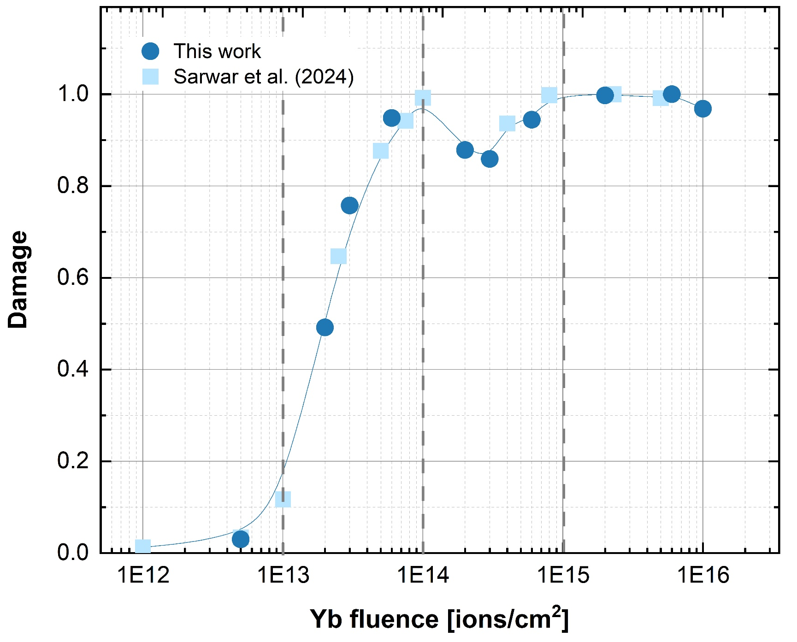
Damage accumulation
5e12
2e13
3e13
6e13
1e14
2e14
3e14
6e14
1e15
2e15
6e15
1e16
I
II
III
III
IV
IV
RBS/c

Slide 12
Implantation with low fluences
5e12
surface
[010] β-Ga₂O₃
[010] β-Ga₂O₃
HRTEM
FFT
(Fast Fourier Transform)

Slide 13
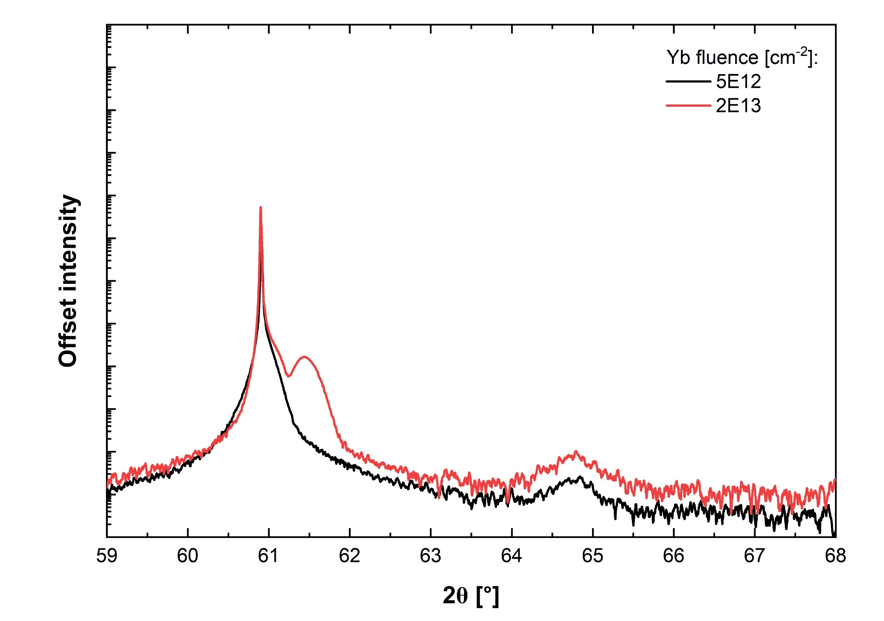
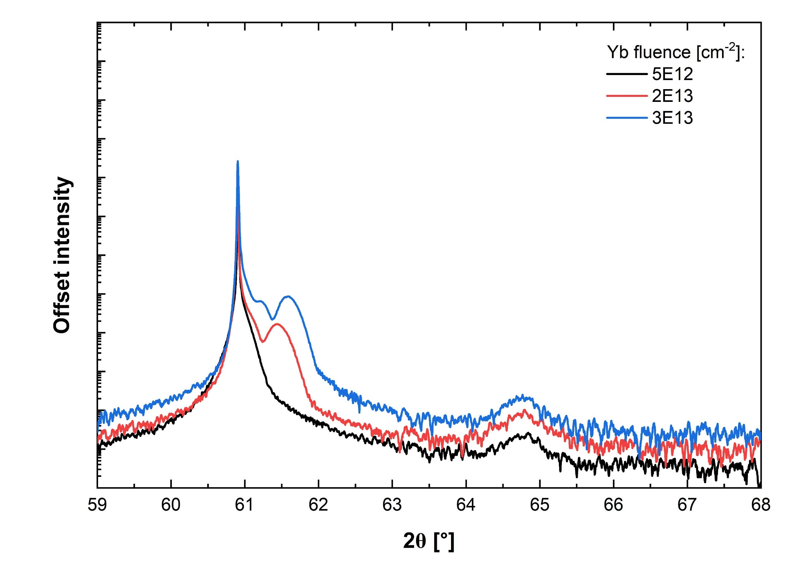
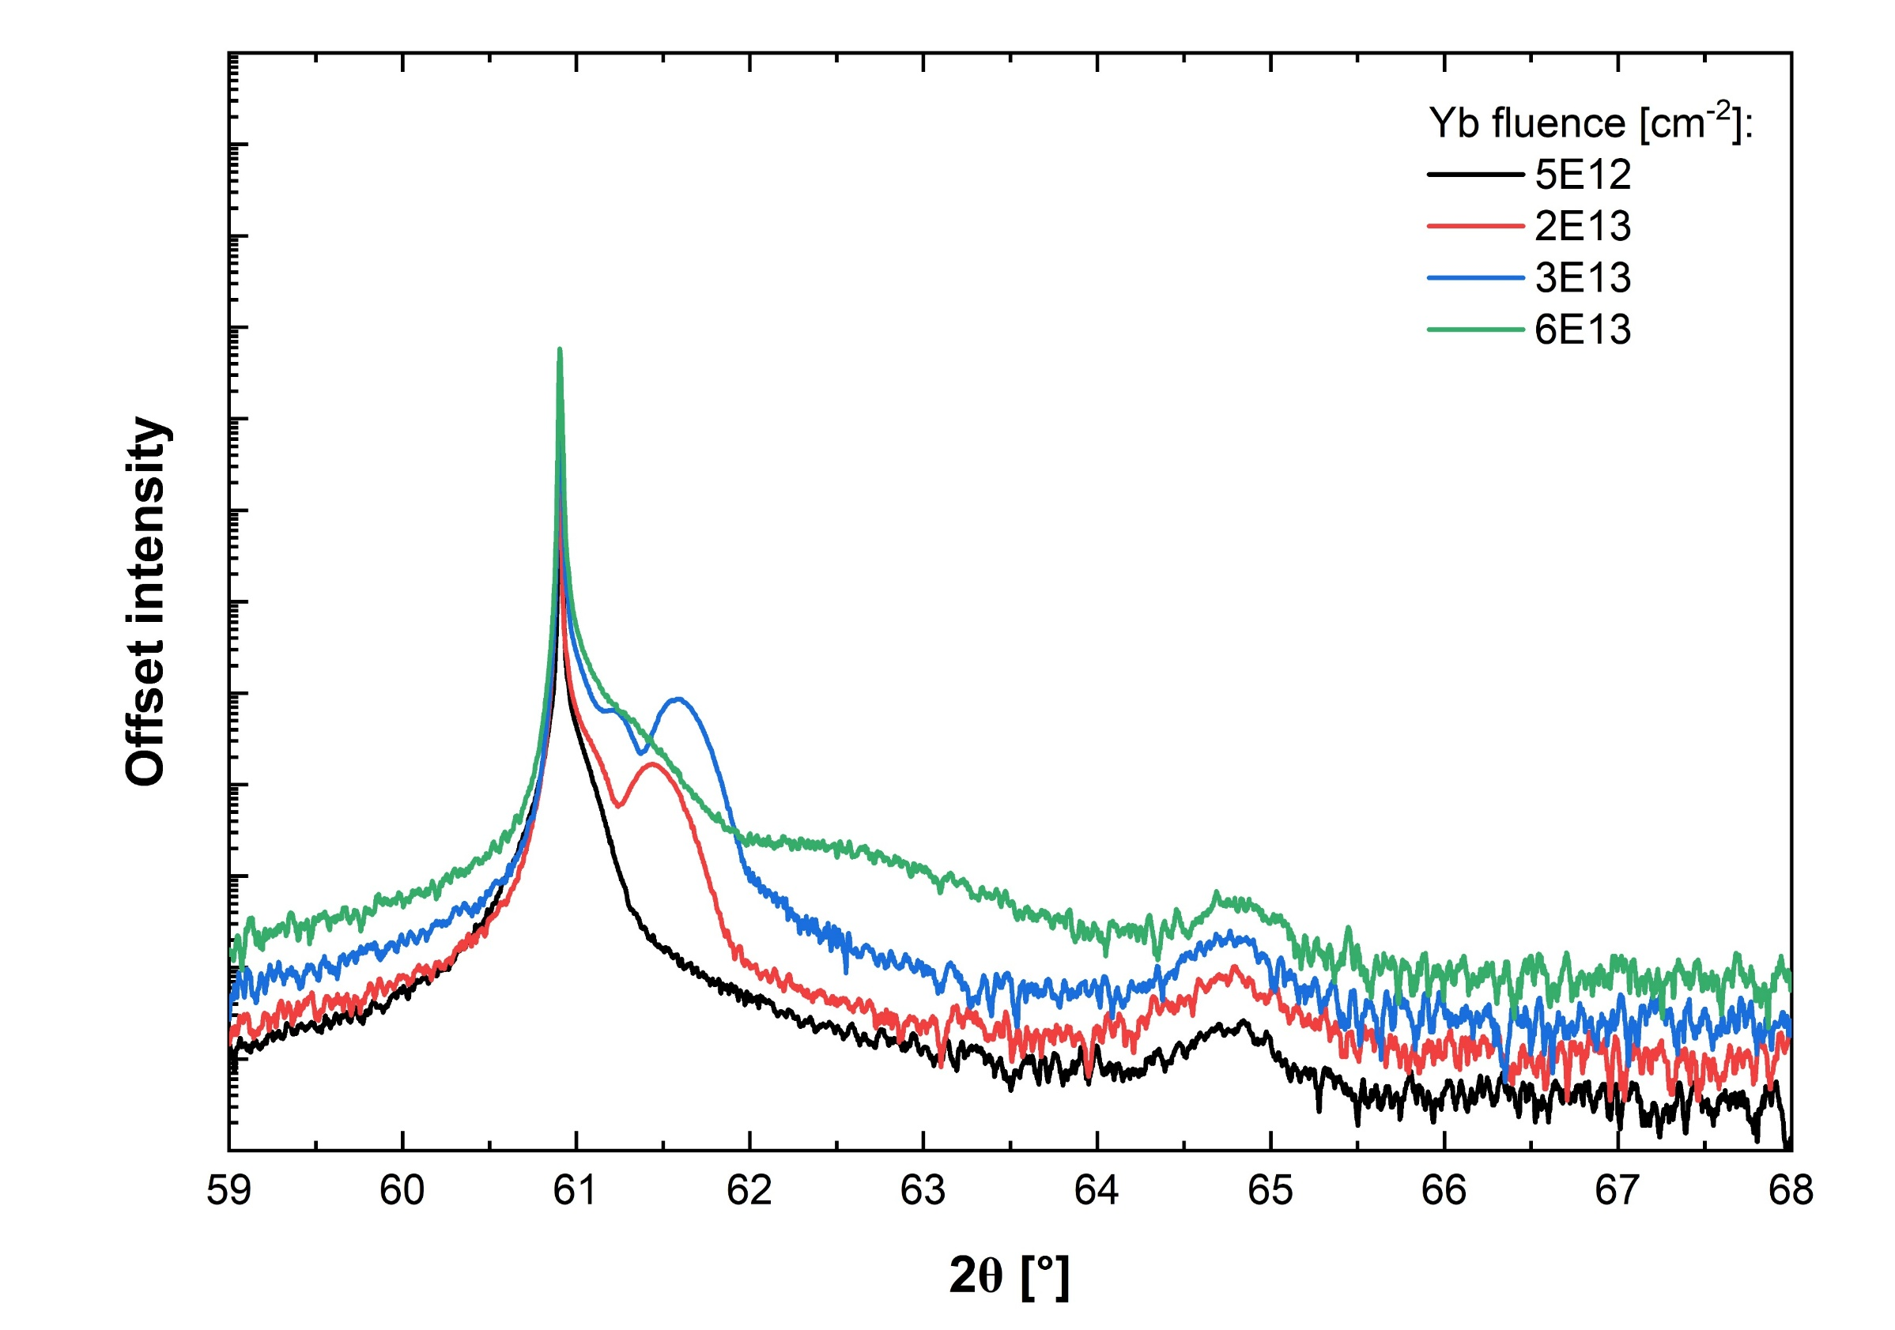
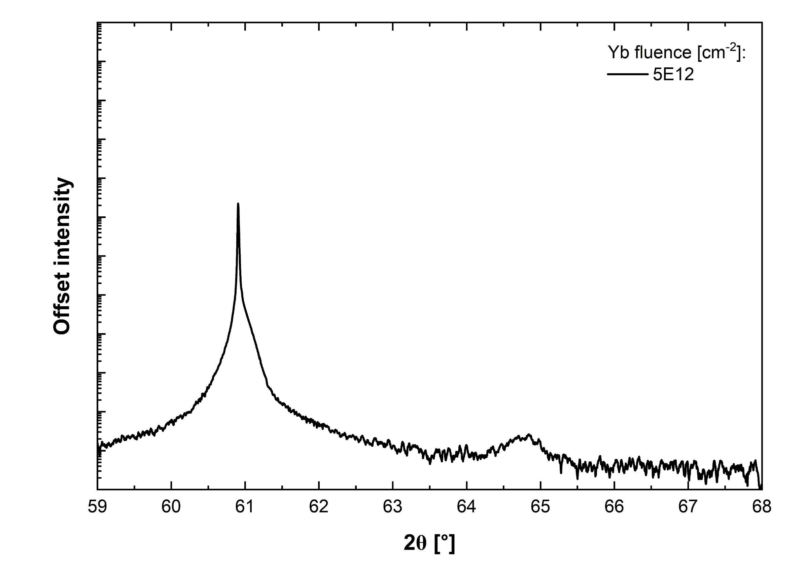
Implantation with low fluences
5e12
2e13
3e13
6e13
HRXRD
β-Ga₂O₃
(020)
sample stage
compressive strain

Slide 14
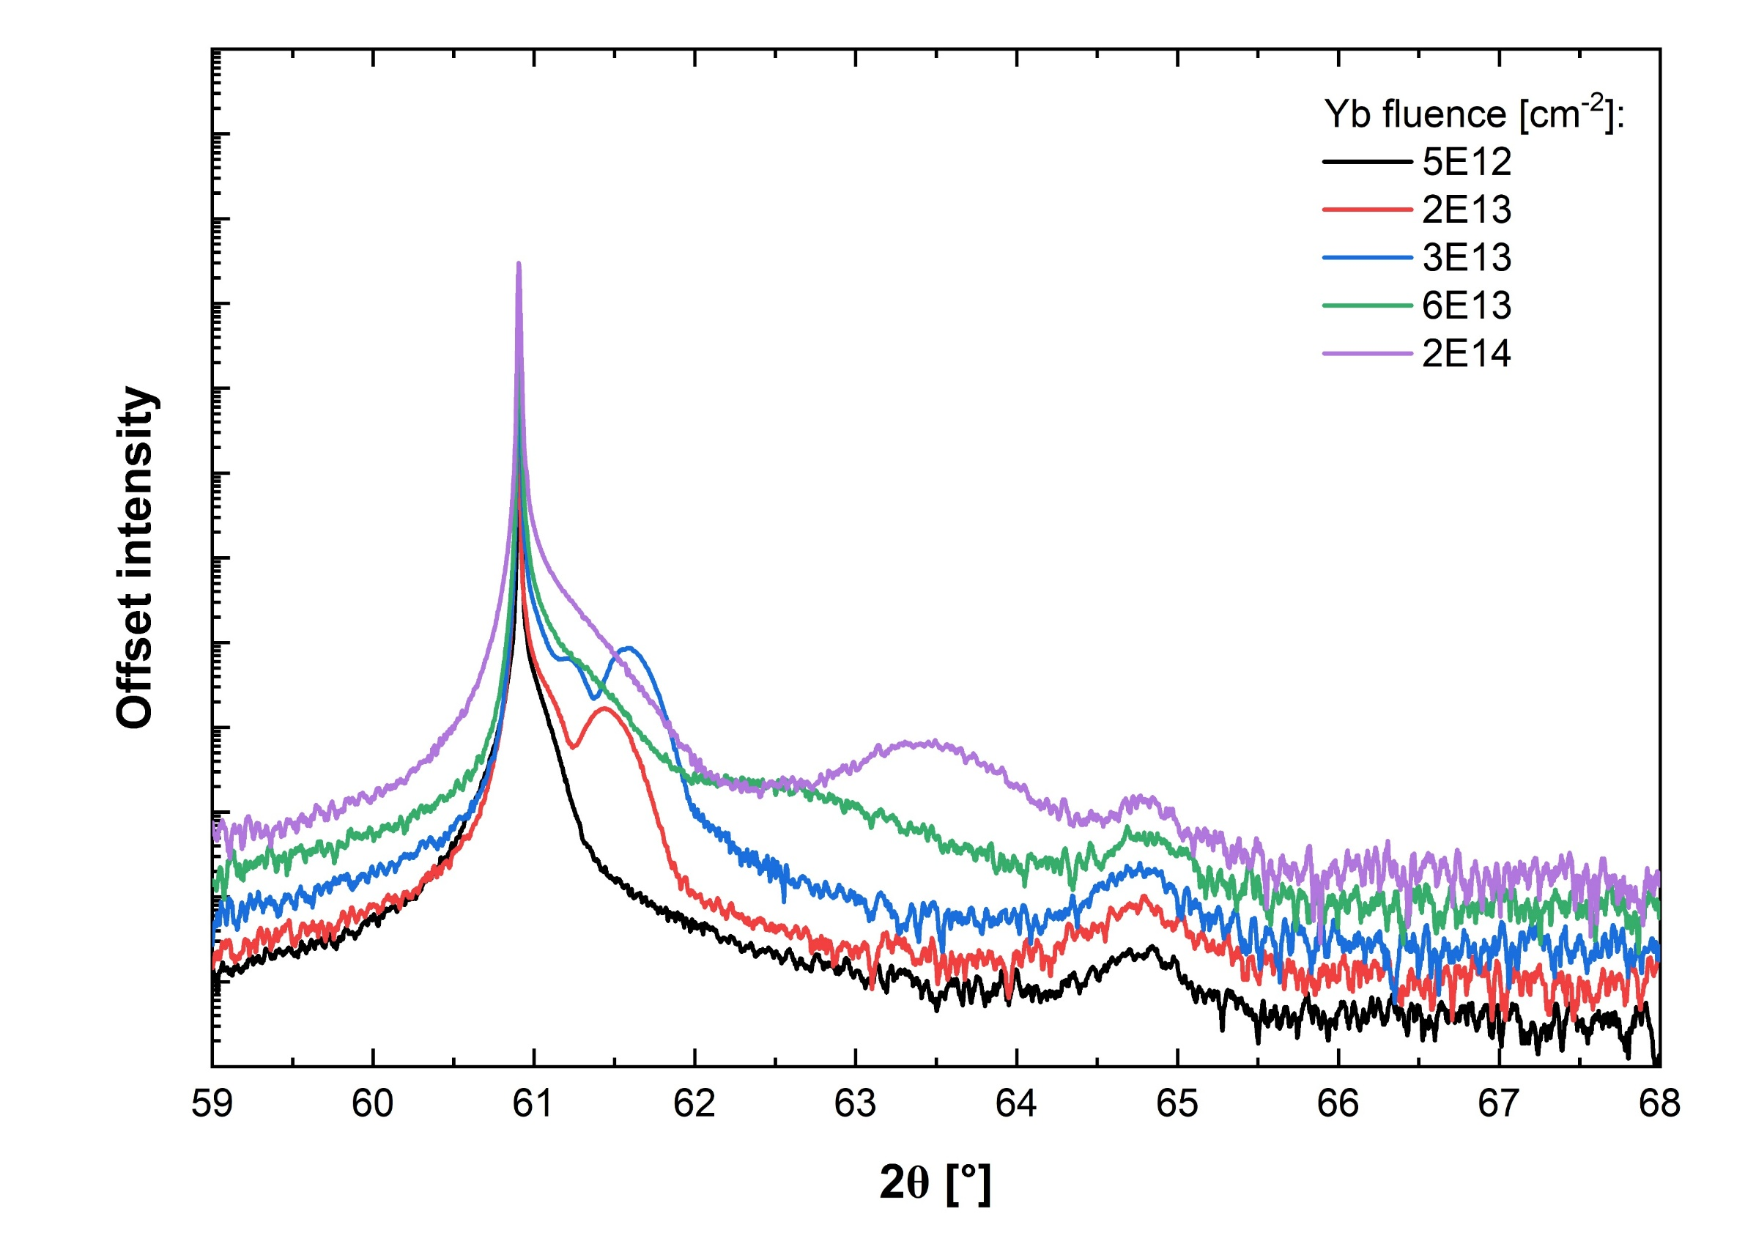
Phase transition
5e12
2e13
3e13
6e13
2e14
HRXRD
β-Ga₂O₃
(020)
γ-Ga₂O₃
(440)

Slide 15
Phase transition
1e14
[010] β-Ga₂O₃
[110] γ-Ga₂O₃
HRTEM
FFT

Slide 16
Radiation resistance
Different response to irradiation: transformation from β to γ phase instead of amorphization
β/γ bilayers exhibit high radiation resistance: no amorphization observed even after irradiation with very high fluences
Amorphization - structural phase transformation from a crystalline solid to a solid that lacks any long-range order
doi:10.1016/B978-0-08-056033-5.00005-7

Slide 17
Further implantation
3e14
[010] β-Ga₂O₃
[110] γ-Ga₂O₃
HRTEM
FFT
I
II
III
IV
stacking faults
[110] γ-Ga₂O₃

Slide 18
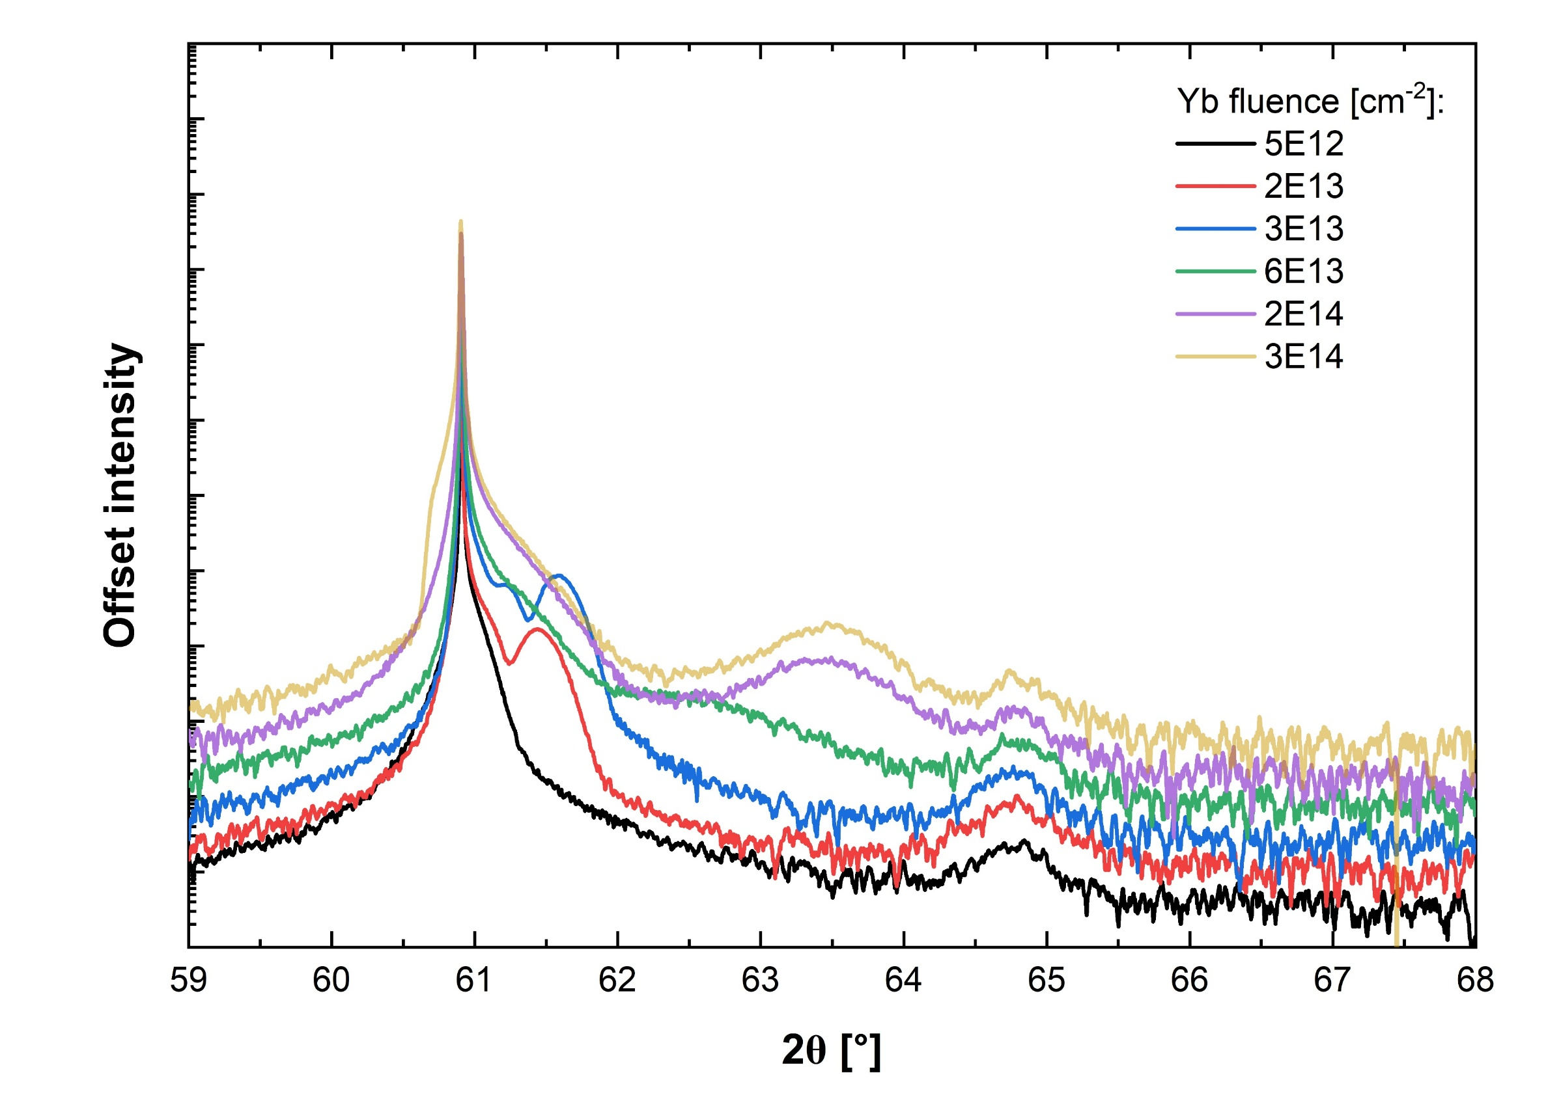
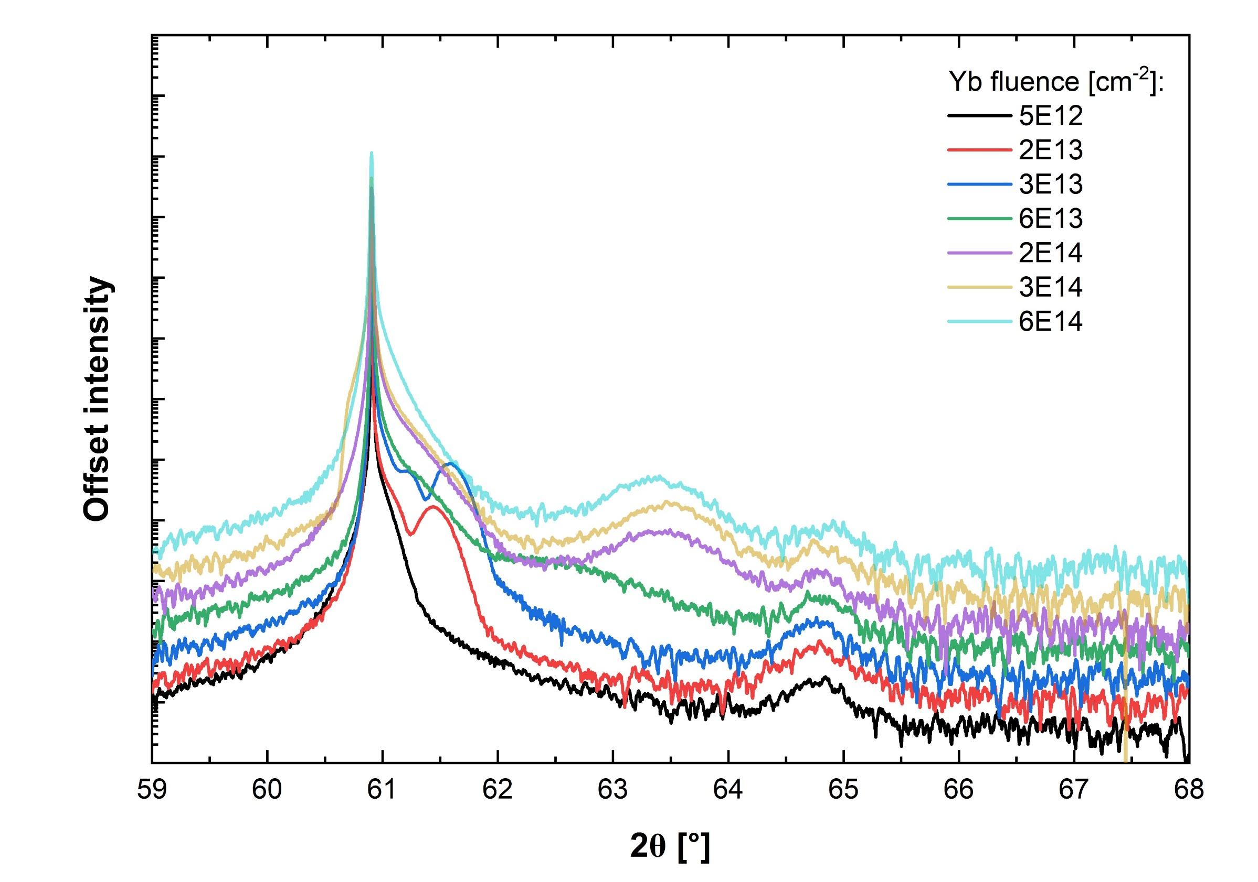
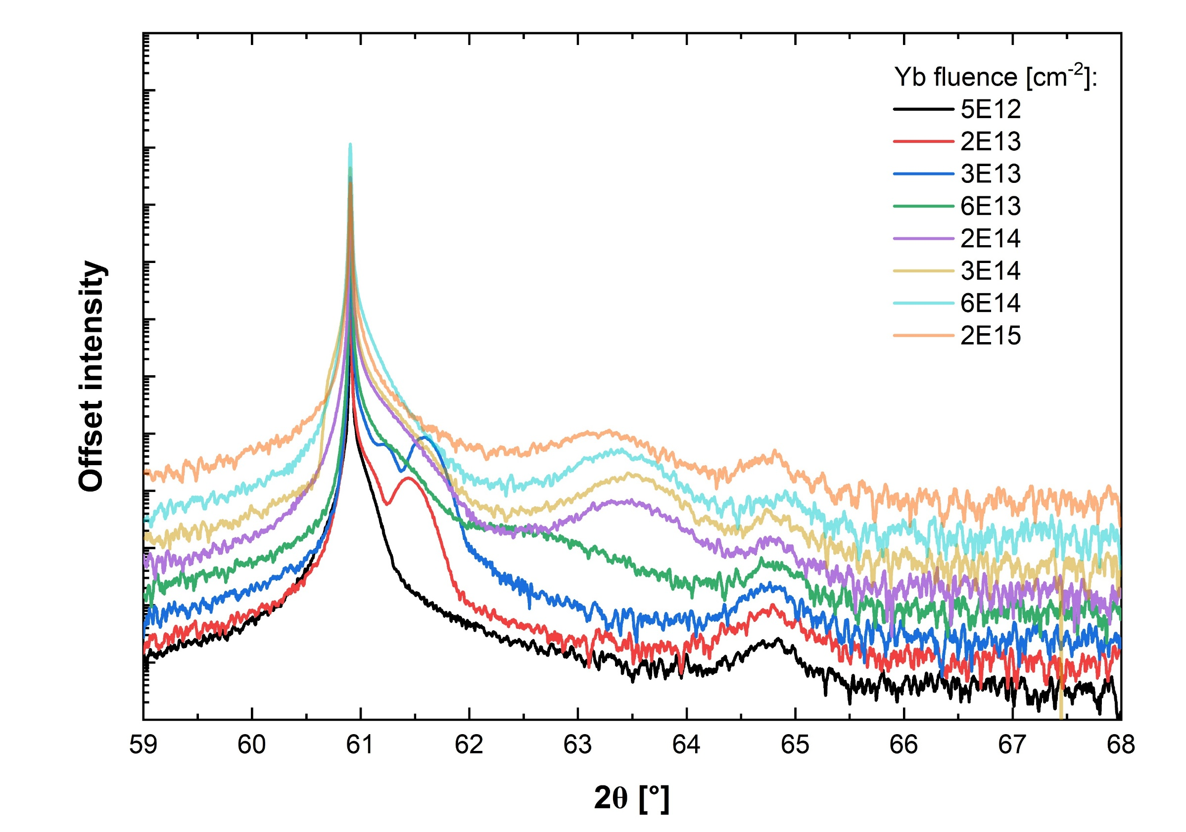
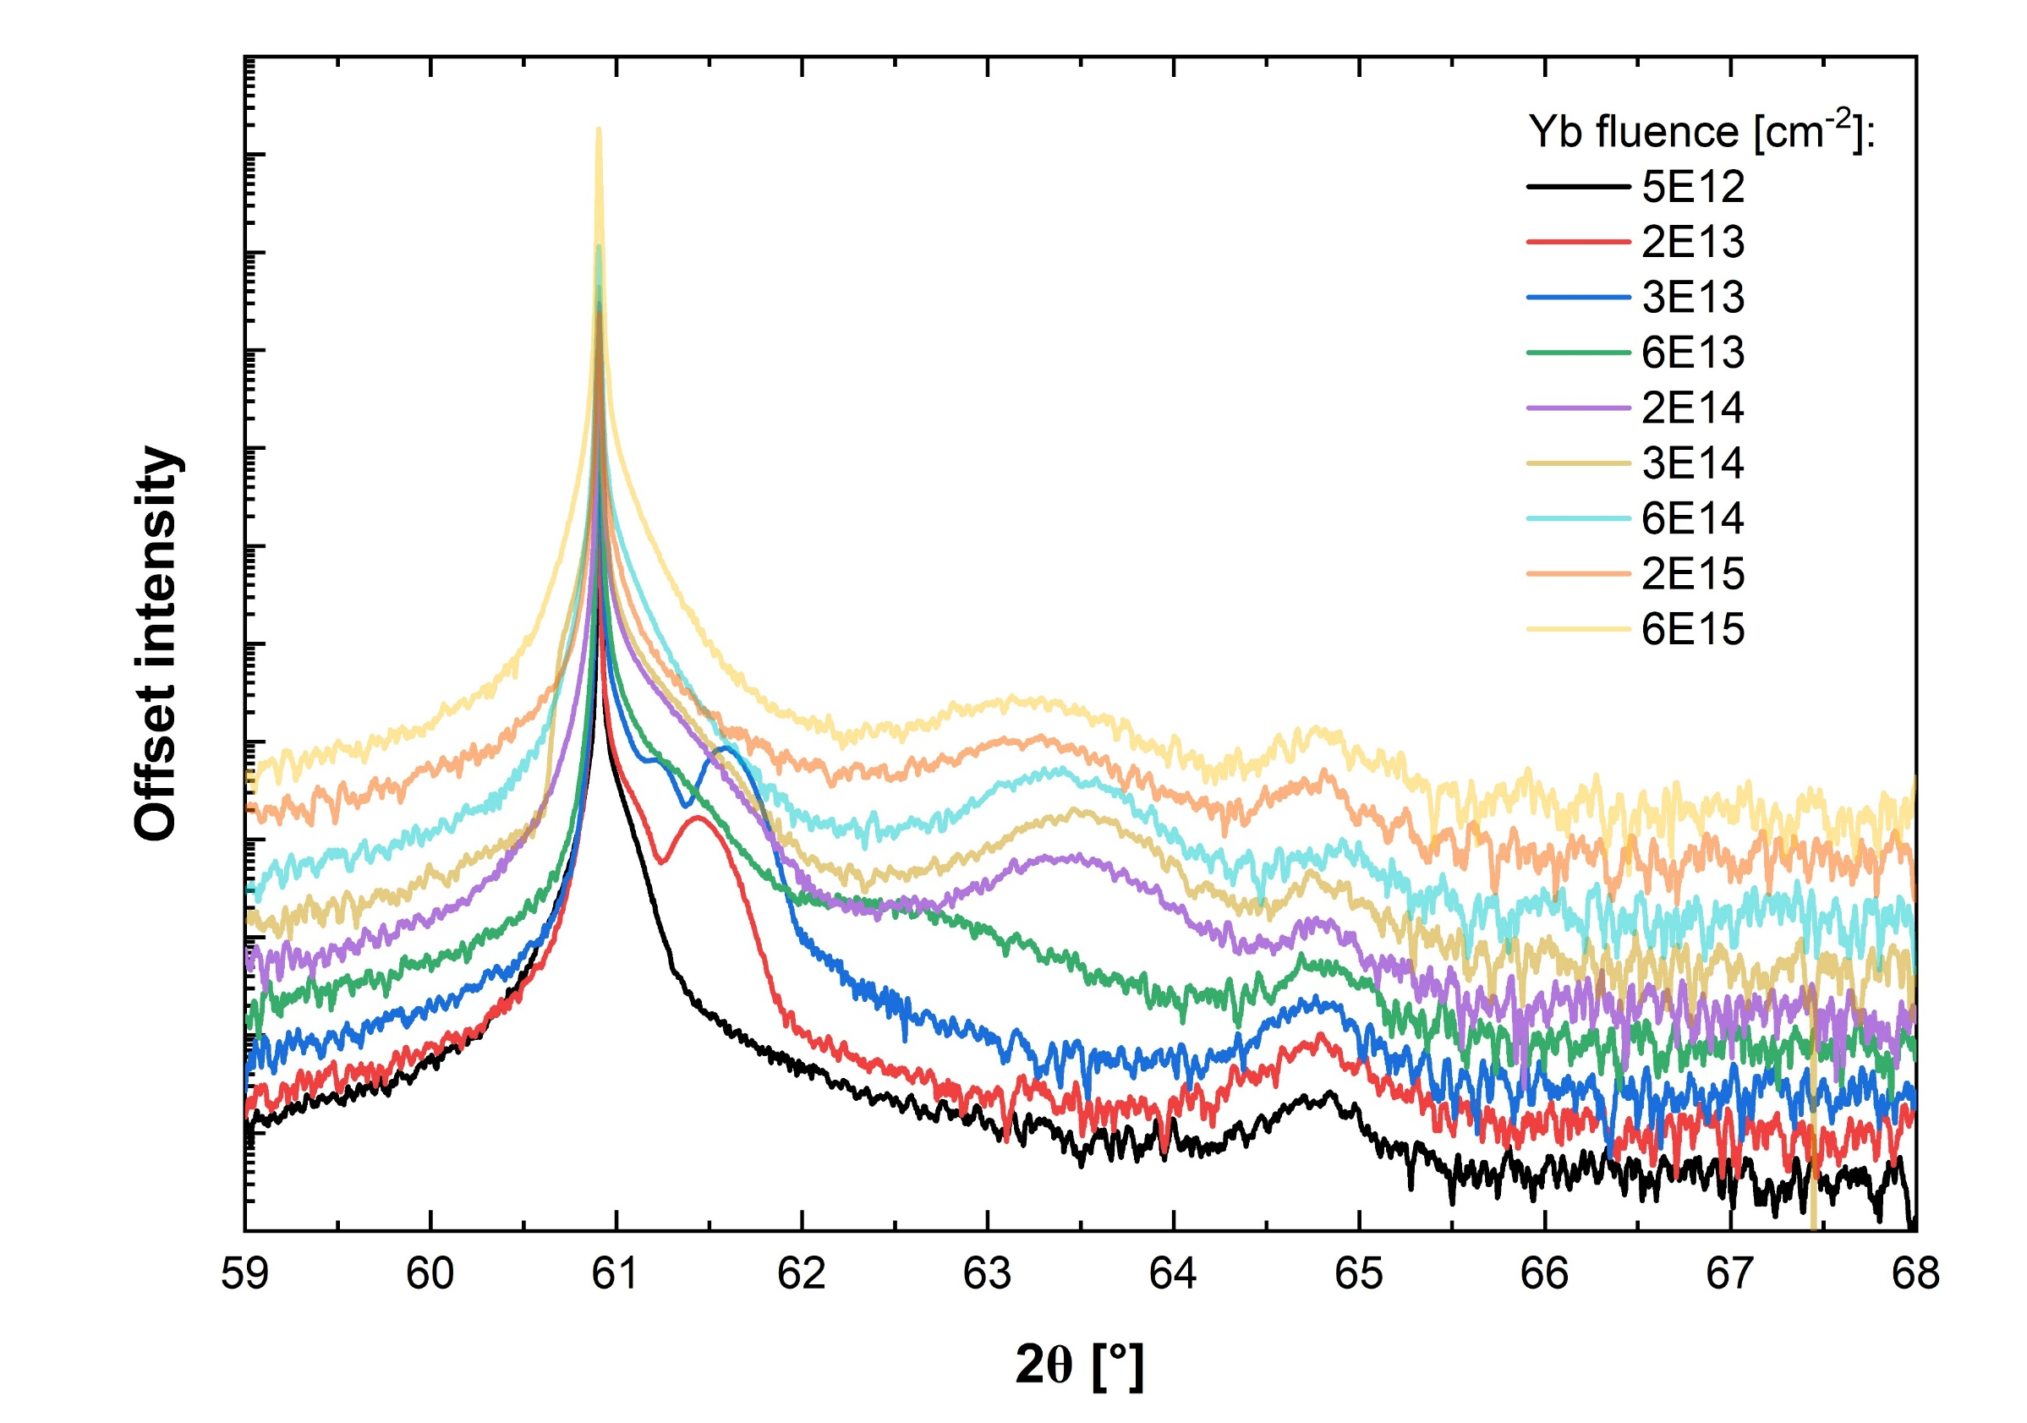
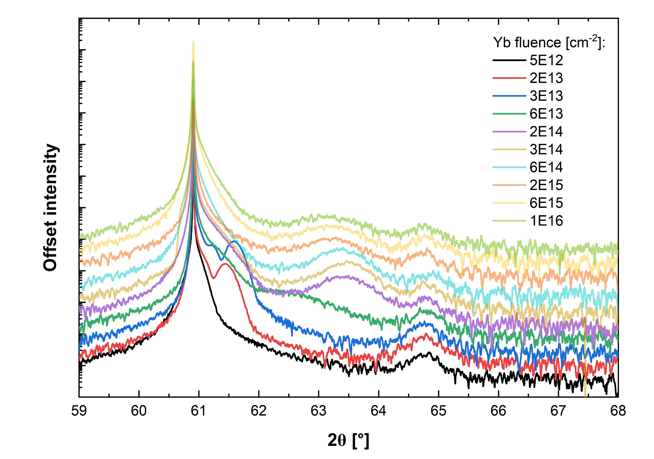
Further implantation
5e12
2e13
3e13
6e13
2e14
3e14
6e14
2e15
6e15
1e16
HRXRD
β-Ga₂O₃
(020)
γ-Ga₂O₃
(440)

Slide 19
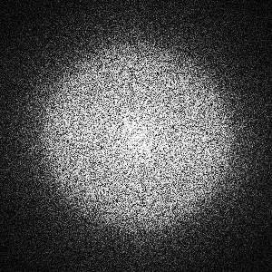
Amorphization
1e15
1e16
[010] β-Ga₂O₃
[110] γ-Ga₂O₃
amorphous
I
II
III
IV
[010] β-Ga₂O₃
[110] γ-Ga₂O₃
amorphous

Slide 20
Conclusion
Increasing compressive strain
Formation of γ phase
Progressive amorphization
Strain relaxation
Stacking faults

Slide 21
Conclusion
The results challenge the concept of extreme radiation resistance of the γ phase or suggest that its stability may depend on irradiation conditions
A chemical effect of RE ions may play a significant role
Next step: implantation with a noble gas Xe

Slide 22




Acknowledgements
The research was carried out within the NCN project UMO-2022/45/B/ST5/02810.
This research was supported by a French government scholarship France Excellence.

