Slide 1

Development of a gamma imager for 3D mapping of radioactivity for applications in nuclear industry
LCIM – Laboratoire Capteurs et Instrumentation pour la Mesure
PHENIICS FEST 2026
Giulia ROSSO
Thesis director: Dominique TROMSON
Supervisors: Guillaume AMOYAL
Maugan MICHEL

Slide 2
Context and objectives
1

Slide 3
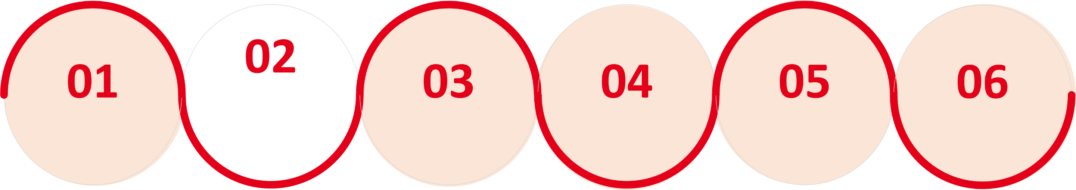
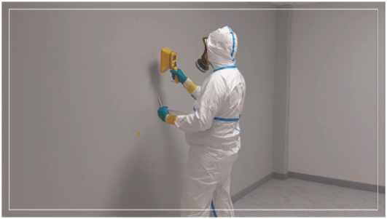
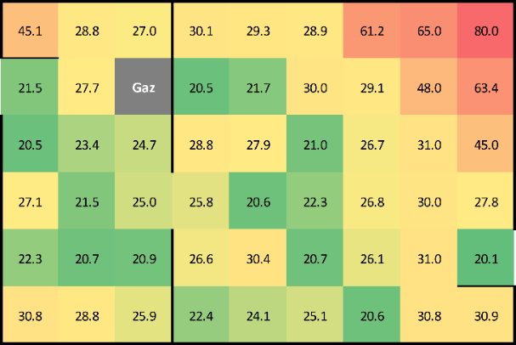
Nuclear decommissioning
Radiological characterization
Planning
Decontamination
Dismantling
Preparation for reuse
Final survey
Detection of radioactive hotspots through radiation imaging
© A. Macario-Barros

Slide 4

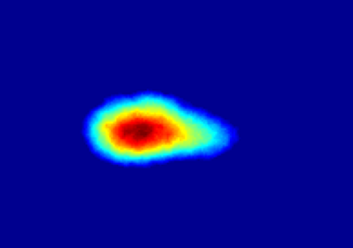


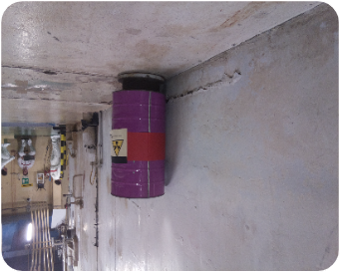
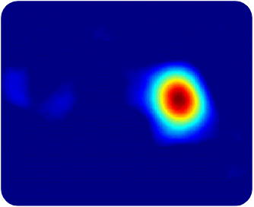
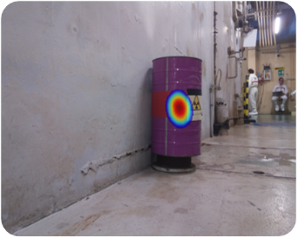
Ionizing radiation imaging
“To see radioactivity”
Several advantages in presence of unknown situations:
Visual localization of radioactive hotspots
Quantitative information (dose/activity)
Remote measurements
ALARA principle
(As Low As Reasonably Achievable)
Detector
Source
Picture
No information about depth!
Visible image
2D radioactivity image
Superimposed image
3D imaging
Pictures from: Euratom project CLEANDEM (grant agreement n° 945335)

Slide 5
3D gamma imaging method
2

Slide 6
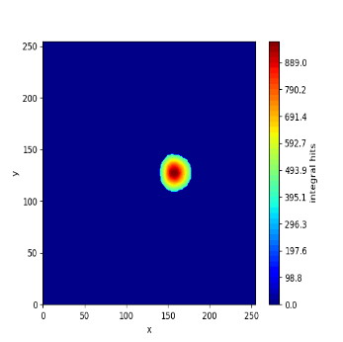

Method’s overview
Recording of 2D gamma images
Move the detector to a different position
Acquisition of images from different points of view (POV)
3D image reprojection
Triangulation
Estimation of the source position
SOURCE
Need to know the detector’s position at each POV!
POV 1
POV 3
POV 2
No prior information about the environment

Slide 7
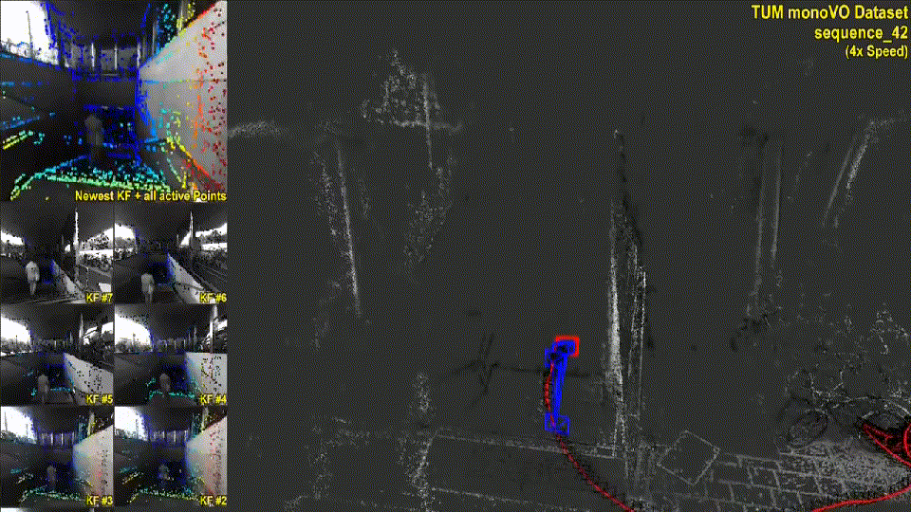
Simultaneous Localization And Mapping
SLAM (Simultaneous Localization And Mapping) problem
“Mathematical problem that seeks to determine a robot’s trajectory while simultaneously creating a map of the environment” ^{[1]}
Engel et.al. (2016)
^{[1]} A. M. Barros, “Modular device for automated and reliable mapping of indoor installations”.

Slide 8
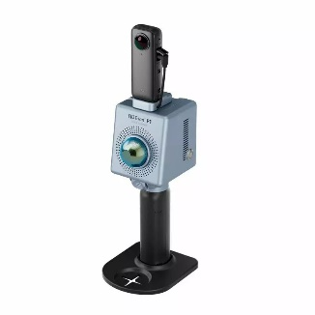
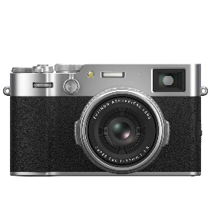
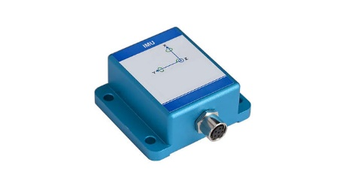











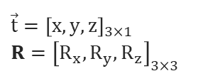
SLAM working principle
Sensor
(LiDAR, visual camera, radar, IMU unit …)
Input data
(depth values, color images, acceleration values …)
$$(\vec{t_{2}}, R_{2})$$
SLAM algorithm
$$(\vec{t_{3}}, R_{3})$$
$$(\vec{t_{i}}, R_{i})$$
$$Trajectory$$
$$(\vec{t_{1}}, R_{1})$$
Trajectory & point cloud estimation
$$t_{1}$$
$$t_{2}$$
$$t_{3}$$
$$[…]$$
$$t_{i}$$
$$time$$
$${\vec{t}=\left[x,y,z\right]}_{3×1}$$
$${R=\left[R_{x}, R_{y}, R_{z}\right]}_{3×3}$$
“Pose” (position & rotation)

Slide 9
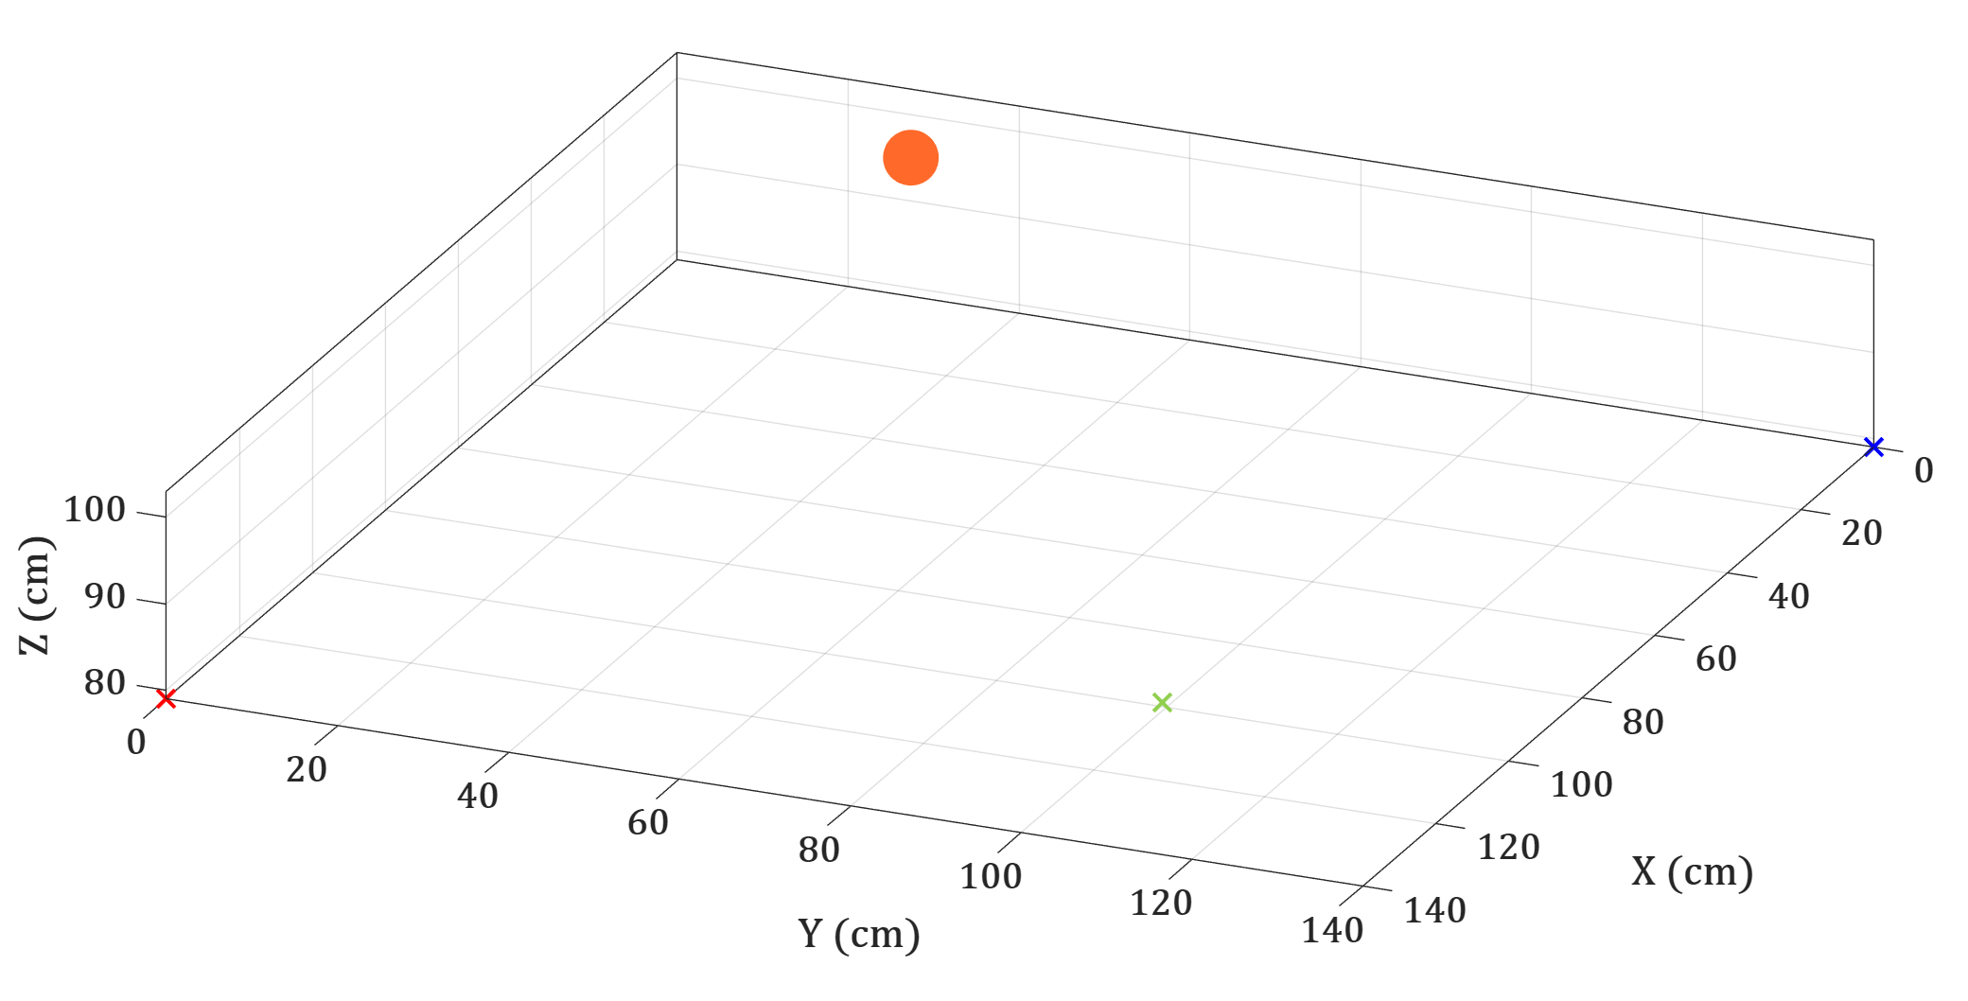
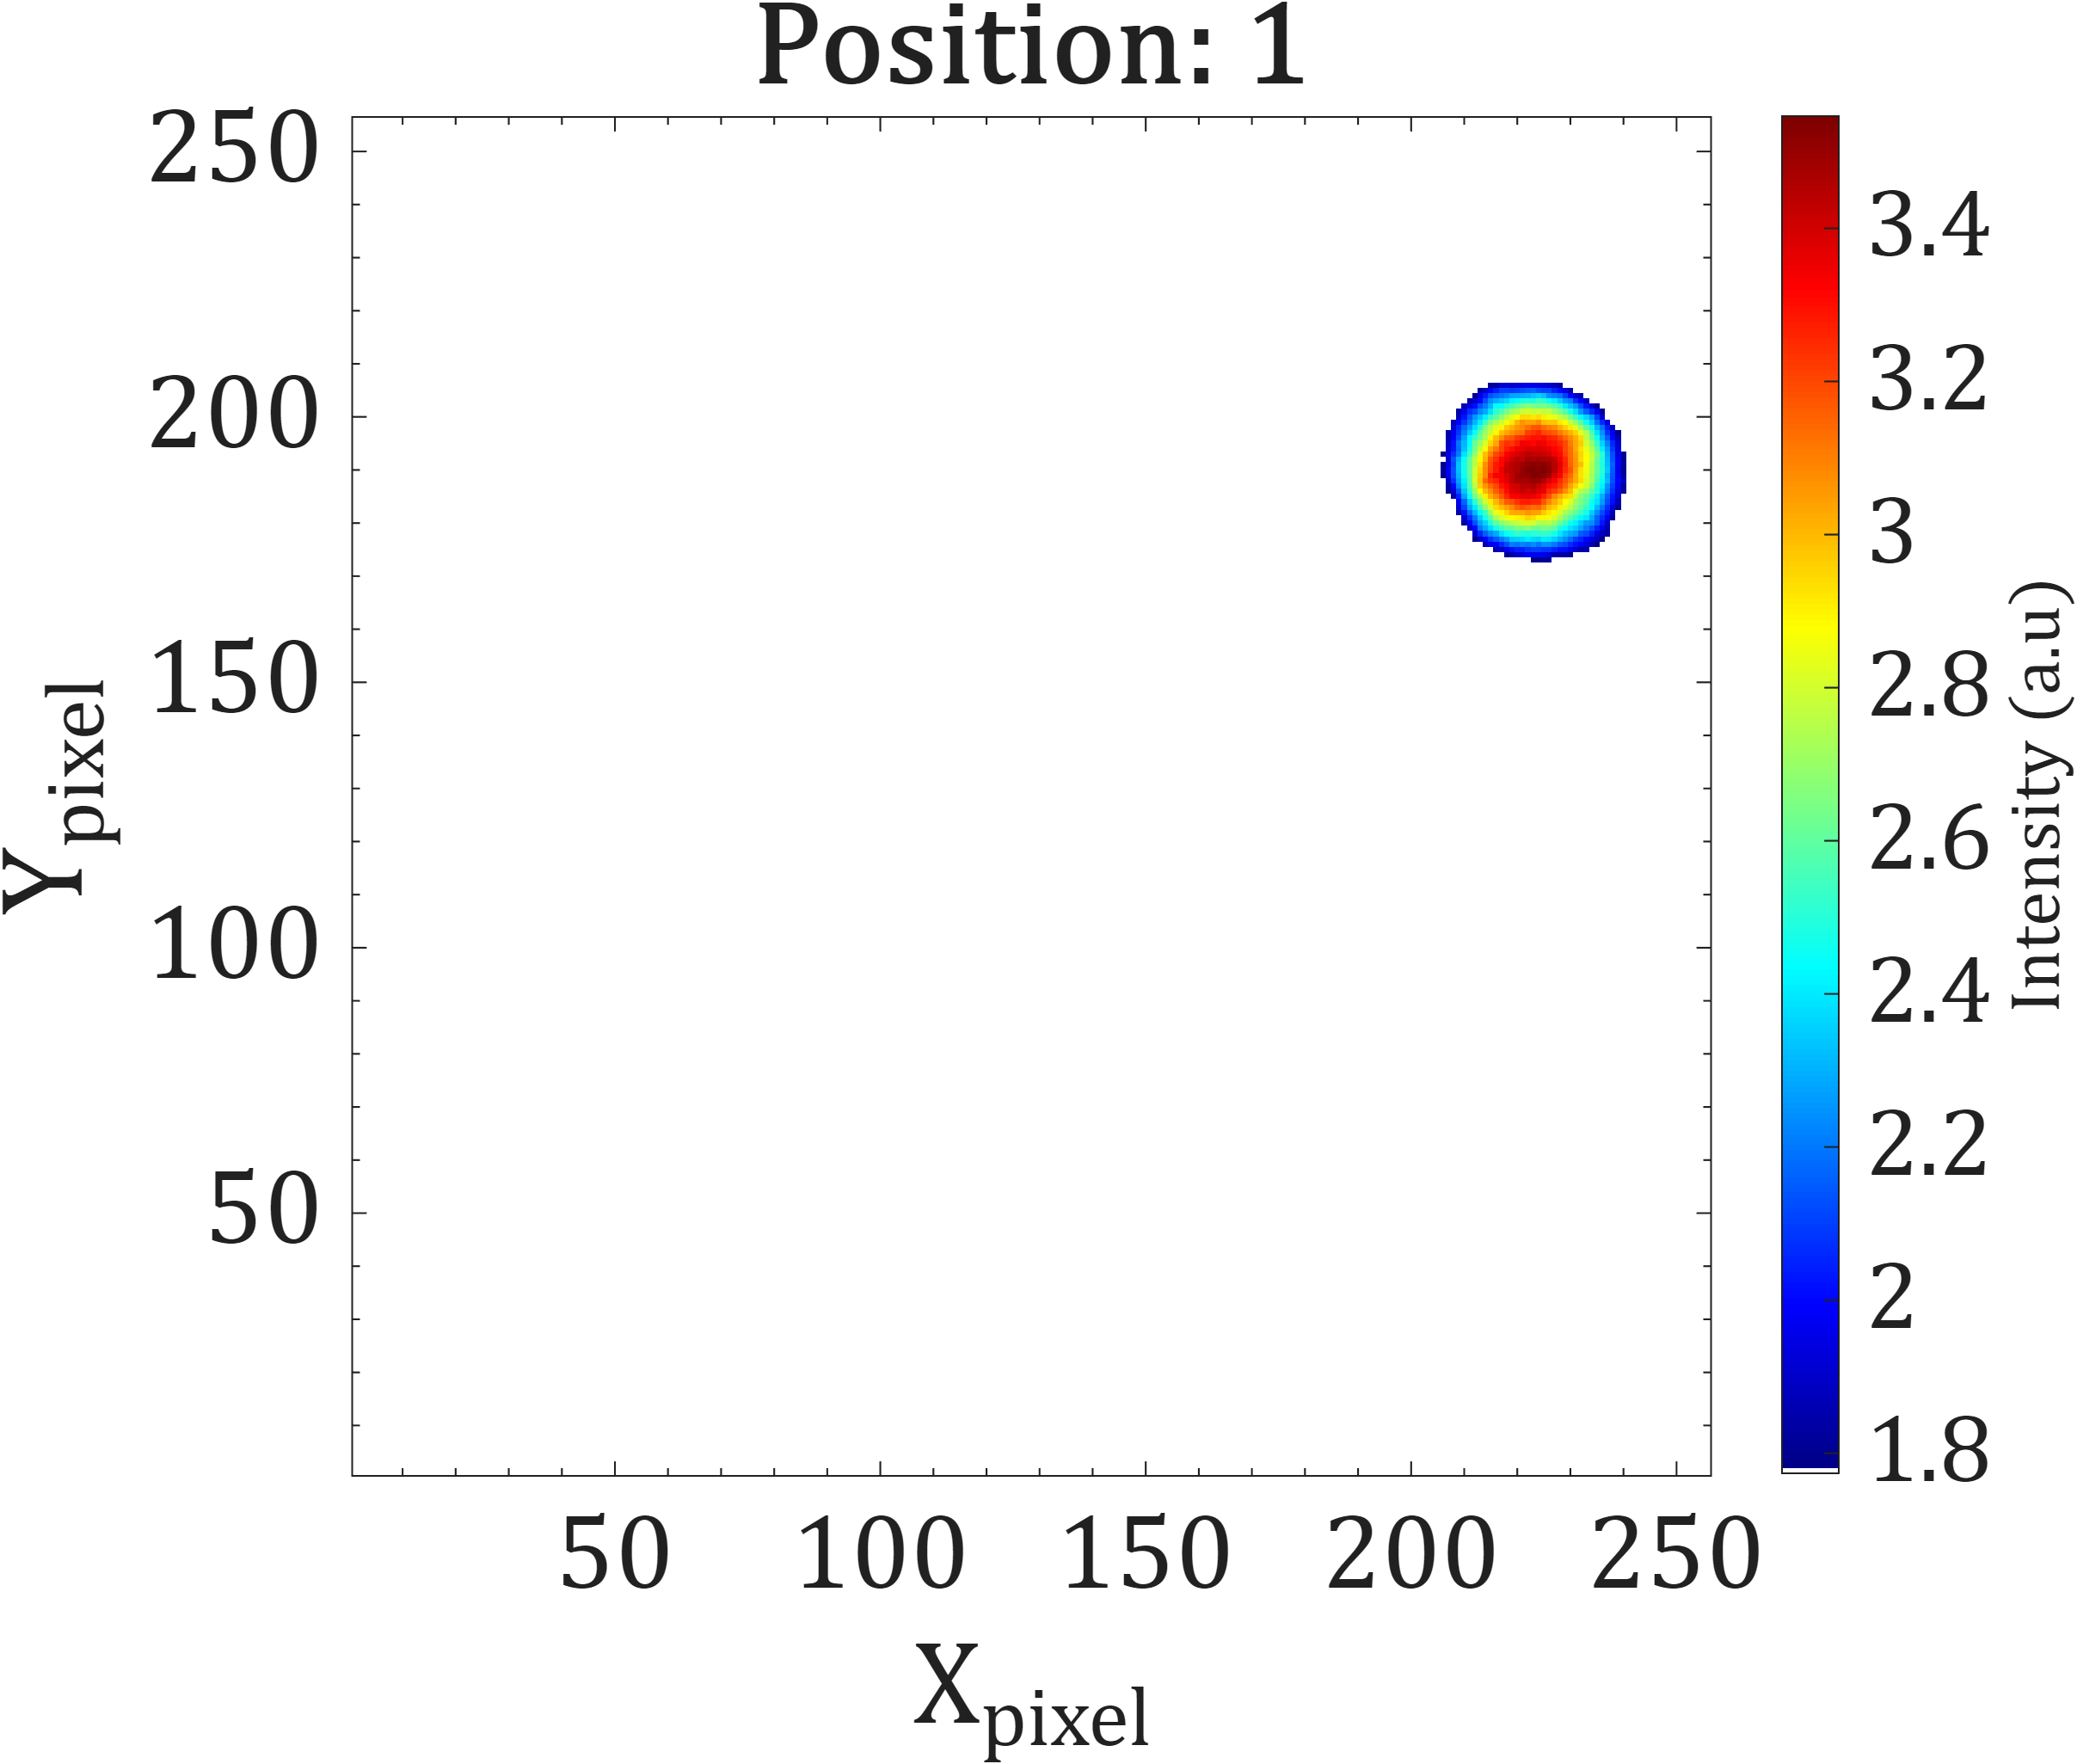
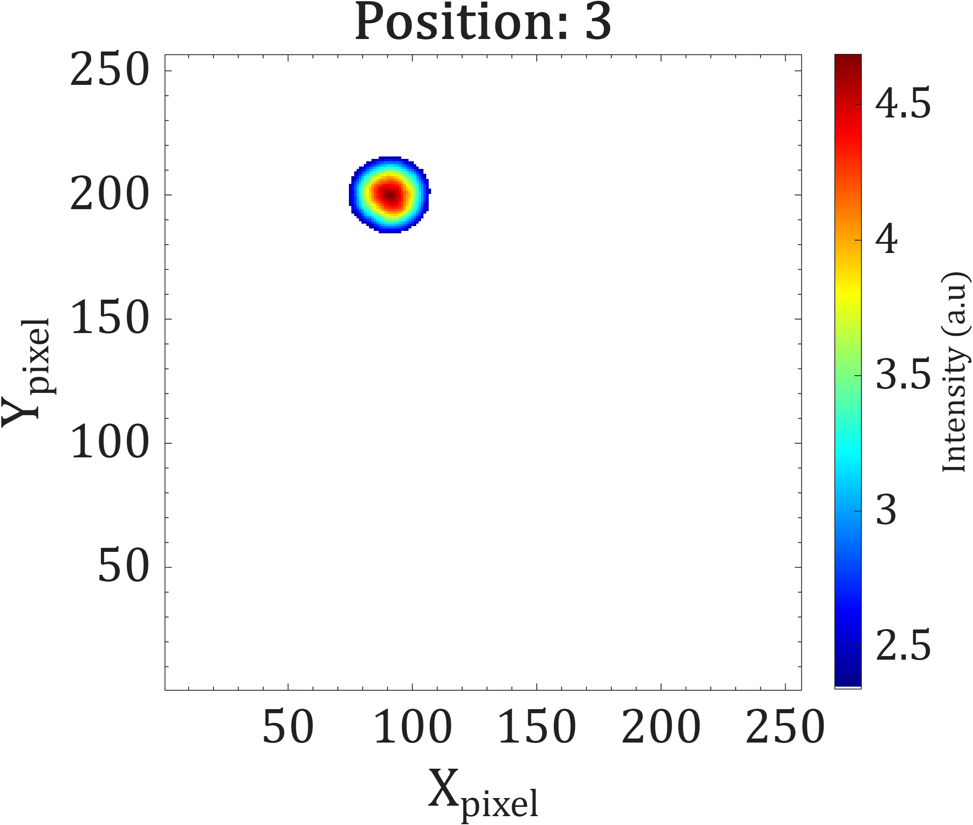
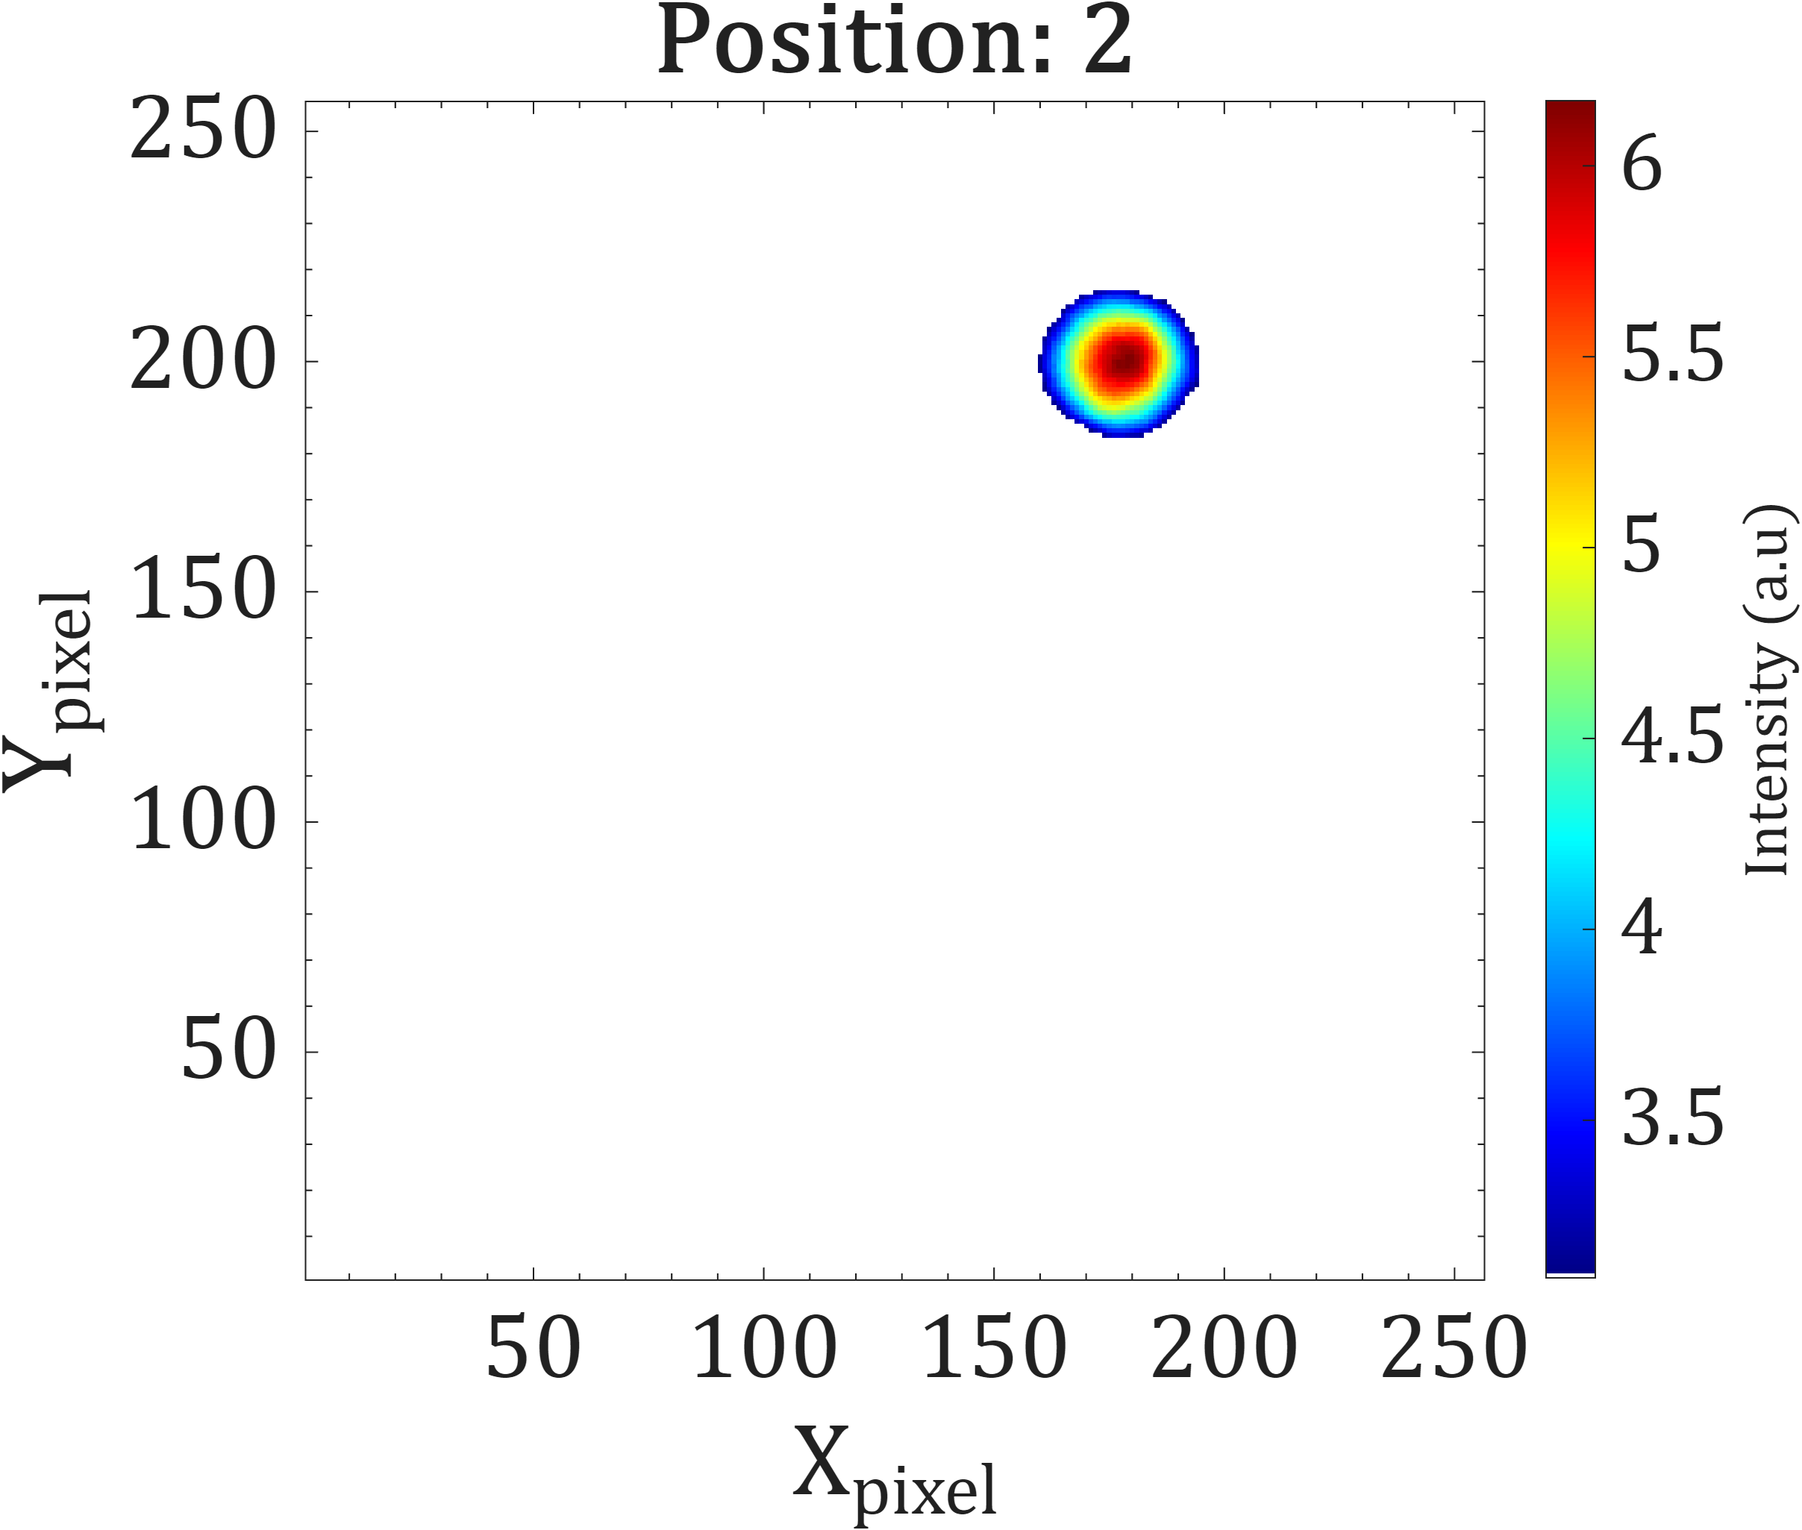
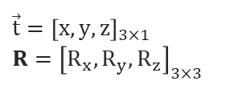
3D gamma imaging and SLAM coupling
Radiological measurement
Spatial localization
Radioactive source
Acquisition of multiple gamma images from different points of view
Acquisition of a video of the surrounding scene
Position 3
Position 1
Position 2
2D gamma imaging processing
SLAM algorithm
3D hotspot back-projection
$${\vec{t}=\left[x,y,z\right]}_{3×1}$$
$${R=\left[R_{x}, R_{y}, R_{z}\right]}_{3×3}$$
Detector’s pose

Slide 10
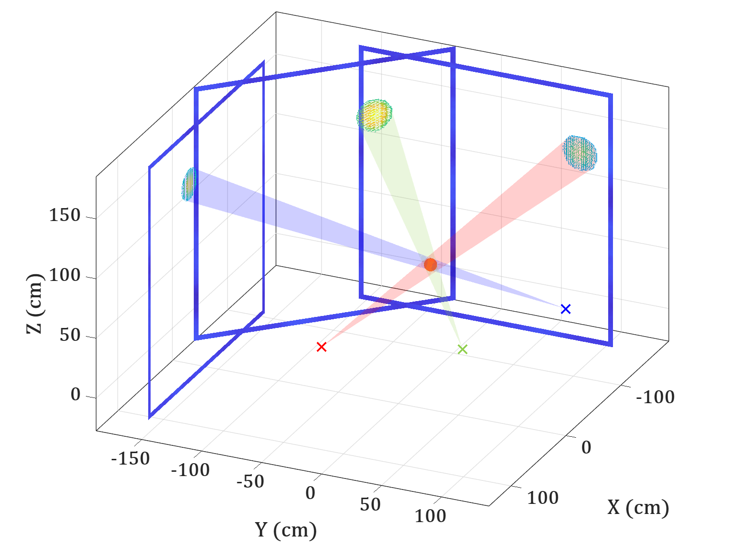




3D gamma imaging and SLAM coupling
Radiological measurement
Spatial localization
Acquisition of multiple gamma images from different points of view
Acquisition of a video of the surrounding scene
Position 3
$$(\vec{T_{3}}, R_{3})$$
Position 1
$$Trajectory$$
$$(\vec{T_{1}}, R_{1})$$
Position 2
$$(\vec{T_{2}}, R_{2})$$
2D gamma imaging processing
SLAM algorithm
3D hotspot back-projection
$${\vec{t}=\left[x,y,z\right]}_{3×1}$$
$${R=\left[R_{x}, R_{y}, R_{z}\right]}_{3×3}$$
Detector’s pose

Slide 11
Development of a prototype
3

Slide 12
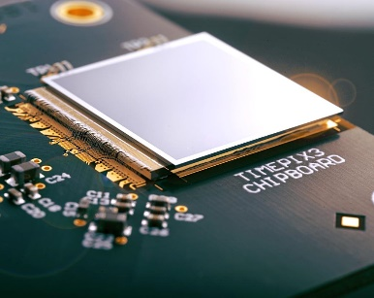
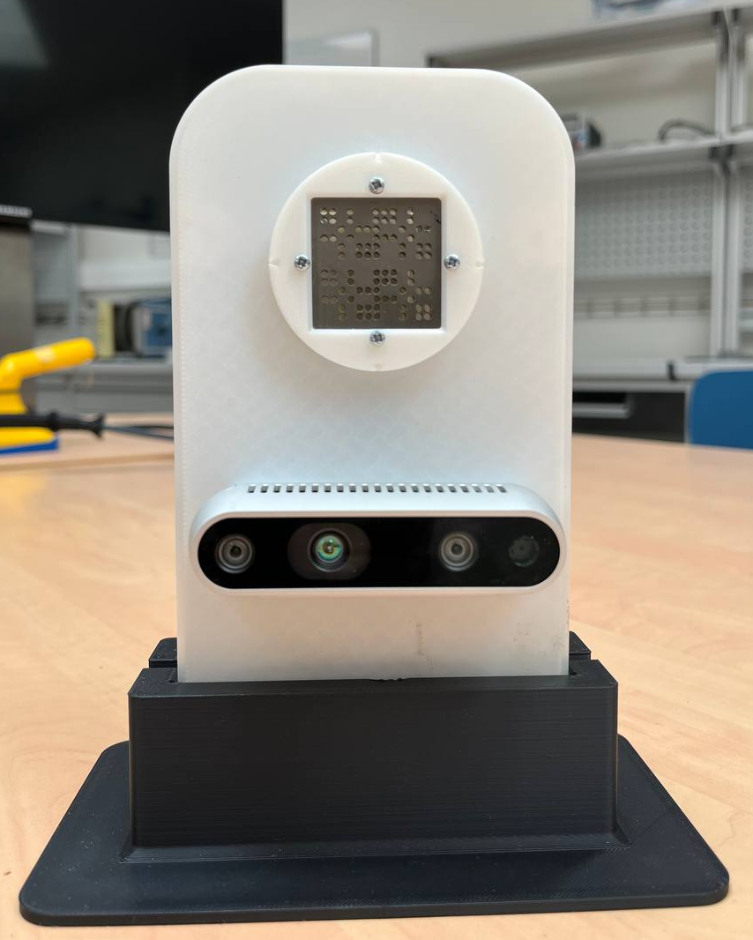
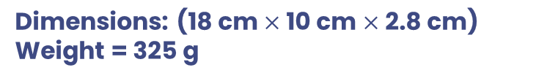
Prototype design
MultImodal RAdioactivity imageR for 3D mapping (MIRAR3D)
Coded-aperture gamma imaging
Timepix3-based hybrid pixel detector
  1 mm CdTe layer
  256 × 256 pixels (55 µm pixel pitch)
  1.56 ns time resolution
4 mm thick MURA rank-7 coded mask tungsten alloy
Picture from: https://kt.cern/technologies/timepix3
Simultaneous Localization And Mapping (SLAM)
Intel ® RealSenseTM RGB-D (color and depth) camera
  Evaluation of the imager’s poses (position and rotation) at each measurement point
  3D sparse point cloud of the environment
Dimensions: (18 cm $×$ 10 cm $×$ 2.8 cm)
Weight = 325 g

Slide 13
Experimental validation
4

Slide 14
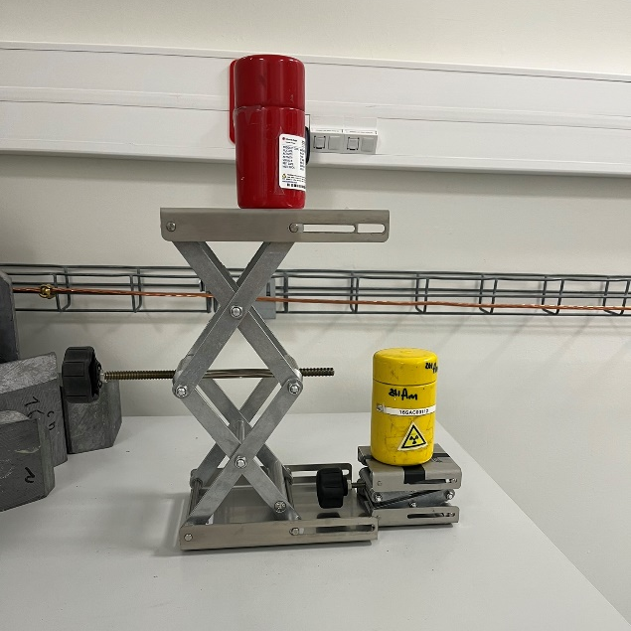
Experimental set-up
Measurement of ²⁴¹Am (25.9 MBq) and ¹³³Ba (39.5 MBq) point-like sources
Three POVs measured
25.1 cm distance between sources
¹³³Ba placeholder
25.1 cm
²⁴¹Am placeholder
POV 3
¹³³Ba
²⁴¹Am
94.7 cm
POV 2
POV 1

Slide 15
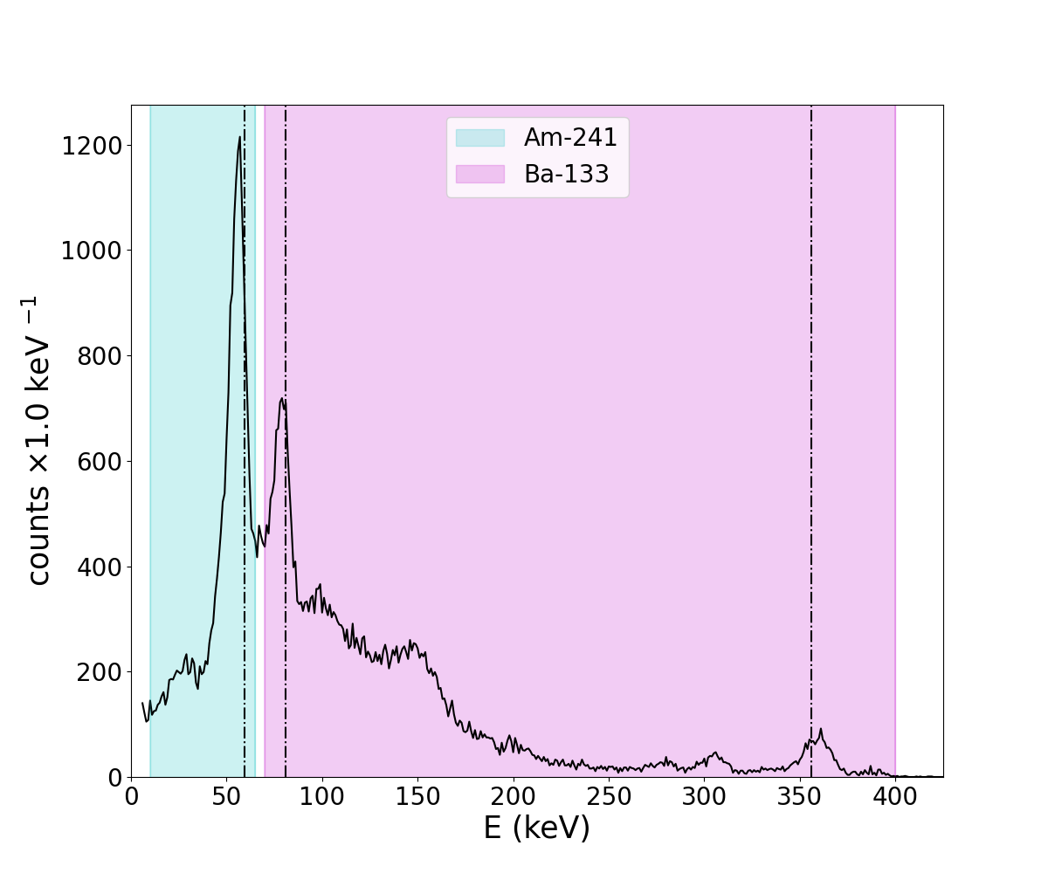
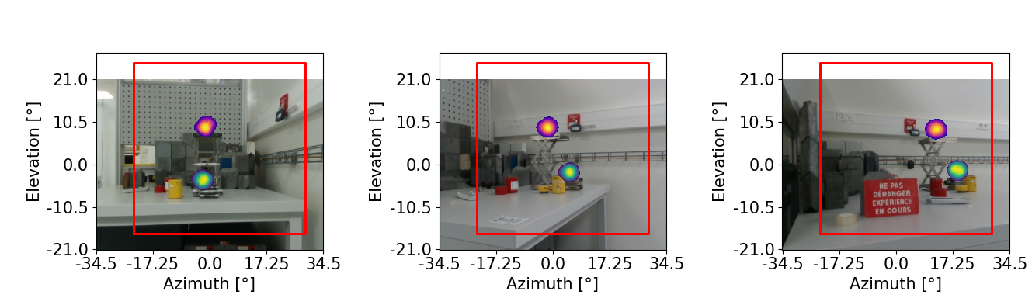
Sources separation
59 keV
“spectro-imaging”:
Separation of the two radionuclides by selecting their energy emission in the energy spectrum.
81 keV
²⁴¹Am
E_{γ}=59 keV
¹³³Ba
E_{γ,1}= 81 keV
E_{γ,2}= 356 keV
356 keV
POV 1
POV 2
POV 3
¹³³Ba
¹³³Ba
¹³³Ba
²⁴¹Am
²⁴¹Am
²⁴¹Am

Slide 16
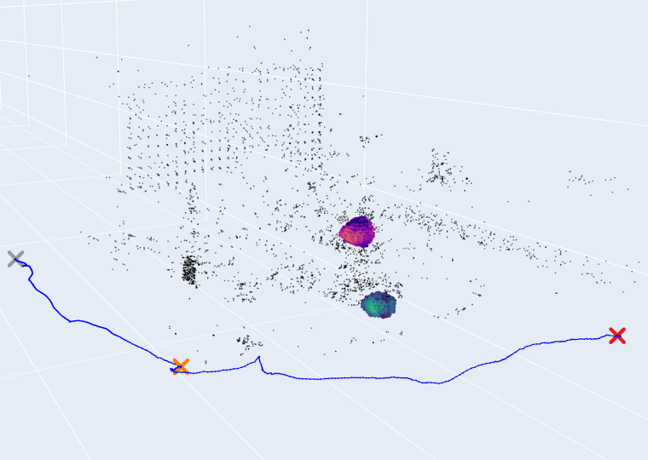
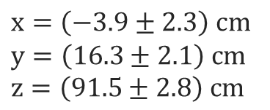
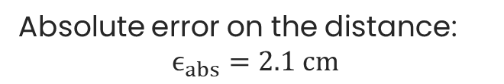


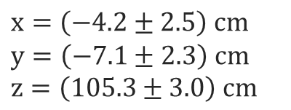
Sources localization
3D spectro-imaging result
Source’s volume barycenter
²⁴¹Am
¹³³Ba
Legend:
× POVs
─ Trajectory
∙ Point cloud
$x=\left(−3.9±2.3\right) cm$
$y=\left(16.3±2.1\right) cm$
$z=\left(91.5±2.8\right) cm$
$x=\left(−4.2±2.5\right) cm$
$y=\left(−7.1±2.3\right) cm$
$z=\left(105.3±3.0\right) cm$
¹³³Ba volume
Estimated distance between sources
POV 3
²⁴¹Am volume
$d_{est}=27.2±3.4 cm$
$d_{real}=25.1±0.5 cm$
Absolute error on the distance:
$$ϵ_{abs}=2.1 cm$$
POV 1
POV 2
z
x
3D gamma spectro-imaging validated!
y

Slide 17
Conclusion
5

Slide 18
Conclusions and perspectives
Conclusions:
Perspectives:
Development and validation of a 3D gamma imaging method
Development of a dedicated prototype
Experimental validation in laboratory conditions
Tests on spatially extended sources
Correction of angular resolution degradation effects
System integration
Looking for field tests!

Slide 19
Thank you for your attention!
Giulia ROSSO
giulia.rosso@cea.fr
Special thanks to: G. AMOYAL, D. FRAS, Q. GENDRE, A. MACARIO BARROS, M. MICHEL, J. PLAGNARD, L. TOSONI, D. TROMSON

Slide 20

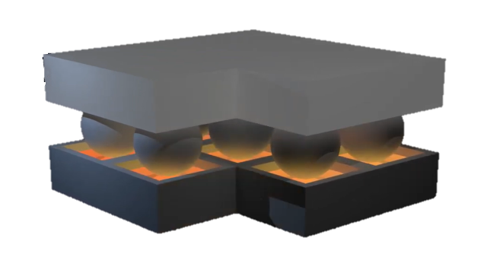
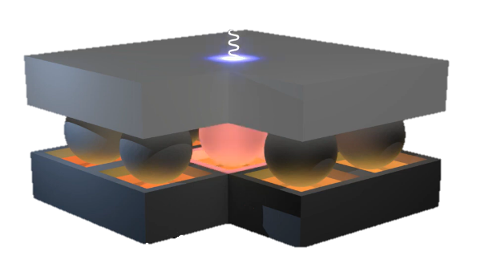
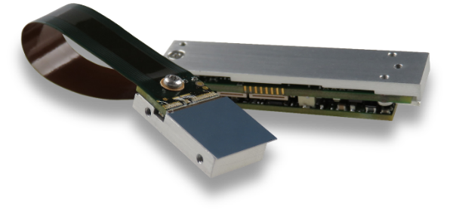

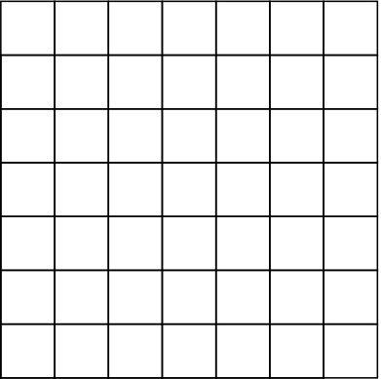








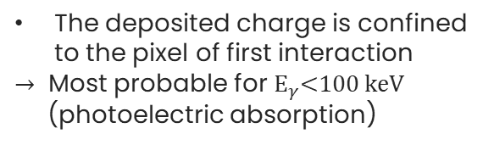
Hybrid pixel detector calibration
Detector’s working principle
MiniPIX TPX3
Hybrid pixel detector based on CERN Timepix3 ASIC
CdTe
Timepix3 ASIC
$256×256$pixels
$55μm$ pixel pitch
Illuminated pixel
Localized energy deposition:
$$10 keV$$
Broadened energy deposition:
$$100 keV$$
The deposited charge is confined to the pixel of first interaction
$→$ Most probable for $E_{γ}\text{<}100 keV$
(photoelectric absorption)
The deposited charge is shared among multiple pixels
$→$ Most probable for $E_{γ}>100 keV$
(Compton scattering)
$$50 keV$$
$$10 keV$$
$$20 keV$$
$$30 keV$$
Detector matrix
Detector matrix

Slide 21
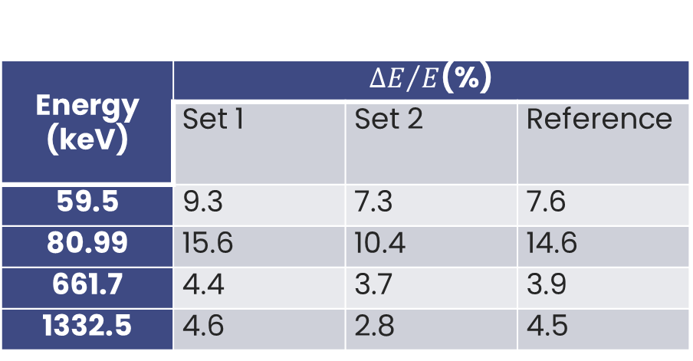
Detector energy resolution
Energy (keV) | ${ΔE}/E$(%)
 | Set 1 | Set 2 | Reference
59.5 | 9.3 | 7.3 | 7.6
80.99 | 15.6 | 10.4 | 14.6
661.7 | 4.4 | 3.7 | 3.9
1332.5 | 4.6 | 2.8 | 4.5

Slide 22
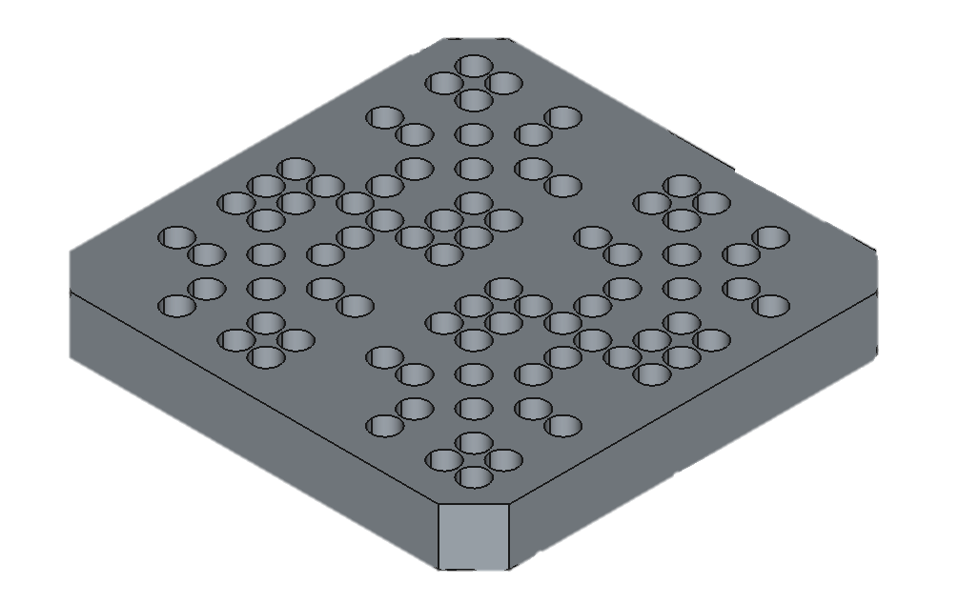
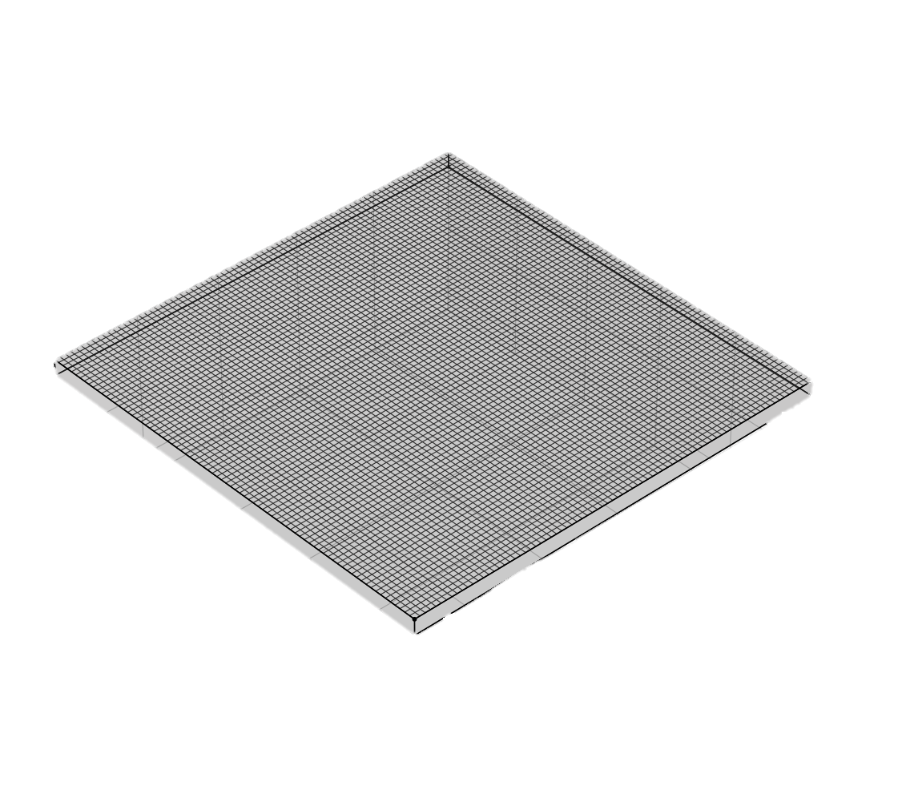
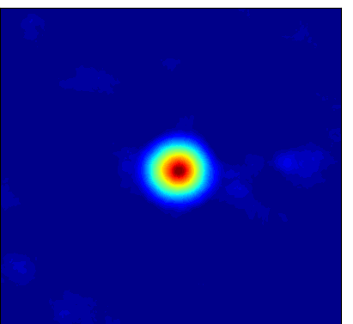
Coded-aperture imaging
Mask
Opaque elements (high Z material)
Transparent elements (holes)
Sensitive to ionizing radiation
Sensitive to the position of interaction (pixelized)
Detector
Flux 1
Flux 1
Flux 2
1.
2.
Flux 2
Coded aperture
Detector

Slide 23
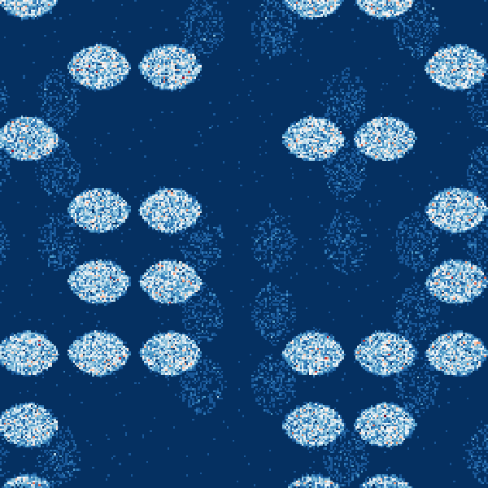
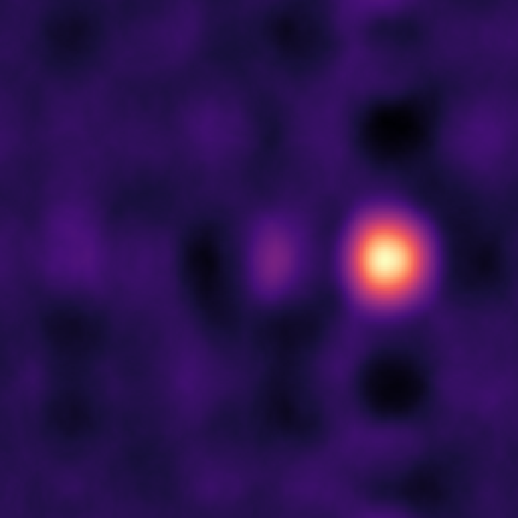
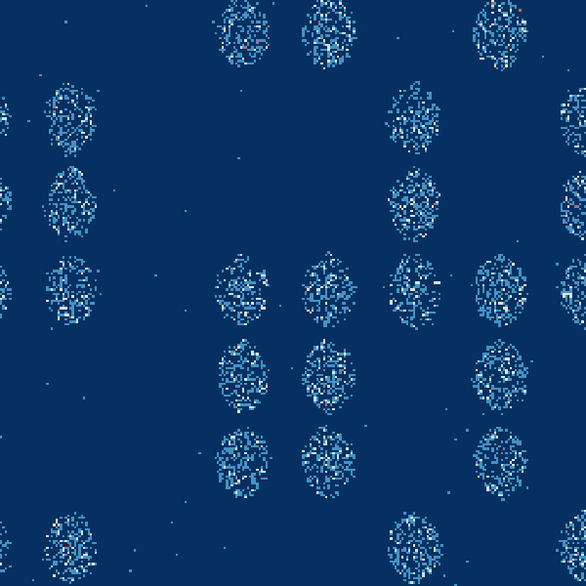
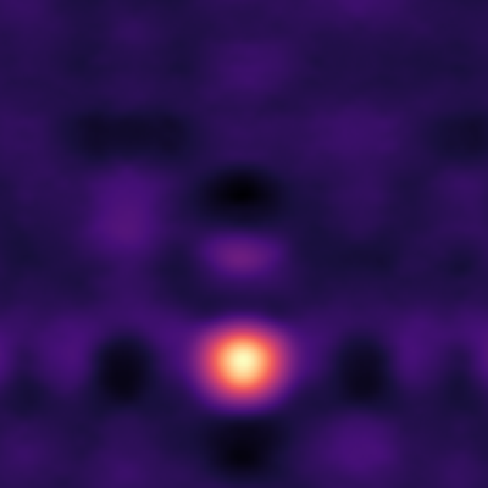
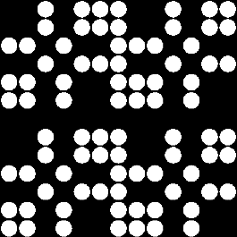
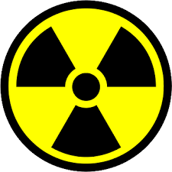
Coded-aperture imaging
Mask
Opaque elements (high Z material)
Transparent elements (holes)
Sensitive to ionizing radiation
Sensitive to the position of interaction (pixelized)
Detector
© E. Reynal De Saint-Michel

