Slide 1
CNN-Based Particle Reconstruction for the Future Calorimeter System
Notes:
Good morning, I am Xin from IJCLab. Today I would like to share my study on CNN-based hadronic energy regression for the ILD SiW-ECAL and AHCAL system. The main question behind this study is whether we can use the deep learning and detailed shower information to improve the hadron energy reconstruction performance.

Slide 2
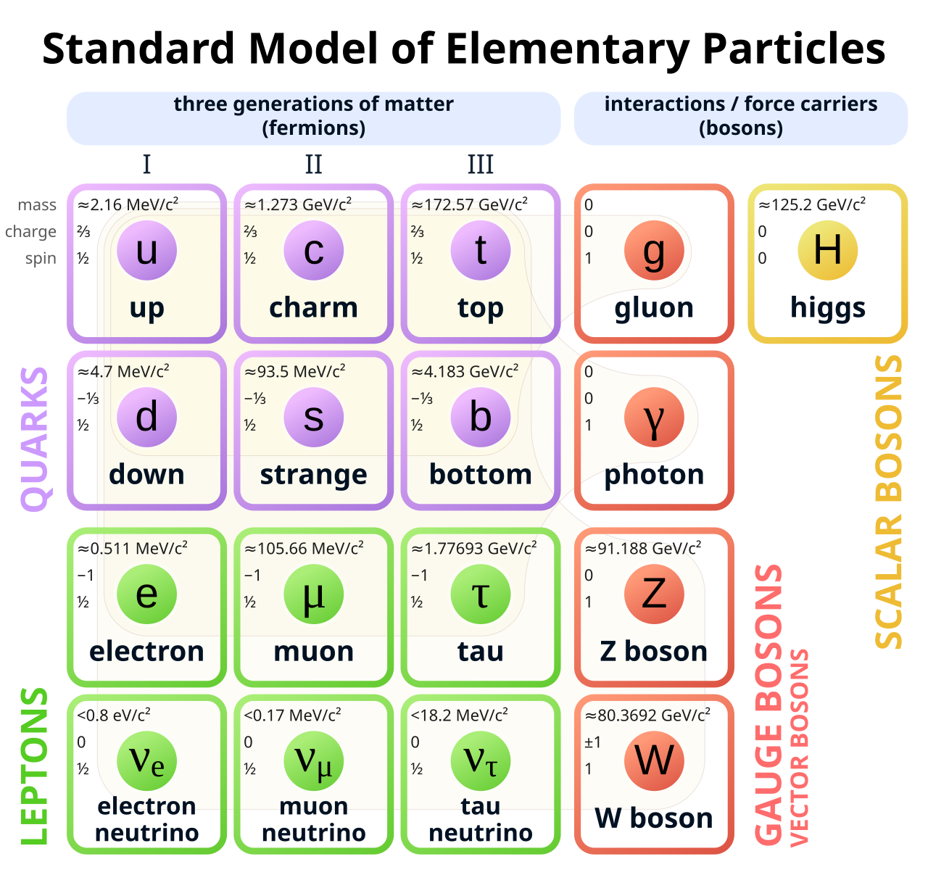
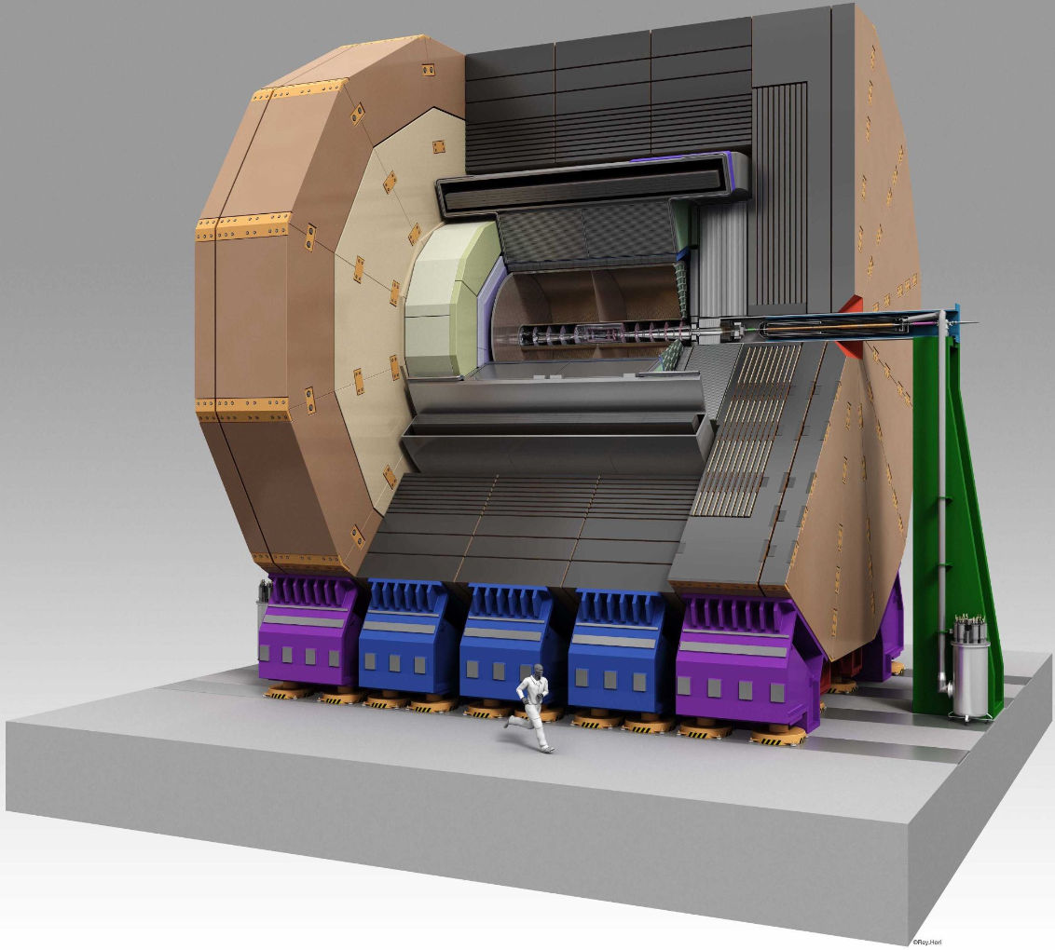

Future detectors
Next-generation colliders
Examples: FCC-ee, ILC
Precision Standard Model examination
New physics discovery
Develop future detectors
Notes:
Let me first give a bit of motivation for this study.
At future Higgs factories, the detector measures the final-state particles produced in collisions, and these measurements are then used to reconstruct physics objects like jets. So the quality of particle energy measurement directly affects the overall physics performance.
In the particle-flow approach, charged particles are mostly measured by the tracker, photons by the ECAL, while neutral hadrons are measured mainly by the calorimeter system. This means that the ECAL and HCAL play a particularly important role for the neutral-hadron part of jet reconstruction.
So from both the physics side and the detector side, calorimeter energy reconstruction really matters. It affects jet energy resolution, and it is also one of the key benchmarks when we evaluate or optimize calorimeter designs.

Slide 3
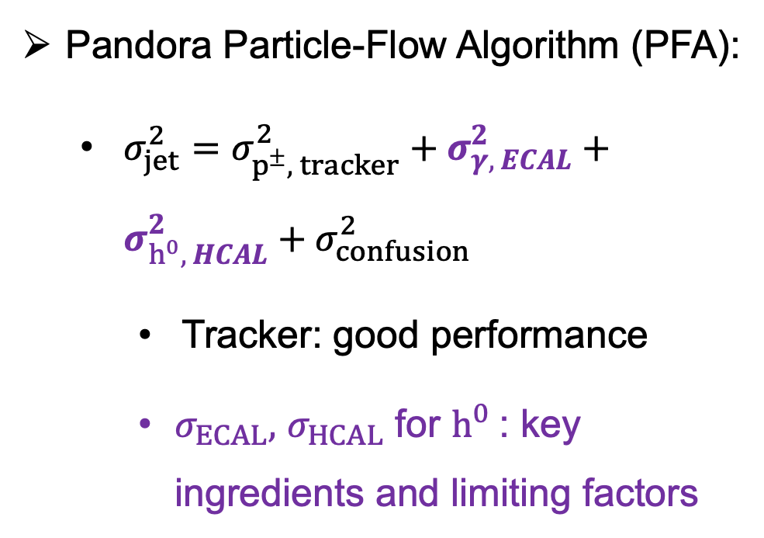
Particle Flow Detector System
Pandora Particle-Flow Algorithm (PFA):
  $σ_{jet}^{2}=$ $σ_{p^{±}, tracker}^{2}+σ_{γ, ECAL}^{2}+σ_{h^{0}, HCAL}^{2}+σ_{confusion}^{2}$
    Tracker: good performance
    $σ_{ECAL},$ $σ_{HCAL}$ for $h^{0}$: key ingredients and limiting factors
Pandora PFA: arXiv:0907.3577
Notes:
Let me first give a bit of motivation for this study.
At future Higgs factories, the detector measures the final-state particles produced in collisions, and these measurements are then used to reconstruct physics objects like jets. So the quality of particle energy measurement directly affects the overall physics performance.
In the particle-flow approach, charged particles are mostly measured by the tracker, photons by the ECAL, while neutral hadrons are measured mainly by the calorimeter system. This means that the ECAL and HCAL play a particularly important role for the neutral-hadron part of jet reconstruction.
So from both the physics side and the detector side, calorimeter energy reconstruction really matters. It affects jet energy resolution, and it is also one of the key benchmarks when we evaluate or optimize calorimeter designs.

Slide 4
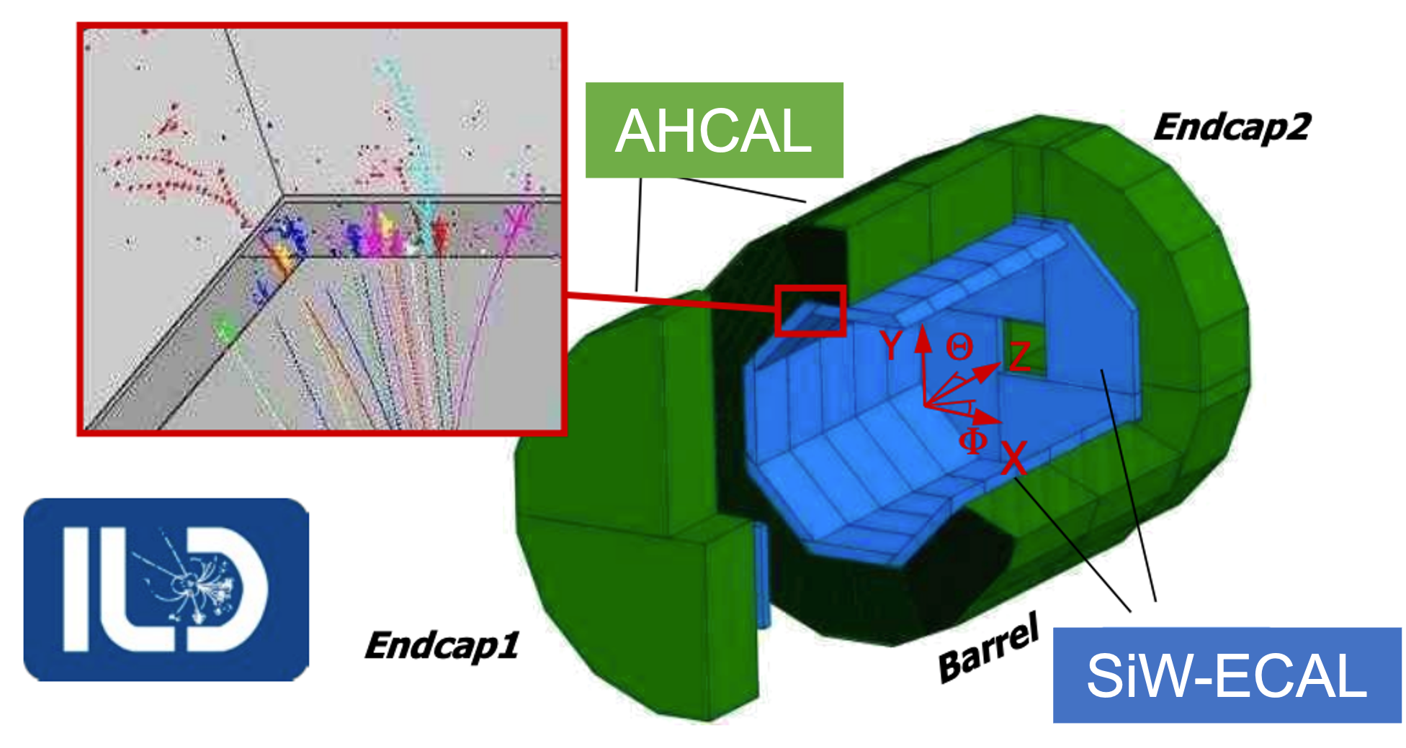
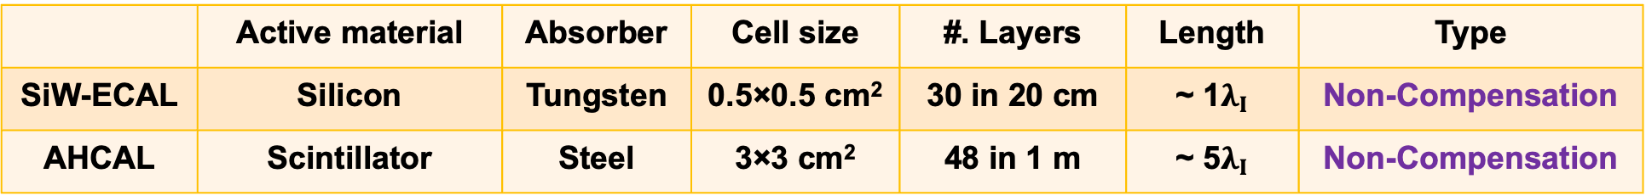
Particle Flow Calorimeter System
 | Active material | Absorber | Cell size | #. Layers | Length | Type
SiW-ECAL | Silicon | Tungsten | 0.5×0.5 cm² | 30 in 20 cm | ~ 1$λ_{I}$ | Non-Compensation
AHCAL | Scintillator | Steel | 3×3 cm² | 48 in 1 m | ~ 5$λ_{I}$ | Non-Compensation
Detector overview:
  Combined SiW-ECAL + AHCAL system in ILD
  High-granularity imaging calorimeter
Goal: study hadron energy reconstruction in the realistic combined system (In PFA calorimeter design, ~55% particles interact in the ECAL)
Notes:
The detector setup considered here is the ILD calorimeter system. It consists of the SiW-ECAL and the AHCAL.
While many previous studies focused on the single calorimeter, here I want to address the energy resolution of the combined ECAL plus HCAL system, which is the more realistic configuration. This is important because hadronic showers develop across both detectors, so the final resolution should be understood at the system level rather than at the level of one subsystem alone.
However, the ECAL and HCAL are quite different in granularity, material, depth, and response.
So in the later model design, I try to preserve and exploit this complementary information from the two calorimeters, rather than forcing everything into a single undifferentiated input.
a single calorimeter subsystem or for simplified highly granular calorimeter setups

Slide 5
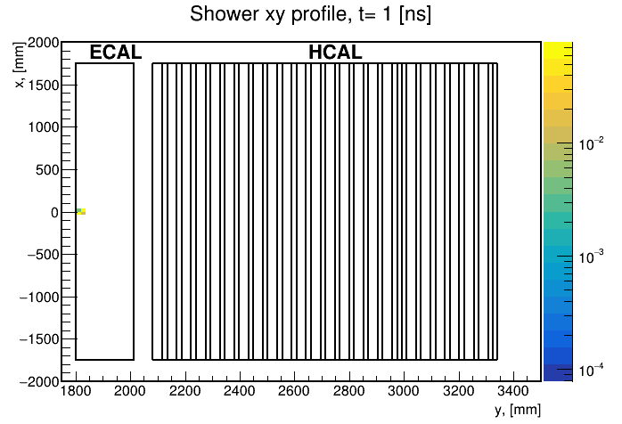
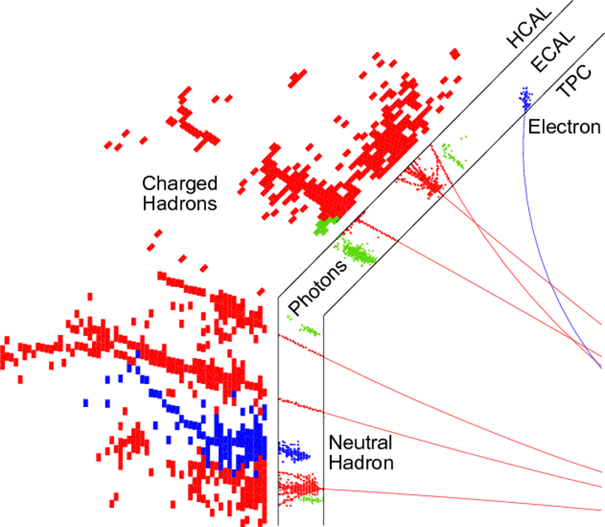
Shower development in Calorimetry

Slide 6
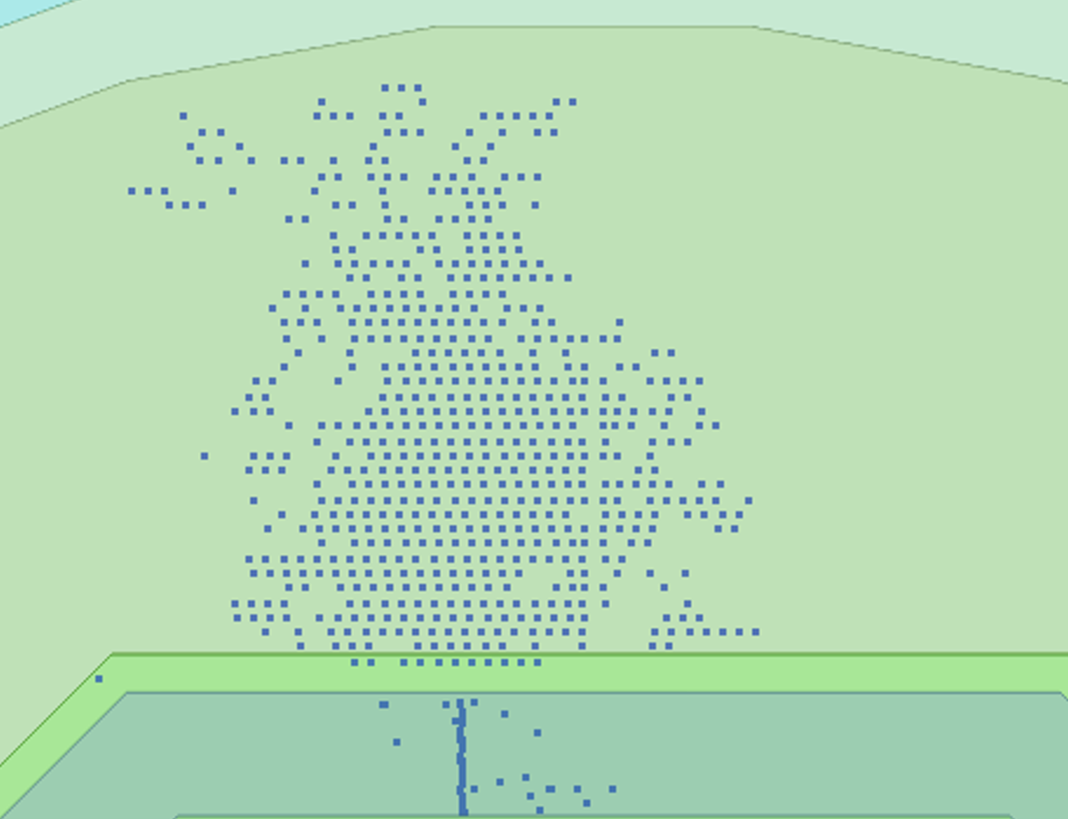
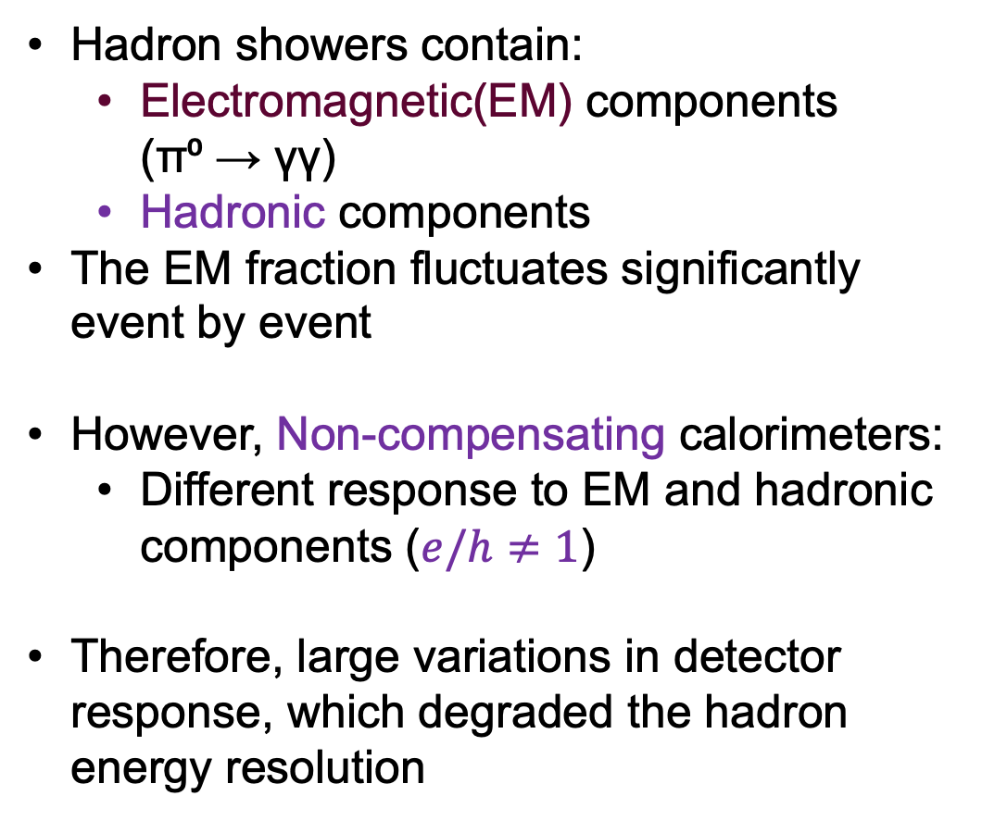
Challenges in Hadron Energy Reconstruction
Hadron showers contain:
  Electromagnetic(EM) components (π⁰ → γγ)
  Hadronic components
The EM fraction fluctuates significantly event by event
However, Non-compensating calorimeters:
  Different response to EM and hadronic components ($e/h≠1$)
Therefore, large variations in detector response, which degraded the hadron energy resolution
My work:
CNN-based approach for the full ECAL + HCAL system (realistic detector setup)
AHCAL
Had.
EM.
SiW-ECAL
Notes:
Now let me come to the main difficulty.
Hadronic showers contain both electromagnetic and hadronic components.
The electromagnetic fraction fluctuates significantly from event to event.
As a result, even for the same true hadron energy, the visible detector response can vary substantially.
This is one of the main reasons why hadron energy reconstruction is much more difficult than electron.
So the central idea of this work is to ask whether a CNN can learn from the full shower topology of the ECAL plus HCAL system and correct for part of this fluctuation.

Slide 7
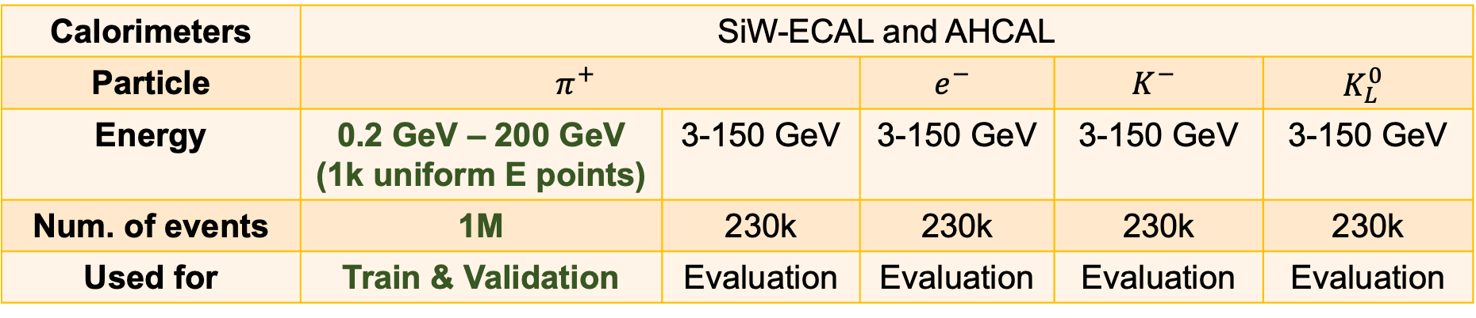
Samples preparation based on ILD software
Single-particle simulation
Hits Digi & Reco
Particle energy reconstruction
Performance comparison
Calorimeters | SiW-ECAL and AHCAL
Particle | $$π^{+}$$ |  | $$e^{−}$$ | $$K^{−}$$ | $$K_{L}^{0}$$
Energy | 0.2 GeV – 200 GeV (1k uniform E points) | 3-150 GeV | 3-150 GeV | 3-150 GeV | 3-150 GeV
Num. of events | 1M | 230k | 230k | 230k | 230k
Used for | Train & Validation | Evaluation | Evaluation | Evaluation | Evaluation
Notes:
This slide summarizes the workflow and the sample preparation.
We start from single-particle simulation, then perform hit digitization, and at last we compare different energy reconstruction methods.
For training and validation, I use a large sample of single charged pions over a broad energy range.
For evaluation, I test not only on charged pions, but also on other particles including kaons, electrons, and neutral kaons.
This setup is useful because it allows us to study both the direct performance on the training-like particle and also the generalization behavior across different particles.

Slide 8
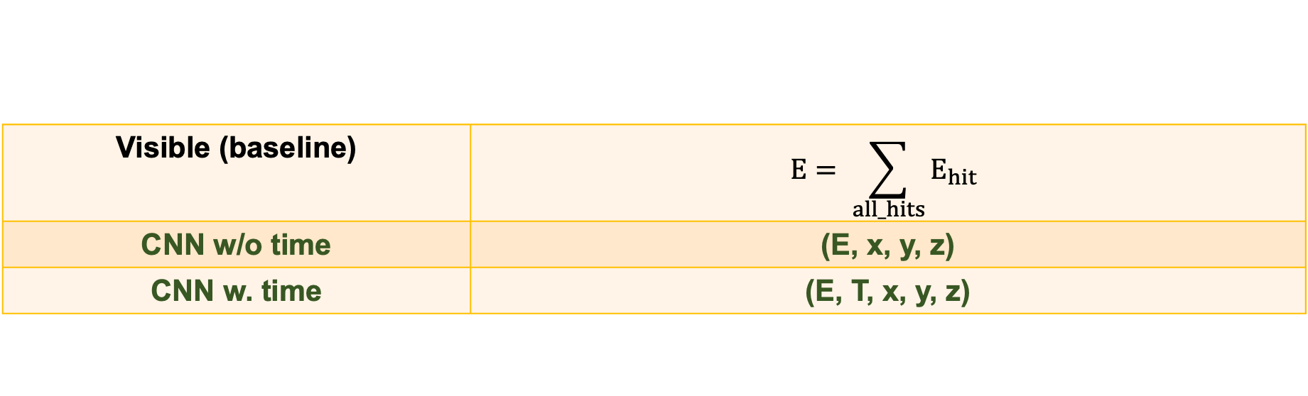
Reconstruction Methods
Single-particle simulation
Hits Digi & Reco
Particle energy reconstruction
Performance comparison
Visible (baseline) | $$E= \sum_{all_hits}{E_{hit}}$$
CNN w/o time | (E, x, y, z)
CNN w. time | (E, T, x, y, z)

Slide 9
What information is encoded into the model?
Physics motivation:
AHCAL
 | EM component | Hadronic component
（x, y, z） | Narrow, compact, shorter | Broader, longer
e | Higher density | Lower, spread out
t | Prompt | Delayed components
Had.
EM.
SiW-ECAL
Notes:
Once the hits are voxelized, the next question is what information each voxel should contain.
From physics, we know that electromagnetic and hadronic components differ in spatial compactness, energy density, and timing behavior.
So in the no-time case, the CNN receives information about where the energy is deposited and how dense the local shower structure is.
In the timing version, I add extra channels that encode how the voxel energy is distributed across different time regions.

Slide 10






What information is encoded into the model?
Ch0: $E_{voxel}/E_{voxel,max}$
Spatial-energy structure
Where and how much energy is deposited
Ch1: $E_{voxel}/E_{total}$
Ch2: $n_{voxel}/n_{voxel,max}$
Ch3: $E_{early}/E_{voxel}$
Spatial-time-category structure
How the energy is distributed in time
Use perfect time for upper-bound study
Ch4: $E_{mid}/E_{voxel}$
Ch5: $E_{late}/E_{voxel}$
Notes:
Once the hits are voxelized, the next question is what information each voxel should contain.
From physics, we know that electromagnetic and hadronic components differ in spatial compactness, energy density, and timing behavior.
So in the no-time case, the CNN receives information about where the energy is deposited and how dense the local shower structure is.
In the timing version, I add extra channels that encode how the voxel energy is distributed across different time regions.

Slide 11
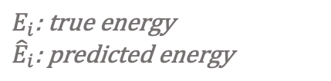
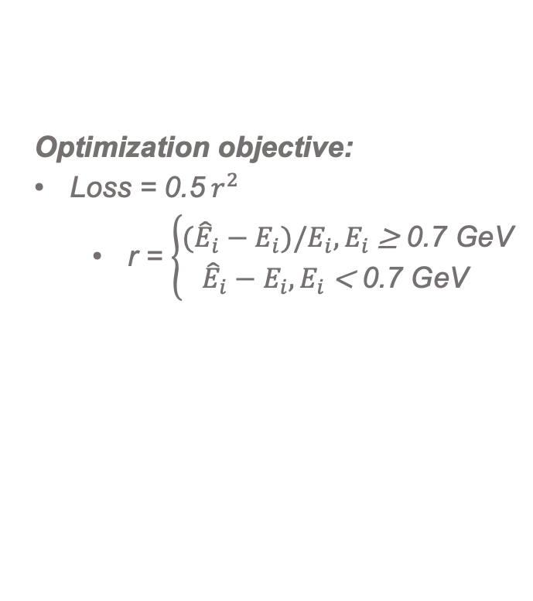
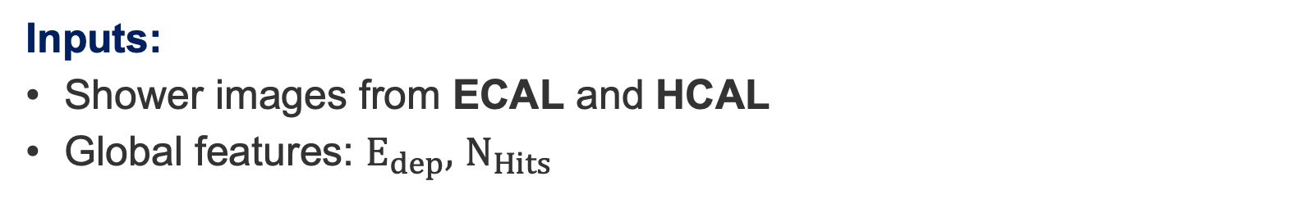
Dual-branch CNN model
$$E_{i}\text{: }\text{true} \text{energy}$$
$${\hat{E}}_{i}\text{: }\text{predicted} \text{energy}$$
Inputs:
Shower images from ECAL and HCAL
Global features: $E_{dep},$ $N_{Hits}$
Optimization objective:
Loss = 0.5${ r}^{2}$
  r = $\left\{\begin{aligned}({\hat{E}}_{i}−E_{i})/E_{i}, E_{i} \text{≥}\text{ 0.7 }\text{GeV} \\ {\hat{E}}_{i}−E_{i},E_{i} \text{<}\text{ 0.7 }\text{GeV} \end{aligned}\right.$
Notes:
This slide shows the architecture of the regression model.
The input consists of voxelized shower images from the ECAL and HCAL, together with some global features such as deposited energy and the number of hits.
The model uses two separate branches at the beginning, one for the ECAL and one for the HCAL.
This is deliberate, because the two calorimeters have different resolutions and capture different aspects of the shower.
After extracting detector-specific features, the two branches are aligned and fused.
I also include longitudinal shower information and global auxiliary features before the final regression stage.
So the overall idea is not just to use a deep network, but to use a calorimeter-aware architecture that respects the detector structure and exploits the complementarity of the ECAL and HCAL.

Slide 12
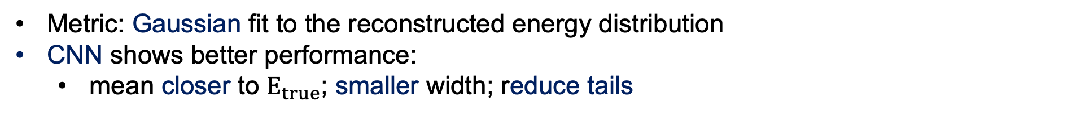
Energy Distribution of $π^{+}$: CNN vs Baseline
Metric: Gaussian fit to the reconstructed energy distribution
CNN shows better performance:
  mean closer to $E_{true}$; smaller width; reduce tails
2 GeV
5 GeV
10 GeV
Blue: visible
Green: CNN w/o time
Red: CNN w. time
80 GeV
100 GeV
150 GeV
Notes:
Now let me move to the results.
This slide compares the reconstructed energy distributions for charged pions between the CNN and the visible-energy baseline.
The key observation is that the CNN distributions are generally closer to the true energy, with a narrower core and reduced low- and high-energy tails.
This means that the CNN is not only improving the average response, but also reducing the event-by-event fluctuations that broaden the reconstructed energy distribution.
So already at the level of the raw energy spectrum, we see that the CNN is learning useful shower information beyond the visible sum.

Slide 13
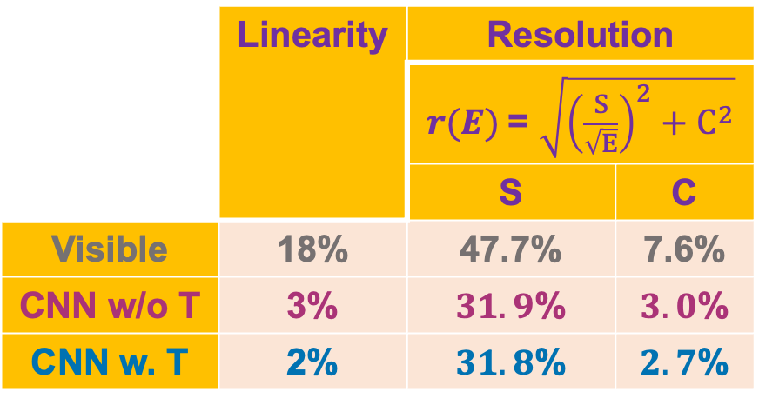
CNN Gain for π⁺ over Baseline
CNN significantly outperforms visible-energy baseline in both linearity and resolution. (40% - 60% improvement in resolution)
The dominant gain comes from the spatial-energy shower structure.
 | Linearity | Resolution
 |  | $r(E)$= $\sqrt{{\left(\frac{S}{\sqrt{E}}\right)}^{2}+C^{2}}$
 |  | S | C
Visible | 18% | 47.7% | 7.6%
CNN w/o T | 3% | $31.9$% | $3.0$%
CNN w. T | 2% | $31.8$% | $2.7$%
Notes:
This is one of the central result slides.
Compared with the visible-energy baseline, the CNN significantly improves both linearity and resolution.
The improvement in resolution is especially strong, reaching roughly 40 to 60 percent depending on the energy region and metric.
This is important because it shows that the network is not making only a small correction.
It is capturing substantial information that the visible-energy sum alone does not use.
So for single-particle hadrons, the gain is both clear and quantitatively significant.

Slide 14
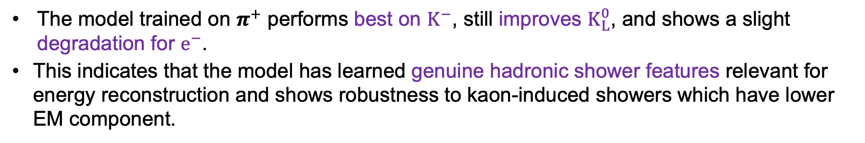
Generalization across particles
The model trained on $π^{+}$ performs best on $K^{−}$, still improves $K_{L}^{0}$, and shows a slight degradation for $e^{−}$.
This indicates that the model has learned genuine hadronic shower features relevant for energy reconstruction and shows robustness to kaon-induced showers which have lower EM component.
Notes:
This slide summarizes the transfer pattern across particles.
The model trained on charged pions performs best on K-minus, still improves K-zero-L, and shows slight degradation for electrons.
I think this pattern is very meaningful physically.
If the model were just a particle-specific numerical fit, we would not necessarily expect such a coherent hierarchy.
Instead, this behavior suggests that the network has learned genuine hadronic shower features that transfer naturally to other hadron-like particles, while not transferring in the same way to electromagnetic showers.

Slide 15
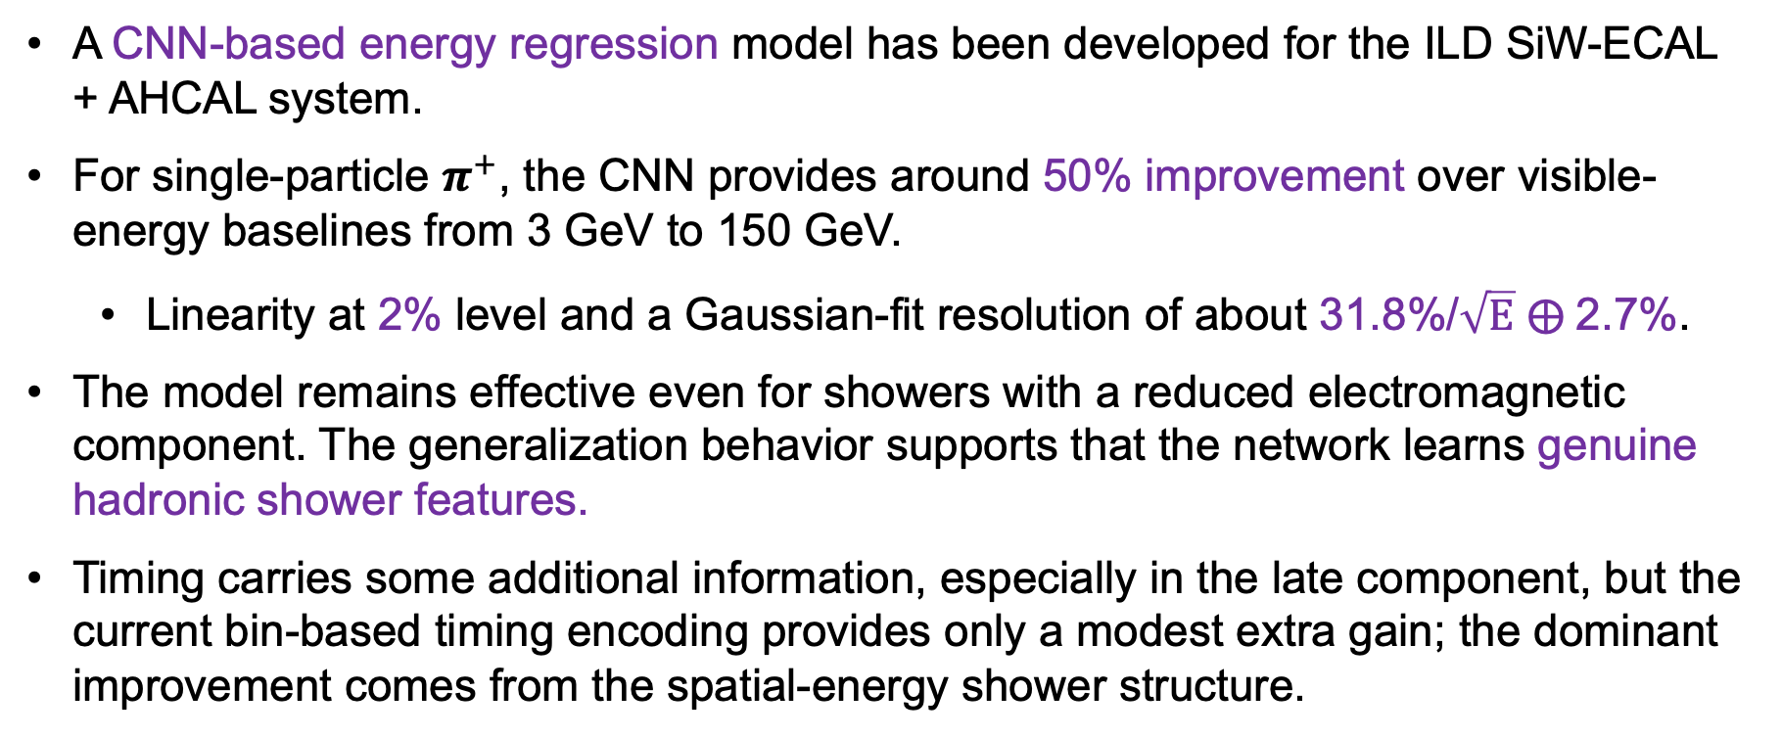
Summary
A CNN-based energy regression model has been developed for the ILD SiW-ECAL + AHCAL system.
For single-particle $π^{+}$, the CNN provides around 50% improvement over visible-energy baselines from 3 GeV to 150 GeV.
  Linearity at 2% level and a Gaussian-fit resolution of about 31.8%/$\sqrt{E}$ $⨁$2.7%.
The model remains effective even for showers with a reduced electromagnetic component. The generalization behavior supports that the network learns genuine hadronic shower features.
Timing carries some additional information, especially in the late component, but the current bin-based timing encoding provides only a modest extra gain; the dominant improvement comes from the spatial-energy shower structure.

Slide 16
Thanks!

Slide 17
Backup

Slide 18
Reco-level calorimeter hit observables
Single-particle simulation
Hits Digi & Reco
Particle energy reconstruction
Performance comparison
X, Y, Z | Reconstructed hit position in detector coordinates
E | Calibrated reconstructed hit energy with 0.5 MIP threshold
T | Earliest contribution within the integration window, relative to the generator-level production time of the incident particle
Notes:
This slide summarizes the workflow and the sample preparation.
We start from single-particle simulation, then perform hit digitization, and at last we compare different energy reconstruction methods.
For training and validation, I use a large sample of single charged pions over a broad energy range.
For evaluation, I test not only on charged pions, but also on other particles including kaons, electrons, and neutral kaons.
This setup is useful because it allows us to study both the direct performance on the training-like particle and also the generalization behavior across different particles.

Slide 19
Detector response and reconstruction work properly
At EM scale (electrons), evaluating the reconstruction performance
Summing of all the visible hits
Linearity: within 2.5%; Resolution: S=17.3%, C=1.2%
Notes:
Before moving to the CNN, it is important to check that the detector response and reconstruction chain are behaving properly. Here I use electrons as a sanity check. I simply sum all visible hit, the response is linear within about 3 percent, and the resolution is consistent with a reasonable electromagnetic performance. So this tells us that the basic simulation and reconstruction setup is working as expected.

Slide 20
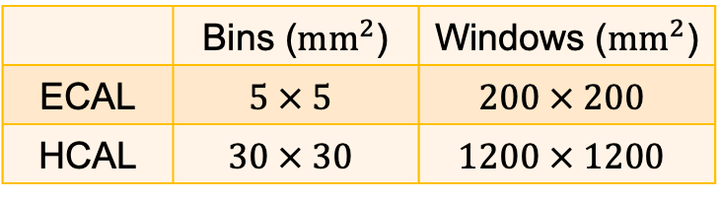
How to perform voxelization?
Hits (x, y, z, e, t)
Voxelization:
  Transform shower hits to calorimeter images
💡 Detector-aware representation
  Transverse plane (X-Z): local windows centered on the shower COG
  Longitudinal direction: native detector segmentation retained
  Preserve different granularity and geometry
Voxel
COG (X-Z)
X-Z plane
 | Bins (${mm}^{2}$) | Windows (${mm}^{2}$)
ECAL | $$5 × 5$$ | $$200 × 200$$
HCAL | $$30 × 30$$ | $$1200 × 1200$$
Notes:
This slide explains the voxelization strategy.
The goal is to transform calorimeter shower hits into local calorimeter images.
For each calorimeter subsystem, I first compute the shower center in the X-Z plane, and then open a local window around that center.
The hits inside this window are converted into voxels.
The ECAL and HCAL are processed separately, because they have very different transverse granularity, so they need different window sizes and bin sizes.
At the same time, along the depth direction, I keep the detector segmentation, so the longitudinal shower profile is retained.
There are two main design considerations.
First, the CNN window should be large enough to cover the relevant shower region, but not so large that the input becomes too sparse or too expensive computationally.
Second, the representation should remain detector-aware, meaning that it should preserve the different granularity and geometry of the ECAL and HCAL.
So I use subsystem-specific windows and bin sizes.
This way, the representation remains close to the actual detector structure rather than being an arbitrary rebinning.

Slide 21
Irregular calorimeter data → CNN input ?
CNN input requirements:
Regular grid format
Operate within a fixed spatial window
However, Detector reality: calorimeter data are irregular
Discrete hits with non-uniform geometry
Different granularity in ECAL and HCAL
Therefore, calorimeter hits need a structured representation for CNN input
Voxelization
AHCAL
SiW-ECAL
Notes:
A key technical issue is that calorimeter data are not naturally in a format that a CNN expects.
CNNs operate on regular grids and fixed windows.
But real calorimeter data consist of irregular hits, non-uniform geometry, and different granularity in the ECAL and HCAL.
So before using a CNN, we need a structured detector-aware representation.
This is why voxelization becomes necessary.
In other words, we want to convert the physical shower into something image-like, but without losing the geometry information that is important for the reconstruction task.

Slide 22
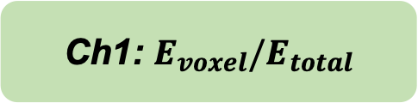
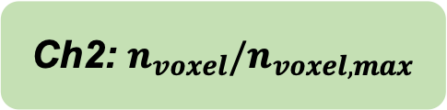
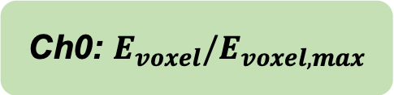
What information is encoded into the model?
 | （x, y, z） | E | t
EM component | Narrow, compact, shorter | Higher density | Prompt
Hadronic component | Broader, longer | Lower, spread out | Delayed components
For CNN w/o timing information:
Ch0: $E_{voxel}/E_{voxel,max}$
Voxel
Spatial-energy structure
Where and how much energy is deposited
Ch1: $E_{voxel}/E_{total}$
Ch2: $n_{voxel}/n_{voxel,max}$
Notes:
Once the hits are voxelized, the next question is what information each voxel should contain.
From physics, we know that electromagnetic and hadronic components differ in spatial compactness, energy density, and timing behavior.
So in the no-time case, the CNN receives information about where the energy is deposited and how dense the local shower structure is.
In the timing version, I add extra channels that encode how the voxel energy is distributed across different time regions.

Slide 23

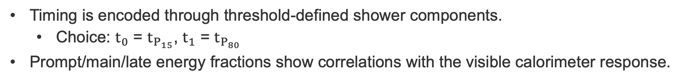


How to implement time?
Timing is encoded through threshold-defined shower components.
  Choice: $t_{0}$ = $t_{P_{15}}$, $t_{1}$ = $t_{P_{80}}$
Prompt/main/late energy fractions show correlations with the visible calorimeter response.
t < $t_{0}$
Ch3: $\frac{E_{early}}{E_{voxel}}$
$t_{1}$< t
Ch5: $\frac{E_{late}}{E_{voxel}}$
$t_{0}$< t < $t_{1}$
Ch4: $\frac{E_{mid}}{E_{voxel}}$
Notes:
Here I explain how the timing information is incorporated.
Instead of giving the model raw hit times directly, I summarize the timing inside each voxel by splitting its energy into early, mid, and late components.
The thresholds are defined using timing percentiles, and they are chosen separately with guidance from the detector response correlations.
The important point is that the model does not see time as an unstructured list of hit timestamps.
It sees a physically motivated decomposition of voxel energy into prompt, intermediate, and delayed fractions.
This is a more stable and more interpretable way to inject timing information into the network.
And as shown on the right, the late energy fraction already shows a visible correlation with the calorimeter response, which suggests that timing should carry useful information.

Slide 24
Time-Separated Spatial Patterns
Temporal structure of the shower is converted into a set of time-resolved spatial and energy maps (combine time with spatial-energy structure).
The model can learn where different time components tend to appear and how they are distributed across the ECAL and HCAL.
Longitudinal
Transverse
Notes:
This slide gives a more visual view of the same idea.
The temporal structure of the shower is converted into a set of time-resolved spatial maps.
So the model can learn not only that delayed energy exists, but where it tends to appear in the ECAL and HCAL.
This is important because timing information is likely to be most useful when combined with spatial structure, rather than treated as a purely one-dimensional variable.
So one can think of this step as making the timing information learnable in a CNN-compatible way.

Slide 25
Dual-branch CNN model
💡Calorimeter-aware design, balance and exploit the complementary information from the two calorimeters.
Notes:
This slide shows the architecture of the regression model.
The input consists of voxelized shower images from the ECAL and HCAL, together with some global features such as deposited energy and the number of hits.
The model uses two separate branches at the beginning, one for the ECAL and one for the HCAL.
This is deliberate, because the two calorimeters have different resolutions and capture different aspects of the shower.
After extracting detector-specific features, the two branches are aligned and fused.
I also include longitudinal shower information and global auxiliary features before the final regression stage.
So the overall idea is not just to use a deep network, but to use a calorimeter-aware architecture that respects the detector structure and exploits the complementarity of the ECAL and HCAL.

Slide 26
What physical information can CNN potentially learn?
Potentially Learned features:
ECAL/HCAL energy sharing | Local density and topology
Shower start and depth | Leakage tendency
Longitudinal spread | Electromagnetic vs non-electromagnetic mixture
prompt / main / late spatial-time patterns (only for CNN w. time information)
Notes:
At this point it is useful to ask what kinds of physical information the CNN may actually learn.
Potentially, it can learn how the shower energy is shared between the ECAL and HCAL, where the shower starts, how deep it penetrates, how broad or compact it is, and whether it shows signs of leakage.
It may also learn the mixture between electromagnetic-like and non-electromagnetic components, and in the timing version it can additionally use prompt, main, and late spatial-time patterns.
So although the regression is data-driven, the information available to the network is closely connected to the physical properties that we expect to matter for hadronic energy reconstruction.

Slide 27
t0/t1

Slide 28
t0/t1

Slide 29
Voxelization strategy and model
Voxelization
Model

Slide 30
Timing realism

Slide 31
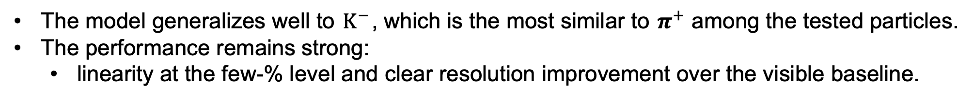
Transfer to $K^{−}$ (Model trained on $π^{+}$)
The model generalizes well to $K^{−}$, which is the most similar to $π^{+}$among the tested particles.
The performance remains strong:
  linearity at the few-% level and clear resolution improvement over the visible baseline.
Notes:
The next question is whether the model can generalize beyond the particle it was trained on.
Here I apply the model trained on charged pions to charged kaons.
The performance remains strong.
The linearity stays at the few-percent level, and the resolution is still clearly better than the visible-energy baseline.
This is physically reasonable, because among the tested particles, the hadronic shower behavior of K-minus is the most similar to pi-plus.
So this result suggests that the model has not simply memorized pion-specific patterns.

Slide 32
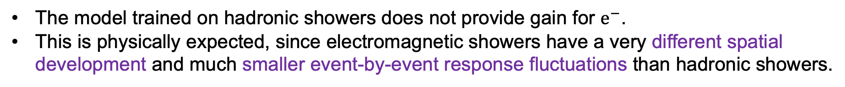
Transfer to $e^{−}$ (Model trained on $π^{+}$)
The model trained on hadronic showers does not provide gain for $e^{−}$.
This is physically expected, since electromagnetic showers have a very different spatial development and much smaller event-by-event response fluctuations than hadronic showers.
Notes:
Now I show the transfer to electrons.
In this case, the hadron-trained model does not provide a strong gain, and in some regions it can even become worse than the visible baseline.
But this is actually a physically expected result.
Electromagnetic showers are much more compact, much more regular, and they have much smaller event-by-event response fluctuations than hadronic showers.
So a model trained to correct hadronic fluctuations should not be expected to improve electromagnetic showers in the same way.
In that sense, this result is useful because it shows that the network is responding to hadronic shower physics rather than applying a universal black-box correction to everything.

Slide 33
Loss curve
CNN w. time
CNN w/o time

Slide 34
Time gain

