Slide 1

Development of a numerical X-ray imaging model for phase-contrast and dark-field imaging
Youliana Mouawad
14 Novembre 2024 → 15 Novembre 2027
Director : Adrien Stolidi (DIN/SMCD/LIMTEC)
Supervisors : Anthony Touron (DIN/SSIA/LSMA) & Juan Carlos García Hernández(DIN/SIMRI/LEMA)
Funded by the Carnot OSIRIS project

Slide 2
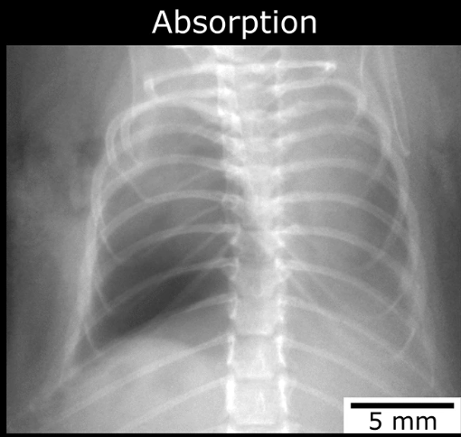
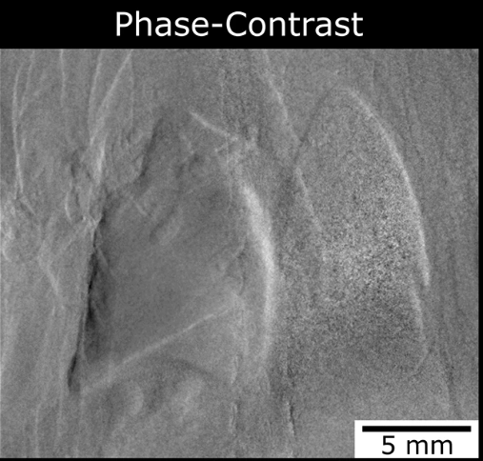
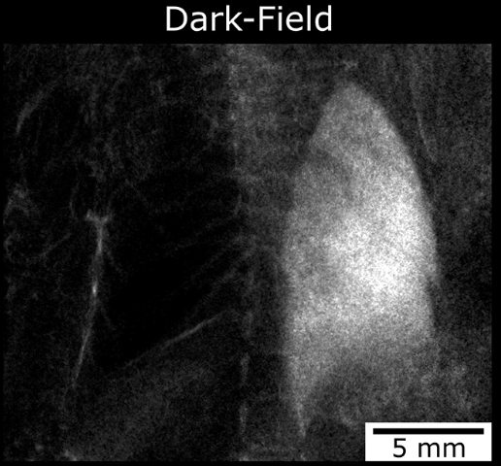
X-ray Imaging Methods
Beam attenuation (Beer–Lambert law)
Low contrast for soft tissues
The object induces a phase shift in the wavefront
The observed image mainly reflects the phase gradient
Enhanced contrast for soft tissues
Sensitive to multiple small-angle scattering
Reveals fine internal microstructure

Slide 3
Objectives
1

Slide 4
Objectives
  Main objective: Design and validate a numerical simulator for phase-contrast and dark-field X-ray imaging, with the best trade-off between accuracy and computation time
  Modeling approaches:
Wave-based
Particle-based
Fresnel :
✅Interference
✅Phase shift
❌Scattering
l
Ray Tracing :
❌Interference
✅Refraction
❌Scattering
Monte Carlo :
❌Interference
✅Refraction
✅Scattering

Slide 5
Existing model in CIVA — Hybrid Fresnel
CIVA environment:
We rely on the existing tools of the imaging system
→ X-ray source, object geometry, detector
Why “hybrid”?
Particle-based step — ray tracing
→ ray launching
→ estimation of absorption and phase shift at the object exit
Wave-optics step — Fresnel
→ propagation of the field to the detector
Model limitations:
Paraxial approximations: limited validity outside small-angle conditions
Thin-object approximation: limitations for big samples
Oversampling / pixel size: direct influence on the result
Numerical errors: due to ray tracing

Slide 6
Developed model

Slide 7


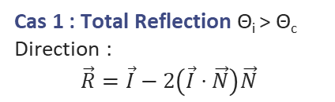



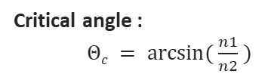
CIVA – Developed Monte Carlo model (Refraction – Reflection)
Incident photon
Reflection
Critical angle :
$Θc = arcsin⁡( \frac{n1}{n2} )$
$$\vec{I}$$
$$\vec{N}$$
$$\vec{R}$$
θᵢ
θᵢ
Cas 1 : Total Reflection Θ_{i} > Θ_{c}
Direction :
$$\vec{R}=\vec{I}−2\left(\vec{I}⋅\vec{N}\right)\vec{N}$$
Refraction
θₜ
$$\vec{T}$$
Absorption
Cas 2 : Refraction
Direction :
$$\vec{T}=\text{η}\vec{I}+\text{(}\text{η}\text{cos} \text{Θ}\text{i} \text{​− }\text{cos} \text{Θ}\text{t}\text{ ​)}\vec{N}$$
avec η = $\frac{n1}{n2}$
Scattering
Refraction
Transmittance

Slide 8
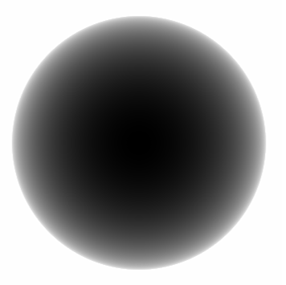
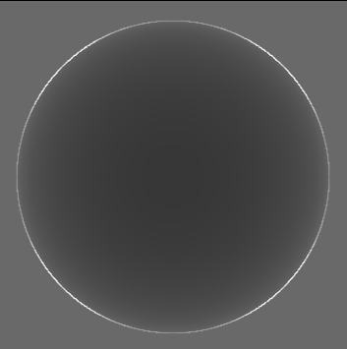
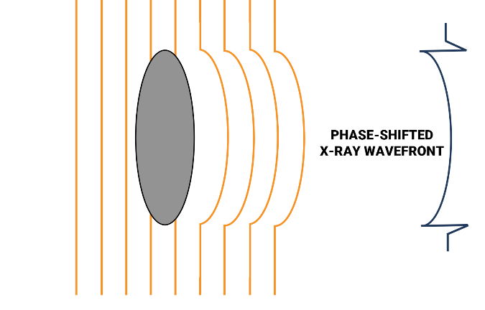
Application of the model to free-space propagation — Case study
Beam propagation in free space, without optics or gratings
The phase shifts induced by the object are converted into intensity variations at the detector
Absorption image :
No phase propagation
Phase image :
Apparence of edge-enhancement

Slide 9
Results
2
Comparison with other models from the literature

Slide 10
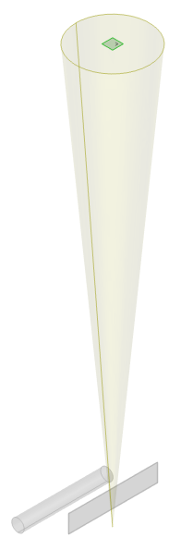
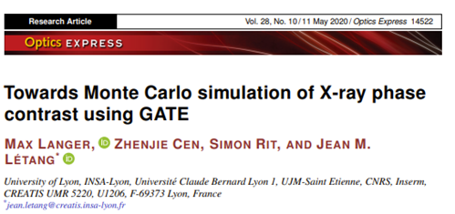
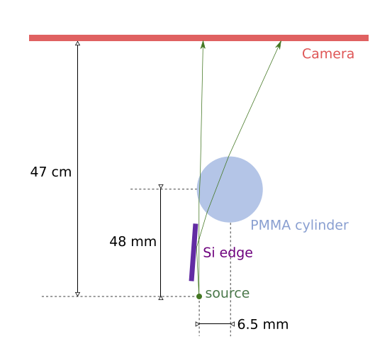
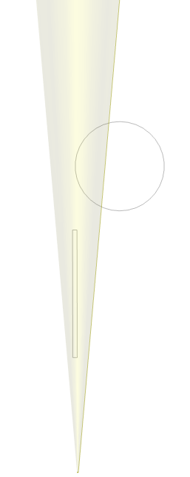
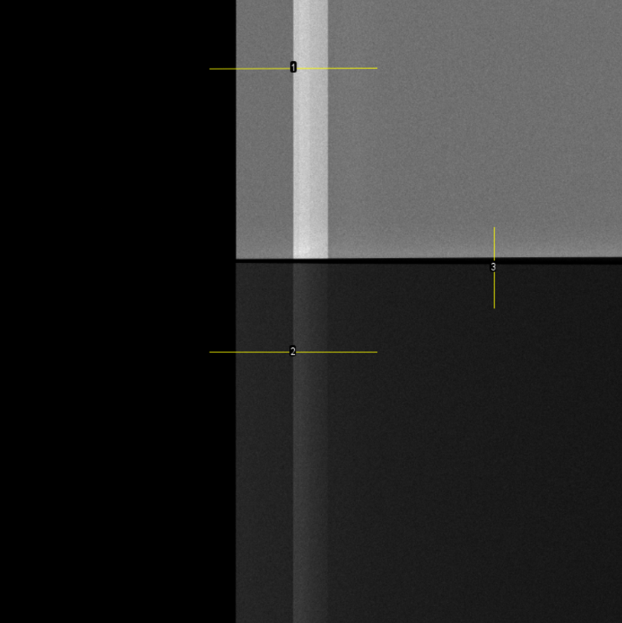
Silicon cylinder / edge – Comparison of CIVA MC refraction / Max Langer
Silicium
Air
Cylindre

Slide 11
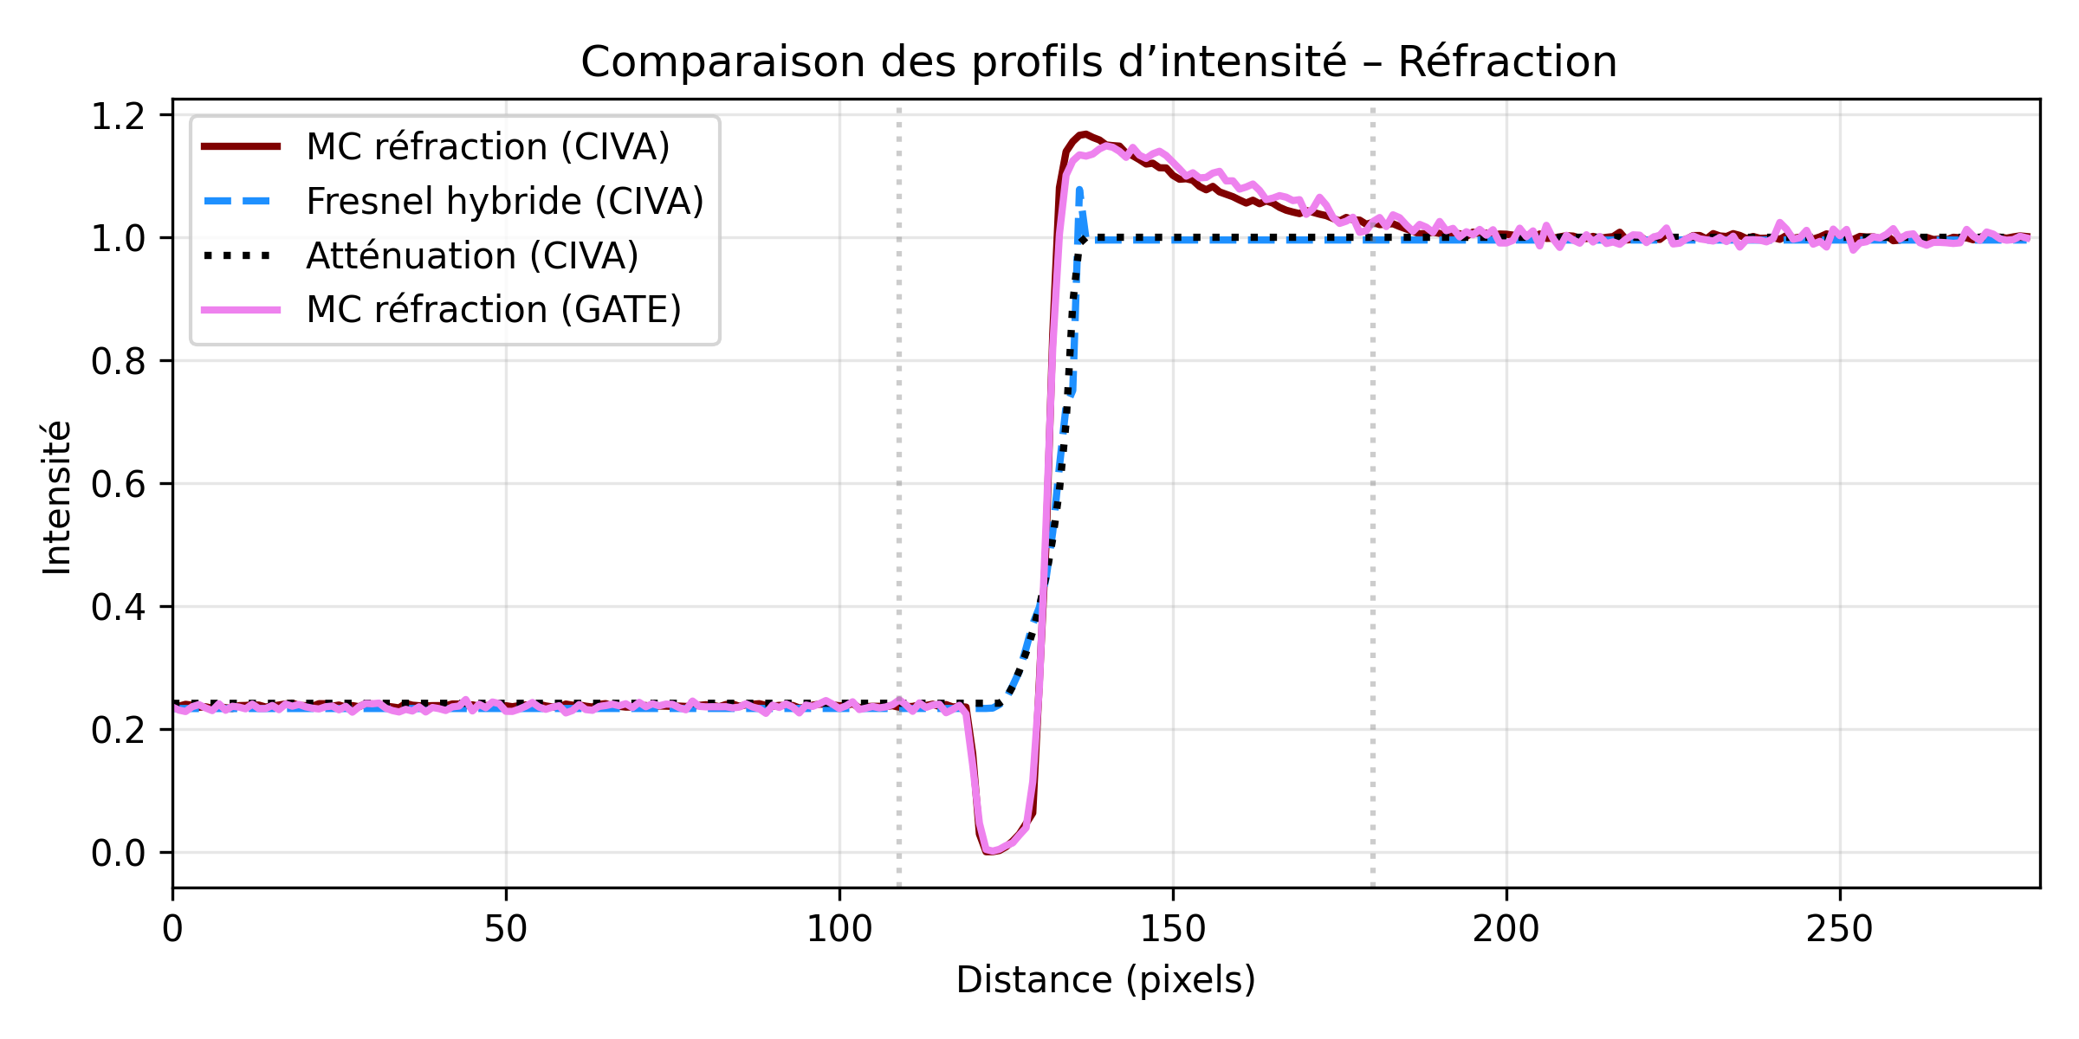

Refraction: MC refraction (CIVA) / Hybrid Fresnel (CIVA) / MC refraction (GATE)
Silicium
Air
Cylindre
GATE (reference) : refraction profile with an overshoot
CIVA MC refraction : good overall agreement with GATE in the overshoot region (similar position and amplitude)
CIVA Fresnel hybrid : wave effects are partially smoothed → attenuated overshoot, therefore refraction contrast is underestimated

Slide 12
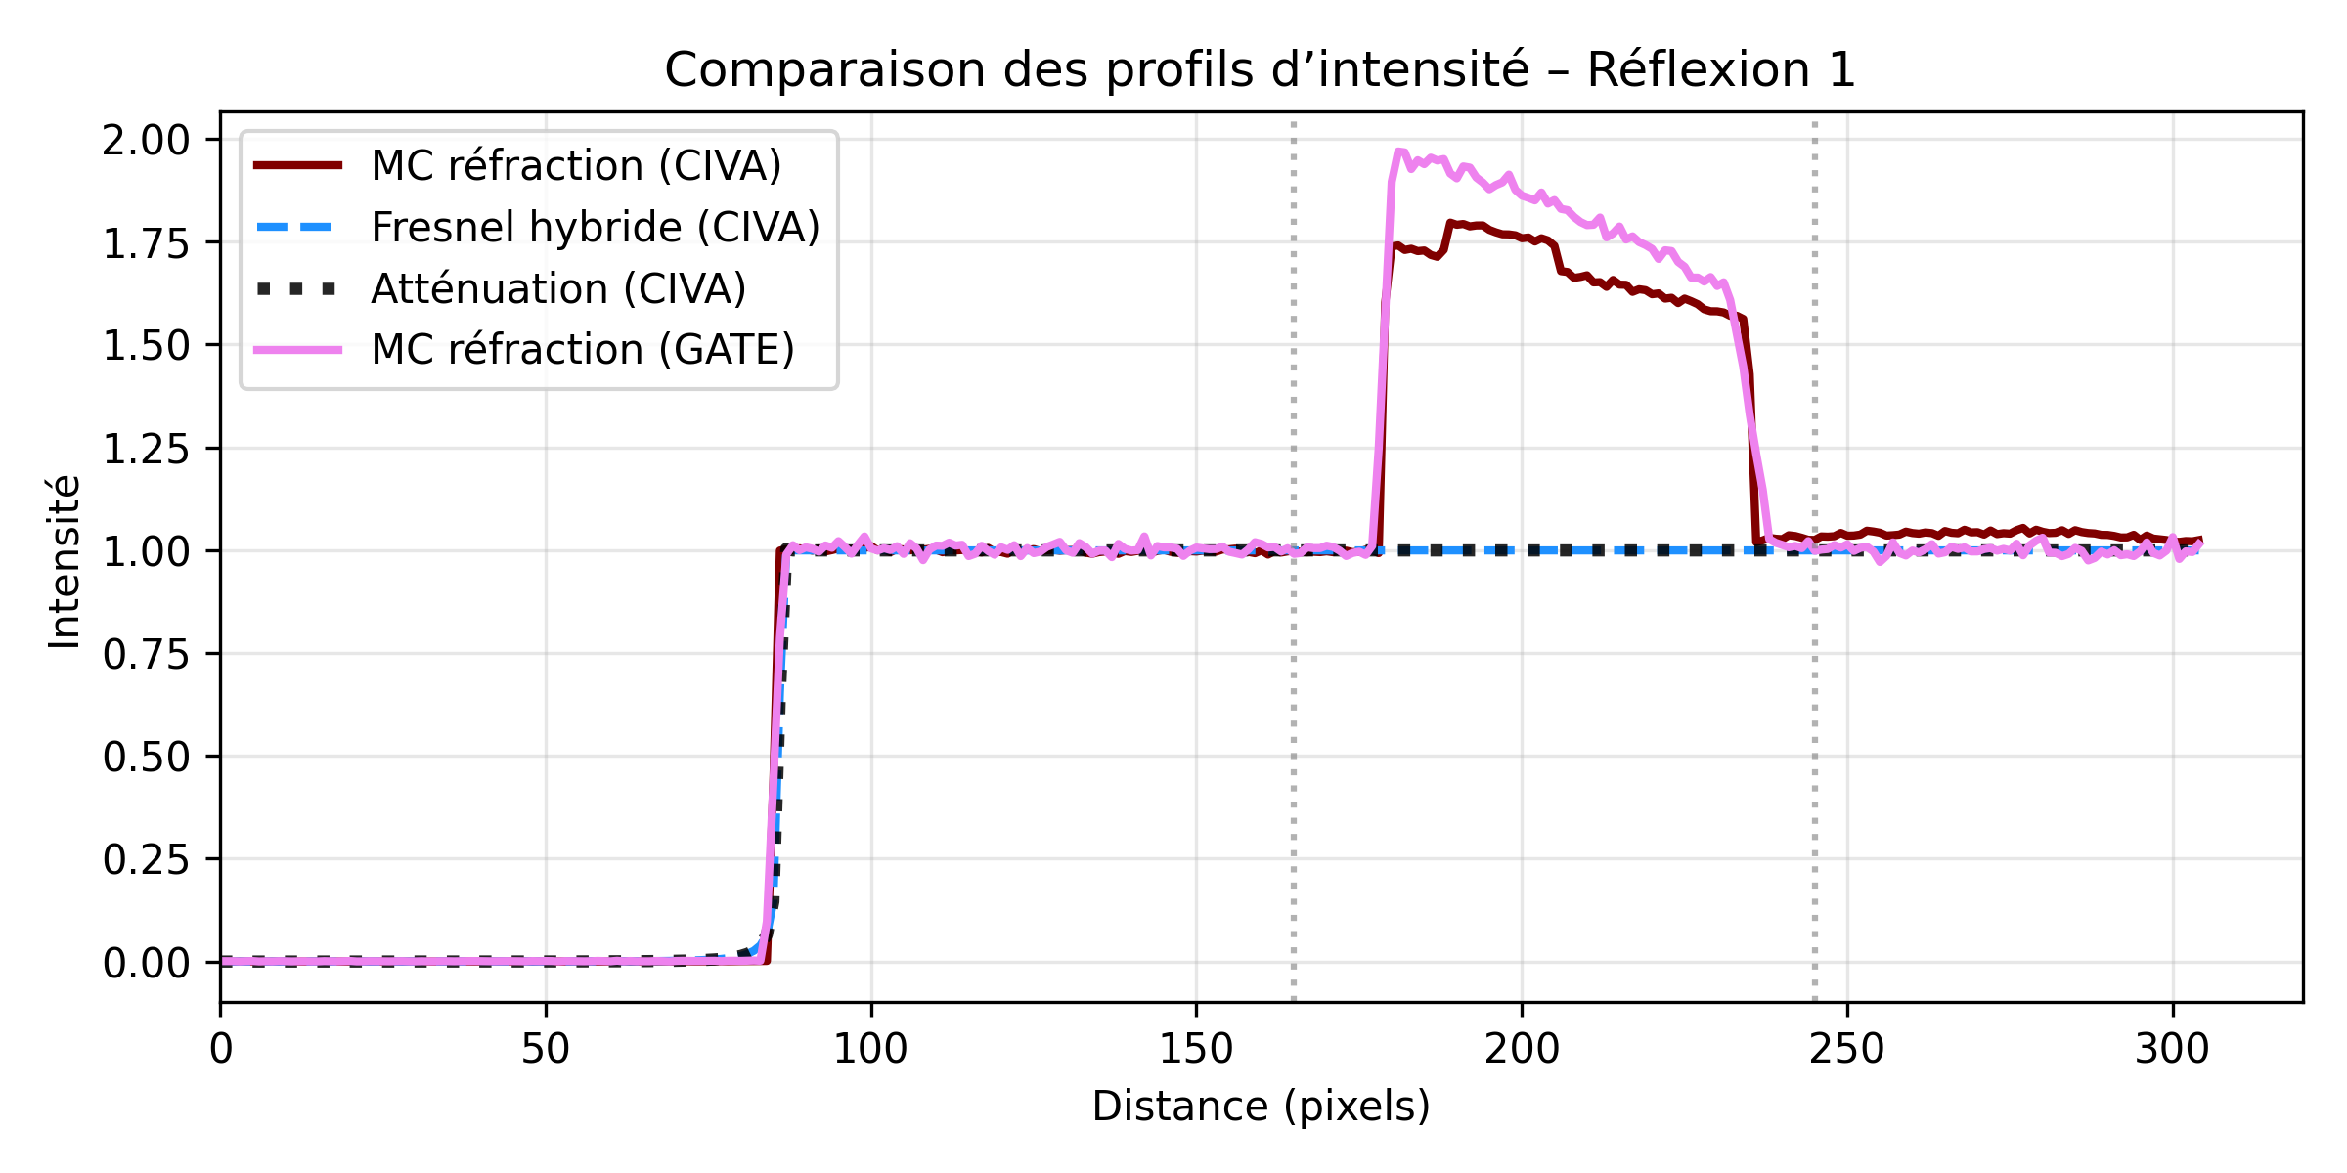
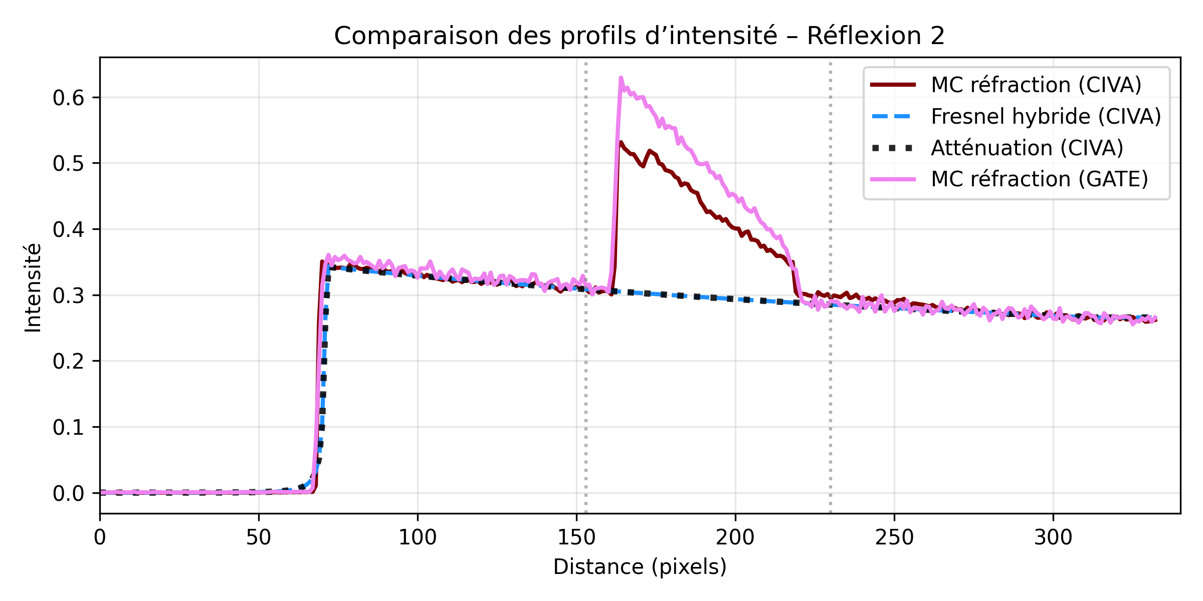

Reflection: MC refraction (CIVA) / Hybrid Fresnel (CIVA) /
MC refraction (GATE)
GATE : the presence of the silicon edge introduces interface effects (reflection), visible as over-intensity
CIVA MC refraction : gives a similar profile to GATE, with close intensity levels and a similar decrease
CIVA Fresnel hybride : the model is focused on Fresnel propagation and does not include reflection
Silicium
Air
Cylindre

Slide 13
Relative errors
Mean relative errors — reference: MC refraction GATE
Refraction :
  MC refraction CIVA vs GATE : 6.52 %
  CIVA Fresnel hybrid vs GATE : 30.73%
Reflection 1 :
  CIVA MC refraction vs GATE : 9.63 %
  CIVA Fresnel hybrid vs GATE : 43.63 %
Reflection 2 :
  CIVA MC refraction vs GATE : 11.27 %
  CIVA Fresnel hybrid vs GATE : 39.37 %
Fresnel hybride :
✅ fast
❌ less accurate on the overshoot and does not model reflection
MC refraction (CIVA) :
✅ best trade-off between computation time — around a few minutes — and profile representativeness, including both refraction and reflection, close to the GATE reference

Slide 14
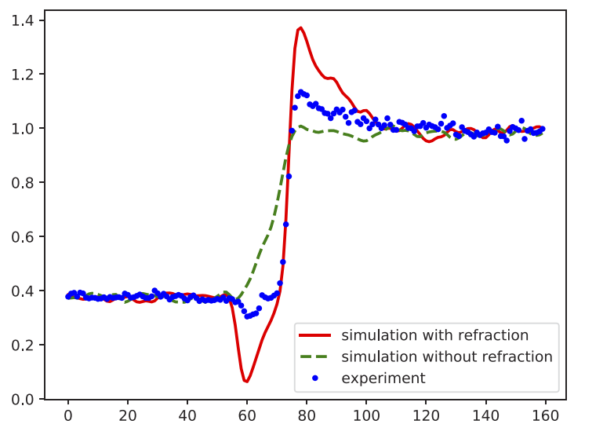
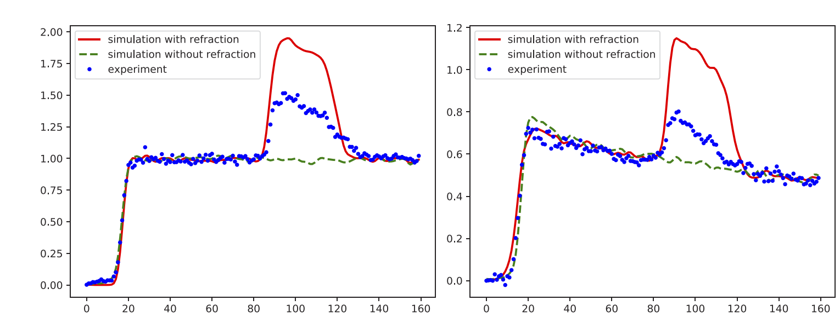
Summary and Motivation
CIVA MC refraction :
✅ good representativeness of the profiles, including refraction and reflection, consistent with the reference
CIVA Fresnel hybrid :
  ✅ simplified and fast model
  ❌ attenuated overshoot, due to smoothed wave effects, and reflection not modeled
  ➡️ MC refraction appears to be the best trade-off between representativeness and computation time; the hybrid model remains a fast approximation.
  Intensity-scale difference: as reported by Max Langer, the simulation shows an intensity overestimation compared with the experiment; a similar trend is observed here → need for an experimental reference + a probabilistic treatment of the interface.

Slide 15
Experimental configuration
3

Slide 16
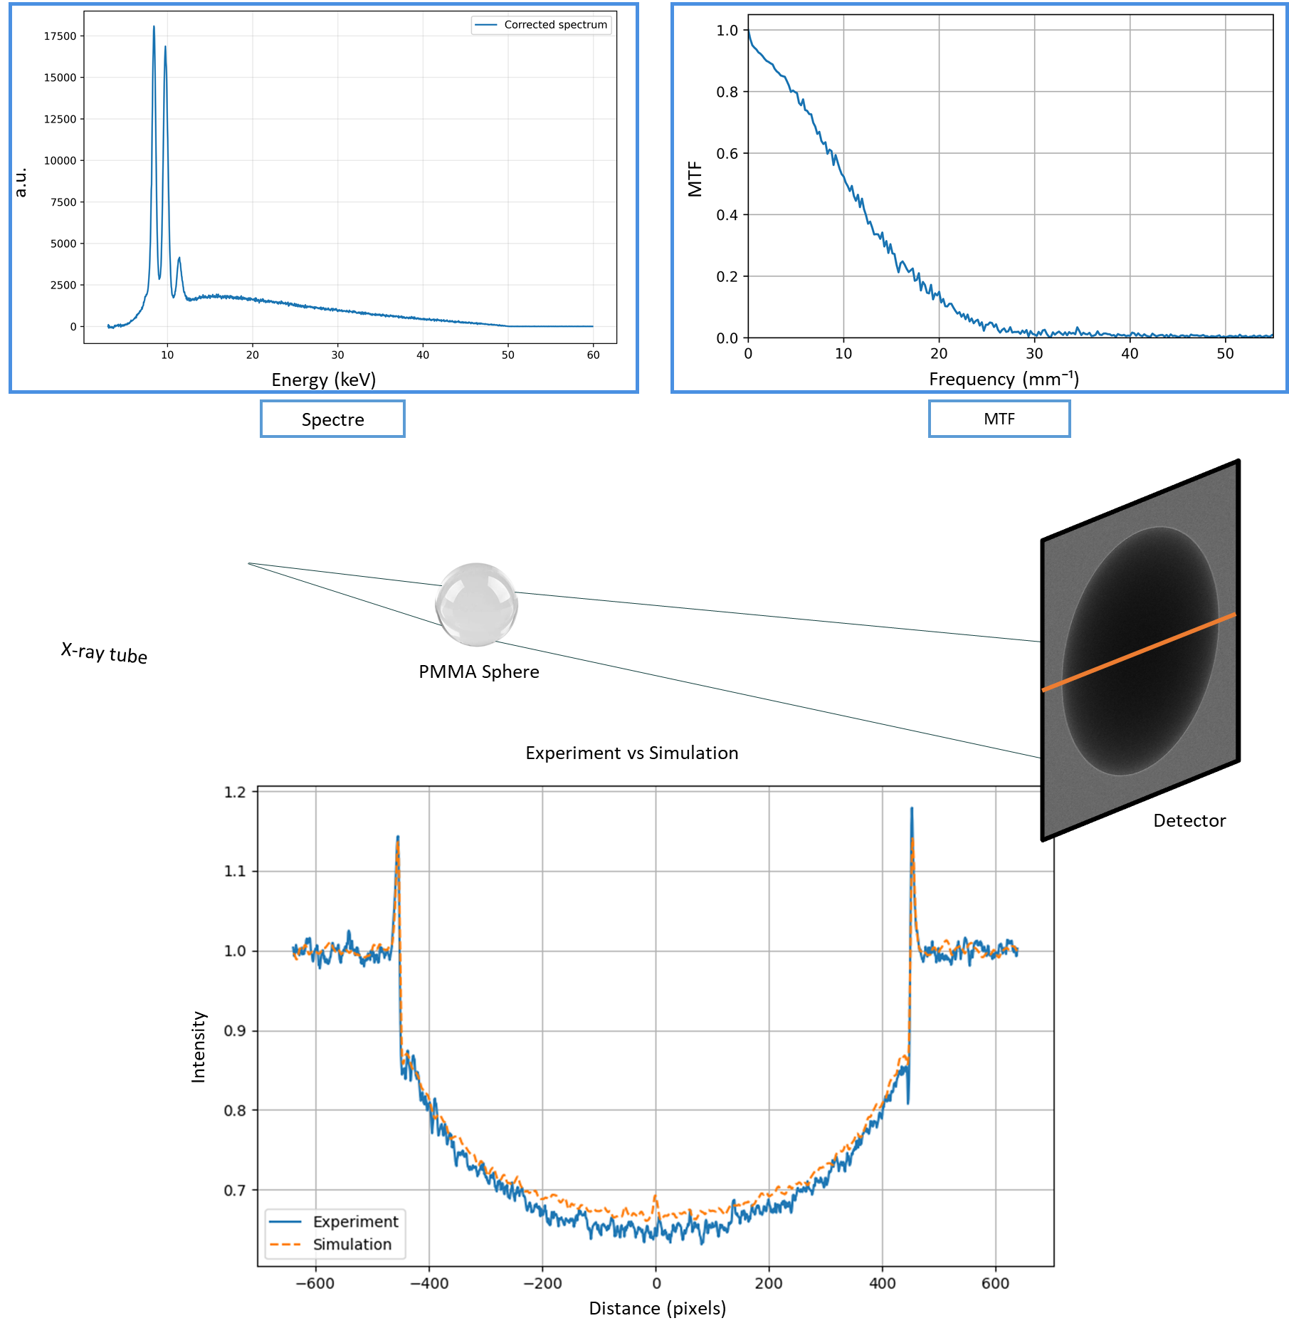
Review of the case study — Reference experimental configuration
Focal spot
size and shape estimated
geometrical blur taken into account
Spectrum
experimentally measured
high-voltage correction
MTF
extracted using the inclined edge method
taking into account the spatial resolution (the system’s ability to reproduce fine details)

Slide 17
Probabilistic model
4

Slide 18
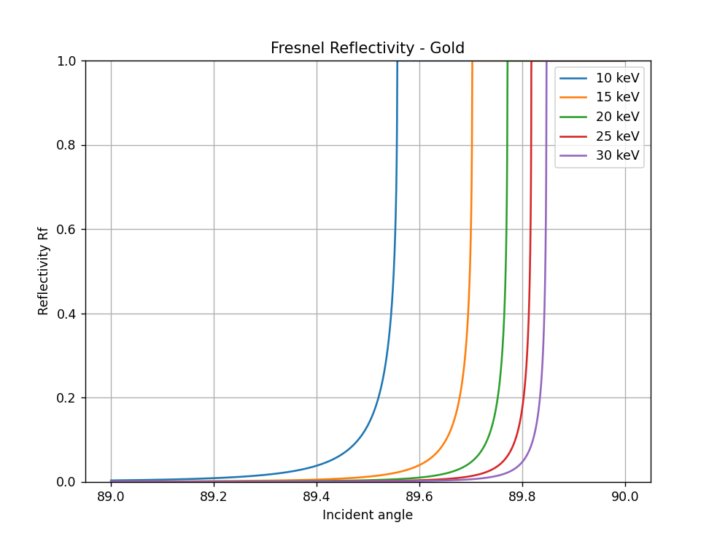
A probabilistic model at the interface
Reminder — deterministic model
interface treated using Snell’s law
depending on the angle of incidence:
  refraction
  Total reflection
At each interface, the Fresnel reflectivity Rf​ is calculated; it represents the fraction of reflected energy
The transmitted / refracted fraction is therefore 1 − Rf
                w_{r} =R_{f} w_{t}​​=1−R_{f}
​
The incident photon contributes to both branches with different weights

Slide 19
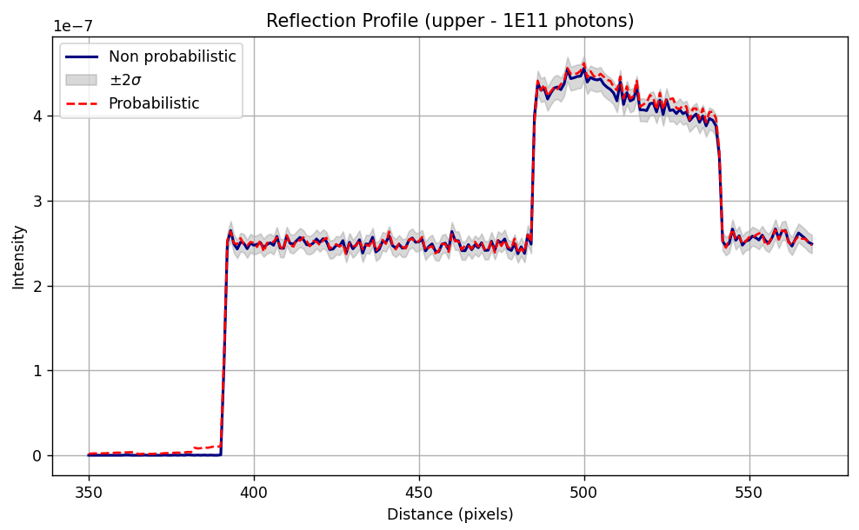
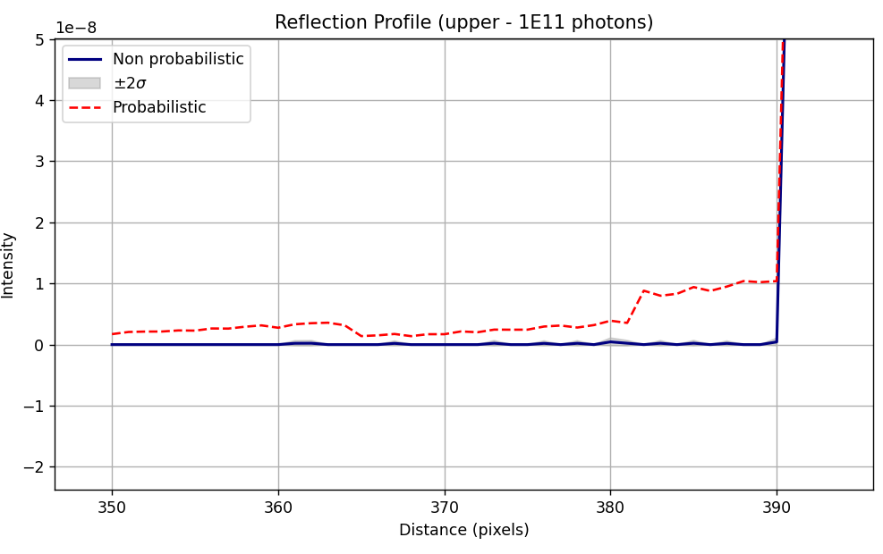
Silicon edge: effect of the probabilistic treatment
A small fraction of photons remains refracted in the silicon
The profiles remain globally similar
The difference appears mainly near the interface
The probabilistic model highlights this contribution

Slide 20
Application study
5

Slide 21
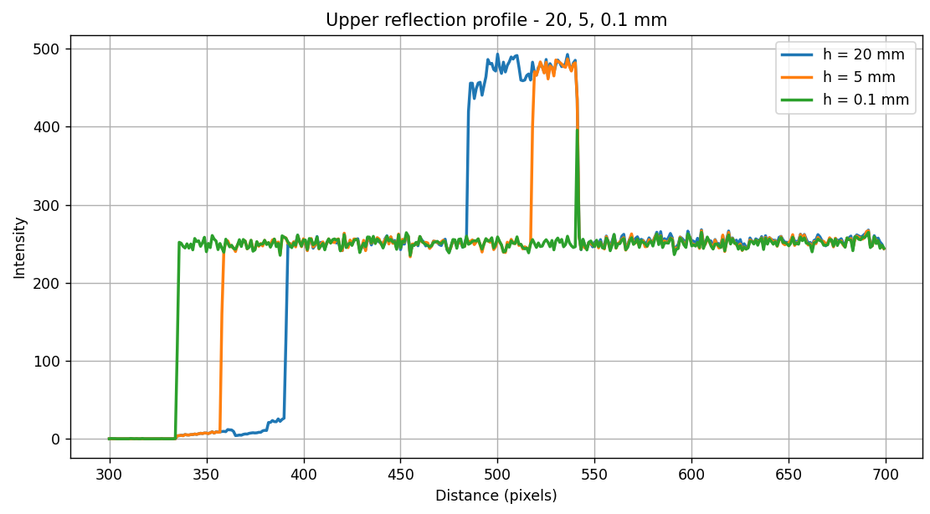
From Max Langer’s configuration to gratings: influence of height
Detector
Detector
Max Langer’s configuration can be considered as representative of the elementary components of gratings used in practice.
What happens when the height of this plate is varied?
Cylinder PMMA
Cylinder PMMA
Gold edge
Gold edge
At the scale of gratings, around 100 µm, edge refraction becomes difficult to exploit on this profile
Case 1 : h = 20 mm
Case 2 : h = 5 mm

Slide 22
Conclusion & Perspectives
Conclusion
The MC model correctly reproduces interface effects in free-space propagation
The probabilistic treatment improves the local description near the interface
The parametric study shows that the visibility of the effect strongly depends on the source, material, and height
Gold is more favorable, but at the scale of gratings (~100 µm), the signature becomes much weaker → test a configuration with the complete grating
Perspectives
Propagate the output signal from the object to the detector in order to include wave effects
Take interference effects into account in order to access phase information
Test the model in grating interferometry
Search for a more favorable configuration to observe the probabilistic effect, with more incident rays at grazing incidence and a sufficient height

Slide 23
Thanks for your attention!

