Slide 1
PHENIICS Fest
Imaging with Micromegas detector with optical readout
Fasoula Elisavet
Irfu, Cea, Universite Paris-Saclay
Supervisors:
Esther Ferrer Ribas
Thomas Papaevangelou
09/06/2026

Slide 2
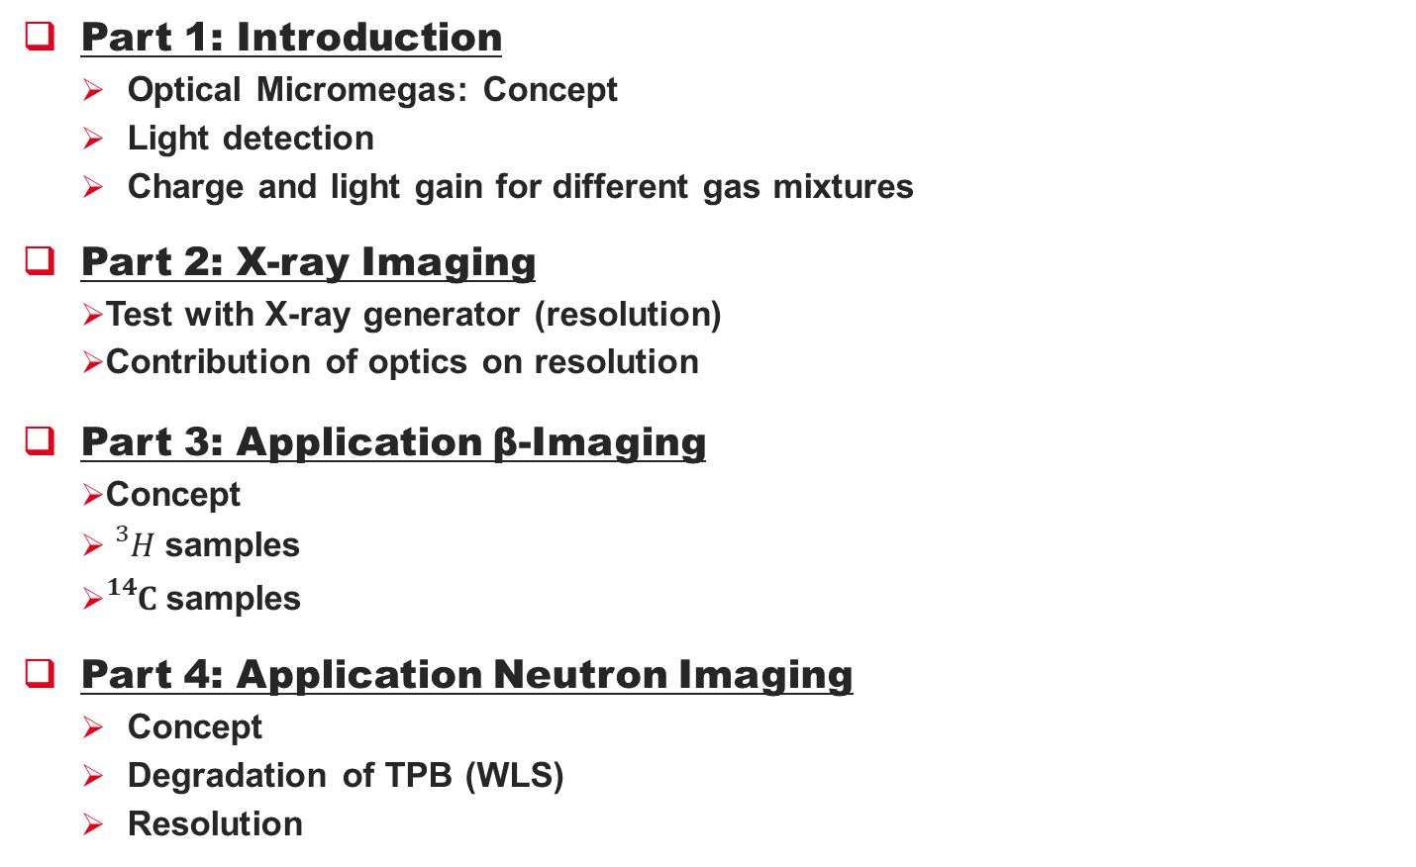
Contents
Part 1: Introduction
  Optical Micromegas: Concept
  Light detection
  Charge and light gain for different gas mixtures
Part 2: X-ray Imaging
  Test with X-ray generator (resolution)
  Contribution of optics on resolution
  Part 3: Application β-Imaging
  Concept
  ${}_{}^{3}{H }$samples
  ${}_{}^{14}{C }$samples
Part 4: Application Neutron Imaging
  Concept
  Degradation of TPB (WLS)
  Resolution
Conclusions/Next steps
Notes:
On the first part we will discuss about the light production mechanisms (in other words: how does the Micromegas work)
and about the light detection devices (lens and the camera)

Slide 3
Introduction
1
  Optical Micromegas: Concept
  Light Detection
  Charge and light gain for different gas mixtures

Slide 4
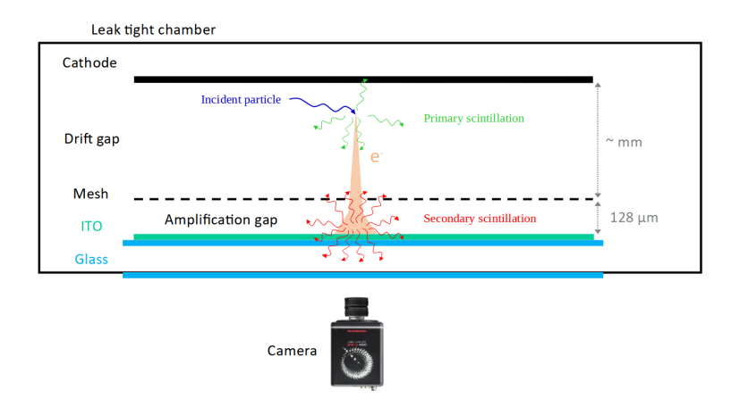
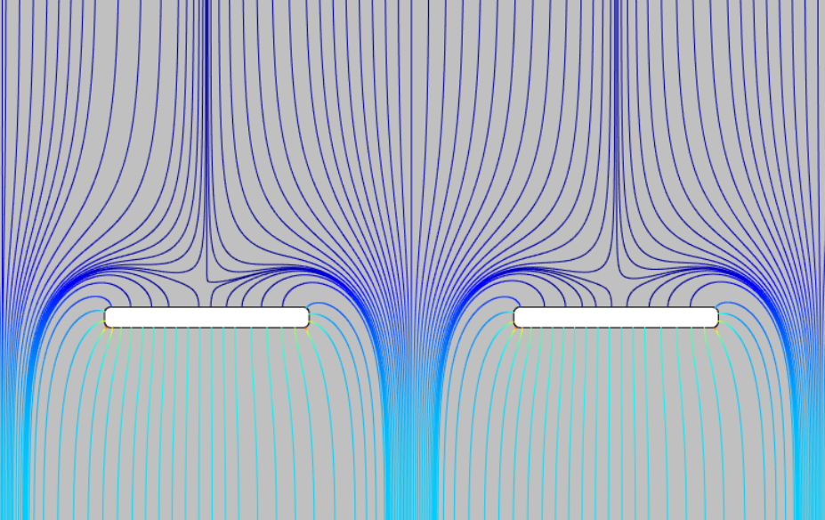
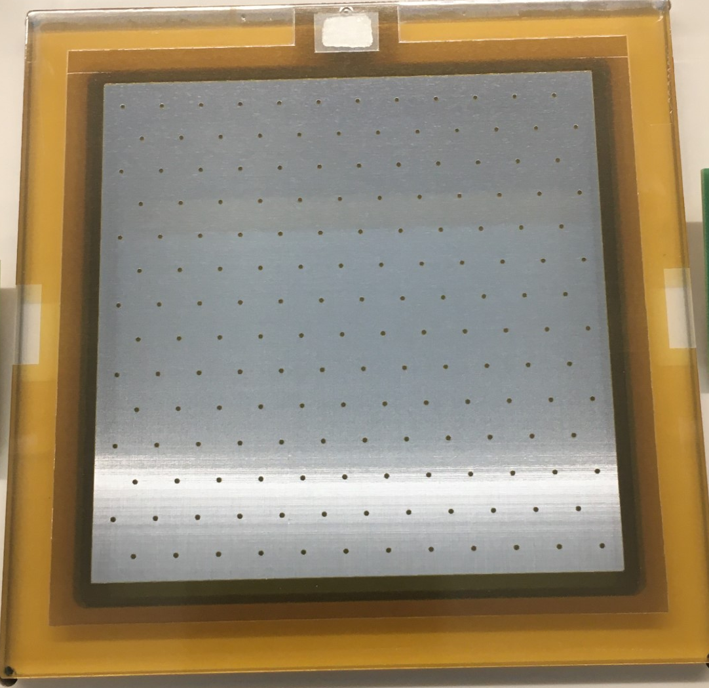
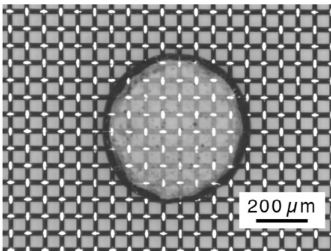
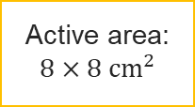
Optical Micromegas: Concept
Optical Micromegas: Standard Micromegas with glass substrate and transparent anode
GAS
Anode
Electric field lines
Amplification
region
Mesh|Pillars
Active area:
$$8×8{ cm}^{2}$$
Animation: Antoine Cools
Notes:
The Micromegas detector consists in three parallel electrodes and two regions separated by a micro-mesh. The conversion gap is defined between the cathode and the mesh while amplification occurs in a gap ranging from 50 µm to 150 µm between the micro-mesh and the anode.
150nm of ITO layer

Slide 5
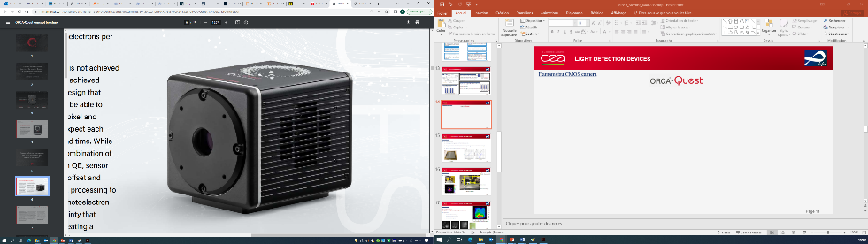
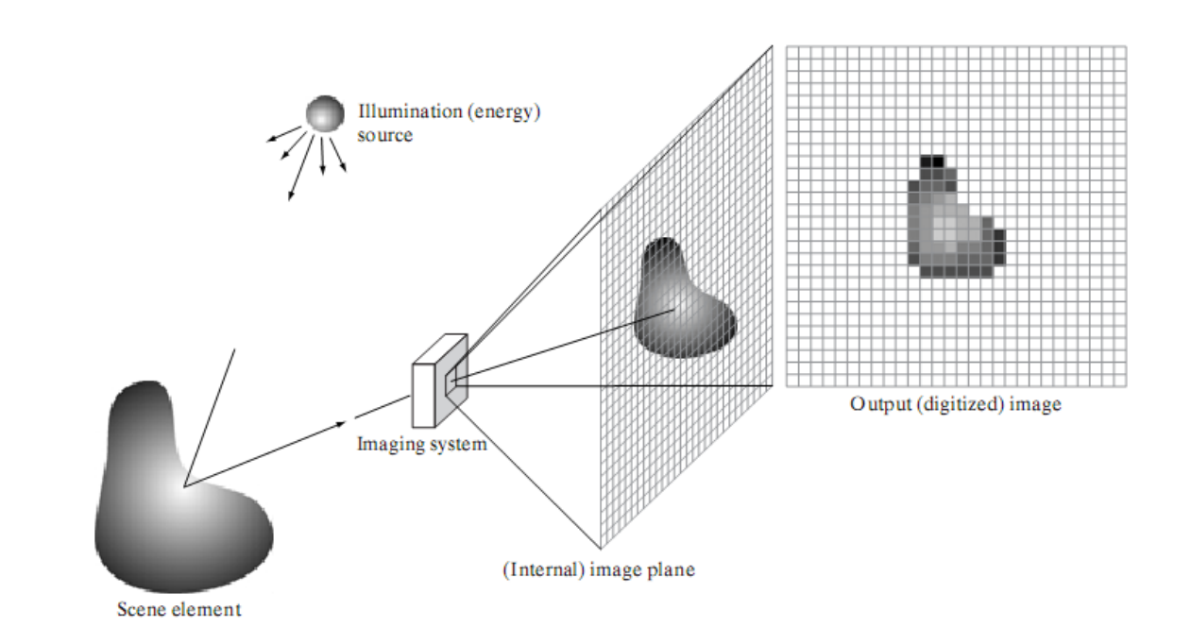

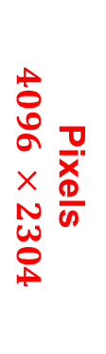
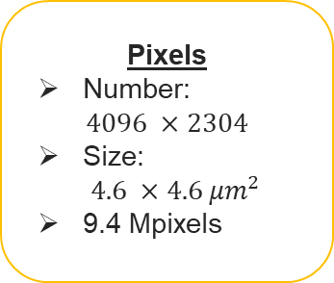
Light detection: Camera
Pixels
Number:
$4096 ×2304$
Size:
$4.6 ×4.6 {μm}^{2}$
9.4 Mpixels
Hamamatsu ORCA Quest qCMOS
Readout Noise
Minimum exposure time
Ultra quiet scan: 0.3 electrons rms
Ultra quiet scan: 199.9 ms/frame
Standard scan: 0.44 electrons rms
Standard scan: 7.2 µs/frame
Dark Noise
Sensor Temperature -${20}^{0}C$: 0.016e/p/s
https://camera.hamamatsu.com/content/dam/hamamatsu-photonics/sites/documents/99_SALES_LIBRARY/sys/SCAS0154E_C15550-20UP_tec.pdf
Sampling and quantization
Pixels
$$4096 ×2304$$
Notes:
one camera pixel corresponds to a 50 µm × 50 µm square on the object.

Slide 6
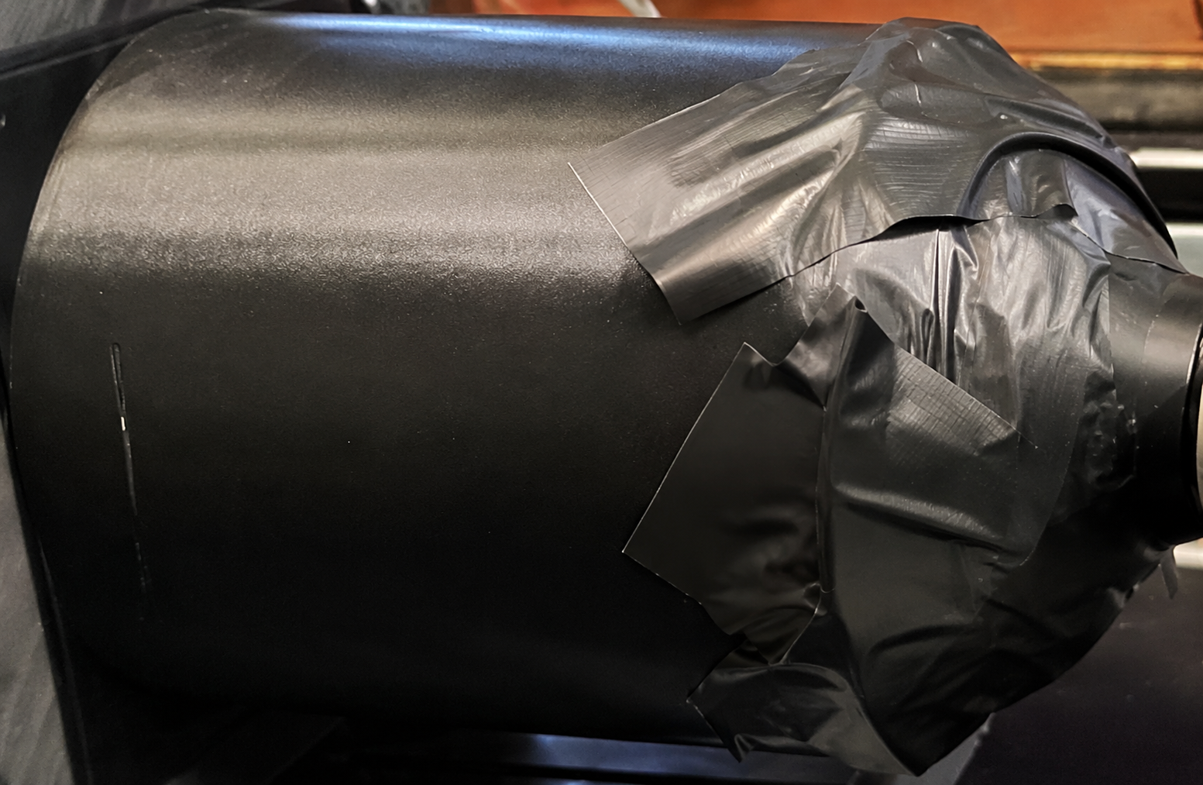
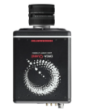
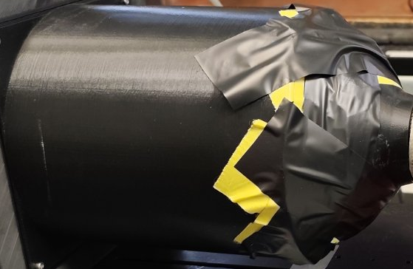
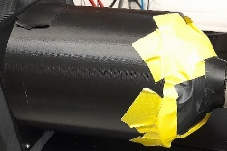
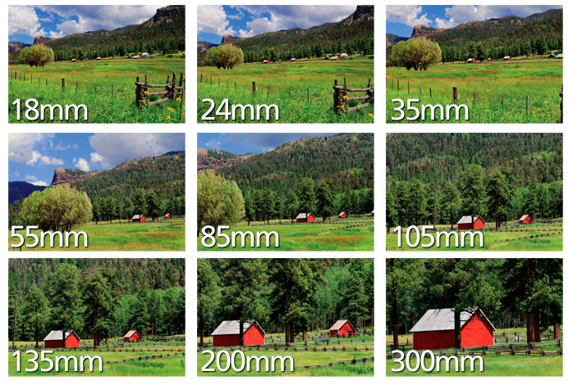
Factors which affect our results
Source/Beam
Chamber
Light Cone
Lens Camera
Hamamatsu ORCA
Quest qCMOS
Camera
Exposure time per frame
Total number of frames
Micromegas
Detector
Gas mixture
Stability
Gain
Diffusion
Track length
Electric field
Gain
Lens
Focal length
Focus
Aperture

Slide 7
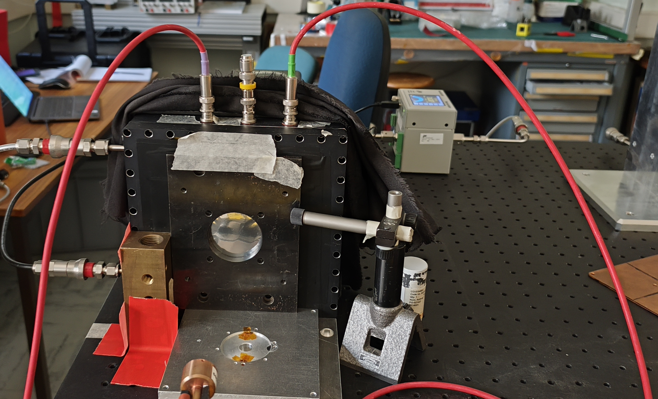
Optimization of gas mixtures for charge and light gain
Setup
Central circle: d=5 cm
4 circles: d=0.5 cm
55Fe source

Slide 8
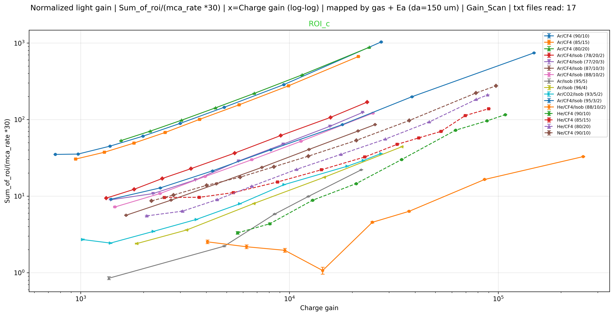
Light gain Vs charge gain for different gas mixtures

Slide 9
X-ray Imaging
2
  Test with X-ray generator (resolution)
  Contribution of optics on resolution

Slide 10
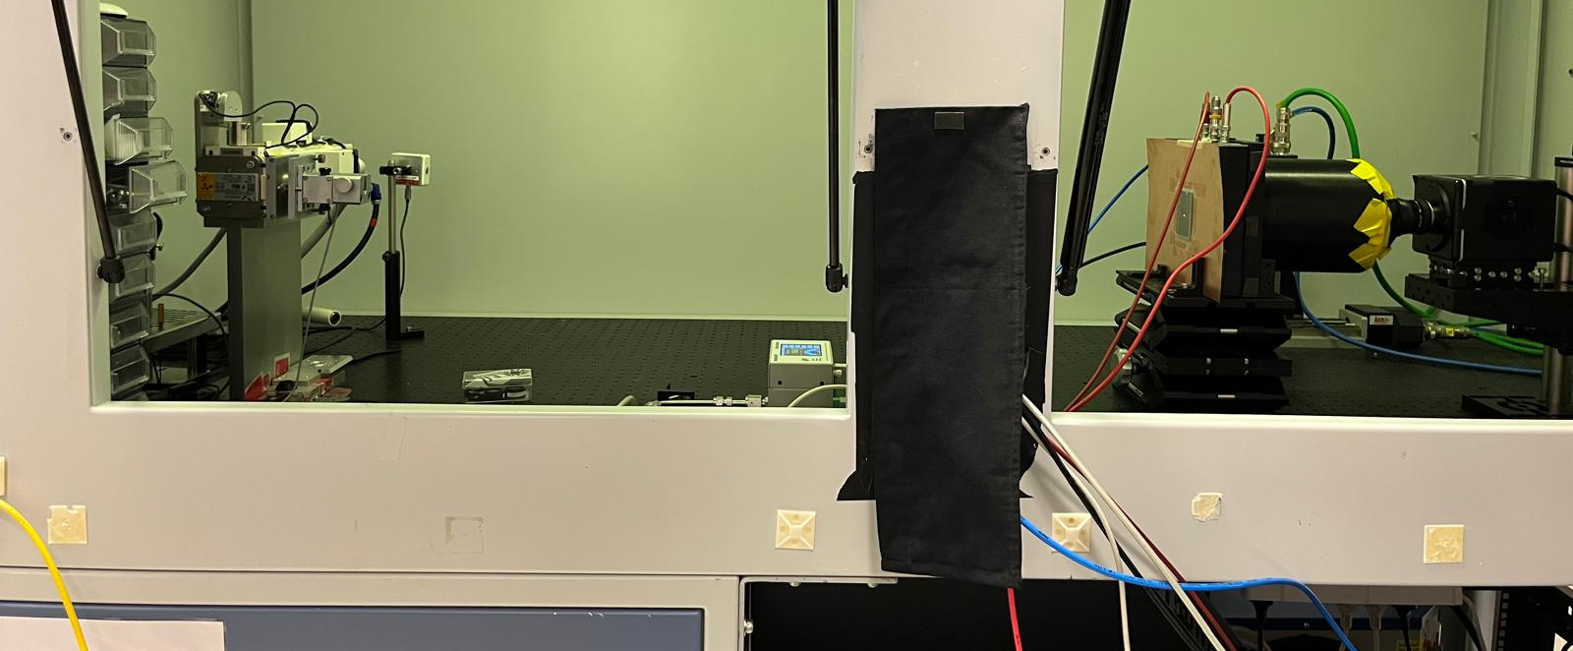
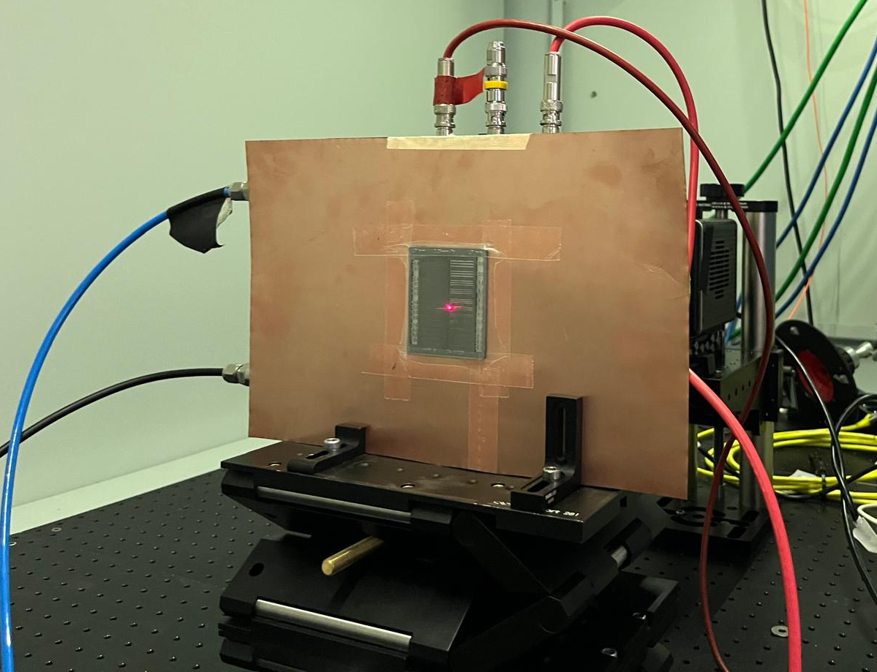
X-ray generator: Setup and Goal
Relative comparison of different detectors types in terms of the spatial resolution
Lens & Camera
Schneider onyx fast lens
Hamamatsu Orca Quest qCMOS
~100cm
Xray generator
Energy: 15 kV-50 kV
Current: 0-40 mA
Operate @ 15 kV, 10 mA
Copper frame & Lead target
Chamber
Different detectors
(black mesh, std, WLS)
Different parameters
(gain, drift, aperture etc)
How??

Slide 11
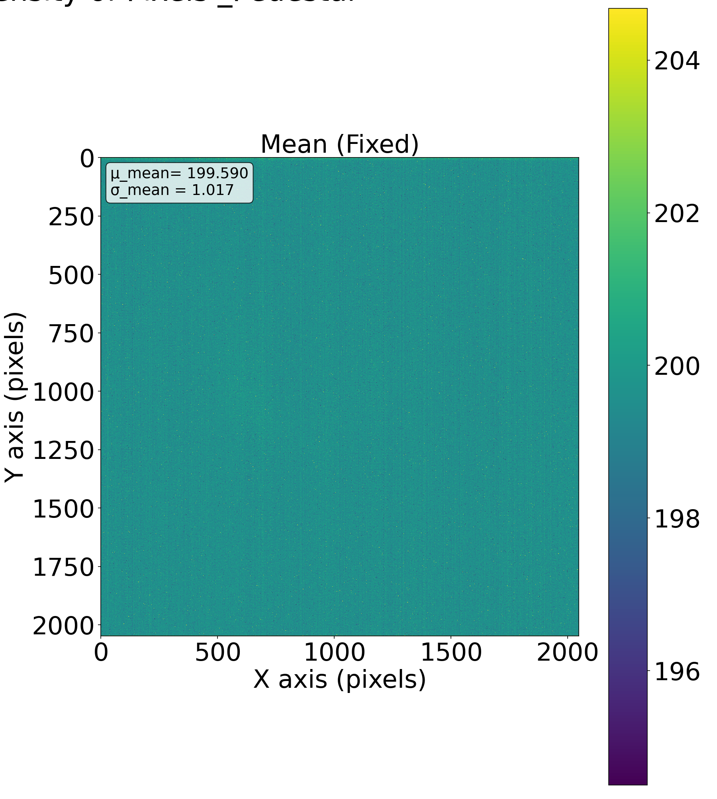
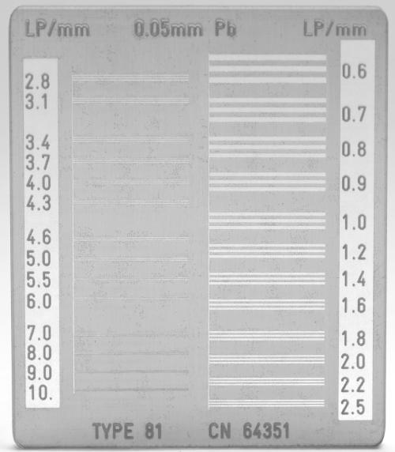
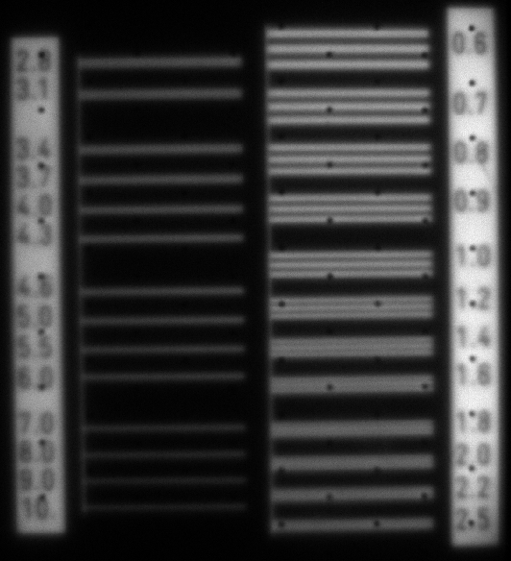
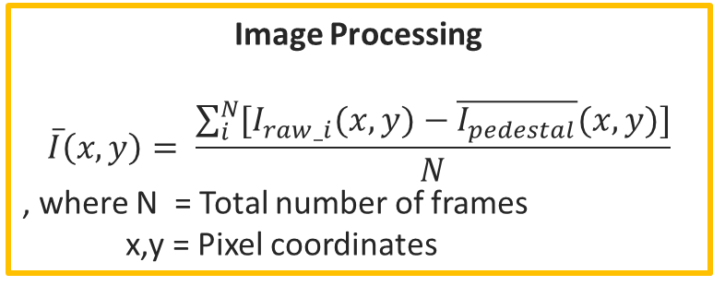
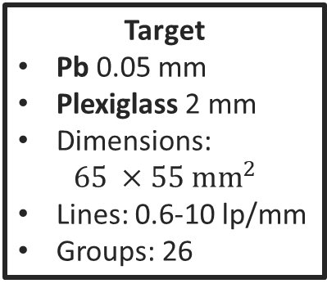
How: Lead target
Preliminary!
Data Acquisition
Pedestal Images: Dark images, no detector
(-> Calculation of the mean intensity per pixel)
Raw Images: Detector & beam/source
Target
Pb 0.05 mm
Plexiglass 2 mm
Dimensions:
$65 ×55 {mm}^{2}$
Lines: 0.6-10 lp/mm
Groups: 26
Image Processing
$$\overline{I}\left(x,y\right)= \frac{\sum_{i}^{N}{[I_{raw_i}(x,y)}−\overline{I_{pedestal}}(x,y)]}{N}$$
, where N = Total number of frames
x,y = Pixel coordinates
Black_Tn
Exp: 10 sec
Total acq: 120 sec
Object
Image
Notes:
Ed = 750V/cm
Ea = 37 kV/cm

Slide 12
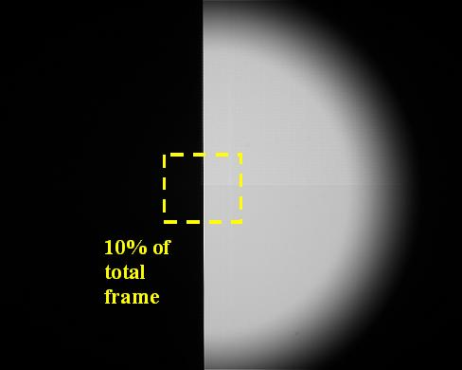
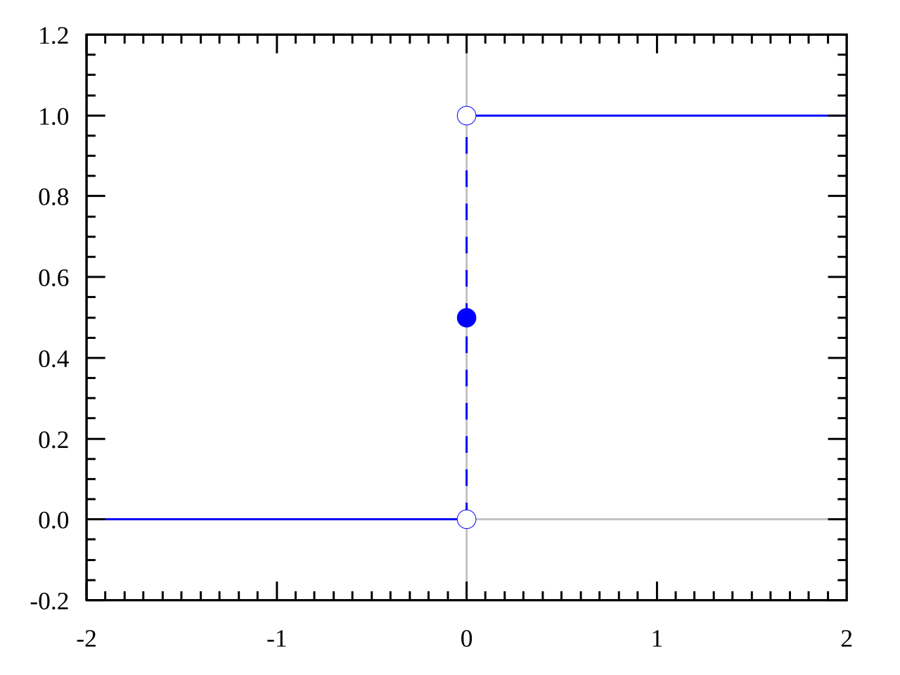
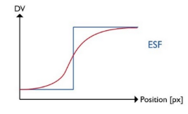
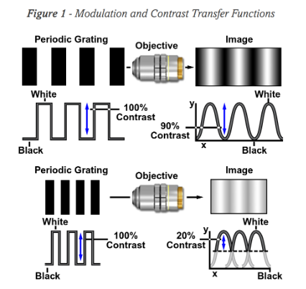
How: Analysis
Analysis for the resolution
Contrast Transfer Function
(CTF)
Edge Spread Function
(ESF)
Step function
Edge Spread Function
Two approaches:
  Analytic
    Assume Gaussian blur
    Fit with error function
    FFT-Fourier Transformation
    MTF-Modulation Transfer Function
  Numeric
    LSF (derivative of ESF)
    FFT-Fourier Transformation
    MTF-Modulation Transfer Function
Contrast:
  ROI & projection
  Peaks & minima
  Contrast calculation
Notes:
The Modulation Transfer Function (MTF) quantifies the imaging performance of an optical system by analyzing its ability to resolve detail and maintain contrast.
MTF of a System = MTF of Lens × MTF of Camera

Slide 13
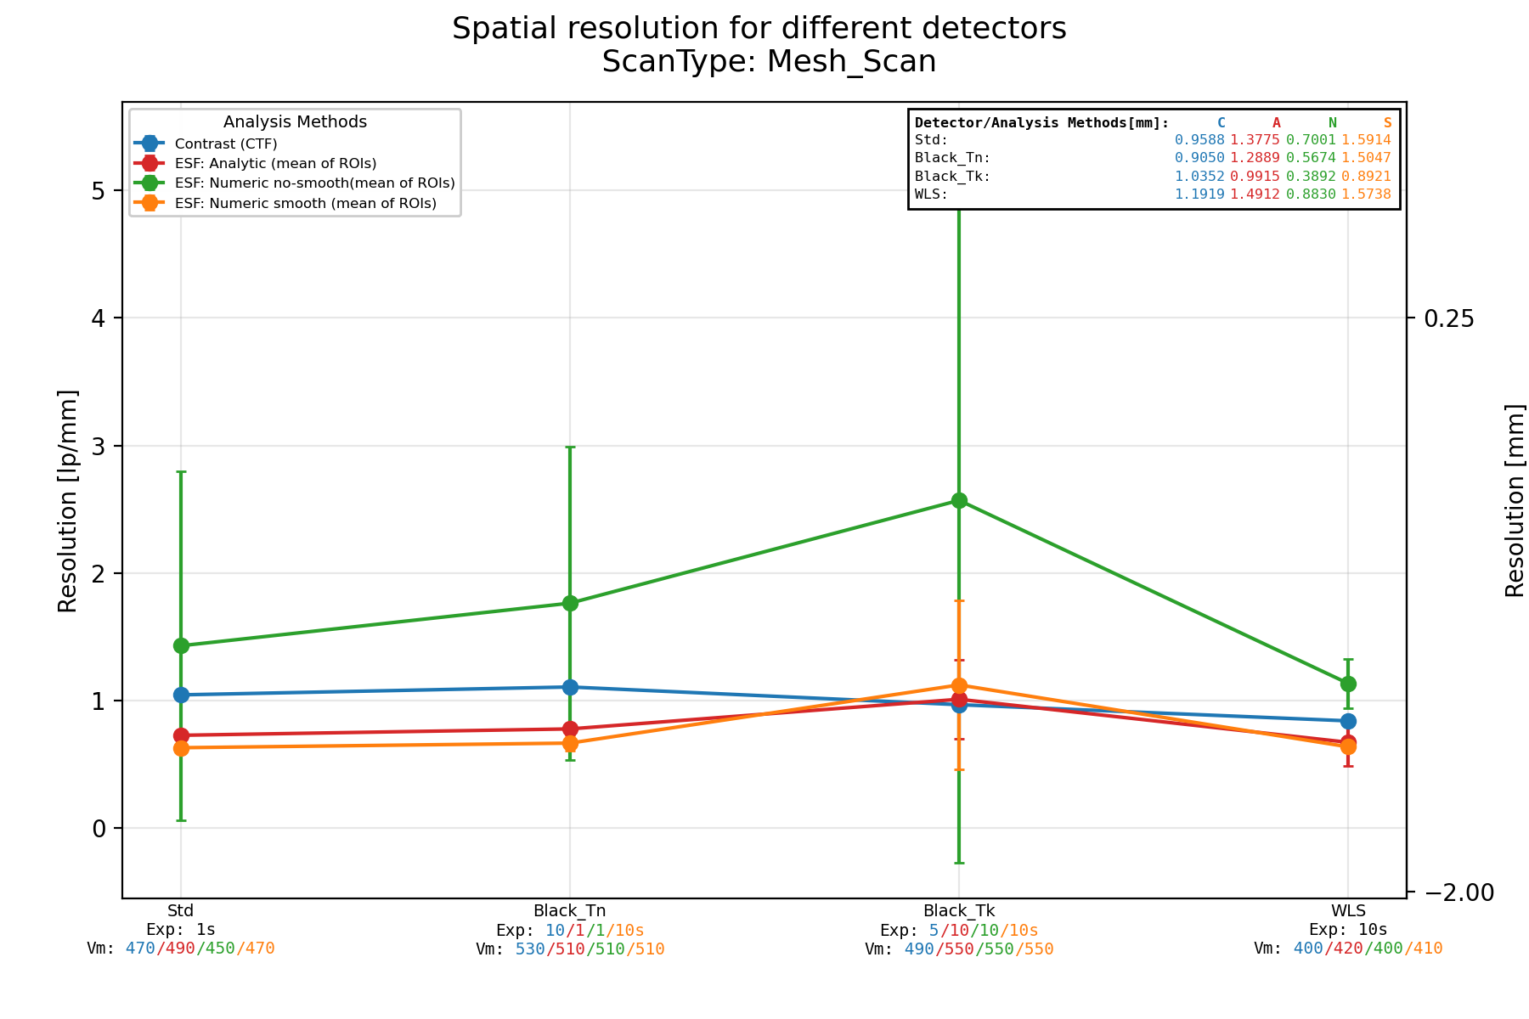
Results: All detectors
Preliminary!
All detectors exhibit similar behavior
The black mesh does not provide significant improvement
The WLS performs better than initially expected

Slide 14
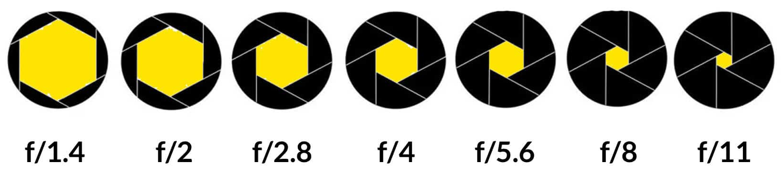
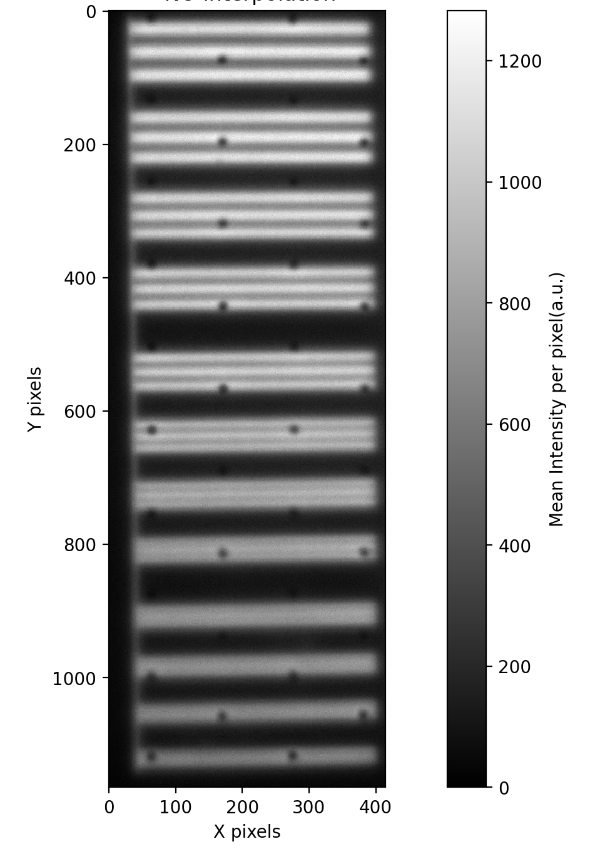
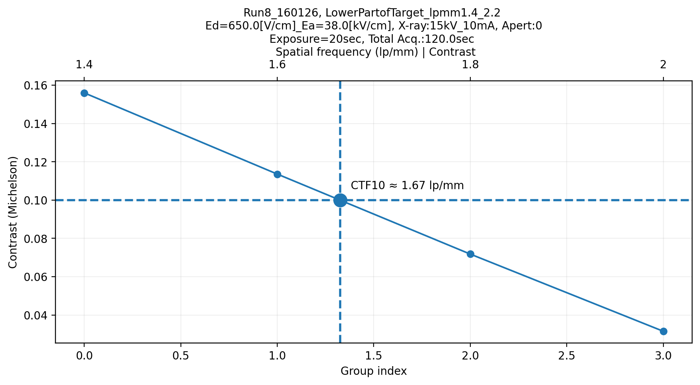
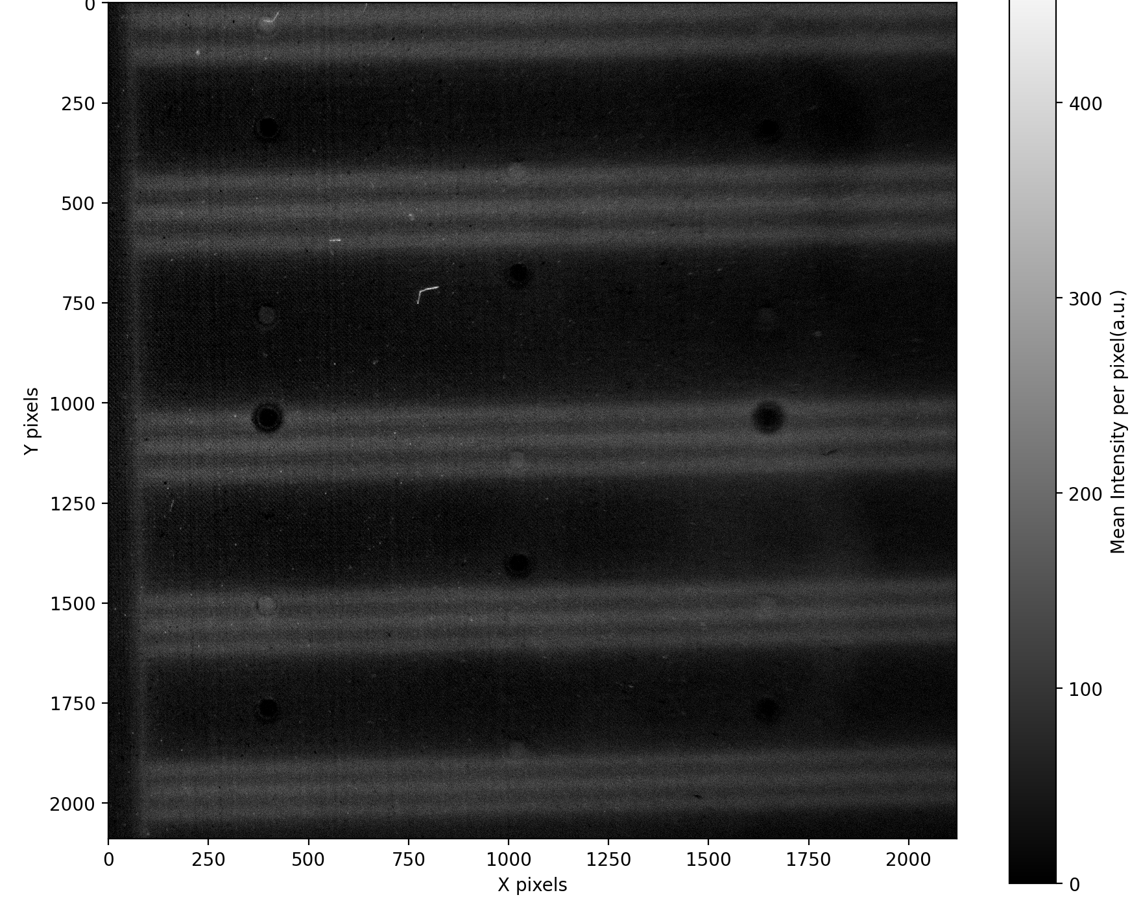
Factors affecting resolution
Preliminary!
Detectors
Optical part: lens, camera
Aperture
Focus
Criterion
CTF @ 10%
lp/mm = 1.67
Resolution ~ 600 μm Vs 926 μm
Lens: Ricoh FL-CC5028
  Focal length: 50 mm
  Aperture: F2.8-F22
Old lens

Slide 15
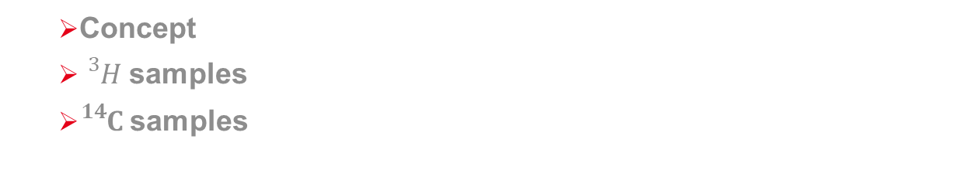
β-Imaging
3
  Concept
  ${}_{}^{3}{H }$samples
  ${}_{}^{14}{C }$samples

Slide 16

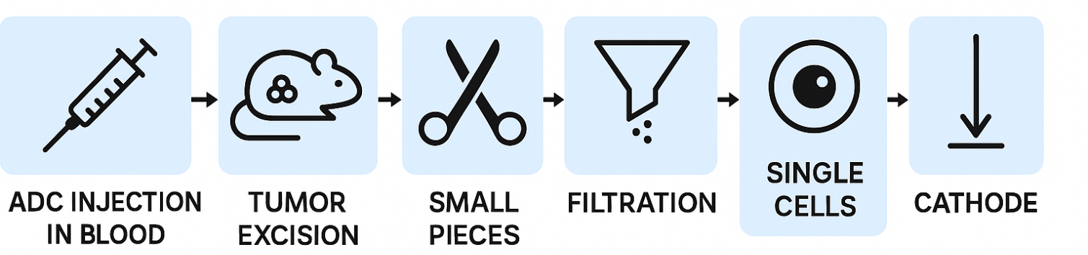
Applications: β-Imaging
QuantiCell Project
Objective: Characterization of how Antibody-Drug Conjugates (ADCs) distribute and accumulate at the single-cell level inside tumors, using dual radioactive labeling (${}_{}^{3}Η$ and ${}_{}^{14}C$ ) and beta detection with Micromegas detectors.
What is the ADC?
“Smart bomb”:
  Antibody →”GPS tracker”
  Linker → chemical connector
  Drug (payload) →killer of cancer cells
What happened with the ADC?
Did it enter the tumor?
Did it go inside the cancer cells?
How much accumulated inside each cell?
¹⁴C signal = how much antibody reached the cell.
³H signal = how much drug reached the cell.
=> Detection of the ADC via their β-decay
→ ADC reached the cell as a whole or if the drug separated off.
labelling
Radio-
active
Trace the track of the ADC
Chemotherapy everywhere in the body Guided drug directly to the cancer cells
Targeted therapy
Single-cells Samples
Notes:
Antibody →finds and binds to a specific target on cancer cells|| : the “GPS tracker” that binds a specific protein on the surface of the cancer cell (e.g. HER2 receptor).
Linker → connects antibody and drug- chemical connector.
Drug (payload) → a highly potent toxin that kills cancer cells once delivered.
Healthy cells usually don’t express that protein (or do so at low levels), so the ADC does not target them efficiently. That is the principle of targeted therapy.
${}_{}^{14}C$ atoms into the Antibody
${}_{}^{3}Η$ atoms into the Drug
-------
Why radioactive isotopes?
³H (tritium) and ¹⁴C (carbon-14) emit beta particles (electrons).
They’re low-energy beta emitters, which:
Don’t travel far → suitable for cellular-level measurements.
Don’t significantly damage the ADC structure → maintain normal biological behavior.
perfect for single-cell measurements without huge radiation hazard.
Radioactive signals are quantitative:
We can directly count how many decays occur → how much drug or antibody is there.
--------------------------
Ideally, you want:
Both ¹⁴C and ³H in the same cells:
¹⁴C → confirms that the antibody arrived.
³H → confirms that the drug was retained.
Therefore:
Cells with both ¹⁴C and ³H → likely internalized ADC.
Cells with only ¹⁴C → probably surface-bound ADC. If the antibody stays on the surface, the drug may not be released inside the cell.
Cells with only ³H → free drug uptake.
This is why combining fluorescence imaging (antibody internalization assays) with beta imaging is powerful.
🤔 Visualization inside tumors
Imagine:
A tumor like a big city.
ADCs are delivery trucks carrying toxins.
¹⁴C tells you whether the truck arrived at a house (cell).
³H tells you whether the toxin was dropped off inside the house.
Micromegas is your city surveillance system, watching every block to see which houses received deliveries!

Slide 17
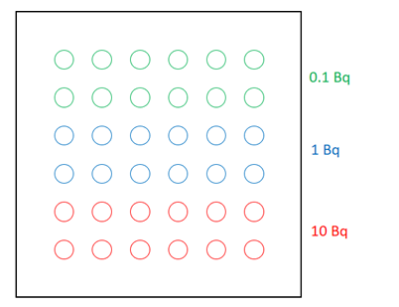
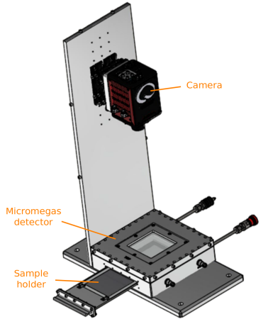
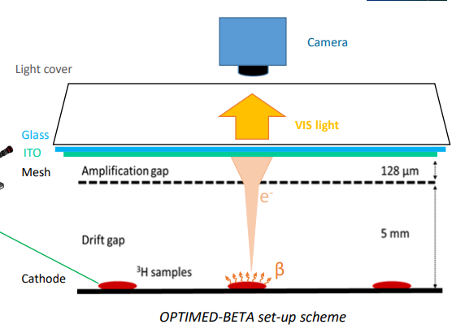

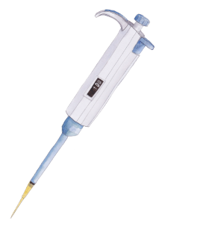
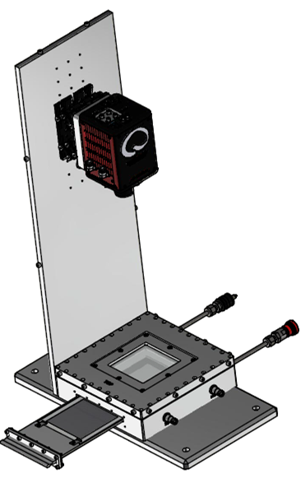
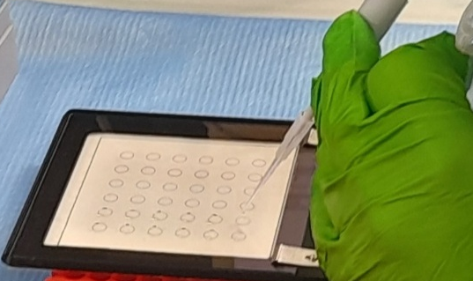
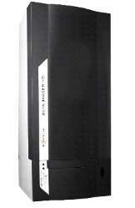
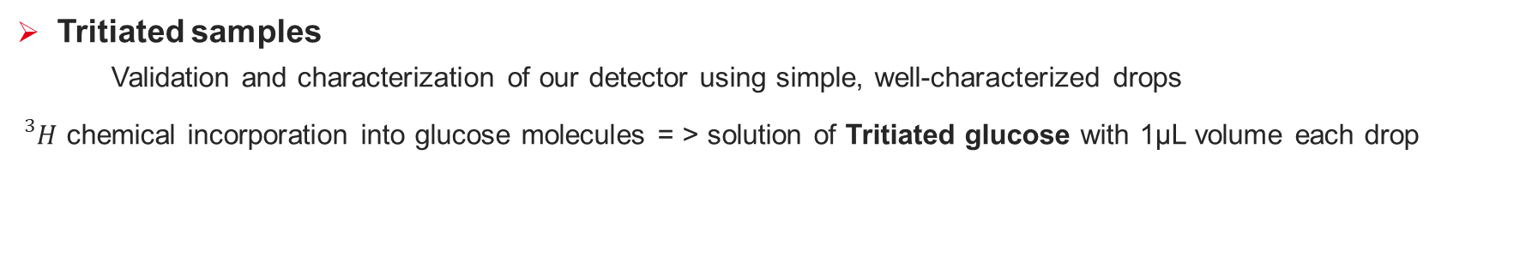
Applications: β-Imaging
Tritiated samples
    Validation and characterization of our detector using simple, well-characterized drops
${}_{}^{3}H$ chemical incorporation into glucose molecules = > solution of Tritiated glucose with 1μL volume each drop
Reference
Tritiated glucose solutions
100 µL
Liquid scintillation measurement
What do we need?
A Micromegas detector which can:
Detect and quantify the activity of sub-Bq activity samples
Separate different radioactive isotopes (like 3H and 14C)
Separate low signal from the background noise
Autoradiography
1 µL
Micromegas autoradiography
Industrial β imager autoradiography
Notes:
AS we do not have single-cells until now, we have to test also the Micromegas sensitivity, that’s why we proceed with tritiated glucose samples

Slide 18
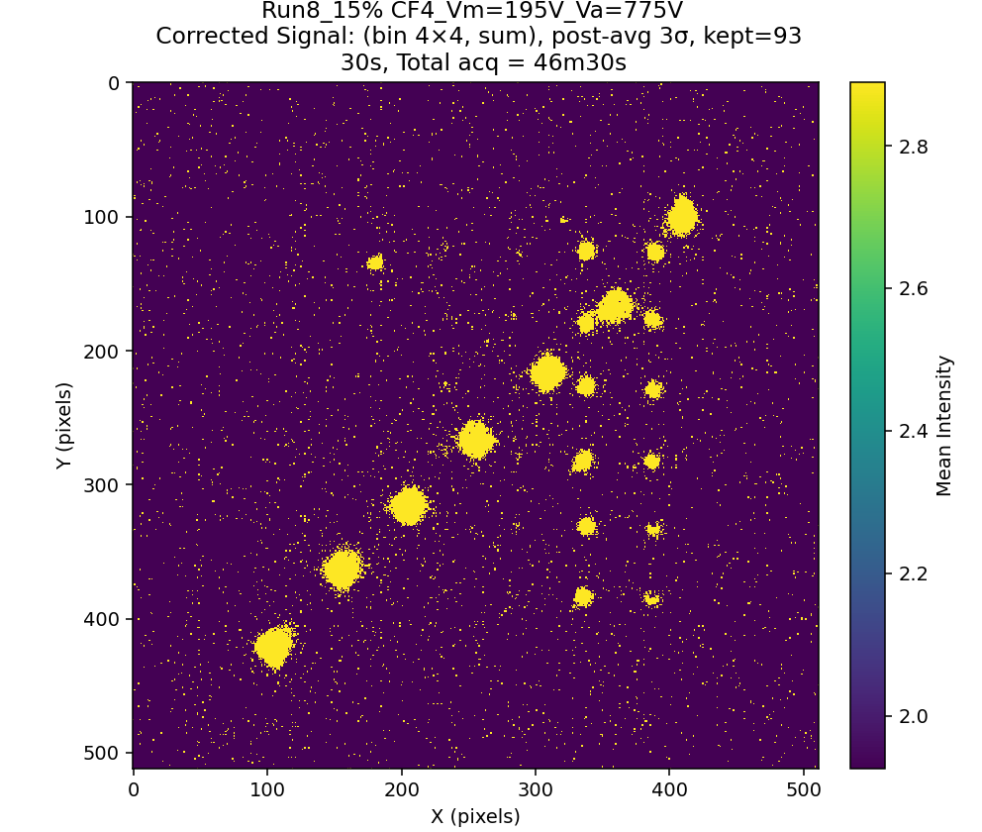
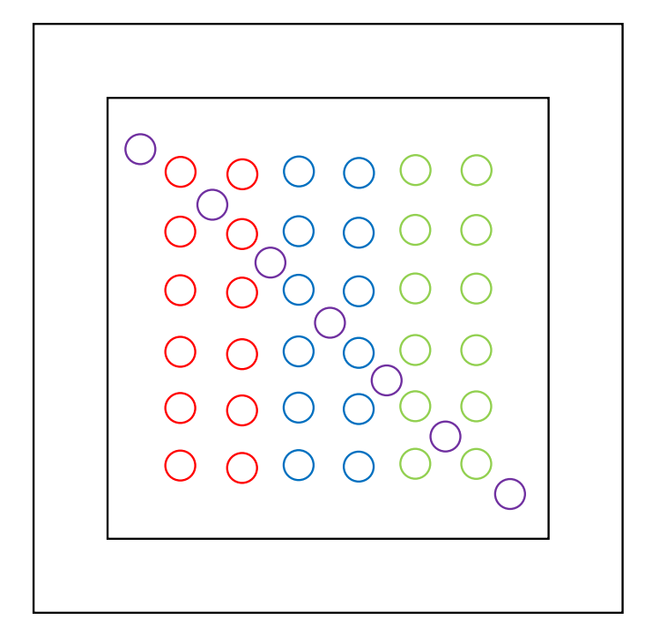
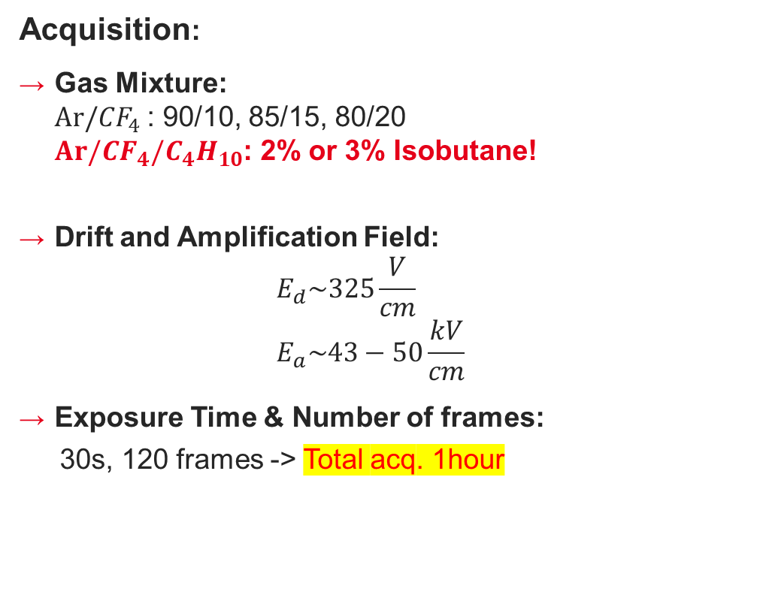
Setup and Acquisition: ${}_{}^{3}H$samples
Acquisition:
Gas Mixture:
$Ar/{CF}_{4}$: 90/10, 85/15, 80/20
$Ar/{CF}_{4}/C_{4}H_{10}$: 2% or 3% Isobutane!
Drift and Amplification Field:
$E_{d}\sim 325\frac{V}{cm}$
$E_{a}\sim 43−50\frac{kV}{cm}$
Exposure Time & Number of frames:
  30s, 120 frames -> Total acq. 1hour
7 samples of 10 Bq
12 samples of 1 Bq
12 samples of 0.1 Bq
12 samples of 0.01 Bq
10Bq
0.01Bq
0.1Bq
1Bq

Slide 19
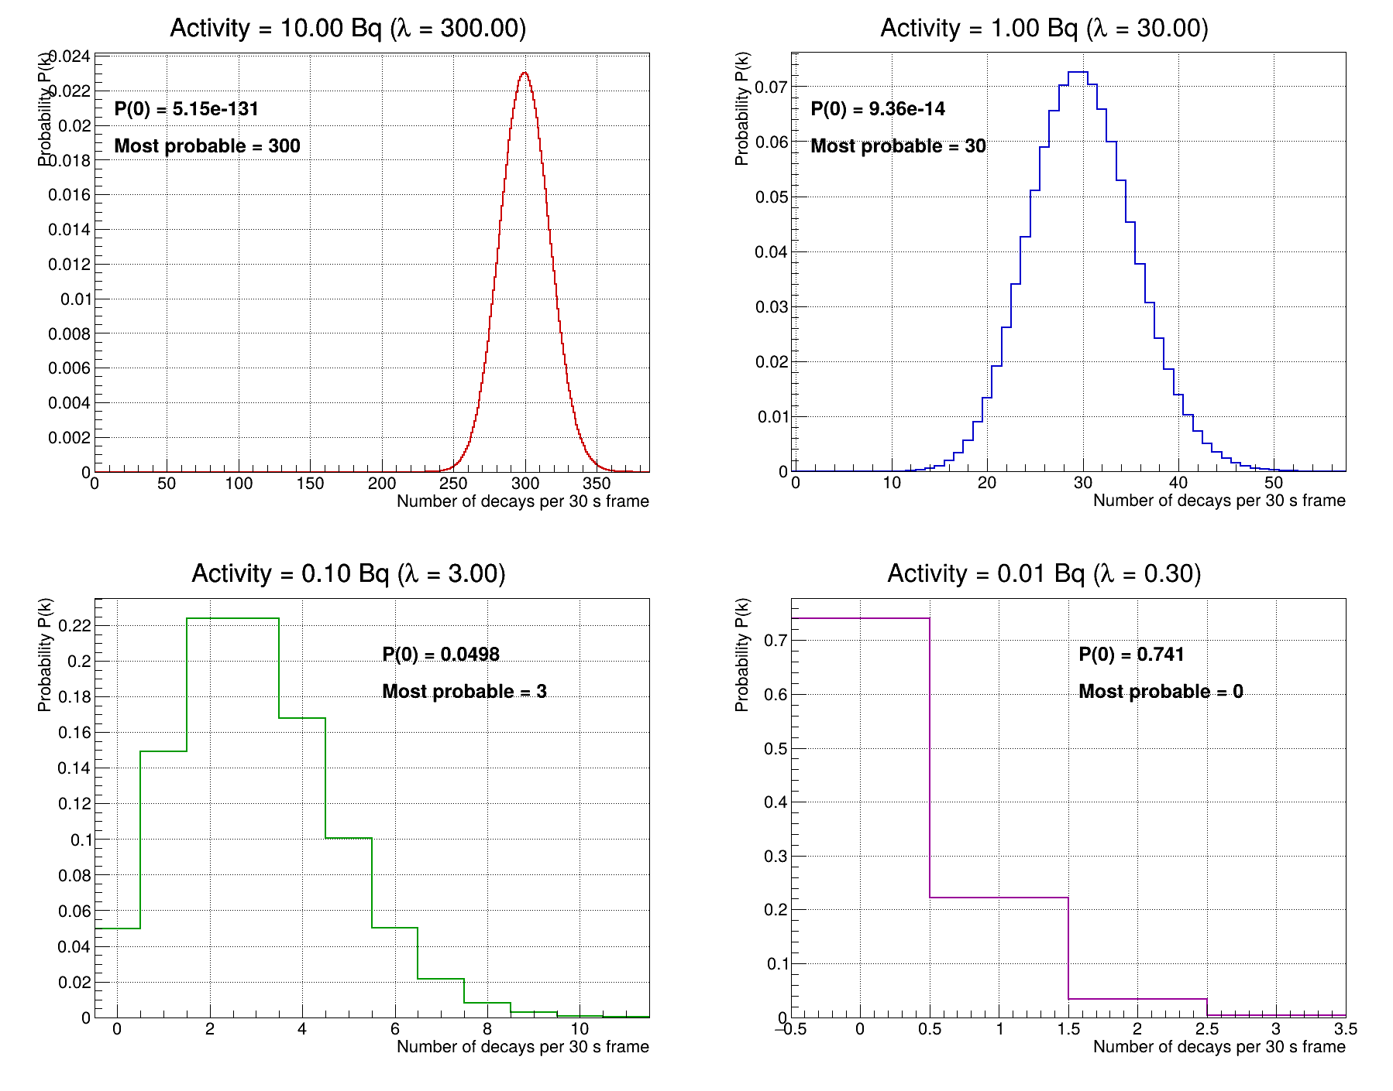
Poisson Statistics
$$P\left(n;λ\right)=\frac{e^{−λ}λ^{n}}{n!}$$
, where λ=expected decays per frame
eg 0.01Bq & 30sec per frame:
λ=0.01decays/sec * 30sec = 0.3 decays per frame
=> 1 decay per 3 frames
P(0) = 0.74 => 74% probability to not see signal

Slide 20
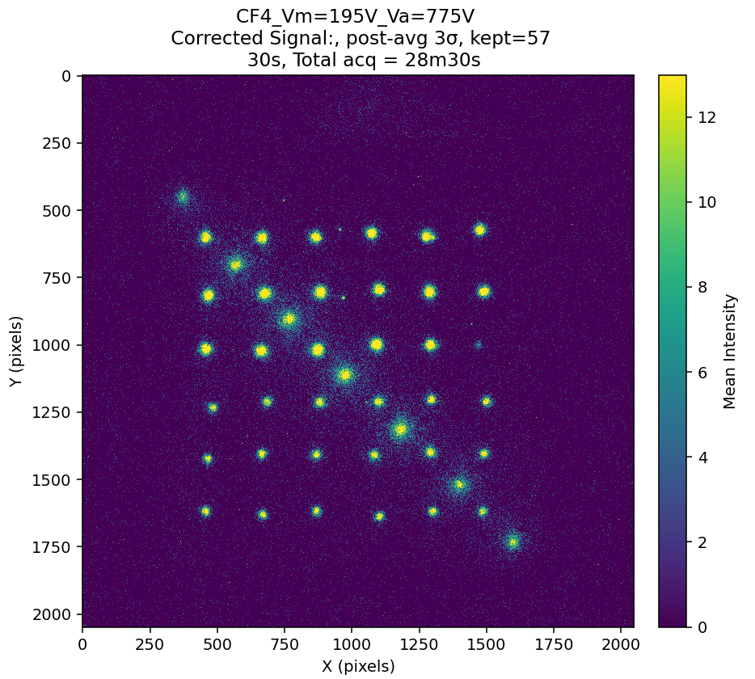
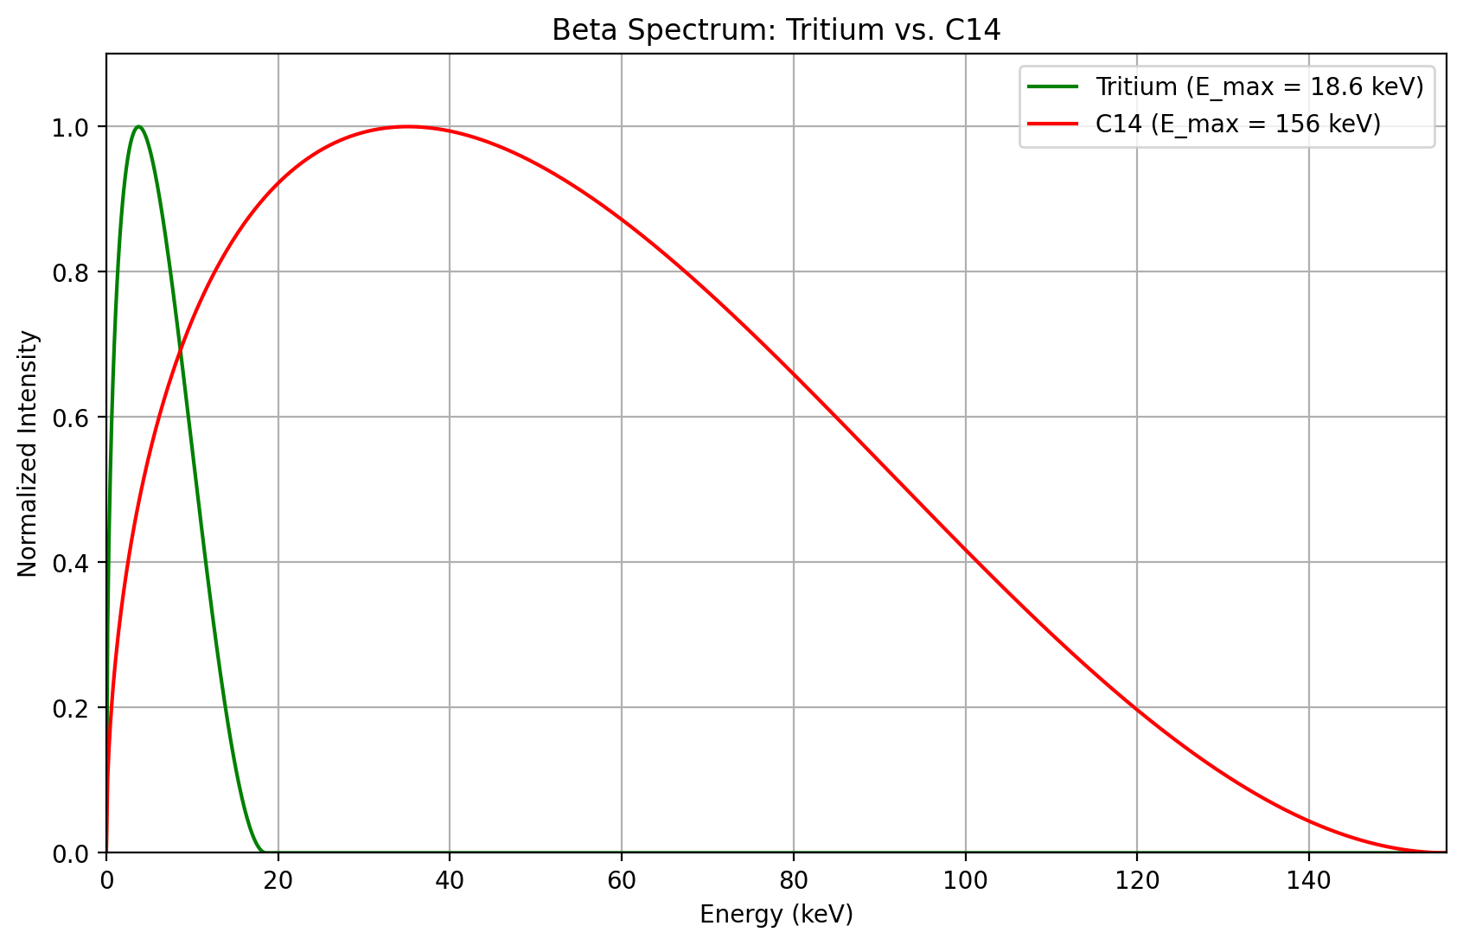

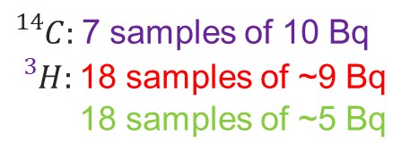
Setup, Acquisition & Results: ${}_{}^{14}C$samples
${}_{}^{14}C:$7 samples of 10 Bq
${}_{}^{3}H:$18 samples of ~9 Bq
18 samples of ~5 Bq
Beta spectrum for the ${}_{}^{14}C$ and ${}_{}^{3}H$
3H: ~9Bq
3H: 5Bq
14C: 10Bq

Slide 21
Neutron Imaging
4
  Concept
  Degradation of TPB (WLS)
  Resolution

Slide 22




Applications: neutron-Imaging
From (thermal) neutrons to charge particles:
  $B_{4}C$ layer on the cathode ~2um
  $n+ {}_{}^{10}B→a+ {}_{}^{7}{Li}$
  Efficiency ~ 5%
α and Li: Heavy fragments
Dense Ionization
Tracks up to ~10 mm in gas => resolution ↓
Minimization of the drift gap (<1 mm)
& use of high electric field (ionization near the converter)
Notes:
B₄C (boron carbide)
->Fast neutrons:
-Test aluminized polypropylene or Mylar (0.1–1 mm) to generate recoil protons.
-Less efficient, worse resolution, but still feasible.

Slide 23

Neutron test beam @ ISIS, UK
Setup
Detectors:
  W014: 5 mm quartz with WLS
Drift gap ~ 200 um
Amplification gap 150 um
Gas: He/CO2 87/13 (86/14) → W014
Beam: Fast and thermal neutrons
Micromegas detector
Beam

Slide 24



Targets
Slit
Width 2 mm
Circle
Diameter 2 mm
Homemade Target
Plastic + Aluminium

Slide 25




Ageing of WLS: W014
1st and 24th (last) acquisition
Beam 6cmX6cm
Beam 3cmX3cm
Slit 2mm
Beam 3cm X 3cm
1st acquisition
Beam 6cm X 6cm
Last acquisition

Slide 26

Slit: MTF, ROIs selection

Slide 27

Beam: MTF, ESF

Slide 28

Beam: MTF, Resolution (mm) | all acquisitions
noCd→Fast+Thermal
Cd → Thermal

Slide 29

Conclusions/Next steps
Conclusions:
  Optimization of gas mixtures for charge & light gain:
    Best gas mixture for charge and light gain: Ar/CF4/Isob (95/3/2)
  X-ray imaging, spatial resolution:
    Detectors with black mesh present better resolution.
  Beta-Imaging:
    Detection of sub-Bq activities ~0.1Bq of Tritiated glucose samples
    Detection of ${}_{}^{14}C$ samples and discrimination of ${}_{}^{14}C \& {}_{}^{3}H$
  Neutron-Imaging:
    Degradation of TPB(WLS) within 5min
Next steps:
  X-ray imaging, spatial resolution:
    Finalizing the analysis of SOLEIL test beam campaing: comparison of spatial resolution for different detectors, lens and gases.
  Beta-Imaging:
    Finalize the discrimination of ${}_{}^{14}C \& {}_{}^{3}H$, and estimation of the activity
    Envisage of new depositions : different activities, different pattern
  Neutron-Imaging:
    Data taking campaign in neutron facility
  Simulations:
    Simulations of transverse diffusion for different gas mixtures and charge gain for different detectors & gas mixtures

Slide 30

Merci! ☺
SPAD Image
29/07/2025

Slide 31
Backup slides
3

Slide 32



Light detection: Scintillation Spectrum
Layer of Indium Tin Oxide (ITO) on the glass substrate
    Electrically conductive
    Optically transparent
    Simple deposited of thin films by evaporation
Key point: Match the light wavelength and the QE of the imaging sensor
  Use of Quenchers,
  like CF4 or Ethane with a noble gas
  i.e. Argon/CF4
  Use of Wavelength Shifter
  Shifts UV light to visible light
  i.e. Tetraphenyl Butadience (TPB) +Argon/C4H10
Transparent window
Lens
Notes:
The TPB is used to shift scintillation light spectrum to visible range with peak around 425nm, This corresponds to ~85% QE of the ORCA camera

Slide 33



Readout
Electronic Readout
Optical Readout
WHY?
Optical readout Vs charge readout
  2D images on real time, without the need of extensive track reconstruction
  High granularity (e.g. 4096$×$2306)
  Bigger active area & lower cost per pixel
  Better spatial resolution?
Disadvantages:
Limited frame rate
Sensitive only to a part of the spectrum
(Need of CF4- based gas mixtures or Wavelength shifters)
Radiation hardness
Recording induced electronic signals with readout electronics
Recording scintillation light with imaging sensors

Slide 34
Diffusion of the different gases, Magboltz

Slide 35





Slide 36
Charge and optical gain

Slide 37

Gases
Gas mixture | Gas Percentage
$$Ar/{CF}_{4}$$ | 90/10
$$Ar/{CF}_{4}$$ | 85/15
$$Ar/{CF}_{4}$$ | 80/20
$${Ar/CF}_{4}/Isob$$ | 88/10/2
$${Ar/CF}_{4}/Isob$$ | 87/10/3
$${Ar/CF}_{4}/Isob$$ | 78/20/2
$${Ar/CF}_{4}/Isob$$ | 77/20/3
$${Ar/CF}_{4}/Isob$$ | 95/3/2
$$Ar/Isob$$ | 96/4
$$Ar/Isob$$ | 95/5
$${Ar/CO}_{2}/Isob$$ | 93/5/2
$${He/CF}_{4}/Isob$$ | 88/10/2
$${He/CF}_{4}$$ | 90/10
$${He/CF}_{4}$$ | 85/15
$${He/CF}_{4}$$ | 80/20
$${Ne/CF}_{4}$$ | 90/10
$${Ne/CF}_{4}/Ethane$$ | 86/10/4

Slide 38



Charge Gain: Ar, He and Ne based mixtures

Slide 39

Light Gain: Ar/CF4 (90/10)
ROIs selection

Slide 40

Ar/CF4/Isob (95/3/2)
He/CF4 (80/20)
Ne/CF4 (90/10)
Ar/CF4 (95/15)
Ar/CF4 (90/10)
Ar/CF4 (80/20)

Slide 41


Light gain
Calculation of light gain:
$$Light gain= \frac{\sum_{i=1}^{i=N_{pxl,roi}}{{\overline{I}}_{i}}}{Rate ∗30sec}$$
, where i=Pixel-i inside the ROI
$$Rate= \frac{Total counts}{Real time}$$
What about noise that does not exist at all spectrums?
(first channels)
Calculation of error:
$$σ_{LG}=LG∗\sqrt{{(\frac{σ_{sum}}{sum})}^{2}+{(\frac{σ_{R}}{R})}^{2}}$$
, where $σ_{sum}=\sqrt{\sum_{i∈ROI}{\frac{σ_{pixel−i}^{2}}{N_{frames}}}}$
and $σ_{R}=\frac{\sqrt{Total counts}}{Real time}$ (poisson)

Slide 42

Ar/CF4 (90/10)
Ar/CF4 (80/20)
Ar/CF4/Isob (95/3/2)
Ar/CF4 (95/15)
Ne/CF4 (90/10)
He/CF4 (80/20)
Ar/CF4/Isob (78/20/2)

Slide 43
beta-Imaging

Slide 44
How could we detect the lowest activity?
Preliminary!
Mask the noisy pixel
  Two different methods for the declaration of noisy pixel
    Two parameters (threshold & occupancy)
Gas Mixture (detector gain)
  90% Ar + 10% ${CF}_{4}$
  85% Ar + 15% ${CF}_{4}$
  80% Ar + 20% ${CF}_{4}$
  Triple gas:
    Ar + 10% ${CF}_{4}$ + 2% Isob
    Ar + 10% ${CF}_{4}$ + 3% Isob
    Ar + 15% ${CF}_{4}$ + 2% Isob
    Ar + 15% ${CF}_{4}$ + 3% Isob
    Ar + 20% ${CF}_{4}$ + 2% Isob
    Ar + 20% ${CF}_{4}$ + 3% Isob
No significant change!

Slide 45



Pedestal, Raw and Signal image
Pedestal Image
Raw Image
Signal Image
10Bq
0.01Bq
0.1Bq
1Bq

Slide 46




Different gas mixtures
Preliminary!
Ar + 10% CF4 + 2% Isobutane
Ar + 15% CF4 + 2% Isobutane
Ar + 15% CF4 + 3% Isobutane
10Bq
0.1Bq
1Bq
Ar + 20% CF4 + 2% Isobutane
Ar + 20% CF4 + 3% Isobutane

Slide 47
neutron-Imaging

Slide 48

Slit: Size 2mm

Slide 49

Slit: Size, All acquisitions
noCd→Fast+Thermal
Cd → Thermal

Slide 50


1st Acquisition: Degradation with time (frame by frame)
Beam 3cmX3cm
$$\frac{y −median}{median} ∗100$$
5min
5min
5min

