Slide 1
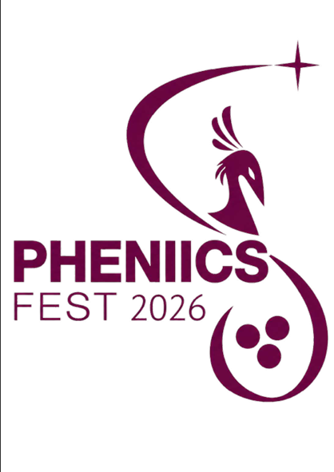

Dosimetric Evaluation of MiniGrid and Minibeam Collimators in Spatial Fractionated Radiotherapy Techniques
Ahmed Glayl
Thesis supervisor: Prof.Yolanda Prezado
Co. Supervisor: Prof. Olivier Seksek

Slide 2
Presentation overview
Context: radiotherapy (RT) and spatial fractionation Radiotherapy (SFRT)
Thesis goals
Methods & results
conclusions
Future perspectives

Slide 3
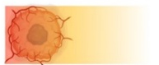
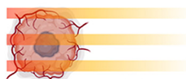
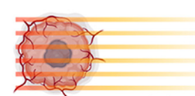
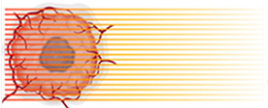
Context Thesis Goals Methods & Results Conclusions Future Perspectives 3/18
Context
Spatially Fractionated RadioTherapy (SFRT): Techniques
Conventional-RT
GRID-RT
Minibeam-RT (MBRT)
Microbeam-RT (MRT)
Uniform field
cm wide beams
≤100 µm wide beams
> 300 µm wide beams
beam width (bw) = 1 — 2 cm ctc = 2 — 4 cm
bw = 0.5 — 1 mm
ctc = 1 — 4 mm
bw = 50 — 100 µm
ctc = 200 — 400 µm
[Fernandez-Palomo et al., 2022]

Slide 4
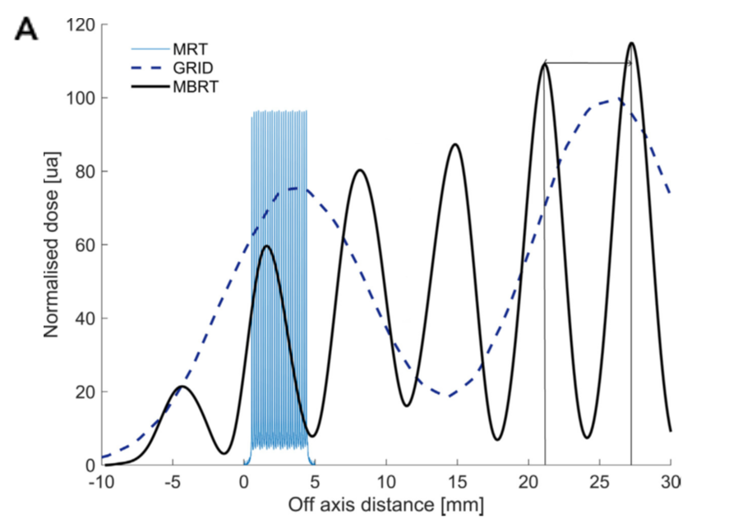
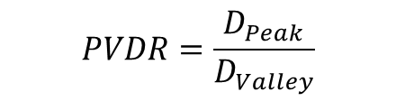
Context
Context Thesis Goals Methods & Results Conclusions Future Perspectives 4/18
Spatially Fractionated RadioTherapy (SFRT)
Peak
SFRT uses a strong spatial modulation of the dose to spare normal tissue and maintain tumor control.
Valley
ctc
$$PVDR=\frac{D_{Peak}}{D_{Valley}}$$
[Lin et al., 2024]

Slide 5
Context Thesis Goals Methods & Results Conclusions Future Perspectives 5/18
This thesis aims to advance SFRT by optimising collimator geometries, beam parameters, and dose modulation, while exploring the potential of Minigrid and Minibeam techniques for improving tumour control and normal tissue sparing in challenging oncological applications.

Slide 6

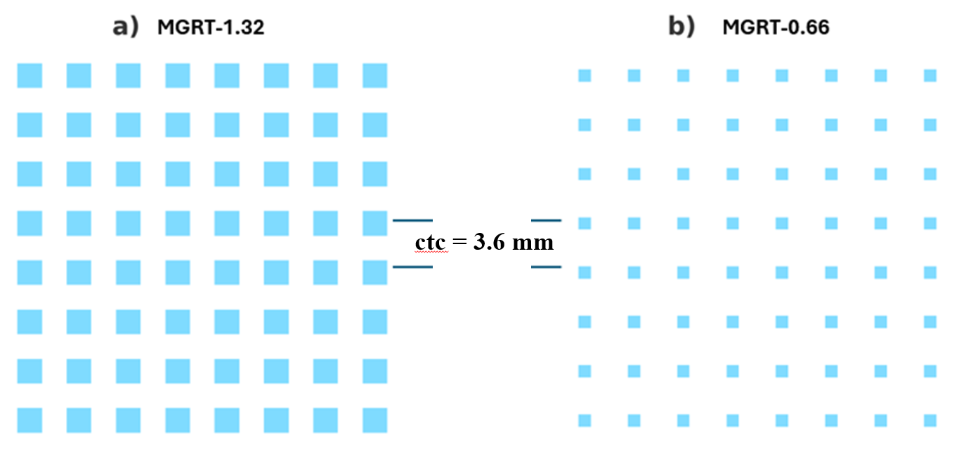
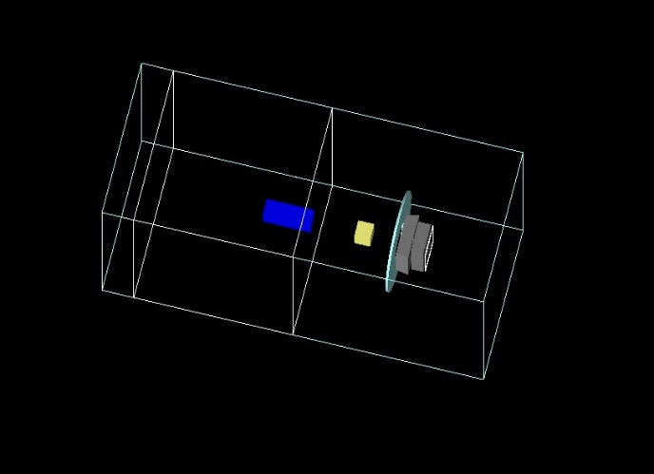
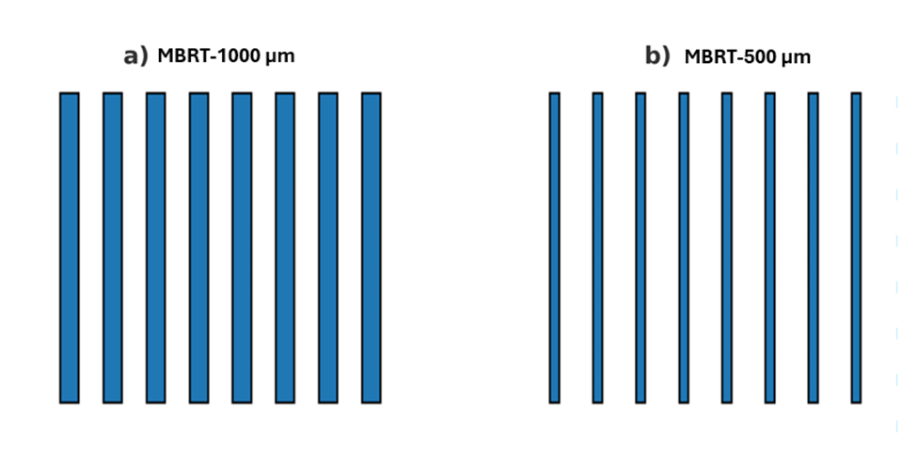
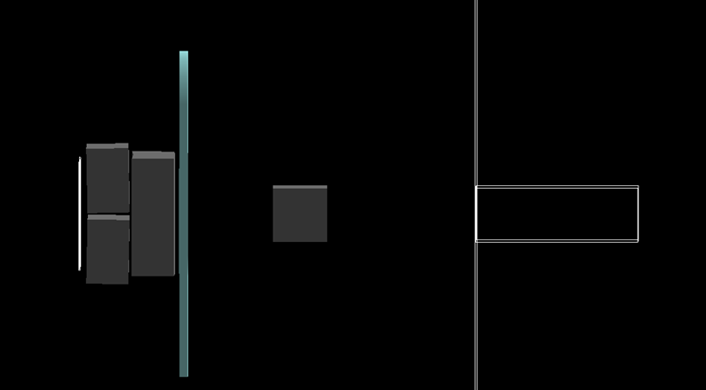
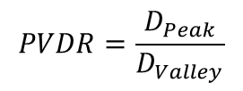
Methods & Results TOPAS MGRT TPS 6/18
TOPAS visualization of LINAC
$$PVDR=\frac{D_{Peak}}{D_{Valley}}$$

Slide 7
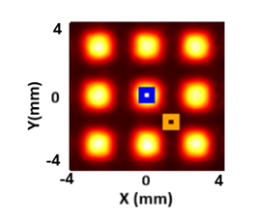
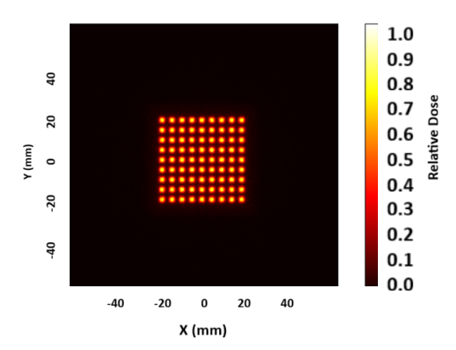
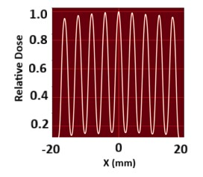
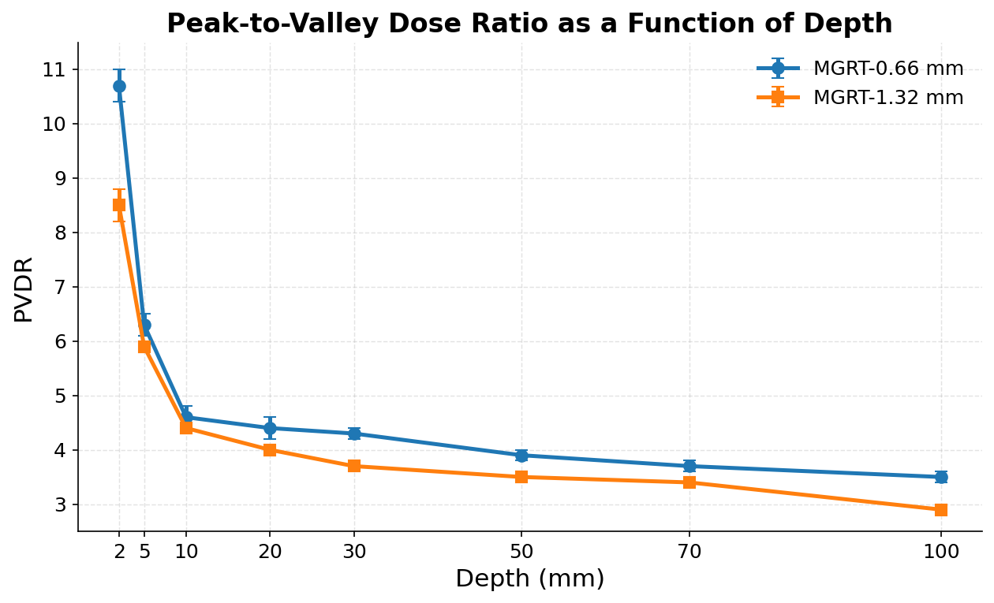
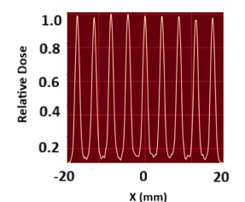
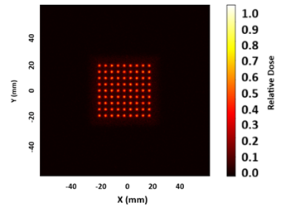
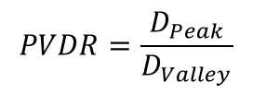


Methods & Results TOPAS MGRT TPS 7/18
$$Peak$$
MGRT Collimator: This collimator type includes a grid structure with two beam widths:
Beam width 1: 1.32 mm,
Beam width 2: 0.66 mm,
ctc 3.6 mm
$$PVDR=\frac{D_{Peak}}{D_{Valley}}$$
$$Valley$$
MGRT 1.32 mm
PVDR
MGRT 0.66 mm
Smaller beam (≤ 1 mm at the isocenter) and higher
PVDR (up to 9)
Smaller beams (≤ 1.32 mm)
Higher PVDR in normal tissues
[Acuña et al., 2025]

Slide 8
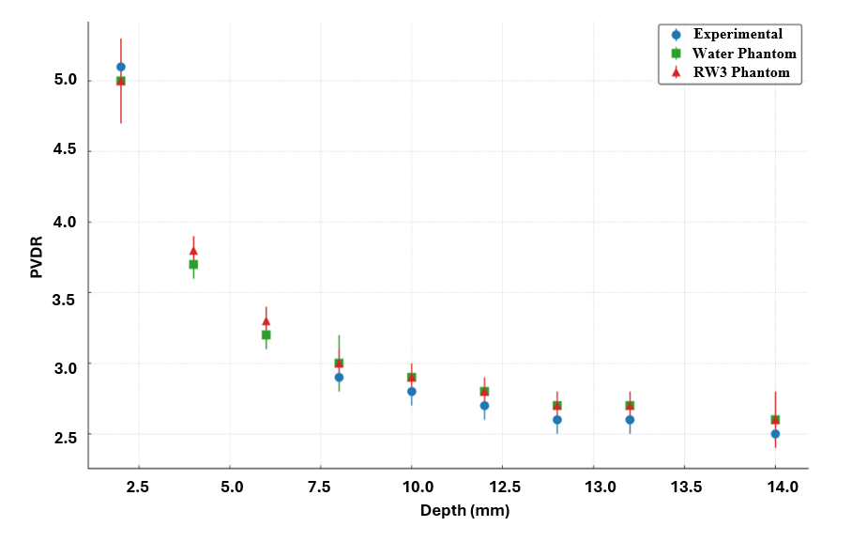
Methods & Results TOPAS MGRT TPS 8/18
MC code validation
LINAC
FFF TrueBeam (6 MV X-rays)
10 cm thick steel collimator,
1.3 x 1.3 mm2

Slide 9
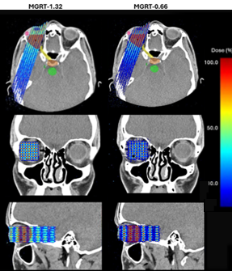
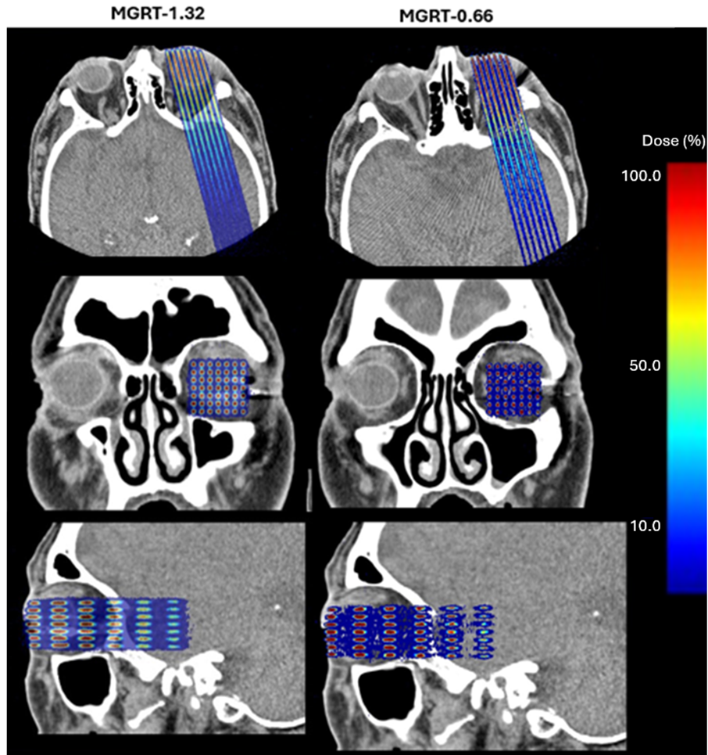

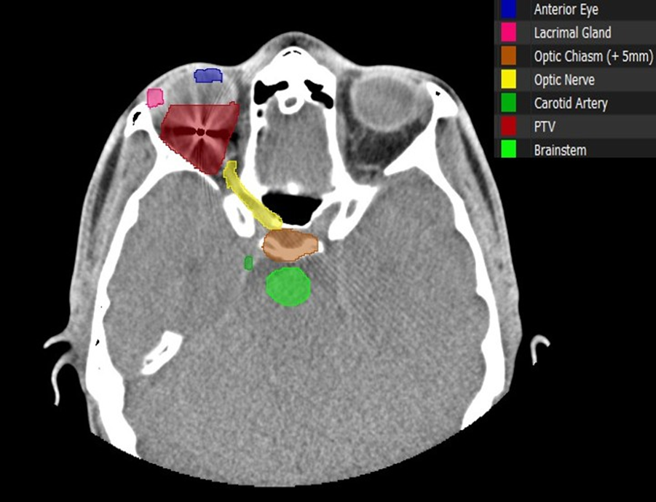
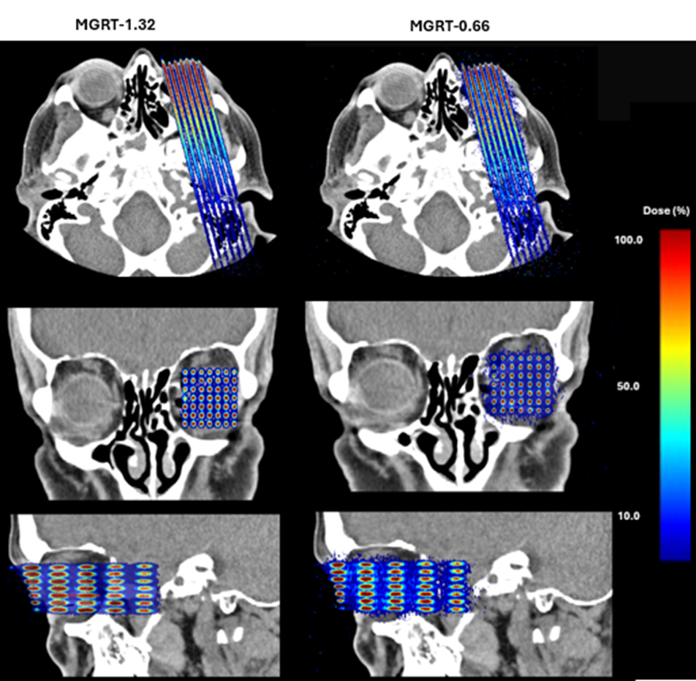
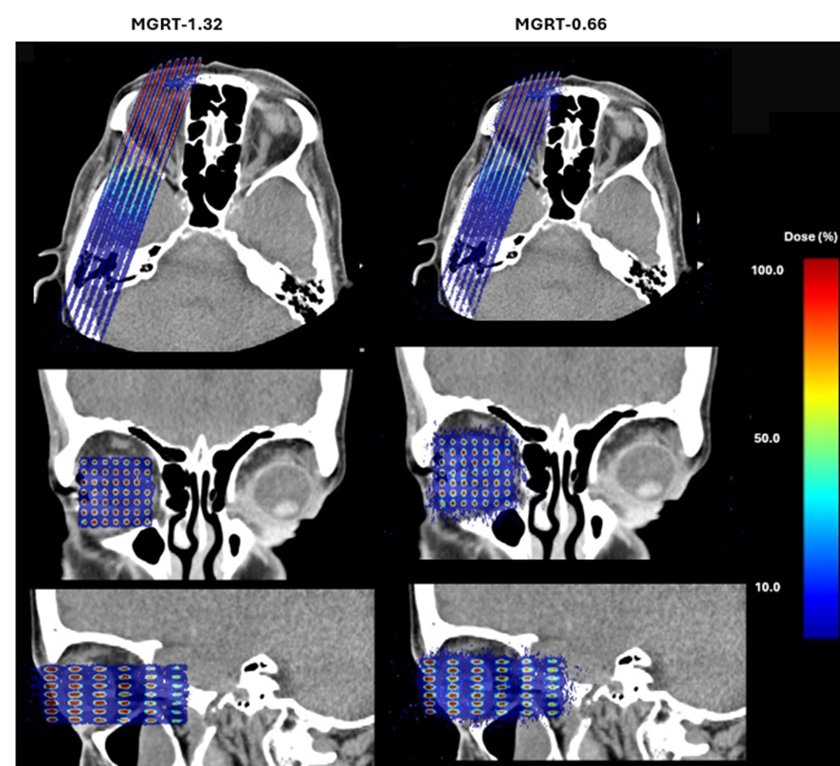
Methods & Results TOPAS GRID-RT TPS (Ocular Tumour) 9/18
Treatment Planning System (TPS)
Treatment planning for Ocular Tumour
Case 1
Case 2
Contouring Methodology
Case 3
Case 4

Slide 10
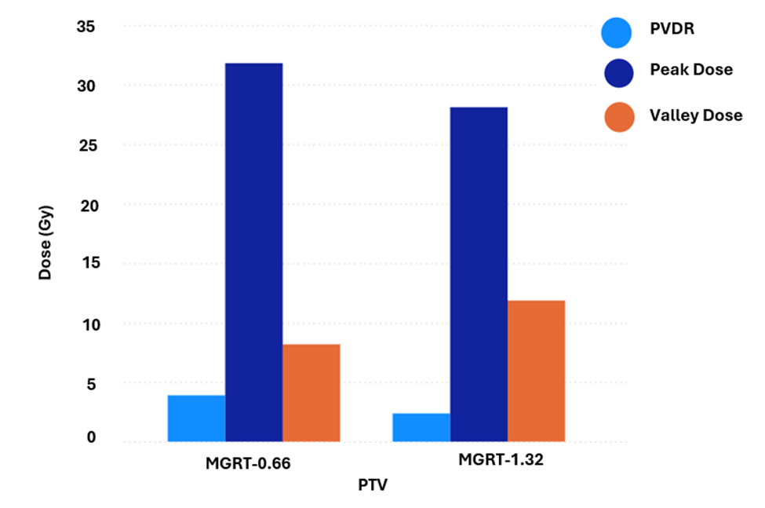
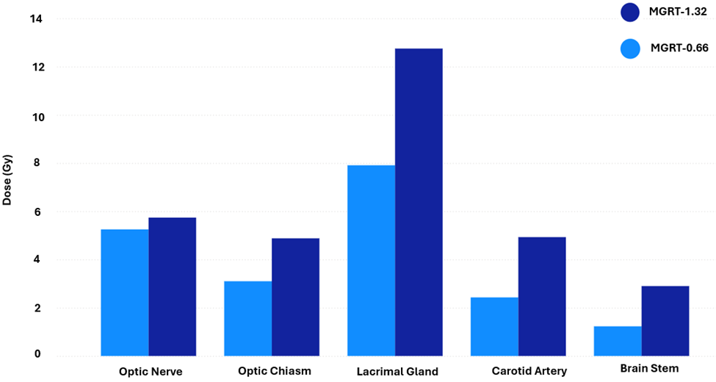

Methods & Results TOPAS GRID-RT TPS (Ocular Tumour) 10/18
Treatment planning for Ocular Tumour
shows the mean dose delivered of the organs at risk for MGRT treatment plans with beam widths of 1.32 mm and 0.66 mm.
PVDR for the PTV in both MGRT configurations (1.32 mm and 0.66 mm beam widths) under a prescribed dose of 20 Gy.
$$PVDR=\frac{D_{Peak}}{D_{Valley}}$$

Slide 11
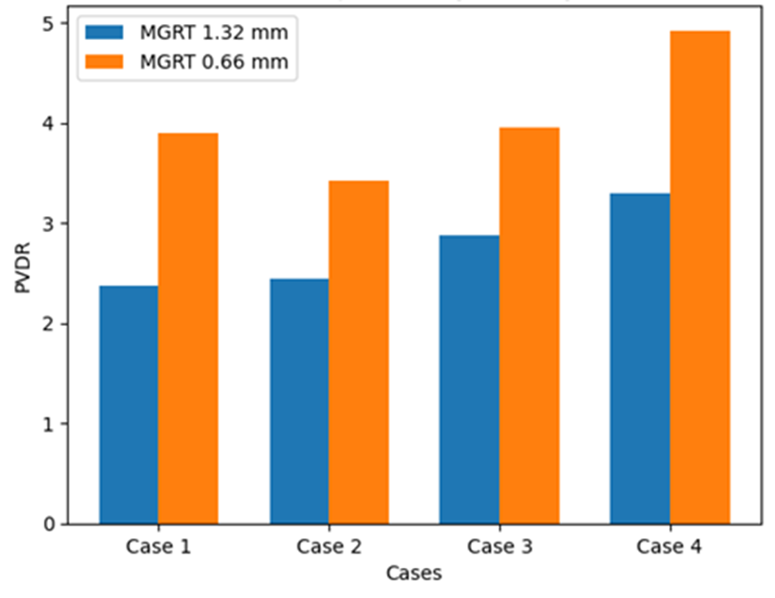

Methods & Results TOPAS GRID-RT TPS (Ocular Tumour) 11/18
Treatment planning for Ocular Tumour
Peak-to-valley dose ratio (PVDR) within the PTV for MGRT plans
Expected to better exploit dose–volume effects than GRID_1.32 therapy
PVDR > 3 in all cases
$$PVDR=\frac{D_{Peak}}{D_{Valley}}$$
Smaller beams (≤ 1.32 mm)
Higher normal tissue sparing
[Acuña et al., 2025]

Slide 12
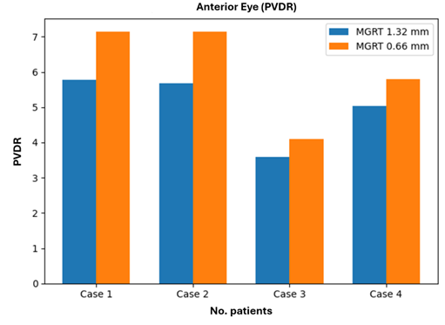
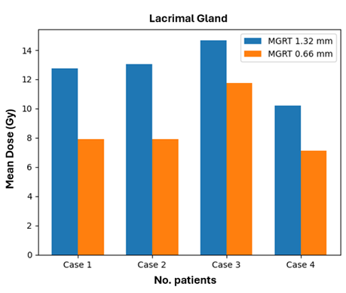
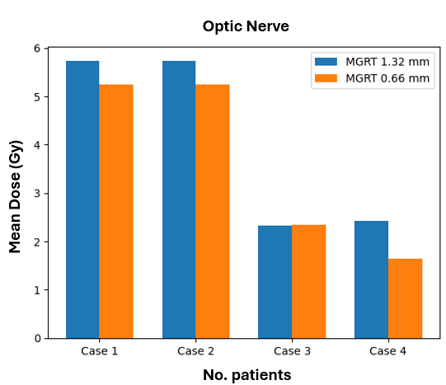
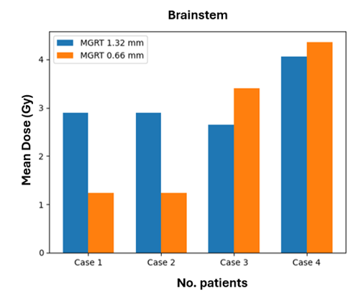
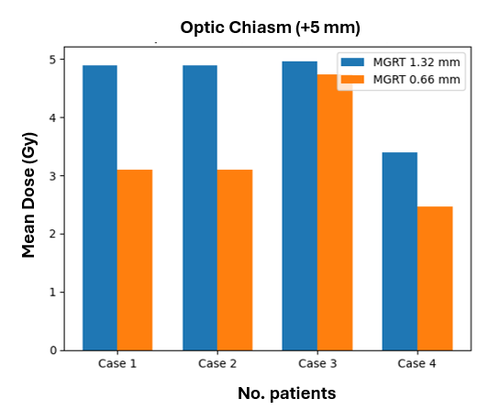
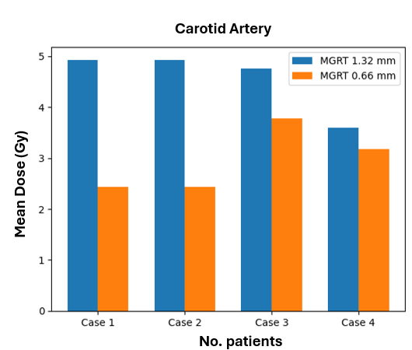
Methods & Results TOPAS GRID-RT TPS (Ocular Tumour) 12/18
Treatment planning for Ocular Tumour
Lower mean doses to several OARs, including the lacrimal gland and carotid artery, were observed with the 0.66 mm configuration.
The optic nerve doses were comparable between both beam configurations in some cases.
Variations in brainstem and optic chiasm doses demonstrate the influence of patient anatomy and beam arrangement on dose distribution.
Narrower beam widths showed greater potential for normal tissue sparing while maintaining dose heterogeneity.

Slide 13
Context Thesis Goals Methods & Results Conclusions Future Perspectives 13/18
SFRT demonstrates strong potential to improve the therapeutic ratio by combining effective tumour irradiation with enhanced normal tissue sparing.
collimator geometry, beam width, and beam spacing strongly influence dose distribution and PVDR values.
Accurate dosimetric modelling is essential for the optimisation and future clinical implementation of SFRT techniques.
Further biological studies and experimental validation are required before routine clinical translation.

Slide 14
Context Thesis Goals Methods & Results Conclusions Future Perspectives 14/18
Optimization of dosimetry and QA protocols
Development of accurate and clinically relevant dose prescription strategies
Establishment of regulatory guidelines and dosimetric standardization for clinical implementation.
Improvement of treatment delivery precision and patient-specific verification methods.
Translation of SFRT from preclinical research to routine clinical practice

Slide 15
Context Thesis Goals Methods & Results Conclusions Future Perspectives Bibliography 15/18
Context Thesis Goals Methods & Results Conclusions Future Perspectives 15/60
Bibliography
Wang, L., Lynch, C., Pitroda, S. P., Piffkó, A., Yang, K., Huser, A. K., ... & Weichselbaum, R. R. (2024). Radiotherapy and immunology. Journal of Experimental Medicine, 221(7), e20232101.
Prezado, Y., Grams, M., Jouglar, E., Martinez-Rovira, I., Ortiz, R., Seco, J., & Chang, S. (2024). Spatially fractionated radiation therapy: a critical review on current status of clinical and preclinical studies and knowledge gaps. Physics in Medicine and Biology.
Iori, F., Cappelli, A., D'Angelo, E., Cozzi, S., Ghersi, S. F., De Felice, F., ... & Iotti, C. (2023). Lattice Radiation Therapy in clinical practice: A systematic review. Clinical and Translational Radiation Oncology, 39, 100569.
Prado, A., Martí, J., de Acilu, P. G., Zucca, D., de la Casa, M. Á., García, J., ... & Fernández-Letón, P. (2024). Dosimetrical and geometrical parameters in single-fraction lattice radiotherapy for the treatment of bulky tumors: Insights from initial clinical experience. Physica Medica, 123, 103408.
Kundapur, V., Torlakovic, E., & Auer, R. N. (2024, July). The Story Behind the First Mini-BEAM Photon Radiation Treatment: What is the Mini-Beam and Why is it Such an Advance. In Seminars in Radiation Oncology (Vol. 34, No. 3, pp. 337-343). WB Saunders.
Ahmed, M., Bicher, S., Combs, S. E., Lindner, R., Raulefs, S., Schmid, T. E., ... & Bartzsch, S. (2024). In Vivo Microbeam Radiation Therapy at a Conventional Small Animal Irradiator. Cancers, 16(3), 581.
Perl, J., Shin, J., Schümann, J., Faddegon, B., & Paganetti, H. (2012). TOPAS: an innovative proton Monte Carlo platform for research and clinical applications. Medical physics, 39(11), 6818-6837.
Faddegon, B., Ramos-Méndez, J., Schuemann, J., McNamara, A., Shin, J., Perl, J., & Paganetti, H. (2020). The TOPAS tool for particle simulation, a Monte Carlo simulation tool for physics, biology and clinical research. Physica Medica, 72, 114-121.
Ramon Ortiz Catalan. Dosimetric studies for proton minibeam radiation therapy. Medical Physics [physics.med-ph]. Université Paris-Saclay, 2022. English. ⟨NNT : 2022UPASP147⟩. ⟨tel-03957981⟩

Slide 16
Thank you for your attention

Slide 17
Dosimetric Evaluation of MiniGrid and Minibeam Collimators in Spatial Fractionated Radiotherapy Techniques
Ahmed Glayl
Thesis supervisor: Prof.Yolanda Prezado
Co. Supervisor: Prof. Olivier Seksek

