Slide 1
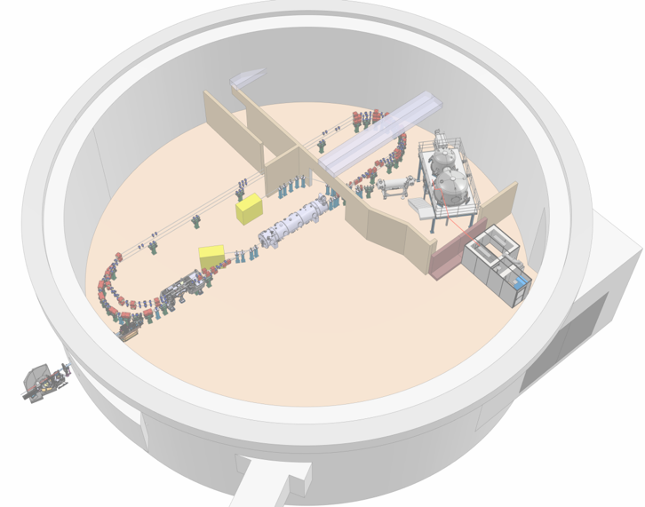

Project Progress Review (PPR) 1-2026
WP- 4
Hadil Abualrob / Luc Perrot / Rasha Abukeshek/ Emmanuel Froidfond
29 mai 2026
Notes:
29/05/2026
1

Slide 2
Etat d’avancement
CERN :
Dernier échange avec Jérémie Bauche (Normal Conducting Magnets group) le 12 Mai 2026
Ils sont en train de préparer l’addendum pour l’accord de collaboration pour le prêt des aimants MDX pour la Phase 1 de PERLE.
La demande est en signature au niveau de département, suite à quoi il nous transmet une proposition de texte.
Information requise de notre côté: définition du niveau maximal acceptable de débit de dose résiduelle pour les aimants, nécessaire à la sélection des aimants pour la campagne de tests
S.WURTH: < 0,1 µSv/h au contact des aimants
Notes:
29/05/2026
2

Slide 3
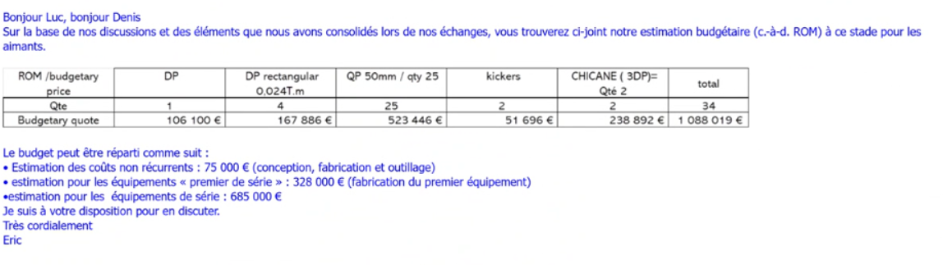
Etat d’avancement
SEF : Meeting during IPAC’26 at Deauville
They recieved the main specs of the magnets from us (Mai 2026)
We explained we will need « sub-phases » of magnets fabrication/delivery → focus on merger (3 dipoles, 7 quads)
They prefere small series production, starting with a prototype
We’ll provide the magnetic design and they carry the mechanical design (contrat simple si inferieur au seuil)
Devis (juin 11, 2025):
~42k€/dipole
~21k€/quadrupole
Notes:
29/05/2026
3

Slide 4
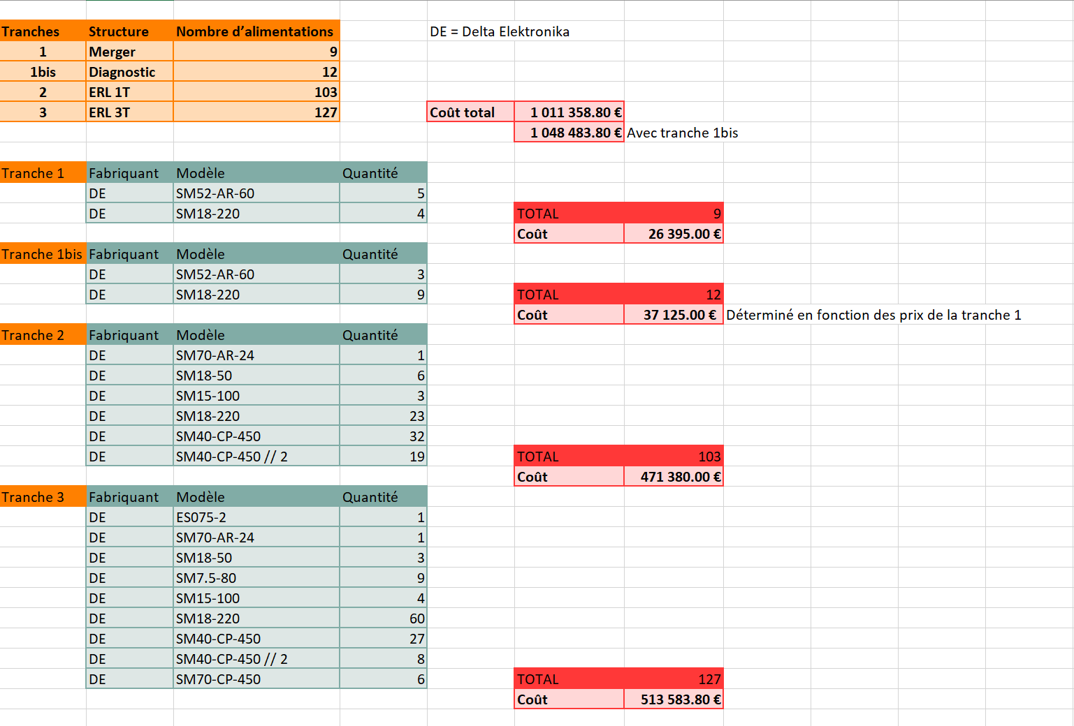
Etat d’avancement
LPSC: suite d’une visite a Grenoble (Emmanuel et Luc)
Aimants du cyclo du LPSC
The quads are 75 mm long with an Aperture of 55 mm, the gradient is small ~ 1.6 T/m
probablement non
Alimentation: Emmanuel a préparé un tableau
premier chiffrage avec le fournisseur "Equipements scientifiques", qui est le distributeur officiel Delta Elektronika en France
a ce jour, pas de récupération d’Alim
Notes:
29/05/2026
4

Slide 5
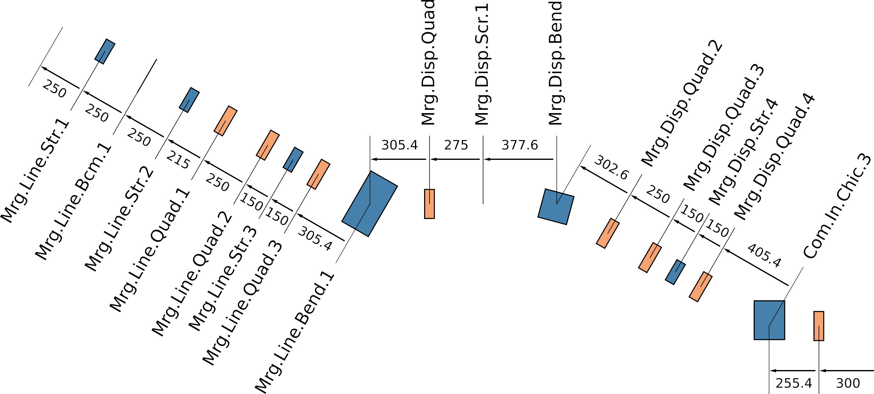

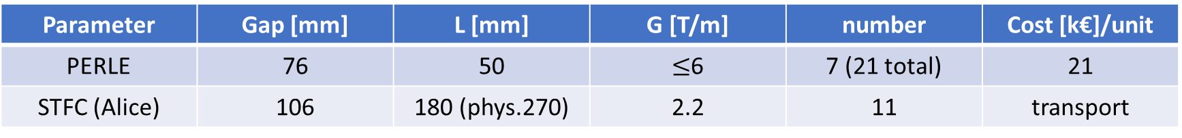
Etat d’avancement
STFC-Darsebury: Mail exchange & Meeting during IPAC’26 at Deauville
ALICE Injector quad Type D
Big aperture → not suitable for the stacked turns
Small Gradient
Length is more suitable for ERL quads -> place in merger?
→ Not a suitable option
Parameter | Gap [mm] | L [mm] | G [T/m] | number | Cost [k€]/unit
PERLE | 76 | 50 | $≤$6 | 7 (21 total) | 21
STFC (Alice) | 106 | 180 (phys.270) | 2.2 | 11 | transport
Notes:
29/05/2026
5

Slide 6
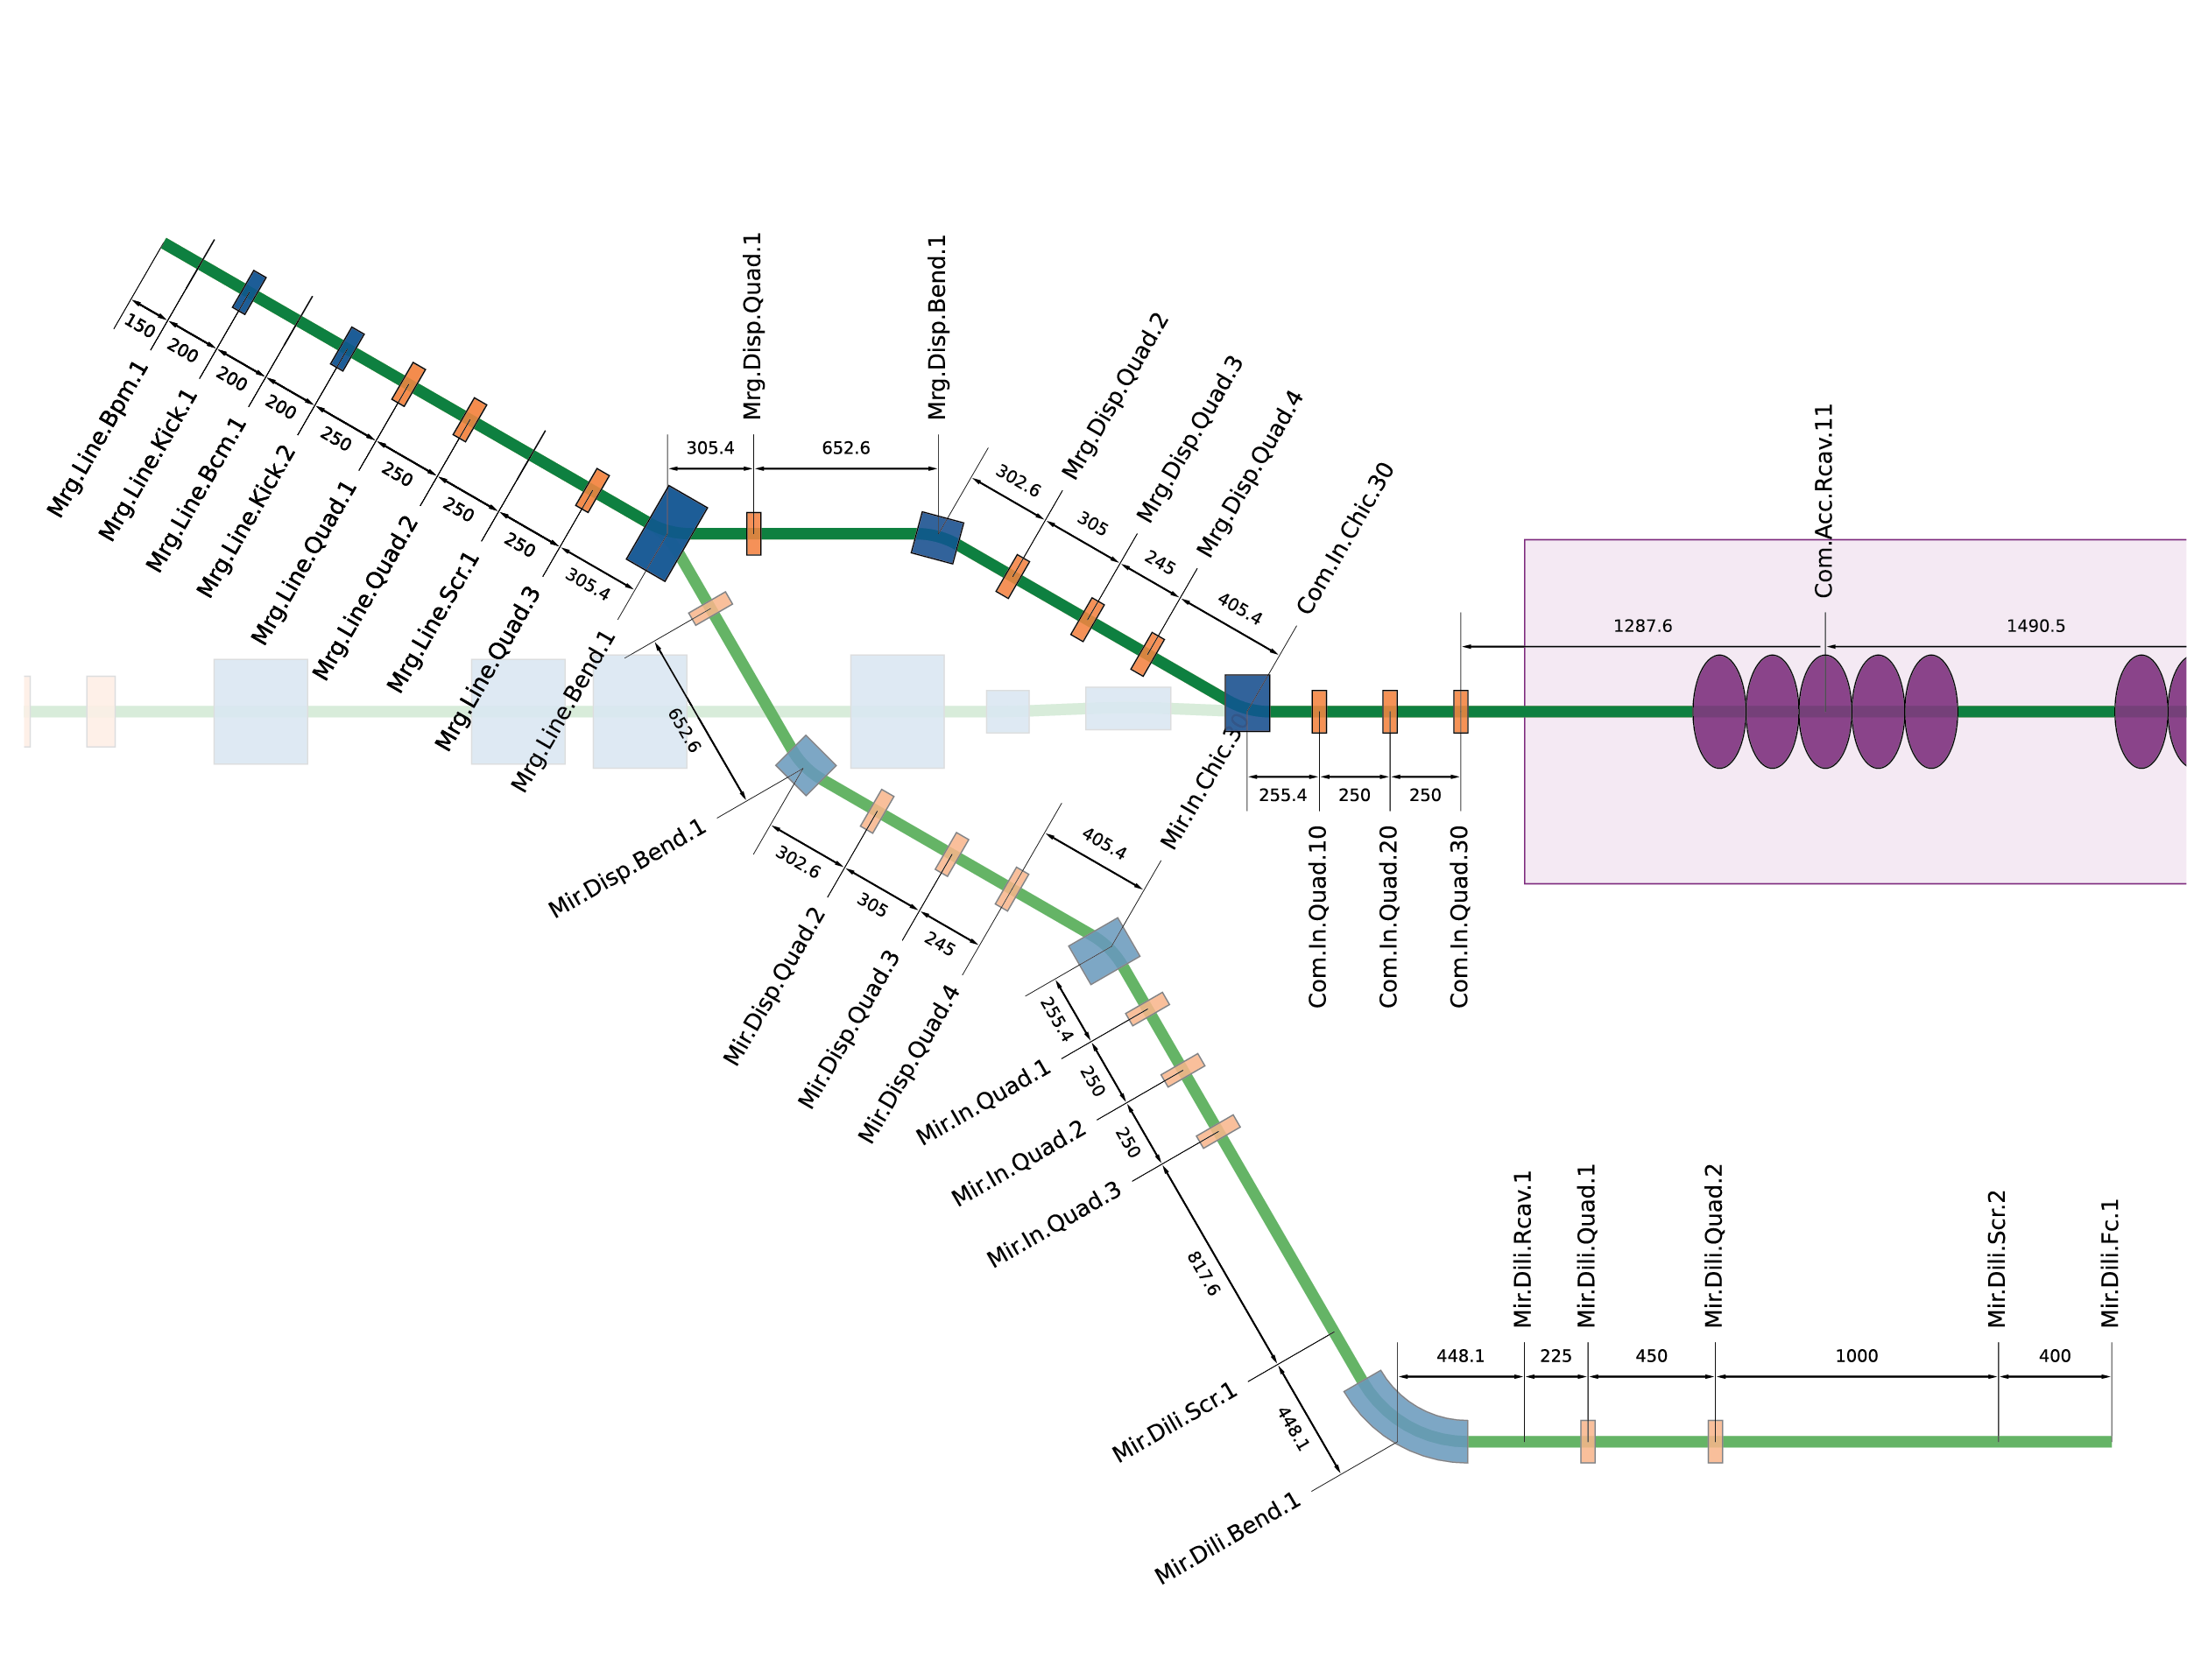
Etat d’avancement
STFC-Darsebury: Mail exchange & Meeting during IPAC’26 at Deauville
ALICE Injector dipole
Used to bend 8 MeV electrons by 30°
Twice the length of PERLE merger dipole →reduce the current (field)
Well compatible option
To consider!
For the merger commission, one dipole can be used for the injector chicane
Must be replaced with a shorter magnet for the single-tour phase
Two options:
2 in merger + 1 in mirror
2 for the middle chicane (inj.+dump)
Parameter | Gap [mm] | L [mm] | B [T] | number | Cost [k€]/unit
PERLE | 76 | 150 300 | 0.08 0.08 | 3(8 total) 2 | 40 42
STFC (Alice) | 71 | 310 | 0.08 | 3 | transport
Notes:
29/05/2026
6

Slide 7
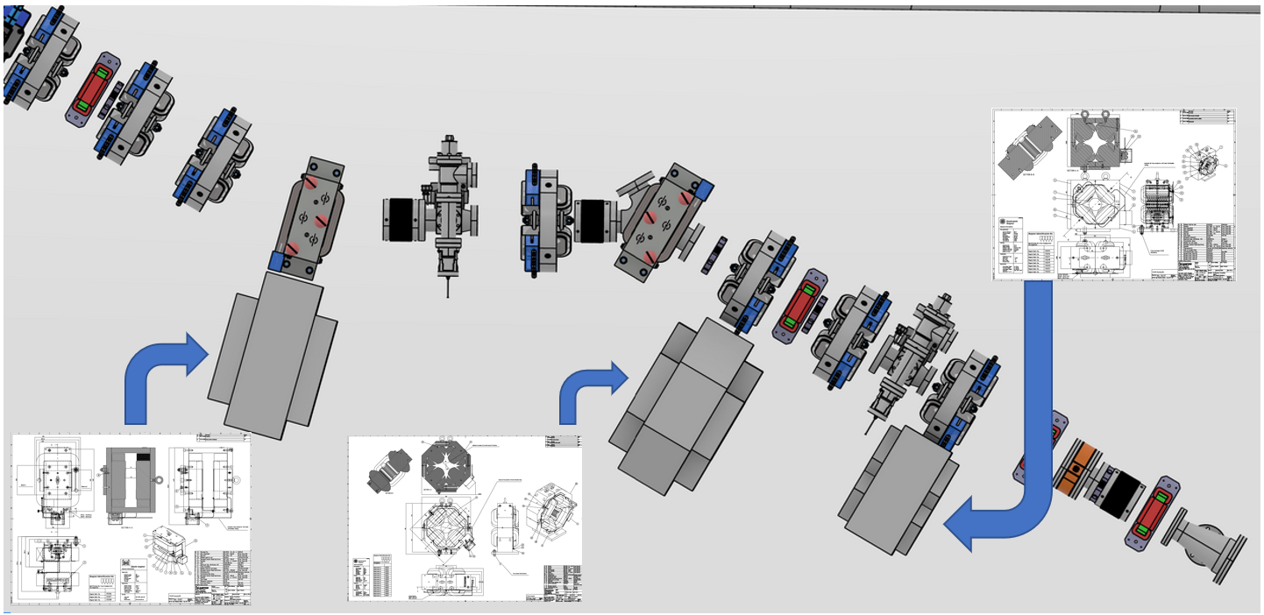
Etat d’avancement
STFC-Darsebury: Mail exchange & Meeting during IPAC’26 at Deauville
Alice injector dipole
Mechanical integration from 2D drawings: Alice quads are not suitable, dipoles can fit with compact quadrupoles
Dipole integration specs
230 kg, assembled in 2 parts (measurements on the bench?)
No support or fiducials
No power supply: ±6A/12V
HT test for the coils needed
Air cooled
STEP file of a simplified 3D model is provided (to be implemented)
Opera 3D provided → Beam Dynamics simulation with field map
Notes:
29/05/2026
7

Slide 8
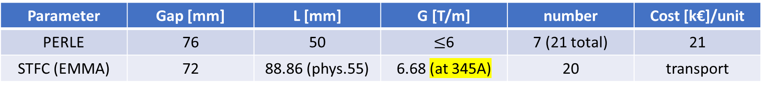
Etat d’avancement
STFC-Darsebury: Mail exchange & Meeting during IPAC’26 at Deauville
EMMA ring quad
New option suggested
Physical length is compact (55mm)
Gradient is compatible
Water cooled, with high current/small voltage power supply as the number of turns is small
STEP file of 3D model is provided (to be implemented)
Parameter | Gap [mm] | L [mm] | G [T/m] | number | Cost [k€]/unit
PERLE | 76 | 50 | $≤$6 | 7 (21 total) | 21
STFC (EMMA) | 72 | 88.86 (phys.55) | 6.68 (at 345A) | 20 | transport
Notes:
29/05/2026
8

Slide 9
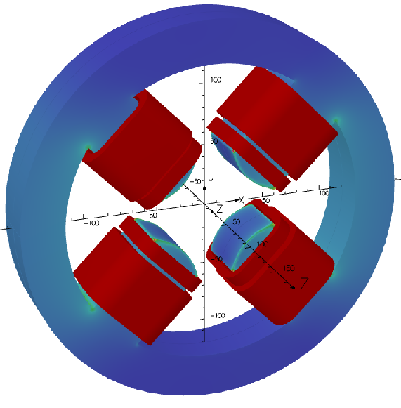
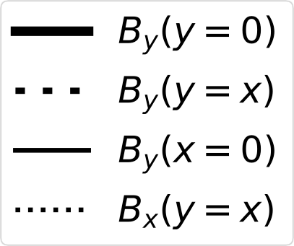

Etat d’avancement
Study of a Corrector-integrated Quadrupole for PERLE
Presented at IPAC’26 by Alex (THP2103)
First design: for the merger quads
OPERA magnet design
BMAD tracking to assess steering, emittance growth, and halo formation
Extend the study to ERL quadrupoles
If this design is adopted → no recuperation of quadrupoles possible
Notes:
29/05/2026
9

Slide 10
Etat d’avancement
Permanent magnets for PERLE
Discussion with HZB (Jens Volker) within the E2-SCALE project for tunable PMs for PERLE
Recycling of PM materials from old magnets/undulators
Initial idea: implement a PM dipole or a tunable PM quadrupole in the diagnostic line
However, PERLE magnet specs are not compatible with existing designs (BESSY III)
Large aperture and low field
Lack of manpower to develop a completly new design
PM not very intersting solution at low energy, as the magnets are of low current (low power consumption)
In the arcs we need high flexibility of tuning with EM
Notes:
29/05/2026
10

Slide 11
Planning et principaux jalons du WP
Planning pour les aimants et les alim calé sur les mise à disposition pour installation
Installation booster 01/06/2028
Distinction en deux blocs : aimants et alim’
Plusieurs phases : études + rédaction CCTP (pour fin juin 2026) → optimisation de quads et conception de correctors
Notes:
29/05/2026
11

Slide 12
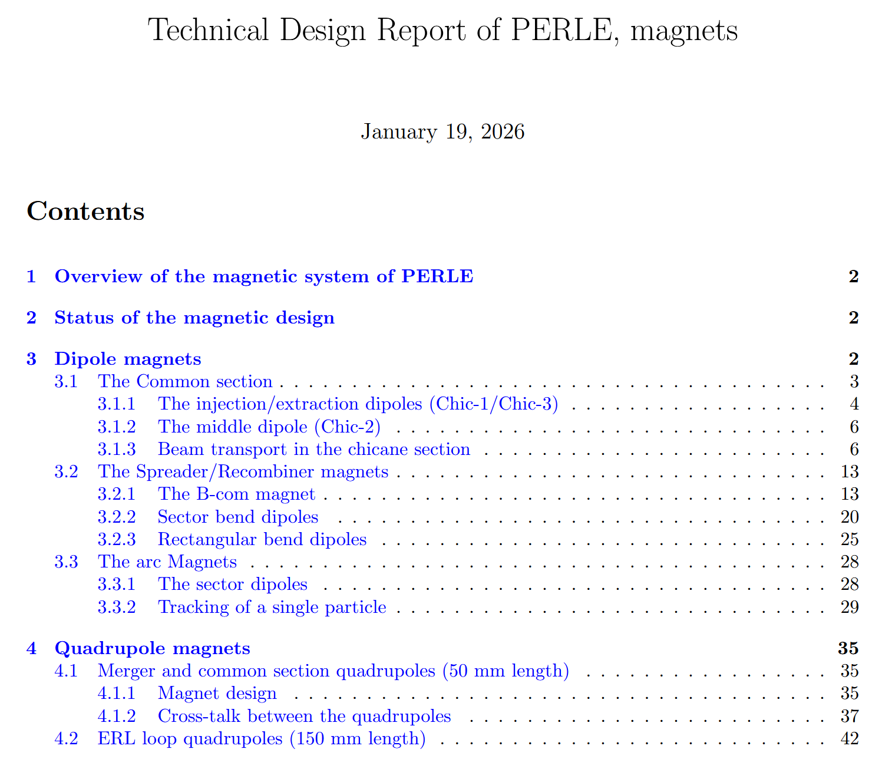
TDR
TDR aimants grandement construits sur l’adaptation de la thèse de Rasha (soutenue le 10 décembre 2025)
Sur « cnrs s-drive » depuis le 19/01/2025
En attente de retour
Notes:
29/05/2026
12

