Slide 1

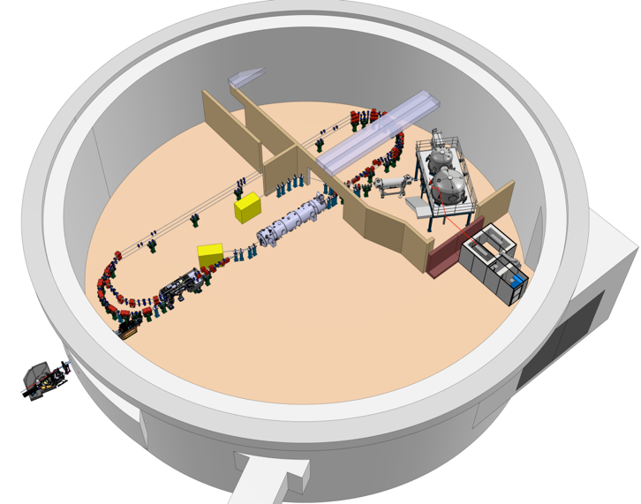
PERLE collaboration board
Photogun : status update and first beam
M. Baylac, R. Roux
June 3, 2026

Slide 2
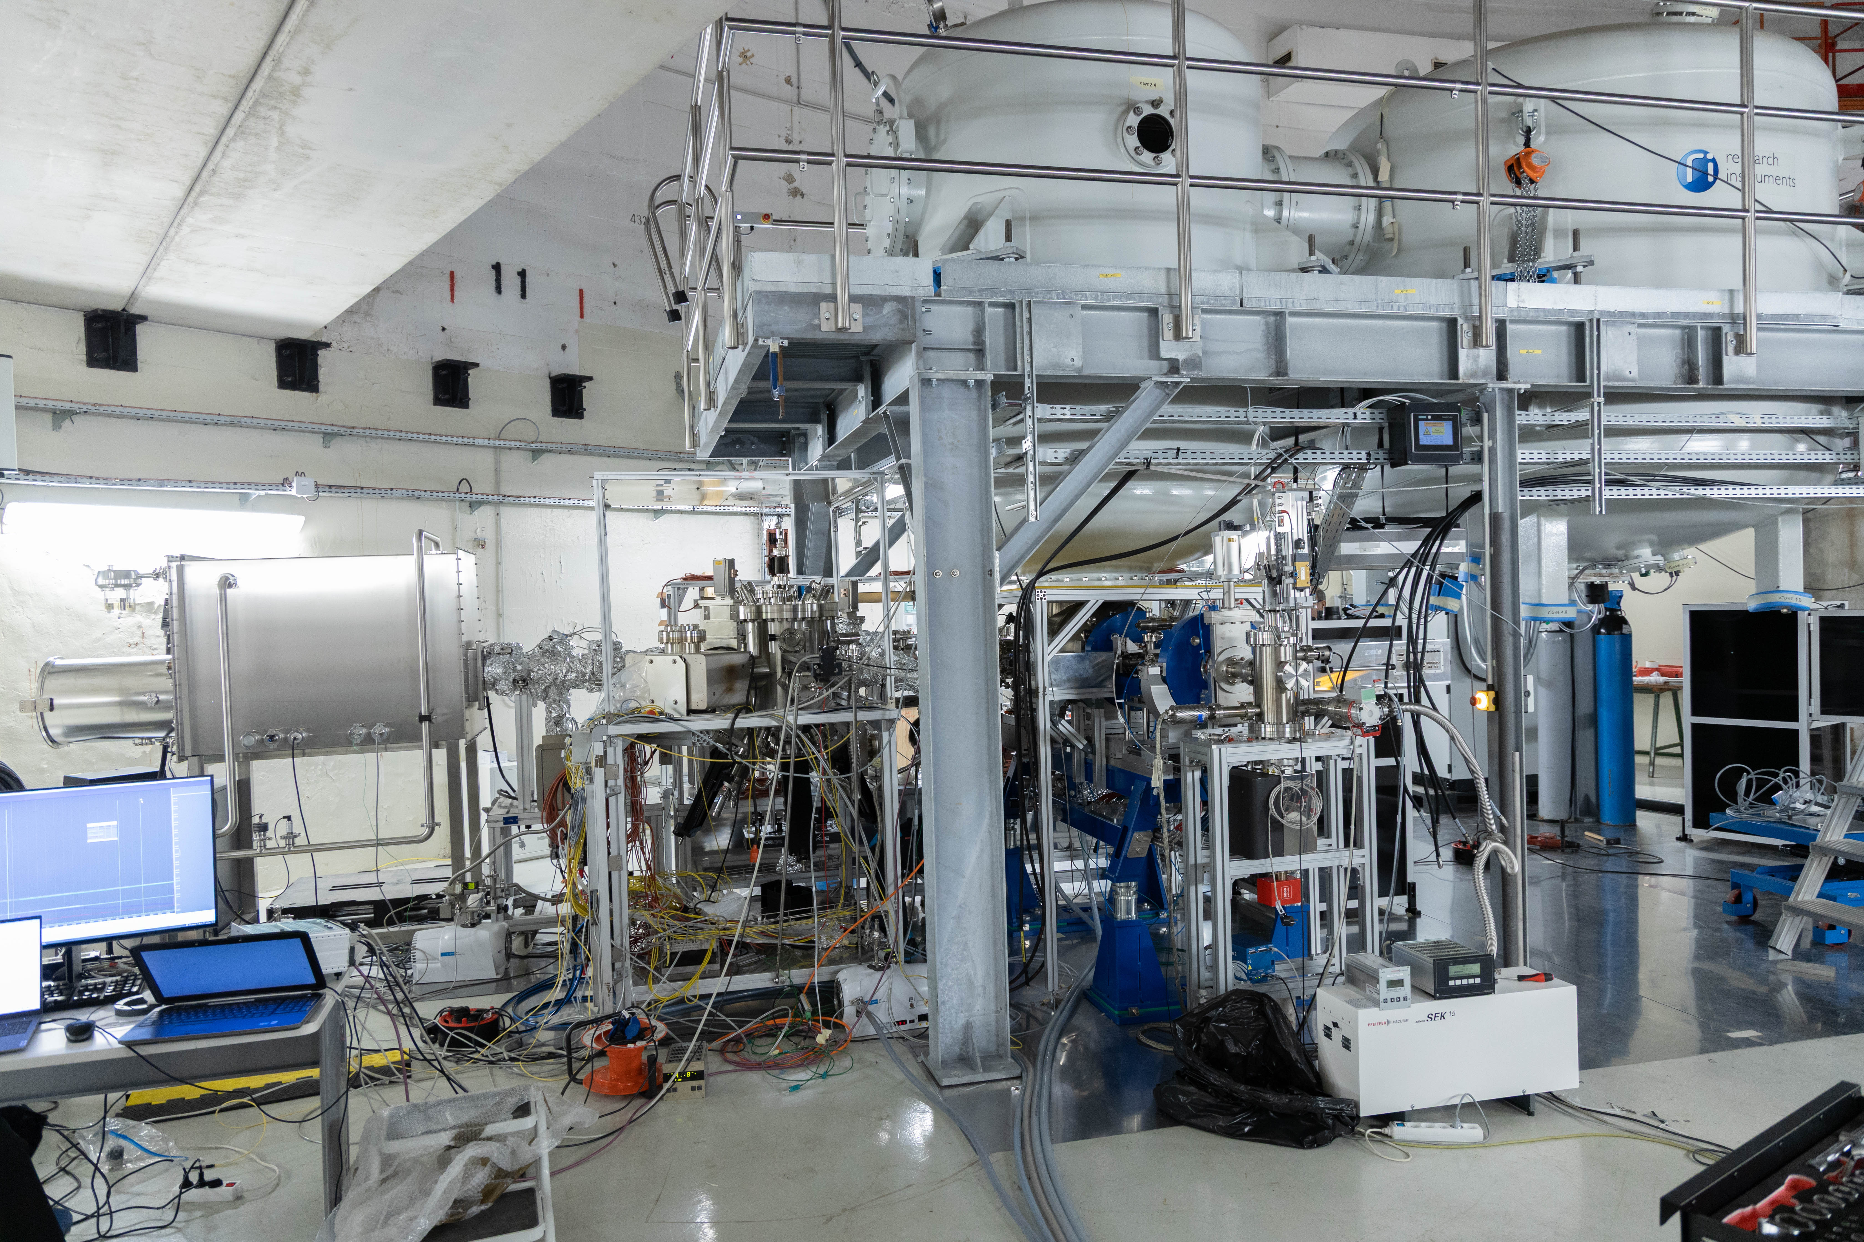
Status on the photogun
Photogun fully assembled
Update on the main sub-systems
First beam
On behalf of the IJCLab and LPSC teams, who have done an excellent job
  Shielded Faraday cup

Slide 3
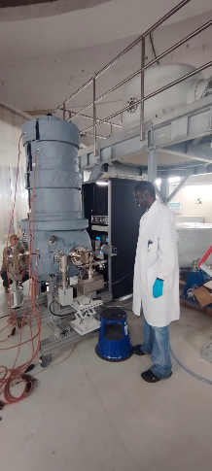
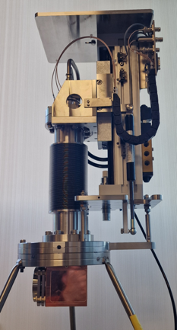
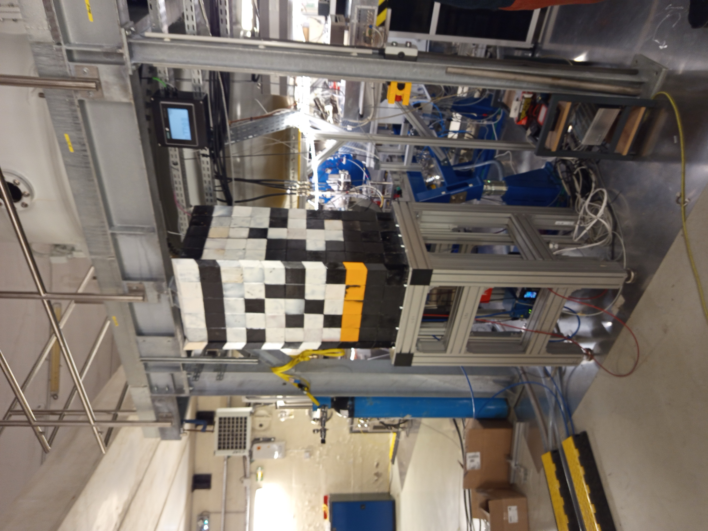
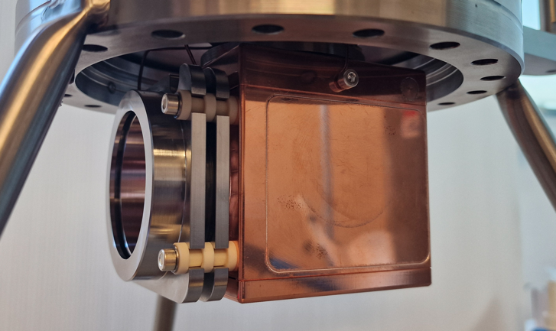
Gun vacuum and diagnostics
Utra high vacuum in gun chamber
  Pressure: 4,8E-12 mbar (november 2025) after the bakeout
  Leak detected close to RGA head in December, slow vacuum degradation
  RGA replaced quickly end of December (no bakeout) : pression 1,4 E-11 mbar
  Beam diagnostics
    7 kW Faraday cup (NTG) purchased
    Polarized repeller ring
    Installed on beam line, baked and shielded
  Faraday cup
  Shielded Faraday cup

Slide 4
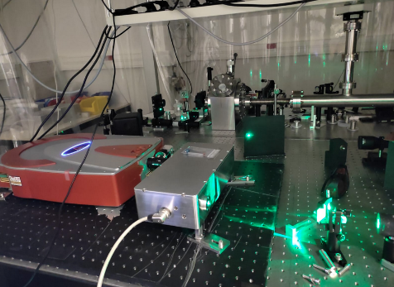
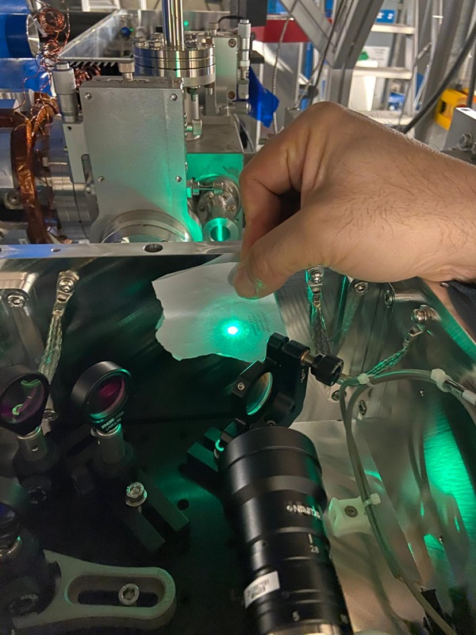
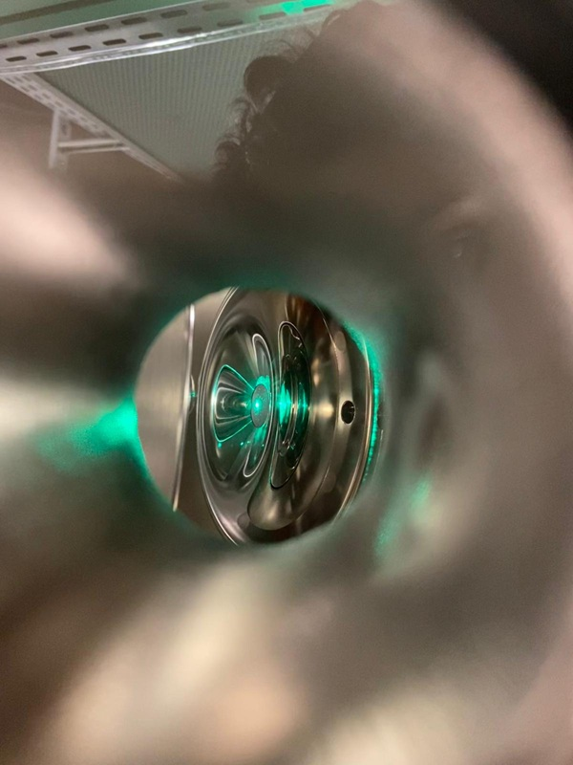
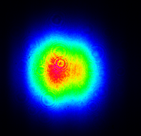

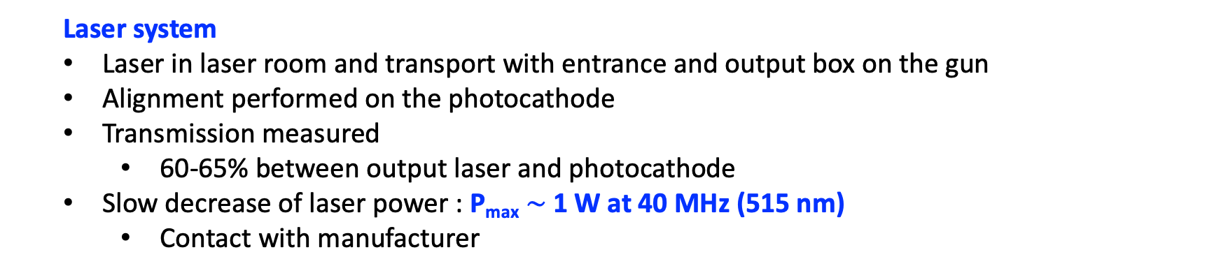
Laser
  Laser system
  Laser in laser room and transport with entrance and output box on the gun
  Alignment performed on the photocathode
  Transmission measured
    60-65% between output laser and photocathode
  Slow decrease of laser power : P_{max} $\sim$1 W at 40 MHz (515 nm)
    Contact with manufacturer
At 80 cm: $φ$x= 2.131 mm; $φ$y = 2.221 mm
  Laser profile
  Laser profile
Laser on photocathode

Slide 5
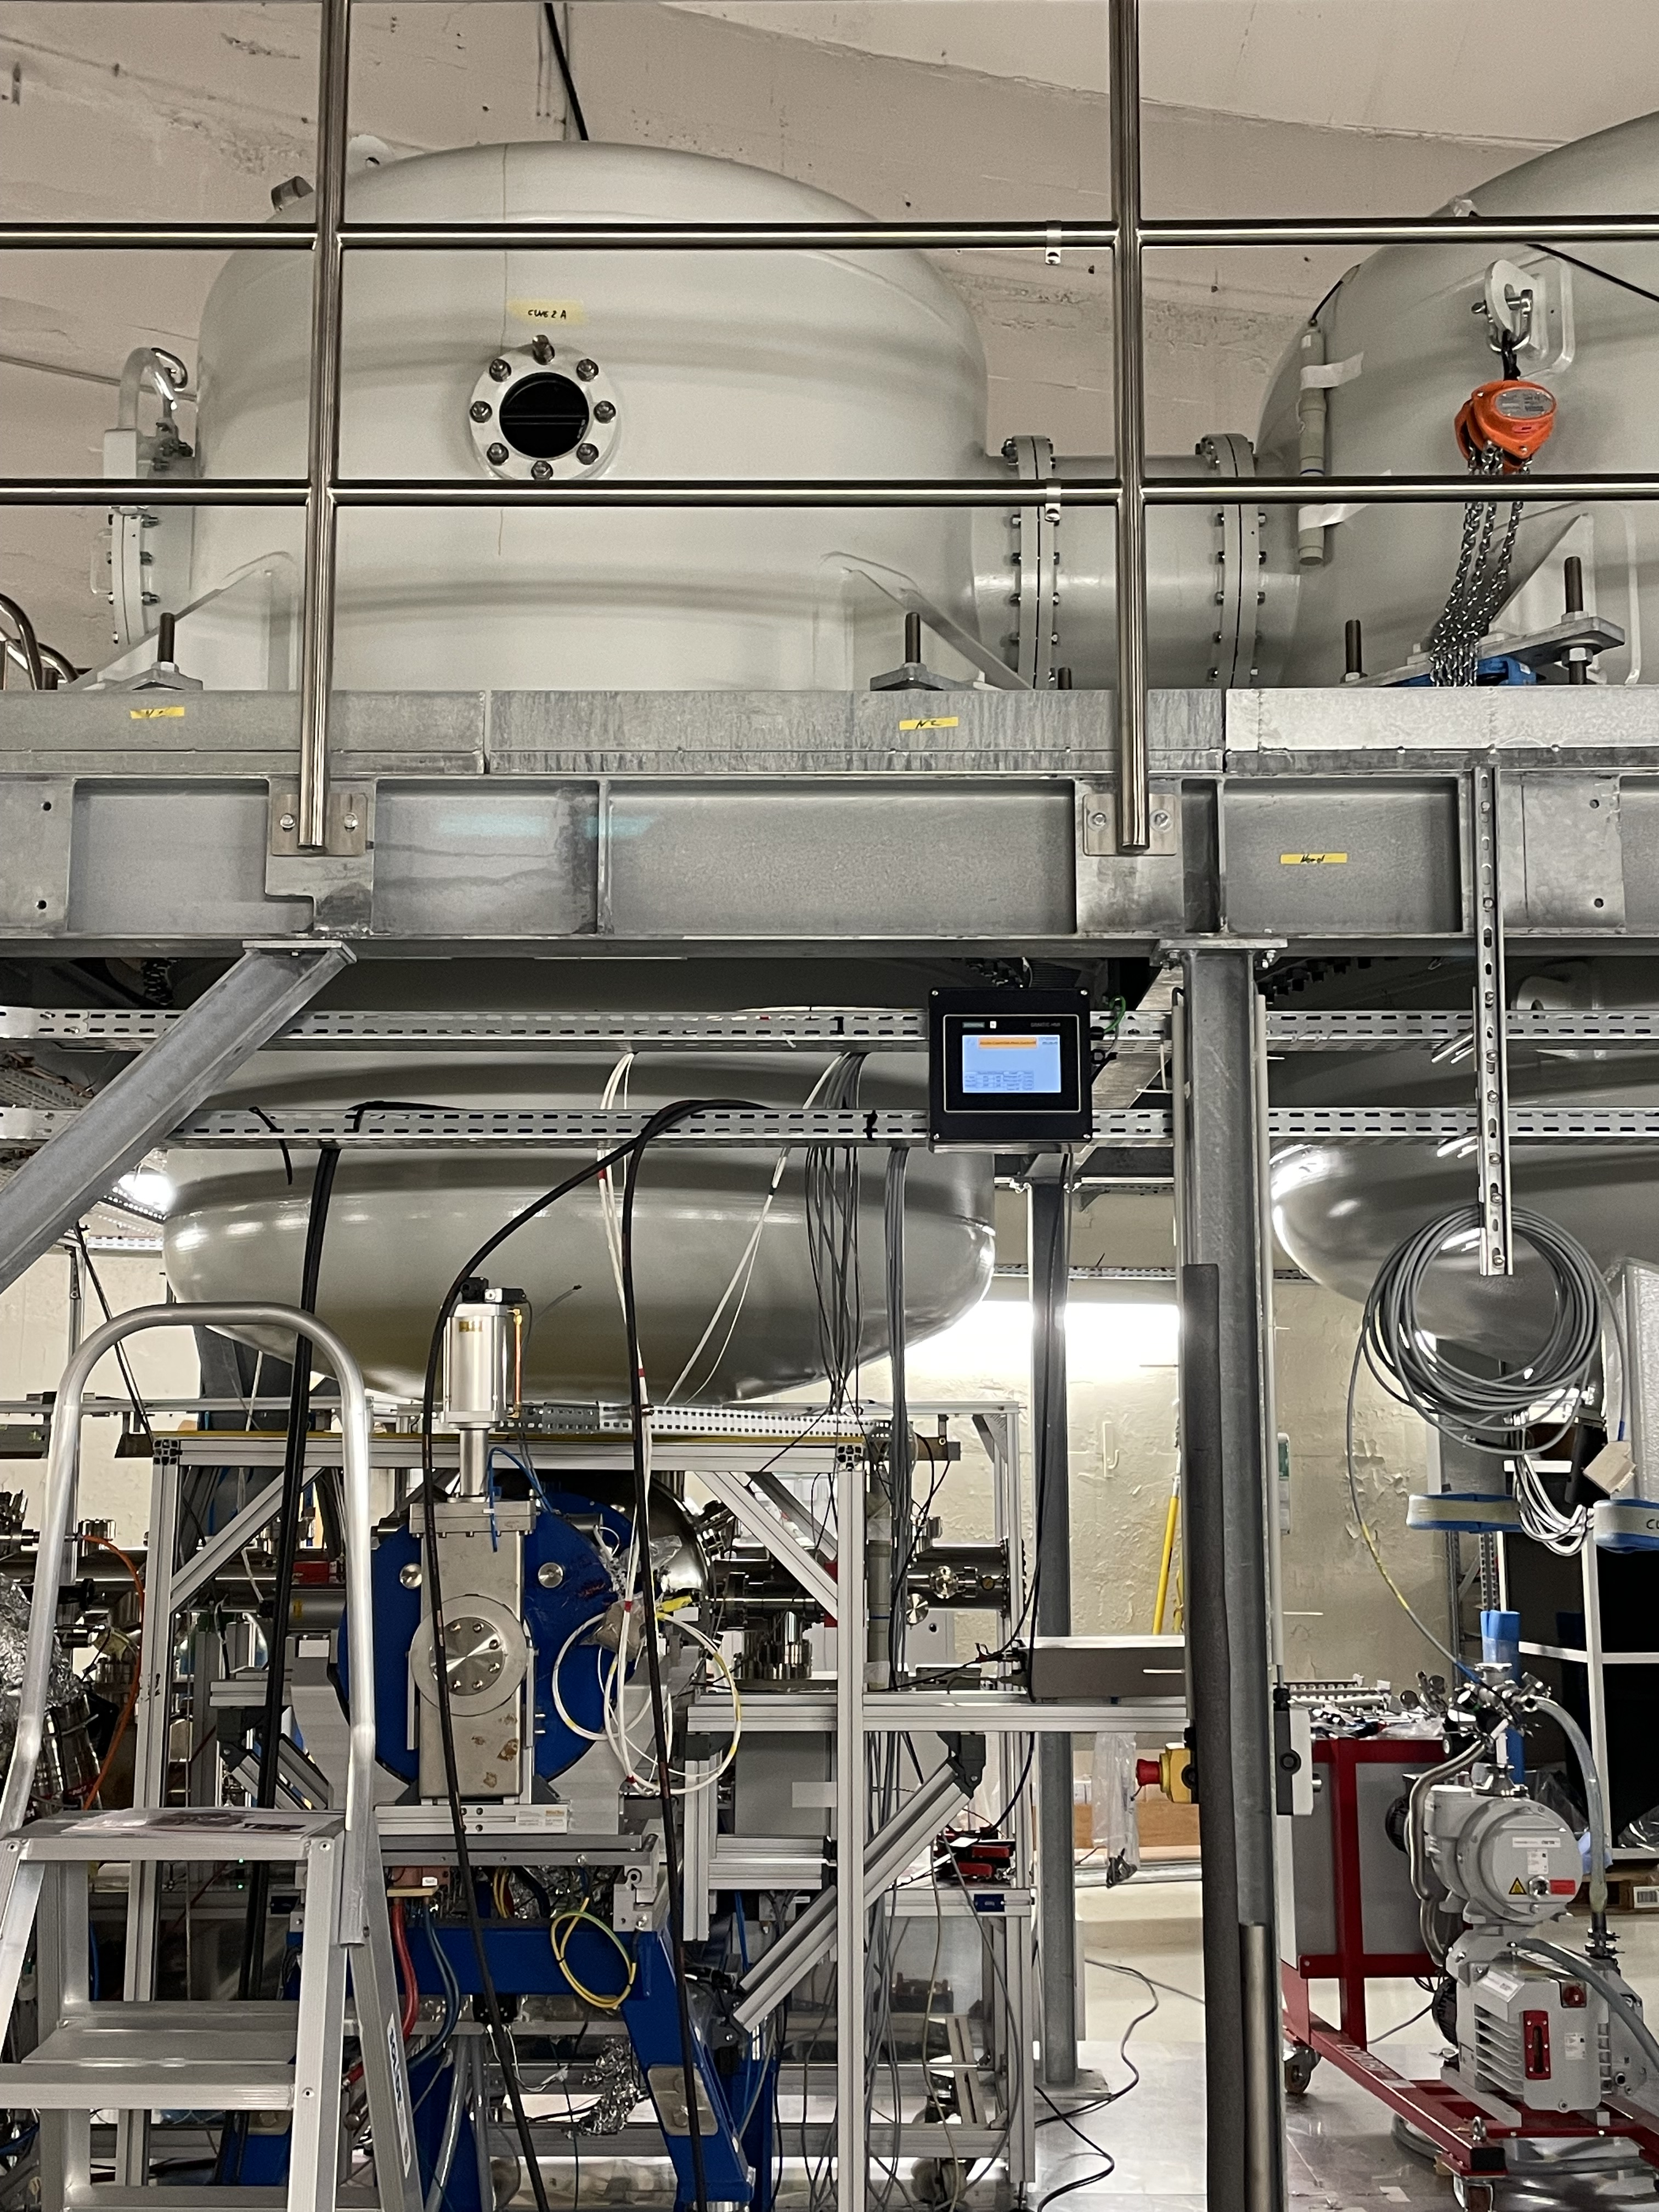
HV conditionning
Xray 2
  HV platform, vessel and columns assembled (450 kV / 50 mA power supply)
  Vessels filled with N2 at 4 bars (absolute), no SF6 (potent greenhouse gas)
    SF6 : global warming potential 23 500 times greater than CO2 over 100 years
  Dummy photocathode (PC) in the gun
  HV conditioning
    HV conditioning up to 350 kV successful (no field emission)
    Then, field emission appeared
      Radiation limited around the gun (Xray probe 1)
        no activity around vessels (Xray probe 2)
      Appeared after displacement of PC and MPS issues
    Still under investigation
Xray 1
Xray 1 close to the gun chamber ➔ important activity, data used for analyzis
Xray 2 close to the HV tanks with N2 ➔ very little activity : no pb with pure N2 as insulating gas

Slide 6
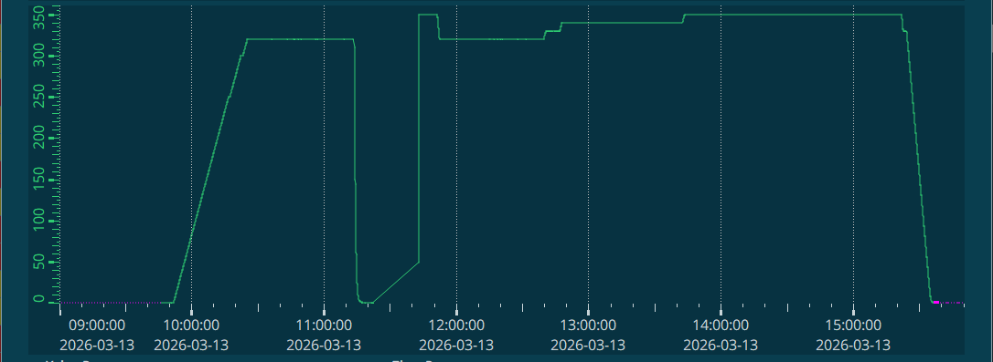
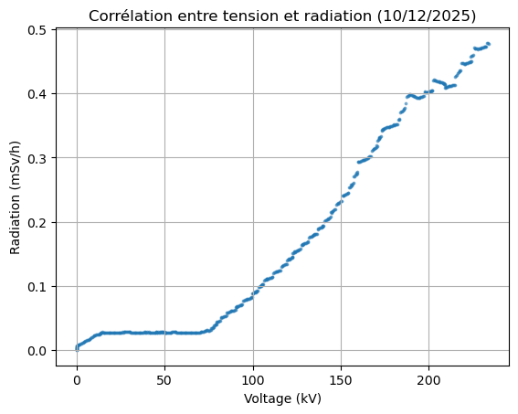
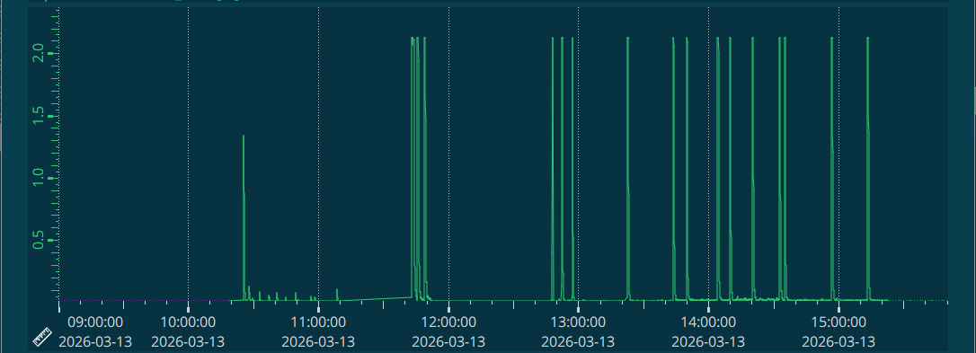

HV conditionning - 1/2
  Successful conditioning
HV (kV)
  Shielded Fraday cup
Xray 1
Probe 1 ($μ$Sv/h)
Pressure 10⁻¹⁰ – 10⁻⁸ mbar

Slide 7
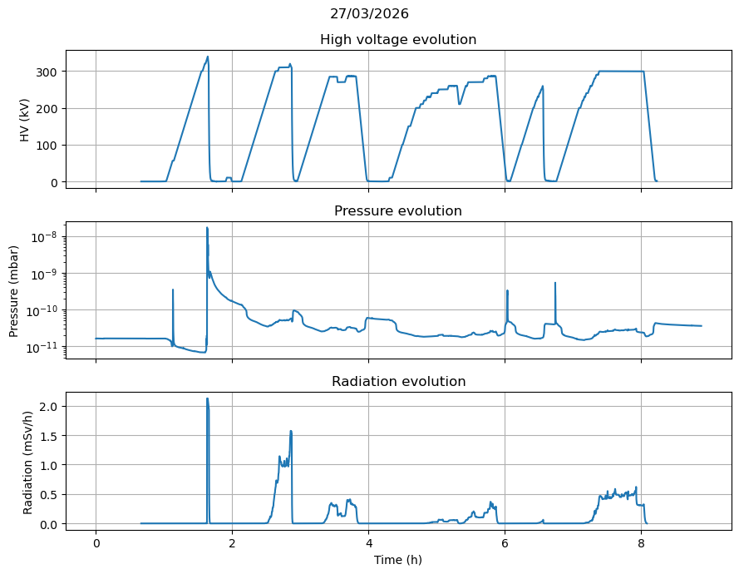
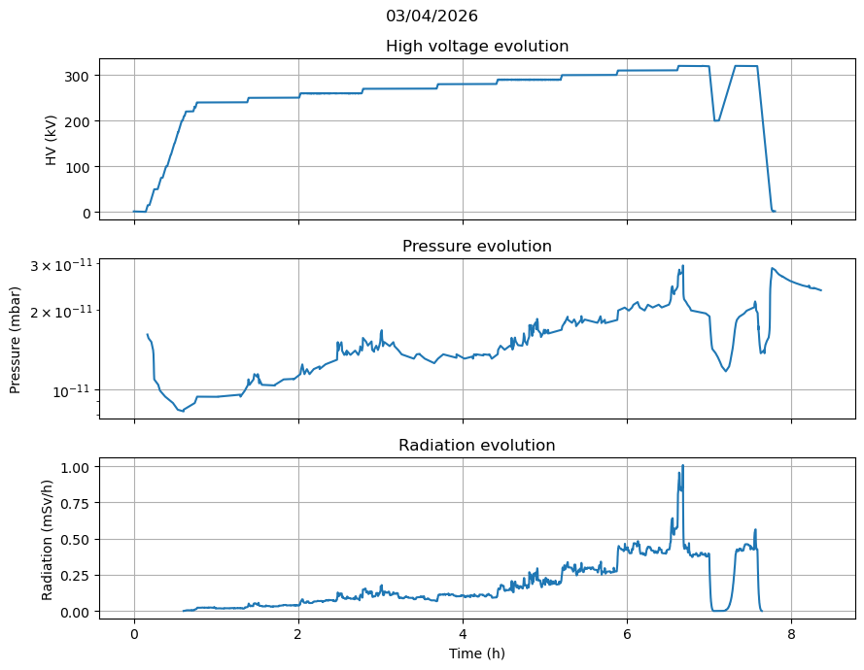
HV conditionning - 2/2
  Field emission
  Shielded Fraday cup

Slide 8
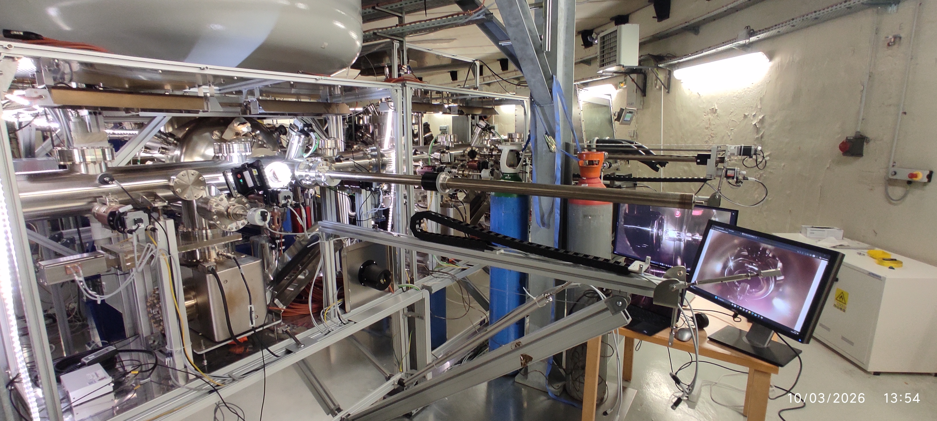
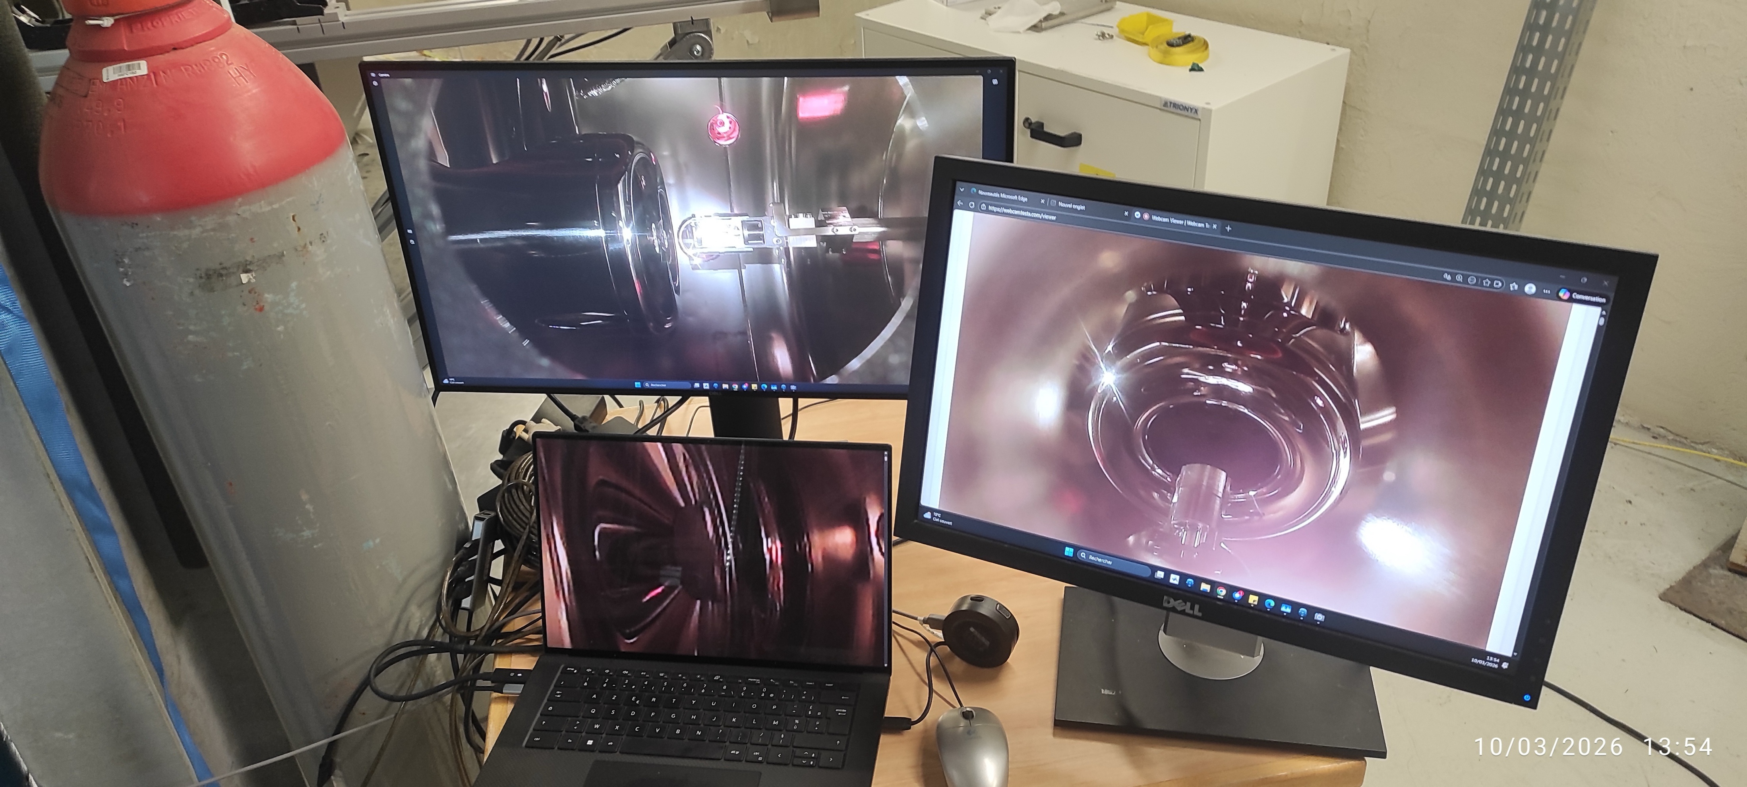
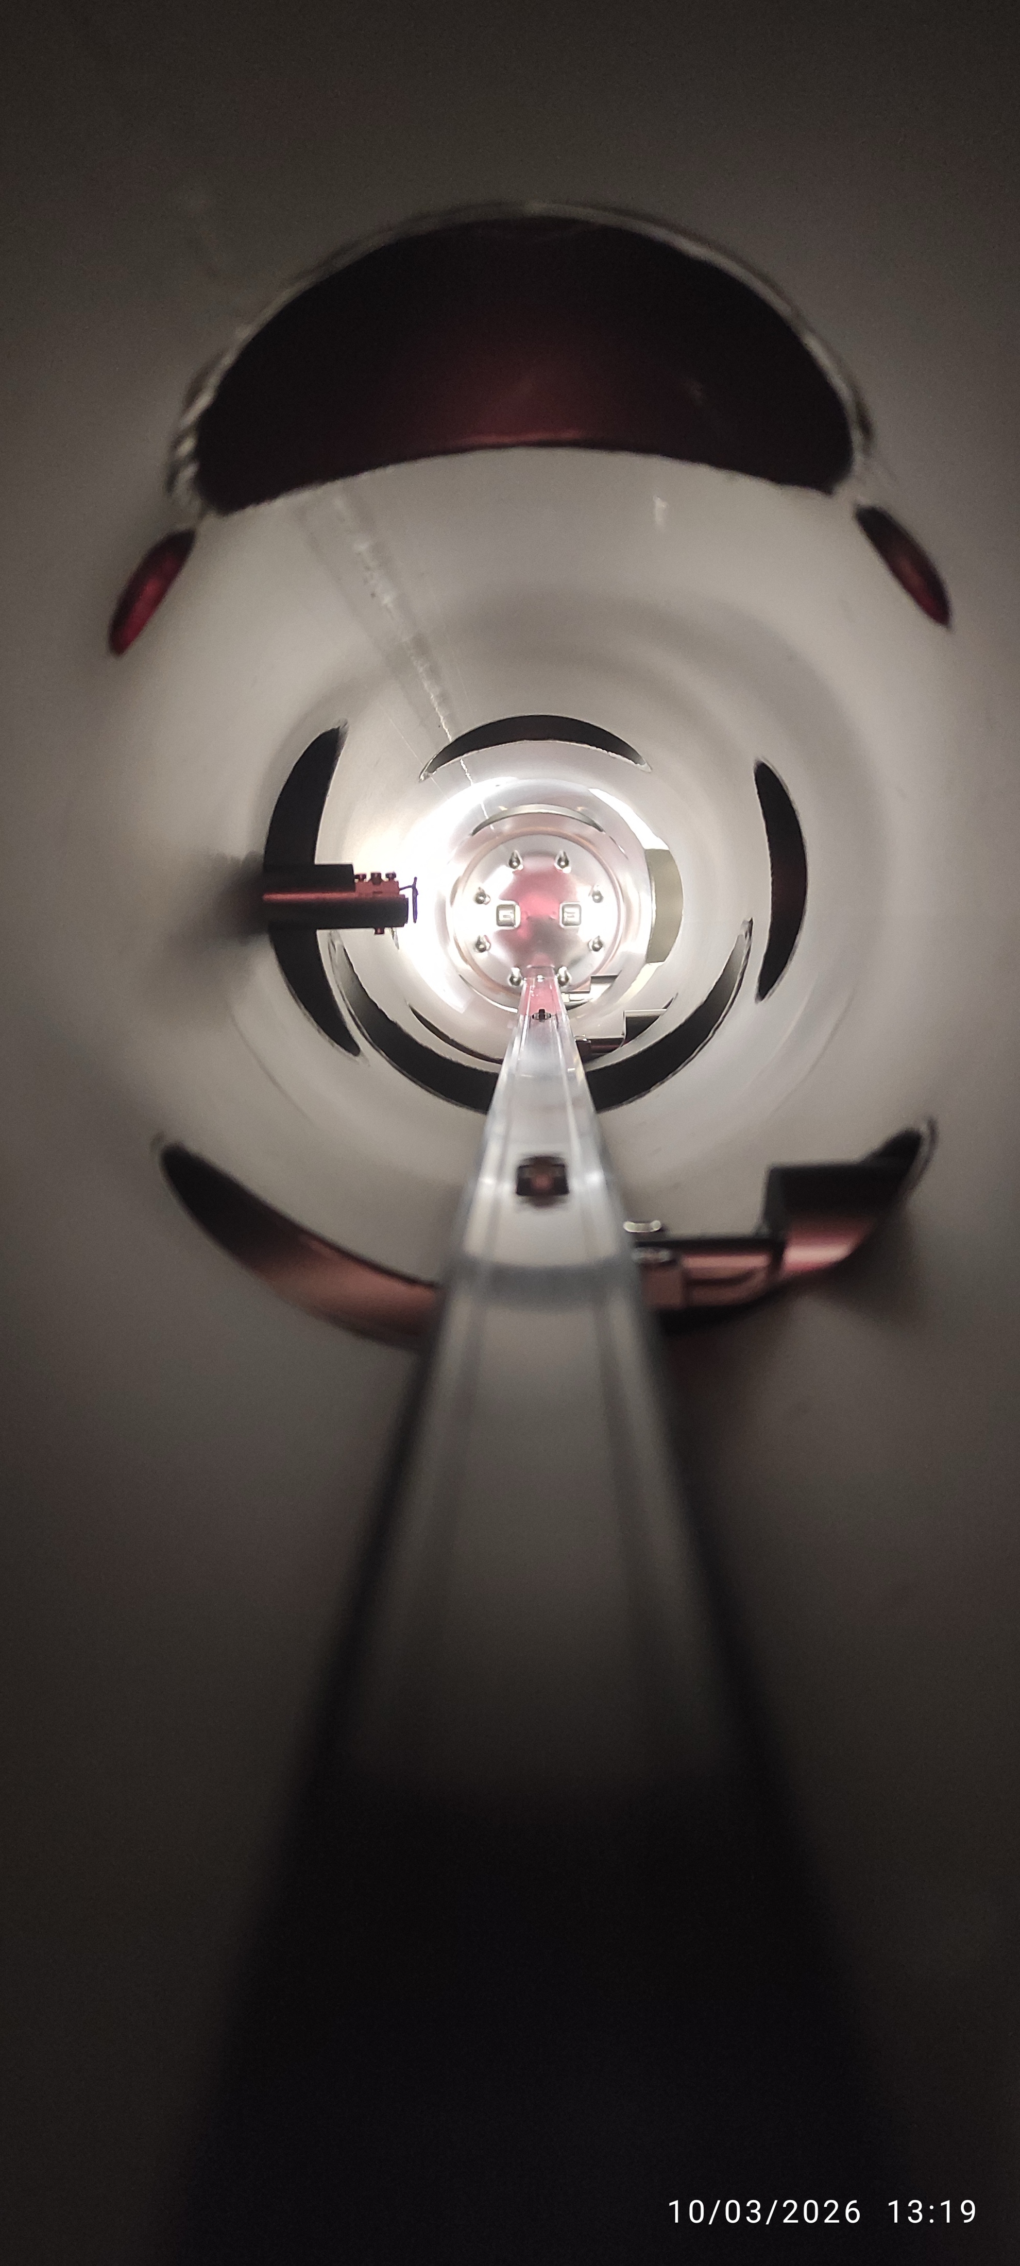
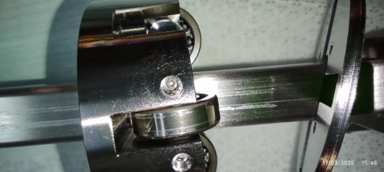
Photocathode
Photocathode Preparation Facility (PPF)
  September: production of the 1st photocathode (PC) of CsK2Sb: QE= 3%, then rapid degradation (vacuum incident)
  Alignment of the PPF by the manufacturer (Createc) March 10-11
    Alignment performed to grab the dummy puck in the gun and re-insertion test
    But bearing on translator stuck, had to be replaced (out of the gun!) ➔ exchange and rebake of transfer chamber (TRA)
Alignment of PPF onto the gun
PERLE- Project Progress Review : 2 - 2026
Translator bearing stuck
Alignment of the puck in the cathode
Alignement puck dans la cathode

Slide 9
Photocathode
Second PC preparation
  Some issue with the software (prep over 2 days)
  QE = 6.5%
01/04/2026
Puck 131088
MBS-005 (inox)
09/04/2026
Puck 131088
MBS-005 (inox)

Slide 10
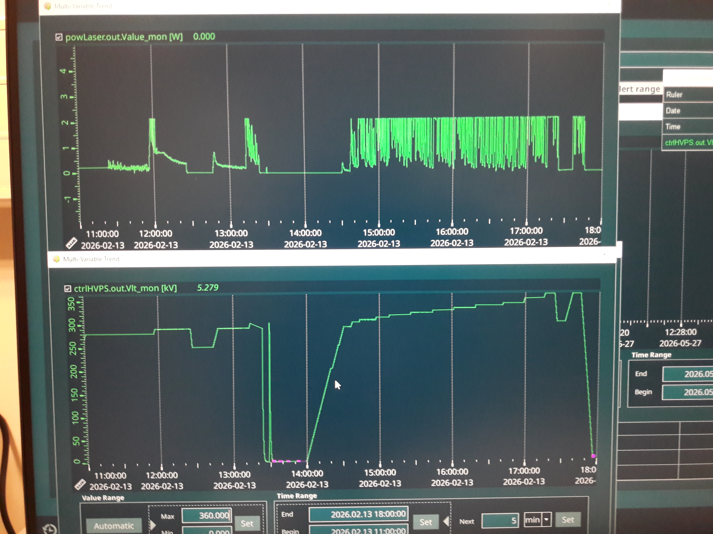
conditionnement
Cathode purement métallique
13/02/2026: 280 kV; 4 mSv au pic, décru vers 1 mSv. Record à 330 kV, > 2 mSv; coupure et remontée brutale à 300 kV

Slide 11
First beam preparation
First beam : 11/05/2026 with a photocathode inserted May 7, last meas before transfer QE = 5.2 %
Conditionning up to 230 kV (13 µSv/h)
15h20 YAG screen, no dark current, insertion of resistor 5 kW
16h31 HT at 200 kV
➔ Test with laser at 10 Hz, AOM = 5 % (that is 5 % of max laser power)

Slide 12
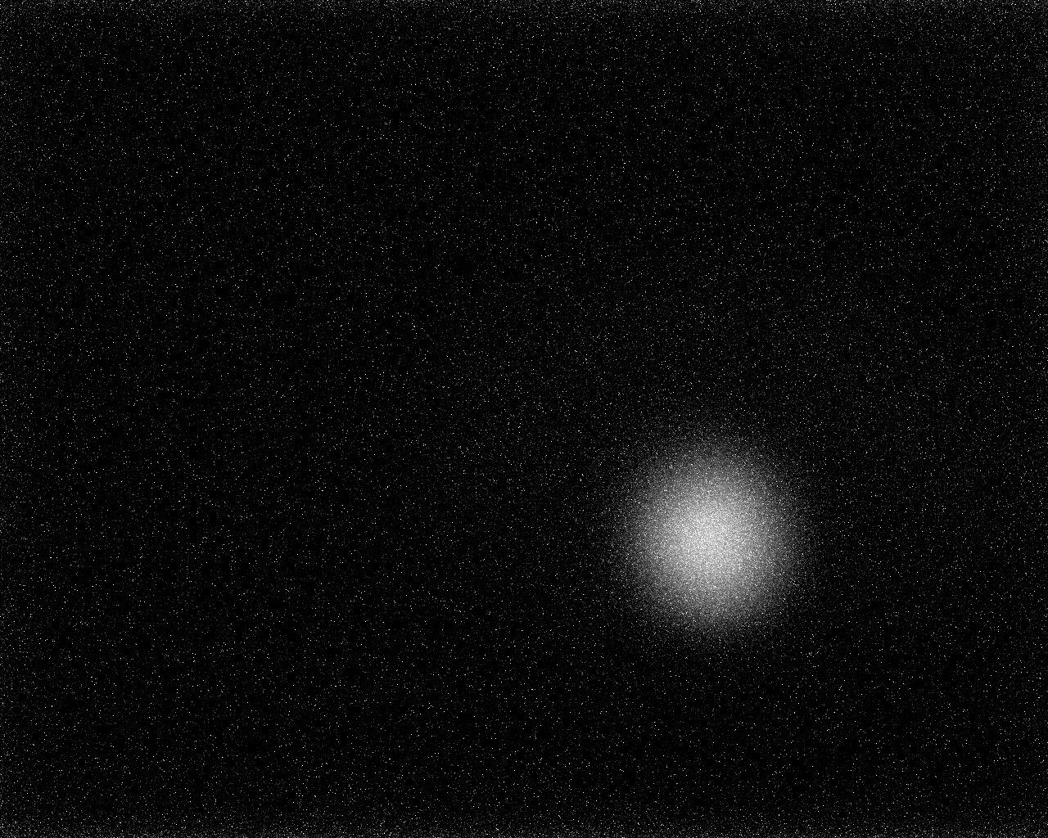
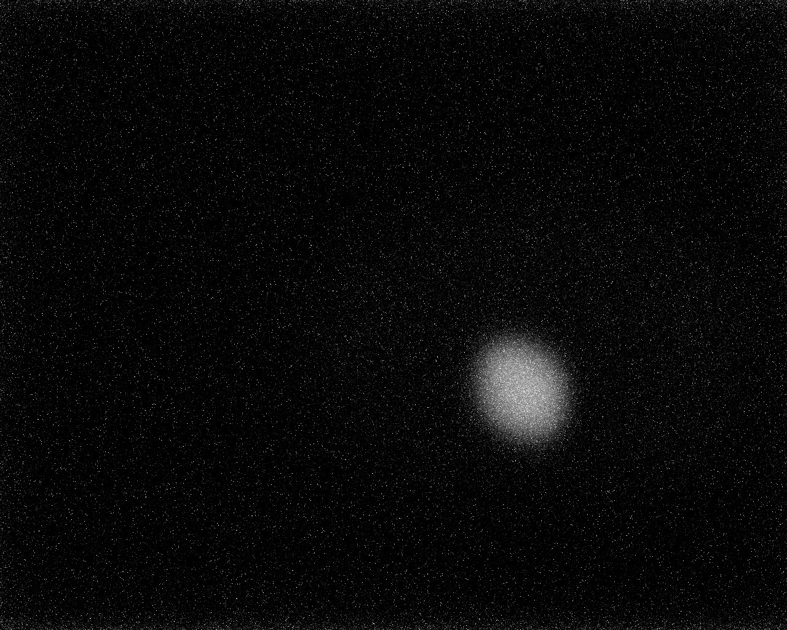
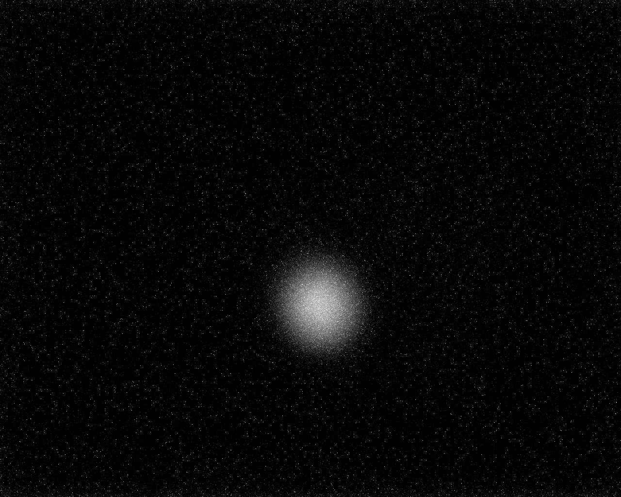
First beam
σ_{x} = 1.6 mm
σ_{x} = 1.48 mm
σ_{x} = 1.52 mm
σ_{y} = 1.7 mm
σ_{y} = 1.6 mm
σ_{y} = 1.8 mm
Some simulations for 10 pC, laser gauss 1.5 mm
➔ σ_{x} = 1.66 mm ➔ agreement looks reasonable, TBC
ε = 0.8 mm.mrad

Slide 13
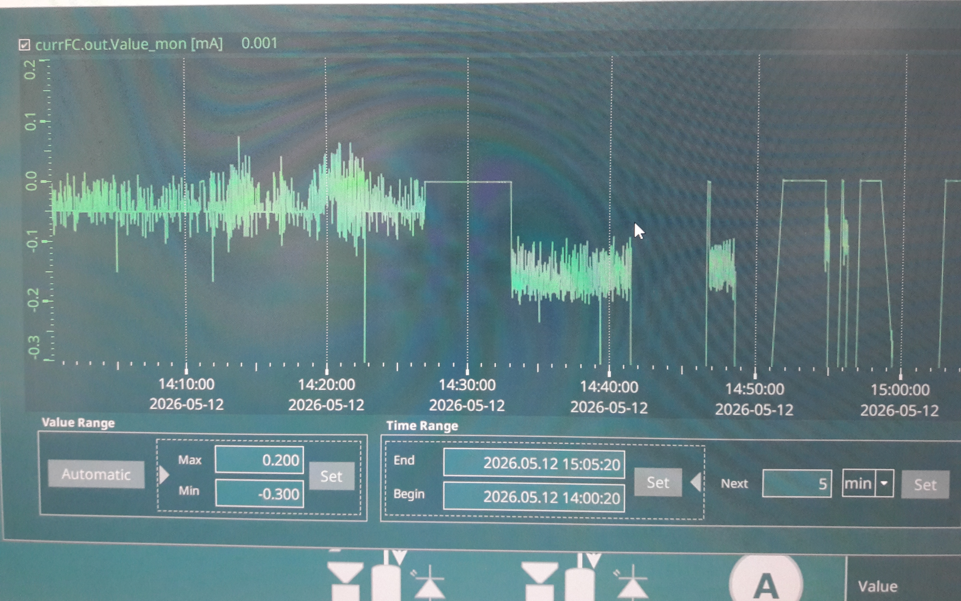
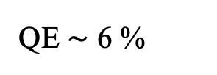
First beam (May 12)
Intensity measurment in Faraday cup (CF)
QE $\sim$ 6 %
AOM (%) | I CF (mA)
5 | 0.5
8 | 1
10 | 1.6
15 | 2.5
Noise (Keithley picoameter) under investigation
ICF (reel) = 10xICF(cc) and I alimHT (reel) = 5x I alimHT (cc)

Slide 14

Beam on May 28
AOM at 30 % for 1h10
QE $\sim$ 4.3 %

Slide 15
Conclusions
First results very encouraging :
  No issue of HV with N2 (no radiation on upper probe)
  2.7 mA à 30 % of max laser power ➔ 5 mA will be available for the injector commissioing
Still to understand, improve
  Field emission at high voltage around the gun
  Resume conditionning of the Faraday cup at high current and reduce measurement noise
  Optimize beam transport (full solenoid scan on viewer)
Persectives
  QE degradation : charge lifetime
  Position of laser beam on the photocathode
  Anode polarization
  New photocathode

Slide 16
BACK UP

Slide 17
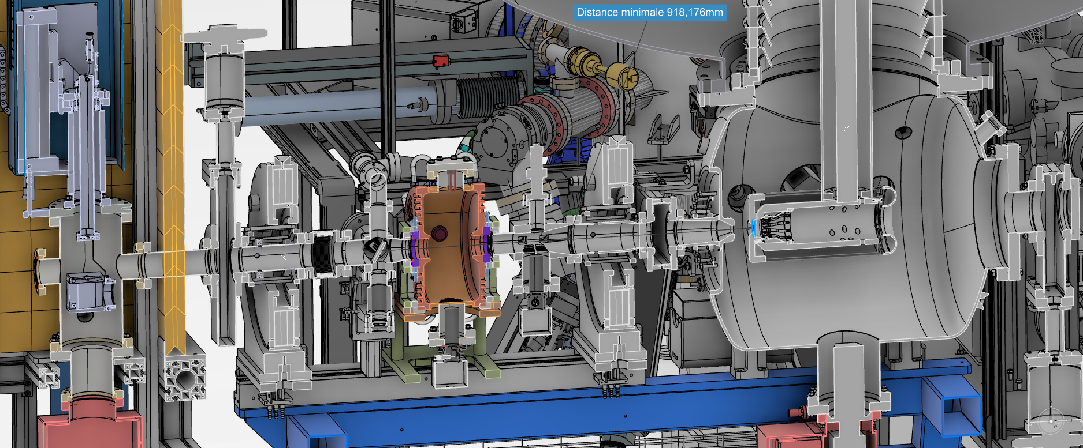
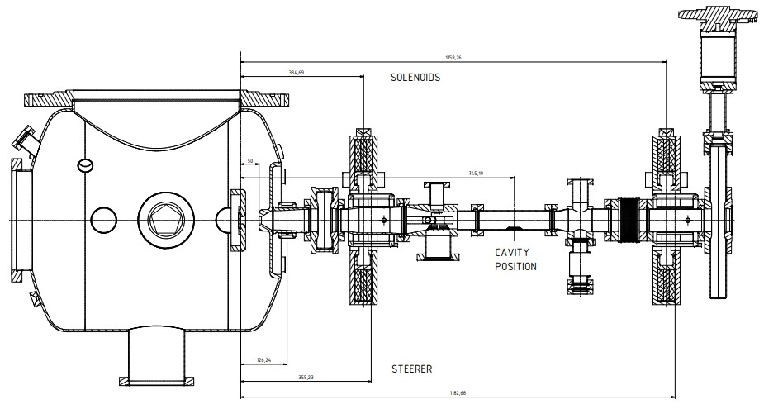

Gun dimensions
X ray probe
View screen : $\sim$1 m from photocathode
Faraday cup : $\sim$1,5 m from photocathode

Slide 18
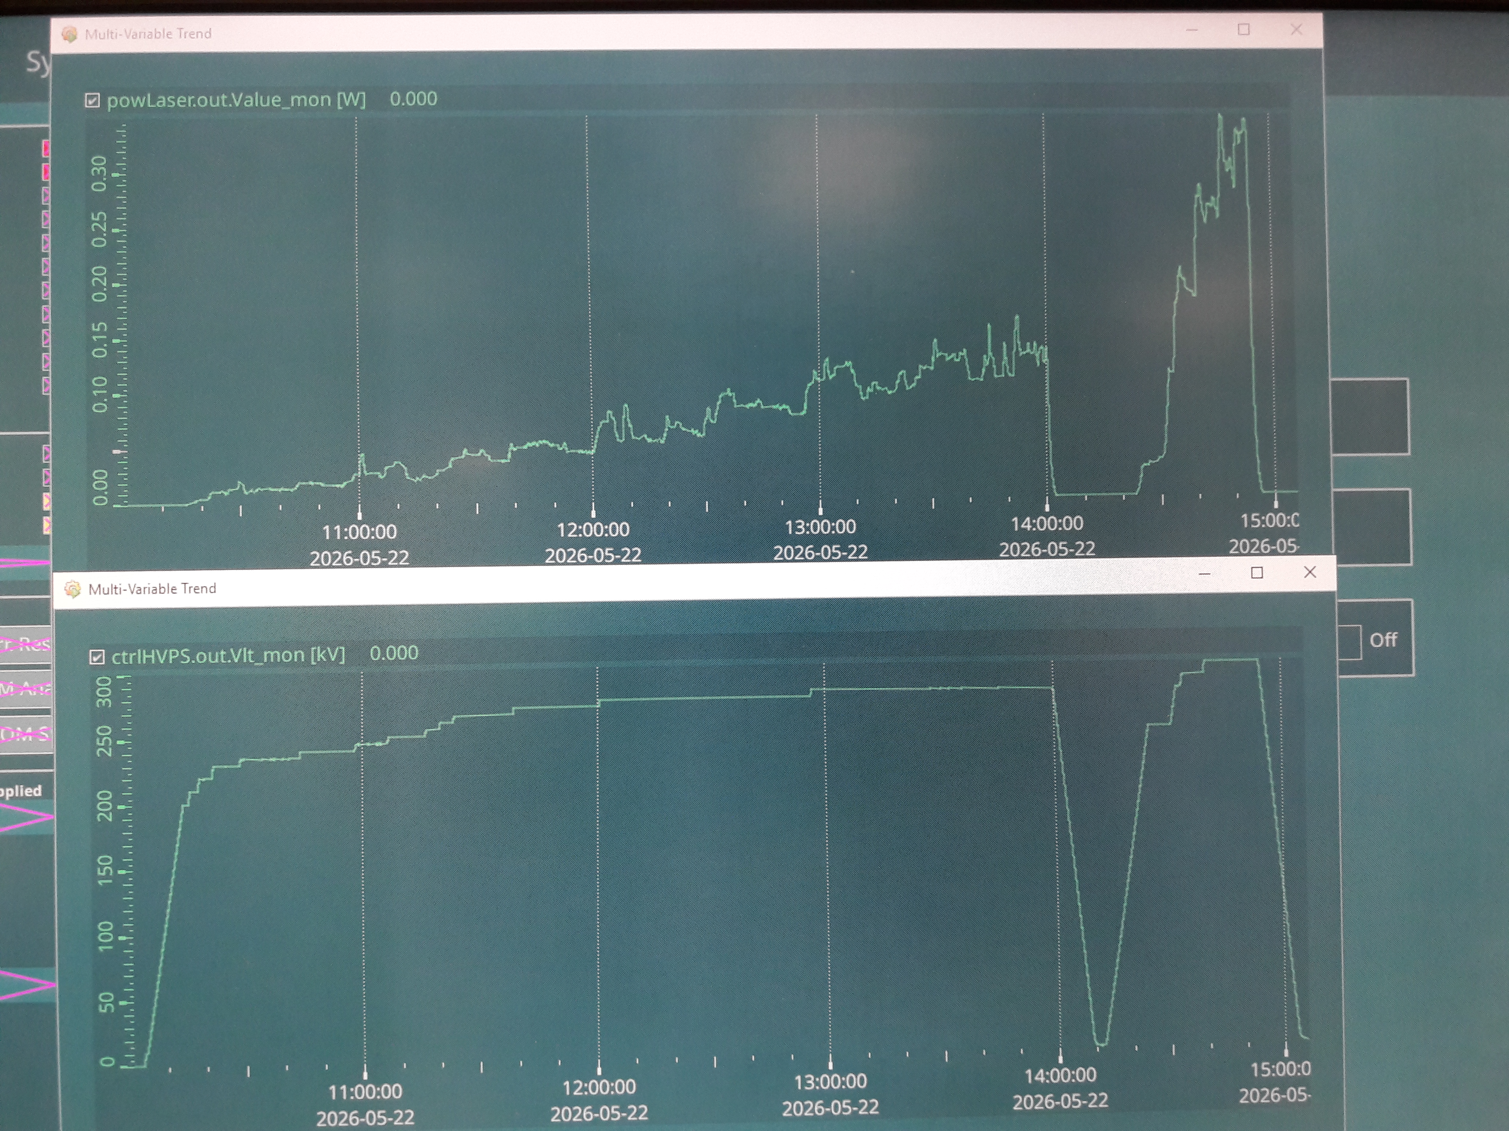
21&22/05/2026
Mesures avec les BPM, alignement parfait pour CorVert = 0.04 A.
conditionnement

Slide 19
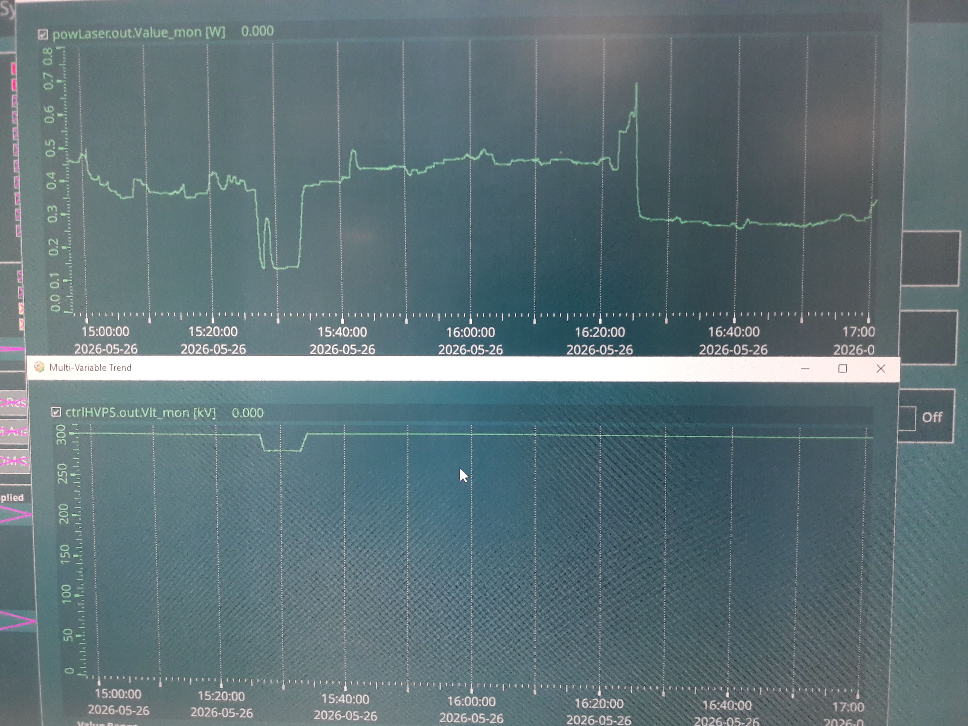
26/05/2026
Conditionnement, tentative pour voir le courant d’obscurité
Vanne fermée
Vanne ouverte
Rien sur le YAG
Rien sur la CF
Aucun changement du niveau de radiations
vanne canon ouverte ou fermée
Pas de faisceau obscur
qui sort du canon?
Radiations = émission de champ
qui reste dans le canon?

Slide 20
conditionnement
Cathode purement métallique
1er conditionnement, le 9/12/2025, on a atteint 250 kV, 0.233 µSv/h
10/12/2025: 260 kV; 2.3 µSV/h
11/12/2025: 295 kV; 1.8 mSv/h au pic, décru vers 30 µSv
26/01/2026: 260 kV; 300 µSv au pic mais 2 arrêts brutaux à 116 kV

Slide 21
conditionnement
13/03/2026, après visite Créatec: 350 kV, vide canon 2,510⁻¹¹ mbar, 2 mSv au pic, décru vers 0,115 mSv. On descend à 320 kV, 0 µSv pendant 1 h. 340 kV, 1 pic court > 2 mSv puis décroit vers 0 et rien pendant 1h. 350 kV, des pics courts > 2 mSv. Encore une coupure et remontée brutale à 350 kV.
27/03/2026: coupures HT sur balise SPR même à 300 kV; pics longs de radiations à 300 kV, 0.4 mSv pendant 30 mn
3/04/2026: conditionnement jusqu’à 320 kV, radiations continues ≈ 0,4 mSv/h

