Slide 1
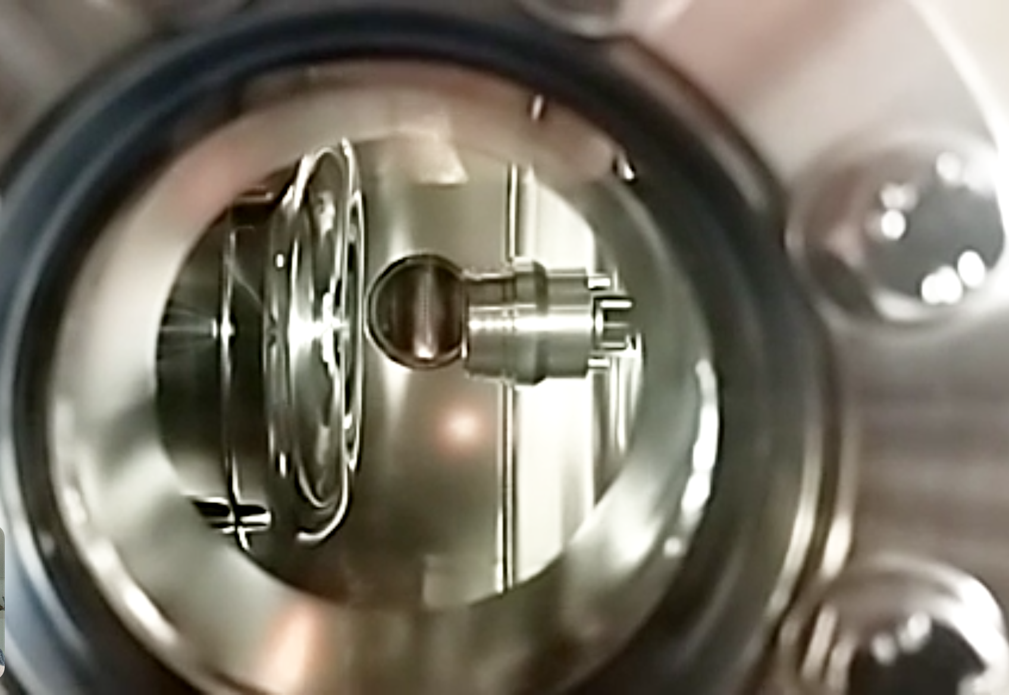
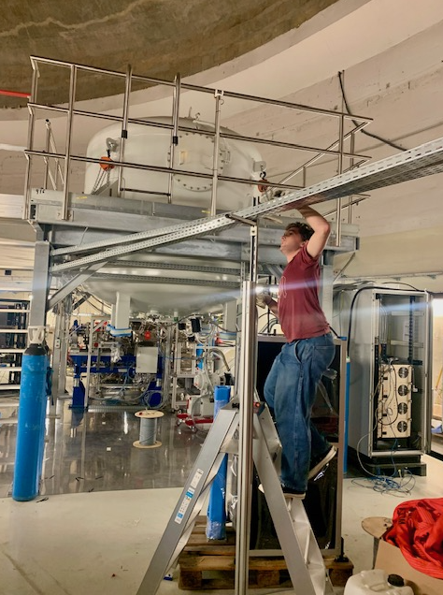
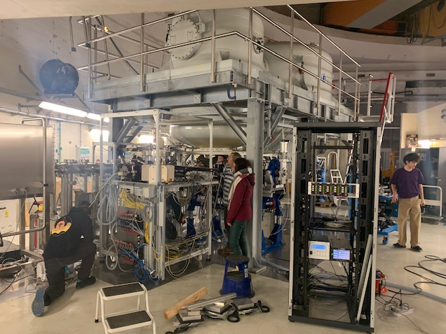
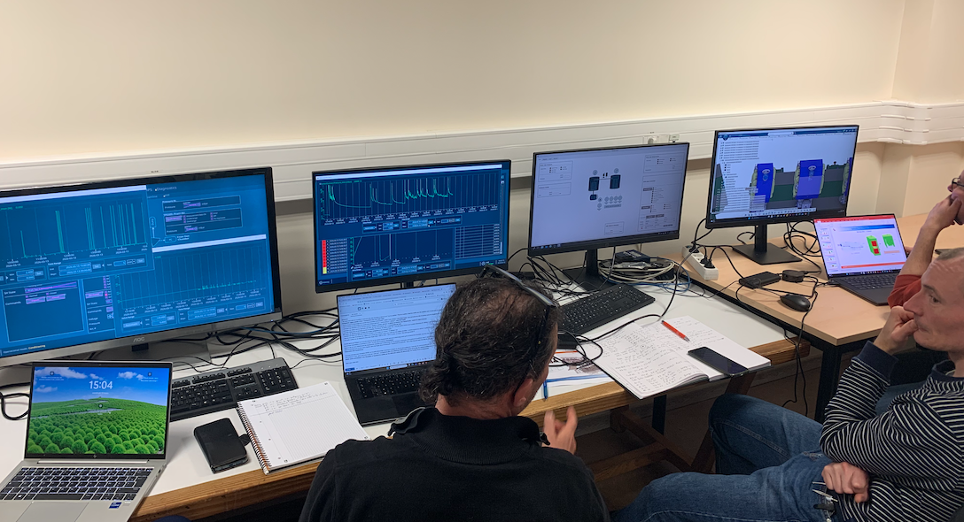
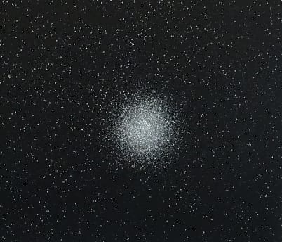
PERLE Collaboration Board Meeting
Project advancements & collaboration matters
Walid Kaabi, Maud Baylac & Achille Stocchi
June, 3rd 2026

Slide 2
PERLE global planning
Design
First electrons April 2026
Upgrade
Laser
Procurement/Construction/Installation
5 mA
20 mA
Commissioning
DC Gun @ 350 keV
Buncher installation
Booster installation
Booster
RF sources upgrade
20 mA
5 mA
Injector @ 7 MeV
Cryomodule installation
0.5 MW
2 MW
ERL 1-loop @ 89 Mev
Civil engineering work
5 MW
ERL 3-loop
TDR
2025
2026
2027
2028
2029
2030
2031
We are here

Slide 3

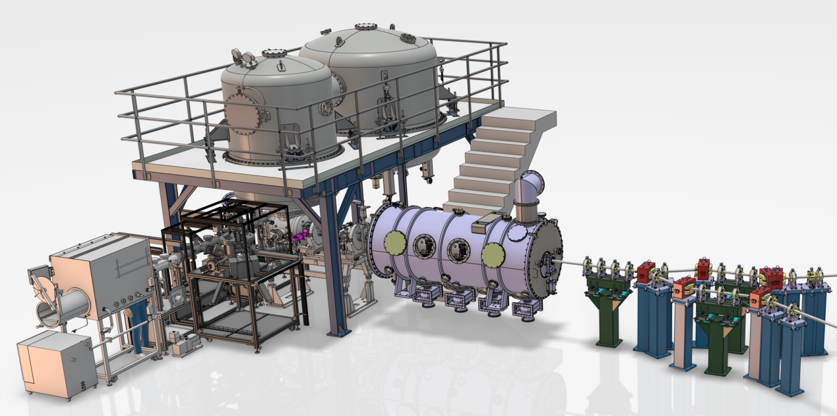

The injection line
HV system
Booster
DC Photogun
Merger
Buncher
Photocathode Preparation Facility (PPF)
Diagnostics line
"This work received government funding managed by the Agence Nationale de la Recheche (ANR) in the France 2030 framework - reference ANR-24-RRII-0001"

Slide 4

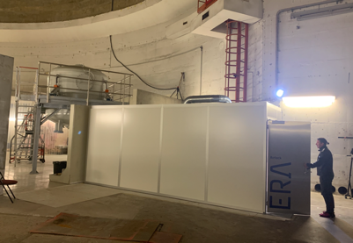
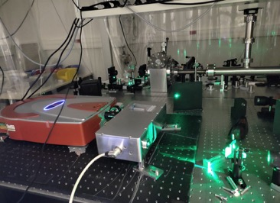
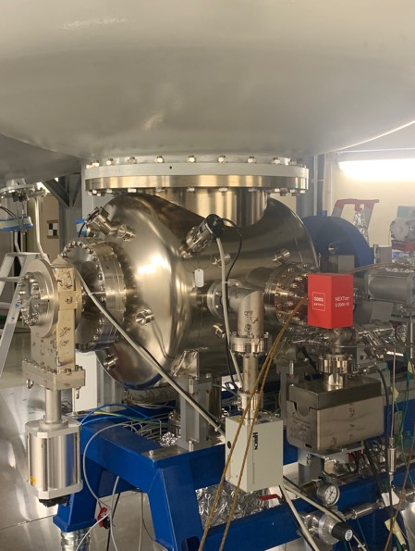
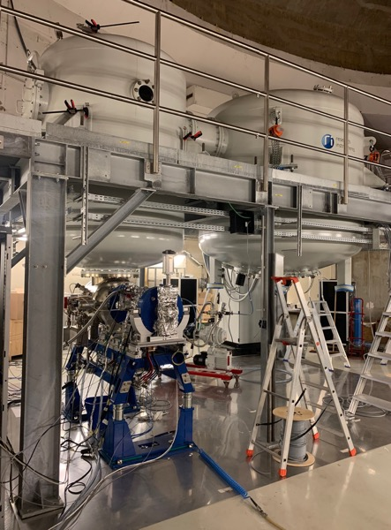
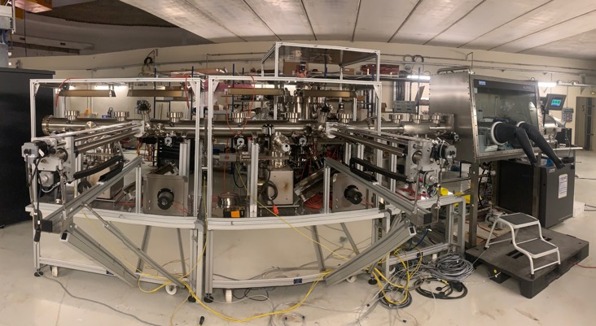
PERLE e- Source:
Electron source Installation in the « Igloo »:
Photocathode Laser room
Laser system
DC Gun
DC Gun & HV system
Photocathodes Production Facility (PPF)
"This work received government funding managed by the Agence Nationale de la Recheche (ANR) in the France 2030 framework - reference ANR-24-RRII-0001"

Slide 5
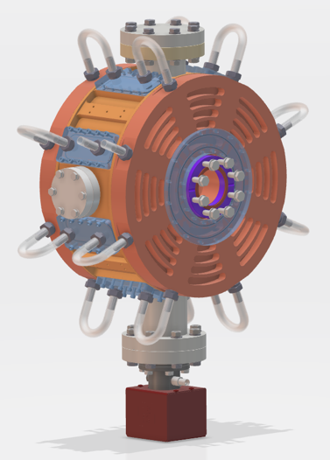
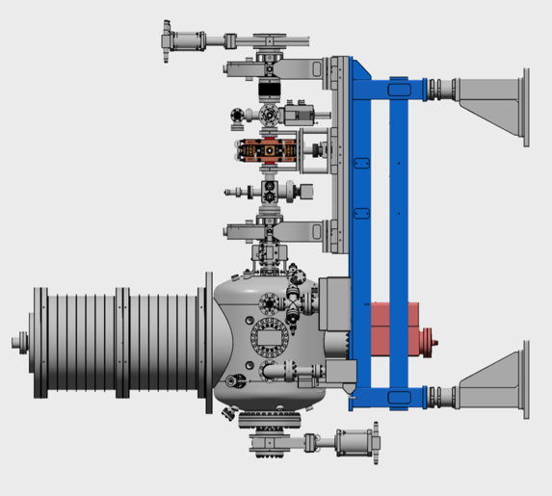
Design of the buncher cavity:
Specifications :
Frequency = 801 MHz
Maximum length = 200 mm
Targeted temperature = 30°C
Power dissipated = 1kW
Material : OFHC
Beam axes flange : CF50
Antenna port : CF 16
Plunger port : CF 40
Vacuum port : CF63
RF power coupler port : CF63
Courtesy to Samuel Marchal

Slide 6
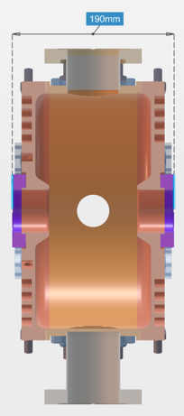
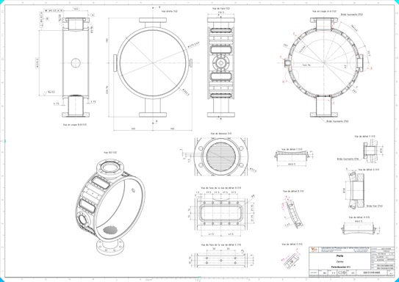

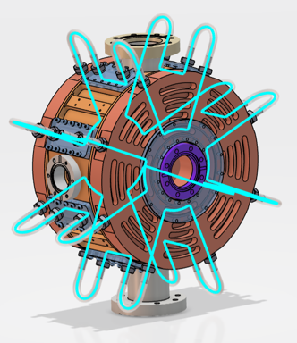
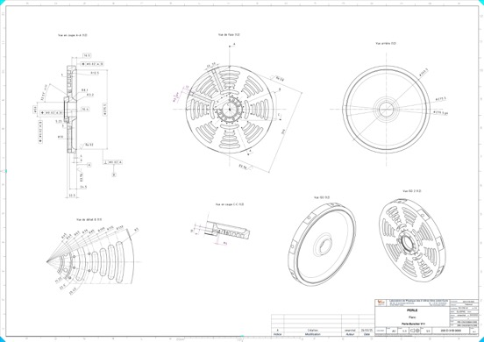
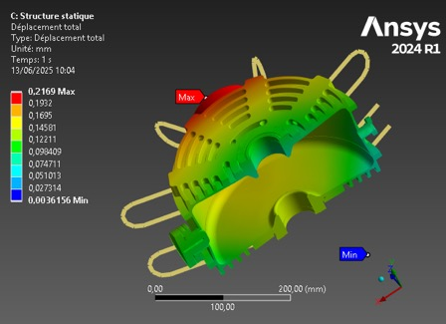
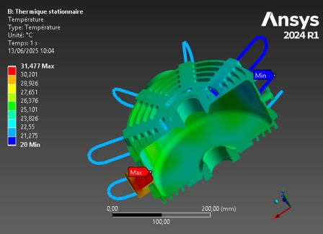
Design of the buncher cavity:
W/2
g/2
The call for tender was lunched end of May
Lcav/2
Cooling scheme optimization
Mechanical drawings folder preparation
RF studies & geometry optimization
Thermal & mechanical studies

Slide 7
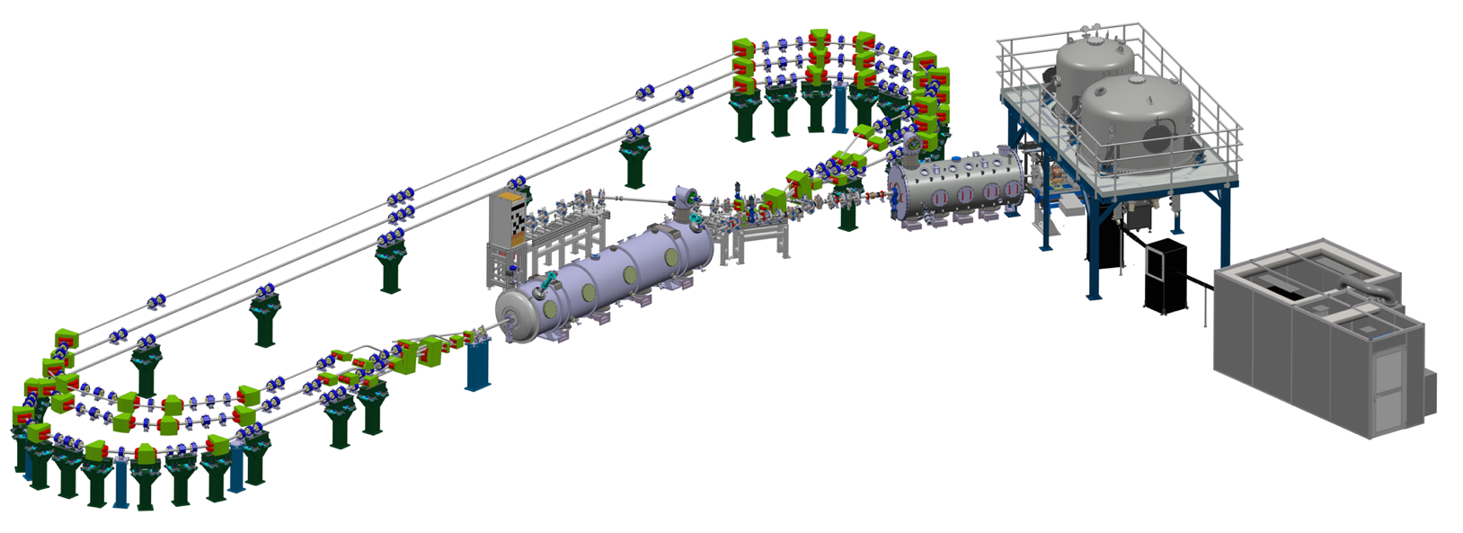
The booster cryomodule:
Slides from Samuel Marchal
Booster :
4 mono-cell cavities cooled at 2 K
Length ≈ 3150 mm
Diameter : 1216 mm
Injection Energie: 7 MeV

Slide 8
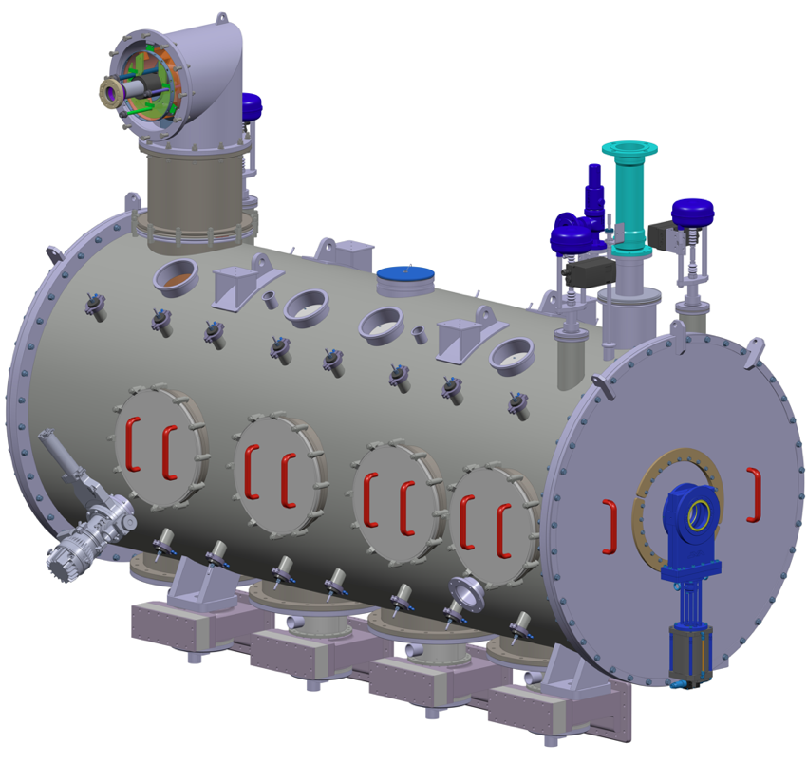
Booster status:
Slides from Samuel Marchal
Instrument. Ports
Cryo. valve
Alignment target support
Level gauge
Vacuum Vessel
Tie rod
Vacuum pump
Tuner trapdoor

Slide 9
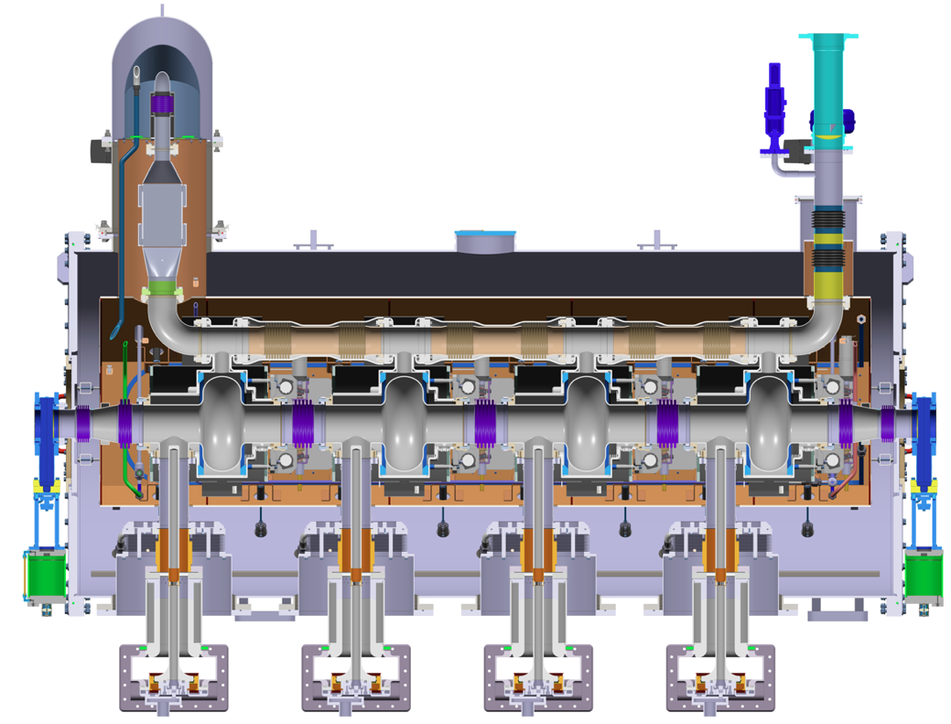
Booster status:
Lifting ring
Rupture disc
Jumper
Valve
Exchanger
Magnetic shielding
Flat bottom
Biphasic tube
Valve
Thermal shielding
CF transition
He tank
Tuner
Cavity
Power coupler
support
Wave guide

Slide 10
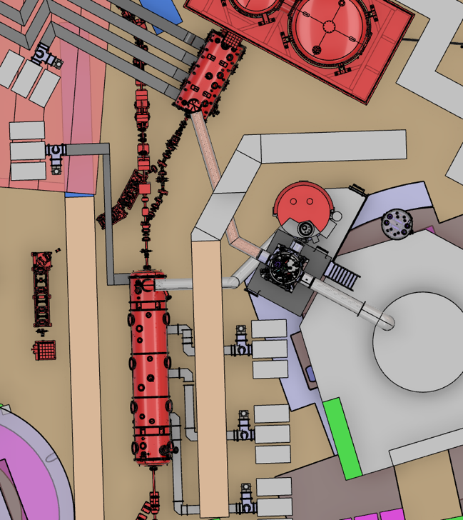
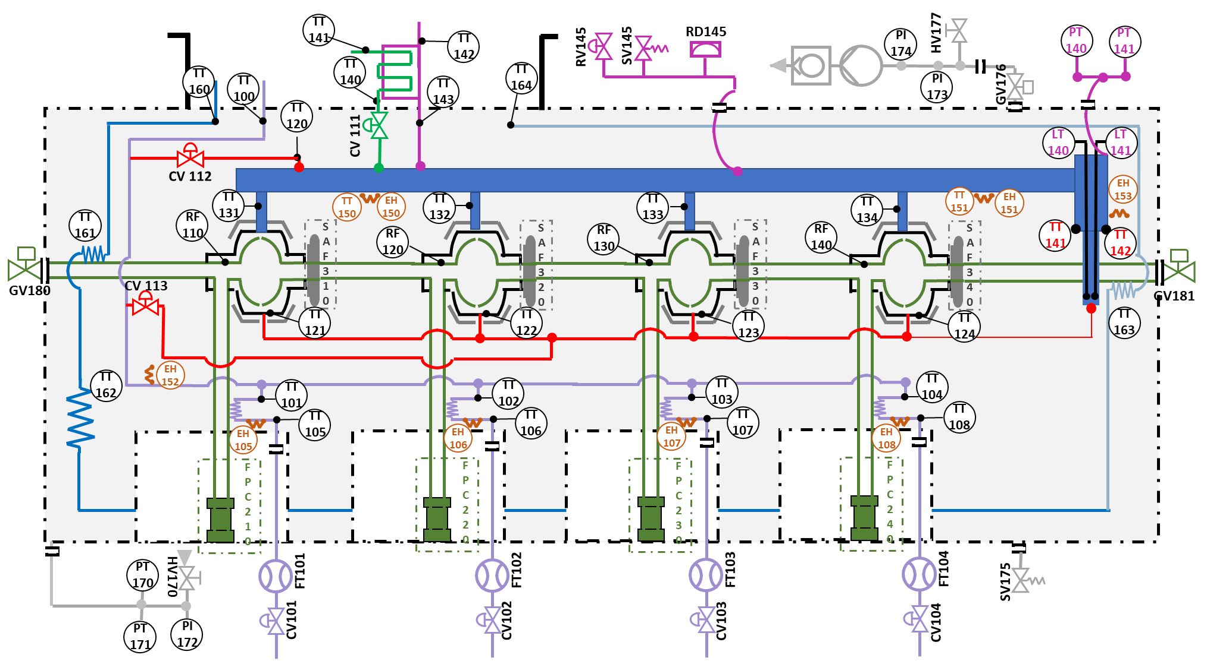
Booster cryogenic distribution:
Booster Cryogenic PID

Slide 11
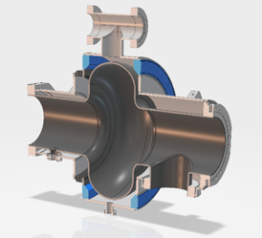
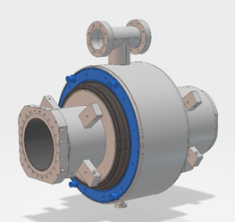
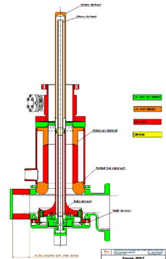
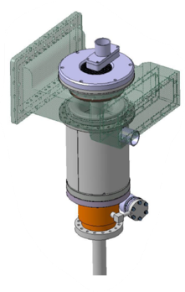
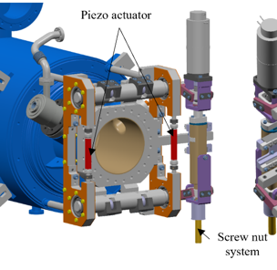
Booster single cell cavity and FPC
4 mono-cell cavities for booster:
  Order placed with Zanon
  Nb sheets sent and received by the manufacturer
  3D step file sent for approval by Zanon, some modifications to implement.
4 RF Fundamental Power Couplers (FPC):
  Same design as Linac cryomodule power couplers
  Set of technical drawings under completion at CERN
  Fabrication planned by CERN mid-June 2026
  RF conditioning will be done at CERN
4 double-wall tube for FPC:
  Same design as the ones of the Linac cryomodule
  Technical specification under review
  Call for tender under completion
4 tuners:
  Design adaptation terminated
  Order to be lunched before summer

Slide 12
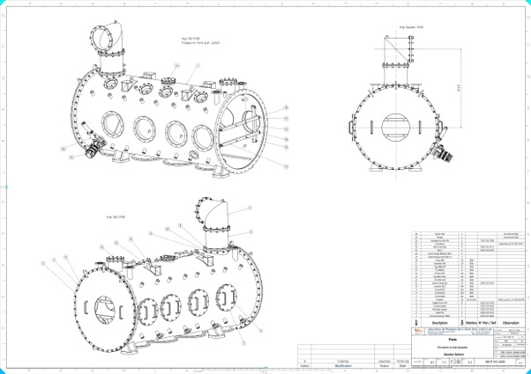
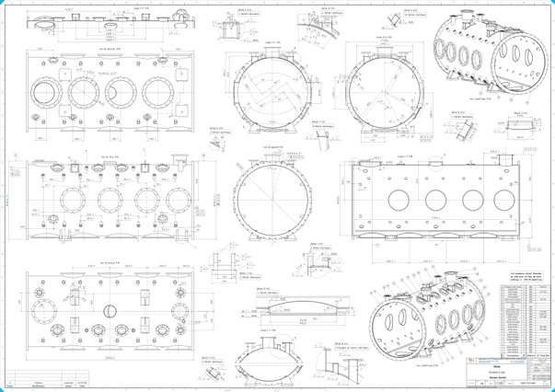
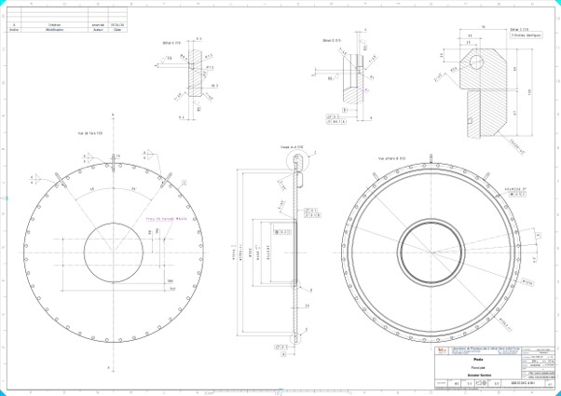
Booster vacuum vessel
The set of technical drawings for the vacuum vessel, flat bottoms and flanges is being finalized, same for the technical specifications.

Slide 13
Planning of the booster:
 |  |  |  |  |  |  |  |  |  |  |  |  |  | TRAVAUX IGLOO
 |  | janv-26 | févr-26 | mars-26 | avr-26 | mai-26 | juin-26 | juil-26 | août-26 | sept-26 | oct-26 | nov-26 | déc-26 | janv-27 | févr-27 | mars-27 | avr-27 | mai-27 | juin-27 | juil-27 | août-27 | sept-27 | oct-27 | nov-27 | déc-27 | janv-28
1000 | Train Cavité |  |  |  |  |  |  |  |  |  |  |  |  |  |  |  |  |  |  |  |  |  | Montage et test au 106
1110 | Monocell
1120 | Tank
1130 | SAF
1160 | Blindage |  |  |  |  |  | Appel d’offres |  |  | Fab
1300 | Vanne a vide tout metal |  |  |  |  |  | Appel d’offres |  |  |  |  |  |  |  | Fab
1170 | Support tirants |  | Simulation |  |  |  | Dossier de Plan + CCTP |  |  | Appel d’offres |  |  |  | Fab
1200 | Soufflet IC
1300 | Transition CF |  | Simulation
6610 | Soufflet tube diph.
2000 | Ecran |  |  |  |  |  | Dossier de Plan + CCTP |  |  | Appel d’offres |  |  |  | Fab
2101 | Flanc gauche | Simulation
2102 | Flanc droit | Simulation
2200 | Fond | Simulation
2300 | Ecran Jumper
2400 | Ecran disque rupt.
2500 | Trappe | Simulation
3000 | Tirants |  | Simulation |  |  |  |  |  |  | Dossier de plan + CCTP |  |  |  | Marché |  |  |  | Fab
4000 | Enceinte |  |  |  | Dossier de Plan + CCTP |  | Appel d’offres |  |  |  | Fab
4001 | Enceinte à vide |  | Simulation
4101 | Fond plat |  | Simulation
4201 | Rallonge jumper
4202 | Coude jumper
4301 | Trappe accès SAF
4701 | Barre
4711 | Barre verticale
4900 | Ensemble Soupape
4901 | Soupape
5000 | Coupleur
5000 | cloche coupleur |  |  |  |  |  | Appel d’offres |  | Fab
6000 | Cryo |  |  |  |  |  |  | Dossier de plan + CCTP |  |  |  | Appel d’offres |  |  |  | Fab
9000 | MLI |  |  |  |  |  |  |  |  | Dossier de plan + CCTP |  |  |  | Appel d’offres |  |  |  | Fab
8000 | Outillages et autres | Cycle de montage |  |  |  |  |  |  |  |  |  |  | Dossier de plan |  |  |  | Fab
Simulation
Call for tender
Set of drawings & tech. specifications
Fabrication
Assembly & test

Slide 14

Status of the Linac cryomodule
Slides from Guillaume Olry
Completed developments:
  New 5cell cavity design
  Mechanical integration of HOM and power couplers
  New cold and warm magnetic shields designs
  Adaptation of the ESS/MYRRHA cold tuning systems
  First cold Beam line absorber mechanical design
  New end-cap design including warm-to-cold transition
  New cryo lines for HOM couplers and beam line absorbers
  Definition of the P&ID (Piping and Instrumentation Diagram)
Current developments:
  Cold BLAs: characterization studies of several samples, thermal and RF calculations → cryo cooling
  Finalization of the cryogenic circuit design to include fast cooling possibility and BLAs cooling.
  Final configuration of the Instrumentation and cabling (temperature sensors, heaters)

Slide 15
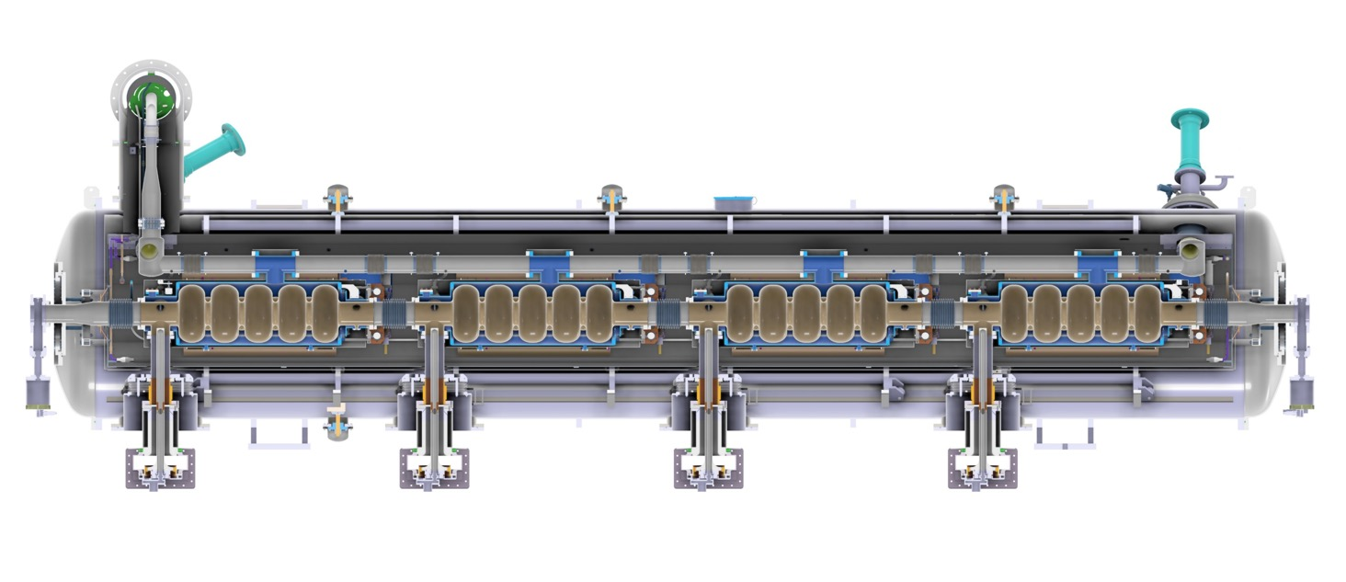
Status of the Linac cryomodule
PERLE Cryomodule should look like this...

Slide 16

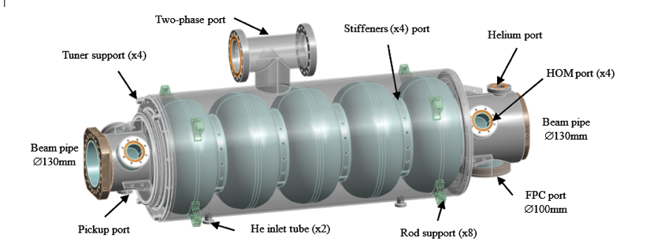
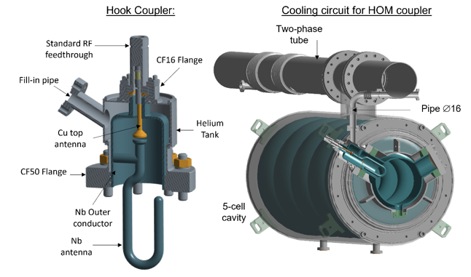

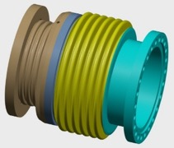
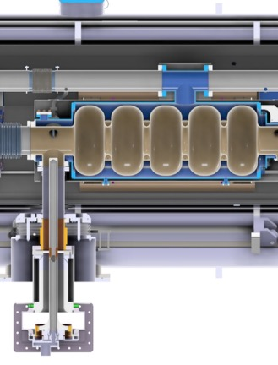
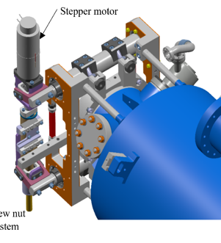

Design status of Linac components
5-cell cavity
HOM coupler
BLA
3D model of the BLA
c/o P.Duchesne
c/o G.Olivier
c/o P.Duchesne
FPC
Cold tuning system
c/o S.Blivet
c/o S.Blivet

Slide 17
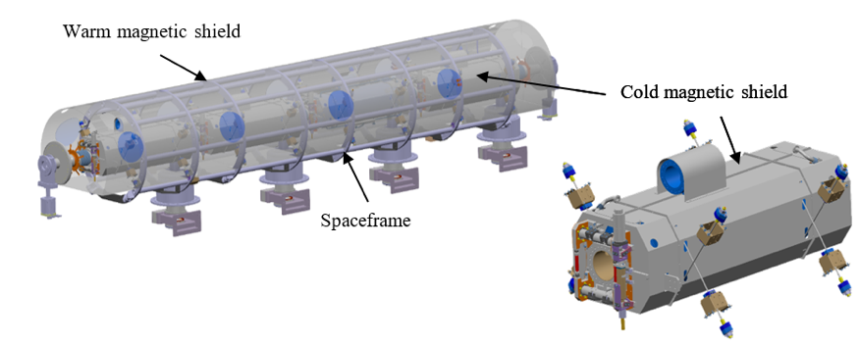
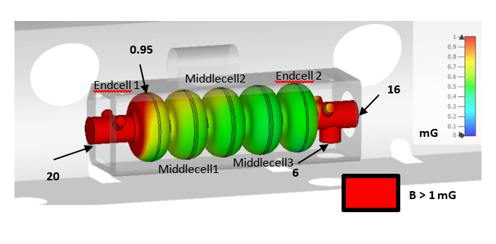
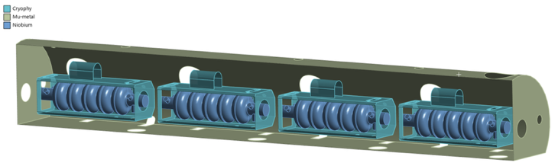
Design status of Linac components
Warm + Cold magnetic shields integration:
Goal: residual B field < 1mG at the cavity surfaces (due to high sensitivity to trapped flux after mid-T bake)
→ double the magnetic shielding, consisting of a 2 mm-thick layer of µ-metal and a 2 mm-thick layer of Cryophy around the cavities
c/o S.Blivet
CST simulations
c/o P.Duchesne

Slide 18
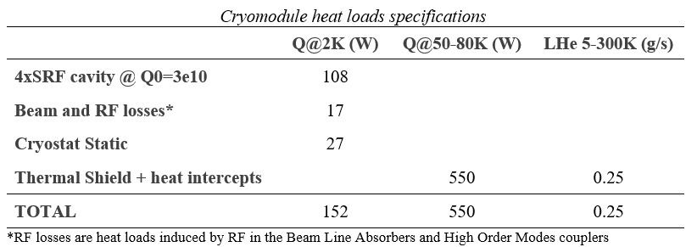
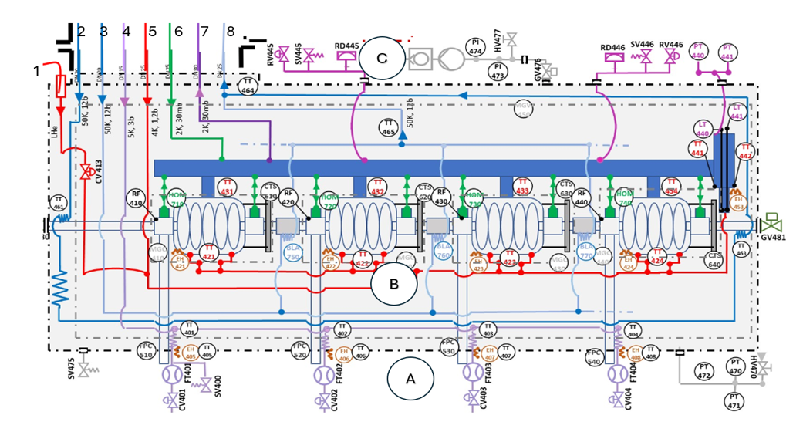
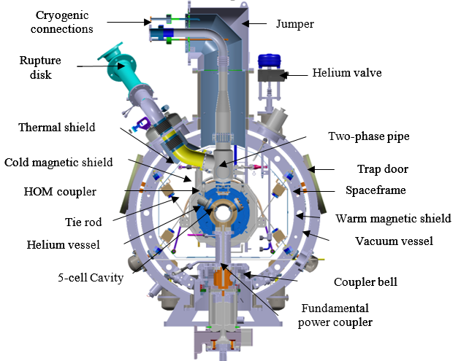
Design status of Linac components
Cryogenic circuits:
No sub-cooling heat exchanger, nor JT valve into the cryomodule (main difference with ESS cryomodule)
New circuits: Cavities fast cooling down (red line #1),HOM couplers (green connexions to the bi-phase pipe), BLA cooling (ligth blue line #3)
Preliminary PID

Slide 19
Status of Linac cryomodule components
Tasks accomplished:
  Niobium material : delivered and shipped to Zanon.
  5-cell cavities : call for tender #2 in 2025. Zanon awarded. Kick-off meeting 16 January 2026. Manufacturing file received for approval (technical drawings approved)...final approval soon then fabrication will start. First bare cavities expected in T1 2027.
  Magnetic shields: material (cryophy and µmetal) ordered. 6 months delay for 2mm thick µmetal...delivery in September 2026.
Still to come:
  HOM couplers (4 additional units w.r. to iSAS-WP4): call for tender in preparation. Publication before summer break.
  Double-wall tubes (for FPC): call for tender in preparation. Publication before summer break.
  Cold tuning systems: all quotations received (~30k€/CTS). Ordering phase is about to start.
  All metal gate valves: quotation received. Super expensive! Ongoing discussion with another supplier (VSE Vakuumtechnik)
  Magnetic shields: call for tender postponed to October 2026
  Cryomodule dished-ends: technical drawings in progress...

Slide 20
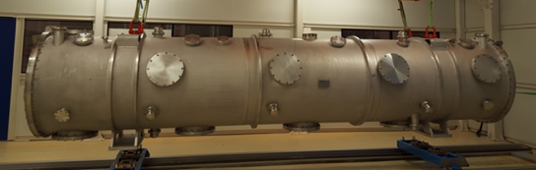
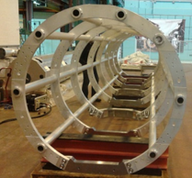
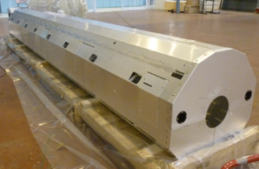
Status of Linac cryomodule components
In addition:
As In-kind contribution of ESS to iSAS, the cryomodule of the linac will reuse ESS medium beta prototype components:
Vacuum vessel
Spaceframe
Thermal shield

Slide 21
Organization of the beam dynamics review:
Goal:
Validation of the scientific choices related to lattice design and beam dynamics studies.
Inputs to be provided:
Final lattice design will be presented in details, including optical functions, optical elements parameters and the phasing strategy.
Current state of diagnostics studies, error studies and various beam dynamics studies will also be shown.
The reports will be sent to the reviewers at least a month in advance, along with a list of questions for the reviewers.
Practical Information:
The review will be held at IJCLab, by Mid/End June 2026, so it does not overlap with the IPAC conference.
A hybrid (zoom-presential) format can be envisaged, considering potential travel issues.
PERLE collaboration will afford all expenses (travel, meals, accomodation) of reviewers if they wish to attend in person.
A visit of the installation is planned.
Postponed to fall 2026, some studies still ongoing + need to make all the documents available in advance for the reviewer.

Slide 22
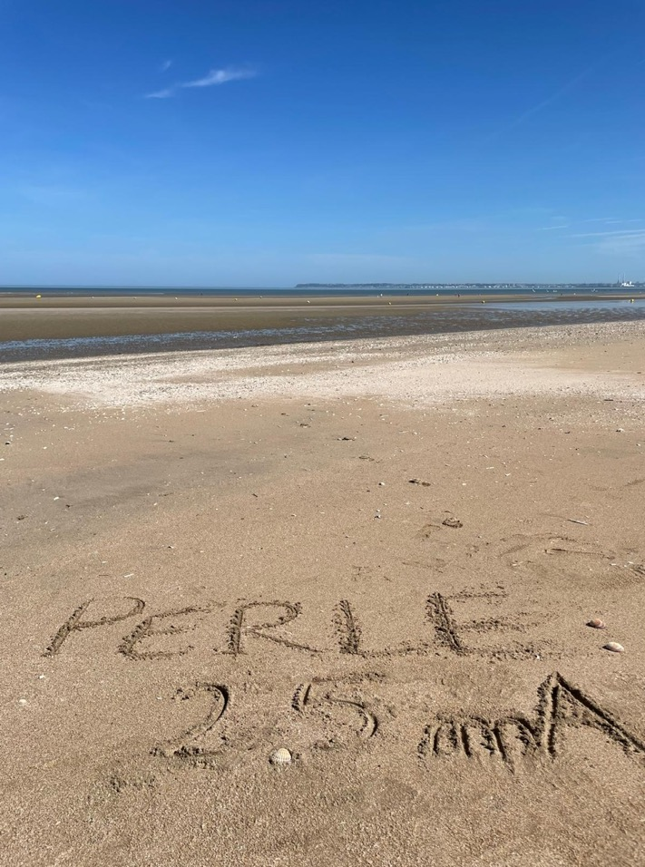
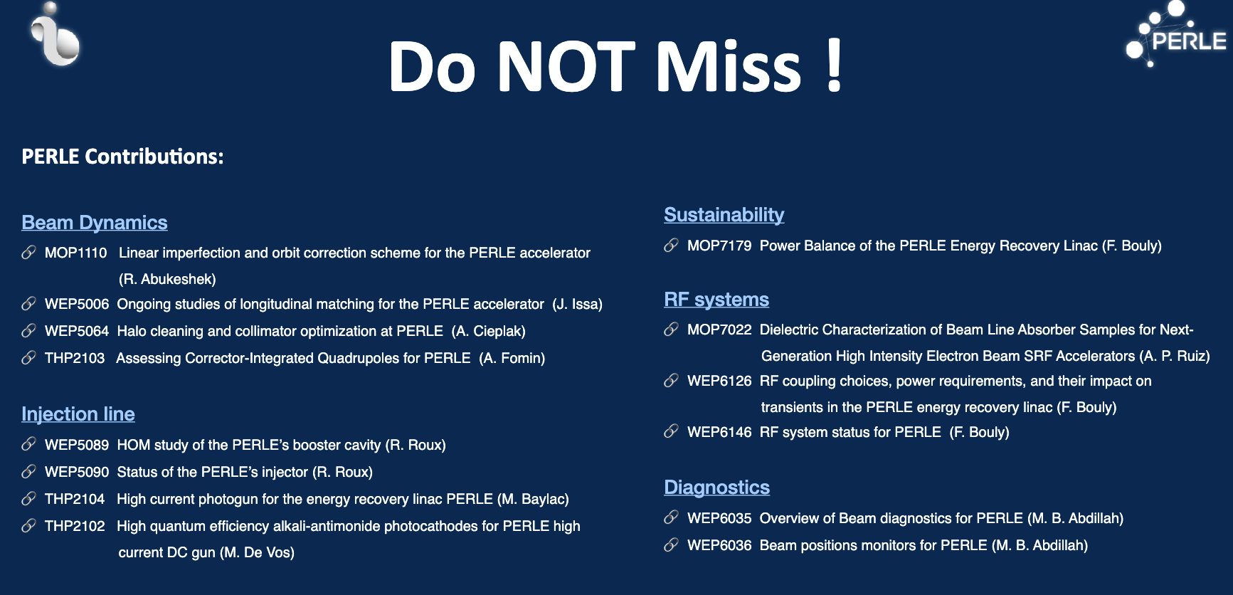
Contributions PERLE à IPAC’26
14 abstracts submitted
11 contributors, including 3 PhDs
+
A contributed Talk by Alex Fomin

Slide 23
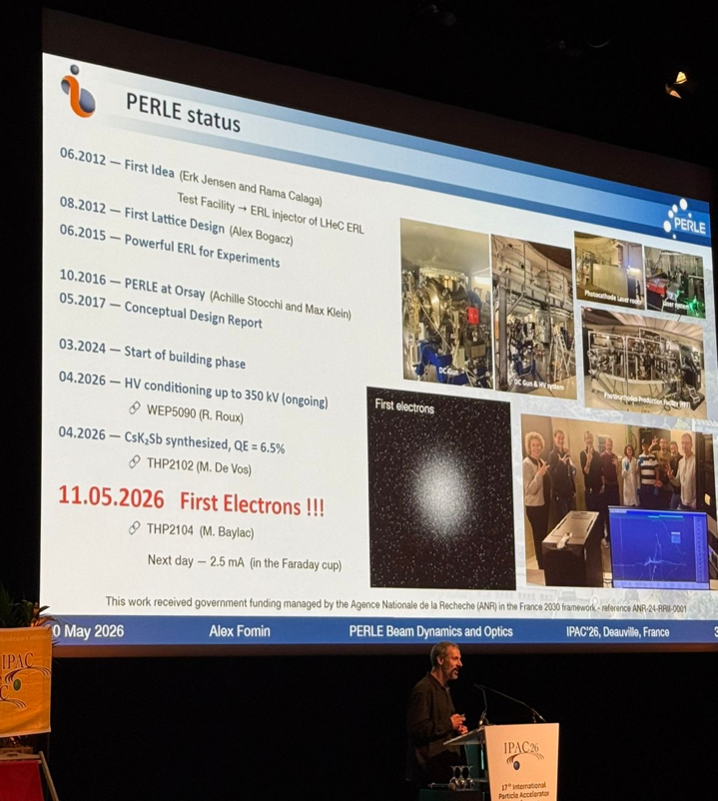






Contributions PERLE à IPAC’26

Slide 24





IN-KIND : News of the Collaboration:
Signature of the Cooperation Agreement between IJCLab/LPSC and Helmholtz Zentrum Berlin (HZB) for the transfer of the Cryo-plant and related equipment and collaboration on SRF activities of mutual interest and activities related to ERLs.
We started to discuss technical details for the Cryo-plant transfer (boxing, handing, transportation), responsibilities…
Gas management panel
Cold Box
Helium pumping station for 2 K operation
C&C cabinets
Cycle compressors

Slide 25



IN-KIND : Status of Magnets- Discussions with Daresbury (I)
Slides from Rasha Abukeshek
STFC-Darsebury: Mail exchange & Meeting during IPAC’26 at Deauville
  ALICE Injector Quad Type D
Big aperture → not suitable for the stacked turns
Small Gradient
Length is more suitable for ERL quads -> place in merger?
→ Not a suitable option
Parameter | Gap [mm] | L [mm] | G [T/m] | number | Cost [k€]/unit
PERLE | 76 | 50 | $≤$6 | 7 (21 total) | 21
STFC (Alice) | 106 | 180 (phys.270) | 2.2 | 11 | transport

Slide 26

IN-KIND : Status of Magnets- Discussions with Daresbury (II)
STFC-Darsebury: Mail exchange & Meeting during IPAC’26 at Deauville
  ALICE Injector dipole
Used to bend 8 MeV electrons by 30°
Twice the length of PERLE merger dipole →reduce the current (field)
Well compatible option
To consider!
For the merger commission, one dipole can be used for the injector chicane
Must be replaced with a shorter magnet for the single-tour phase
Two options:
  2 in merger + 1 in mirror
  2 for the middle chicane (inj.+dump)
Parameter | Gap [mm] | L [mm] | B [T] | number | Cost [k€]/unit
PERLE | 76 | 150 300 | 0.08 0.08 | 3(8 total) 2 | 40 42
STFC (Alice) | 71 | 310 | 0.08 | 3 | transport

Slide 27

IN-KIND : Status of Magnets- Discussions with Daresbury (III)
STFC-Darsebury: Mail exchange & Meeting during IPAC’26 at Deauville
  Alice injector dipole
    Mechanical integration from 2D drawings: Alice quads are not suitable, dipoles can fit with compact quadrupoles
Dipole integration specs
230 kg, assembled in 2 parts (measurements on the bench?)
No support or fiducials
No power supply: ±6A/12V
HT test for the coils needed
Air cooled
STEP file of a simplified 3D model is provided (to be implemented)
Opera 3D provided → Beam Dynamics simulation with field map

Slide 28

IN-KIND : Status of Magnets- Discussions with Daresbury (IV)
STFC-Darsebury: Meeting during IPAC’26 at Deauville
  EMMA ring quad (new option suggested)
Physical length is compact (55mm)
Gradient is compatible
Water cooled, with high current/small voltage power supply as the number of turns is small
STEP file of 3D model is provided (to be implemented)
Parameter | Gap [mm] | L [mm] | G [T/m] | number | Cost [k€]/unit
PERLE | 76 | 50 | $≤$6 | 7 (21 total) | 21
STFC (EMMA) | 72 | 88.86 (phys.55) | 6.68 (at 345A) | 20 | transport

Slide 29
IN-KIND : Status of Magnets- Other discussions
CERN: last exchange with Jérémie Bauche (Normal Conducting Magnets group) on May 12th 2026
An addendum to the PERLE Collaboration Agreement in preparation for the long-term loan of identified MDX dipoles for the Arc in phase 1 (PERLE single turn) → 12 units.
SEF (French company): last exchange during IPAC26
Main specs and parameters of needed magnets were sent to the company (May 26) following a first discussion.
Agreement on the staged strategy for magnets order/fabrication/delivery → Focus on merger (3 dipoles, 7 quads).
SEF prefers small series production, starting with a prototype.
IJCLab will deliver the magnetic design, SEF will perform the mechanical design.

Slide 30

NEW POSSIBLE FUNDINGS : Application for funding: SESAME program
  Submission of application for funding (SESAME program- Région Ile de France) → Project CRISP (CRyogénie et Injecteur Supraconducteur de PERLE) to Fund of the Inter-Connection Box (ICB): Total cost 550k€.
  After the first selection at the university level, CRISP is among the 8 projects selected for the final selection by Région Ile de France.

Slide 31


NEW POSSIBLE FUNDINGS : Preparation for application of E2-SCALE:
E2-SCALE:
Energy Efficient and Sustainable Collider, Accelerator, and Light-source research infrastructures for Europe
Innovate for Sustainable
Accelerating Systems
Commun project between current European projects iSAS (coordinated by IJCLab) et RF 2.0 (coordinated by KIT- Germany) for the European call INFRA-TECH-2026-01-01.
Development of high efficiency Solid State Amplifier (SSA) @ 800 MHz- 60 kW, (collaboration with JEMA-France and CERN.
PERLE proposed as a facility for the integration, test and validation of the developed SSA, and the Cryomodule FCC developed in the project.

Slide 32

Collaboration Agreement Extension

Slide 33
Thank you for your attention!

Slide 34

TDR- Structure and advancement:
Les p’tites flèches indiquent les changements par rapport à la PPR précédente ou les points d’attention supplémentaires
Avancement
a < 25% : pas de plan ou de détails d’avancement
a=25% : plan reçu mais V0 en cours de rédaction
a= 50 % : V0 reçue en relecture ou en correction
a > 50 % : V1 corrigée
a ≥ 75% : version finale prête et /ou corrections mineures
a = 100 % : version finale intégrée au TDR. Relue & approuvée par Coord. chapitre et Coord. Board.

