Slide 1
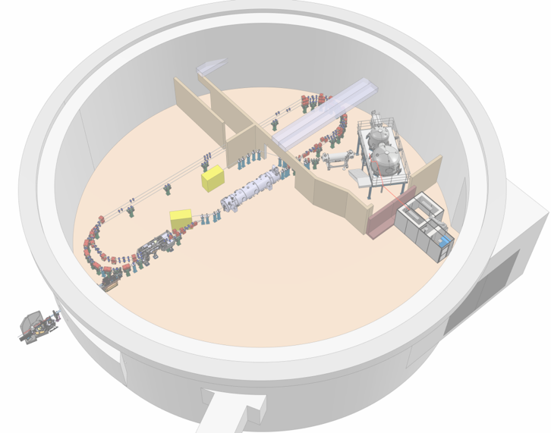

Project Progress Review (PPR) 5-2026
WP- 4
Rasha Abukeshek/ Hadil Abualrob / Luc Perrot / Emmanuel Froidfond
26 juin 2026
Notes:
26/06/2026
1

Slide 2
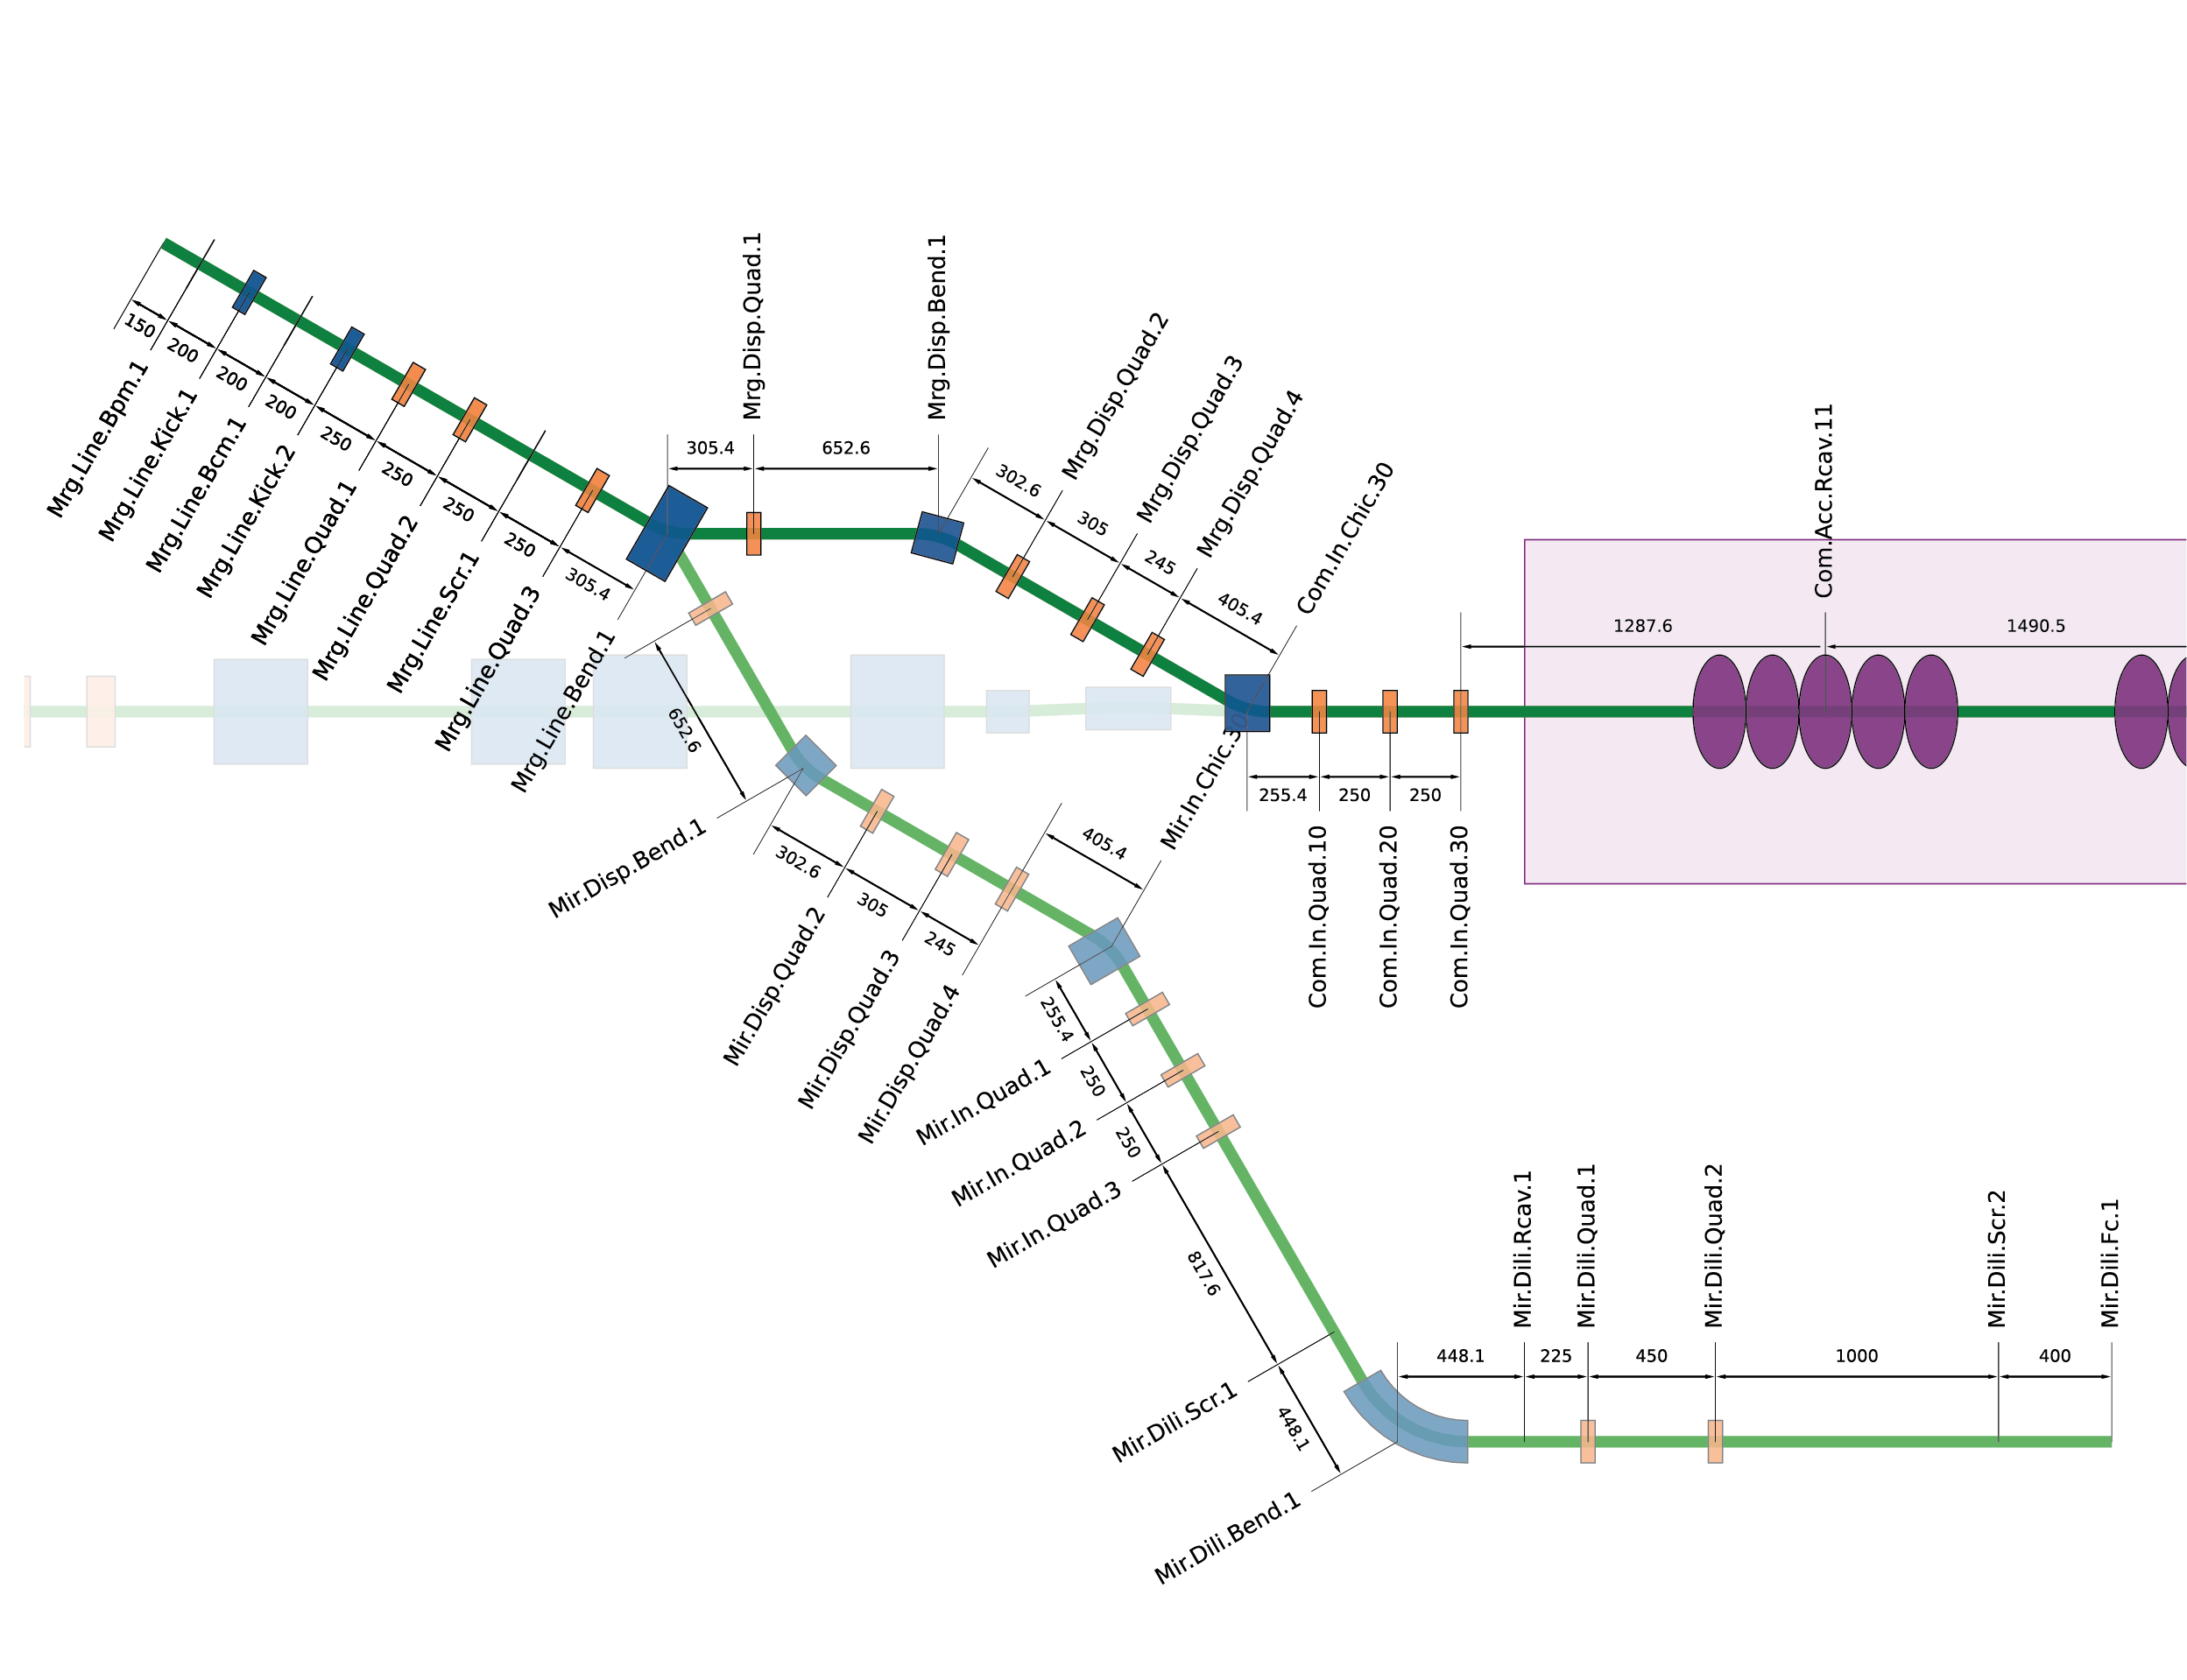
Recuperation in progress – Magnets PERLE single Tour
STFC: 3 dipoles and 20 quads
fully construct the merger
Diagnostic line: all quads + 1 dipole (when replacing the injection chicane)
 | Dipoles |  | Quadrupoles
Parameter | number | Cost [k€]/unit | number | Cost [k€]/unit
PERLE | 5 | 40 | 7 (21 total) | 21
STFC (Alice) | 3 | transport | 20 | transport
CERN: Arc dipoles (12)

Slide 3
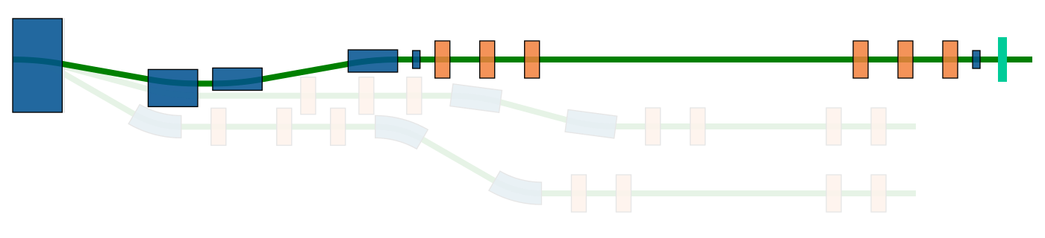
Missing Magnets for PERLE single Tour
Merger: 4 correctors
Possible recuperation from bERLinPro:
Quads: 52
Spr./Rec. dipoles (if space allows)
Diagnostic:
- Dipole spectrometer
- Dipole magnet
B-com (spr./rec.): 4 dipoles
Bot (spr./rec.): 4 dipoles
Bot
Chicane (inj. & Dump): 6 dipoles
Quadrupoles (ERL loop): 52

Slide 4
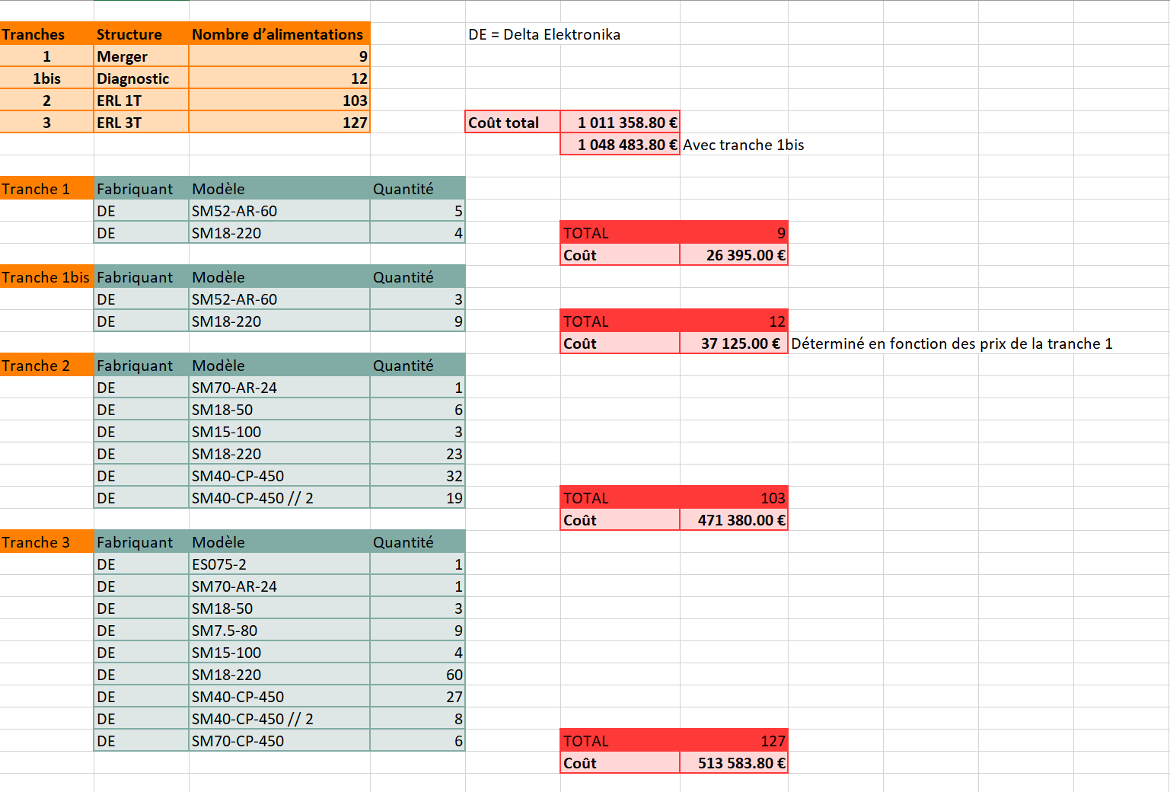
Etat d’avancement
Alimentation: Emmanuel a préparé un tableau
  premier chiffrage avec le fournisseur "Equipements scientifiques", qui est le distributeur officiel Delta Elektronika en France
  a ce jour, pas de récupération d’Alim
    Thomx Alim: possible types
Notes:
26/06/2026
4

Slide 5
Etat d’avancement
Alimentation: Thomx Alim for PERLE
- For correctors and most of quads
Possible for arc dipoles (but not CERN’s ones)
Ok for Alice dipoles in merger (2/3)
Qte | Current [A] | Voltage [V] | Type | P_max | Ok pour PERLE? | Comments
8 | 300 | 170 | Unipole | 51 kW | oui* | Sur-dimensionnée, probablement refroidissement eau, triph.
4 | 300 | 85 | Unipole | 25.5 kW | oui* | Sur-dimensionnée, probablement refroidissement eau, triph.
2 | 300 | 45 | Unipole | 13.5 kW | oui* | Sur-dimensionnée, probablement refroidissement eau, triph.
2 | 12 | 18 | Unipole | 216 W | oui | TOP.SPR3.QUAD.4 ?, TOP.REC1.QUAD.3, MID.A2S3.QUAD.1 ?, MID.A2S3.QUAD.2 ?, MID.A2S3.QUAD.3 ?, BOT.REC1.QUAD.2
33 | 12 | 6 | Unipole | 72 W | oui | TOP.SPR3.QUAD.4 ?, TOP.REC1.QUAD.3, MID.A2S3.QUAD.1 ?, MID.A2S3.QUAD.2 ?, MID.A2S3.QUAD.3 ?, BOT.REC1.QUAD.2
12 | 12 | 3 | Unipole | 36 W | oui | TOP.SPR3.QUAD.4 ?, TOP.REC1.QUAD.3, MID.A2S3.QUAD.1 ?, MID.A2S3.QUAD.2 ?, MID.A2S3.QUAD.3 ?, BOT.REC1.QUAD.2
12 | ±12 | ±3 | Bi-pole | 36 W | oui | Correcteurs
10 | ±12 | ±3 | Bi-pole | 36 W | oui | Correcteurs
Notes:
26/06/2026
5

Slide 6
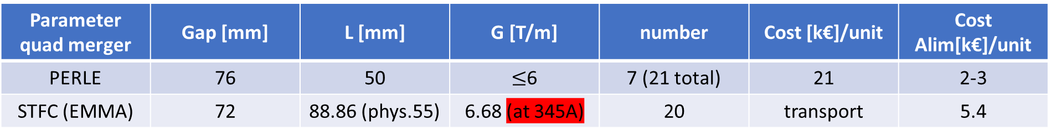
Etat d’avancement
Alimentation: Missing Alim for merger
- Alim for EMMA ring quad
Alimentation: Missing Alim for merger
- Bipolar Alim for 1st switching dipole
Water cooled, with high current/small voltage (4V) power supply as the number of turns is small
Parameter quad merger | Gap [mm] | L [mm] | G [T/m] | number | Cost [k€]/unit | Cost Alim[k€]/unit
PERLE | 76 | 50 | $≤$6 | 7 (21 total) | 21 | 2-3
STFC (EMMA) | 72 | 88.86 (phys.55) | 6.68 (at 345A) | 20 | transport | 5.4
+20k€ to the merger budget
Price of one quad!
Notes:
26/06/2026
6

Slide 7
Etat d’avancement
Cost comparison: Merger
 | Dipoles |  |  | Quads
Parameter | number | Cost [k€]/unit | Cost Alim[k€]/unit | number | Cost [k€]/unit | Cost Alim[k€]/unit
PERLE | 5 | 40 | ThomX + 1 | 7 merger (21 total) | 21 | 2-3 (ThomX?)
STFC | 3 | transport | ThomX + 1 | 20 | transport | 5.4
Notes:
26/06/2026
7

Slide 8
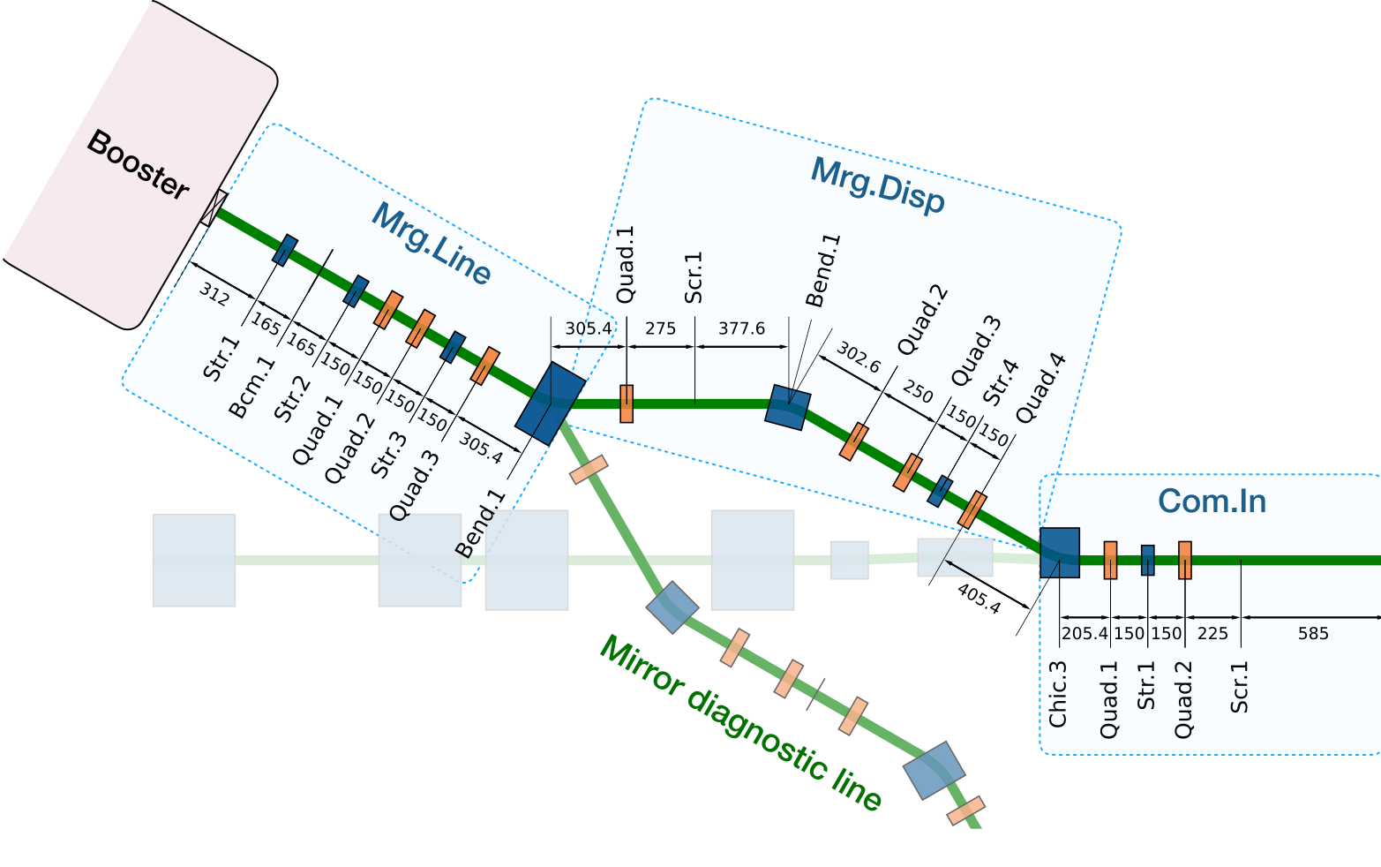
Etat d’avancement
STFC-Darsebury: Mechanical integration
    Still in progress
    3 possible compromised positions:
      quads have a larger transverse section
      Dipole have larger length
Notes:
26/06/2026
8

Slide 9
Etat d’avancement
STFC-Darsebury :
  Waiting for the list of diagnostics:
    Most probable: screens and Faraday cup from VELA
  Magnets radiological report:
    Alice dipoles: not activated at all, checked on juin19,2026 using a scintillation detector
    EMMA quads: still waiting for records (paper)
    Gamma ray spectroscopy possible after mid-july
  Organizing a visit to Daresbury:
    Waiting for diagnostics list
    For September 2026
Notes:
26/06/2026
9

