Slide 1


Mid-term Advisory Board meeting
Oct 30, 2026

Slide 2
iSAS Mid-term Advisory Board meeting
Agenda
Agenda items
  Advisory Board recommendations from Berlin meeting follow-up
  Questions to Advisory Board
  Preparation of Lund annual meeting hosted by ESS
  Upcoming meetings
  AOB
Presentation(s) available on:
iSAS project Indico page

Slide 3
Advisory Board recommendations from Berlin meeting follow-up
Written response to recommendations: sent last May
Response to WP-specific review & comments: progress made shared by each WP (dedicated template slide for Steering Committee updates)

Slide 4
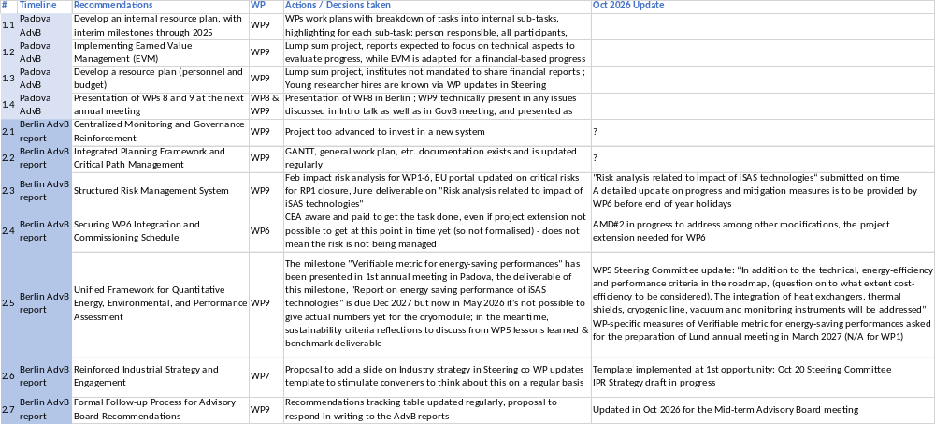
Advisory Board recommendations from Berlin meeting follow-up
Reminder of response to recommendations
Table to Follow-up Process for Advisory Board Recommendations

Slide 5
Advisory Board recommendations from Berlin meeting - follow-up
#2.1 Centralized Monitoring and Governance Reinforcement
ANSWERS - MAY 2026
  Every other meeting (so each trimester) the Coordination panel becomes the Steering committee (includes the WP leaders & deputies), so as to integrate a cross-coordination of feedback.
  The project Coordinator, the Scientific Coordinator and the project manager meet weekly to discuss the outstanding issues and prepare the upcoming committee meetings.
  UPDATE - OCT 2026
    NONE

Slide 6
Advisory Board recommendations from Berlin meeting - follow-up
#2.2 Integrated Planning Framework and Critical Path Management
ANSWERS - MAY 2026
  A GANTT for all WPs, general work plan, WP workplans, documentation exists, is updated regularly and is recorded in the project data repository, the presentations are available in the project Indico page.
    UPDATE- OCT 2026
      NONE

Slide 7
Advisory Board recommendations from Berlin meeting - follow-up
#2.3 Structured Risk Management System
ANSWERS - MAY 2026
  February impact risk analysis for WP1-6, EU portal updated on critical risks for RP1 closure
  UPGRADE - OCT 2026
    "Risk analysis related to impact of iSAS technologies“ submitted on time in June
    A detailed update on progress and mitigation measures is to be provided by WP6 before end of year
#2.4 Securing WP6 Integration and Commissioning Schedule
ANSWERS - MAY 2026
  CEA aware and paid to get the task done, even if project extension not possible to get at this point in time yet (so not formalised) - does not mean the risk is not being managed
  UPGRADE - OCT 2026
    AMD#2 in progress to address, among other modifications, the project extension needed for WP6

Slide 8
Advisory Board recommendations from Berlin meeting - follow-up
#2.5 Unified Framework for Quantitative Energy, Environmental, and Performance Assessment
ANSWERS - MAY 2026
  The milestone "Verifiable metric for energy-saving performances" has been presented in 1st annual meeting in Padova, the deliverable of this milestone, "Report on energy saving performance of iSAS technologies" is due Dec 2027 but now in May 2026 it's not possible to give actual numbers yet for the cryomodule; in the meantime, sustainability criteria reflections to discuss from WP5 lessons learned & benchmark deliverable
  UPGRADE- OCT 2026
    WP5 Steering Committee update: “In addition to the technical, energy-efficiency and performance criteria in the roadmap, question on cost-efficiency have to be considered. The integration of heat exchangers, thermal shields, cryogenic line, vacuum and monitoring instruments will be addressed”
    WP-specific measures of Verifiable metric for energy-saving performances asked for the preparation of Lund annual meeting in March 2027 (N/A for WP1)

Slide 9
Advisory Board recommendations from Berlin meeting - follow-up
#2.6 Reinforced Industrial Strategy and Engagement
ANSWERS - MAY 2026
  Proposal to add a slide on Industry strategy in Steering Committee WP updates template to stimulate conveners to think about this on a regular basis
  UPGRADE - OCT 2026
    Template implemented at 1st opportunity: Oct 20 Steering Committee
    IPR Strategy draft in progress with advanced discussion between INFN and CNRS ILO
    Proposal of a specific Workshop in 2027 in Lund on Supply Resilience (see WP7)
#2.7 Formal Follow-up Process for Advisory Board Recommendations
ANSWERS - MAY 2026
  Recommendations tracking table updated regularly, proposal to respond in writing to the AdvB reports
  UPGRADE - OCT 2026
  Updated in Oct 2026 for the Mid-term Advisory Board meeting

Slide 10
WP1 – FE-FRT: progress to take into account
Advisory Board recommendations
Progress to take into account Advisory Board recommendations
  “While technical challenges such as cooling during cold tests remain under investigation, no critical blockers have been identified“
    This has been proven by CERN’s final TDD1 cold test, which showed very good performance by the FE-FRT itself and mainly limitations by the complications arising from anti-cryostat operation in a VTS setup. However, this requires further analysis, but should fulfill MS3
  “…although inconsistencies in ceramic ring preparation persist.”
    to tackle that, a much simpler and easier to use test resonator has been produced to measure permittivity of samples after treatment, radiation exposure , etc. This will also give more insight into the use of HZB’s FERMAT teststand and the required parameters for the FE-FRT itself. To not impair the task’s progress, the FE-FRT assembly and testing at HZB is pushed forward with systematic, consecutive testing to reach MS4. All work is on track here.
  “Looking ahead, efforts should concentrate on delivering the remaining project objectives, particularly the integration of the FRT into the PERLE module, while ensuring that supporting studies remain targeted.”
    To target this, MS1/D2 have been requested to be shifted towards the end of the project to allow a collaborative effort of all WP1 partners (HZB, CERN and IJCLab) to work on the objective by incorporating the lessons learned by task 1.2 and 1.3, the fundamental studies of 6.2 (U Lancaster) and also by WP6 with the procurement of cryo-module #1 (iSAS PERLE module), which should lead to a reasonable and realistic design.
  “…assessing energy and carbon savings using consistent methodologies;”
    A measure to quantify this information within the framework of the energy savings metric of iSAS has been developed. Here, all losses will be tried to be taken into account, i.e. RF power savings versus cryogenic losses, to name one.

Slide 11
WP2 – LLRF: progress to take into account
Advisory Board recommendations
Progress to take into account Advisory Board recommendations
  “The Board encourages the teams to maintain this momentum and to continue delivering high-quality results in support of the overall project objectives. “
  Beyond this, there were general comments to work on visibility
    Action: systematic check before publication of proper iSAS acknowledgment
    Action: visibility through presence at workshop and conferences
    Not just WP2, also External Relations (Maud Baylac) ESSRI workshop for ex. – Indico and double publication on ArXiv updated regularly

Slide 12
WP3 – Nb3Sn on Cu: progress to take into account
Advisory Board recommendations
Progress to take into account Advisory Board recommendations
  “coating defects remain a critical concern given their direct impact on RF performance, and further effort is needed to better control and characterize them.”
    The new chemical facility at UKRI and cleanroom at LNL are steps towards improved contamination control.
    As we move from samples to cavities, we will introduce additional handling and cleaning protocols adapted from bulk Nb cavity procedures.
  “the reproducibility of the optimized coating process across laboratories (INFN and UKRI) has yet to be convincingly demonstrated and should be treated as a priority“
  “the programme would benefit from a stronger focus on systematically linking surface condition and quality to superconducting performance, as this relationship is central to both defect mitigation and process reproducibility.”
    A systematic study is planned using the same substrate material, polishing procedure, and Nb₃Sn coating recipe (at INFN and UKRI)
    The study will assess coating reproducibility and the effectiveness of the ALD layer in reducing thermoelectric currents.
    Characterization will combine measurements of Tc and trapped flux with analyses of surface morphology and crystal structure.
  “Clarification is also needed on the status of the optimized recipe: whether validation is essentially complete and the project is ready to transition to the working cavity testing phase (Task 3.5)”
    Studies on planar samples at INFN and UKRI consistently identify the same favourable conditions: low power, high pressure, a buffer layer, deposition temperature > 600 °C, and no post-annealing.
    These results provide a basis for moving to cavities, but the recipe still requires optimization for each cavity coating system.
    The identified trends will guide the search for the optimal operating conditions in both newly developed systems.

Slide 13
WP4 – HOM dampers and FPC: progress to take into account
Advisory Board recommendations
Progress to take into account Advisory Board recommendations
  The limited availability of key components, such as SPL antennas (only 4 windows and antennas from SPL are available), represents a significant vulnerability, as no spares are currently available .
    The CERN workshop has the experience and the level of competences to succeed the operations. A CERN team of highly competent experts has been formed. The lack of spare parts will be taken into account and they will proceed with the utmost caution
  An interference from one of the HOMs that cannot be mounted on the cavity for the ESS test has been mentioned and should be clarified.
    Misunderstanding, all HOM C can be mounted on the ESS test bench
  The Board considers that a more systematic approach to risk analysis is needed in this work package, including the identification of mitigation strategies.
    The risk analyses have been updated, see D#34 Risk analysis related to impact of iSAS technologies, June 2026
  In parallel, a quantitative assessment of the expected energy savings associated with the design choices should be developed in order to better justify the proposed solutions.
    See M#32 Verifiable metric for energy-saving performances, May 2025
    WP-specific measures of Verifiable metric for energy-saving performances asked for the preparation of Lund annual meeting in March 2027

Slide 14
WP5 : progress to take into account
Advisory Board recommendations
Recommendations from Advisory Board
  WP5 is both innovative and strategically important, as it integrates the technological advances from other work packages into a coherent cryomodule design. The effort to define sustainability criteria through a structured survey is particularly valuable. (Done and Addressed in Task 5.2, benchmarking)
  However, the current approach remains largely qualitative, and it is not yet clear how the results of the survey will translate into concrete design decisions. The IAB therefore recommends strengthening the quantitative dimension of the analysis, including the use of well-defined performance indicators.
  In addition, aspects related to reliability and availability, such as mean time between failures (MTBF) and mean time to repair (MTTR), should be more explicitly incorporated into the evaluation framework.
  Safety considerations should also be integrated from the early stages of the design process.
Addressing Recommendations
  Concluding on precise MTBF values is extremely difficult because failure rates are heavily influenced by manufacturing quality, assembly, and the specific cryomodule configurations across different facilities (no clear link to the technology choice, as most facilities reported effort to minimize risks during the design phase).
  Instead, the strategy shifts toward minimizing Mean Time to Repair (MTTR) by allowing component repairs inside the tunnel.
  This approach includes features like access ports for servicing cold tuning systems and planning for coupler exchanges using mobile clean rooms. It also relies on rigorous quality assurance and testing to prevent leaks in welds and joints within the cryogenic distribution system.
  Thus, a purely quantitative MTBF analysis is not feasible due to the variety of designs/implementations across facilities.
  Given rhe current stage of development of new technologies, and the significant influence of manufacturing processes and installation quality on failure rates, therefore, the strategy focuses on robust maintainability features MTTR.

Slide 15
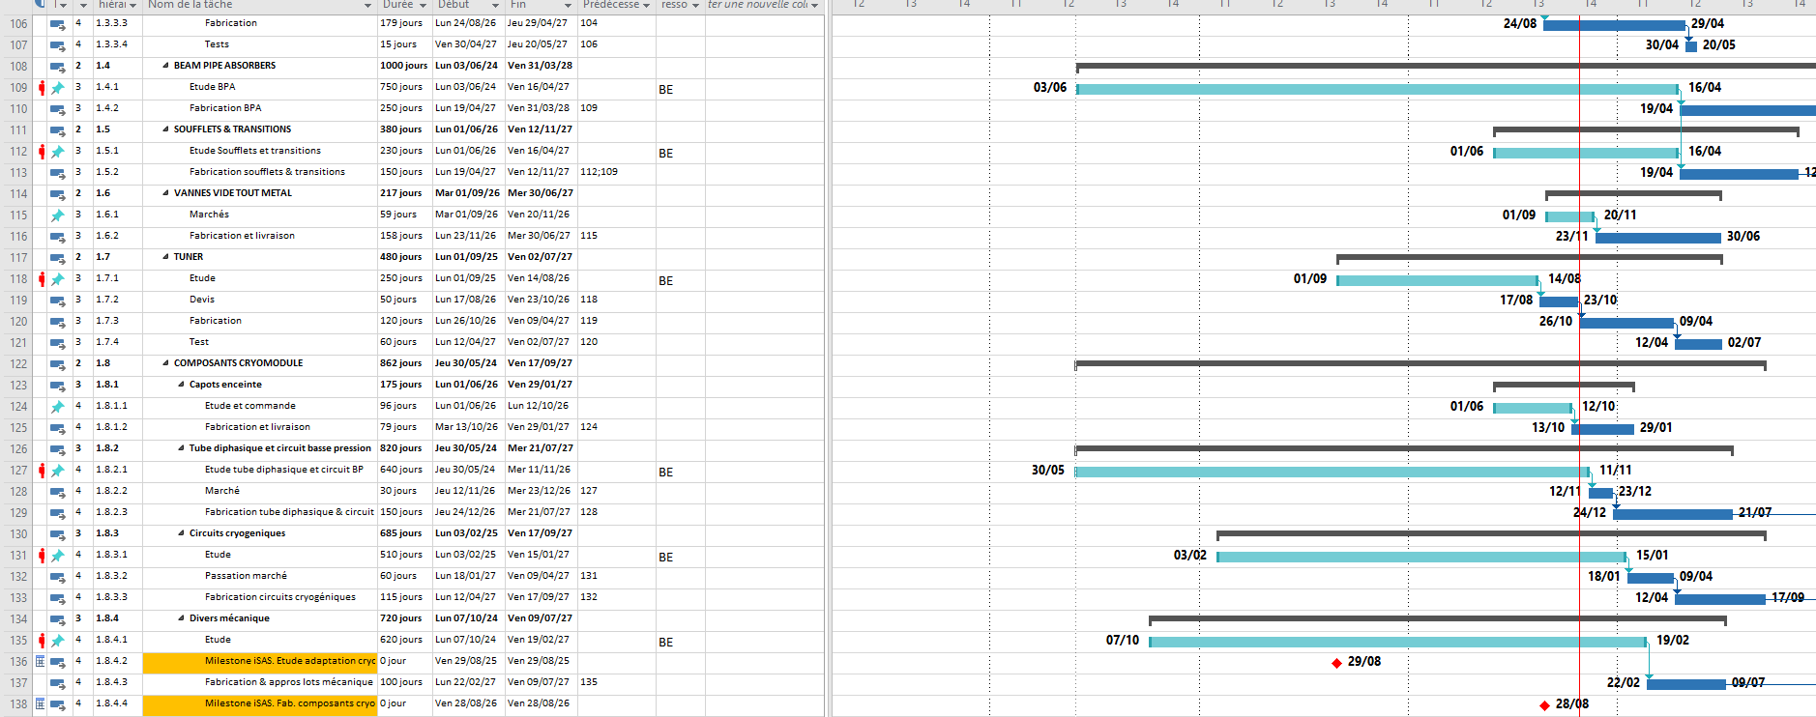
WP6 : progress to take into account Advisory Board recommendations
The IAB strongly recommends establishing a fully integrated and detailed execution plan covering assembly, integration, and commissioning. This should take the form of a comprehensive Gantt chart with clearly identified dependencies, critical paths, and resource allocations. Particular attention should be given to ensuring that all required tooling, facilities (e.g. cleanroom access), and control systems are prepared in advance, mitigating potential bottlenecks once the cryomodule becomes available.
Developing a Product Breakdown Structure (PBS) for both the cryomodule and all ancillary systems needed for cold testing would further strengthen planning, ensuring readiness of components and availability of shared or external resources at the appropriate time
A detailed Gantt chart exists taking into account: all critical components life-cycle (from design then fabrication and finally to test) and main operations such as the cryomodule assembly at CEA and test at Lund. Critical path: 5cell cavities task is identified as the main driver of this cryomodule task.
PBS is reflected through the Gantt chart to monitor the progress of the main critical components.
Most of the tooling will be reused and already available.
There is no warning at the moment about non-availability of needed facilities (CEA clean-room and ESS test stand).
Interfaces (RF/Cryo), instrumentation and control systems have been already identified and discussed with ESS team and there are no sticking points.
In addition, the absence of spare parts, currently constrained by budget, should be revisited through a structured risk analysis to evaluate potential failure modes and their impact on the overall project, with mitigation measures defined where necessary.
Not yet done as the main priority for many months is to launch all orders before end of 2026 in order to start procurements. Will be revisited beginning of 2027.
Finally, safety compliance should be explicitly integrated into the project risk register, as gaps in this area could have significant consequences not only during installation and commissioning but also for long-term operation.
Not sure to fully understand this recommendation...All new components which are needed for the cryomodule adaptation have been designed and will be produced following the Eu standards.

Slide 16
WP7 – Integration into industrial solutions:
progress to take into account Advisory Board recommendations
Progress to take into account Advisory Board recommendations
  “Supply chain robustness and the long-term availability of critical components developed or procured by industry are not yet addressed in a systematic manner. Even within constrained resources, this topic could be advanced through lightweight but targeted approaches, such as focused consultations, a dedicated workshop with key suppliers, or structured bilateral exchanges with major industrial actors. This would support a more forward-looking assessment of vulnerabilities and align with broader European priorities on technological sovereignty and industrial resilience”.
    WP7 Action. Focusing the next iSAS industrial Workshop on: Supply resilience and long-term availability of accelerator components
    1. Laboratory needs: components to be installed, future requirements, expected facility lifetimes, and maintenance and spare-part needs.
    2. Industry perspective: production capacity, dependencies on subcontractors, obsolescence risks, and the conditions required to sustain production and retain expertise.
    3. Priority setting: assessment of case studies to identify vulnerabilities based on their impact on accelerators, available alternatives, and the time required to qualify their production.
    4. Agreement on actions: development of a joint action plan between laboratories and industry, structured by technology
  “The recommendation to involve Industrial Liaison Offices (ILOs) from major iSAS partner”
  A pragmatic and resource-compatible way forward would also be to engage existing industrial partners through a short survey or structured exchange to better understand their sustainability goals, constraints, and expectations.”
    Extend the participation to other ILOs representatives before the next IB review meeting and discuss together the possible survey to be sent around to the iSAS industrial partners
    RI has already experience in sustainability (contact them directly)

Slide 17
WP8 – Societal impact: progress to take into account
Advisory Board recommendations
Progress to take into account Advisory Board recommendations
  “A unified, coherent, and more user-friendly site should therefore be considered a priority”
    Improvements have been made, but still room for ameliorations, and focus is still on improvements
  “establishing a single consolidated website with a clearly visible and dedicated “Industry” section”
    If you click on “Industrial section” on the iSAS website menu, it redirects you to the INFN hosted Industrial section of the website, and if you click on the iSAS logo from the INFN site, it redirects you to the main iSAS website
  “providing direct access on the project website to all publications and presentations would significantly enhance visibility and usability of project outputs”
    Project Indico page, data repository, conference talks, proceedings, papers accessible from website, as well as double publication on ArXiv
  “In addition, publishing the results of the WP5 survey would add value by making stakeholder feedback more widely accessible and reusable”
    Published on Indico as well as on Cordis
    The survey is on ArXiv : https://arxiv.org/abs/2606.24590
  “definition of a limited set of measurable impact indicators”
    Verifiable metric for energy-saving performances set indicators in May 2025, they will be monitored (1st update expected for March 2027 annual meeting in Lund), and results published in Report on energy saving performance of iSAS techn. due in Dec 2027 but prob. 2028 if project extension granted
  “highlight not only scientific outputs but also the human dimension of the project, in particular its role in training and supporting young scientists”
    Mentoring programme will be discussed in round-table in annual meeting in Lund, and hopefully broadened, noted that more communication efforts should focus on iSAS supporting young accelerator scientists – for now, a selection of indicators have been quoted in RP1 report to quantify iSAS societal impact

Slide 18
Questions to Advisory Board
Any comments on PO recommendations from RP1 evaluation?
Perspectives going forward
tbd

Slide 19
Preparation of Lund annual meeting hosted by ESS
March 3-5 Save the date to be sent soon
We have programmed
  // WP session in Day 1
  General session in Day 2
  Industry 3supply Resilience” Workshop – Day 3
  Visits – Day 3
  Governing board – Day 3
Role for the Advisory Board in the annual meeting
  Programming a Advisory Board meeting (not done at the previous annual meeting) ?
  Rapport two weeks after the meeting
Any ideas for an invited talk?
AOB

Slide 20
Upcoming other meetings
iSAS project Indico page
  Governing Board meeting
  Nov 17 10-11 am CET
  Are expected: members of the Governing Board
  Autumn online meeting
  Coordination panel meetings
  Are expected: members of the Coordination panel (that includes ex-officio Coordination panel members, the Advisory Board & Governing Board Chairpersons)
    Dec 1 10-11:30 am CET
    Feb 23 10-11:30 am CET
    May 18 10-11:30 am CET

Slide 21
Upcoming other meetings
iSAS project Indico page
  Steering Committee
  Are expected: members of the Steering Committee, a.k.a. WP Leaders & Deputies as well as members of the Coordination panel (that includes ex-officio Coordination panel members, the Advisory Board & Governing Board Chairpersons)
    Jan 12 10-11:30 am CET
    April 6 10-11:30 am CET to discuss Advisory Board recommendations post 3rd Annual meeting (tbc)
    June 29 10-11:30 am CET

Slide 22
Thank you!

Slide 23
Back up

Slide 24
Recommendations from evaluation of RP1
& progress made since
“To improve the implementation, we would recommend the following changes:
  Close monitoring of the delays affecting Work Package 6 is recommended. A detailed update on progress and mitigation measures should be provided within six months, given that these delays affect the overall project timeline and the successful achievement of the project objectives.
  While the iSAS consortium demonstrates commitment to the efficient management of intellectual property rights (IPR), it has not yet provided evidence that a formal IPR strategy has been discussed or established. The consortium is therefore advised to define such a strategy, taking into account the potential for commercial exploitation and/or the need to protect the project’s IPR, while ensuring alignment with the IP practices of all participants.
  The next Data Management Plan update should provide details on the collaboration with 2020 ESCAPE project and EOSC, as the progress in this area remained limited over the reporting period.”

Slide 25
Verifiable metric for energy-saving performances
Update on the metric expected for the next annual meeting in Lund (March 3-5)
Reminder of the measures and calculations defined together
At the end of the project, the following cases will be evaluated to determine the energy saving metric of iSAS:
WP1 FE-FRT: measurements of RF power (TESLA cavity in CW mode at 16-20 MV/m) compared to a reference case (to be converted to wall plug power)
  Reference test 1: conservative Q_{L} = 1.10⁷ with piezo system
  Reference test 2: high Q_{L} = 5.10⁷ with piezo system
  FE-FRT case test 3: low and high Q_{L} with FE-FRT
WP2 LLRF: calculations and measurements in different facilities/test conditions (CW, pulsed …)
  Measure the accelerator AC consumption with and w/o the applied LLRF optimization (instantaneous AC consumption)
  Measure the peak and the integrated forward RF power with and w/o the LLRF optimization (RF power usage)
  Compute the AC-to-RF efficiency of the high-power source (i.e. SSA) with and w/o working point optimization of LLRF
  Provide examples of improved up-time or trip recovery time thanks to LLRF supervisory control and fault diagnostics

Slide 26
Verifiable metric for energy-saving performances
WP3 Nb₃Sn on Cu: comparison of P_{acc} per cell at 1MV/m for Nb₃Sn and for bulk Nb
  Measurement of Q₀ vs E_{acc} via an RF test ➔ deduce the surface resistance
  From the surface resistance of Nb₃Sn, estimate the operational (and construction) cost at 4K and compare to bulk Nb 2K same gradient
  Study cases
    QPR data already available
    1.3 GHz cavity baseline by I.FAST
    new cavity optimized at the end of ISAS
WP4/5 FPC: calculation of electrical power consumption with existing coupler design (800 MHz)
  Comparison between cooling regime (turbulent/laminar) with existing design
  Electrical consumption considering the inlet line to couplers with feedback from ESS
  Comparison between a two-loop design (50K & 5K) and the existing one-loop design
WP4 HOM: calculation of the electrical power consumption (800 MHz)
  Comparison between 2 schemes: HOM@2K and HOM@5K

Slide 27
Verifiable metric for energy-saving performances
WP4 BLA: calculation of the electrical power consumption (800 MHz)
  Comparison between 3 schemes: no cold BLA (BLA@300K), BLA@50K and BLA@50K with thermalization @5K
ERL: case of PERLE
  Evaluation of the beam power at the IP as a fraction of total electricity consumption for PERLE and comparison with a classical accelerator

Slide 28
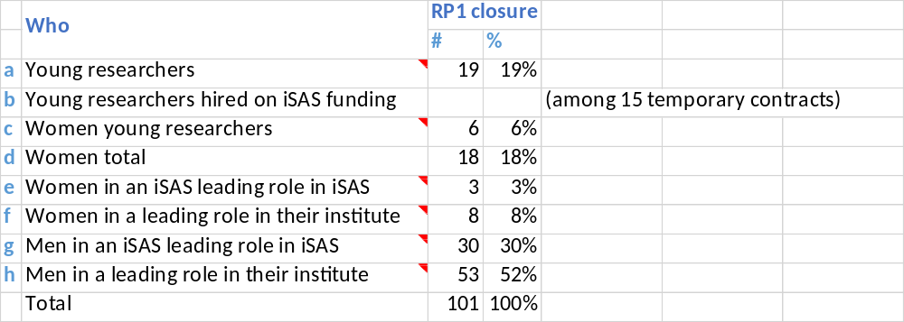
WP8 – Societal impact:
status/evolution of Task 8.1 Training & Early Career
Task 8.1 Training & Early Career
Quantitative metrics from June RP1 Review meeting
  Number of young researcher hires
      7 young researcher hires by the project as yet at EPFL, HZB, ESS, IJCLab, DESY & HZB
  Beyond online courses, young researchers hired to work for the iSAS project get an opportunity to get a hands-on continuous training on iSAS technologies and participate to their development as a new generation of researchers familiar with iSAS technologies
Quantitative metrics since June RP1 Review meeting
  Stats extracted from Researchers involved in the project for Part A table:

Slide 29
WP8 – Societal impact:
status/evolution of Task 8.2 Outreach & Dissemination
Task 8.2 Outreach & Dissemination
Quantitative metrics from June RP1 Review meeting
  Some indicators to showcase the efforts taken:
    Number of news articles written on the iSAS website
      9 as yet in external communication (plus the short-form LinkedIn posts and internal communication news articles within institutes°
    Number of news articles published in external sources about iSAS: 4
      CERN Courier
      Actus in2p3
      Alto Vincentin online
      Accelerating News (pending)
    Number of conference talks and papers in the project data repository
      27 conference talks and papers referenced as yet (papers published or accepted for publication and unpublished conference talks)

