Slide 1


iSAS Coordination panel meeting
8th Sept, 2026

Slide 2
iSAS Coordination panel meeting
Agenda
Agenda items
  Recommendations from evaluation of RP1 & progress made since
  Advisory Board recommendations from Berlin meeting follow-up
  Amendment (AMD#2) update
  Invitation to the final RF2.0 Project Meeting in Karlsruhe (18-20 Nov)
  iSAS Workplan update
  AOB
Presentation(s) available on:
iSAS project Indico page

Slide 3
Recommendations from evaluation of RP1 & progress made since
“To improve the implementation, we would recommend the following changes:
  Close monitoring of the delays affecting Work Package 6 is recommended. A detailed update on progress and mitigation measures should be provided within six months, given that these delays affect the overall project timeline and the successful achievement of the project objectives.
  While the iSAS consortium demonstrates commitment to the efficient management of intellectual property rights (IPR), it has not yet provided evidence that a formal IPR strategy has been discussed or established. The consortium is therefore advised to define such a strategy, taking into account the potential for commercial exploitation and/or the need to protect the project’s IPR, while ensuring alignment with the IP practices of all participants.
  The next Data Management Plan update should provide details on the collaboration with 2020 ESCAPE project and EOSC, as the progress in this area remained limited over the reporting period.”

Slide 4
Recommendations from evaluation of RP1 & progress made since
Evaluation closed without observations from iSAS Consortium
Formal IPR Strategy
Sept 16 meeting w/ WP7 & INFN TT office to draft a proposal for the consortium
Progress made on communication
Conference talks & publications: double publication on ArXiv
Proposal for iSAS collaborators list for the website (alphabetical order of contributors as with big collaborations in particle physics)
Mentoring programme starting Sept 2026
What is iSAS? video in progress

Slide 5
iSAS collaborators list for the website
V. Almaraz¹, J. Angot², O. Azzolini³, S. Barriere⁴, M. Baylac², C. Benjamin⁵, S. Berry⁶, S. Blivet⁷, F. Bordry⁴, F. Bouly², J. Branlard⁸, G. Burt⁹, S. Calvo⁴, K. Canderan⁴, L. Celona³, E. Chyhyrynets³, I. Curci⁶, J. D'Hondt¹⁰, P. Duchesne⁷, P. Duthil⁷, M. Eberenz⁸, P. Echevaria¹, N. Elias¹¹, F. Eozénou⁶, D. Ford³, A. Frahm¹, N. Gandolfo⁷, M. Garlasche⁴, D. Giove³, Y. Gómez-Martínez², S. Gorgi Zadeh⁴, P. Goudket¹¹, C. Joly⁷, W. Kaabi⁷, Y. Kalboussi⁶, S. Keckert¹, G. Keppel³, J. Knobloch¹², F. Kramer¹, O. Kugeler¹, M. Lazzari³, W. Leemans⁸, D. Longuevergne⁷, R. Losito⁴, A. Maalberg¹, A. Macpherson⁴, A. Madur⁶, C. Maiano¹¹, O. Malyshev⁵, M. Masullo³, G. Mauro³, P. McIntosh⁵, A. Miyazaki⁷, E. Montesinos⁴, E. Nappi³, A. Neumann¹, G. Olivier⁷, G. Olry⁷, V. Parma⁴, A. Perez-Ruiz⁷, M. Perez-Ruiz¹, T. Pieloni¹³, P. Pierini¹¹, C. Pira⁸, A. Plaçais², T. Proslier⁶, A. Prudnikava¹, H. Przybilski¹¹, G. Rosaz⁴, H. Saugnac⁷, H. Schlarb⁸, C. Schmidt⁸, M. Schuster¹, J. Schwindling⁶, D. Seal⁵, M. Seidel⁹, A. Sequi³, C. Sharp⁴, N. Shipman¹, E. Simpson¹¹, M. Skiba¹¹, G. Sorbello³, A. Stocchi⁷, D. Till⁷, M. Titov⁶ , M. Tytgat¹⁴, J. Ullrich¹, A. Ushakov¹, R. Valizadeh⁵, L. Vanhecke¹³, P. Vedrine⁶, H. Weise⁸
On behalf of the iSAS project
¹ Helmoltz Zentrum Berlin (HZB), Berlin, Germany
² Laboratoire de Physique Subatomique et de Cosmologie, Grenoble, France
³ Istituto Nazionale di Fisica Nucleare, Italy
⁴ European Organization for Nuclear Research, Geneva, Switzerland
⁵ UKRI/STFC Daresbury Laboratory, Daresbury, Warrington, UK
⁶ Commissariat à l’énergie atomique et aux énergies alternatives, Saclay, France
⁷ Laboratoire de Physique des 2 Infinis Irène Joliot-Curie, Orsay, France
⁸ Deutsches Elektronen-Synchrotron DESY, Germany
⁹ University of Lancaster, Lancaster, UK
¹⁰ National Institute for Subatomic Physics, Amsterdam, Netherlands
¹¹ European Spallation Source, Lund, Sweden
¹² University of Siegen, Siegen & HZB, Berlin, Germany
¹³ École Polytechnique Fédérale de Lausanne, Lausanne, Switzerland
¹⁴ Vrije Universiteit Brussel, Brussels, Belgium

Slide 6


Slide 7
Advisory Board recommendations
Berlin report follow up
Written response to recommendations: sent last May
Response to WP-specific review & comments: planned in an additional template slide for next Steering Committee, Oct 20

Slide 8
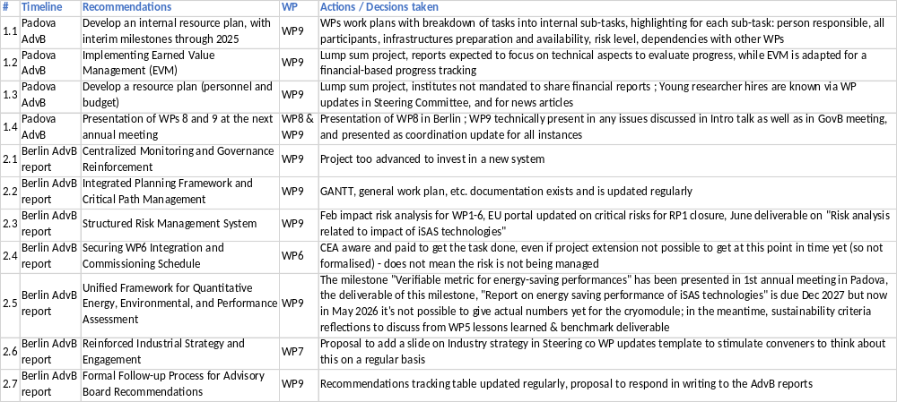
Advisory Board recommendations from Berlin meeting follow-up
Recommendations tracking table:

Slide 9
Amendment to the Grant agreement
AMD#2 in progress
List of items and justification for AMD#2 discussed with WPs & validated by the Governing Board
PO now reviewing for greenlight
Next steps: modifications into EU Portal, signature by Coordination, then EU
WP1
Budget transfer from CERN to HZB to hire young researcher at HZB (contingent on the one-year extension being granted for iSAS)
Task 1.2 to Task 1.4 transfer of roles and resources
M#2 Design ready for FE-FRT integration in 802 MHz cavity delay from M30 August 2026 to M56 Oct 2028
D#1 Report of FE-FRT integration with PERLE cavities delay from M36 Feb 2027 to M60 Feb 2029
WP2
M#6 Demonstration of energy-efficient SSA operation delay from M30 August 2026 to M34 Dec 2026 due to setting up a complete SSA test stand at DESY from scratch
Cryoelectra to withdraw, as they have not contributed as expected as a manufacturer of solid-state power amplifiers

Slide 10
AMD#2
List of items and justification for AMD#2
WP3
M#13 Report on mechanical strength test of SC coatings delay from M30 August 2026 to M36 Feb 2027 due to a cryostat upgrade
WP4
M#44 Engineering report of the fabrication of BLA delay from M30 August 2026 to M36 Feb 2027 due to delay in procurement of a 1.3 GHz BLA
WP5
D#19 Report on beam dynamics study for ERL with iSAS CM delay from M43 Sept 2027 to M48 Feb 2028 to take into account duration of PhD contract
D#18 Parametric design for a sustainable CM with iSAS techn. delay from M46 Dec 2027 to M58 Dec 2028 due to 1 year extension

Slide 11
AMD#2
List of items and justification for AMD#2
WP6
Proposed 1 year project extension until M60 Feb 2029 due to unavoidable procurement delays totalling 9 months
M#24 Assembly of adapted CM delay from M39 May 2027 to M51 May 2028
D#21 Report on test of adapted CM delay from M46 Dec 2027 to M58 Dec 2028
WP9
Budget transfer from WP6 to WP9 within CNRS budget meant to support the iSAS European Project Manager salary until the end of the project
Due to 1 year extension:
D#30 Report on energy saving performance of iSAS techn. delay from M46 Dec 2027 to M58 Dec 2028
D#31 Final reports of the achievement in the WPs delay from M48 Feb 2028 to M60 Feb 2029
M#47 Organisation of 5th & final project meeting and report added in M59 Jan 2029

Slide 12
RF2.0 invitation
Invitation to RF2.0 Project Meeting in Karlsruhe (18-20 Nov)
E2-SCALE results expected for Oct
Who might be interested to represent iSAS and present E2-SCALE?

Slide 13
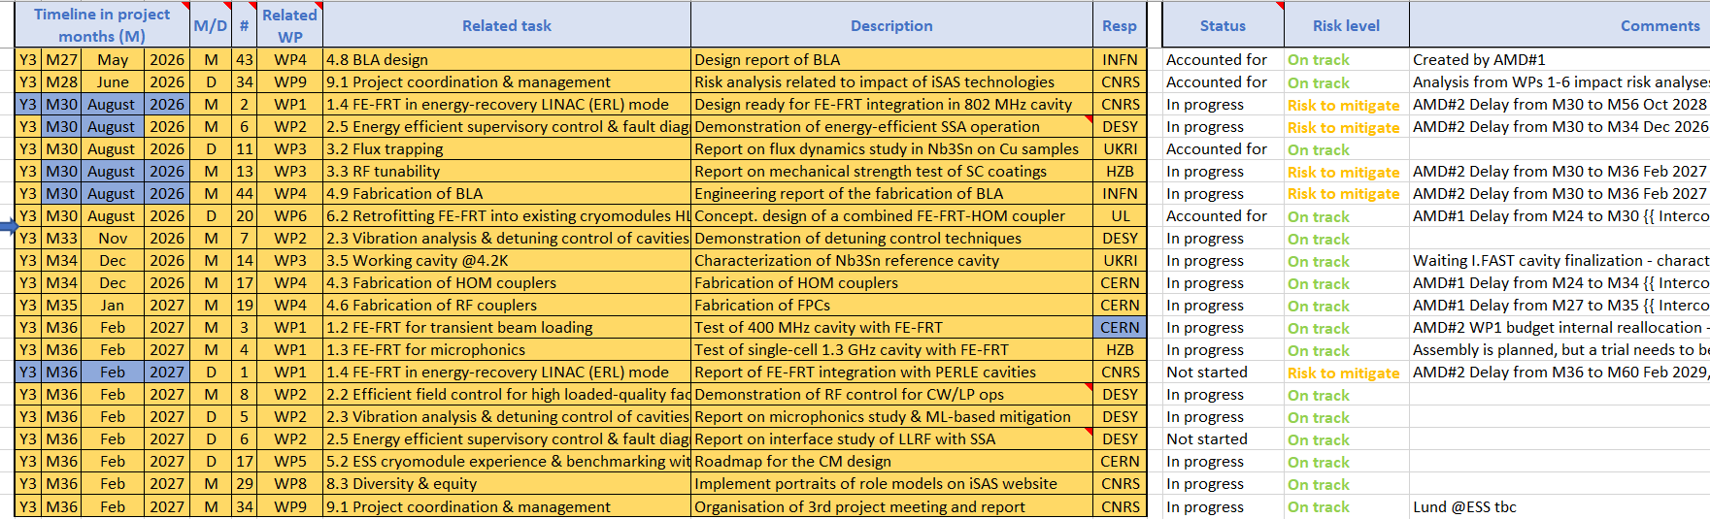
Work plan
Milestones & Deliverables status by timeline for the 3rd project year
Next milestone due Nov, on track

Slide 14
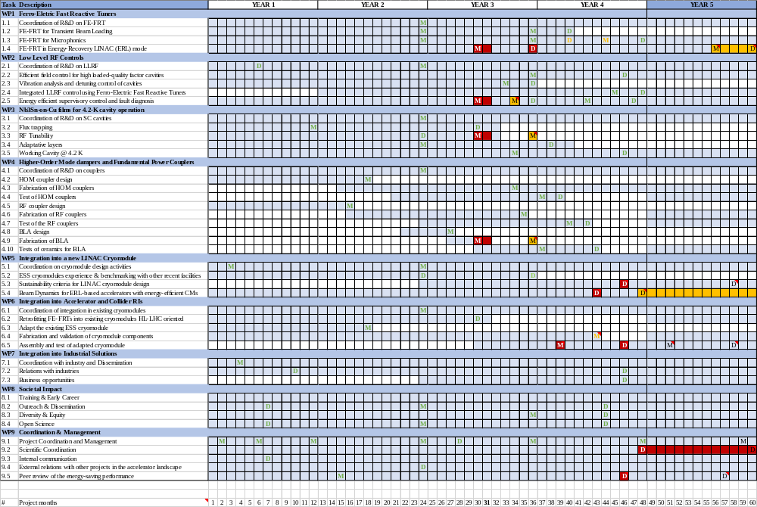

Slide 15
Upcoming related meetings
Indico page for Coordination panel - Steering committee meetings
  Coordination panel meetings
  Are expected: members of the Coordination panel (that includes ex-officio Coordination panel members, the Advisory Board & Governing Board Chairpersons)
    Sept 8 10:30-12:00 am CET
    Dec 1 10-11:30 am CET
    Feb 23 10-11:30 am CET
    May 18 10-11:30 am CET
  Steering Committee
  Are expected: members of the Steering Committee, a.k.a. WP Leaders & Deputies as well as members of the Coordination panel (that includes ex-officio Coordination panel members, the Advisory Board & Governing Board Chairpersons)
    Oct 20 10-11:30 am CET including progress status on the Advisory Board report recommendations
    Jan 12 10-11:30 am CET
    April 6 10-11:30 am CET to discuss Advisory Board recommendations post 3rd Annual meeting (tbc)
    June 29 10-11:30 am CET

Slide 16
Upcoming other meetings
iSAS project Indico page
  Advisory Board meeting
  Oct 30 10-11 am CET
  Are expected: members of the Advisory Board & of the Coordination panel
  Autumn online meeting to discuss w/ Coordination panel after progress status on the Advisory Board report recommendations has been shared in Oct 20 Steering Committee
  Governing Board meeting
  Nov 17 10-11 am CET
  Are expected: members of the Governing Board
  Autumn online meeting
  3rd annual project meeting in Lund (tbc)
  March 3-5
  Are expected: members of the iSAS Consortium, invited speakers
    Advisory board discussion – March 4
    Industry 1st review – March 5
    Governing board - March 5

Slide 17
Thank you!

Slide 18
Back up

