Slide 1


WP3
Nb₃Sn on Cu films for 4.2K cavity operation
Steering Committee Meeting
20.10.2026
Activities Update - Points of attention
All information contained in this presentation and any accompanying documents is for iSAS project only and must be treated as strictly confidential.
Any dissemination, distribution or other use of this information without the consent of its owner is prohibited.
Funded by the European Union. Views and opinions expressed are however those of the authors only and do not necessarily reflect those of the European Union or the European Commission. Neither the European Union nor the granting authority can be held responsible for them.

Slide 2
Steering Committee Jan 2025
WP3: Nb₃Sn on Cu films for 4.2K cavity operation
INFN, CEA, HZB, UKRI
Convener: Cristian Pira (INFN), Deputy O. Malyshev (UKRI)
Main contacts with other partners:
T. Proslier (CEA), O.Kugeler (HZB), O. Malyshev (UKRI), R. Valizadeh (UKRI)
Task 3.1: Coordination of R&D on SC Cavities – M1-M48
• General coordination by INFN.
Task 3.2: Flux Trapping – M1-M32
Explore new coating parameters for planar samples and small resonators to minimize flux trapping in SC A15 films.
Upgrade the STFC choke cavity and the HZB QPR to support detailed flux trapping analyses of coated SC films.
Characterize trapped flux, flux viscosity and the interaction with the RF field with SC A15 films in small resonators and planar samples with the upgraded systems.
Task 3.3: RF Tunability – M1-M32
• Explore new coating parameters on planar samples and resonators to enhance the mechanical strength in SC A15 films.
• Mechanical film-stability tests with planar samples.
• Build cavity tuning system and perform vertical cryo-tests of coated cavities to explore RF performance limits and acceptable tuning without incurring film damage.
• Devise cavity tuning schemes for Nb3Sn cavities fulfilling the required tuning parameters while taking into account the constraints of Nb3Sn. The implementation of FE-FRT to assist will be considered.
Task 3.4: Adaptative layers – M1-M40
• Develop adaptative layers by atomic layer deposition on Cu that are stable up to 650 °C.
• Compare performance Nb3Sn on Cu with and without adaptive layers on planar samples and QPR.
Task 3.5: Working Cavity @4.2 K – M1-M48
• Improve I.FAST 1.3-GHz superconducting coating recipe based on Tasks 3.2-3.4 results.
• Prepare 1.3-GHz thin film cavities with an optimized coating recipe.

Slide 3

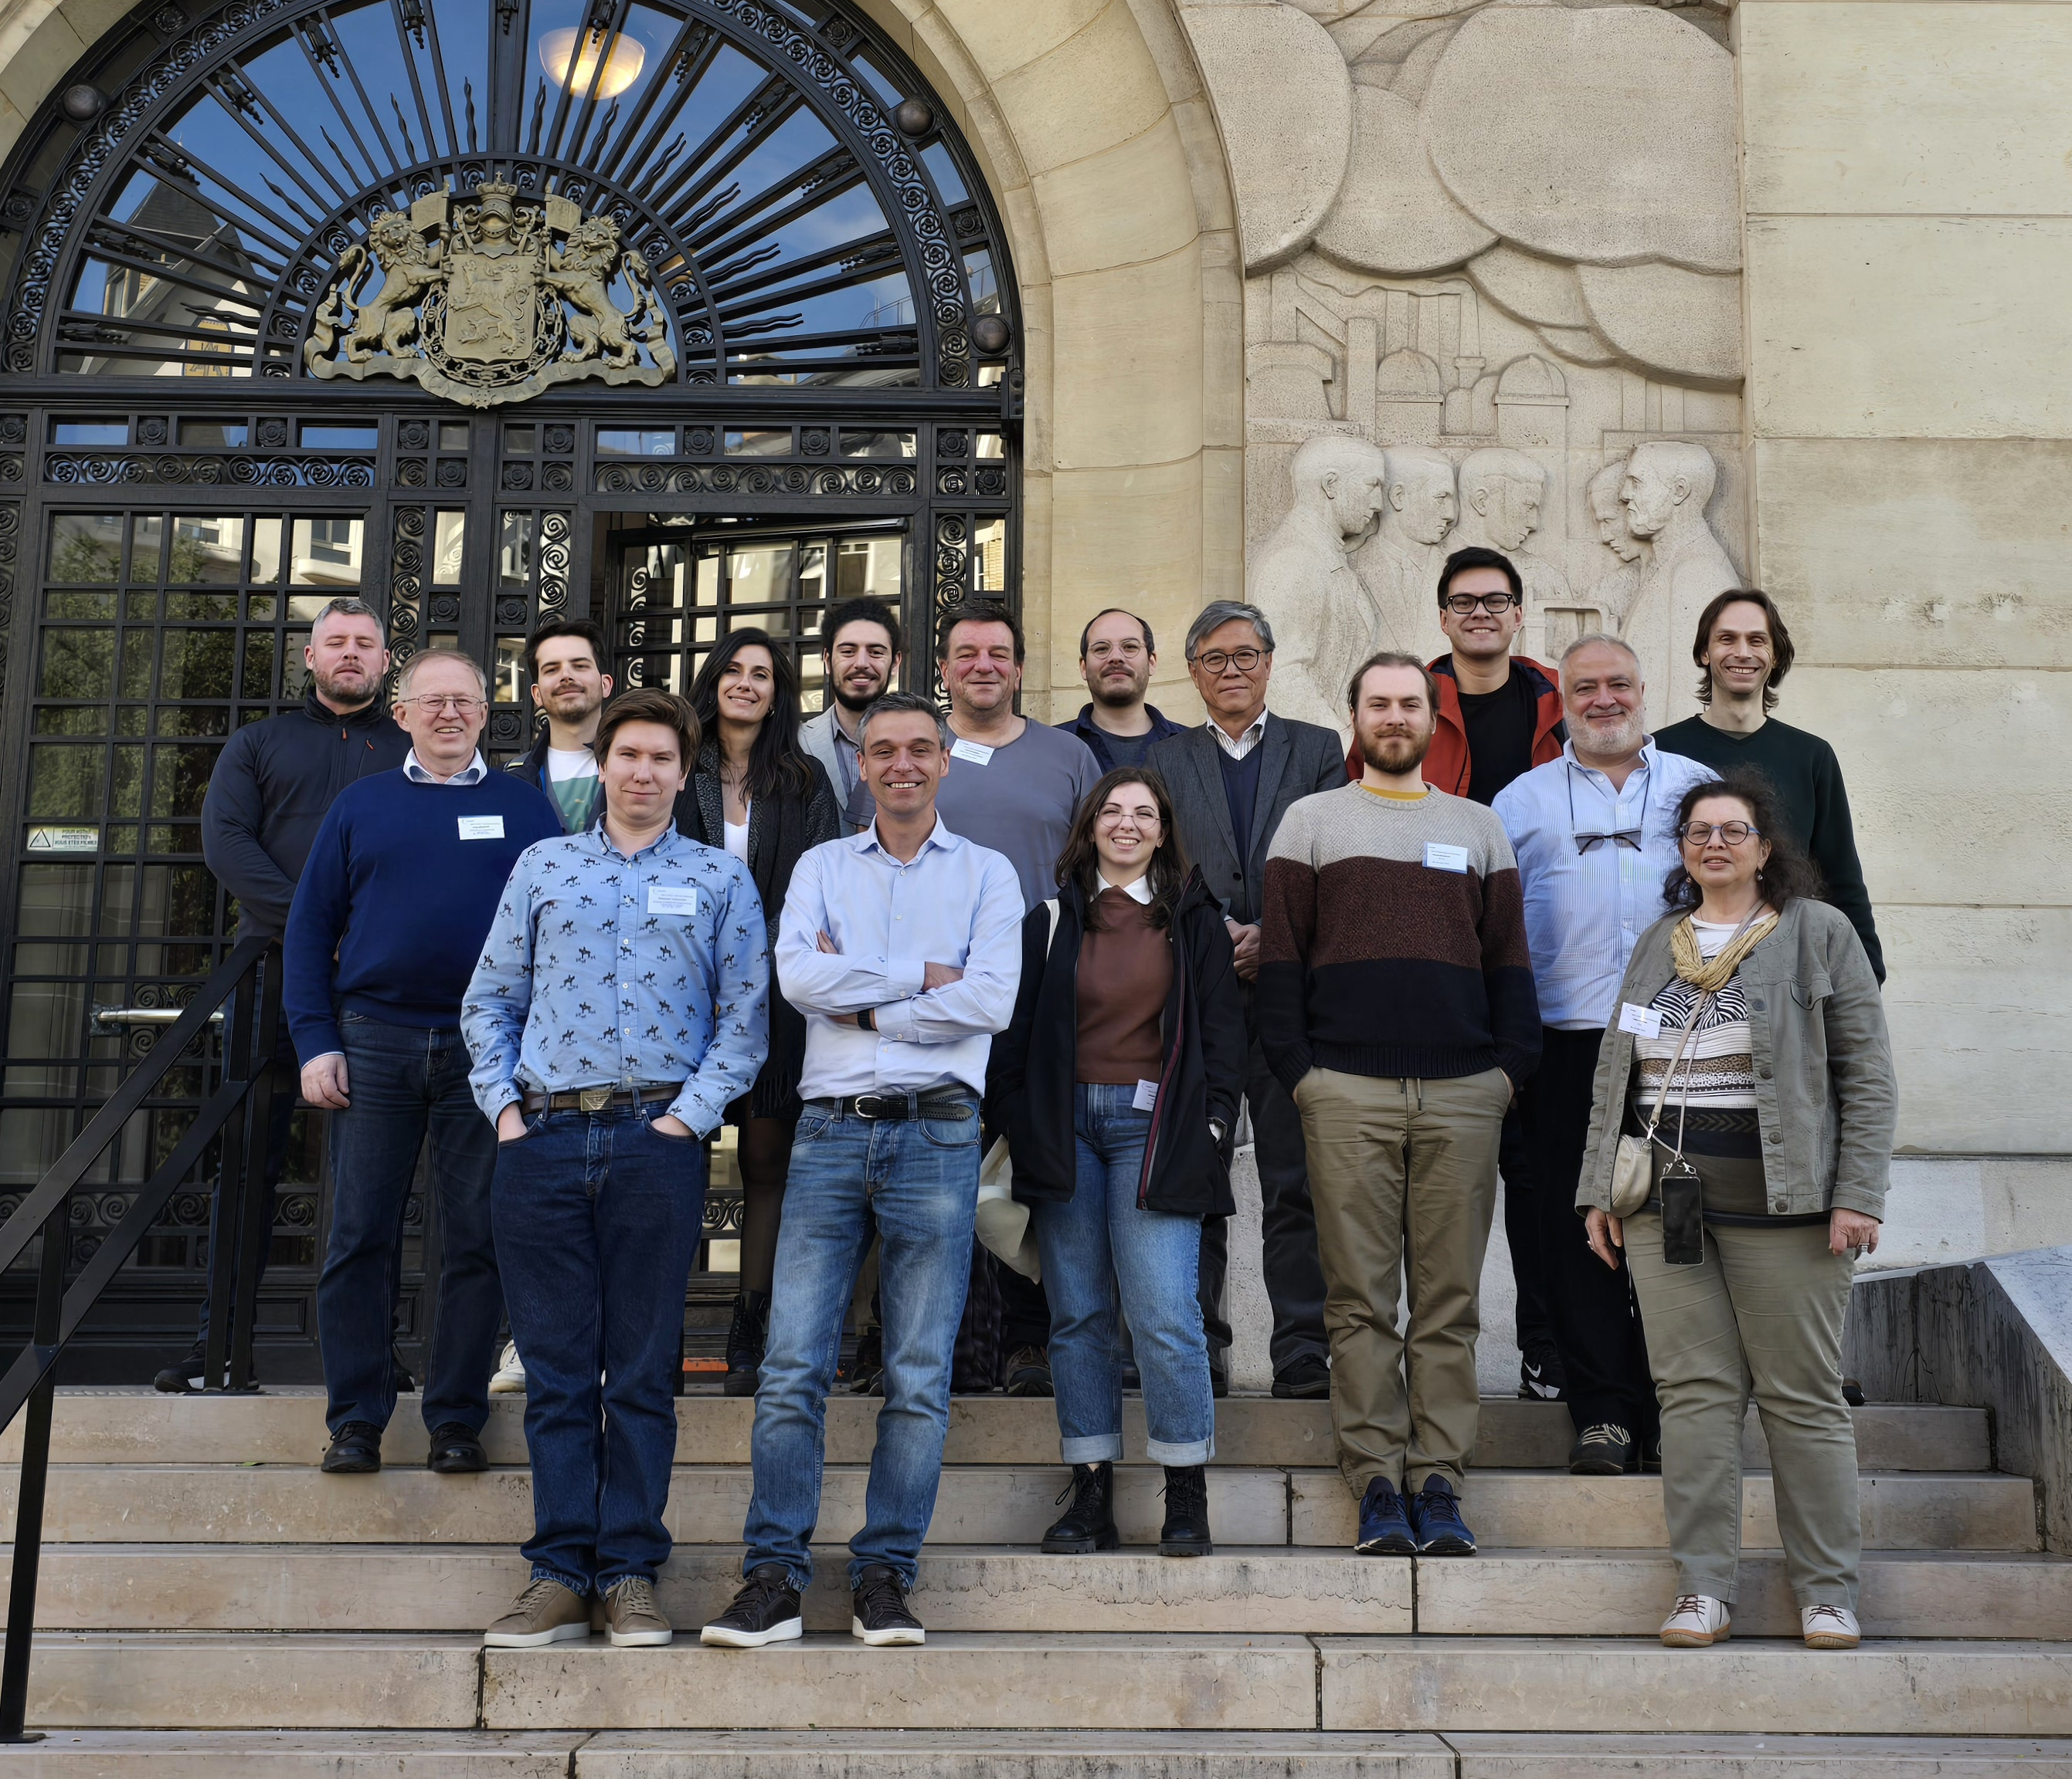

WP3 – SRF: status/evolution of Task 3.1
Coordination (INFN, CEA, HZB, UKRI) – Cristian Pira
Milestone 39 Impact risk analysis WP3 - INFN - Presentation M24
Completed
Periodic meeting (in person and online) every 2-3 months (possibly in collaboration with I.FAST → EPITA)
Zanon is joining WP3 meetings as industrial reviewer
WP3 Meeting 01 - Task leaders Pre-Kick-Off remote meeting on 21/02/2024 https://agenda.infn.it/event/40107/
WP3 Meeting 02 - Kick-Off meeting in Paris (hybrid) on 16/04/2024 (in collaboration with I.FAST WP9) https://indico.cern.ch/event/1357302/sessions/528505/#20240416
WP3 Meeting 03 - Task Leaders remote meeting on 17/07/2024 (in collaboration with I.FAST WP9) https://indico.cern.ch/event/1437516/
WP3 Meeting 04 - Hybrid meeting in Berlin on 02-03/12/2024 (in collaboration with I.FAST WP9) https://events.hifis.net/event/1875/
WP3 Meeting 05 - Annual meeting in LNL (hybrid) on 12/03/2025 https://indico.ijclab.in2p3.fr/event/11291/timetable/#20250312
WP3 Meeting 06 - I.FAST Annual meeting in Cracow (hybrid) on 08/04/2025 http://indico.cern.ch/event/1464979/timetable/#20250408.detailed
Informal update during SRF2025 Conference in Tokyo (21-26/09/2025)
WP3 Meeting 07 - Online meeting on 24/11/2025 https://indico.ijclab.in2p3.fr/event/12433/
WP3 Meeting 08 - Online meeting on 20/03/2026 https://indico.ijclab.in2p3.fr/event/13566/
WP3 Meeting 09 - Annual meeting in HZB (hybrid) on 22/04/2026 https://indico.ijclab.in2p3.fr/event/11960/timetable/#20260422
WP3 Meeting 10 - in person meeting during Thin Film SRF Workshop 2026 in Chester (21-25/09/2026)
WP3 Meeting 11 – Online Meeting in November (TBC)
ISAS WP3 kick-off Meeting in Paris

Slide 4
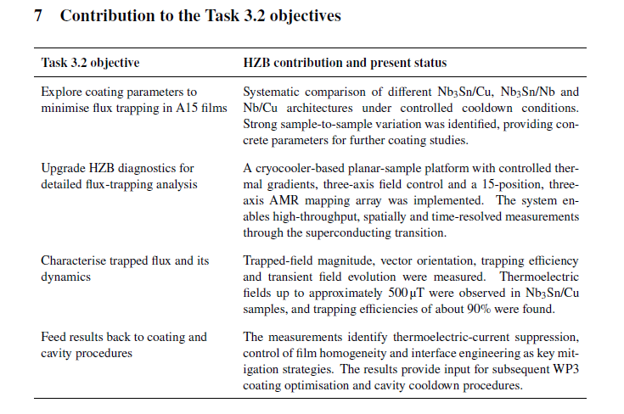
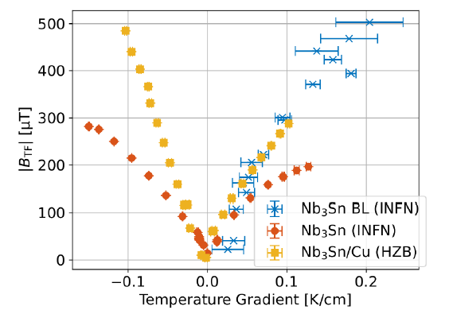
WP3 – SRF: status/evolution of Task 3.2
Flux Trapping (INFN, CEA, HZB, UKRI) – Oleg Malyshev
Milestone 3.1 Modification of choke cavity for flux trapping study - Engineering report M12
Completed
Deliverable 3.2 Flux trapping Report on flux dynamics study in Nb3Sn on Cu samples - HZB - Report M30
Completed

Slide 5
WP3 – SRF: status/evolution of Task 3.3
Tunability (INFN, CEA, HZB, UKRI) – Oliver Kugeler
Deliverable 3.1 Cavity tuning Report on implementation of cavity Q vs F tuning tool - HZB - Report M24
Completed
6 months delay requested on ISAS Amendment N.2
Milestone 3.3 Report on mechanical strength test of SC coatings - Test report M30 → M36
Delay due to a cryostat upgrade
The samples are currently being prepared and ready, as planned
Unfortunately, the cryostat at CEA, which is used for Tc and stress-strain measurements, is currently undergoing maintenance for an upgrade, and no precise date has been given for the completion of the work. We reasonably expect the cryostat to be ready within the next 3 months, but to be on the safe side, we are requesting a 6-month postponement of the milestone delivery.
This delay has no impact on the rest of the work in WP3.

Slide 6
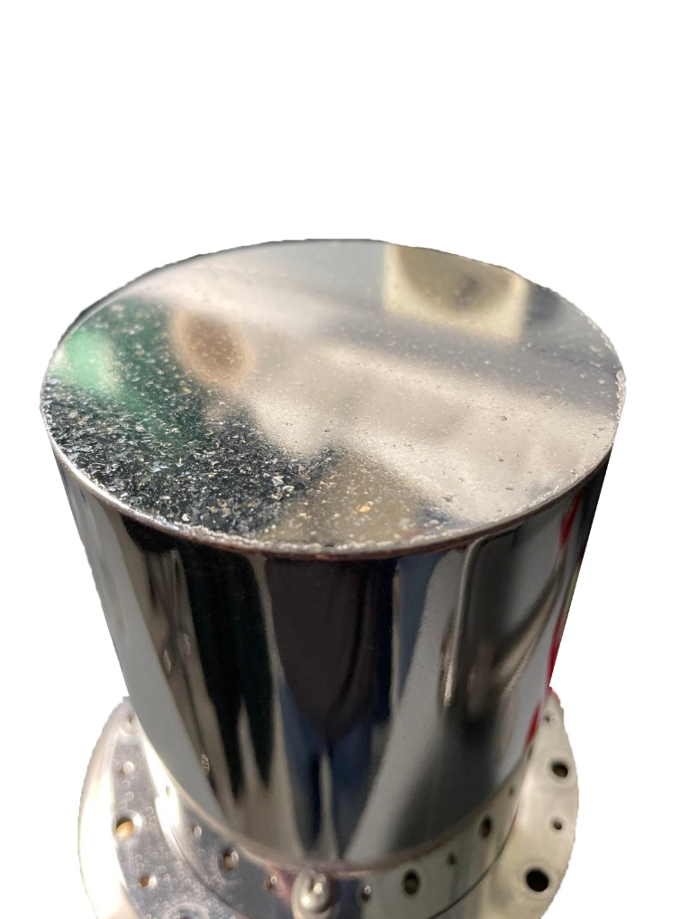
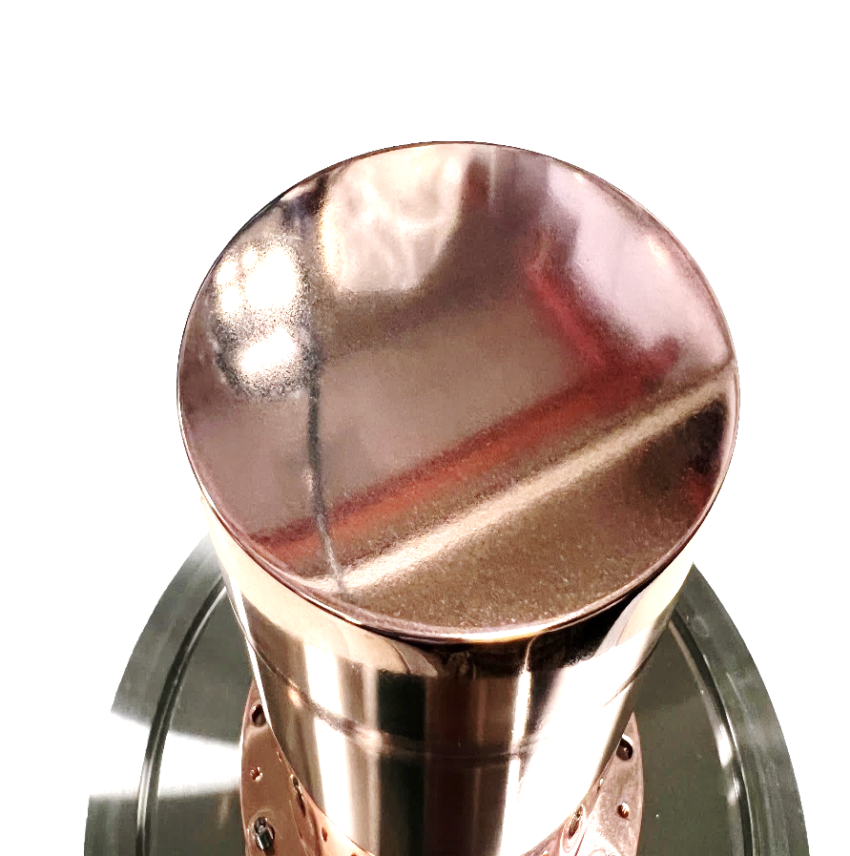
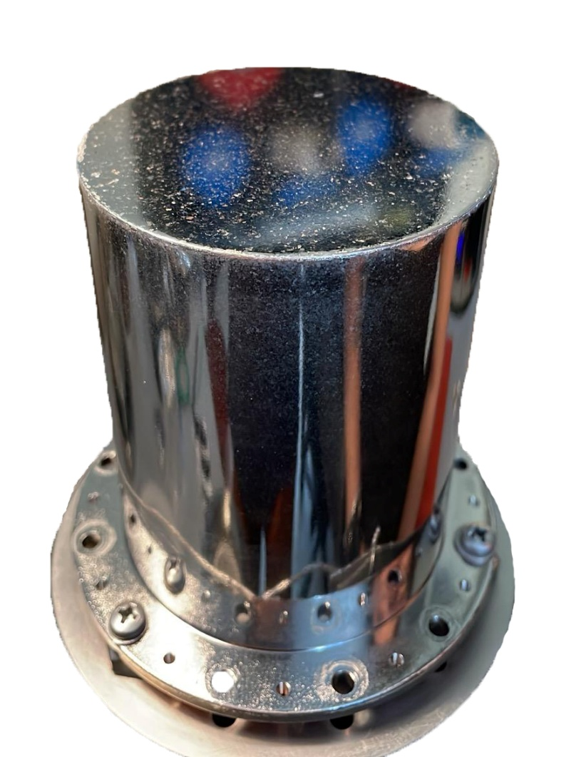
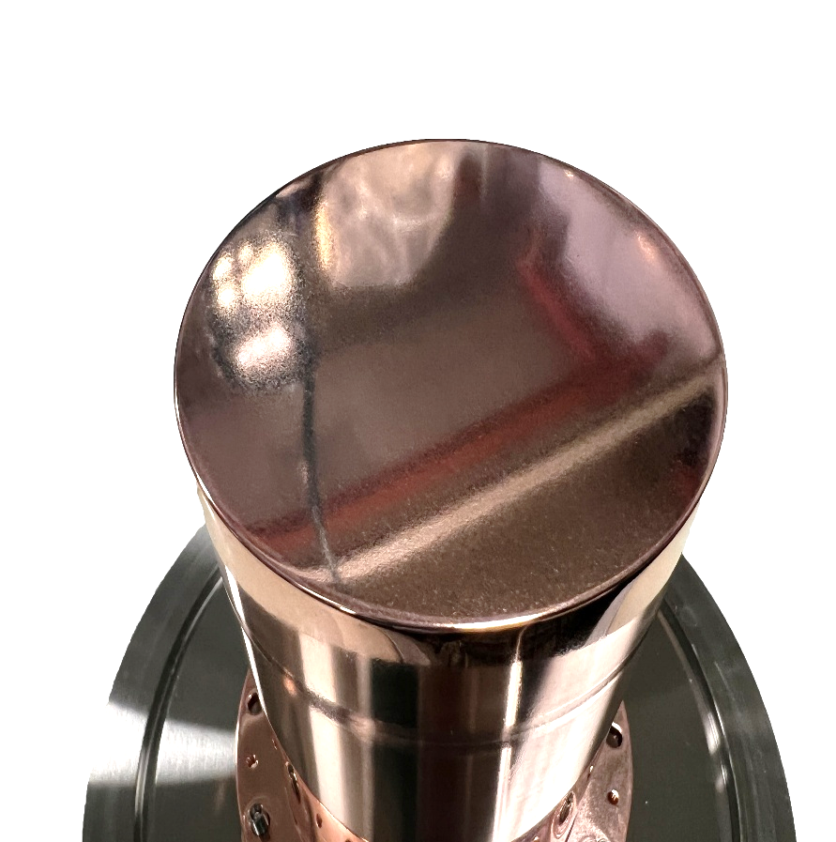
WP3 – SRF: status/evolution of Task 3.4
Adaptive Layers (INFN, CEA, HZB, UKRI) – Thomas Proslier
Milestone 3.2 Developed ALD adaptive layers on Cu - Test report M24
Completed
On track
Deliverable 3.3 Adapt. Layer Report on QPR study of Nb3Sn on Cu & adaptive layers - CEA - Report M38
Nb₃Sn coated successfully on different adaptive layers at INFN. Test ongoing
Other coating in progress (Oxide ALD adaptive layer + Nb PVD adaptive layer)
Tunneling spectroscopy measurements in progress
Nb-buffer layer
Nb₃Sn layer
ALD layer
Cu QPR

Slide 7
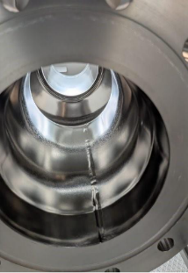
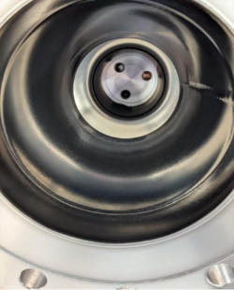
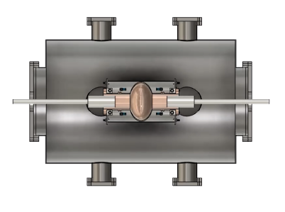
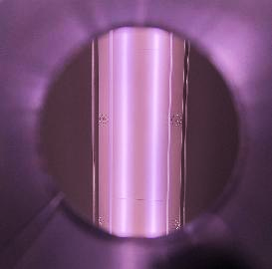
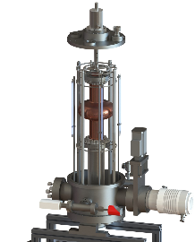
WP3 – SRF: status/evolution of Task 3.5
Working Cavity (INFN, CEA, HZB, UKRI) – Reza Valizadeh
before coating
Milestone 3.4 Characterization of Nb3Sn reference cavity - Test report M34
On track
1.3 GHz Nb cavity successfully coated with Nb₃Sn at UKRI
Tested at HZB in November
Cu contamination killed the RF performances
Cu contamination removal ongoing
Baseline Test is scheduled for December
Collaboration with JLab has started: the Nb3Sn VTD cavity will be used as the baseline
after coating
Nb3Sn Coating system @ UKRI
Deliverable 3.4 4.5-K Cavity Report on 4.5-K Cavity performance & tunability tests - INFN - Report M46
On track
@ INFN
Test ongoing
Low Tc at the moment, but rising (12 to 15 K) → coating parameter exploration phase
Design of rotating cavity system done
@ UKRI
Coating System update ongoing
Lack of personnel (Two people left STFC/UKRI)
ignited plasma
First plasma on 1.3 GHz rectangular magnetron @ LNL

Slide 8
WP3 – SRF: points of attention
Two people left STFC/UKRI: Dr. Chris Benjamin (scientist) and Mr. Liam Smith (technician). There is no recruiting at STFC in present, and it is unknown when this ban on recruiting will be lifted up.
UKRI will be still performing what has been promised for iSAS, but it may take some time to restructure our workload to fill the gaps.
The impact on Task 3.4 is significant but not critical, as INFN and UKRI are working in parallel on two different facilities (the idea was to have two conceptually different coating systems to increase the likelihood of success by exploring two different approaches simultaneously.

Slide 9
WP3 – SRF: Tasks Status
Timeline in project months (M) |  |  |  | M/D | # | Related task | Description |  | Status | Risk level
Y1 | M12 | Feb | 2025 | M | 3.1 | 3.2 Flux Trapping | Modification of choke cavity for flux trapping study |  | Done and submitted | Delivered on time
Y2 | M24 | Feb | 2026 | M | 3.2 | 3.4 Adaptive Layers | Developed ALD adaptive layers on Cu |  | Done and submitted | Delivered on time
Y2 | M24 | Feb | 2026 | D | 3.1 | 3.3 RF Tunability | Cavity tuning Report on implementation of cavity Q vs F tuning tool |  | Done and submitted | Delivered on time
Y2 | M24 | Feb | 2026 | M | 39 | 3.1 Coordination of R&D on SC Cavities | Impact risk analysis WP3 |  | Done and submitted | Delivered on time
Y3 | M30 | Aug | 2026 | D | 3.2 | 3.2 Flux Trapping | Flux trapping Report on flux dynamics study in Nb3Sn on Cu samples |  | Done and submitted | Delivered on time
Y3 | M34 | Dec | 2026 | M | 3.4 | 3.5 Working Cavity @4.2K | M3.4 Characterization of Nb3Sn reference cavity |  | In progress | On track
Y4 | M30→M36 | Feb | 2027 | M | 3.3 | 3.3 RF Tunability | Report on mechanical strength test of SC coatings |  | In progress | 6 months delay
Y4 | M38 | Apr | 2027 | D | 3.3 | 3.4 Adaptive Layers | Adapt. Layer Report on QPR study of Nb3Sn on Cu & adaptive layers |  | In progress | On track
Y4 | M46 | Dec | 2027 | D | 3.4 | 3.5 Working Cavity @4.2K | 4.5-K Cavity Report on 4.5-K Cavity performance & tunability tests |  | In progress | On track
All tasks are on track except M3.3
The delay of M3.3 is not critical, extension requested

