Slide 1


WP5:Integration into a new LINAC Cryomodule
Steering Committee meeting, 20-Oct-2026
WP Leader: Nuno Elias (ESS)
WP Deputy: Vittorio Parma (CERN)
All information contained in this presentation and any accompanying documents is for iSAS project only, and must be treated as strictly confidential.
Any dissemination, distribution or other use of this information without the consent of its owner is prohibited.
Funded by the European Union. Views and opinions expressed are however those of the authors only and do not necessarily reflect those of the European Union or the European Commission. Neither the European Union nor the granting authority can be held responsible for them.

Slide 2
WP5: Integration into a new LINAC Cryomodule
Institutes participating: ESS, CERN, IJCLAB, EPFL
Convener: Nuno Elias (ESS)
Task 5.1: Coordination on cryomodule design activities– M1-M48
• General coordination by ESS as described above.
Task 5.2: ESS cryomodules experience and benchmarking with other recent facilities– M1-M36
• Compile the lesson learned from the ESS CM testing activities, technical commissioning, and initial operation.
• Benchmarking with projects in the implementation phase (worldwide).
• Develop a roadmap to develop a new, sustainable CM design.
Task 5.3: Sustainable criteria for LINAC cryomodule design– M24-M48
• Integrate findings from the other iSAS WPs into a generic CM design.
• Explore the sustainability criteria for the design.
Task 5.4: Beam Dynamics for ERL-based accelerators with energy-efficient cryomodules – M1-M48
• Simulate the beam dynamics of ERL-based accelerators when the energy efficient CM is included.
• Study the lattice design to optimize the beam and energy saving performances.

Slide 3
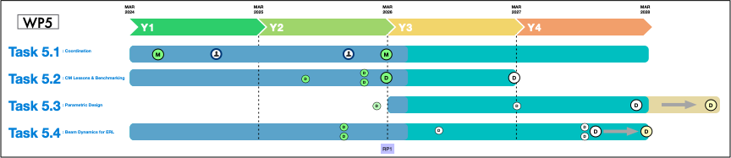
WP5 – Coordination: status/evolution of Task 5.1
Task 5.1: Coordination on cryomodule design activities– M1-M48
• General coordination by ESS as described above.
Milestone : M21 In-person WP kick-off meeting at ESS (Due date: M3 or Jun-2024)
Milestone : M42 Impact Risk analysis (Due date: M24 or Feb-2026)
Deliverable: D16 Compilation of ESS CM lessons learned & benchmarks (Due date: M24 or Feb-2026)
Deliverable: D17 Roadmap for the CM design (Due date: M36 or Feb-2027)
Deliverable: D18 Parametric design for a sustainable CM with iSAS tech. (Due date: M46 or Dec-2027)
Deliverable: D19 Report on beam dynamics study for ERL with iSAS CM (Due date: M43 or Sep-2027)

Slide 4
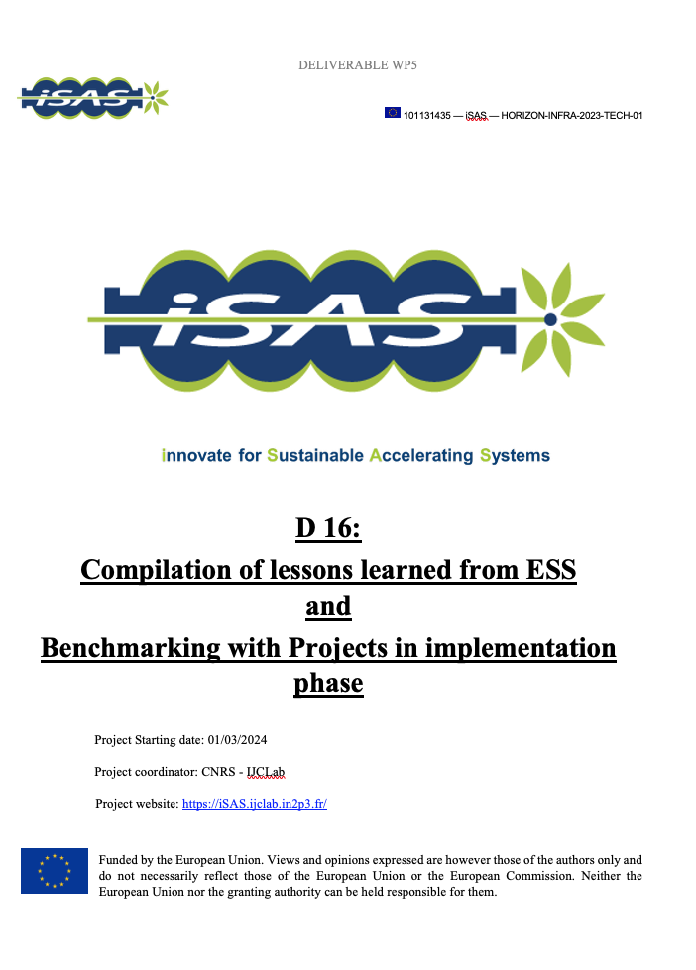
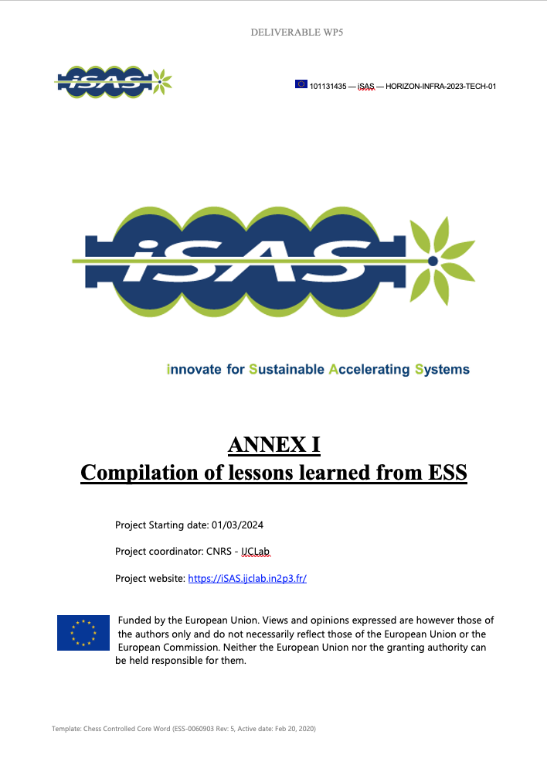
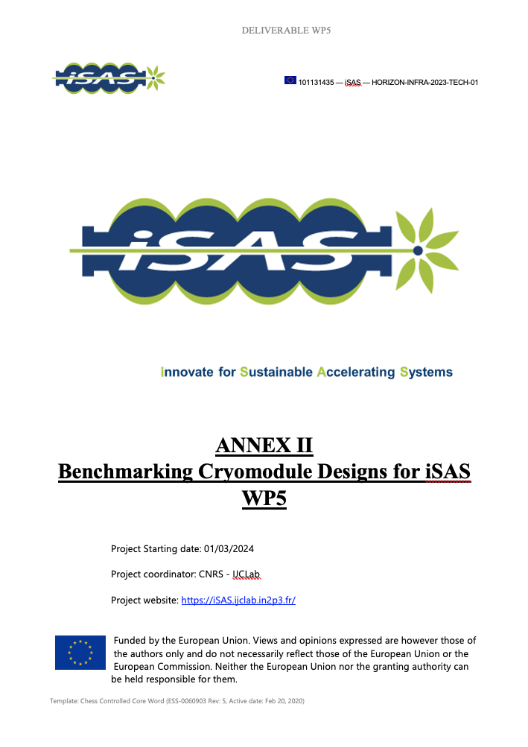
WP5 – Coordination: status/evolution of Task 5.1
Task 5.1: Coordination on cryomodule design activities– M1-M48
• General coordination by ESS as described above.
Activities
  Regular WP5 Coord.: meetings + dedicated meetings task specific (ongoing)
  Milestone 21: Completed “In-person WP kick-off meeting at ESS” :
  Milestone 42: Completed “WP5 impact Risk Analysis” :
  Deliverable 16: Completed Report “Compilation of ESS CM lessons learned
  & benchmarks from facilities in implementation phase”
    Annex I : Detailed Report on ”Compilation of Lessons Learned from ESS”
    Annex II: Detailed Report on “Benchmarking Cryomodule Designs for iSAS WP5”
  Recruitment PhD student (EPFL): Started: (Apr-2024) ; Completed (Oct-2024)
  Recruitment Junior Engineer (ESS): Started: (Mar-2025) ; Completed (Oct-2025)
  In-Person meeting at IJCLab: Workshop Prepare start of Task 5.3
Report Period 1
  Report on WP5 activities conducted up to RP1 and Meeting with Reviewers

Slide 5
WP5 – Coordination: status/evolution of Task 5.1
Task 5.1: Coordination on cryomodule design activities– M1-M48
• General coordination by ESS as described above.
WP5 Outreach, Conferences and papers
  Participation on conference Sustainability for High Energy Physics (SustainHEP), Nuno presented the goals of ISAS and specifically the work of WP5 regarding cryomodule design, “Developing a Roadmap for Sustainable Cryomodule Design”.
  Participation on International Cryogenics Engineering Conference: ICEC (Emma Simpson, Nuno Elias) paper on “Lessons Learned from the ESS Elliptical Cryomodule Design and Operation: Paving the Way for Sustainable Accelerating Systems (iSAS)”.
  Participation on International Particle Accelerators Conference: IPAC26.
  Paper “ICEC Recirculation Modelling for Energy-Recovery Linacs”, Lode Vanhecke.
  Participation on International Workshop on Advanced Beam Dynamics for Energy Recovery Linacs (ERL 2026), presented “Beam Instability studies for Future ERL-based Applications”, Lode Vanhecke.
Other points of attention
  Karin Canderan, finished her fellowship at CERN and is starting a new contract at CERN (Nov26)
  Next iSAS annual meeting at ESS (3-5Mar2027), LOC

Slide 6
WP5 (INT#1) – Design new CM: status/evolution of Task 5.2
Task 5.2: ESS cryomodules experience and benchmarking with other recent facilities– M1-M36
• Compile the lesson learned from the ESS CM testing activities, technical commissioning, and initial operation.
• Benchmarking with projects in the implementation phase (worldwide).
• Develop a roadmap to develop a new, sustainable CM design.
Task 5.2 (ESS, CNRS, CERN) – Done
  Milestone 42: Completed “WP5 impact Risk Analysis” :
  Deliverable 16: Completed Report “Compilation of ESS CM lessons learned
  & benchmarks from facilities in implementation phase”
Ongoing
Mid-project deliverable to set the roadmap for integrating the initial progress with the technology developments obtained in WP1 to 4 into a new, optimized energy-efficient CM design.
Preparation of survey meeting with Technologies WPs. Evaluation of technology readiness and maturity.
Addressing specificities/risks of each ISAS Technology, looking at different methodologies for integration in a cryomodule environment (typical constraints/ interfaces with beam physics, RF, LLRF, cryogenics, vacuum, instrumentation, cabling, alignment, WtrC/IAirC.)
Deliverable 5.1 : Compilation of ESS CM lessons learned & benchmarks (Due date: M24 or Feb-2026)
Deliverable 5.2 : Roadmap for the CM design (Due date: M36 or Feb-2027).

Slide 7
WP5 (INT#1) – Design new CM: status/evolution of Task 5.3
Task 5.3: Sustainable criteria for LINAC cryomodule design– M24-M48
• Integrate findings from the other iSAS WPs into a generic CM design.
• Explore the sustainability criteria for the design.
Task 5.3 (ESS, CNRS, CERN) – Ongoing
This task is dedicated to the main deliverable of the WP5, i.e., a parametric design of a sustainable cryomodule. Based on the developed technical roadmap and under the guidance of experts, the developments of the parametric design will be conducted.
Direct or indirect, the relevant European institutes are engaged and a continued update with WP1-4 experts will enhance the transversal integration activity.
In addition to the technical, energy-efficiency and performance criteria in the roadmap, (question on to what extent cost-efficiency to be considered). The integration of heat exchangers, thermal shields, cryogenic line, vacuum and monitoring instruments will be addressed.
Deliverable 5.3 : Parametric design for a sustainable CM with iSAS tech. (Due date: M48 or Feb-2028, extension requested for late 2028)

Slide 8
WP5 – Design new CM: status/evolution of Task 5.3
Task 5.3: Sustainable criteria for LINAC cryomodule design – M24-M48
• Integrate findings from the other iSAS WPs into a generic CM design.
• Explore the sustainability criteria for the design.
Activities: Task Started: M24 (Mar26)
  In-person workshop at IJCLAB in 28-Jan-2026, brainstorming towards parametric design (create a team)
PARAMETRIC
DESIGN for a
SUSTAINABLE
CRYOMODULE with
ISAS TECHNOLOGIES
- Which Parameters
are relevant?
- Design Drivers?
- Requirements?
- Constraints ?
- Uncertainty ?
- Energy Savings
- Main Functions
- State-of-the art
- Lifecycle
- Main Components
- Looking into the future at proposed acc. syst.
- Desired / Achievable degree of complexity?
- Availability
- Maintainability
- Repairability
- Systems Integration
- Best Practices
- Quantification of gains
- Systems Engineering approach
- Industrial Solutions?
- Design Dilemmas
Main Ongoing Activity : Exhaustive Mapping of: how requirements/constraints shape final cryomodule design architecture and integration solutions (Beam, RF, Cryo, Machine goals, Machine architecture, etc)

Slide 9
WP5 (INT#1) – Design new CM: status/evolution of Task 5.4
Task 5.4: Beam Dynamics for ERL-based accelerators with energy-efficient cryomodules – M1-M48
• Simulate the beam dynamics of ERL-based accelerators when the energy efficient CM is included.
• Study the lattice design to optimize the beam and energy saving performances.
Task 5.4 (EPFL, CNRS, CERN) – ONGOING
The beam dynamics study includes collaborations with leading research groups across Europe. ERL-specific beam dynamics effects using dedicated simulations to study the impact of the new sustainable SRF system on the beam quality, the attainable intensity and the efficiency of energy recovery in a quantitative way.
The study aims to identify the most relevant beam dynamics effects in ERL mode including the new iSAS technologies.
Thereafter, realistic lattice parameter sets are developed for specific research applications of ERL-based accelerators that will allow to specify the tolerances and acceptable HOM amplitudes.
These results will help in the development of efficiency-optimized ERL-based accelerators. The results also set limits on the required HOM damping for the cryomodule that will be designed in this work package and feed back into the HOM design criteria in WP4.
Deliverable 5.4 : Report on beam dynamics study for ERL with iSAS CM (Due date: M42 or Oct-2027)
extension requested for Feb 2028

Slide 10
WP5 (INT#1) – Design new CM: status/evolution of Task 5.4
Task 5.4: Beam Dynamics for ERL-based accelerators with energy-efficient cryomodules – M1-M48
• Simulate the beam dynamics of ERL-based accelerators when the energy efficient CM is included.
• Study the lattice design to optimize the beam and energy saving performances.
Task 5.4 (EPFL, CNRS, CERN) – Latest Activities
Beam dynamics: benchmark of developed recirculation model (comparing the PEARL lattice optics) with codes like BMAT and MAD-X, showing strong agreement (transverse beta function and transverse beam size).
Current threshold (on instabilities and bbu) studies on the PEARL lattice using higher-order modes (HOMs) indicate that the dominant threshold mode heavily depends on the lattice itself rather than just the cavity, finding a threshold current value around 0.43.
Simulations on misalignments showed that transverse and angular misalignments do not significantly affect the current threshold, though longitudinal (bunches see different phases) misalignments require careful handling.
Low-level RF (LLRF) implementation successfully compensates for beam loading transients during simulation, and ongoing work includes expanding bunch parameters (bunch charges and bunch current), studying microphonics, and exploring BBU mitigation techniques.
Deliverable 5.4 : Report on beam dynamics study for ERL with iSAS CM (Due date: M48 or Feb-2028)
extension requested for Feb 202

Slide 11
WP5 : progress to take into account
Advisory Board recommendations
Recommendations from Advisory Board
  WP5 is both innovative and strategically important, as it integrates the technological advances from other work packages into a coherent cryomodule design. The effort to define sustainability criteria through a structured survey is particularly valuable. (Done and Addressed in Task 5.2, benchmarking)
  However, the current approach remains largely qualitative, and it is not yet clear how the results of the survey will translate into concrete design decisions. The IAB therefore recommends strengthening the quantitative dimension of the analysis, including the use of well-defined performance indicators.
  In addition, aspects related to reliability and availability, such as mean time between failures (MTBF) and mean time to repair (MTTR), should be more explicitly incorporated into the evaluation framework.
  Safety considerations should also be integrated from the early stages of the design process.
Addressing Recommendations
  Concluding on precise MTBF values is extremely difficult because failure rates are heavily influenced by manufacturing quality, assembly, and the specific cryomodule configurations across different facilities (no clear link to the technology choice, as most facilities reported effort to minimize risks during the design phase).
  Instead, the strategy shifts toward minimizing Mean Time to Repair (MTTR) by allowing component repairs inside the tunnel.
  This approach includes features like access ports for servicing cold tuning systems and planning for coupler exchanges using mobile clean rooms. It also relies on rigorous quality assurance and testing to prevent leaks in welds and joints within the cryogenic distribution system.
  Thus, a purely quantitative MTBF analysis is not feasible due to the variety of designs/implementations across facilities.
  Given rhe current stage of development of new technologies, and the significant influence of manufacturing processes and installation quality on failure rates, therefore, the strategy focuses on robust maintainability features MTTR.

