Slide 1


WP8: Societal impact
Steering Committee meeting,
Oct 20, 2026
All information contained in this presentation and any accompanying documents is for iSAS project only, and must be treated as strictly confidential.
Any dissemination, distribution or other use of this information without the consent of its owner is prohibited.
Funded by the European Union. Views and opinions expressed are however those of the authors only and do not necessarily reflect those of the European Union or the European Commission. Neither the European Union nor the granting authority can be held responsible for them.

Slide 2
WP8: Societal impact
CNRS
Convener: Adèle de Valera (CNRS)
Main contacts with other partners: Nicholas Shipman (HZB)
WP8 Main goal
The iSAS method of achieving societal impact has four main directions:
Training & Early Career
  Essential actions to ensure that a new generation of highly skilled accelerator researchers in academic and industrial sectors are trained in the iSAS energy-saving technologies
Outreach & Dissemination
  Communication actions within society for a better acceptance of new technologies
Diversity & Equity
  Crucial actions to attract more women and other less-represented populations to the accelerator science community, which is currently highly unbalanced in terms of diversity
Open Science
  Decisive actions with partners in academia and industry to establish an open access collaboration on technologies that respects intellectual property and to achieve the ambition of iSAS to expedite the development and deployment of energy-saving technologies

Slide 3
WP8: Societal impact
CNRS
Convener: Adèle de Valera (CNRS)
Main contacts with other partners: Nicholas Shipman (HZB)
Task 8.1: Training & Early Career – M1-M48
• Train early career and industrial researchers in the development and operation of iSAS technologies.
Task 8.2: 8.2 Outreach & Dissemination – M1-M48
• To gain widespread acceptance for our deliverables, inform the community about our efforts to make
accelerator systems more sustainable from an energy consumption point of view.
Task 8.3: Diversity & equity – M1-M48
• The accelerator world suffers from a lack of diversity and therefore actions are taken to raise awareness and to
attract more diverse scientists to accelerator physics.
Task 8.4: Open science – M1-M48
• Developed a Data Management Plan and an Open Access platform.

Slide 4
WP8 – Societal impact:
status/evolution of Task 8.1 Training & Early Career
Past developments
  Feasibility study
    New online courses to create
      Phase 1 to develop iSAS tech
      Phase 2 to use iSAS tech
      & hands-on training during validation phase
Current developments
  Reminder for volunteers who already have teaching materials on iSAS topics

Slide 5
WP8 – Societal impact:
status/evolution of Task 8.2 Outreach & Dissemination
Past developments
  D#33 Creation of a Dissemination & Exploitation Plan
  Creation of iSAS logo
  Promotional mug with logo created & distributed
  Database of disseminating actions, updated regularly
  Conference Coordinator nominated, Nicholas Shipman to manage publications arising from the iSAS project
  Database of conference papers in the project data repository, created and updated regularly
  News items written on iSAS website, interviews for specialised publications
  M#27 First update of iSAS D&E plan
  Participation to ESSRI'26 (Sept 30): Maud Baylac posted on LinkedIn
Current developments
  FCC news article in progress at IJCLab com' team: mention of iSAS & website to be added
  Interview of Walid Kaabi for E2-SCALE submission: on hold until E2-SCALE Oct submission results
  Accelerating news article to be published in Dec edition, by Maud Baylac
  What is iSAS? Video: 45' rushes of Achille interview 1st, to get a sense of how to intersect w/ other participants in early Dec

Slide 6
WP8 – Societal impact:
status/evolution of Task 8.3 Diversity & equity
Past developments
  Genera General Assembly in Sept 2025 in Limerick
    The iSAS Consortium has been represented, to discuss among other topics the new network MoU
    MoU signed
  M#29 Implement portraits of role models on iSAS website, due M36 Feb 2027: 3 portraits published
Current developments
  Mentoring programme
    Flyer done
    News article done
    Potential mentors & mentees not already volunteers within consortium contacted w/ flyer
    Round table to discuss mentoring experience at next annual meeting in Lund
  Genera General Assembly, Oct 7-9, 2026, Vilnius
    Best practice sharing

Slide 7
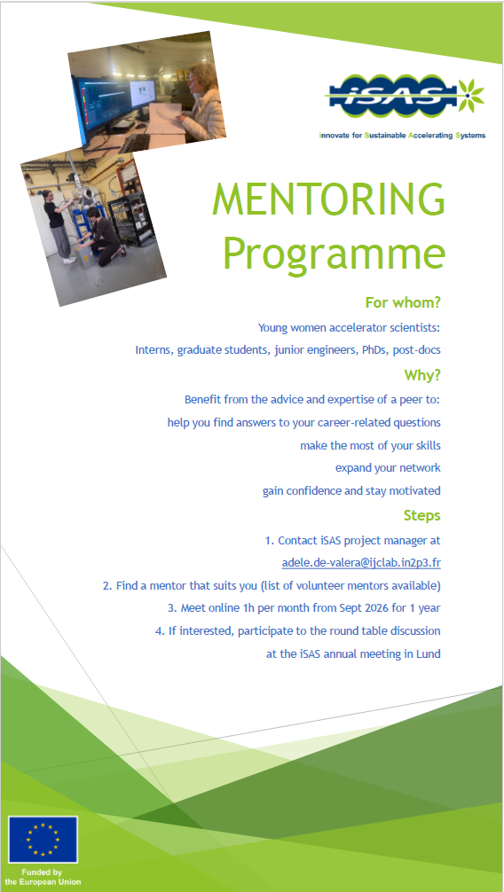

Slide 8
WP8 – Societal impact:
status/evolution of Task 8.4 Open science
Past developments
  D#25 Development of a data management plan (DMP)
    Specifies expectations in terms of data types & formats, volume, storage, access rights, security
  M#28 Update of the DMP
  Deliverables published on Cordis after validation from RP1 evaluation
  Conference talks & publications: available through the website, Indico, repository & double publication on ArXiv
Current developments
  List of iSAS contributors for the website: published after checking w/ GB members & concerned
  Reminder to add the right EU logo on all publications
  Reminder to double any publication on ArXiv

Slide 9
WP8 – Societal impact:
status/evolution of Task 8.4 Open science
iSAS Contributors
On the iSAS website
On behalf of the iSAS project
V. Almaraz[1], J. Angot[2], C. Antoine[3], O. Azzolini[4], S. Barriere[5], M. Baylac[2], N. Belouchrani[6], C. Benjamin[7], S. Berry[3], S. Blivet[6], F. Bordry[5], F. Bouly[2], J. Branlard[8], G. Burt[9], S. Calvo[5], K. Canderan[4], L. Celona[4], E. Chyhyrynets[4], I. Curci[3], A. De Valera[6], J. D'Hondt[10], M. Dissanayake[9], P. Duchesne[6], P. Duthil[6], M. Eberenz[8], P. Echevarria[1], J. Einstein-Curtis [8], N. Elias[11], F. Eozénou[3], D. Fonnesu[4], D. Ford[4], A. Frahm[1], N. Gandolfo[6], M. Garlasche[5], D. Giove[4], Y. Gómez-Martínez[2], S. Gorgi Zadeh[5], P. Goudket[11], H. Jiang[9], C. Joly[6], W. Kaabi[6], Y. Kalboussi[3], S. Keckert[1], G. Keppel[4], J. Knobloch[12], F. Kramer[1], O. Kugeler[1], M. Lazzari[4], W. Leemans[8], D. Longuevergne[6], R. Losito[5], A. Maalberg[1], A. Macpherson[5], A. Madur[3], C. Maiano[11], O. Malyshev[7], M. Masullo[3], G. Mauro[4], P. McIntosh[7], A. Miyazaki[6], E. Montesinos[5], E. Nappi[4], A. Neumann[1], G. Olivier[6], G. Olry[6], V. Parma[5], A. Perez-Ruiz[6], M. Perez-Ruiz[1], T. Pieloni[13], P. Pierini[11], C. Pira[4], A. Plaçais[2], T. Proslier[6], A. Prudnikava[1], H. Przybilski[11], H. Saugnac[6], H. Schlarb[8], C. Schmidt[8], M. Schuster[1], J. Schwindling[3], D. Seal[7], M. Seidel[9], C. Sharp[5], N. Shipman[1], S. Simon[7], E. Simpson[11], M. Skiba[11], G. Sorbello[4], P. Spruzzola[4], A. Stocchi[6], D. Till[6], M. Titov[3] , M. Tytgat[14], J. Ullrich[1], A. Ushakov[1], R. Valizadeh[7], R.VallCorba Carbonell[3], L. Vanhecke[13], P. Vedrine[3], H. Weise[8]
Academic partners cited
[1] Helmoltz Zentrum Berlin (HZB), Berlin, Germany
[2] Laboratoire de Physique Subatomique et de Cosmologie, Grenoble, France
[3] Commissariat à l’énergie atomique et aux énergies alternatives, Saclay, France
[4] Istituto Nazionale di Fisica Nucleare, Italy
[5] European Organization for Nuclear Research, Geneva, Switzerland
[6] Laboratoire de Physique des 2 Infinis Irène Joliot-Curie, Orsay, France
[7] UKRI/STFC Daresbury Laboratory, Daresbury, Warrington, UK
[8] Deutsches Elektronen-Synchrotron DESY, Germany
[9] University of Lancaster, Lancaster, UK
[10] National Institute for Subatomic Physics, Amsterdam, Netherlands
[11] European Spallation Source, Lund, Sweden
[12] University of Siegen, Siegen & HZB, Berlin, Germany
[13] École Polytechnique Fédérale de Lausanne, Lausanne, Switzerland
[14] Vrije Universiteit Brussel, Brussels, Belgium

Slide 10
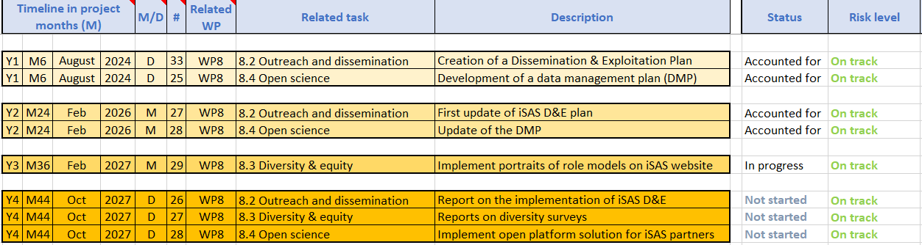
WP8 – Societal impact:
WP8 Work plan update
WP8 Work plan update
Full update attached in Indico page for Steering Committee, Oct 20

Slide 11
WP8 – Societal impact: progress to take into account
Advisory Board recommendations
Progress to take into account Advisory Board recommendations
  “A unified, coherent, and more user-friendly site should therefore be considered a priority”
    Improvements have been made, but still room for ameliorations, and focus is still on improvements
  “establishing a single consolidated website with a clearly visible and dedicated “Industry” section”
    If you click on “Industrial section” on the iSAS website menu, it redirects you to the INFN hosted Industrial section of the website, and if you click on the iSAS logo from the INFN site, it redirects you to the main iSAS website
  “providing direct access on the project website to all publications and presentations would significantly enhance visibility and usability of project outputs”
    Project Indico page, data repository, conference talks, proceedings, papers accessible from website
  “In addition, publishing the results of the WP5 survey would add value by making stakeholder feedback more widely accessible and reusable”
    Published on Indico as well as on Cordis
  “definition of a limited set of measurable impact indicators”
    Verifiable metric for energy-saving performances set indicators in May 2025, they will be monitored (1st update expected for March 2027 annual meeting in Lund), and results published in Report on energy saving performance of iSAS techn. due in Dec 2027 but prob. 2028 if project extension granted
  “highlight not only scientific outputs but also the human dimension of the project, in particular its role in training and supporting young scientists”
    Mentoring programme will be discussed in round-table in annual meeting in Lund, and hopefully broadened, noted that more communication efforts should focus on iSAS supporting young accelerator scientists – for now, a selection of indicators have been quoted in RP1 report to quantify iSAS societal impact

Slide 12
WP8 – Societal impact: plans to achieve milestones & deliverables
Milestones & deliverables on track?
  Yes
Plans to achieve milestones & deliverables
  Cooperation with Task leaders or other WP(s) to be reactivated? 8.1 Training & early career
  Delay risks to be anticipated? N/A
  Risk mitigation measures to be implemented? N/A
  Any risks realized to share? N/A
  Any new risks emerged to share? N/A

Slide 13
WP8 – Societal impact: conference talks, proceedings, publications
Conference talks, proceedings, publications
  Any news to communicate? Cf. 8.2, 8.3, 8.4
  Any participation to a conference to share? N/A
  Any publications to share (w/ the EU logo as in slide 1 & available on ArXiv)? N/A

Slide 14
WP8 – Societal impact:
young researcher hires, changes in WP composition
Young researcher hires, changes in WP composition
  Any participants changed responsibilities? N/A
  Any new participants to the WP? N/A
  Any hires on iSAS budget? N/A

Slide 15
WP8 – Societal impact: ideas for connections to industry
Ideas for connections to industry
  Any contacts with industry to share? N/A
  Any opportunities raised to share? N/A

Slide 16
Thank you!

Slide 17
Back up

Slide 18
WP8 – Societal impact:
status/evolution of Task 8.1 Training & Early Career
Task 8.1 Training & Early Career
Number of young researcher hires
    7 young researcher hires by the project as yet at EPFL, HZB, ESS, IJCLab, DESY & HZB
Beyond online courses, young researchers hired to work for the iSAS project get an opportunity to get a hands-on continuous training on iSAS technologies and participate to their development as a new generation of researchers familiar with iSAS technologies

Slide 19
WP8 – Societal impact:
status/evolution of Task 8.2 Outreach & Dissemination
Task 8.2 Outreach & Dissemination
Quantitative metrics
  Some indicators to showcase the efforts taken:
    Number of news articles written on the iSAS website
      9 as yet in external communication (plus the short-form LinkedIn posts and internal communication news articles within institutes°
    Number of news articles published in external sources about iSAS: 4
      CERN Courier
      Actus in2p3
      Alto Vincentin online
      Accelerating News (pending)
    Number of conference talks and papers in the project data repository
      27 conference talks and papers referenced as yet (papers published or accepted for publication and unpublished conference talks)

Slide 20
WP8 – Societal impact:
status/evolution of Task 8.3 Diversity & equity
Task 8.3 Diversity & equity
Genera network
  The European Genera network coordinator was consulted during the development of the iSAS project to shape the Diversity and equity task.
  The network, including among its partners DESY, CERN, ESS, INFN & the French National Institute of Nuclear and Particle Physics (IN2P3), has been joined by the iSAS Consortium in order to support its Diversity and equity work via tools and feedback.
  On the basis that gender diverse teams improve collective intelligence and research performance, the objectives of this network are, among others: to support, coordinate and improve EDI in physics research organisations, to establish a community of practice to support EDI progress within the Network’s institutions.

Slide 21
WP8 – Societal impact:
status/evolution of Task 8.4 Open science
Task 8.4 Open science
Beyond what has been planned in the Data Management Plan (DMP) and its subsequent update, concrete steps have been taken to ensure the open access of the project results
To make sure the project data is easy to access, the link to the project data repository is available via the iSAS website as well as via the project Indico page
Deliverables are accessible in the project data repository, and shared widely once the review is done
The Verifiable metric for energy-saving performances and the Compilation of ESS CM, lesson learned & benchmarks, two of the main outcomes for the iSAS sustainability criteria framework are referenced and accessible in ArXiv, an open-access archive for nearly 2.4 million scholarly articles in the fields of physics among others. They are regularly quoted in conference talks and papers, so the source was to be found as easily as possible
Publications are submitted under a Creative commons 4.0 license, with the Physical Review Accelerators and Beams, a trusted open access journal for significant developments in accelerator science, technology, and applications, or the Joint Accelerator Conferences Website (JACoW), an international collaboration that publishes proceedings for accelerator conferences around the world

