Slide 1


iSAS Steering Committee meeting,
Coordination update
20th Oct, 2026

Slide 2
iSAS Steering Committee meeting
Coordination update
Agenda
Agenda items
  Recommendations from evaluation of RP1 & progress made since
  Advisory Board recommendations from Berlin meeting follow-up
  Amendment (AMD#2) update
  Update on the Verifiable metric for energy-saving performances
  Presentation of E2-SCALE to the final RF2.0 Project Meeting in Karlsruhe (18-20 Nov)
  iSAS Workplan update
  Upcoming meetings
  AOB
Presentation(s) available on:
iSAS project Indico page

Slide 3
Recommendations from evaluation of RP1
& progress made since
“To improve the implementation, we would recommend the following changes:
  Close monitoring of the delays affecting Work Package 6 is recommended. A detailed update on progress and mitigation measures should be provided within six months, given that these delays affect the overall project timeline and the successful achievement of the project objectives.
  While the iSAS consortium demonstrates commitment to the efficient management of intellectual property rights (IPR), it has not yet provided evidence that a formal IPR strategy has been discussed or established. The consortium is therefore advised to define such a strategy, taking into account the potential for commercial exploitation and/or the need to protect the project’s IPR, while ensuring alignment with the IP practices of all participants.
  The next Data Management Plan update should provide details on the collaboration with 2020 ESCAPE project and EOSC, as the progress in this area remained limited over the reporting period.”

Slide 4
Recommendations from evaluation of RP1
& progress made since
Evaluation closed without observations from iSAS Consortium
Formal IPR Strategy
Sept 16 meeting w/ WP7 & INFN Technology Transfer Office
1st draft on Oct 1st proposed by INFN TT Officer, reviewed by IJCLab TT Officer
Soon to be shared to the iSAS Consortium for approval

Slide 5
Advisory Board recommendations from Berlin meeting follow-up
Berlin report follow up
Written response to recommendations: sent last May
Response to WP-specific review & comments: progress made shared by each WP (dedicated template slide for Steering Committee updates)
Discussions with Coordination panel in mid-term Advisory Board meeting on Oct 30

Slide 6
Amendment to the Grant agreement
AMD#2 in progress
List of items and justification for AMD#2 discussed with WPs & validated by the Governing Board
PO now reviewing for greenlight
Modifications into EU Portal in parallel
Next steps: signature by Coordination, then EU
WP1
Budget transfer from CERN to HZB to hire young researcher at HZB (contingent on the one-year extension being granted for iSAS)
HZB added as contributor for Task 1.4 (the lead remains with CNRS)
M#2 Design ready for FE-FRT integration in 802 MHz cavity delay from M30 August 2026 to M56 Oct 2028
D#1 Report of FE-FRT integration with PERLE cavities delay from M36 Feb 2027 to M60 Feb 2029
WP2
M#6 Demonstration of energy-efficient SSA operation delay from M30 August 2026 to M34 Dec 2026 due to setting up a complete SSA test stand at DESY from scratch
Cryoelectra to withdraw, as they have not contributed as expected as a manufacturer of solid-state power amplifiers

Slide 7
AMD#2
List of items and justification for AMD#2
WP3
M#13 Report on mechanical strength test of SC coatings delay from M30 August 2026 to M36 Feb 2027 due to a cryostat upgrade
WP4
M#44 Engineering report of the fabrication of BLA delay from M30 August 2026 to M36 Feb 2027 due to delay in procurement of a 1.3 GHz BLA
WP5
D#19 Report on beam dynamics study for ERL with iSAS CM delay from M43 Sept 2027 to M48 Feb 2028 to take into account duration of PhD contract
D#18 Parametric design for a sustainable CM with iSAS techn. delay from M46 Dec 2027 to M58 Dec 2028 due to 1 year extension

Slide 8
AMD#2
List of items and justification for AMD#2
WP6
Proposed 1 year project extension until M60 Feb 2029 due to unavoidable procurement delays totalling 9 months
M#24 Assembly of adapted CM delay from M39 May 2027 to M51 May 2028
D#21 Report on test of adapted CM delay from M46 Dec 2027 to M58 Dec 2028
WP9
Budget transfer from WP6 to WP9 within CNRS budget meant to support the iSAS European Project Manager salary until the end of the project
Due to 1 year extension:
D#30 Report on energy saving performance of iSAS techn. delay from M46 Dec 2027 to M58 Dec 2028
D#31 Final reports of the achievement in the WPs delay from M48 Feb 2028 to M60 Feb 2029
M#47 Organisation of 5th & final project meeting and report added in M59 Jan 2029

Slide 9
Verifiable metric for energy-saving performances
Update on the metric expected for the next annual meeting in Lund (March 3-5)
Reminder of the measures and calculations defined together
At the end of the project, the following cases will be evaluated to determine the energy saving metric of iSAS:
WP1 FE-FRT: measurements of RF power (TESLA cavity in CW mode at 16-20 MV/m) compared to a reference case (to be converted to wall plug power)
  Reference test 1: conservative Q_{L} = 1.10⁷ with piezo system
  Reference test 2: high Q_{L} = 5.10⁷ with piezo system
  FE-FRT case test 3: low and high Q_{L} with FE-FRT
WP2 LLRF: calculations and measurements in different facilities/test conditions (CW, pulsed …)
  Measure the accelerator AC consumption with and w/o the applied LLRF optimization (instantaneous AC consumption)
  Measure the peak and the integrated forward RF power with and w/o the LLRF optimization (RF power usage)
  Compute the AC-to-RF efficiency of the high-power source (i.e. SSA) with and w/o working point optimization of LLRF
  Provide examples of improved up-time or trip recovery time thanks to LLRF supervisory control and fault diagnostics

Slide 10
Verifiable metric for energy-saving performances
WP3 Nb₃Sn on Cu: comparison of P_{acc} per cell at 1MV/m for Nb₃Sn and for bulk Nb
  Measurement of Q₀ vs E_{acc} via an RF test ➔ deduce the surface resistance
  From the surface resistance of Nb₃Sn, estimate the operational (and construction) cost at 4K and compare to bulk Nb 2K same gradient
  Study cases
    QPR data already available
    1.3 GHz cavity baseline by I.FAST
    new cavity optimized at the end of ISAS
WP4/5 FPC: calculation of electrical power consumption with existing coupler design (800 MHz)
  Comparison between cooling regime (turbulent/laminar) with existing design
  Electrical consumption considering the inlet line to couplers with feedback from ESS
  Comparison between a two-loop design (50K & 5K) and the existing one-loop design
WP4 HOM: calculation of the electrical power consumption (800 MHz)
  Comparison between 2 schemes: HOM@2K and HOM@5K

Slide 11
Verifiable metric for energy-saving performances
WP4 BLA: calculation of the electrical power consumption (800 MHz)
  Comparison between 3 schemes: no cold BLA (BLA@300K), BLA@50K and BLA@50K with thermalization @5K
ERL: case of PERLE
  Evaluation of the beam power at the IP as a fraction of total electricity consumption for PERLE and comparison with a classical accelerator

Slide 12
Presentation of E2-SCALE to the final RF2.0 Project Meeting
Invitation of a few iSAS consortium members to RF2.0 Project Meeting in Karlsruhe (18-20 Nov)
E2-SCALE results expected for Oct
Achille Stocchi & a few iSAS consortium members who worked on the E2-SCALE proposal to represent iSAS and present E2-SCALE

Slide 13
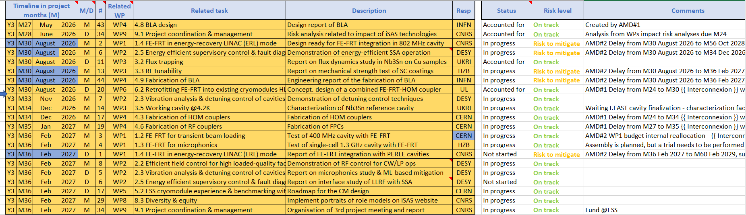
Work plan
Milestones & Deliverables status by timeline for the 3rd project year
Next milestone due Nov, on track
AMD#2 modifications highlighted in colour (still in evaluation by the PO)

Slide 14
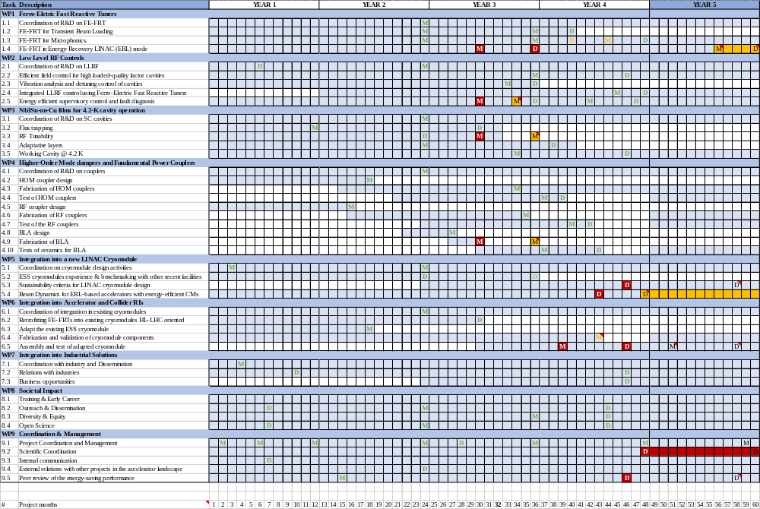

Slide 15
Upcoming related meetings
Indico page for Coordination panel - Steering committee meetings
  Steering Committee
  Are expected: members of the Steering Committee, a.k.a. WP Leaders & Deputies as well as members of the Coordination panel (that includes ex-officio Coordination panel members, the Advisory Board & Governing Board Chairpersons)
    Oct 20 10-11:30 am CET including progress status on the Advisory Board report recommendations
    Jan 12 10-11:30 am CET
    April 6 10-11:30 am CET to discuss Advisory Board recommendations post 3rd Annual meeting (tbc)
    June 29 10-11:30 am CET

Slide 16
Upcoming other meetings
iSAS project Indico page
  Advisory Board meeting
  Oct 30 10-11 am CET
  Are expected: members of the Advisory Board & of the Coordination panel
  Autumn online meeting to discuss w/ Coordination panel after progress status on the Advisory Board report recommendations has been shared in Oct 20 Steering Committee
  Governing Board meeting
  Nov 17 10-11 am CET
  Are expected: members of the Governing Board
  Autumn online meeting

Slide 17
Upcoming other meetings
iSAS project Indico page
  Coordination panel meetings
  Are expected: members of the Coordination panel (that includes ex-officio Coordination panel members, the Advisory Board & Governing Board Chairpersons)
    Dec 1 10-11:30 am CET
    Feb 23 10-11:30 am CET
    May 18 10-11:30 am CET
  3rd annual project meeting in Lund
  March 3-5
  Save the date to be sent soon
  Are expected: members of the iSAS Consortium, invited speakers
    Advisory board discussion – March 4
    Industry 1st review – March 5
    Governing board - March 5

Slide 18
Thank you!

Slide 19
Back up

