Slide 1



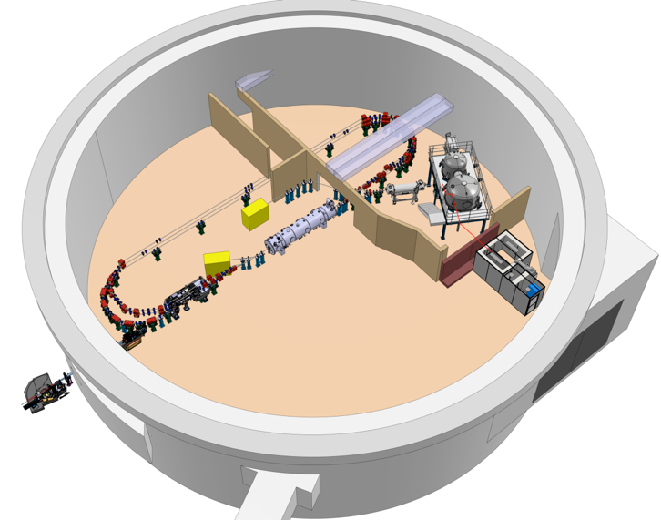


Project Progress Review
WP- 08: RF systems
Présenté par C. JOLY pour le compte de l’équipe
X. Lafay, S. Berthelot, J-F. Yaniche, O. Frossard, A. Martens, P. Gauron, F. Bouly, A. Buthod, C. Guérin with a strong interaction with the IDROGEN Team :
D. Charlet, A. Back, C. Esnault, C. Cheik-ali , C. Soulet, Gaetan Seuillot, Mathias Vecchio, Sid Ali Cherrati in collaboration with P-E. Potty , Michel Lours( LTE lab) , Cédric Viou (ORN lab).

Slide 2
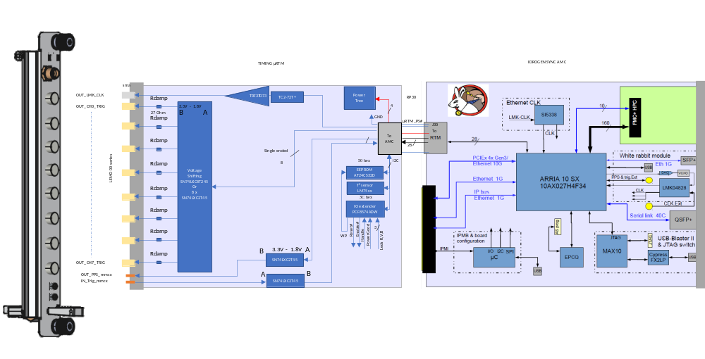
Etat d’Avancement
Cavity qualification facility upgrade → 1 kW amplifier SAT : SSA delivery will be delivered soon, planned in September.
MO → Two developments in //,
      New version of REFGEN in µRTM version with help of D. Charlet // pursue to try to improve the IDROGEN + WR performances
      (OXCO + PLL) ultra low noise liked developed for MYRRHA
Timing → Good news : IP2I Lyon accepts to realize the layout.
(X. Lafay & C. Joly)

Slide 3
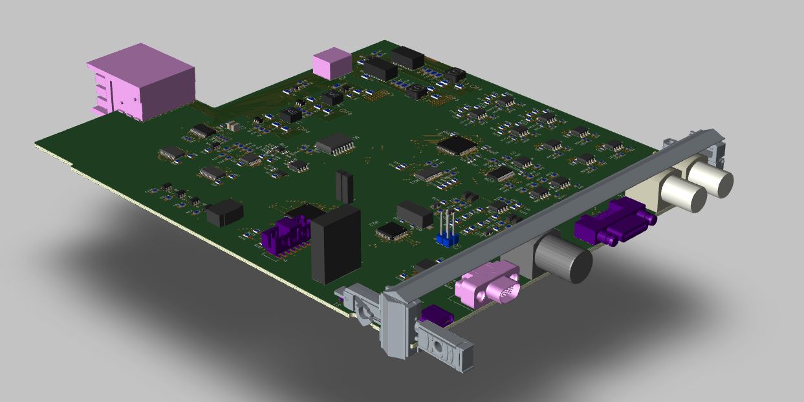
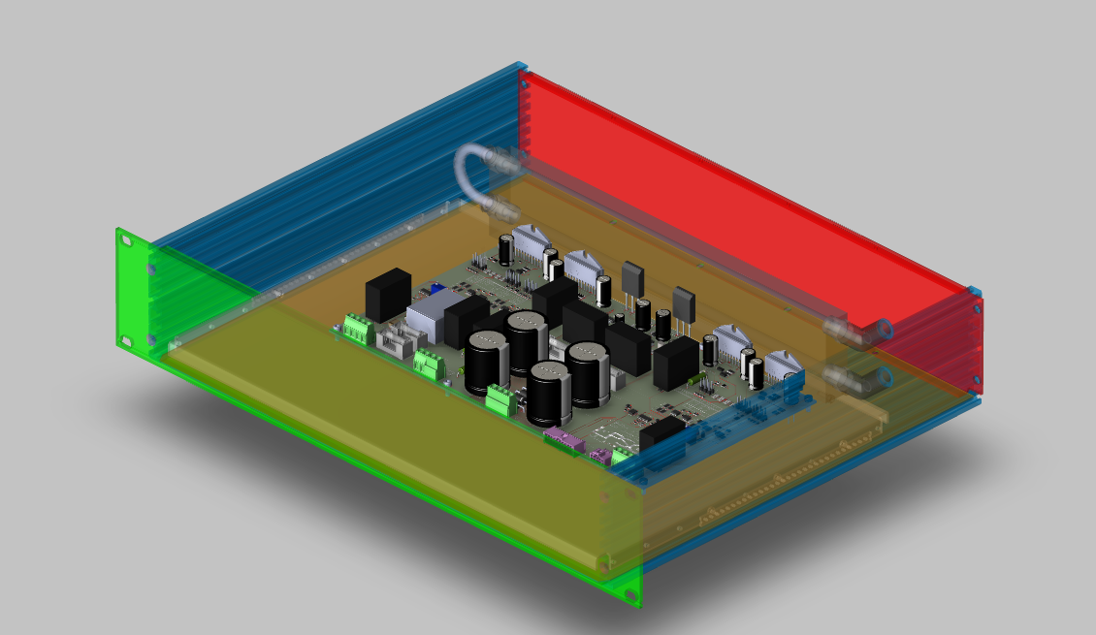
Etat d’Avancement : Frequency Tuning System (FTS)
FTS C&C board ( C. Joly & A. Buthod) → All files finished et validated. Call for tender planned this month. In parallel, I will launch the firmware development before the procurement of the first prototype to compensate a part of the delay.
FTS Power module prototype for Piezo actuators→ Power module PCB wiring of the two boards and water cooling exchanger in progress (J-F. Yaniche, S. Berthelot, G. Olivier and IJCLab mechanics workshop). The delivery of some components have delayed. We hope to receive them before the end of October. No impact due to delay on the FTS C&C board.

Slide 4
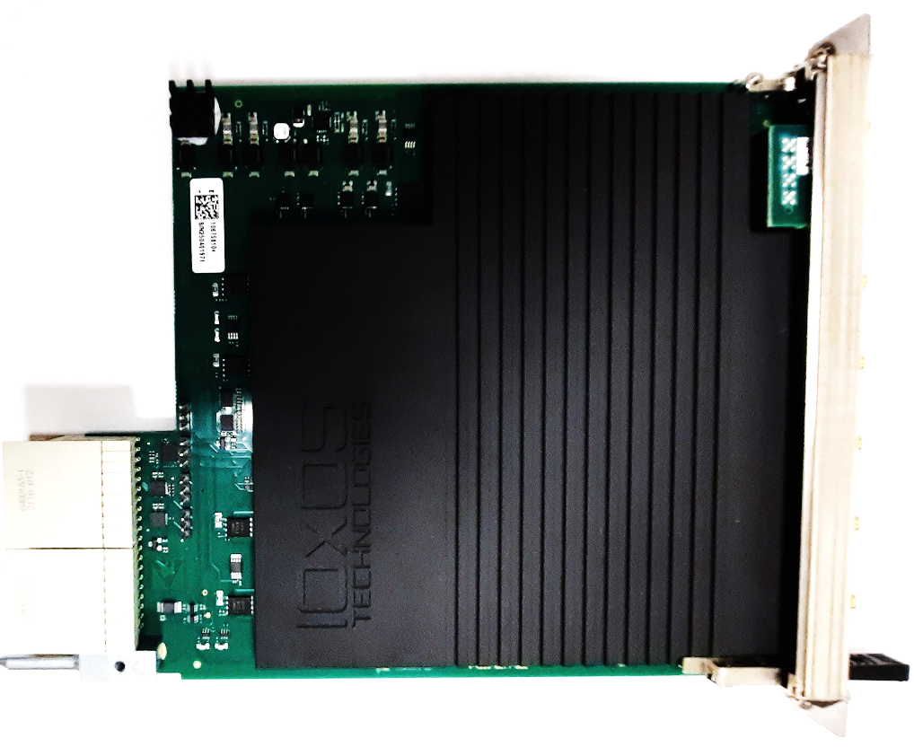

Etat d’Avancement : LLRF system
LLRF → RF front-end RDC1470 v2 validated and the production of all electronic boards has begun!
Many measurements have been realised and two improvements realised (THD and Crosstalk) in collaboration with IOXOS.
In the Firmware side, the driver integration in EPICs stay a problem to resolve. Hopefully, the configuration is operational at 80% using the application of the previous driver after a first configuration with the new driver…
P. Gauron continues to find a solution to resolve the problem.
We have a possible solution using EEE tools from ESS (TBC)

Slide 5
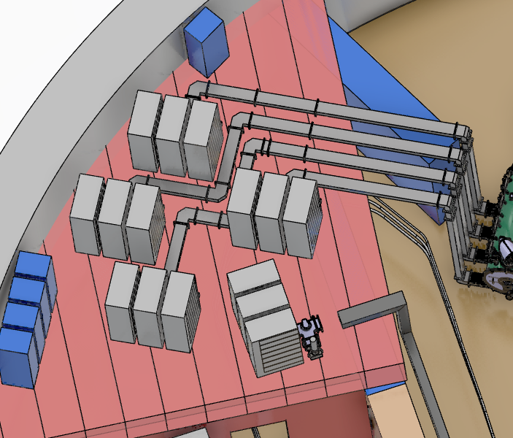
Etat d’Avancement : RF Power systems
RF powers Amplifiers → RFPA 8.8kW R.AS development in progress
(M. Adnane, S. Berthelot & C. Joly)
RF power circulators and RF load → New strategy validated and call for tender writing in progress with two batches : One for the Booster at 60kW and one option for the LINAC at 40kW operating also with 140kW RF power transient.
RF powers Amplifiers implantation in the IGLOO
→ Booster
  RF circuits and RFPAs implantation need to be upgraded due to the new strategy
  (E. Bourdelas, S. Brault, S. Berthelot, C. Joly)
→ ERL Linac
  RF circuits implantation verification in standby.

Slide 6
Planning et Principaux Jalons du WP-8 : RF systems
Design
First electrons
5 mA
Procurement / Construction / Installation
DC Gun @350 keV
20 mA
Commissioning
DC gun
operation
Buncher installation
Booster
RF sources upgrade
Booster installation
Injector @ 7MeV
DMO & Timing
Boards Proto
series
5 mA
20 mA
Feedback systems +racks µTCA
Boards Proto
series
Frequency Tuning System
Boards Proto
series
Cavity Sim. and algorithms opt.
First ERL
demonstration
0.5MW
RF proc. & modification
Reparation
Cryomodule
installation
Cavity Qualification facility upgrade
PERLE 1-LOOP 89MeV
RF power Amplifiers
series
2MW
RF power Circulators & loads
SSA prototype
8.8kW ordered
series
ERL 1-LOOP
Cryogenic
installed
IGLOO ready
2024
2025
2026
2027
2028
2029
2030
2031
today

Slide 7
Points de vigilance
Disponibilité des ressources:
  Ing Conception → C. Joly, 1 T/AI CAO, routage → IP2I Lyon , suivi de prod – discussion pour routage 2ème carte ok
  D. Charlet (~ mi 2027)
Dépenses à prévoir ( à consolider) :
2026
  116k€ approvisionnements cartes IOXOS (8 + 2 spares) → fait!
  120 k€ Châssis MTCA 9 native-R2 allowing independent systems → standby due to CPU : see for only booster.
  500k€ Circulateurs + charges : (nb: 4 for 60kW→ call for tender before end of 2026 with an option for 4 at 40kW
2027
  Series IDROGEN+ REFGEN+ TIMGEN depending of needs +C&C FTS (8 + 2 spares)
  270k€ k€ Amplificateurs SSA (nb : 3 at 8.8 kW) Phase 1 (~5mA) for the injector → 300k€ min
  ~ 400k€ Lignes RF , RF cables
  1.4M€ ? Amplificateurs SSA (nb 4 at 40kW) → Reflexion en cours avec G. Olry, R. Roux, …
2028
  ? Upgrade Amplificateurs SSA for the Booster ( power 8.8 kW to 50kW, bandwidth-dependent)

Slide 8
Points de vigilance suite

