Slide 1



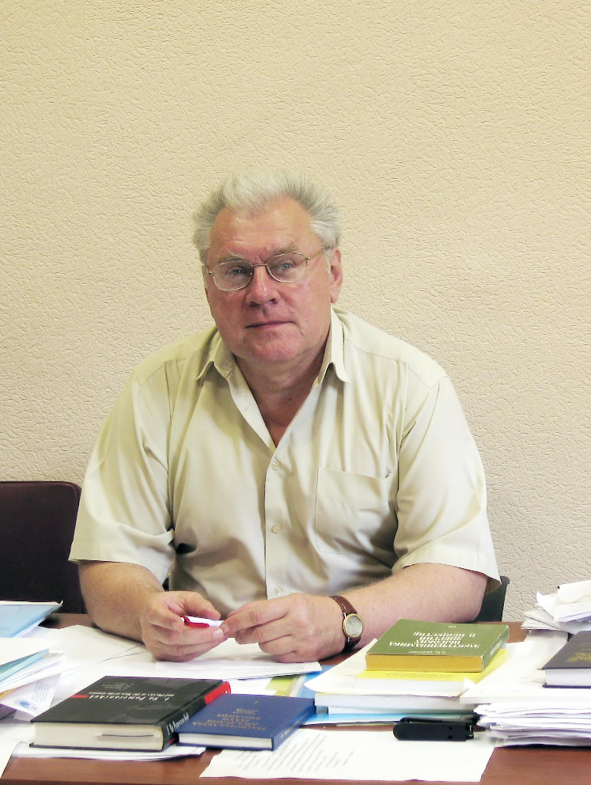





French-Ukrainian Workshop 2026
“Instrumentation Developments for High Energy Physics”
dedicated to the blessed memory of Nikolai F. Shul’ga
October 12-14, 2026, IJCLab, University Paris-Saclay, Orsay
Multiple scattering effect on radiation of ultra relativistic electrons in matter:
LPM & TSF effects
Sergii FOMIN
Leading researcher at the Akhiezer Institute for Theoretical Physics
National Science Center "Kharkiv Institute of Physics and Technology"
e-mail: spfomin@gmail.com
15.09.1947 - 23.01.2024

Slide 2
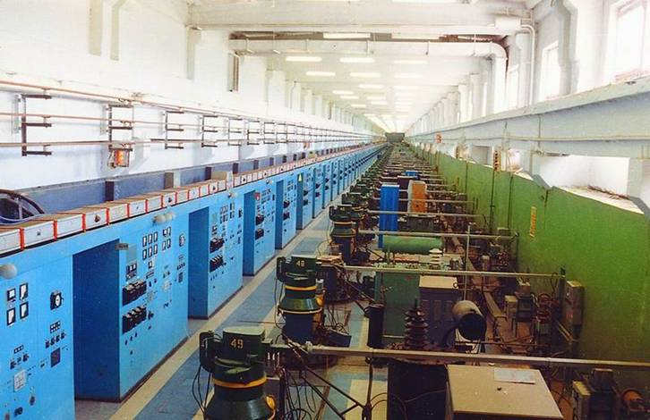
Experimental discovery of relativistic positrons and electrons channeling phenomenon on the Electron Linac 2 GeV
(KIPT, 1968-1971)

Slide 3
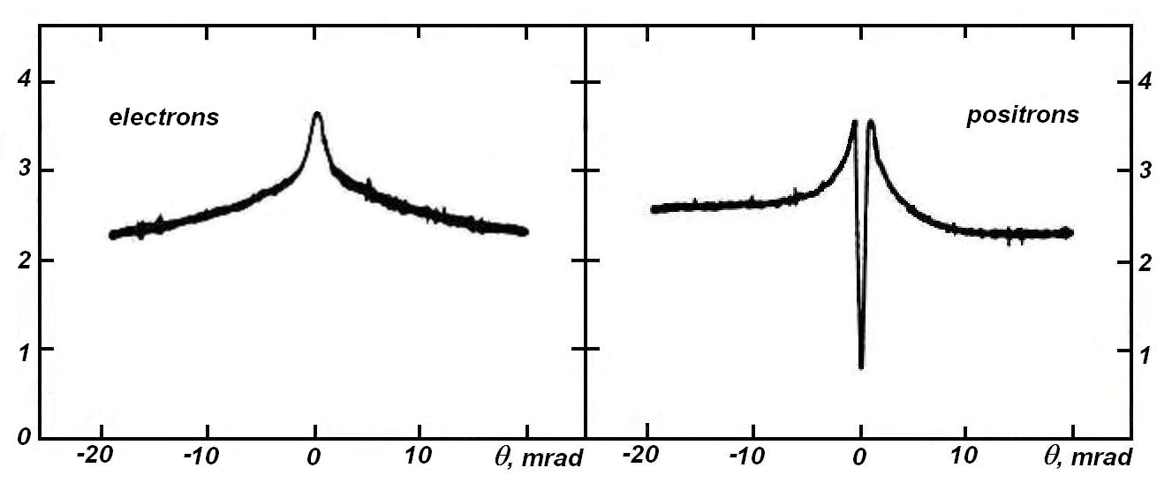
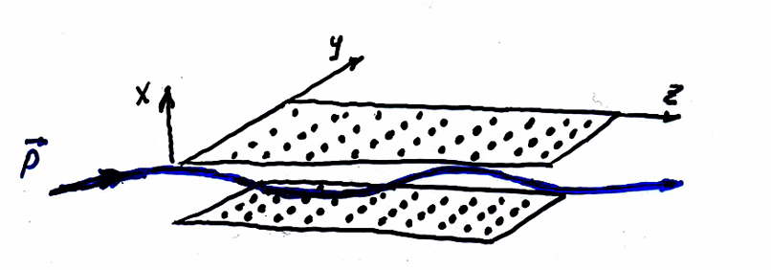
Experimental discovery of the phenomenon of channeling of relativistic electrons and positrons in a crystal at LUE-2 GeV (KIPT, 1968 -1971)
I.A.Grishaev, V.L.Morokhovsky, V.I.Kasilov, G.D.Kovalenko, B.I.Shramenko et al.
Ukrainian Physical Journal, 15 (1971) 1548; JETP Letters, 16 (1972) 162.
    Shul’ga’s Master thesis "Coherent bremsstrahlung of electrons and positrons of ultra relativistic energy in crystals" (1971)
    A.I. Akhiezer, P.I. Fomin, N.F. Shul’ga, JETP Letters, 1971, v.13, p.713.

Slide 4
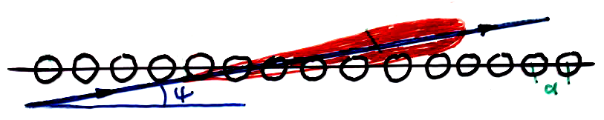
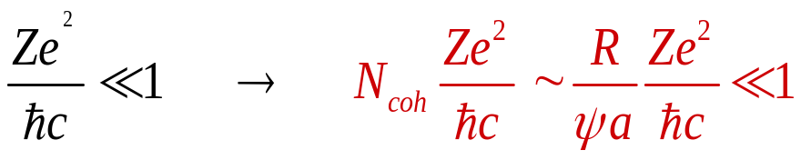

Higher Born Approximation in the Coherent Bremsstrahlung Theory
A.I. Akhiezer and N.F. Shul’ga (1975)
PARADOX
This condition did not fulfill practically for experiments
(1960-1970) on verification of F–T–Ü theoretical results.
But the experiments were in good agreement with this theory !!!
Why ???

Slide 5
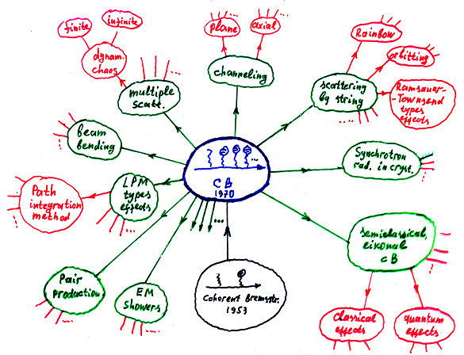
New Research Directions in High-Energy Electrodynamics in Crystals
Illustrated by N.F. Shul’ga

Slide 6

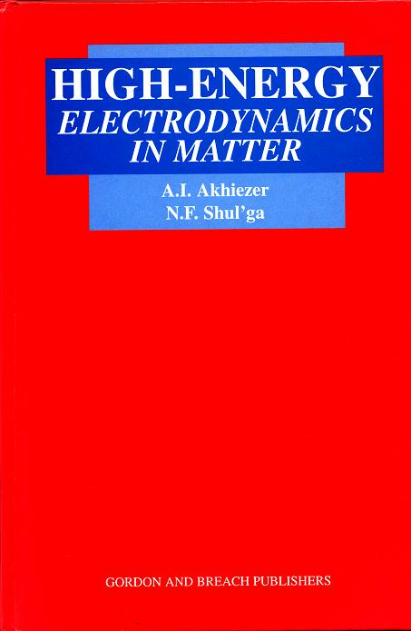

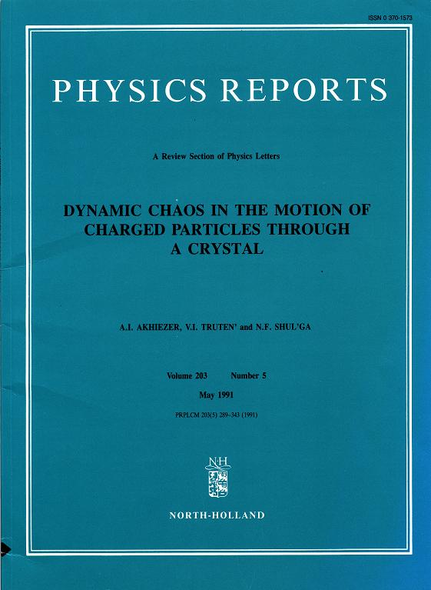
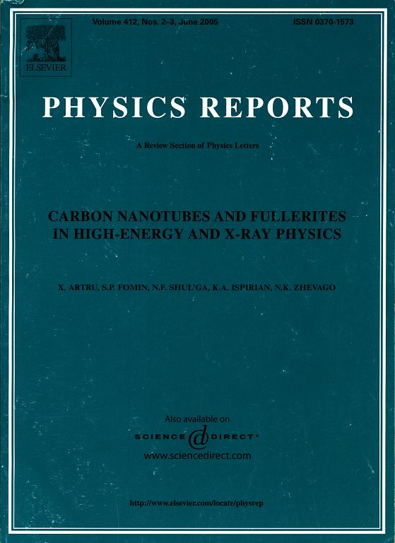
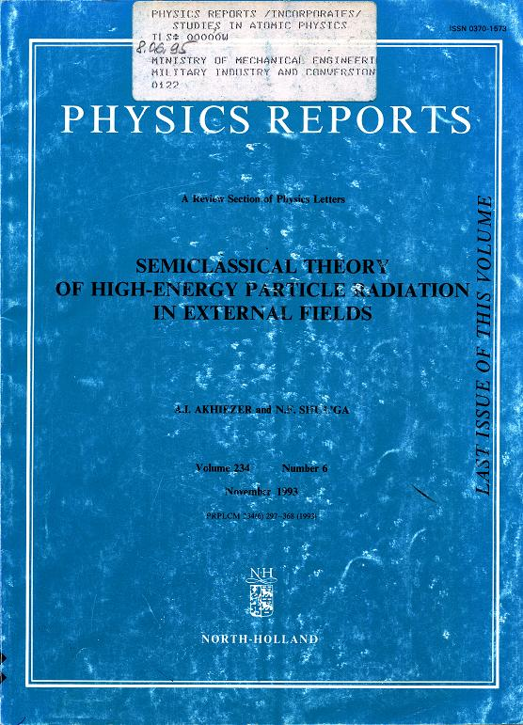
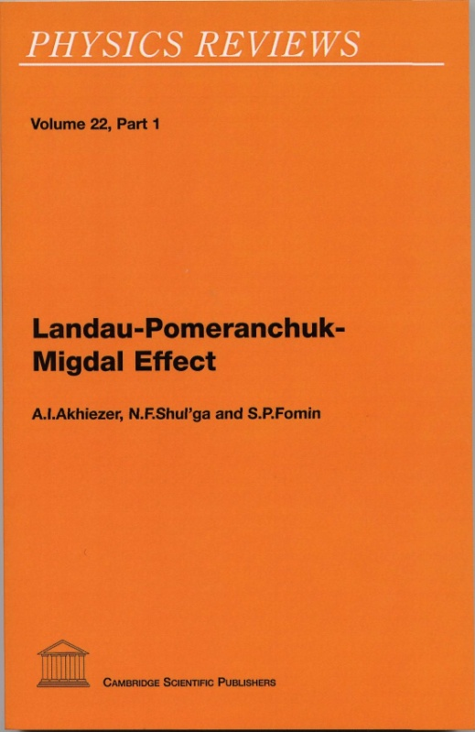
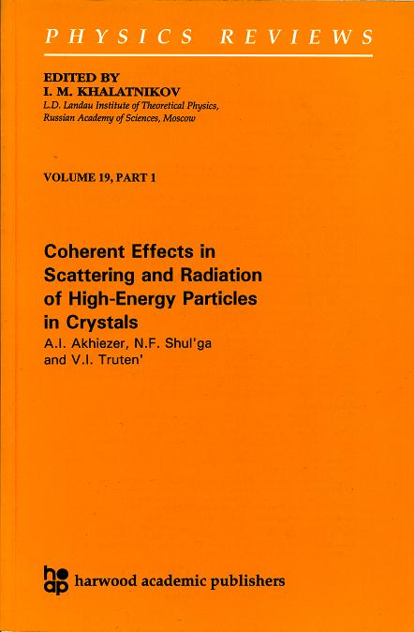
Scientific results: more than 300 articles + 12 monographs and reviews

Slide 7
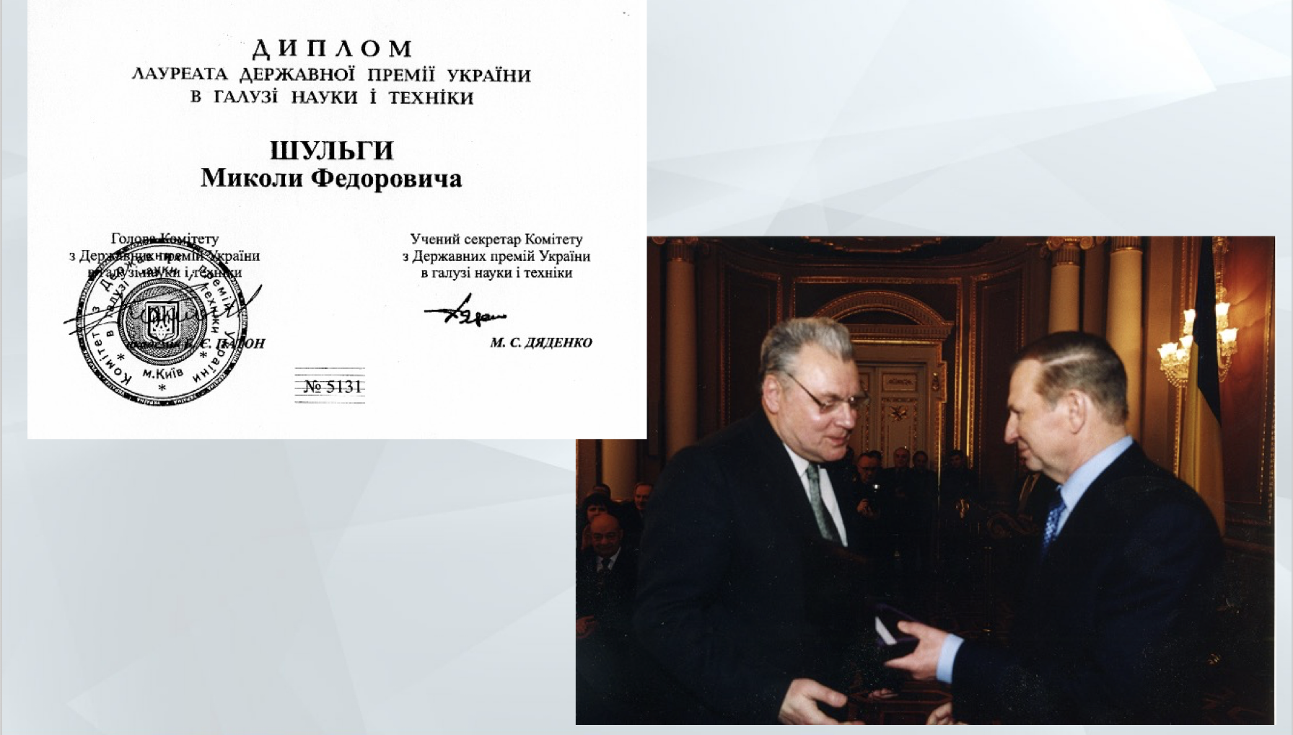

2002 State Prize of Ukraine in the Field of Science and Technology

Slide 8
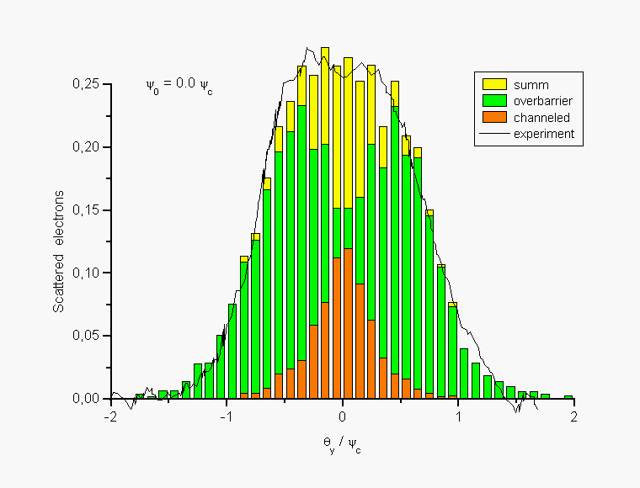
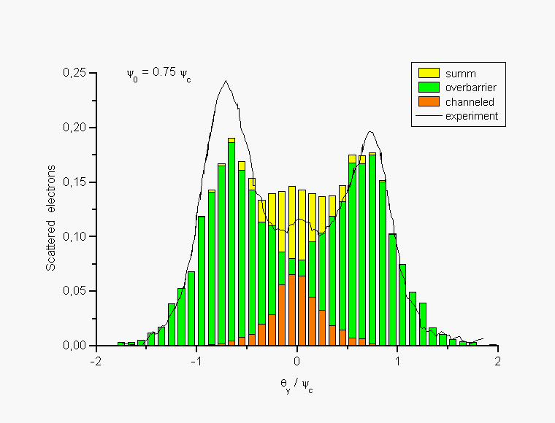
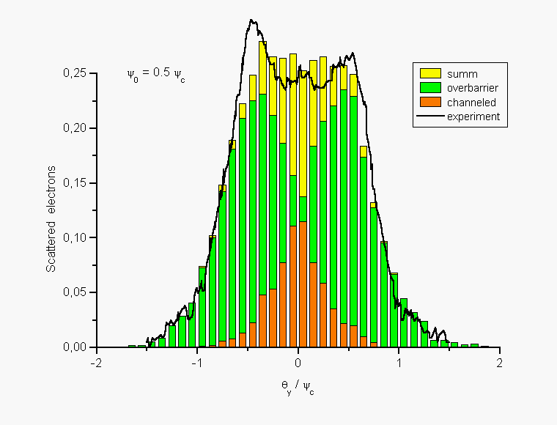
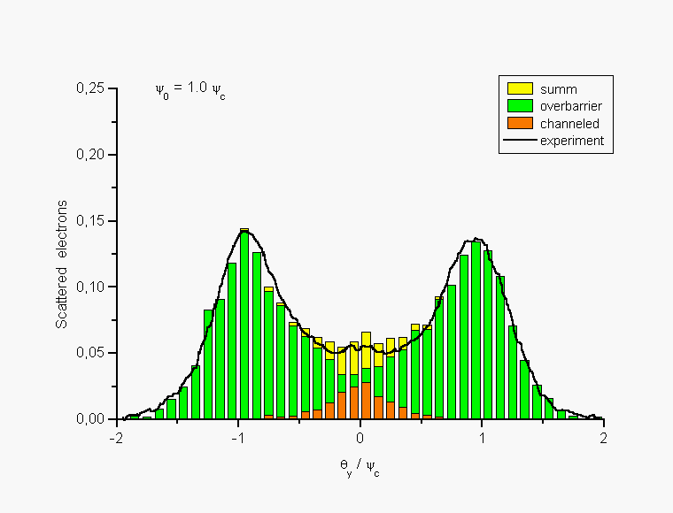
Comprehensive theoretical and experimental studies of
the basic mechanisms of radiation of relativistic electrons in crystals
S.P. Fomin et al., Features of Angular Distributions of 1 GeV Electrons Scattered by Thin Silicon Monocrystals” Problems of Atomic Science and Technology. #6, 2001, pp. 138-143. ( T_{crys} = 10 μm )

Slide 9
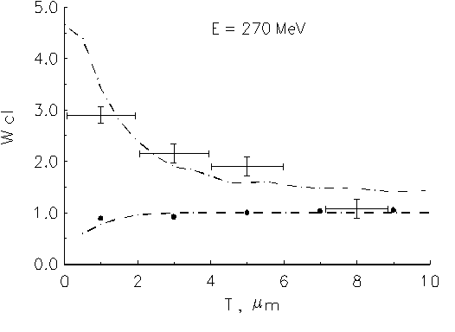
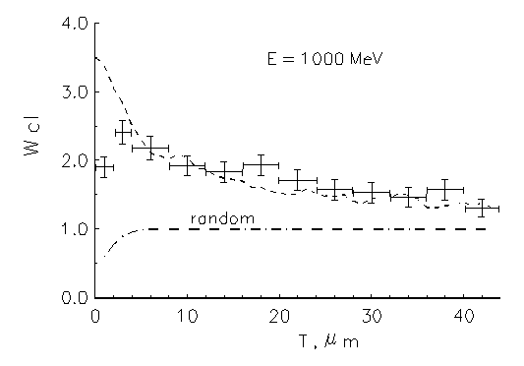
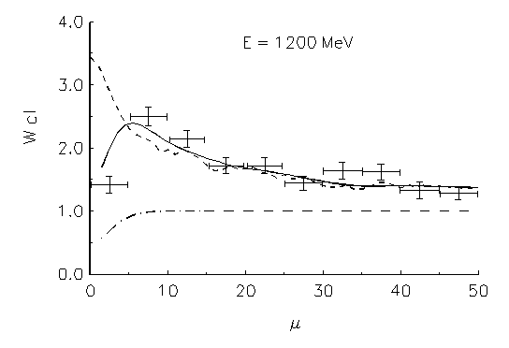
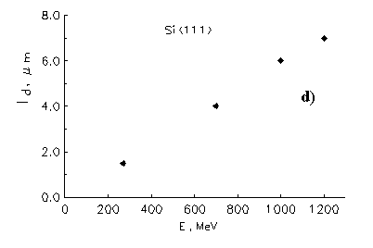
Study of the dynamics of beams of relativistic positrons and electrons in a crystal under channeling conditions
S.P. Fomin, A. Jejcic, V.I. Kasilov et al., Investigation of the electron channeling by means of induced
electronuclear reactions. Nuclear Instrument and Methods B 129 (1997) 29.

Slide 10
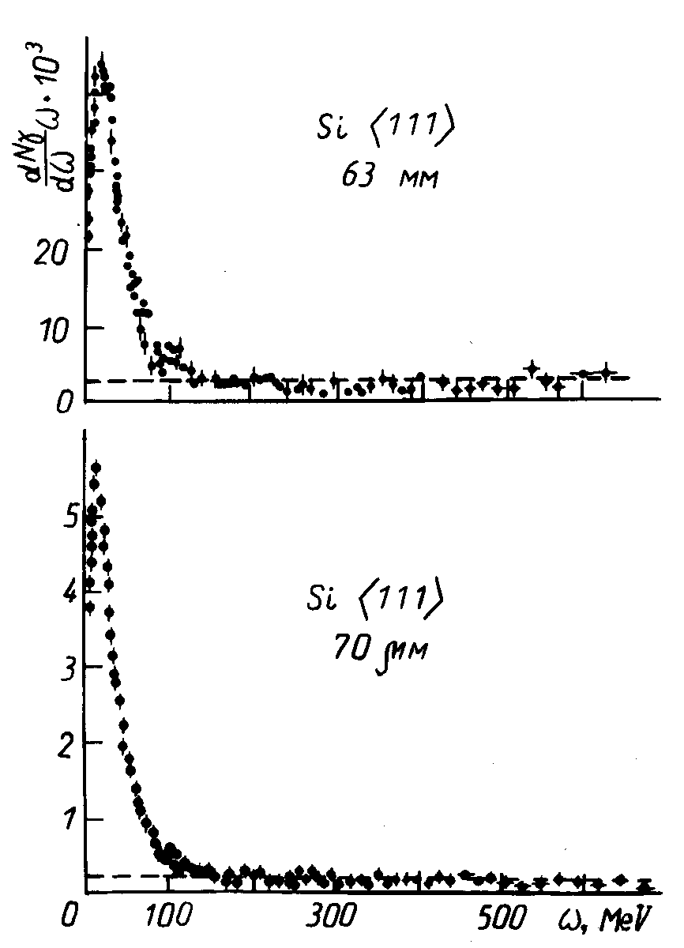
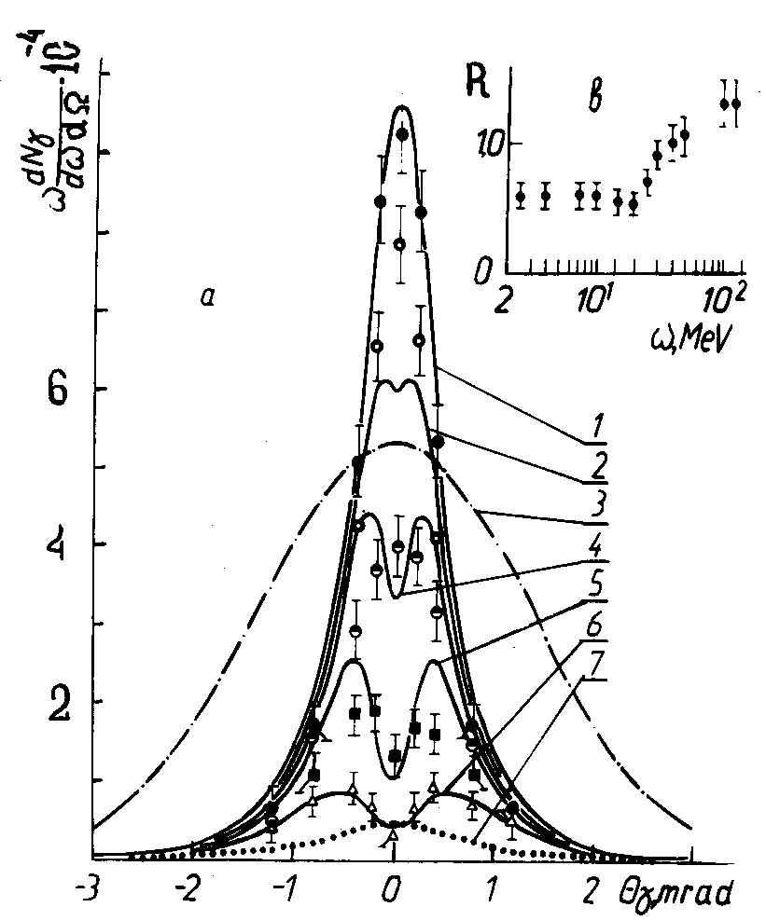
Theoretical and experimental studies of spectral and spectral-angular characteristics of gamma radiation in crystals
Antipenko et al. Features of the spectral-angular distribution of gamma-quanta emitted by GeV electrons in a thick crystal. Physics Letters A, 158 (1991) 176—180.

Slide 11
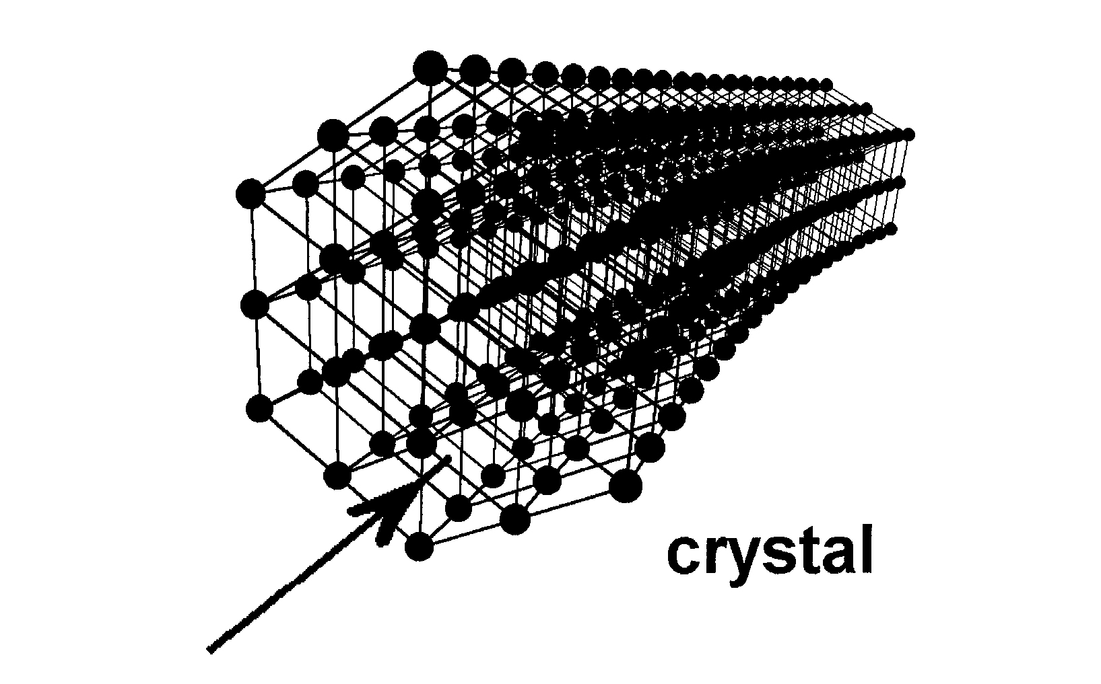
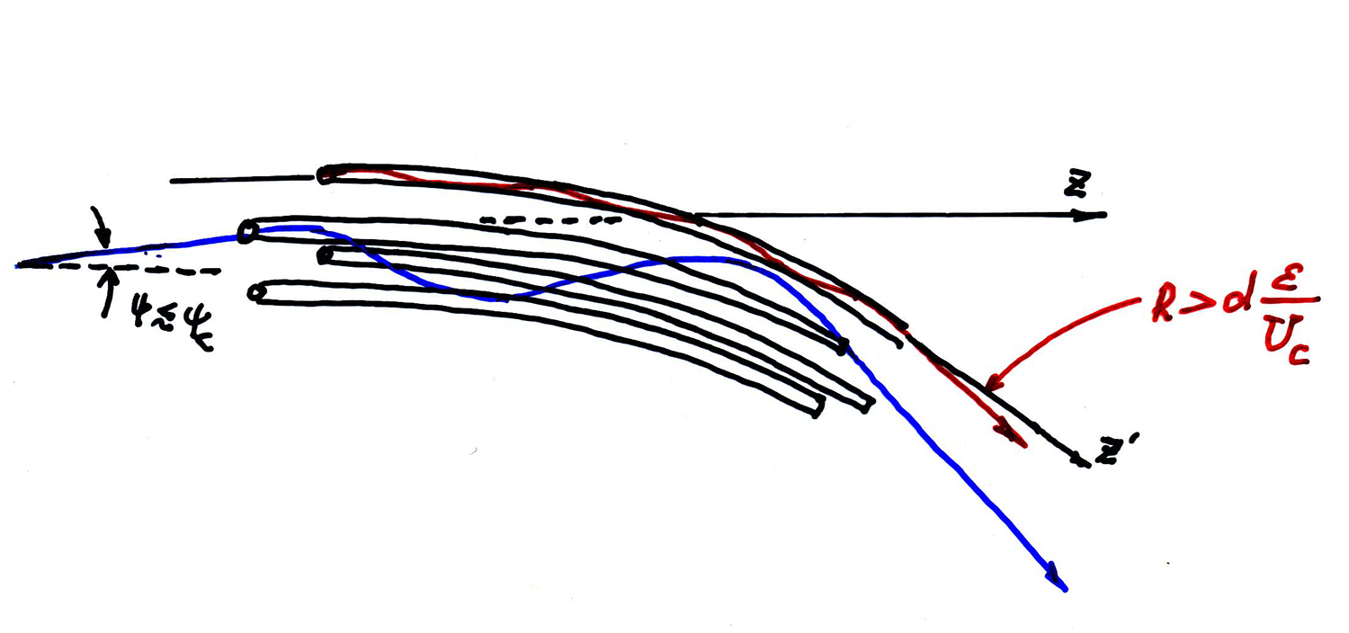
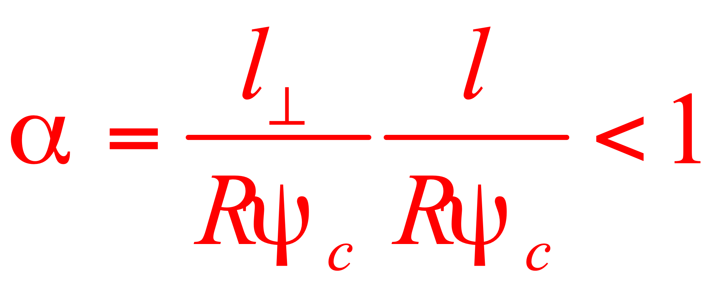
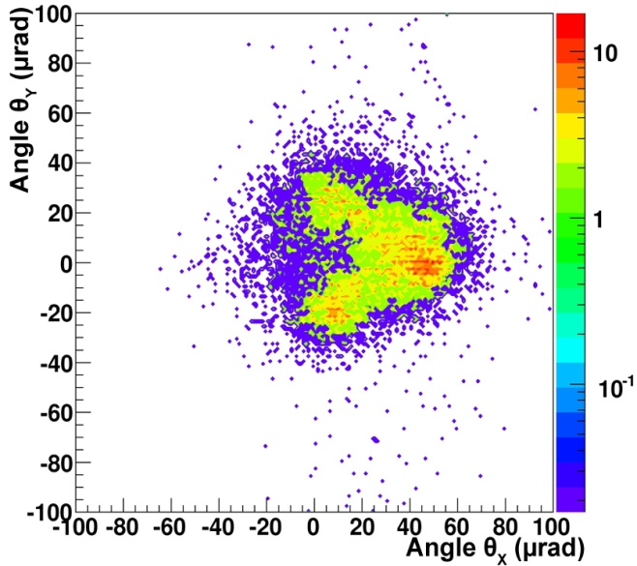
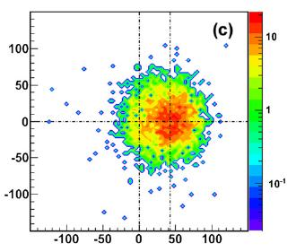
Stochastic mechanism of deflection of high-energy
charged particle beam in a bent crystal
Predicted in KIPT: A.A. Greenenko, N.F. Shul'ga, JETP Lett., 54 (1991) 520; NIM B 173 (2001) 178.
Grinenko-Shul’ga condition
CERN experiment UA9: W. Scandale et al. Phys. Rev. Lett. 101 (2008) 164801; Phys. Lett. B 680 (2009) 301
p - protons with energy 400 Gev, p - mesons with energy 150 GeV

Slide 12
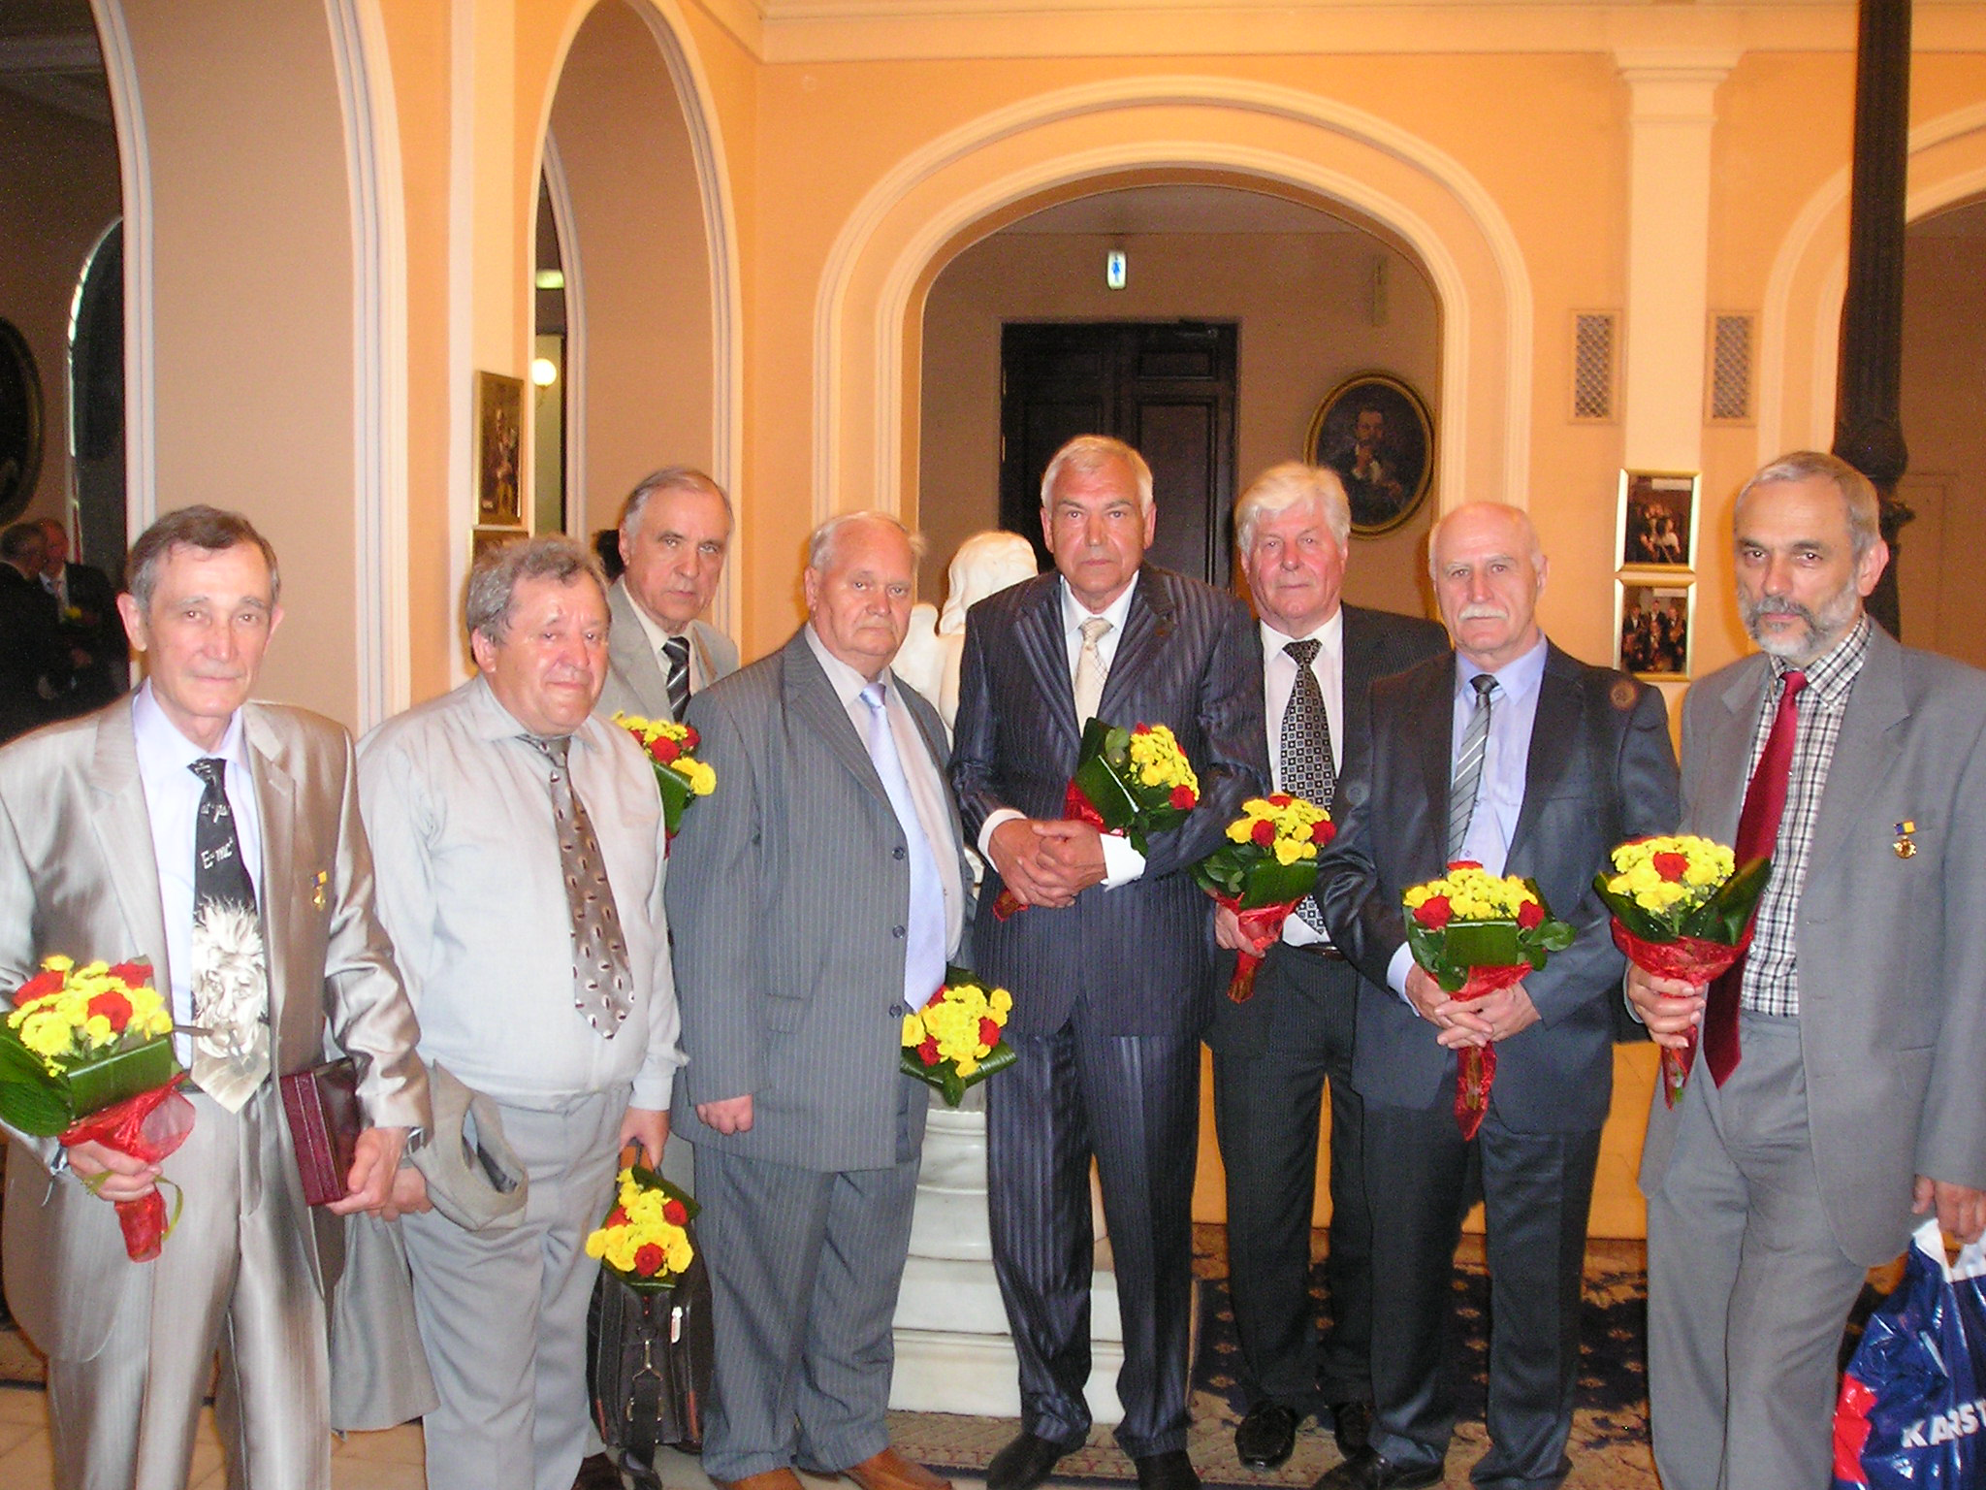
For a series of studies on the dynamics of relativistic particle beams
and its radiation in crystals, a group of researchers from the department,
which had been led for many years by Nikolai Shul’ga, was awarded
the 2012 Ukrainian State Prize in Science and Technology.

Slide 13
Multiple scattering effect on radiation
of ultra relativistic electrons in matter:
Landau-Pomeranchuk-Migdal (LPM) &
Ternovsky-Shul’ga-Fomin (TSF) effects

Slide 14
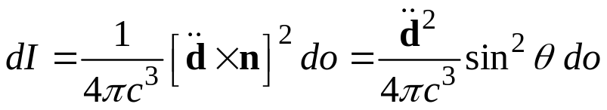
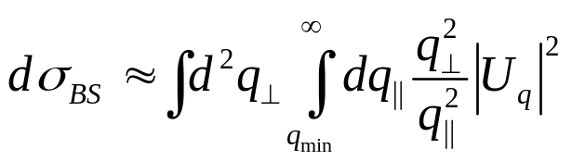
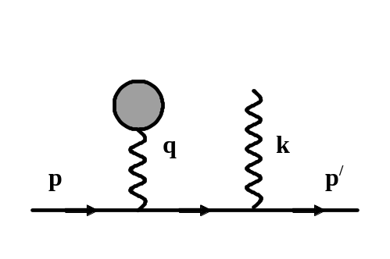
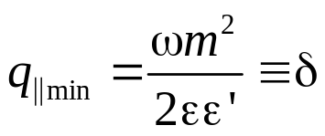


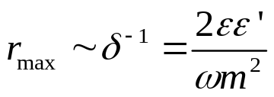


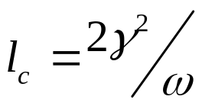



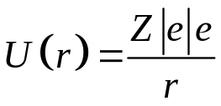
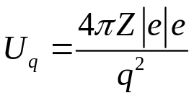
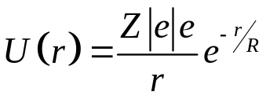
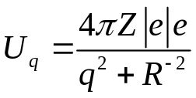







Radiation of charged particle at scattering in an external field
Classical Electrodynamics:
R
v
e
Quantum Electrodynamics:
$θs=q⊥$ / p
=>
($ℏ$ = c = 1)
Thomas-Fermi model:
=>
$$γ=ε/m$$
If
r_{max}
If
$$⇒$$
$$⇒$$

Slide 15
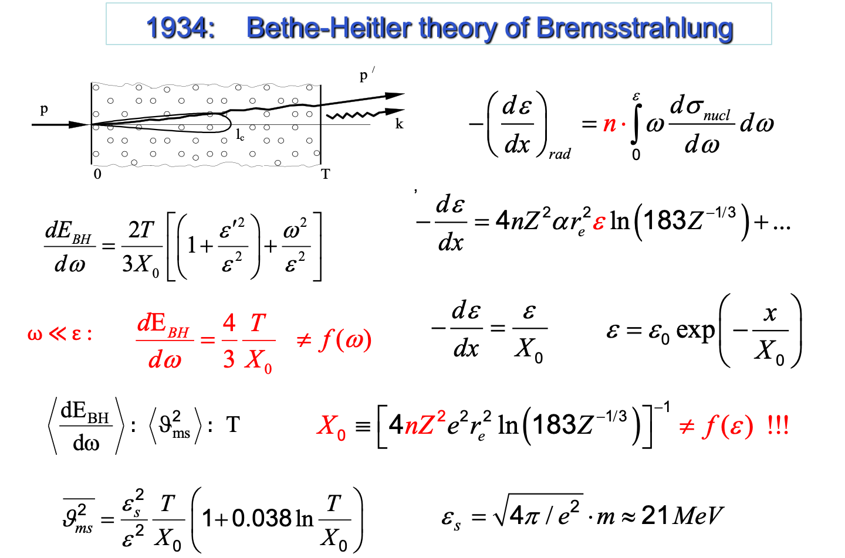



1934: Bethe-Heitler theory of Bremsstrahlung
H. Bethe & W. Heitler, Proc. Roy. Soc. A 146 (1934) 83. (Born approximation: )
$$\sim$$
$$\sim$$

Slide 16






Coherence Length (Ter-Mikaelian, 1953)
M. Ter-Mikaelian (1953)
L. Landau & Ya. Pomeranchuk (1953)
crystal
amorphous media

Slide 17
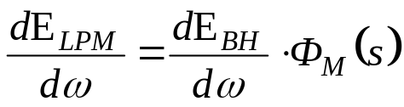
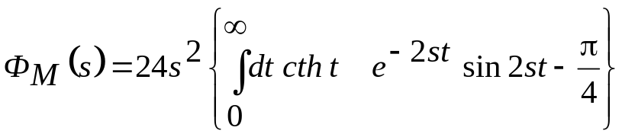
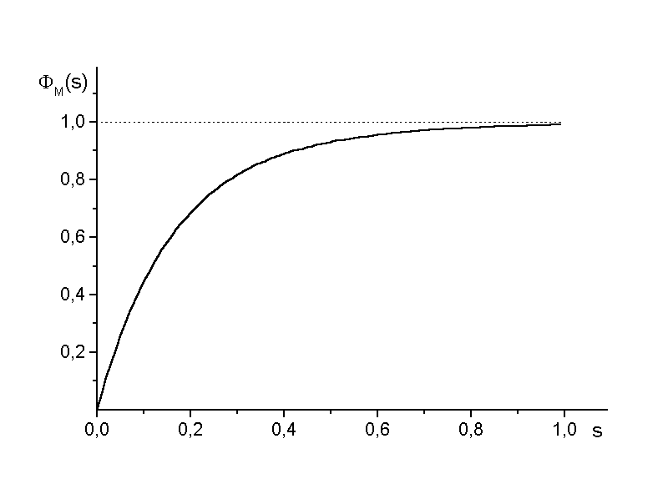
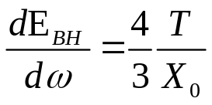
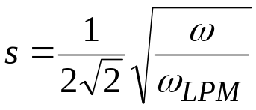

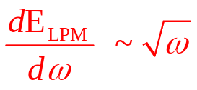
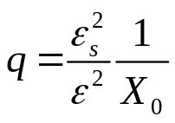
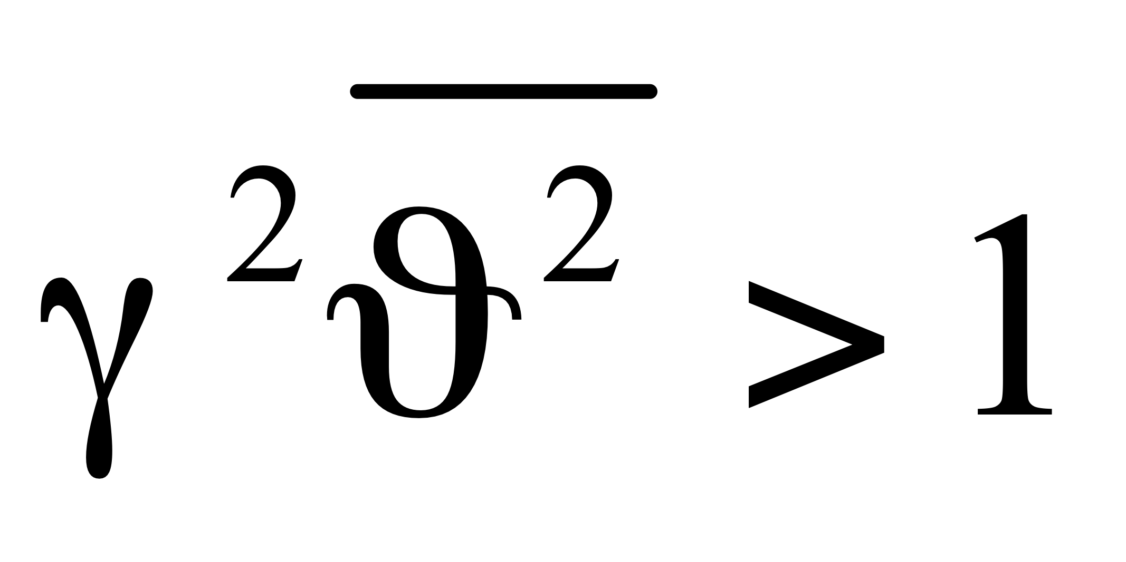
Quantitative theory of the Landau-Pomeranchuk effect
in a boundless amorphous medium
A.B. Migdal, Dokl. Akad. Nauk SSSR 96 (1954) 49; JETP 32 (1957) 633.
Cosmic ray M.Miesowicz, O.Stanisz, W.Wolther. Novo Cimento 5 (1957) 513.
experiments: A.Varfolomeev et al. Sov. Phys. JETP 11 (1960) 23.
17

Slide 18
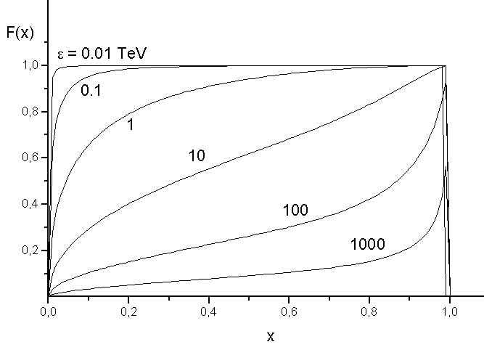

LPM effect for very high energy
F(x) = E’_{LPM} / E’_{BH}
x = ω/ ε
Increasing of Radiation length !!! GEANT, …
Detector design and Radiation shielding calculation …
18

Slide 19

SLAC experiment E-146 (1994-1999)

Slide 20





SLAC experiment E-146 (1994-1999)
Anthony P.L. et al., Phys. Rev. Lett. 75 (1995) 1949.
Klein S., Rev. Mod. Phys. 71 (1999) 1501.
Bethe-Heitler ? ? ? LPM effect
, but T < l_{c}
& T > l_{c}
F.F. Ternovsky. JETP 12 (1961) 123.
Notes:
The discrepancies observed in the mentioned cases could not be eliminated either by adding the dielectric suppression or by adding transition radiation. All these discrepancies related to cases of relatively thin targets compared to the coherent length for a given part of the emission spectrum, while Migdal’s theory considered an infinite medium. The only article devoted to the LPM effect in a target of finite thickness that specialists from SLAC were able to find at that time was Ternovsky’s article in 1961. But when they substituted the parameters of the E-146 experiment into the Ternovsky formula, instead of suppressing the radiation, they obtained an excess over the result of the Bethe-Heitler theory and called this an unphysical result in their publication.

Slide 21













Radiation in a thin layer of matter :
Shul’ga N.F. and Fomin S.P., JETP Lett. 27 (1978)126;
Fomin S.P. and Shul’ga N.F., Phys. Lett. A114 (1986)148.
$$\frac{d^{2}E}{dωdo}=\frac{e^{2}}{4π^{2}}{\left|\overset{⃗}{k}×\overset{⃗}{I}\right|}^{2}$$
$$\overset{⃗}{I}=i\overset{∞}{\underset{−∞}{∫}}dte^{i(ωt−\overset{⃗}{k}⋅\overset{⃗}{r}(t))}\frac{d}{dt}\frac{\overset{⃗}{v}(t)}{ω−\overset{⃗}{k}⋅\overset{⃗}{v}(t)}$$
$$\overset{⃗}{I}≈i\left(\frac{{\overset{⃗}{v}}^{′}}{ω−\overset{⃗}{k}⋅{\overset{⃗}{v}}^{′}}−\frac{\overset{⃗}{v}}{ω−\overset{⃗}{k}⋅\overset{⃗}{v}}\right)$$
suppression
of radiation
T
Notes:
In fact, the problem of radiation in a thin layer of matter was specifically considered in our article in 1978. In this work, it was shown that in the case of a thin target compared to the coherence length, a special case is realized, which is not described by either the Bethe-Heitler theory or the Migldal theory.
The fundamental difference in this case was a very strange dependence of the radiation intensity on the thickness of the target, namely “logarithmic”, instead of the usual “linear” for both the Bethe-Heitler theory and the Migldal theory.
This seems paradoxical. As the thickness of the target increases, the number of collisions between the electron and target atoms increases. The electron is scattered on these atoms, but practically does not emit!
A detailed physical explanation of this strange behavior was given a little later in the work of Phys. Let. A 1986. This strange suppression of radiation was explained in this work by a relativistic delay in the restoration of the own Coulomb field of an ultra relativistic electron after scattering through a large angle (more than 1/gamma - the characteristic angle of radiation of a relativistic particle). That is, when the radiation non-dipole parameter Xi becomes greater than unity. In other words, we are talking about the bremsstrahlung of an electron with a non-equilibrium intrinsic Coulomb field, or, as the radiation of a “half-bare” electron.

Slide 22










Quantitative theory of radiation in a thin layer of matter
Shul'ga N.F., Fomin S.P., JETP Lett. 63 (1996) 873; JETP 86 (1998) 32; NIM B145 (1998) 73.
:
,
22

Slide 23





Evolution of electromagnetic field at electron’s scattering
E.L. Feinberg. JETP 50 (1966) 202. S.P. Fomin, N.F. Shul’ga. Phys. Lett. A 114 (1986) 148.
A.I. Akhiezer, N.F. Shul’ga. Sov. Phys. Uspekhi, 30 (1987) 197.

Slide 24
Other publications on this subject
R. Blankenbacler, S.D. Drell. The Landau-Pomeranchuk-Migdal effect for finite targets.
Phys.Rev. 1996, v. D53, p. 6265-6281.
R. Blankenbacler. Structured targets and Landau-Pomeranchuk-Migdal Effect.
Phys. Rev. 1997, v. D55, p. 190-195.
B.G. Zhakharov. Structured targets and Landau-Pomeranchuk-Migdal effect for finite-size targets. JETP Lett. 1996, v. 64, p. 781-787.
B.G. Zhakharov. Light-cone path integral approach to the Landau-Pomeranchuk-Migdal effect. Yadernaya Fiz. 1998, v. 61, p. 924-940.
R.Baier, Yu.L.Dokshitser, A.H.Mueller, S.Peigne, D.Schiff. The Landau-Pomeranchuk-Migdal effect in QED. Nucl. Phys. 1996, v. B478, p. 577-597.
V.N. Baier, V.M. Katkov. Landau-Pomeranchuk-Migdal effect and transition radiation in structured targets. Phys. Rev. 1999, v. D60, 076001, 12 p.
. . . . . . . .

Slide 25

2005
A.I. Akhiezer, N.F. Shul'ga, S.P. Fomin.
The Landau-Pomeranchuk-Migdal Effect.
Cambridge Scientific Publishers, Cambridge, UK, 2005, 215 p.

Slide 26



CERN NA63 experiment 2005
SPS secondary positron beam E = 178 GeV, target thickness: 2, 10, 20 μm

Slide 27


Thickness dependence !!!
N. Shul'ga, S. Fomin: JETP Lett. 27(1978)126. Phys.Let.A 114(1986)148; JETP 86(1998)32
ε _{TSF} = m²t / 2 ≈ 660 GeV ∙ t (μm)
If ε << ε _{TSF} :
ω_{TSF} ≈ 2γ²/t
t ≈ l_{c}(ω)
ω₁ = 800 MeV ω₂ = 350 MeV ω₃ = 150 MeV
27

Slide 28


Ternovsky-Shul’ga-Fomin effect of suppressing the radiation
of relativistic electrons in a thin layer of matter (TSF effect)
Predicted in KIPT: N.F. Shul’ga, S.P. Fomin, JETP Letters, 27 (1978) 126.
Confirmed at CERN: H.D. Thomsen et al. Physical Review D 81 (2010) 052003.
Theoratical interpretation: A.S. Fomin, S.P. Fomin, N.F. Sul’ga, Nuovo Cimento 34C (2011) 45.
Ulrik Uggerhøj (spokesman of the CERN collaboration NA63):
“… we have 'seen' the 'half-bare' electron “ !!!
BH - Bethe-Hietler Theory of Bremsstrahlung
TSF - Ternovsky-Shul’ga-Fomin effect
LPM - Landau-Pomeranchuk-Migdal effect
Scope of applicability of theories
Diagram from PhD thesis of Heine Thomsen, CERN - Aarhus University, 2010

Slide 29












Spectral-angular distribution of radiation in a thin amorphous target
Fomin S.P., Shul'ga N.F. and Shul'ga S.N., Phys. of Atomic Nuclei 66 (2003) 396.
$$\frac{d^{2}E}{dωdo}=\frac{e^{2}}{4π^{2}}{\left|\overset{⃗}{k}×\overset{⃗}{I}\right|}^{2}$$

Slide 30




Angular Distribution of Radiation at Non-Dipole Mode
Bethe-Heitler theory of Bremsstrahlung is valid if
At high energies, the non-dipolar radiation mode predominates
New SLAC experiment proposal
Spectral-angular distribution of radiation
at transition from dipole to non-dipole mode
Our theory predicts radical changes
of angular distribution at
Experimental check is necessary
for including to GEANT and other codes !
30

Slide 31




LPM and TSF effects in a crystal
Shul’ga N., Fomin S., JETP Letters 27 (1978)126; Phys. Lett. A114 (1986)148.
Laskin N., Mazmanishvili A., Shul’ga N., Phys. Lett. A112 (1985) 240.
Multiple scattering on crystal atomic strings
Shul’ga N., Truten’ V., Fomin S., J. Techn. Phys. 52 (1982) 2279.
$\frac{〈θ_{cr}^{2}〉}{〈θ_{ms}^{2}〉}≈\frac{R}{8ψd}$

Slide 32




LPM in a thick crystal
CERN experiment: Bak J.F. et al. Nucl. Phys., B302 (1988) 525.
Theory of LPM in crystal: Laskin N., Shul’ga N., Phys.Lett. A135 (1989) 147.
e⁻ : E=10 GeV
e⁺: E=20 GeV
32

Slide 33








Multiple scattering on crystal atomic strings – MC simulation
S.P. Fomin, I.V. Kyryllin, M.S. Malovytsia, S.M. Shulga, G. Kube, A. Novokshonov, S. Strokov, A. Fomin. Probl. Atom. Sci. Tech. 2025. Vol. 157. №3. P. 30–36.
E = 6 GeV , Si <111>
$$θ=2ψ sin{\frac{φ}{2}}$$
T = 10 mm

Slide 34



TSF effects in a crystal
DESY experiment proposal 2025
Deutsche Forschungsgemeinschaft (DFG) project # 531314364
E_{e} = 6 GeV $γθ_{cr}\left(T_{cr}\right)>1$ ${γω}_{p}<ω<2γ^{2}/T$ 0.3 MeV < $ω$ < 4 MeV
---
crys
S.P. Fomin et al. Problems of Atomic Science Technology, 2025, #3(157), pp. 30-36.
34

Slide 35








TSF effects in a crystal
DESY experiment proposal 2025
$$l_{c}>T$$
ω _{TSF} ≈ 2γ ²/T
$$γθ_{cr}\left(T,ψ\right)>1$$
${γω}_{p}<ω<2γ^{2}/T$
E_{e} = 6 GeV Si <111> T = 10 μm
$$γψ_{L}≈2$$
300 keV < ω < 4 MeV
E_{e} = 6 GeV Ge <111> T = 10 μm
$$γψ_{L}≈2.9$$
600 keV < ω < 4 MeV
E_{e} = 17 GeV Si <111> T = 10 μm
$$γψ_{L}≈3.4$$
1 MeV < ω < 30 MeV
E_{e} = 17 GeV Ge <111> T = 10 μm
$$γψ_{L}≈5.2$$
2 MeV < ω < 30 MeV
Thank you for your attention !

