Slide 1

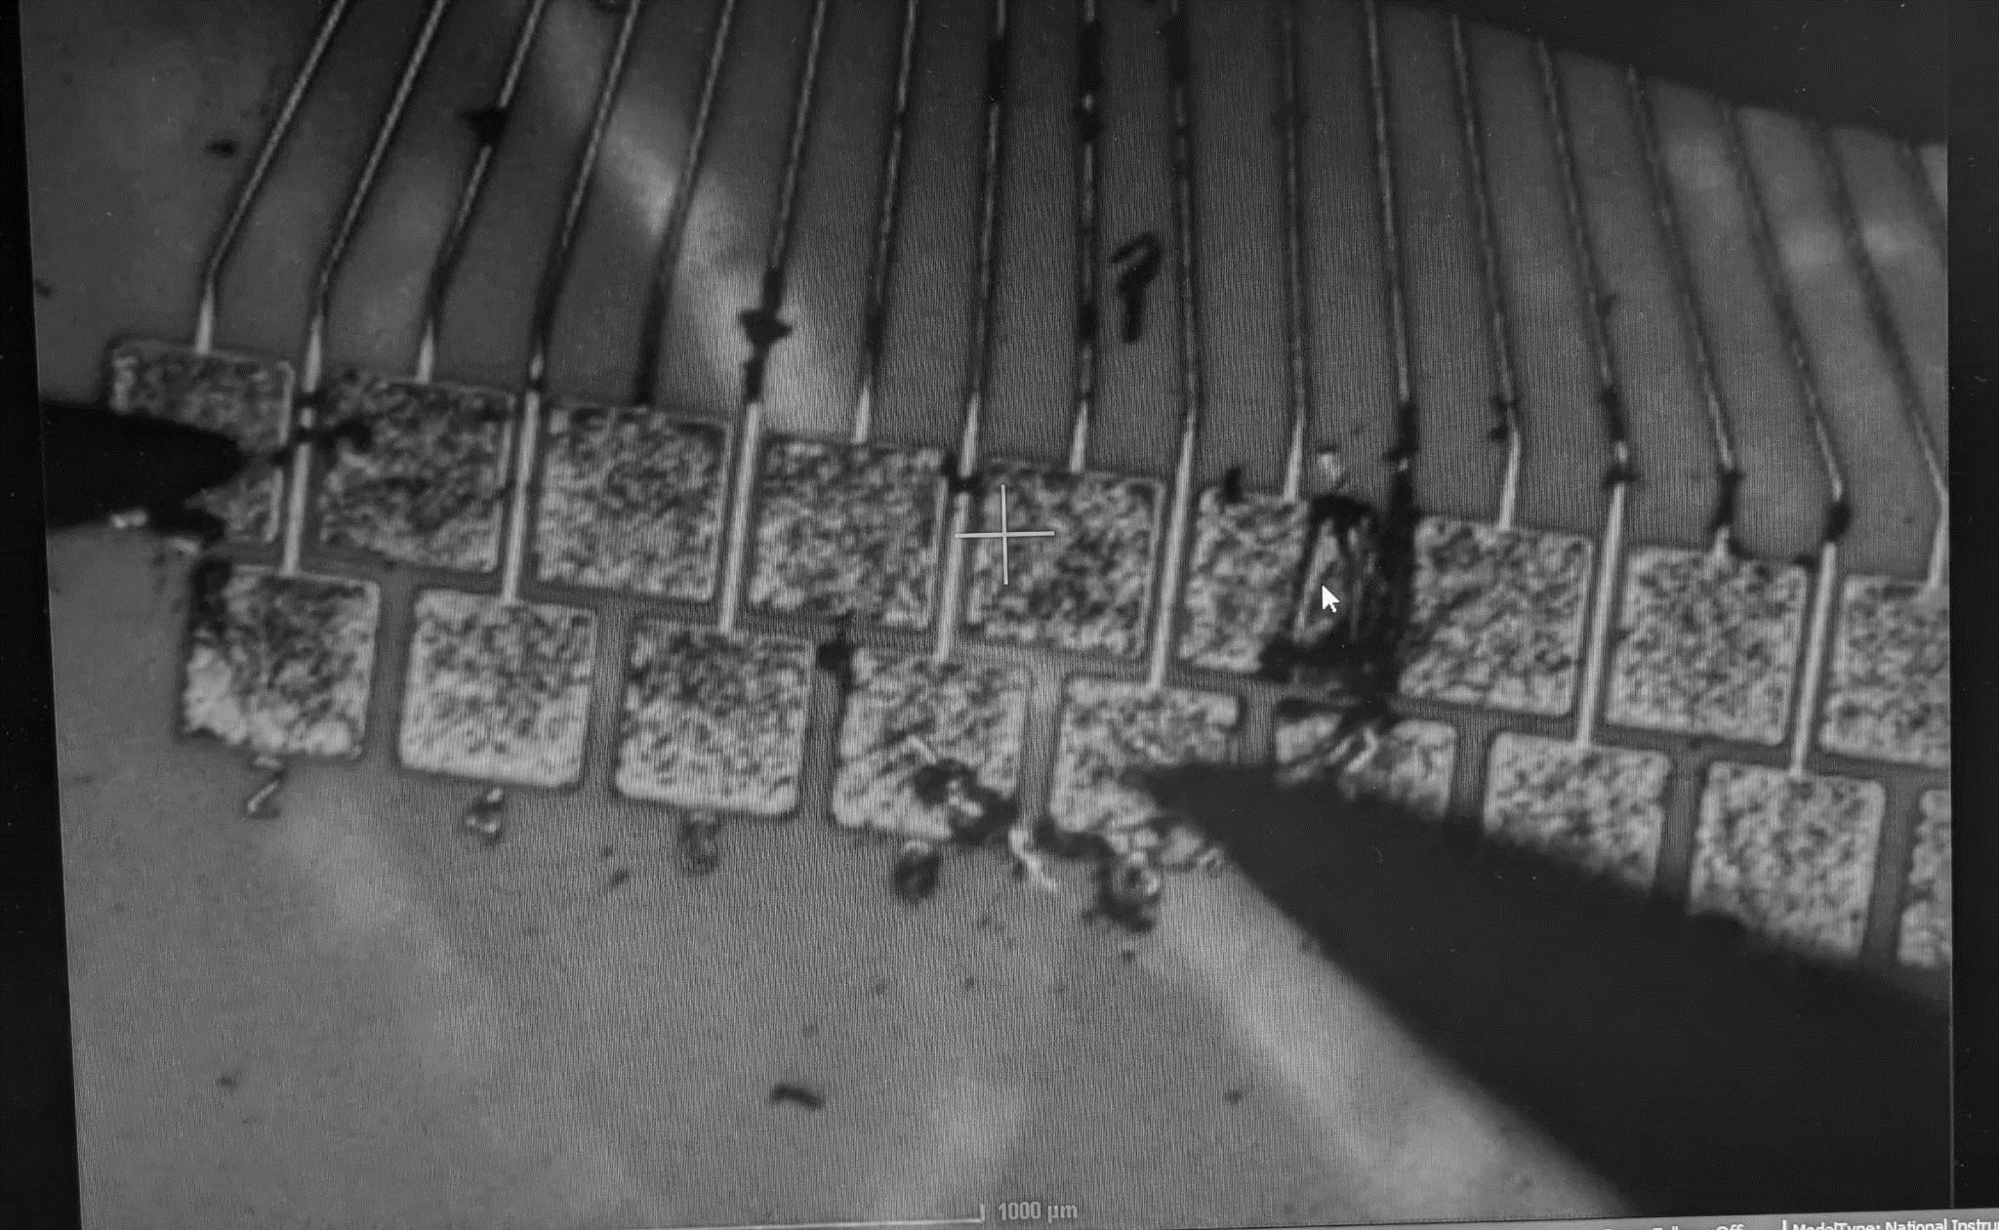


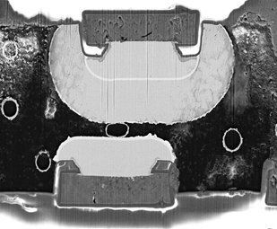

Advanced Interconnection Techniques
French-Ukrainian Workshop 2026
12 - 14 Oct 2026
Y. Khwaira², D. Dannheim¹, E. Shaheen¹, G. Calderini², M. Vicente³, M. Lauser¹, X. Aubert², A. Lale¹, N. Wood¹
¹ CERN, ² LPNHE-Paris,³Geneva Connection Technologies

Slide 2

Outline
In-house hybridization in a Nutshell.
Device Structures.
ACP and ACF Hybridisation introduction.
Aging studies setup and measurments.
Connectivity Status and Electrical Characterisations.
Conclusions and future work.

Slide 3
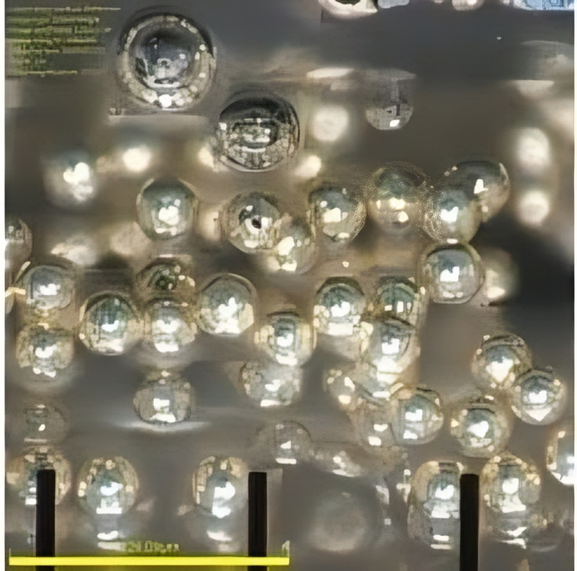
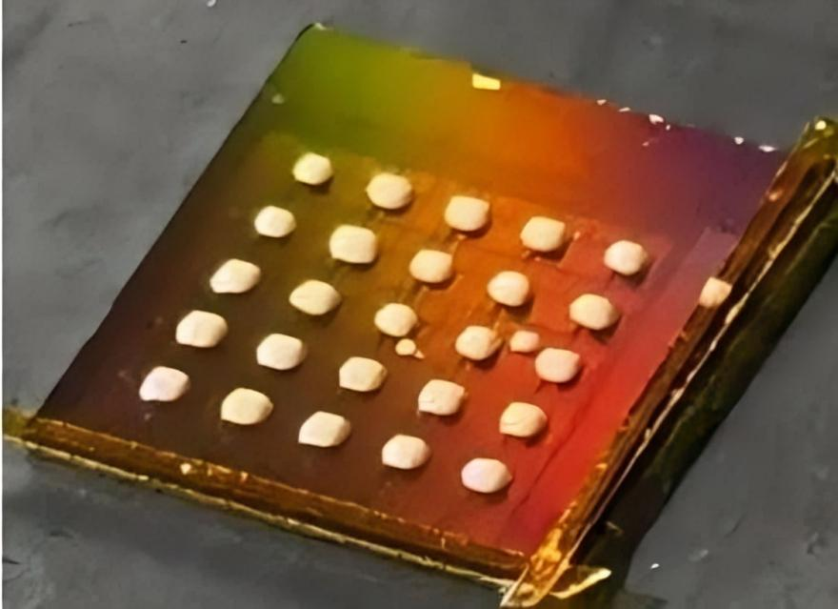
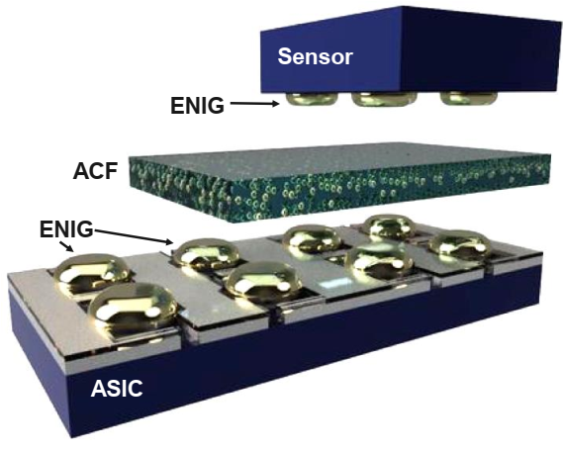
In-house hybridization in a Nutshell
  Motivation:
  High-density hybrid pixel detectors require reliable interconnections.
  Maximum in-house for short turnaround times and rapid adjustments.
  Investigate ACP/ACF for fast, low-cost detector assembly.
  Our work focuses on two key stages:
    The creation of ENIG (Electroless nickel immersion gold) bumps thought UBM (Under bump metalization) plating at CERN (Ahmet Talk for more info).
    Flip-chip hybridization process using ACF (Anisotropic Conductive Film) and ACP Hybridisation ACP (Anisotropic Conductive Paste).
  An innovative interconnection technique to:
    Single die processing.
    Adaptable to the application.
    Scalable and cost-efficient.
    Low temperature process.
ACP Hybridisation (Anisotropic Conductive Paste)
Conductive Particles
ACP drops on the chip
ACP mixtures: Araldite 2011 + conductive particles
ACF Hybridisation (Anisotropic Conductive Film)
Top chip
ACF Conductive Particles
ENIG Bumps
Bottom chip
3

Slide 4
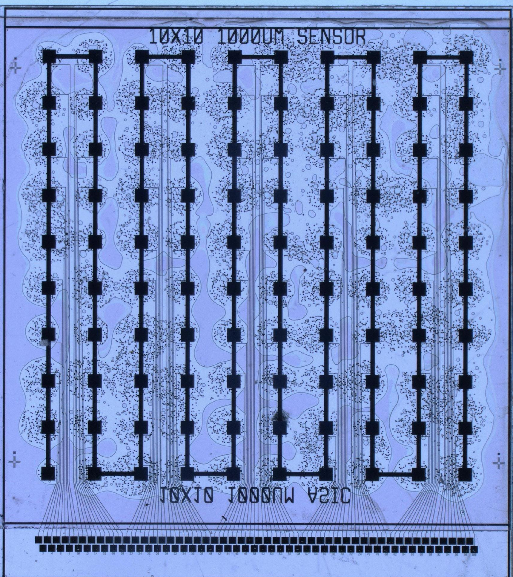
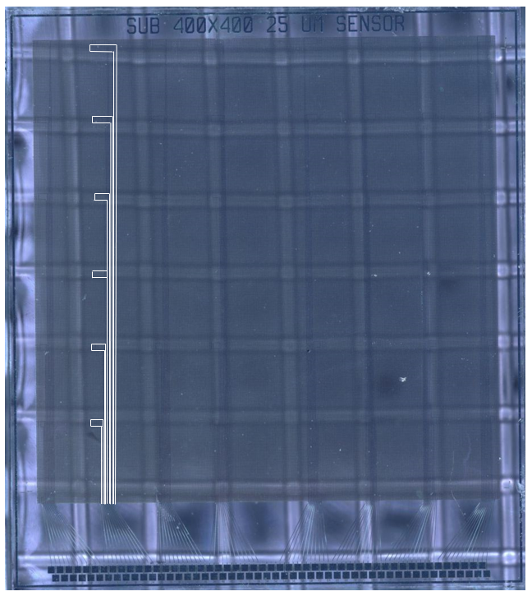
Devices Structure
  Two testing devices designed by FBK:
    Interconnection routing in continuous column-wise structure (Daisy Chain).
    Independent islands, with series of connections varied in length per Island.
1. Daisy Chain Device
10x10 - 1mm pitch
2. Island-Like Device
8x6 - 25μm pitch
Hybridisation with ACP
Hybridisation with ACF
4

Slide 5
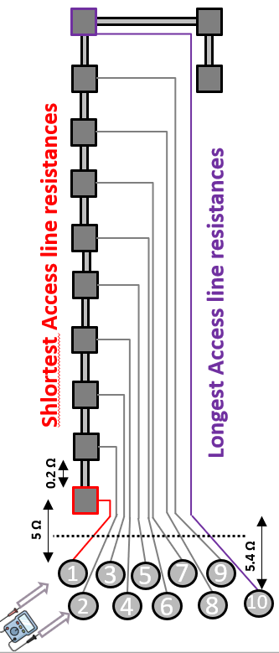
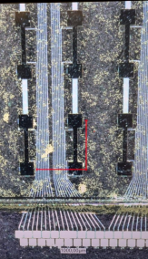
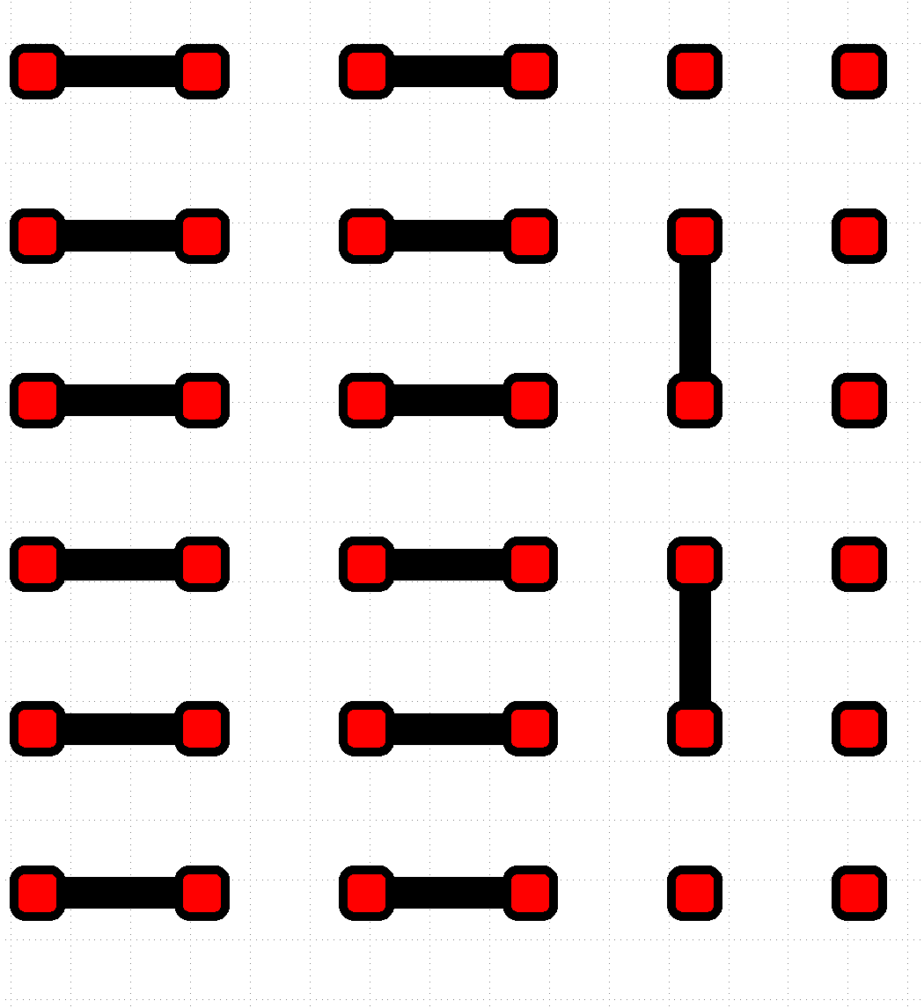
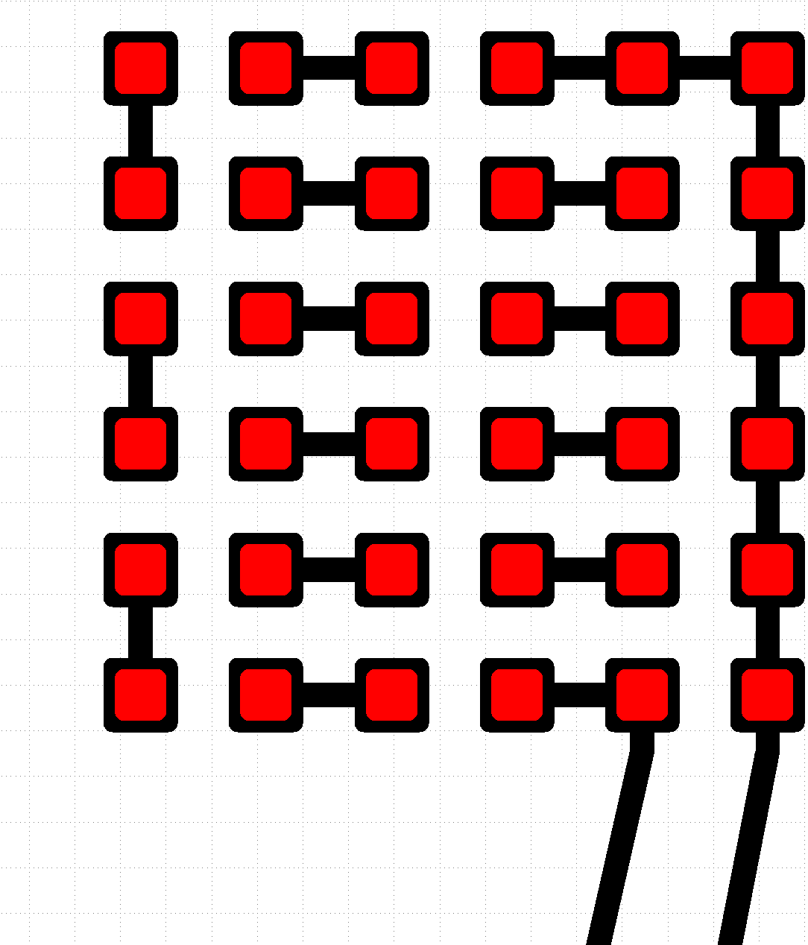
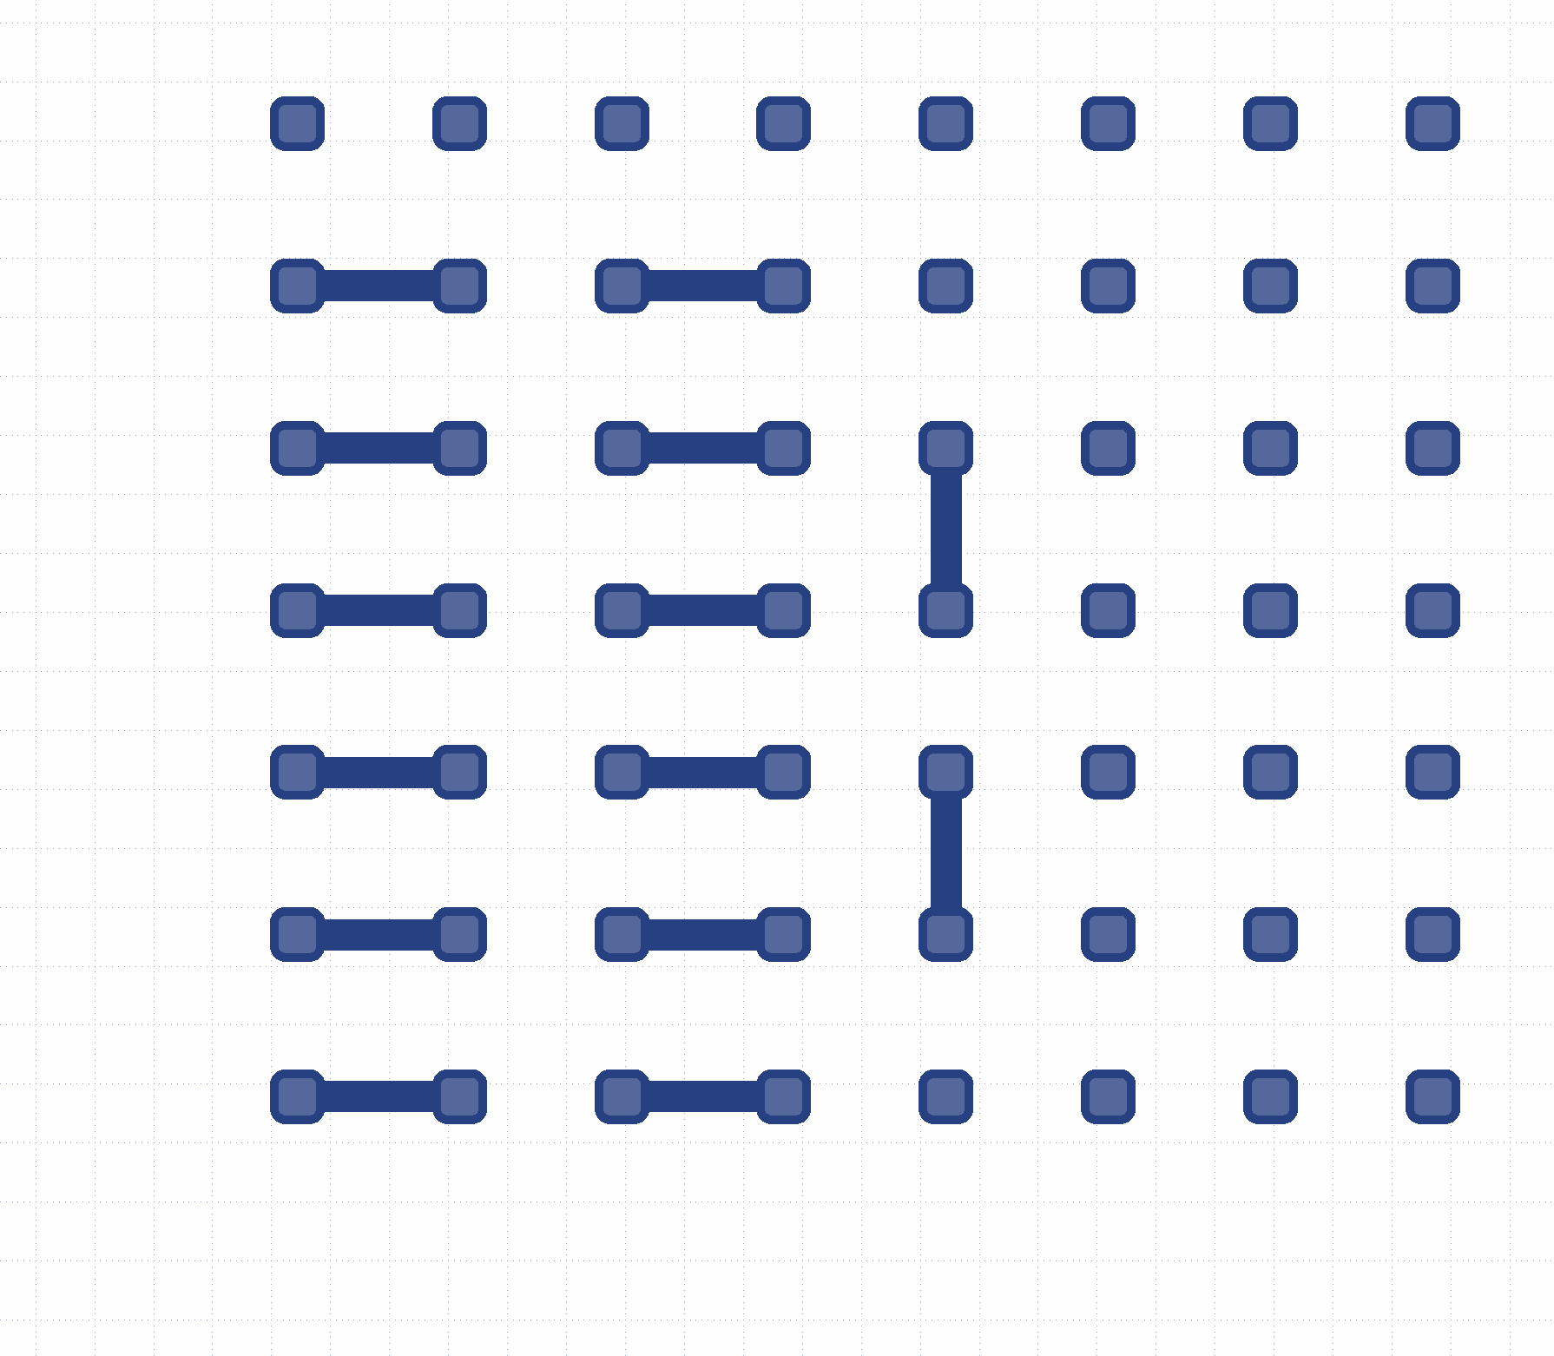
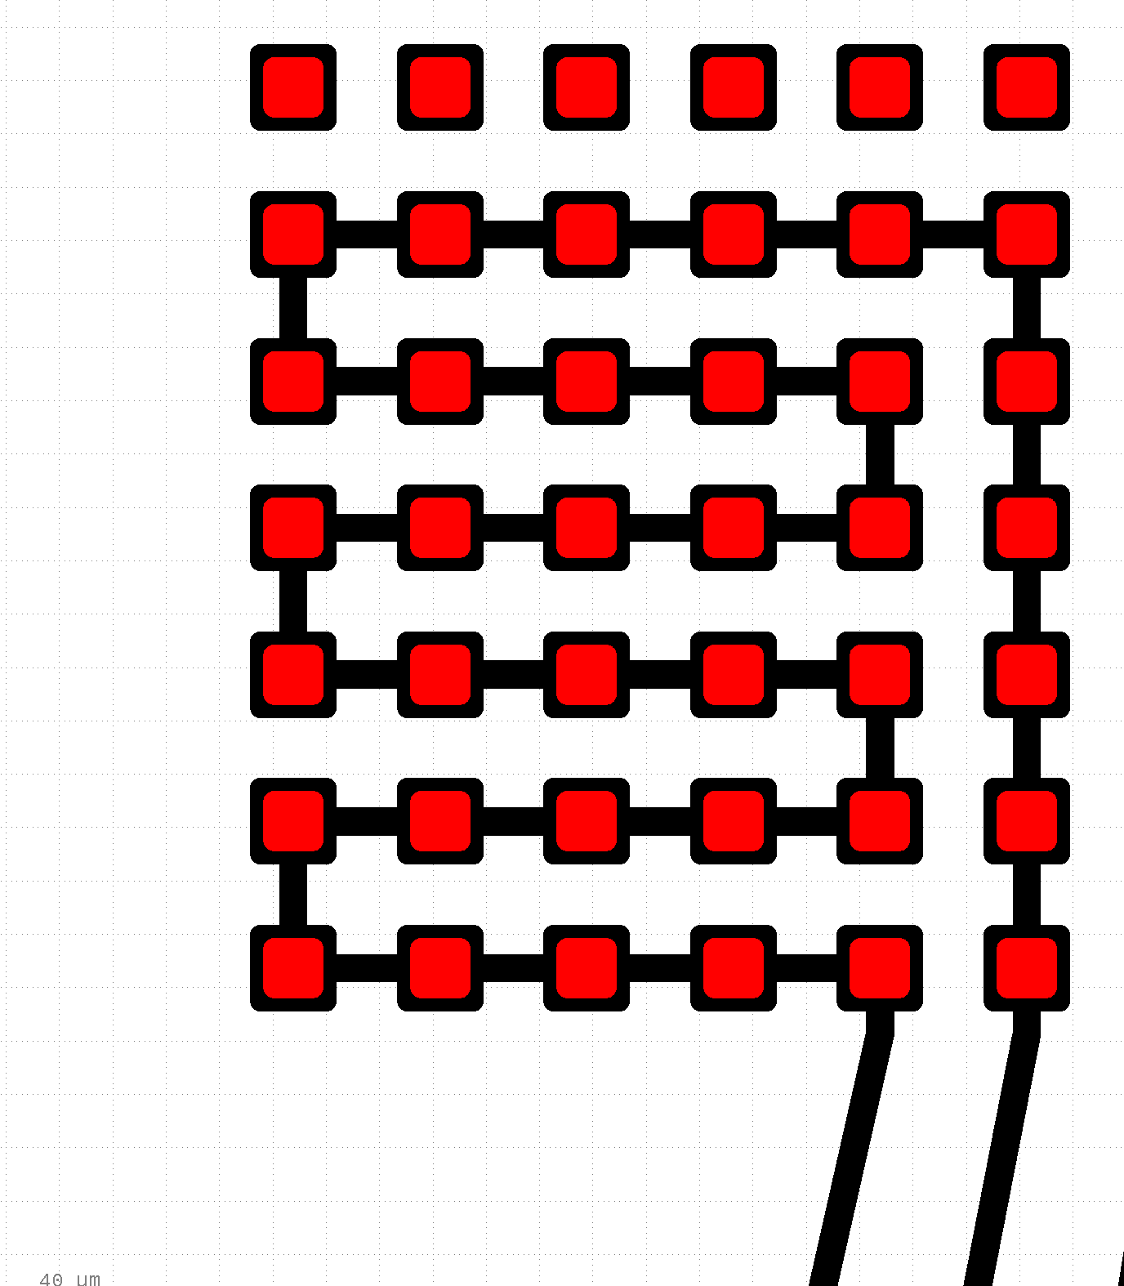
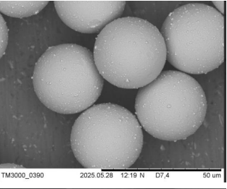
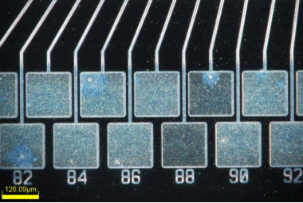
ACP Hybridisation
Daisy Chain Device
10x10 1mm pitch, ACP of 30μm
  Hybridisation of chips with ACP:
    No UBM involved.
    Interconnections accessible with highly oxidised pads.
    A Column-major routing
    Continuous daisy chains.
    4 daisy chains testing assemblies done with ordinary and spiky particles.
.. Etc
Top Chip
Pattern
Bottom Chip
Pattern
Flip-chip Daisy chain
+
=
30μm
Conductive Particles
2 Wires
Resis. Meas.
Lengths are not to scale.
5

Slide 6
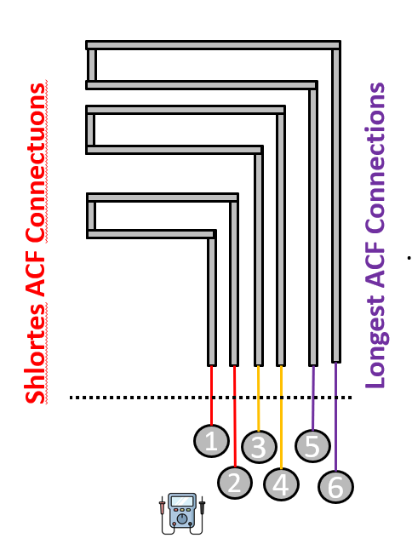
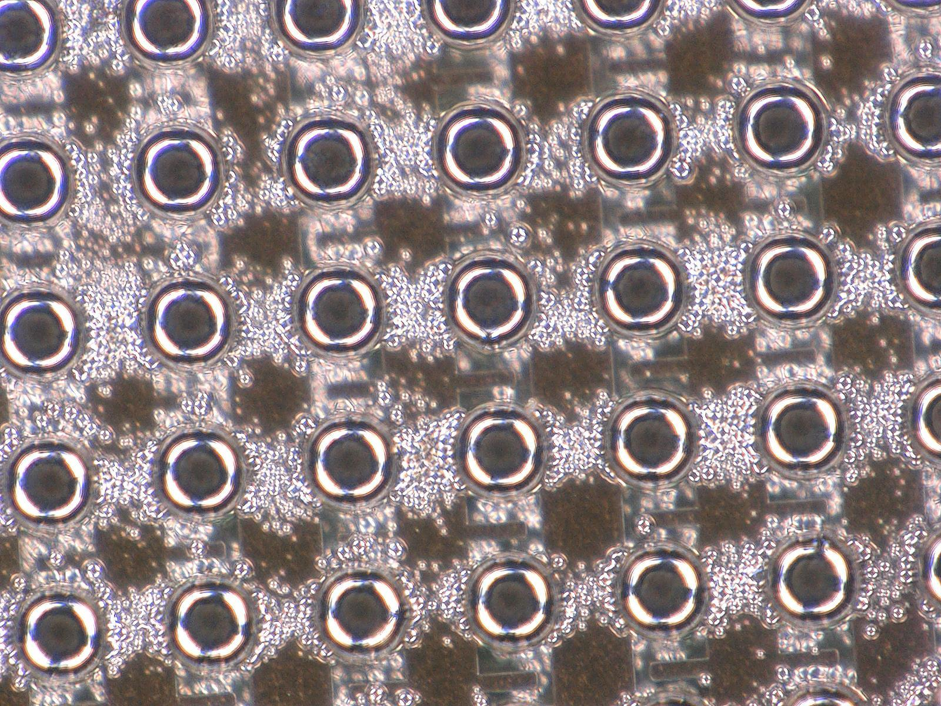
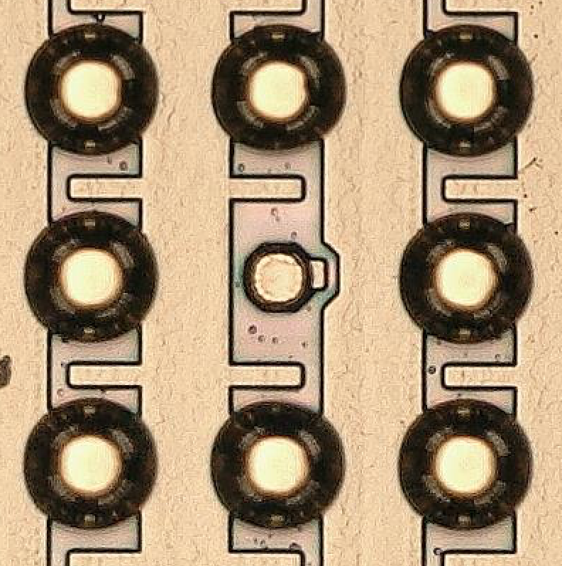
ACF Hybridisation
Island-Like Device - 6x8 Matrix - ACF
  Hybridisation of chips with ACF:
    UBM involved.
    Interconnections accessible with highly oxidised pads.
    Island-like routing with independent access pads/lines.
    5 assemblies done with 48 Island structure (6x8 matrix).
ACF Challenges due to UBM:
  Uniformity of nickel bump height across different chips.
  Non-plated or skipped pads and incomplete coverage.
  Reproducibility of deposition between chips and batches.
  Overplating, where unwanted areas are plated.
Plated pads
Skipped pad
Over-plating
6

Slide 7
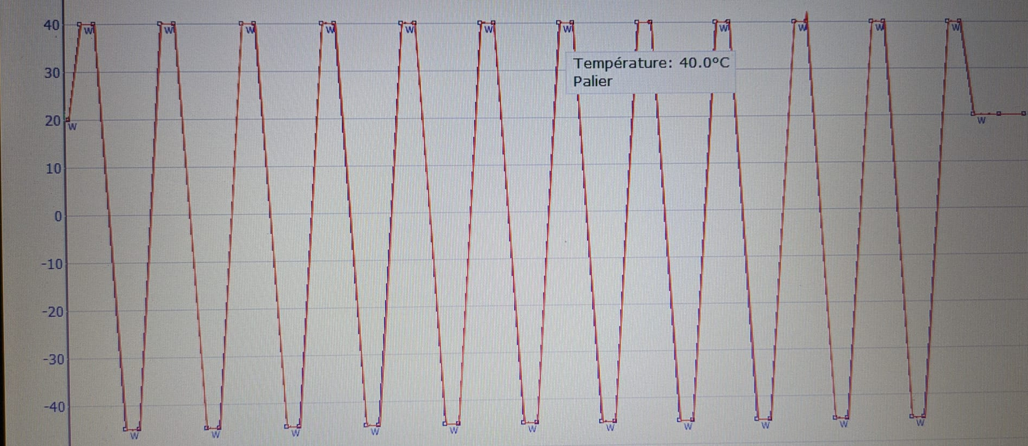
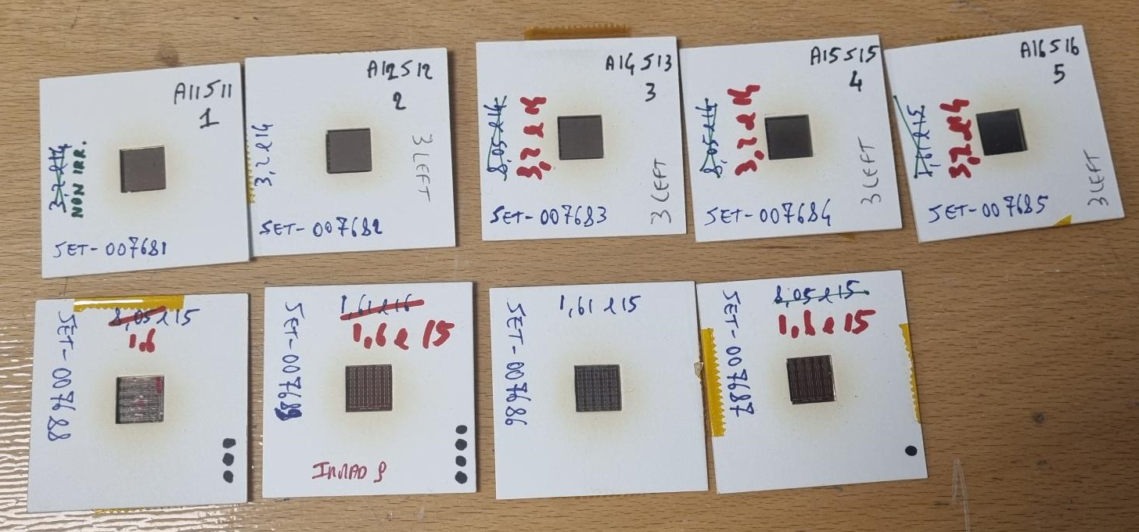
Aging Studies and Measurements
  Testing Steps:
    Before Thermal cycling.
    After Thermal cycling
      10 TC’s : 40°C → -45°C in 30mins, at each target value → 15mins dwell time.
    1st cycle of irradiation (1.81 × 10¹⁴ neq/cm² and 1.2 × 10¹⁵ neq/cm²)
    2nd cycle of irradiation up to 5.37 x 10¹⁶ neq/cm².
    Irradiation is ongoing.
  Electrical Characterisations:
    Evaluate the access lines resistances for ACP/ACF assemblies.
    Connectivety (Open/Connected), resistance per connection and yield.
    Overall resistance on full chain.
Thermal Cycling in LPNHE Climate Chamber
40°C
-45°C
@IRRAD/CERN (24 GeV p+)
5 ACF’s
4 ACP’s
ACP/ACF assemblies mounted and prepared for irradiation at IRRAD/CERN
7

Slide 8
Aging Studies and Measurements - Summary
Sample ID | Thermal Cycling | 1st step (neq/cm²) | 2nd step (neq/cm²) | Total fluence (neq/cm²)
ACF (no thermal cycling)
ACF-SET-007681 | No | Not irradiated | 5.37 × 10¹⁵ | 5.56 × 10¹⁵
ACF-SET-007682 | No | 1.81 x 10¹⁴ | 5.37 × 10¹⁵ | 5.56 × 10¹⁵
ACF-SET-007683 | No | 1.81 x 10¹⁴ | 5.37 × 10¹⁵ | 5.56 × 10¹⁵
ACF-SET-007684 | No | 1.81 x 10¹⁴ | 5.37 × 10¹⁵ | 5.56 × 10¹⁵
ACF-SET-007685 | No | 1.81 x 10¹⁴ | 5.37 × 10¹⁵ | 5.56 × 10¹⁵
ACP (10 thermal cycles)
ACP-SET-007686 | Yes, 10 TC’s | 1.2 × 10¹⁵ | 5.37 × 10¹⁵ | 6.39 × 10¹⁶
ACP-SET-007687 | Yes, 10 TC’s | 1.2 × 10¹⁵ | 5.37 × 10¹⁵ | 6.39 × 10¹⁶
ACP-SET-007688 (spiky Particle) | Yes, 10 TC’s | 1.2 × 10¹⁵ | 5.37 × 10¹⁵ | 6.39 × 10¹⁶
ACP-SET-007689 | Yes, 10 TC’s | 1.2 × 10¹⁵ | 5.37 × 10¹⁵ | 6.39 × 10¹⁶
8

Slide 9
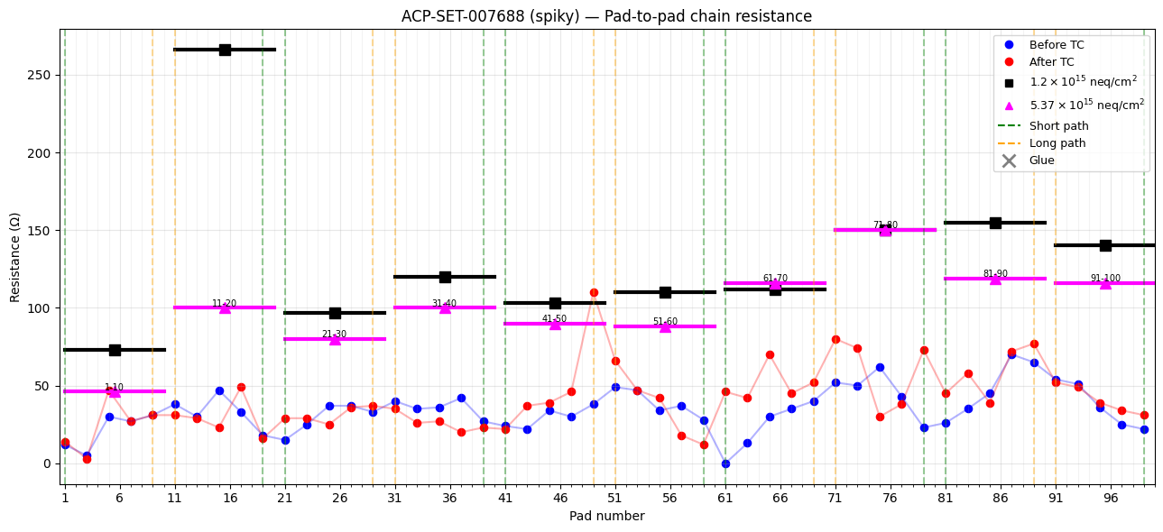
Aging Studies and Measurements (ACP)
Overall resistance remains stable during irradiation; a few scattered points are attributed to measurement fluctuations.
The resistance contribution from the access lines is reproducible across all pads.
9

Slide 10
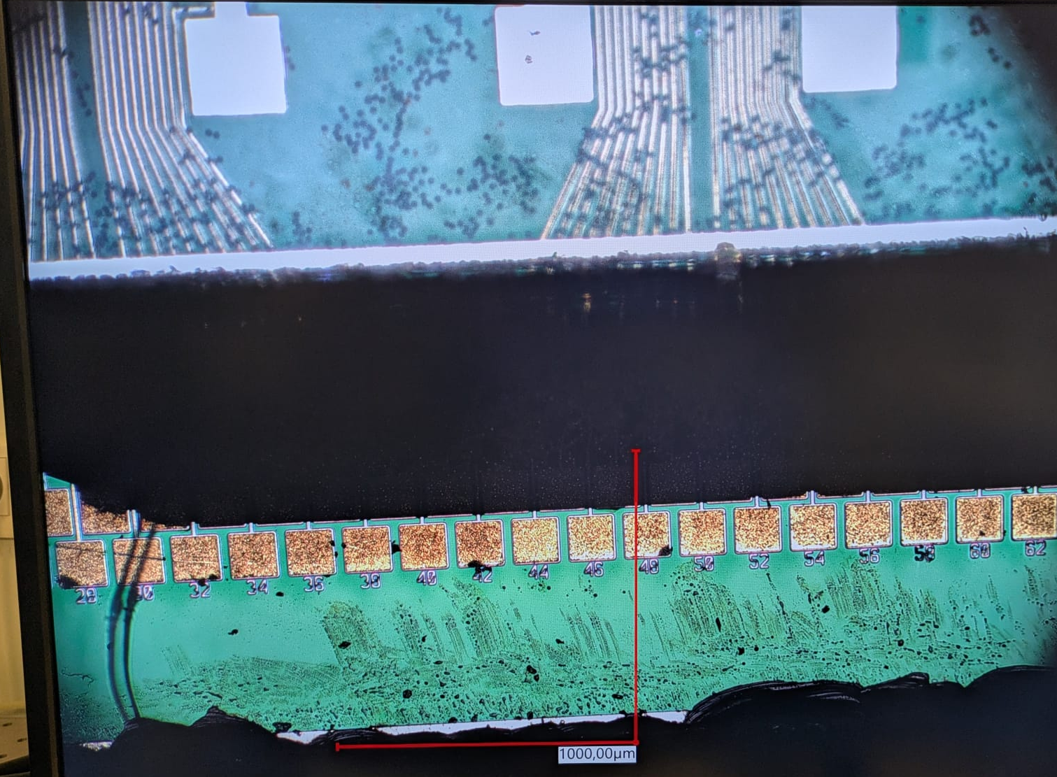
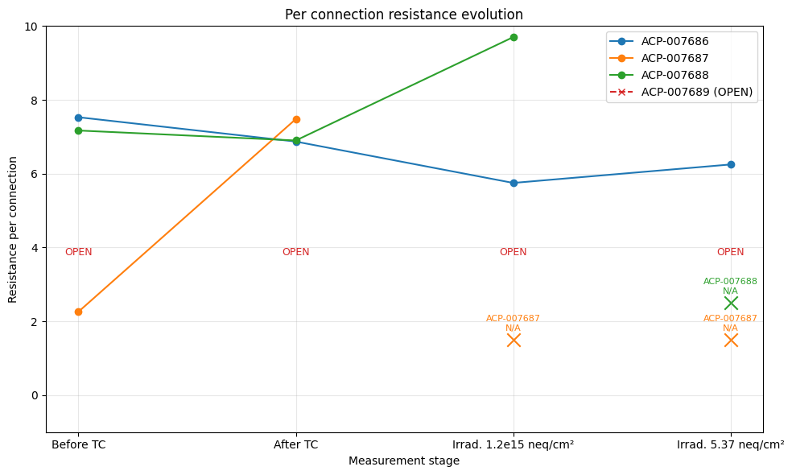
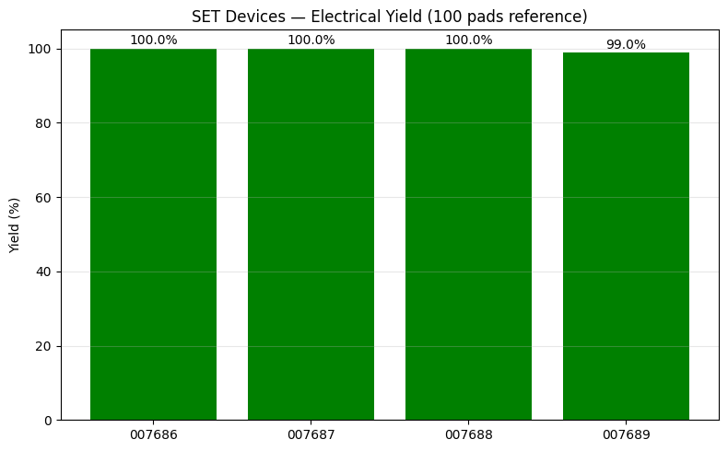
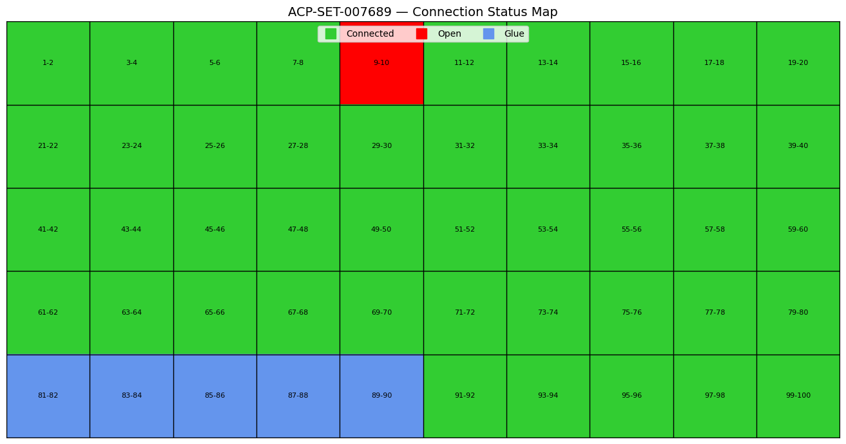
Aging Studies and Measurements (ACP) - Summary
  Connectivity Status and resistance per connection
    400 ACP connections with only one open connection (seen before TC).
    99,75% connectivity yield after 6.39 × 10¹⁶ (neq/cm²).
    Limited number of pads covered with glue due to squeeze-out, no measurement was possible on glued covered pads.
Top pads covered with glue
ACP
10

Slide 11
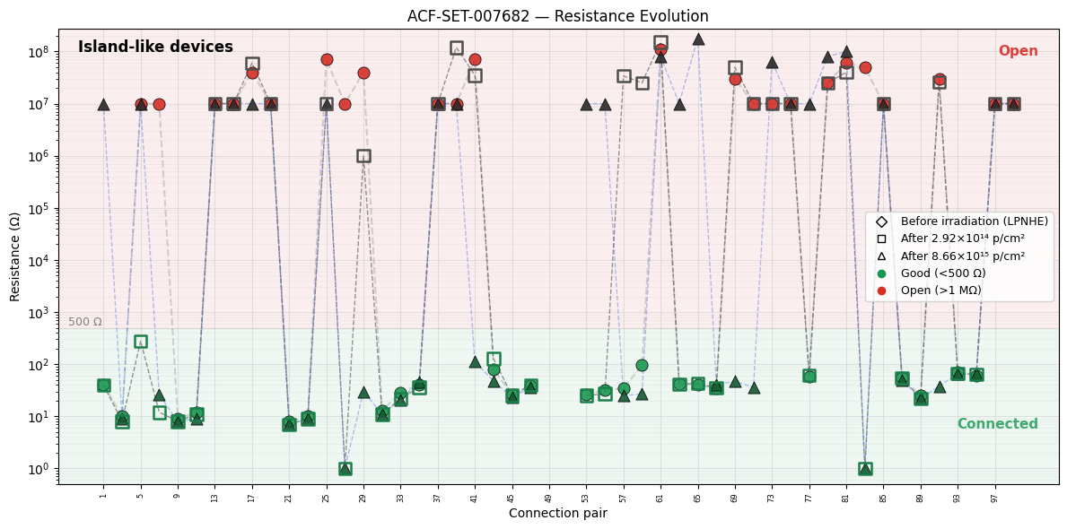
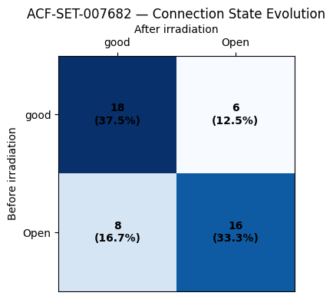
Aging Studies and Measurements (ACF)
  5 Testsed assemblies
    Broad ranges of resistance values, classified into two regions.
    Transition matrix identifies connection state direction.
State transition
11

Slide 12
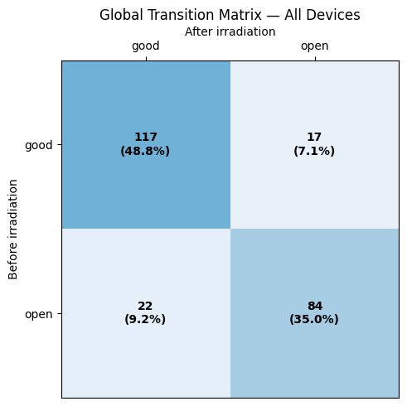
Aging Studies and Measurements (ACF) - Summary
  5 irradiated assemblies
    192 measurements (48 pad paris/device).
    Most connection pairs remain in their original state after irradiation (Matrix diagonal).
    Overall state stability is high (~84%) in the matrix diagonal.
    Limited degradation after irradiation is observed.
    Limited recovery/improvement of open connections – or due to measurement fluctuation.
      Open → Good: 22 (9,7%)
      Good → Open: 17 (7.1%)
State transition
12

Slide 13
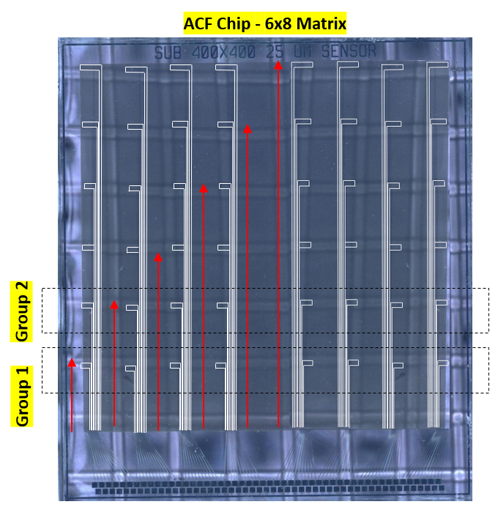
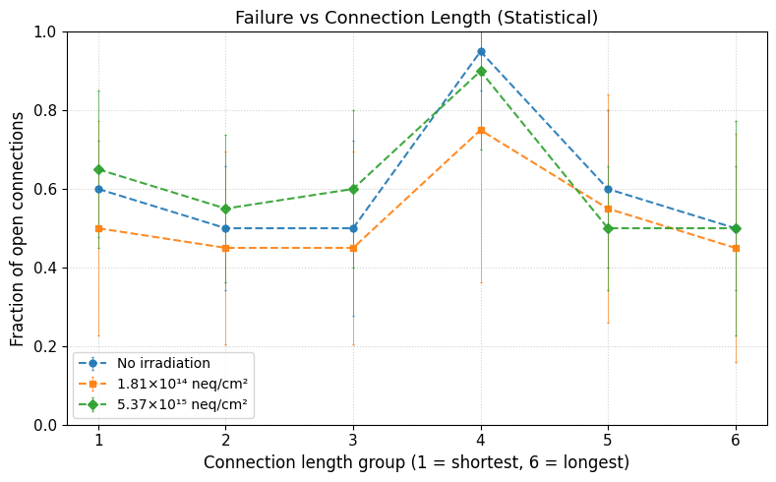
Aging Studies and Measurements (ACF) - Summary
  5 irradiated assemblies summary
    Strong correlation of open connection in Group 4 Islands that is consistent in the three stages.
    No other clear dependences on the connection length in Group 1,2,3,5,6.
    The fraction of open connections tends to be stable for all other groups in the three testing stages.
13

Slide 14
Conclusions and future work
  4 ACP - thermal cycled and irradiated daisy chains assembled and studied:
  Excellent electrical connectivity, with 99.75% connectivity yield before/after 6.39 × 10¹⁶ neq/cm², indicating no degradation due to environmental or irradiation tests.
  Pad-to-pad resistance remained stable, with an overall access line resistance of approximately 32 Ω across the full chain.
  While the initial results are promising, a larger statistical sample is required to confirm the observed performance and to eliminate discrepancies.
  5 ACF - irradiated assemblies assembled and studied:
  The majority of connections remained in the same electrical state after irradiation, with an overall state stability of ~84%.
  A small fraction of connections changed state, with both Good → Open (7.1%) and Open → Good (9.7%) transitions, suggesting that part of these variations may be related to measurement fluctuations.
  No correlation was found between connection length and electrical performance.
    Additional irradiated assemblies are required to improve the statistical significance of these observations and confirm the identified trends.
  Future work:
  Extend the irradiation campaign.
  Improve measurements stability.
  More samples (better statistics).
  Disassembling selected assemblies to understand failure mechanisms (electrical or microscopic characterization).
14

Slide 15
Thanks ☺

Slide 16
Backup

Slide 17
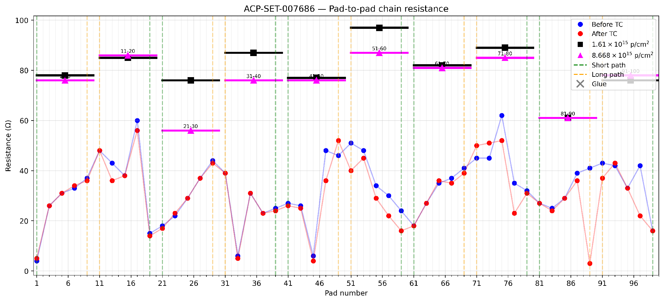
Aging Studies and Measurements (ACP)
  Pad-to-pad resistance evaluation
    2-Pad and 10-Pad Segmentation measurements.
    Overall access lines resistance: 32Ω (From Pad 1 to Pad 100).
14

Slide 18
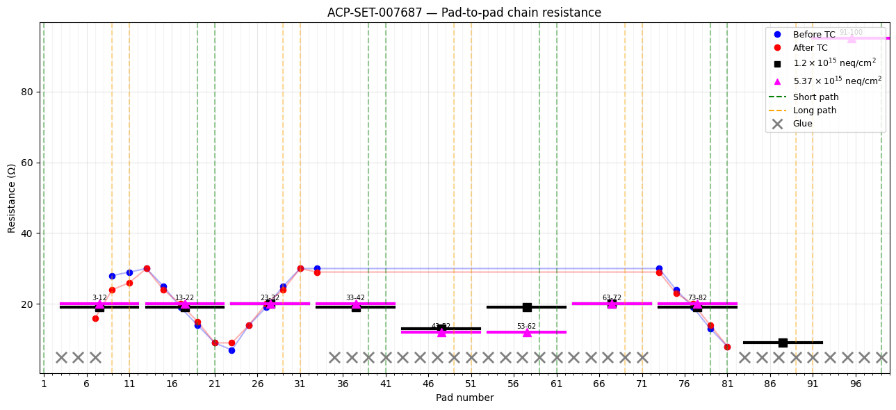
Aging Studies and Measurements (ACP)
  Pad-to-pad resistance evaluation
    2-Pad and 10-Pad Segmentation measurements.
    Overall access lines resistance: 32Ω (From Pad 1 to Pad 100).
15

Slide 19
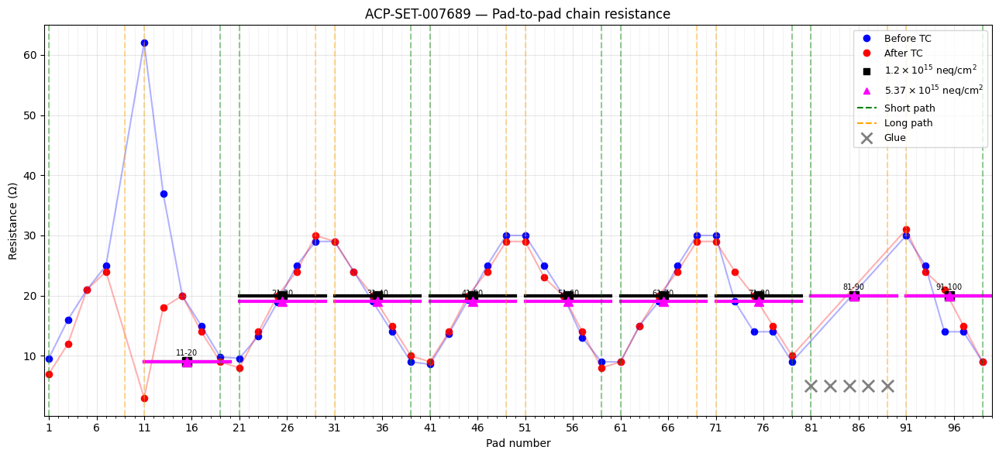
Aging Studies and Measurements (ACP)
  Pad-to-pad resistance evaluation
    2-Pad and 10-Pad Segmentation measurements.
    Overall access lines resistance: 32Ω (From Pad 1 to Pad 100).
16

Slide 20
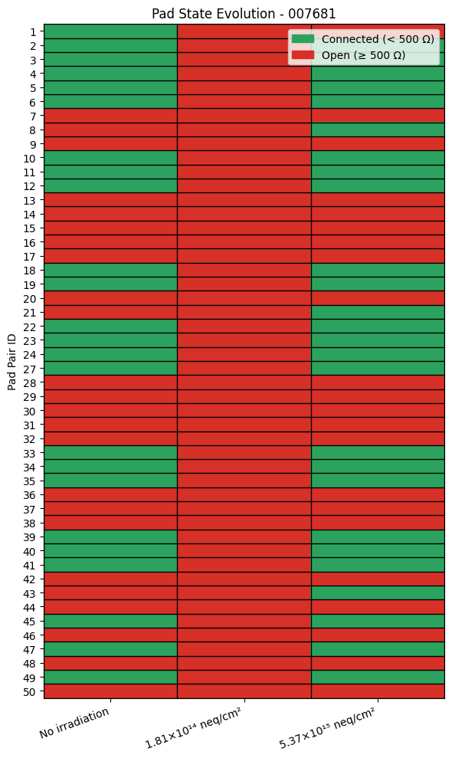
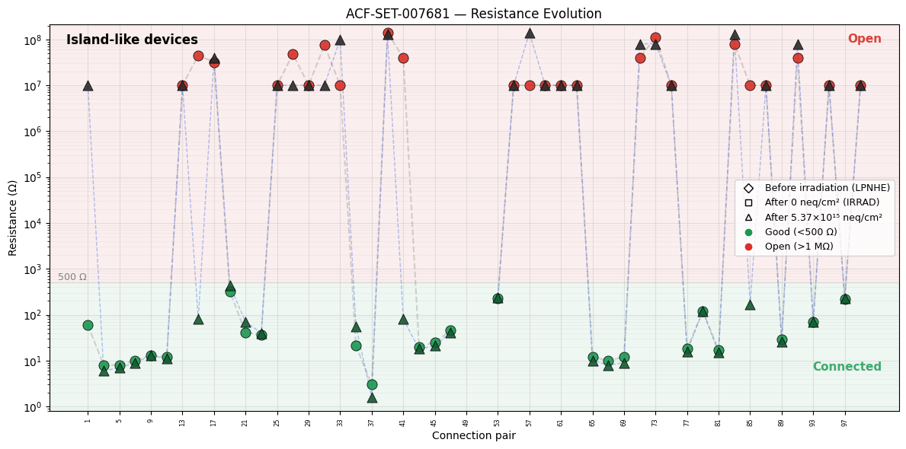
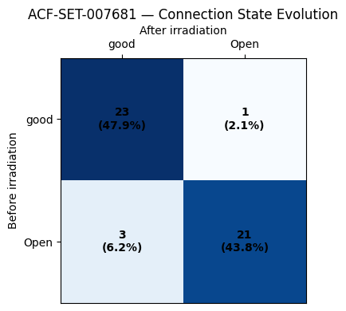
Aging Studies and Measurements (ACF)
  5 Testsed assemblies
    Broad ranges of resistance values, classified into two regions.
    Transition matrix identifies connection state direction.
32Ω
29.2Ω
24.1Ω
14.8Ω
8.6Ω
5.4Ω
Island
Location
Resistances
State transition
17

Slide 21
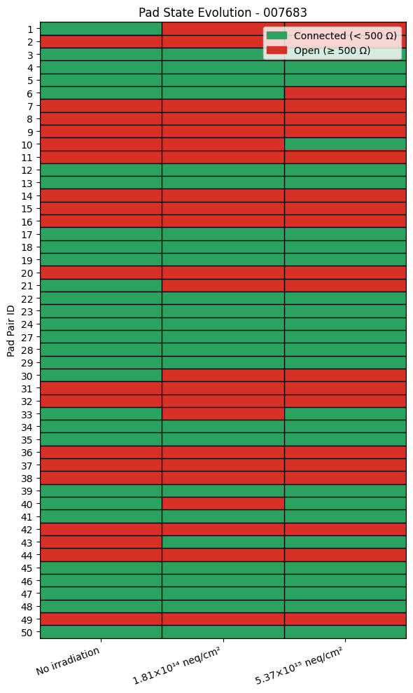
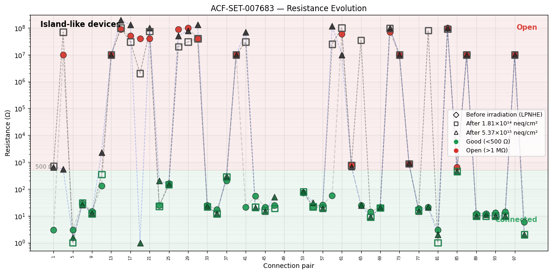
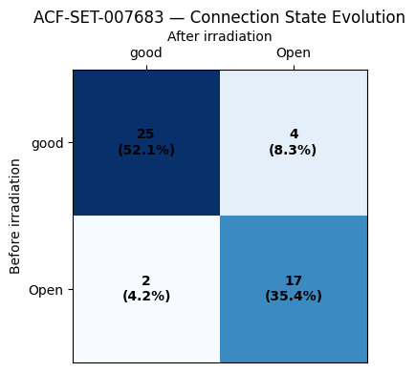
Aging Studies and Measurements (ACF)
  5 Testsed assemblies
    Broad ranges of resistance values, classified into two regions.
    Transition matrix identifies connection state direction.
State transition
18

Slide 22
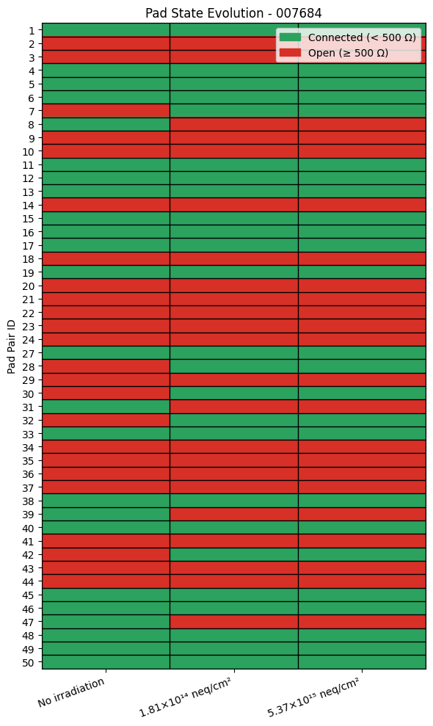
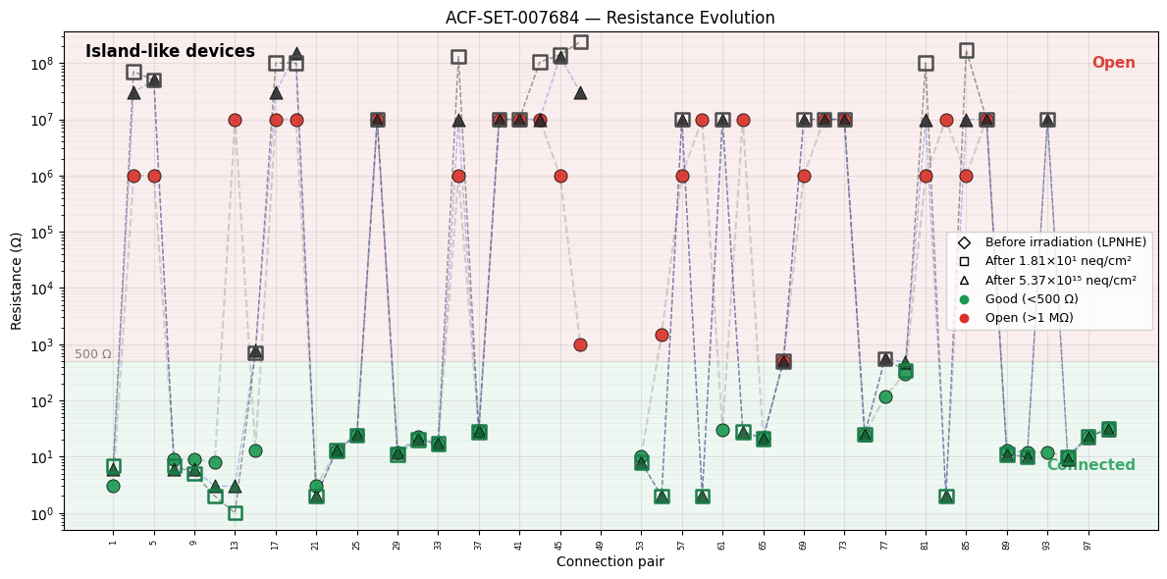
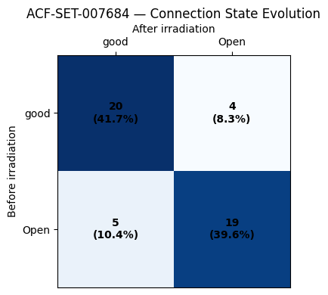
Aging Studies and Measurements (ACF)
  5 Testsed assemblies
    Broad ranges of resistance values, classified into two regions.
    Transition matrix identifies connection state direction.
State transition
19

Slide 23
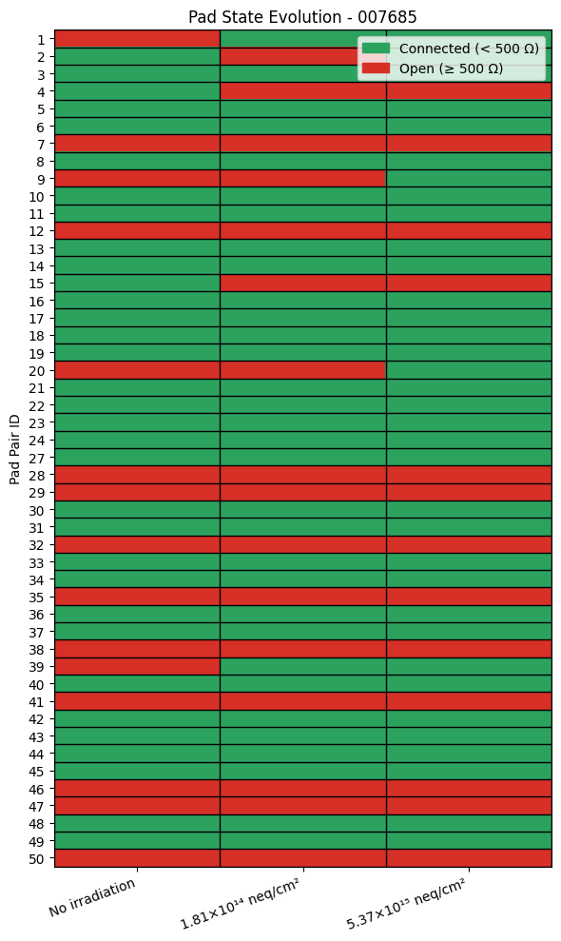
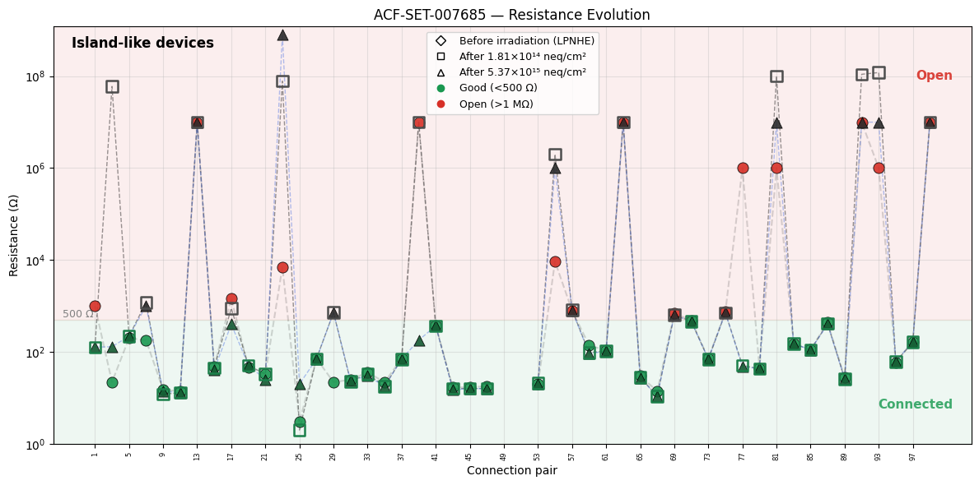
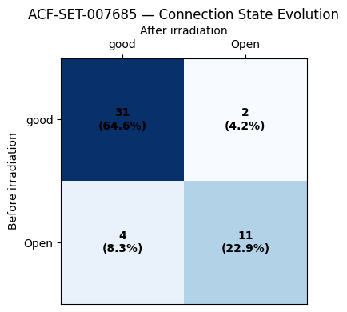
Aging Studies and Measurements (ACF)
  5 Testsed assemblies
    Broad ranges of resistance values, classified into two regions.
    Transition matrix identifies connection state direction.
State transition
20

