Slide 1

Challenge Based Innovation
Boosting innovation around particle accelerator technoligy
12th October 2026
Nicolas DELERUE
This project received funding from the European Union’s Horizon Europe Research and Innovation Programme under GA No. 101290927.

Slide 2
What is the CBI?
A challenge to interest and attract students on the use of accelerator technology!
Who?
  4 teams of 6 students or young professionals selected from more than 100 individual applications from across the world.
  The teams are formed by the steering committee with diversity criteria in mind (academic, country of study, gender,…).
How?
  We set them a challenge and ask them to propose an innovative use of accelerator technology!
  Online seminars before the CBI
  In-person seminars during the CBI
  On the last day they present their work in person in front of a jury at CERN.
When and where?
  During 10 days (typically the last two weeks of July) at the European Scientific Institute (ESI) in Archamps (near Geneva) with visits at CERN.
It was pioneered during the EU-funded project I.FAST thanks to an idea by Louis Rinolfi (CERN + ESI)
So far there have been 5 CBIs: 4 funded by I. FAST and 1 in Sarajevo funded thanks to a private sponsor (3PF with funds from IFIGENEIA and I. FAST/EPITA and others).
Future CBI will be organised in the framework of EPITA.

Slide 3
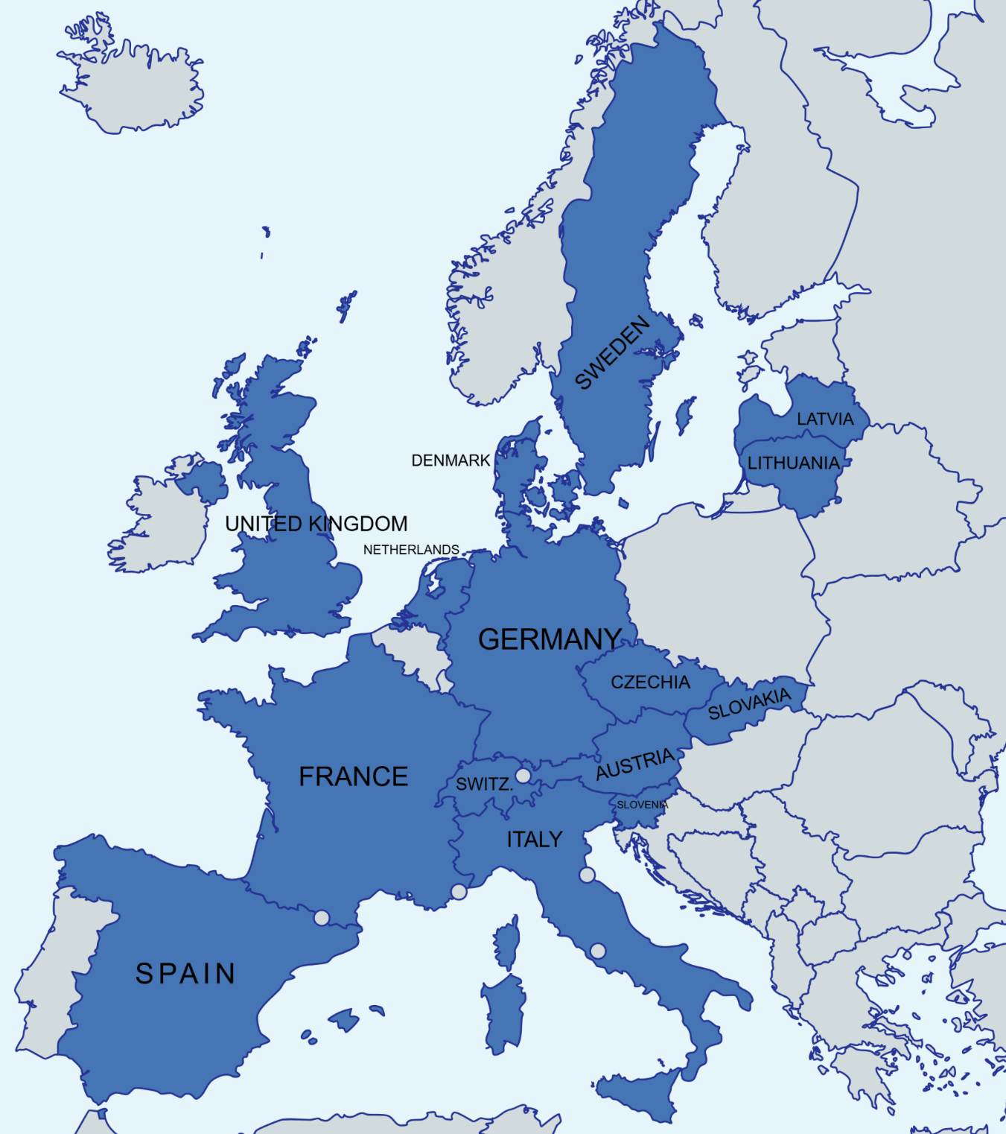


EIPTA Consortium
42 Beneficiaries + 3 Associated Partners
15 European countries + CERN and ESS
10 universities 38.5%
16 Deep-Tech
38%
6 RI operators 23%
10 research labs 38.5%

Slide 4











































Slide 5
Project fact sheet
Project number and acronym: GA No. 101290927 – EPITA
Start date: 1 May 2026
End date: 30 April 2030
Duration: 48 months
Reporting Periods: 2 periods of 24 months each
Consortium: 42 Beneficiaries + 3 Associated Partners
Maximum EU contribution: 9,999,999.75 €
12 Work Packages
49 deliverables and 44 milestones
Note:
The GA was signed by CERN & EU on 11.05.2026
Next step: Beneficiaries to sign their Accession Form

Slide 6
Past CBIs
So far there have been 5 CBIs: 4 funded by I. FAST and 1 in Sarajevo funded thanks to a private sponsor (3PF with funds from IFIGENEIA and I. FAST/EPITA and others).
2022 and 2023: Topic was “Accelerators for the environment”
2024 and 2025: Topic was “Accelerators for healthcare”
2026: Topic was “how particle accelerators can be used to address societal issues; case study: implementation in the Balkans”

Slide 7
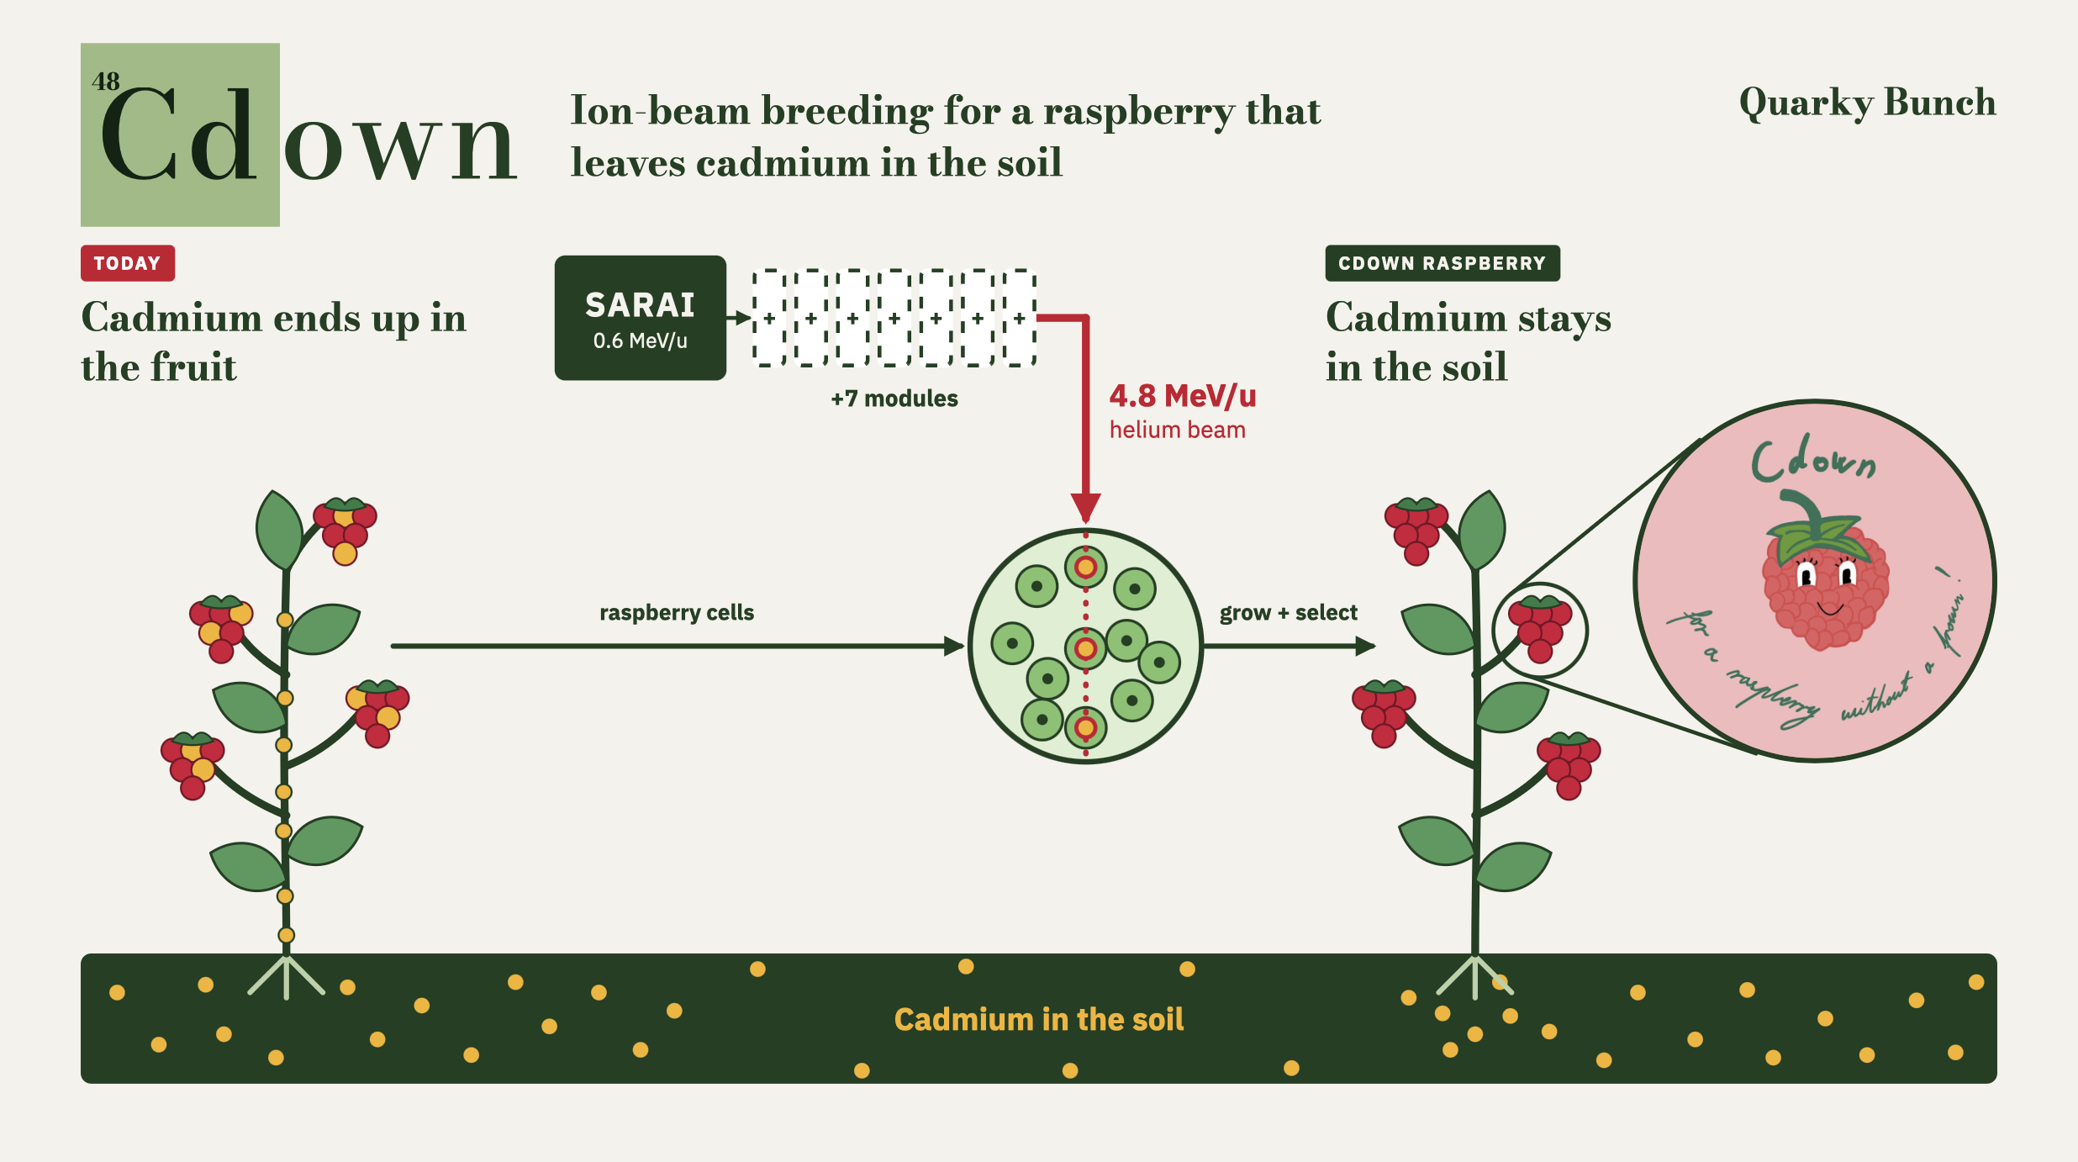
Example of past projects:2026

Slide 8
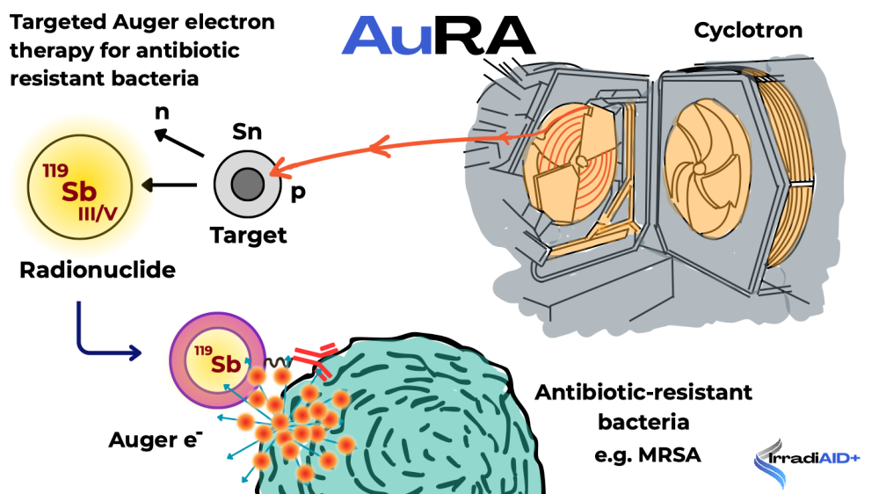
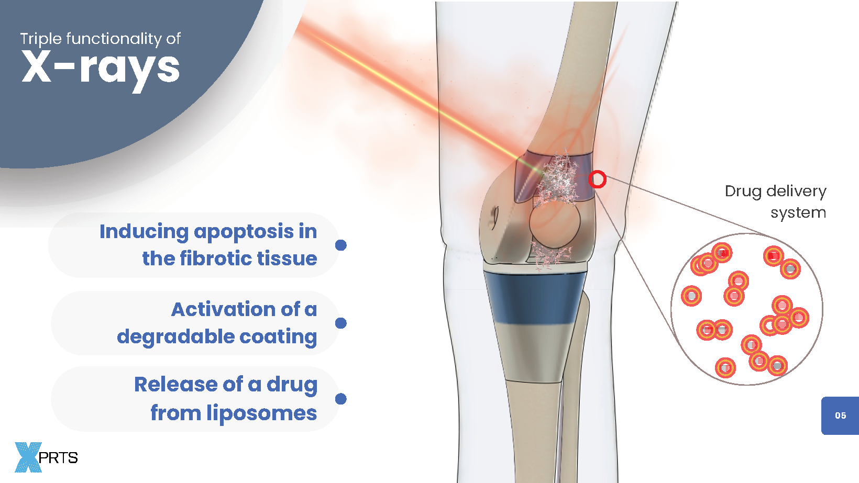
Example of past projects
2025 and 2024

Slide 9
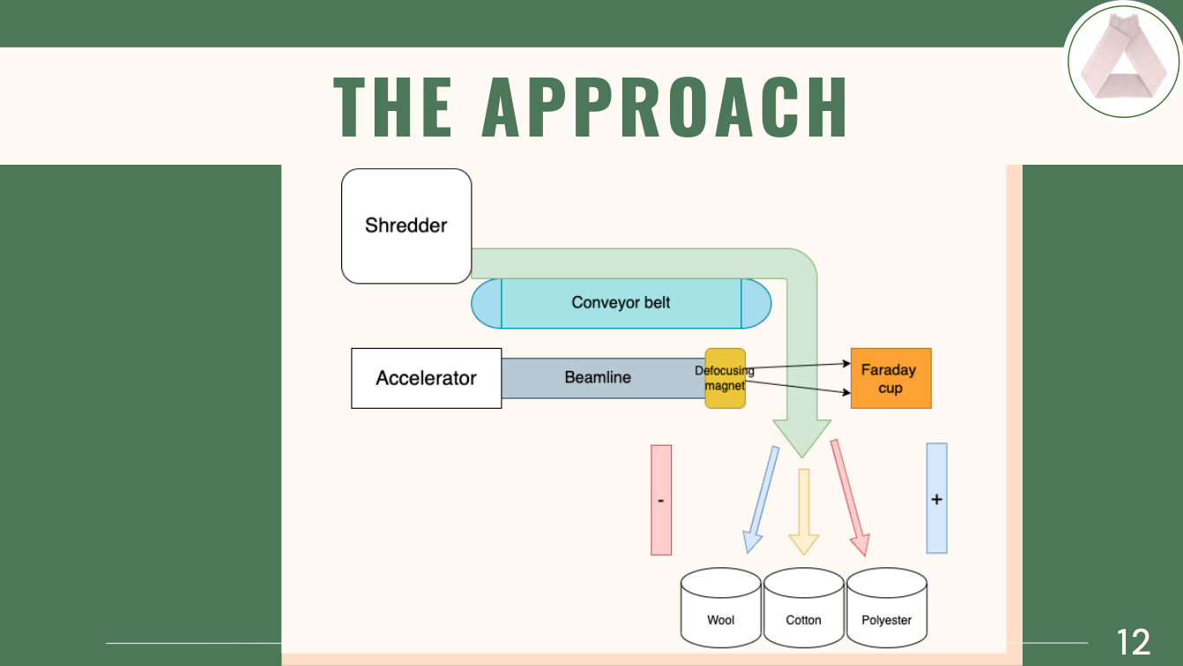
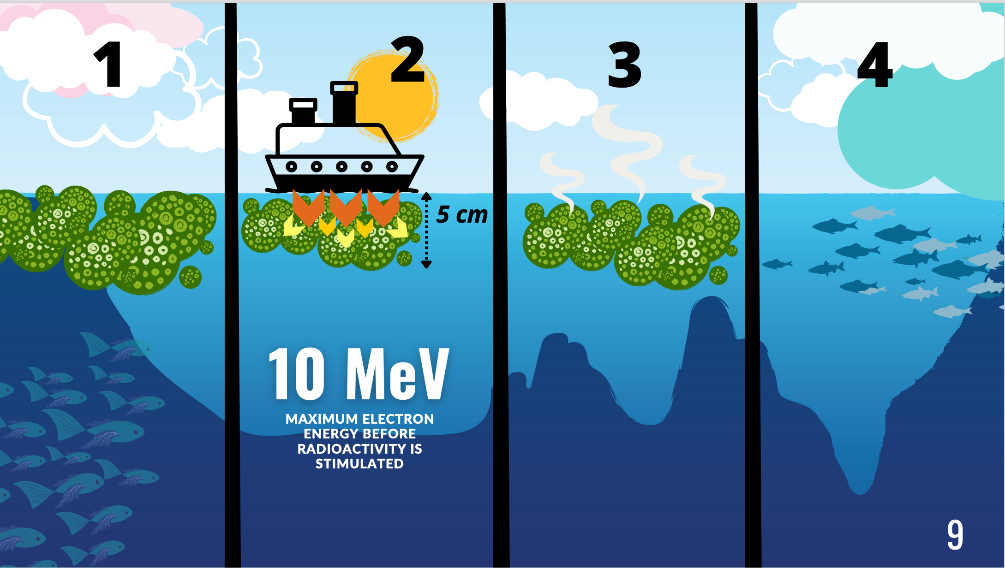
Example of
past projects
2023 and 2022

Slide 10
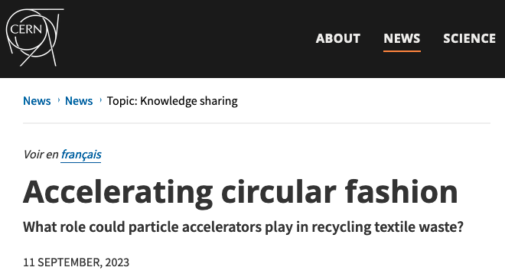

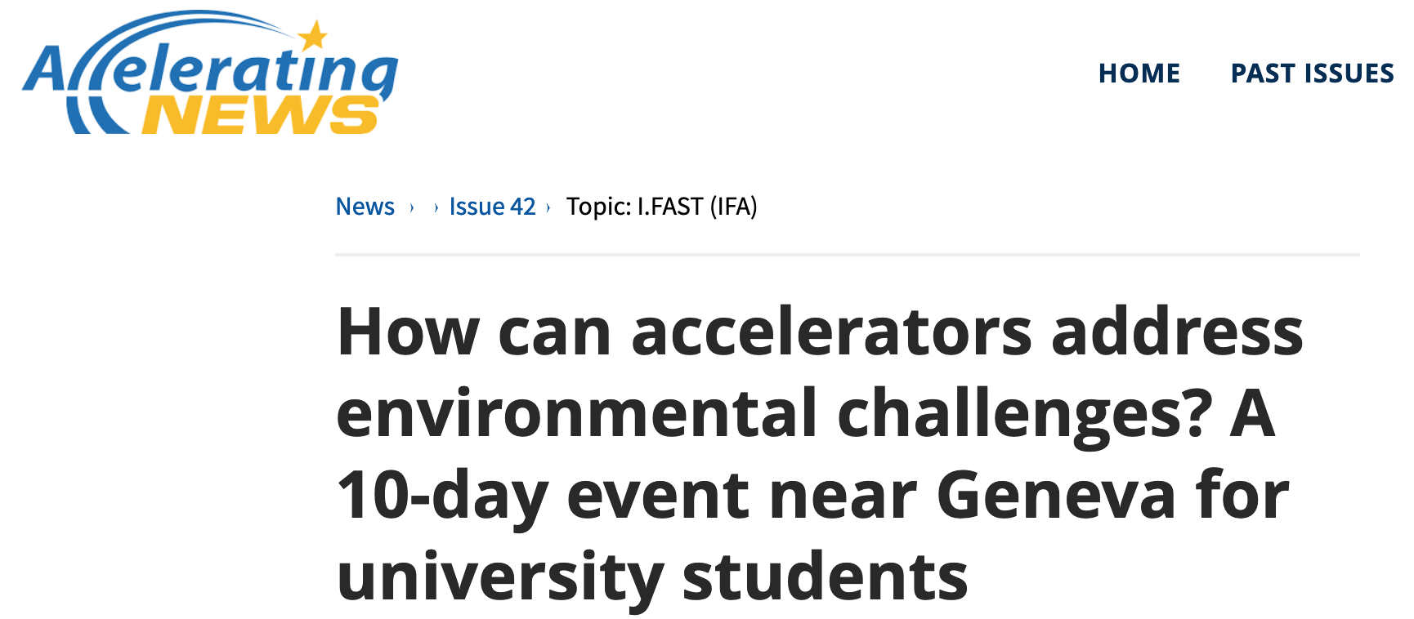
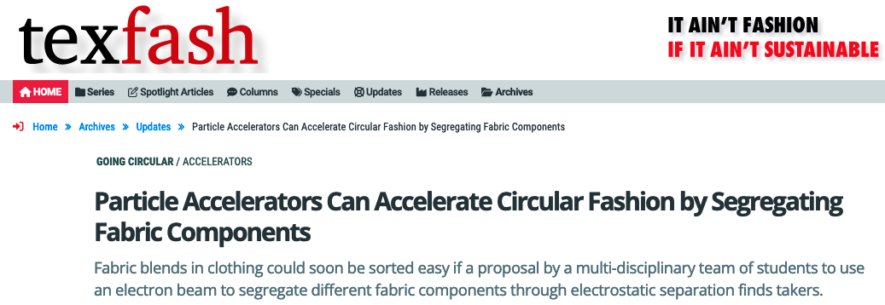
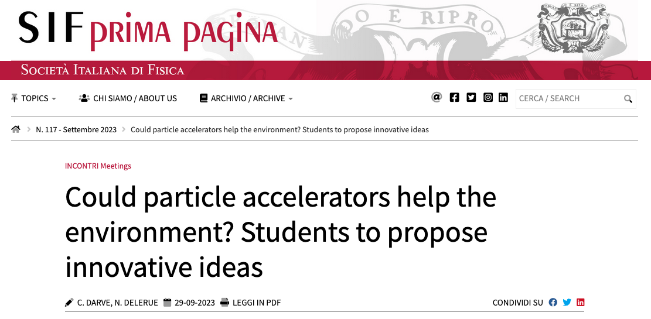
News coverage
Each issue led to coverage in journals and newsletters related to particle accelerators.
However we were surprised to discover that one of the projects got picked up by a Textile Fashion Magazine!

Slide 11
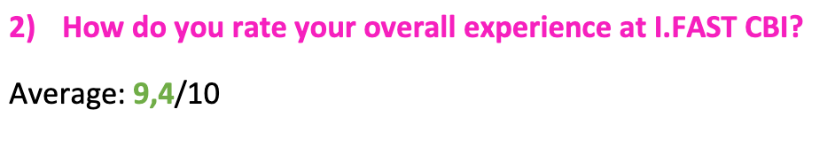
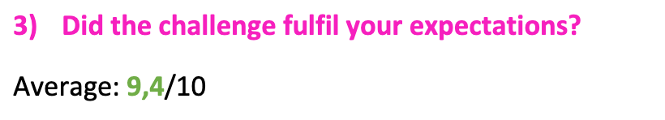
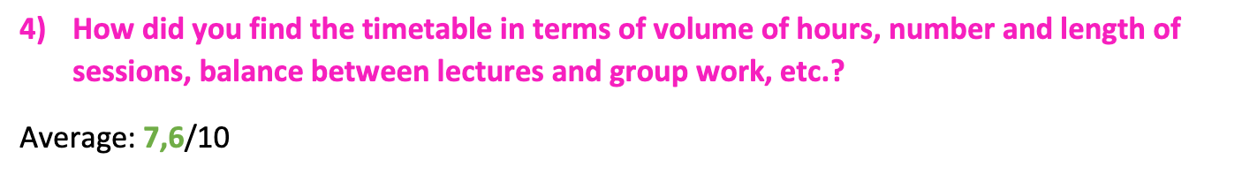
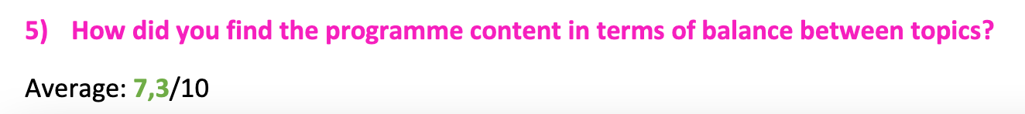
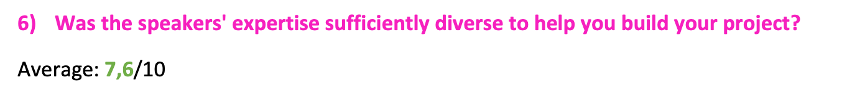
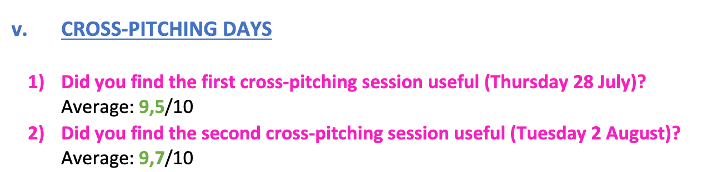
Students’ Feedback
Students feedback is very positive.

Slide 12
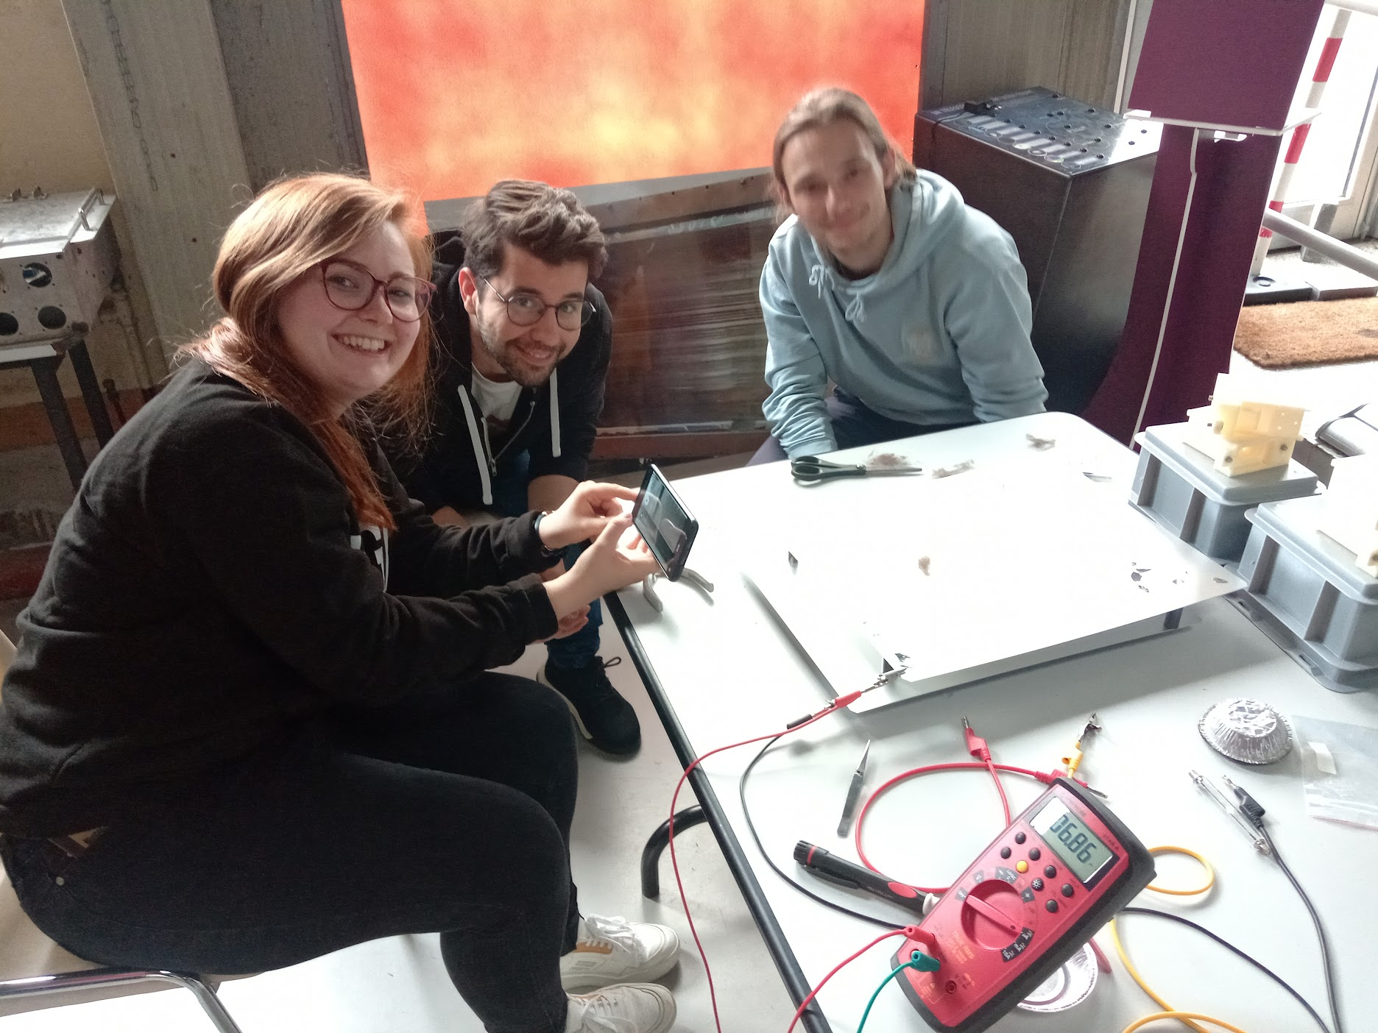
The projects after the CBI…
Each year some teams expressed interest in continuing their project after the CBI.
We help them either to prepare a publication or to make validation experiments. But so far none has completed that extra step.
One team founded a start-up based on their idea.
Some teams were disappointed to discover (after the CBI) that their idea was already patented.

Slide 13
Students selection
We welcome students form all across Geographical Europe (including Ukraine) except countries under CERN embargo.
We aim at maximizing diversity:
  Geographical diversity
  Academic diversity (not only physicists and engineers)
  Gender balance
Selection is based on overall student profile (creativity, leadership,…), not solely academic performance

Slide 14
Outlook
The EPITA CBI 2027 will take place in Archamps near Geneva, probably from Tuesday 13th July to Thursday 22nd July
Topic is to be decided.
  Accelerators for sustainability?
  Accelerators for cultural heritage?
All applications welcome!
Strong opportunity to showcase innovation potential around particle accelerator technology.
Positive feedback from students, jury and funding partners.

Slide 15
Thank you for your attention.
Any questions?

