Slide 1
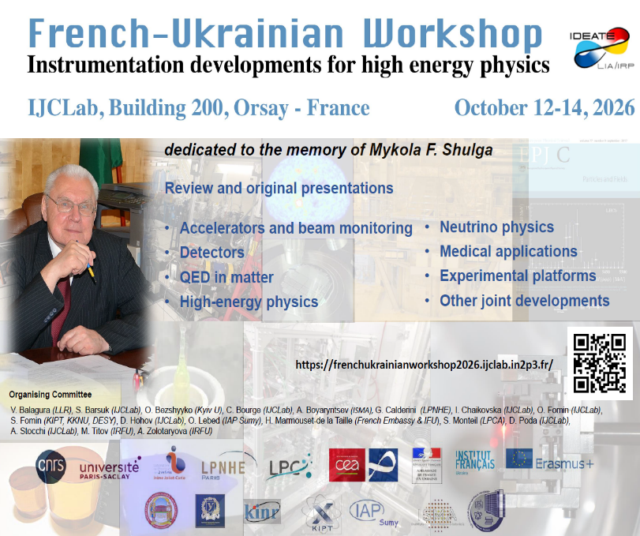
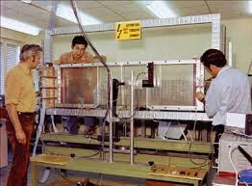
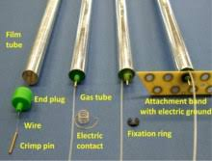
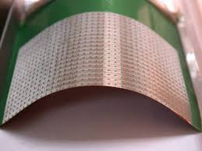
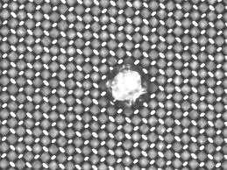
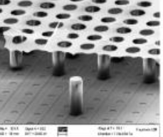
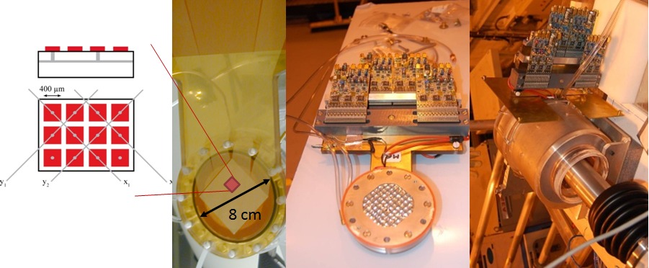
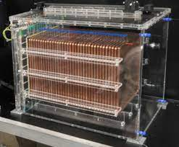
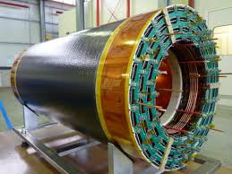
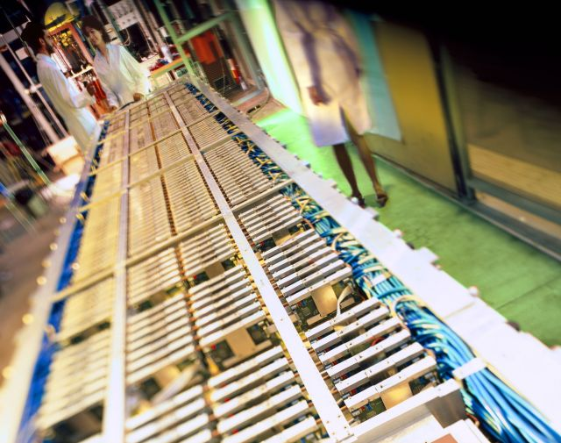
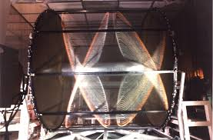
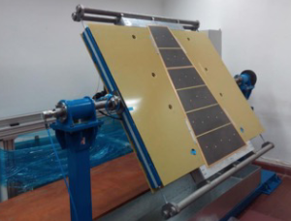
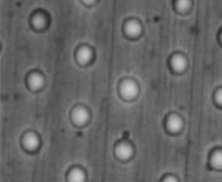
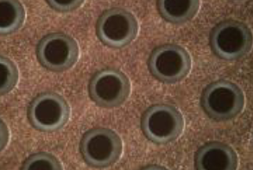
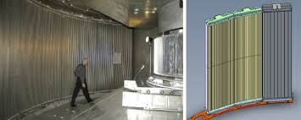
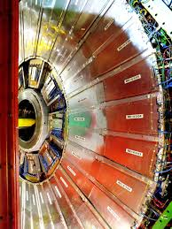
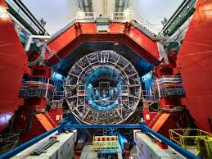
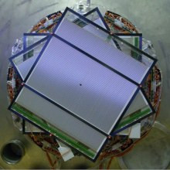
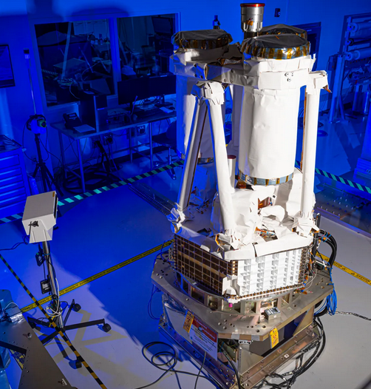
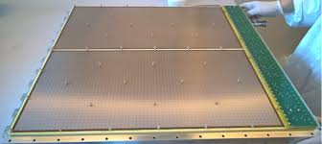
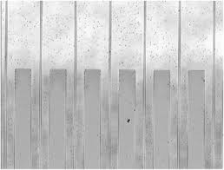
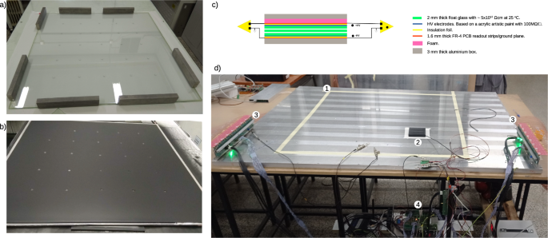
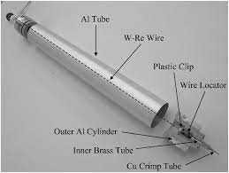
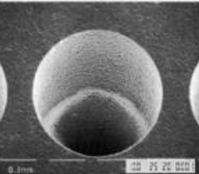
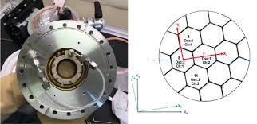
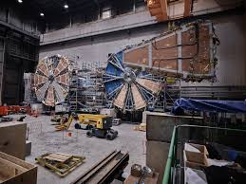
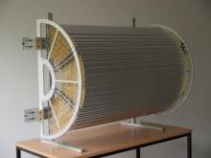
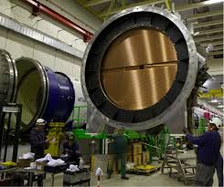
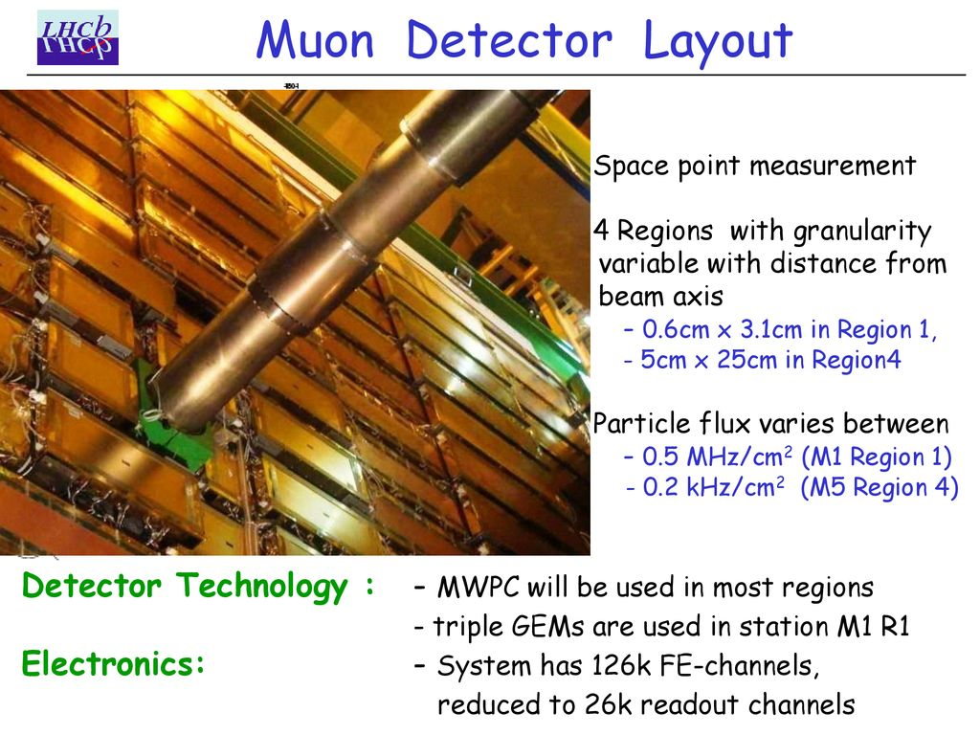
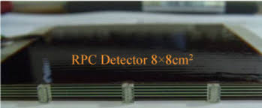
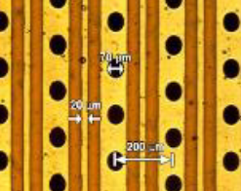
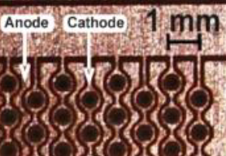
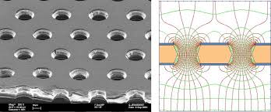
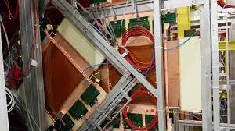
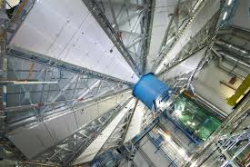
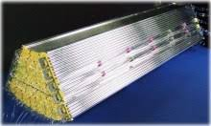
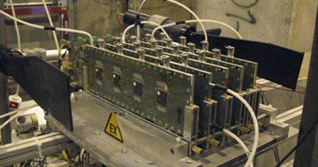
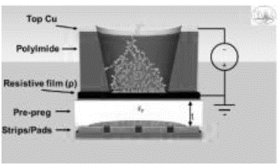
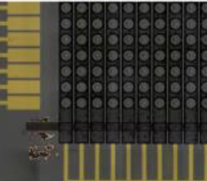
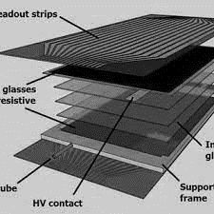
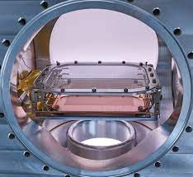
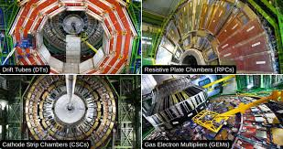
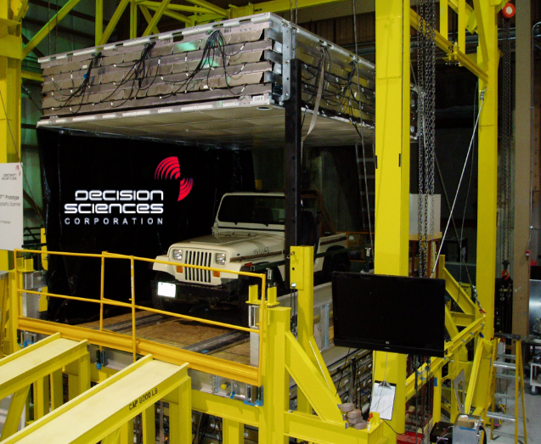
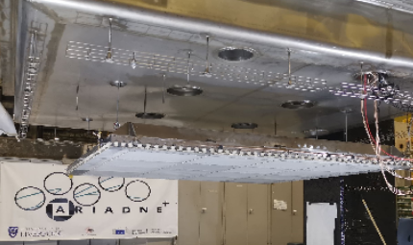
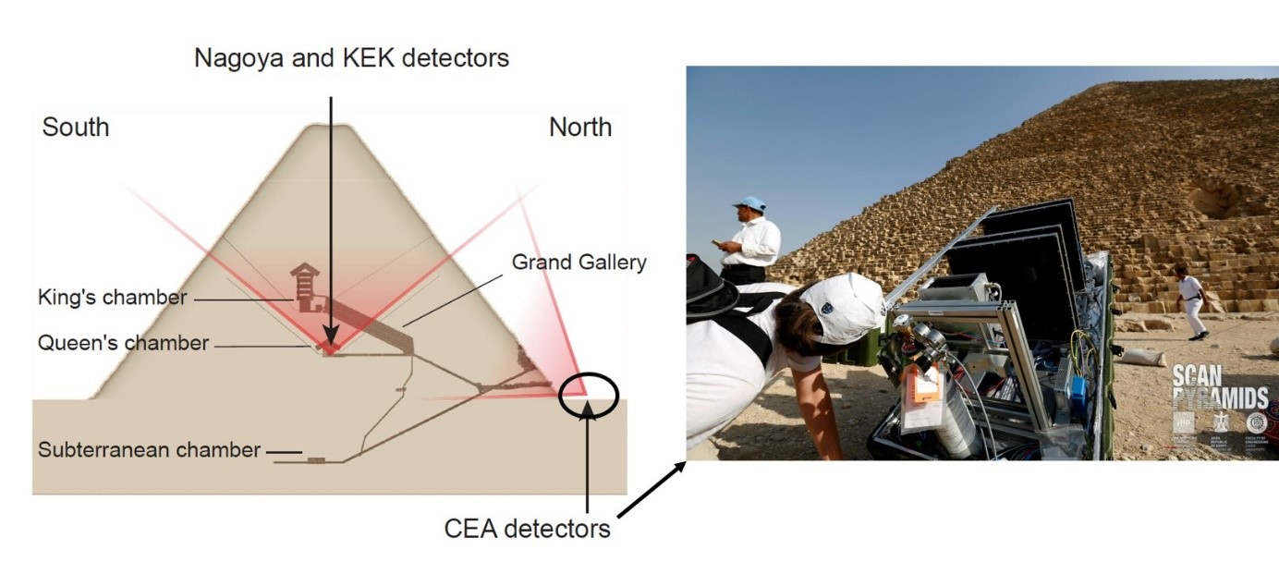
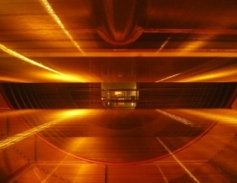
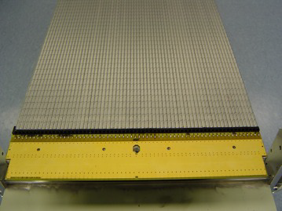
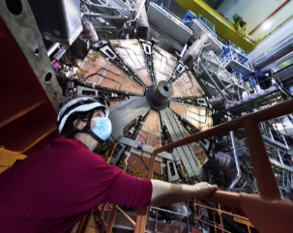
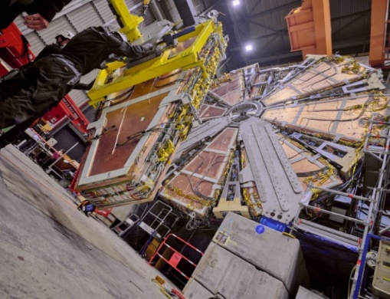
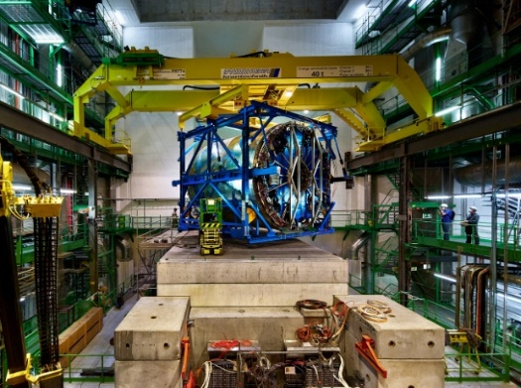





DRD1 Collaboration & Gaseous Detectors for Future Facilities: Trackers / PID (dE/dx, dN/dx) & Muon Systems
Eraldo Oliveri (CERN) / Maxim Titov (CEA Saclay / Irfu, France)
ATLAS NSW MM
ALICE GEM-TPC
CMS GEM Muon
French-Ukrainian Instrumentation Workshop 2026,
IJCLab, Orsay, France, Oct. 12-14 (2026)

Slide 2


From ECFA Detector R&D Roadmap to DRD1 Collaboration
ECFA TF1: Performance Targets and Main Drivers from Facilities:
major HL-LHC Upgrades (ALICE, LHCb), Future HEP & NP Colliders (EiC, FCC, Linear & Muon Colliders), DM & Rare Event, etc …
Detector Challenges for Future Facilities : Detectors Readiness Matrix
The most urgent R&D topics were identified by Detector Readiness Matrix
Detector R&D Themes (DRDTs) were formulated
as high-level deliverables
Both were used to define projects & deliverables in DRD1 proposal
Detector Research and Development Themes
Detector Challenges for Future Facilities : Detectors Readiness Matrix
DOI: 10.17181/CERN.XDPL.W2EX

Slide 3




DRD Collaborations Should Cover “Strategic R&D”
DRD’s should address strategic R&D (TRL 3-7) bridging the gap between the “blue-sky” R&D (TRL 1-2) and before experiment- specific engineering takes over (TRL 8-9)
Covers the development and maturing of technologies, e.g.
  Iterating through different options
  Improving radiation hardness
  Scaling up challenges: detector area, number of chan./layers,..
DRD “strategic aim” provide affordable technological solutions
to timely address & fulfill project performance requirements
Backed up by “strategic funding”, agreed with funding agencies
Technology Readiness
Levels (TRL):
A healthy environment in detector instrum. is more than “strategic R&D”:
“Blue-sky” and Generic R&D (funded by national & EU programs) as
an integral part of the R&D portfolio in DRD’s
Systems engineering to be integrated in R&D efforts

Slide 4


DRD’s at a Glance
&
Project
Timelines
T. Bergauer
Project timelines for “Large experiments”
  synchronized with LHC schedule
Project Timelines for
“Smaller Experiments”
  DM and Neutrino
D. Contardo

Slide 5




DRD1: Large and Diversified Community
EoI from more than 165 Institutes, 5 Industrial and Research Foundations
More than 30 Countries, > 700 members
DRD1 website: https://drd1.web.cern.ch
Two community-wise active years with many collaborative initiatives :
DRD1 collaboration is Scientifically
Organized in 8 WG’s and 9 WP’s:
Working Groups: serve as the backbone of detector R&D providing a platform (“RD51 Legacy”) for sharing knowledge, expertise & efforts by supporting strategic detector R&D directions, facilitating the establishment of common projects between institutes, and distributed R&D activities with centralized facilities;
Work Packages: reflect the ECFA Detector R&D Themes (DRDTs) for the long-term funding addressing strategic R&D goals, outlined in the ECFA Detector R&D Roadmap document with dedicated funding lines;
https://indico.cern.ch/category/17841/
https://indico.cern.ch/category/17385/
DRD1 MoU distributed for signature in Jul. 2025
Strategic funding to be agreed with FA’s / institutes via WP’s in MoU Annexes → first DRD1 WP endorsement is ongoing, to be completed in Sep. 2026

Slide 6



DRD1: Collaboration Organization and Management
Organizational structure of the DRD1 Collaboration is described in MoU Annex 4
DRD1 milestones:
Dec. 2023: Approval of the DRD1 Collaboration Organizational Structure
Dec. 2023: Elections of the Spokespersons, CB Chair / Deputy for 2024-2025
Jun. 2024: All DRD1 management positions are filled and approved by CB for 2-years term
Dec. 2025: Elections of the CB Chair and
DRD1 Spokespersons (2026-2027)
Jun. 2026: Appointments for the new DRD1 management team for 2026-2028
Nov. 2026: DRDC review for the DRD1 re-approval for the next 3-years term
WG Conveners (around 40); WP (Project) Leaders (around 30))

Slide 7






DRD1: Gaseous Detector Technologies (I)
R&D on new technologies, architectures, resistive materials, stability, upscaling, …
Wire Chambers
Resistive Parallel
Plates
Drift Chambers & TPC
TRD & RICH
2024 - 2026: Seamless integration of ALL gaseous detector technologies
into single collaborative effort (MWPC / Drift / TPC / MPGD / RPC)

Slide 8


DRD1: Gaseous Detector Technologies (II)
Primary choice for large-area coverage with low material budget & dE/dx & ToF functionality
- Several Higgs Factory concepts use gas detectors for the main tracker & muon systems
R&D Challenges:
High rates: reduce ion back drift
Reduce aging and radiation hardness
Fast Timing: Multi-Gap RPCs: achieved ~60ps time resolution (ALICE TOF Detector, Z.Liu, NIM A927 (2019) 396), Micromegas with timing (PICOSEC concept): 25ps
Eco-friendly gas mixtures: with lower Global Warming Potential (GWP): 92% of CERN emissions related to LHC experiments
Common readout system SRS for Gas Detectors
Common Issues:
MPGD: the main challenges remain large areas, high rates, precise timing capabilities, and stable discharge-free operation
RPC: focus stays on improving high-rate and precise timing capabilities, uniform detector response, and mechanical compactness.
Straw tubes: requirements include extended length and smaller diameter, low material budget, and operation in a highly challenging radiation environment.
Large-volume Drift chamber with a reduced material budget in a high-rate environment requires searching for new materials. Avalanche-induced Ion Back Flow (IBF) remains the primary challenge for TPC applications in future facilities.

Slide 9




WG3: Eco-Friendly Gaseous Detectors
New ecological gas mixture
are mandatory
DRD1 Topical Workshop, organized by WG3, on GreenHouse gases:
June 18, 2025, as the part of the DRD1 Collaboration Meeting:
  Reduce the Green House Ga emission at future accelerator (main concern)
  Avoid risks of gas cost escalation and supply problems (secondary concern)
F - gas policy regulations
CERN-HSE,
Industrial partners
Gas-mixture optimization
WG4 simulation of eco-gases: modelling cross sections- CERN-ETH Zürich project
Working Sub-group between DRD1 and European Laboratory Directors Group (LDG) Sustainability Panel is initiated

Slide 10





WG8: Communication & Education & Career
DRD1 Bulletin (#12 – Apr. 2026)
DRD1 Forum
Exchange about common
questions, used by multiple WGs
DRD1 Website
Updated lists of collaboration events, WG/WP descriptions / contacts, job & training opportunities
Regular newsletter containing announcements, upcoming events, communications from WGs, job opportunities, etc.
https://drd1-forum.web.cern.ch
DRD1 Logo:
https://drd1.web.cern.ch
DRD1 Gaseous Detector Seminar Series:
https://gitlab.in2p3.fr/gcharles/rdg/-/wikis/Accueil
DRD1 Summer Students projects @ CERN
→ topics of common interest to collaboration activates
DRD1 Detector School Series
DRD1 Annual Awards
DRD1 Notes Repository
Bell engraved with
the words “DRD1 CERN”

Slide 11




WG8: DRD1 Detector School Series
The DRD1 Gaseous Detector School is planned as a regular
event hosted by one of the DRD1 member institutes
2026: 3rd DRD1 School, FRIB facility, US, July 8-17:
https://indico.cern.ch/event/1572535/ → first DRD1 School in the US
2026: DRD1 Topical School “Gaseous Detector Simulation”, Bari, Italy, May 18-22: https://indico.cern.ch/event/1606443/overview
2025: 2nd DRD1 School, FTD, Univ. Bonn, Germany, Sep. 17-24, 2025: https://indico.cern.ch/event/1384298 → 1st RD1 School outside CERN
2024: 1st DRD1 School, CERN, Nov. 27 – Dec. 6: https://indico.cern.ch/event/1384298
2023: RD51 School, CERN, Nov. 27 – Dec. 1: https://indico.cern.ch/event/1239595
Additional topical schools could offer in-depth training
on selected topics:

Slide 12
Gaseous Tracking Systems @ Future Colliders
Experiment / Timescale | Application Domain | Gas Detector Technology / Gas Mixture | Total detector size / Single module size | Operation Characteristics / Performance | Special Requirements/ Remarks
ILC TPC CENTRALTRACKER: START > 2040 | e+e- Collider Tracking+ dE/dx | MM, GEM (pads) GridPix (~ 50 μm pixels) Ar/CF4/iC4H10 (95:3:2) | Total area: ~ 20 m² Single unit detect: ~ 400 cm² (pads) ~ 130 cm² (pixels) | Max. rate: < 1 kHz Spatial res.: <150µm Time res.: ~ 15 ns dE/dx: < 5 % | - Si + TPC mom. res: δp/p < 9*10⁻⁵ 1/GeV - Power-pulsing - Low IBF
CEPC TPC CENTRAL TRACKER START: > 2040 | e+e- Collider Tracking + dN/dx | Gridpix,TEPIX (large 200~ 500 μm pixels) Ar/CF4/iC4H10 (95:3:2) | Total area: ~ 2x10 m² Single unit detect: ~ 300 cm² (pixels) | Max.rate:>1 MHz/cm² Spatial res.: ~100µm Time res. : ~ 10 ns dE/dx: < 5 % PID: 3σ sep. power | - Higgs & Low lumi -Z - Combined ITK/OTK δp/p < 10⁻⁵ 1/GeV - Continues readout - Low IBF and dN/dx
CEPC DRIFT CHAMBER TRACKER START: >2040 | e+e- Collider Tracking + dN/dx | Drift Chamber He/iC4H10 (90:10) | Total volume: 50 m³ Cell size: ~18mmx 18mm | Max. rate: <1 MHz/cm² Spatial res.: < 100µm dE/dx: < 5 % PID: 3σ sep. power | - Particle separation with cluster counting - Combined ITK/OTK - Continues readout
FCC-ee IDEA CENTRAL TRACKER START: >2040 | e+e- Collider Tracking/ Triggering | Drift Chamber He/iC4H10 (90:10) Straws, TPC | Total volume: 50 m³ Single unit detect: (12 m² X 4 m) | Max. rate: <1 MHz/cm² Spatial res.: <100 µm Time res.: 1 ns dE/dx: < 5 % PID: 3σ sep. power | Particle separation with cluster counting
SUPER TAU CHARM FACTORY START: > 2025 | e+e- Collider Main Tracker | Drift Chamber He / C2H6 (50:50) | Total volume: ~ 4.8 m³ | Max. rate: 200 kHz/cm² Spatial res.: ~100 µm Time res.: ~ 2 ns Rad. Hard.: ~ 5 Gy/y
SUPER TAU CHARM FACTORY START: > 2025 | e+e- Collider Inner Tracker | Inner Tracker / (cylindrical μRGroove) or TPC / MPDG Ar/CF4/CO2 | Total area: ~ 3.5 m² Single unit detect: 0.5 m² | Max. rate: 20-300 kHz/cm² Spatial res.: ~<120 µm Time res.: ~ 5 -10 ns Rad. Hard.: 5 kGy/y | Challenging mechanics & mat. budget < 1.2% X0

Slide 13



Approaches for an Inner Tracker with Gaseous Detectors
Silicon vertex detector for flavour tagging.
Particle identification via dE / dx (dN /dx) measurements in the gaseous detector
Silicon wrapper providing a precision space point at the exit of the ID and PID via TOF
dE/dx (or dN/dx) allows for π/K separation only after the combination of the measurements with several cells/tubes (∼ 100 – 200)
ILC –TPC with MPGD-based Readout
Target requirement of a spatial resolution of 100 um in transverse plane and dE/dx resolution < 5% (based on 200 TPC measurement points ) have been reached with all MPGD technologies (GEM, MM and GridPix)
arXiv: 2003.01116
If dE/dx combined with ToF using e.g. Si-ECAL,
P < 10 GeV region for π-K separation covered

Slide 14

Motivation for a Drift Chamber or Straw-type Tracker
An ultra-light drift chamber (IDEA concept) targetted for FCC-ee and CePC (was inspired by DAFNE KLOE Wire Chamber and by the more recent version for MEG2 experiment
Drift Chamber R&D Challenges:
Aging studies for new modular DC designs
→ smaller drift cells & higher fields, higher gain for cluster counting?
New wire materials- new alloy metallized carbon wire
→ specific topics: wire corrosion, coating quality, …
Operation with hydrocarbon-free mixtures
Motivation of a Straw-tube tracker instead of Drift Chamber

Slide 15




Motivation for a Large-Area Pixel TPC Based on “GridPix”
Testbeams with GridPixes: 160 GridPixes (Timepix) & 32 GridPixes (Timepix3)
NIM A956 (2020) 163331
A PIXEL TPC
IS REALISTIC!
Gridpix TPC R&D Challenges:
Optimization of gas mixture and pad size to improve track resolution: pixel size ~ 200 – 300 um → cost reduction
Ion backflow suppression (double grid, graphene coating)
Switch to Timepix4 (4 sides-buttable, lower energy consumption, …
Build readout for Timepix4 detectors) Equip LP module with GridPixes
Optimization of GridPixes (e.g. low IBF, reduce resistivity of protection layer)
3 modules for LP TPC @ DESY: 160 (1 x 96 & 2 x 32) GridPixs
320 cm² active area, 10,5 M. channels, new SRS Readout system
Module with
96 InGrids
on 12 „octoboards“
H. Qi
LP Endplate with 3 modules
IEEE TNS 64 (2017)5, 1159-1167

Slide 16



DESY Test-Beam with 32 GridPixes (Timepix3) Modules: PID
A new way of cluster counting algorithm is to measure the distance between hits → corresponds to an exponential function.
The slope indicates the energy loss
NIM A 1081 (2026) 170849
Pixelized readout allows for various improvements of energy loss determination:
Standard energy loss dE/dx
/ electron counting
/ cluster counting dN/dx
Adding different test beam events to build a 1m long track (including 60% active area):
Projected particle separation
power for an ILD pixel TPC

Slide 17



Ion Backflow: CePC TPC Simulations
TPC selected as main tracker for CEPCreference detector in TDR:
CePC TDR Simulations included:
Pair production (beamstrahlung)
Single-Beam (Beam-Gas Coulomb, Beam Gas Bremsstrahlung, Beam Thermal Photons, Touchek Scat.)
Maximum Δrφ reaches 800 μm in the low-Z- mode (need optimization and calibration)
After ~2.75 m drift distance
arXiv:2510.05260

Slide 18
Open Question about TPC: Can it Work at the Tera-Z ?
Synchrotron Radiation (SR) @ Tera-Z:
SR produced when beam particles pass through final quadrupoles off-axis,, is extremely challenging:
- 3 orders of magnitude higher than Beamstralhung,
also much larger than ALICE TPC
- Depends on details of still-developing MDI design:
beam pipe design and material, SR masks, ...
D. Jeans, 2026 FCC Week
Must drastically reduce SR:
Tighter upstream collimation ?
Shielding of the magnetic shell ?
Beam-pipe material and/or coating ?
TPC hits are induced by
~MeV photons entering TPC

Slide 19


Gaseous Detectors @ HL-LHC (ATLAS) Muon Upgrades
Experiment / Timescale | Application Domain | Gas Detector Technology / Gas Mixture | Total detector size / Single module size | Operation Characteristics / Performance | Special Requirements / Remarks
ATLAS MUON UPGRADE CERN LS2 / | Hadron Collider (Tracking/Triggering) | Endcap: Res. MM Ar/I C4H10 Co2 (93:5:2) and sTGC Cp2/n-pen (55:45) | Endcap area: 1200 m² Single unit detect: (2.2x1.4m² ) ~ 2-3 m² | Max. rate:20 kHz/cm² Spatial res.: <100 µm Time res.: ~ 10 ns Rad. Hard.: ~ 0.5 C/cm² | Redundant tracking and triggering; Challenging constr. in mechanical precision
ATLAS MUON UPGRADE (BIS78 PILOT) CERN LS2 | Hadron Collider (Tracking/Triggering) | Part of Inner Barrel: RPC + sMDT | Barrel area (3 layers): 140 m² Single unit det.: ~ m² | Max. rate:1 kHz/cm² Spatial res.: ~ 7 mm Time res.: ~ 1 ns Rad. Hard.: 300 fb | Redundant tracking and triggering; 9 layers with 2D hit position + time
ATLAS MUON UPGRADE (BI PROJECT) CERN LS3 | Hadron Collider (Tracking/Triggering | Inner Barrel: RPC | Barrel area: 1400 m² Single unit det.: ~ m² | Max. rate:10 kHz/cm² Spatial res.: ~ ( 0.1 x 1) cm in (η , ϕ) Time res.: ~ 0.5 ns Rad. Hard.: 3000 fb | Redundant tracking and triggering; 9 layers with 2D hit position + time
ATLAS MUON UPGRADE (not approved) CERN AFTER LS3 | Hadron Collider (Tracking/Triggering) (2.7 ≤|h| ≤ 4.0) | Forward region: Res MM, μWELL, μPIC | Total area: ~ 5 layers x1 m² Single unit detect: 0.1 m² | Max. rate: 10 MHz/cm² Spatial res.: ~200 µm Time res.: ~ 5 ns Rad. Hard.: ~ 10 C/cm² | Hit rates (given at 25 cm) falls rapidly with the distance from the beam axis. Miniaturization of readout elements.

Slide 20
Gaseous Detectors @ HL-LHC (CMS & LHCb) Muon Upgrades
Experiment / Timescale | Application Domain | Gas Detector Technology / Gas Mixture | Total detector size / Single module size | Operation Characteristics / Performance | Special Requirements / Remarks
CMS MUON UPGRADE GE11 CERN LS2 | Hadron Collider (Tracking/Triggering) | 3-GEM Ar/CO2 (70:30) | Total area: ~ 50 m² Single unit detect: 0.3-0.4m² | Max. rate: 5 kHz/cm² Spatial res.: 0.6 –1.2mm Time res.: ~ 10 ns Rad. Hard.: ~ 0.18 C/cm² | Redundant tracking and triggering, improved pt resolution in trigger
CMS MUON UPGRADE GE21 CERN LS3 | Hadron Collider (Tracking/Triggering) | 3-GEM Ar/CO2 (70:30) | Total area: ~ 105 m² Single unit detect: 0.3-0.4m² | Max. rate: 1.5 kHz/cm² Spatial res.: 1.4 –3.0mm Time res.: ~ 10 ns Rad. Hard.: ~ 0.09C/cm² | Redundant tracking and triggering, displaced muon triggering
CMS MUON UPGRADE ME0 CERN LS3 | Hadron Collider (Tracking/Triggering) | 3-GEM Ar/CO2 (70:30) | Total area: ~ 65 m² Single unit detect: 0.3m² | Max. rate:150 kHz/cm² Spatial res.: 0.6 –1.3mm Time res.: ~ 10ns Rad. Hard.: ~ 7.9 C/cm² | Extension of the Muon System in pseudo-rapidity, installation behind HGCAL
CMS MUON UPGRADE RE3.1, RE 4.1 CERN LS3 | Hadron Collider (Tracking/Triggering) | iRPC C2H2F4/iC4H10/SF6 (95.2:4.5:0.3) | Total area: ~ 140 m² Single unit detect: 2m² | Max.rate: 2 kHz/cm² Spatial res.: ~1-2cm Time res.: ~ 1 ns Rad. Hard.: 1 C/cm² | Half of chambers have been installed; remaining during LS3
LHCb MUON UPGRADE CERN LS4 | Hadron Collider (particle identification) | μ-RWELL / G-RWELL Ar/CO2/CF4 (45:15:40) | Total area: ~ 90 m² Single unit detector from 0,3x0,25 m² to 0,6 x0,3 m² | Max.rate: 970 kHz/cm² Spatial res.: ~ cm Time res.: < 5 ns Rad. Hard.: ~ 3,5 C/cm² | About 600 detectors
LHCb MUON UPGRADE CERN LS4 | Hadron Collider (particle identification) | MWPC Gas mixture Ar/CO2/CF4 (38:57:5) | New MWPC (M5R3) Total area: ~88 m² Single unit detector 0.46 m². About 200 gaps | Max.rate: O(100) kHz/cm² Spatial res.: 0.7-7 cm Time res (1 gap): ~3.5 ns Time res (4 gaps): ~6 ns Rad. Hard. (@50/fb): <0.1 C/cm (M2R3) | Present MWPCs: Total area: ~1451m² Single unit detector from 0.3 m² to 0.46 m². About 4000 gaps

Slide 21
Muon Systems at Future Colliders (FCC, LHeC, Muon)
HL-LHC Muon Systems works (mostly) for future colliders:
Linear Colliders (ILC/CLIC): no challenges , same technology can be used for HCAL (RPC, MPGD)
LHeC: CDR uses design similar to ATLAS Phase 2; barrel – 2ns generation RPC & small MDT)
Muon Collider: based on CLIC & ps-timing detectors to reject BIB background
FCC-hh: Rad-hard design and hydrocarbon-free mixtures needed for the very forward region
Experiment / Timescale | Application Domain | Gas Detector Technology / Gas Mixture | Total detector size / Single module size | Operation Characteristics / Performance | Special Requirements / Remarks
LHeC COLLIDER MUON SYSTEM | Electron – Proton Collider Tracking/Triggering | RPC / MDT | Total area ~ 400 m² Single unit detect: 2-5 m² | Max.rate: 3 kHz/cm² Time res.: ~0.4 ns Rad. Hard.: 0.3 C/cm² Spatial res.: 1mm (RPC) 80 µm (MDT single tube)
FCC-ee PRESHOWER DETECTOR START: >2040 | Lepton Collider Tracking | μ-RWELL | Total area: 225 m² Single unit detect: (0.5x0.5 m²⁾ ~0.25 m² | Max. rate: 10 kHz/cm² Spatial res.: ~60-80 µm Time res.: 5-7 ns Rad. Hard.: <100 mC/cm²
FCC-ee MUON SYSTEM START: >2030 | Lepton Collider Tracking/Triggering | μ-RWELL RPC | Total area: 3000 m² Single unit detect: ~0.25 m² | Max. rate: <1 kHz/cm² Spatial res.: ~150 µm Time res.: 5-7 ns Rad. Hard.: <10 mC/cm²
FCC-hh COLLIDER MUON SYSTEM START: > 2050 | Hadron Collider Tracking/Triggering | All HL-LHC technologies (MDT, RPC, MPGD, CSC) | Total area: 3000 m² | Max. rate: < 500 kHz/cm² Spatial res.: <100 µm Time res.: ~ 3 ns Rad. Hard.: ~ C/cm² | Redundant tracking and triggering;
MUON COLLIDER MUON SYSTEM START: > 2050 | Muon Collider | RPC or new generation fast Timing MPGD | Total area: ~ 3500m² Single unit detect: 0.3-0.4m² | Max.rate: <100 kHz/cm² Spatial res.: ~100µm Time res.: <10 ns Rad. Hard.: < C/cm² | Redundant tracking and triggering

Slide 22





Muon System for the FCC-hh Collider
Barrel Muon system (2 layers) : 2000 m² total
Endcap Muon System (2 layers): 500 m² total
Forward Muon System: (4 layers): 320 m² total
ATLAS MDT Drift Tubes:
ATLAS Muon System HL-LHC: (kHz/cm²):
MDTs barrel: 0.28
MDTs endcap: 0.42
RPCs: 0.35
TGCs: 2
Micromegas und sTGCs: 9-10
HL-LHC muon system gas detector technology will work for most of the FCC detector area
LHCb Muon System (MWPC):
<0.5kHz/cm²
<10kHz/cm²
Rad-hard design and hydrocarbon-free gas mixture studies will be needed for the very forward region ((R < 1m; Rate ~ 500 kHz/cm2)

Slide 23




DRD1 WG1/WG2 Topical Workshop on FCC-ee (I)
DRD1 – FCC-ee Workshop: Technologies and Applications of Gaseous Detectors at FCC-ee :June 16, 2026:
joint WG1/WG2 workshop to establish a informal bridge between the gaseous detector DRD1 community and the FCC-ee detector concepts
2 concepts: CLD and IDEA in the conceptuel design review from 2019
3 additional concepts these days: ALFA, ALLEGRO, ILD
Tracking,
PID/Timing
https://indico.cern.ch/event/1675383//
PICOSEC
Tracking
Calorimetry.
Muons
Calorimetry.
Muons

Slide 24

DRD1 WG1/WG2 Topical Workshop on FCC-ee (I)
DRD1 – FCC-ee Workshop: Technologies and Applications of
Gaseous Detectors at FCC-ee :June 16, 2026:
https://indico.cern.ch/event/1675383//
Common DRD1 topics across all gaseous tracking technologies are: cluster counting/timing, low-mass detector construction, advanced front-end electronics, & validation in future collider environments which requires simulation expertise.
Detector Challenges for
Future Facilities :
Detectors Readiness Matrix
Challenges on Tracking Systems:
- mechanics to scale from prototypes to real dimension(4 to 5 meter long wires) while keeping the needed performance (resolution and material budget)
- Ion backflow at the tera-Z and the management of thedistortion for TPC
- detector operation at the tera-Z * manageable occupancy
- electronics to match the data-throughput needed for dN/dx
Challenges on Muon Systems:
- eco-gas are always an open task for RPC
- scalable manufacturing together with industries for all the technologies
- manageable (and financeable) number of channels for the tracking muon system

Slide 25




MPGD Gaseous Tracking @ Electron – Ion Collider (EiC)
Proposed EIC detector concepts & their future upgrades feature a form of large MPGD detectors: Tracking (GEM, MM, μRWELL), Tracking/PID (GridPix), TRD (GEM)
Experiment / Timescale | Application Domain | Gas Detector Technology / Gas Mixture | Total detector size / Single module size | Operation Characteristics / Performance | Special Requirements/ Remarks
ELECTRON-ION COLLIDER (EIC) START: > 2032 - | ePIC Barrel Inner Tracker: | CyMBaL: Cylindrical MM Ar/CO₂/iC₄H₁₀ (93:2:5) | Total area: ~ 10 m² 48 Curved tiles Module: 59 × 34 cm² | Luminosity (e-p): 10³³ Spatial res.: 300/ 500 µm Time resolution: 20 ns Max. rate: ~3 kHz/cm² | low mass, large area; Engineering integration into ePIC
ELECTRON-ION COLLIDER (EIC) START: > 2032 - | ePIC Barrel Outer Tracker: | MPGD-BOT: Thin Gap Hybrid GEM-μRWELL Ar/CO₂/iC₄H₁₀ (93:2:5) | Total area: ~ 14 m² 24 planar modules Module: 170 × 33 cm² | Luminosity (e-p): 10³³ Spatial res.: ~150 µm Time resolution: 10 ns Max. rate: ~0.3 kHz/cm² | large are; Thin-gap & hybrid technology Integration into ePIC
ELECTRON-ION COLLIDER (EIC) START: > 2032 - | ePIC End Cap Tracker: | MPGD-ECT: GEM-μRWELL Ar/CO₂/iC₄H₁₀ (93:2:5) | Total area: ~ 2.6 m² 16 quadrants Module: 45 × 45 cm2 | Luminosity (e-p): 10³³ Spatial res.: ~150 µm Time resolution: 20 ns Max. rate: ~10 kHz/cm² | Large area; hybrid technology; mechan. constraints; Integration into ePIC
There is a major synergy & complementarity for MPGD R&D Needs between Energy Frontier Colliders and Nuclear Physics (NP) Experiments
→ often rate-capabilities for tracker needs are higher in NP experiments

Slide 26



MPGD Tracking @ EiC
… the most critical R&D needs:
Hybrid GEM-μRWELL technology: large gain & detector stability for large detectors (MPGD-BOT & MPGD-ECT):
- Detector gain optimization with double amplification
structures; gas optimization studies
Thin-gap MPGD technology: maintain good spatial resolution performance over a large range of particle angles (MPGD-BOT)
- Mechanical structure & stability with large thin-gap MPGDs
- Gas studies for performance optimization (spatial and time
resolutions, detector efficiency)
Low mass and curved MPGD geometry: Optimization of the inner tracker in barrel central region (CyMBaL)
- Curved tile geometry with Micromegas technology
- R&D on mechanical structure for low mass detector (.5%
X0 material budget)
2D strips readout development: low channel count & spatial resolution performance (CyMBaL, MPGD-BOT, MPGD-ECT)
- Capacitive-sharing for high performance & low channel
counts readout for MPGD-BOT
- 2D resistive strip readout for curved Micromegas tile for
CyMBaL
- Fine pitch 2D strip readout for MPGD-ECT in micro-TPC
operation mode
K. Gnanvo

Slide 27

DRD1 WPs
The Work Packages (WPs) form the strategic R&D pillars as defined by the Detector R&D roadmap, which was a key outcome of the last European Strategy update.
Each WP consolidates activities around specific technological challenges - ranging from advanced tracking systems and calorimetry to photon detection and precise timing.
These projects are defined by clear objectives, milestones, and deliverables, providing a focused roadmap to address the critical needs of future collider experiments, neutrino studies, and other high-impact applications.
DRD collaborations do not bring funding “ab initio” in core MoU
Only resource-loaded Work Packages described in MoU Annexes will be backed up by FAs and needs to be endorsed (milestones, tasks, deliverables)
WP1 | Trackers, hodoscopes, large area muon systems
WP2 | Drift chambers
WP3 | Straws and drift tubes
WP4 | Tracking TPCs
WP5 | Gaseous calorimeters
WP6 | Gaseous photon detectors
WP7 | Timing detectors
WP8 | Reaction/decay TPCs
WP9 | BHEP applications
DRD1 does not prioritize future projects in the WPs and keeps open various options for gaseous detector technologies. It facilitates clustering of research teams to address technology challenges, based on priorities of participating institutes backed up by FA’s resources. This has the advantage that the technologies can be further advanced until specific choices have to be made once the project is approved.

Slide 28




DRD1 Work Packages Highlights (I)

Slide 29





Summary: DRD1 Work Packages Highlights (II)

Slide 30
DRD1: Summary and Outlook
DRD1, a community-driven collaboration, covers a large set of different gaseous detector technologies, different applications and a large and diversified community; it promotes the clustering of different research teams, acting as a seed for long-term collaborations and activities. DRD1 aims to offer a proper R&D framework (WGs & WPs) to support both strategic and generic, blue-sky, and technology-driven R&D
DRD1 has been (successfully) proactive so far in building DRD1 structure and external engagements, and it is important to maintain this approach → many other DRDs “adapted and adopted” such an approach
Finalization and initiation of the DRD1 MoU signature process took more than one year, but it is now progressing
Endorsement of (resource-loaded) Work Packages and their recognition at the FA’s level is the next fundamental step
Strong support for “Strategic R&D” at the level of the Funding Agencies for
- strengthening the recognition of the DRDs’ resource plans and needs
- establishment of long-term funding mechanisms linked to the DRDs
would be highly effective
NEXT: Boost the DRD1 Research Program and Common Activities (several important initiatives are already underway)→ many others from the DRD1 proposal are in the pipeline,

Slide 31

Outlook: Towards Realization of Future Colliders
We aim for a discovery machine; this will require novel technologies and new ideas.
There is plenty of time to explore new ideas; think of the box and rethink current paradigms.
We should build the strongest science case and demonstrate that we can meet the physics challenges with the most advanced detectors that we can design, to improve the likelihood that this very ambitious process be realized.
We need to work together in a unified and objective fashion, leading with the science.
The ask is huge; we need to work for a common goal.

Slide 32

BACKUP SLIDES !

Slide 33




DRD1 MoU Signature Status
July 2026 Status:
Number of Institutes: 135
Membership Changes from MoU release: 5 new and 3 withdrawn
Signature:
60 signed out of the 74 sent
Not sent MoU:
61 (57 in current Annex 1 + new)
all will be contacted
MoU Signed (60)
MoU not sent (61)
Pending or Frozen MoU Signature (14)
CERN – DoE / NSF Official Guidelines since May 2026

Slide 34

DRD1: Common Community Initiatives and Activities
Required strong prioritization based on limited DRD1 Common Resources in 2025
Many other common community developments from the DRD1 proposal were in the pipeline, depending on the available resources
These days start to ramp-up available DRD1 resources for Common Collaboration-Wide Activities
DRD1 is “TECHNOLOGY - DRIVEN R&D COLLABORATION”
aims to promote the development and diffusion of gaseous detectors and to support the advancement of these technologies for the next generation experiments and applications.

Slide 35



WG7: DRD1 Test-Beams / SPS
Common DRD1 Test Beam campaigns at EHN1/SPS Semi-permanent installation (H4):
2024: 3 DRD1 test-beam campaigns (8/8/5 setups)
2025: 2 DRD1 test-beam campaigns (13 /17 setups)
2026: 2 DRD1 test-beam campaigns (~15 setups)
May/July 2026: DRD1 test beam –
~15 setups in parallel (31 group)
Groups expressing interest with most of themparticipating to DRD1 test beam in 2026: 1. CERN, 2. CEA IRFU / Université Paris-Saclay, 3. INFN Bari / University of Bari, 4. INFN Bologna / University of Bologna, 5. INFN Ferrara / University of Ferrara, 6. INFN Frascati, 7. INFN Napoli / University of Napoli, 8. INFN Pavia, 9. INFN Pisa / University of Pisa, 10. INFN Roma Tre / University of Roma Tre, 11. INFN Torino / University of Torino, 12. AUTH (Aristotle University of Thessaloniki), 13. Czech Technical University in Prague, 14. Helsinki Institute of Physics, 15. USTC (University of Science and Technology of China), 16. LICP, 17. Jefferson Lab, 18. Weizmann Institute of Science, 19. Max Planck Institute (MPI), 20. LMU Munich, 21. University of Bonn, 22. University of Michigan, 23. University of Santiago de Compostela, 24. HUN-REN Wigner Research Centre for Physics, 25. Ruđer Bošković Institute (RBI), 26. Technische Universität Wien, 27. TU Darmstadt, 28. GSI Helmholtz Centre, 29. ULB (Université libre de Bruxelles), 30. University of Wisconsin, 31. Yonsei University.

Slide 36


DRD1 WPs: “Existing” and “Additional” Resources
Scientific progress can be quantitatively evaluated only after internal DRD1 WP endorsement, when institutions, deliverables, timelines, and resources are formally approved by the CB, RB, and funding agencies.
During endorsement, WPLs will report about the WP status for quantitative assessment and available resources
List of “existing” resources, at the time of the DRD1 proposal*
List of “additional” resources needed, at the time of the DRD1 proposal*
* Information based on original DRD1 proposal submitted in 2023

Slide 37


DRD1: Summary of the WP Status
The first-ever DRD1 Work Package Endorsement Procedure (requires approval by DRD1 CB and RB) has been initiated
Expect to have the first WP (WP4 on TPCs) approved by end of Sep. 2026

Slide 38




Resistive Plate Chambers: Performance & Trends
Trigger and BX tagging at
LHC / HL-LHC:
RPC Future R&D Challenges:
Will 10 kHz/cm2 be reachable and sustainably for 10-20 years of future collider operation?
What will be the trigger and aging performance with eco-friendly mixtures ?
MRPC challenges to produce large-areas of low resistivity glass
Multi-Gap Resistive Plate Chambers (MRPC):
ALICE TOF detector (160m²) achieved time res. ~ 60 ps
New studies with MRPC with 20 gas gaps using a low-resistivity
400 μm-thick glass → down to 20 ps time resolution

Slide 39



Early MPGD Detector Concepts @ CERN Experiments
Experiment / Timescale | Application Domain | MPGD Technology | Total detector size / Single module size | Operation Characteristics / Performance | Special Requirements / Remarks
COMPASS TRACKING > 2002 | Fixed Target Experiment (Tracking) | 3-GEM Micromegas w/ GEM preampl. | Total area: 2.6 m² Single unit detect: 0.31x0.31 m² Total area: ~ 2 m² Single unit detect: 0.4x0.4 m² | Max.rate: ~100kHz/mm² Spatial res.: ~70-100µm (strip), ~120µm (pixel) Time res.: ~ 8 ns Rad. Hard.: 2.5 C/cm² | Required beam tracking (pixelized central / beam area)
TOTEM TRACKING: > 2009 | Hadron Collider / Forward Physics (5.3≤|h| ≤ 6.5) | 3-GEM (semicircular shape) | Total area: ~ 4 m² Single unit detect: up to 0.03m² | Max.rate:20 kHz/cm² Spatial res.: ~120µm Time res.: ~ 12 ns Rad. Hard.: ~ mC/cm² | Operation in pp, pA and AA collisions.
LHCb MUON DETECTOR > 2010 | Hadron Collider / B-physics (triggering) | 3-GEM | Total area: ~ 0.6 m² Single unit detect: 20-24 cm² | Max.rate:500 kHz/cm² Spatial res.: ~ cm Time res.: ~ 3 ns Rad. Hard.:~ 0.5 C/cm² | Redundant triggering
COMPASS RICH UPGRADE > 2016 | Fixed Target (RICH - detection of single VUV photons) | Hybrid (THGEM + CsI and MM) | Total area: ~ 1.4 m² Single unit detect: ~ 0.6 x 0.6 m² | Max.rate:100 Hz/cm² Spatial res.: <~ 2.5 mm Time res.: ~ 10 ns | Production of large area THGEM of sufficient quality

Slide 40
Gaseous Tracking (MPGD) for Hadron & Nuclear Physics
Experiment/ Timescale | Application Domain | MPGD Technology | Total detector size / Single module size | Operation Characteristics/ Performance | Special Requirements/ Remarks
COMPASS @ CERN Run: > 2002 | Hadron Physics (Tracking) | GEM Micromegas w/ GEM preampl. | Total area: 2.6 m² Single unit detect: 0.31x0.31 m² Total area: ~ 2 m² Single unit detect: 0.4x0.4 m² | Max.rate:10^7 Hz (~100kHz/mm² ) Spatial res.: ~70-100 µm (strip), ~120µm (pixel) Time res.: ~ 8 ns Rad. Hard.: 2500 mC/cm² | Required beam tracking (pixelized central / beam area)
TOTEM: Run: > 2009 | High Energy/ Forward Physics (5.3≤|eta| ≤ 6.5) | GEM (semicircular shape) | Total area: ~ 4 m² Single unit detect: up to 0.03m² | Max.rate:20 kHz/cm² Spatial res.: ~120µm Time res.: ~ 12 ns Rad. Hard.: ~ mC/cm² | Operation in pp, pA and AA collisions.
SBS in Hall A @ JLAB Run: 2021 - 2025 | Nuclear Physics (Tracking) nucleon form factors / struct. | GEM | Total area: 14 m² Single unit detect. 0.6x0.5m² | Max. rate:400 kHz/cm² Spatial res.: ~70µm Time res.: ~ 15 ns Rad. Hard.: 0.1-1 kGy/y.
pRad & pRad-II / X17 in Hall B @ JLAB Run: 2017 & 2026 - 2027 | Nuclear Physics (Tracking) precision meas. of proton radius | GEM | Total area: 3 m² Single unit detect. 1.2x0.6 m2 | Max. rate:25 kHz/cm² Spatial res.: ~70µm Time res.: ~ 15 ns
SoLID in Hall A@ JLAB Run: > 2020 | Nuclear Physics (Tracking) | GEM and μRWELL | Total area: 40m² Single unit detect. 1.2x0.6 m2 | Max. rate:600 kHz/cm² Spatial res.: ~100µm Time res.: ~ 15 ns Rad. Hard.: 0.8-1 kGy/y. | Muon tracker system
E42 and E45 @ JPARC Run: > 2020 | Hadron Physics (Tracking) | TPC w/ GEM, gating grid | Total area: 0.26m² 0.52m(diameter) x0.5m(drift length) | Max. rate:10⁶ kHz/cm² Spatial res.: 0.2-0.4 mm | Gating grid operation ~ 1kHz

Slide 41





Cylindrical MPGDs as Trackers for Hadron & Nuclear Physics
Experiment/ Timescale | Application Domain | MPGD Technology | Total detector size / Single module size | Operation Characteristics/ Performance | Special Requirements/ Remarks
KLOE-2 @ DAFNE Run: 2014-2017 | Particle Physics/ K-flavor physics (Tracking) | Cylindrical GEM | Total area: 3.5m² 4 cylindrical layers L = 700mm R = 13, 15,5, 18.0, 20.5 cm | Spatial res:(r phi) = 250um Spat. res.(z) = 350um | - Mat. budget 2% X0 - Operation in 0.5 T
BESIII Upgrade @ Beijing Run: 2018-2022 | Partcile Physics/ e+e- collider (Tracking) | Cylindrical GEM | 3 cylindrical layers R ~ 20 cm | Max. rate: 10 kHz/cm² Spatial res:(xy) = 130um Spat. res.(z) = 1 mm | - Material ≤ 1.5% of X₀ for all layers - Operation in 1T
CLAS12 @ JLAB Run: > 2017 | Nuclear Physics/ Nucleon structure (tracking) | Planar (forward) & Cylindrical (barrel) Micromegas | Total area: Forward ~ 0.6 m² Barrel ~ 3.7 m² 6 cylindrical layers R ~ 20 cm | Max. rate: ~ 30 MHz Spatial res.: < 200µm Time res.: ~ 20 ns | - Low material budget : 0.4 % X0 - Remote electronics
ASACUSA @ CERN Run: > 2014 | Nuclear Physics (Tracking and vertexing of pions resulting from the p-antip annihilation | Cylindrical Micromegas 2D | 2 cylindrical layers L = 60 cm R = 85, 95 mm | Max. trigger rate: kHz Spatial res.: ~200µm Time res.: ~ 10 ns Rad. Hard.: 1 C/cm² | - Large magnetic field that varies from -3 to 4T in the active area
MINOS Run: 2014-2016 | Nuclear structure | TPC w/ cylindrical Micromegas | 1 cylindrical layer L=30 cm, R = 10cm | Spatial res.: <5 mm FWHM Trigger rate up to ≈1 KHz | - Low material budget
CMD-3 Upgrade @ BINP | Particle physics (z-chamber, tracking) | Cylindrical GEM | Total arear: ~ 3m² 2 cylindrical layers | Spatial res.: ~100µm

Slide 42
Gaseous Tracking (MPGD) for Nuclear Physics @ JLab
Experiment/ Timescale | Application Domain | MPGD Technology | Total detector size / Single module size | Operation Characteristics/ Performance | Special Requirements/ Remarks
MOLLER in Hall A @ JLAB Run: > 2027 | Nuclear Physics (Tracking) precision meas. of the Weak Mixing Angle | GEM | Total area: 4 m² Single unit detect. 0.5 x 0.5m² | Max. rate:200 kHz/cm² Spatial res.: ~300µm Time res.: ~ 15 ns Rad. Hard.: 0.1-1 kGy/y.
BoNus & BoNus12 in Hall B @ JLAB Run: 2007 & 2021 | Nuclear Physics (Tracking) precision meas. of proton radius | GEM | Total area: 3 m² | Max. rate:30MHz | Radial TPC Detector with Cylindrical GEM readout
GEM-TRD in Hall D @ JLAB Run: > 2027 | Nuclear Physics (Tracking) | GEM | Total area: 2.25m² Single unit detect. 1.5 x 0.5 m2 | Max. rate: kHz/cm² Spatial res.: ~100 µm
CLAS12 Hi-lumi in Hall B@ JLab Run: > 2020 | Nuclear Physics (Tracking) | μRWELL | Total area: 25 m²) Largest unit detect. 1.5 x 0.5m² | Max. rate: 20kHz/cm² Spatial res.: ~100 µm Time resolution: 10 – 20 ns

Slide 43





MPGD Technologies for Photon Detection
Experiment / Timescale | Application Domain | MPGD Technology | Total detector size / Single module size | Operation Characteristics / Performance | Special Requirements / Remarks
COMPASS RICH UPGRADE Start > 2016 | Hadron Physics (RICH - detection of single VUV photons) | Hybrid (THGEM + CsI and MM) | Total area: ~ 1.4 m² Single unit detect: ~ 0.6 x 0.6 m² | Max.rate:100 Hz/cm² Spatial res.: <~ 2.5 mm Time res.: ~ 10 ns | Production of large area THGEM of sufficient quality
PHENIX HBD Run: 2009-2010 | Nuclear Physics (RICH – e/h separation) | GEM+CsI detectors | Total area: ~ 1.2 m² Single unit detect: ~ 0.3 x 0.3 m² | Max. rate: low Spatial res.: ~ 5 mm (rf) Single el. eff.: ~ 90 % | Single el. eff. depends from hadron rejection factor
SPHENIX Run: 2021-2023 | Heavy Ions Physics (tracking) | TPC w/GEM readout | Total area: ~ 3 m² | Multiplicity: dNch/dy ~ 600 Spatial res.: ~ 100 um (rf) | Runs with Heavy Ions and comparison to pp operation
Electron-Ion Collider (EIC) Start: > 2025 | Hadron Physics (tracking, RICH) | TPC w/GEM readout + Cherenkov RICH with GEM readout | Total area: ~ 3 m² Total area: ~ 10 m² | Spatial res.: ~ 100 um (rf) Luminosity (e-p): 10³³ Spatial res.: ~ few mm | Low material budget High single electron efficiency
ALICE VHPID
THGEM
HBD Concept:

