Slide 1


18
[ F]FDG interactions with human serum albumin: Binding and molecular modeling studies
Anna Butenko
Supervisor: Valeria Trusova
V. N. Karazin Kharkiv University | School of Physics and Technology
12-14 October 2026, Orsay, France
01

Slide 2
  Introduction & Clinical Background
- FDG and HSA
- Standard uptake value
2. [¹⁸F]FDG–Albumin Interactions
- Equilibrium binding and saturation
- Binding kinetics
- Molecular modeling
  Biophysical Impact and Conclusion
OUTLINE
02

Slide 3
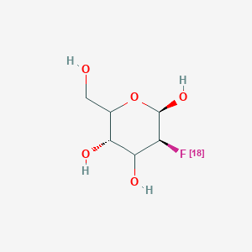

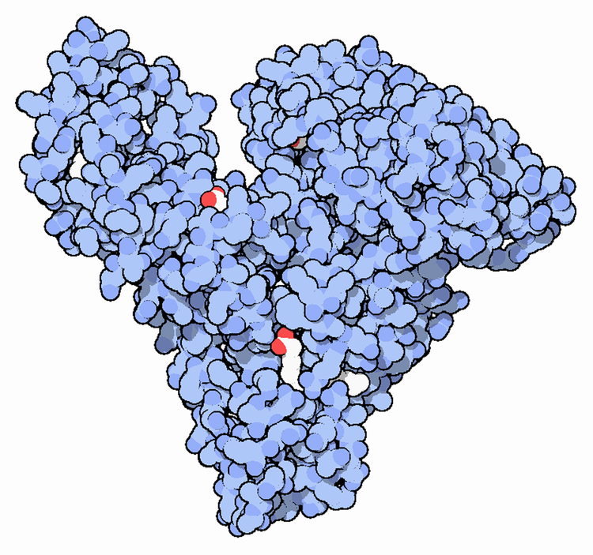


[¹⁸F]FDG in PET scanning
  [¹⁸F]Fluorodeoxyglucose – a glucose analog, with the ¹⁸F substituted for the hydroxyl group at the C-2
Reflects the distribution of glucose uptake in the organism, particularly highlighting high-glucose-using cells
By the long-standing assumption it circulates 100% unbound as a free diffusible solute
Human serum albumin concentration may correlate with standardized [18F]FDG uptake values in the body
03

Slide 4
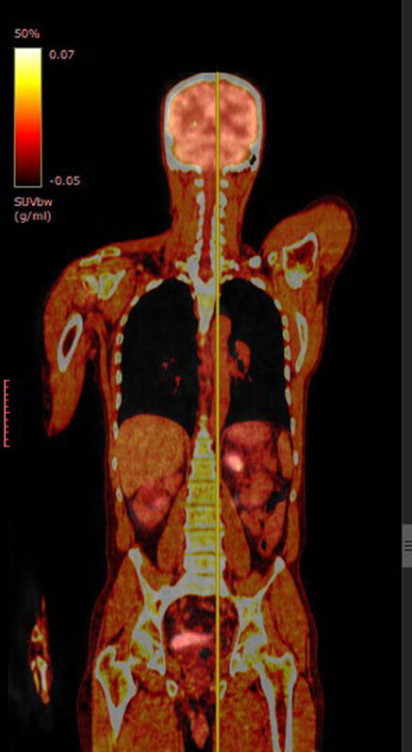
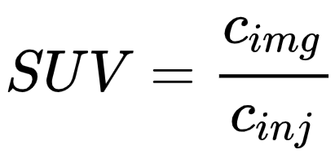
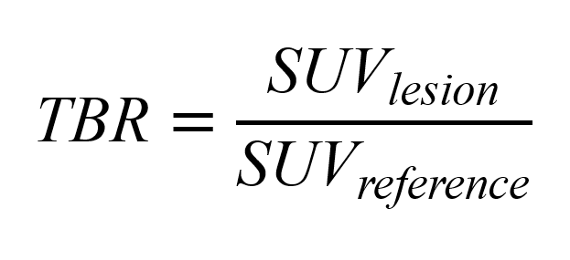
Target-to-Background Normalization
  Standardized Uptake Value (SUV):
  Target to Background Ratio (TBR):
  Clinical сonsequence: Blunted reference SUV inflates target-to-background ratios, leading to false-positive response assessments.
04

Slide 5
Multi-Technique Methodological Framework
Equilibrium Binding Assays
Binding Kinetics
01
02
  Radiometric titration of clinical [¹⁸F]FDG with HSA at 37 °C.
  Evaluated in the presence (5 mM) and absence of D-glucose.
  Output: Separation via centrifugation; Langmuir single-site fitting
  Time-resolved radiometric sampling over 0-90 min at physiological conditions.
  Pseudo-first-order association kinetics.
  Output: Association rate constant and characteristic equilibration time.
Molecular Modeling (in silico)
Competitive Displacement
03
04
  Global search on HSA crystal structure via AutoDock Vina.
  100 ns all-atom MD in GROMACS 2023.2
  Output: Binding pocket mapping (Sudlow's site I) and conformational stability.
  Warfarin as the canonical fluorescence reporter for Sudlow’s site I.
  Displacement using the non-radioactive analog 2-deoxy-D-glucose (2-DG).
  Output: Spectrofluorometric validation of site-specific pocket competition.
05

Slide 6
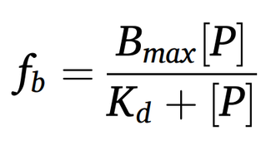
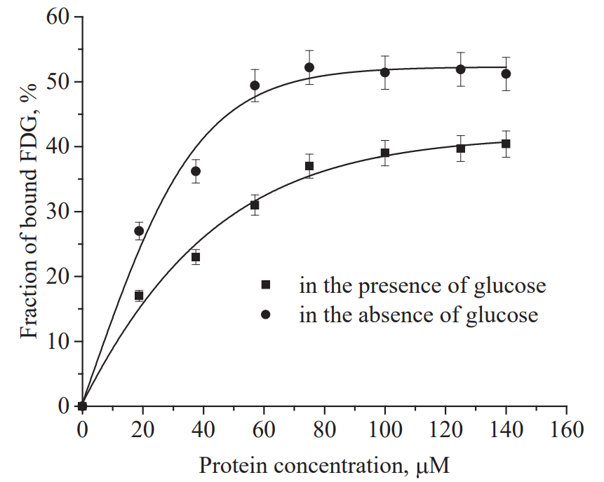

Binding Results
  Binding data were analyzed using the Langmuir single-site model:
  Bound fraction plateaus at ~40% at physiological glucose (5mM);
  Bound fraction increases to ~50% in the absence of glucose;
  Apparent dissociation constant:
  Interaction saturates near 70-100 muM HSA;
  Validated at physiological HSA 700 μM: bound fraction remains steady at ~40%.
Fig. 1. Percentage of [18F]FDG binding to HSA in the absence and presence of glucose. Solid lines represent theoretical curves providing the best fit.
06

Slide 7
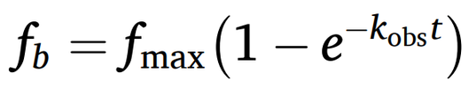
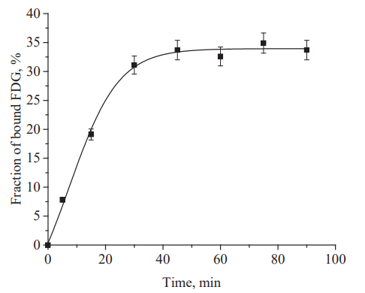

Binding Kinetics
  The kinetic profiles were fitted to a pseudo-first-order association model:
  Apparent rate constant:
  Equilibrium is fully achieved within 30-35 min;
  Equilibration occurs well within the standard 50-60 min clinical uptake window.
Fig. 2. Kinetic profile of [18F]FDG binding to human serum albumin. Protein concentration was 70 μM.
07

Slide 8
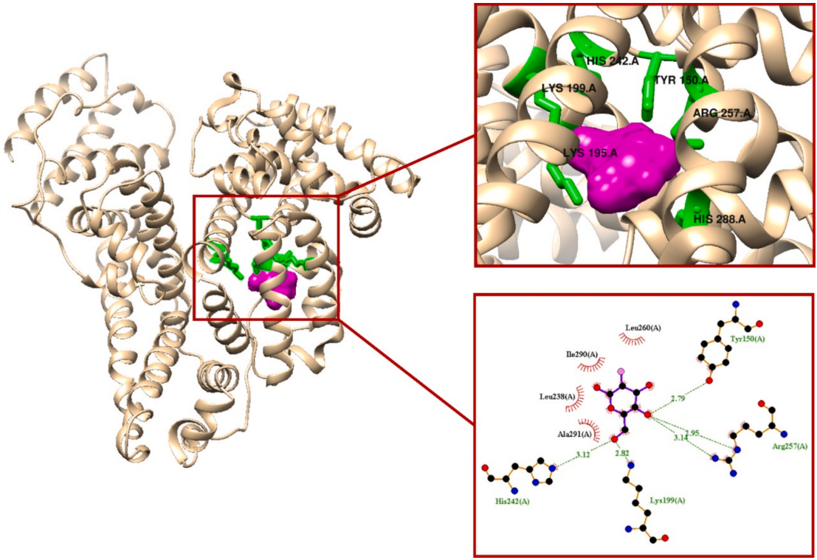
Structural Identification
Molecular docking:
  Blind docking converged to
subdomain IIA (Sudlow’s site I).;
  Predicted binding energy: -5.8 kcal/mol;
  Direct polar contacts and H-bonds: Tyr150, Lys199, His242, Arg257
Molecular dynamics:
  [¹⁸F]FDG remained stably bound in site I pocket across the entire trajectory;
  Stable RMSD, RMSF, and radius of gyration.
Warfarin displacement studies:
  Dose-dependent displacement plateau of 15-18%;
  Preserved spectral shape confirms competitive site I occupancy.
Fig. 3. The best scored docked pose and binding interactions for HSA-[18F]FDG complexes. Show in green are the amino acid residues constituting the binding site. [ 18F]FDG is highlighted in magenta.
08

Slide 9
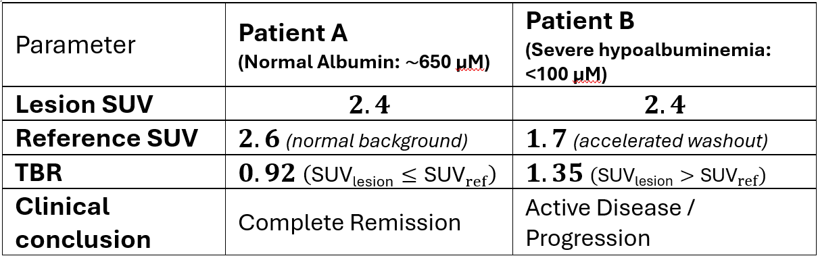
Biophysical Mechanism of False-Positive Risk
Liver & Blood Pool (Reversible Equilibrium):
  Hypoalbuminemia (<100 μM) causes loss of dynamic buffering → rapid renal clearance;
  Result – reference SUV may drop by 30-40%.
Tumor Lesions (Irreversible Trapping):
  High GLUT-1/3 expression and hexokinase activity trap [¹⁸F]FDG intracellularly early on;
  Result – lesion SUV remains largely unaffected.
Table 1. Representative scenario indicating a risk of false positive decision for patients with hypoalbumenia
09

Slide 10
Conclusions
  [¹⁸F]FDG reversibly binds human serum albumin (~40% bound, Kd≈43 μM).
  Localizes to Sudlow’s site I without altering protein conformation.
  Reaches dynamic equilibrium within 30-35 min, acting as a vascular buffer.
  Saturation at ~100 µM explains liver and blood-pool SUV drops in hypoalbuminemia.
  Patient albumin and glycemic parameters need to be considered when interpreting borderline SUV thresholds in cachectic oncology patients.
  Future work should examine [¹⁸F]FDG-albumin interactions in human plasma and evaluate their contribution to PET variability across diverse clinical settings.
Thank you, and I’ll be glad to hear your questions
10

