Slide 1



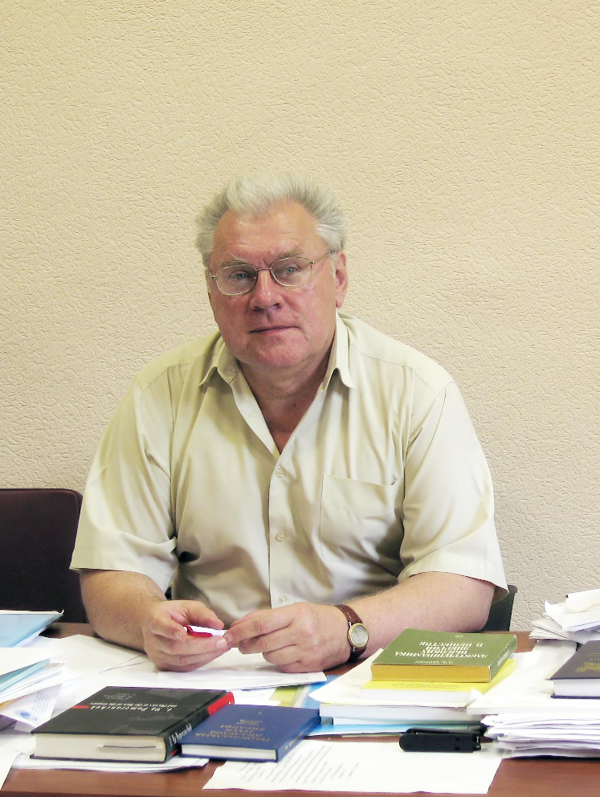





French-Ukrainian Workshop 2026
“Instrumentation Developments for High Energy Physics”
dedicated to the blessed memory of Nikolai F. Shul’ga
October 12-14, 2026, IJCLab, University Paris-Saclay, Orsay
Advanced concept for a fast breeder reactor based on the phenomenon of nuclear deflagration
Sergii FOMIN
Leading researcher at the Akhiezer Institute for Theoretical Physics
National Science Center "Kharkiv Institute of Physics and Technology"
e-mail: spfomin@gmail.com
15.09.1947 - 23.01.2024

Slide 2

Outlook:
Introduction
Nuclear deflagration phenomenon
Mathematical approach & results of calculations
Our achievements in the study of the Nuclear Burning Wave
Stability study and intrinsic safety of FR in NBW mode
Transient processes & power control of the NBW reactor
Main features of the NBW reactor & unsolved problems

Slide 3
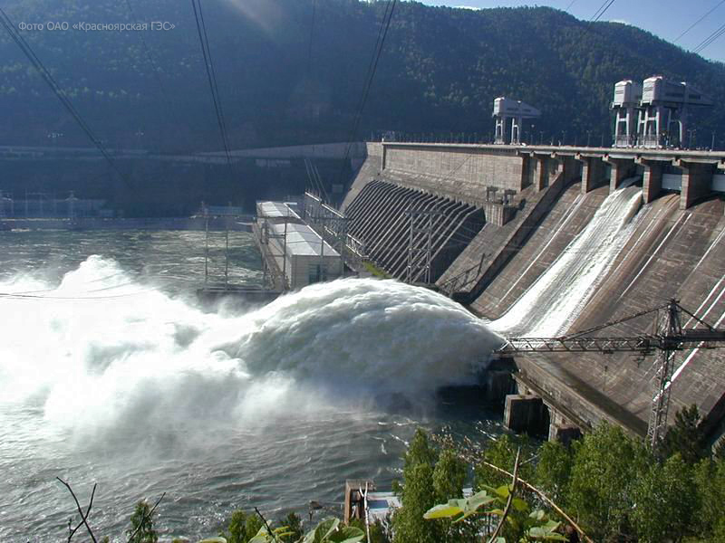
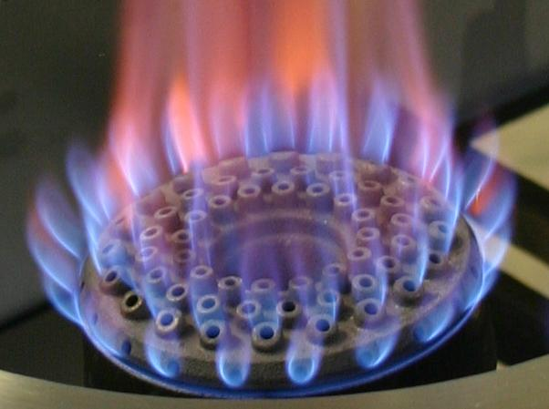

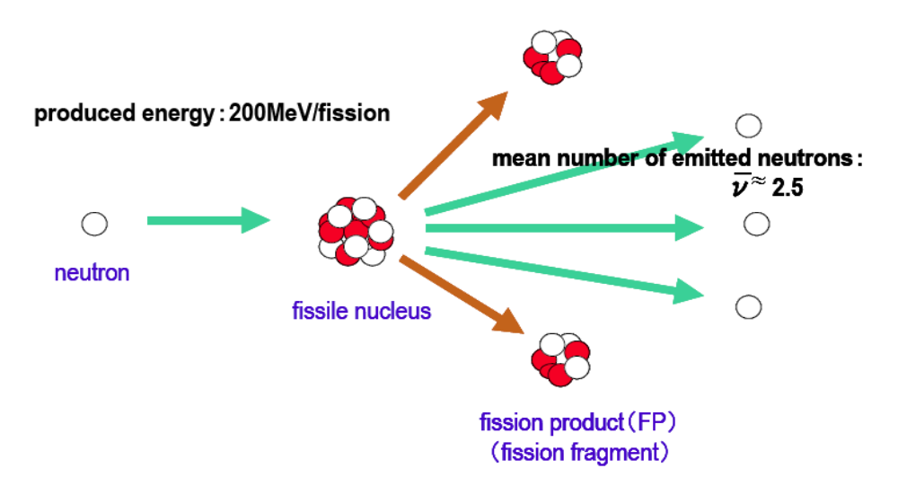

Different kinds of “Energy sources”
- Gravitational interaction: hydroelectric power plant
- Electromagnetic interaction: burning of organic fuels (coal, oil, gas)
- Strong interaction: “Nuclear power” is the binding energy
of the nucleons in the nucleus
$$E=mgh$$
Fission of 1 atomic nuclear of Uranium releases ~ 200 MeV,
i.e. 10⁸ times more !!! than at oxidation of 1 carbon atom
To boil 1 liter of water ~ 0.1 kWh
~ to drop 40 t٠m of water
~ to burn 10 g of gasoline
~ to split 10¹⁶ nuclei of ²³⁵U
1 cm³ contains 10²² of ²³⁵U atoms that allows to boil 1 million liters of water

Slide 4
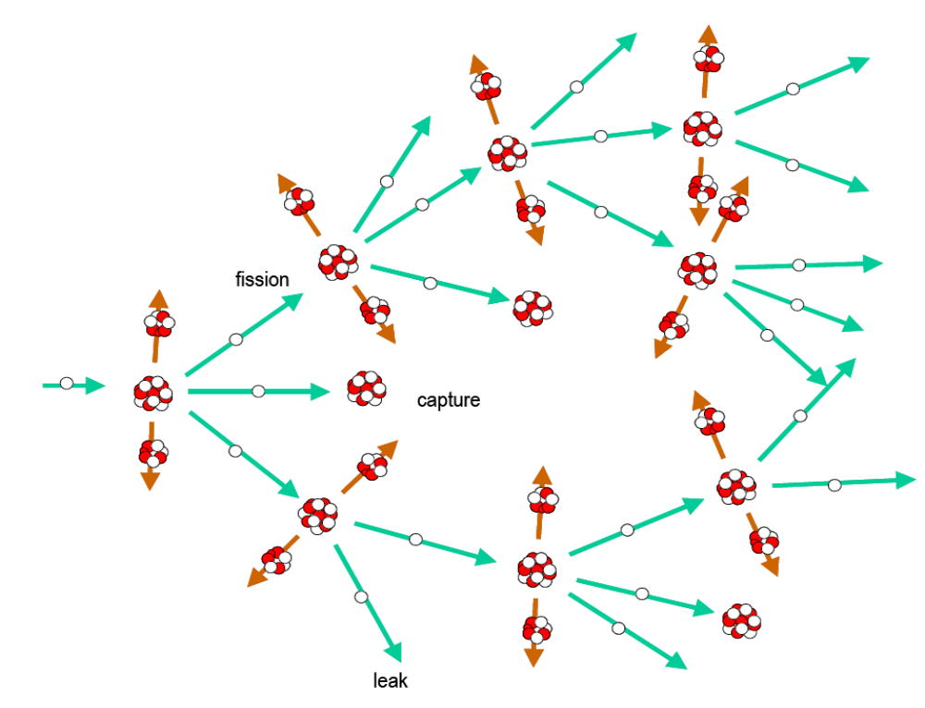
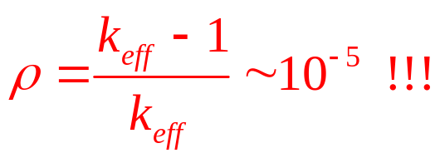
Key parameters of a chain nuclear reaction
1939: Leo Szilárd and Enrico Fermi
Neutron lifetime
~ 10⁻⁷s – fast n
~ 10⁻⁴ s – thermal n
Delayed neutrons
< 1%, ∆t ~ 10 s
~ 0.6% (²³⁵U)
~ 0.2% (²³⁹Pu)
Neutron multiplication factor k_{eff} = 1 !!!
Reactivity
ρ << β !!!
Neutron mean free pass l ~ 3 cm
Reactivity margin !!!

Slide 5
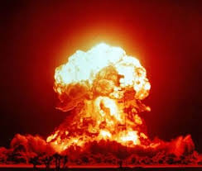
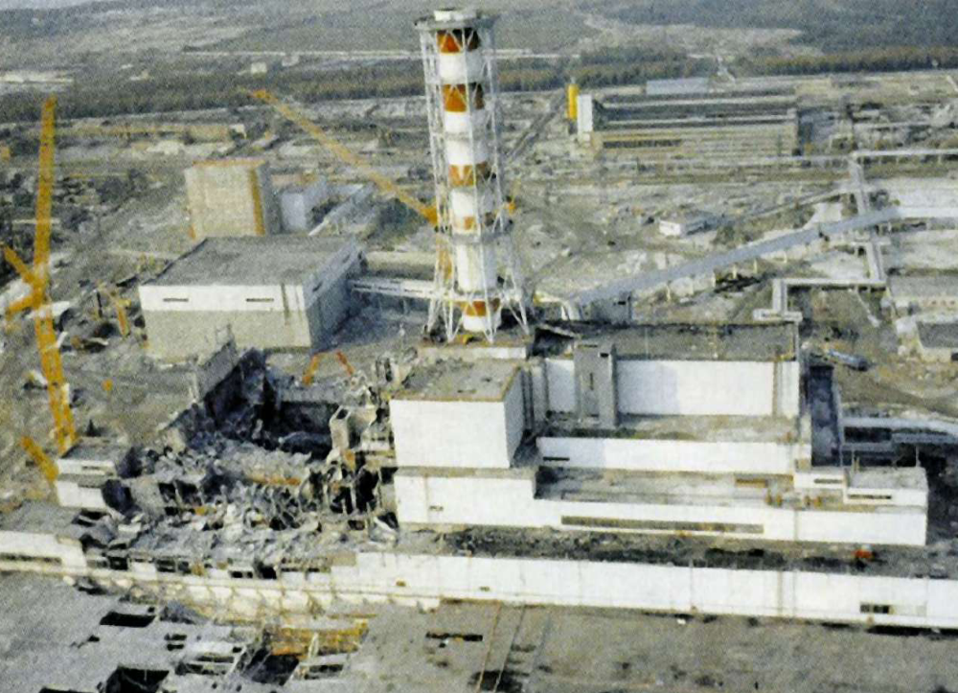
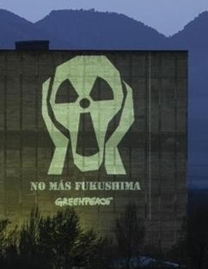
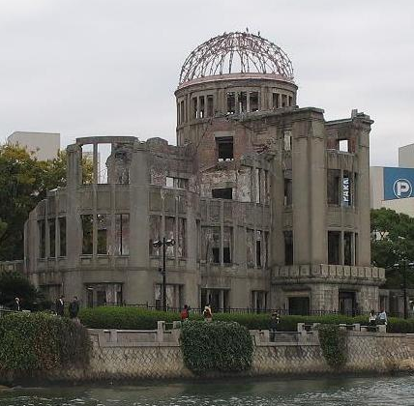
Nuclear Power Challenges
Safety !!! (Chernobyl accident −> Radiophobia)
Limited fuel resources (0.7% of U-235 & 99% of U-238)
Ecological problems (nuclear waste utilization – mainly MA)
Nonproliferation of fissile materials (nuclear terrorism)
Atomic Bomb House, Hiroshima

Slide 6
Nuclear fuel reproduction
²³⁷Np
T_{½} = 6.75 days
²³³U
²³⁴U
²³⁵U
²³⁶U
²³⁷U
T_{½} = 27 days
Th-U fuel cycle
²³³Pa
β
T_{½} = 22.2 min
²³²Th
²³³Th
²⁴¹Am
²⁴³Am
(n, γ)
T_{½} = 14,3 years
T_{½} = 4.98 hours
²³⁹Pu
²⁴⁰Pu
²⁴¹Pu
²⁴²Pu
²⁴³Pu
T_{½} = 2,35 days
²³⁹Np
U-Pu fuel cycle
β
T_{½} = 23.5 min
²³⁸U
²³⁹U
(n, γ)

Slide 7
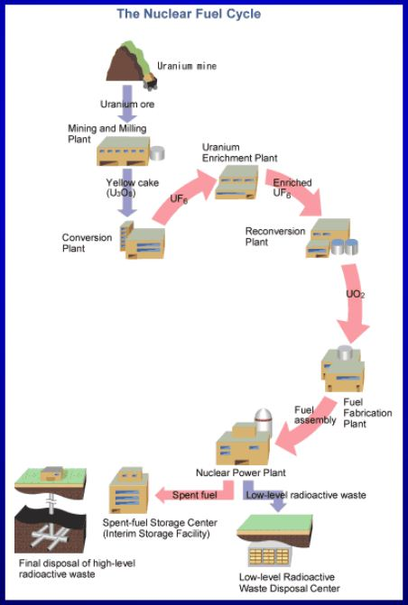
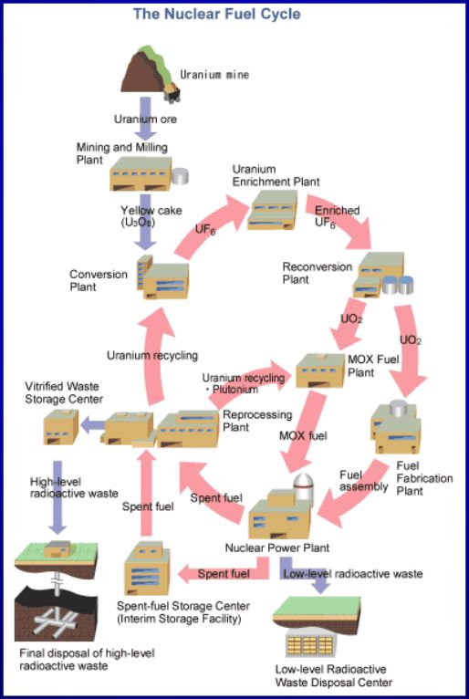
Open and closed nuclear fuel cycles

Slide 8
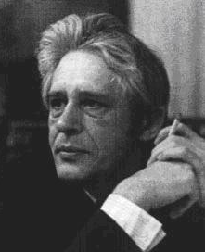
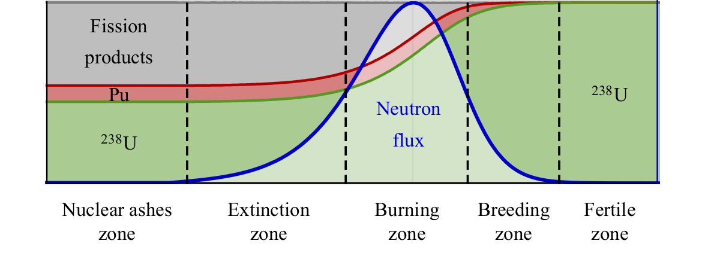
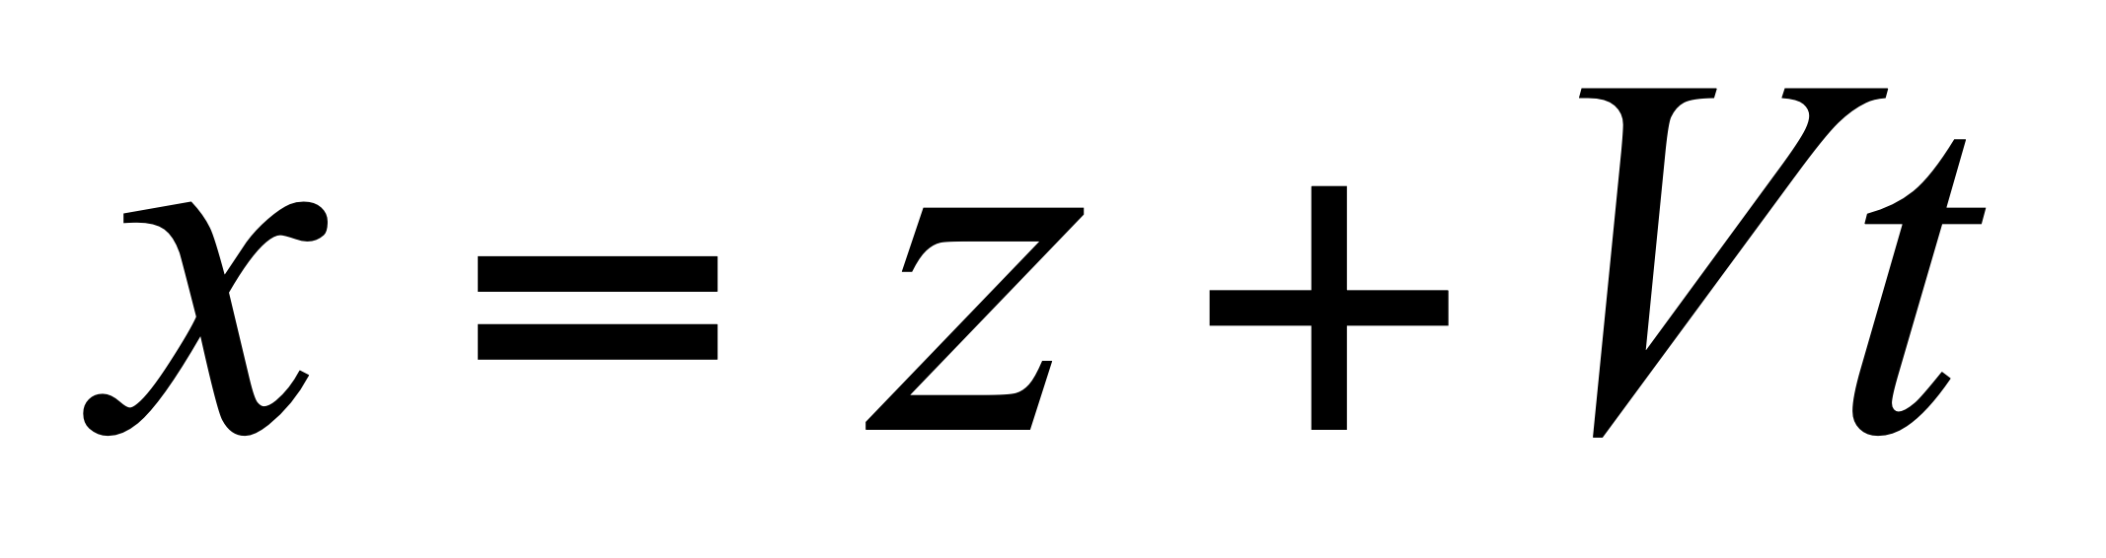
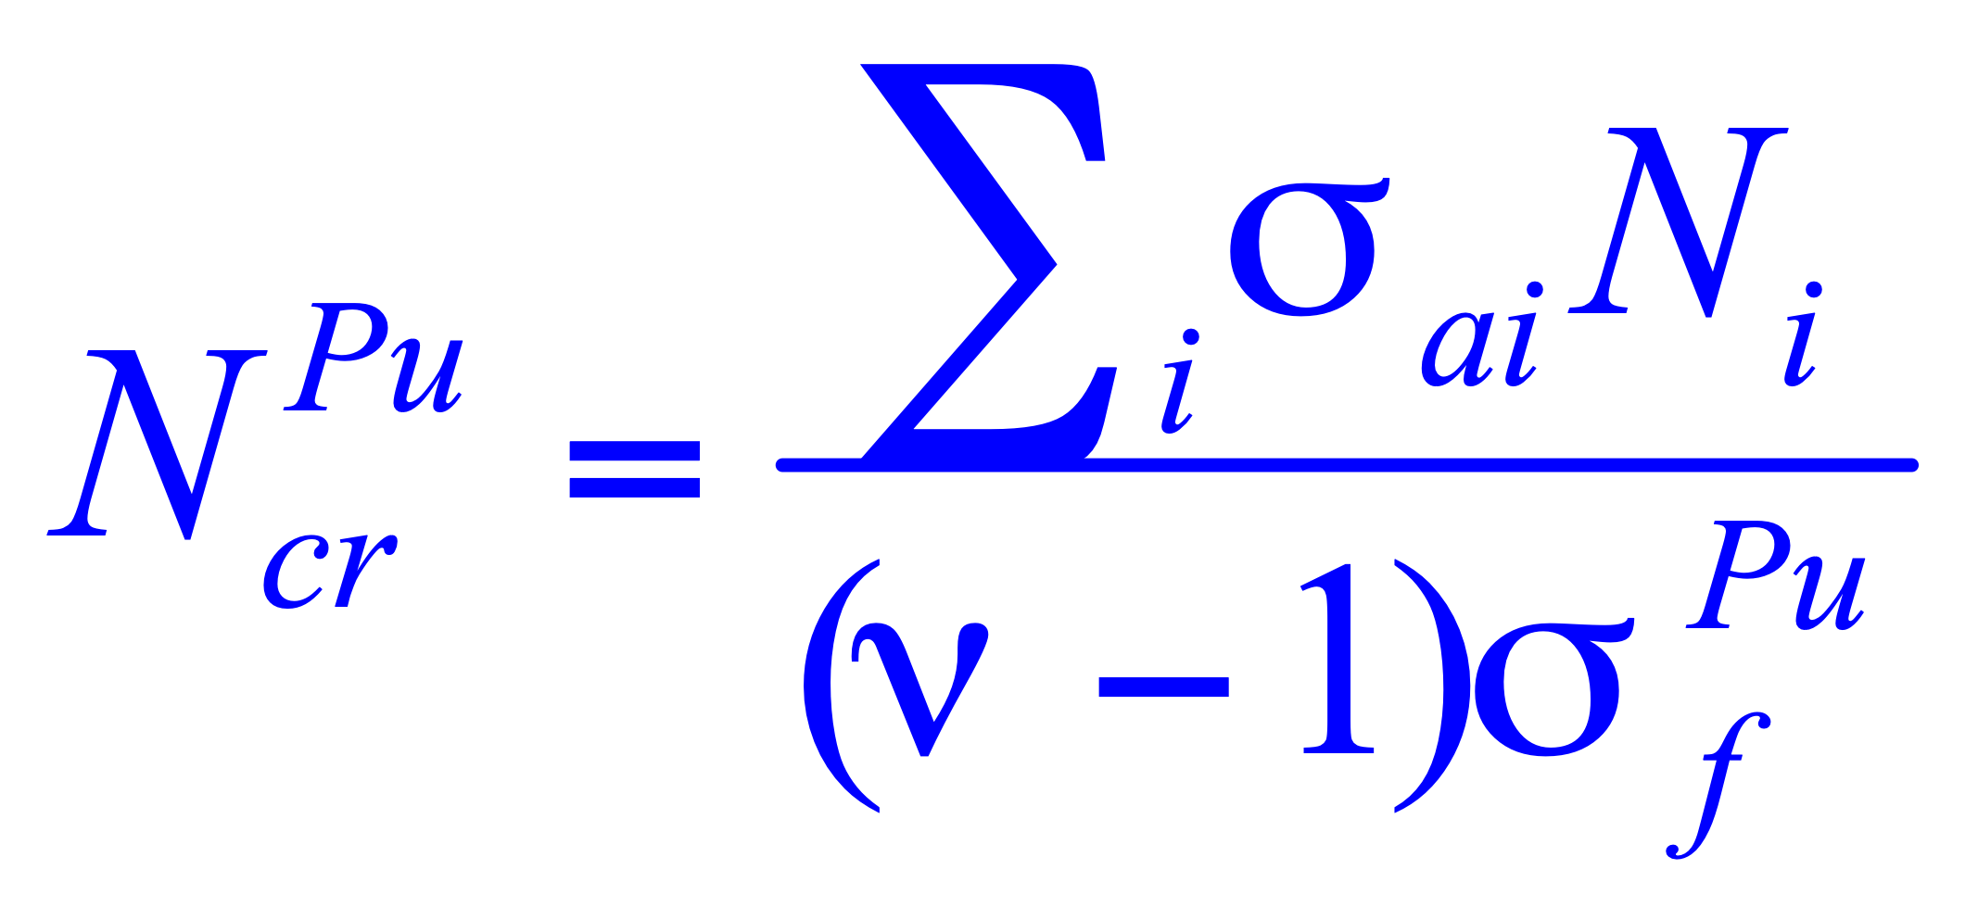
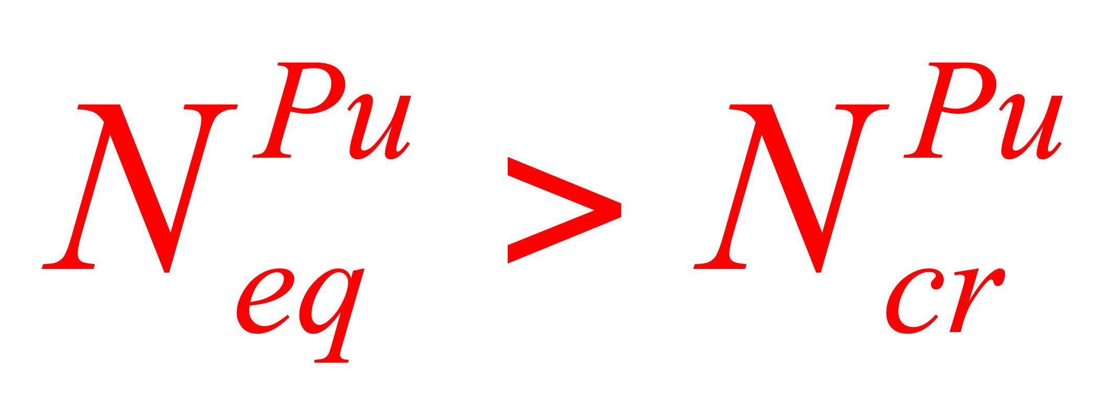
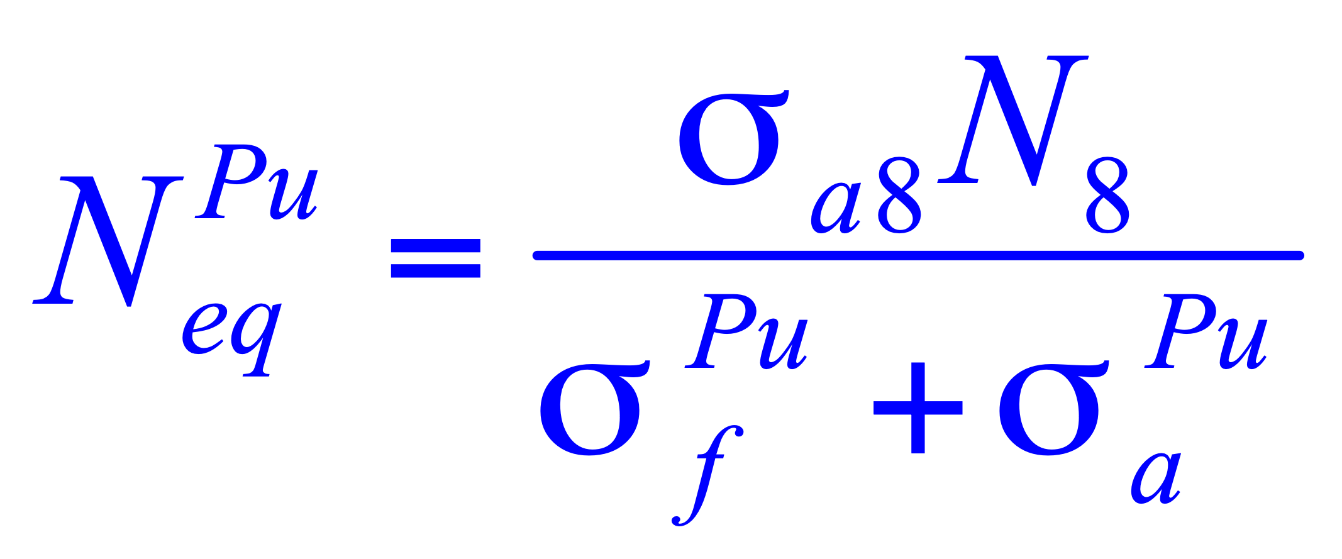
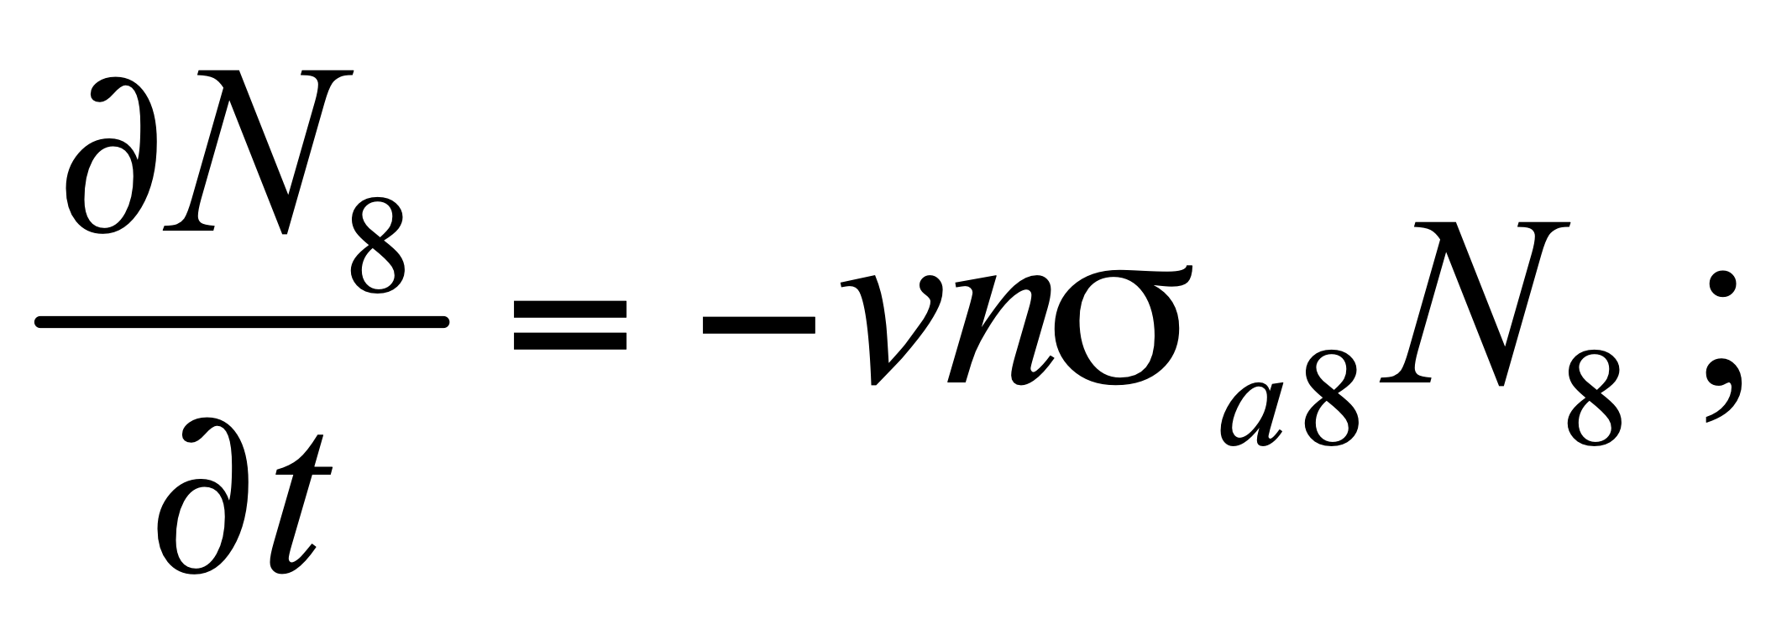
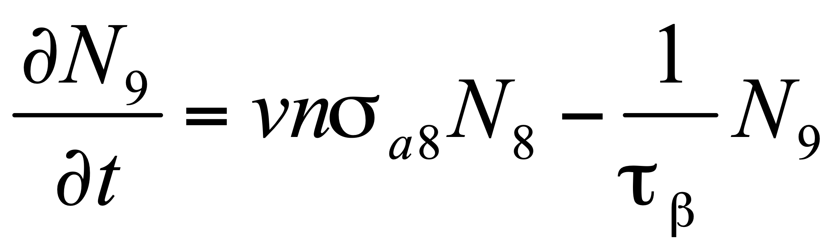
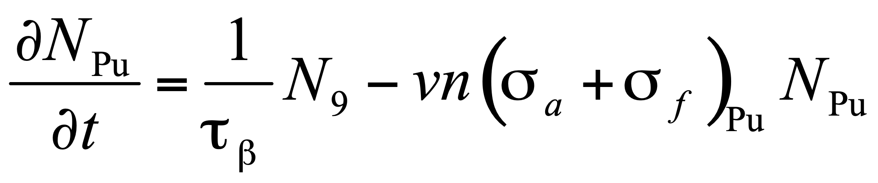
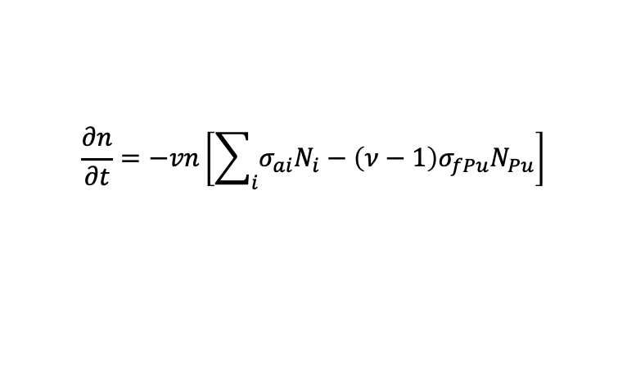
1988: Lev Feoktistov (IAE, USSR): Nuclear Burning Wave concept
L.P. Feoktistov. Preprint IAE-4605/4, 1988.
L.P. Feoktistov. Sov. Phys. Doklady, 34 (1989) 1071.
238U (n,γ) → 239U (β) → 239Np (β) → 239Pu (n,fission) ...
T_{1/2} ≈ 2.35 days
Concept & Analytical approach
n(z,t) = ? – one-dimensional problem
Neutron balance equation
$$\frac{∂n}{∂t}=−vn\left[\sum_{i}{σ_{ai}N_{i}}−\left(ν−1\right)σ_{fPu}N_{Pu}\right]$$
Set of burnup equations
Feoktistov
criterion

Slide 9
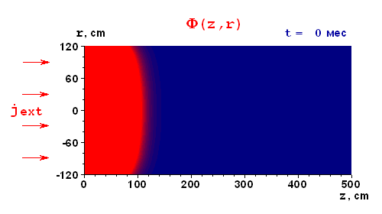
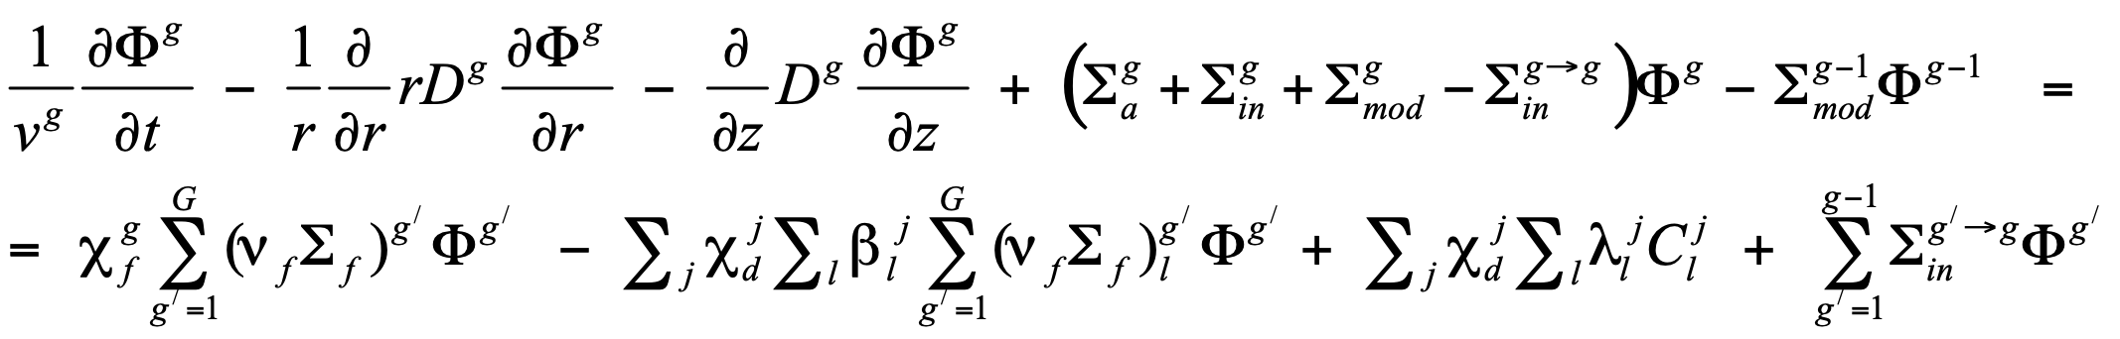
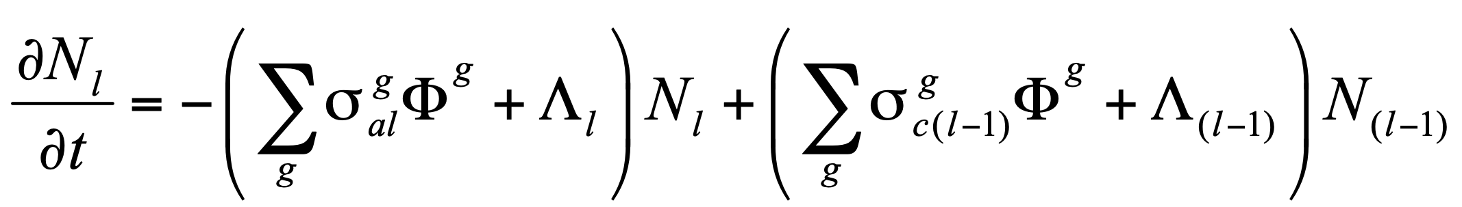
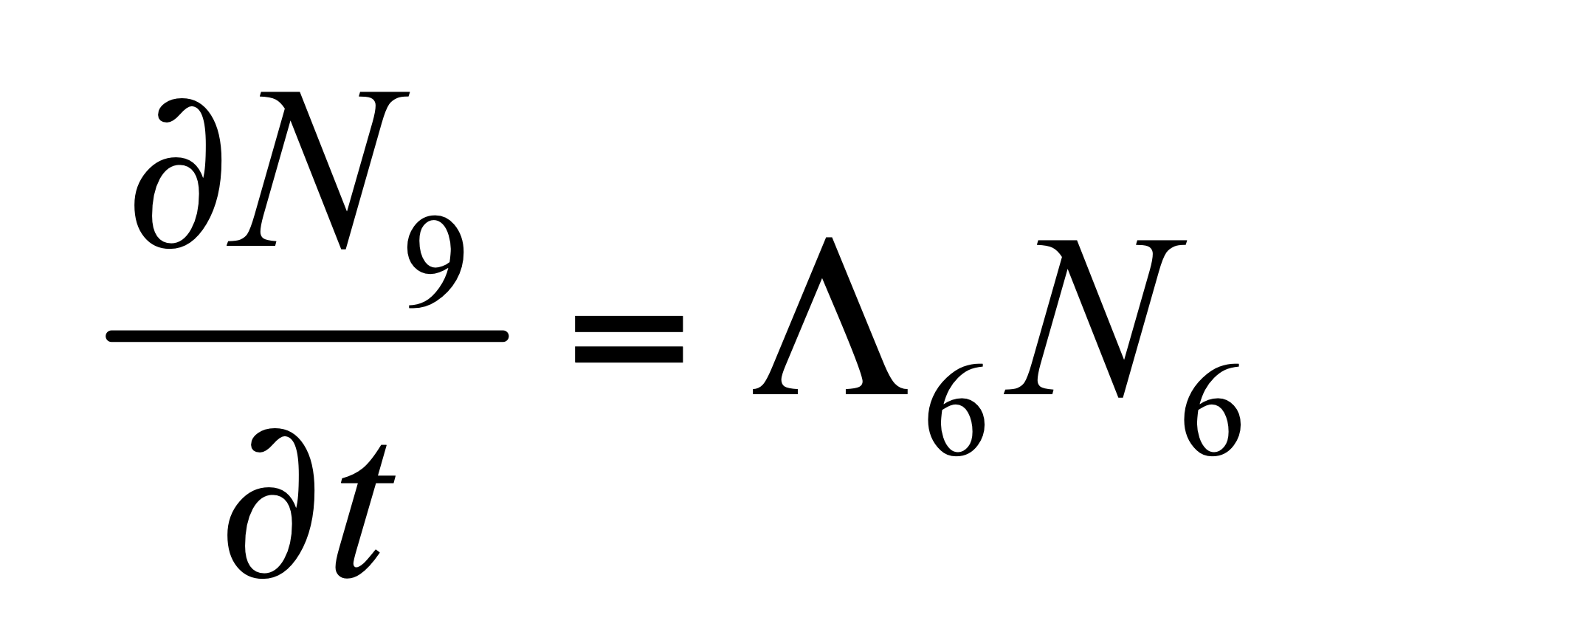
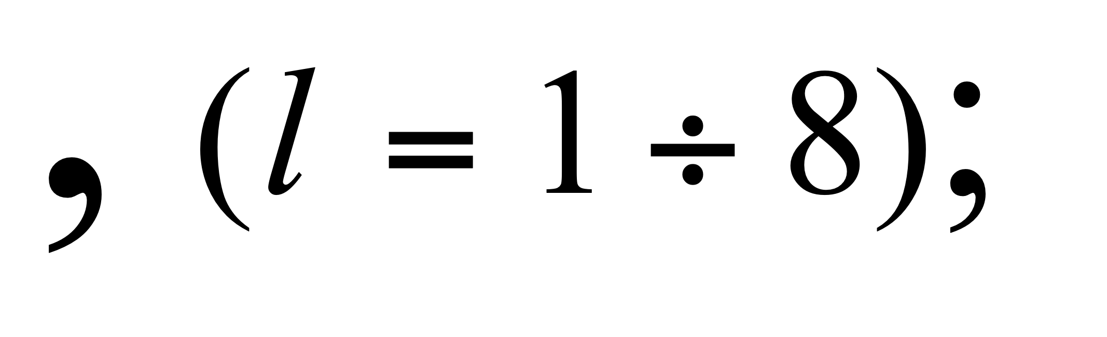
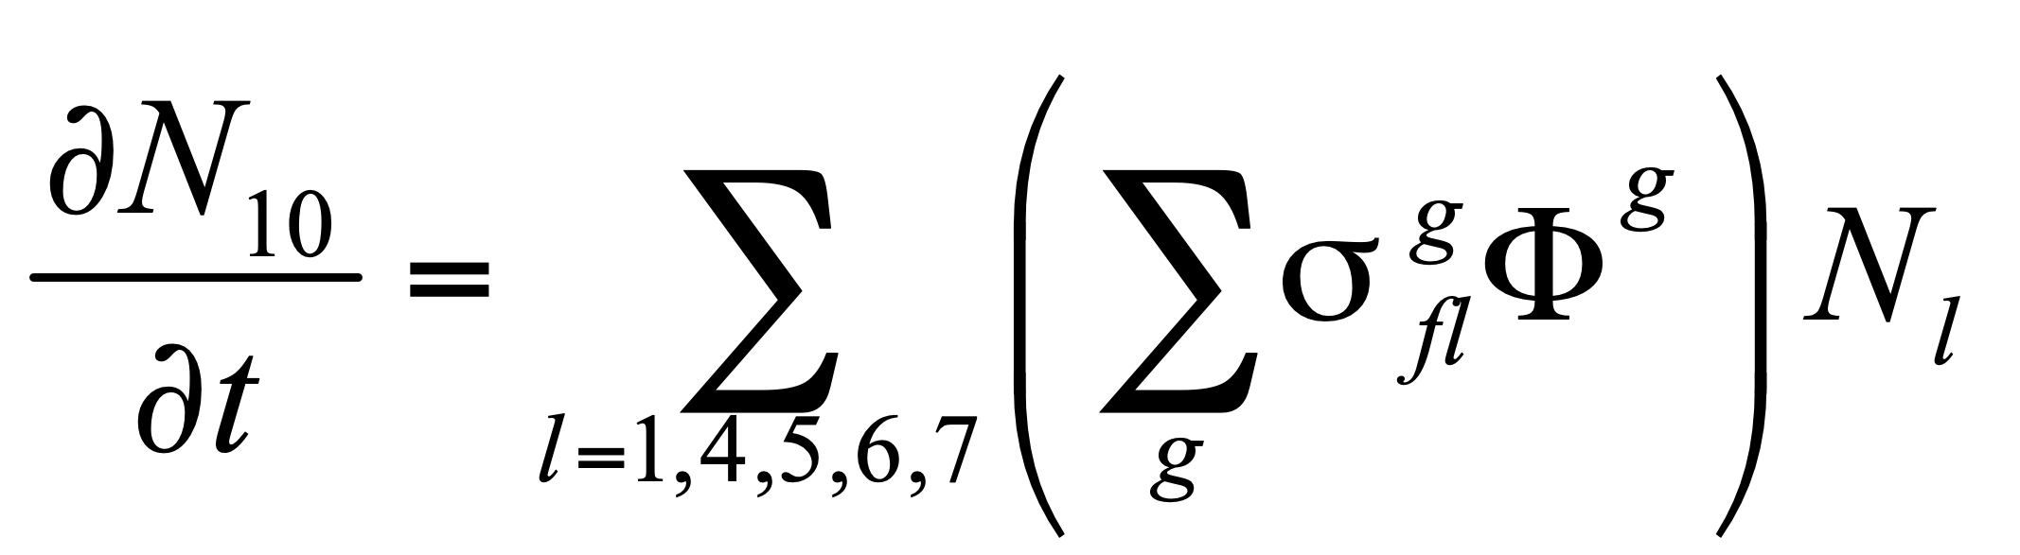
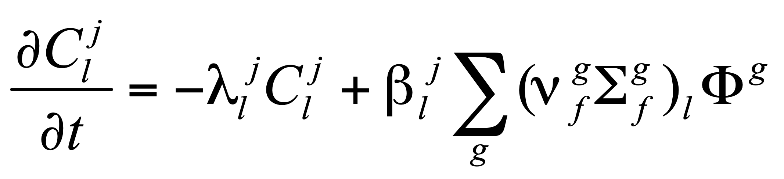
2D Non-Stationary Theory of Nuclear Burning Wave
S. Fomin, et al. - 1st IC “Global 2009”, Paris, paper 9456.
r
R
238 U
90 %
239 Pu
10 %
238 U 100 %
j _{ext}
L _{ign}
L
z
Ignition zone
Breeding zone
Nuclear Burning Wave
Non-Stationary Nonlinear Multi-Group Diffusion Equation of Neutron Transport
Together with Fuel Burn-up Equations and Equations of Nuclear Kinetics
Metal fuel (44%)
Pb-Bi coolant (36%)
CM - Fe (20%)
j_{ext} ~ 10¹⁵ cm^{‑2} s^{‑1}
t_{off} = 400 days
of Precursor Nuclei of Delayed Neutrons

Slide 10
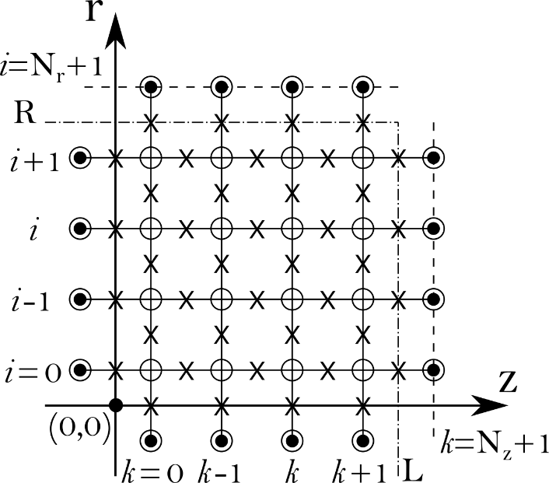

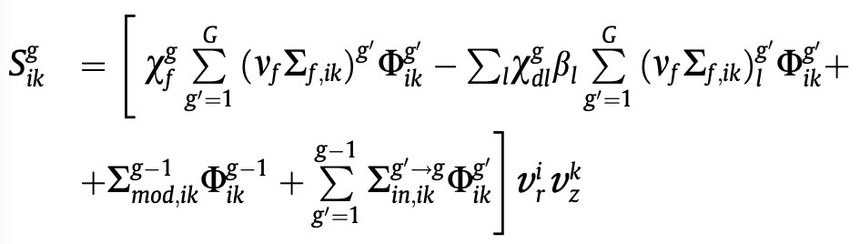

FANTENS-2D computing code
(FAst Neutron Transport in Evolving Nuclear Systems)
A two-dimensional pattern of a rectangular grid in a cylindrical coordinate system (z, ρ) with steps h and τ (uniform steps for (z, ρ) and with variable step for τ ) was used. The solutions of the set of the algebraic equations were obtained by finite-difference technique using the implicit difference Crank-Nicolson scheme.
This symmetric-in-time scheme has an unconditional stability at any relation between space and time steps.
It is the unique implicit scheme that has approximation of the second order of accuracy in h and τ.
S. Fomin et al., Annals of Nuclear Energy, 148 (2020) 107699.

Slide 11
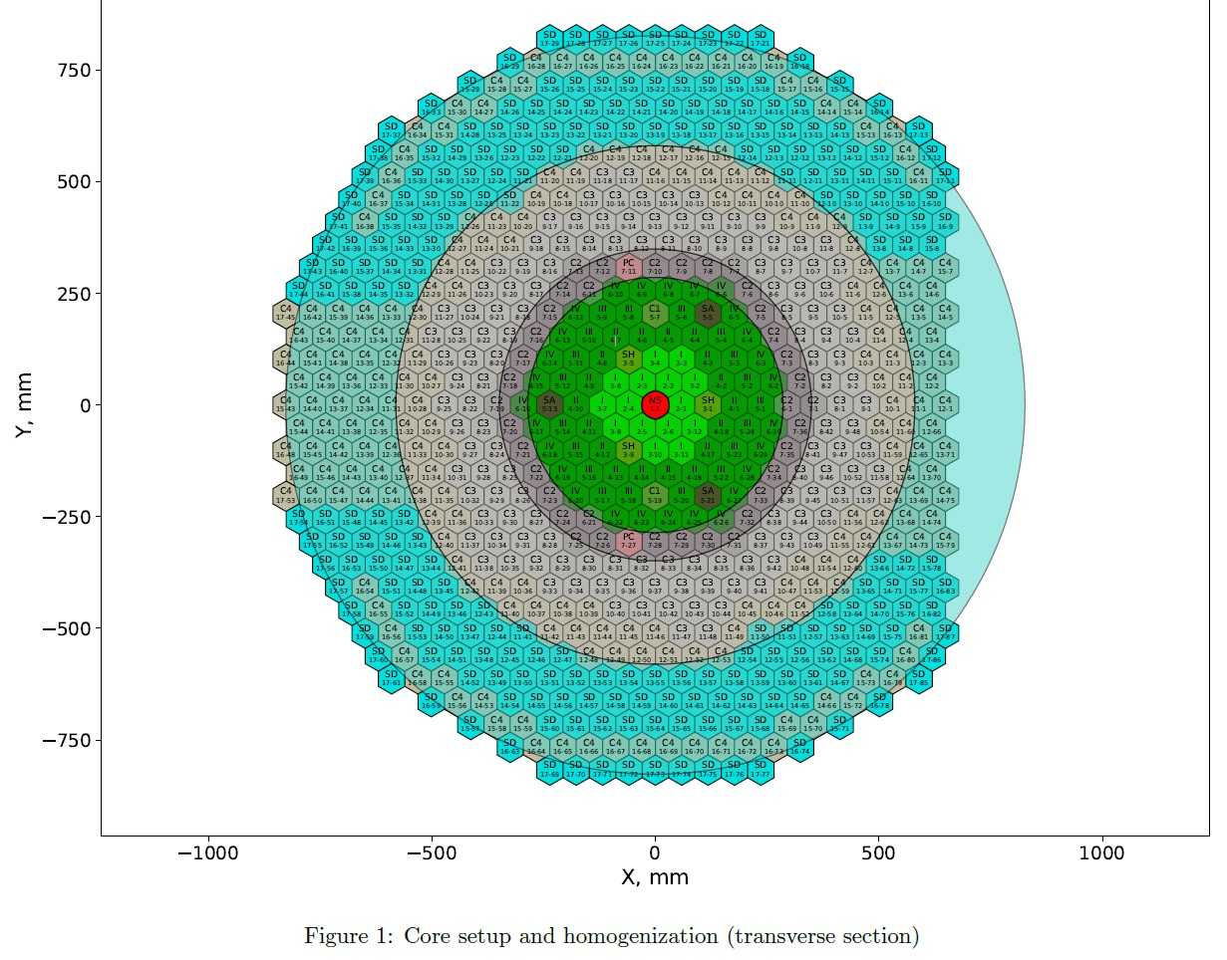
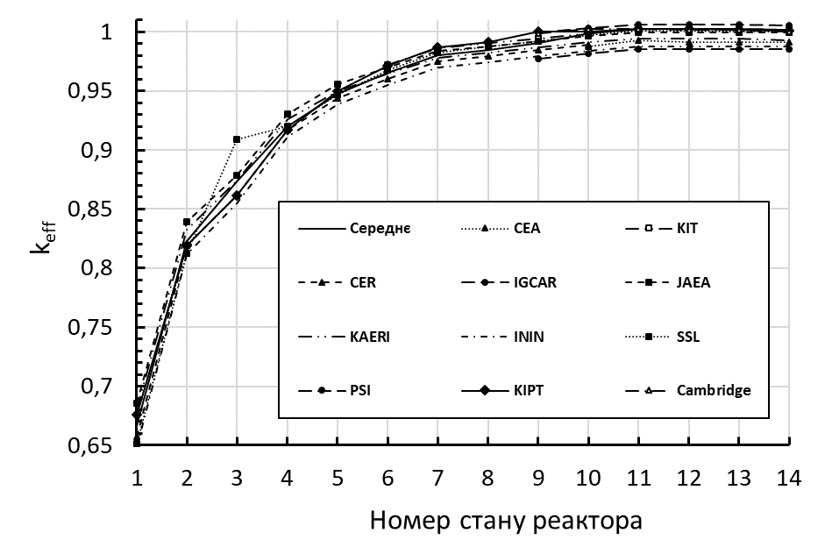
S.P. Fomin, M.S. Malovytsia - IAEA Research Agreement No: 22942/R0 (2018-2022)
IAEA CRP: Neutronics Benchmark of CEFR Start-Up Tests
Neutronics simulations of CEFR Start-up Tests using deterministic code FANTENS-2D
China Experimental Fast Reactor (CEFR) 65MW(th) pool-type sodium cooled fast-spectrum reactor core
Results of k_{eff} calculations for the sequential loading of fuel assemblies into the core of a CEFR reactor, performed by representatives of different groups using various deterministic computer codes
The results of k_{eff} calculations for fuel loading into the core of the CEFR reactor, performed using
the FANTENS-2D code, showed good agreement with the results obtained by other research groups.

Slide 12
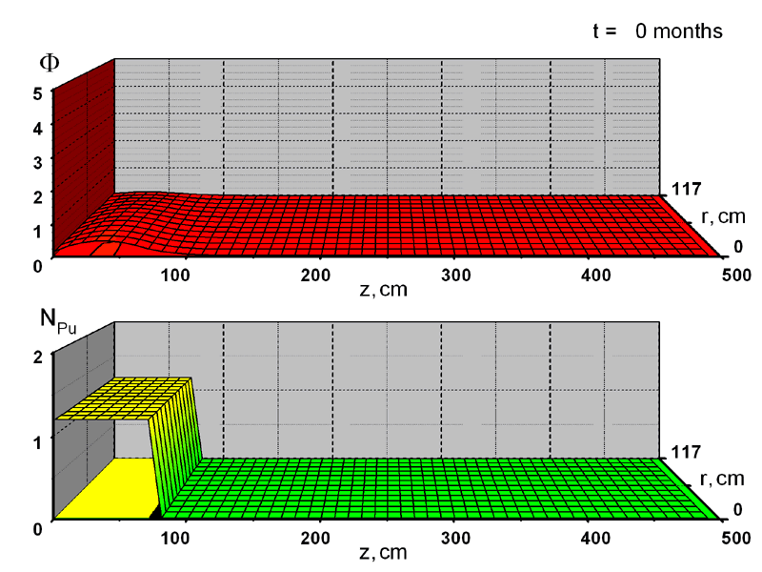
2D Non-Stationary Theory of Nuclear Burning Wave
S. Fomin, et al. - 1st IC “Global 2009”, Paris, paper 9456.
NBW Reactor : R=117 cm, L = 500 cm
,10¹⁷ cм^{‑2} с^{‑1}
,10²¹ cм^{‑3}

Slide 13
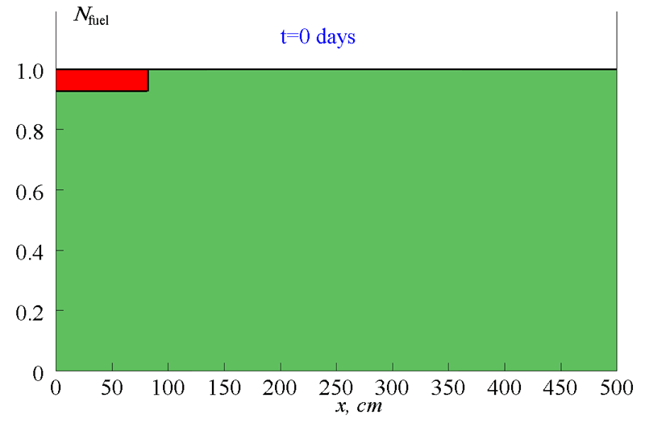
    Fuel burn-up
Fission
products
239Pu
238U
(Results of calculation in buckling approximation)

Slide 14
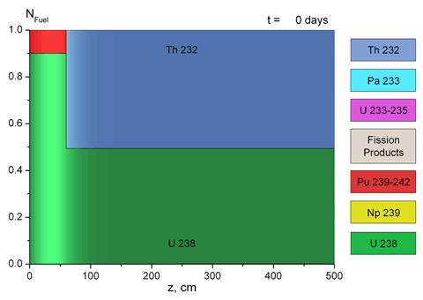
Fuel burn-up for mixed Th-U-Pu cycle
S. Fomin et al., ICAPP 2010 (San Diego, USA) paper 10302.
S. Fomin et al., Progress in Nuclear Energy, 52 (2011) 800-805.

Slide 15
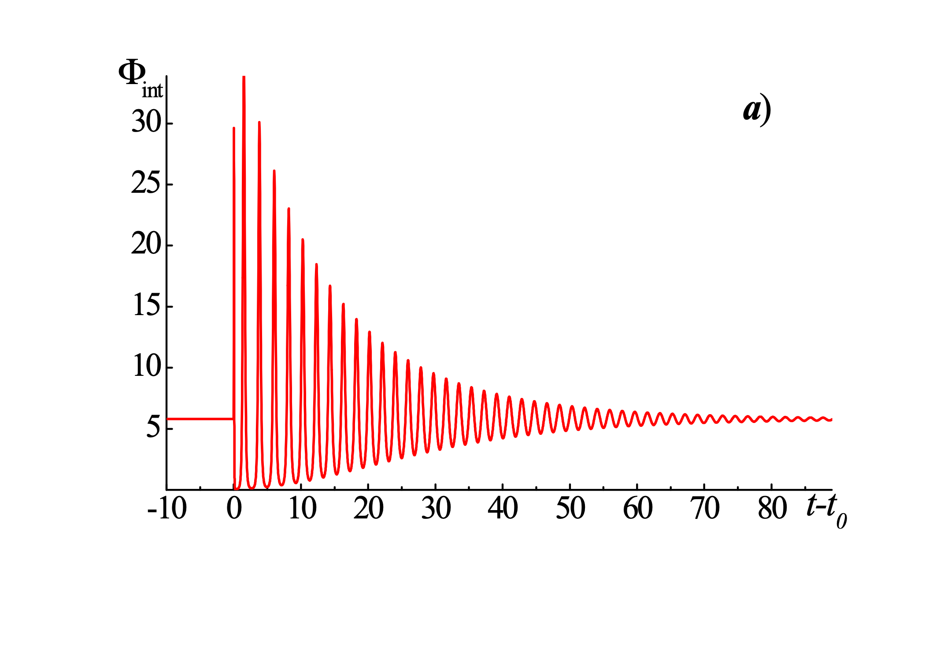
Stability study of the NBW mode
S. Fomin et al., IC “Fast Reactors 2013“ (Paris, France) paper CN-199-457.
R = 230 cm
t ≈ 2.5 days
Perturbation of integral neutron flux F_{int} (×10²² cm/s) caused by an external neutron source
via time t (days). The source with intensity Q_{ext} = 2×10¹¹ (cm⁻³ s^{‑1}) starts at t₀ = 3650 days,
lasts during 1 hour and is situated at 160 < z < 170 cm

Slide 16
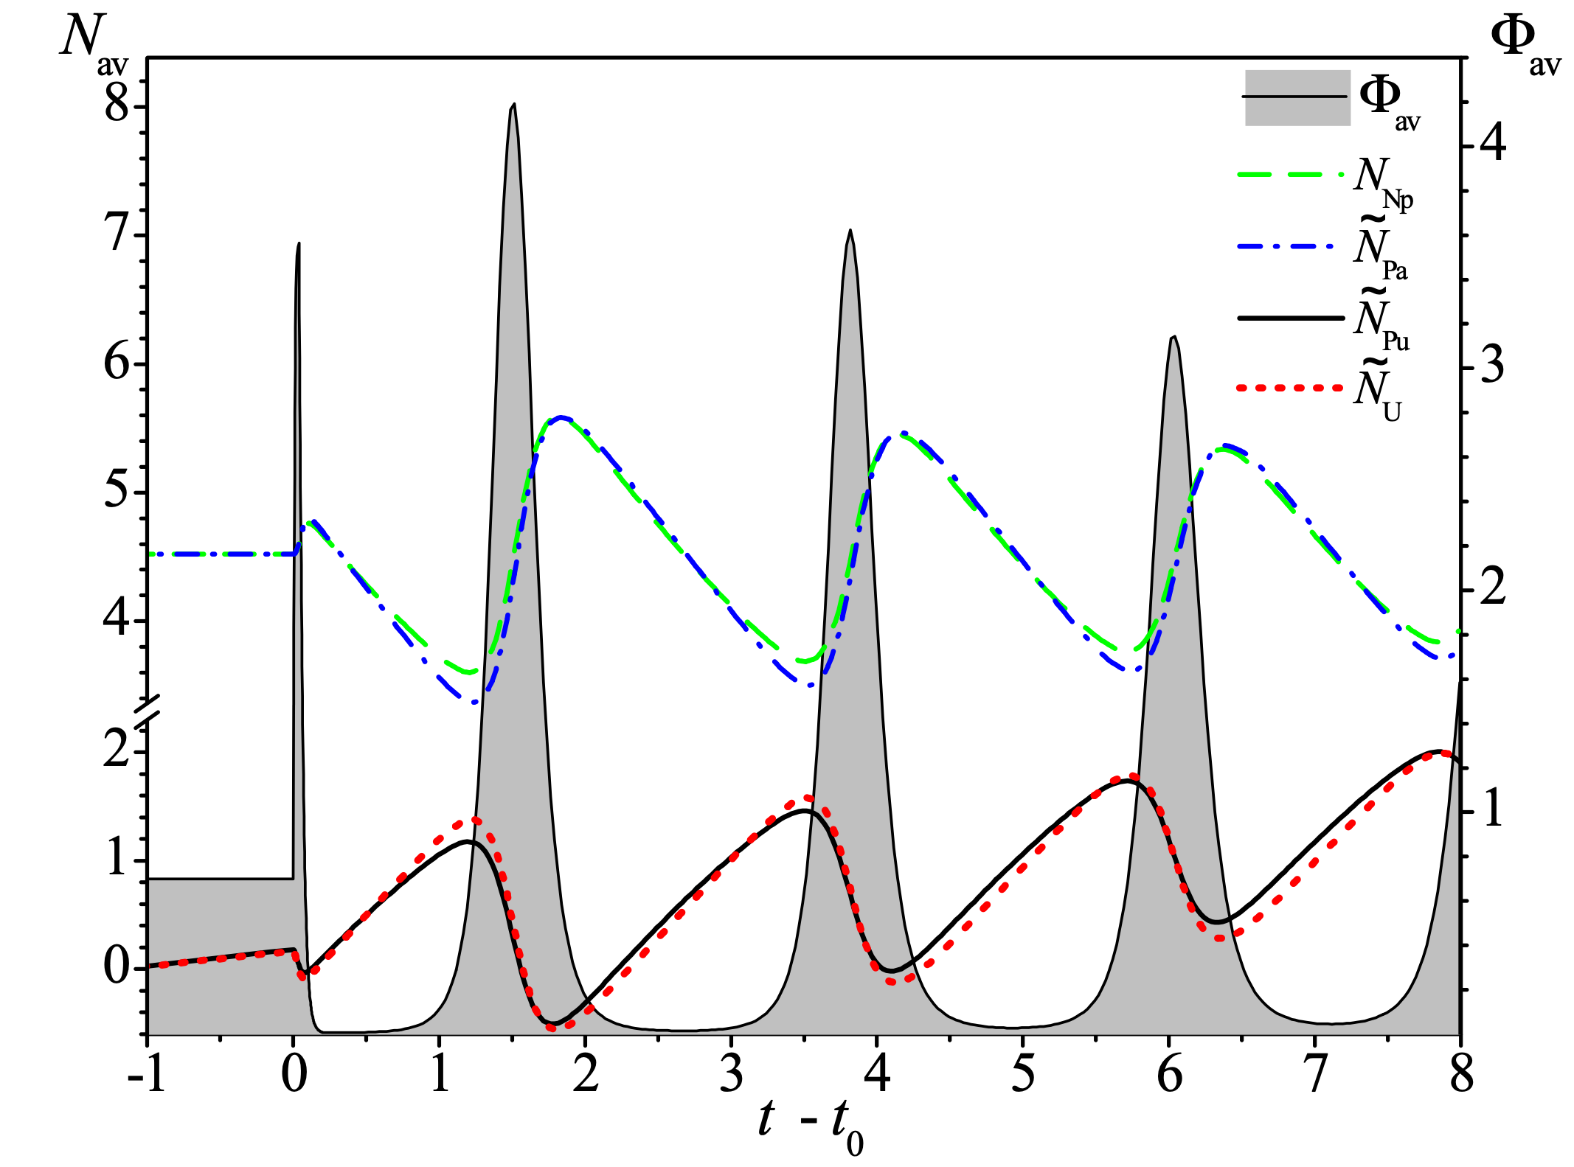

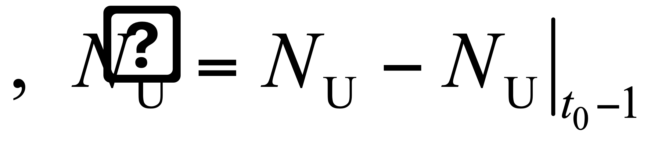
Negative Reactivity Feedback inherent to the NBW mode
S. Fomin et al., IC “Fast Reactors 2013“ (Paris, France) paper CN-199-457.
t ≈ 2.5 days
Evolution of the volume-averaged neutron flux F_{av} (×10¹⁵ cм^{‑2} с^{‑1}) and concentrations N_{av} (×10¹⁷ cm^{‑3}) of the main fissile and intermediate nuclides in the fuel of mixed Th­-U-­Pu cycle with time t (days) at the initial stage of the neutron flux perturbation t₀ = 3650 days. The averaged nuclide concentrations: N_{Np} is for ²³⁹Np, N_{Pa} = N_{Pa} - 53.1·10¹⁷ cm^{‑3}, is for ²³⁹Pu is for ²³³U.

Slide 17
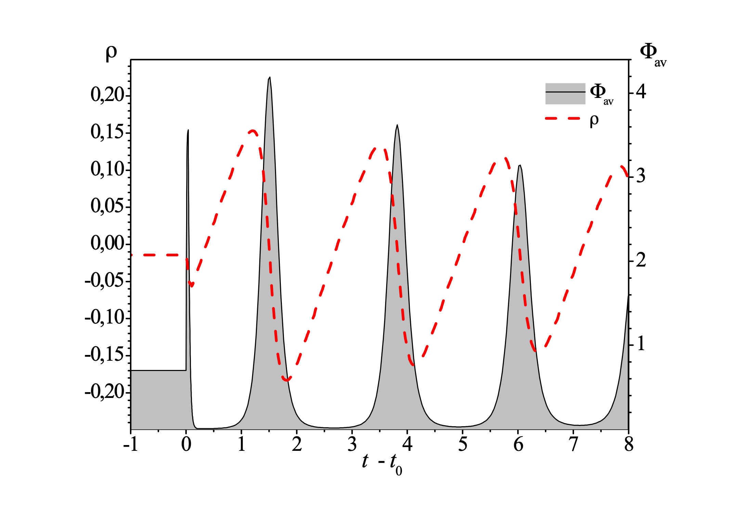
Negative Reactivity Feedback
S. Fomin et al., IC “Fast Reactors 2013“ (Paris, France) paper CN-199-457.
Variation of the reactivity ρ ($) with time t (days) along the variation of the volume-averaged neutron flux F_{av} (×10¹⁵ cм^{‑2} с^{‑1})

Slide 18
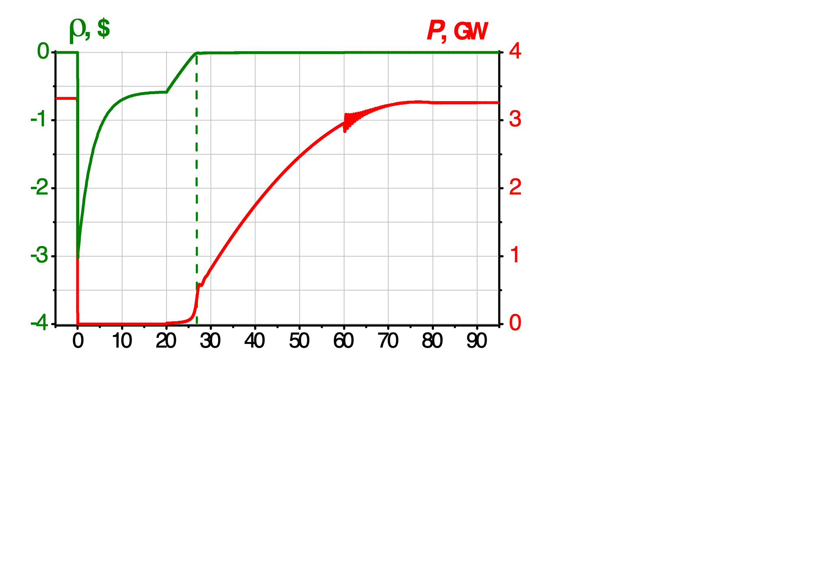
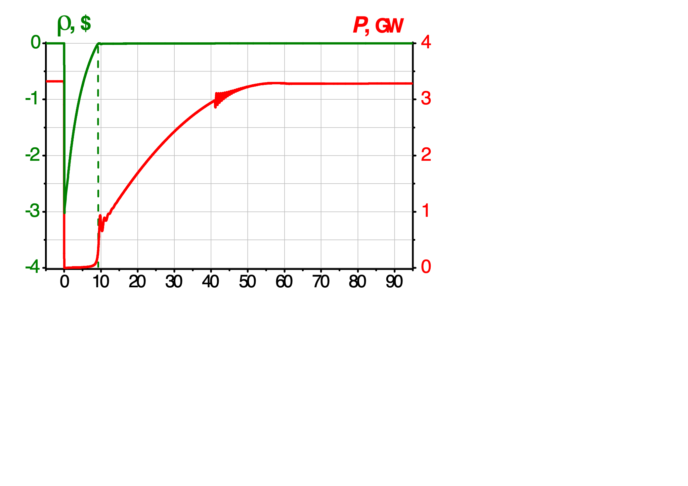
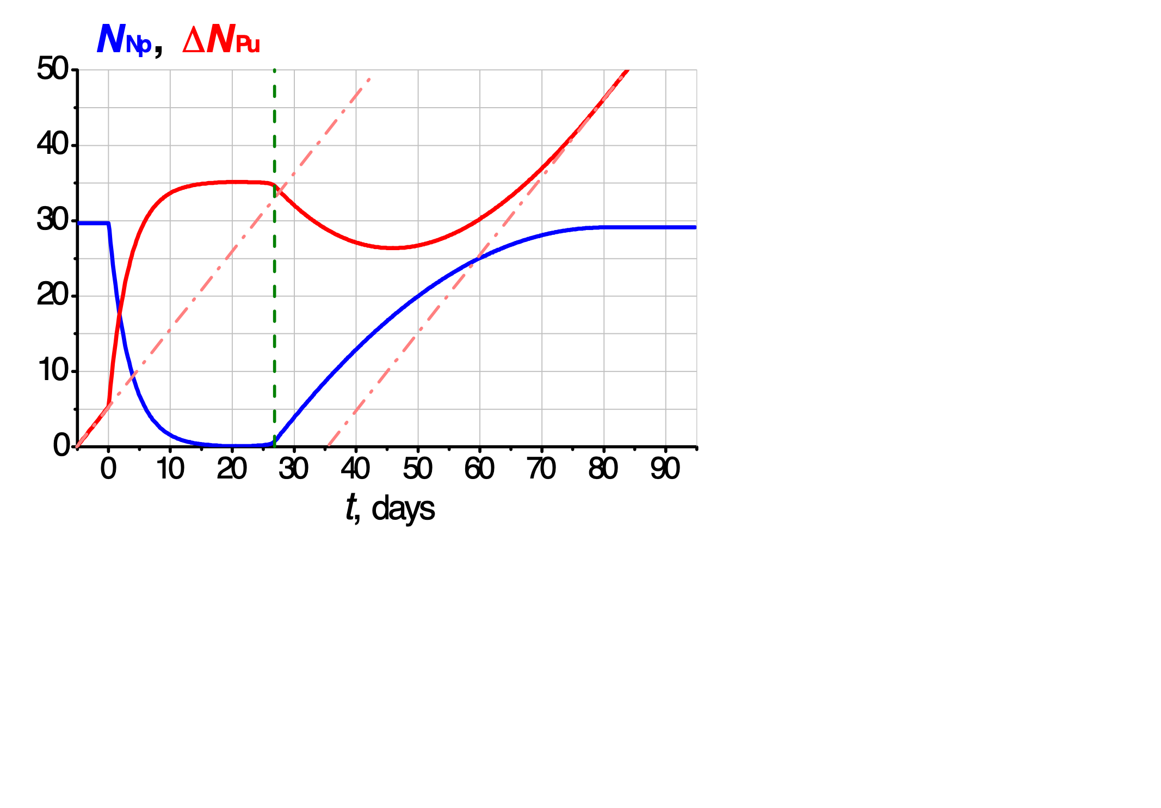
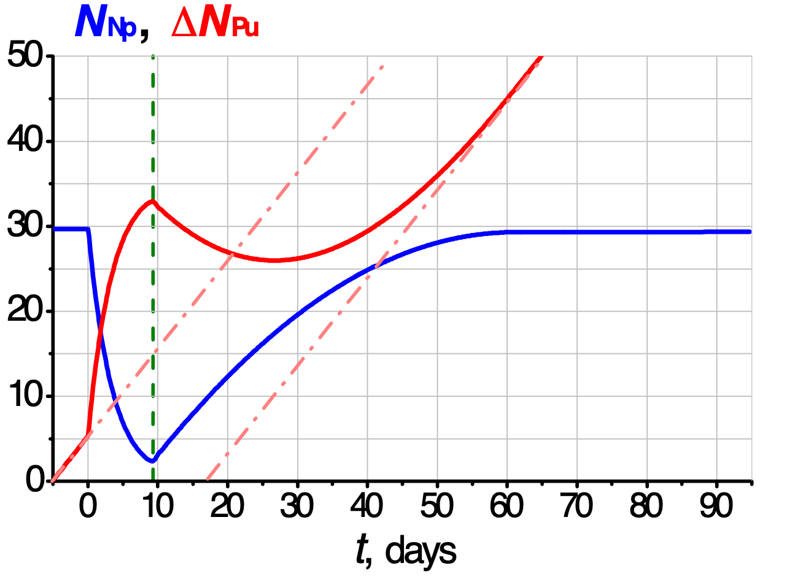
Shutdown and Restart of the NBW Reactor with U-Pu fuel
S. Fomin et al., IC Global 2015 (Paris, France) paper 5254.

Slide 19
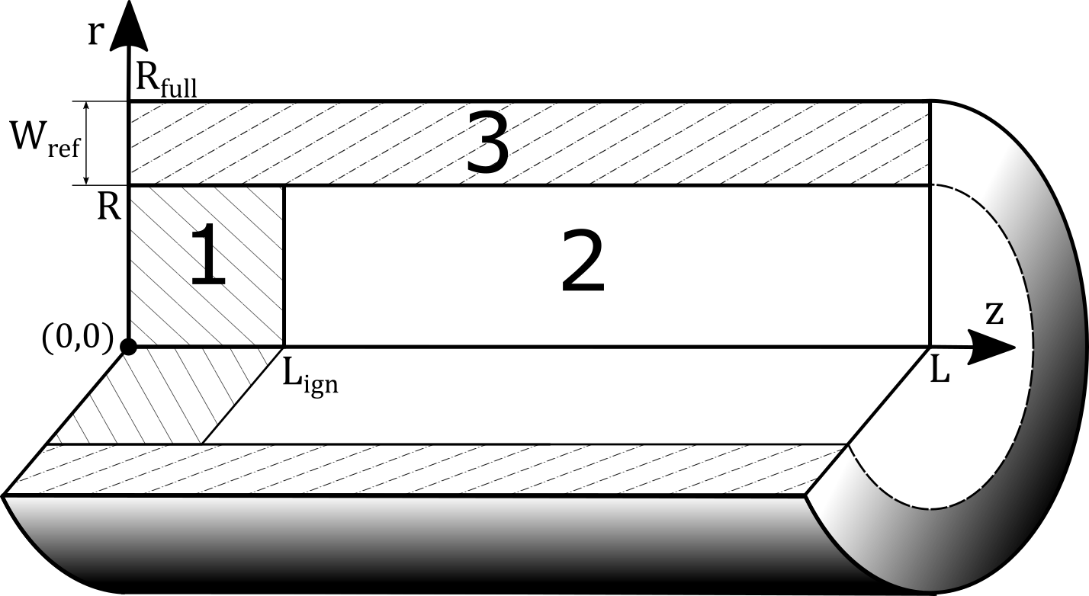
Radial reflector effect study
2D Non-Stationary Theory of Nuclear Burning Wave
S. Fomin et al., Annals of Nuclear Energy, 148 (2020) 107699.
Radial reflector Pb-Bi
Breeding zone ²³⁸U
Ignition zone ²³⁸U + ²³⁹Pu (10%)

Slide 20
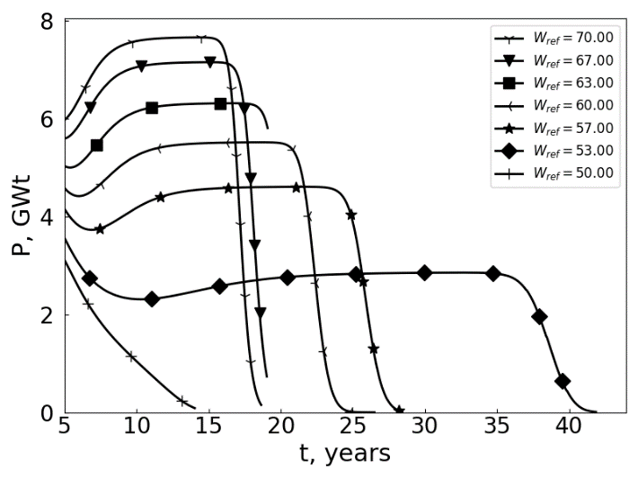
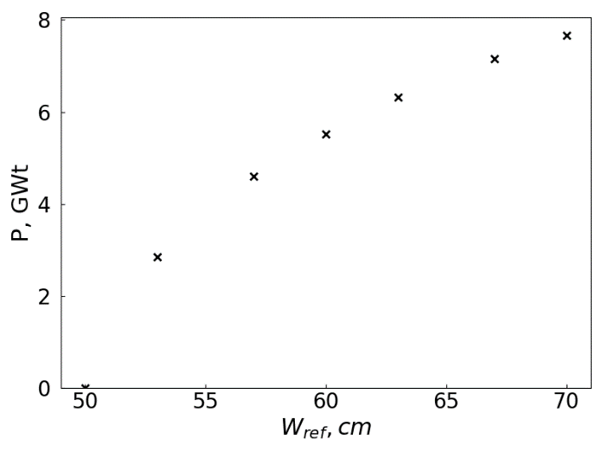
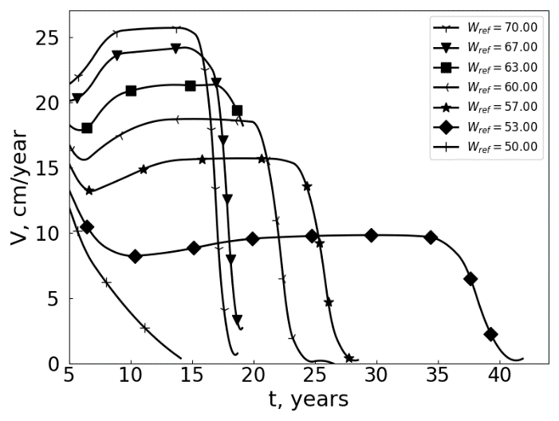
Reactor Power Control by Reflector Efficiency
S.P. Fomin et al., Annals of Nuclear Energy, 148 (2020) 107699.
Malovytsia M.S., “Power control of an advanced fast reactor operating in a self-sustained Nuclear Burning Wave mode”, PhD thesis, 2021,
V.N. Karazin Kharkiv National University,
Kharkiv, Ukraine.
20

Slide 21
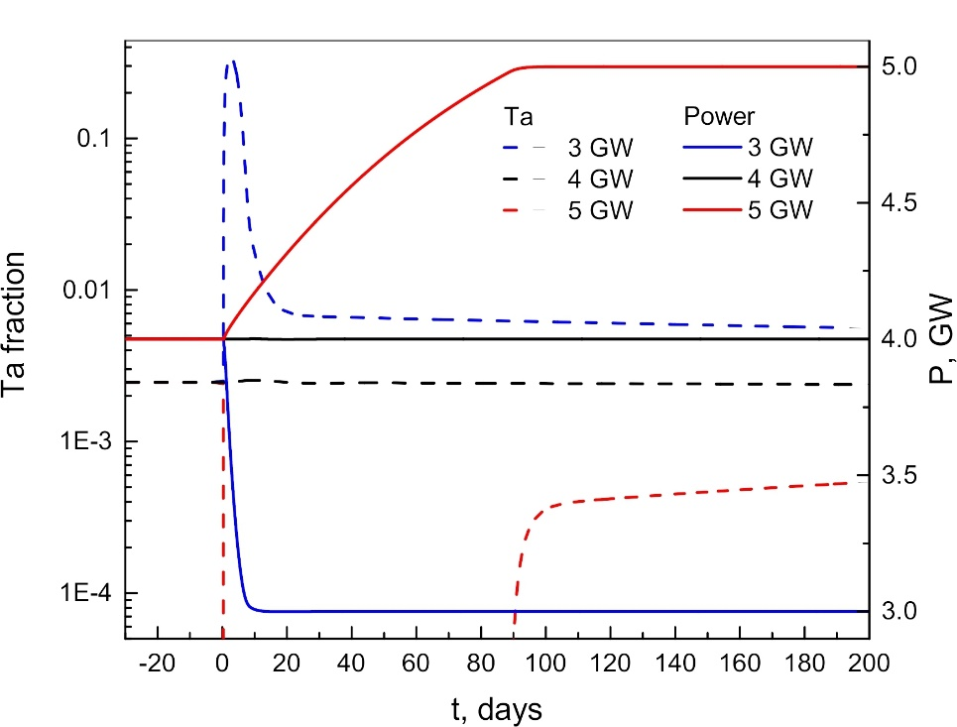
Reactor Power Control by Reflector Efficiency
S. Fomin et al., IC “Fast Reactors 2022“, IAEA, Vienna, Austria, paper CN- 291-365.
Malovytsia M.S., PhD thesis, 30 June 2021, Kharkiv, Ukraine.

Slide 22
Main features of NBW reactor with mixed Th-U-Pu fuel cycle
Reactor composition (vol. frac.):
Fuel = 55% (F_{Th} = 62%, p = 0.20), Coolant = 30%, CM = 15%, R = 215 cm
- negative feedback on reactivity - intrinsic safety (!!!)
- long-term (decades!!) operation without refuelling and external control
- possibility of ²³²Th and ²³⁸U utilization as a fuel
- fuel burn-up depth for both ²³⁸U and ²³²Th ≈ 50% (one through cycle !)
- neutron flux in active zone ≈ 2·10¹⁵ n/сm²s
- neutron fluence during the whole reactor campaign ≈ 3·10²⁴ n/сm²
- energy production density in active zone ≈ 200 W/сm³
- total power at the steady-state regime ≈ 1.2 GWt
- wave velocity at the steady-state regime ≈ 2 сm/year
- possibility of nuclear waste burn out (expected)

Slide 23
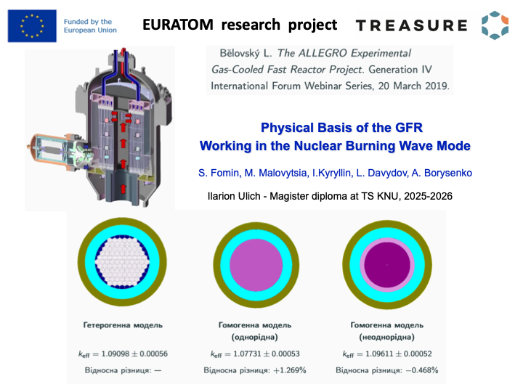

Slide 24






Neutron flux Ф
²³⁸U concentration
EURATOM program
project # 101164616
(2024-2028) 18 groups
Work Package 1, Task 1.1
ALLEGRO type helium-cooled
fast reactor with metal fuel
UZr (10% wt) in the NBW mode
²³⁹Pu concentration
Fission products concentration
The volume fraction ratio:
- fuel (20% porosity) - 42%
- He coolant (7 MPa) - 38%
- SM (Zircaloy-4) - 20%
Radial reflector SiC :
- 78 % silicon carbide
- 22 % He coolant (1 MPa)
Wave velocity –
V ≈ 10 cm/year
Thermal power – P_{Th} ≈ 3.6 GW
Radial (along r) and axial (along z) distributions of flux and components of the cylindrical NBW reactor core of radius R = 126 cm with the radial reflector of thickness W_{ref} = 71 cm

Slide 25
List of our publications on the NBW reactor :
S. Fomin et al., Annals of Nuclear Energy, 32 (2005) 1435-1456.
S. Fomin et al., Problems of Atomic Science & Technology, 6 (2005) 106-113.
S. Fomin et al., ICENES (2005) (Brussels, Belgium) paper IC058.
S. Fomin et al., Nuclear Science & Safety in Europe. Springer (2006) 239-251.
S. Fomin et al., ICAPP’06 (2006) (Reno, USA) paper 6157.
S. Fomin et al., Problems of Atomic Science & Technology, 3 (2007) 156–163.
S. Fomin et al., ICAPP’07 (2007) (Nice, France) paper 7499.
S. Fomin et al., Progress in Nuclear Energy, 50 (2008) 163-169.
Yu.Mel’nik et al., Atomic Energy, 107 (2009) 288-295.
S. Fomin et al., Global 2009 (Paris, France) paper 9456.
S. Fomin et al., ICAPP 2010 (San Diego, USA) paper 10302.
S. Fomin et al., Progress in Nuclear Energy, 52 (2011) 800-805.
O. Fomin et al., Journal of KNU, #104, «Nuclei, Particles, Fields», issue 2 /58/ (2013) 49-56.
S. Fomin et al., IC “Fast Reactors 2013“ (Paris, France) paper CN-199-457.
S. Fomin et al., IC “Global 2015” (Paris, France) paper 5254.
S. Fomin et al., Problems of Atomic Science & Technology, 3 /121/ (2019) 80–85.
S. Fomin et al., Annals of Nuclear Energy, 148 (2020) 107699.
S. Fomin et al., IC “Fast Reactors 2022“ (Vienna, Austria) paper CN- 291-365.

Slide 26
Conclusion
Advantages of the Burning Wave Reactor
No reactivity margin required during operation
Inherent safety due to negative reactivity feedback
Use of natural/depleted uranium and thorium as fuel
Decades of operation without refuelling
Potential transmutation of long-lived radioactive waste
Main Results
Physical justification of inherent safety
Application of thorium–uranium fuel
Smooth reactor start-up methodology
Safe shutdown and restart capability
Power control via radial reflector efficiency
Remaining Challenge
Neutron fluence remains too high for currently available structural materials

Slide 27

THANK YOU FOR ATTENTION!

Slide 28


Slide 29


Slide 30



Institute of Solid-state Physics, Materials Science and Technologies
Various nuclear concepts require low void swelling of structural materials at very high exposures (>200 dpa), high temperatures (700⁰C) and at super high levels of helium and hydrogen.
Due to high swelling of austenitic steels (life-limited by swelling to 150 dpa) the nuclear materials community has moved toward ferritic and ferritic/martensitic alloys and ODS - Oxide dispersion-strengthened alloys.

