Slide 1

Evolution of Neutron-Capture Cross Sections of Fission Products Under High-Neutron-Fluence Irradiation
Maksym MALOVYTSIA
researcher at NSC Kharkiv Institute of Physics and Technology
mmalovytsia@gmail.com
French-Ukrainian Workshop 2026

Slide 2
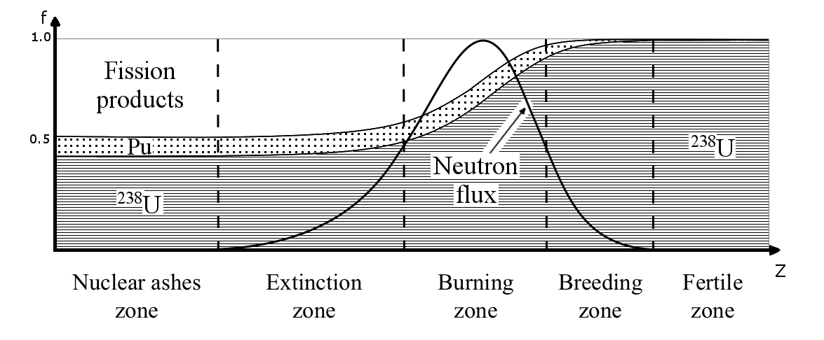
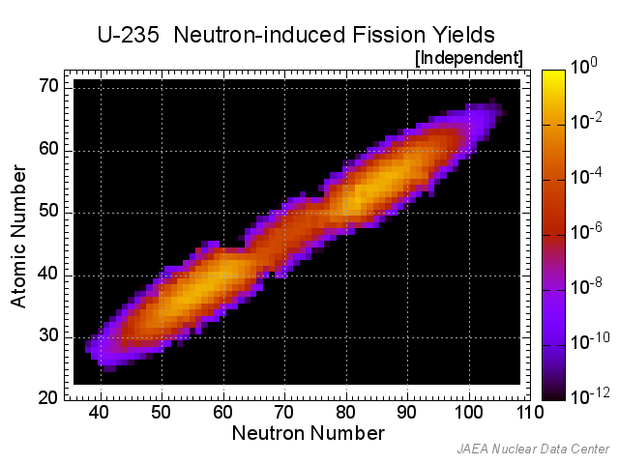
Motivation of study
Strong influence on the neutron absorption by fission products at high burnup levels (= high fluence)
Change of the fission product composition with time and fluence
Challenge of accounting for all of the possible fission products ~1000 nuclides
Developing a fast method for accounting for fission product evolution

Slide 3
Methods for accounting for fission products
Full vector of fission products. Around 1000 nuclides + the transmutation chains which are influenced by the neutron flux
  - Very time consuming
Accounting only for “important” nuclides, which are considered strong neutron absorbers (e. g. Xe-135, Sm-149, Gd-157 etc.)
  Less time consuming, still requires full transmutation chains that result in production of the “important” nuclides
One-lump lumped fission product model
  - Simplest model, usually independent from time and fluence
  4. Two-lump lumped fission product model
  - Accounting for even- odd- A lumps, with transmutation between them

Slide 4
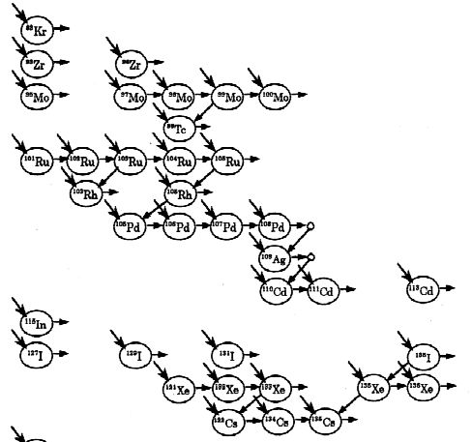
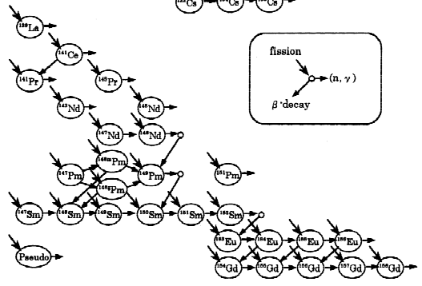
Accounting for important fission products
Hiroshi Sekimoto, Kouichi Ryu & Yoshikane Yoshimura (2001) CANDLE: The New Burnup Strategy, Nuclear Science and Engineering, 139:3, 306-317, DOI: 10.13182/NSE01-01

Slide 5

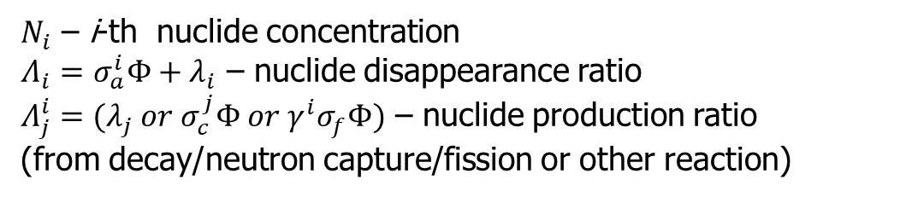
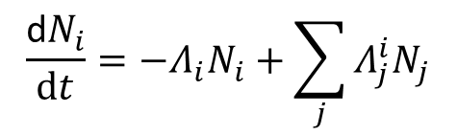
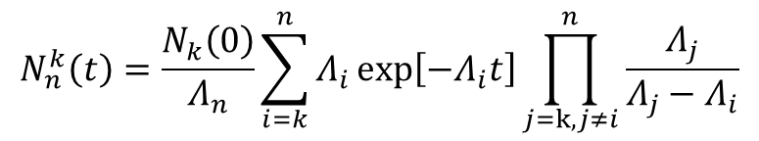
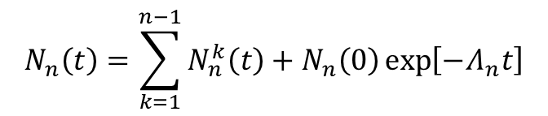
Calculating nuclide evolution
$238U−\left(n,g\right)→$ $239U−\left(β−\right)→239Np−\left(β−\right)→239Pu$
$$N_{1}→N_{2}→ N_{2}→…→ N_{n}$$
Mass conservation law for nuclide transmutation chain
$N_{i}$ – i-th nuclide concentration
$Λ_{i}=σ_{a}^{i}Φ+λ_{i}$ – nuclide disappearance ratio
$Λ_{j}^{i}=(λ_{j} or σ_{c}^{j}Φ or γ^{i}σ_{f}Φ)$ – nuclide production ratio
(from decay/neutron capture/fission or other reaction)
$$\frac{\text{d}N_{i}}{dt}=−Λ_{i}N_{i}+\sum_{j}{Λ_{j}^{i}N_{j}}$$
For $Φ=const$ the system of equations can be solved analytically for nuclide n :
$$N_{n}\left(t\right)=\sum_{k=1}^{n−1}{N_{n}^{k}\left(t\right)+N_{n}\left(0\right)\exp\left[−Λ_{n}t\right]}$$
$$N_{n}^{k}\left(t\right)=\frac{N_{k}\left(0\right)}{Λ_{n}}\sum_{i=k}^{n}{Λ_{i}}exp\left[−Λ_{i}t\right]\prod_{j=k,j≠i}^{n}{\frac{Λ_{j}}{Λ_{j}−Λ_{i}}}$$
If $Φ=Φ(t)$ the time interval can be split into a set of smaller intervals, at which the flux can be considered relatively constant

Slide 6
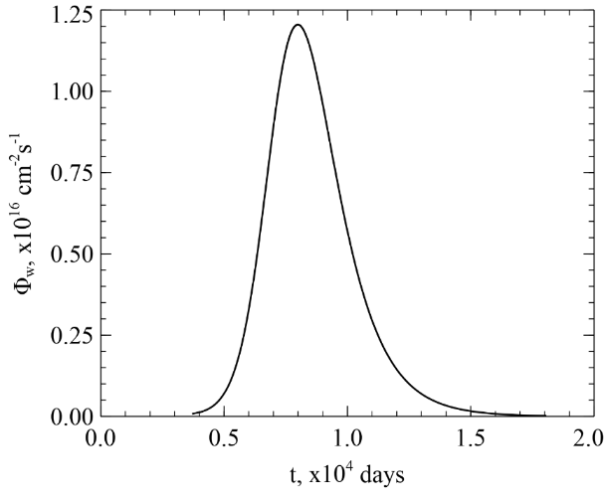
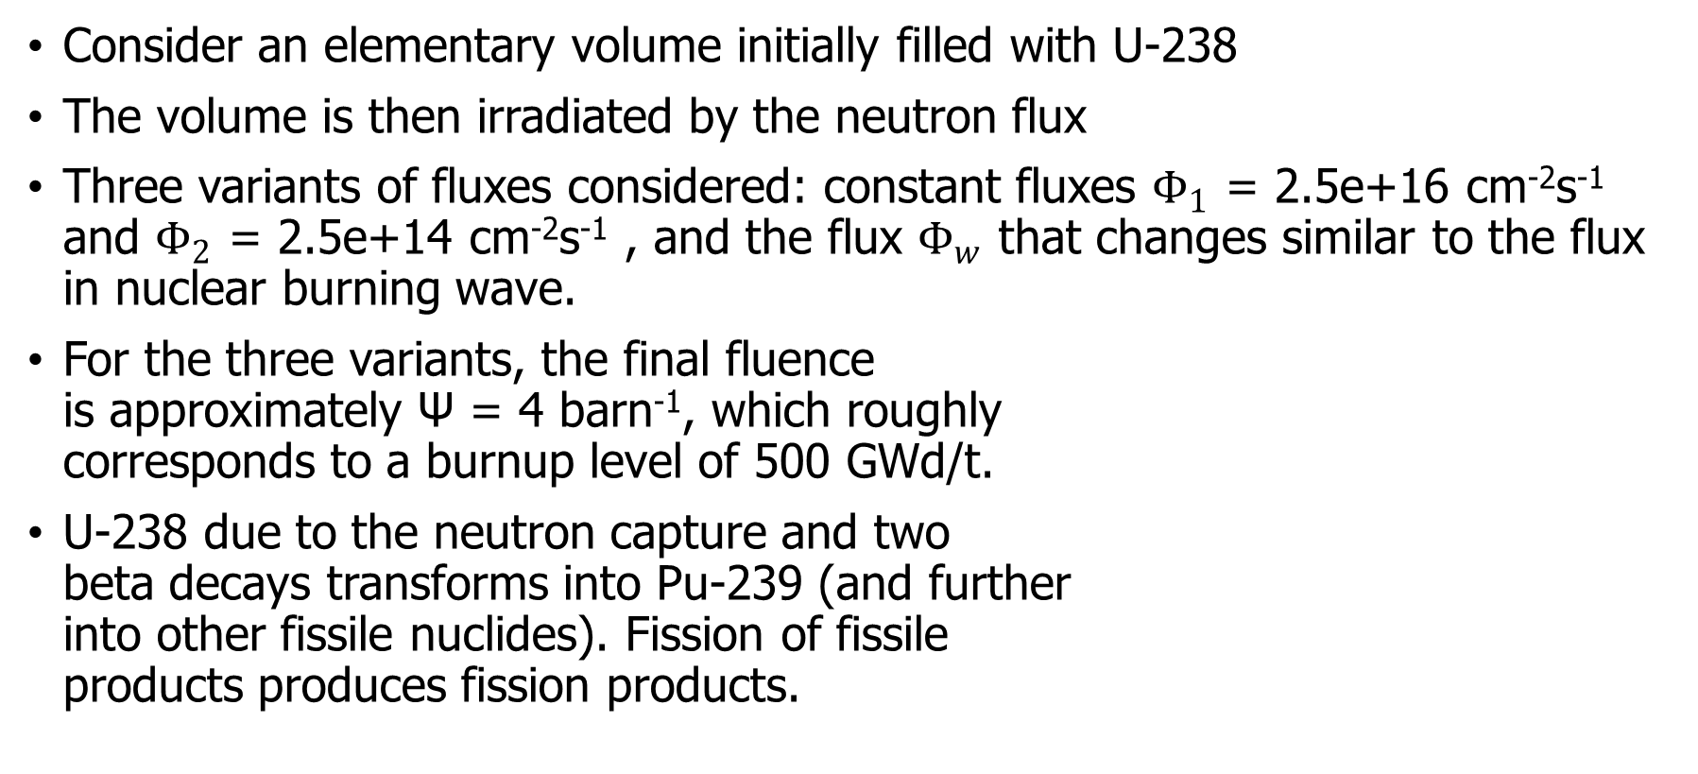
Methodology of research
Consider an elementary volume initially filled with U-238
The volume is then irradiated by the neutron flux
Three variants of fluxes considered: constant fluxes $Φ_{1}$ = 2.5e+16 cm⁻²s⁻¹ and $Φ_{2}$ = 2.5e+14 cm⁻²s⁻¹ , and the flux $Φ_{w}$ that changes similar to the flux in nuclear burning wave.
For the three variants, the final fluence
is approximately Ψ = 4 barn⁻¹, which roughly
corresponds to a burnup level of 500 GWd/t.
U-238 due to the neutron capture and two
beta decays transforms into Pu-239 (and further
into other fissile nuclides). Fission of fissile
products produces fission products.

Slide 7
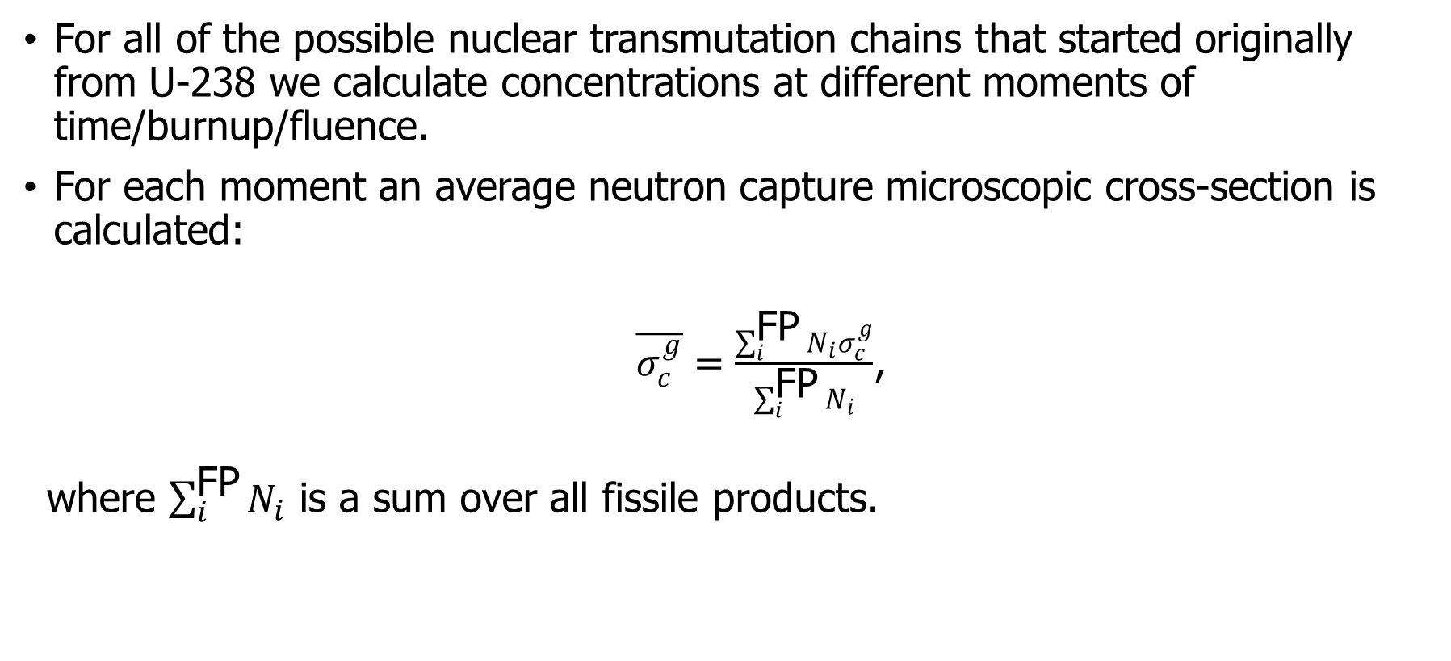
Methodology of research
For all of the possible nuclear transmutation chains that started originally from U-238 we calculate concentrations at different moments of time/burnup/fluence.
For each moment an average neutron capture microscopic cross-section is calculated:
  $\overline{σ_{c}^{g}}=\frac{\sum_{i}^{\text{FP}}{N_{i}σ_{c}^{g}}}{\sum_{i}^{\text{FP}}{N_{i}}}$,
  where $\sum_{i}^{\text{FP}}{N_{i}}$ is a sum over all fissile products.

Slide 8
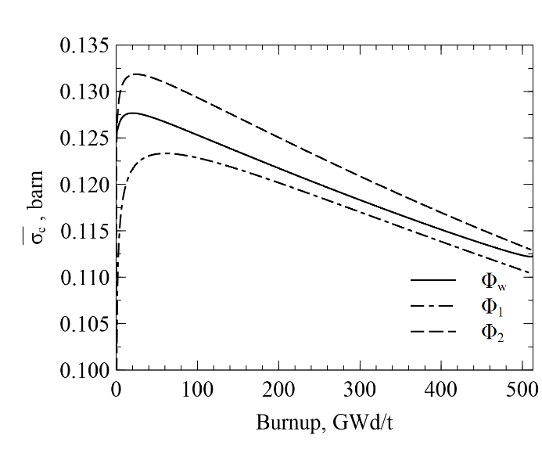
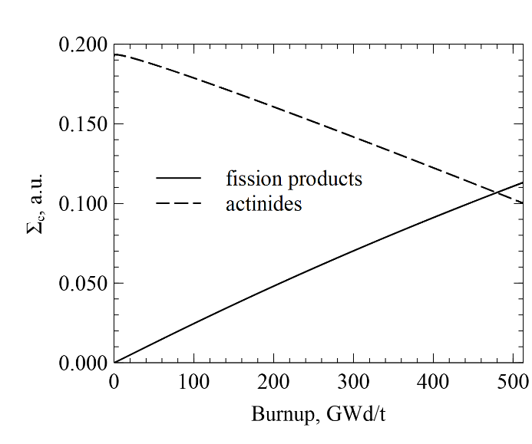
Results

Slide 9
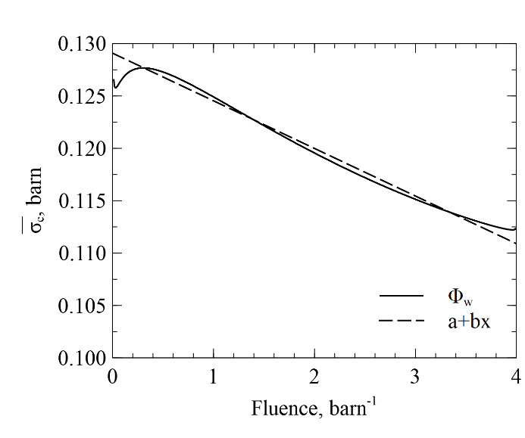

Results
$$\overline{σ_{c}}\left(Ψ\right)=a−bΨ$$
a = 0.1290 barn, b = 0.00454 barn²

Slide 10
Conclusions
Nuclear fission products have a strong influence on neutron absorption ratio at high burnup levels
Taking into account all of the fission products in the neutron absorption calculation can become a time-consuming operation
One lumped fission product model is a fast method to account for the presence of fission products, however, and additional consideration is required to account for evolution of the fission products.
An approximation is proposed to account for fission product evolution in the one-lump fission product model

Slide 11
Acknowledgements
This work was partially supported by the EURATOM research project "TREASURE," project number 101164616.

Slide 12
Thank you!
contacts:
Maksym MALOVYTSIA
mmalovytsia@gmail.com

Slide 13
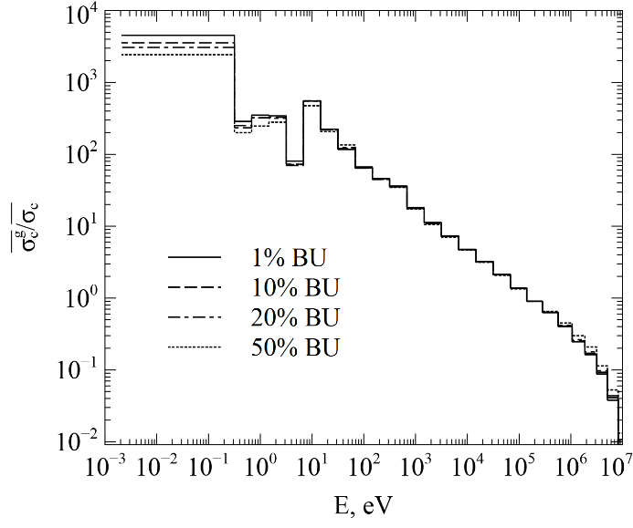
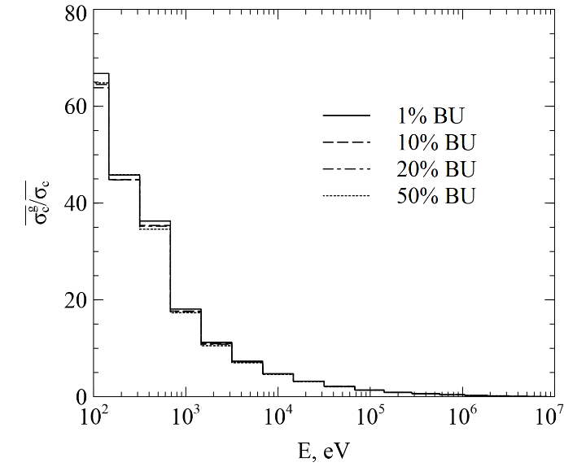
Change in the group structure of cross-sections

Slide 14
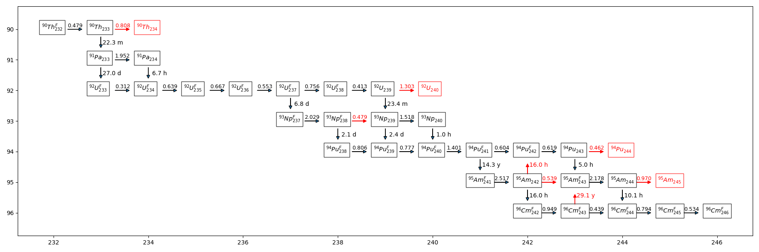
Fuel transformation cyce

