Slide 1
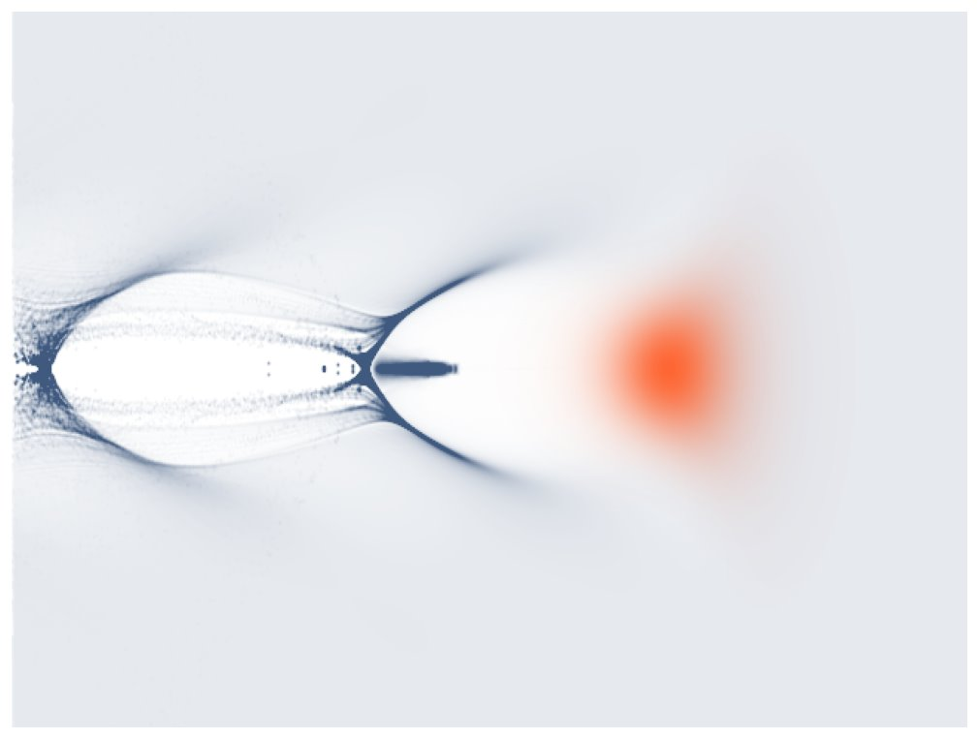



Effect of optical aberrations on laser wakefield acceleration
Kalyani SWAIN
Postdoctoral Researcher, CNRS/IJClab/IN2P3
kalyani.swain@ijclab.i2p3.fr

Slide 2
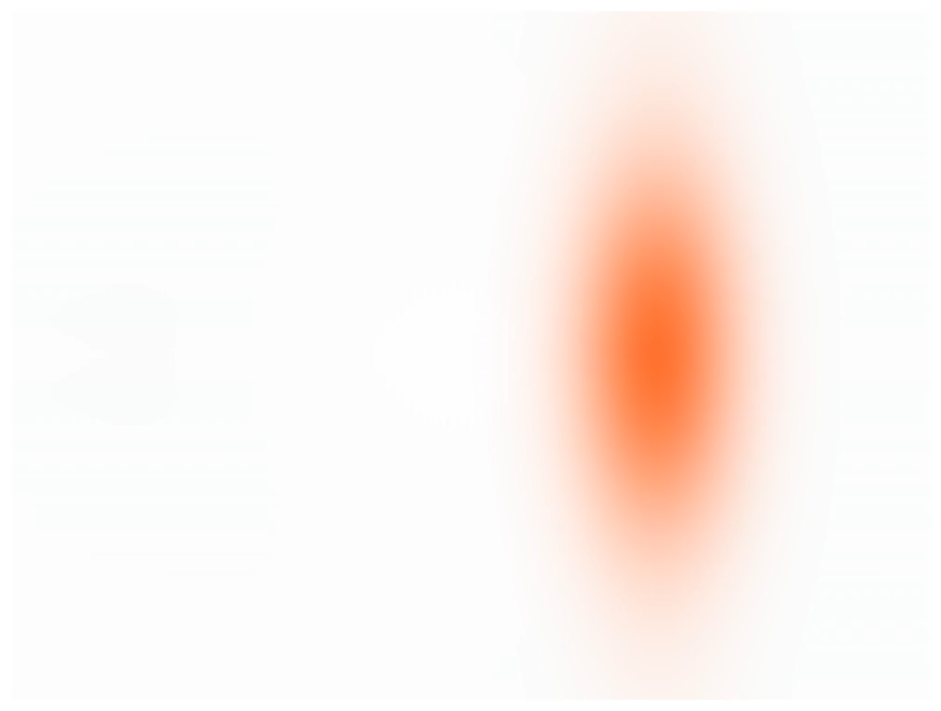


Laser wakefield acceleration:
From concept to reality:
  Theoretical Inception [1]
  Chirped Pulse Amplification [2]
  The Dream Beam [3]
  Multi-GeV Milestones [4,5, and many more]
[1] T. Tajima and J.M. Dawson, Phys. Rev. Lett. 43, 267, 1979.
[2] D. Strickland and G. Mourou, Opt. Commun. 56(3), 219–221 (1985)
[3] Faure, J., Glinec, Y., Pukhov, A. et al. Nature 431, 541–544 (2004)
[4] W. P. Leemans, B. Nagler, S. M. Hooker, et al.," Nature Physics 2, 696–699 (2006).
[5] Leemans et al., Phys. Rev. Lett. 113, 245002 (2014)
[6] Gonsalves et al., Phys. Rev. Lett. 122, 084801 (2019)
[7] K. Põder, J. C. Wood, et al. Phys. Rev. Lett. 132, 195001 (2024).
Simulation laser envelope model
Recent challenges:
Shot-to-shot variability in charge, energy, and pointing.
Higher repetition rates, and efficient acceleration.
The Global Projects: ​
  Synchrotron Upgrades: PETRA IV (DESY).
  Others: BELLA, EPAC, SIOM and Tau Systems etc.
  EuPRAXIA, 1 GeV water-window FELs
​PALLAS goal: Controlled injection mechanisms​, mitigating spatio-temporal couplings, and high-fidelity start-to-end simulations.

Slide 3
Outline
Laser wakefield acceleration
PALLAS: Laser-plasma injector test facility (J. Serhal, Today's talk)
Particle-in-cell simulation
Random scan and Envelope model
Realistic simulation workflow
Effect of optical aberrations on the electron beam
Summary

Slide 4
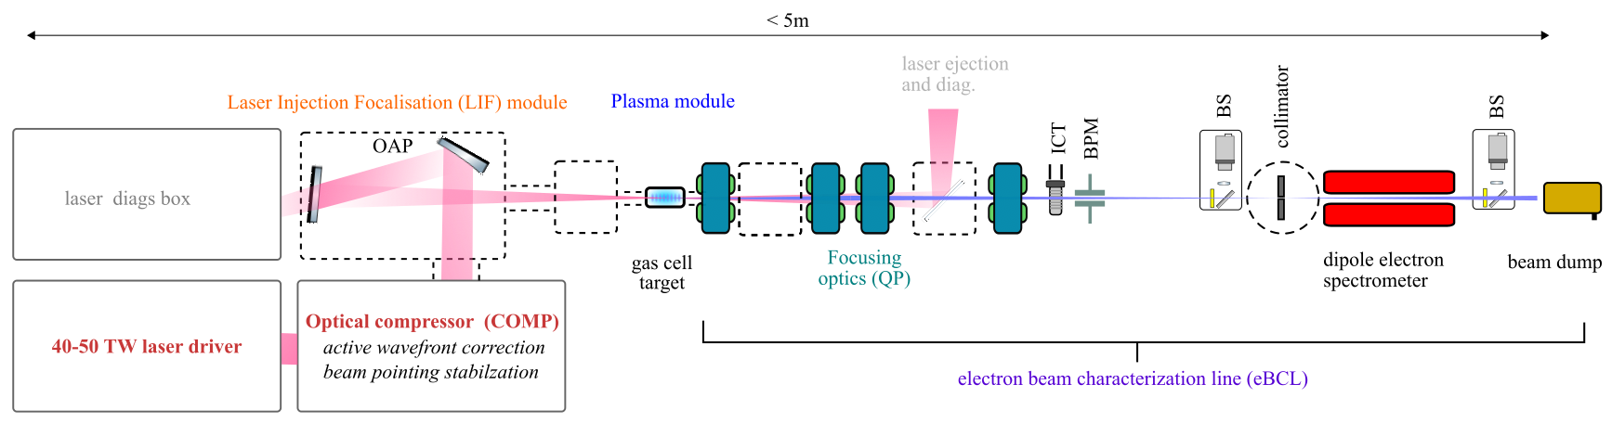
PALLAS: Laser-plasma injector test facility
Continuous 10Hz operation PALLAS is aiming to generate an electron beam of
  Energy:150-250 MeV,
  Energy spread <5%,
  Charge > 30pC,
  Emittance < 2mm.mrad
  The PALLAS test facility [(IJClab 2019)] includes:
    Plasma target development [(Drobniak, Baynard, Cassou, et al. 2023),(Drobniak 2023)]
    Electron beam characterization and transport (Guyot 2025)
    Advanced method for laser control and optimization of laser-plasma accelerator (Gkane, 2026).

Slide 5
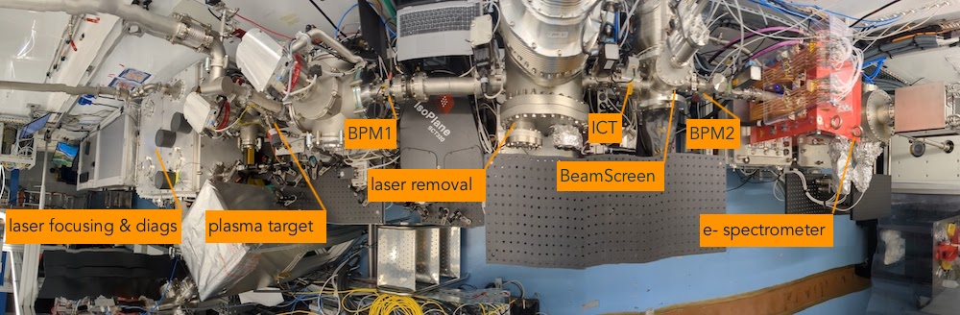
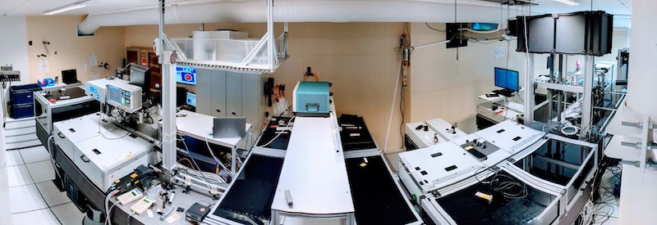
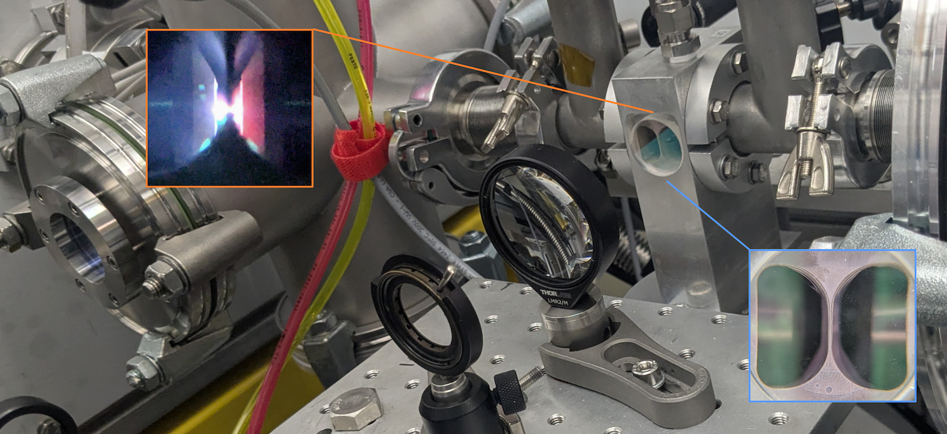
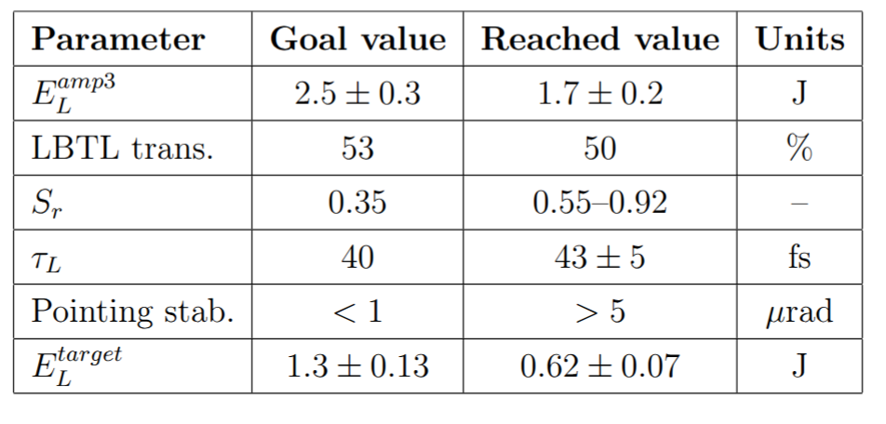
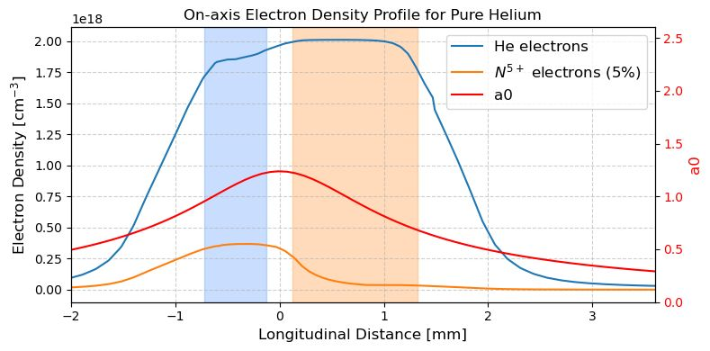
PALLAS: Laser-plasma injector test facility
Laserix laser driver
Plasma target:
    Two chamber gas cell
    Ionization injection
J. Serhal, phd.
[1] Drobniak, P., E. Baynard, A. Beck, et al. “Two-Chamber Gas Target for Laser-Plasma Electron Source.” Review of Scientific Instruments 96, no. 3 (2025): 033304. https://doi.org/10.1063/5.0226055.
[2] P Drobniak, J Serhal, et al. Validation of a Compact and Tunable Continuous Gas-Flow Laser-Plasma Target for Electron Beam Production Above 150 MeV, Appl. Sci. 2026, 16(5), 2312;
https://doi.org/10.3390/app16052312

Slide 6
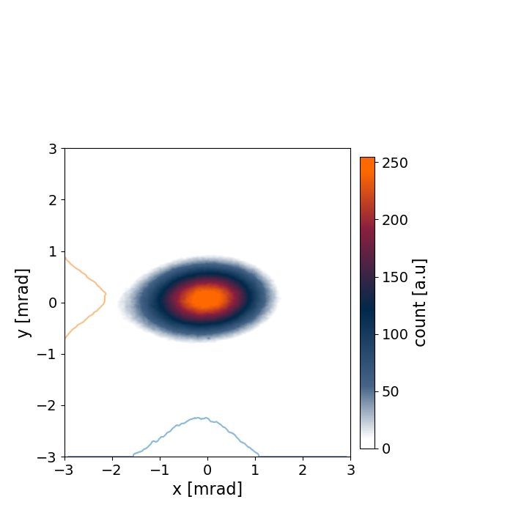
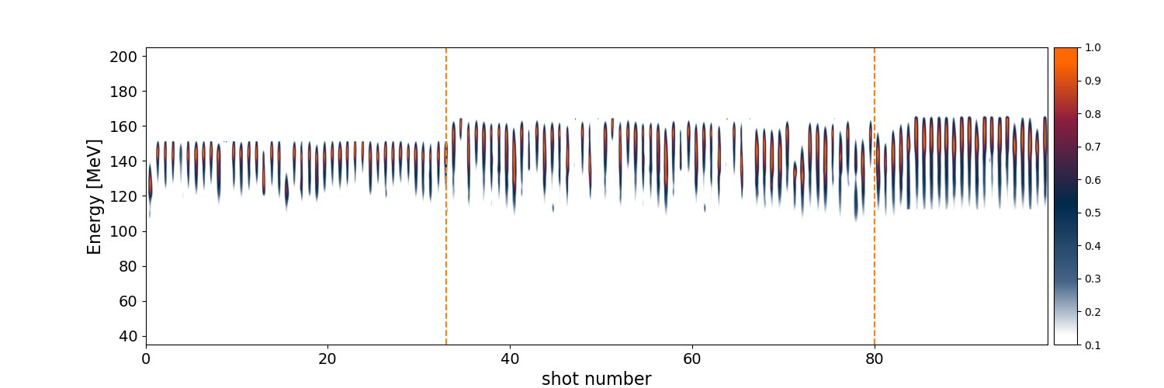
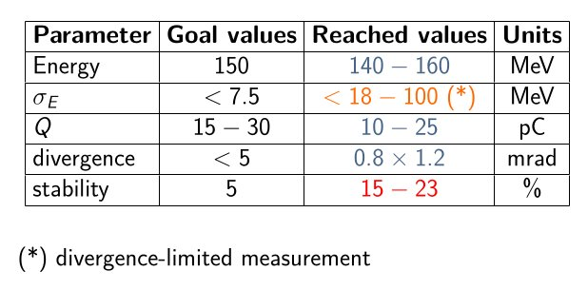
PALLAS: First electron beam
  During recent commissioning energy reached ~200 MeV
  PALLAS next goal: Controlled injection mechanisms​, mitigating spatio-temporal couplings, and high-fidelity start-to-end simulations.
  More details on https://pallas.ijclab.in2p3.fr/ and https://gitlab.in2p3.fr/pallas

Slide 7
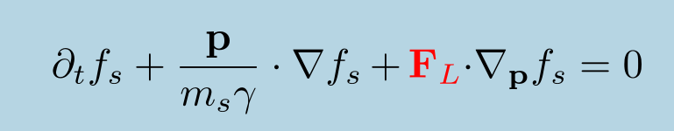
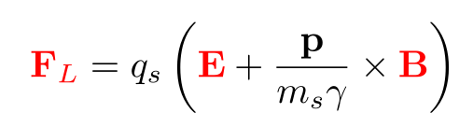
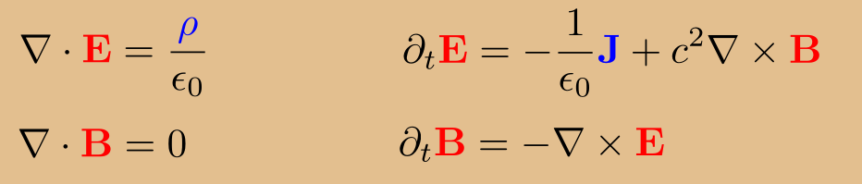
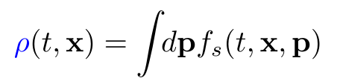
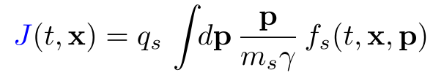
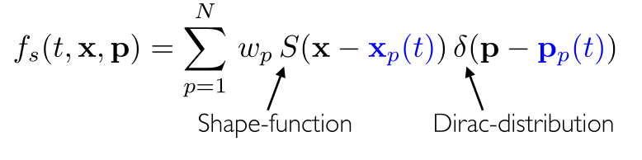
Particle-in-cell simulation
Vlasov Equation:
Particle-in-cell (PIC) simulation
Initialize particles
Lorentz Force:
Assign to grid
Particle pusher solve equation of motion
Solve Maxwell field equations
Δt
Maxwell's Equations
Interpolate forces
https://smileipic.github.io

Slide 8
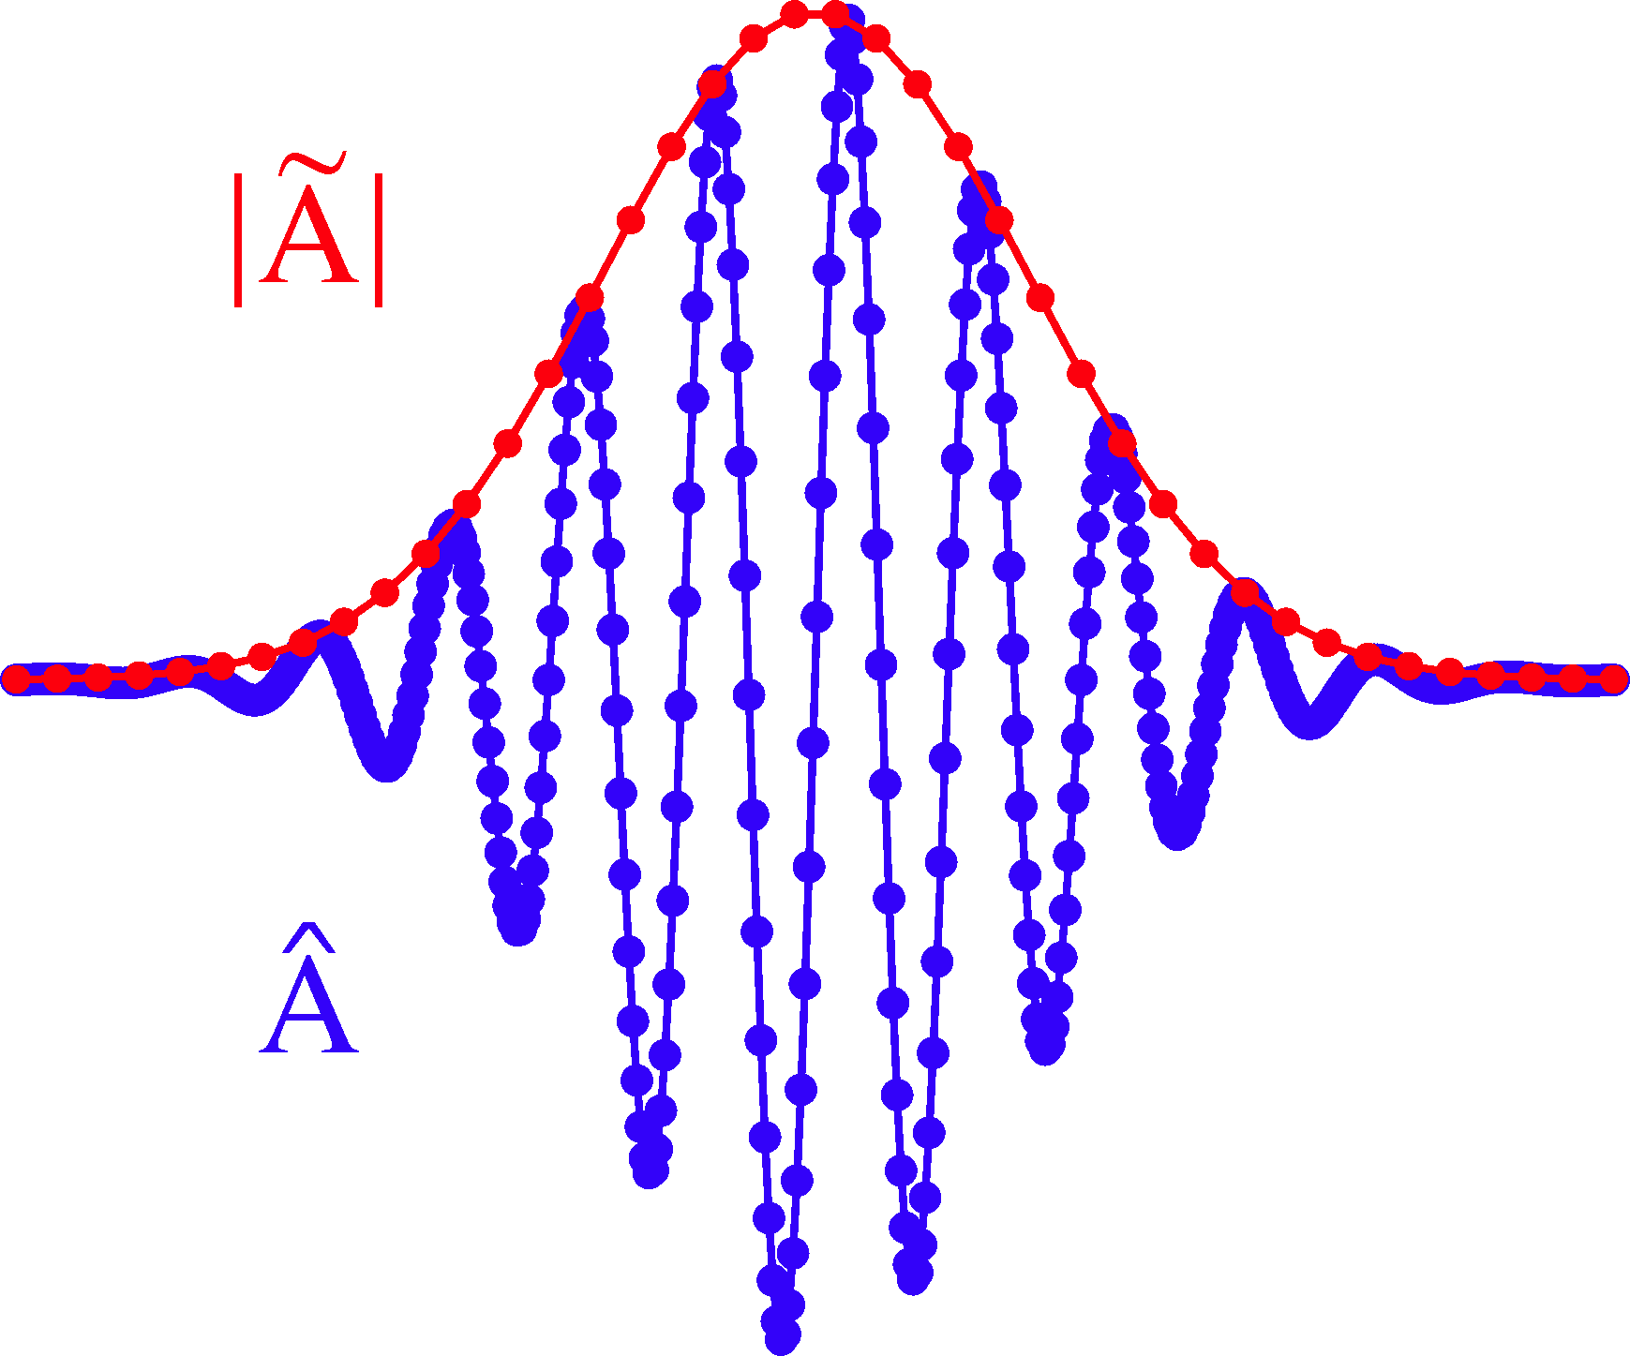
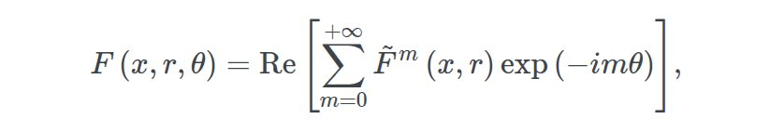
Particle-in-cell simulation
3D simulations are computationally expensive
Envelope Model in Smilei [1,2,3]
Azimuthal mode decomposition in cylindrical geometry [https://smileipic.github.io/tutorials/advanced_wakefield_AMcylindrical.html]
Low-fidelity simulations:
      Random Scan (RS)
      Bayesian Optimization (BO)
[1] P. Mora and T. M. Antonsen Jr, Physics of Plasmas 4, 217 (1997)
[2] D. Terzani and P. Londrillo, Computer Physics Communications 242, 49 (2019)
[3] F. Massimo et al., Plasma Phys. Control. Fusion (2019)
High fidelity realistic simulation:

Slide 9
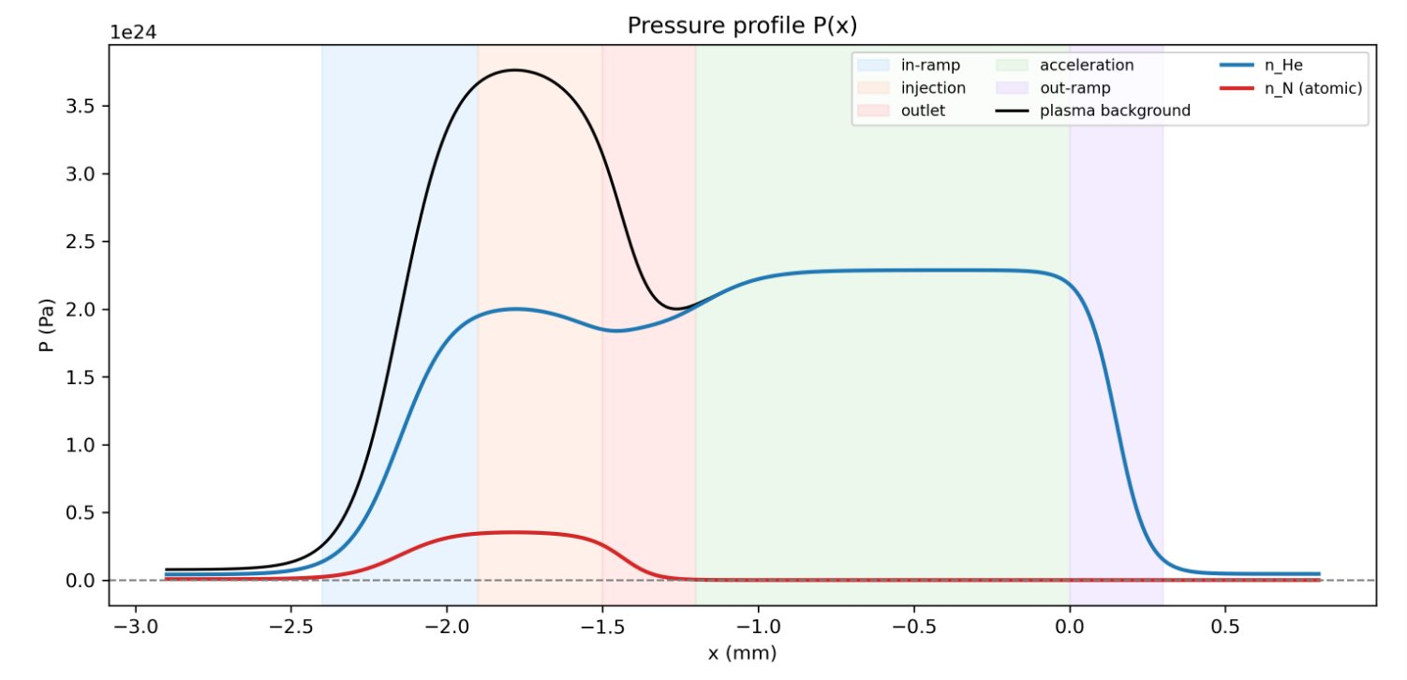
Low fidelity random scan simulation
Variable Range | Range
P_max | 4000 – 7000
cN2_max | 0.05 – 0.25
L_inj | 0.4 – 0.8
dip_frac | 0.1 – 0.5
x_of | 250 – 1750
Fixed Geometry | Value | Fixed Geometry | Value
a_0 | 1.25 | round_inj | 1.0
x_start | -2.4 | round_acc | 1.0
L_inramp | 0.4 | L_outramp | 0.3
sharp_in | 2.0 | P_min | 100.0
L_outlet | 0.3 | cN2_soft | 0.018
dip_round | 1.0 | he_smooth | 0.3
L_acc | 1.2
Smilei Parameters | Value | Smilei Parameters | Value
dx | 0.10 * um | Lx | nx * dx
dr | 0.16 * um | Lr | nr * dr
dt | 0.75 * dx/c | T_sim | 55330
nx | 640 | npatch_x | 32
nr | 896 | npatch_r | 64
 |  | No of PPC | 1

Slide 10
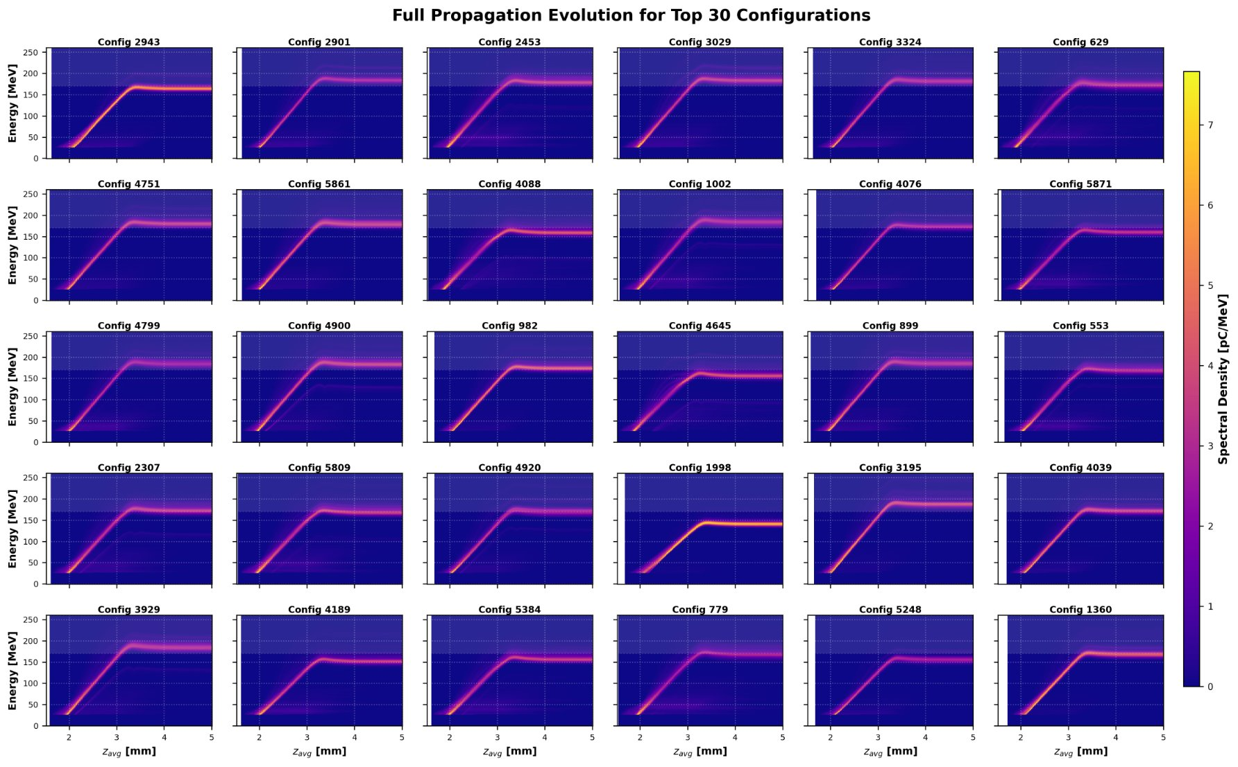
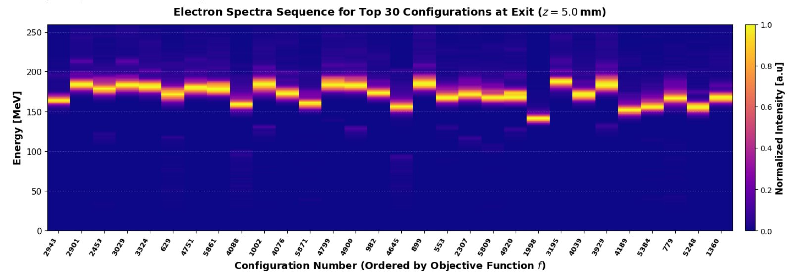
Envelope Model Random scan simulation

Slide 11
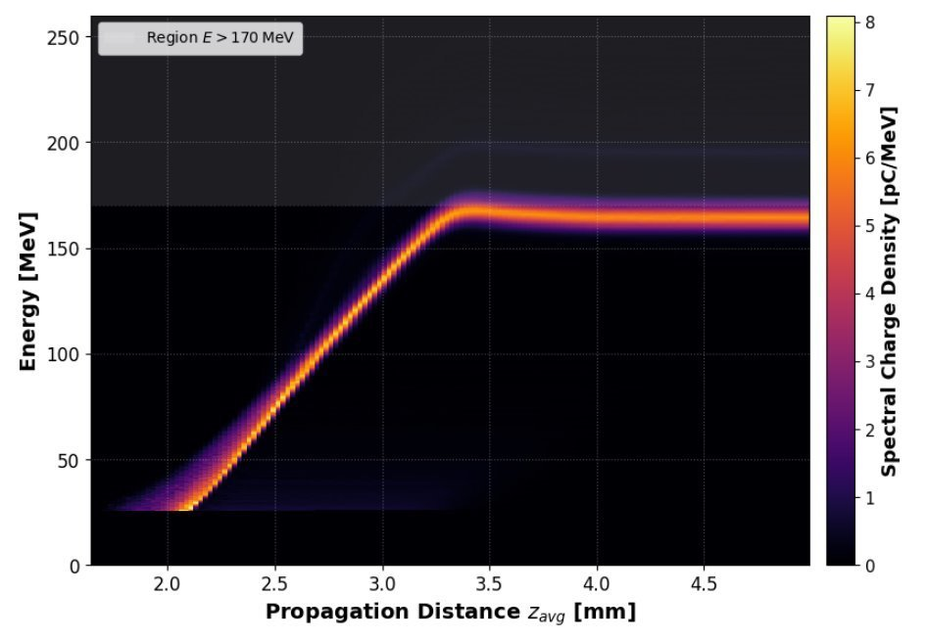
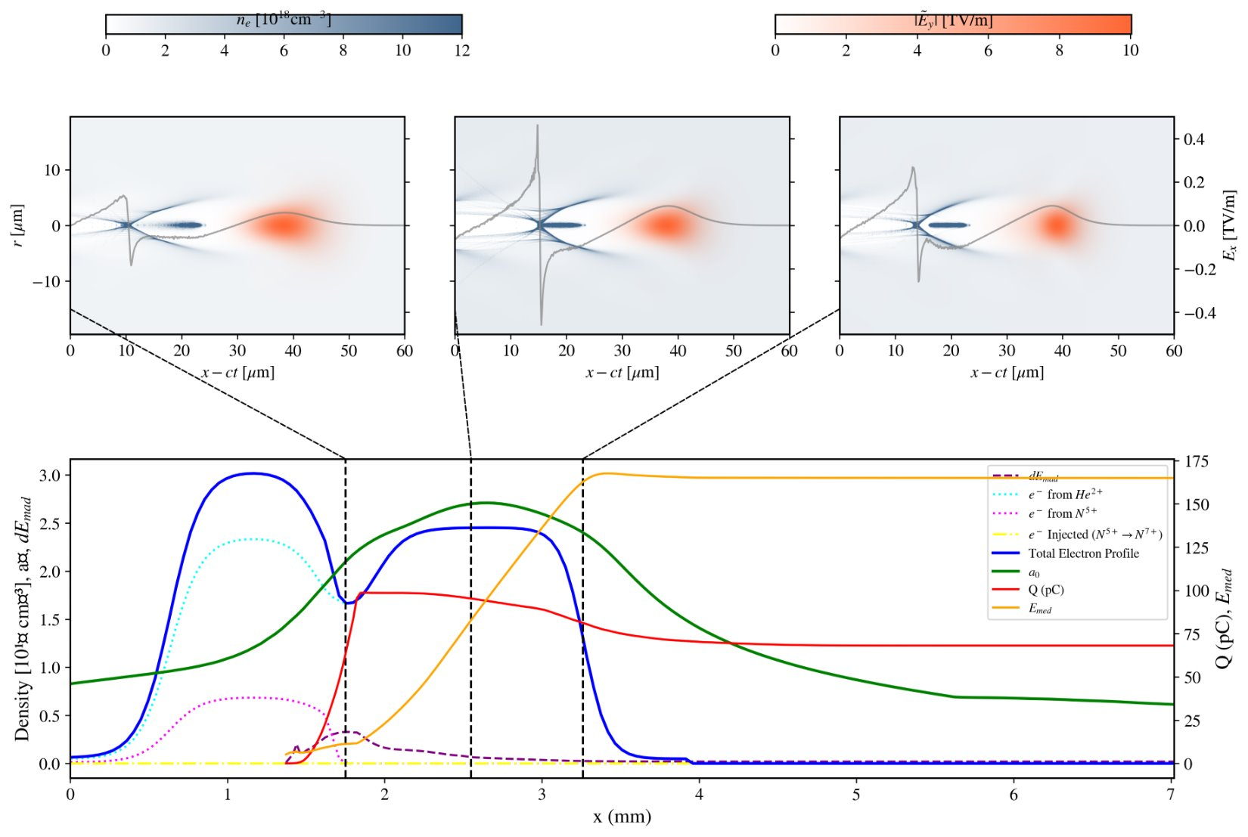
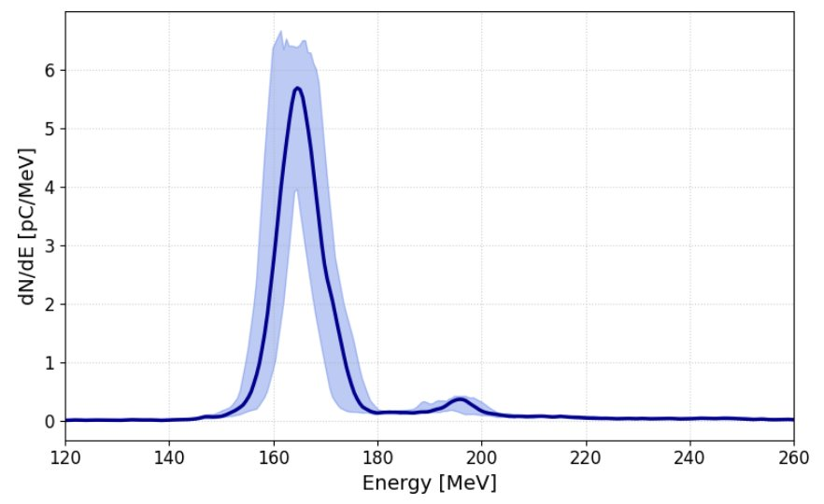
Random scan (RS) simulation
Low fidelity random RS simulations are useful to find the best laser and plasma parameter working point.
Also helpful in optimization time of different parameters in high-fidelity realistic simulation.
IJClab | K SWAIN | 15/09/2026 | ECLIM2026

Slide 12
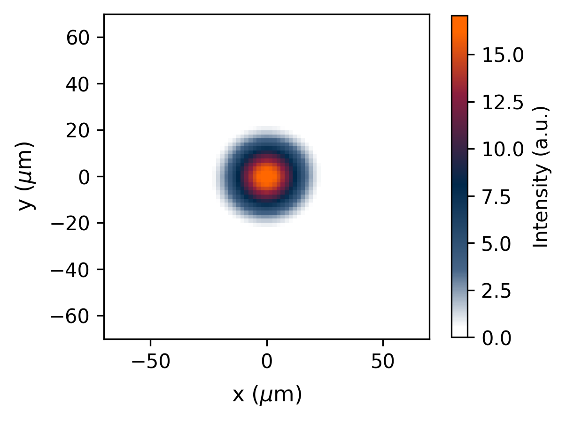
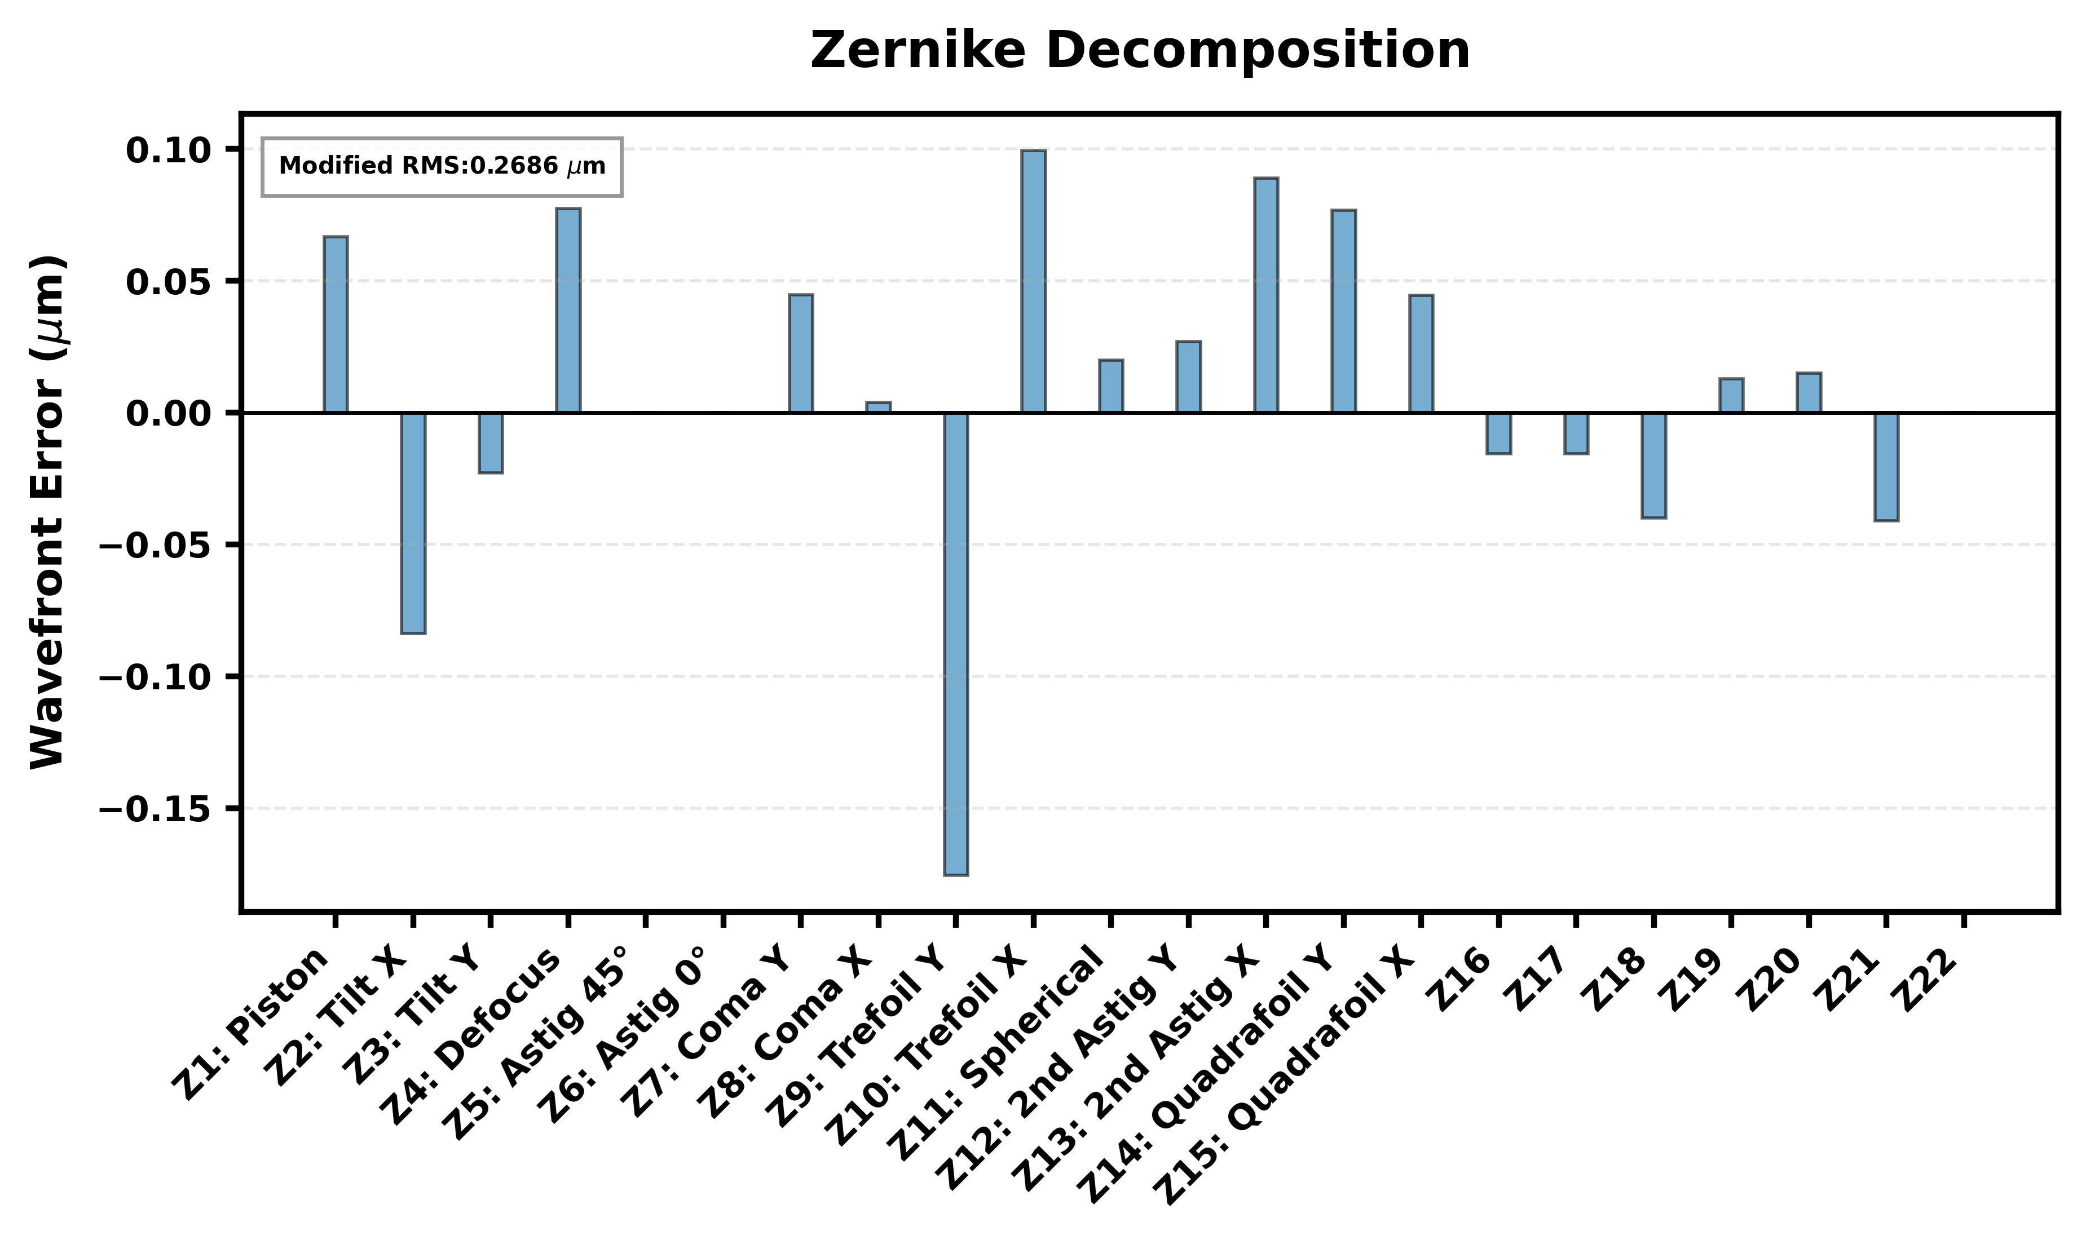
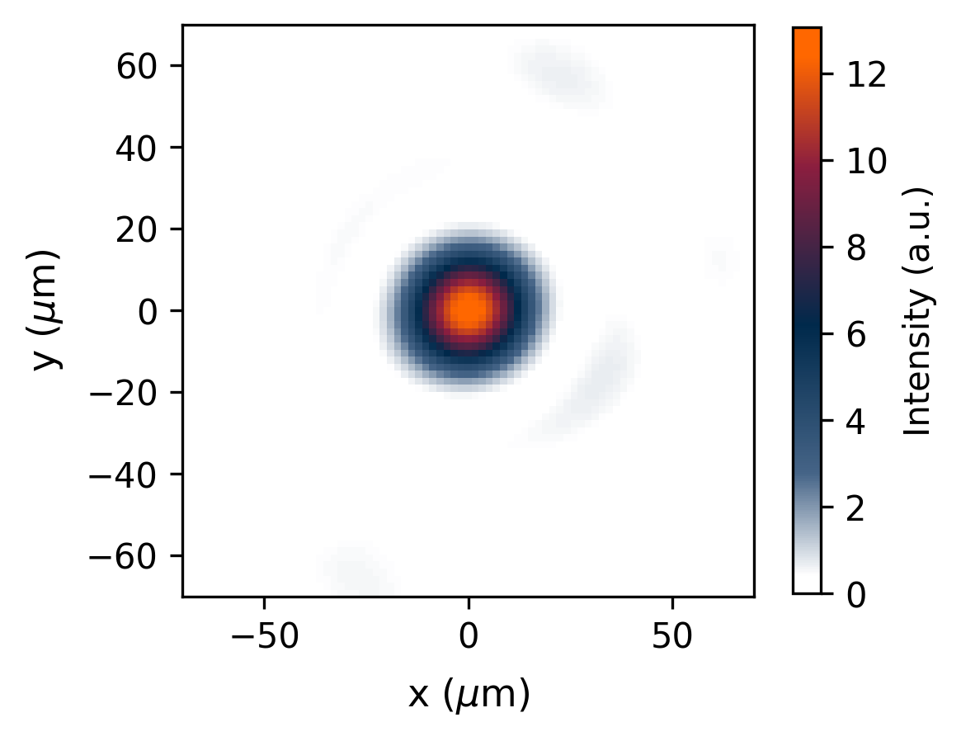
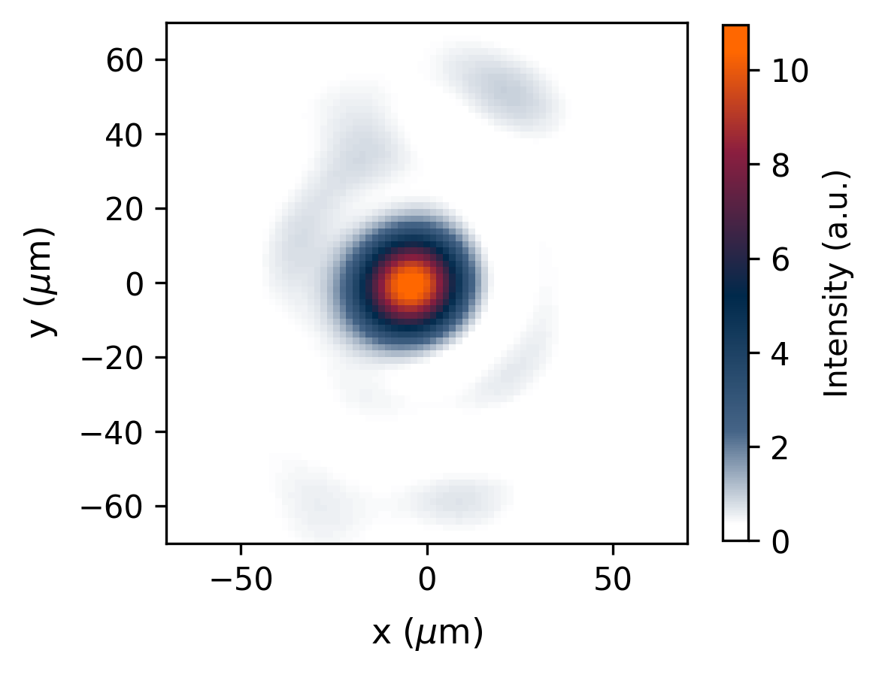
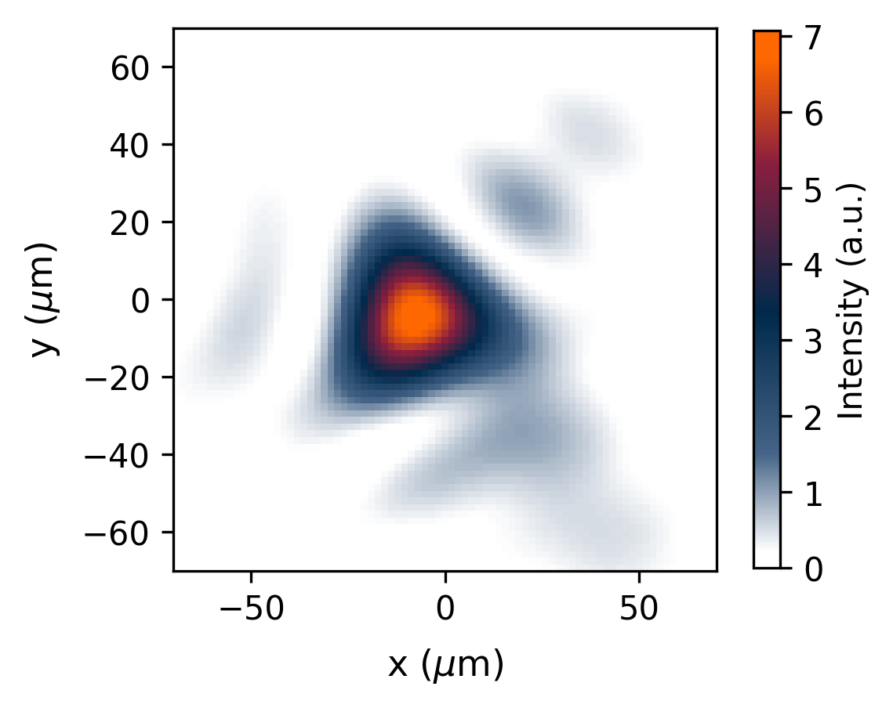
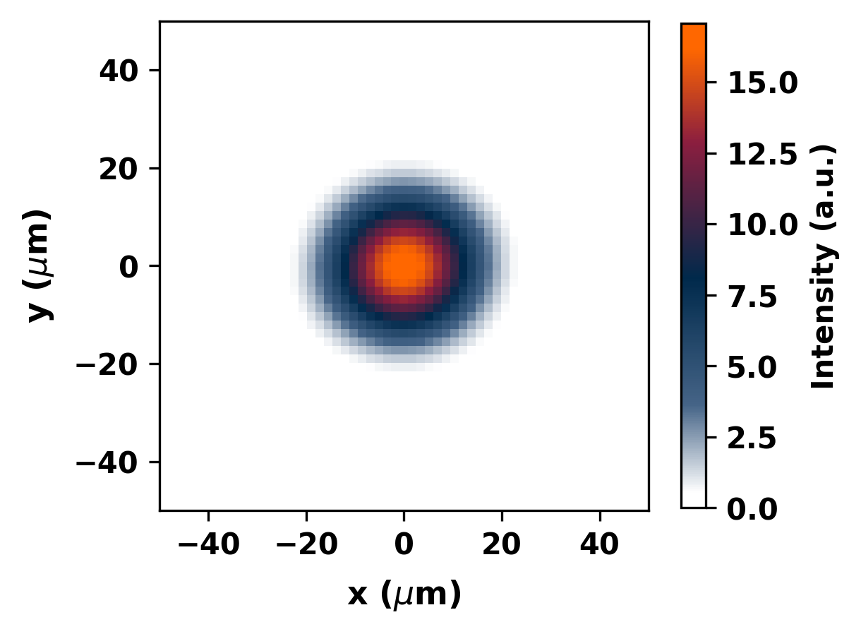


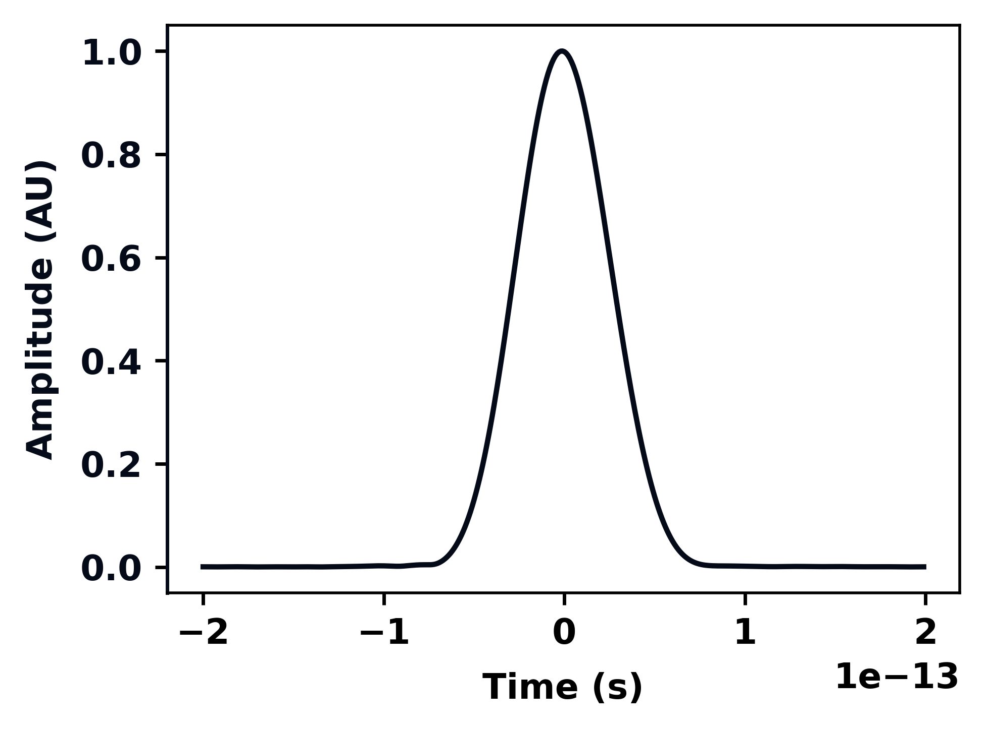
Realistic simulation workflow
Slava Smartsev, Post doctoral researcher
Quasi-3D azimuthal mode (AM) decomposition in cylindrical geometry
Spatial phase retrieval using Gerchberg saxton algorithm (GSA) [1,2,3,4]
Decomposed into Zernike modes
Reconstruction of Far field (Intensity+ Phase)
https://github.com/LASY-org/lasy
M Thévenet et al 2025 J. Phys.: Conf. Ser. 3124 012014
[1] Ralph W Gerchberg Optik, 35:237–246, 1972.
[2] J. R. Fienup. Phase retrieval algorithms: a comparison. Appl. Opt., 21(15):2758–2769, Aug 1982.
[3] I. Moulanier, L. T. Dickson, F. Massimo, G. Maynard, and B. Cros, J. Opt. Soc. Am. B 40, 2450-2461 (2023)
[4] Massimo, F. and Moulanier, I., et al. Phys. Rev. E 113, 055211

Slide 13
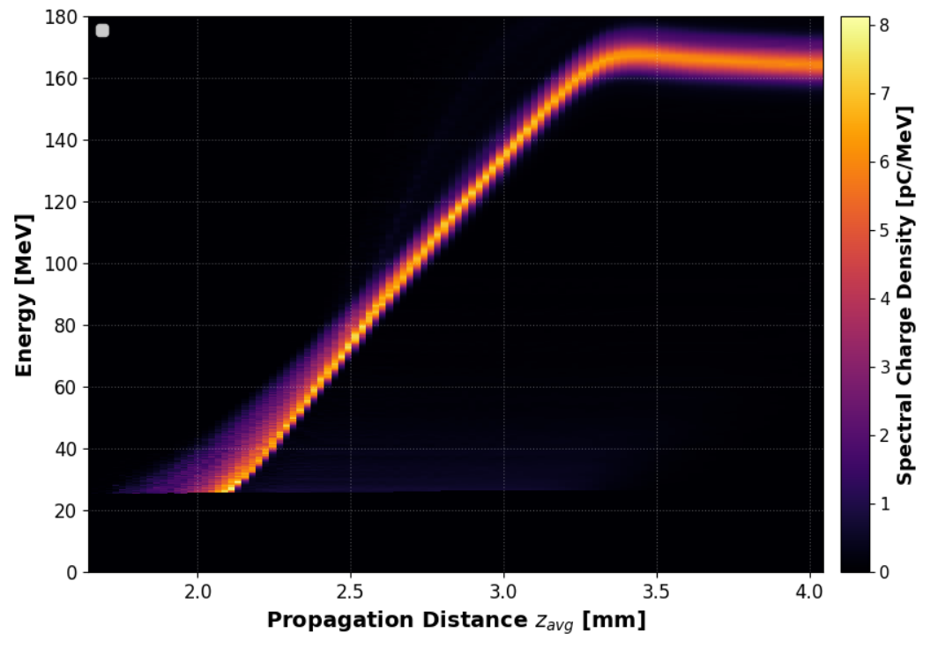
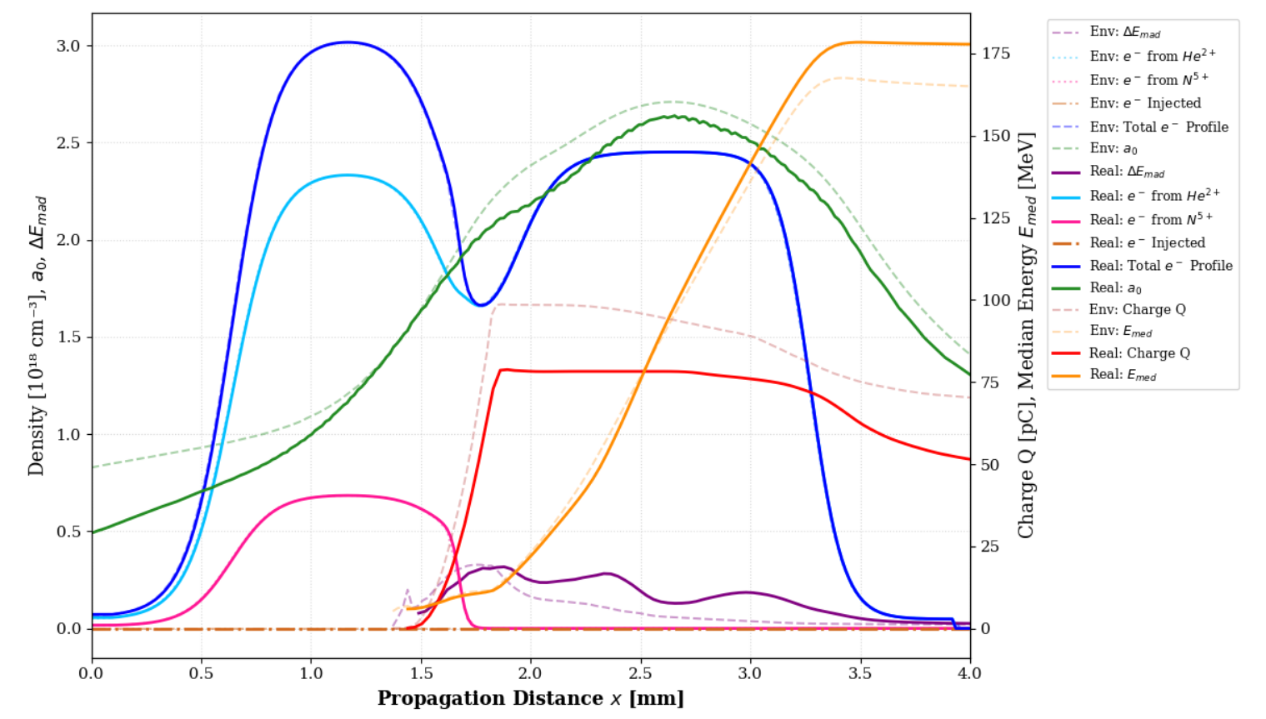
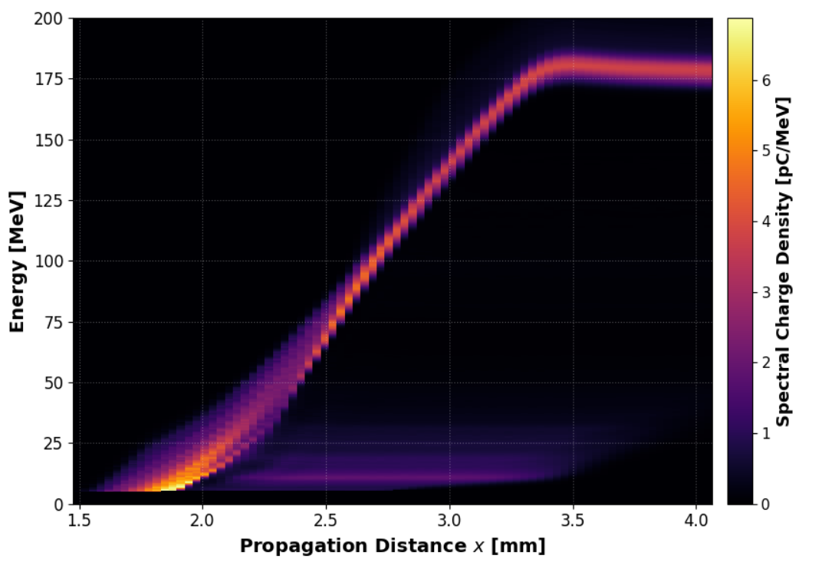
Envelope and realistic simulation comparison
Realistic Simulation parameters | Value | Realistic Simulation parameters | Value
Δx (µm) | 0.03 | Δt (fs) | ~ 0.09
Δr (µm) | 0.35 | Nsteps | 250,000
Lx × Lr (µm ) | 153.6 × 179.2 | Nm | 3
Nx × Nr | 5120 × 512 | ppc | 8

Slide 14
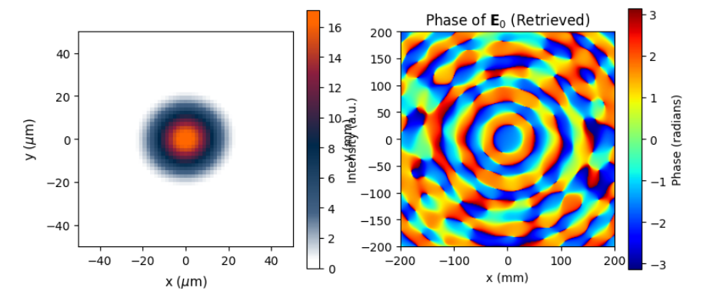
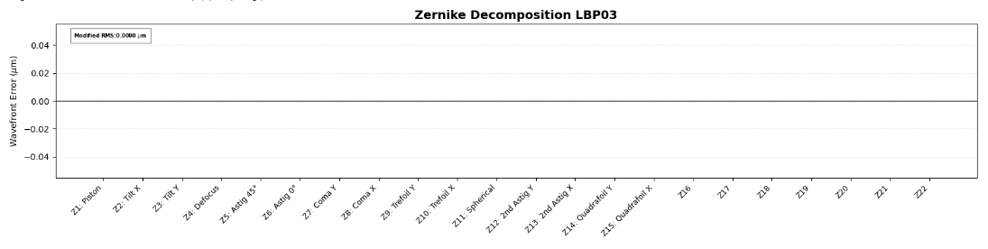
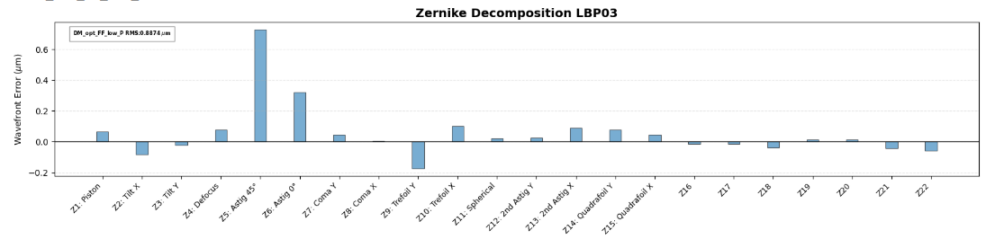
Effect of optical aberrations on the electron beam (Flat Phase)
Strehl: 1.0
Strehl: 0.30112133916687167

Slide 15
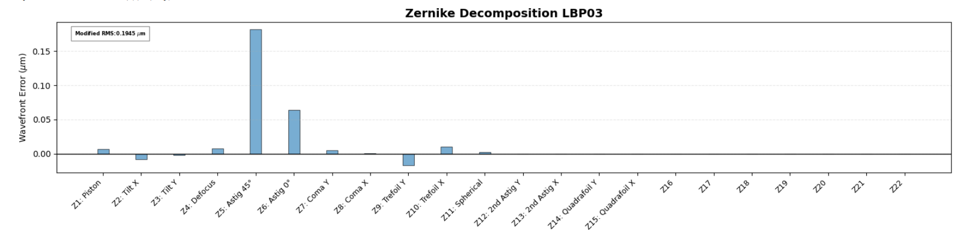
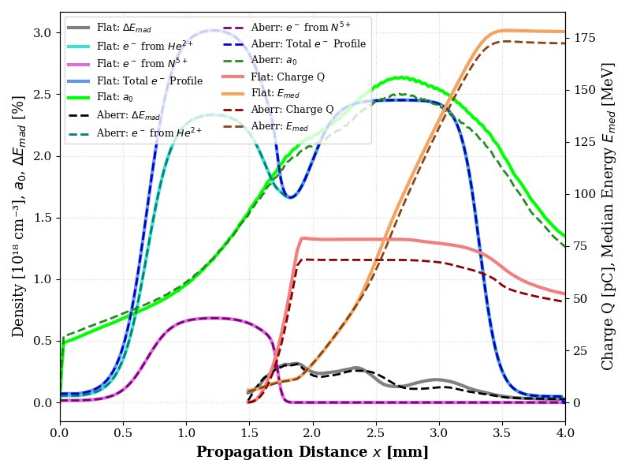
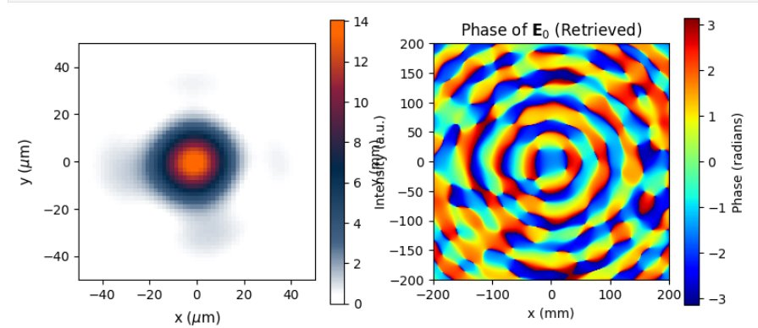
Effect of Astigmatism on the electron beam (test1)
Strehl: 0.9658446028346874​

Slide 16
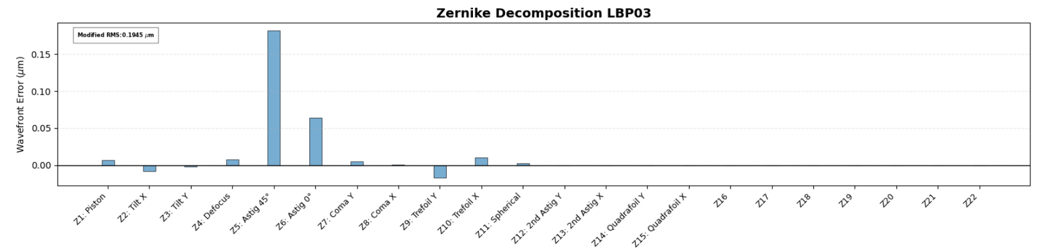
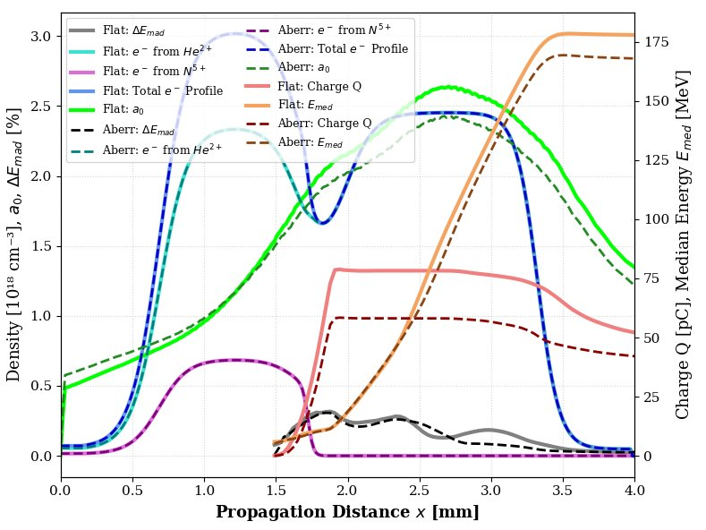
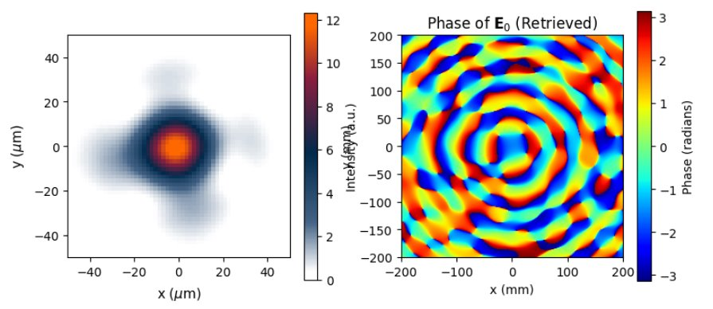
Effect of Astigmatism on the electron beam (test2)
Strehl: 0.9439715278183798​

Slide 17
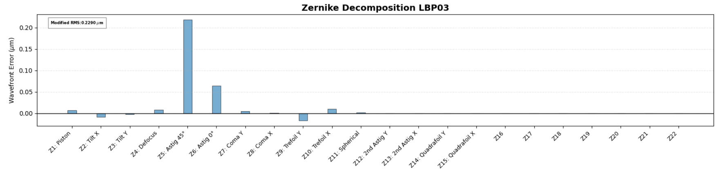

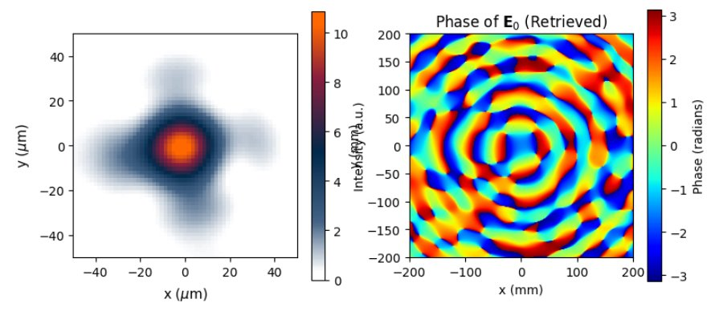
Effect of Astigmatism on the electron beam (test3)
Strehl: 0.9231824765837418

Slide 18
Summary
Importance of High-fidelity simulation to improve and optimize the laser and plasma parameters. More importantly high-fidelity simulations may help to understand the effect of spatio-temporal coupling in the laser wakefield acceleration.
Effect of asigmatism on the charge, energy and stability of the electron beam using high fidelity simulations.
Low fidelity simulations with envelope approximations are quick and helpful to optimize the plasma parameters for the high fidelity simulation setup.

Slide 19
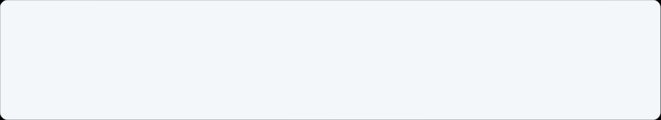










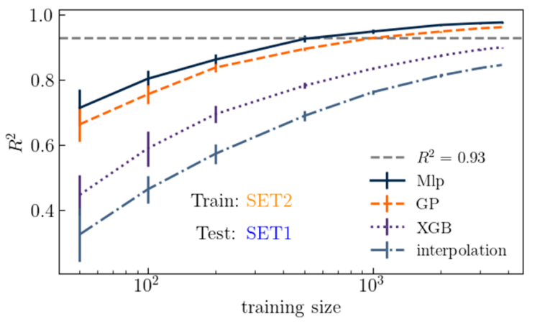
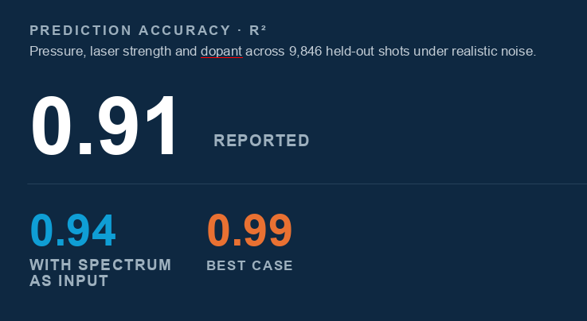
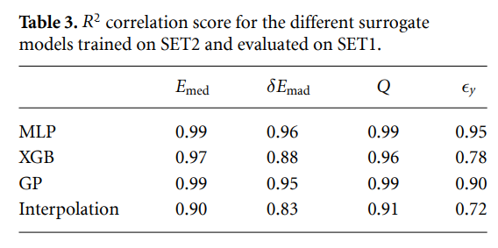
Other simulation activities
Surrogate Model
INPUT PARAMETERS
MEASURED ELECTRON BEAM​
Inverse Model
a_0
P
c_N2
x_of
Surrogate
MODEL
a_0
x_of
P
c_N2
M. Lenivenko, phd
G Kane et al 2026 Mach. Learn.: Sci. Technol. 7 030502

Slide 20




Collaboration
PALLAS Team
​National level with​
LPGP: F. Massimo et al.​
LOA: J. Gauthier, L. Ononenko, P. Rousseau, C. Thaury et al.​
LLR: Arnaud Beck,​
International within EuPRAXIA and DMLab​
LNF-INFN: A. Biagioni, G. Costa, L.Crincoli et al.​
DM-lab (DESY,KIT): M. Kirchen (DN EPACE), M. Fuchs (CNRS MITI 2024) ​
Industrial partnership : Amplitude Laser; Imagine Optics​
+ Slava, Elsa, Olivier, Konrad, Jean Noel, Arnd, Jean Louis, Victor​
IN2P3/IJClab​
E. Baynard, C. Bruni, K. Cassou, J.-N. Cayla, J.L. Coacolo, V. Dalifar, J. Demailly,D. Douillet, P. Drobniak, P. Gauron, A. Gonnin, E. Jules, G. Iaquaniello, S. Kazamias, V. Kubytsky, V.Lafage, E. Legay, B. Lucas, Y. Peinaud, K. Malkinski, O. Neveu, L. Perot, M. Pittman.​, S. Smartsev
phd students: M. Lenivenko, M. Pintonato, J. Serhal, G. Kane(2025), C. Guyot(2024), P.Drobniak(2023)​
IN2P3/LLR : A. Beck, A. Cauchois, A. Mahjoub, A. Specka.​ IN2P3/LP2I-B : A. Huber, A. Maitrallain, C.-E. Demonchy, M. Tarisien​
Thank you for your attention!

