Slide 1
Management Overview
StratusLab First Periodic Review
Brussels, Belgium
4 July 2011

Slide 2






StratusLab Project
Goal
Create comprehensive, open-source, IaaS cloud distribution
Focus on supporting grid services
Information
1 June 2010—31 May 2012 (2 years)
6 partners from 5 countries
Budget : 3.3 M€ (2.3 M€ EC)
Contacts
Site web: http://stratuslab.eu/
Twitter: @StratusLab
Support: support@stratuslab.eu
CNRS (FR)
UCM (ES)
GRNET (GR)
SIXSQ (CH)
TID (ES)
TCD (IE)

Slide 3
Introductions
All partners and all activities are represented.
Charles LOOMIS | CNRS/LAL | Project coordinator, WP2 manager
Ruben MONTERO | UCM | Technical coordinator
David O’CALLAGHAN | TCD | WP3 manager
Marc-Elian BEGIN | SixSq | WP4 manager
Vangelis FLOROS | GRNET | WP5 manager
Henar MUNOZ | TID | WP6 manager
Christophe BLANCHET | CNRS/IBCP | WP2
Ignacio LLORENTE | UCM | WP6

Slide 4
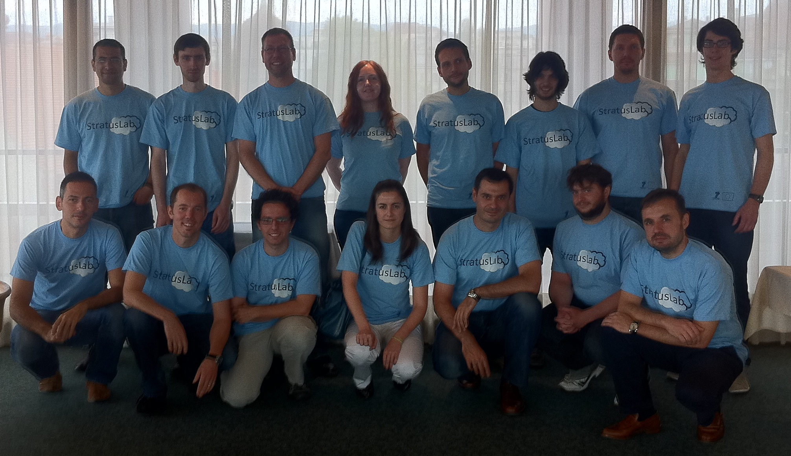
And the other participants…

Slide 5
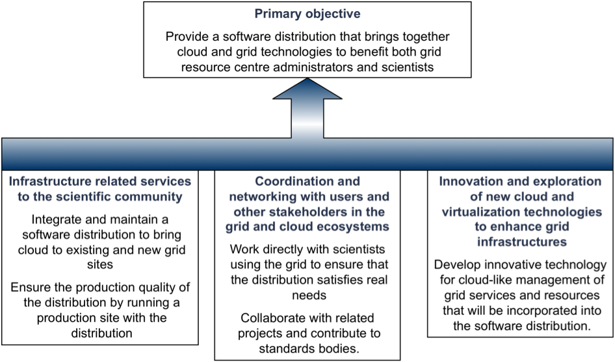
Objectives
Following presentations give detailed objectives for each work package.

Slide 6
Changes in the Roadmap
Hybrid Cloud ←→ Cloud API (public cloud)
Cloud API (public cloud) moved from Y2 to Y1
Hybrid cloud moved from Y1 to Y2
Users requested access to public cloud sooner
Federated cloud makes more sense once StratusLab distribution is complete and stable
Appliance Repository ←→ Marketplace
Emphasis on security and ability to understand image content
Separate metadata and image storage
Allows policies to be defined for “acceptable” images
Takes advantage of cloud storage capabilities
Changes motivated by interactions with targeted communities.
No affect on objectives, milestones, or deliverables.

Slide 7
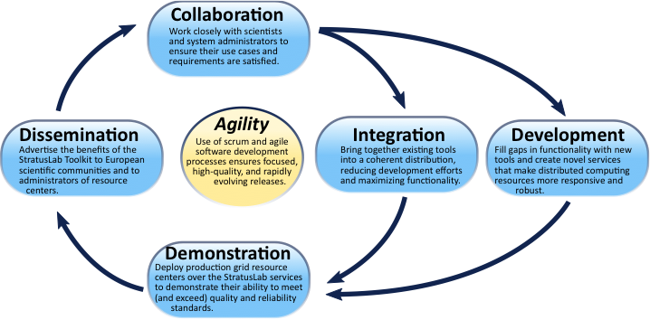
Project Organization
WP2 (NA)
Interactions with
Targeted Communities
WP1 (MGT)
Project Management
WP6 (JRA)
Innovative Cloud-like Service for Grid Site Management
WP3 (NA)
Dissemination
WP4 (SA)
Integration
WP5 (SA)
Infrastructure Operations

Slide 8
Project Management
Project Management Board
Project coordinator
Technical coordinator
One representative from each partner
Meets quarterly
Sets overall goals of project and monitors progress
Technical and Scientific Coordination Group
Technical coordinator
Activity manager from each work package
Meets monthly
Defines overall architecture and development priorites

Slide 9
Deliverables
Number | Title | Due Date
D2.1 | Review of the Use of Cloud and Virtualization Technologies in Grid Infrastructures | PM2
D4.1 | Reference Architecture for StratusLab Toolkit 1.0 | PM3
D5.1 | Infrastructure Specification | PM3
D3.1 | Initial Plan for Dissemination, Collaboration and Standardization Activities | PM4
D6.1 | Cloud-like Management of Grid Sites 1.0 Design Report | PM5
D5.2 | Infrastructure Tool and Policy Specification | PM6
D6.2 | Cloud-like Management of Grid Sites 1.0 Software | PM11
D2.2 | Report on Evaluation of StratusLab Products | PM12
D3.2 | Report on Dissemination, Collaboration and Standardization Activities | PM12
D3.3 | Exploitation and Sustainability First Plan | PM12
D4.2 | StratusLab Toolkit 1.0 | PM12
D4.3 | First Year Software Integration Report | PM12
D5.3 | First Year Infrastructure Operations Report | PM12
D6.3 | First Year Cloud-like Management of Grid Sites Research Report | PM12

Slide 10
Milestones
Number | Title | Due Date
MS1 | Establishment of Management Infrastructure and Metrics Definition | PM3
MS6 | Website Operational | PM3
MS2 | Contact Procedures and Supporting Tools for Targeted Communities | PM4
MS7 | StratusLab Development, Certification and Release Procedures in Place | PM6
MS3 | Creation of Virtual Appliances for Bioinformatics Community | PM9
MS10 | Initial virtual appliance repository | PM9
MS14 | Release of Cloud-like Management of Grid Services and Resources 1.0 Beta | PM9
MS8 | Release of StratusLab 1.0 Beta | PM10
MS11 | Operation of Site Running StratusLab toolkit v1.0 | PM10
All milestones, deliverables, and quarterly reports have been submitted on schedule.
Two technical notes (Marketplace and Grid Service Operations in the Cloud) have also been produced.

Slide 11
Financial Information
Underspending
Most (but not all) partners are underspending by ~25-30%
No negative effects on work program, but…
Need to discuss shifting budgets, prolonging project, etc.
 | RTD | Coord. | Mgt. | Other | Total
Planned Total | 634127 | 807419 | 122166 | 1573509 | 3137221
Planned RC | 377363 | 527193 | 122166 | 1273278 | 2300000
Y1 Planned Total | 237797 | 403709 | 61083 | 786754 | 1489344
Y1 Planned RC | 141511 | 263596 | 61083 | 636639 | 1102829
Y1 Actual Total | 205059 | 305588 | 43792 | 565515 | 1119956
Y1 Actual RC | 111050 | 222273 | 43792 | 565515 | 942632
Diff Total | -14% | -24% | -28% | -28% | -25%
Diff RC | -22% | -16% | -28% | -11% | -15%

Slide 12
CNRS (1)
 | RTD | Coord. | Mgt. | Other | Total
Planned Total |  | 345,806.00 | 122,166.00 | 155,491.00 | 623,463.00
Planned RC |  | 231,258.00 | 122,166.00 | 116,619.00 | 470,043.00
Y1 Planned Total |  | 172,903.00 | 61,083.00 | 77,745.50 | 311,731.50
Y1 Planned RC |  | 115,629.00 | 61,083.00 | 58,309.50 | 235,021.50
Y1 Actual Total |  | 180,303.34 | 43,792.51 | 68,925.17 | 293,021.02
Y1 Actual RC |  | 143,795.56 | 43,792.51 | 68,925.17 | 256,513.24
Diff Total |  | 4% | -28% | -11% | -6%
Diff RC |  | 24% | -28% | 18% | 9%

Slide 13
UCM (2)
 | RTD | Coord. | Mgt. | Other | Total
Planned Total | 241200.00 | 67600.00 |  | 282240.00 | 591040.00
Planned RC | 180900.00 | 45207.00 |  | 211680.00 | 437787.00
Y1 Planned Total | 90450.00 | 33800.00 |  | 141120.00 | 265370.00
Y1 Planned RC | 67837.50 | 22603.50 |  | 105840.00 | 196281.00
Y1 Actual Total | 58389.00 | 8553.00 |  | 32527.00 | 99469.00
Y1 Actual RC | 43792.00 | 5720.00 |  | 32527.00 | 82039.00
Diff Total | -35% | -75% |  | -77% | -63%
Diff RC | -35% | -75% |  | -69% | -58%

Slide 14
GRNET (3)
 | RTD | Coord. | Mgt. | Other | Total
Planned Total | 38,700.00 | 73,440.00 |  | 382,320.00 | 494,460.00
Planned RC | 19,350.00 | 43,656.00 |  | 286,740.00 | 349,746.00
Y1 Planned Total | 14,512.50 | 36,720.00 |  | 191,160.00 | 242,392.50
Y1 Planned RC | 7,256.25 | 21,828.00 |  | 143,370.00 | 172,454.25
Y1 Actual Total | 15,840.00 | 19,688.40 |  | 140,217.26 | 175,745.66
Y1 Actual RC | 7,920.00 | 11,703.66 |  | 140,217.26 | 159,840.92
Diff Total | 9% | -46% |  | -27% | -27%
Diff RC | 9% | -46% |  | -2% | -7%

Slide 15
SixSq (4)
 | RTD | Coord. | Mgt. | Other | Total
Planned Total |  | 30,600.00 |  | 510,708.00 | 541,308.00
Planned RC |  | 27,285.00 |  | 510,708.00 | 537,993.00
Y1 Planned Total |  | 15,300.00 |  | 255,354.00 | 270,654.00
Y1 Planned RC |  | 13,642.50 |  | 255,354.00 | 268,996.50
Y1 Actual Total |  | 1,804.00 |  | 259,712.00 | 261,516.00
Y1 Actual RC |  | 1,609.00 |  | 259,712.00 | 261,321.00
Diff Total |  | -88% |  | 2% | -3%
Diff RC |  | -88% |  | 2% | -3%

Slide 16
TID (5)
 | RTD | Coord. | Mgt. | Other | Total
Planned Total | 354227.00 | 168133.00 |  | 141598.00 | 663958.00
Planned RC | 177113.00 | 98307.00 |  | 71667.00 | 347087.00
Y1 Planned Total | 132835.13 | 84066.50 |  | 70799.00 | 287700.63
Y1 Planned RC | 66417.38 | 49153.50 |  | 35833.50 | 151404.38
Y1 Actual Total | 130830.73 | 47847.75 |  | 37316.99 | 215995.47
Y1 Actual RC | 59338.53 | 27751.70 |  | 37316.99 | 124407.22
Diff Total | -2% | -43% |  | -47% | -25%
Diff RC | -11% | -44% |  | 4% | -18%

Slide 17
TCD (6)
 | RTD | Coord. | Mgt. | Other | Total
Planned Total |  | 121,840.00 |  | 101,152.00 | 222,992.00
Planned RC |  | 81,480.00 |  | 75,864.00 | 157,344.00
Y1 Planned Total |  | 60,920.00 |  | 50,576.00 | 111,496.00
Y1 Planned RC |  | 40,740.00 |  | 37,932.00 | 78,672.00
Y1 Actual Total |  | 47,392.00 |  | 26,821.00 | 74,213.00
Y1 Actual RC |  | 31,694.00 |  | 26,821.00 | 58,515.00
Diff Total |  | -22% |  | -47% | -33%
Diff RC |  | -22% |  | -29% | -26%

Slide 18
Questions?

