Slide 1
Work Package 4 Software Integration and Distribution
StratusLab First Periodic Review
Brussels, Belgium
4 July 2011

Slide 2
Introduction
Work Package 4:
Integration, testing and creation of an open source production quality cloud software distribution
Definition of a clear architecture and features able to fulfill grid sites requirements
Provide simple usage patterns for end-users and system administrators
Objectives
Definition of a reference architecture and selection of software components
Integration and management of open-source distribution, definition and maintenance of reference configurations
Technical support for installation and configuration of the distribution, following industrial practices in terms of quality, maintainability, testability and usability
Definition of a process for contextualisation of the virtual appliances
Tasks
T4.1: Definition of Reference Architecture (SixSq, UCM, TID)
T4.2: Integration of Open-source Distribution (SixSq)
T4.3: Contextualisation of Grid Services (UCM, TID)
T4.4: Technical Support (SixSq, UCM, TID)

Slide 3
Achievements
Open source production quality IaaS cloud distribution
Five (5) public releases of StratusLab with incremental functionality
StratusLab v1.0, a complete distribution for foundation cloud services
Simple installation procedure
Simple manual installation procedure with single configuration file
Automated installation with Quattor to better integrate with site management

Slide 4
Achievements
Automated build and test system
Built a comprehensive build and test infrastructure, spanning two sites and over 12 machines (physical and virtual) – at GRNet and LAL
Automated procedure including systematic installation, configuration and system-testing of all StratusLab services, from clean (re-imaged) machines daily
Key services: Hudson, Maven/Nexus, YUM and APT repositories

Slide 5
Achievements
Agile/Scrum methodology
Put in place agile/Scrum methodology, to which all work packages and partners contribute
15 sprints and demos
Clear IaaS Architecture (v1.0 and v2.0)
IaaS Cloud Architecture able to fulfill grid site requirements
Evolution from v1.0 to v2.0

Slide 6
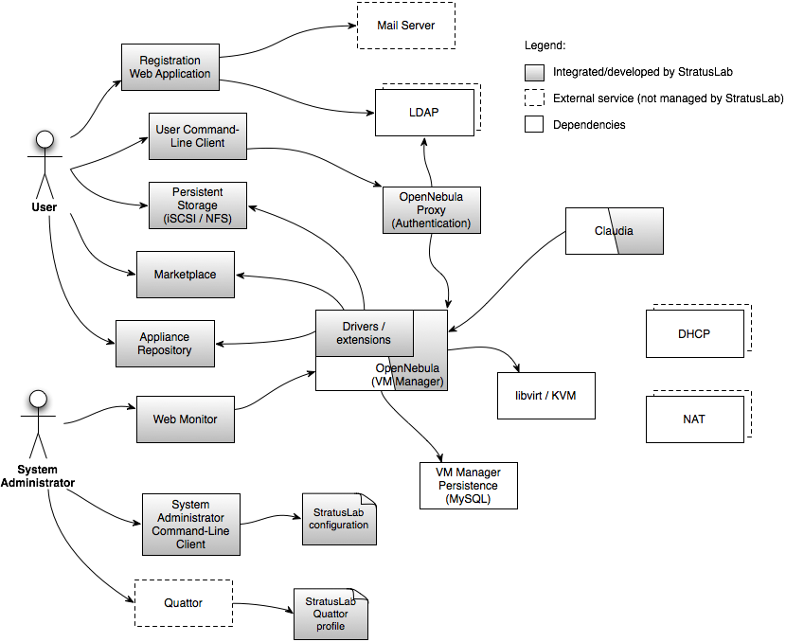
Architecture Vision v1.0
Available for production use in StratusLab v1.0

Slide 7
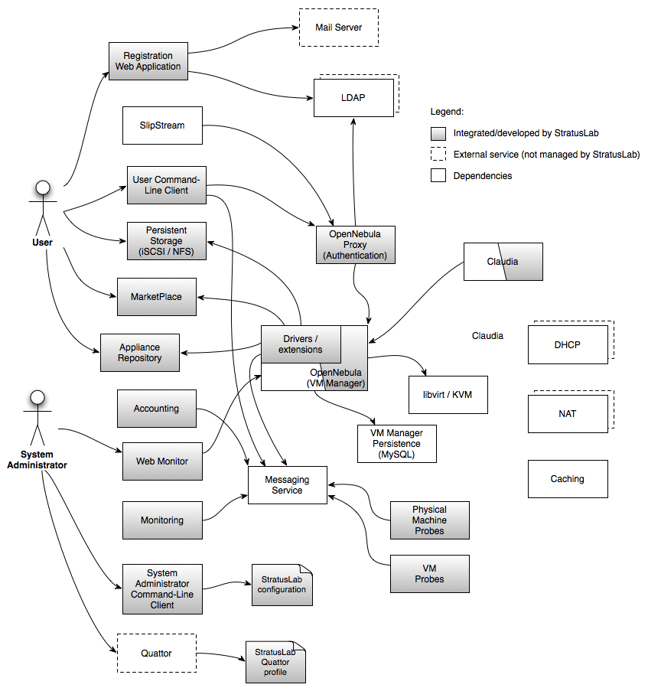
Architecture Vision v2.0
Work in progress…

Slide 8
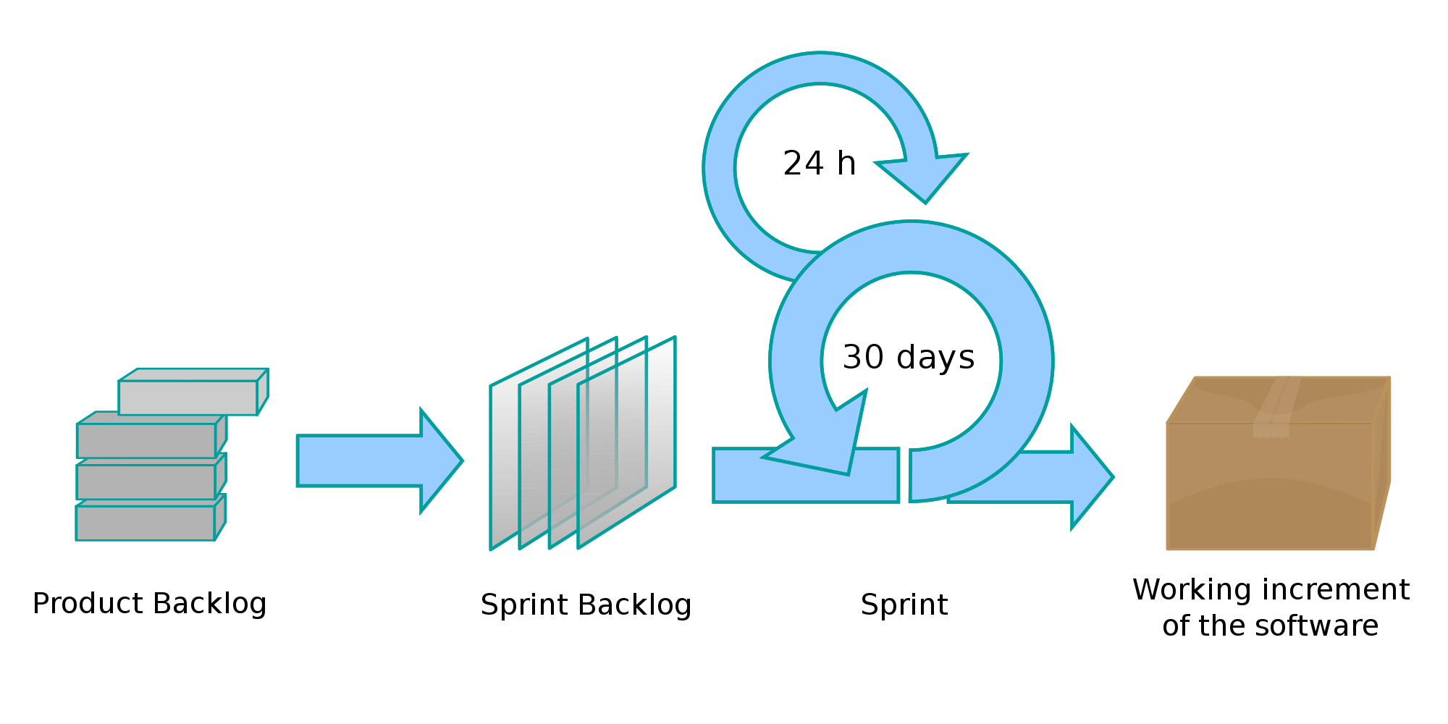
Scrum in StratusLab
TSCG
Stategic
Daily meeting
over phone!!
All WPs
All partners
Aim at producing
new StratusLab
release every 2
sprints
Planning
Meeting
Tactical
~3 weeks
Captured in JIRA

Slide 9
Benefits from Agile and Scrum
Incremental development
Generate early and regular feedback
Improve robustness through each sprint
Validate assumptions with real implementation
Prioritised functionality
Skills across all activities and all partners maximised at every sprint
Ability to react to opportunities and changes by steering incremental development
Reduce integration and configuration risk with continuous integration and deployment

Slide 10
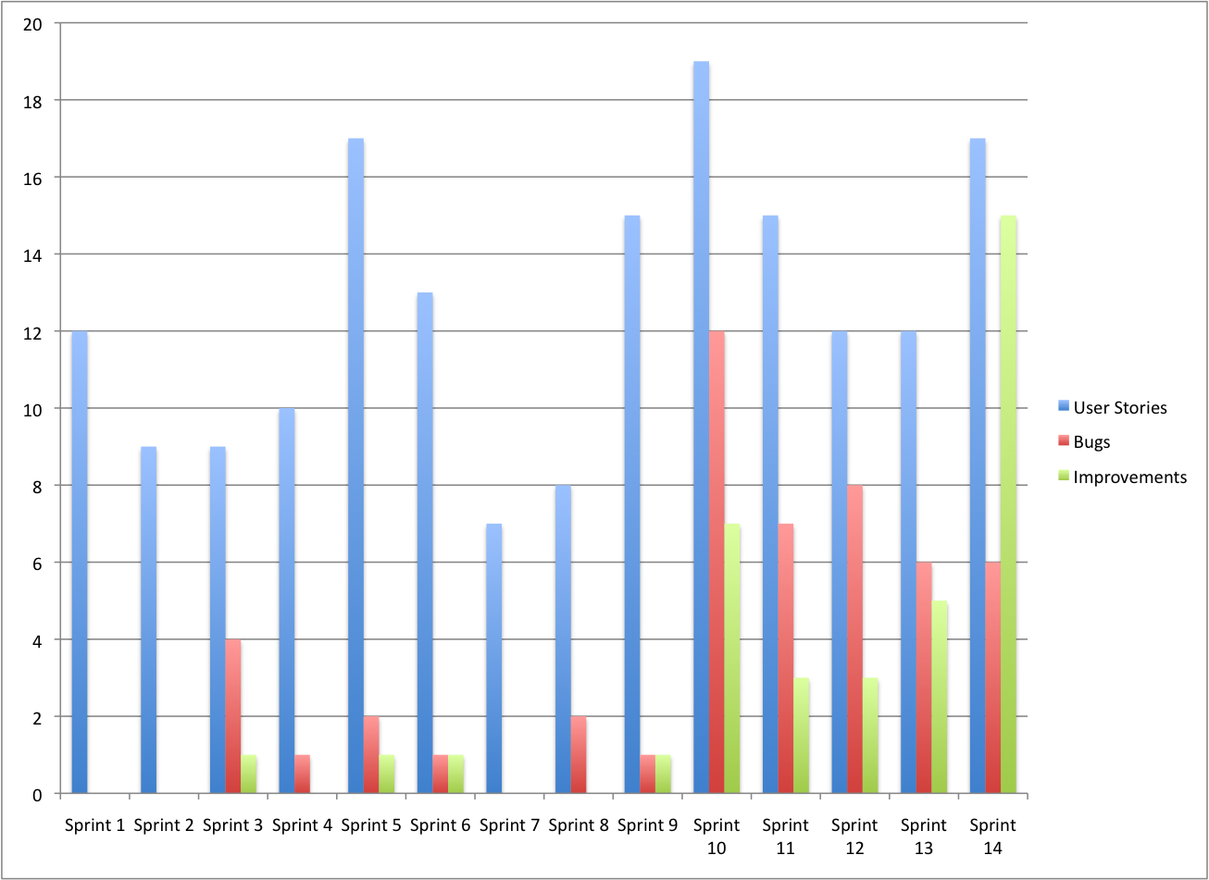
Sprint Highlights – done!
Kick off
v0.2
v1.0
v0.3
v0.1
v0.4
Winter
break

Slide 11
JIRA Task Board

Slide 12
Hudson in action

Slide 13
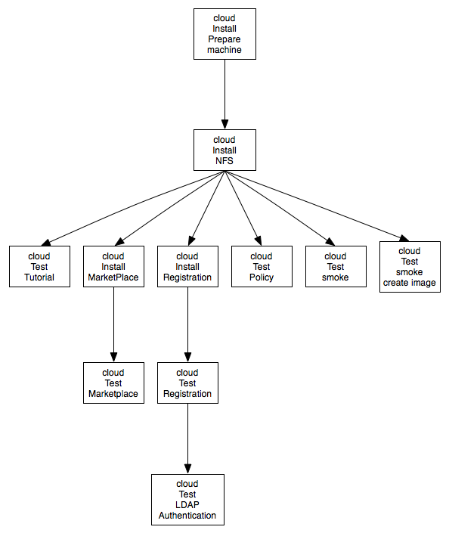
Hudson jobs – continuous testing
Triggered daily
Triggered following every commit

Slide 14
Metrics
Scrum metrics include work from all partners and WPs
Steady sprint rate
Steady implementation of work items
Note: no target defined
Metric | Q2 | Q3 | Q4
No. of completed sprints | 5 | 5 | 4
No. of releases | 1 | 1 | 1
No. of open user stories | 38 | 72 | 101
No. of implemented user stories | 69 | 40 | 67
No. of open bugs | 6 | 15 | 22
No. of fixed bugs | 7 | 11 | 27

Slide 15
Issues and Improvements
Issues encountered
Production releases sometimes difficult with interrupted production service
Documentation is sometimes lagging behind features
Improvements needed
Shift more effort in automating upgrades
Release more often, such that each upgrade is smaller and better understood
Improve further our definition of ‘DONE’ by adding documentation update

Slide 16
Plans for Y2
Overall roadmap of activity
D4.4: Reference Architecture for StratusLab Toolkit v2.0 (PM15)
MS9: Release of StratusLab 2.0 Beta (PM22)
D4.5: StratusLab Toolkit v2.0 (PM24)
D4.6: Software Integration Final Report (PM24)
Priorities for Y2
More regular releases, with higher upgrade automation
Improve and widen unit and system tests
Support wider range of platforms (user and/or sysadmin CLI), including Ubuntu
Continue responding to change within project scope

Slide 17
Questions?

