Slide 1
Work Package 2
Interactions with Targeted Communities
StratusLab First Periodic Review
Brussels, Belgium
4 July 2011

Slide 2
Introduction
Description of Work Package
  Manage interactions with targeted communities: users and system administrators.
Objectives
  Manage communication with resource providers regarding their needs concerning virtualization and cloud technologies and their feedback on StratusLab software.
  Manage communication with end-users regarding their use of resources running StratusLab software and their needs for direct access to virtualization and cloud features.
  Training sessions will be organized to encourage dissemination of technical information and adoption of the StratusLab software.
  Evaluate early versions of StratusLab software from a users perspective with respect to utility and stability.

Slide 3
Introduction
Tasks
  T2.1: Interactions with Resource Providers and End-users
  (CNRS/LAL, CNRS/IBCP, TID)
  T2.2: Intensive Evaluation of StratusLab Products
  (CNRS/LAL, CNRS/IBCP, TID)

Slide 4
Achievements
Requirements Gathering
  Surveys of system administrators and users early in project
  Broadly validated foreseen features and roadmap
  Trust issue for user-generated images → Marketplace
  Need for public cloud infrastructure → Move cloud API to Y1
HEPiX Collaboration
  Interested in using Marketplace for sharing images
  Detailed discussions about requirements
  Related discussions about security requirements
  Provided HEPiX Marketplace instance and support during tests
  Improved Marketplace implementation

Slide 5
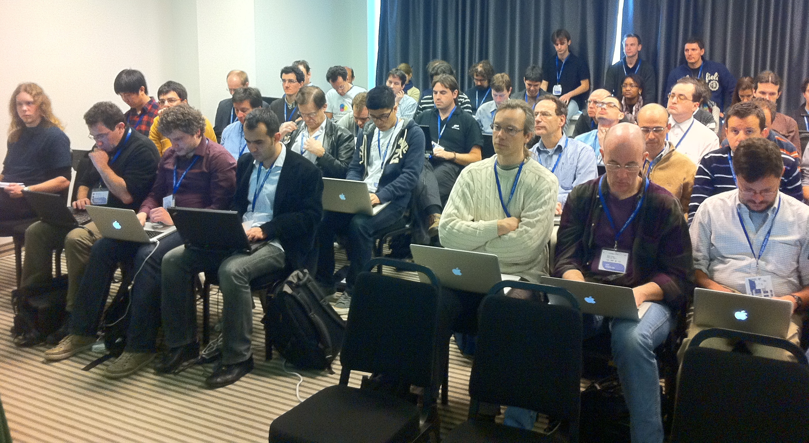
Achievements
24/24 Completed Tutorial
54 Attendees in Total
Tutorials
  Development of tutorial
  material (user and
  administrator)
  Regular presentation of
  tutorials
  Very successful tutorial at
  EGI User Forum
User-based Evaluation
  Automated testing of standard tutorial, application benchmarks, etc.
  Tests of installation and features provided with release
  Evaluation against outside requirements (EGI Virtualization Workshop)
  Bioinformatics appliances as test of support for PaaS

Slide 6
Issues
Better Follow-up
  Once contact is made with person/group, need better follow-up to ensure that fruitful collaboration emerges from contact
  More contacts with commercial sector
Improved Documentation
  Need to do better in keeping documentation current with releases
  Ensure that documentation covers full range of functionality of releases
Automated Testing
  Wider range of application use cases should be tested automatically
  Benchmarks should be run systematically to test application performance on cloud

Slide 7
Plans for Y2
Overall roadmap of activity
  Build on successes of Y1 program
  D2.3: Survey of Targeted Communities Concerning StratusLab (M14)
  D2.4: Final Report on StratusLab Adoption (M24)
  D2.5: Report on Evaluation of StratusLab Products (M24)
Priorities for Y2
  Continue contacts with users and administrators with better follow-up
  Continued emphasis on tutorials (EGI UF, DCI Summer School)
  Make stronger effort for contacts within commercial sector
  Expand automated testing to wider range of use cases
  Improve documentation

Slide 8
Questions?

