Slide 1
Work Package 5
Infrastructure Operations
StratusLab First Periodic Review
Brussels, Belgium
4 July 2011

Slide 2
Introduction
Description of Work Package
  WP5 is responsible for the provision and operation of the project’s computing infrastructure
Objectives
  Deployment and provision of reference cloud service
  Deployment and operation of grid sites on top of cloud services
  Testing and benchmarking of cloud distribution pre-release versions
  Distribution and maintenance of Virtual Machine appliances
  Provision of project support services’ infrastructure (testbeds, pre-production sites, build service etc.)
  User support for the all above
Tasks
  Τ5.1 Deployment and Operation of Virtualized Grid Sites (GRNET, LAL)
  Τ5.2 Testing of the StratusLab distribution (LAL, GRNET)
  Τ5.3 Virtual Appliances Creation and Maintenance (TCD, GRNET)

Slide 3
Achievements
Provision of production-level open IaaS cloud
  Follows the evolution of StratusLab distribution releases
  Open access to third parties
  Testbed for new applications
  Used for various tutorials and demonstrations

Slide 4
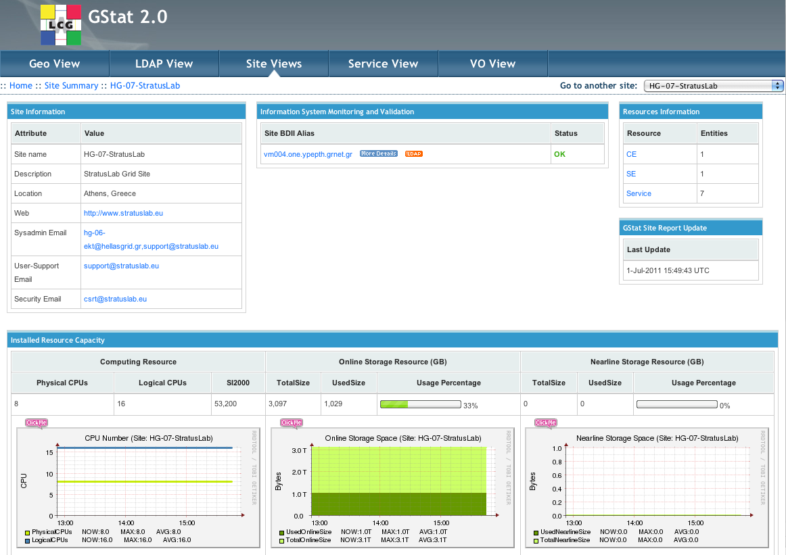
Achievements (ctd.)
Deployment and operation of certified Grid site
  HG-07-StratusLab. Deployed on the reference cloud services
  Certified by the GRNET-NGI. Part of the national grid infrastructure
  Grid node appliances prepared and distributed by WP5
  Feedback to grid community
    “Grid over Cloud” Technical Report
HG-07-StratusLab monitoring from GStat

Slide 5
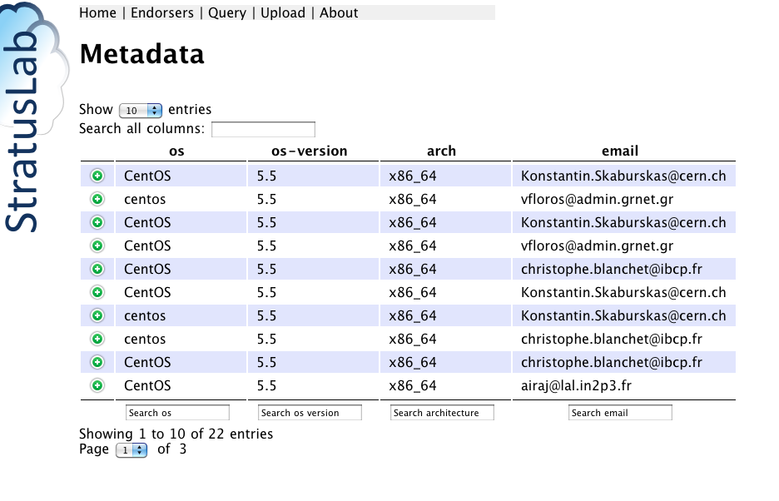
Achievements (ctd.)
  Image creation
  Recipe for preparing StratusLab-ready VMs
  Prepared a large number of images and appliances available from the Marketplace
Marketplace and Appliance Repository
  Integral part of the public cloud service
  Marketplace: Metadata for
  image appliances
  Repository: Online storage
  for VM images and appliances
  (referenced from the Marketplace
  metadata)

Slide 6
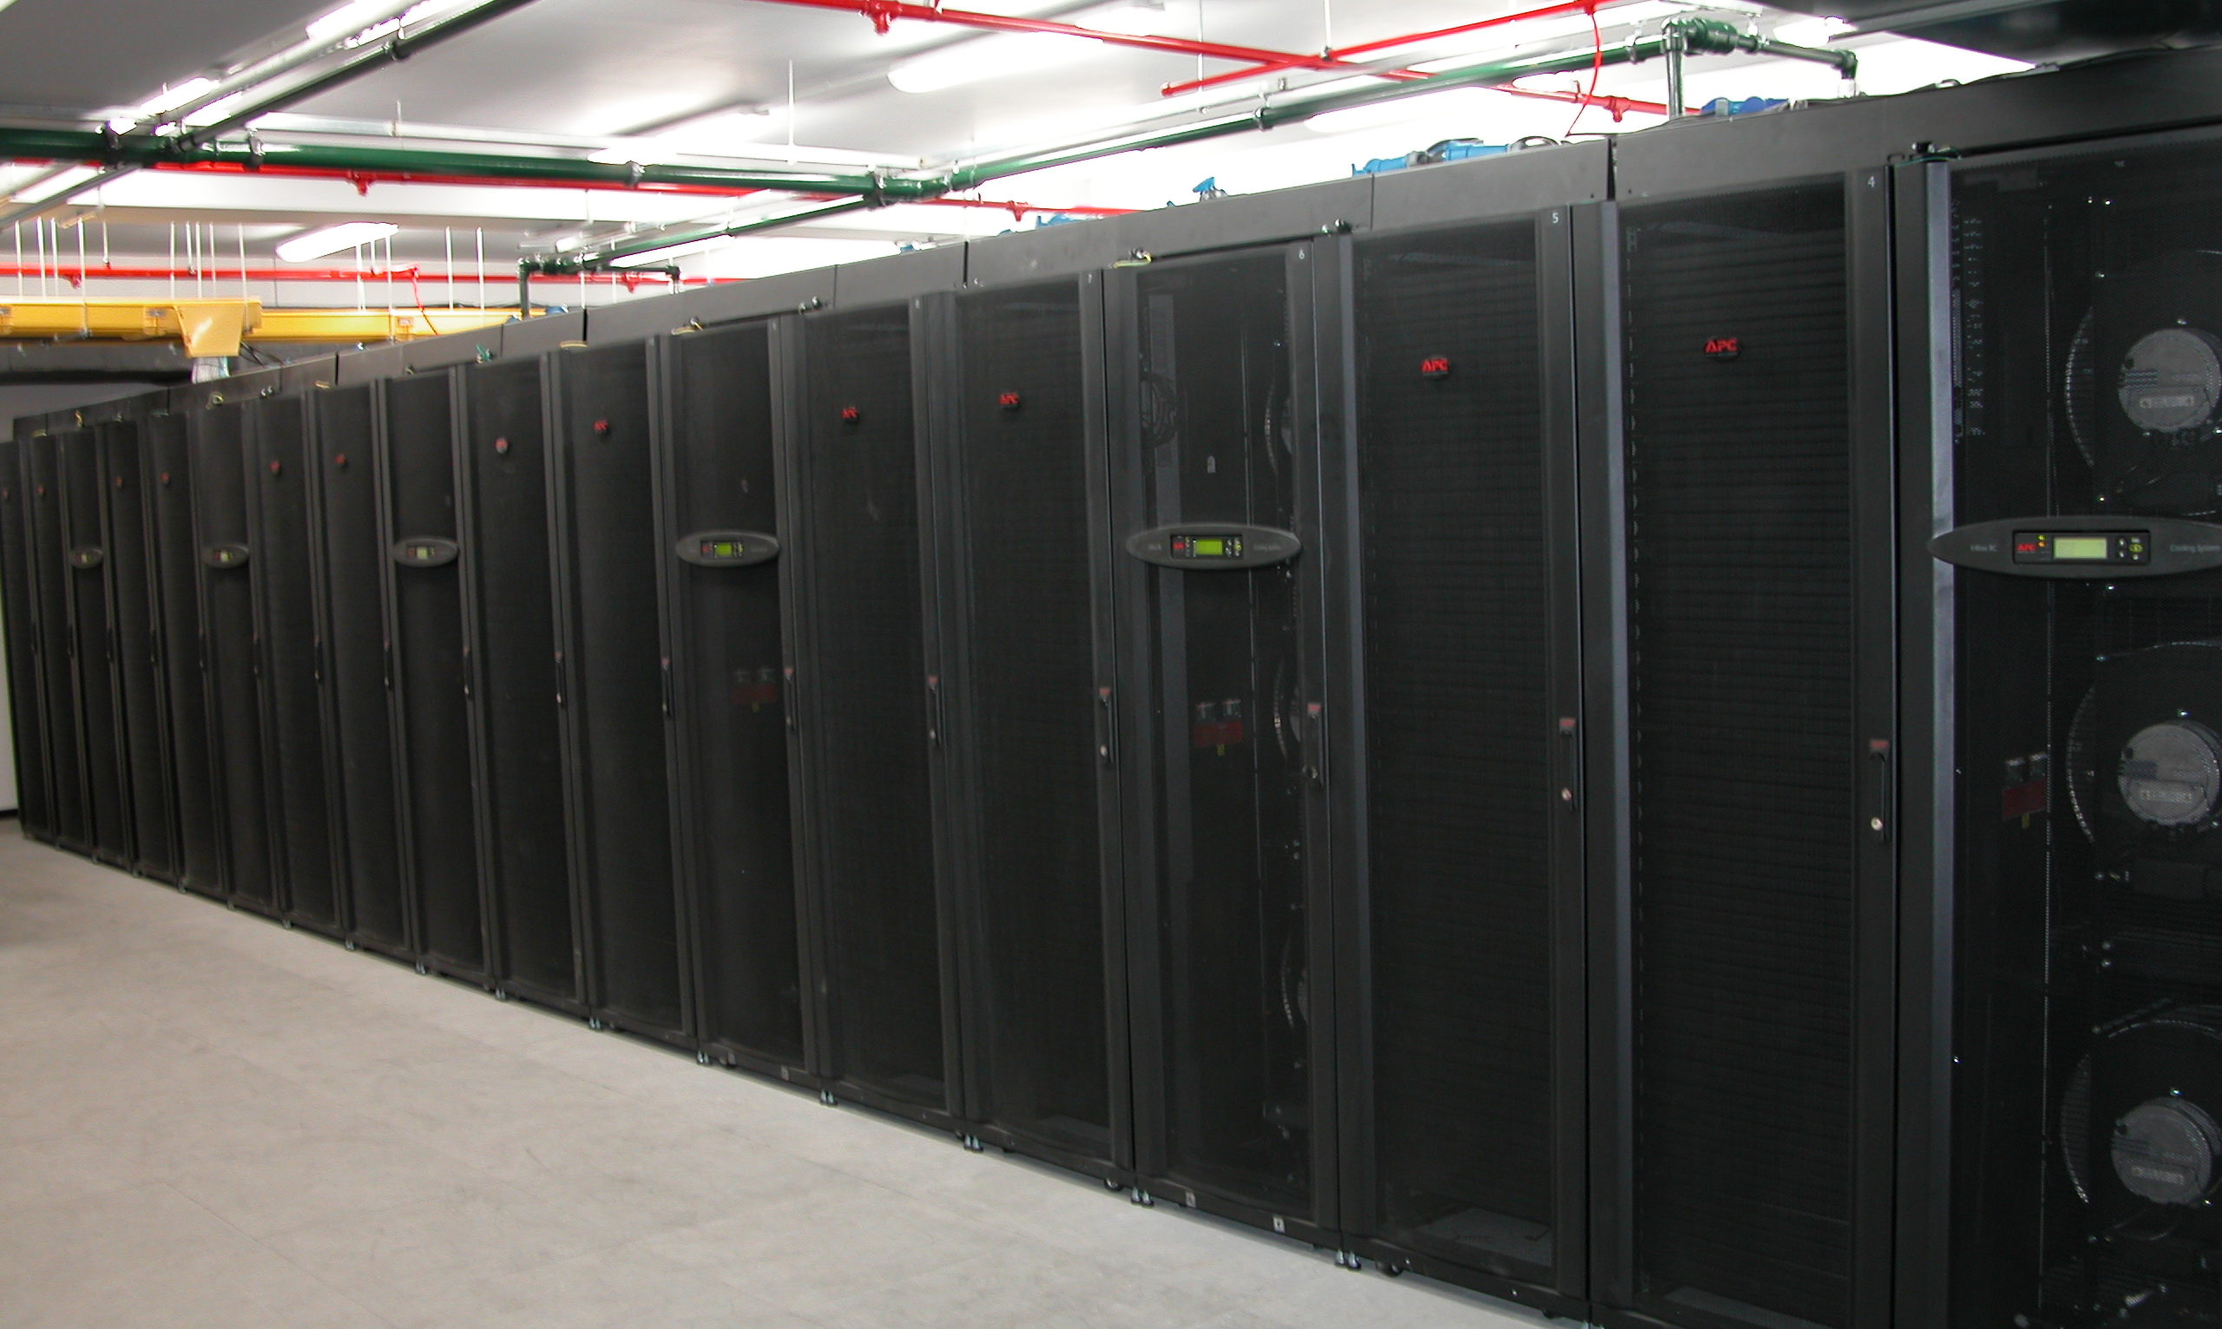
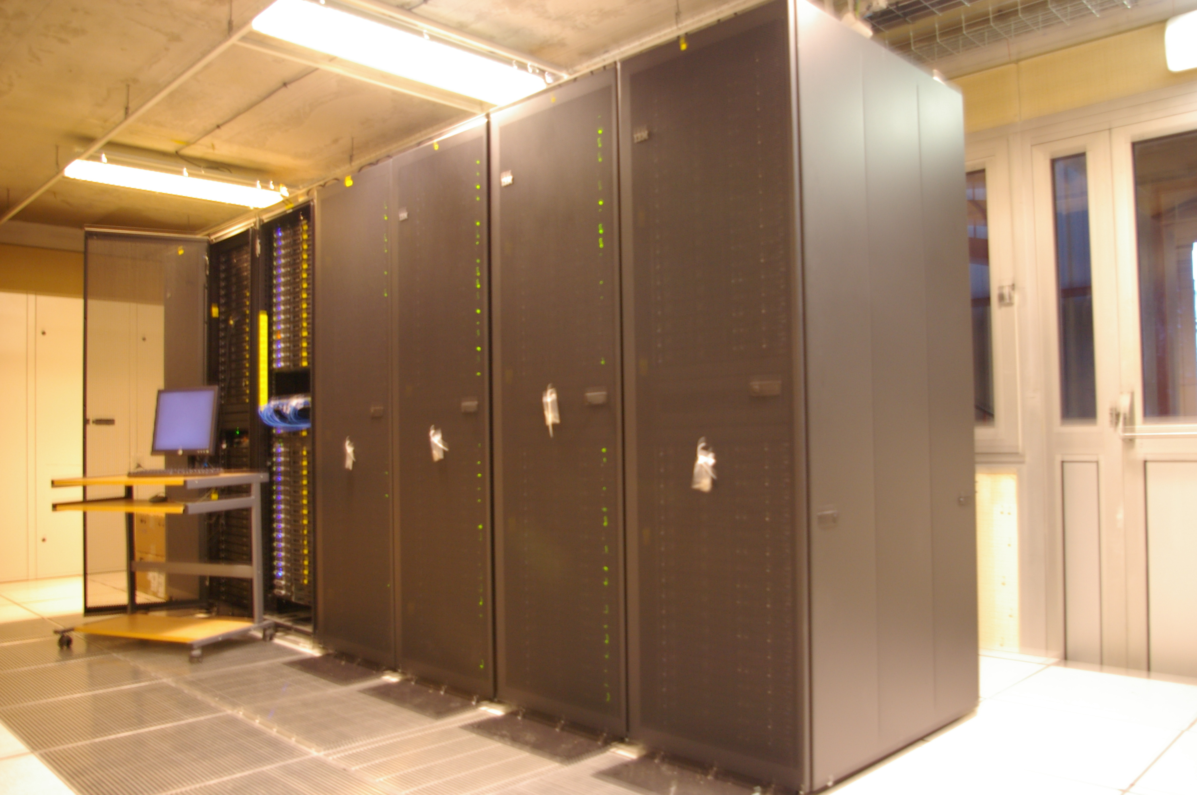
Physical Resources
GRNET Cloud (YPEPTH)
32 nodes
  48GB memory,
  2x140GB HD,
  dual quad core HT enabled
20TB storage space (NAS)
2x10 Gb/s link to GEANT
Reference Cloud Service
16 + 1 Nodes
256 cores (Hyper-threaded)
768 GB total main memory
3TB storage space over NFS
LAL Cloud
3 different configurations
Cloud service (private)
7 + 1 nodes
  168 total cores,
  2x250GB HD per node
  252GB total main memory
2x10 Gb/s link to GEANT

Slide 7
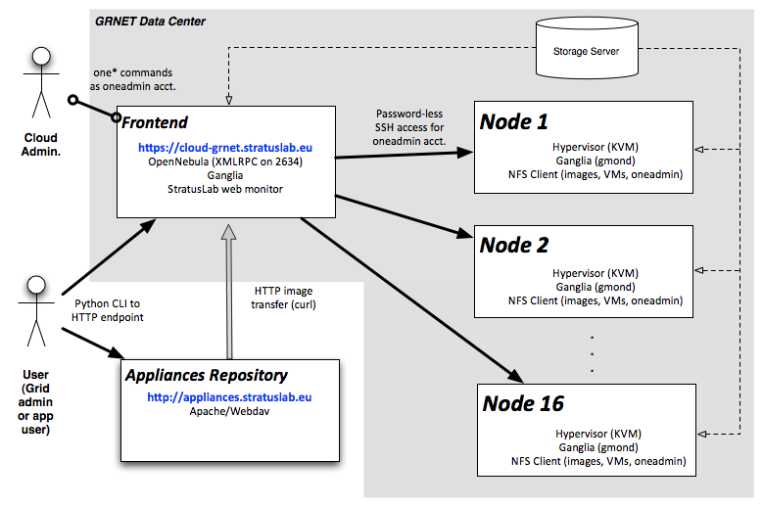
Reference Cloud Service Architecture

Slide 8
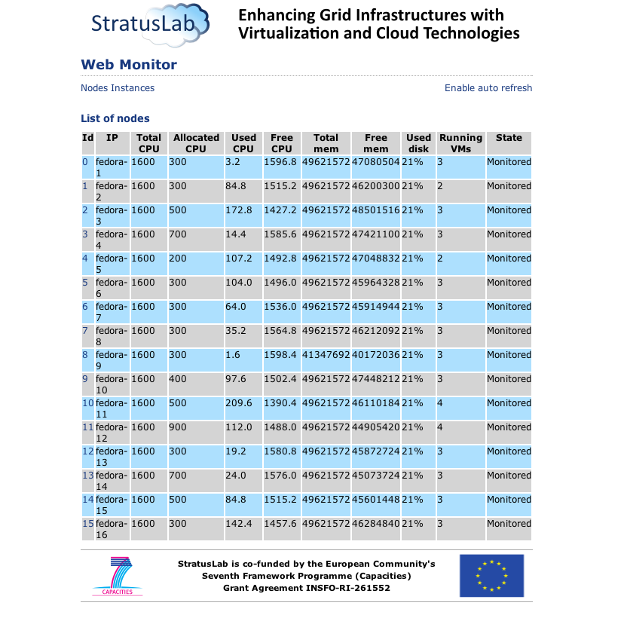
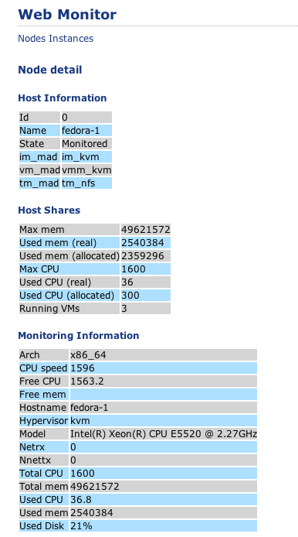
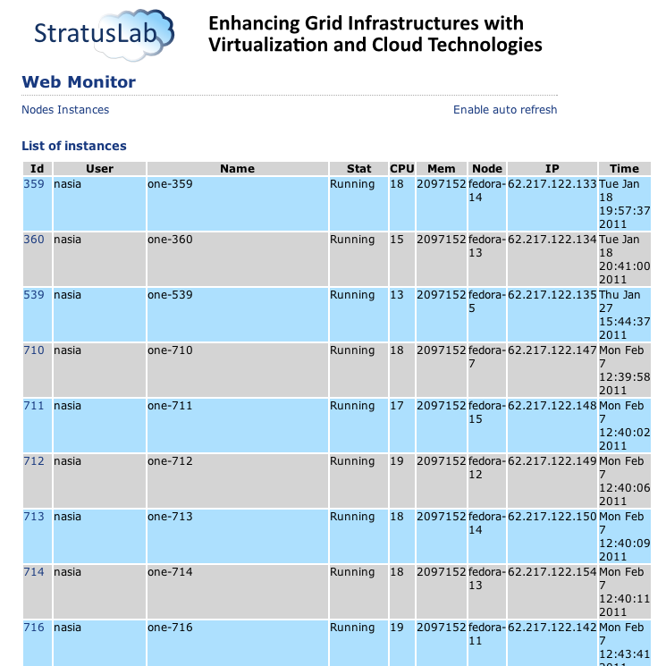
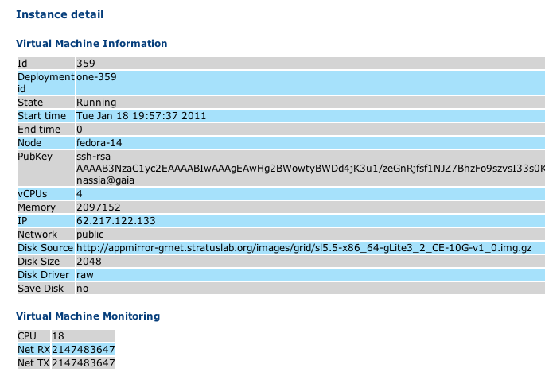
Service Monitoring
Physical Nodes
VM Instances
Node details
Instance Details

Slide 9
Metrics
WP5 metrics target
  Service usage statistics
  Availability and reliability of services – QoS
  Level of committed physical resources
IaaS Cloud
Metric | Q1 | Q2 | Q3 | Q4 | Y1 Target
No. of prod. sites running StratusLab dist. | - | 1 | 1 | 1 | 5
No. of sites exposing the cloud API | - | 1 | 1 | 1 | 0
Delivered CPU through cloud API | - | - | 256 cores | 256 cores | -
Storage used | - | - | 3 TB | 3 TB | -
No. of sites providing scale-out | - | - | - | - | -
Fraction of resources by scale-out of a site | - | - | - | - | -

Slide 10
Metrics – Cloud services
Appliance Repository
Metric | Q1 | Q2 | Q3 | Q4 | Y1 Target
No. base machine images | - | 5 | 7 | 8 | 5
No. of base machine image downloads | - | 783 | 2628 | 7072 | -
No. appliances | - | - | 6 | 7 | 5
No. of appliance downloads | - | 0 | 252 | 687 | -
Grid site
Metric | Q1 | Q2 | Q3 | Q4 | Y1 Target
Availability of sites | - | - | - | 100% | 80%
Reliability of sites | - | - | - | 100% | 80%
No. of VOs served via StratusLab sites | - | - | 1 | 1 | 10
No. of sci. disciplines served via StratusLab sites | - | - | 0 | 0 | 3
Delivered CPU | - | - | 16 cores | 16 cores | -

Slide 11
Metrics (more interesting)*
Metric | Y1
Total Users | 38
External users (third parties) | 26
Internal users (project members) | 12
Total number of VMs instantiated | 2433
Average VMs per external user | 11.13
Average VMs per internal user | 119.68
Average cores per VM instance | 1.63
Average memory per VM instance | 761.62 MB
Average running time for VM instances | 29.62 hours
Maximum running time for a VM | 119.68 days
Average instantiation time of VMs | 6.07 minutes
* Additional metrics available from D5.3 and QR4

Slide 12
Issues
Security breaches due to insecure VM images
  Hijacked VMs used to attack other sites
  Breached VMs terminated immediately
  Defective images removed and replaced by fixed ones
  Improved logging and introduced quarantine mechanisms
Instability of physical resources
  Datacenter frequent reconfiguration introduced downtimes to production and support services
  Situation improved radically through tighter coordination with the datacenter’s admin staff
Degraded performance of cloud service
  Shared storage over NFSv3 cannot meet performance requirements of cloud services
  Alternative solutions under testing but no considerable improvement achieved
  Investigating “smarter” ways for image management (e.g. caching) and continue seeking for a high-performance distributed FS solution

Slide 13
Improvements
Things to work on…
  Better interaction with WP4. Faster and more efficient release cycle of StratusLab software.
  Improve reference cloud service performance
  Extend the usage of grid site. Support more VOs and communities.
  Enhance the user interaction with the StratusLab Marketplace.
  Reformed end-user support – Use request tracker

Slide 14
Plans for Y2
Overall roadmap of activity
  MS11 - Operation of site running StratusLab v1.0 (M13) – (Achieved!)
  D5.4 - “Economic Analysis of Infrastructure Operations” (M18)
  MS12 – Delivery of Virtual Appliance Repository (M18) – (Achieved!)
  MS13 - Operation of site running StratusLab v2.0 (M24)
  D5.5 - “Infrastructure Operations Final Report” (M24)
Priorities for Y2
  Cloud-like capabilities of Grid sites (elasticity, advanced management)
  Work towards federated Cloud Services
  Expand the physical infrastructure of the public services
  Encourage exploitation of StratusLab Marketplace by third parties
  Investigate economic impact of cloud computing

Slide 15
Questions?

