Slide 1
Conclusions & Planning
StratusLab First Periodic Review
Brussels, Belgium
4 July 2011

Slide 2
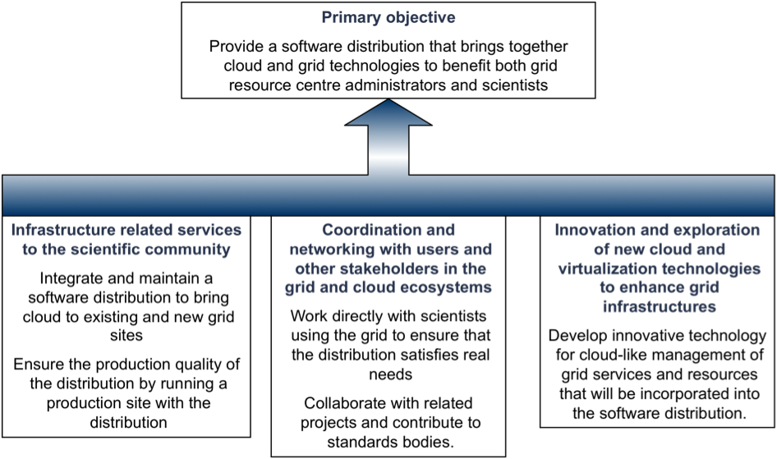
Objectives

Slide 3
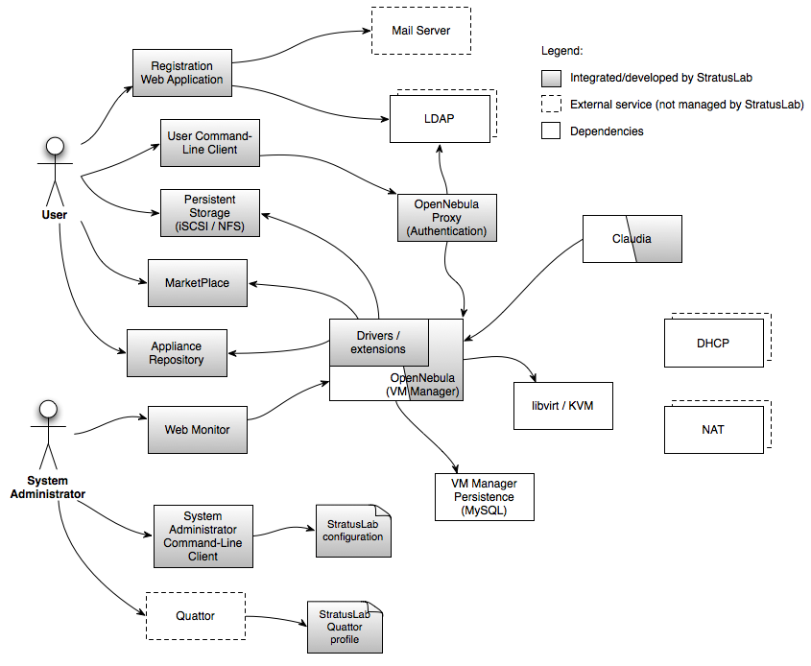
Primary Objective
StratusLab Distribution
v0.1, v0.2, v0.3, v0.4
v1.0 (production) in M13
Features
Compute, storage, and networking services
Federative aspects: Marketplace, Grid Authn.
Incorporates latest versions of OpenNebula and Claudia

Slide 4
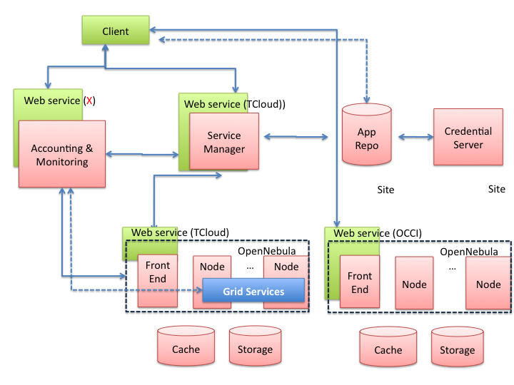
Innovative Services
Service Manager
Integrated Claudia
Service deployment supports PaaS over StratusLab cloud
Autoscaling support
Advanced Features
Integrated OpenNebula
Group and role support
Fault tolerance hooks
Image management

Slide 5
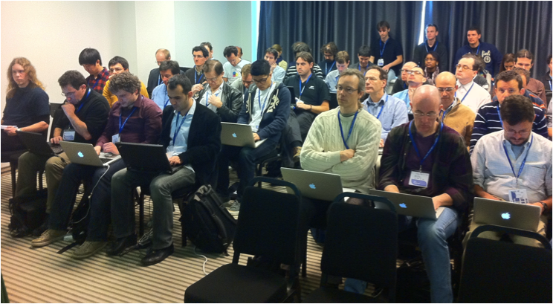
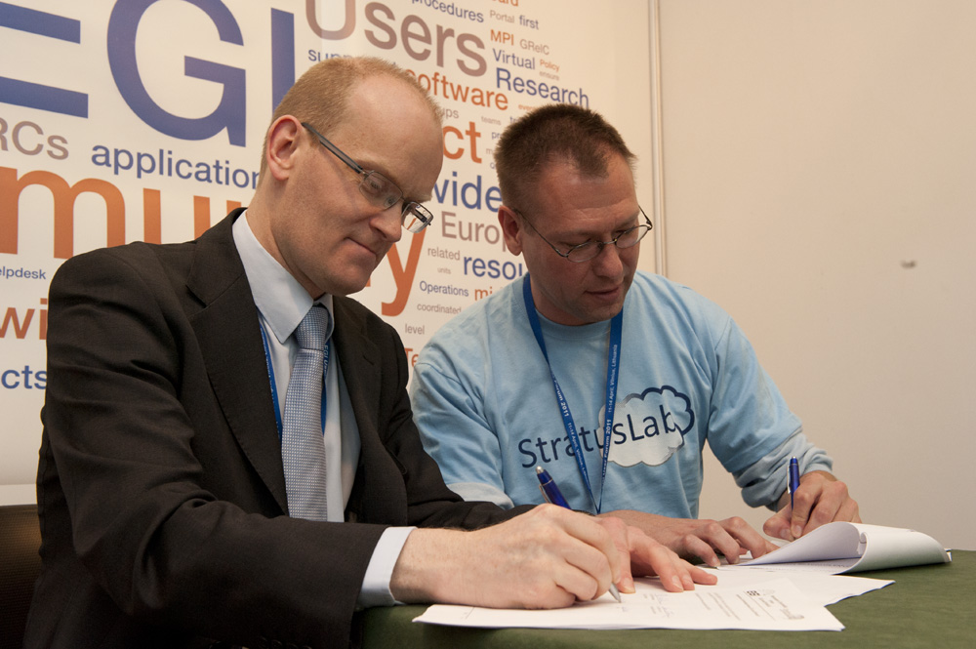
Coordination and Networking
Targeted Communities
Surveys have influenced project’s work plan
Successful tutorials
Related Projects
Intensive work with groups like HEPiX to ensure services meet real needs
DCI projects: EGI, EDGI, VENUS-C, …
Collaboration with SIENA

Slide 6
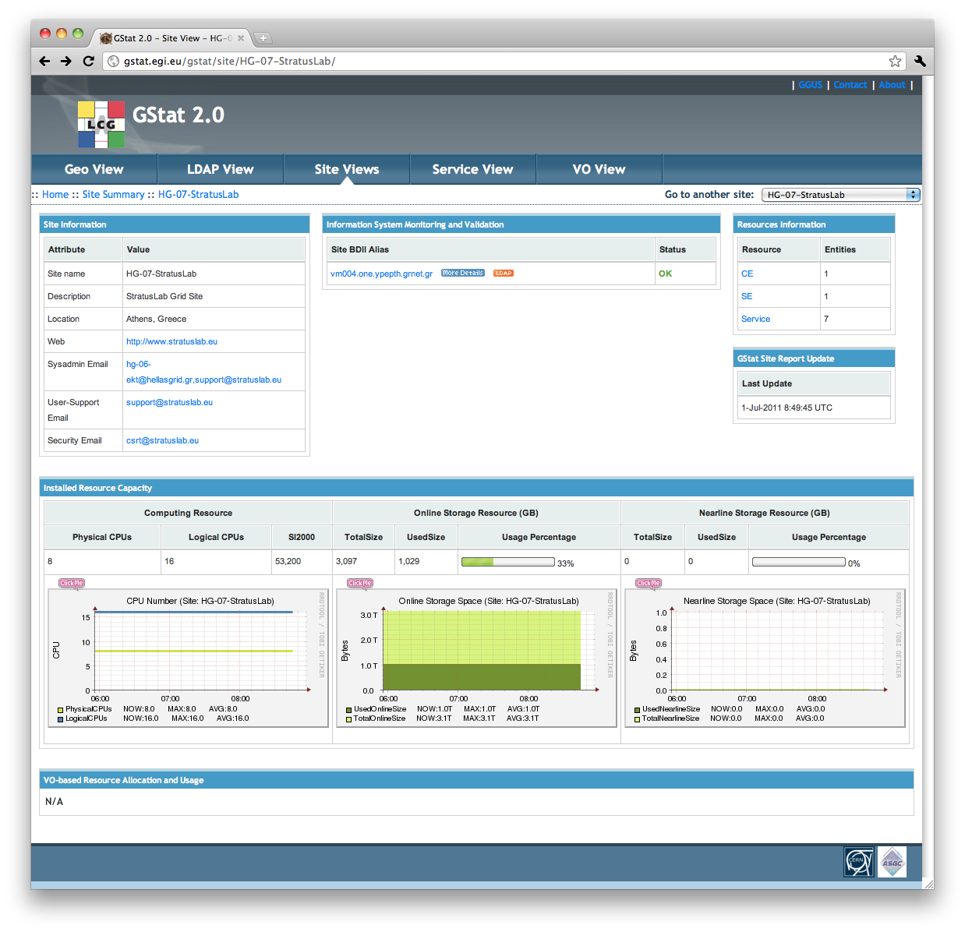
Infrastructure Related Services
Processes and Tools
Integration processes focus on iterative improvements
Tools to measure and to improve quality
Production Services
Reference cloud infrastructure to generate feedback
Complete, certified grid site running over StratusLab cloud

Slide 7
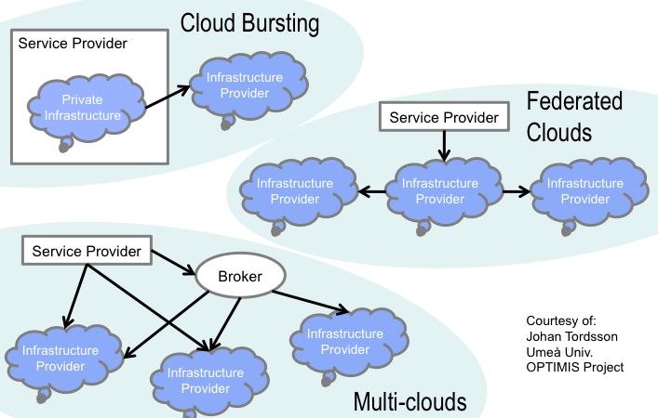
Year 2
Priorities
Incremental improvements in functionality and performance
Adoption of standard interfaces: TCloud, OCCI (OVF), CDMI, Network
Investigation of federated cloud scenarios

Slide 8







Architecture of StratusLab
Grid Services
Marketplace
Share existing images
Federation facilities
Security
1
Availability Zones
Images
Networks
QoS
Multi Cloud
Cloud/Grid Sites
Grid Services
Cloud API
Grid Services
Cloud API
2
Cloud Bursting
External Clouds
Needs to consider Image & VLANs
Needs to consider placement
Can integrate other EU FP-clouds

Slide 9
Year 2 Plans
Storage
Volume Management (snapshots, attach/detach)
Massively scalable deployments
Compute
Cloud bursting
Massively scalable deployments
Networking
Dynamic VLAN
Firewalling
IPv6
Service
Elasticity of virtualized grid services
Accounting

Slide 10
Questions?

