Slide 1



Laser source for ThomX
Optical R&D for Laser beam - electron beam Compton scattering Technology
Interest for Compton scattering
Laser beam for ThomX
Technical solution
  ➔ Fabry-Perot optical resonator
R&D on optical cavities
F. Zomer, 8, juin, 2011

Slide 2
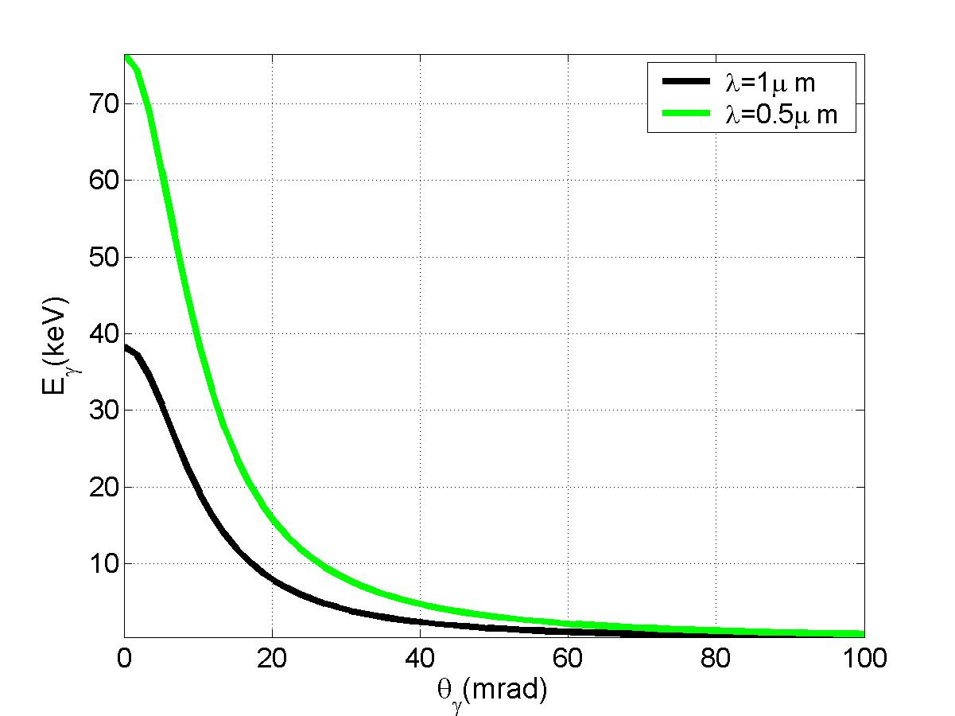
Some interest in Compton scattering
Energy distribution ~flat with
ω_{f,max}=4γ² ω_{laser}
with γ∼100 (E_{electron}=50ΜeV)
ω_{f,max}=40000ev if ω_{laser}  1eV
Compton scattering is the
most powerful mechanism
to boost photon energies
Laser
ω_{laser}
photon : ω_{f}
electron
θ
γ=E_{electron}/m_{e}c²
(scattered electron)
Tolhoek, Rev.Mod.Phys.28(1956)277
We are interested by using the scattered photon
collimator
2 body process ➔ ω_{f}=f(θ)
➔ ~monoenergétic beam
by selecting Backscattered
photons at ω_{f,max}
ω_{f} (keV)
E_{electron}=50MeV
Sprangle et al. JAP72(1992)5032
θ (mrad)

Slide 3

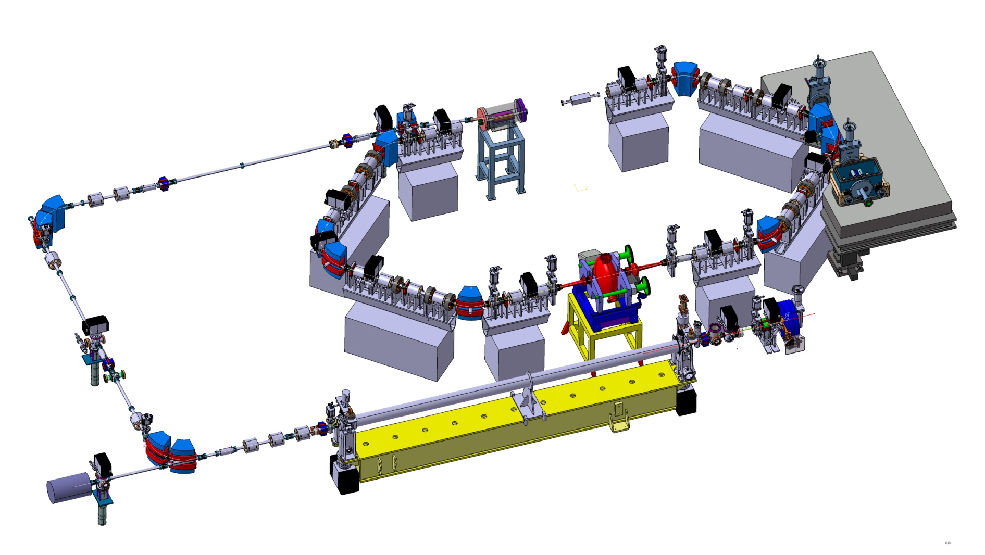
Cavité optique
The compact Compton X-ray machine (museum , medical applications)
~50MeV
electrons ring
Optical resonator
Size ~10mx7m
X rays
Photo gun
S-band (3GHz) LINAC

Slide 4
➔Technical solution to reach high laser average power:
Fabry-Perot cavity
One needs 100-500kW laser beam average power
⬄ at present

Slide 5
Fabry-Perot cavity:
Principle with continous wave
Gain=F/π=1/(1-R)
~10kW
e beam
~1W
isolateur
LASER
~1W
JLAB/Saclay Polarimeter, NIMA459(2001)412
HERA /Orsay Polarimeter, JINST 5(2010)P06005
When ν_{Laser} ∝ c/2L ⇒ résonance
But: Δν/ν_{Laser} = 10⁻¹¹ ⇒ STRONG & ROBUST laser/cavity feedback needed…

Slide 6
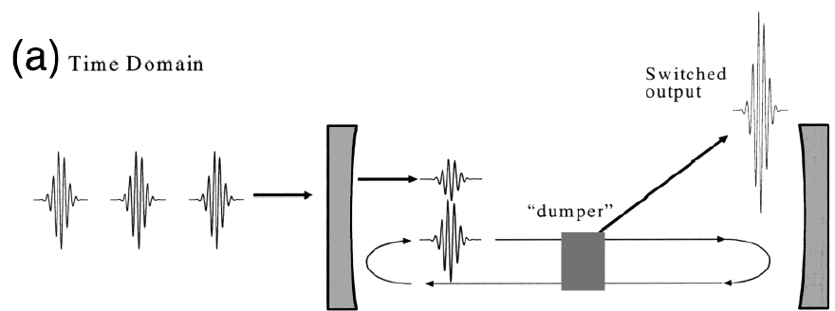
Fabry-Perot cavity in pulsed regime
Electron beam
1ps
Mode lock
oscillator
Fabry-Perot cavity
with Super mirrors
Same feedback technics (more complexe) is used in cw & pulsed regime
State of the art (Garching MPI) : ~70kW, 2ps pulses @78MHz, stored in a cavity
(O.L.35(2010)2052) ~20kW, 200fs pulses @78MHz

Slide 7
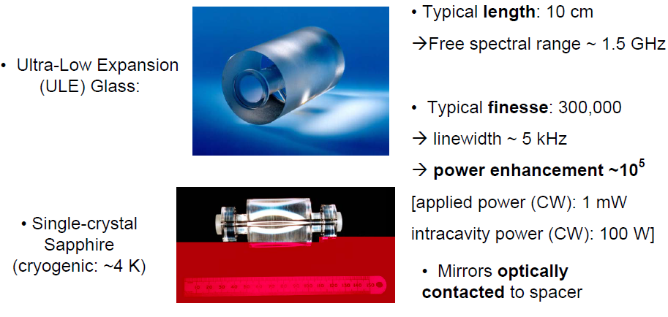

Issue for the laser cavity feedback
Laser incident average power 50W
Cavity finesse : F=4000xπ
To reach ~100kW in cavity
ThomX Optical path length : L~16m
Cavity resonance
frequency linewidth
Δν=c/(LF)~1.5kHz !
Δν/ν=λ/(LF)~5x10⁻¹²
Same numbers as in metrology !!!
M. Oxborrow

Slide 8
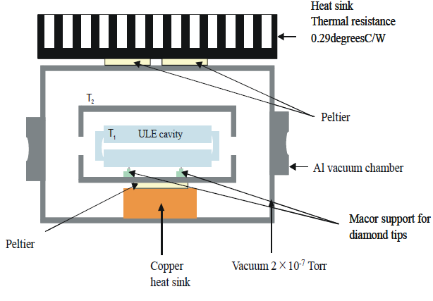
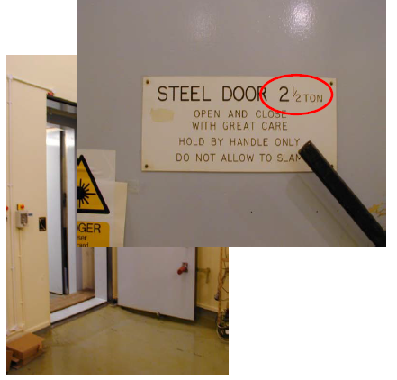
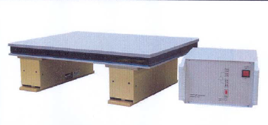
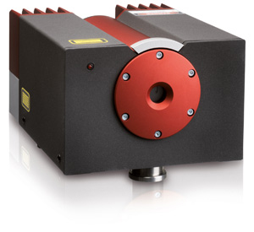
From a feedback point of view:
Locking a ‘16m’ cavity to finesse~ 4000 (‘gain’~1300) is equivalent to
Lock a 0.2m cavity to 300000 finesse !
BUT
The hyper stable small cavity is ‘hyper’ temperature stabilised
Into an hyper isolated room
In the case of ThomX
‘Huge’ laser beam average power
  Larger frequency/amplitude noise
  ‘Bad’ beam profile quality
‘Giant’ cavity geometry
  Uneasy isolation from noisy accelerator
  environment
R&D required
Put on an hyper stabilised optical table
And an hyper stable cw laser is used, linewidth 1kHz
http://www.innolight.de/index.php?id=mephisto
~100mW power
M. Oxborrow

Slide 9


Four-mirror Fabry-Perot cavity R&D at ATF
(MightyLaser-ANR-08-BLAN-0280-01)
R&D context
Starting point : ILC polarised positron source (2005):
>10MW cavity average power needed for ILC/CLIC
Now : fundings for compact X-ray sources projects
Quantum beam/Japan; ThomX/France
100kW-1MW average power needed

Slide 10
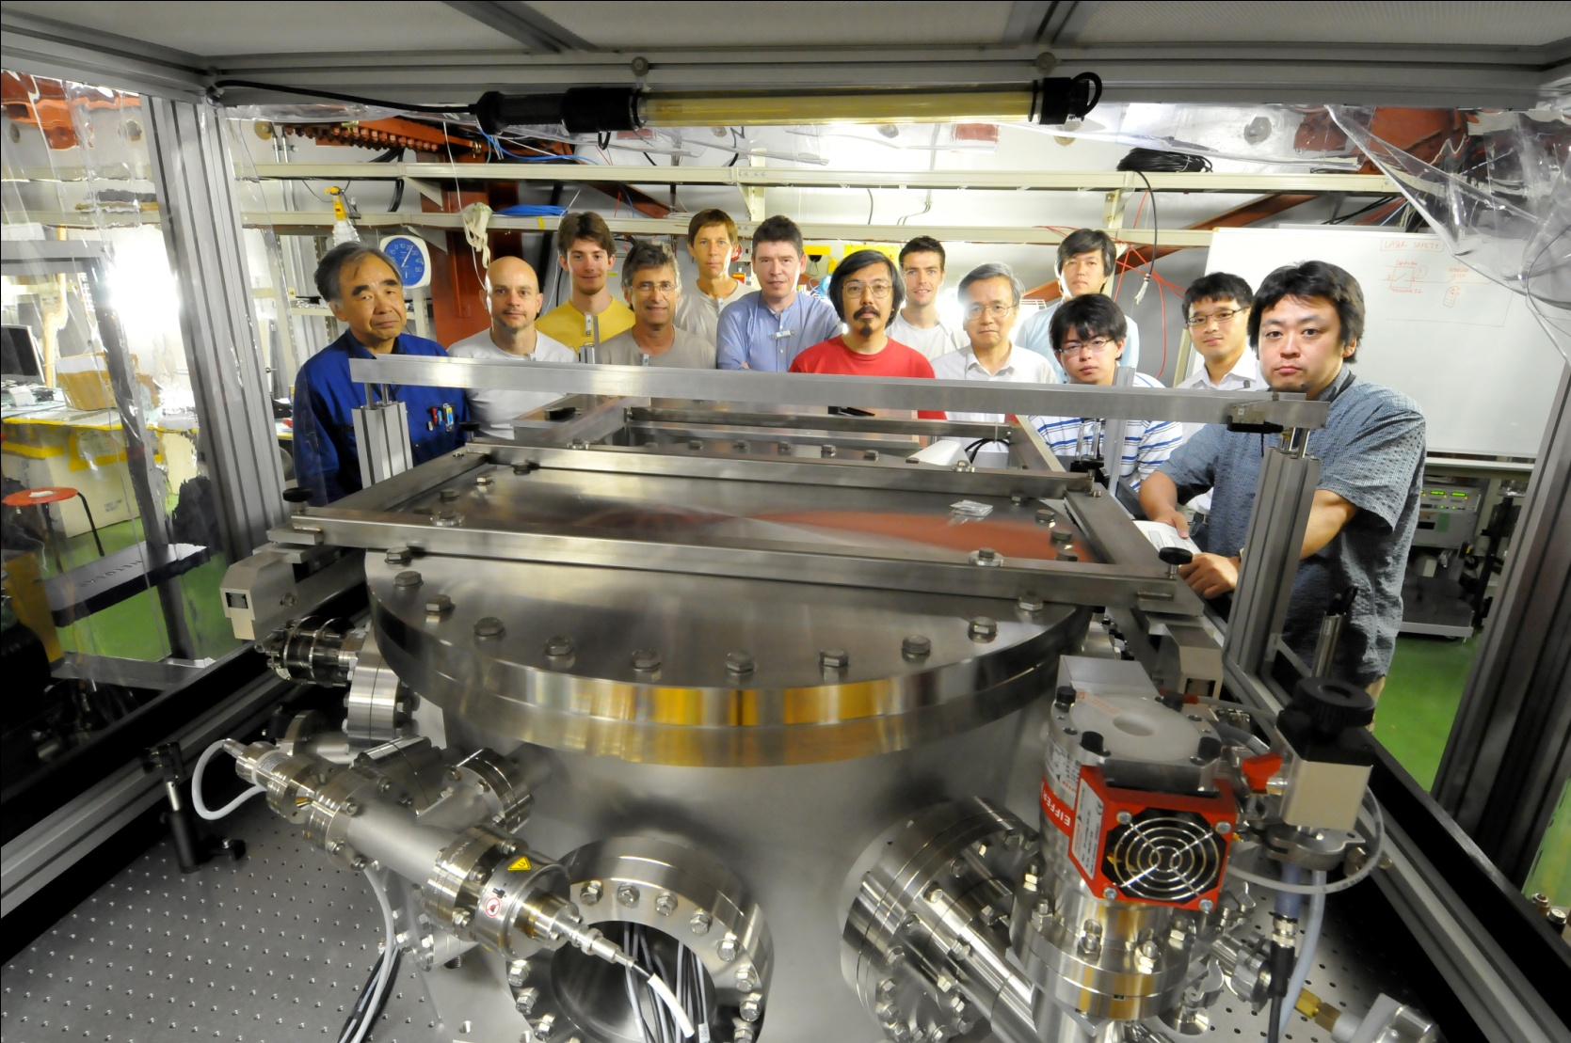
French Japanese Collaboration
+I. Chaikovska, N. Delerue, R. Marie LAL/France
Araki-san

Slide 11
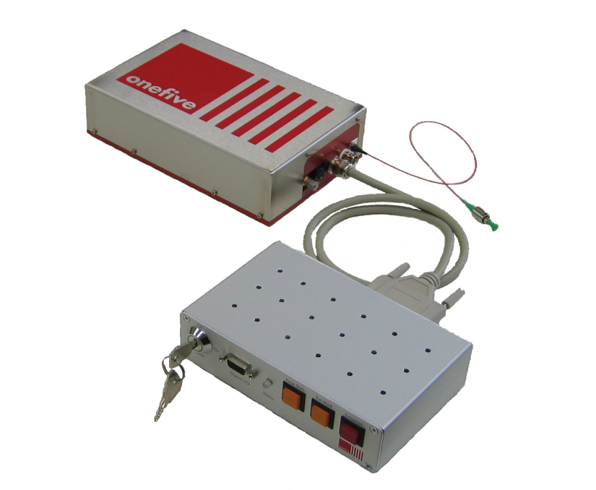
2 steps R&D
STEP ONE: commissioning a 4-mirror cavity at ATF, done end 2010
Oscillator (customize
commercial)
=0.2W, 1030nm
Δt~0.2ps frep=178.5MHz
STEP TWO: upgrade mirrors & laser power
~5W
→100W
Amplifier
photonic fiber
Yb Doped
4-mirror
Fabry-Perot cavity
Gain~1000
1 piezo
→~10000
2 piezos
1 temp. Ctrl.
Numerical feedback
ATF clock
STEP ONE (done end 2010)
With cavity laser/coupling ~50% ➔Power_cavity~2.5kW
STEP TWO (with sapphire mirror substrates)
With cavity laser/coupling ~50% ➔Power_cavity~250kW
Final goal: to reach the MW average power (➔~5mJ/pulse but @178.5MHz…)

Slide 12
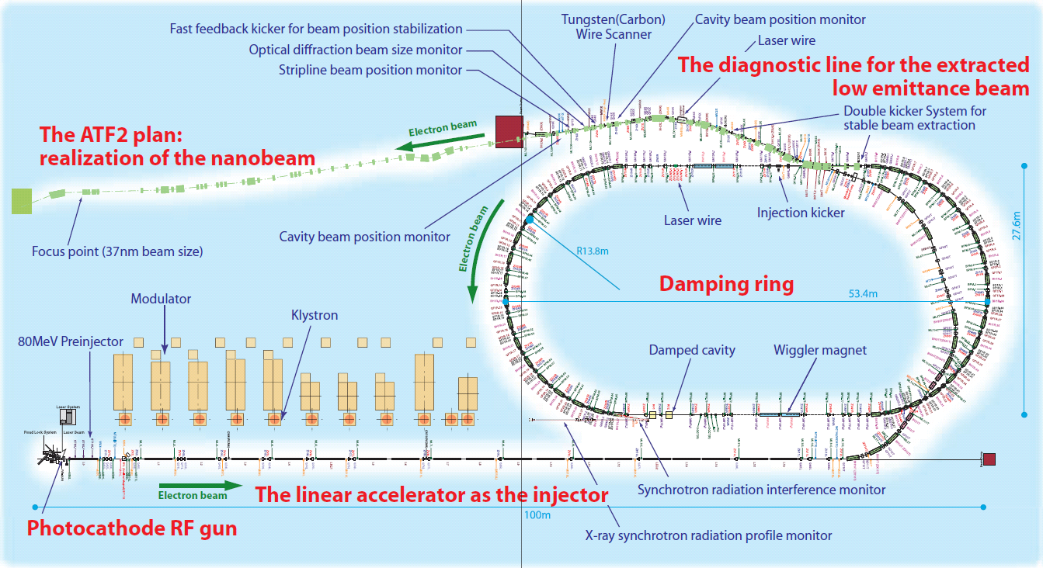
Cavity installation on the Accelerator Test Facility (ATF) at KEK
~30MeV γ
BaF2 calo
Cavity

Slide 13
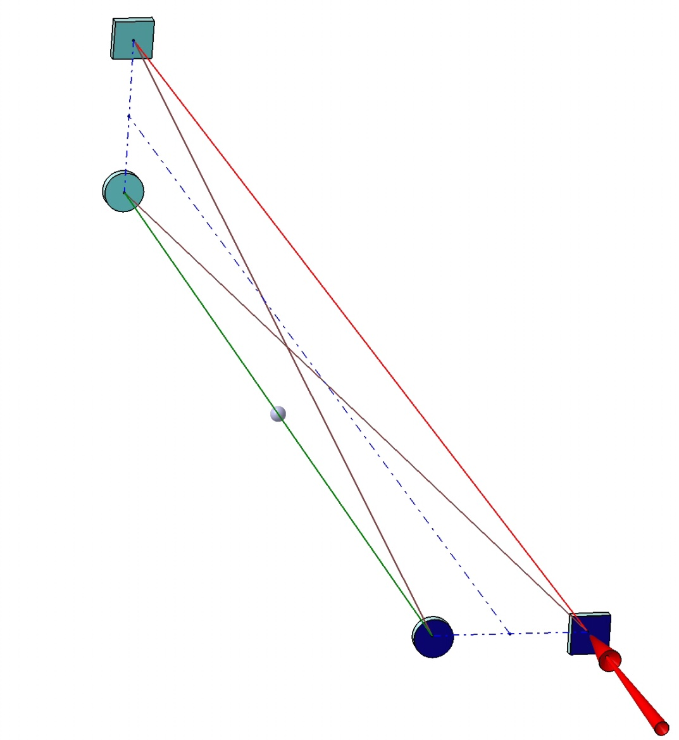
Small laser beam size +stable resonator ➔ 2-mirror cavity
Stable solution: 4-mirror cavity
as in Femto laser technology
Laser input
BUT
➔linearly polarised eigen-modes
which are instable because of vibrations
at very high finesse (KEK geometry)
e⁻ beam
Non-planar 4-mirror cavity
➔Stable & circularly polarised
eigenmodes (AO48(2009)6651)
as needed for an CLIC/ILC polarised positron source

Slide 14
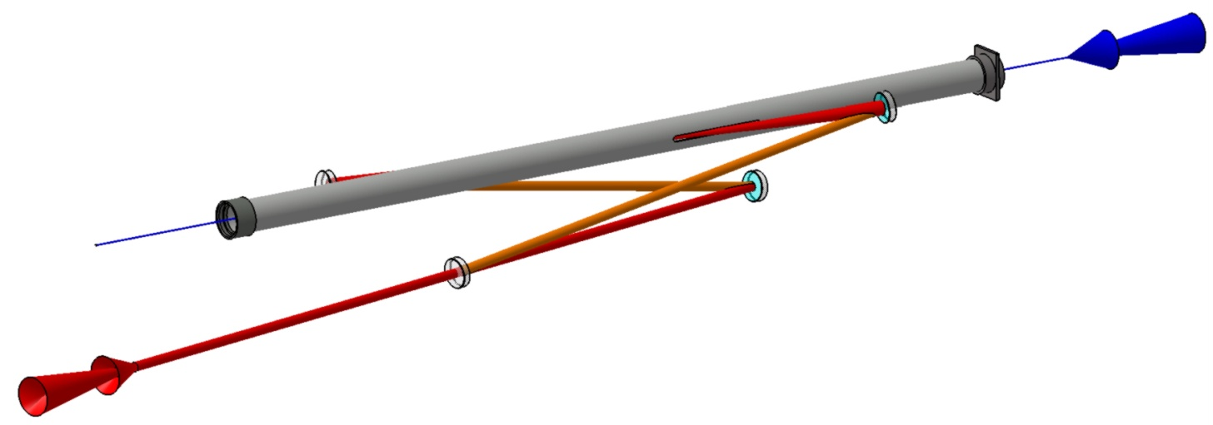
Non planar 4-mirror compact cavity design for
an accelerator (➔ATF)
ATF beam pipe: 5mm slit…
2 spherical mirrors
Angle laser / e⁻ beam= 8°
ATF e⁻ beam
laser/beam
Interaction point
~50cm
Injection laser
2 flat mirrors

Slide 15
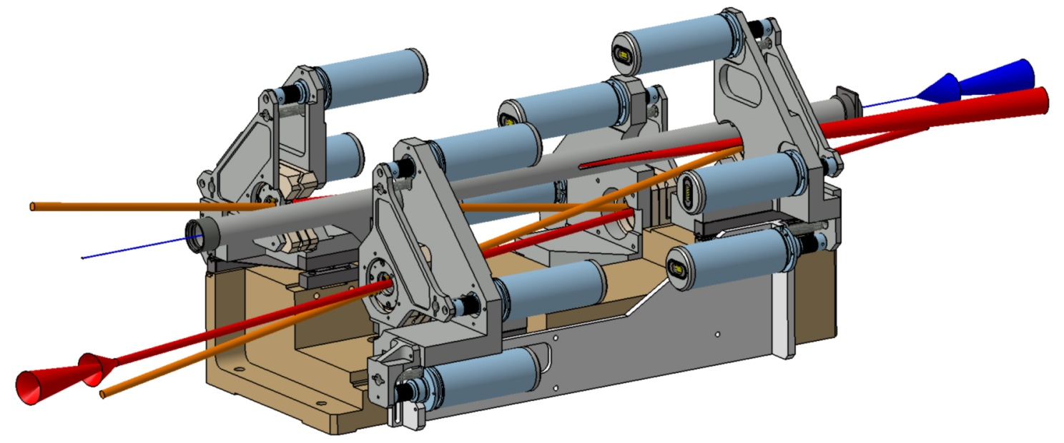
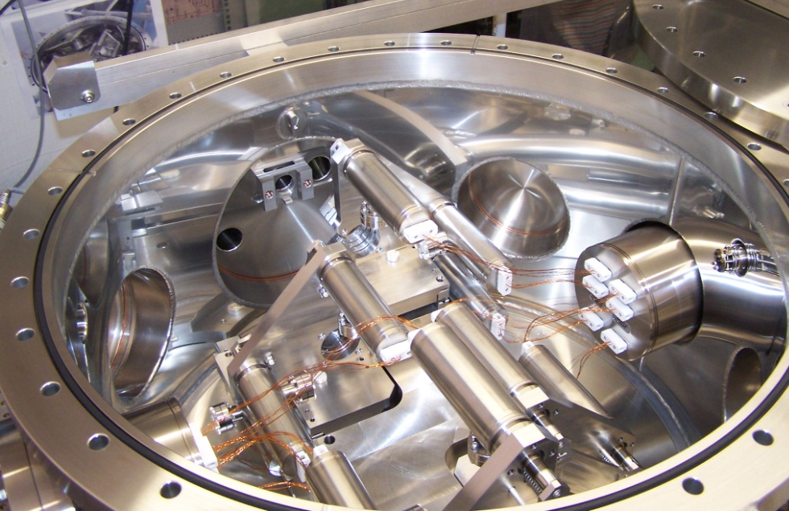
Mirror positioning system
12 encapsulated Motors
2 spherical mirrors
e⁻
Vacuum inside
~3x10⁻⁸mbar
without baking
(in situ)
laser
Invar base
to ensure
length
stability
2 flat mirrors

Slide 16
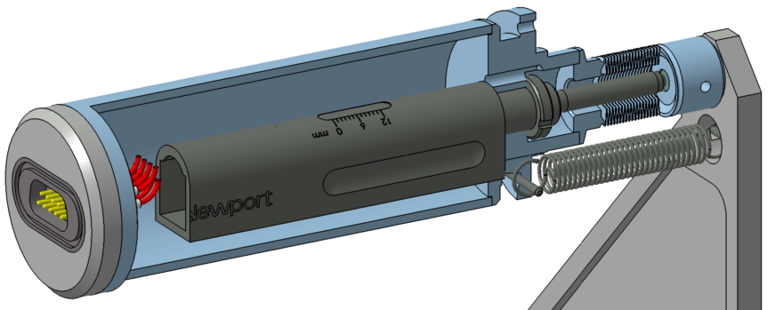
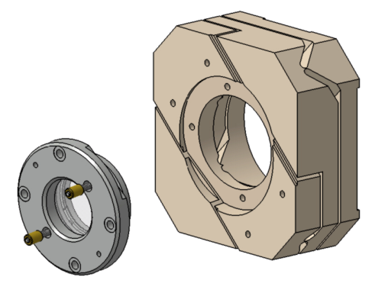
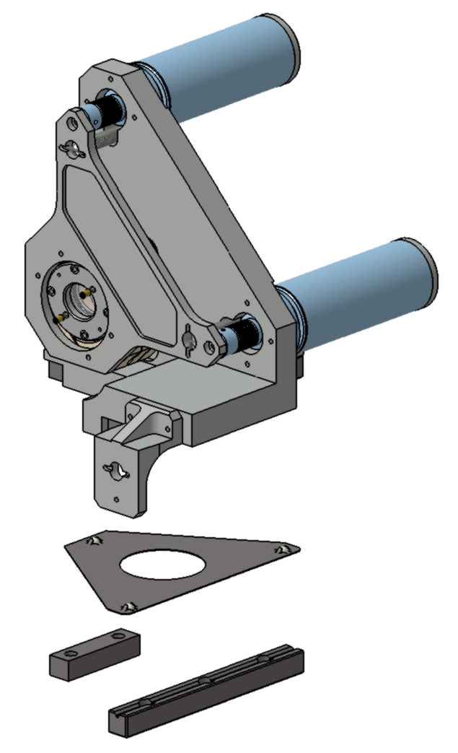
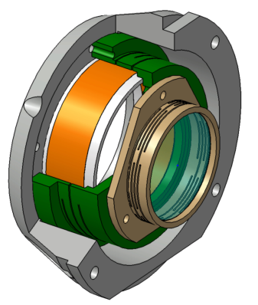
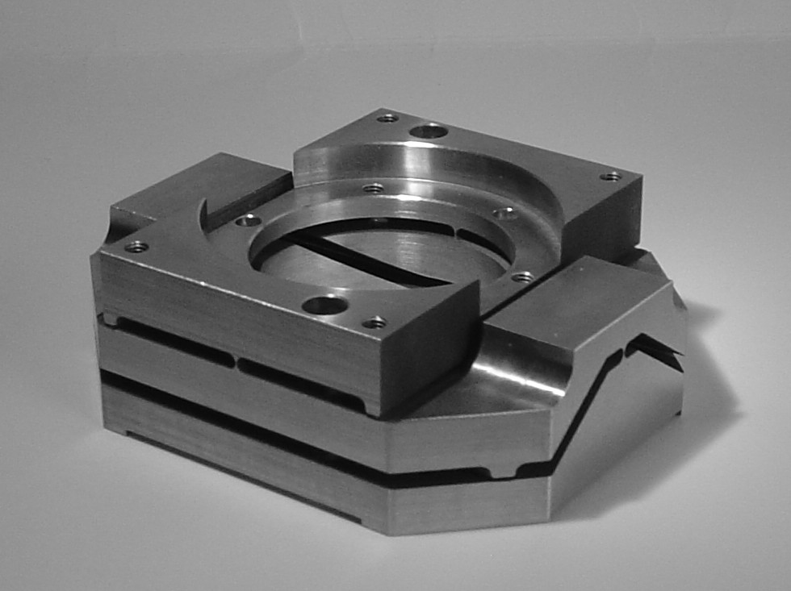
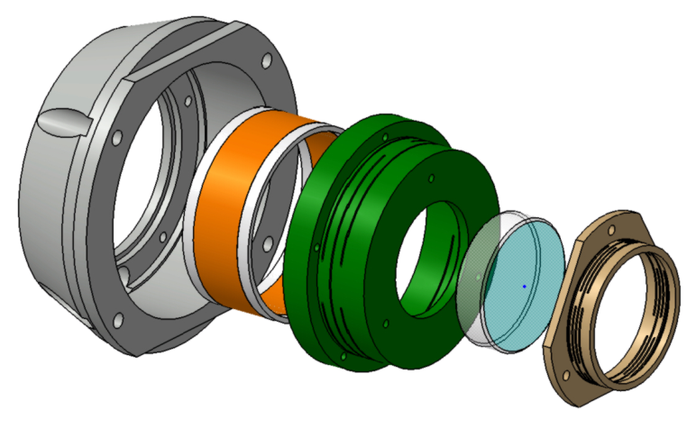
Details
Actuator
Gimbal→ θx θy
θx
Piezo Mounting
θy
Z Translation on 3 balls
Ring Piezo
Spring ring
Mirror

Slide 17
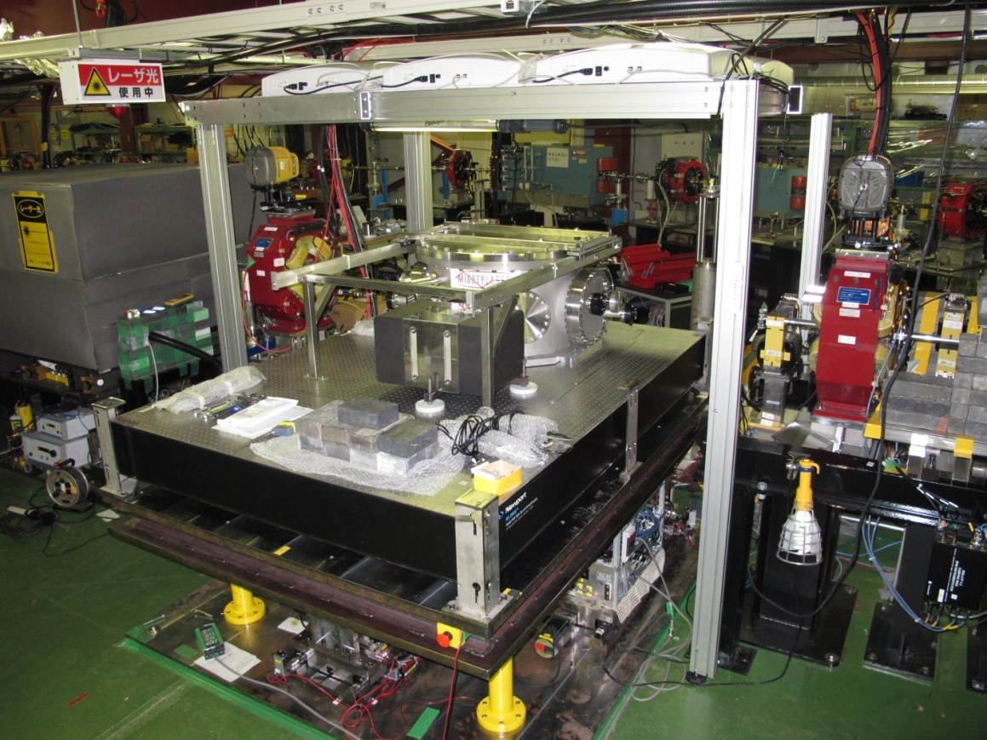
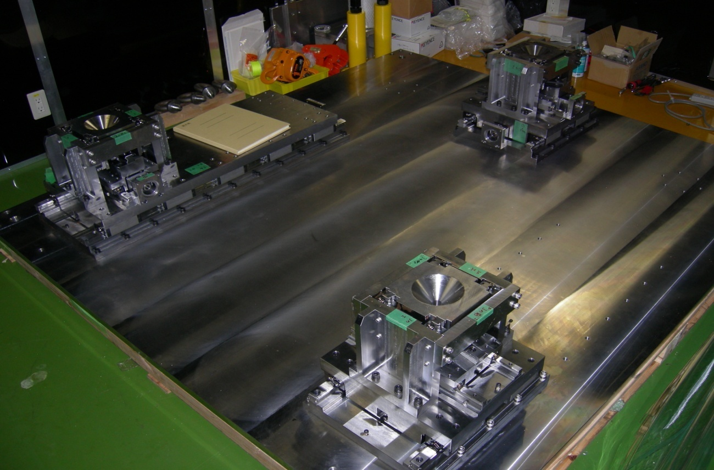
Class 100 air flow
Electron beam pipe
ATF table mount system (~1µm precision) used for spatial laser and e⁻ beam matching
Assumed ATF Beam Line
KEK 2-mirror cavity
Implementation at ATF
Pulse Motor Port
for
Up-Down Move
Pulse Motor Port
for
Horizontal Move
From Hirotaka-san

Slide 18
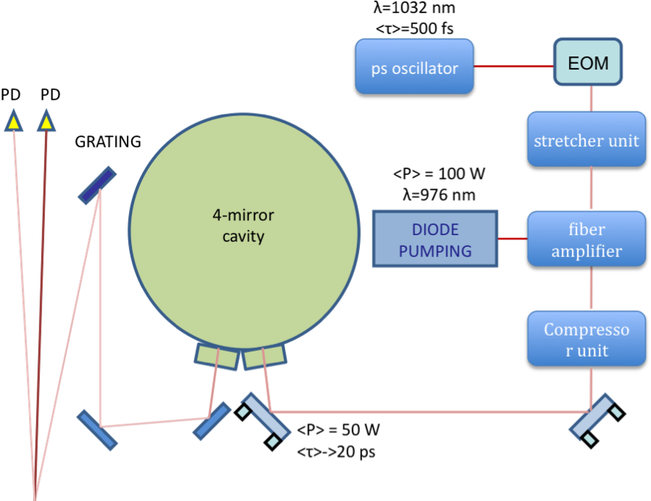
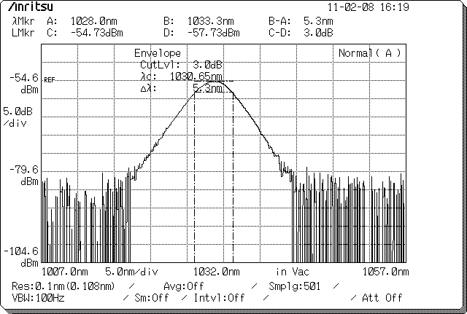
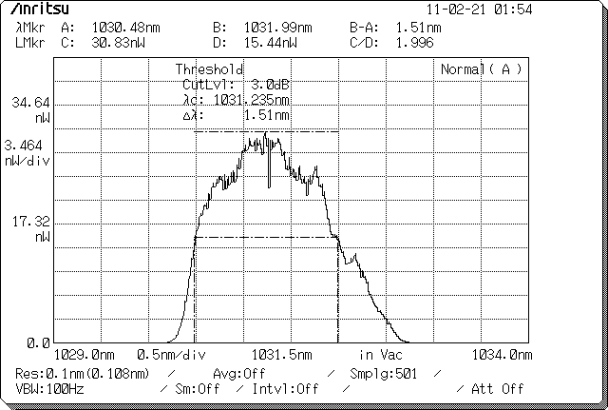
The optical scheme
Feedback
system
Signal reflected by the cavity used to build the laser/cavity feedback signal:
  interference between the modulated incident laser beam
  AND the leackage on the beam circulating inside the cavity

Slide 19

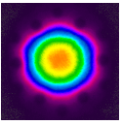
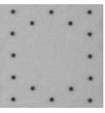
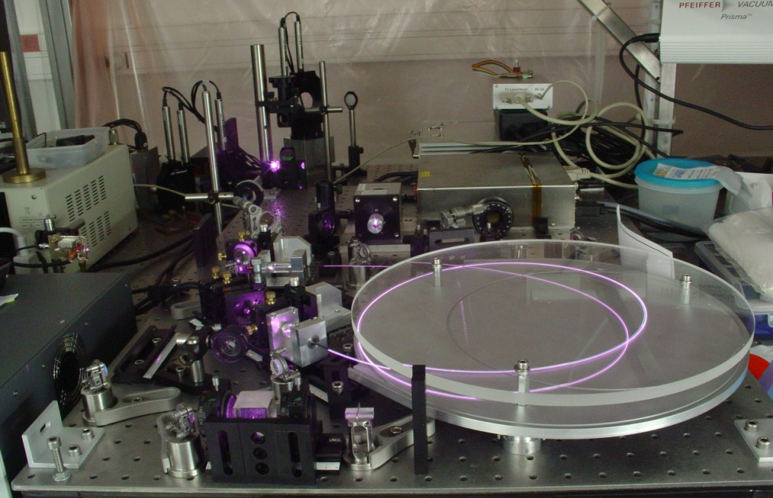
The laser amplification R&D
We use Ytterbium
doped photonic
cristal fiber
as amplifier
Ø core = 40 µm
Ø cladding = 200 µm
We obtained 60W average power ~stable thanks to connectorisation R&D
800W (11µJ/pulse) demonstrated with the same technique Limpert,OL35(2010)94
Toward
cavity
laser
Fiber
amplifier
19

Slide 20
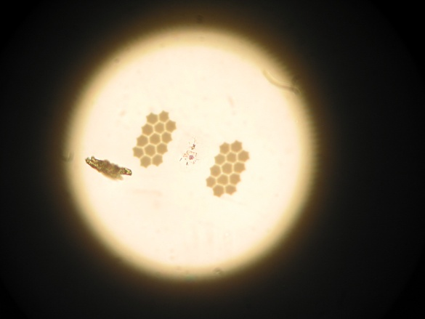
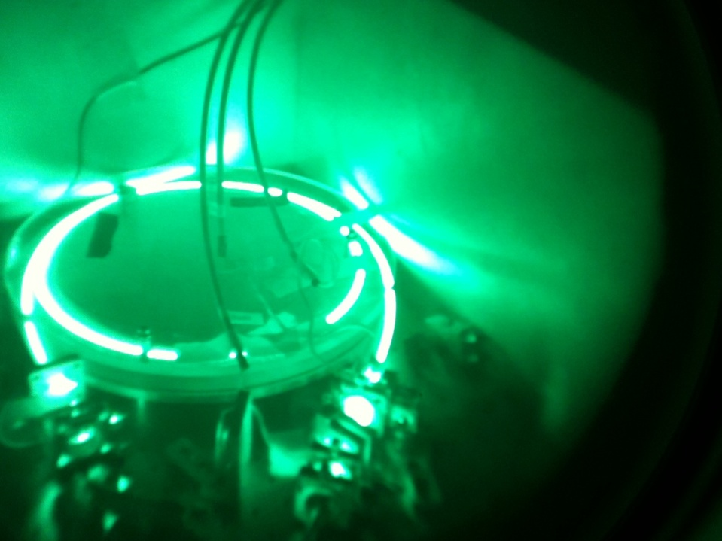
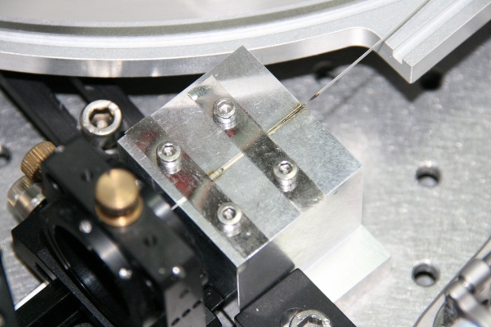
But we broke, burnt many fibres
Using 100W pumping diode (focused on 400µm)…
➔technological R&D to reach long term stability and reliability …
➔additive phase noise also an issue…

Slide 21
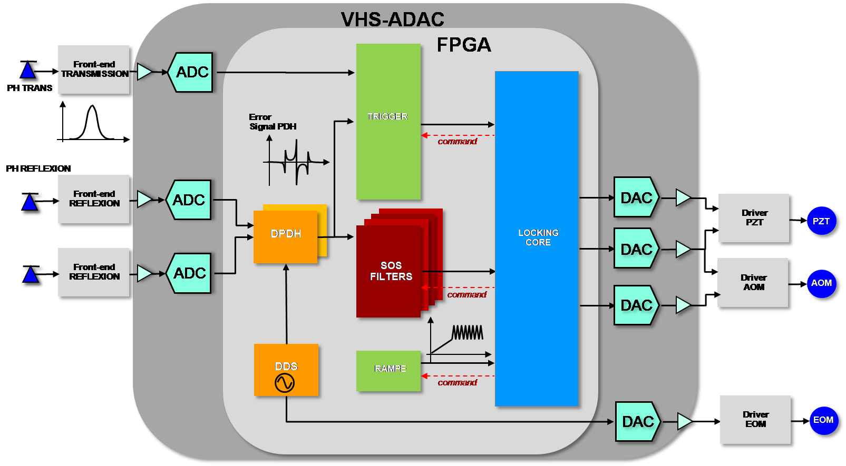
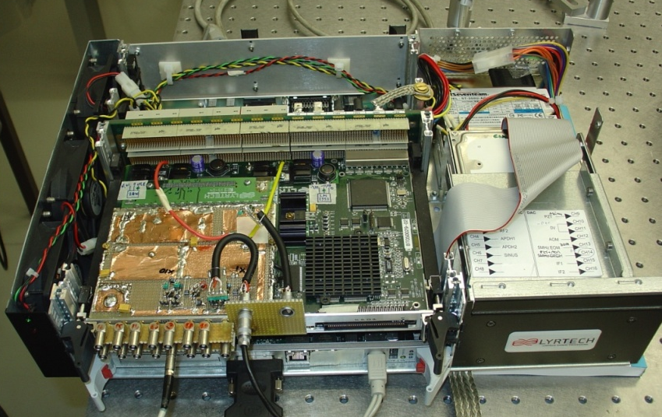
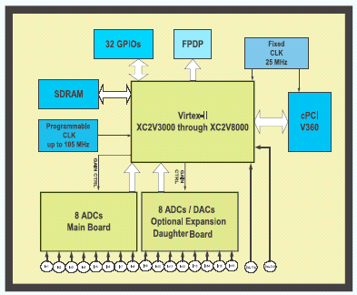
Laser/cavity numerical feedback development
Clk = 100 MHz
8x ADC 14 bits
8x DAC 14 bits
FPGA Virtex II
  Filtering => algo. To reach 18 bits / 400 kHz
  Modulation/demodulation made inside the FPGA
  Feedback Identification procedure included
  ‘in the FPGA’

Slide 22
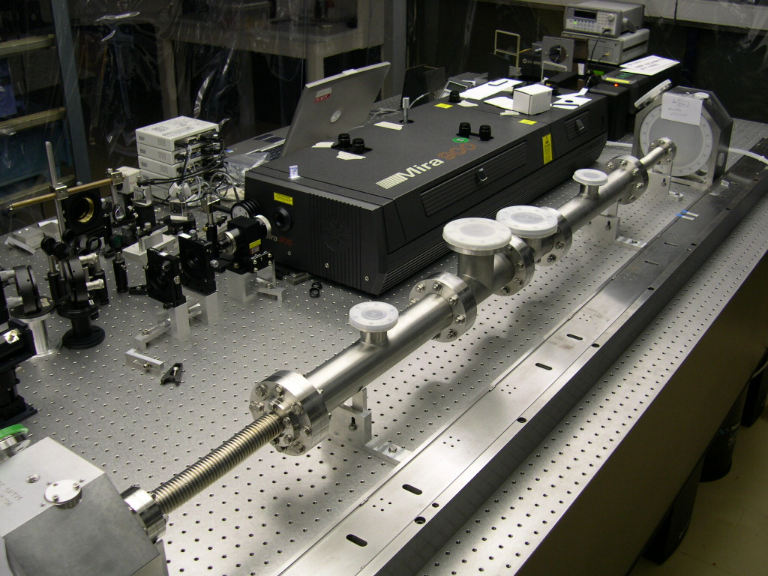
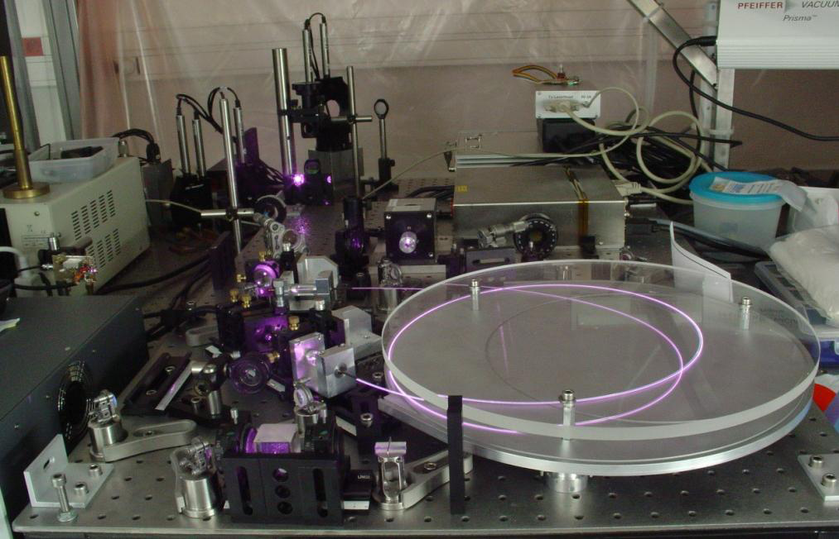
With a feedback developped for a Ti:sapph
oscillator / 2 mirror cavity
(MIRA : 800nm, 2ps@76MHz, pumped
with a green laser beam)
It took only ~ an hour to lock
an Yb amplified doped
oscillator to the KEK 4-mirror cavity
(ONEFIVE : 1032nm, 200fs@178.5MHz,
diode pumped)
amplifier
But it takes some time to optimise
the feedback…

Slide 23
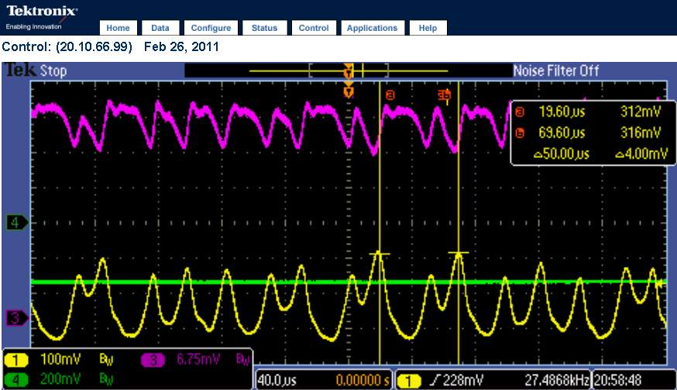
Results before the earth quake
Before optimising the feedback filters
After an optimisation of the feedback
Power stacked inside the cavity

Slide 24
Results before the earth quake
One very short run before ATF breakdown (modulator on fire
3 week before the earth quake…)
Laser power ~10W (we had ~60W aside)
Cavity laser/coupling ~30% (best obtained~60%)
➔Power_cavity~3kW
PM Waveform
Max : ~25/γ/bunch-Xsing (Emax=28MeV)
Average: ~3/γ/bunch-Xsing➔10⁷/s (full spectrum)

Slide 25
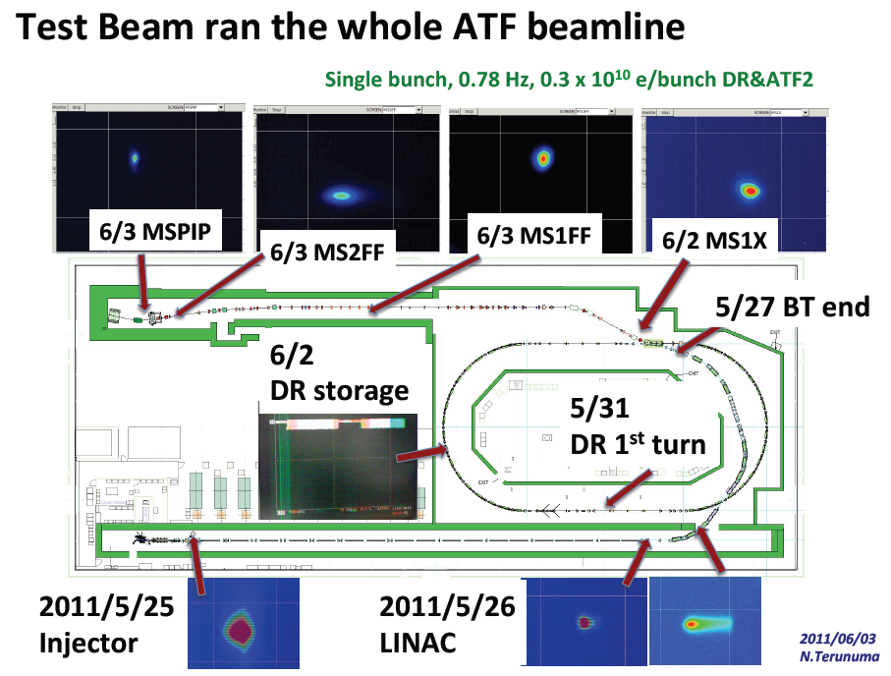

Slide 26
Summary
We build & installed a tetrahedron cavity at ATF
  ➔Stable circularely polarised eigen modes
  Commisisoning ok in 2010 with at most in 2011
    ~10W laser power, 60% coupling & cavity gain ~1000 (6kW inside the cavity)
Restart in july 2011…
  Goal: to reach 100kW by end 2011
  Cavity mirror change
    Higer finesse
    sapphire substrates to limit thermal load effects

