Slide 1
Low Mass Higgs searches with H→bb decay at Tevatron
On behalf of DØ and CDF collaborations
Yuji Enari
LPNHE, Paris Universites VI & VII
IN2P3-CNRS
July 28th 2011
Higgs Hunting 2011

Slide 2
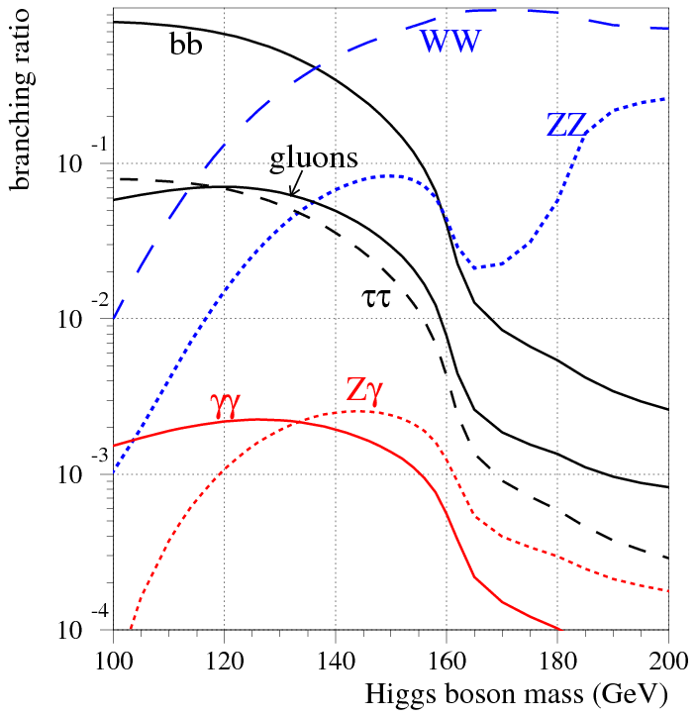
H→bb decay mode
Importance of H→bb
because of top is too heavy, bb pair is the heaviest fermion pair at low mass range (MH<<2xM_{top})
Leading decay mode at range of MH<2xM_{W}
Discovering H→bb mode is essential to establish SM.

Slide 3
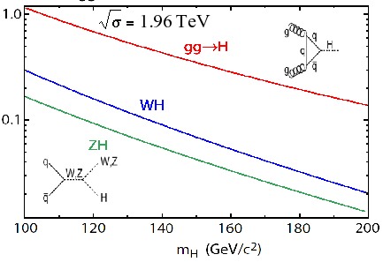
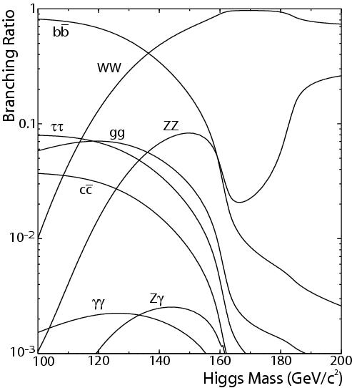
SM Higgs Production
Highest cross section: gg→H
H decays into bb in the low mass region
→ Due to high multi-jet BG, almost impossible
W or Z associated production for low mass
High pT lepton with H→bb decay.

Slide 4
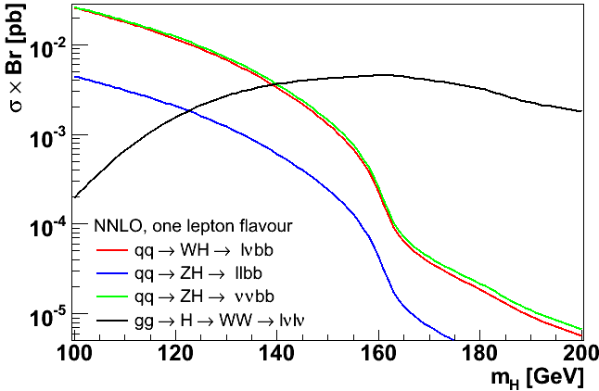
Three Channels with H→bb
Other SM Higgs search
- H→ γγ
- VH→τ + jets
- VH→ll(l)+x
- H→WW→lvjj
→ See next talk !
ZH→νν bb
MET+bb
WH→lν bb
l+MET+bb
ZH→ll bb
2l(e/μ)+bb
Multi-Jet (MJ) Background:
HIGH LOW
Note: No Single analysis can find Higgs → Combination with Dzero and CDF.

Slide 5
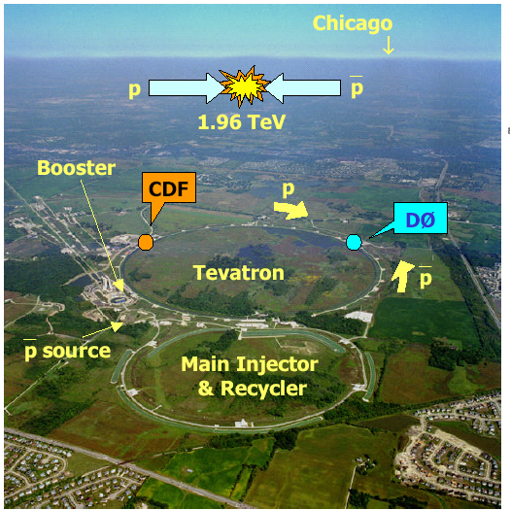
The Tevatron

Slide 6
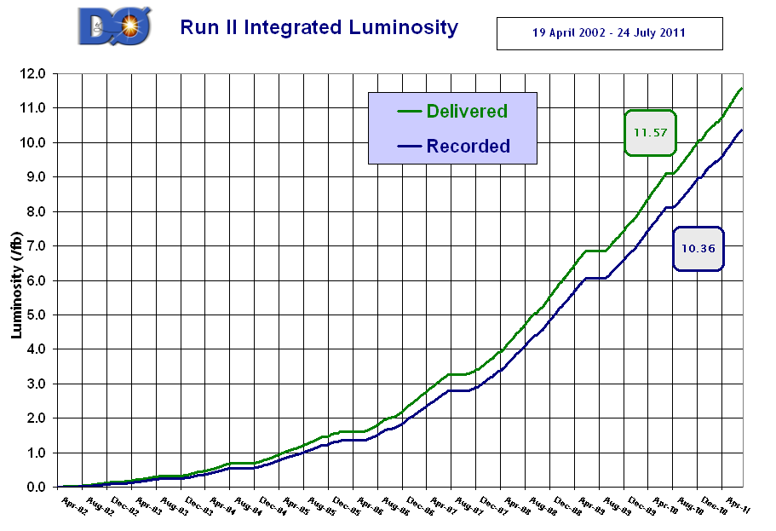
Data Set
Tevatron RunII integrated luminosity
July 24th 2011: 11.57 fb⁻¹ delivered,
10.36 fb⁻¹ recorded.
Data taking efficiency: > 90%, 93%(highest),
Analyzed data set:
7.5∼7.9 fb⁻¹
8.5∼8.6 fb⁻¹
recorded data upto 2011 March
2002 2003 2004 2005 2006 2007 2008 2009 2010 2011
Thanks to the Tevatron Accelerator Group for great effort !!

Slide 7
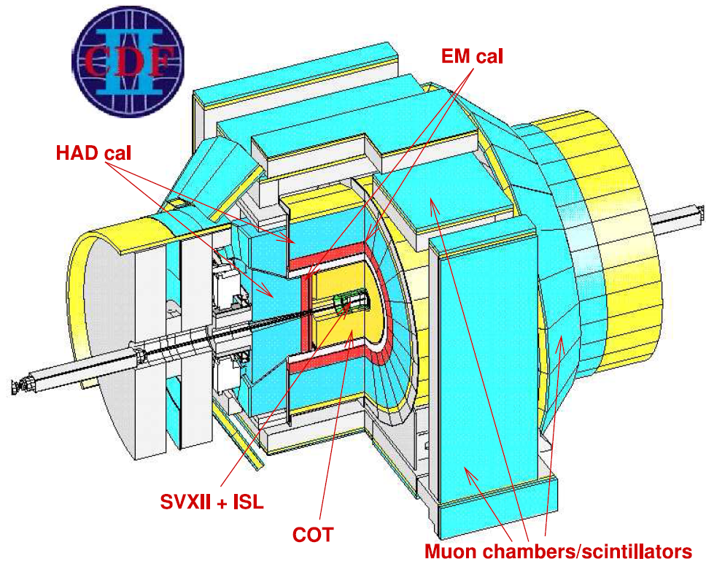
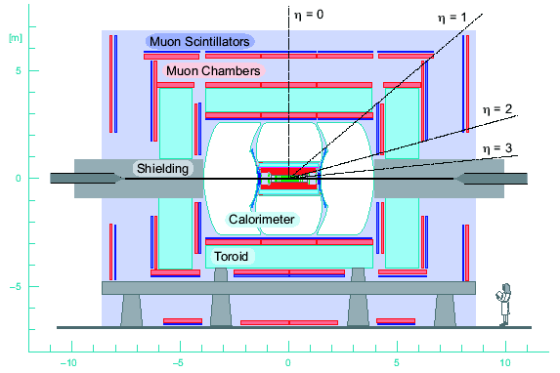
CDF and DØ Detector
Tracker
Solenoid Magnet
protons
3 Layer Muon
System
Electronics
Preshowers
General purpose detector
Good hermeticity
Rapidity coverage
CDF Dzero
Track 2.0 2.5
Cal (EM,HAD) 3.6 4.0
Muon 1.0 2.0
B-field 1.4 T 2.0 T

Slide 8
Analysis on low mass Higgs Search
W or Z boson reconstruction
W→lν, Z→ll, Z→νν
Higgs candidate reconstruction
Dijet mass, b-jet tagging.
MultiVariate Analysis (MVA)
Result
I’ll try to cover
NEW Features, updated points
as much as I can.

Slide 9
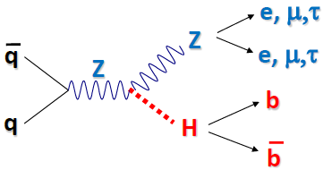
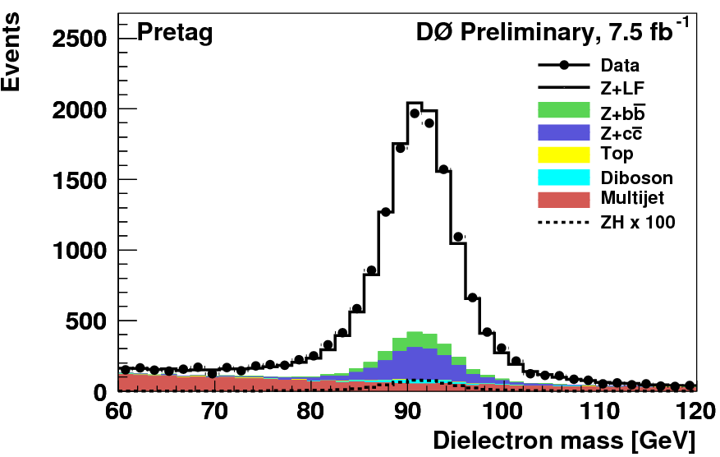
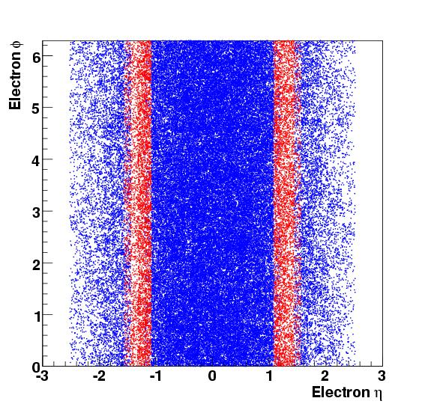
Z boson Reconstruction
Maximize signal acceptance
Inclusion of isolated tracks
Electron in GAP,
Lowering pt cut on lepton
pT > 10 GeV
Relatively easy because of good triggering on leptons or some such low multi-jet BG
→ Already established last year.
Multi-Jet BG is estimated from Data.

Slide 10
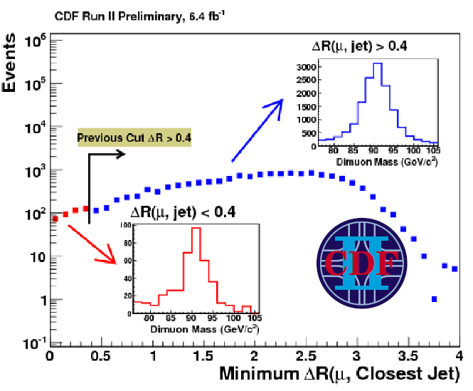
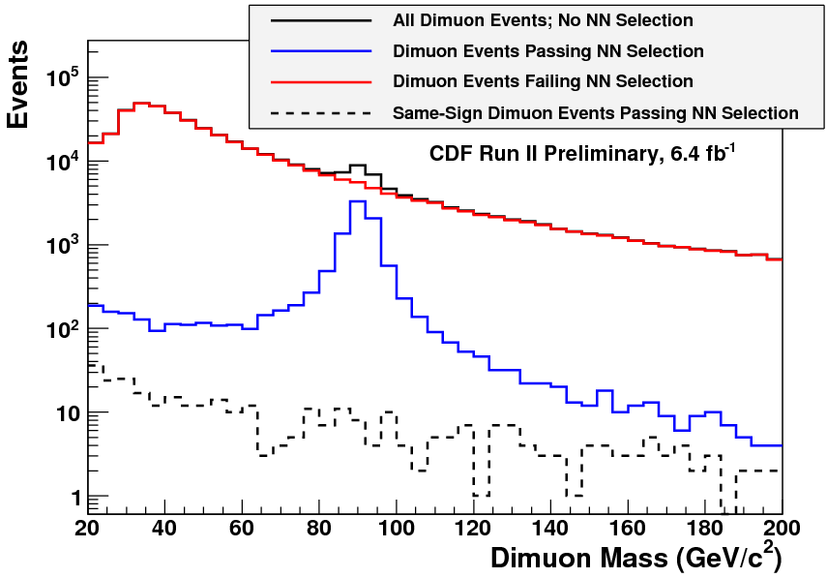
How to get more acceptance?
Revisit the definition of object ID.
Ex: muon separation from jet
Optimized identification by MVA
Case of CDF muon ID
Build NN with
pT, η, φ, E_{EM}, E_{HAD}, ΔR(μ, jets),
Track χ², d0, silicon hit, isolation
→ ∼ 20% improvement on llbb.

Slide 11
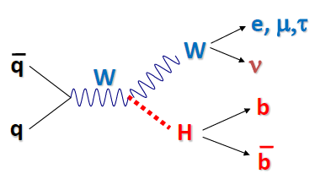
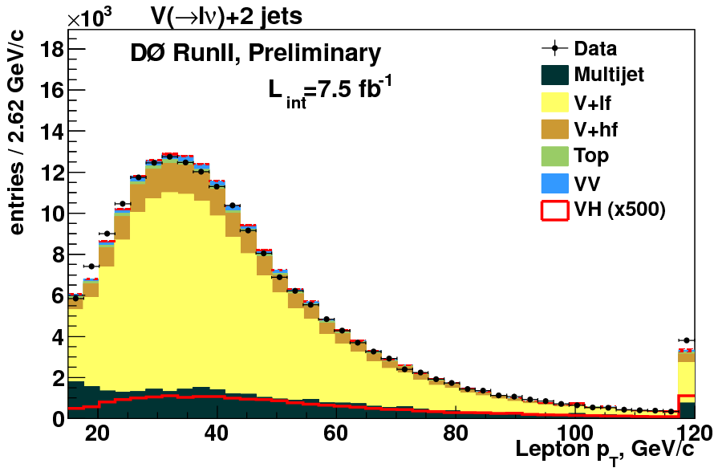
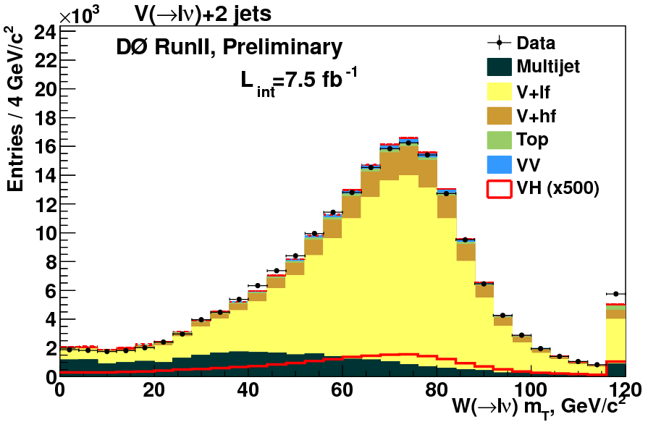
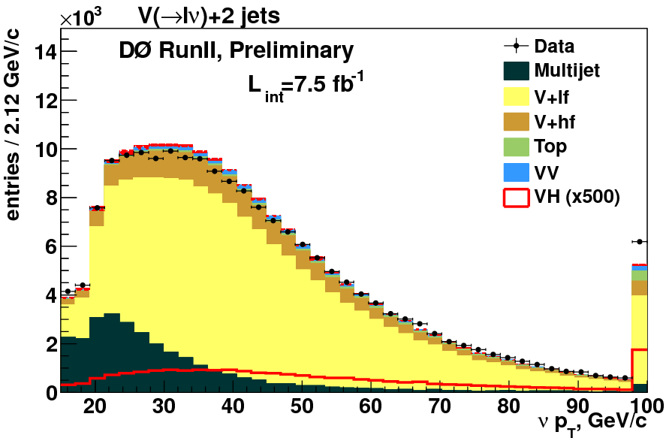
W boson Reconstruction
jet
Lepton:
electron/ muon pT > 15 GeV
jet
ν
E_{T}
ET
electron
Lepton pT ( GeV)
Missing E_{T}
MET> 15 (20) GeV for electron (muon).
W Transverse Mass (GeV)
Multi-Jet Background is estimated from Data.
Missing ET (GeV)

Slide 12
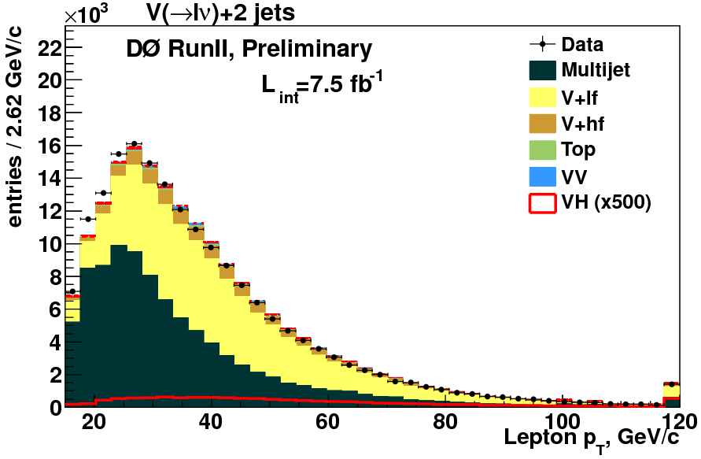
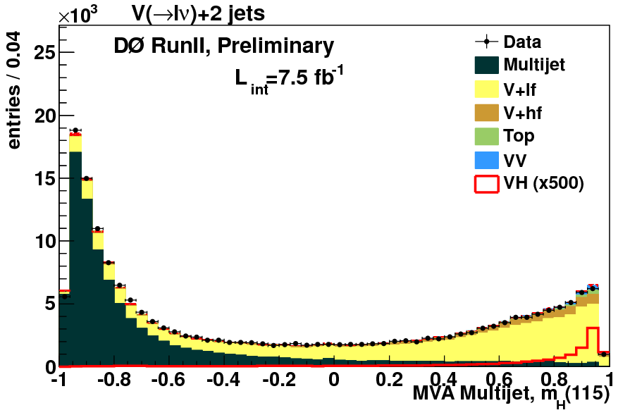
How to get more signal for lvbb?
Revisit lepton ID
DØ muon
loosen muon requirement
Update isolation requirement
Use all trigger terms
DØ Electron
Looser criteria
Optimize Multi-Jet (MJ) rejection
QCD veto was WtrMass > 40 – 0.5 MET
CDF
- isolated track.
→ include loose electron track.
∼ 5% gain in sensitivity.
∼ 15% gain in muon efficiency.
∼ 15% gain in signal efficiency with same level of Multijet component.
CDF
- Introduce MVA to kill MJ.
“Support Vector Machine”
Replaced with QCD veto.

Slide 13
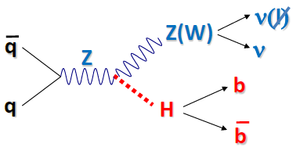
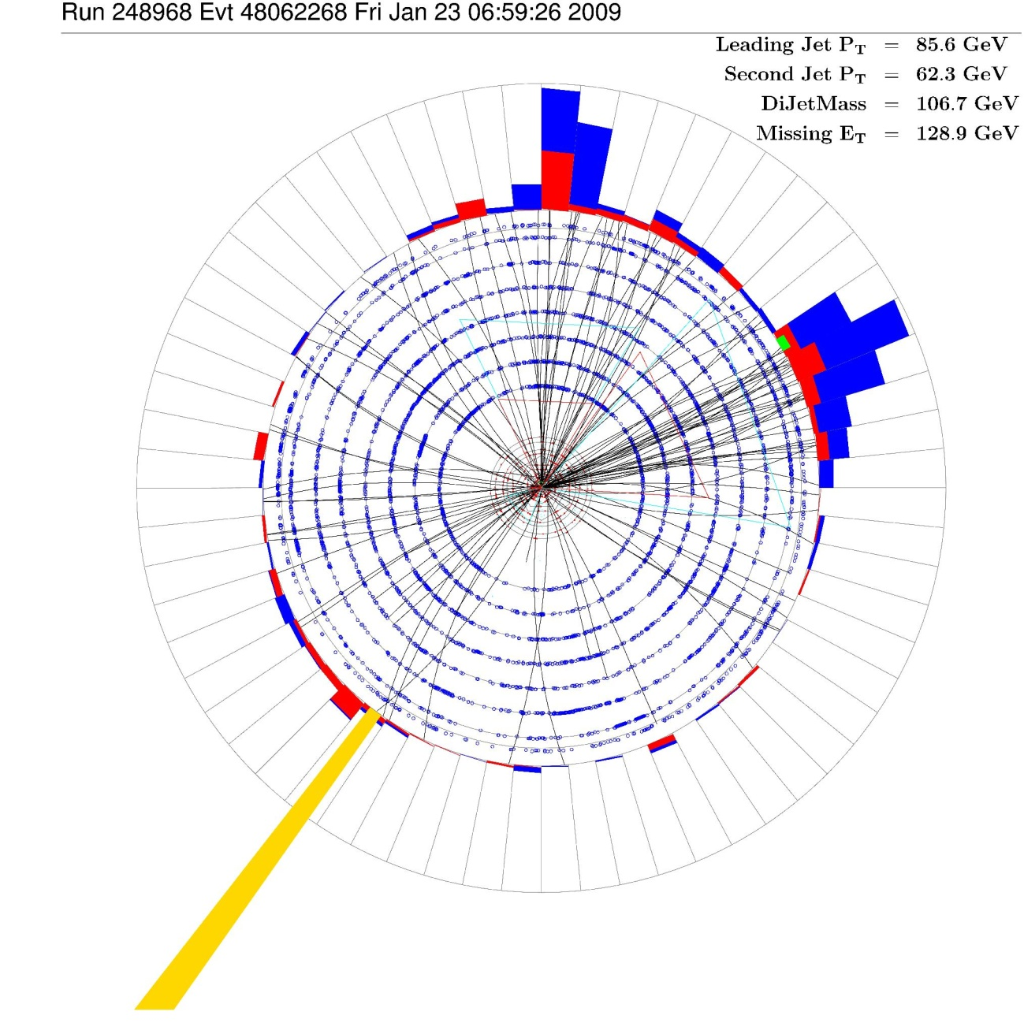
Z→vv reconstruction
Jets + large MET (>40 GeV)
Expect high multi-jet Background
- Signal sample
- Control sample
Multi-Jet
Electro-weak
W→μ, subtract muon pT

Slide 14
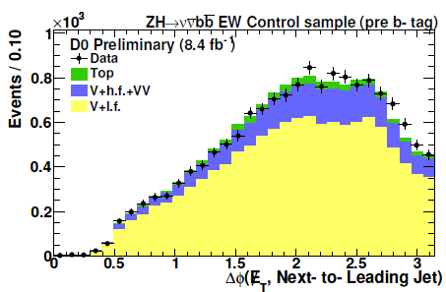
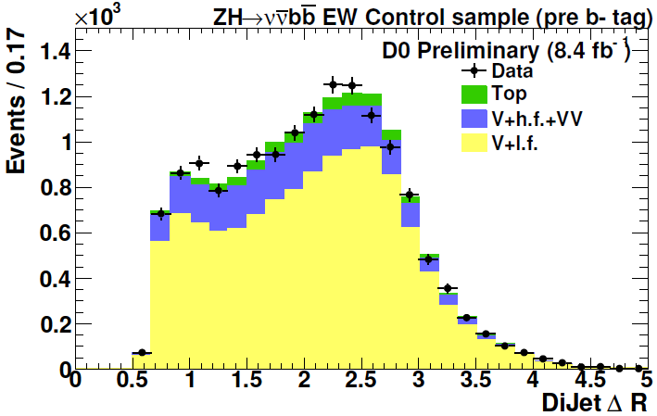
Z→vv reconstruction
ν ( l )
q
Z(W)
Z
ν
b
q
H
b
Jets + large MET (>40 GeV)
Expect high multi-jet Background
- Signal sample
- Control sample
Multi-Jet
Electro-weak
W→μv, subtract muon pT

Slide 15
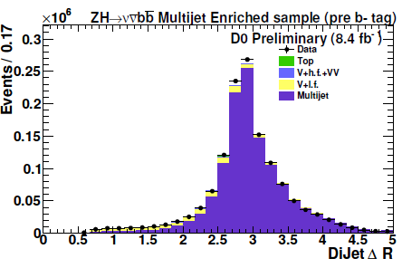
Z→vv reconstruction
Jets + large MET (>40 GeV)
Expect high multi-jet Background
- Signal sample
- Control sample
Multi-Jet
Electro-weak
W→μ, subtract muon pT

Slide 16
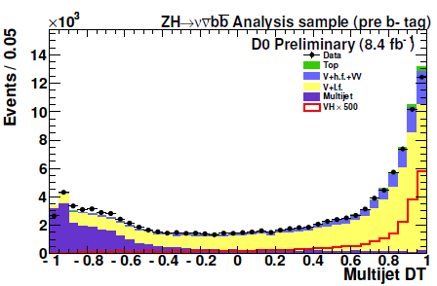
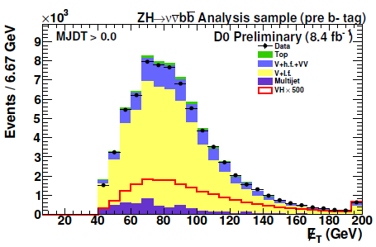
Z→vv reconstruction
Jets + large MET (>40 GeV)
Expect high multi-jet Background
- Signal sample
- Control sample
Multi-Jet
Electro-weak
W→μ, subtract muon pT

Slide 17
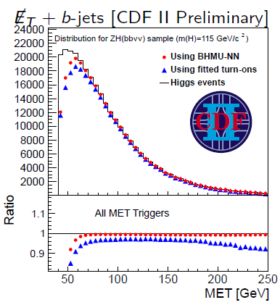
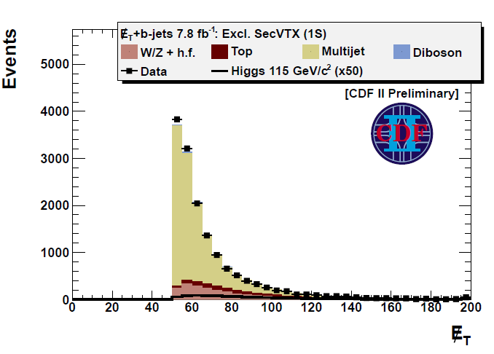
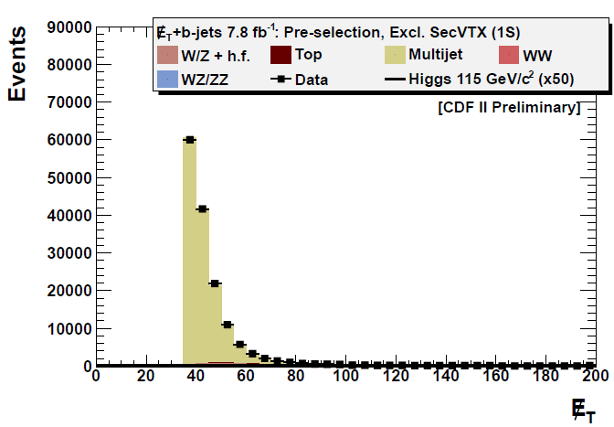
Improvement on vvbb
Additional trigger by L2 update
Understanding of the upgraded MET trigger
NN function is used to parameterize complex trigger turn on.
MET selection
From 45 GeV
to 30 GeV
30∼40% more signal
with x10 Background
Applying MVA for reject QCD, obtained 2.5 better S/sqrt(B) in tagged sample

Slide 18
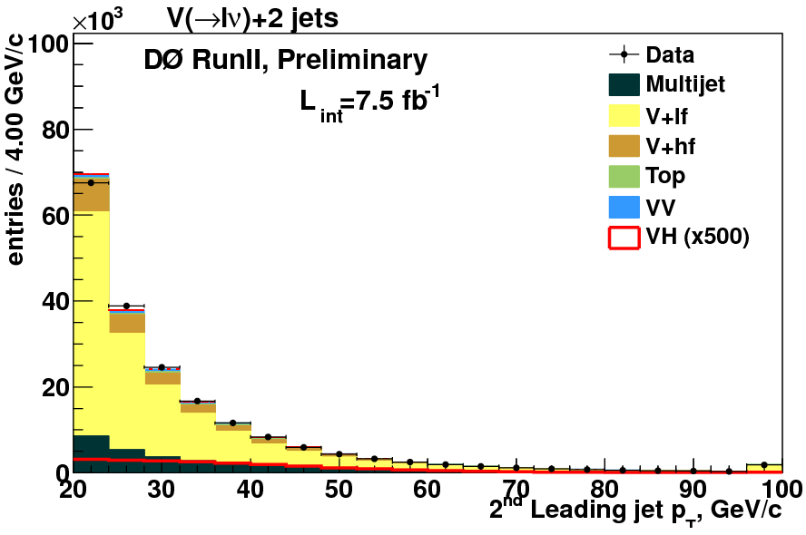
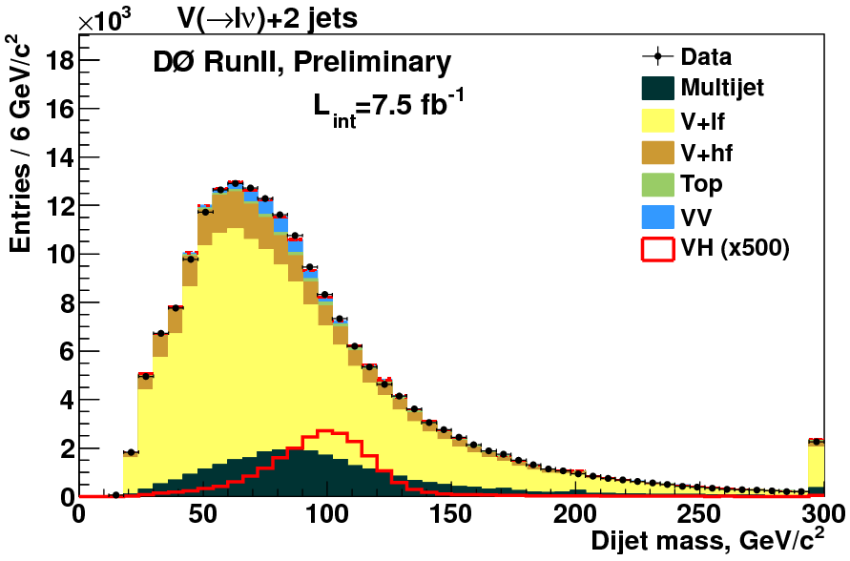
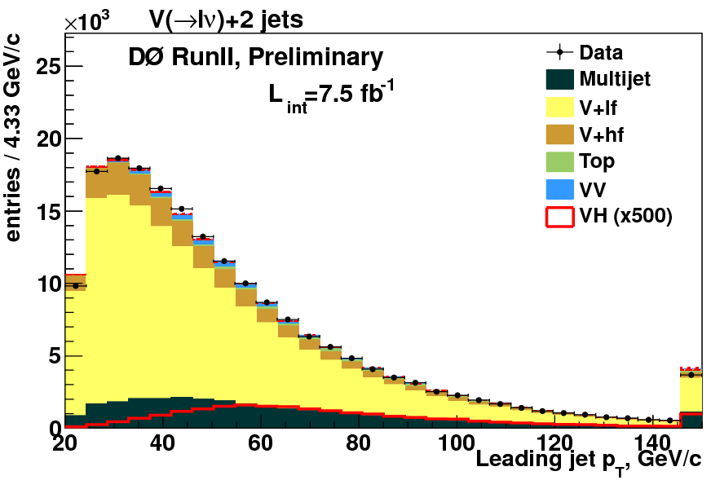
Higgs Candidates

Slide 19
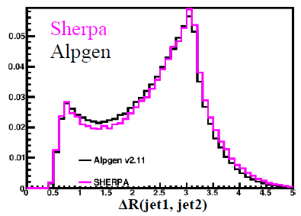
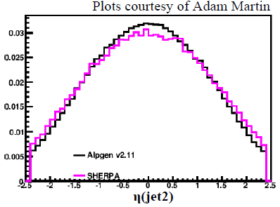
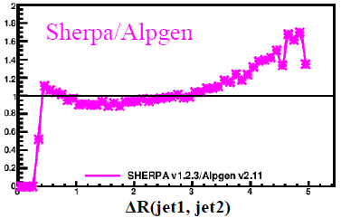
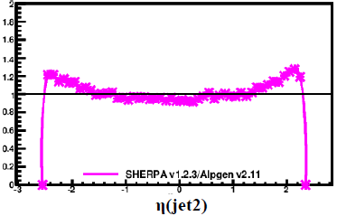
V+Jets Modeling
ALPGEN+PYTHIA is used in both CDF and D0.
DØ analyses apply reweighting from extracted from data to V+Jets monte carlo.
Lepton η, Jet η, angle between jets, W pT
Consistency check between lepton, data epoch, final state, etc..

Slide 20
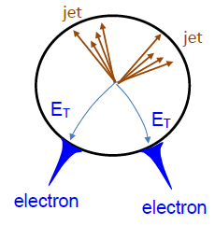
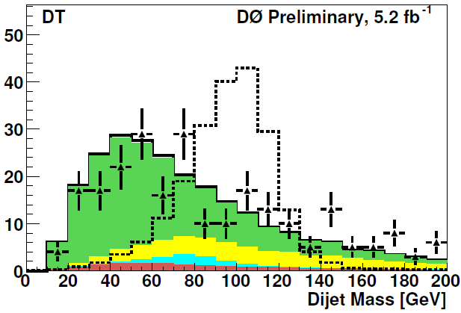
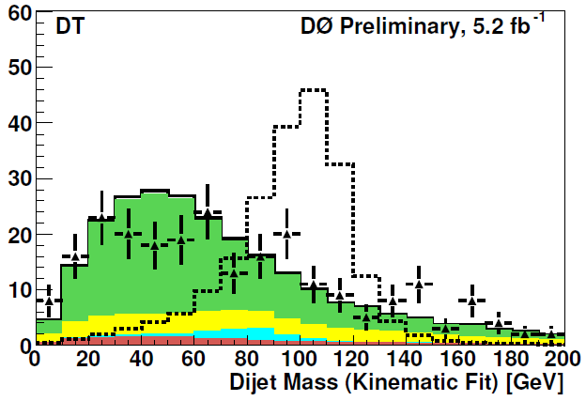
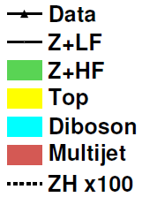
Dijet system in ZH→llbb
ZH→llbb
No real missing ET
Use full kinematics information
Dijet Mass can be constrained
15 % improvement on Mass resolution

Slide 21
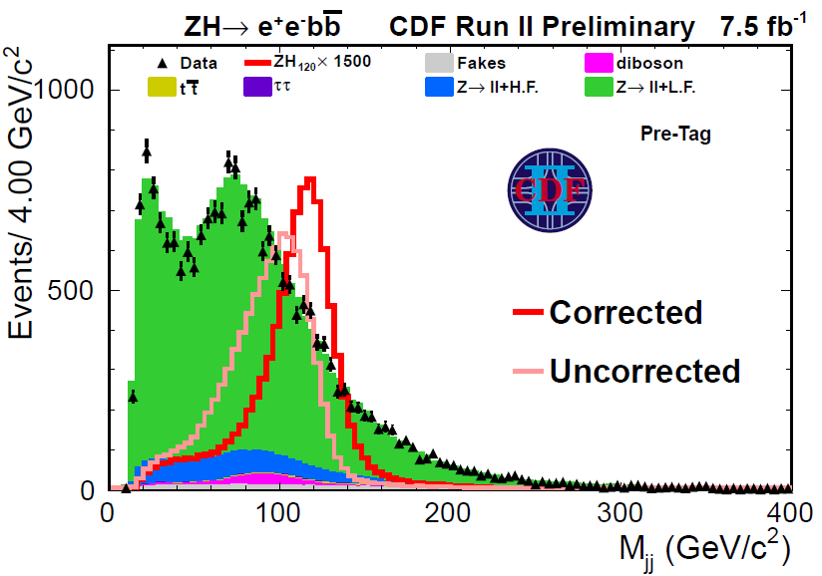
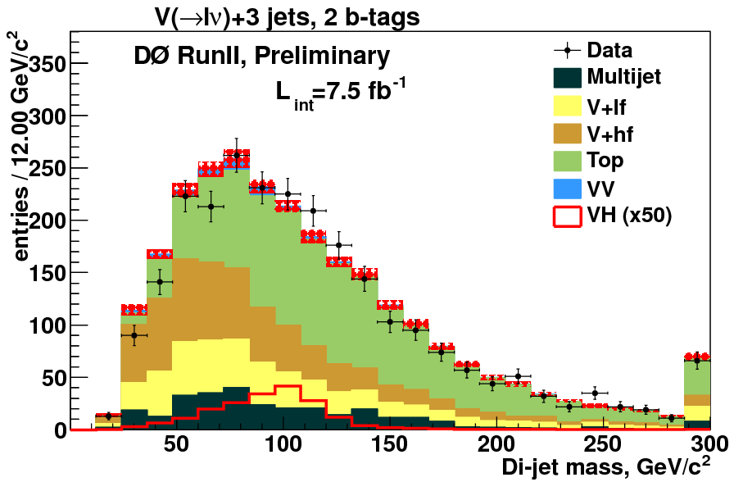
Dijet system
In CDF llbb analysis, NN function is used to correct dijet system.
∼ 15 % improvement is observed.
How to choose 2jets from 3jets or more?
D0 lvbb
instead of using two largest pT jets, use two most b-like jets from bID information.

Slide 22
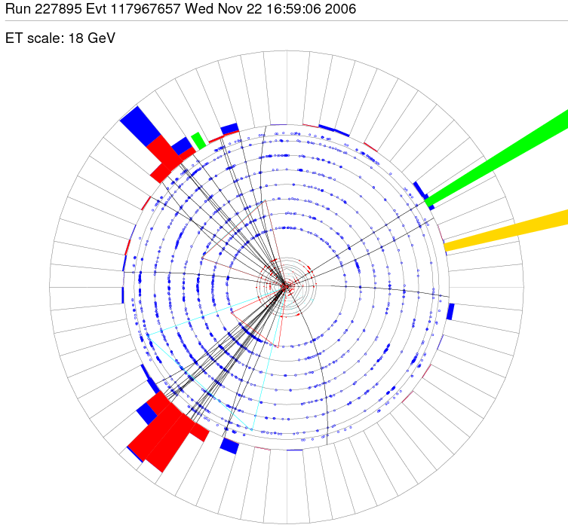
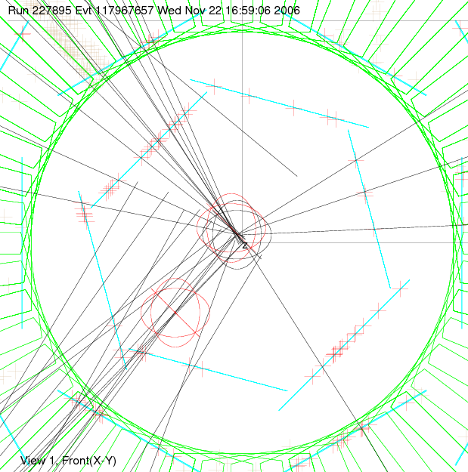
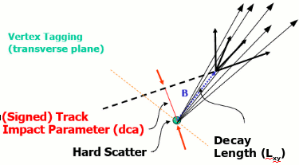
b-Jet Identification

Slide 23
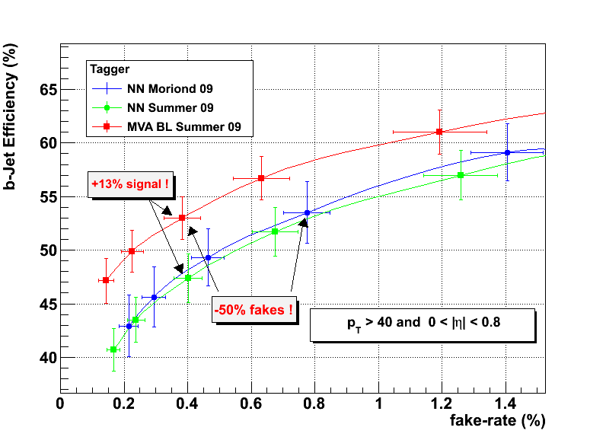
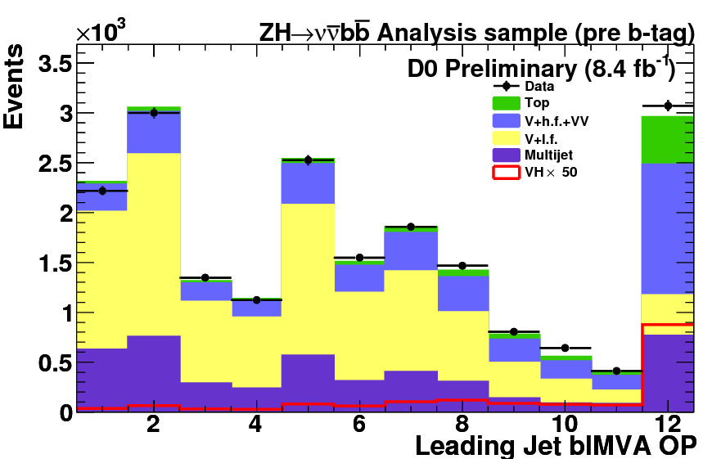
New feature on DØ b-tagging
MVA tagger
Better performance
Modeling
Update on TRF, Fake rate measurement
Systematic uncertainty reduced by 50% on fake rate.
Usage
Application of TRF
Use all operating point.
Use shape of bID MVA output in the final MVA
Two orthogonal sample
2 b-tag: both jet pass Loosest tag
1 b-tag: one of jet pass Loosest tag

Slide 24
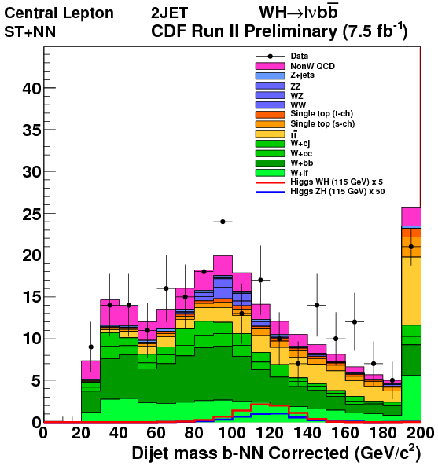
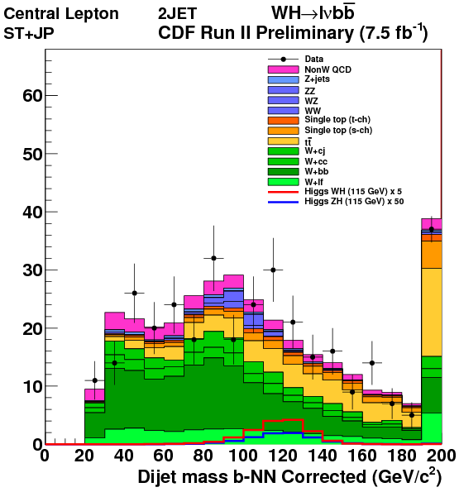
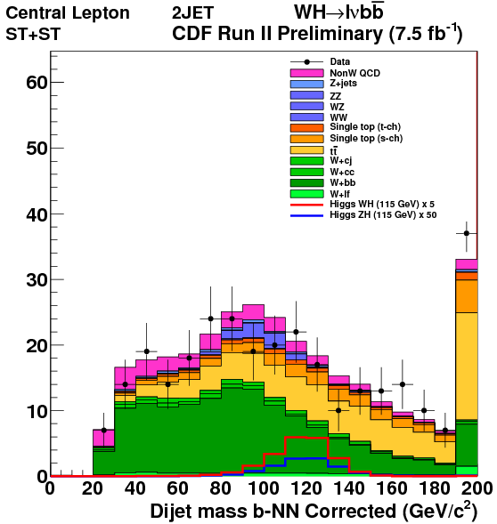
bID usage in CDF analysis
Four orthogonal b-tagged sample
ST-JP
S:B = 1:140
ST-JP
S:B = 1:100
ST-ST
S:B = 1:70
1-ST
S:B = 1:400
Each sample has different background composition
→ Final MVA should be optimized separately.
pretag

Slide 25
MVA usage @ CDF/D0
D0 analyses often use BDT with TMVA
“Stochastic gradient boosting” seems to be good.
Matrix Element analysis: takes time, not processing recently.
CDF analyses use various MVA
BNN, NEAT, NN, Support Vector Machine, ….
NN is often used in the corrections (dijet mass, trigger turn-on)
Proceed Matrix Element analysis (not this summer)
Key feature / Trend
Trying to reduce number of input variable
Trying to find optimal usage
An interesting example from DØ lvbb
== Build MVA in order to choose input variable ==
MVA for ttbar vs WH and MVA for Wbb/cc vs WH
→ Use the union of the most powerful
14 variables of two MVAs for final MVA

Slide 26
An example of MVA optimization
CDF llbb
1. ttbar vs ZH
2. Charm vs bottom
8 % gain is observed
from original network.

Slide 27
Results from DØ
ZH→llbb
∫Ldt=8.6 fb⁻¹
∫Ldt=8.5 fb⁻¹
VH→vvbb
∫Ldt=8.4 fb⁻¹
WH→lvbb
95% CL Exp (obs) Limit
4.8 (4.9) x SM
@ MH=115 GeV
95% CL Exp (obs) Limit
3.5 (4.6) x SM
@ MH=115 GeV
95% CL Exp (obs) Limit
4.0 (3.2) x SM
@ MH=115 GeV
10% gain on top of Lumi

Slide 28
Results from CDF
ZH→llbb
∫Ldt=7.9 fb⁻¹
∫Ldt=7.5 fb⁻¹
VH→vvbb
∫Ldt=7.8 fb⁻¹
WH→lvbb
95% CL Exp (obs) Limit
3.9 (4.8) x SM
@ MH=115 GeV
95% CL Exp (obs) Limit
2.7 (2.6) x SM
@ MH=115 GeV
95% CL Exp (obs) Limit
2.9 (2.3) x SM
@ MH=115 GeV
20% gain on top of Lumi
13% gain on top of Lumi
18% gain on top of Lumi

Slide 29
Cross check on Diboson process
Bench mark of H→bb searches with real data.
VZ→leptons + heavy flavor jets
Z→bb yields is 5 times larger, but more W+jets, also there is BG from WW.
Apply very close analysis with low mass H→bb analysis, and check sensitivity.
For m_{H}=115 GeV
WH→lνbb: σ = 26 fb
ZH→ννbb: σ = 15 fb
ZH→llbb: σ = 5 fb
Total VH: σ = 46 fb
Replace Z with H
WZ→lνbb: σ = 105 fb
ZZ→ννbb: σ = 81 fb
ZZ→llbb: σ = 27 fb
Total VZ: σ = 213 fb

Slide 30
Leptons (L) + HF jets in diboson
2 L + HF jets
1 L +MET + HF jets
0 L + MET + HF jets
Best fit is 0 pb.
Cross section limit (obs):
1.3 x SM @ 95 CL
Cross-section measurement: σ(WW+WZ)_{mes} /σ_{SM}= 1.1
3.0 s.d. from BG only hypo.
Cross-section measurement: σ(WZ+ZZ)_{mes} /σ_{SM}= 1.5 ± 0.5
2.8 s.d. from BG only hypo.
+0.3
−0.4

Slide 31
Search for ttH production
σ ∼ 5 fb @
MH=115 GeV
Search H→bb with ttbar.
Three modes in t→blν, t→bjj
Lepton+jets + H→bb: l+MET+jets
Lepton+jets + H→bb: MET+ jets
All jets + H→bb : Jets.
a.
b.
L=7.5 fb⁻¹ at MH=115 GeV
exp. = 11.7 x SM, obs = 22.9 x SM
L=5.7 fb⁻¹ at MH=115 GeV
exp. = 20.2 x SM, obs = 28.1 x SM

Slide 32
VH and VBF →jjbb
Other signatures with all jets
Signature: 4 or 5 Jets with 2 b-tags.
VH--> V→jj, H→bb
50<Mjj<120 GeV
VBF→ forward jets + H→bb
Mjj>120 GeV
σ_{VBF} ∼ 80 fb @
MH=115 GeV
QCD BG is dominant background (98%)
Data driven estimation
Cross check with side band region
Use NN with jet shape information
L=4.0 fb⁻¹ at MH=115 GeV
exp. = 17.8 x SM, obs = 9.1 x SM

Slide 33
Summary
Proving H→bb mode is essential to establish SM.
Data of 7.5 fb⁻¹(CDF) and 8.5 fb⁻¹ (Dzero) is analyzed for H→bb with vector boson associated production.
More than 30% larger data set than 2010 summer.
Significant improvement has been established
10-20% improvement on top of lumi.
(20 - 40% gain from last summer)
The most sensitive channel reached 2.7 x SM.
See Gavin’s talk for Tevatron combination
We also perform a H→bb only combination.
Benchmark analysis, VZ→leptons + heavy flavor jets, start to see signals. Tevatron combination is under preparation.

Slide 34
BACK UP

Slide 35
Systematic Uncertainty
In case of WH→lvbb (%)
Source | W→ev | W→μv
Luminosity | 6.1 | 6.1
BG X section | 6-20 | 6-20
Lepton ID/Trigger | 2-3 | 3-5
Jet ID | 1-2 | 1-2
Jet Energy Scale | 2-5 | 2-5
b-Jet ID | 9-11 | 9-11
Multi-Jet BG | 1.0 | 1.0
PDF, MC Model | 2-3 | 2-3
Flat Systematics
W+hf: 20%
Diboson : 6%
ttbar : 10%
Single top: 12%
Shape Systematics

Slide 36
From CDF vvbb

Slide 37
WW+WZ search in lν + HF jets
WW+WZ search in lν + HF jets (2/2)
8/12
Thibault Guillemin
The final discriminant used is the dijet invariant mass
➔ combination of four samples: central leptons/non-central muon, 1-tag/2-tag
1-tag
2-tag
Cross-section measurement:
LLR for the B-only and S+B hypotheses
WW+WZ→lν +HF jets observed with a significance of 3.0 S.D. from the B-only hypothesis
Bayesian posterior

Slide 38
Improvements
Yellow are existing improvements to be propagated to final analysis
White are the areas we are working on.
Notes:
Put some figures in three pages.

Slide 39
Need to consider degradations
Dzero Tracker consists from scintillation fibers
10% light yield loss per 2.5 fb⁻¹ of luminosity.
Silicon detector will reach the limitation on bias voltage in order to compensate gain drop due to radiation.

Slide 40
Expected detector aging.
Reasonable estimation on detector aging
Degradation affects only latest dataset.
Ambitious but achievable improvements is considered.

Slide 41
2 × Dzero on 3σ observation
2 fb⁻¹ / year.
2014
2013
2012
2011
2010
Required lumi. to make 3σ observation including improvements and detector aging effects.

Slide 42
Background and Signal
Cross section at √s = 1.96 TeV
Background Estimation
Multi-Jet : from data
W+Jet
Z+Jets
ttbar,
Diboson Pythia
s-top COMPHEP
ALPGEN/Pythia
9 order difference
Signal Estimation
WH/ZH Pythia

Slide 43
Check on the excess: signal injection
Inject expected signal event of MH=115 GeV and check how limit curve look like.
With current luminosity, we suppose to have ∼ 1 sigma excess in wide range due to mass resolution.
Looks consistent what we observe in MH~ 130 GeV.
Injected signal of this plot:
ZH→vvbb with scale factor of 4.2

