Slide 1
LHC: the grand vision
[Where we stand, where we’re going]
Paris Sphicas
CERN & University of Athens
Higgs Hunting workshop
July 28-30, 2011
Prelude – reminder of why, what and how
  The Look Elsewhere Effect
pp collisions at 7 TeV
  Strong interaction physics (jets, QCD); Electroweak signals (W/Z production & properties); The top quark (still there)
Searching for New Physics
  Closing in on the Higgs
  SUSY; searches for exotica
So where have all the New Physics Signals Gone?
Summary

Slide 2
Prelude
Note ambivalent title of talk
Comes after a huge fraction of the audience attended EPS; and after 95% of what is to be said has been said already
(in HH 2011); on a Sat morning
Charge to the current speaker: account for LEE effect during workshop

Slide 3

1st-gen Look Elsewhere Effect

Slide 4
Bibliography
Googled “sleeping during seminar”; top hit was http://physics.illinois.edu/events/sleeping.asp
“The Art of Sleeping in Seminars
  Through long years of experience, we have accumulated the following useful set of rules. These should be helpful to beginning research students. However, we have also observed seasoned veterans making some of these simple errors. For advanced students, these rules can also be applied to regular courses.
    Always lean forward, not backward. If you lean backward, your mouth will fall open and you'll snore.
    Never sit back against a wall. Your head will bang against it, waking the rest of the audience. (Similar remarks apply to desks.)
    Plus 9 more very useful pieces of advice

Slide 5
My solution to the LEE effect: repeat-with-no-shame

Slide 6
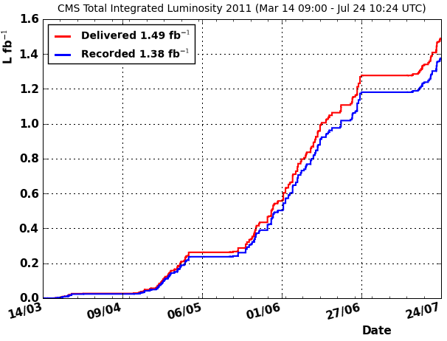
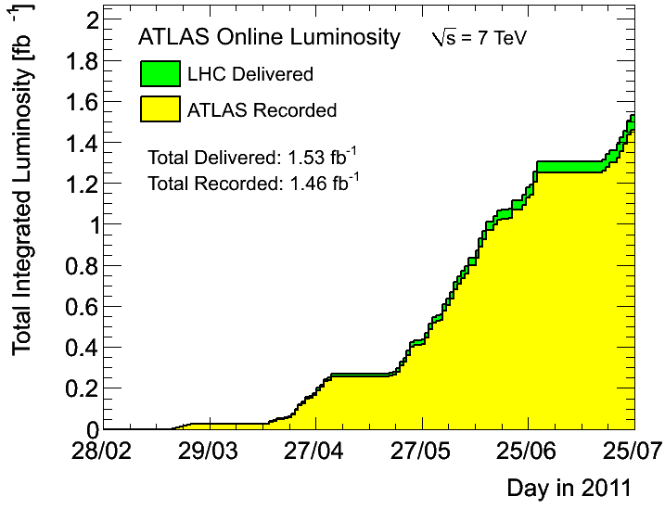
LHC physics in July 2011: snapshot
2011 has been [so far] a very successful year for the LHC its experiments. By EPS: 1.5fb^{–1} delivered, 1.4fb^{–1} recorded by each of CMS & ATLAS.
Overall ε(data taking) ~93%.
Average frac operational channels per subsystem >98.5%
Overall ε(data taking) ~95%.
Average frac operational channels per subsystem >97%
L≈ 1.74x10³³cm⁻²s⁻¹
CMS
ATLAS

Slide 7
LHC physics in July 2011: snapshot
2011 has been [so far] a very successful year for the LHC its experiments. By EPS: 1.5fb^{–1} delivered, 1.4fb^{–1} recorded by each of CMS & ATLAS.
Overall ε(data taking) ~93%.
Average frac operational channels per subsystem >98.5%
Overall ε(data taking) ~95%.
Average frac operational channels per subsystem >97%
L≈ 1.74x10³³cm⁻²s⁻¹
CMS
ATLAS

Slide 8
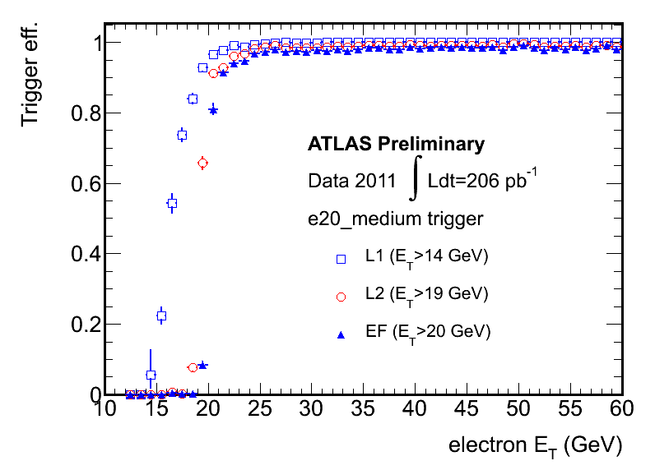
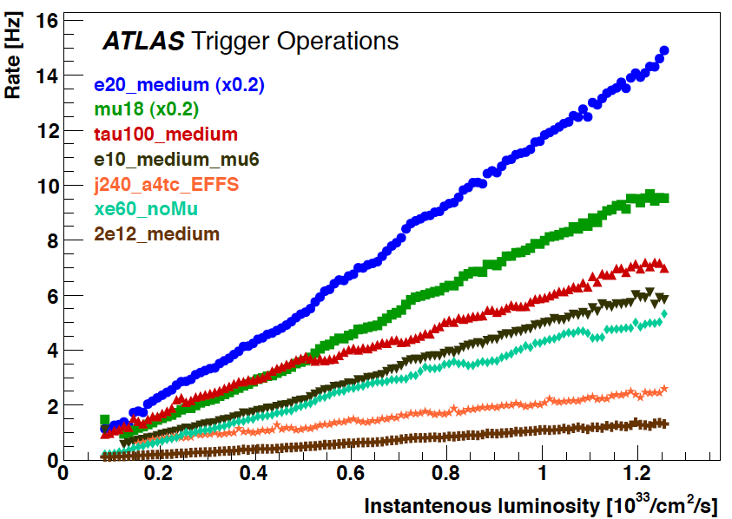
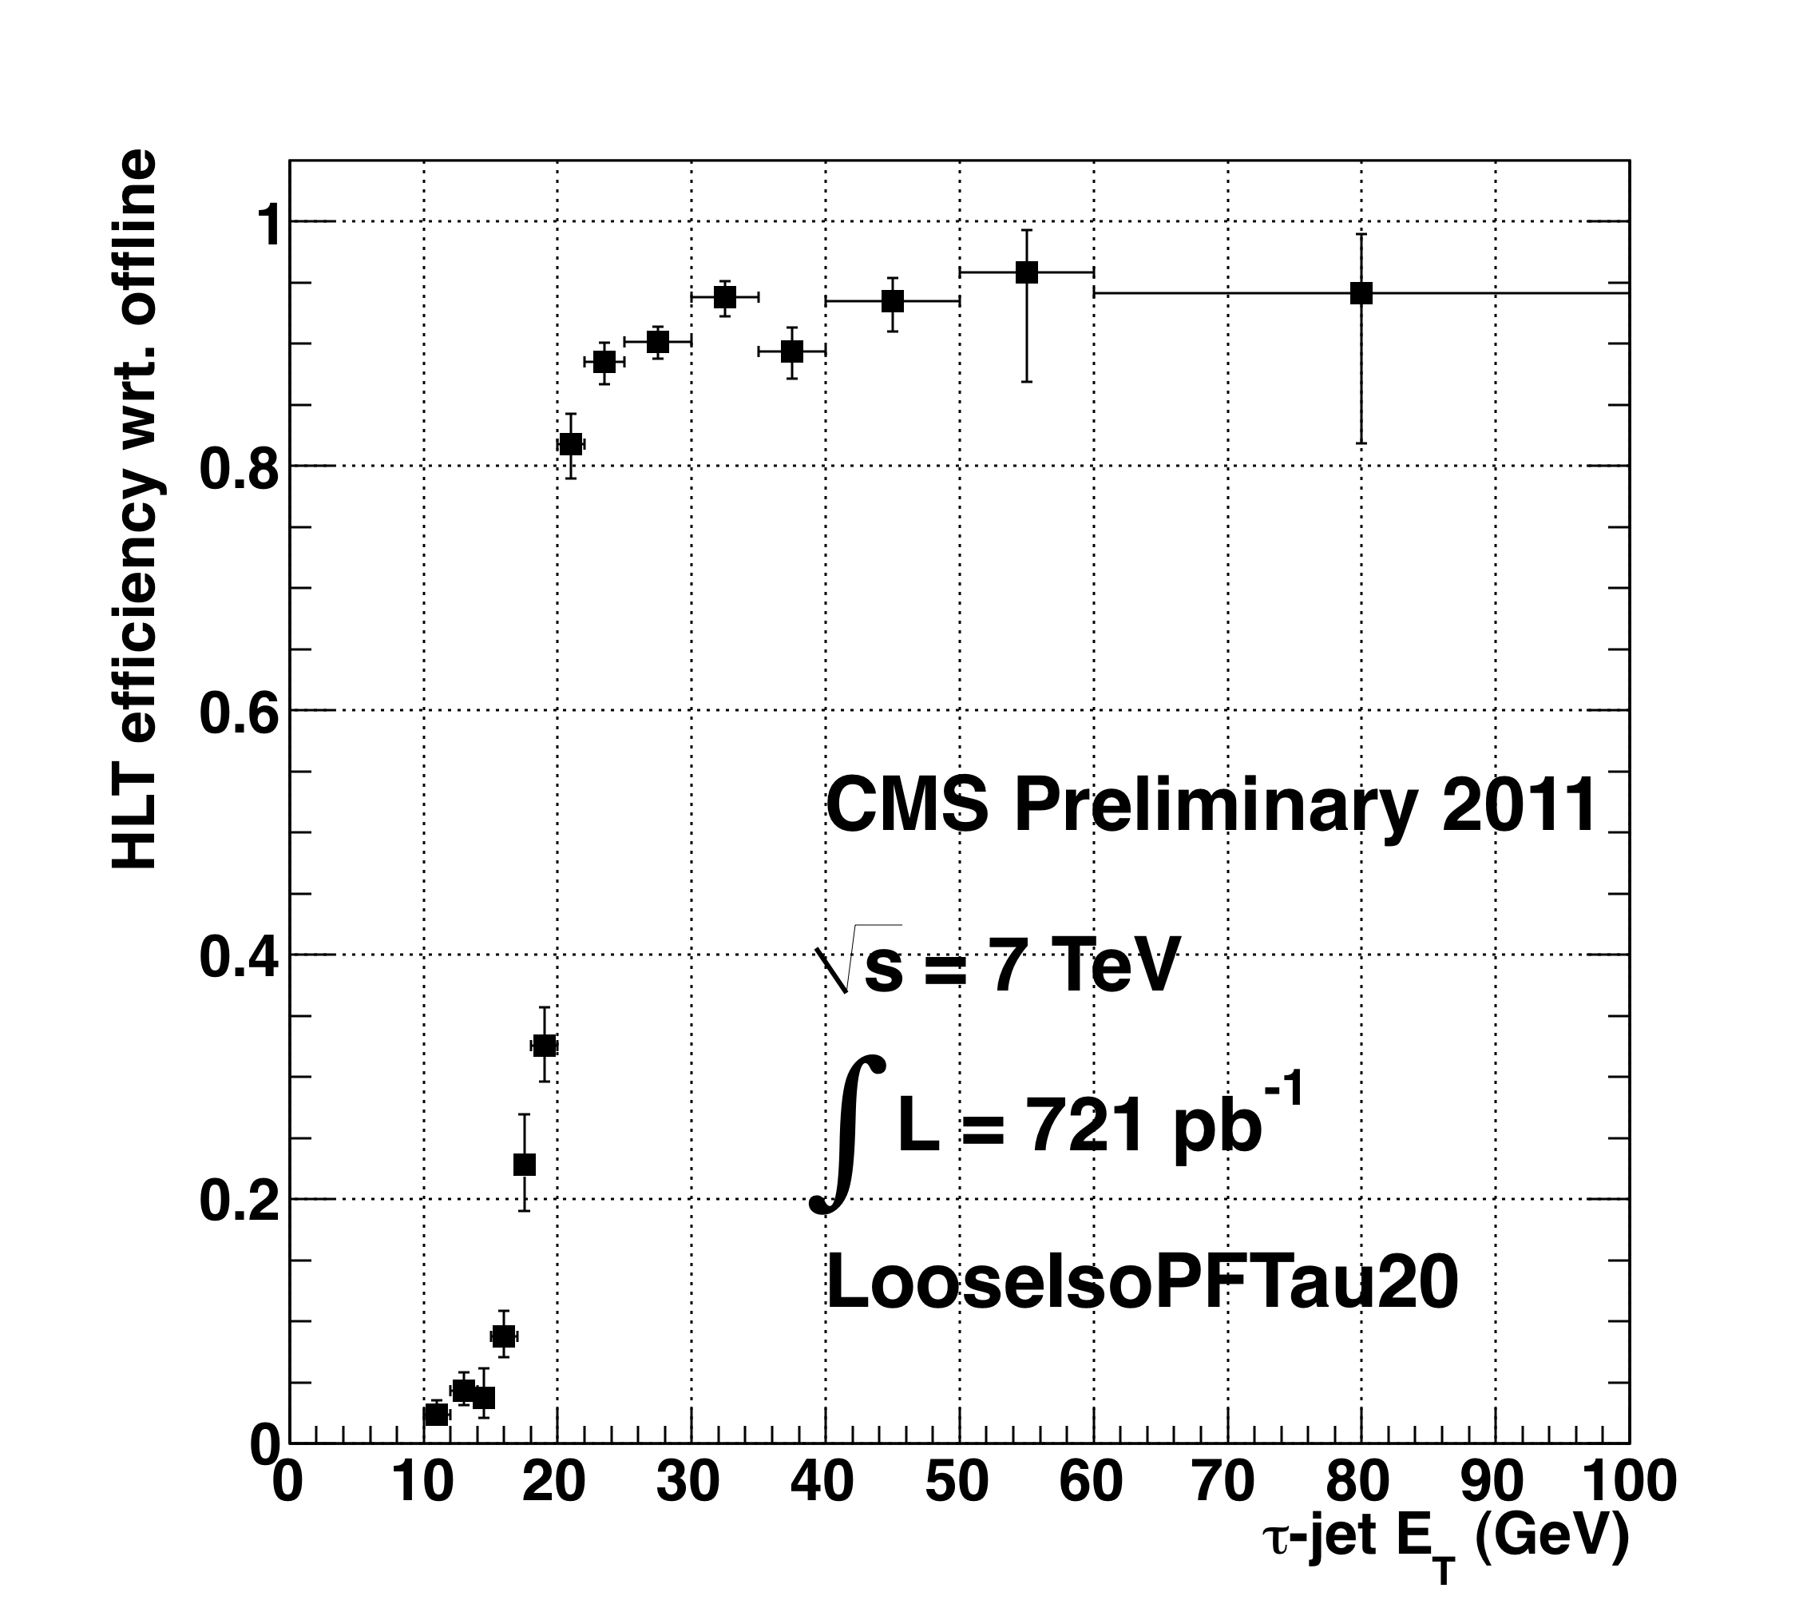
Trigger, trigger and trigger
Trigger menus:
  Optimized for luminosity increase from 10³² to 5x10³³ cm^{–2}s^{–1}.
  Multi-object triggers important now
Isolated Muon P_{T}>12GeV &
Hadronic Tau E_{T}> 20GeV
τ-jet E_{T} (GeV)

Slide 9
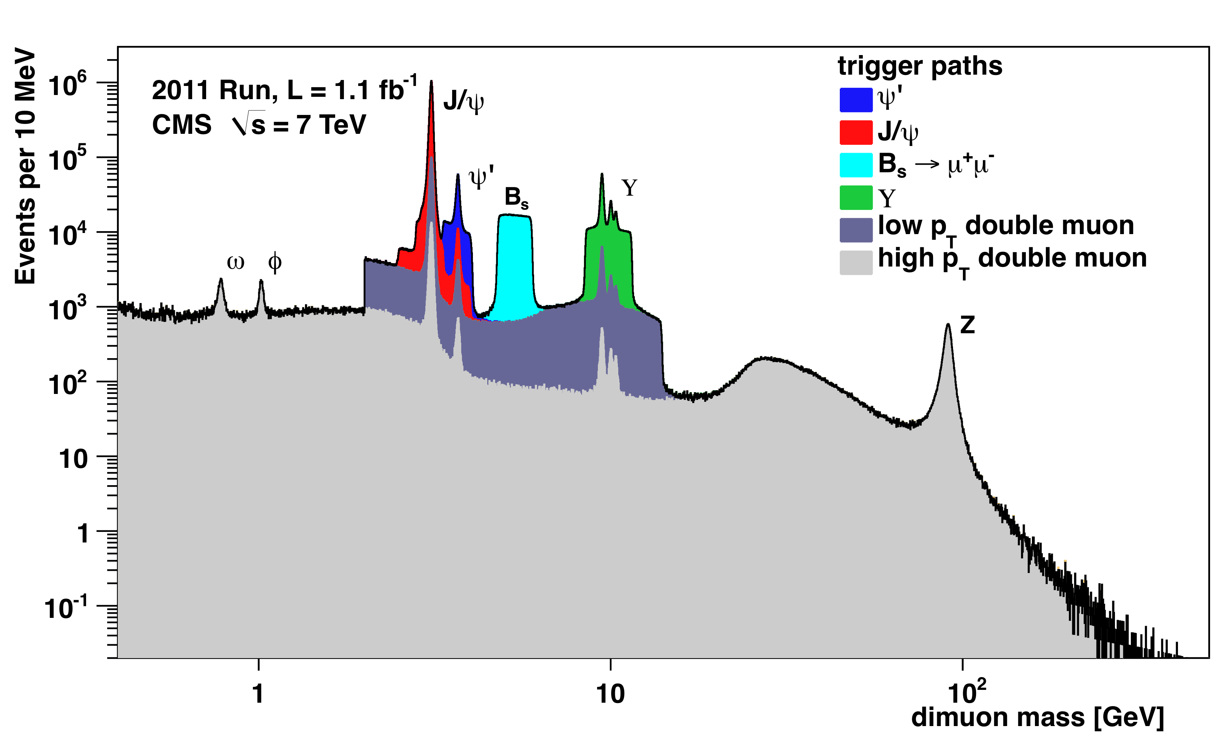
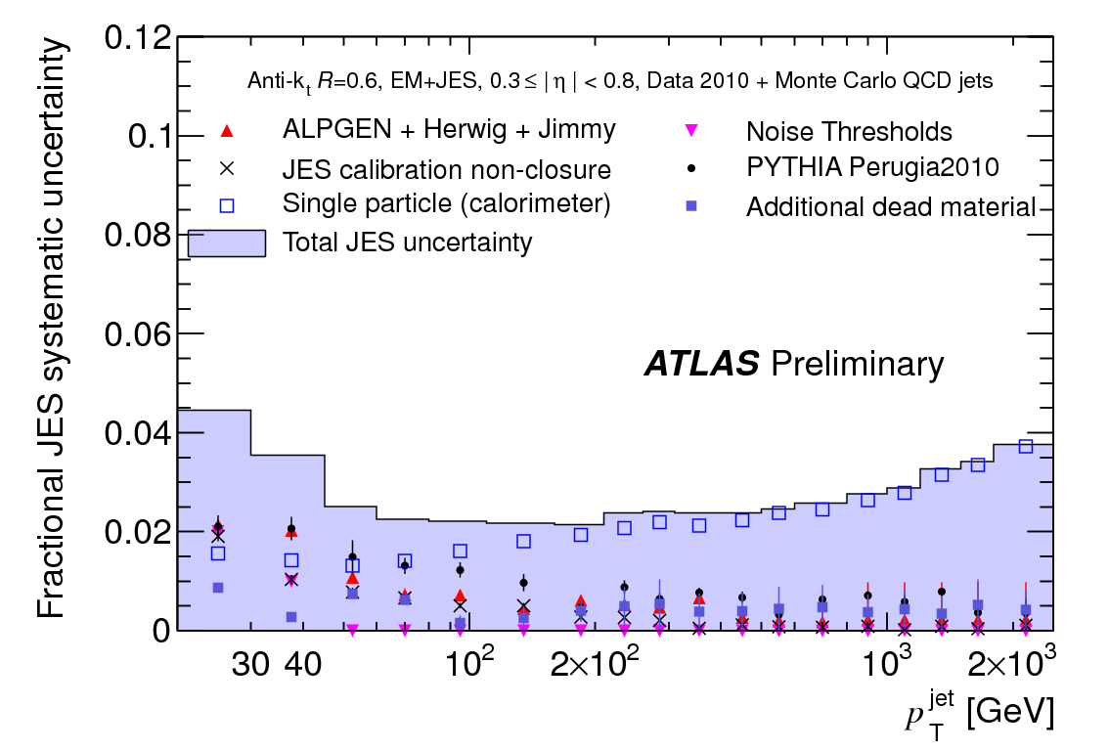
Detector performance
The startup of the experiments was the biggest discontinuity with the past: it was fast and efficient.
3 %
Standard Candles
2011 pileup → higher prel. JES error for E_{T}<100 GeV jets ( ±2-5% for |η|<2.1 )

Slide 10
Addressing the 2nd-generation
(experimenter’s terminology)Look Elsewhere Effect

Slide 11

2nd-gen Look Elsewhere Effect

Slide 12
Addressing Type-II
(String theorists’s terminology)
Look Elsewhere Effect:
Condensed version of the talk in two transparencies
(Latest finding: this “Type-II” LEE is dual to the “Type-I” LEE, under sleepiness → 1/sleepiness)

Slide 13
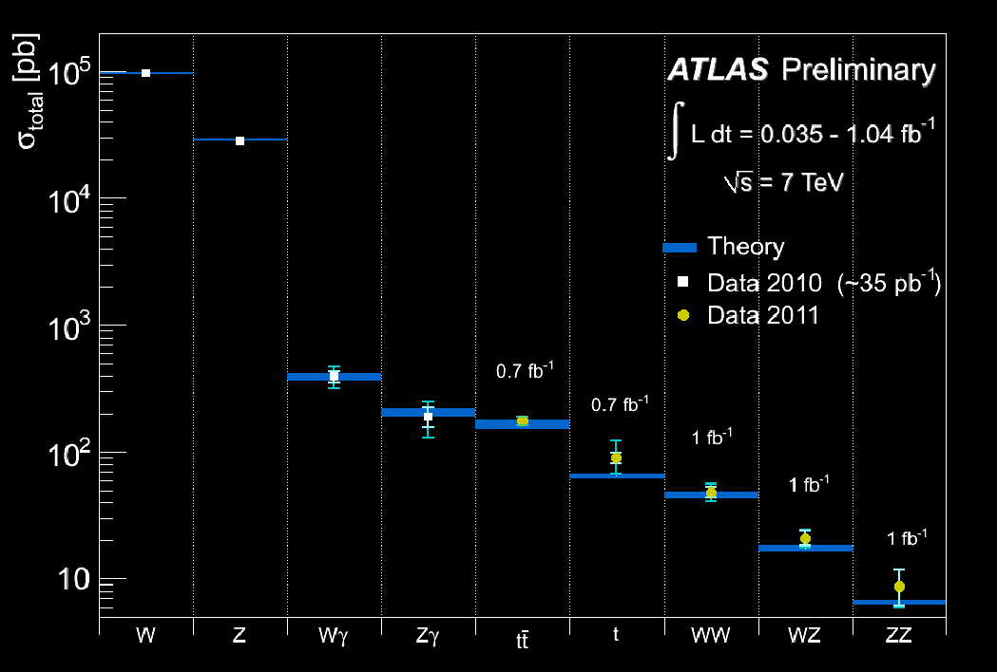
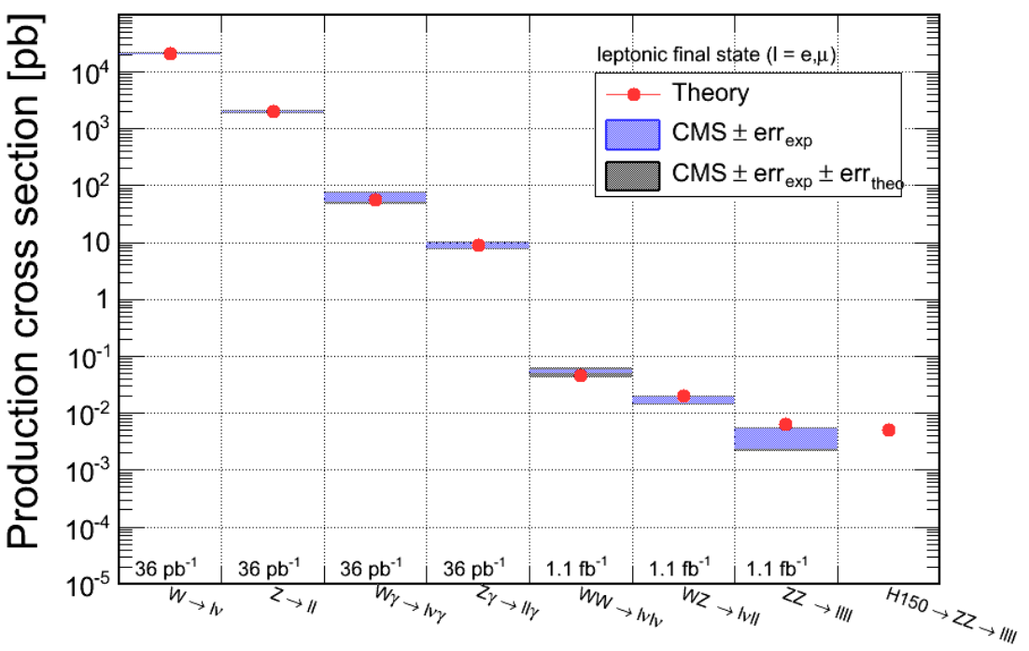
July 2011: Tevatron passes baton to LHC
All Standard Model processes have been observed at the LHC as well. Only missing piece is the Higgs (on both sides of the Atlantic).

Slide 14
First excitement and the morning after
Within a year, the SM has been re-established as solid ground from which to start the searches
Searches have started in earnest: three categories
  The Higgs and its extended [?] family
  SUSY [dominated by “CMMSM-inspired” searches so far]
  Exotica [interesting: nowadays, almost becoming standard to split Exotica into “Extra Dimensions” and “True exotica”]. Thankfully, while EDs do not explain “naturalness”, they are still relevant.
Quick summary for the impatient:
  Closing in on the H; limits on M_{H} now exceed those of the Tevatron. Tantalizing “feature” in WW channel.
  Maybe nature has not chosen natural values after all; no signs of SUSY below 1 TeV [!?!?]. Not so fast!
  Exotica: great place to train students [smaller groups, they get to work on all steps of the analysis]; only problem: no signs of it.
Some talk of “what if it’s only the Higgs”?
Some extra thoughts [outside 2nd-gen LEE effect; for these thoughts, you have to stay awake

Slide 15
The LHC Tour de Force

Slide 16
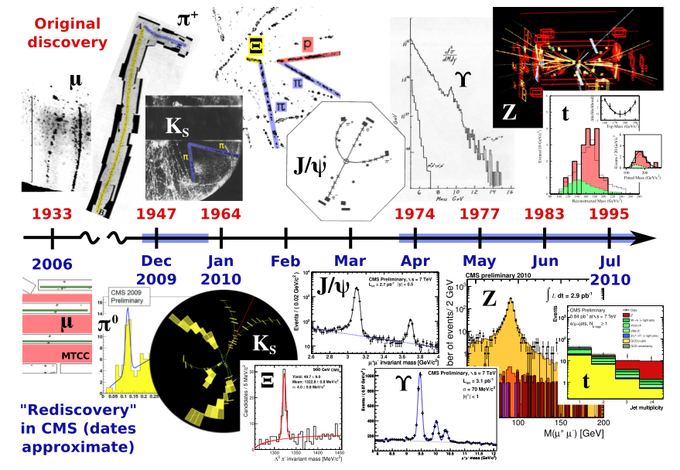
Around the standard model in 7 months

Slide 17
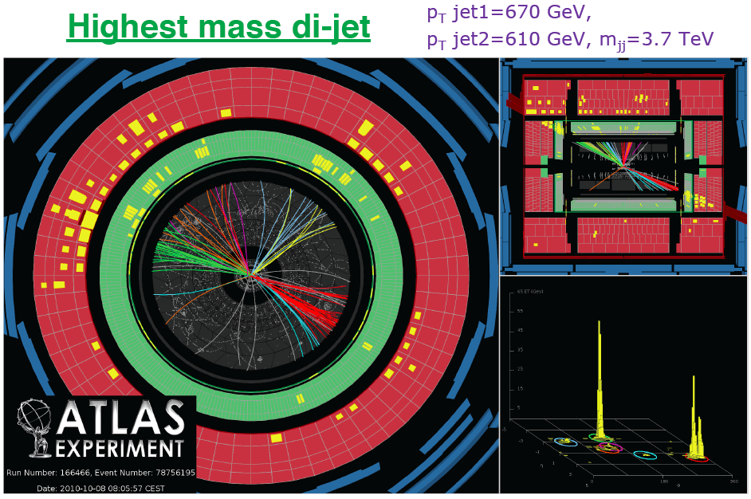
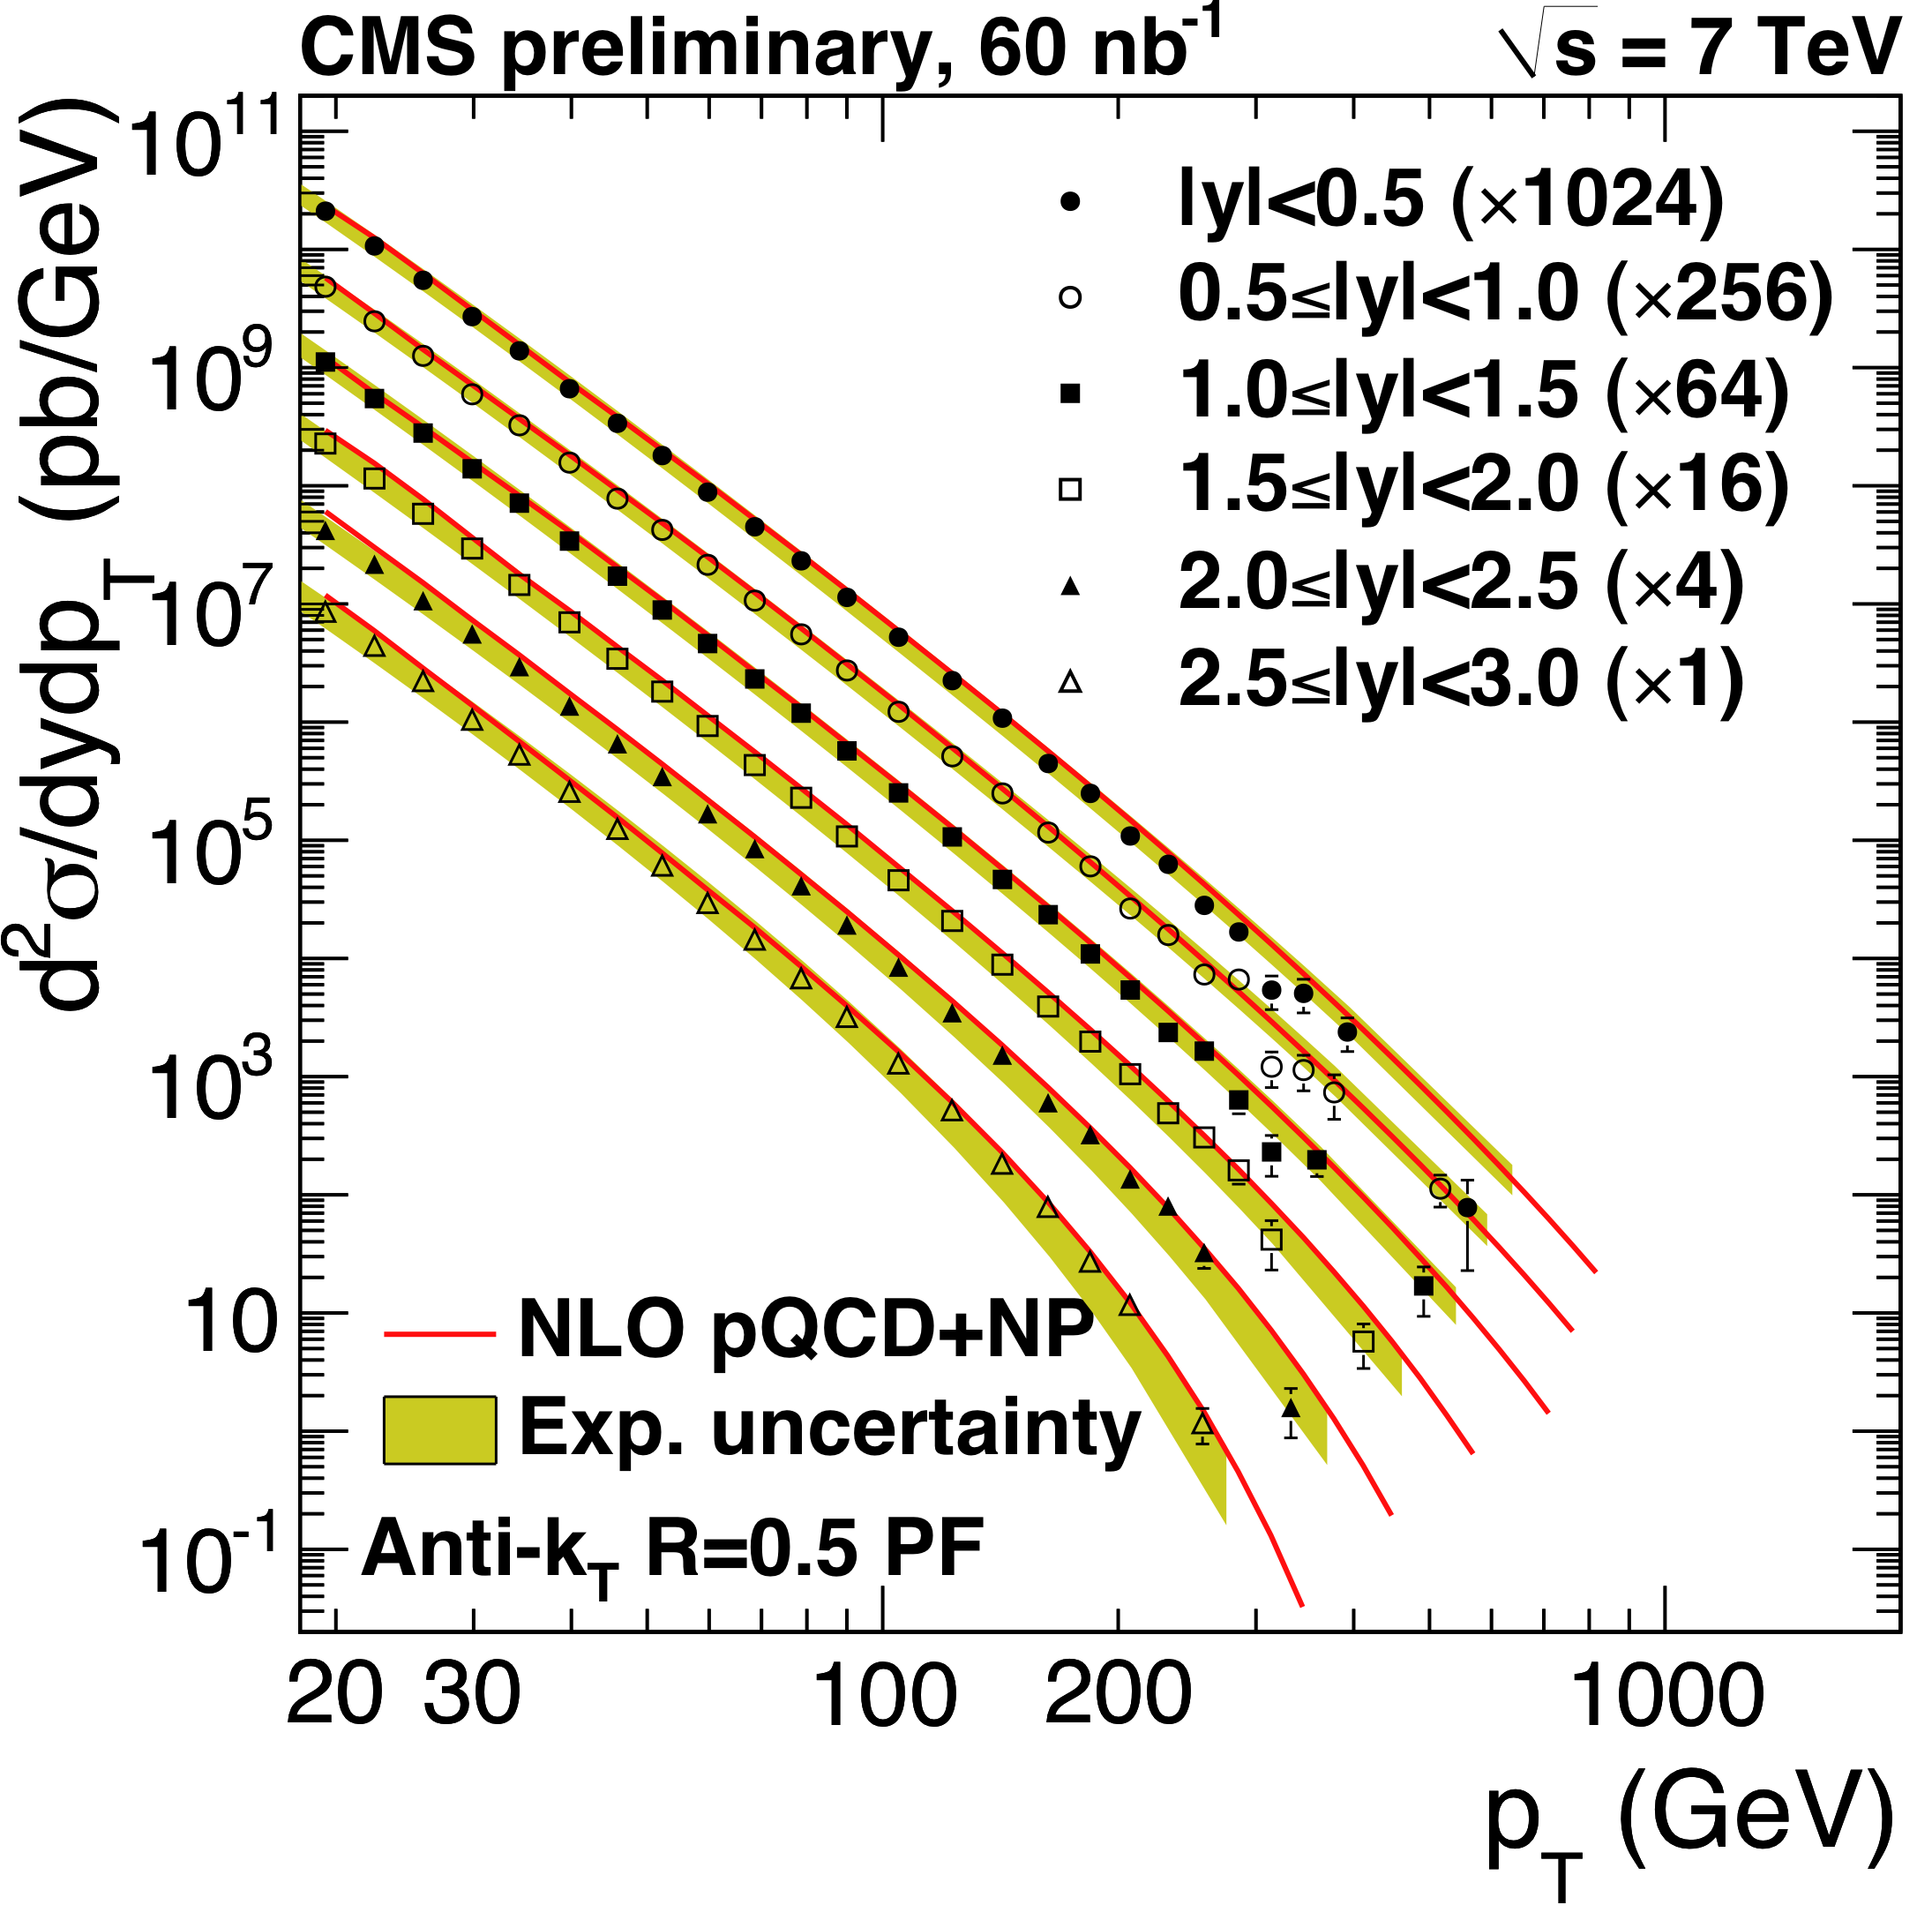
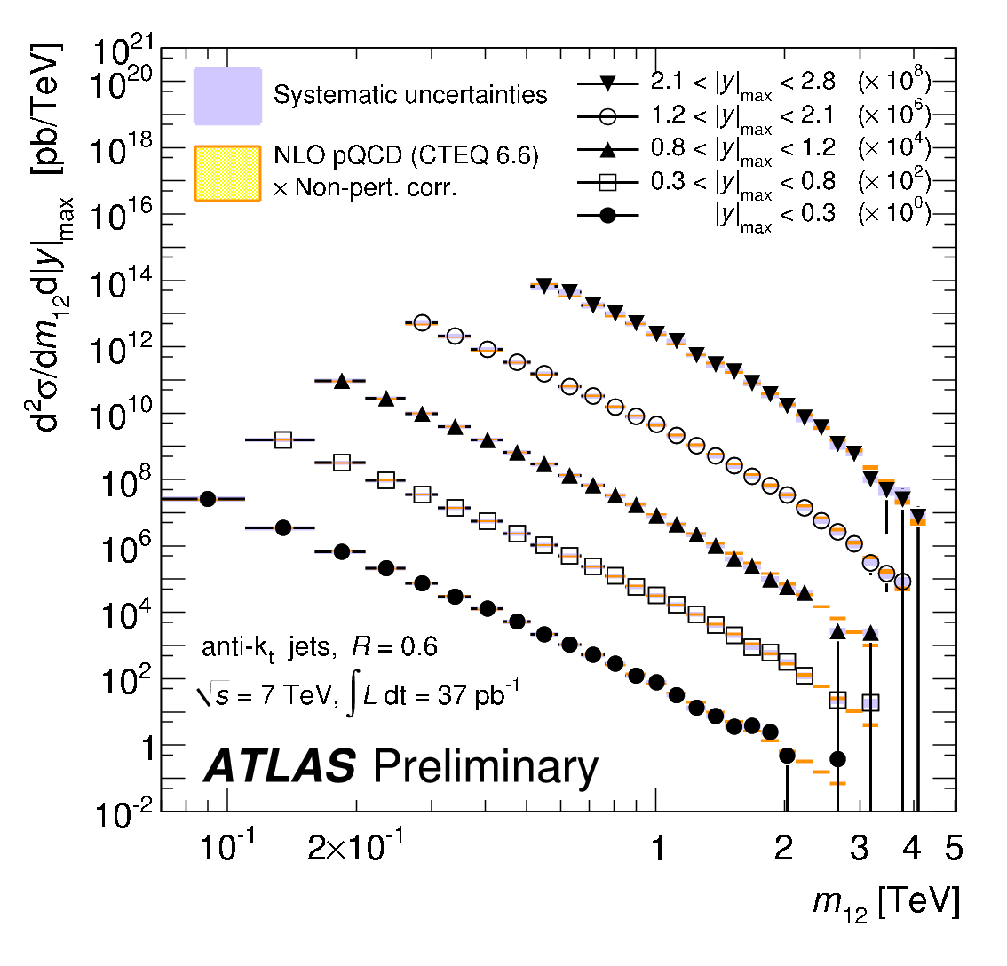
Jets
To probe the hard scatter:
  The hard scatter: jet P_{T} and η, dijet correlations, dijet mass,…
Excellent agreement with QCD

Slide 18
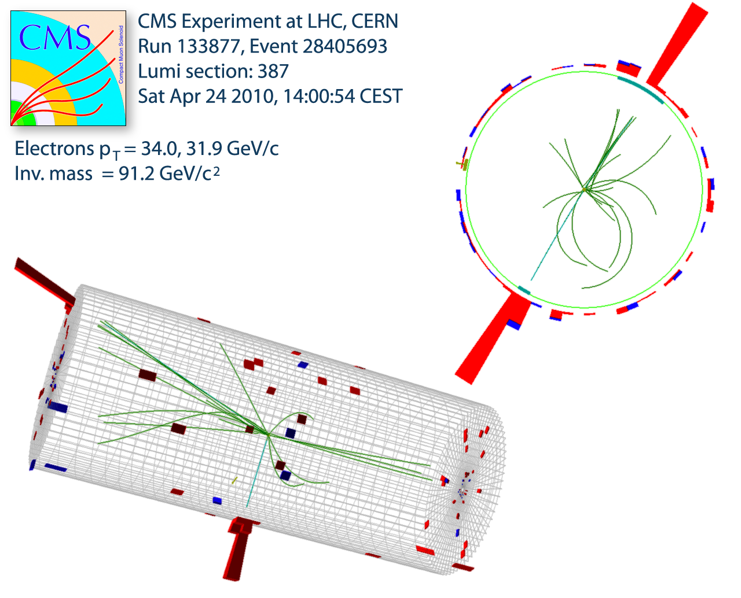
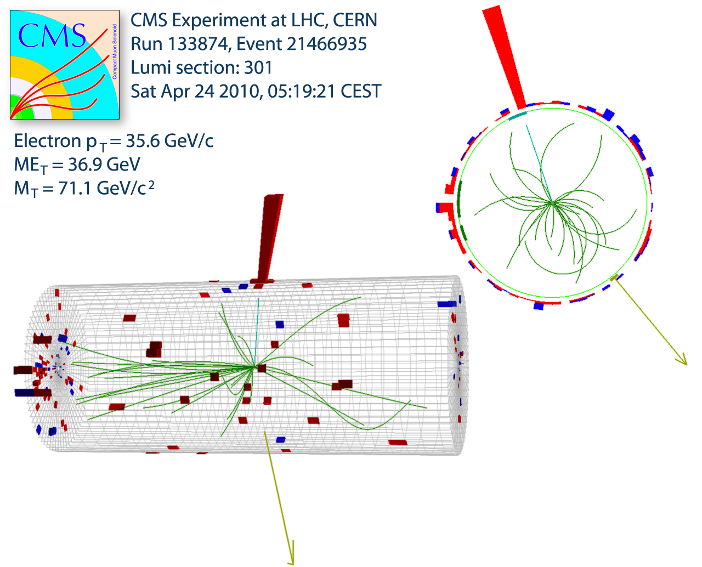
W/Z production at 7 TeV: clean & beautiful
Z → electron + positron
W → electron + neutrino

Slide 19
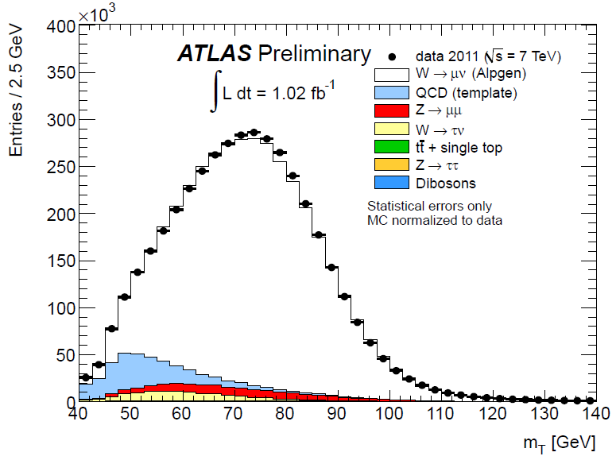
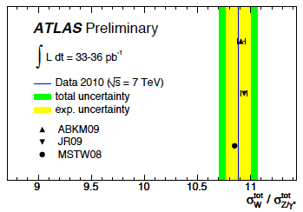
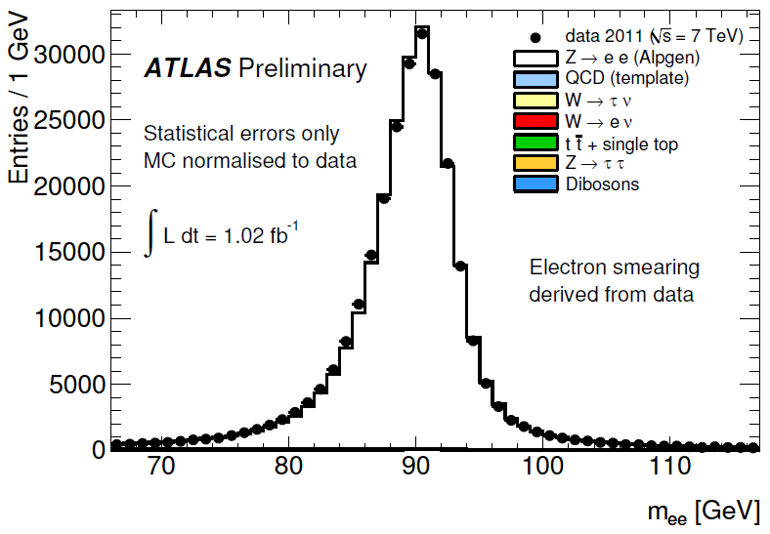
W/Z production (+LHC-specific obs)
Excellent agreement between data and simulation
Good agreement with NNLO+PDF theory predictions
Move to “new environment”:
  σ(W⁺)≠σ(W–) (~1.4)
  W polarization
W→μν
~4.3 M W→μν
Z→ee
264k Z→ee

Slide 20
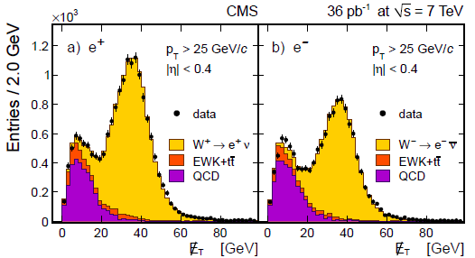
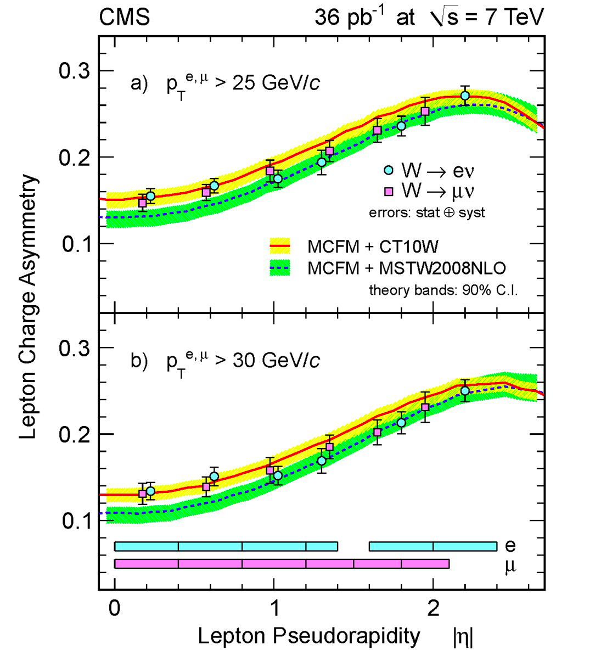
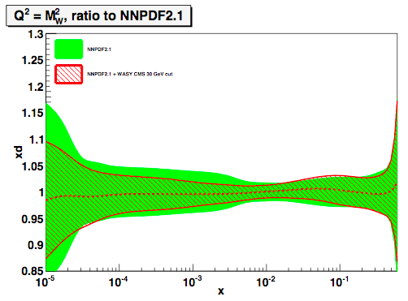
W production: charge asymmetry
Split samples in η; fit W⁺, W–.
In 10^{–3} < x < 10^{–2}:
measurement already improves d,u,q-bar PDFs by >40%

Slide 21
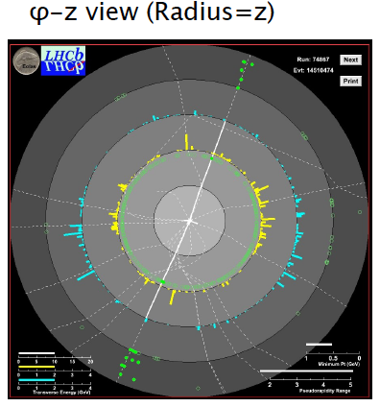
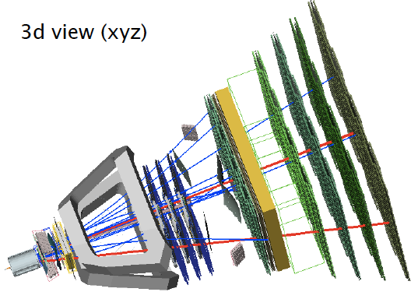
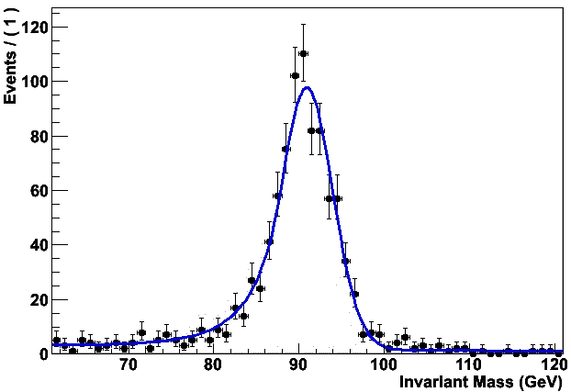

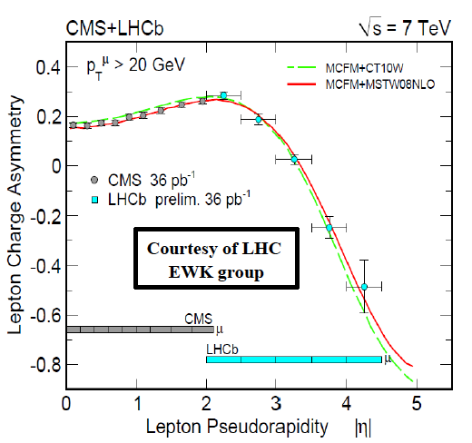
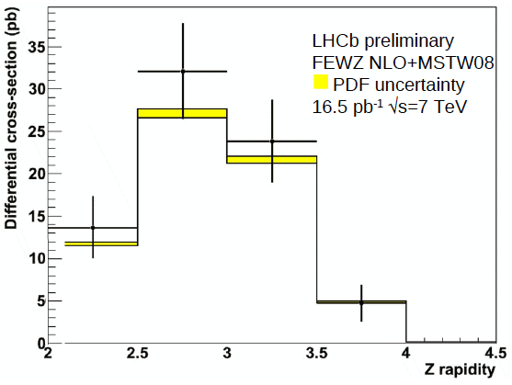
W & Z production in the forward region

Slide 22
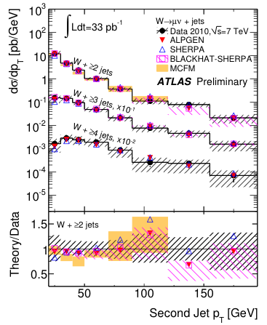
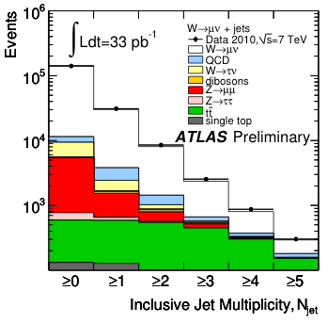
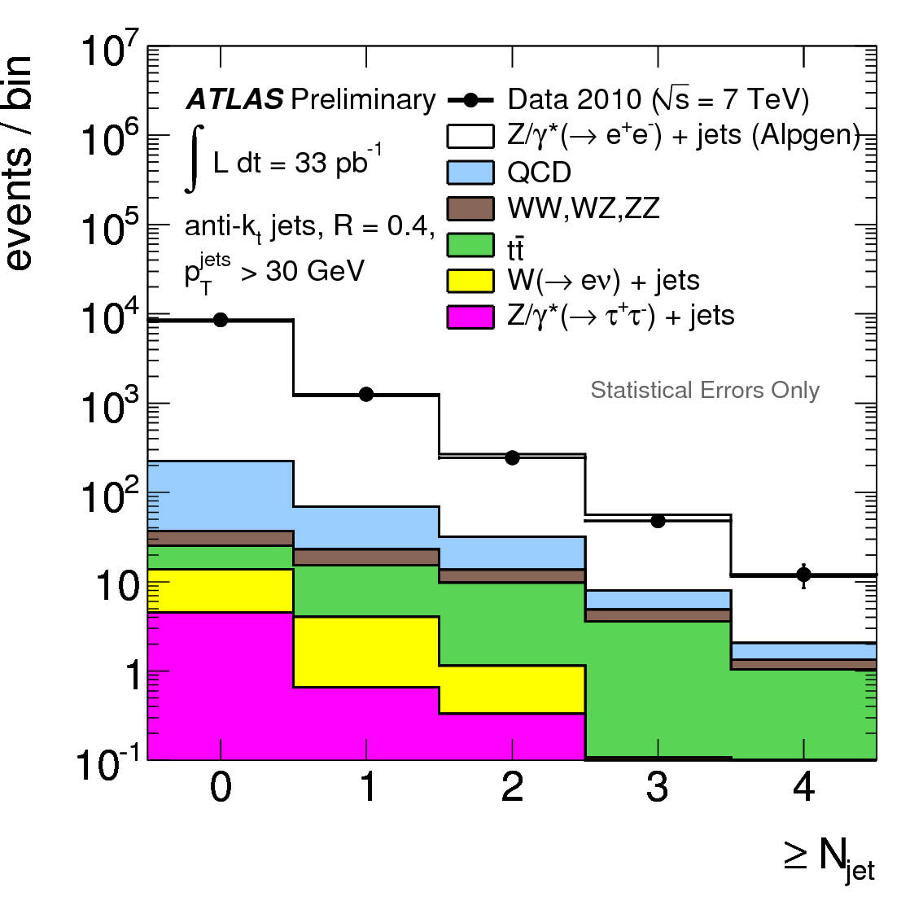
W/Z + jets
Background for top and new physics; especially at high p_{T}(W/Z); each jet “costs” ~α_{s}
Jet multiplicity and p_{T} distributions
  Good description by state-of-the art QCD NLO calculations and LO multi-parton generators
W+jets
Z+jets

Slide 23
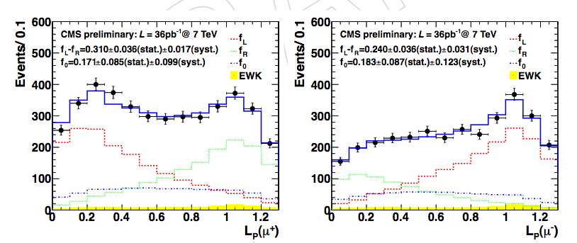
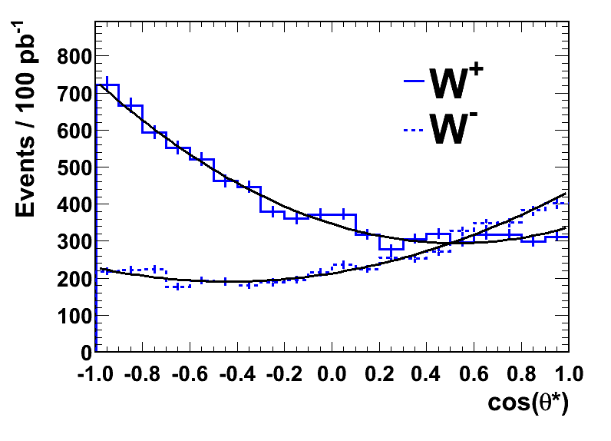
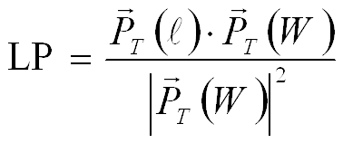
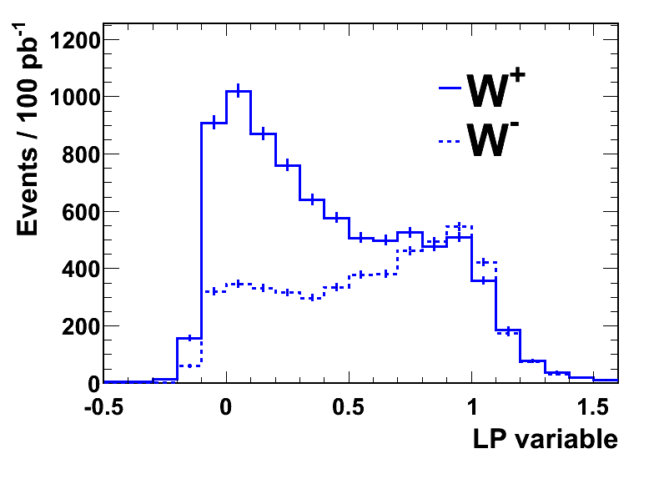
LHC-specific: W polarisation in pp
Production of high P_{T} (>50 GeV) W bosons:
  Valence quark – gluon (q_{v}-g) dominates. Strong polarisation effects in transverse plane at LHC expected.
  Initial states and CP counterparts not present in equal amounts at pp collider in contrast to pp-bar (Tevatron)
  ➔ W’s produced in pp are mainly left-handed.
CMS z-dir
W⁺
W–
 | Combined Result
(f_{L}-f_{R})– | 0.226 ± 0.031 (stat) ± 0.050 (syst)
(f₀)– | 0.162 ± 0.078 (stat) ± 0.136 (syst)
(f_{L}-f_{R})⁺ | 0.300 ± 0.031 (stat) ± 0.034 (syst)
(f₀)⁺ | 0.192 ± 0.075 (stat) ± 0.089 (syst)
helicity
helicity
Preferred W spin directions
W+1jet dominant production mechanism at LHC (not a Feynman diagram)
However: cannot measure cosθ* (missing neutrino)
HiggsHunting Workshop
23
July 28-30, 2011
Notes:
23

Slide 24
Top physics

Slide 25
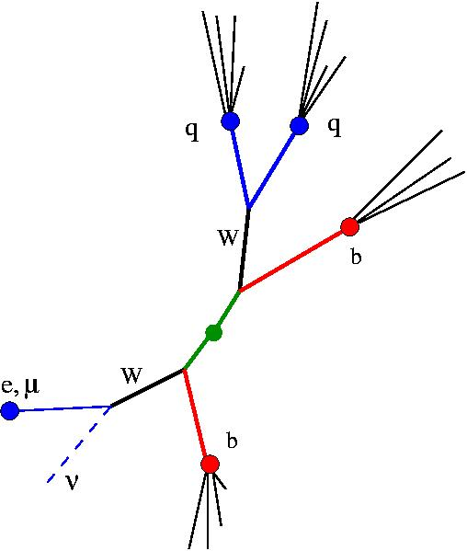
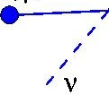

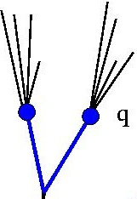
The top
If the J/ψ, Y, W and Z are standard candles, then the top is a candelabra*
  Leptons, missing E_{T}, additional jets; and b-tagging
  Analysis requires all that has gone into the W and Z, plus increased QCD background (because of higher jet multiplicity).
    Plus interplay with W/Z+jets production
0-lepton: not-clean; Br~4/9
Dilepton: cleanest but Br~4/81
1-lepton: semi-clean; Br~8/27
*: first heard this from Ken Bloom, U of Nebraska

Slide 26
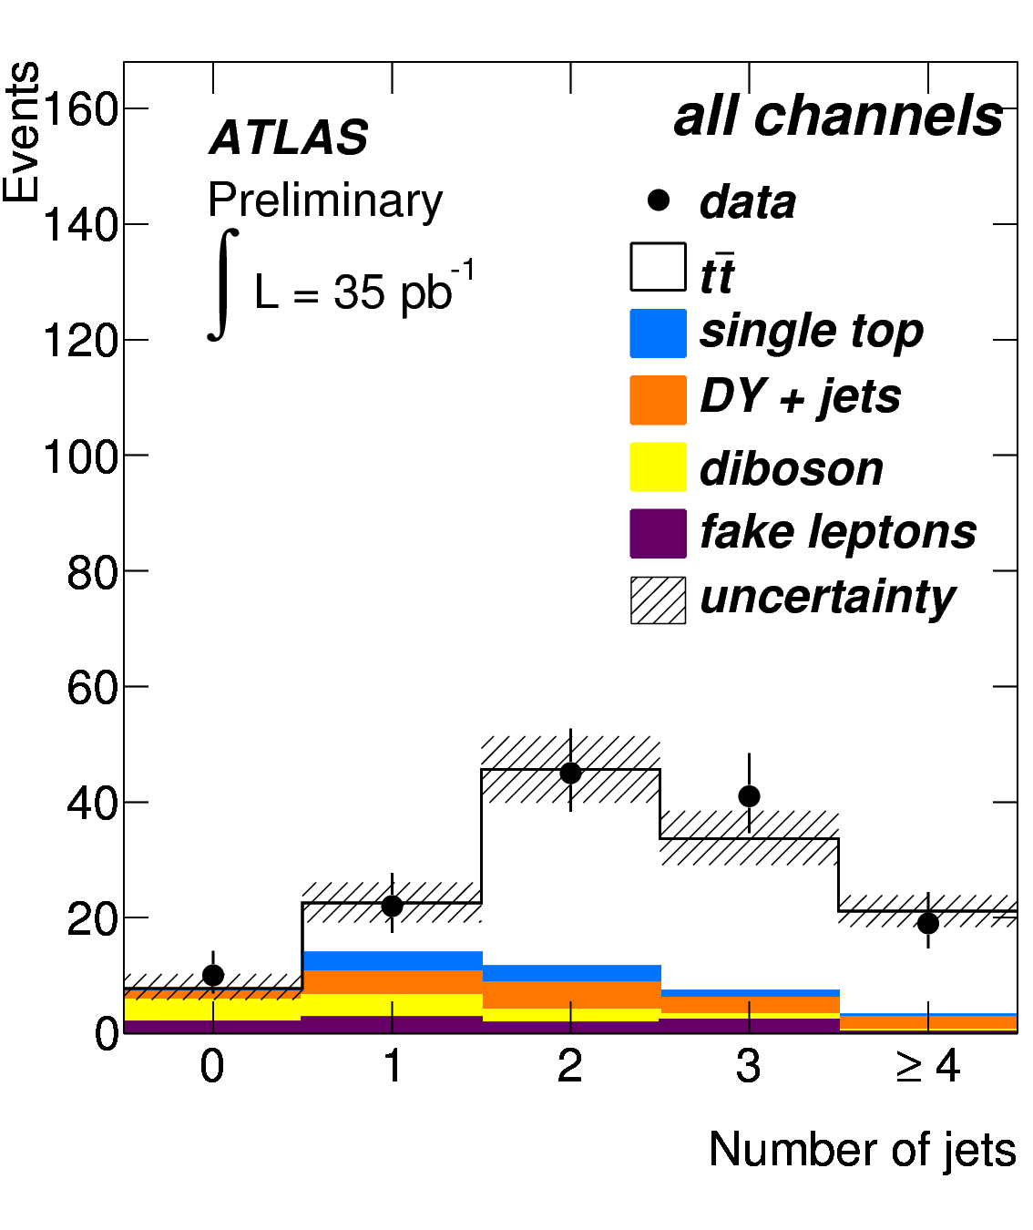
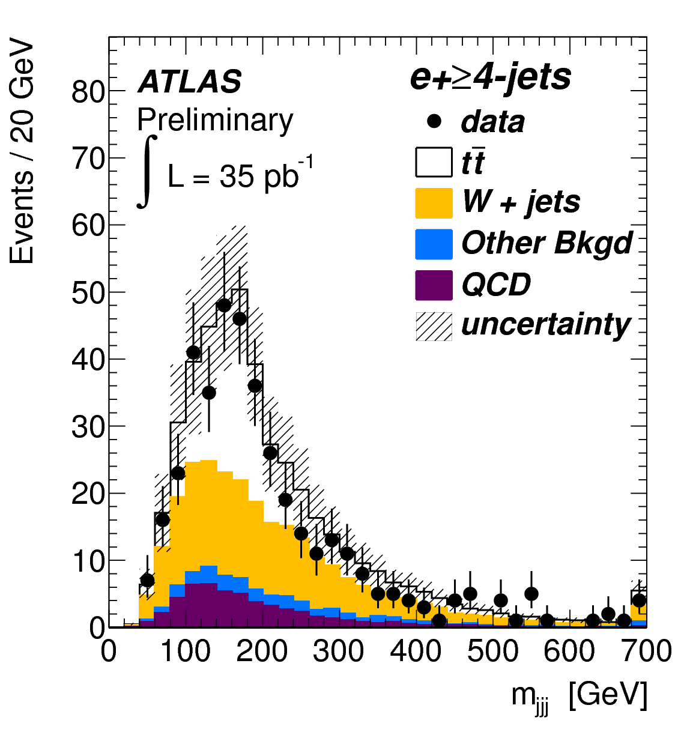
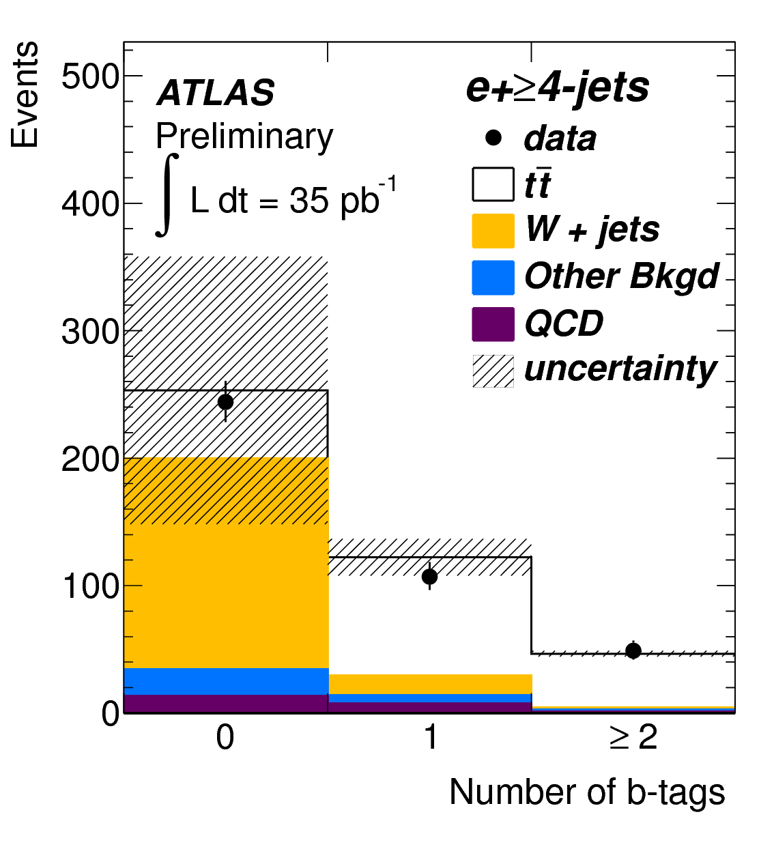
Top cross-section measurements (I)
Simplest measurement from dilepton channel
  tt→WbWb→lνblνb with l=e or μ (5% of tt events)
  Relatively clean final state – backgrounds from Z/γ*+jets or fake leptons estimated from data control samples
    Signal in ll+≥2 jets (no b-tagging), especially e-μ channel
  O(100) events in 2010 data – statistics limited
Higher statistics in semileptonic channel
ttWbWblνbjjb, l=e/μ (30%)
Lepton+≥4 jets selection, re-construct m_{top} from 3 jets
Bkgs: W+jets, QCD (fake lepton)
Combined analysis of 3 and ≥4 jet samples with 0,1,2 b-tags to maximize sensitivity

Slide 27
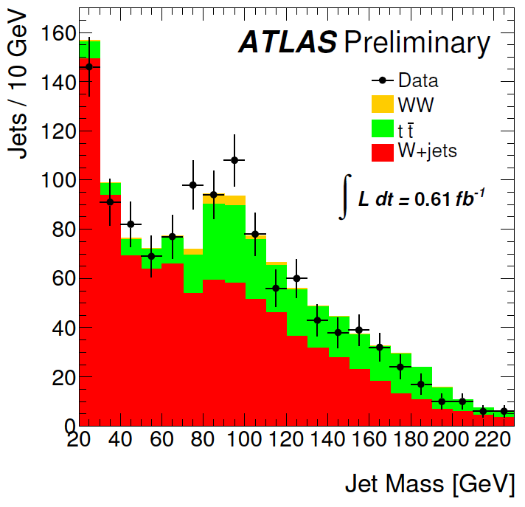
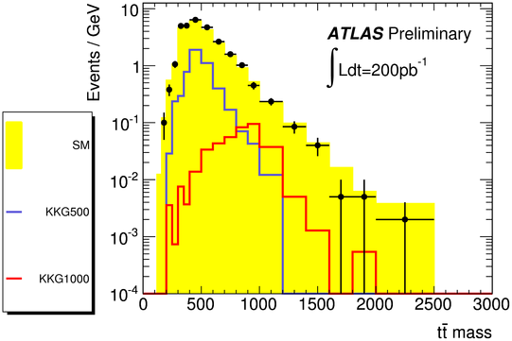
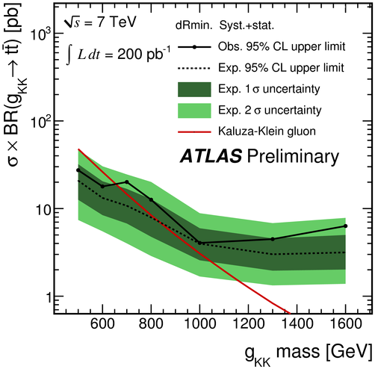
The biggest new tool: jet substructure
Reconstruct semileptonic tt events; look in m(t-tbar) distribution for possible resonances
Events with W→ℓν with p_{T}(W)>200 GeV
Mass distribution of split & filtered subjets with p_{T}>180 GeV
Evident hadronic W peak from boosted tt
Promising for the future
Next stop: High-P_{T} VH!

Slide 28
Closing in on the Higgs
(accounting for both
1st-gen & 2nd-gen LEE)

Slide 29
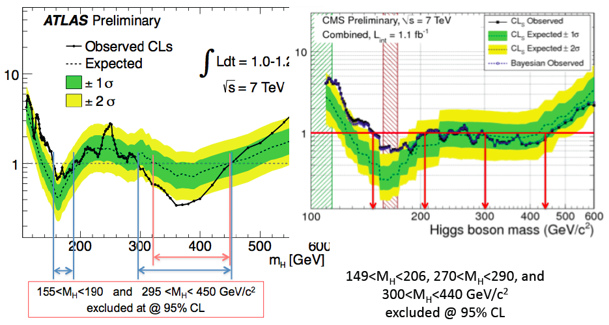
The Higgs[?]
Both experiments have a ~2σ excess over a broad M_{H} range of ~40 GeV
Are we seeing the hair on the Higgs boson?
A common systematic (aka mistake)?
Can always blame Statistics! ☺

Slide 30
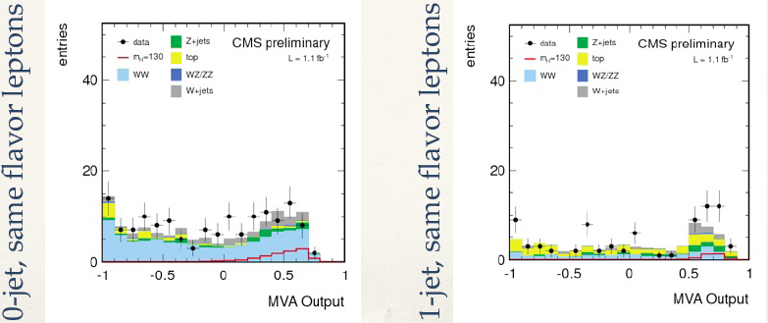
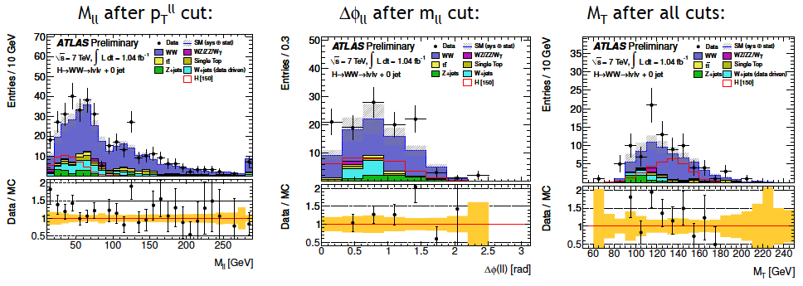
A common [?] “systematic” [?]
Both CMS and ATLAS: some “rattling” in the distributions
Not exactly what (only) the Higgs would really look like

Slide 31
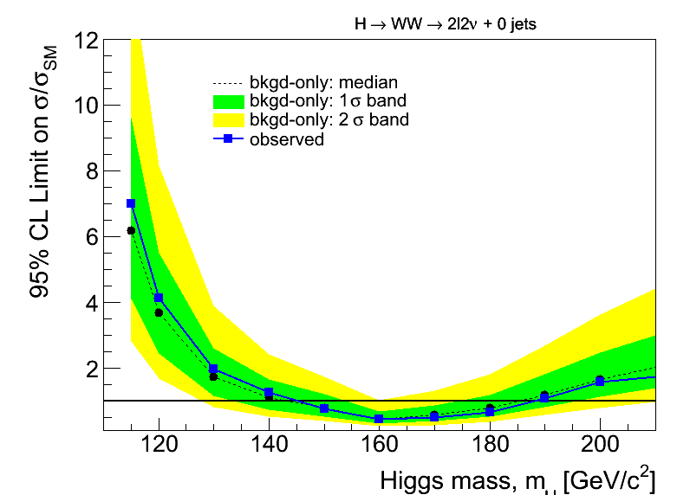
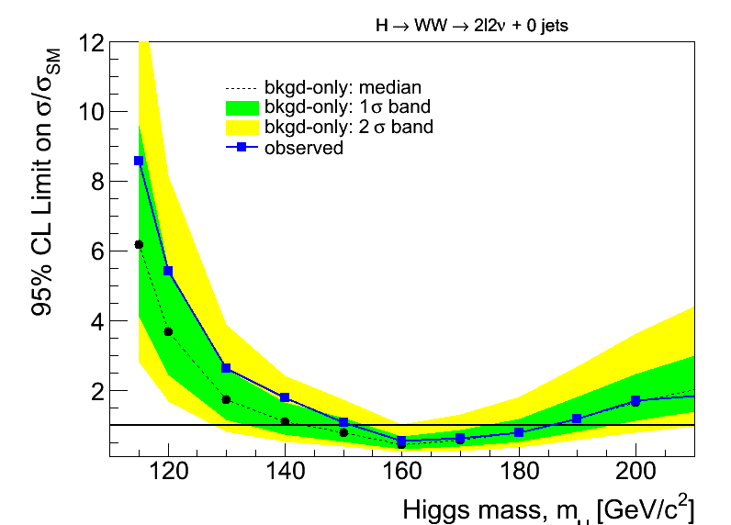
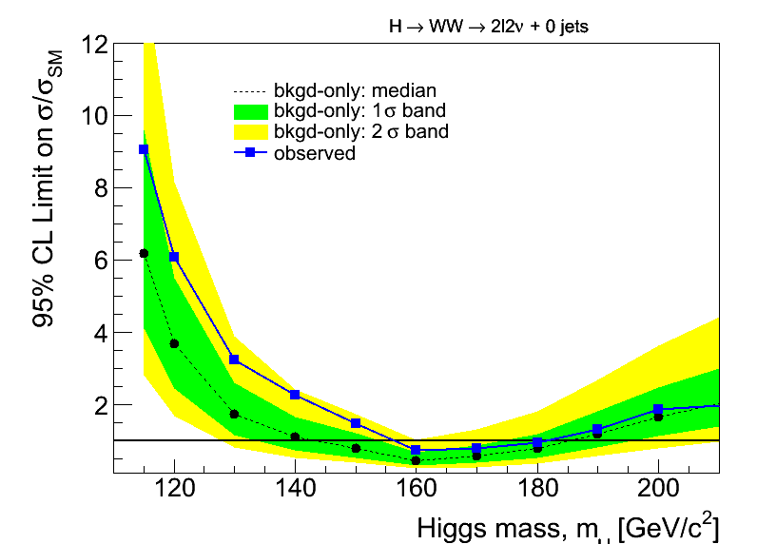

Early signal? Would look broad indeed
Injecting a signal at different masses…
M_{H}=120
M_{H}=130
M_{H}=140
M_{H}=150

Slide 32
What the LHC was really built for
The LHC was not built to “find the Higgs”. It was built to provide direct information [aka probe] EWK Symmetry Breaking
A definitive statement on this front meant having a machine that would probe the TeV mass scale
  Because unitarity needs something by 1 TeV scale
LHC no-lose theorem: expect discoveries at TeV scale
  BIG discovery: if there is no Higgs, this is big news for the Standard Model; Technicolor? Strong WW scattering? ???
  BIG discovery: if there is a Higgs, someone must stabilize it
So, quickly, the mission statement of the LHC became “provide a definitive answer to what governs physics at the TeV scale”.
  Grand hope was [still is] that a lot of “stuff” happens at ~TeV.

Slide 33
Reasons to vote for Physics BSM
List is very well known (it’s been around for so long – too long in fact – there are multiple versions of it)
  1. What is the dynamics of electroweak symmetry breaking ?
  2. What is the nature of dark matter ?
  3. What physics is associated with the vacuum energy ?
  4. Does or how does gravity enter the picture ?
  5. What causes the hierarchy of fermion masses and mixings ?
  6. Why three generations ?
  7. What is the origin of the matter-antimatter asymmetry ?
  8. What scale are neutrino masses set at ?
  9. What resolves the strong CP problem ?
  10. What questions have we not asked ?

Slide 34

Where is the new physics?
One major point from theory colleagues:
The Higgs shows the way
\

Slide 35
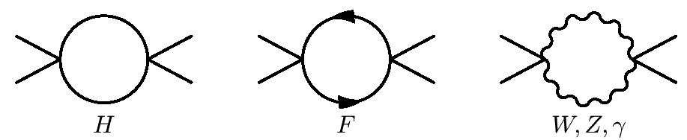

Scale of New Physics = F(M_{H})
V(φ)
Q²→∞, λ →∞!
φ
+
≠
V(φ)
φ

Slide 36
Searches for signs of exotic New Physics

Slide 37
Many (many) possibilities
Compositeness; new contact interaction(s)
Exotica:
  Leptoquarks
  New gauge bosons (W’, Z’) – or resonances
  Fourth generation (b’)
  TeV-scale gravity: Black Holes; mono-jets; mono-photons; UED
    Universal Extra dimensions (diphotons)
Supersymmetry
  Squarks and gluinos
    Decays into jets and MET plus 0, 1 or 2 leptons
    Decays into photons (GMSB)
SUSY-based exotica
  Long-lived particles
The totally unexpected

Slide 38
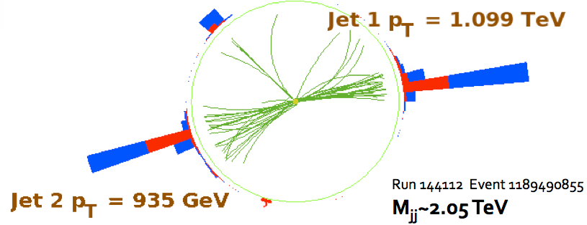


Dijet mass (and null search)
Very early search for numerous resonances BSM: string resonance, excited quarks, axi-gluons, colorons, E6 diquarks, W’ & Z’, RS gravitons
Four-parameter fit to describe QCD shape

Slide 39


Contact interactions (null search)
The χ distributions do not exhibit any excess at low χ. Good description by QCD.
Lower limit on scale of contact interaction Λ=5.6 TeV (95% CL) Most stringent limit to date.
36pb⁻¹

Slide 40



(Null) search for W′
2011 update:
1.03 fb⁻¹
Combined (SSM) limit:
M(W’)>2.20 TeV obs
M(W’)>2.27 TeV exp
2011 update:
1.13 fb⁻¹

Slide 41





(Null) search for BHs
arXiv:1012.3375
Expect lots of activity in the event, so
  Use S_{T} = Sum E_{T} of all objects (including ME_{T}) with E_{T}>50 GeV.
    Great against pileup (in the future as well)
Key for search: S_{T}-invariance of final state multiplicity
  A posteriori wisdom: FSR/ISR collinear do not affect S_{T} a lot
Use N=2 shape (with uncertainties) to fit higher multiplicities – where signal more prominent
A candidate event with 10 jets and S_{T} = 1.3 TeV
M_{BH}> 3.5-4.5 TeV
(semi-classical
approximation)
No excess, so set limits on minimum M_{BH}

Slide 42

Monojets? Nothing beyond SM
p_{T}^{jet} = 602 GeV
E_{T}^{miss} = 523 GeV
SM interpretation: Z → νν + jet

Slide 43
Real BSM Searches
(Beyond Standard Minimalism)

Slide 44


W+(jet-jet) (Tevatron)
CDF: arXiv:1101.6079
Dijet mass: excess (“bump”) of 253 evts in mass window 120−160 GeV.
Significance was 3.2σ
Then >4σ.
Bump compatible
with a particle of M=150 GeV, Γ=14 GeV.
Not compatible with
SM Higgs boson.
Light Z’ boson?
Color-octet axial-vector boson?
Technicolor? (ρ_{T}→WZ)
SUSY?
New (“unified”) flavor symmetry?
Scalar doublet (no vev)?
…

Slide 45
Supersymmetry

Slide 46




Supersymmetry: TO“E” at the Weak Scale
spin
For a small price increase (600% in number of parameters plus an unknown SB mechanism), achieves quite a lot:
  No fine-tuning (large radiative corrections cancel)
  If Lightest SUSY Particle stable: offers “natural” dark-matter
  Equality of Strong, Weak and EM couplings at ~10¹⁶ GeV
Despite conventional wisdom, SUSY is actually quite predictive: it specifies spins & couplings of superpartners
  Unfortunately, it tells us nothing about the masses
    For this depends on the SUSY breaking mechanism
  End result: large space of signatures, dependent on models
Huge number of theoretical models
  MSSM-124. Hard work to study particular scenario. Reduce complexity: use model of dynamical SYSY breaking
    mSUGRA (gravity-mediated)
    GMSB (gauge-mediated)
    AMSB (anomaly-mediated; studied in less detail)
boson
fermion
+
= 0
λ²
λ
λ
gauge boson
gaugino
= 0
+
g²
g
g

Slide 47

SUSY: what we do not know
Agnostic approach: consider all possible mass hierarchies: there are 9! = 362880 of them
  ME_{T}: 4x8! (161,280) cases, LSP=weakly-interacting, neutral particle; phenomenology depends crucially on mass hierarchy
  CHAMPs: 8! (40,320) cases, LSP=e_{R} (charged, color-neutral); signature: CHAMP (independently of hierarchy)
  R-hadrons: 4x8! (161,280) cases, LSP=colored object; again, independent of hierarchy
arXiv:1008.2483: “How to look for supersymmetry under the lamppost at the LHC”; P.Konar, K.Matchev, M.Park, G.Sarangi

Slide 48



SUSY with ME_{T}: signatures and bkgs
Searches distinguished by the number of leptons
  In all cases, demand “(high-P_{T}) jets + (high) ME_{T}”
  0l (all-hadronic); 1l; 2l (and break down into OS and SS)
QCD multijets
Z(→νν)+ jets
(W,t)+jets; W→τν
QCD: small
W/Z(→lν)+jets
t(→lν)+jets
W/Z(→lν)+jets
WW, WZ
tt(→llν)+jets

Slide 49
SUSY search with ME_{T}: summary of 2010
No signs yet. But all analysis methods in place; now need more data (2011!)
Corner around which SUSY would lie
Transp from
March 2011

Slide 50




SUSY updates: 0-lepton analysis
2011 update: 1fb^{–1}; shape analysis in H_{T}:=Σ_{jets} p^{jet}_{T}
EWK bkg (W+jets, tt+jets, Z+jets) from data control samples: W→μν and γ+jets
Events with α_{T}>0.55
CMS
H_{T} (GeV)

Slide 51


In brief: SUSY moving further out
Simplified model: two squark (q) generations, m(χ₁⁰)~0
m_{g}>800 GeV m_{q}>850 GeV
Equal mass case: m_{g}=m_{q}>1.075 TeV
MSUGRA/CMSSM:
tanβ=10, A₀=0, μ>0
Equal mass case:
m_{q}=m_{g} > 980 GeV
2010→2011
2010→2011

Slide 52


Simple SUSY is receding
Plenty of literature on the subject. Basic message:
  CMSSM being cornered. Not excluded [yet] but looking unlikely [e.g. high “fine-tuning price of the LHC”]
  Then again, CMSSM is not SUSY
    It is only one SUSY scenario. More complicated “models” are likely. Back to ensuring that signatures are exhaustive!
http://arxiv.org/abs/1101.2195
MasterCode Project (Oliver Buchmüller et al)

Slide 53


Recently: use simplified models
CMSSM
What we see:
much simpler…
Simplified model spectrum (sms)
with 3 particles, 2 decay modes

Slide 54



Simplified Model Spectra
So far: squark and gluino pair-production topologies
Limits are “best of three” hadronic searches (not a combination)
Black lines are QCD-like cross sections
Theoretical uncertainties like ISR simulation under study
Theoretical uncertainties not included
Caution: usage of SMs is the sole responsibility of the user. SUSY and all its incarnations bear no obligation for any and all hasty conclusions (from SMs).

Slide 55

SUSY is far from excluded (let alone dead)
Simple models (e.g. universal soft masses) being squeezed
Numerous other scenarii still very much unprobed [thus very unconstrained]. Examples:
  Large flavor splitting: very heavy squarks [1st, 2nd gen], light 3rd gen (plus gluino at ~1-1.5 TeV)
  Low MET: not only within R_{p}-violation; small mass splittings equally lethal to signature
    Could even have all sparticles with mass < ~0.5 TeV…
Cohen et al (96)
Barbieri et al (07)

Slide 56
Heavy Stable Charged Particles
Both in SUSY and other SM extensions:
  SUSY (split SUSY: M(gluino)<<M(squark) → long lifetime; GMSB models: stau NLSP, decaying via gravitational coupling only…)
  Other: hidden valleys; GUTs; …
Two types of signatures: MIP & strongly-interacting
MIP: HSCP passes through tracker & muon chambers
R-hadrons traversing material can flip Q or become neutral
dE/dx: Massive, charged particles traversing detector: highly ionizing tracks (tracker, possibly muon dets)
(Out-of-time) Jet: particles stopping in the detector and decaying – possibly out-of-time with the collisions

Slide 57




Heavily ionizing tracks
Mass estimate from approximate Bethe-Bloch:
  K and C determined from proton data
    Mass resolution: 12% at 300 GeV
Cut on I_{AS} (MIP compatibility) & p_{T} (I_{AS}, p_{T}: uncorrelated)
  Bkg
K=2.58 MeV c²/cm
C=2.56 MeV/cm
600

Slide 58







Stopped gluinos (I)
Slow (β < 0.4) long-lived gluinos hadronize into and then stop in the dense material of the CMS detector
  Their number builds up with luminosity:
They then decay μs, s or day(s) later. Their decay:
Spectacular jets in the absence of beam

Slide 59


Slide 60
Simplified Theory Spectra: a vulgar Experimentalist’s view
Effective Theories are easy to teach – even to fourth-year undergraduates [even more so if they’ve had Quantum Mechanics]
  As Gian [Giudice] already pointed out: ETs can explain things very very well: Newton’s Law for the solar system and the point proton for the atom,
Most important characteristic of Effective Theories: they explain things within a range of energy scales – no pretense of explaining “everything”
  Perhaps our notion of SUSY should give up solving all three problems (naturalness, grand unification, dark matter) in one shot
    Two out of three would not be a bad scoring average!
  How about resurrecting R_{P}-violating SUSY and leaving dark matter to axions? Or… ? Beyond the loss of “minimality” – would nature [still] be well described [?]
    Free dictionary: “The verb minimize … undergone … extension of meaning. In its strict sense it means "to reduce to the smallest possible level," but quite often the context requires us to interpret what the smallest possible level might be.”

Slide 61
Some near-term prospects

Slide 62

Pileup is here [to stay…]

Slide 63

The new known unknown
MET resolution as Function(Nvrtx) (plus OOT pileup)

Slide 64



Attempts at conquering our fears: ways around Pileup
Obvious step: to protect MET and jet veto selections from the effect of PU → use tracking information
  New vertexing algo: reconstruct efficiently vertices separated in z down to 1mm.
Event-by-event correction for tracks/energy in the isolation or clustering cones -- but from incompatible vertices.
  But these are early days; the devil is in the details… (OOT/INT)
new algo

Slide 65
LHC draft plan

Slide 66

CMS+ATLAS Projections
Old transp: March 2011
2xCMS≈ATLAS+CMS | Limit @ 95% CL | 3σ sensitivity | 5σ sensitivity
1 fb⁻¹ | 120 - 530 | 135 - 475 | 152 - 175
2 fb⁻¹ | 114 - 585 | 120 - 545 | 140 - 200
5 fb⁻¹ | 114 - 600 | 114 - 600 | 128 - 482
10 fb⁻¹ | 114 - 600 | 114 - 600 | 117 - 535

Slide 67
BSN physics?
(Beyond Standard Naturalness)

Slide 68

The three main scenarios
G. Altarelli
Joint EPS-ECFA meeting
July 26, EPS-HEP 2011

Slide 69
Not to forget
Global consensus that we are really only at the start of the LHC. There is still a lo[oooo]t of room for beautiful new physics
D. Gross @ EPS HEP 2011 [“Outlook from Theory”]:
  “Nobody said it would be easy” (while smiling)
Since we are not afraid of hardhsip [“bring it on”] we only need to worry about the how we will get there
  This is fundamentally an experimental issue ☺
Are our physics analyses [searches in particular] getting too compartmentalized?
  Are the “interesting events” getting the attention they deserve, across physics groups?
  Have you recently checked your “bad” or “rejected for some filter reason” events?

Slide 70
Even more… prepare for the morning after
Are our physics efforts ready to deal with an excess of events [say] at least one lepton, moderate MET and >4 jets?
Or an excess of dileptons plus MET, mostly in the one-jet and not in the zero-jet channel?
  Theorists beware: the above is a purely hypothetical scenario. Any resemblance to familiar events is purely coincidental.
What precisely is the process we will follow to converge upon an interpretation of this excess in terms of “fundamental physics”?
  Are the physics links across groups in place [organization!]?
  Are the communication channels with theory in place?
  How do we effectively/efficiently scan the space of possible “explanations”? Aka “Beyond subscribing to hep-ph Physics”
    For now I will keep my daily subscription…

Slide 71
An anecdote from history (I)
The Montgolfier brothers (Joseph-Michel and Jacques-Étienne Montgolfier)
  Signature: (known for ~10⁴ years before them) smoke rises from a fire.
  What they concluded: smoke contained a special gas (proudly named the Montgolfier Gas) that caused it to rise; M-Gas was claimed to contain a special property which they called levité.
  Next: had to confirm all this; contrived means to contain “levité”: paper (convenient, since inheritors of a paper factory).
  Construction phase: applied their paper to the inside of a large bag made of cloth; and went to great lengths to ensure that the fires they used to fill their gas bags were dark and sooty (coat the paper and keep their special secret gas contained).
In parallel: professor Jacques Alexandre César Charles of the Conservatoire National des Arts et Métiers.
  [Tempting to think that] as a chemist, Charles knew that the Montgolfiers and their balloon were both full of hot air

Slide 72
An anecdote from history (II)
Prof. Charles:
  Knew that hydrogen was lighter than air; and he knew how to produce it.
    He had studied the work of Robert Boyle, who had produced hydrogen in England more than a century before – by combining metal and acid.
  “All” he had to do was make a fabric impermeable to hydrogen; Like all good research scientists: he brought the problem to the attention of his colleagues → Robert brothers: impermeable fabric coated with latex rubber
    Technology Transfer: process had been developed as part of their secret, high-tech, black market manufacture of condoms
As a chemist, he probably knew (suspected?) there was no special gas with "levité" property from a common fire.
Charles studied the effect of temperature on air; heated air tends to rise.
  Poetic justice: scientific principle describing how much a Montgolfier hot air balloon can lift is called Charles' Law.

Slide 73
What if life gets really interesting?
Are our physics analyses too compartmentalized?
  Well known effect: for a given a set of symptoms, medical doctors with different specializations in medicine arrive at different diagnoses [just try going to a rheumatologist, an endocrinologist, a psychologist and cardiologist for what may be only an indigestion]
    Are we sending patients to the wrong ward? What would a proper, smart, experienced Higgshunting physicist do with a neutralino decay?
  Are “interesting events” getting the attention they deserve, across “physics groups”?
We have yet to find a way to do a true blind search for new physics (and no, automated programs are not the solution)

Slide 74
Summary

Slide 75
Summary
LHC and experiments’ startup at 7 TeV impressive
  By now the detectors are fully ready scientific instruments: physics-producing engines
With ~40pb⁻¹ the LHC has observed all particles of the standard model (indirectly, even neutrinos)
  Solid basis for understanding the “background” to searches at higher mass and transverse energy scales
With 1fb⁻¹ we entered the true Higgs discovery era. With a few more fb⁻¹: firm discovery [no matter what]
  “SUSY” explorable over very large area with 1fb⁻¹; possible new resonances. Very large reach for other new physics.
  But nobody said it would be easy. May soon have to start looking hard for the more complicated scenarios.
  Perhaps unification should start in the physics [search] groups
Thankfully, there is also always the anthropic principle. Anthropicaly, history repeats itself → we will find the unexpected!
The journey has only just started!

Slide 76
Acknowledgements
For borrowed material, many thanks to:
Juan Alcaraz, Dave Charlton, Pippa Wells, Christos Leonidopoulos, Guido Alarelli, Jie CHien

