Slide 1
Technical Overview
StratusLab First Periodic Review
Brussels, Belgium
4 July 2011

Slide 2
Contents
  The StratusLab Vision
  Architecture of StratusLab
  Cloud Services & Infrastrcutures
  Year 2 Plans

Slide 3

  The StratusLab Vision
Grids
Clouds
Usage
  Job Processing
  Big Batch System
  File Sharing Services
Achievements
  Federation of Resources
  VO Concept
But…
  User experience
  Complexity
Usage
  Raw infrastructure
  Elasticity & Pay-per-use
  Simple Web Interface
Achievements
  Agile Infrastructures
  IT is another Utility
But…
  Interoperability
  Federation
  Resource Sharing
  Resource Management
  Scientific Applications
  Customize Environments
  Uniform Security
  Flexibility & Simplicity

Slide 4




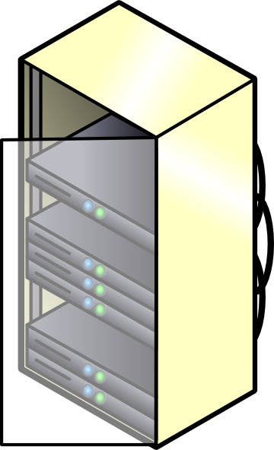



  The StratusLab Vision
2
  Batch Job Processing
  Custom Execution Environments
  Grid Service Integration
  Industry Applications
  Other WMS (pilots)
  Complete Services (cluster)
Access
Grid Middleware
IaaS Interface
LRMS (LSF, PBS…)
StratusLab Toolkit
1
Service
Virtual CE, WN…
Other (web, mail...)
Raw machines
3
Provision
Grid Sites
External Providers

Slide 5


  Architecture of StratusLab
Grid Services
MarketPlace
  Federation facilities
  Security
  Grid specific services
  Sharing existing VM images
  Registry of metadata
  Image are kept elsewhere
  Supports trust
Appliance Repo
  Storage VM images
  Distributed
  Multi-protocol
Grid Services
Cloud API
Grid Services
Cloud API
Cloud/Grid Site
Cloud/Grid Site

Slide 6





Architecture of StratusLab
Interface/Apps
Web GUI
CLI (strarus-*)
Cloud (OCCI/CDMI)
Claudia
Complete Services
Automatic Elasticity
TCloud Interface
Storage Service
Networking
Private
Local
Public
VM Disk Images
Persistent
Volatile
Static
Users
Accounting
VOMS proxy
Hosts
Storage
Quattor install
Ganglia Monitoring
Xen/KVM hypervisor
NFS/SAN
Quarantine

Slide 7
Architecture of StratusLab
OCCI (IaaS)
TCloud ( Ext. IaaS)
User/Admin
CLI
Web
Monitor
AuthN
Proxy
Claudia
OpenNebula XML-RPC Interface
REST/CDMI
Cloud Manager
Storage Manager
Networking
Compute
Image
iSCSI
NFS
DHCP
NAT
Ganglia
KVM/Xen
Storage Service
Market Place
Performace

Slide 8

Architecture of StratusLab
Grid Services
MarketPlace
  Federation facilities
  Security
  Sharing existing VM images
1
  Availability Zones
  Images
  Networks
  QoS
Multi Cloud
Cloud/Grid Sites
Grid Services
Cloud API
Grid Services
Cloud API
2
Cloud Bursting
  Needs to consider Image & VLANs
  Needs to consider placement
  Can integrate other EU FP-clouds
External Clouds

Slide 9
Cloud Services & Infrastructures
StratusLab
Distribution
Reference
Deployment
Cloud
Services
Stratus Components
Easy to install
Thoroughly tested
Regularly released
Supported
Showcase
Evangelization
Know-how
Best practices
Available to users
Marketplace
Appliance Repository
Internal Services
Testing Infrastructure
Code Repositories
LDAP
TBC…

Slide 10
Year 2 Plans
Storage
  Volume Management (sharpshooting, attach/detach)
  Massively scalable deployments
  Cloud Interfaces for Storage Services
Networking
  Dynamic VLAN
  Firewalling
  Interfaces for Network management
Compute
  Cloud bursting
  Accounting
Service
  Elasticity of virtualized Grid Services
  Interfaces for Service Management

Slide 11
Questions?

