Slide 1
Work Package 4
Software Integration and Distribution
StratusLab First Periodic Review
Brussels, Belgium
4 July 2011

Slide 2
Introduction
Work Package 4:
  Integration, testing and creation of an open source production quality cloud software distribution
  Definition of a clear architecture and features able to fulfill grid sites requirements
  Provide simple usage patterns for end-users and system administrators
Objectives
  Definition of a reference architecture and selection of software components
  Integration and management of open-source distribution, definition and maintenance of reference configurations
  Technical support for installation and configuration of the distribution, following industrial practices in terms of quality, maintainability, testability and usability
  Definition of a process for contextualisation of the virtual appliances
Tasks
  T4.1: Definition of Reference Architecture (SixSq, UCM, TID)
  T4.2: Integration of Open-source Distribution (SixSq)
  T4.3: Contextualisation of Grid Services (UCM, TID)
  T4.4: Technical Support (SixSq, UCM, TID)

Slide 3
Achievements
Open source production quality IaaS cloud distribution
  Five (5) public releases of StratusLab with incremental functionality
  StratusLab v1.0, a complete distribution for foundation cloud services
Simple installation procedure
  Simple manual installation procedure with single configuration file
  Automated installation with Quattor to better integrate with site management

Slide 4
Achievements
Automated build and test system
  Built a comprehensive build and test infrastructure, spanning two sites and over 12 machines (physical and virtual) – at GRNet and LAL
  Automated procedure including systematic installation, configuration and system-testing of all StratusLab services, from clean (re-imaged) machines daily
  Key services: Hudson, Maven/Nexus, YUM and APT repositories

Slide 5
Achievements
Agile/Scrum methodology
  Put in place agile/Scrum methodology, to which all work packages and partners contribute
  15 sprints and demos
Clear IaaS Architecture (v1.0 and v2.0)
  IaaS Cloud Architecture able to fulfill grid site requirements
  Evolution from v1.0 to v2.0

Slide 6
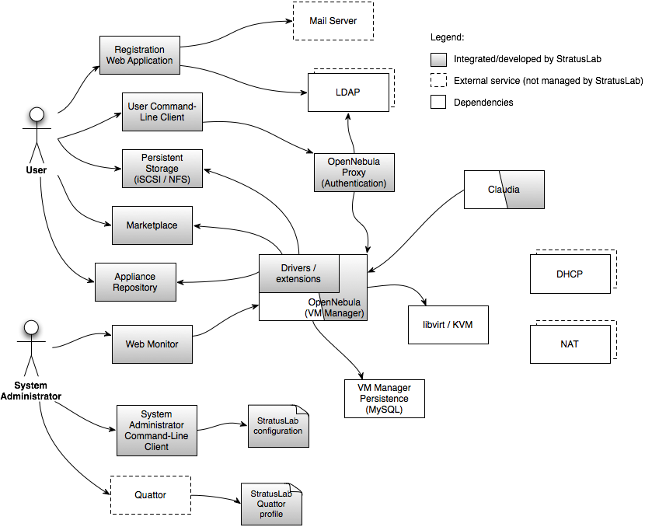
Architecture Vision v1.0
Available for production use in StratusLab v1.0

Slide 7
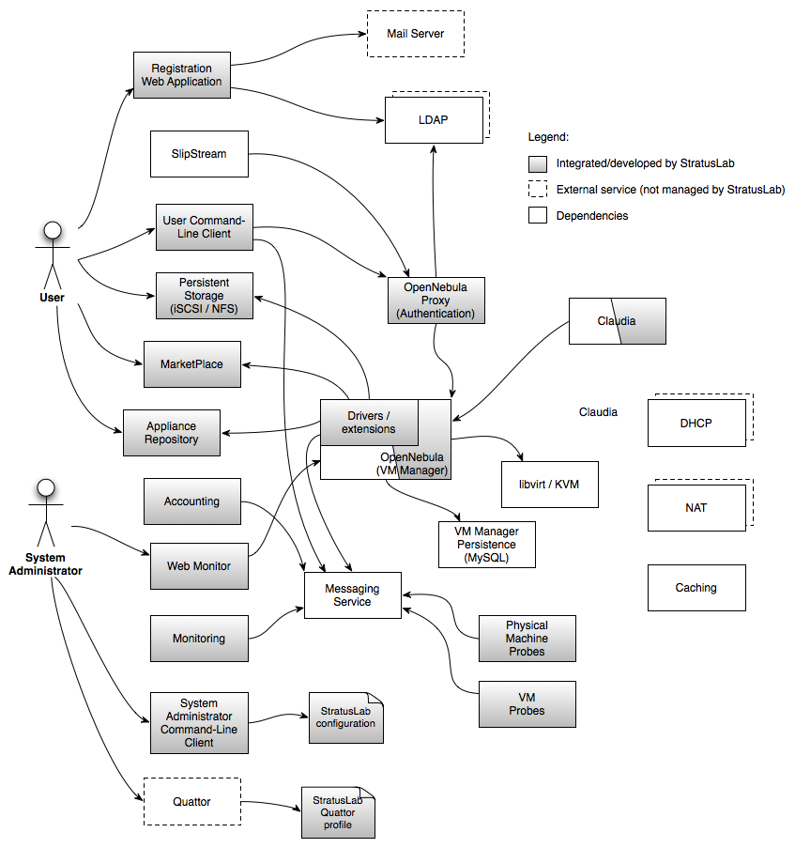
Architecture Vision v2.0
Work in progress…

Slide 8
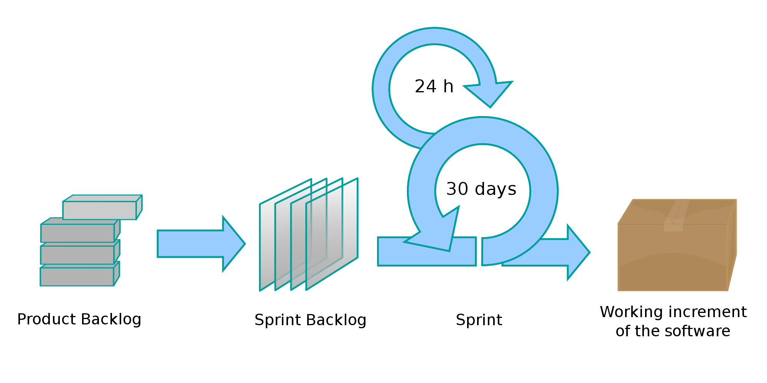
Scrum in StratusLab
TSCG
Stategic
All WPs
All partners
Aim at producing
new StratusLab
release every 2
sprints
Planning
Meeting
Tactical
~3 weeks
Captured in JIRA

Slide 9
Benefits from Agile and Scrum
Incremental development
  Generate early and regular feedback
  Improve robustness through each sprint
  Validate assumptions with real implementation
Prioritised functionality
  Skills across all activities and all partners maximised at every sprint
  Ability to react to opportunities and changes by steering incremental development
  Reduce integration and configuration risk with continuous integration and deployment

Slide 10
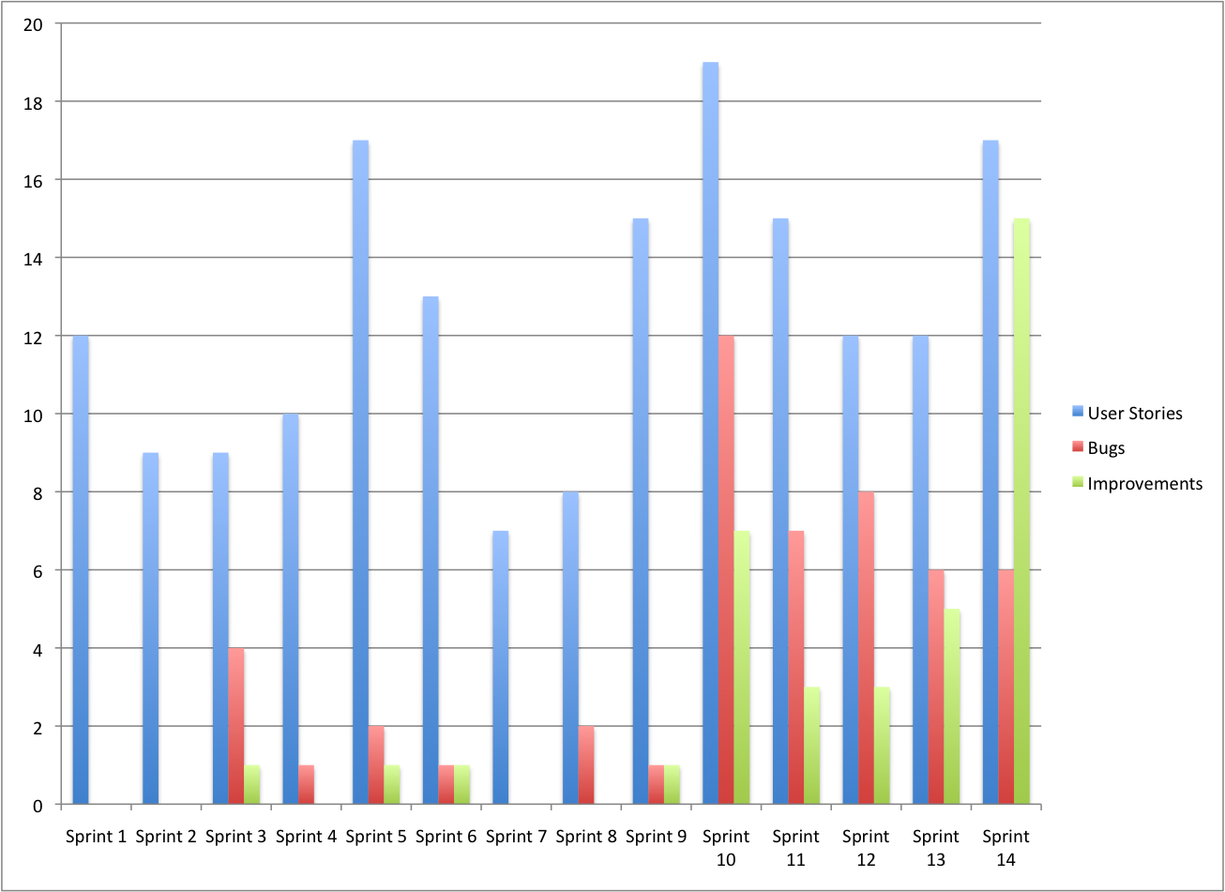
Sprint Highlights
Kick off
v0.2
v1.0
v0.3
v0.1
v0.4
Winter
break

Slide 11
JIRA Task Board

Slide 12
Hudson in action

Slide 13
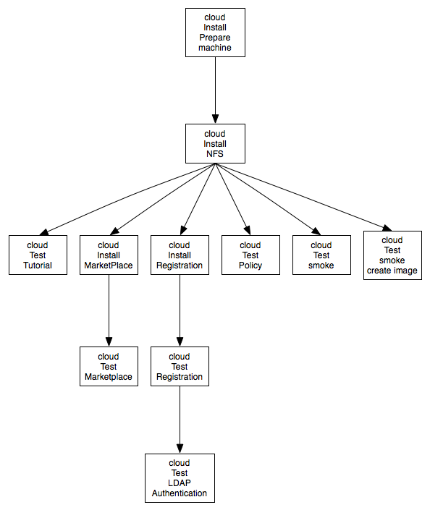
Hudson jobs – continuous testing
Triggered daily
Triggered following every commit

Slide 14
Metrics
Scrum metrics include work from all partners and WPs
  Steady sprint rate
  Steady implementation of work items
  Note: no target defined
Metric | Q2 | Q3 | Q4
No. of completed sprints | 5 | 5 | 4
No. of releases | 1 | 1 | 1
No. of open user stories | 38 | 72 | 101
No. of implemented user stories | 69 | 40 | 67
No. of open bugs | 6 | 15 | 22
No. of fixed bugs | 7 | 11 | 27

Slide 15
Issues and Improvements
Issues encountered
  Production releases sometimes difficult with interrupted production service
  Documentation is sometimes lagging behind features
Improvements needed
  Shift more effort in automating upgrades
  Release more often, such that each upgrade is smaller and better understood
  Improve further our definition of ‘DONE’ by adding documentation update

Slide 16
Plans for Y2
Overall roadmap of activity
  D4.4: Reference Architecture for StratusLab Toolkit v2.0 (PM 15)
  MS9: Release of StratusLab 2.0 Beta (PM22)
  D4.5: StratusLab Toolkit v2.0 (PM24)
  D4.6: Software Integration Final Report (PM24)
Priorities for Y2
  More regular releases, with higher upgrade automation
  Improve and widen unit and system tests
  Support wider range of platforms (user and/or sysadmin CLI), including Ubuntu
  Continue responding to change within project scope

Slide 17
Questions?

