Slide 1
Demonstration
StratusLab First Periodic Review
Brussels, Belgium
4 July 2011 (v2)

Slide 2
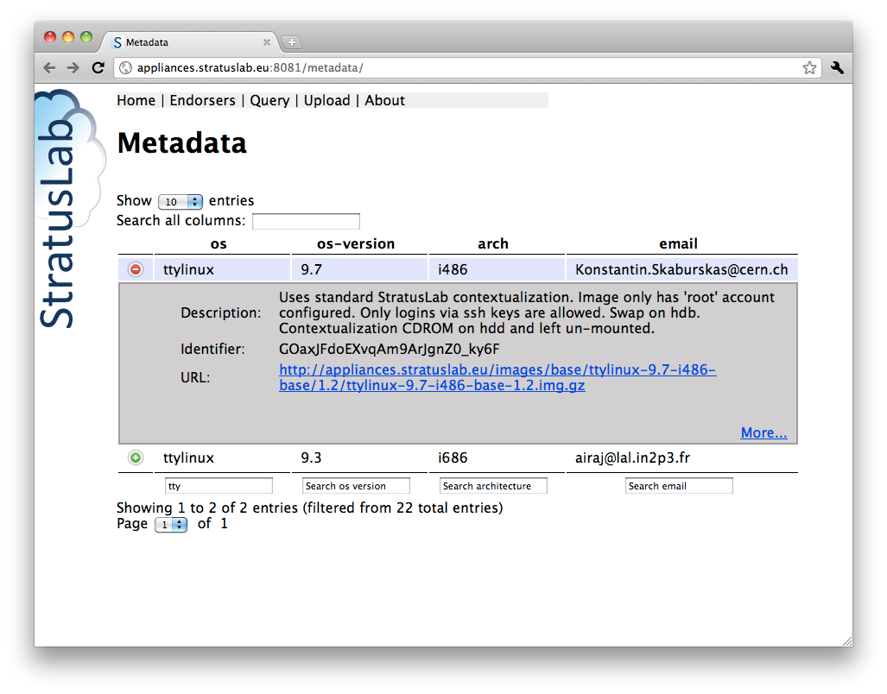
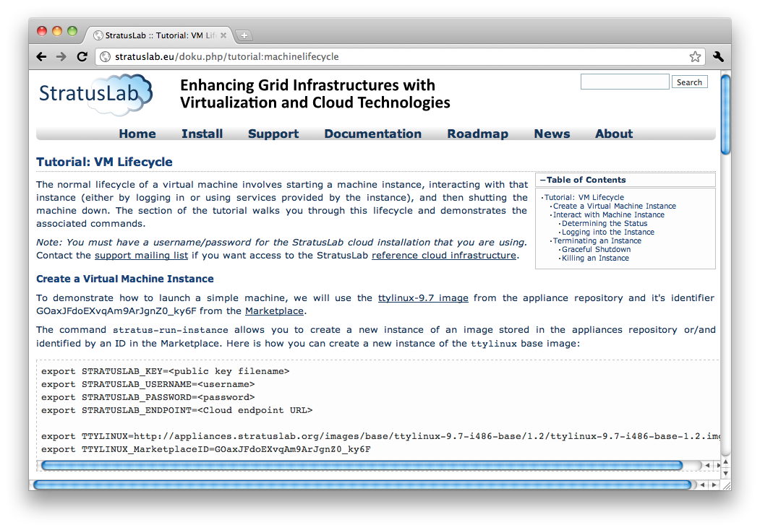
Introduction
Manual Installation
  Script-assisted installation of complete StratusLab cloud.
Tutorial
  Selection of VM image via
  the Marketplace.
  Abbreviated tutorial showing
  VM lifecycle.

Slide 3
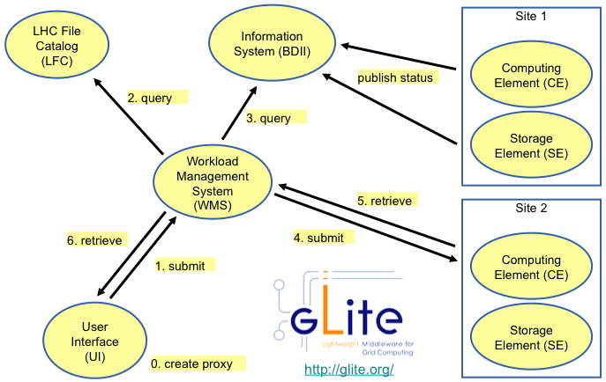
Introduction
Grid Site Installation
  Services described via OVF are deployed automatically by Claudia.
  Contextualization includes the provision of service certificates.
Autoscaling of Grid Service
  Show that number of
  worker nodes grows
  and shrinks with
  queue length.

Slide 4
Infrastructures
“Private” Machines
  Couple of machines with Fedora 14 preinstalled.
  Used for demonstration of installation.
  Used for tutorial.
Reference Infrastructure
  Used for tutorial in case of problems with previous installation.
“Pre-installed” Machines
  Set of machines pre-installed with StratusLab v1.0.
  Demonstration of grid site installation and elasticity.

Slide 5
Installation

Slide 6
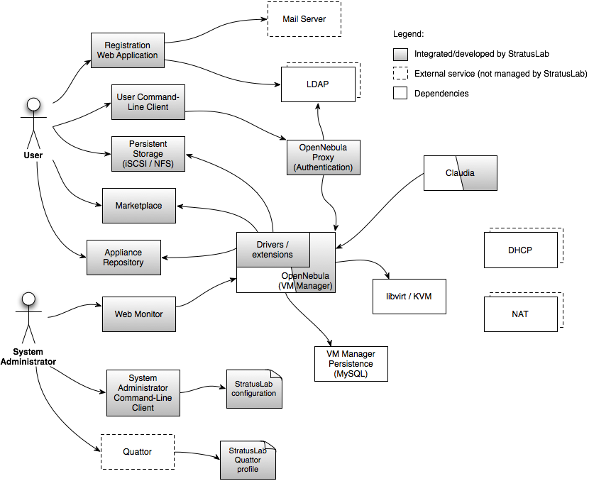
Installation Demo Services Involved

Slide 7
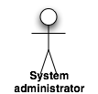

Installation Demo Deployment
Marketplace
Appliance
Repository
TCD
Front-end
Node
GRNET

Slide 8
Tutorial

Slide 9
Autoscaling

Slide 10
Grid Site
Installation

Slide 11
Summary
Manual Installation
  Simplifies StratusLab installation for system administrators.
Tutorial
  Showed Marketplace use and standard VM lifecycle.
Grid Site Installation
  Automated installation of grid site services via OVF description.
Autoscaling of Grid Service
  Automated management of grid services, responding to peak loads.

Slide 12
Questions?

