Slide 1
Conclusions & Planning
StratusLab First Periodic Review
Brussels, Belgium
4 July 2011 (v3)

Slide 2
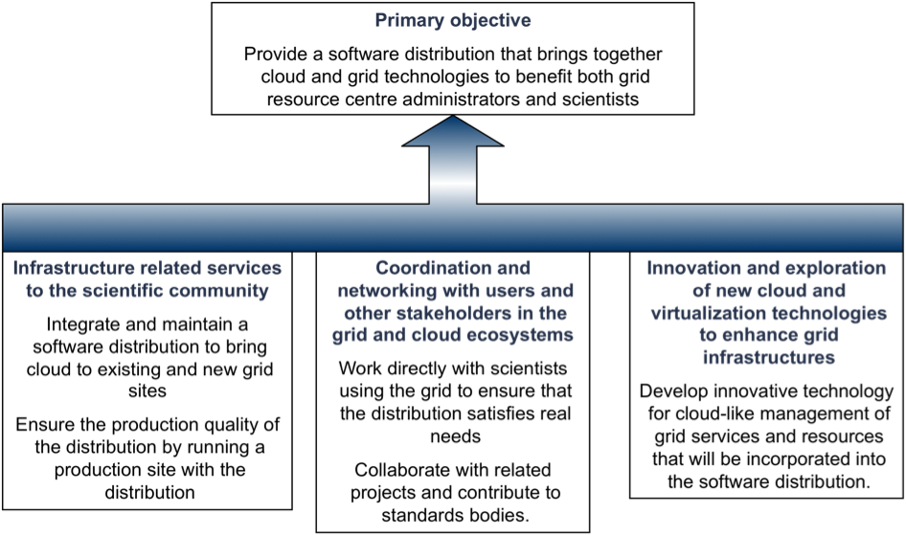
Objectives

Slide 3
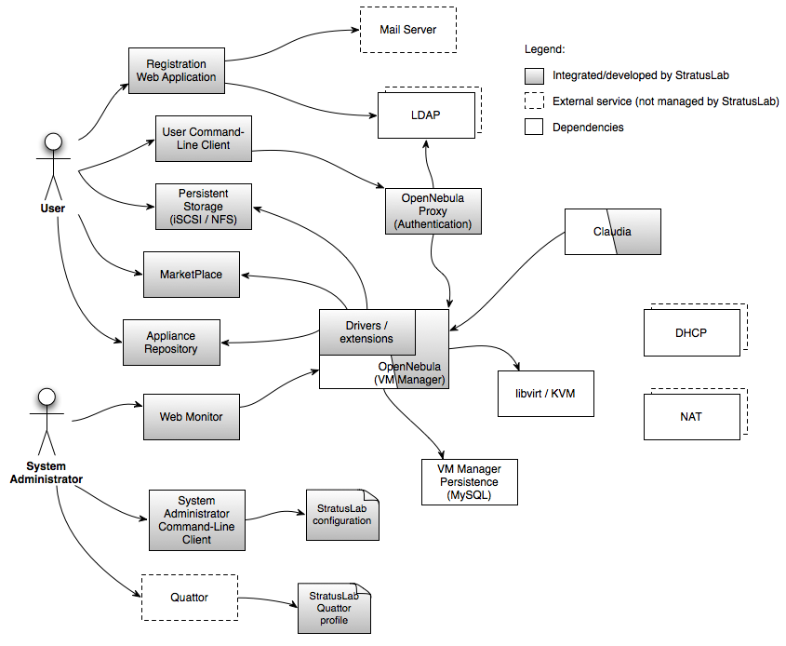
Primary Objective
StratusLab Distribution
  v0.1, v0.2, v0.3, v0.4
  v1.0 (production) in M13
Features
  Compute, storage, and networking services
  Federative aspects: Marketplace, Grid Authn.
  Incorporates latest versions of OpenNebula and Claudia

Slide 4
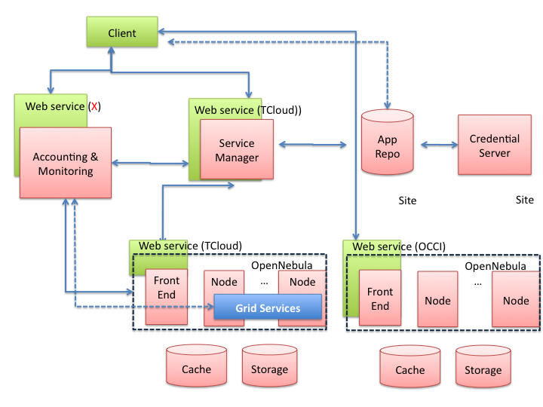
Innovative Services
Service Manager
  Integrated Claudia
  Service deployment supports PaaS over StratusLab cloud
  Autoscaling support
Advanced Features
  Integrated OpenNebula
  Group and role support
  Fault tolerance hooks
  Image management

Slide 5
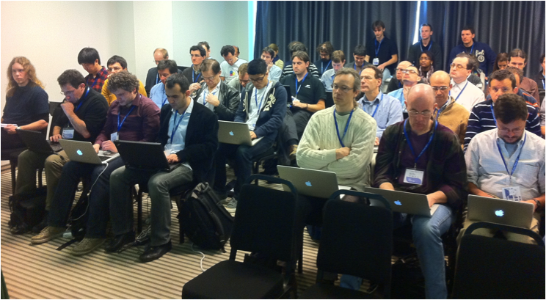
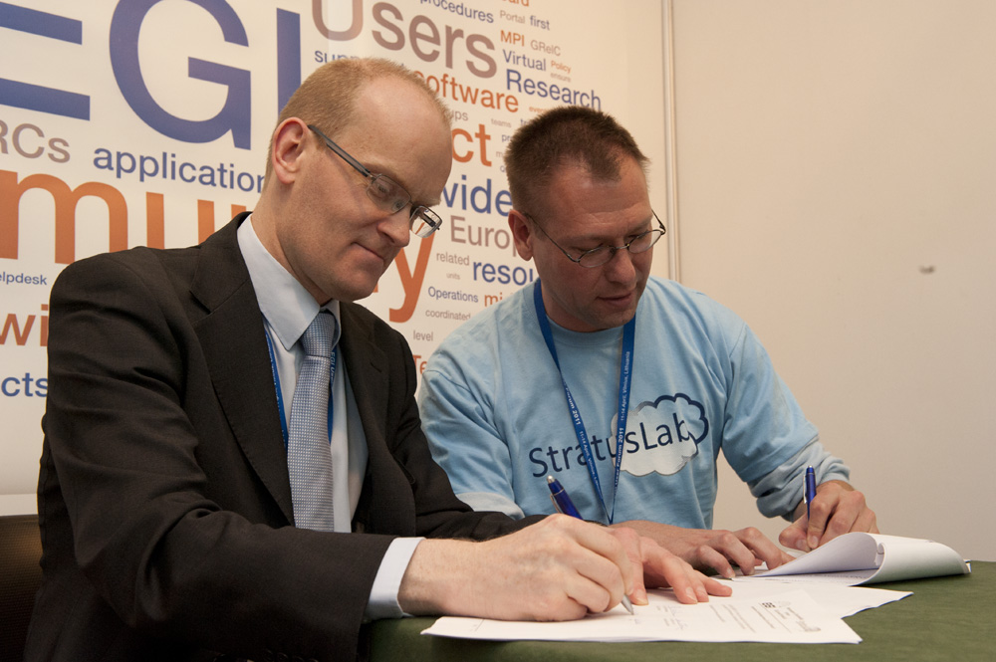
Coordination and Networking
Targeted Communities
  Surveys have influenced project’s work plan.
  Successful tutorials.
Related Projects
  Intensive work with groups like HEPiX to ensure services meet real needs.
  DCI projects: EGI, EDGI, VENUS-C, …
  Collaboration with SIENA

Slide 6
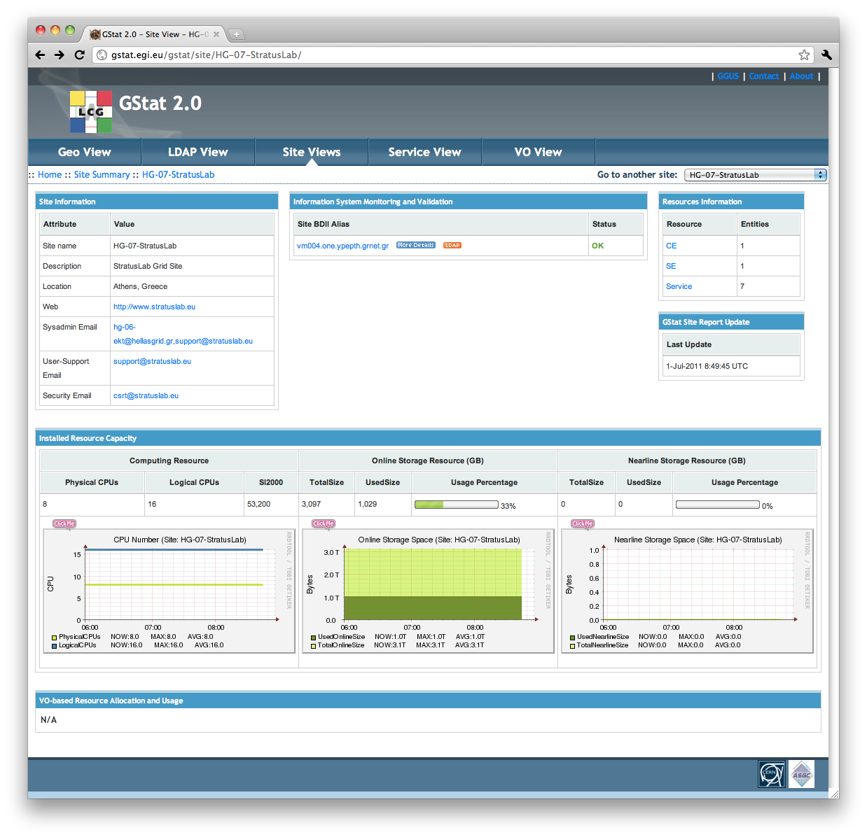
Infrastructure Related Services
Processes and Tools
  Integration processes focus on iterative improvements.
  Tools to measure
  and to improve quality.
Production Services
  Reference cloud infrastructure to generate feedback
  Complete, certified grid site running over StratusLab cloud

Slide 7
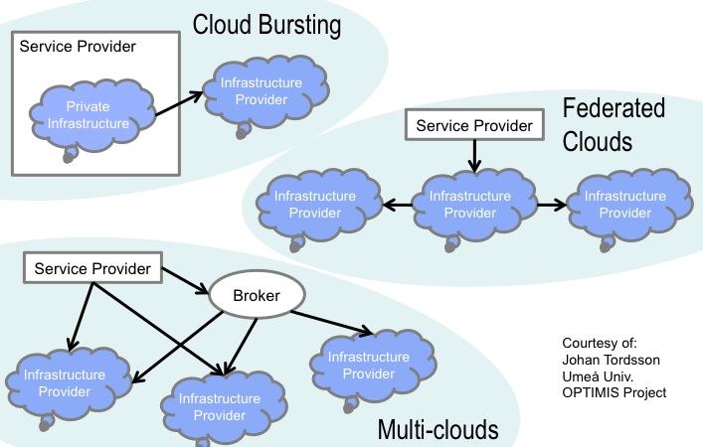
Year 2
Priorities
  Incremental improvements in functionality and performance
  Adoption of standard interfaces: TCloud, OCCI (OVF), CDMI, Network
  Investigation of federated cloud scenarios

Slide 8







Architecture of StratusLab
Grid Services
Marketplace
  Share existing images
  Federation facilities
  Security
1
  Availability Zones
  Images
  Networks
  QoS
Multi Cloud
Cloud/Grid Sites
Grid Services
Cloud API
Grid Services
Cloud API
2
Cloud Bursting
External Clouds
  Needs to consider Image & VLANs
  Needs to consider placement
  Can integrate other EU FP-clouds

Slide 9
Year 2 Plans
Storage
  Volume Management (snapshots, attach/detach)
  Massively scalable deployments
Compute
  Cloud bursting
  Massively scalable deployments
Networking
  Dynamic VLAN
  Firewalling
  IPv6
Service
  Elasticity of virtualized grid services
Accounting

Slide 10
Questions?

