Slide 1
Work Package 3 Dissemination, Collaboration, Standardization Exploitation and Sustainability
StratusLab First Periodic Review
Brussels, Belgium
4 July 2011

Slide 2
Introduction
Description of Work Package
WP3 coordinates the project’s activities in dissemination, collaboration with related projects and standards bodies, and exploitation and sustainability.
Objectives
Disseminate results of the project to resource providers, end-users, and the general public
Identify project contributions to standards bodies and standardization efforts
Coordinate interactions with related projects, developing Memoranda of Understanding between projects where appropriate.
Tasks
T3.1 Dissemination (TCD, All)
T3.2 Collaboration with Standards Bodies and Related Projects (TCD, All)
T3.3 Development of Exploitation and Sustainability Plan (SixSq, All)

Slide 3
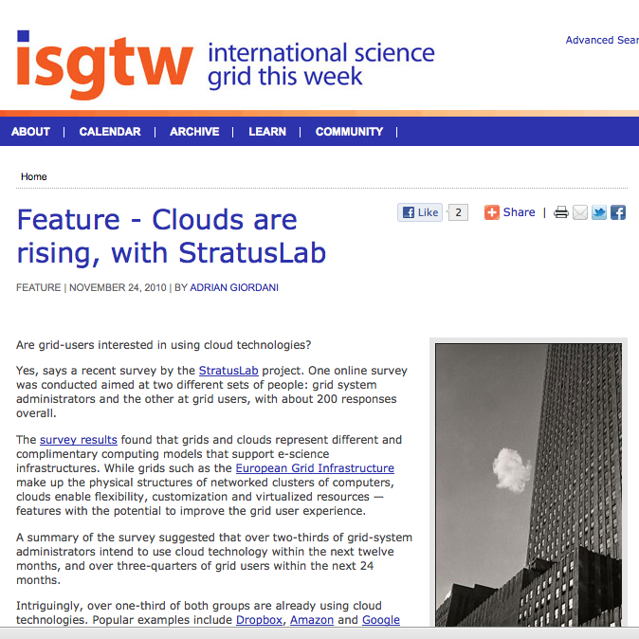
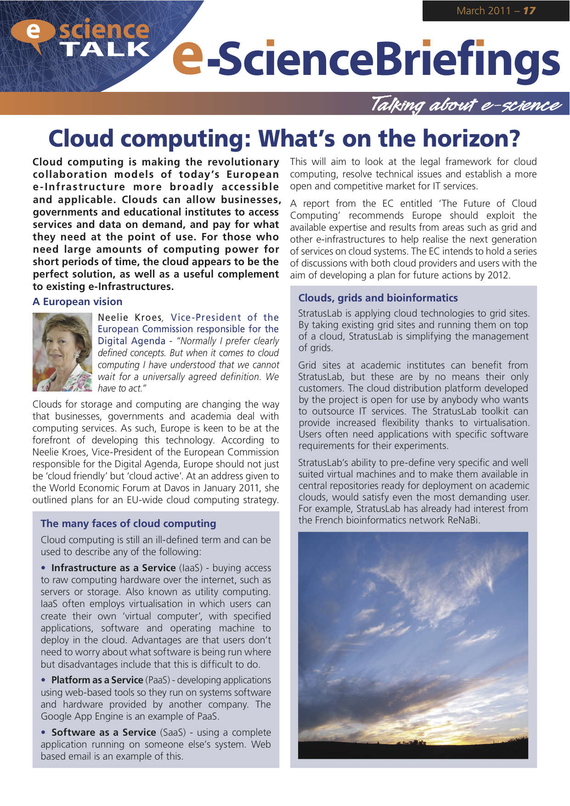
Achievements
Press / media
Press releases for launch and software releases
International Science Grid This Week and e-ScienceTalk

Slide 4
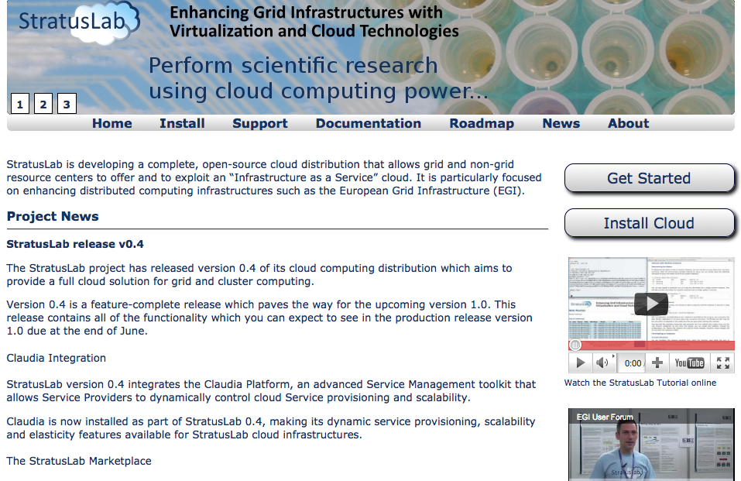
Achievements
Website / online
Re-designed website at http://www.stratuslab.eu/
Use of Twitter @StratusLab, RSS news feed
Analytics

Slide 5
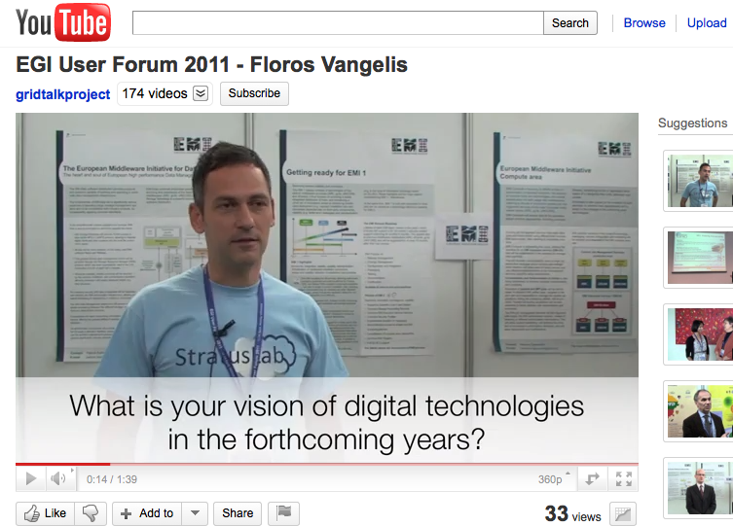
Achievements
EGI User Forum and Technical Forum
Strong, recognized presence at EGI TF 2010 and EGI UF 2011
Excellent venue for e-Infrastructure community
Talks, demos, posters, tutorials by StratusLab

Slide 6
Achievements
Over 40 Talks and Events
XtreemOS Summer School, Günzberg, Germany, July 2010
CSIC graduate course on Grid and e-Science, Valencia, Spain, Jul 2010
EuroPar 2010, Ischia, Italy, Aug 31 – September 3 2010
CERN, Geneva
HPC 2010 International Workshop on High-performance Computing, Grids and Clouds, Cetraro, Italy, Jun 21 – 25, 2010
SWSTE 2010, Herzlia, Israel, Jun 15 – 16, 2010
First European Summit on Future Internet, Luxembourg, Jun 2 – 3
EuroPar 2010, Aug 31 – Sep 3 2010
Integrating Cloud Monitoring and Accounting with Grid Operational Tools, EGI Technical Forum 2010, 14 Sep 2010
Operational Considerations From Running Grid Services on Cloud Resources, EGI Technical Forum 2010, 14 Sep 2010
StratusLab Accounting Requirements, EGI Technical Forum 2010, 15 Sep 2010
Cloud Challenges, EGI Technical Forum 2010, 16 Sep 2010
ICT 2010, Brussels, Belgium, 27–29 Sep 2010
GRISBI Bioinformatics School, Roscoff, France, 1 Oct 2010
OGF30/Grid2010, 25–28 Oct 2010
CloudComp 2010, 26–28 Oct 2010
ISC Cloud 2010, 28–29 Oct 2010
HP Labs Seminar, Nov 2010
7th International Cloud Computing Expo, 1 Nov 2010
SlipStream and StratusLab, Cloud & ICT 2.0 Summit, Geneva, 18 Nov 2010
OW2 Annual Conference , 24–25 Nov 2010
Spanish NGI meeting, Barcelona, Spain, 2 Dec 2010
“StratusLab : Le projet et sa distribution cloud” (C. Loomis, LAL) at France-Grille Cloud Event in Lyon, France, 13 Dec 2010
UCM talk at France-Grille Cloud Event in Lyon, France, 13 Dec 2010
“Cloud Computing – Anatomy and Practice” (M.-E. Bégin, SixSq) at Groupe romand des utilisateurs/trices de GNU/Linux et de Logiciels libres, Morge, Switzerland, 11 Jan 2011
“StratusLab Cloud Distribution” (C. Loomis, LAL) “Opening the Cloud” 2011 ASSYST Meeting on Cloud Computing, Paris, France, 31 Jan 2011
UCM talk at Cloud Expo Europe 2011, London, United Kingdom, 2 Feb 2011
“Bioinformatics distributed infrastructure, services and cloud computing” (C. Blanchet, CNRS IBCP) at ELIXIR Workshop - Bioinformatics Infrastructures, Amsterdam, Netherlands, 22 Feb 2011
“Security Management in OpenNebula Cloud Architectures” (Javier Fontán, UCM) at 9th RedIRIS Security Forum on Cloud Computing, 9 Mar 2011
“StratusLab Cloud: Early success stories and community feedback” (V. Floros, GRNET) at CloudScape III, Brussels, Belgium, 15 Mar 2011
“StratusLab: Enhancing Grid Infrastructures with Virtualization and Cloud Technologies” (C. Loomis, LAL) at EU-Canada Future Internet Workshop, Waterloo, Ontario, Canada, 23 Mar 2011
StratusLab Booth at the EGI User Forum 2011, Vilnius, Lithuania, 11–14 Apr 2011
“Operating Grid Services on the StratusLab Cloud” (V. FLoros, GRNET) at the EGI User Forum 2011, Vilnius, Lithuania, 11 Apr 2011
“StratusLab Tutorial” at the EGI User Forum 2011, Vilnius, Lithuania, 12 Apr 2011
“StratusLab Collaborations” at the ECEE Workshop during the EGI User Forum 2011, Vilnius, Lithuania, 13 Apr 2011
“Sharing Virtual Appliances with the StratusLab Marketplace” at the HEPiX Workshop in Darmstadt, Germany, 5 May 2011
Panel Discussion: sharing knowledge on StratusLab's experience in applying agile (and Scrum) in academic context and FP7 contracts (Marc-Elian Bégin, SixSq) at XP2011, Madrid, Spain, 11 May 2011
“StratusLab use cases” at EGI User Virtualisation Workshop, Amsterdam, Netherlands, 12 May 2011
“Cloud Computing and StratusLab” at Journée Grille de production EGI, Lille, France, 17 May 2011
“StratusLab: Enhancing Grid Infrastructures with Cloud and Virtualization Technologies” at the TERENA Networking Conference in Prague, Czech Republic, 19 May 2011
“StratusLab: Enhancing Grid Infrastructures with Cloud and Virtualization Technologies” at Journées GRISBI in Lyon, France, 26 May 2011
“Grid-Ireland Operations Centre / TCD presentation” featuring StratusLab at Lero Cloud Computing seminar Cork, Ireland, 26 May 2011

Slide 7
Achievements
Release dissemination
Dissemination plan for each public release
Draft text of announcements, etc.
Initial release v0.1:
Announcements to relevant mailing lists
Press release, picked up by HPCwire, Sys-Con, CloudExpo News, DSA Research Blog, and OpenNebula Blog
Announcement in International Science Grid This Week
Public releases v0.2, v0.3, v0.4
Announcements to relevant mailing lists and ISGTW
Release v1.0 (Q5 / Y2)
Target wider audience, given stability and maturity of v1.0

Slide 8
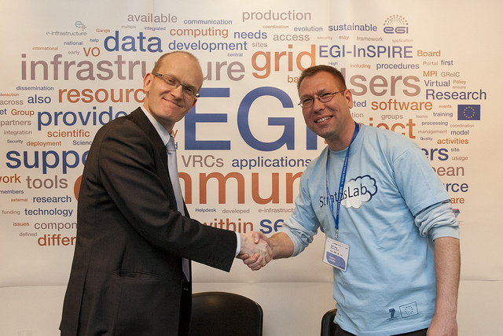
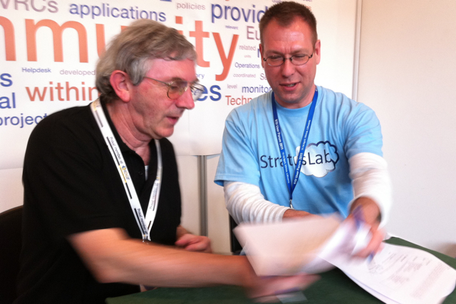
Achievements
Collaboration
European Grid Infrastructure
Plan to use StratusLab as part of EGI Federated Virtual Infrastructure
Collaboration on SPG virtualization security policies, related to HEPiX
MoU signed April 2011
European Desktop Grid Initiative
Use infrastructure and tools, providing requirements and use-cases
MoU signed April 2011

Slide 9
Achievements
Signed MoU
CYFRONET, Poland
Federated virtual infrastructure and computational chemistry
MoU signed June 2011
Finalized MoU
VENUS-C
ready for signature
MoUs in progress
IGE
EMI
Other collaborations
ttylinux, SARA HPC Cloud, NIIF, Mantychore, Contrail

Slide 10
Achievements
Standardization
SIENA
StratusLab representation on editorial board of “SIENA European Roadmap on Grid and Cloud Standards for e-Science and Beyond”
On-going updates to SIENA on StratusLab status
Use of standards
OCCI
TCloud
CDMI
OVF
(future networking standard)

Slide 11
Achievements
Sustainability and Exploitation through commercial use
SixSq and SlipStream
SlipStream engine for multi-machine runtime environments for software release
StratusLab provides a private cloud backend for customers for whom public clouds are unsuitable
SixSq will investigate commercial integration and support of StratusLab
Telefonica I+D Global Cloud Initiative
TID will exploit StratusLab, Claudia and TCloud API
Part of TID IaaS Cloud Product Line to be used by Telefonica companies and clients
UCM and C12G
Value-added services around OpenNebula through the University Office of Technology Transfer
C12G Labs, a UCM spin-off, to provide support subscription and value-added services

Slide 12
Achievements
Exploitation and Sustainability Plan
Plan for commercial and non-commercial exploitation of project outputs, and investigate models of sustainability
Exploitation
Commercial integration and support
E-Infrastructure deployment for cloud and grid infrastructures
OpenNebula, as a means to bring StratusLab developments to users
Collaborating projects, training, and future cloud research
Sustainability
Promotion through dissemination and commercial activity
Community and process for users and developers
Harness support for cloud technology
Further public funding, and support for and from national infrastructures
The “First Plan” provides a good picture of exploitation and sustainability activities, and a basis for the “Final Plan” (due M24)

Slide 13
Metrics
Dissemination metrics
Announcement list populated but not growing
In addition, the @StratusLab Twitter account has 60 users
Website views grew after initial release
In both cases, we expect further growth after release 1.0
“discussion site” not available. See Issues, next.
Metric | Q2 | Q3 | Q4 | Y1 Target
Nº of people on announcement list | 67 | 67 | 67 | 25
Nº of views of website | 2922 | 4623 | 4579 | –
Nº registered users on discussion site | – | – | – | 50

Slide 14
Issues
Discussion Forum
Issue
The project had expected to have a technical discussion mailing list, weblog or web forum to encourage dialogue with the user community.
A discussion feature has been added to the website for testing, but it has not been widely advertised and it is difficult to accurately measure usage. Only one external user has posted comments.
Solution
Will make greater use of discussion features on re-designed web site.
Will investigate other mechanisms, such as conventional discussion mailing list.

Slide 15
Plans for Y2
Overall roadmap of activity
Release dissemination (continual)
Talks and presentations (continual)
Release v1.0 (M14, July 2011)
Finalise MoUs with VENUS-C, IGE, EMI (Q5, June–August 2011)
EGI Technical Forum (M16, September 2011)
EGI User Forum (M23, April 2012)
Release v2.0 (M24, May 2012)
D3.4 Final Review of Dissemination, Collaboration and Standardization Activities (M24, May 2012)
D3.5 Exploitation and Sustainability Final Plan (M24, May 2012)

Slide 16
Plans for Y2
Priorities for Y2
Broaden dissemination audience
Related communities and general public
Match changes in technical focus
Implement existing MoUs and develop other collaborations
Exploitation and sustainability planning began in Q4 and will continue throughout Y2
Overcome obstacles to adopting StratusLab given project is due to finish in May 2012

Slide 17
Questions?

