Slide 1
StratusLab Cloud Distribution
StratusLab Tutorial (Orsay, France)
17-18 November 2011

Slide 2






StratusLab Project
Goal
Create comprehensive, open-source, IaaS cloud distribution
Focus on supporting grid services
Information
1 June 2010—31 May 2012 (2 years)
6 partners from 5 countries
Budget : 3.3 M€ (2.3 M€ EC)
Contacts
Site web: http://stratuslab.eu/
Twitter: @StratusLab
Support: support@stratuslab.eu
CNRS (FR)
UCM (ES)
GRNET (GR)
SIXSQ (CH)
TID (ES)
TCD (IE)

Slide 3
Project Principles
Grid and cloud technologies are complementary
Uniform security model (grid)
Sharing of resources, algorithms, and expertise (grid)
Dynamic allocation of resources (cloud)
Customized environments (cloud)
Only develop new software when necessary
Integrate existing solutions if possible
Practical development → real needs of users
Maintain production quality with rapid evolution
Use agile and scrum methodologies
Iterative integration: always maintain working distribution
Public releases approximately every 6 weeks

Slide 4




Infrastructure as a Service (IaaS)
Goal
Offer remote access to computing resources
Advantages
Customized environments
Rapid access via simple API
Complete control (root access) with “pay as you go” model
Disadvantages
Non-standard interfaces (vendor lock-in)
Creating new virtual machines is difficult
Software as a Service (SaaS)
Platform as a Service (PaaS)
Infrastructure as a Service (IaaS)

Slide 5
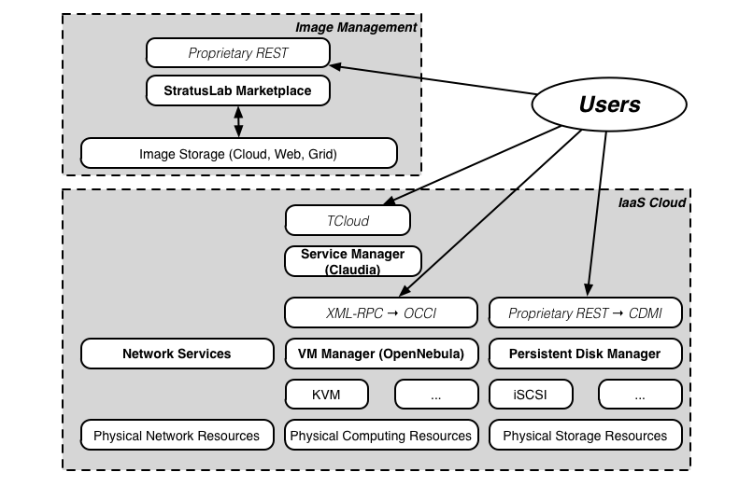
StratusLab Architecture (v1.0)

Slide 6
Compute Services
OpenNebula (opennebula.org)
Provides core of virtual machine management (start, stop, kill)
Plug-in architecture allows use of multiple hypervisors (kvm, …)
Enhancements
Quarantine of stopped images for forensic analysis
Improved logging of user and resource information
Ability to pass error messages from plug-ins to user
Improved fault tolerance
Improved management of network addresses
Support for users, groups, and roles (post-1.0)

Slide 7
Storage Services
Persistent (Read-Write) Disks
Allows the storage of service state or user data
Mounted as a disk on VMs
Disks are persistent and have a lifecycle independent of a single VM
Can be mounted by single VM at any time
Only available within a single cloud instance
Static (Read-Only) Disks
Useful for distribution of quasi-static databases
Handled and shared like VM images via Marketplace
Volatile (Read-Write) Disks
Useful for temporary (!) data storage
Data will disappear when VM instance is destroyed

Slide 8
Other Storage Types
File-based Storage
Normal client tools can be installed in VMs
Access services normally from VM (e.g. tools for SRM)
Unlikely to be implemented by StratusLab, although will provide CDMI interface to persistent storage service
Object Storage
Simple object storage, usually minimal hierarchy and chunked data
Won’t implement this in StratusLab, could take implementations from elsewhere, e.g. OpenStack
Key-value Pair Database
Exposes simple API for “database” of key-value pairs (e.g. Cassandra)
Can deploy VM with persistent disk to provide this service

Slide 9
Networking Services
IP Address Classes & Selection
Public: Internet-accessible services
Local: Batch systems or parallel calculations
Private: Slaves in pilot job systems
Future Services
IP address reservation
User specified firewalls
Dynamic VLANs
IPv6 use/validation

Slide 10
Marketplace
Machine image creation is a barrier to cloud adoption
Creating virtual machine images is time-consuming
Ensuring that machines are secure and correct is difficult
Sharing existing machines lowers this barrier
Marketplace facilitates sharing of images
Registry of metadata for machine & disk images
Image contents are kept in cloud, grid, or web storage
Supports trust between creators, users, and administrators
Benefits
End-users: browse and use existing images for their analyses
Creators: publicize their work and attract larger user base
Cloud Admins.: Use metadata to evaluate trustworthiness of images

Slide 11
Other Services
Claudia: Service Manager
Provides service (ensemble of machines) management
Dynamic control/scaling based on monitoring feedback
Currently being integrated with other StratusLab services
Authn/Authz
Authentication done through common proxy service
Allows username/password from LDAP or from file
Allows use of grid certificates and VOMS proxies
Authorization done in individual services
Delegation currently not needed/used (will change if machine or disk images are protected)

Slide 12
Other Services
Registration Service
Web service for user registration
LDAP DB for easy integration with cloud and other services
Accounting/Monitoring
Ganglia for monitoring of physical and virtual infrastructure
Simple scripts to extract accounting information for reports
No publication of the information for the moment

Slide 13
Accessing Services
StratusLab Client
Command line scripts in python/java with few dependencies
Works on Mac OSX, Linux, and Windows
Programming Interfaces
Most services provide REST interfaces
Easy to program from any language
Straightforward resource ←→ URL mapping
Standard interfaces will be implemented (OCCI, CMDI, …)
Libraries
None currently provided
jclouds (java, clojure) will be implemented shortly

Slide 14
Appliances
Appliances
Provide pre-configured, pre-installed software and services
Makes it easier to get started quickly using cloud resources
Can make and publish your own appliances
StratusLab-Provided Appliances
Base images: ttylinux, CentOS 5.5, Ubuntu 10.04, OpenSuSE (soon)
Grid: CE, SE, WN, APEL/BDII, UI
Bioinformatics: Data server and analysis images

Slide 15
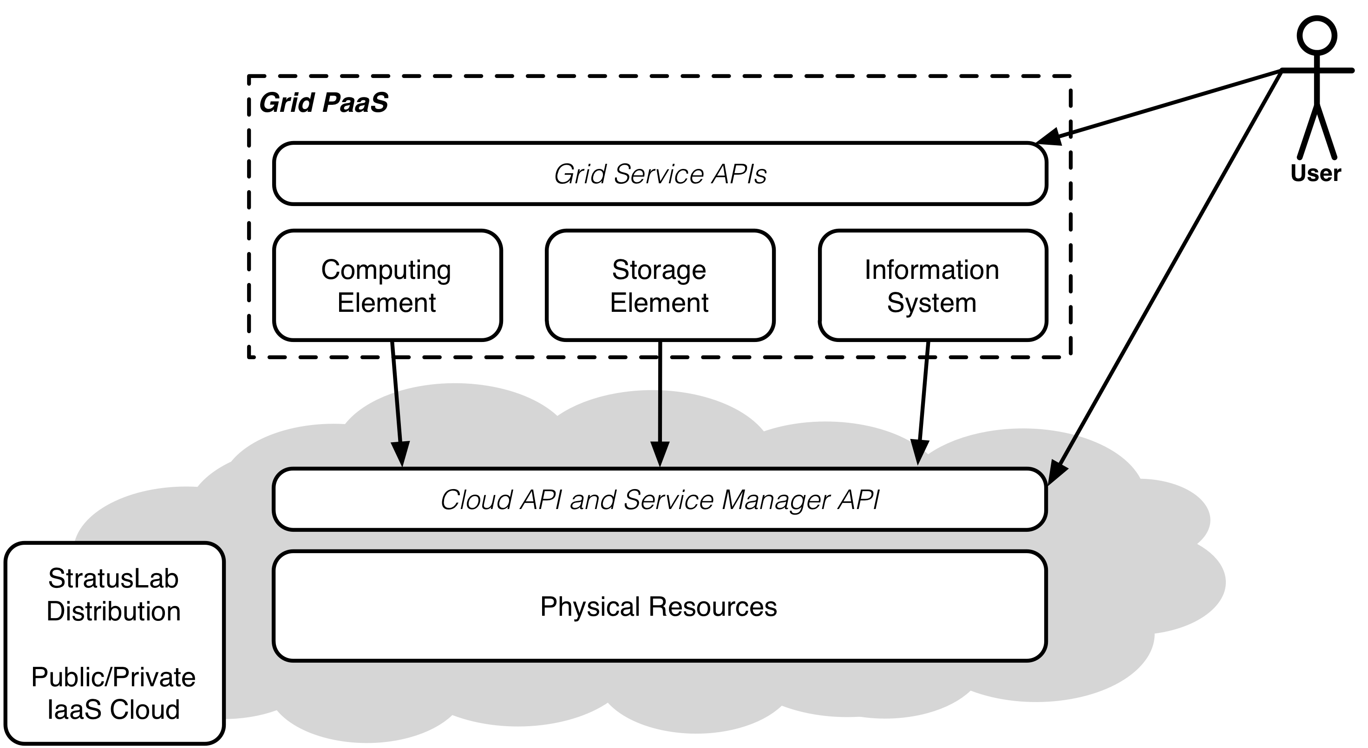
Grid and Cloud Together

Slide 16
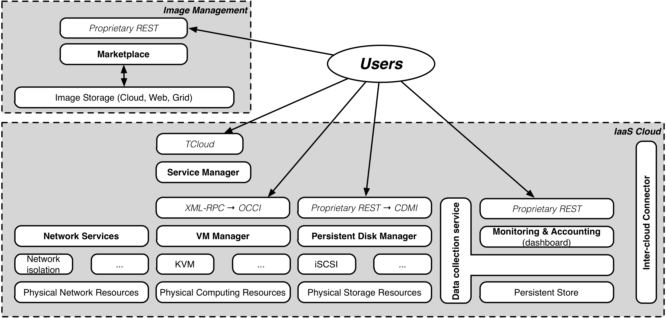
StratusLab Architecture (v2.0)
Existing releases provide complete IaaS cloud solution.
Future work concentrates on monitoring, accounting, and federation.

Slide 17
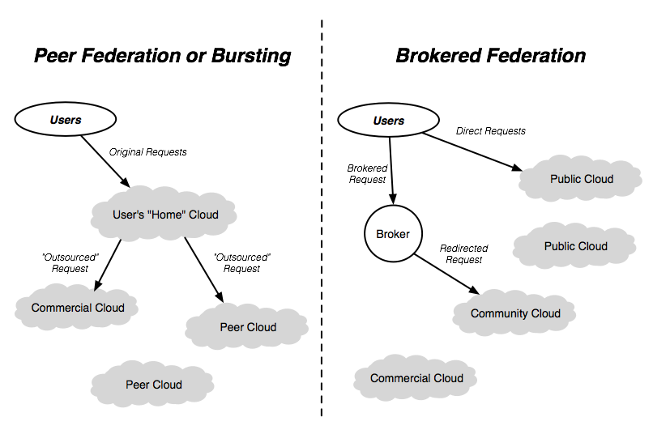
Hybrid Clouds and “Sky” Computing

Slide 18
Questions and Discussion

