Slide 1
Contextualization
StratusLab Tutorial (Orsay, France)
17-18 November 2011

Slide 2
Contextualization
Horrible word but…
Machines must be able to run in variable network/machine contexts
Information on how to integrate with local context must be given to VM
No universal standard for doing this (StratusLab, HEPiX, AWS, …)
StratusLab Contextualization
Information packaged into CD-ROM image and made available to VM
VMs mount CD-ROM image and run a script using context information
Networking information is passed exclusively via DHCP
Additional information can be passed to VMs to configure services

Slide 3
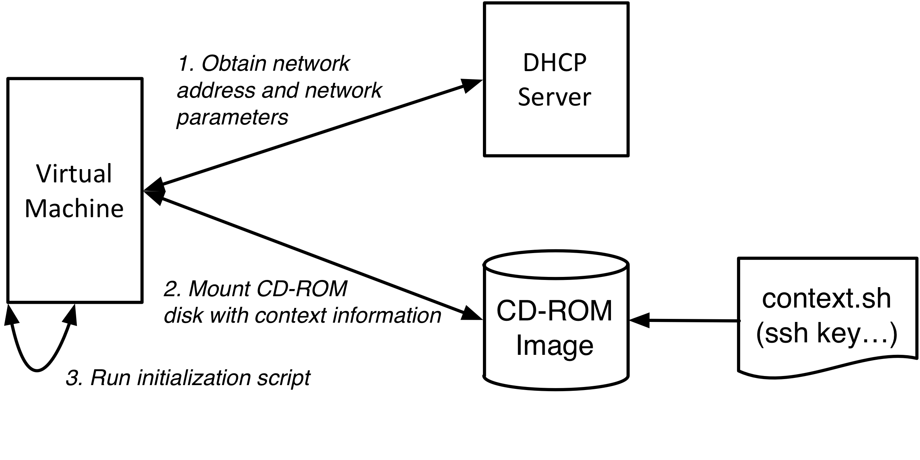
Contextualization
Discovery of VM Context
Network connections (DHCP)
Authentication/Authorization (SSH Keys)
Service Configuration (e.g. Grid Certificates)

Slide 4
Questions and Discussion

Slide 5
Exercises: Contextualization
Discover Contextualization Procedure
Log into a VM and find CD-ROM image.
What files are present?
What information is passed to machine?
How is that information used within the machine?
Modify the Context
Look for command line option to send user-defined context
Send some customized information via the context
Verify that the information can be found on the running machine
How could you use this to configure your services?

