Slide 1
Introduction to Cloud Technology
StratusLab Tutorial (Orsay, France)
17-18 November 2011

Slide 2

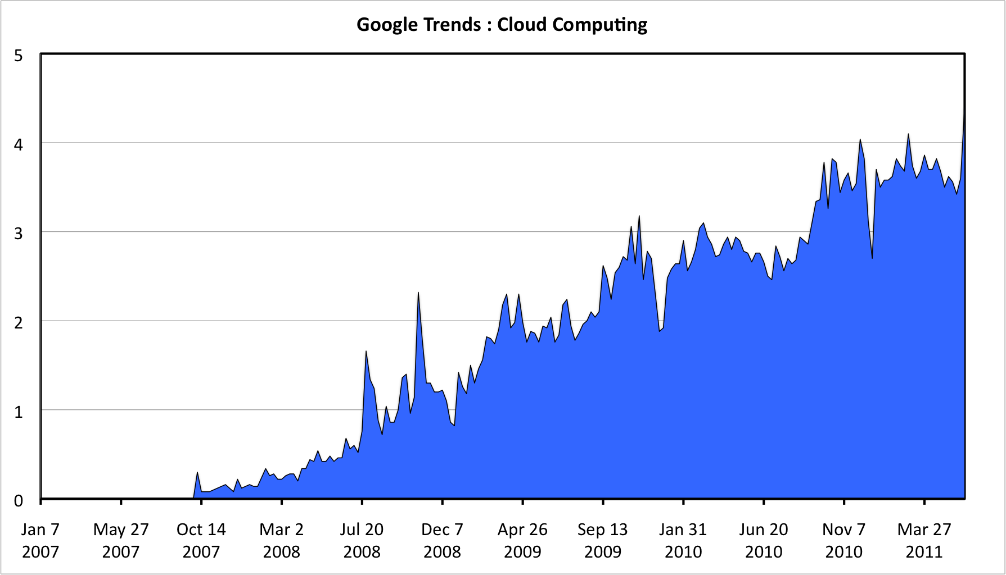
Cloud Marketing
“Cloud” is currently very trendy, used everywhere
  Many definitions that are often incompatible
  Very often used to market pre-existing (non-cloud) software
  But…
  interesting and
  useful concepts and
  tools coming from
  “cloud”
Cloud
Computing

Slide 3
“The” Cloud
Many previous cloud (or cloud-like) initiatives:
  Commodity Computing (Sun, 2005)
  Utility Computing (IBM, HP, Microsoft, …)
  Amazon EC2 (2006), EBS (2008)
Cloud is the convergence of several concepts:
  Mature virtualization technology with little performance degradation
  Appearance of simplified APIs (REST, XMLRPC, …)
  Excess of commercial computing capacity (Amazon, Google, …)

Slide 4
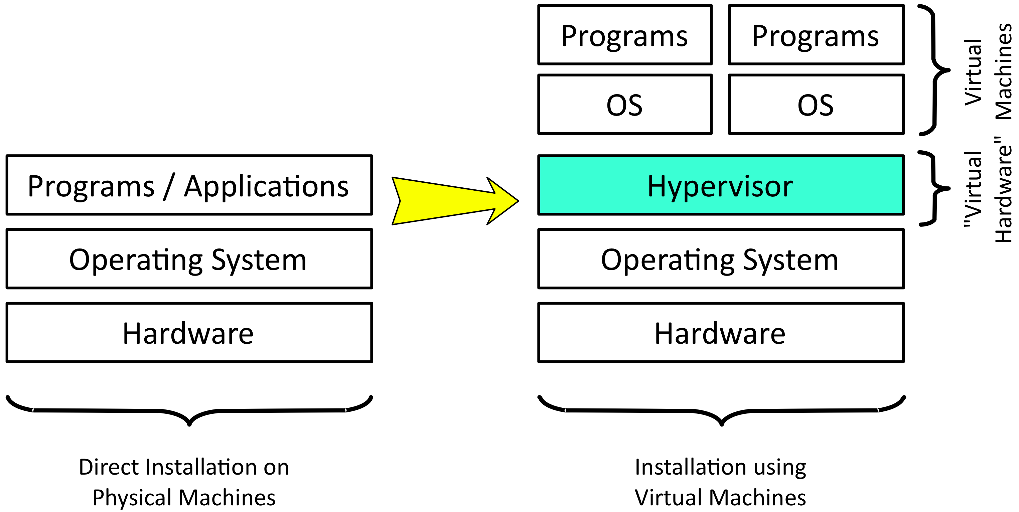
Virtualization

Slide 5
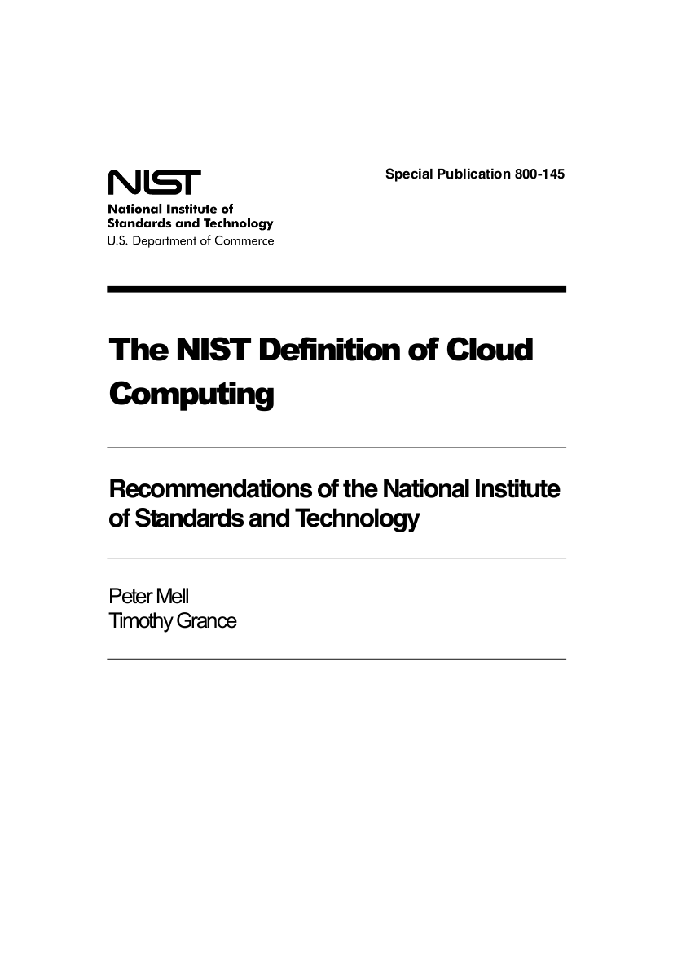
What is a Cloud?
NIST: Best Definitions
  Essential characteristics
  Service models
  Deployment models
  Just 2 pages of text!
  http://csrc.nist.gov/publications/
  nistpubs/800-145/SP800-145.pdf

Slide 6
Cloud Taxonomy (Service Models)
Vendor Lock-In
Software as a Service (SaaS)
Flexibility
Platform as a Service (PaaS)
Infrastructure as a Service (IaaS)

Slide 7



Software as a Service (SaaS)
Architecture
  Essentially web-hosting
Advantages
  Very simple use: web interface with no software installation
  Very accessible: laptop, smartphone, …
Disadvantages
  Questions about data: access, ownership, reliability, etc.
  Integration of different services is often difficult
Software as a Service (SaaS)
Platform as a Service (PaaS)
Infrastructure as a Service (IaaS)

Slide 8


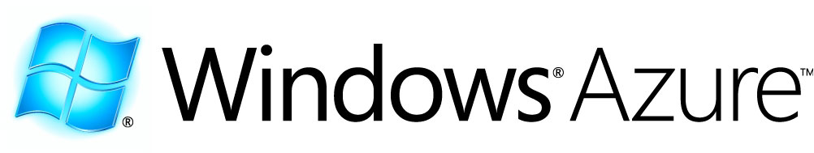
Platform as a Service (PaaS)
Architecture
  Platform and infrastructure for creating web applications
Advantages
  Load balancing, automatic failover, etc.
  Programmers can forget about the low-level “plumbing”
Disadvantages
  Restricted number of languages
  Applications are not portable between different providers
Software as a Service (SaaS)
Platform as a Service (PaaS)
Infrastructure as a Service (IaaS)

Slide 9


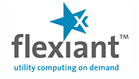

Infrastructure as a Service (IaaS)
Architecture
  Access to remote virtual machines
Advantages
  Customized environment
  Simple and rapid access
  Access as “root”
  Pay-as-you-go model
Disadvantages
  Non-standardized interfaces (vendor lock-in)
  Virtual machine creation is difficult and time-consuming
Software as a Service (SaaS)
Platform as a Service (PaaS)
Infrastructure as a Service (IaaS)

Slide 10
Cloud Taxonomy (Service Models)
Vendor Lock-In
Software as a Service (SaaS)
Flexibility
Platform as a Service (PaaS)
Infrastructure as a Service (IaaS)

Slide 11
Deployment Models
Private
  Single administrative domain, limited number of users
  E.g. site uses cloud for standard site services, managed by sysadmins
Community
  Different administrative domains but with common interests/procedures
  E.g. high-energy physics community
Public
  People outside of institute’s administrative domain, general public
  E.g. Amazon Web Services (EC2, S3, …)

Slide 12
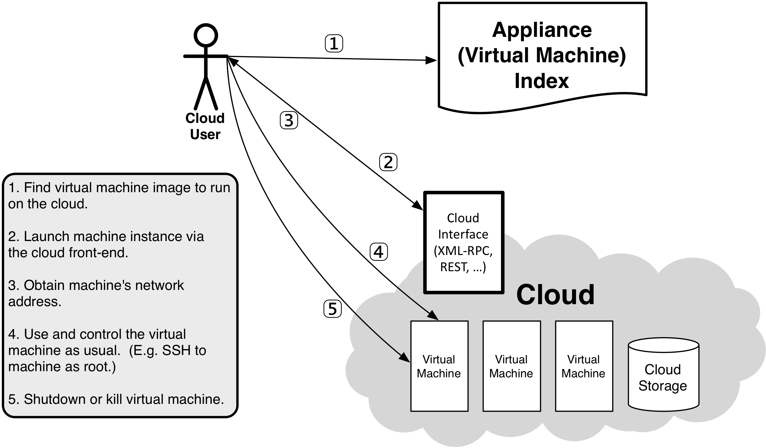
Using an IaaS Cloud

Slide 13
Why use an IaaS cloud?
Customized Environment
  Deployment of software with a large number or difficult dependencies
  Use an environment that has already been validated
Development and Testing of Software
  Easy access to many different operating systems
  Change computing environment without impacting other developers
  Test software systems that consist of several machines
Service Deployment
  Deploy services without the intervention of the local site administrator
  Create platforms (PaaS) pour scientific communities
Dynamic access to very significant computing resources

Slide 14
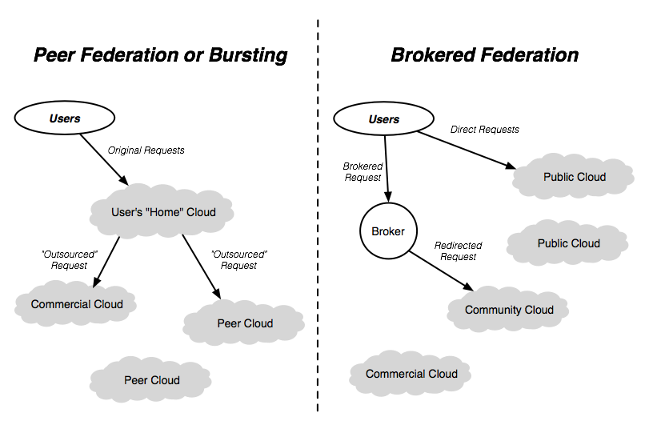
Hybrid Clouds and “Sky” Computing

Slide 15
Questions and Discussion

Slide 16
Exercise: Your Interest in Clouds
Researchers and Engineers (End-users)
  Use existing academic and/or commercial software on cloud
  What scientific domains?
Developers
  Modify existing software to use cloud resources
  Create new software for the cloud
  What types of software?
Administrators
  Provide cloud resources to researchers, engineers, and/or developers
  What types of users? Local, multi-institute, …?

