Slide 1









UA9 instrumentation
G.Cavoto
INFN Roma
Seminar
Jan 24th 2011
LAL - Orsay

Slide 2
Outline
Description of what we have now in SPS
  Layout
  Detectors
    Beam Loss Monitor, direct beam imaging,…
  Performances
Ideas for a possible layout for LHC
Current layout in SPS:
  W. Scandale et al., JINST 6 T10002 (2011)

Slide 3
What we measure
Detect inelastic interaction secondary products
  Instrument region close to crystal or to the absorbers/secondary collimator where no other BLM available (or BLM dynamic range is not appropriate)
  External to vacuum chamber
Detect channeled beam
  Measure ch. beam profile
    Check crystal torsional effect, axial channeling…
  Count channeled particles
  Possibly without absorbing the beam or just before beam dump
  Either in vacuum or in secondary vacuum (Roman Pot)
Detect leakage around the ring
  Use accelerator BLM distributed over the whole ring
Measure beam parameters (current, emittance, orbits, …)
  Use accelerator devices
SPS BLM are difficult to use in our experiment (old instrumentation,
insensitive to low current)
LHC BLM are modern and reliable

Slide 4
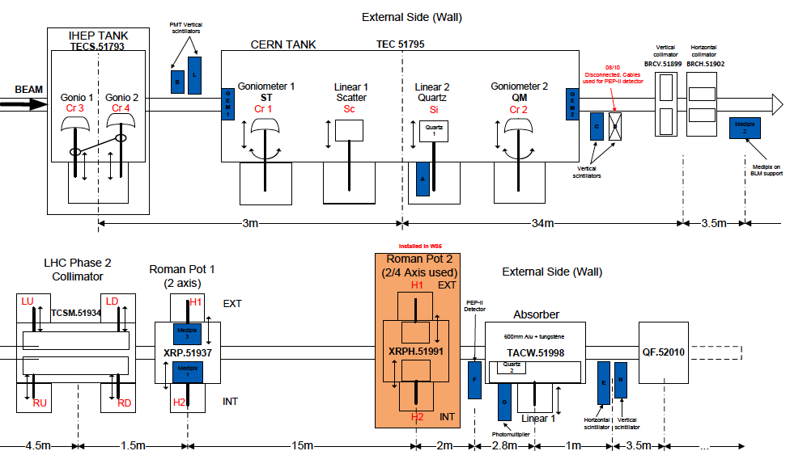
Collimation region
Protons
hitting
the crystal
BLM Scint
Inelastic interaction of protons
in the crystal
✖
Deflected beam
BLM GEM
65 m
Intercepted by LHC collimator
Absorbed
by secondary collimator
(TAL)
Imaged by
Medipix
BLM Scint
BLM Cerenkov

Slide 5
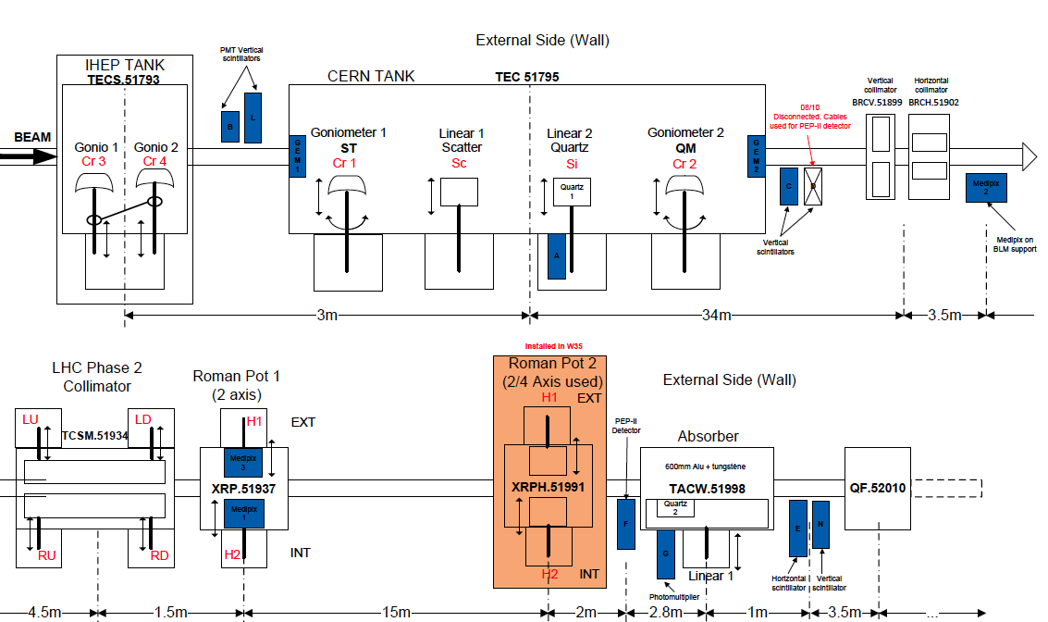
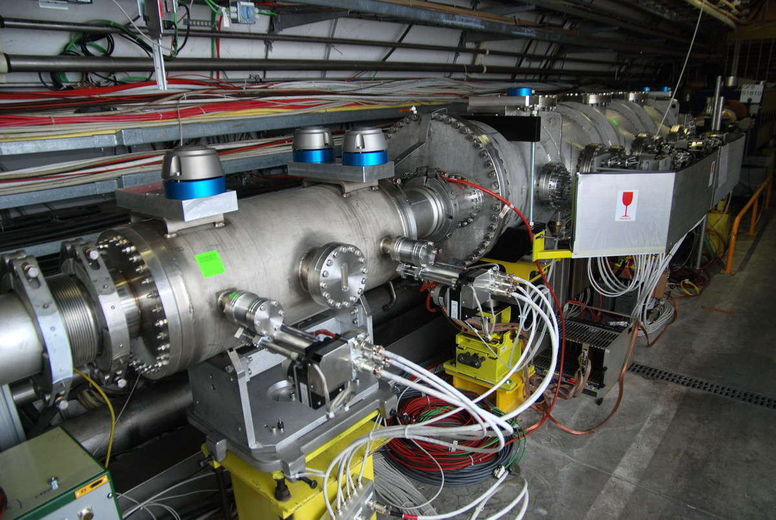
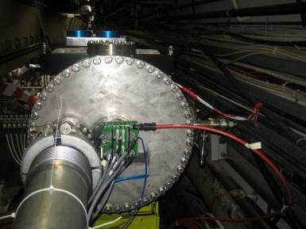
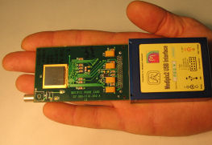
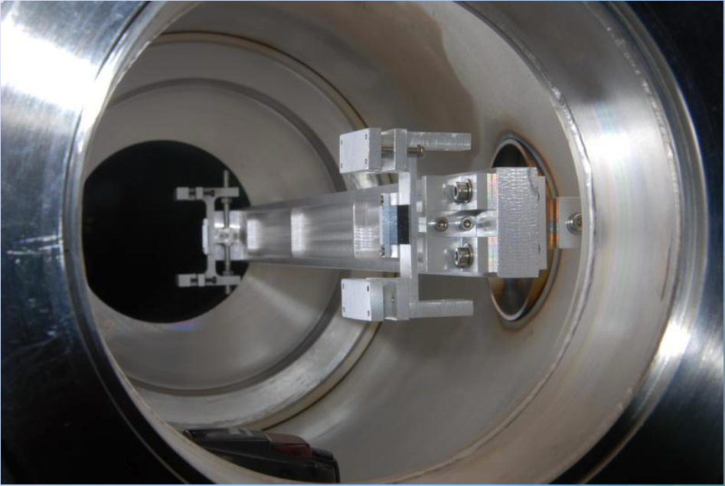
UA9 devices
scintillators
Tanks with goniometers
2 Triple GEM detector
at large angle
Active area 10x10 cm²
128 pads 6x12 mm²
3 Medipix
in roman pot
Active area 1.4x1.4 cm²
65536 pads 55x55 μm²

Slide 6
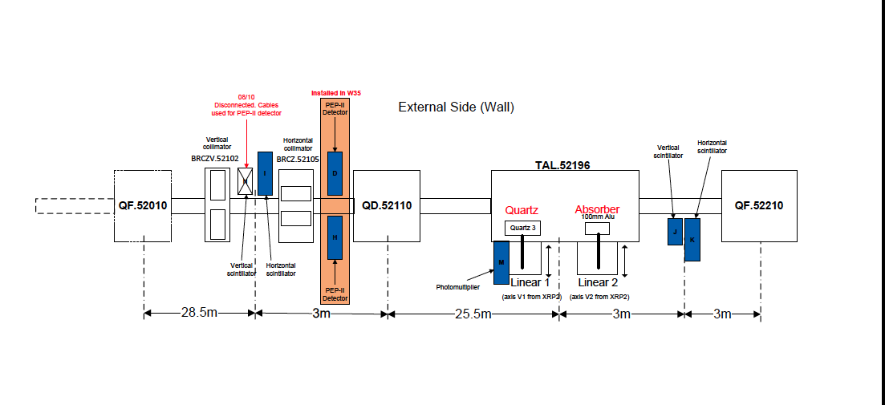
Dispersive region
TAL2 Al scatterer
New scatterer + BLM (scint, Cerenkov, ionization ch.)
in highly dispersive region to detect
1) off-momentum particles (produced in the crystals)
which are displaced lateraly
2) any not absorbed secondary halo
Observe the spray rate as a function of scatterer lateral position

Slide 7
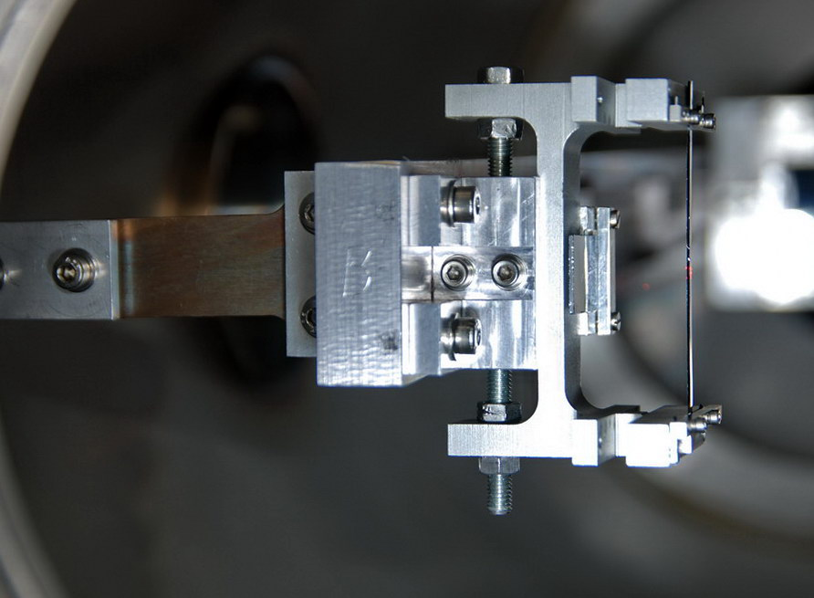
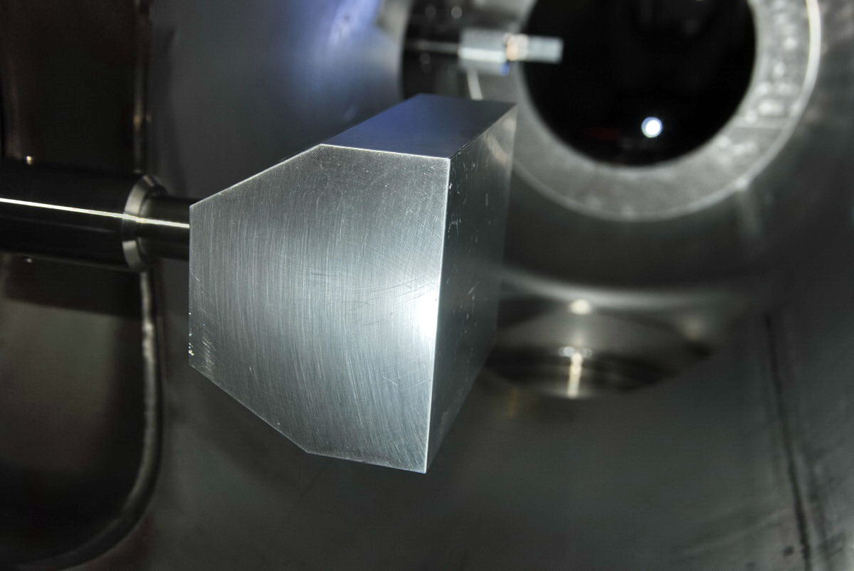
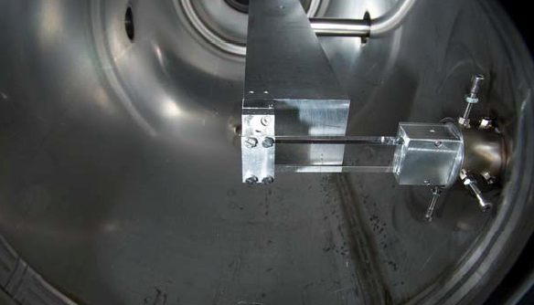
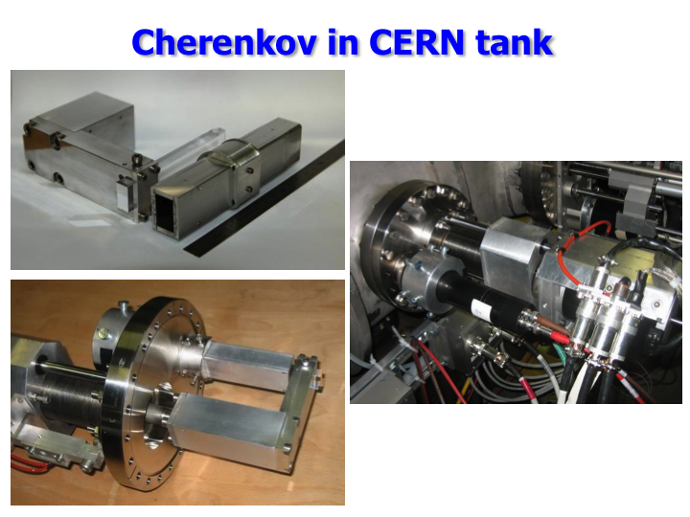
SPS UA9 devices
Strip crystal in IHEP tank
TAL2 Al scatterer
TAL absorber & Quartz Cerenkov detector
High quality mechanical devices, accurate motion system

Slide 8
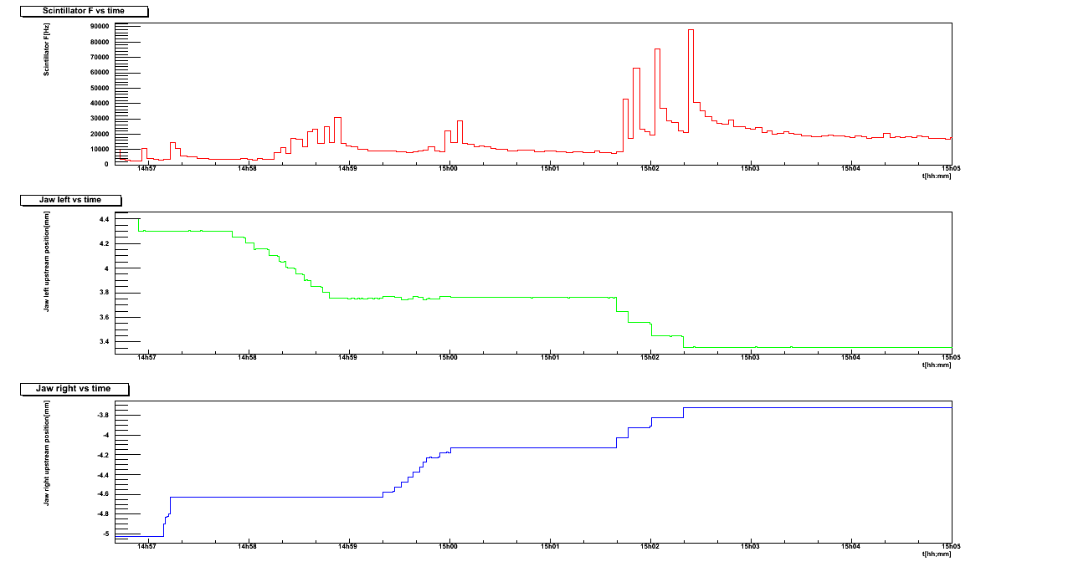
Alignment procedure
1) Search of the closed orbit, 2) redefine the beam at how many sigma we want.
Crystal and all UA9
movable devices are aligned during each fill.
Standard and fast procedure to find
channeling configuration and
collimation!
BLM rate
1
Same distance from closed orbit
Collimator jaws positions
2
Alignment position

Slide 9
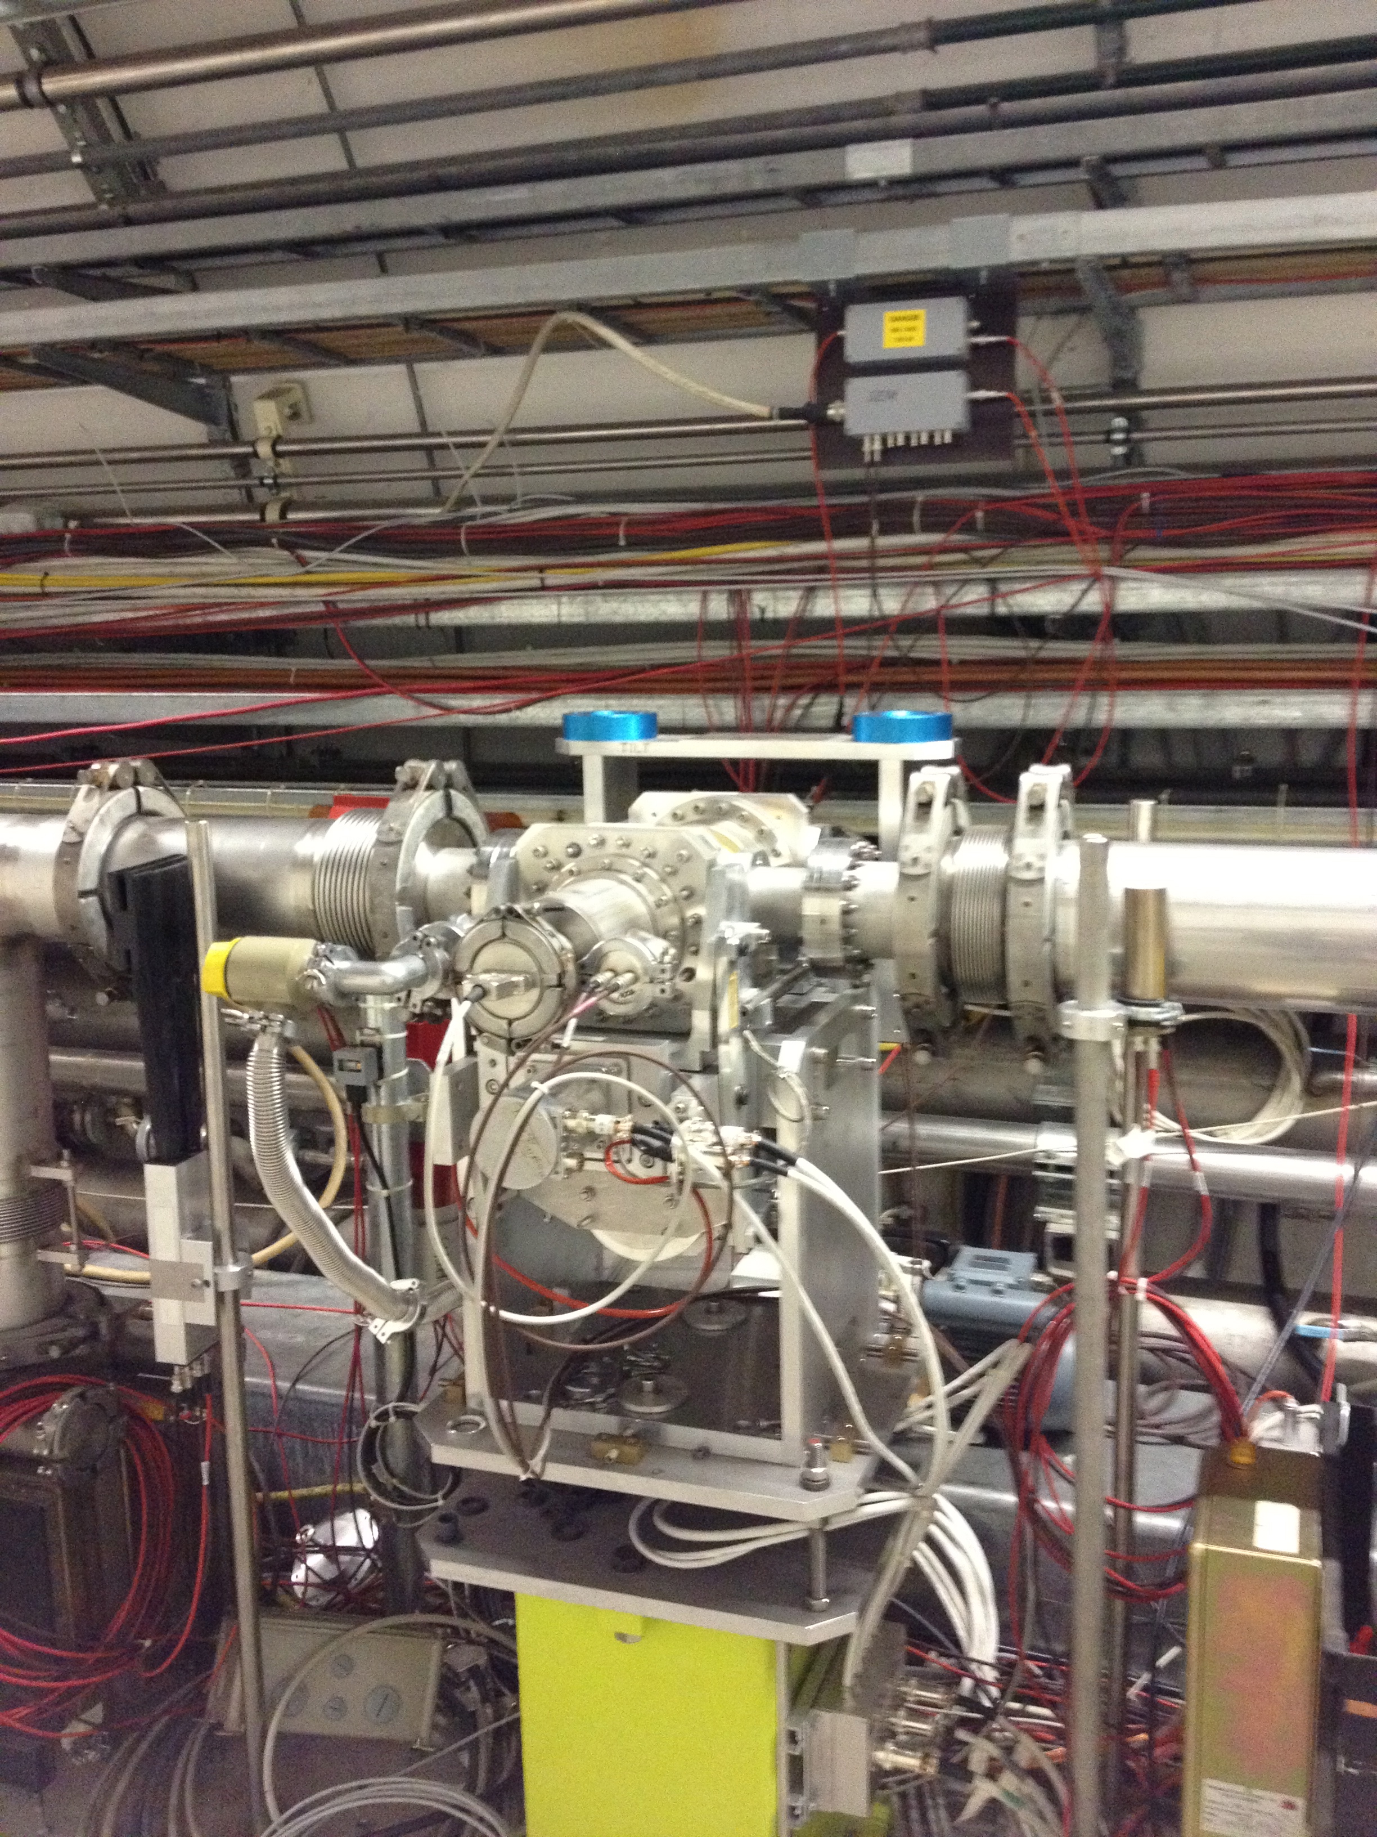
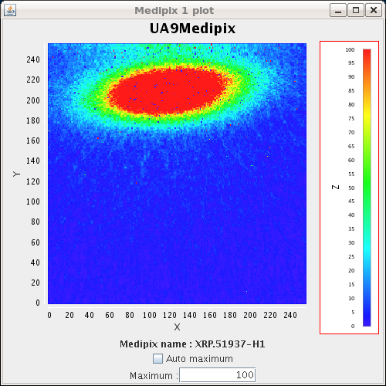
Roman pots
      Movable device housing
      detectors in secondary
      vacuum
        Used to acquire images
        of channeled beam
          Very important to confirm channeling
          online
        Relevant to measure
        channeled beam
        direction (from centroid)
        and flux of proton of channeled
        beam
Vertical displacement
Horizontal displacement
Online picture
with Medipix

Slide 10
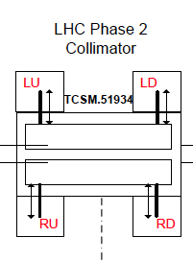
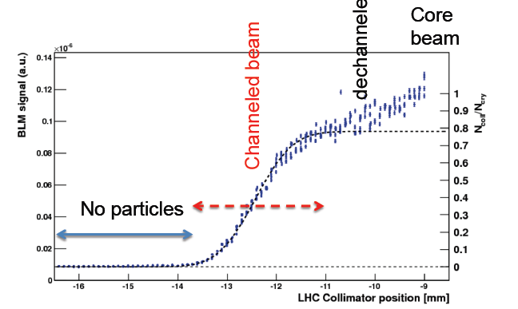
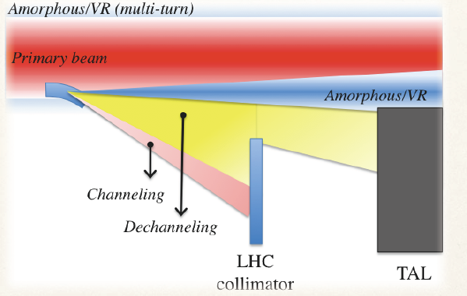
LHC collimator scans
Core
beam
dechanneled
Channeled beam
Protons
No particles
Moving jaw!
      Measurement of channeled beam position and width
        σ_{beam} ~0.6mm
      Comparison of plateau with core beam
        Deflection efficiency ~80%,
      Close to expectation (92% and 0.33mm)

Slide 11
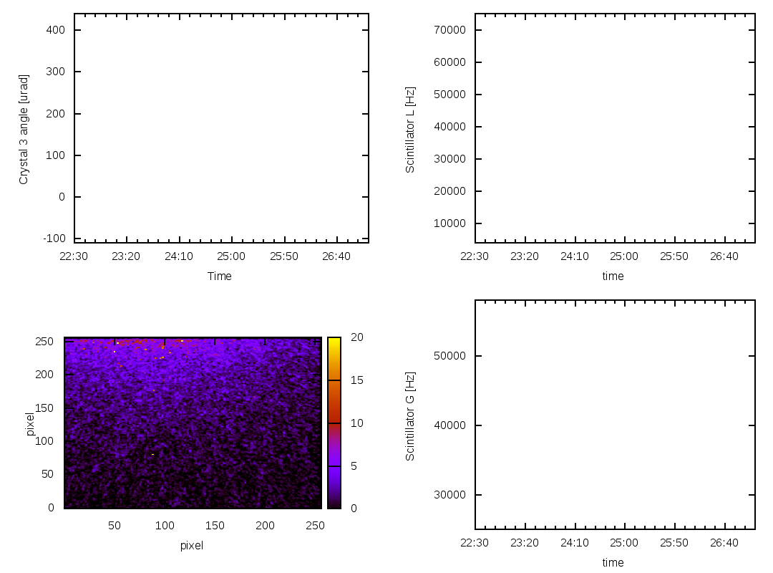
Rotating crystal in the beam
Crystal angle
(around a vertical axis)
BLM rate
close to
crystal
Periphery of circulating beam
Appearance of 120 GeV/c proton beam
deflected by crystal channeling

Slide 12
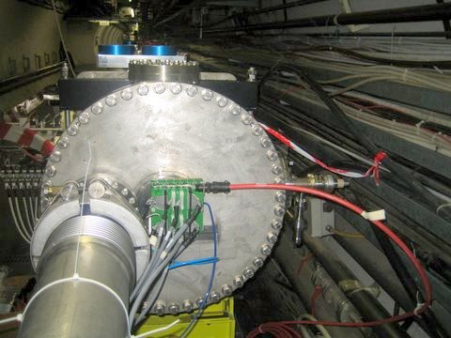
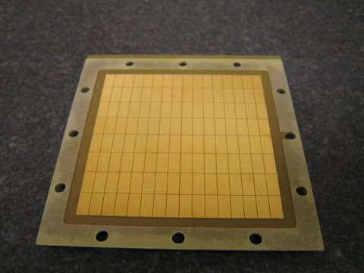
GEM on SPS
      Two GEM mounted on Ex-RD22 tank since 2009
      Operate during UA9 MD, data synchronized with other UA9 BLM
128 pads 6x12 mm²
GEM2
Downstream
CERN tank
vertical
HV to power GEM
foils.
10x10 cm2 active area
Carioca chip on board
DAQ crate remote
Electronics to control
thresholds and LV PS

Slide 13
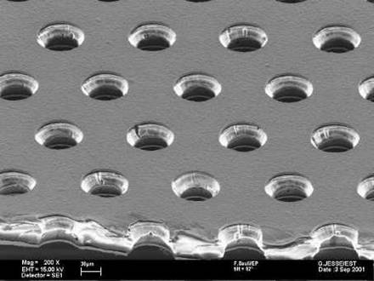
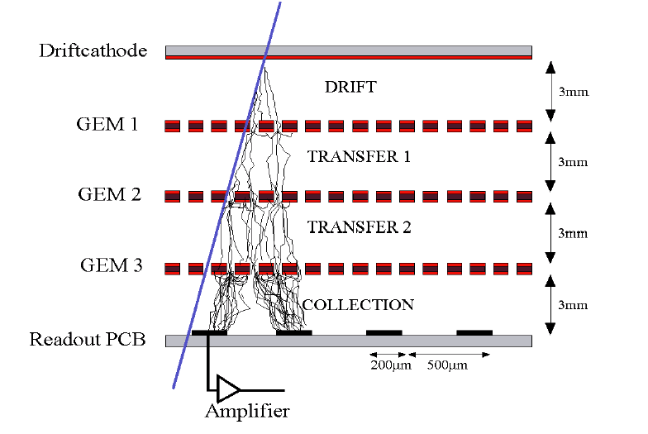
Gas Electron Multiplier
A Gas Electron Multiplier (F.Sauli, NIM A386 531 1997) is made by 50 μm thick kapton foil, copper clad on each side and perforated by an high surface-density of bi-conical channels;
70 µm
140 µm
50 µm
Triple GEM
Gain
~20
~20
~20
~8000

Slide 14
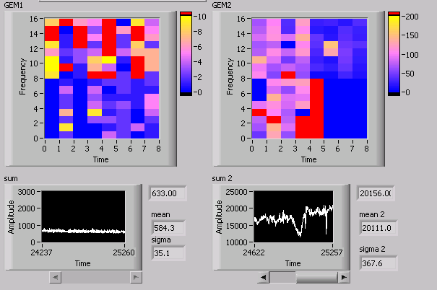
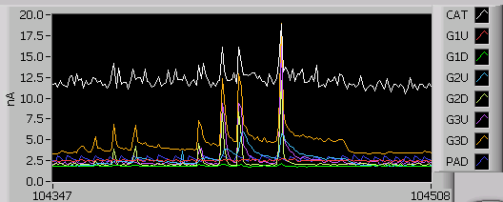
Monitoring with GEMs
The GEM are acquired every second getting an online image of inelastic scattering
at large angle
Current vs time.
Also the total current drawn by the GEM chamber is a good measurement of the flux of particles from inelastic interactions.
Very large dynamic range
When an angular scan is performed on crystal, a drop appear on the total rate measured by the downstream GEM
during the channeling time period.

Slide 15
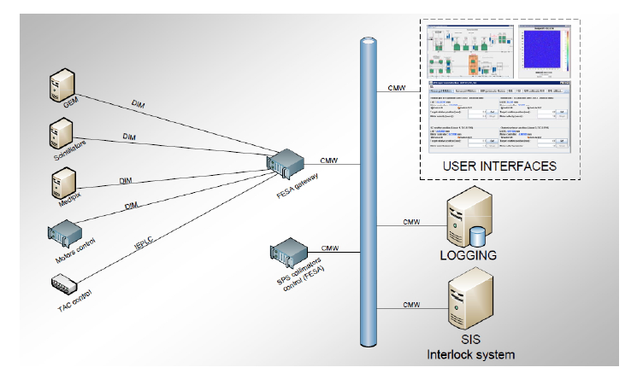
Data Synchronization
Use of middleware accelerator
infrastructure to save data
Every subsystem provide a
“measurement” every second
Data are partially available online
More refined analysis can be made
offline

Slide 16
Basic layout for LHC
  Goniometer
  Special beam line monitor
    Close to goniometer ahd absorber
    Sensitive to secondaries
  Micro-RomanPot
    Intercept channeled particles
From SPS UA9 layout experience
Gonio
BLM
BLM
Absorber
Micro RP
I assume standard LHC BLM are much better than standard SPS

Slide 17
Goniometer spec for LHC
Total angular range : >10 mrad
“Resolution”: <0.1 µrad
  Minimum step of motor
“Accuracy”: < 1 µrad
  How precisely the motor goes to a given ang. position
  Related to channeling critical angle scale
Maximum tilt inaccuracy: < 1 µrad
  Linear-angular coupling,…
Linear resolution: 5 µm
Total linear range: 40 mm

Slide 18
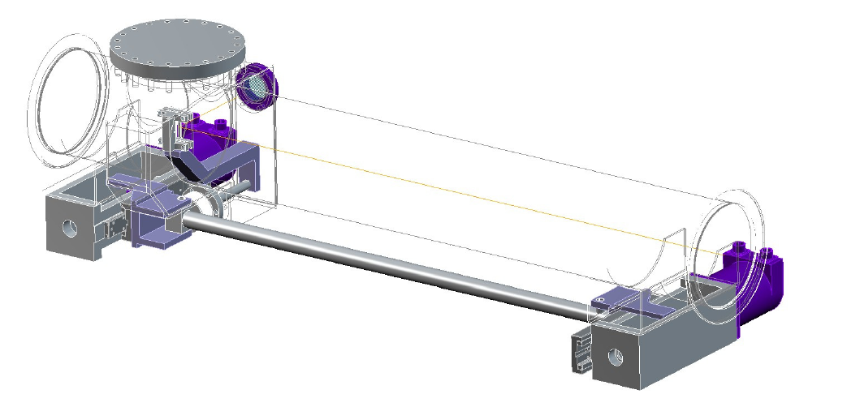
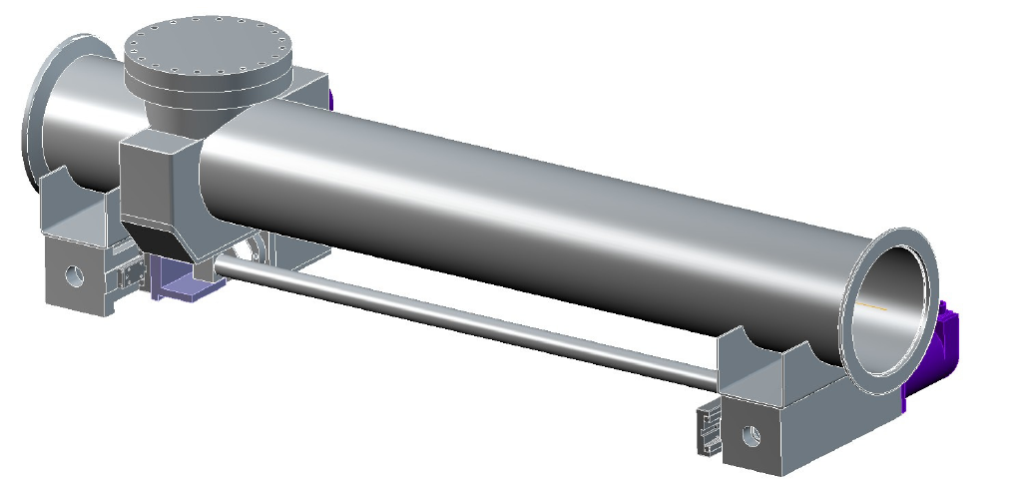
Goniometer from CINEL srl (Italy)
To be built in the next weeks and to be tested on SPS at first
This will be the first critical device for the UA9 LHC setup
Mechanical devices (motors, encoder, etc.) are a very delicate element

Slide 19
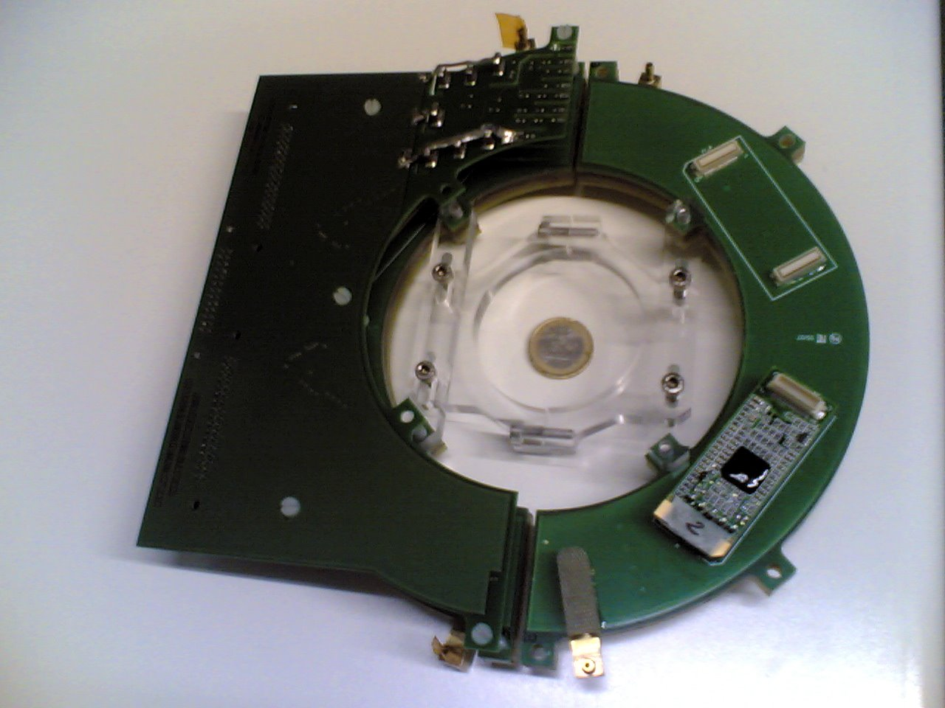
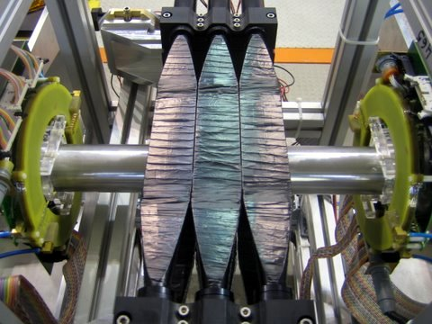
BLM close to crystals
LUMI GEM detector
Dafne (LNF) luminometer
LHC close-to-crystal can be modeled on this

Slide 20
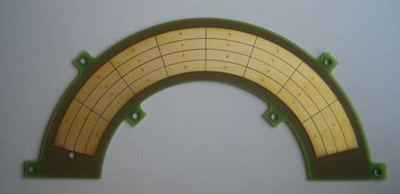
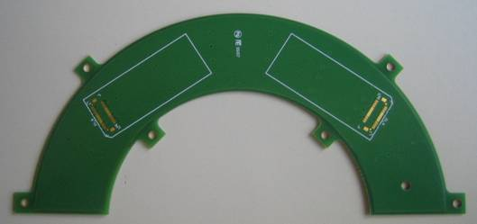
Details on LUMI GEM
20 cm diameter
PAD PCB
Instrinsically radiation hard
detector (No flammable gas)
GEM principle:
Localized electron multiplication
can sustain large rate
(MHz/cm2)
Back side
places for 2 FEE cards
Each pad can count
number of m.i.p.’s
crossing it.
[threshold well know ]

Slide 21
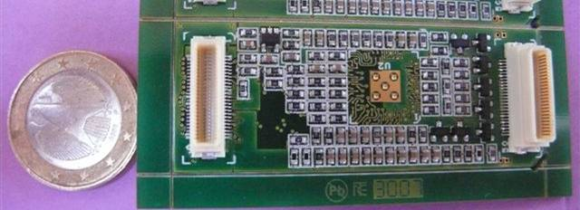
More on GEM BLM
      Electronics Radiation Hard
      (Carioca chip, used for LHCb)
  Can be made in several modules
  (put at different distances in coincidence)
  Can be made movable
    (to scan different angles)
  Addition of degrader can make them sensitive to neutron
  Electronics (hit definition) and slow control (thresholds and FE LV PS) in compact FPGA (to be tested in SPS this year)
x
4
1

Slide 22
Relavant facts for BLM
  Sensitive to secondaries (inelastic interaction)
    Should be able to detect mips with full efficiency
  On SPS doing test with one bucket filled
    Bunch length few ns
    Revol. Frequency 43 MHz
    Secondary particles arrives “bunched” on the BLM
  Scint BLM are NOT counting secondary
    If one or more mips crossing scint ALWAYS count one
    Fully efficient (it is sensitive at low flux ) but saturates at rev.freq.
    Linearity guaranteed for low flux
  Gate with RF signal
    Very important to reject out of filled bunch particle
    Need < ns time resolution to distinguish among close bunch (5ns)

Slide 23
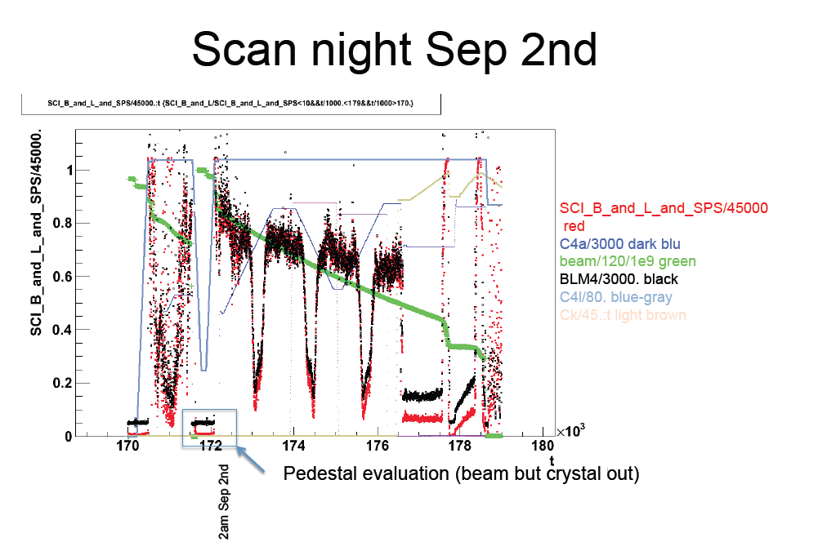
Example of different BLMs
Ionization chamber rate
Scints rate

Slide 24
Detector for RP
    Intercept channeled protons.
      O(100 proton) in few ns [SPS] on a fraction of mm^2
      every 43 MHz
    Should give a signal proportional to crossing protons
      Good knowledge of calibration and efficiency
      Not saturate
    Spatial resolution
      “image” of beam (shape). Not critical
      If two RP at different machine azimuth: beam direction
    Trigger from machine timing
Positive experience with Medipix
Very good spatial resolution
But calibration is not totally understood
Timing is possible but…
Not clear if it can stand high dose
Other more robust Si
Pixel/strip ?
Test a scint fiber odoscope in SPS

Slide 25
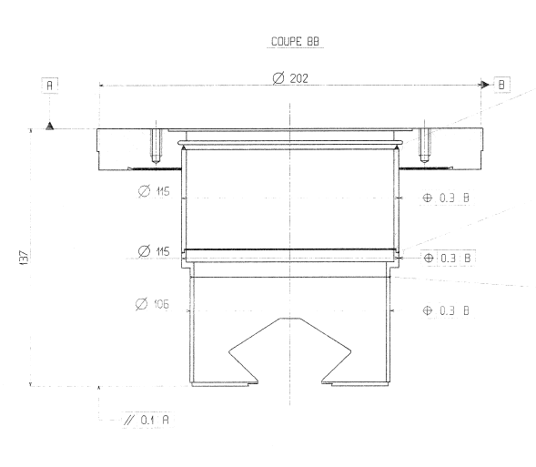
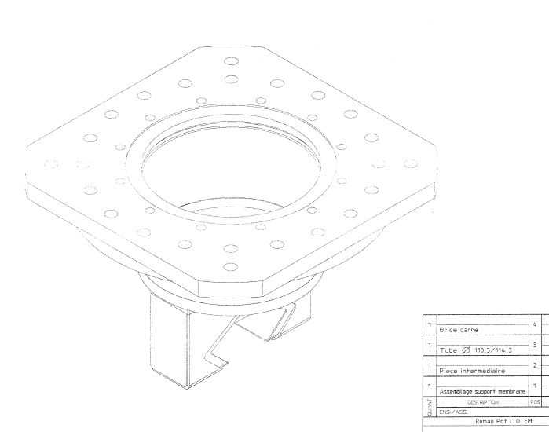
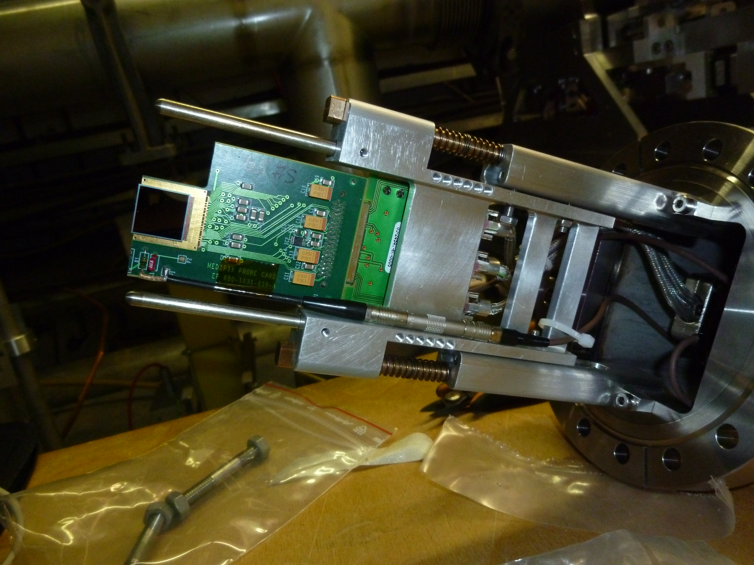
Roman pot (sec. vacuum)
Thin window (200 μm Al thick)
where the detector
active region should be placed
Add scintillating fibers in front of
Medipix device
(calibration, trigger,…)

Slide 26
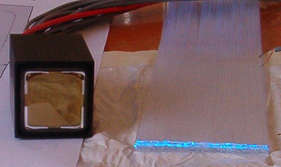
Detector concept
One or more layers of fibers:
Plastic (PMMA, polystyrene) fibers:
  scintillation (blue)
  n_{core}≅1.6, n_{cladding}≅1.4
  Round or square fibers
  Diameter/side from 250 μm to few mm
Quartz (SiO₂) fibers: Cerenkov emission
  Different cladding materials (silica, hard plastic, PMMA)
  Core diameter from 100 μm to 2 mm
Directly coupled to multi-channel photodetector (e.g. multi-anode PMT)

Slide 27
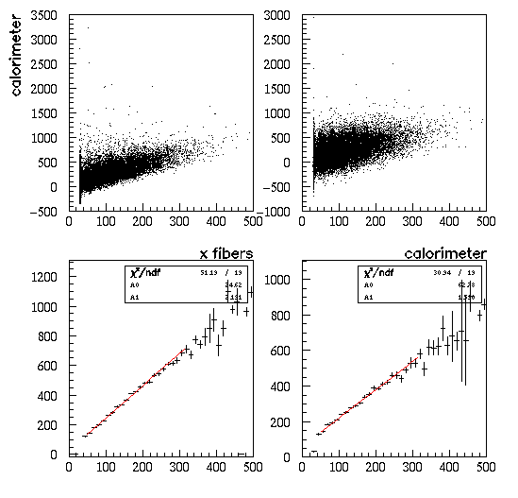
Scintillating fiber detector
From LNF BTF test
On similar detectors
Single particle sensitivity, response proportional to number of electrons in beam
≈1 photo-electrons/mm at 50 cm from PMT, 20% quantum efficiency

Slide 28
Profilometer
Two layers of 32x4 0.5 mm fibers
Fibers routed to vacuum-air
interface
Hamamatsu MA 64 ch
H7546 PMT coupled
directly on to vacuum-air
interface
Four fiber coupled to a signal
photocathode pixel
Need advanced electronics
to acquire the signals!!!
Measure pulse height and timing
Two layers
32X4 0.5mm fibers
16 mm
Project at INFN RM, in construction

Slide 29
Some comments
    UA9 devices must reliable
      Position in high rad. environment
      Few and short accesses during the year
    In LHC devices must comply with strict regulation
      Cables, HV PS, gases, etc.
      Accelerator safety
    We never achieved a satisfactory system able to count incoming (to crystal) particles and channeled
    particles
      Fast electronics to digitize each pulse of a detector
      would be an important step

Slide 30
Backup slides

Slide 31
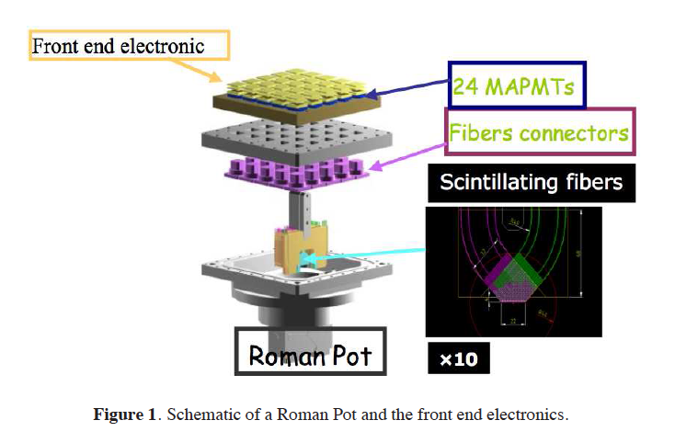
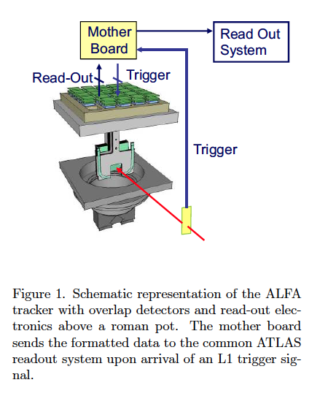
Possible readout
MAROC2 chip, developed for scintillating fiber detector for ATLAS luminosity measurement (ALFA)

Slide 32
Another possibility…
Quartz fibers:
Cerenkov emission in place of scintillation
lower light yield
Better radiation resistance
Particle
v>c/n_{core}
cosθ=(n_{core}(v/c))⁻¹
n_{core}
n_{cladding}

Slide 33
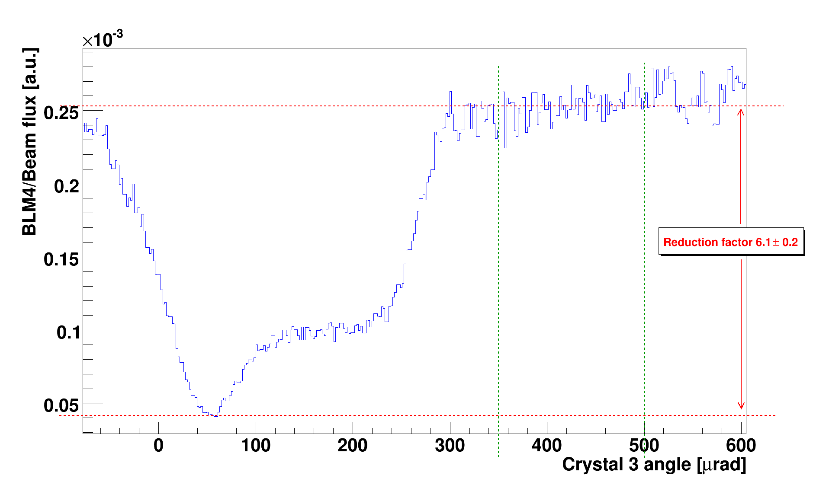
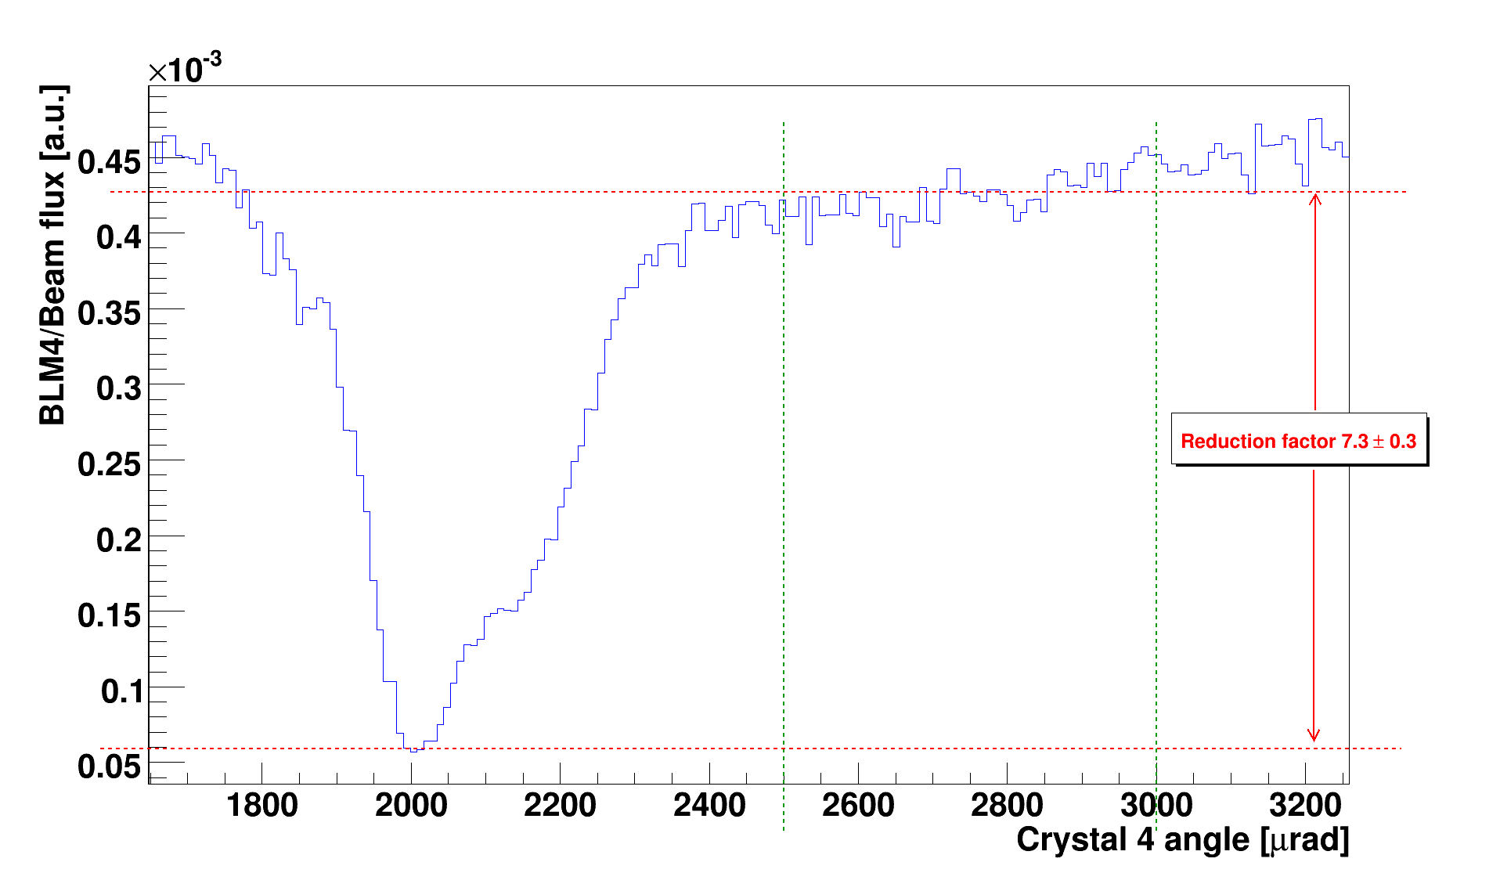
Angular scans
    Reduction factor of the inelastic losses due to inelastic interactions in channeling versus amorphous orientations.
      Measured with LHC-BLM and GEM detectors
      Very reproducible in several scans and fills
Losses in amorphous regime
channeling
channeling
Volume reflection
Volume
reflection
Depending on crystals 5 – 9 reduction factor (protons)
NEW: measurement also with Pb ions: 2-4 factor
Still off with respect to simulation

Slide 34
Tools to make progress
Simulation.
  Proton Tracking
  Aperture model
    Inelastic interaction
  Crystal simulation
  Detector simulation (GEANT4,FLUKA,…)
Use of mixed tool
  ICOSIM
Obviously we need this to make a conceptual design (next months?)
A detailed simulation can come later

Slide 35
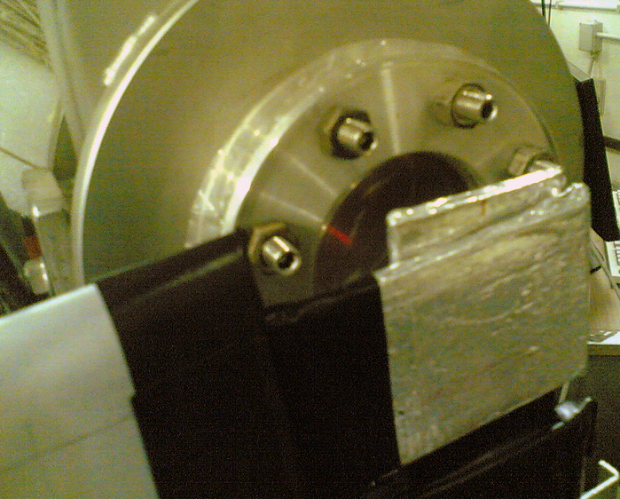
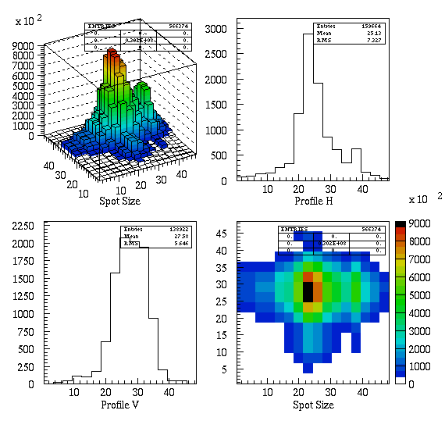
Scintillating fiber detector
Fiber detectors (x and y views, 4 layers, 1 mm diameter fibers)
Working since 2003 at Frascati BTF

Slide 36
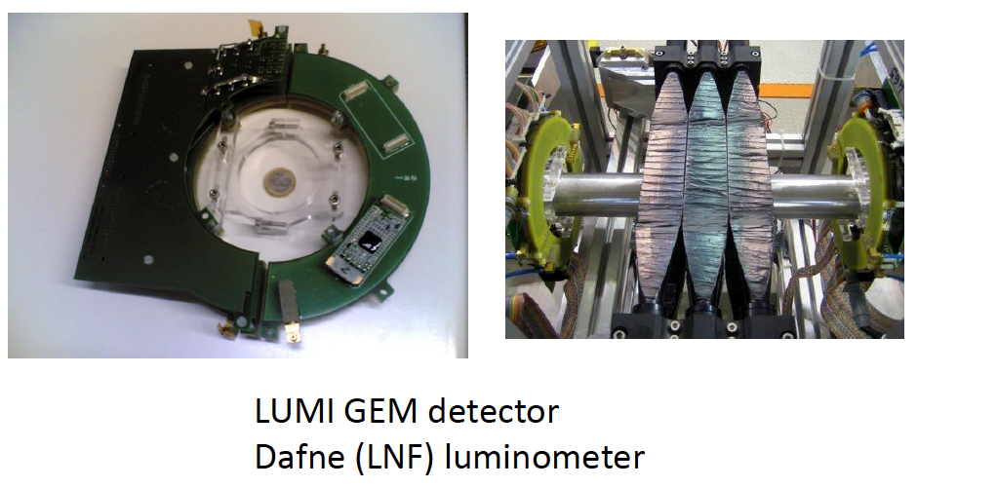
BLM based on GEM
    Sustain high rate (100 KHz/cm2)
      Limit given by spacing of GEM foil holes
    Linear (sensitive to mip)
    Measure rate on small element (0.5x1cm2 pads)
    Already used in
    LHCb
New compact DAQ board
(see F.Murtas) can avoid
problem with long cable
SPS 2010 shows they reproduce standard SPS BLMs.

Slide 37
Road-map for a test in LHC
Parameters | Obtained in 2009 | Obtained in 2010 | Required for LHC
Channeling efficiency | 75 | 80 | 90÷95 | ★★
Nuclear loss reduction | 5 | 5-10 | 20÷30 | ★★
Goniometer: angular accuracy [µrad] | 30÷40 | 10 | 1÷2 | ★
Crystal bend [µrad] | 140÷150 | 150÷170 | 50÷100 | ★★★
Crystal torsion [µrad] | 20÷30 | 0.1÷1 (*) | 0.1÷1 | ★★★
Amorphous layer on crystal | About zero | About zero | About zero | ★★
Collimation leakage reduction | - | 5 | Should be analyzed | ★★
(*) On external beam test

