Slide 1









UA9 the crystal-assisted collimation experiment at the SPS
W. Scandale
for the UA9 Collaboration
CERN – IHEP - Imperial College – INFN – JINR – LAL - PNPI – SLAC
LAL January 24, 2012

Slide 2
Multi stage collimation as in LHC
The halo particles are removed by a cascade of amorphous targets:
Primary and secondary collimators intercept the diffusive primary halo.
Particles are repeatedly deflected by Multiple Coulomb Scattering also producing hadronic showers that is the secondary halo
Particles are finally stopped in the absorber
Masks protect the sensitive devices from tertiary halo
beam core
0
primary halo
6
secondary halo
& showers
6.2
7
secondary halo
& showers
primary collimator
0.6 m CFC
secondary collimator
1m CFC
secondary collimator
1m CFC
10
Normalizes aperture [σ]
tertiary collimator
absorber 1m W
tertiary halo
& showers
>10
Sensitive devices
(ARC, IR QUADS..)
masks
Collimation efficiency in LHC ≅ 99.98% @ 3.5 TeV
  Probably not enough in view of a luminosity upgrade
  Basic limitation of the amorphous collimation system
    p: single diffractive scattering
    ions: fragmentation and EM dissociation

Slide 3
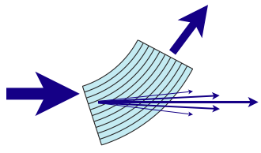
Crystal assisted collimation
Bent crystals work as a “smart deflectors” on primary halo particles
Coherent particle-crystal interactions impart large deflection angle that minimize the escaping particle rate and improve the collimation efficiency
θ_{ch} ≅ α_{bending}
1 m CFC
3 mm si
amorphous
channeling
<θ>_{MCS}≅3.6μrad @ 7 TeV
θ_{optimal @7TeV}≅ 40 μrad
R. W. Assmann, S. Redaelli, W. Scandale, “Optics study for a possible crystal-based collimation system for the LHC”, EPAC 06
beam core
0
primary halo
6
Multiple Coulomb scattered halo (multi-turn halo)
6.2
Dechanneled particles in the crystal volume
7
Deflected halo beam
10
Normalizes aperture [σ]
Silicon bent crystal
secondary halo
& showers
>10
primary collimator
0.6 m CFC
absorber
1m W
Sensitive devices
(ARC, IR QUADS..)
secondary collimator
1m CFC
secondary collimator
1m CFC
masks
Collimators partially retracted
Absorber retracted

Slide 4
Potential improvements
Larger impact parameter: crystals deflect the halo particles coherently to a larger angle than the amorphous primary collimator,
    better localization of the halo losses
    reduced collimation inefficiency ➔ ×10⁻¹ expected in LHC from simulations
    higher beam intensities (if limited by halo density)
Less nuclear events: inelastic nuclear interactions with bent crystals strongly suppressed in channeling orientation
  reduced loss rate in the vicinity of the crystal
  reduced probability of producing diffractive events in proton-crystal interactions
  reduced probability of fragmentation and e.m. dissociation in lead ion-crystal interactions
Less impedance: reduced amount of material in the beam peripheral
    optimal crystals are much shorter than the amorphous primary collimators
    primary and secondary collimators are in more retracted positions

Slide 5
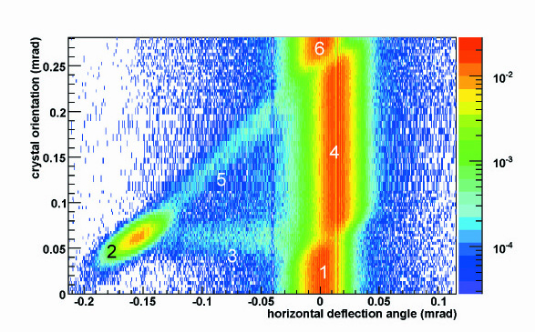
Coherent interactions in bent crystals
6. amorphous
5. Volume Capture
4. Volume Reflection P=95÷97%
2. Channeling
P=50÷85 %
3. dechanneling
1. amorphous
Two coherent effects could be used for crystal collimation:
  Channeling ➔ larger deflection with reduced efficiency
  Volume Reflection (VR) ➔ smaller deflection with larger efficiency
SHORT CRYSTALS in channeling mode are preferred ➔ ×5 less inelastic interaction than in VR or in amorphous orientation (single hit of 400 GeV protons)
W. Scandale et al, PRL 98, 154801 (2007)
W. Scandale et al., Nucl. Inst. and Methods B 268 (2010) 2655-2659.

Slide 6
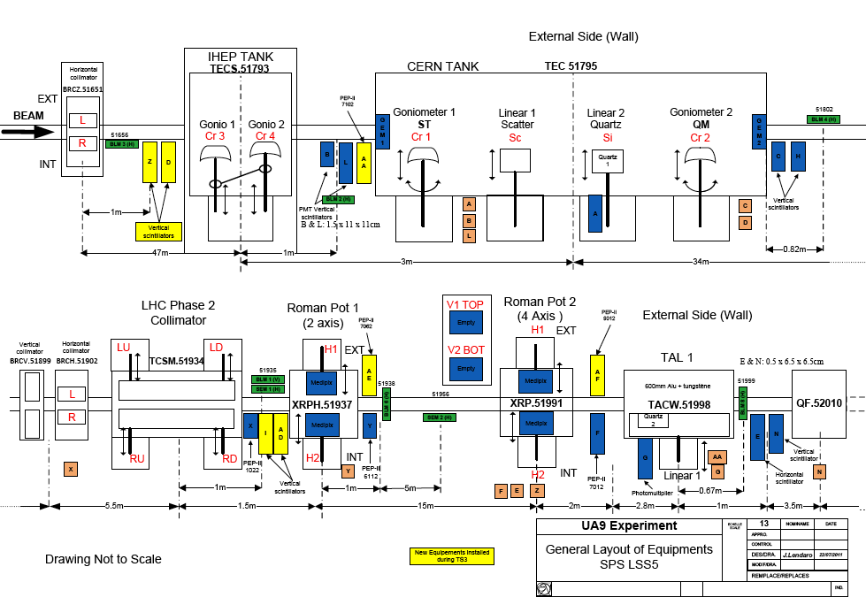
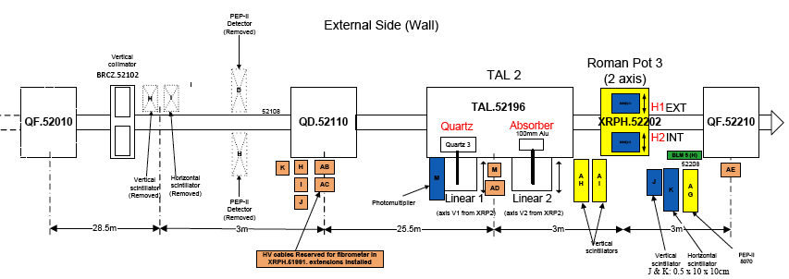
UA9 layout in the SPS
Collimation region
High dispersion area

Slide 7


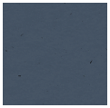
UA9 schematic layout
~ 67m / Δμ=90°
~45m / Δμ=60°
~ 45m / Δμ=60°
crystal4
crystal3
not used in 2011
1m Cu, LHC-type collimator
60 cm W absorber
10 cm Al scraper
Medipix in a two sided Roman pot
Medipix in a two sided Roman pot
Collimation region
High dispersion area
Observables in the collimation area:
Intensity, profile and angle of the deflected beam
Local rate of inelastic interactions
Channeling efficiency (with multi-turn effect)
Observables in the high-D area:
Off-momentum halo population escaping from collimation (with multi-turn effect)
Off-momentum beam tails

Slide 8
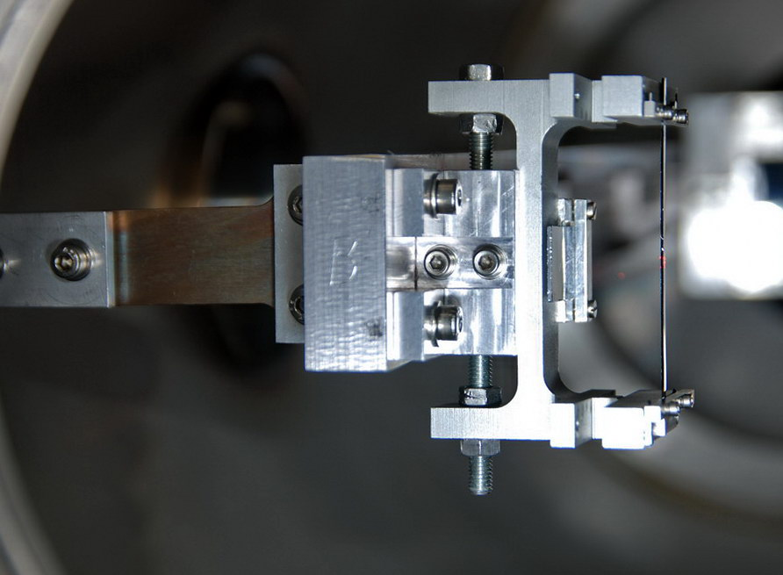
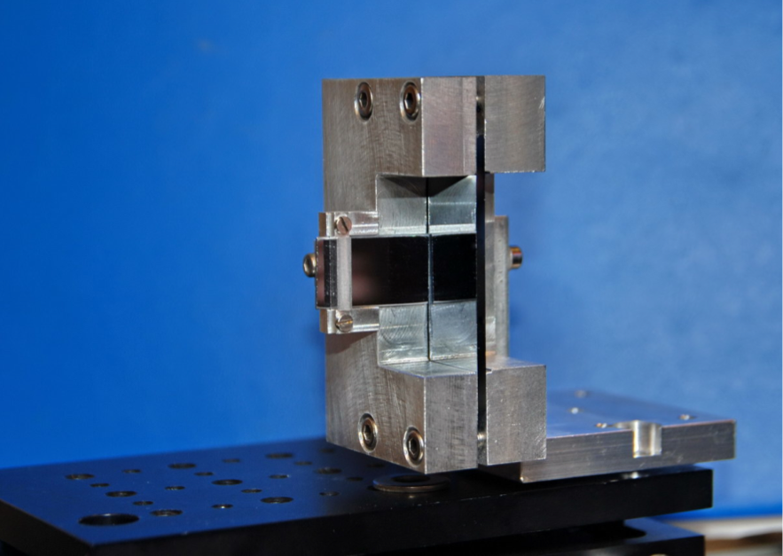
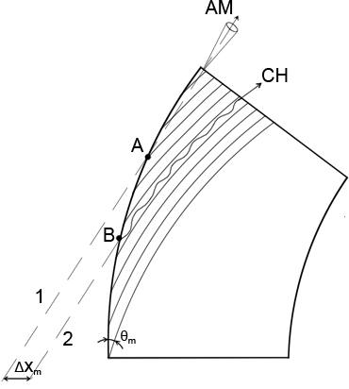
Crystals
Strip crystal 2mm long
Bent along (110) planes
Equidistant planes
Quasimosaic crystal 1.9 mm long
Bent along (111) planes
Non-equidistant planes d1/d2 = 3
Crystal 3
Crystal 4
Residual imperfections:
  Residual torsion ≈ 1 μrad/mm
  Amorphous layer size ≤ 1 μm
  Miscut ≈ 100 μrad
➔ different paths for different vertical hit points
➔ different paths at small impact parameter
Torsion is no longer an issue
torsion over the beam size < critical angle
full mitigation of the detrimental effects
Schematic view of the residual miscut angle

Slide 9
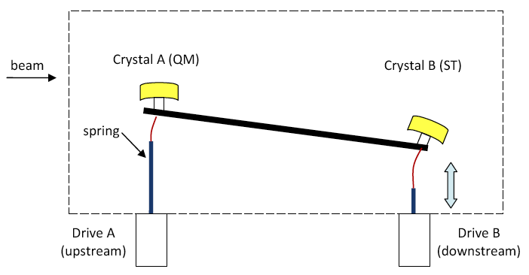
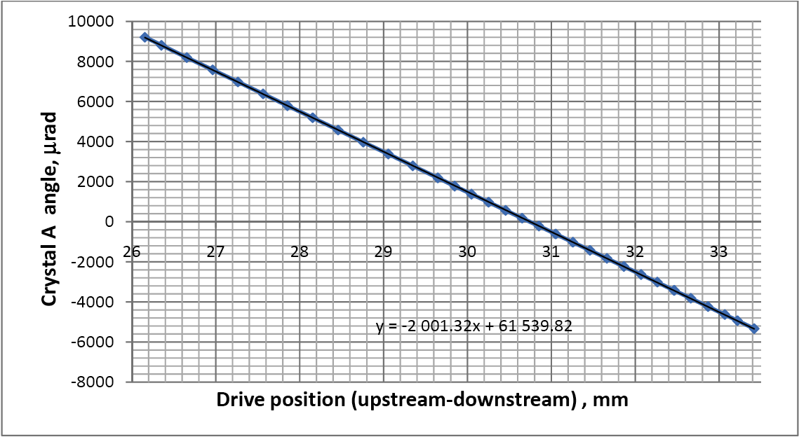
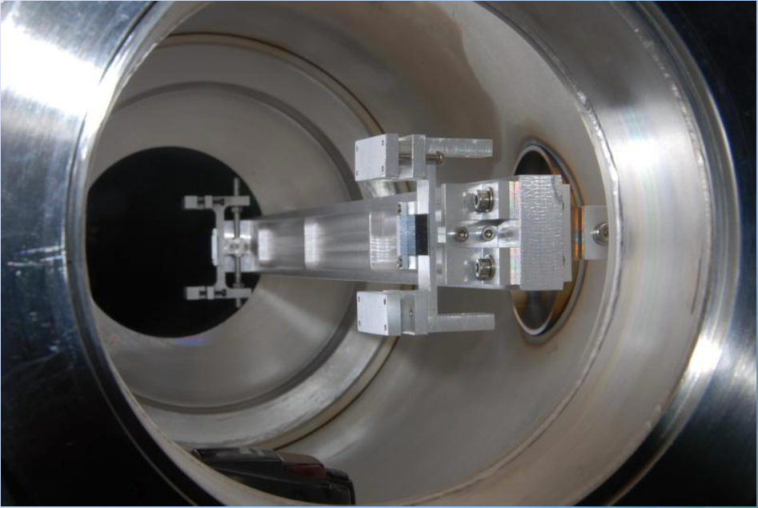
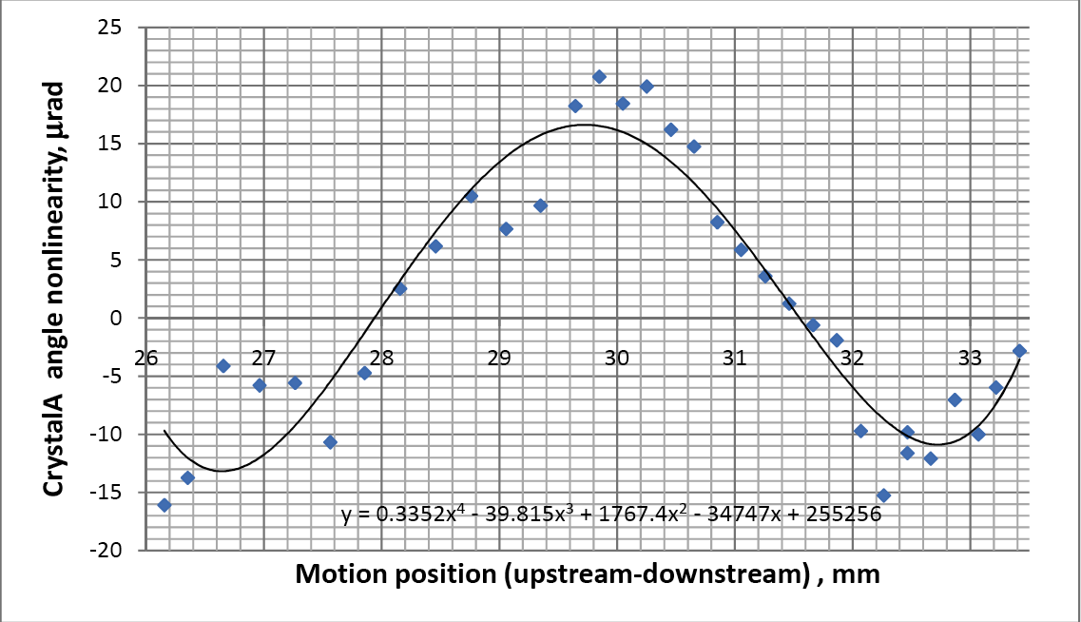
Goniometer
The critical angle governs the acceptance for crystal channeling
120 GeV ➔ θ_{c} = 20 μrad
270 GeV ➔ θ_{c} = 13.3 μrad
Transfer function
residual inaccuracy
|δϑ| ≤ 10 μrad
Non-linear part of the transfer function
in a full angular scan
the drive position changes by 300 µm around the initial value in the plotted range

Slide 10

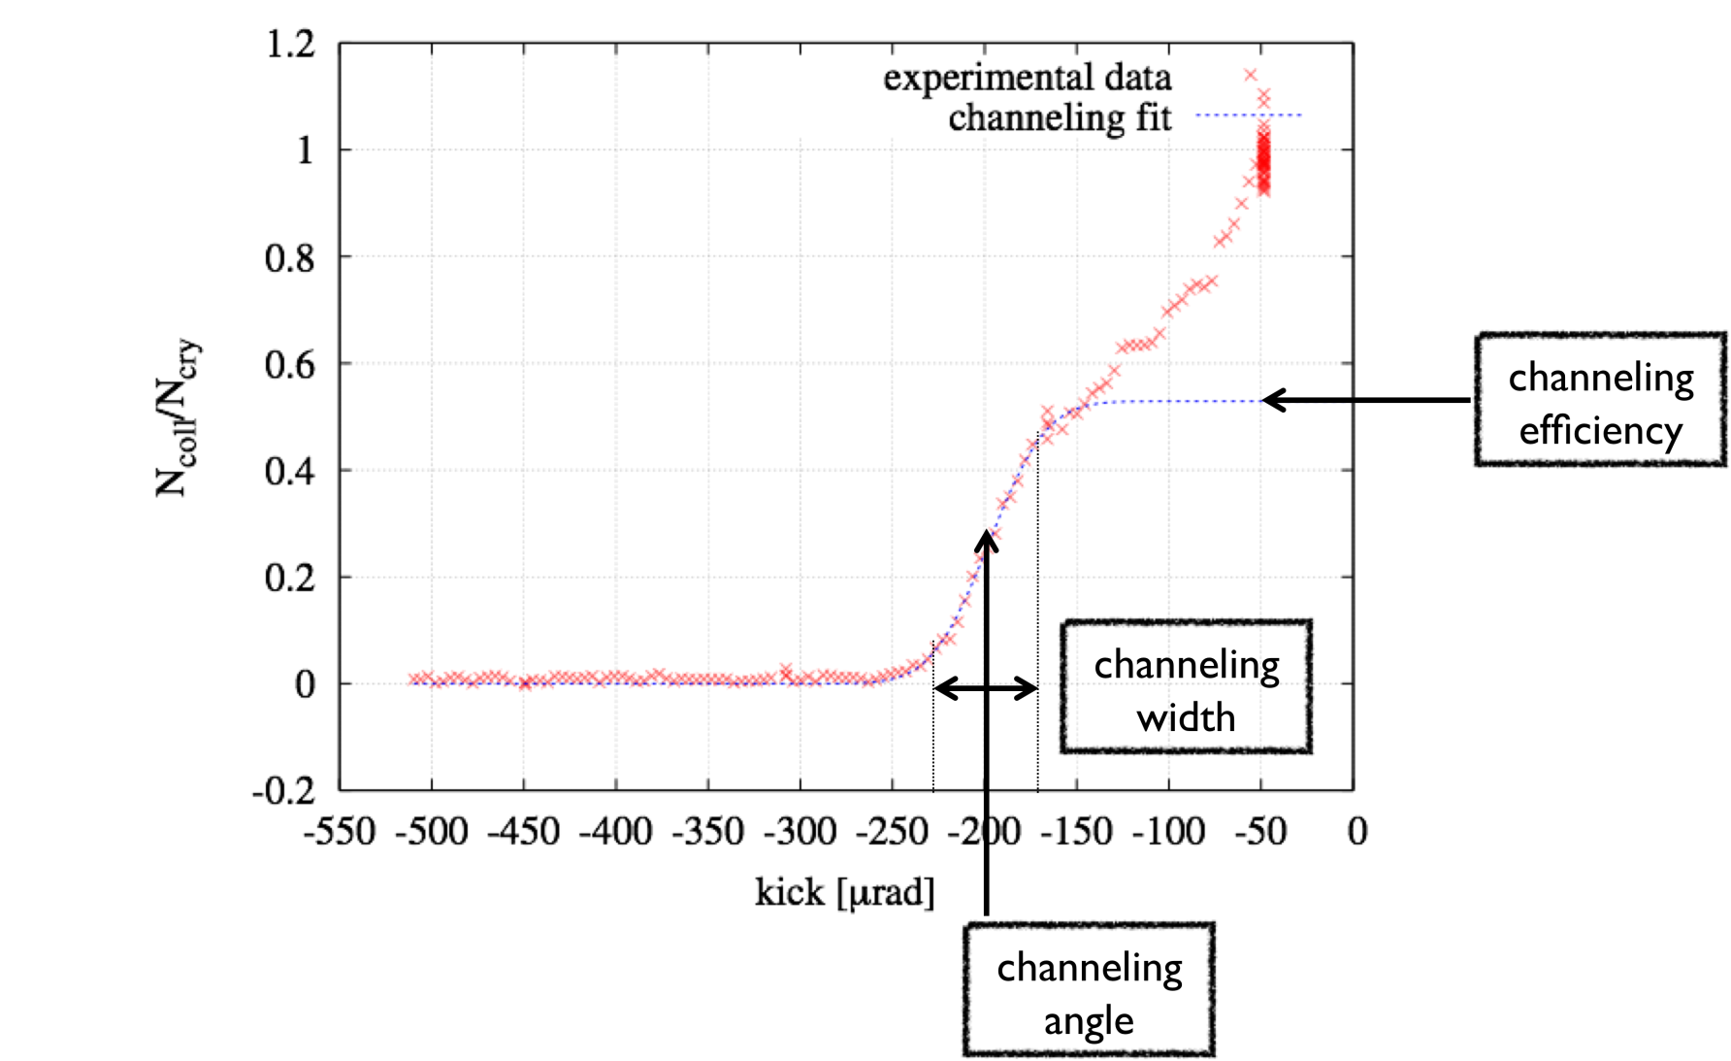
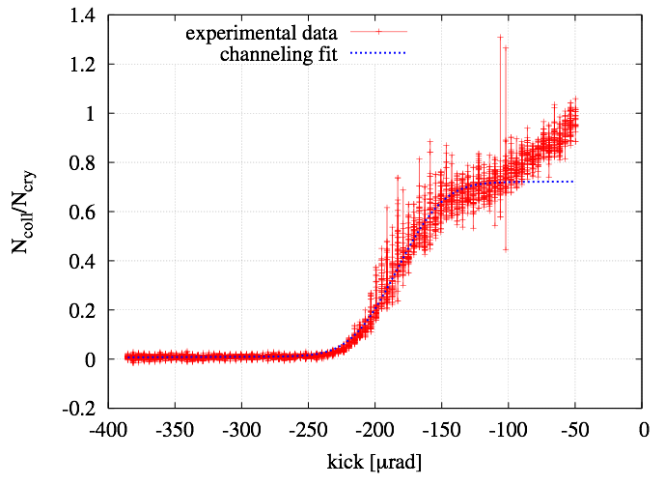
Channeling efficiency by coll. scans
~ 67m / Δμ=90°
~45m / Δμ=60°
~ 45m / Δμ=60°
absorber
collimator
Crystal 3
Proton beam at 120 GeV
BLMs
Pb-ion beam at 120 GeV
Efficiency 70-85%
Efficiency 50-74%
Ncoll/Ncry [-]
channeling kick
Equivalent crystal kick[μrad]

Slide 11
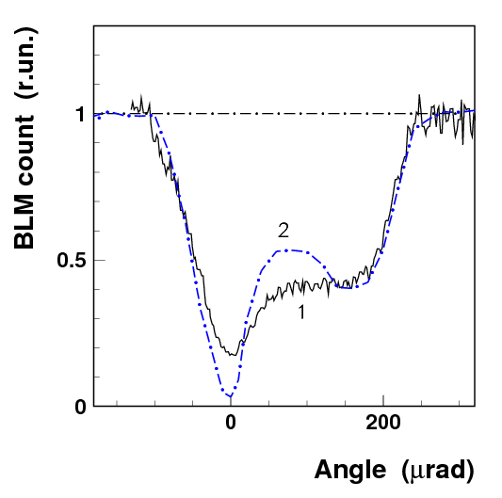
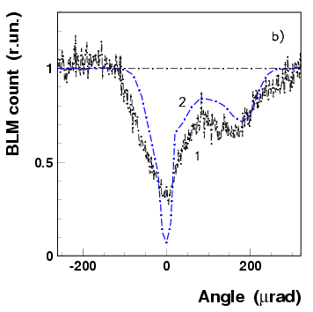
Loss rate reduction at the crystal
~ 67m / Δμ=90°
Loss rate reduction factor
for protons 5÷8
for lead ions ≈ 3
σ_{tot}(lead ions)=σ_{h}+σ_{ed}=5.5 b≅10×σ_{tot}(p)
Nuclear spray
absorber
Loss rate counters
protons
Lead ions
simulation
simulation
data
×5÷8 reduction
×3 reduction
data

Slide 12
Loss rate reduction at the crystal
~ 67m / Δμ=90°
Discrepancy between data and simulation:
crystal surface imperfections
miscut angle
Nuclear spray
absorber
Loss rate counters
protons
Lead ions
simulation
First hit
Second hit
simulation
data
×5÷8 reduction
×3 reduction
Miscut angle
data

Slide 13
off-momentum halo population
~ 67m / Δμ=90°
~45m / Δμ=60°
Off-momentum halo
deflected in the dispersive area of the TAL2
Absorber
    P, Pb: diffractive scattering and ionization loss
Scraper
(TAL2)
Nuclear spray
Medipix in a two sided Roman pot
BLMs
Off-momentum halo population
Linear scan made by the TAL2 (or Medipix) with the crystal in fixed orientation
angular scan of the crystal with the TAL2 (or the Roman pot) in fixed position in the shadow of the absorber

Slide 14
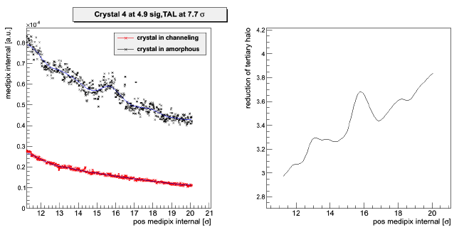
off-momentum halo: linear scans
proton beams
Crystal 4
Crystal at 4.9 σ
TAL at 7.7 σ
scans with the Roman pot of the internal side (momentum loss side)
Medipix counts [a.u.]
Reduction factor
Medipix position [σ]
Medipix position [σ]

Slide 15
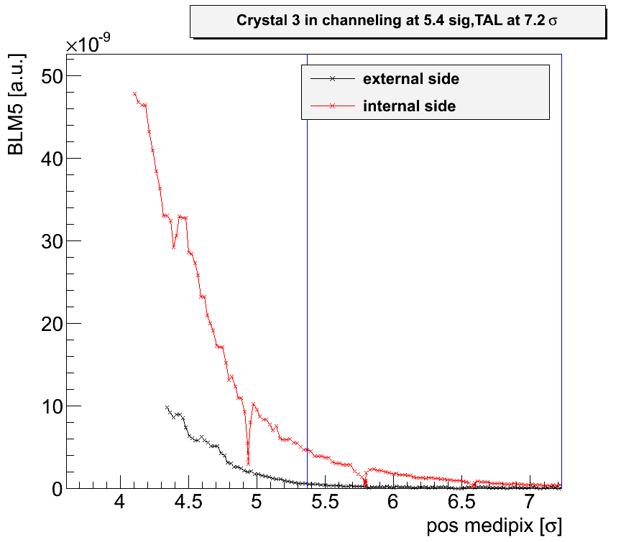
off-momentum halo: beam tails
preliminary
Loss rate as a function of the medipix position at the high-dispersion location
proton beams
Crystal 3
Crystal at 5.4 σ
TAL at 7.2 σ
Crystal
TAL absorber
More populated tails on the internal side than on the external side
Particles that have lost momentum are continuously produced by the interactions with the crystal and the absorber edges
Beam tails

Slide 16
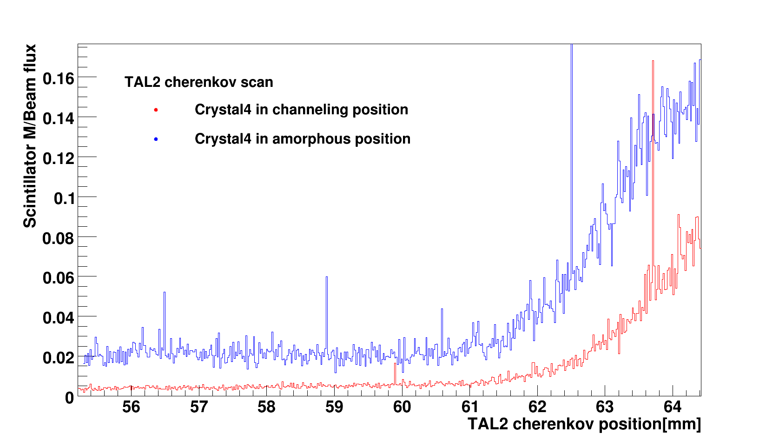
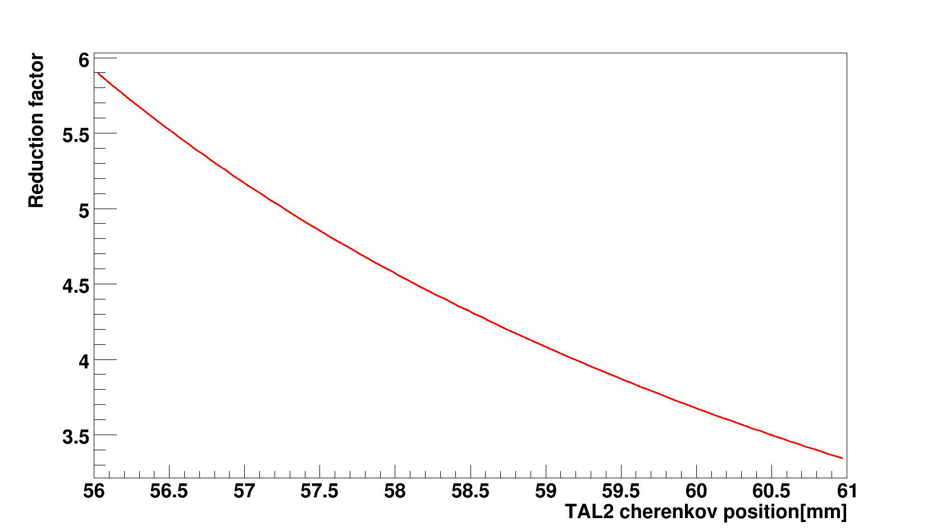
off-momentum halo: linear scan
preliminary
Crystal 4
Pb-ion beams
1 σ ≈ 1.2 mm
decreasing distance from the beam centre
Reduction factor

Slide 17
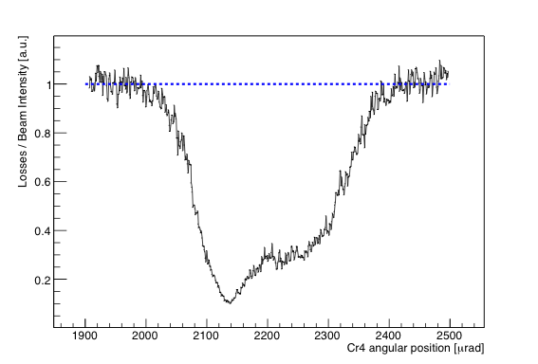
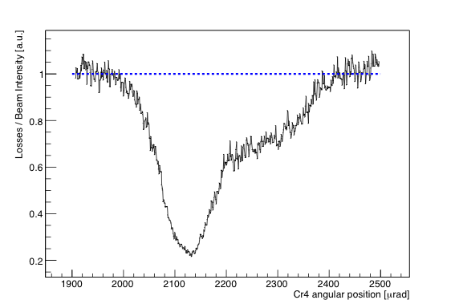
off-momentum halo: angular scans
Crystal 4
close to the crystal
proton beams
Loss rate as a function of the crystal orientation
× 10
Crystal at 5.6 σ
TAL at 7.6 σ
TAL2 at 9.3σ
in the dispersive area
reduction factor in the dispersive area
Decreases due to off-momentum particles produced in the absorber
Increases when the TAL2 is more and more retracted
× 5

Slide 18
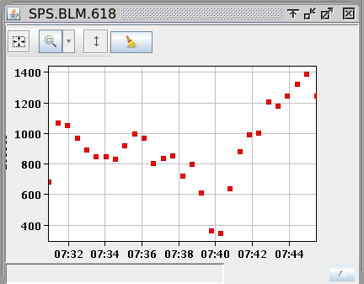
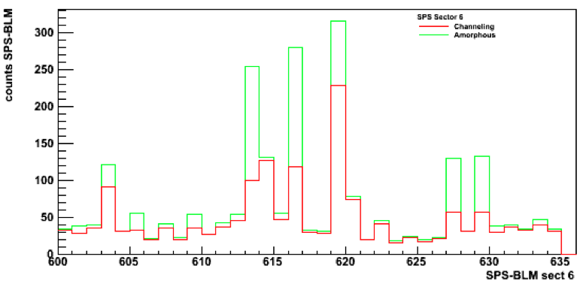
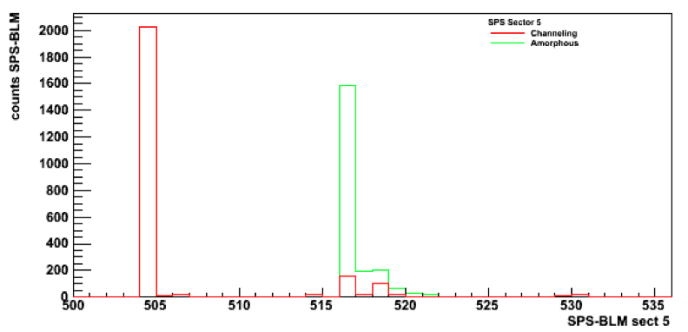
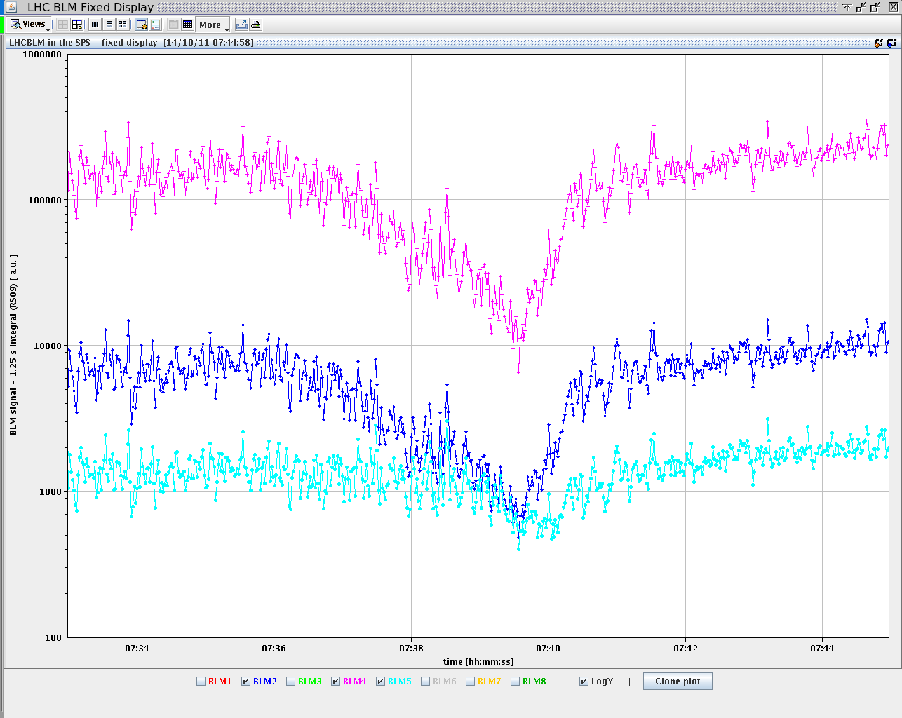
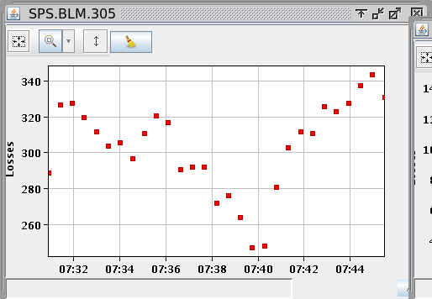
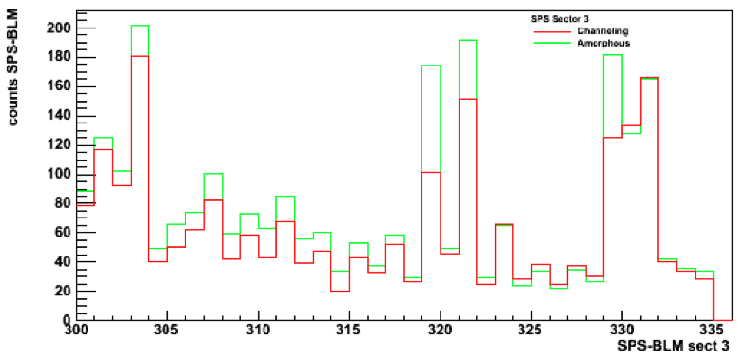
off-momentum halo: angular scans
proton beams
preliminary
Crystal 4
Crystal at 5.6 σ
TAL at 7.6 σ
TAL2 at 9.3σ
Loss rate along the SPS
Sextant 5
amorphous
channeling

Slide 19
Perspective for 2012
  The extension of UA9 to LHC is seen favorably by LHCC and by the accelerator directorate (to be announced soon)
  time allocation in LHC to be shared in between the machine and the experiments (however very limited)
  dedicated run time to avoid conflicts with the high-luminosity operation.
UA9 in the North Area and in the SPS
  The main goal will be to validate scenarios, detectors and hardware for LHC
  Upgrade of the SPS experimental setup required
crystal collimation scheme for the high-intensity SPS operation.
  Preliminary investigations based on UA9 experimental setup
  Later an ad-hoc setup is required.
  The collimation is requested at high-energy in pulsed mode
    Very demanding constraints on crystal acceptance and on goniometer stability
UA9 request to the SPSC
5 days in the SPS (4 with protons and 1 with Pb-ions)
5 weeks in H8 (3 with protons and 2 with Pb-ions)

Slide 20
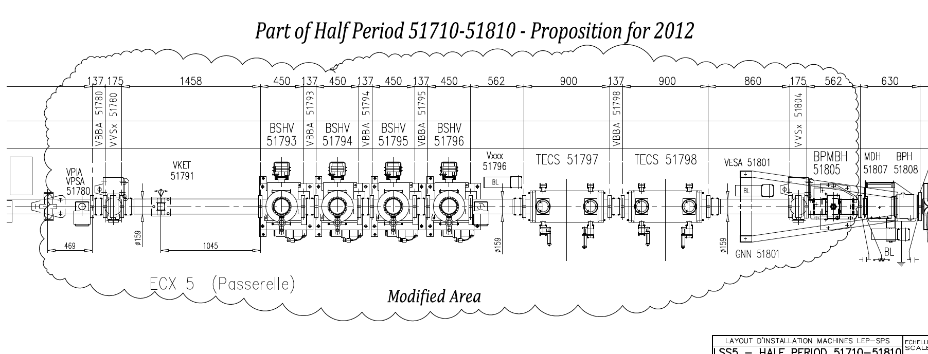
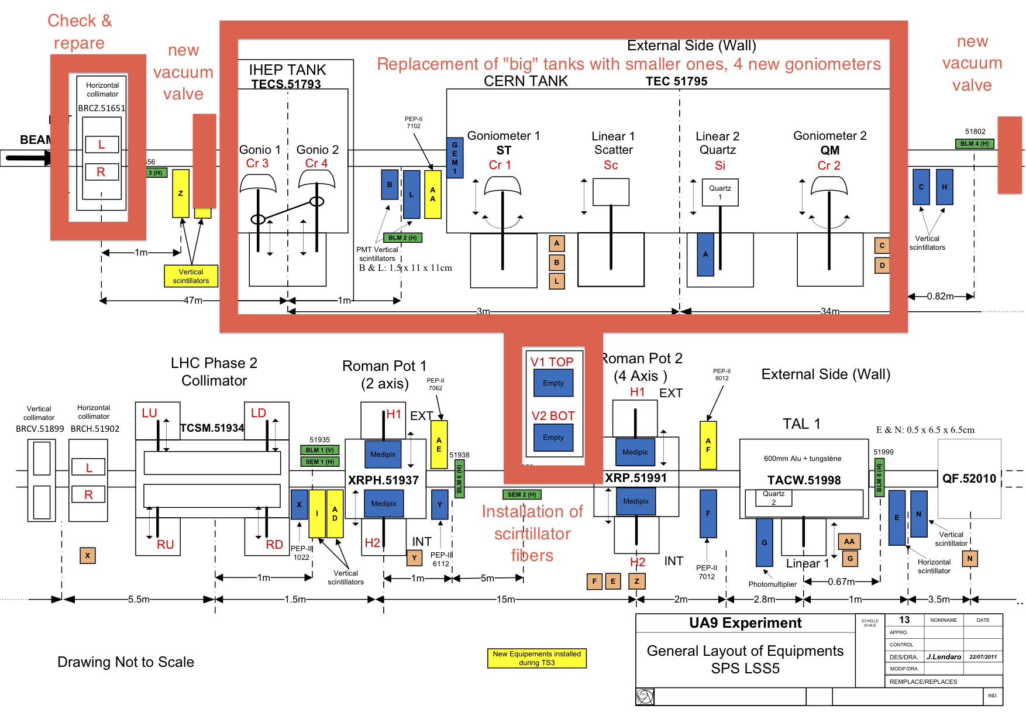
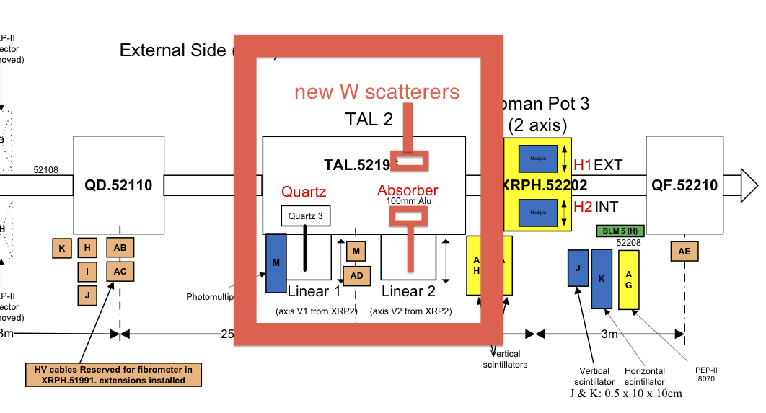
New hardware and priorities for 2012
SPS – 5 full days
  High intensity, high flux operation for loss maps along the SPS
  Operation with Pb-ions
  Hardware test for LHC (crystals and goniometer)
  Collimation efficiency of multi-strip crystals
H8 – 5 weeks
  Test of new crystals for LHC
  Test of instrumentation for LHC
  Deflection efficiency with Pb-ions
  x-ray spectra PXR as a tool to detect the crystal integrity

Slide 21
Recent publications
1. W. Scandale et al., Physics Letters B 692 (2010) 78–82, “First Results on the SPS Collimation with Bent Crystals”
2. W. Scandale et al., Physics Letters B 693 (2010) 545–550, “Deflection of high-energy negative particles in a bent crystal through axial channeling and multiple volume reflection stimulated by doughnut scattering”.
3. W.Scandale et al. Probability of Inelastic Nuclear Interactions of High-Energy Protons in a Bent Crystal. Nucl. Instr. Meth. B, 268 (2010) 2655.
4. W.Scandale et al. Multiple volume reflections of high-energy protons in a sequence of bent silicon crystals assisted by volume capture. Phys. Letters B, 688 (2010) 284.
5. W.Scandale et al., Observation of Multiple Volume Reflection by Different Planes in One Silicon Crystal for High-Energy Negative Particles. EPL 93 (2011) 56002.
6. W. Scandale et al, JINST, 1748-0221_6_10_T10002, Geneva (2011), “The UA9 experimental layout”.
7. W, Scandale et al., Physics Letters B 701 (2011) 180–185, “Observation of parametric X-rays produced by 400 GeV/c protons in bent crystals”.
8. W. Scandale et al., Physics Letters B 703 (2011) 547–551, “Comparative results on collimation of the SPS beam of protons and Pb ions with bent crystals”.
9. W. Scandale et al., “Status of UA9, the Crystal Collimation Experiment in the SPS”, Invited talk at the IPAC11, San Sebastian, Spain, September 2011.
acknowledgments
The EN/STI group was of an extraordinary support to UA9
BE/OP-BI-RF groups carefully prepared the SPS for our needs
Special thanks to our funding agencies, reference Committees and Referees

